Slide 1
MDP International Relations and Collaborations
MDP, by definition, is collaborative
MDP provides the strategic plan and goals for high field magnet and conductor R&D in the US (particularly for OHEP)
Leveraging through well-organized collaborations is essential for achieving the MDP goals

Slide 2
Start to identify and categorize level of collaborations
International
  CERN
  EuroCirCol
  PSI
  KEK? – they are interested
  IHEP?
Other OHEP-funded programs
  OSU
  TAMU?
  NCSU?
  BNL?
Industry
Internal to MDP?
Tier 1
  Direct participation in MDP program (funds, labor) or other DOE funded programs
Tier 2
  Industry (SBIR, direct funded by MDP)
Tier 3
  Broad overlap of goals, e.g. International programs with whom we exchange information

Slide 3
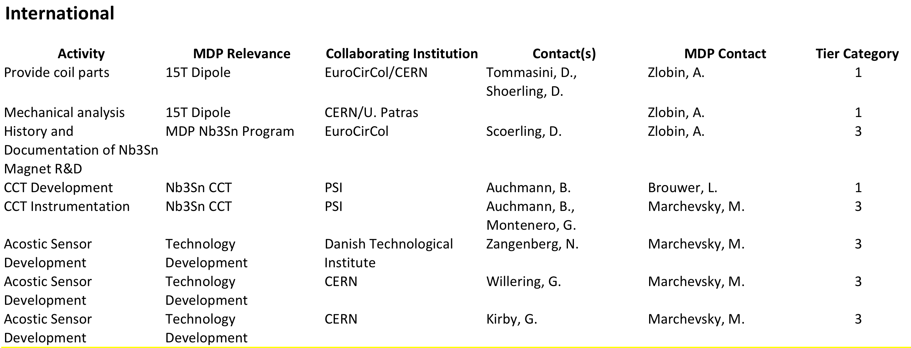
What I have so far . . .

Slide 4
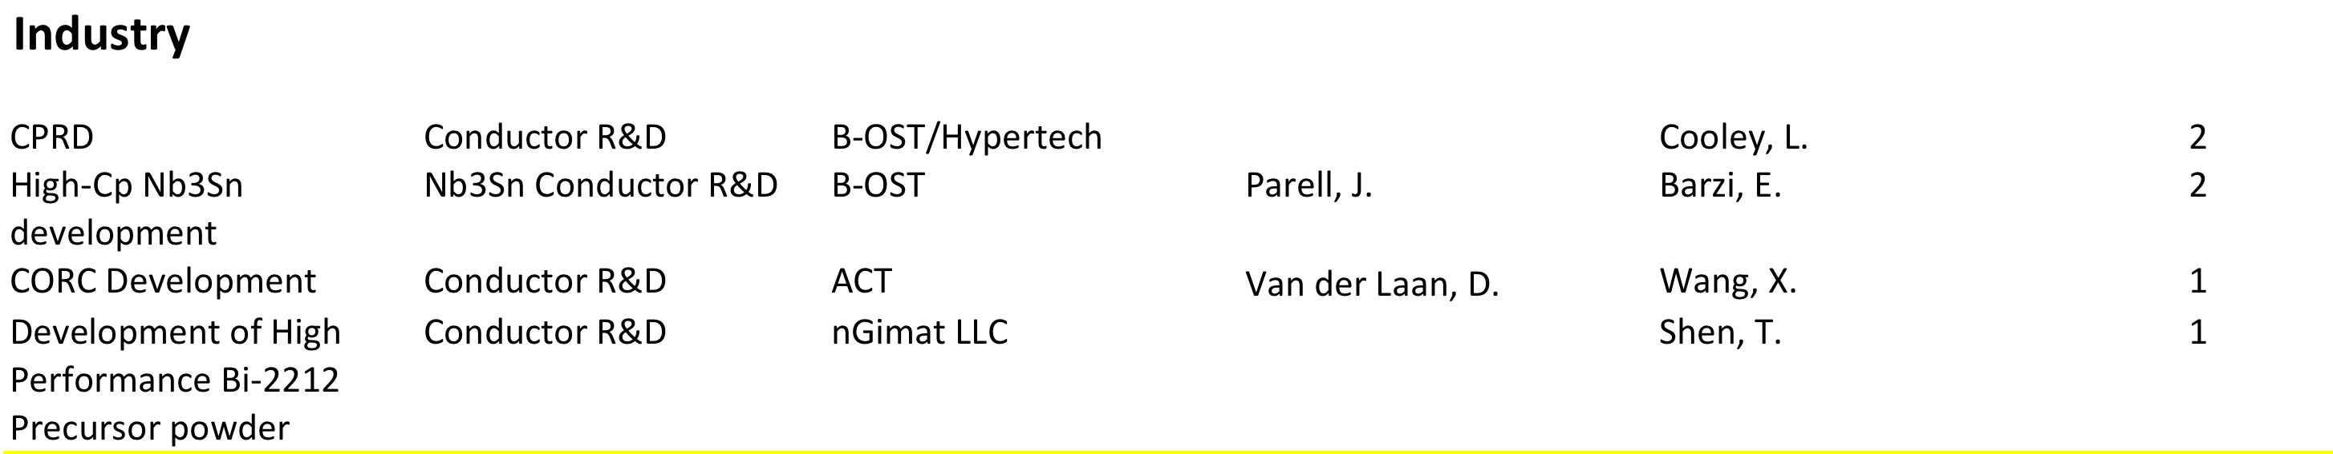
What I have so far . . .

Slide 5
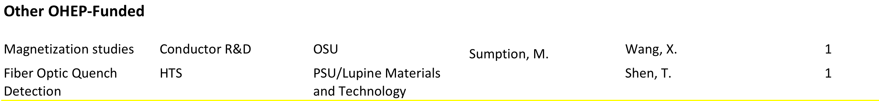
What I have so far . . .

Slide 6
Next Steps
Augment/modify the list
Associate a “value” to each activity
Start and End dates?
Include MDP-internal collaborative activities
Include relevant activities outside OHEP? E.g. Fusion?

