Slide 1
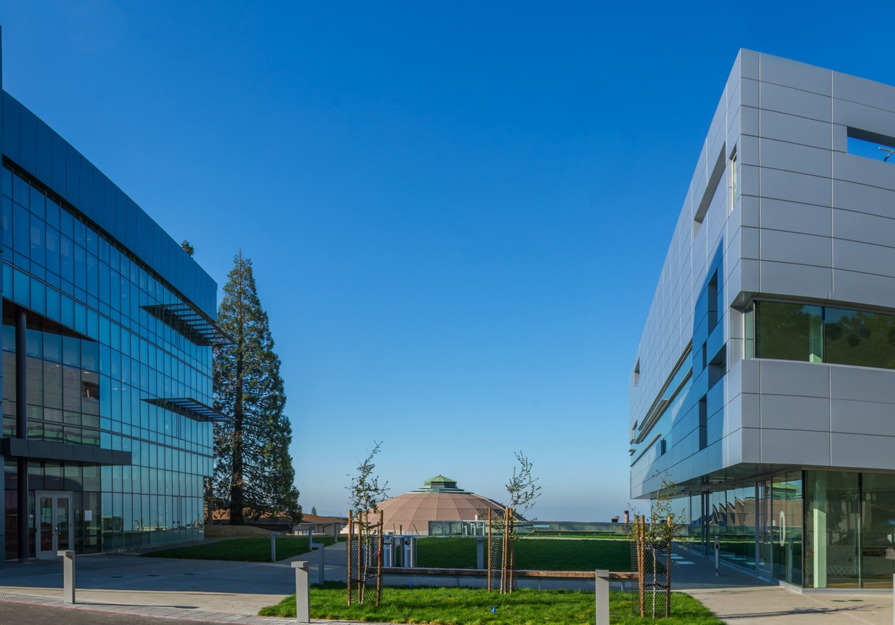
Introduction and review of EOC feedback
External Advisory Committee
Soren Prestemon
Director, US Magnet Development Program
Director, Berkeley Center for Magnet Technology
Lawrence Berkeley National Laboratory
August 19, 2022
LBNL, Berkeley, CA

Slide 2
EOC - Charge
  Joe Minervini (Chair)
  Steve Gourlay (Co-chair / Backup)
  Luca Bottura
  Luisa Chiesa
  Danko van der Laan
  Ruben Carcagno
  Nicolai Martovetsky
Charge
Comment on the project status, in particular technical advances on the conductor, cable, and magnet design and on the facility preparations.
Has the project made judicious decisions as it proceeds in design? Are there suggestions to improve the methods and timeliness of project decisions for the stakeholders?
Are project risks reasonably documented and understood by the project team? Are there additional risks that the project should consider?
What are the long-term considerations that we should be acting on now?
Have we reasonably addressed feedback from the last EOC meeting?
Role of the Oversight Committee (OC):
  Represent user interests in facility plans
  Provide guidance and oversight for the overall facility development
  Provide feedback on performance goals, overall design, and its implementation
  Provide advice to the project management in terms of:
                - Responsiveness to community needs
    - Coordination and integration of efforts magnet/facility
    - Balance of project risk and cost & schedule
  Provide guidance on:
    - Facility operational structure and user needs
    - Collaboration and coordination with other laboratories
  Provide feedback to sponsors on project team performance

Slide 3
Previous EOC meeting report
Very nice report – significant feedback – thank you!
Organized along the following topics:
  Project Structure and Management
  15T Magnet Design,
  Facility Design,
  Facility Usage,
  Budget and Schedule.
Here I will touch on a subset of the feedback
A General comment in the report:
“a detailed overview summary of these facilities, both defunct and still in operation, could be very useful.”
will be addressed by a dedicated talk:
“Review of existing and planned cable testing capabilities”, by G. Velev

Slide 4
EOC report – addressing feedback on Project Structure and Management
“…a clear organization chart should be created with well-defined Roles, Responsibilities, Authorities, and Accountabilities.”
The current organization is shown to the right.
  Note that resources (people) are managed by SP and GV within the two organizations (not the PM’s).
  R2A2s are not fully nailed down

Slide 5
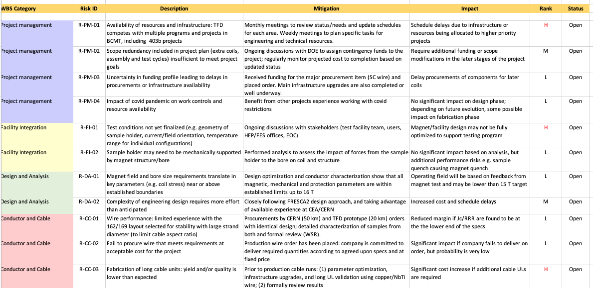
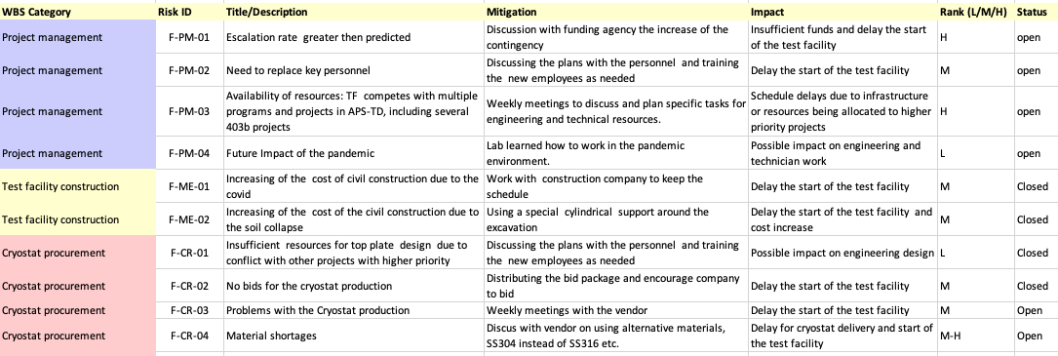
EOC report – addressing feedback on Project Structure and Management
“…The project might benefit from a more rigorous approach to the Risk Management process.”
A simple risk register has been drafted. Feedback from the EOC on format and content is most welcome. (A subset shown to the right)

Slide 6
EOC report – addressing feedback on 15T Magnet Design
“But beware, this is an R&D magnet, hopefully achieving 15 T operational..”
The talks by the Test Facility Dipole team will strive to show how we are trying to mitigate uncertainty in magnet performance, e.g. through design margin, wire procurement, etc.
  Nevertheless, we recognize many risks:
    Conductor variability
    Cable performance reproducibility
    Magnet design and fabrication issues
    Resources to finalize design, and for fabrication
    …
“The rest of the engineering still needs much work, so the timeline is a bit optimistic.
Indeed, the design schedule has slipped somewhat – cost impact is not too large, but we do not expect to be able to significantly recover schedule
  Resources are particularly challenging since ~1 year

Slide 7
EOC report – addressing feedback on Facility Design
“Test pit construction may be advancing too fast. There has been no convergence on facility specifications.”
The EOC guidance has been very useful. For example, the BNL lambda plate seal approach is being implemented.
The sample holder interface is indeed a major consideration – this is an active area of investigation now, and your feedback is much appreciated!
“The uniform length of field of 1 m within 1% field quality is excellent. It is important to have the entire highest stage twist pitch in the high field region so that the current cannot be shorted by strands that never enter the high field.”
We (SP) made the decision to converge on 75cm good field region. We think this is competitive for the facility, while addressing practical challenges of weight and length. It also enables the project to move forward with plans on multiple fronts (conductor & cable length, magnet components, etc.)

Slide 8
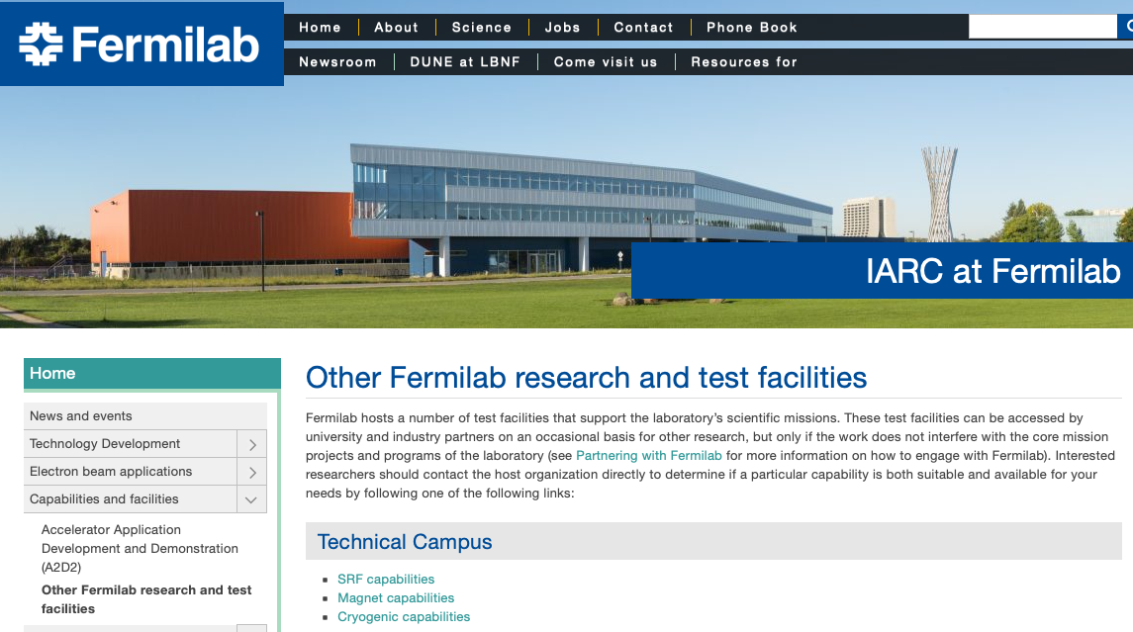
EOC report – addressing feedback on Facility Usage
“There was quite a bit of discussion on the business model. After all was said and done, it was clear there is not one. They need to work with DOE to iron out the details.
This has not been actively addressed. DOE is strengthening / clarifying public/private partnerships and initiating additional funding “tools” (e.g. INFUSE).
At FNAL, Accelerator Test Facilities have some experience in supporting “users” from labs, Universities, and industry.

Slide 9
EOC report – addressing feedback on Budget and Schedule
“there are several risk contingencies built into the budget and schedule. The impact of these should be explicitly shown.
We will try to distinguish between risk mitigation “built into” the TFD plan and risks identified in the risk register. Those built in provide “opportunities”, but most likely serve as mitigation. Cost and schedule impact can be quantified.
“The project schedule is based on some assumptions of the availability of resources and facilities…How will this project be coordinated with ongoing program commitments…?
Resources and facilities are definitely a challenge on the TFD front. Primary issues:
  Designer support
  Technicians for cable and magnet fabrication
  Competition for cabling facility
Note: DOE HEP and FES offices have been strongly supportive:
So far we (FNAL and LBNL) have not been limited by funding
When costs are higher than planned, the offices have accommodated (example: procurement of cryostat)
We have not yet gone through a cost and schedule review; effort underway at LBNL to validate cost estimate for magnet labor & M&S

Slide 10
Backup

Slide 11
Facility parameters/specifications for FES and HEP needs
(From Conceptual Cost and Schedule document) (1 of 2)
The test facility will be constructed in Industrial Building 1, APS-TD, Fermilab. The proposed place is selected based on the proximity to the needed base infrastructure for such a test stand, including cryogenic, power, water and crane.
Minimum operating temperature of the facility is 1.9K for the magnet providing the background field and 4.2-4.3 K *(under discussion) for the test samples.
The test pit cryostat should accommodate a dipole (coldmass) with maximum dimensions of 1.3 m and length of 3.0 m. [now using max length 3.1 m]
The maximum weight of the dipole cold mass should not exceed 22 (Standard) tons, limited by the crane capacity.
The test facility should be efficient and safe, minimizing the time for experiment preparation and no helium losses after quenches.
Operational lifetime of the facility at least 20 years.

Slide 12
Magnet parameters/specifications for FES and HEP needs
(From Conceptual Cost and Schedule document) (2 of 2)
Background dipole field > 15T.
Homogeneous field region>500-600mm, preferably>1000mm.
Cryostat to accommodate sufficient sample length to keep sample joint in low field.
Well dimension 90x140, and preferably100x150.
  It would be preferable to make the well compatible with FRESCA2 samples [note EDIPO was actually 94x144]
Field quality in the transverse plane -target is to keep all harmonics below 20 units at 35 mm radius and 15 T field.

Slide 13
Process used to develop the draft specifications document
Initial discussions internally
  Xiaorong Wang – leads REBCO HTS development at LBNL
  GianLuca Sabbi – leads LBNL role in EDIPO replacement magnet design
Followed by detailed discussion with Joe Minervini
I then drafted a the “Cable Test Facility Requirements Questionnaire”
  Reviewed it with Joe Minervini and Xiaorong Wang
Developed a list of stakeholders, with initial guidance from Joe Minervini, and iterated with FES program managers
The stakeholders were then contacted and asked to respond to the questionnaire
Stakeholder responses were then consolidated in the draft specification document, with only minor iteration on the document after the first draft

