Slide 1
Review of the Test Facilities
G. Velev

Slide 2
Outline
Requested by EOC at the last meeting
Credit for the information goes to Mark Bird NHMFL/FSU
Other information is collected from publications
Some comparison with the HFVMTF test facility
Notes:
General Plant Project
Purple

Slide 3
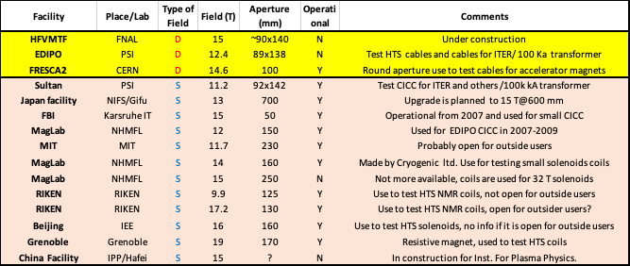
Summary of the test facilities

Slide 4
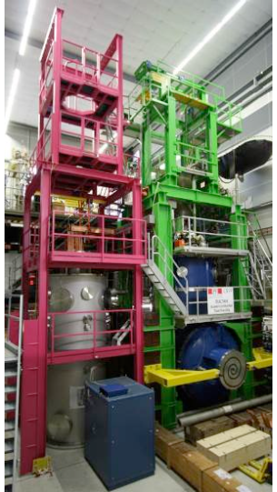
EDIPO Test Facility
Background field - 12.35 T rectangular aperture 89x138 mm²
Magnet cooled by forced flow supercritical helium (4.4 K?)
Homogenous length 900 mm @12.3 T @ 1%
AC Dipole coils +/- 0.52 T @ 1 Hz
Sample powering: SC transformer 100kA
Sample test Temperature: 4.5 -50.0 K
Use to test SC cables in conduit for fusion

Slide 5
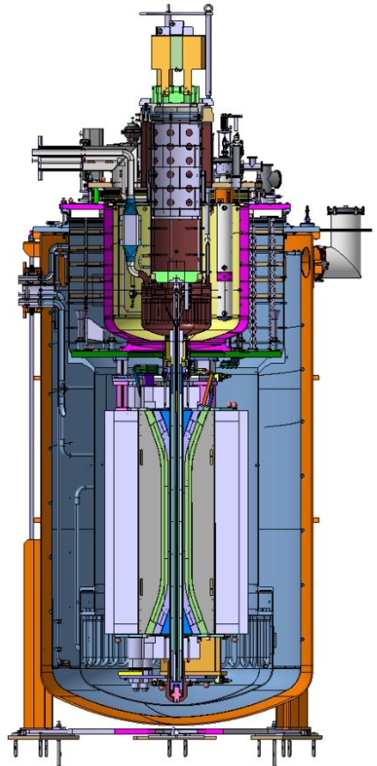
FRESCA 2 TF
Background field - 14.6 T at 100 mm round aperture
Magnet operates at 1.9 K and 4.3 K
Homogenous length: no info
AC Dipole coils: N/A
Sample powering: direct 32 kA for short time at 4.5K
Use to test SC cables, mostly for HF magnets

Slide 6
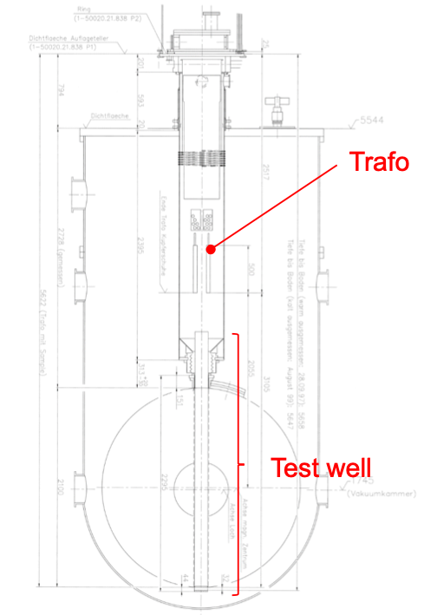
Sultan TF
Background field - 11.2 T rectangular aperture 92x142 mm²
Magnet operates at 4.4 K
Homogenous length ~425 mm @11.2 T @ 1%
AC Dipole coils: +/-0.42 T /6 Hz
Sample powering: SC transformer 100kA
Use to test SC cables for fusion

Slide 7
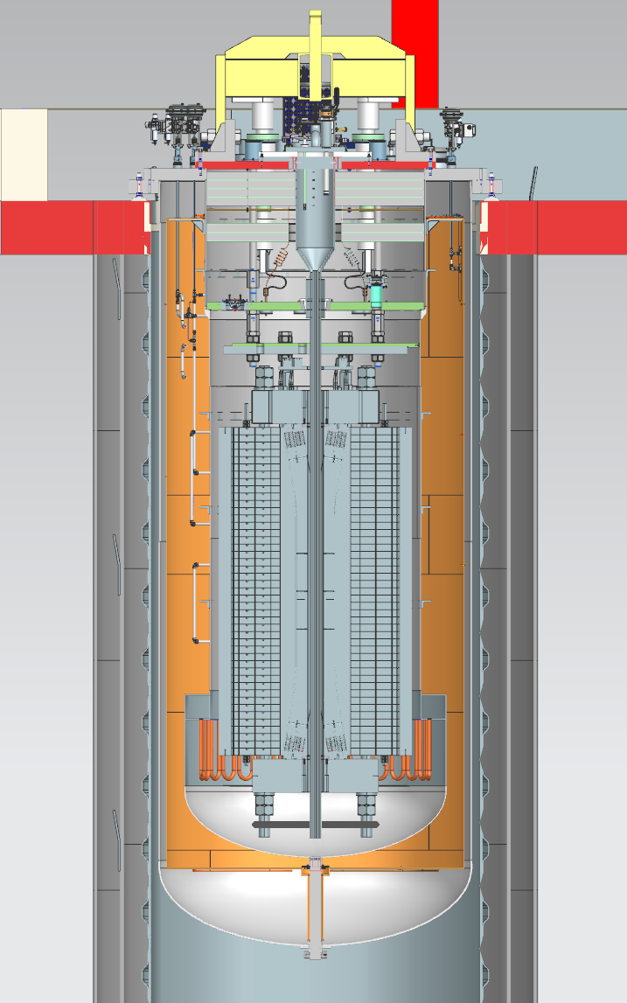
HFVMTF
Background field - above 15 T rectangular aperture ~89x138 mm²
Magnet operates at 1.9 K
Homogenous length ~750 mm @15.0 T @ 1%
AC Dipole coils: N/A
Sample powering: SC transformer 100kA
Use to test SC cables in conduit for fusion and cables for HF magnets
HFVMTF will have similar or better capability than FRESCA2 at CERN or EDIPO/Sultan at PSI

