Slide 1



G. Sabbi, LBNL
External Oversight Committee
August 19, 2022
TFD Overview

Slide 2
Presentation Outline
Magnet features and parameters
    Focus on decision process (charge question #2)
Technical progress (charge question #1) covered in next presentations:
    Conductor and Cable
    Magnetic and mechanical analysis
    Engineering, infrastructure and procurements
Risk Register (charge question #3)
Schedule and Cost Updates
Summary

Slide 3
Background and References
HEPdipo study (2017-2018)
  Options to replace damaged EDIPO magnet
  Collaboration of PSI/EPFL, CERN, LBNL, F4E
Integrated Project Team (From December 2019)
  Focus on management (LBNL, FNAL, OFES, OHEP) but includes technical aspects, interfaces and addressing review recommendations
Conceptual Design Review (June 2020)
  Presented magnet parameters, coil layout, conductor and cable options, preliminary mechanical analysis and quench protection
  Endorsed main design features
External Oversight Committee (January 2021)
Wire Specification Review (October 2021)
  Comprehensive wire/cable studies and characterization, and design/analysis updates, to support wire design selection

Slide 4
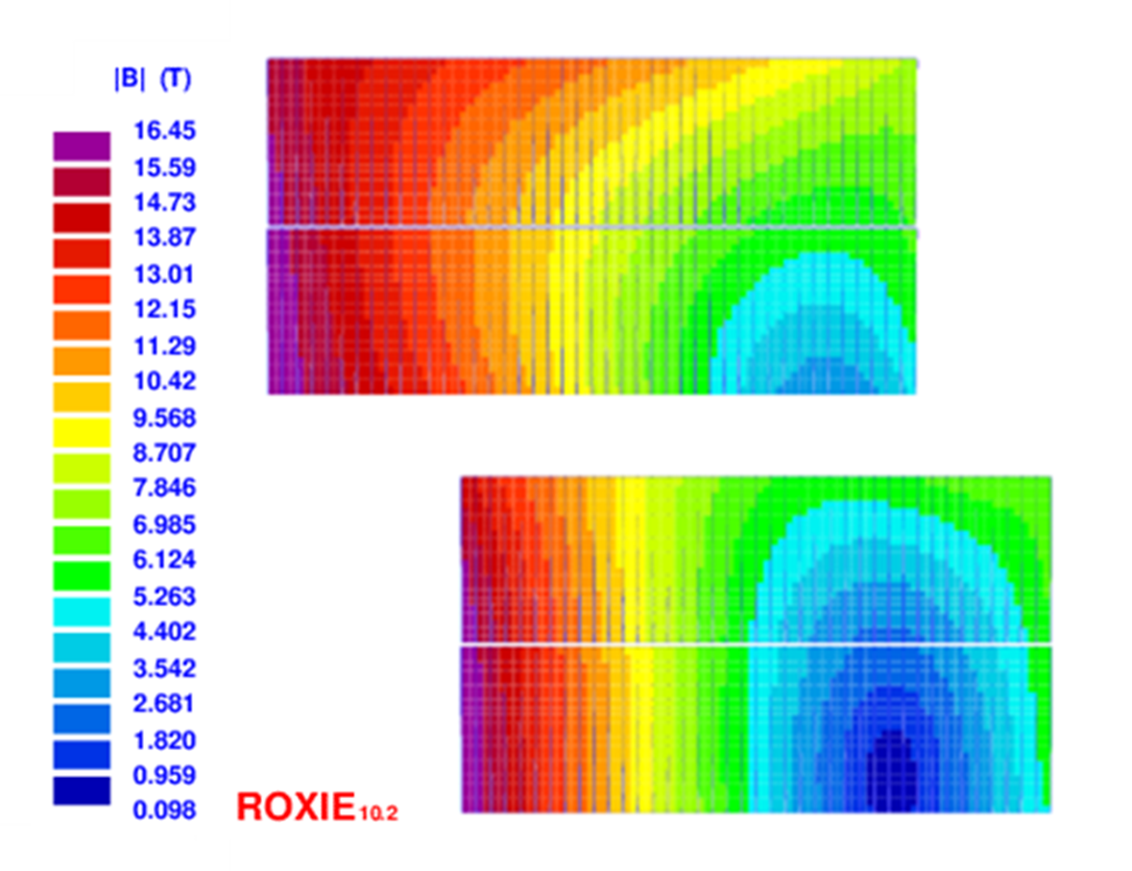
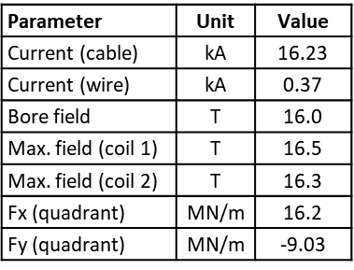
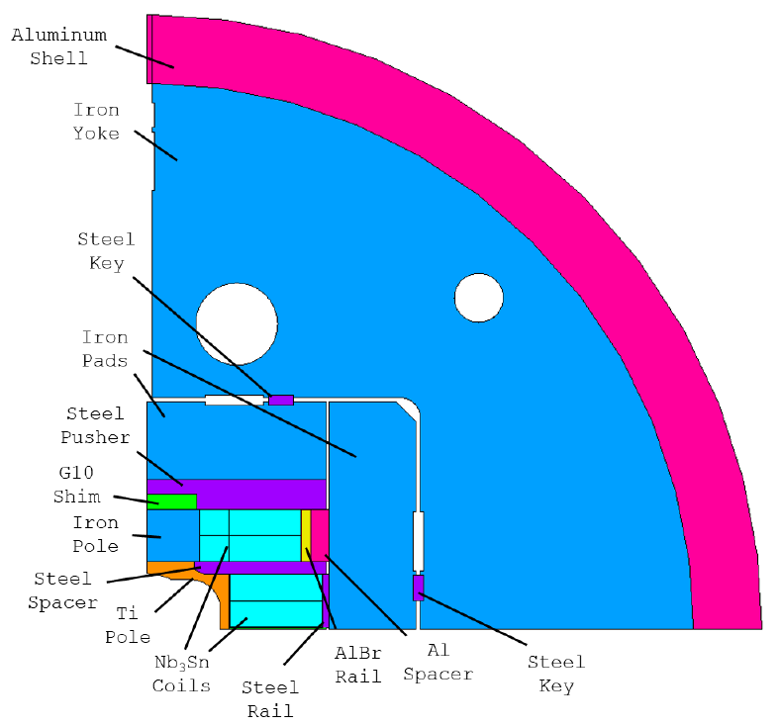
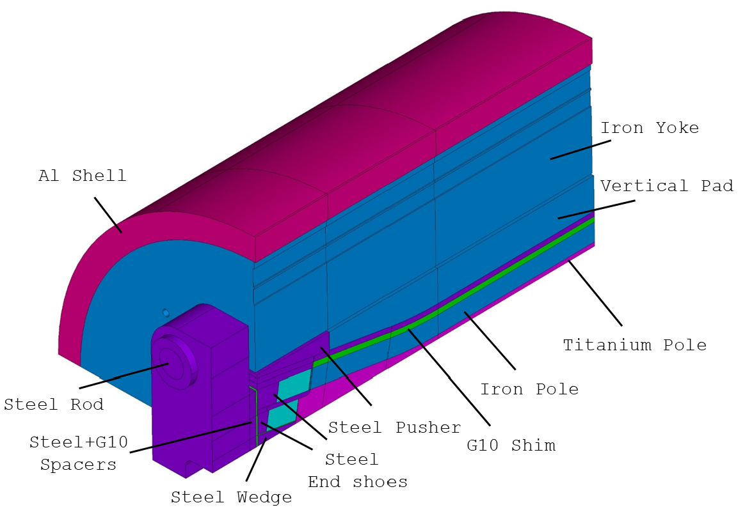
Magnet Design
Parameter | Unit | Value
Shell OD | m | 1.3
Shell length | m | 2.0
Total length | m | 2.9
44 turns/layer
40 turns/layer
D. Arbelaez, P. Ferracin, R. Hafalia, P. Mallon, D. Martins Araujo, J. L. Rudeiros Fernandez, G. Vallone et al.

Slide 5
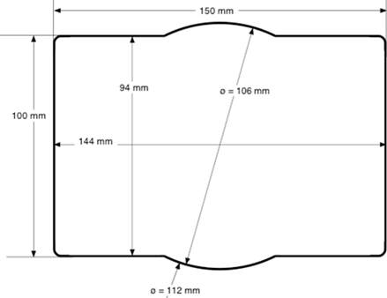
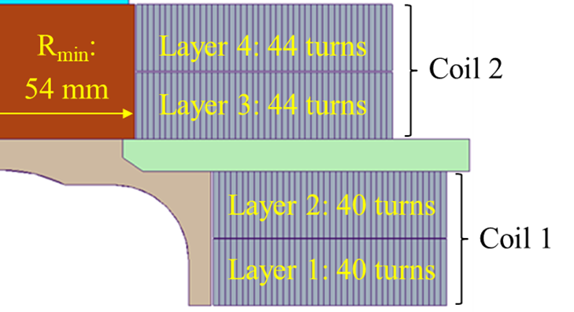
Magnet Features and Parameters (1)
Clear bore size: rectangular 144 mm x 94 mm with superimposed 106 mm radius
  From HEPdipo study (compatibility with SULTAN/EDIPO and FRESCA2 samples)
  Larger radius required at the inner corners (high field coil layout)
  Current pole piece dimension still allows for a 3 mm thick “test well”
  Presented to CDR, IPT and EOC
Field target for operation: 15 T at 1.9 K
  Practical Nb₃Sn dipole limit (user community wants highest possible field)
  Design optimization achieves 16 T without exceeding established criteria
  Presented to CDR, IPT and EOC
Maximum length (3.1 m), weight (20000 kg) stored anergy (20 MJ)
  Test facility interface document agreed upon with Fermilab and DOE/IPT
  Required early on to make progress on facility design/construction
  Presented to CDR, IPT and EOC1

Slide 6
Magnet Features and Parameters (2)
Dipole design: Rutherford cable, accelerator coil with shell-based structure
  HEPdipo study and comparison with EDIPO upgrade option
  Basic assumption from the proposal
Coil layout: block type with flared ends, non graded, “LD” layout
  Block-coil follows from EDIPO/LD1/FRESCA2 studies, FRESCA2 performance demonstration, and rectangular bore; confirmed in HEPdipo study
  Non-graded coil has lower development time/risk to reach 16 T at <85% SSL
  LD layout has lower coil stress (vs. FRESCA2) in rectangular bore
  Comparison and selection of these features was the major focus of the CDR
Design criteria (magnetic, mechanical, protection)
  Based on HL-LHC/AUP documentation, in turn derived from GARD/LARP
  Presented to CDR
No AC coils
  Lower user priority and incompatible with the “accelerator dipole” approach
  Presented to CDR, IPT and EOC

Slide 7
Magnet Features and Parameters (3)
Wire specification: RRP 162/169, 1.1 mm diameter
  Options presented to CDR, final specification formally reviewed at WSR
  WSR included feedback from wire and cable characterization by CERN, LBNL, FNAL, NHMFL, and analysis of magnet margin including strain
Cable parameters
  44 strands to match bore vertical size with 2+2 layers
  Comprehensive characterization of development cable provided a satisfactory reference (some further improvement desired)
  Results used to support wire specification at WSR
Uniform field length: 750 mm within 1% variation
  Left open until recently pending magnetic and mechanical optimization
  Balance of: user requirements, agreed limits on magnet length, weight and stored energy; magnet cost and risk
  More details in following presentations

Slide 8
CDR Feedback and Response (1)
Magnet design:
Alternatives have been properly considered and selected design minimizes risk
Main elements of the design fully endorsed by the committee: block coil, non-graded layout, shell-based structure
=> Confirmed key design choices and started design optimization
Consider increased margin to quench (conductor properties and magnetic design)
=> Margin was increased through coil design optimization and higher Jc
Consider increased shell thickness for margin (relative to using LD1 shell)
=> Shell thickness was increased; cost of new shell is acceptable
Include CLIQ protection system for added robustness and redundancy
=> Included CLIQ in baseline test facility design and operation plan
=> Detailed protection analysis performed to optimize CLIQ configuration
https://conferences.lbl.gov/event/359/

Slide 9
CDR Feedback and Response (2)
Design tools, resources and collaboration:
Continue collaboration with FRESCA2/HEPdipo teams and US conductor Labs
=> Conductor characterization at NHMFL, FNAL, CERN
=> FRESCA2 engineering feedback, CAD models from CEA and CERN
Conductor and cable:
Consider higher sub-element design for stability in large diameter wire
=> Selected 162/169 vs. 108/127 (although mainly driven by higher I_{c})
Develop a cable alternative option with more strands (48 vs 44) and a smaller wire (1 mm vs. 1.1 mm)
=> Insufficient resources/infrastructure to pursue both alternatives
Requirements and interfaces
Clarify magnet and facility requirements and get stakeholder approval
=> Seeking input of IPT and EOC committees and HEP/FES community

Slide 10
WSR Feedback and Response
Move ahead with procurement with the present specification
=> Order placed
Add options for 40 km additional length, for 2 additional cable, within the same procurement
    => Difficult to implement as a fixed price option, however, contract includes some provisions in case we want to order additional wire
Increase the amount of informative testing, possibly both at the supplier and the verification lab
    => Working on verification testing contract with NHMFL
In parallel with procurement, and prior to finalization of magnet design, complete stability threshold measurements, and other planned measurements
    Ongoing contract with FNAL for wire/cable characterization, but some technical challenges (e.g. 1.9K) and competition for Lab time
    Exploring possible collaboration with CERN/UniGE for 1.9K testing

Slide 11
EOC1 (Magnet) Feedback and Response
Not enough statistics/confidence from wire purchased by CERN (162/169)
=> Additional data from 20 km procured by LBNL for prototype cable
15 T magnet should still be recognized as R&D and not production magnet
=> We agree and are taking this into account in design and fabrication
It is probably better that the test well not be made a big structural member, because users may need the corners for supporting of the sample.
=> Winding pole needs the rounded corners to limit bending/coil stress
    => However, role of the test well needs to be clarified
The uniform length of field of 1 m within 1% field quality is excellent
    => We are proposing 75 cm to balance performance, cost and risk
Concerned with sample support and potential interaction with magnet structure
=> Some initial discussion in analysis presentation
Document identified risks in a Risk Register along with mitigation strategies
=> Next slides

Slide 12
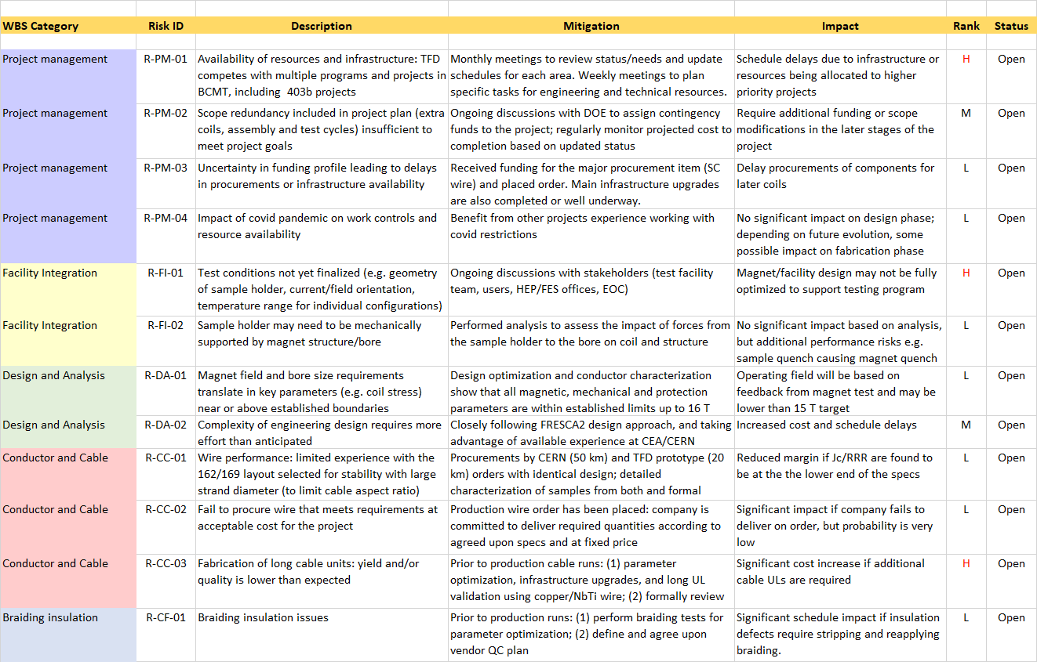
Risk Register

Slide 13
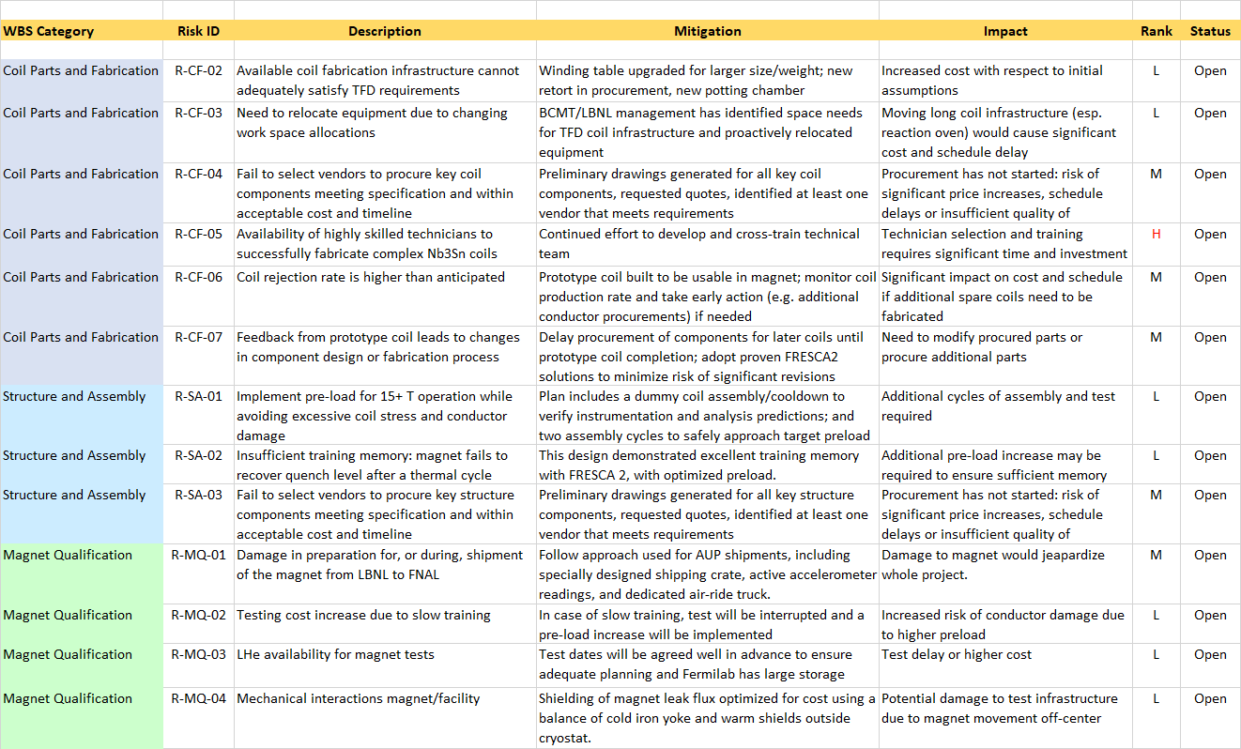
Risk Register

Slide 14
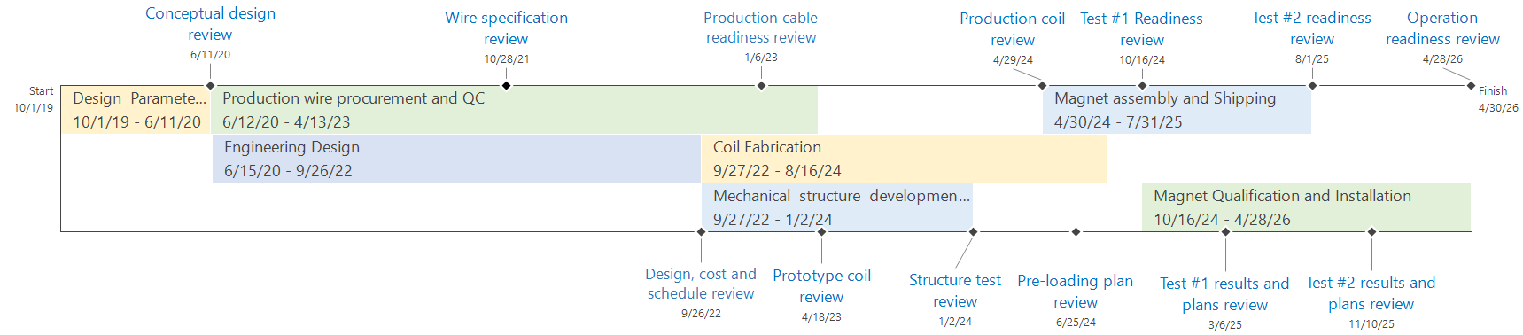
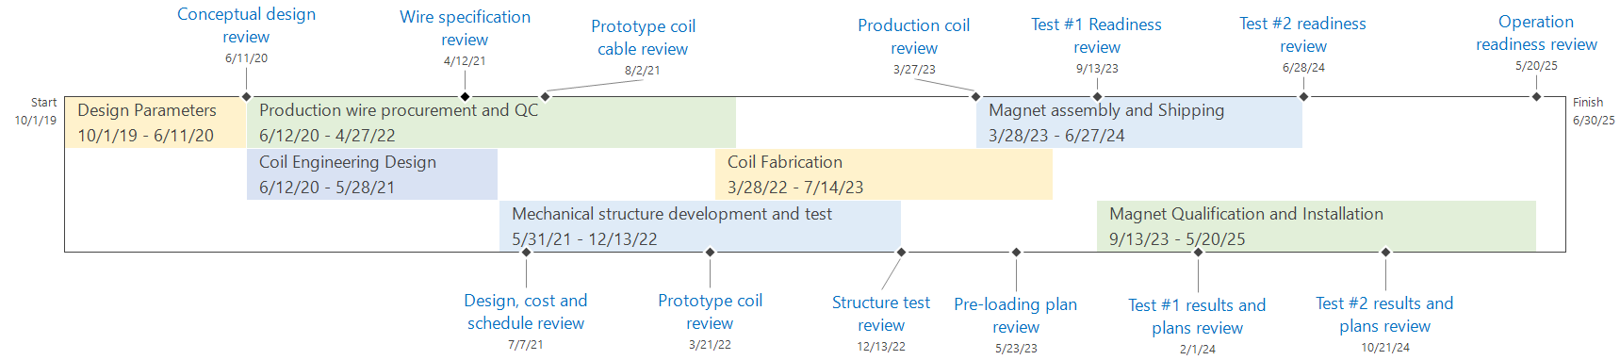
TFD Schedule: EOC2 vs EOC1
August 2022 (EOC2)
April 2021 (~EOC1)

Slide 15
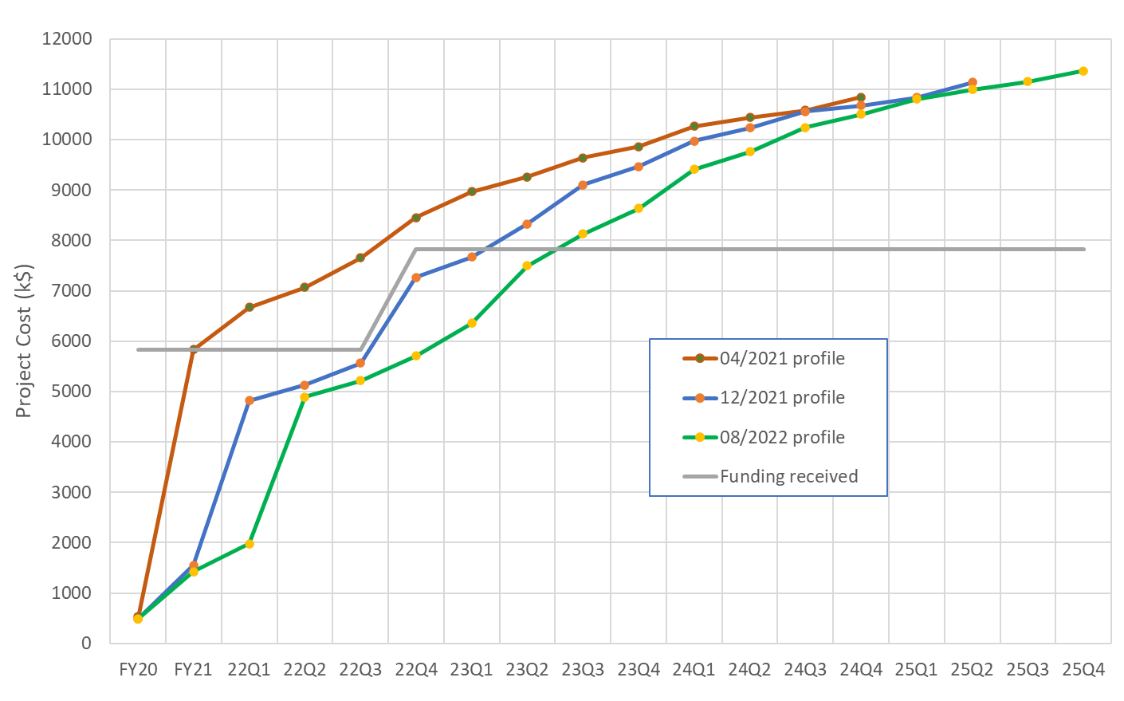
Funding Profile

Slide 16
Magnet Development and Fabrication Plan
The TFD plan follows the approach used in similar high field magnet programs and projects (e.g. LARP/QXF, FRESCA2)
In particular, significant resources are allocated to magnet development and production phase has built-in “scope” contingency to mitigate risk
Development (~46% of total project cost):
  Conceptual design and analysis
  Cable development and characterization
  Nb₃Sn practice coils
  A magnet assembly and cool-down using instrumented aluminum coils to verify design calculations and strain gauge instrumentation
Production (~36% of total project cost)
  Coil fabrication (two inner and two outer), magnet assembly and test
Scope contingency (~18% of total project cost, ~51% of production cost):
  One set of spare coils (one inner and one outer double-layer)
  Two complete cycles of assembly and vertical test to allow for an adjustment of pre-load and/or replacing one or two coils with spares.

Slide 17
Summary
Main magnet features and specifications have been defined taking into account previous studies (e.g. HEPdipo) and further analysis for TFD
  Confirmed through conceptual design review
Recent design and analysis effort has focused on incorporating engineering requirements and fabrication/assembly considerations, including feedback from vendors on component manufacturability and cost
  More details in next presentations
Following a successful Wire Specification Review we requested a final quote for the production wire and placed the order
A risk register has been compiled to better capture and track information from project plan and feedback from reviews, IPT and EOC meetings
Main concerns are in the areas of resource/infrastructure availability for engineering design and fabrication, and full definition of the sample test configurations and their possible implications on the magnet design

Slide 18
Additional Slides
(Schedule Details)

Slide 19
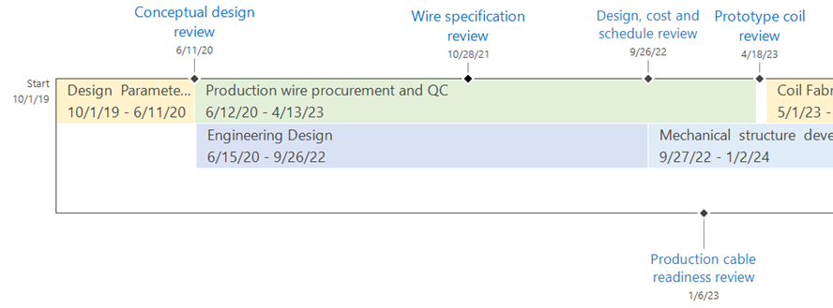
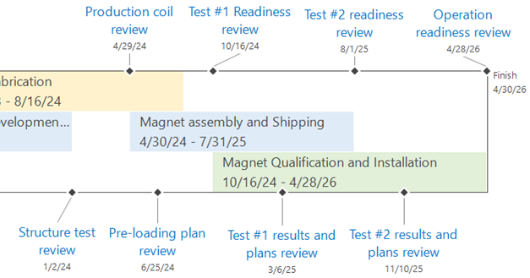
Magnet Schedule and Milestones

Slide 20
Design, Conductor, Prototype Coil

Slide 21
Production Cables and Coils

Slide 22
Structure, Assembly and Test

