Slide 1
HTS Cable Test Facility Project - Conductor Status
Ian Pong (ipong@lbl.gov)
on behalf of the SMP Materials Team
Lawrence Berkeley National Laboratory

Slide 2
Outline
Status (scope and schedule)
Wire procurement
Bare cable fabrication
Direct braiding
Wire
Cable
Braiding
With contributions from Al Baskys, Jean-Francois Croteau, Elizabeth Lee, Andy Lin, and Michael Naus

Slide 3
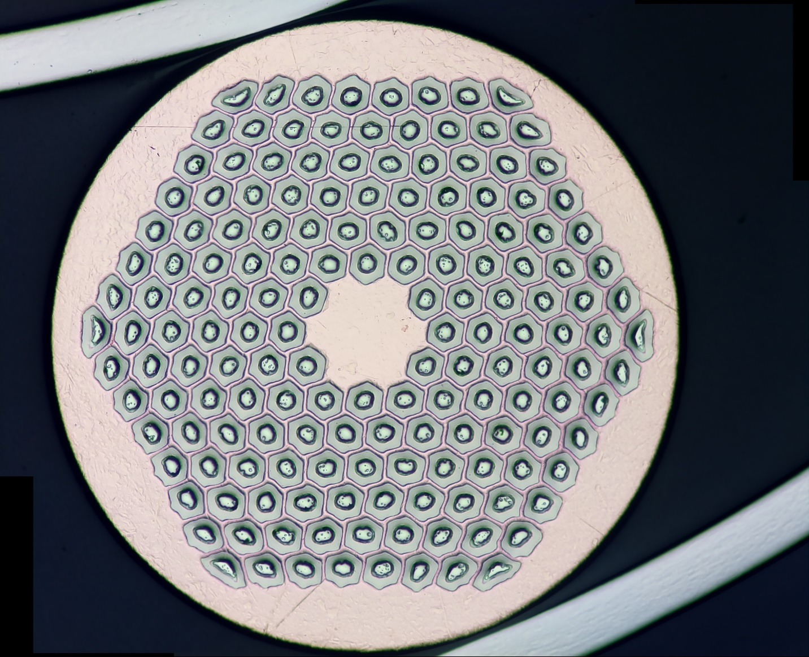
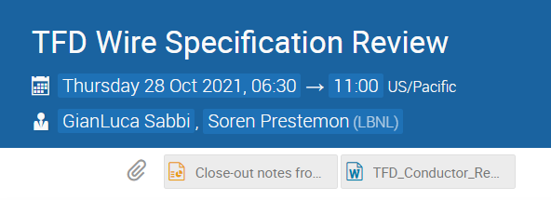
Status: Wire Procurement
Wire
Cable
Braiding
Wire for the Development Cables (completed)
LBNL PO 7509895 – 108/127 RRP® in Cable W10OL1301
CERN DEM-1.1 Wire – 162/169 RRP® in Cable W12OL1302
Prototype (completed)
LBNL PO 7576493 – 162/169 RRP® in Cable W12OL1303
Production (in progress)
LBNL PO 7629842 – 162/169 RRP® for 5 cables (3 long, 2 short)
Signed on 2022 03 11
Shipment A due ~2022 09
Last shipment by 2022 06 01
Expecting to buy an extra unit as spare
Photo credit: Al Baskys

Slide 4
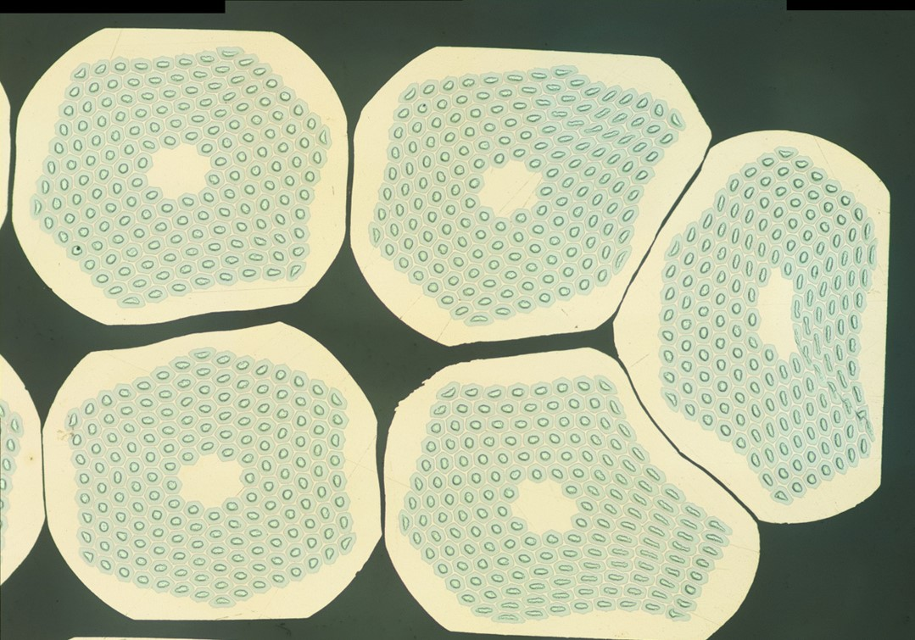
Status: Bare Cable Fabrication
Wire
Cable
Braiding
Development Cables (completed)
A paper published: https://doi.org/10.1109/TASC.2021.3094410
Prototype Cable (completed)
A special seminar: W12OL1303 Cable Summary Presentation 2022 05 18
Production Cables (to start in spring 2023)
Hardware upgrades in progress
Diagnostics upgrades in progress
Possibly preceded by a dummy (Cu) cable to qualify upgrades and minimize risk (threat)
Photo credit: Al Baskys and Jean-Francois Croteau

Slide 5
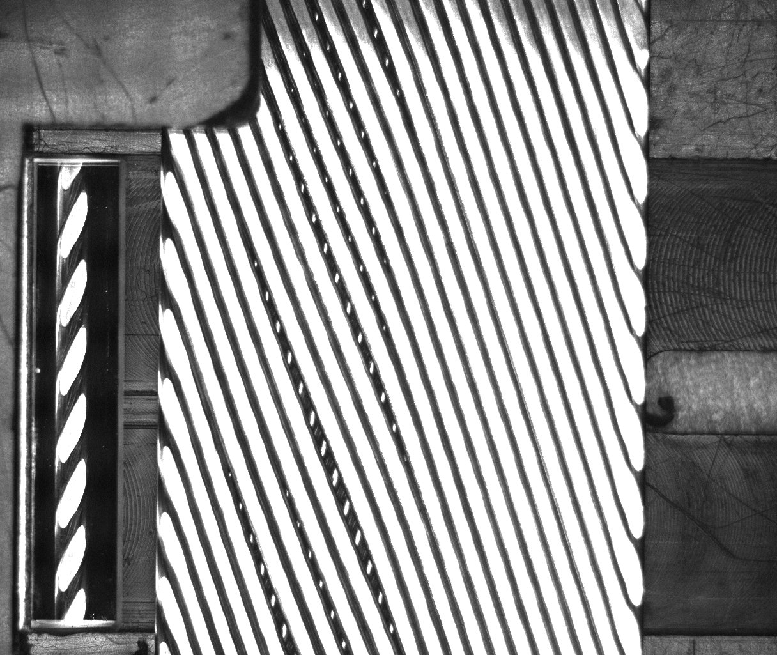
The Prototype Cable Observations
Wire
Cable
Braiding
Top face
Payout direction
The twist pitch on the top face is significantly shorter leading making it less compact and resulting in gaps
The top roller likely running at different speed relative to the cable than the bottom roller
Mandrel asymmetry during run also indicates that cable biased towards the top roller
19.7°
72.4 mm
155 mm
81.5 mm
Bottom face
17.6°
25.86 mm

Slide 6
Alignment and Asymmetry
Wire
Cable
Braiding
After 1303 cable production run, vertical misalignment of the mandrel and cable axes observed
Misalignment likely caused
Asymmetric mandrel angle for the top and bottom broad faces
Asymmetric friction and possibly thereby different relative speed wrt rollers
Suspected cause for strand gap on top cable face
0.5 mm
1.5 mm
Mandrel tip
Roller aperture

Slide 7
Good news: Extracted Strand RRR is good
Wire
Cable
Braiding
Cable ID | Wire ID | Major RRR | Minor RRR | Bottom RRR | Top RRR | End-to-End
W12OL13037A05E | WO11S20517A01A | 140 | 195 | 251 | 224 | 223
W12OL13037A11E | WO11S20506A05A | 179 | 271 | 321 | 281 | 285
W12OL13037A16E | WO11S20506A03A | 133 | 214 | 271 | 233 | 234
W12OL13037A21E | WO11S20517A02A | 162 | 251 | 318 | 268 | 274
W12OL13037A27E | WO11S20517A02A | 186 | 252 | 323 | 263 | 277
W12OL13037A33E | WO11S20515A01A | 162 | 235 | 325 | 266 | 273
W12OL13037A38E | WO11S20515A01A | 171 | 258 | 329 | 277 | 283
W12OL13037A43E | WO11S20516A01A | 120 | 159 | 194 | 159 | 169
Extracted Strad Average |  | 157 | 229 | 292 | 246 | 252
Strand from billet #20516 worse than others, consistent with vendor and start-up RRR data
Specification: >100

Slide 8
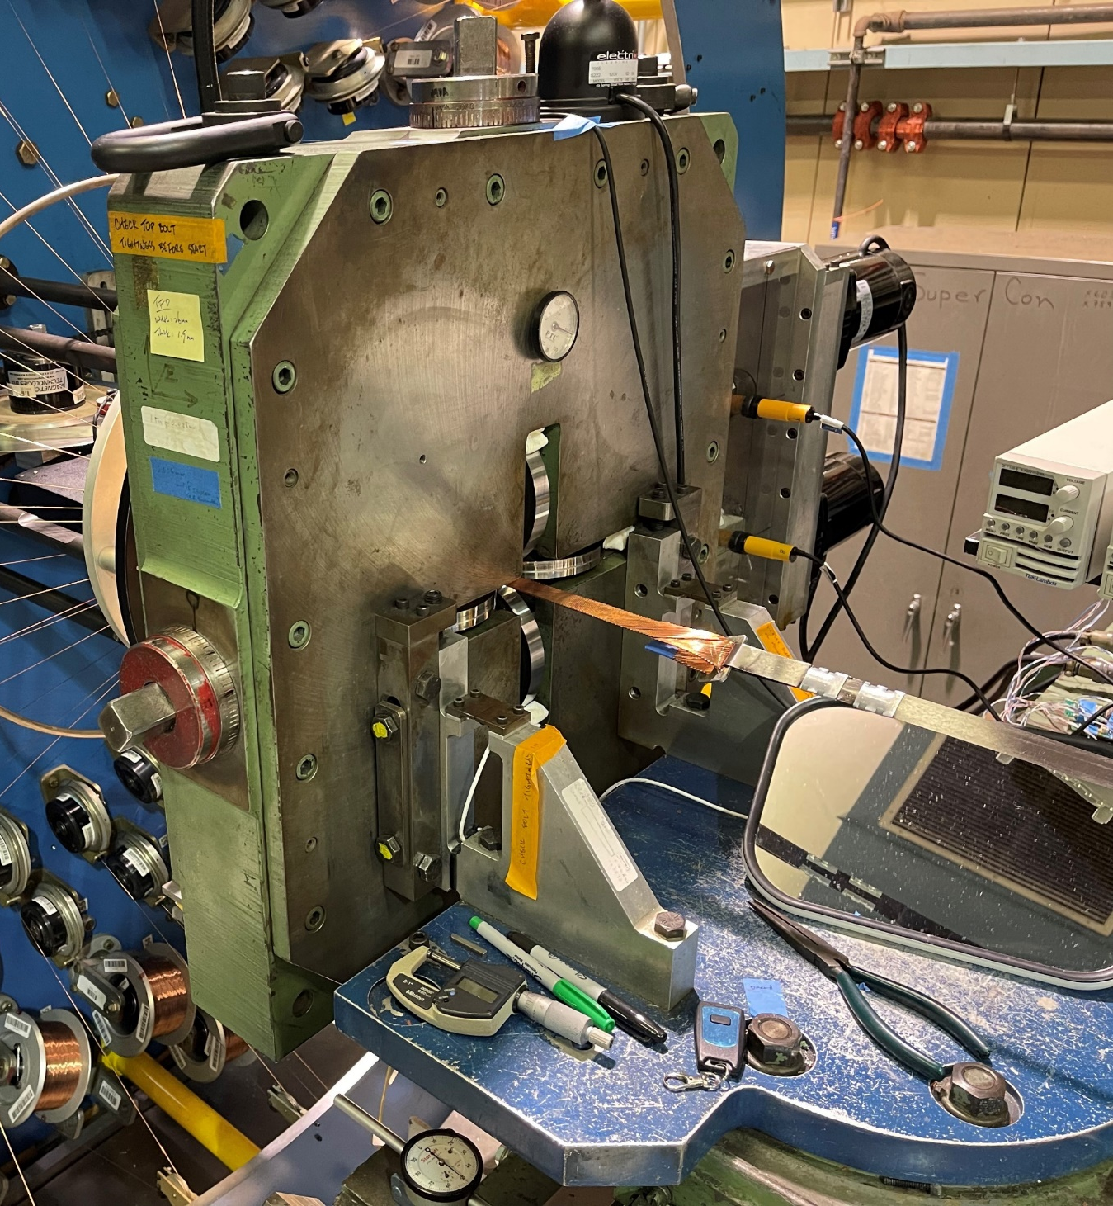
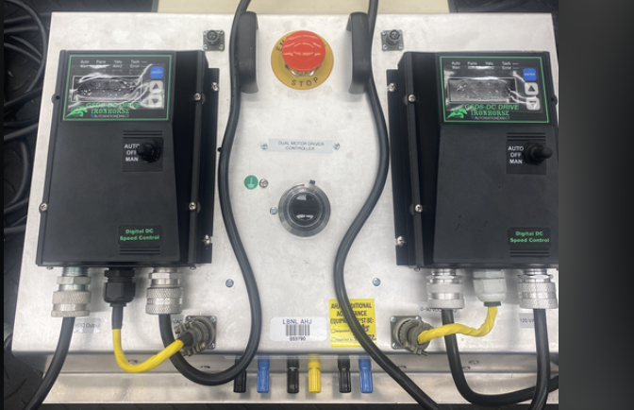
Nevertheless: Cabling Machine Improvements
Wire
Cable
Braiding
Diagnostics (in progress)
Monitoring and logging motor/roller speed as well as motor voltage for any indications of motor load/speed imbalance
Monitoring lubricant rate
Monitoring slip on caterpuller
Ambient conditions during cabling runs
…
Turkshead (in progress)
Higher power motors with drivetrain modification
Encoders for semi-closed loop control and single point safety stop
…
Photo credit: Elizabeth Lee

Slide 9
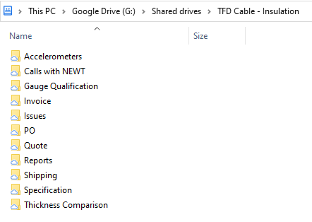
Status: Direct Braiding
Wire
Cable
Braiding
Prototype Cable (completed)
LBNL PO 7631056 – also procured sufficient raw material for the production cable
Production Cable
Need 10-stack hardware upgrade: Web Job Order #J28098.B

