Slide 1
High Temperature Superconductor Cable Test Facility
TFD engineering design and fabrication
José Luis Rudeiros Fernández, Diego Arbelaez, P. Ferracin, R. Hafalia, R. Lee, P. Mallon, G. Sabbi, M. Solis, G. Vallone
Lawrence Berkeley National Laboratory
August 19, 2022
LBNL, Berkeley, CA

Slide 2
Outline
PLM and parameter document
Coil design
Magnet design
Procurement
Infrastructure
Summary

Slide 3
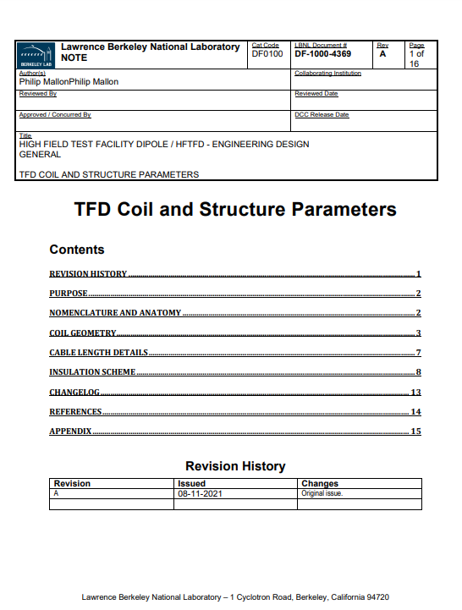
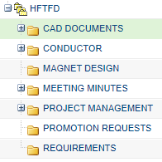
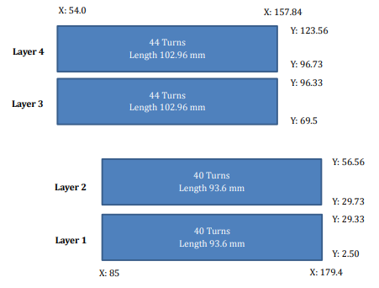
PLM and parameter document
All engineering data related to the magnet is managed in the PLM (product lifecycle management) tool used at LBNL (PTC Windchill).
The parameters required to define the components of the magnet are compiled in a master document managed from the PLM system.

Slide 4
Outline
PLM and parameter document
Coil design
Magnet design
Procurement
Infrastructure
Summary

Slide 5
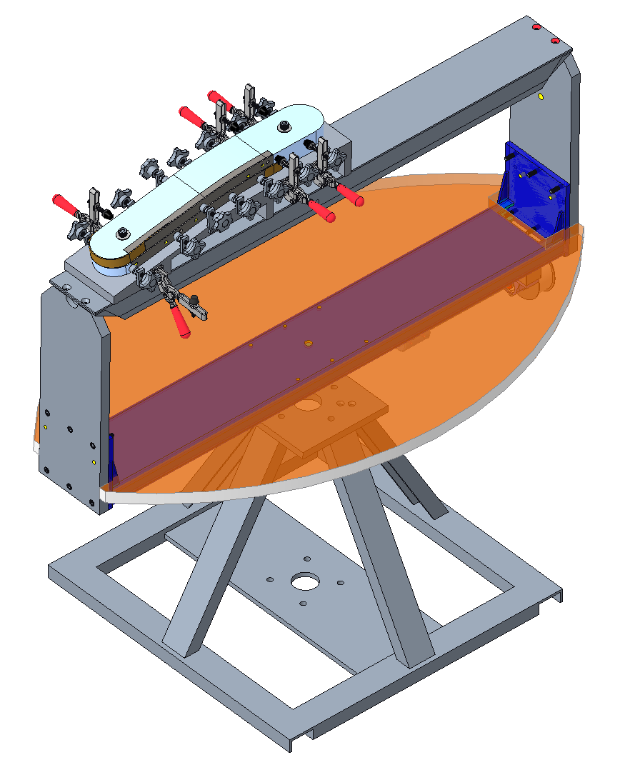
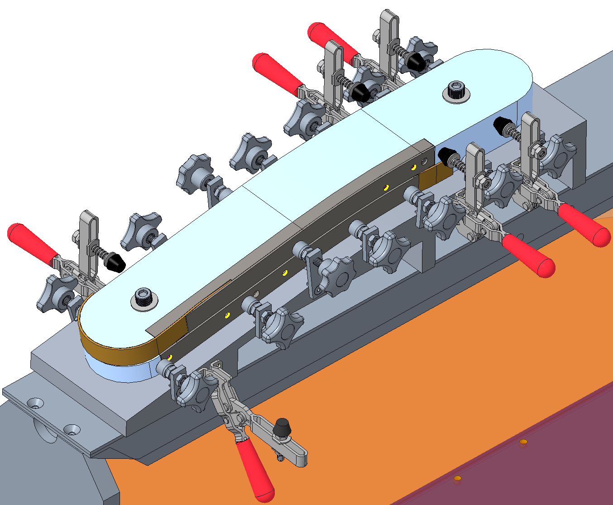
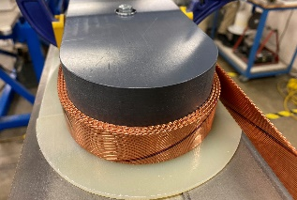
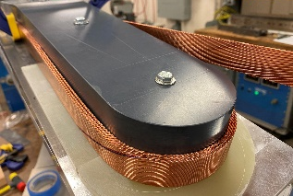
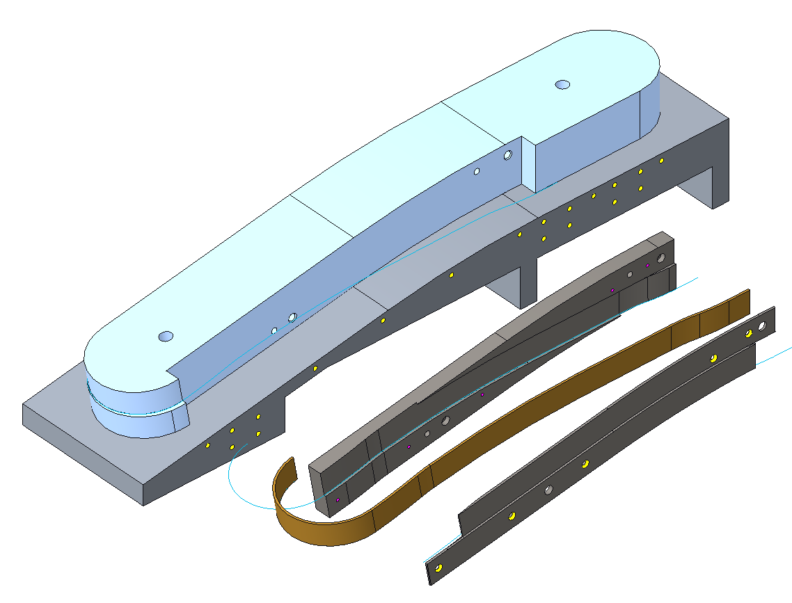
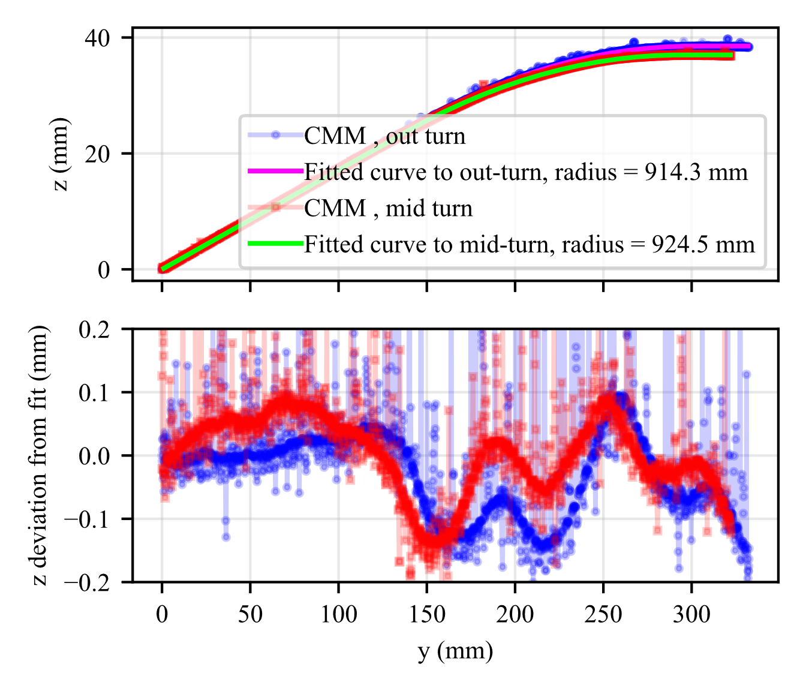
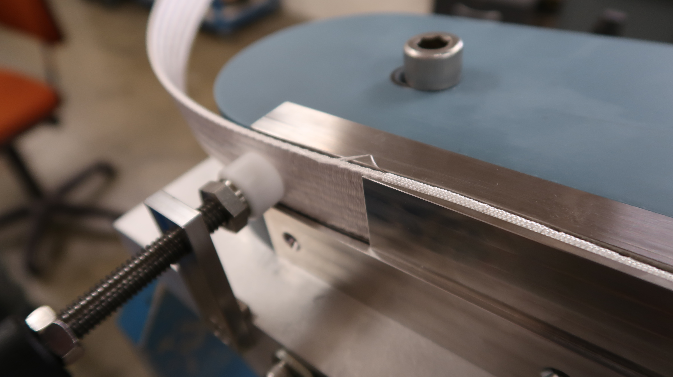
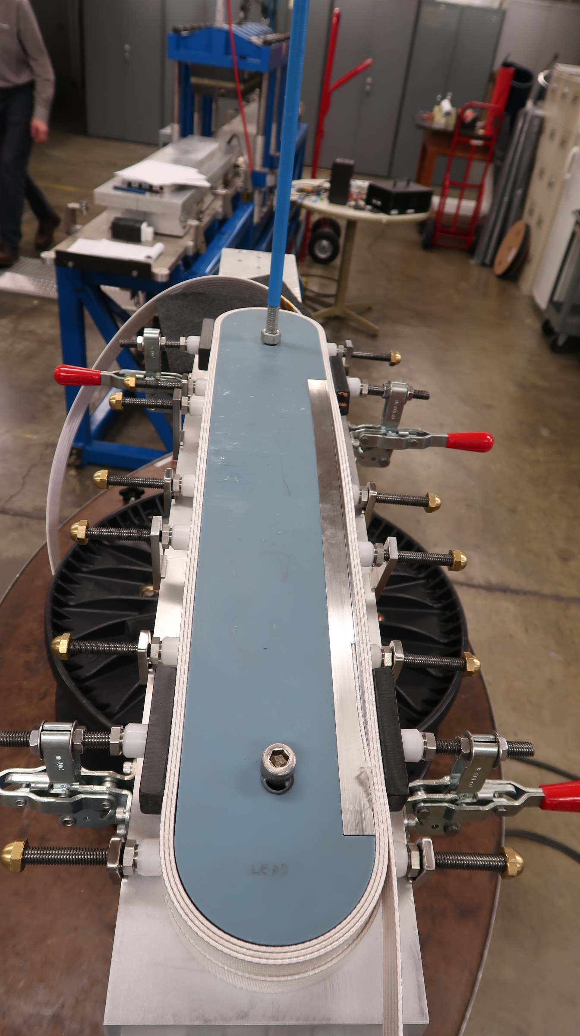
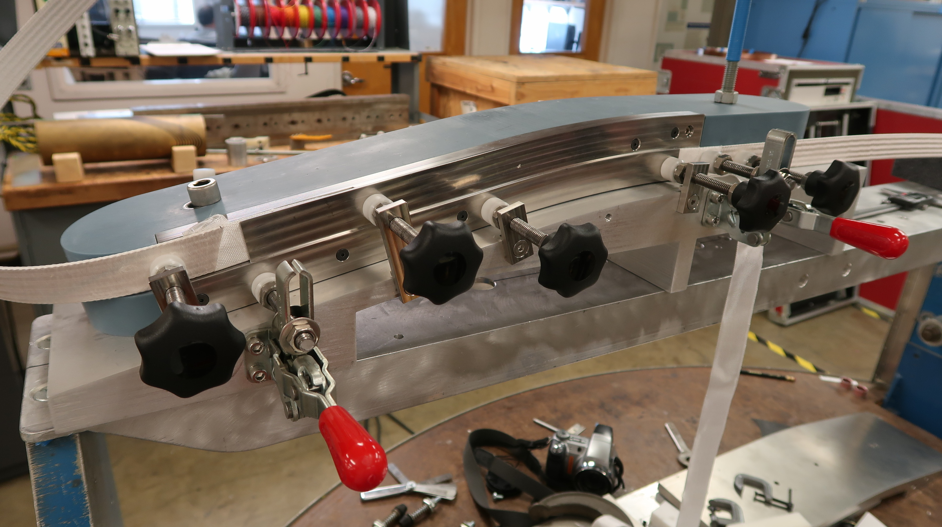
Coil design – Prototyping and design iterations
Winding tests
Layer jump tests
$$\hat{k}$$
$$y_{t}$$
$$y_{c}$$
Pole piece
A series of winding tests were performed in order to determine the optimal hard bend radius of the cable in the transition-to-ramp region (1400 mm).
The design of the layer jump region was also validated through a series of tests.
1
2
3
$$\hat{i}$$
$$\hat{j}$$
Base support
Supports
3D printed support
Winding table
3D printed bluestone pole
Base support
Steel insert
Cable geometry
Steel shim
1st chicane
Layer transition
2nd chicane
*Rudeiros Fernández, JL, et al. "Engineering Design of a Large Aperture 15 T Cable Test Facility Dipole Magnet." IEEE Transactions on Applied Superconductivity 32.6 (2022): 1-5.

Slide 6
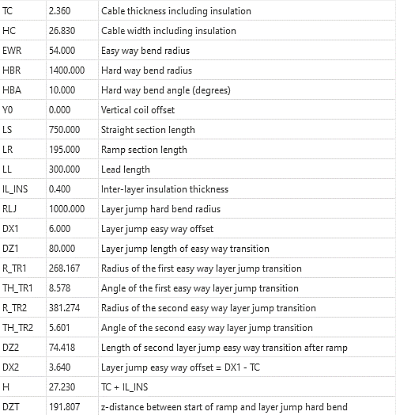
Coil design – Parametric CAD models – Final configuration
A fully parametric CAD model of each coil has been implemented in CREO parametric.
The geometrical values in the model reflect the master parameter document.
The current version of the parametric models include a straight section length of 750 mm.
Main parameters (example)
Coil 1
Coil 2

Slide 7
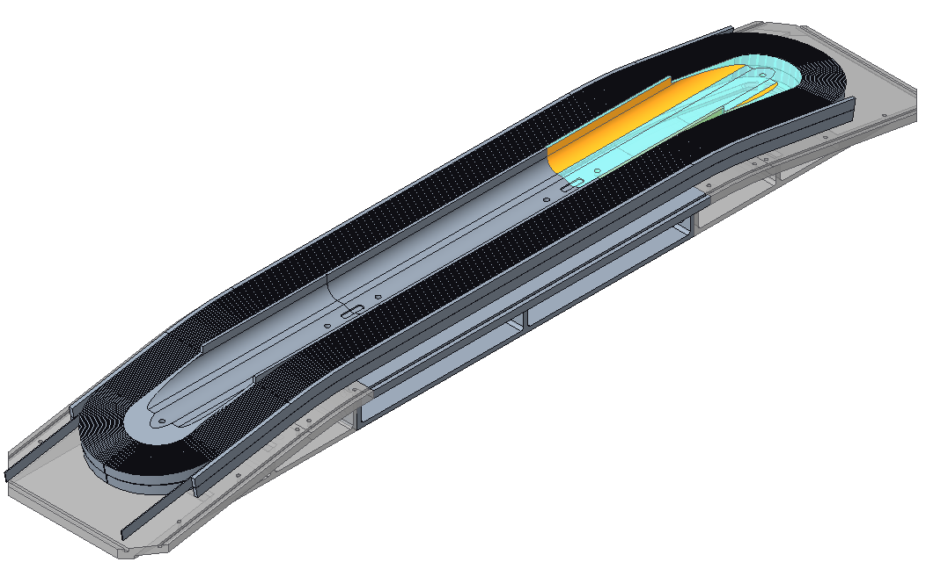
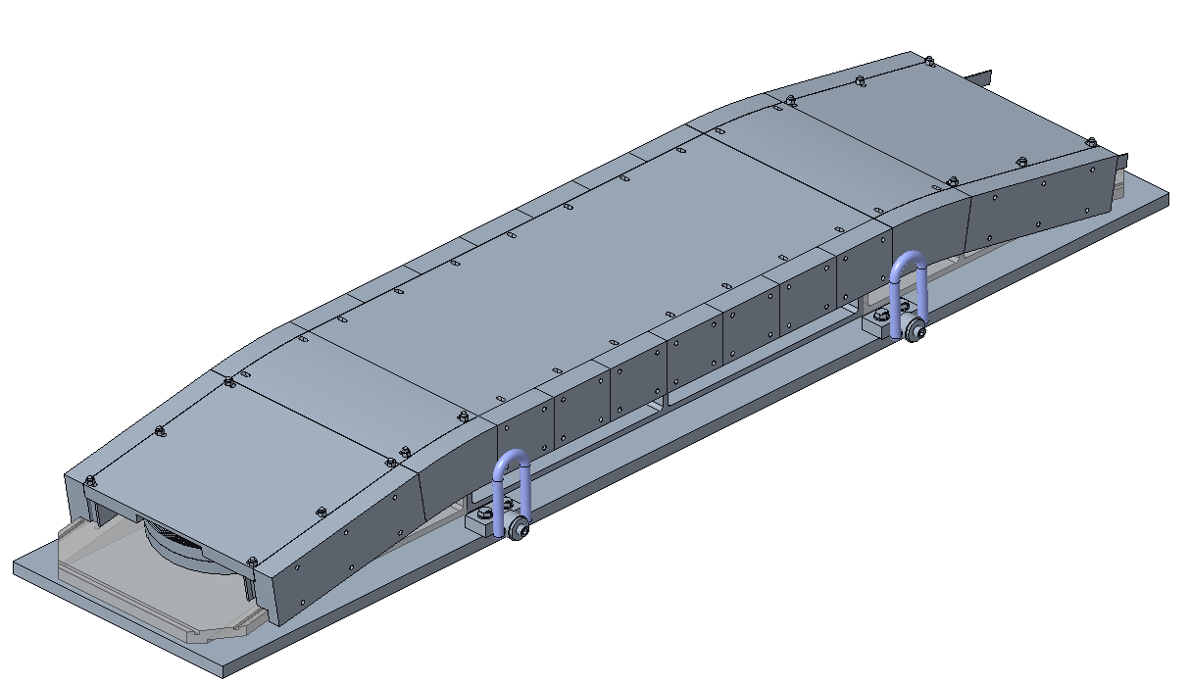
Coil design – Tooling
Winding tooling
The winding tooling for Coil 1 is currently being finalized, incorporating the design feedback from the winding and layer jump tests.
The reaction tooling for Coil 1 is being developed along with the winding + reaction + impregnation manufacturing sequence.
Reaction tooling

Slide 8
Outline
PLM and parameter document
Coil design
Magnet design
Procurement
Infrastructure
Summary

Slide 9
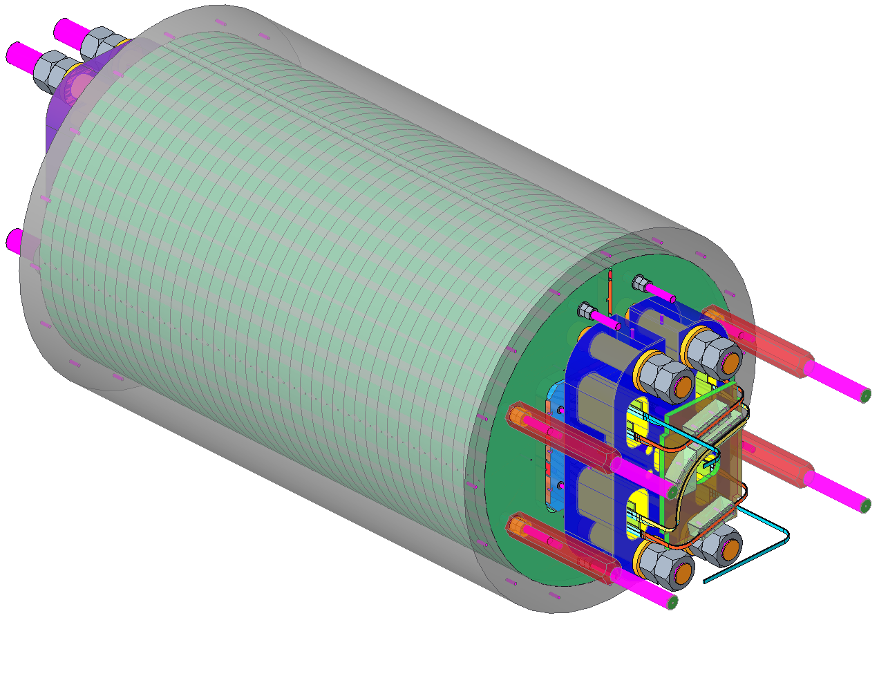
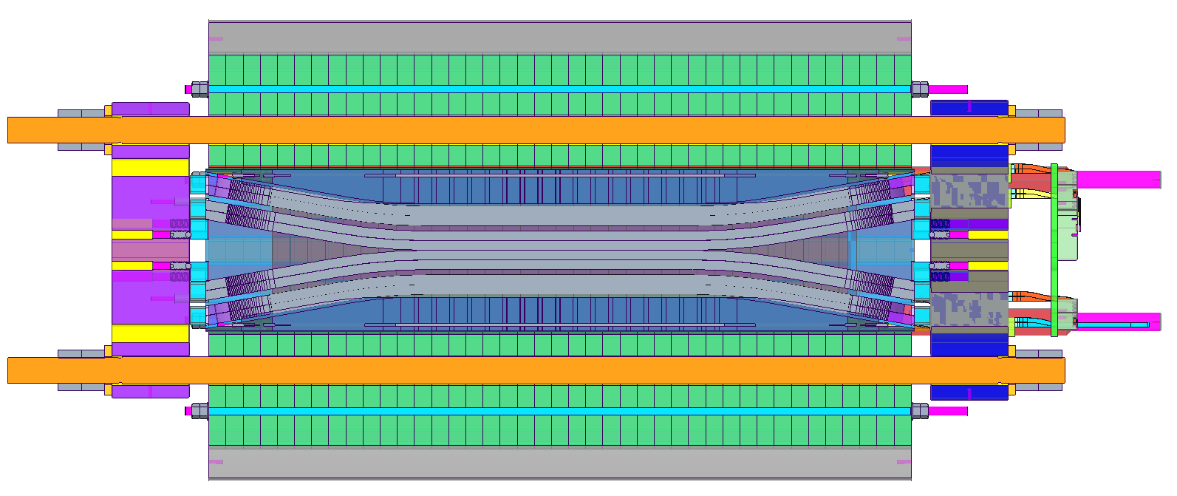
Magnet design – Main Overview
End-plate
1.98 m
Coil 1
Coil 2
Aluminum shell
Rods
Yoke laminations

Slide 10
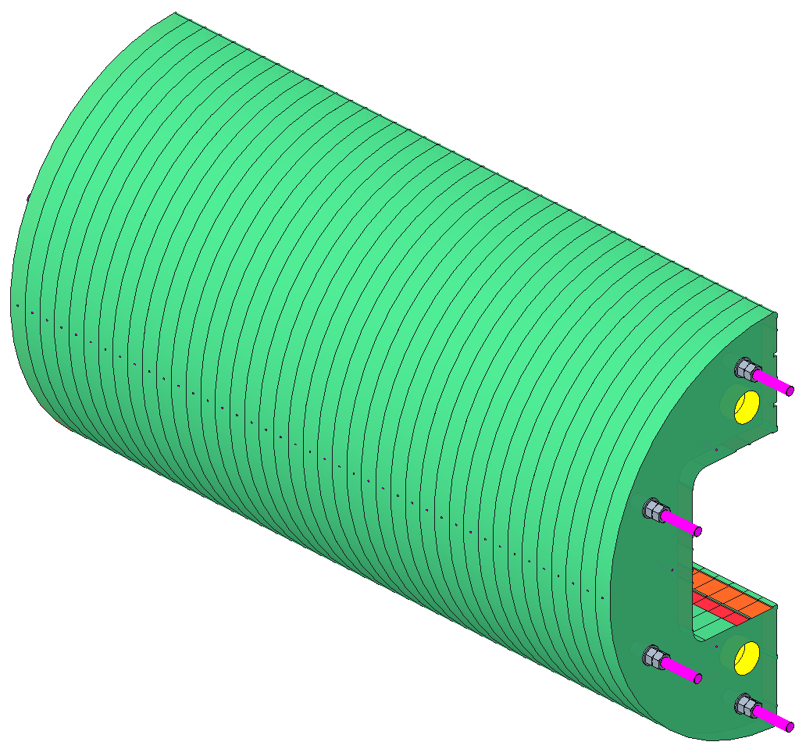
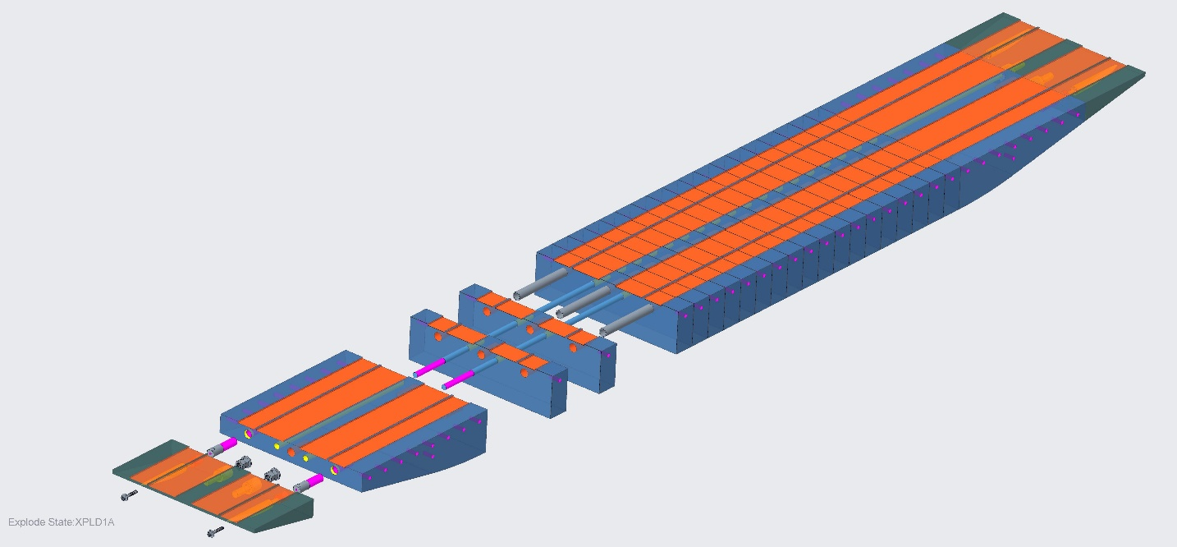
Magnet design –Yoke and Pads
The yoke structure has been adapted to laminations manufactured with ARMCO grade 4 plate stock of ~50 mm. The current design includes the optimized location and size of keys and bladders.
The vertical and horizontal pads are now constructed as a laminated structure based on ARMCO grade 4.
The structure of the pads has been optimized to facilitate the manufacturing and assembly of the parts and to allow for the transition to steel segments towards the ends of the magnet.
Aluminum shell
Yoke
Horizontal pad
Vertical pad

Slide 11
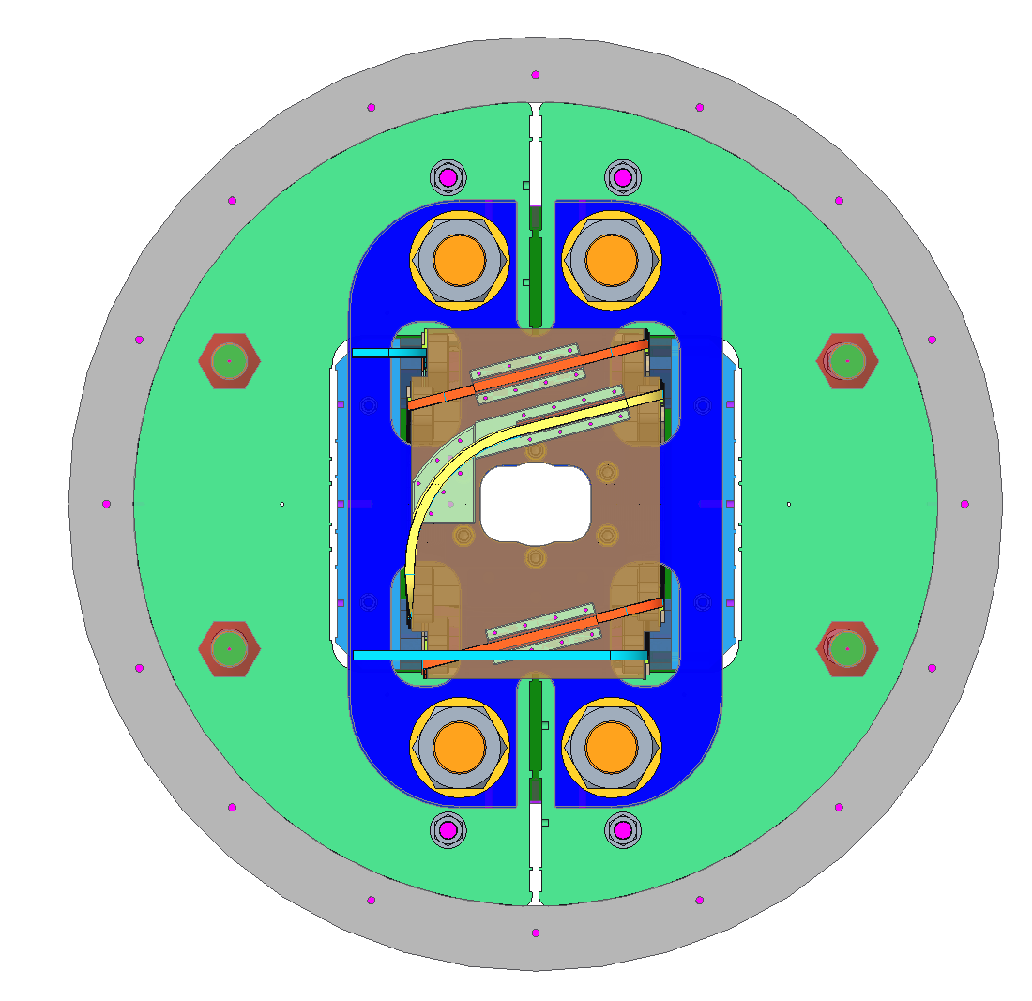
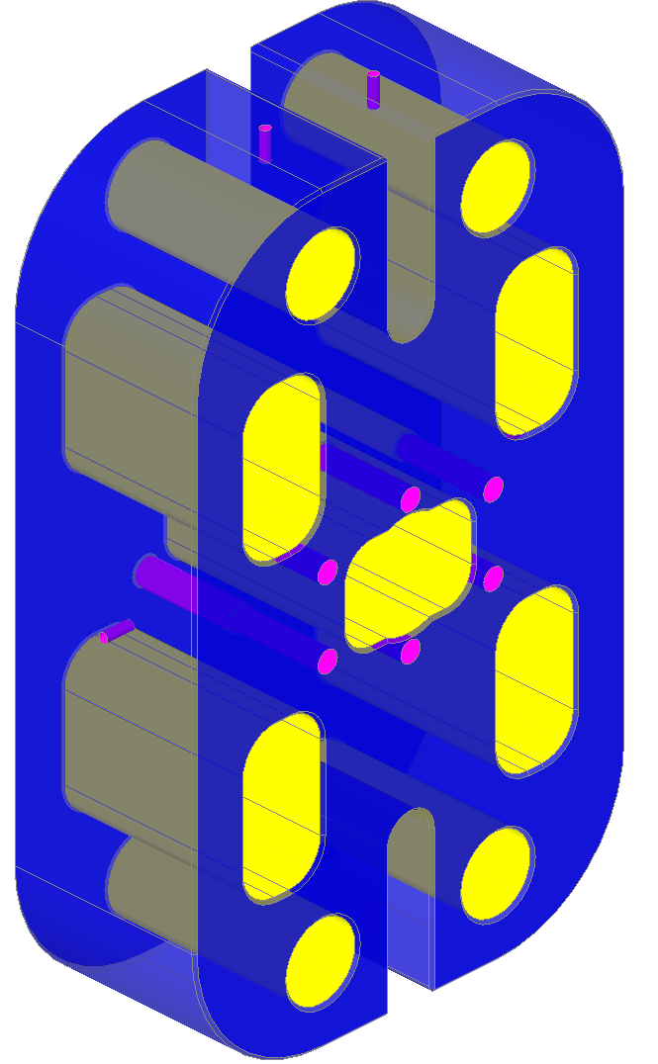
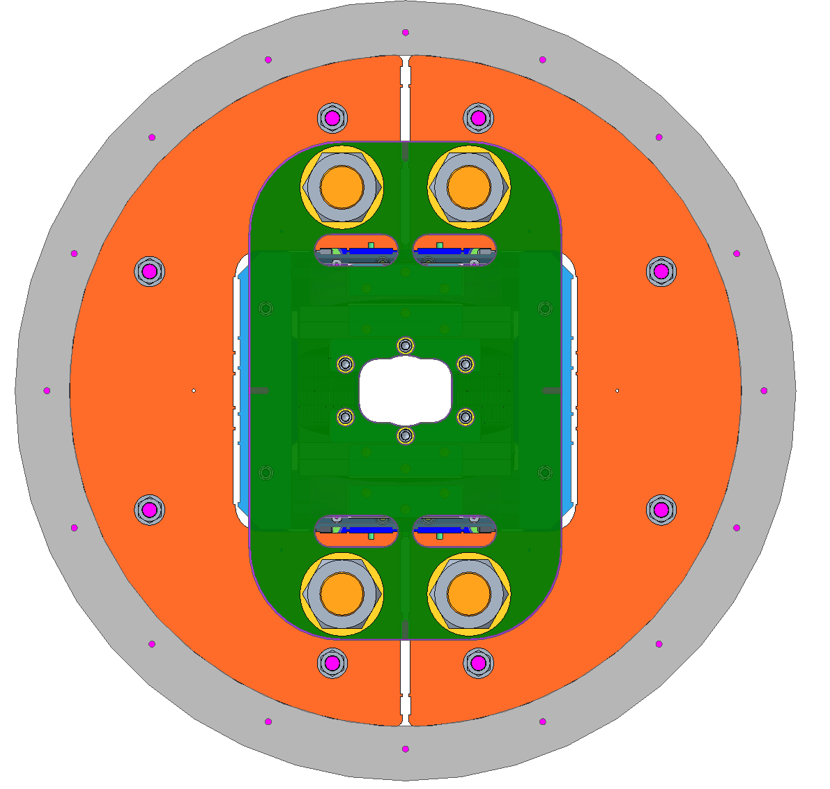
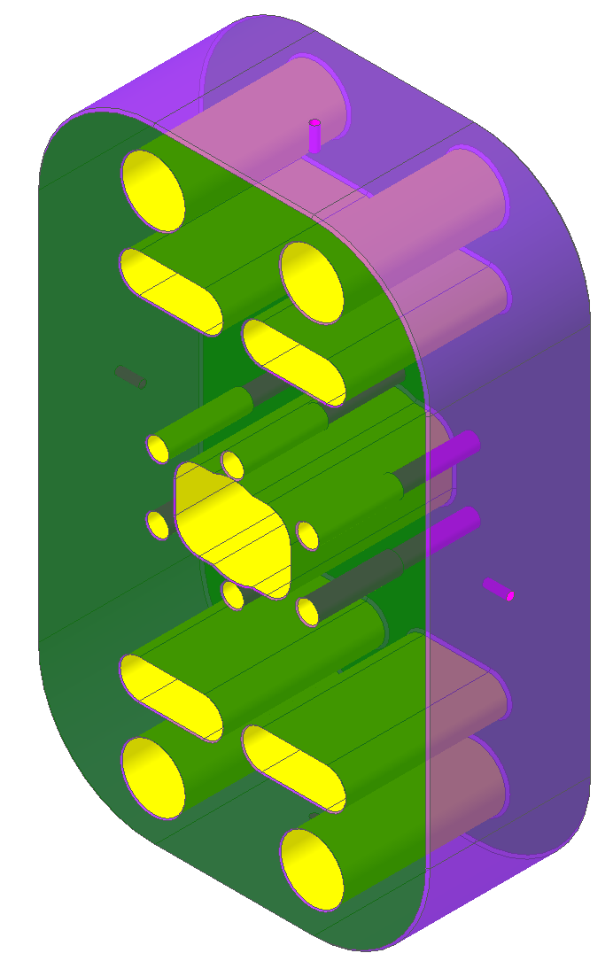
Magnet design – End plates
The geometry of the end plates geometry has been created based on the FE analysis, and to comply with the following constraints:
Allow for the leads to pass through the end plate towards the splice box.
Allow for clear access to the aperture of the magnet.
Allow for clear access to all bladders and keys locations during the assembly operations.
Lead end
Return end

Slide 12
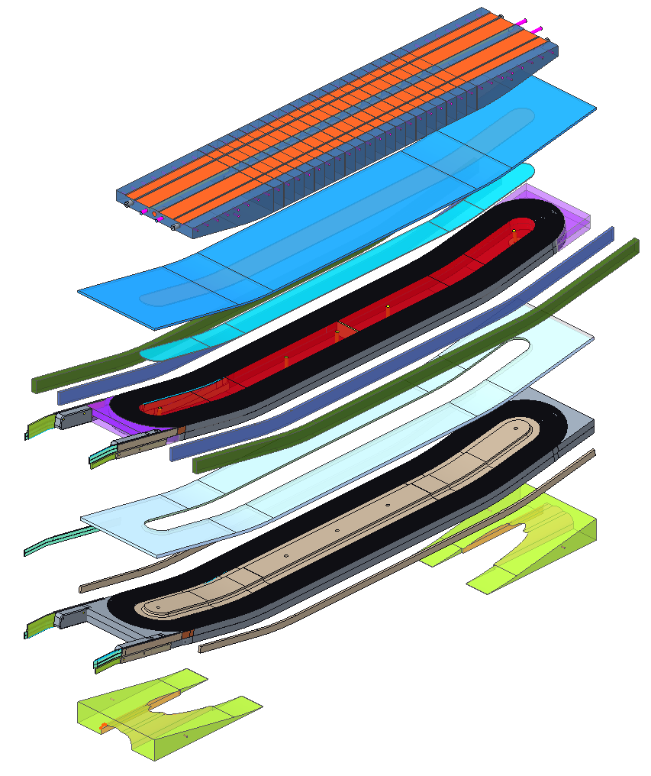
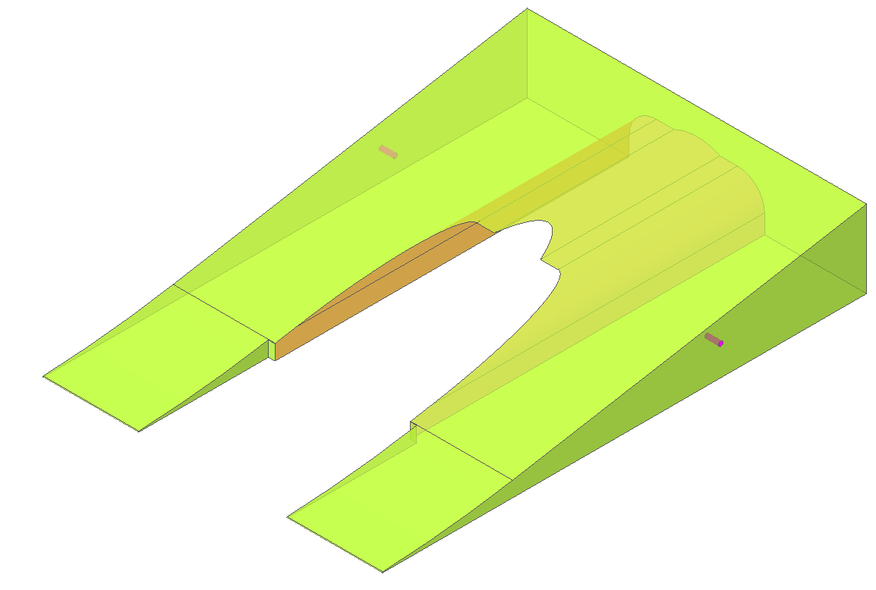
Magnet design – Wedge design
The wedge has been re-designed to incorporate the modifications from the FE analysis to reduce the stress in the conductor.
The wedge will be impregnated along with coil 1 but will be mold released following the analysis recommendations.

Slide 13
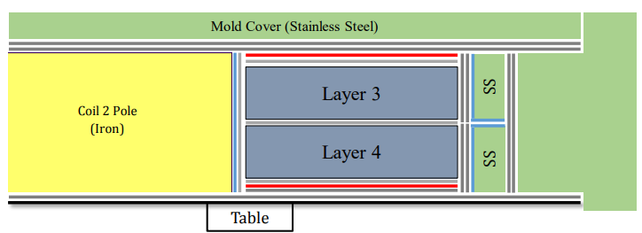
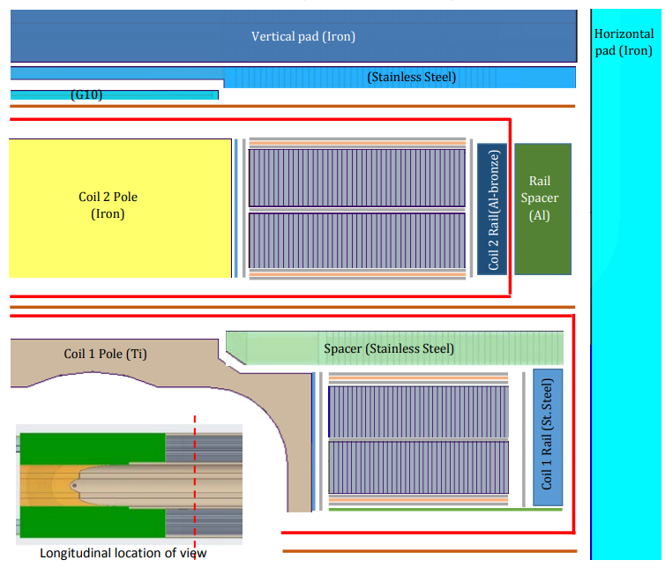
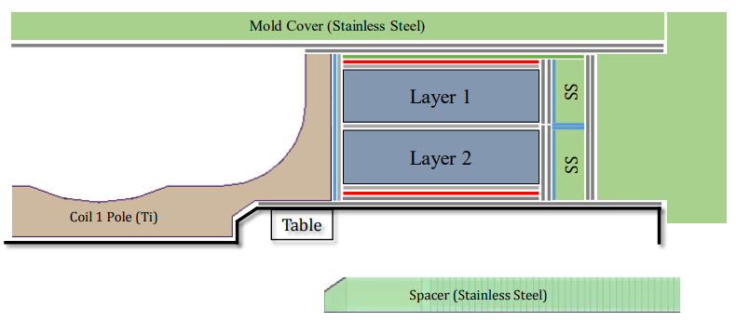
Magnet design – Insulation scheme
The global insulation scheme for winding, reaction, and magnet assembly has been developed following the constraints for insulation, manufacturing of the coils, and magnet assembly.
The ID and dimensions of the various layers are recorded in the parameter master document and are currently being implemented in the CAD models.
Winding and reaction
Magnet assembly

Slide 14
Outline
PLM and parameter document
Coil design
Magnet design
Procurement
Infrastructure
Summary

Slide 15
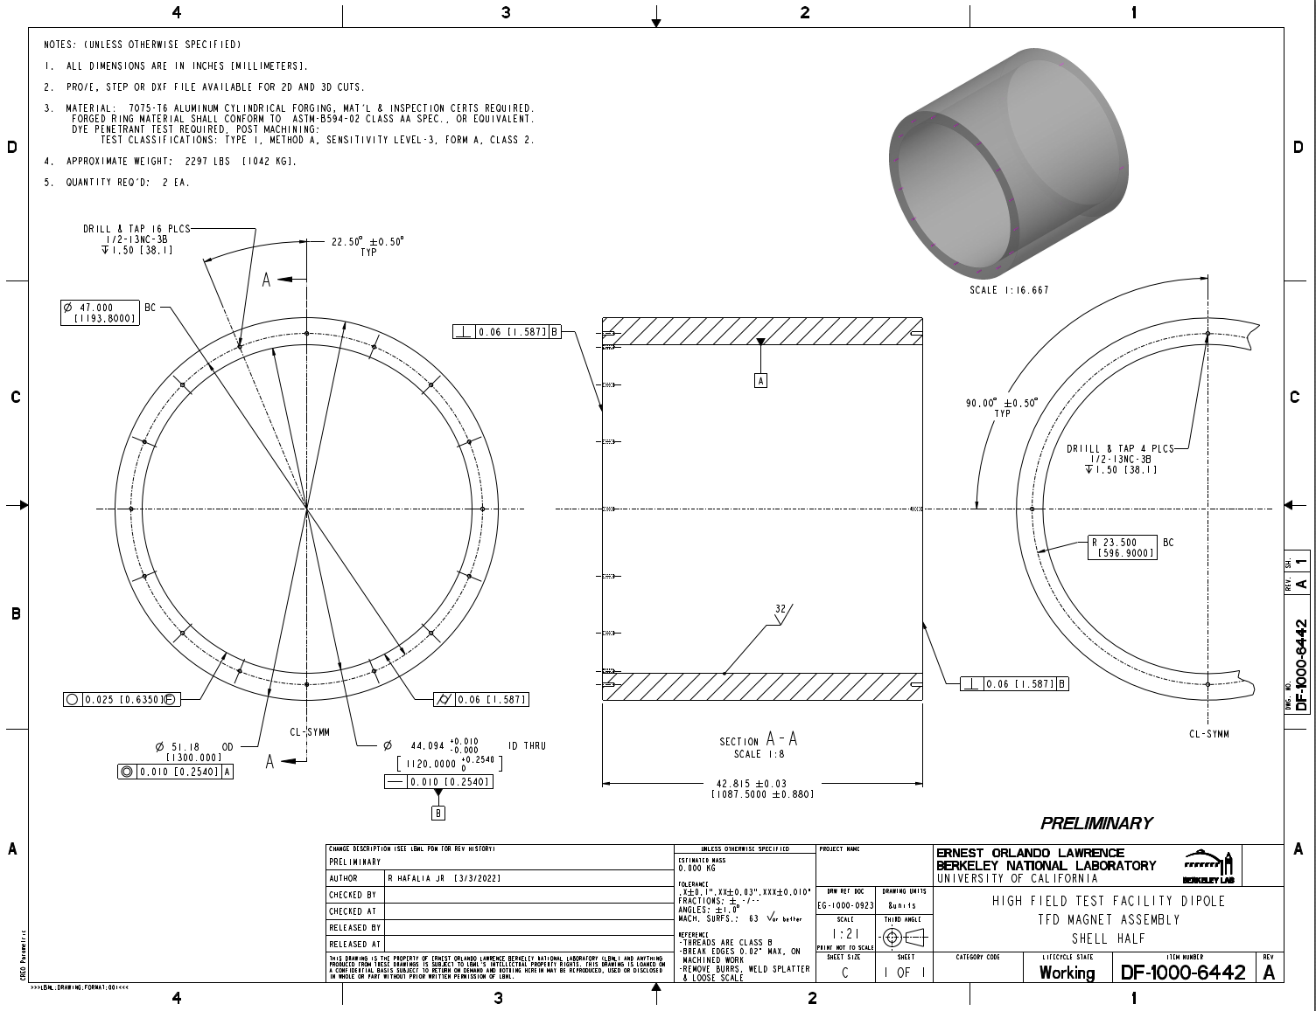
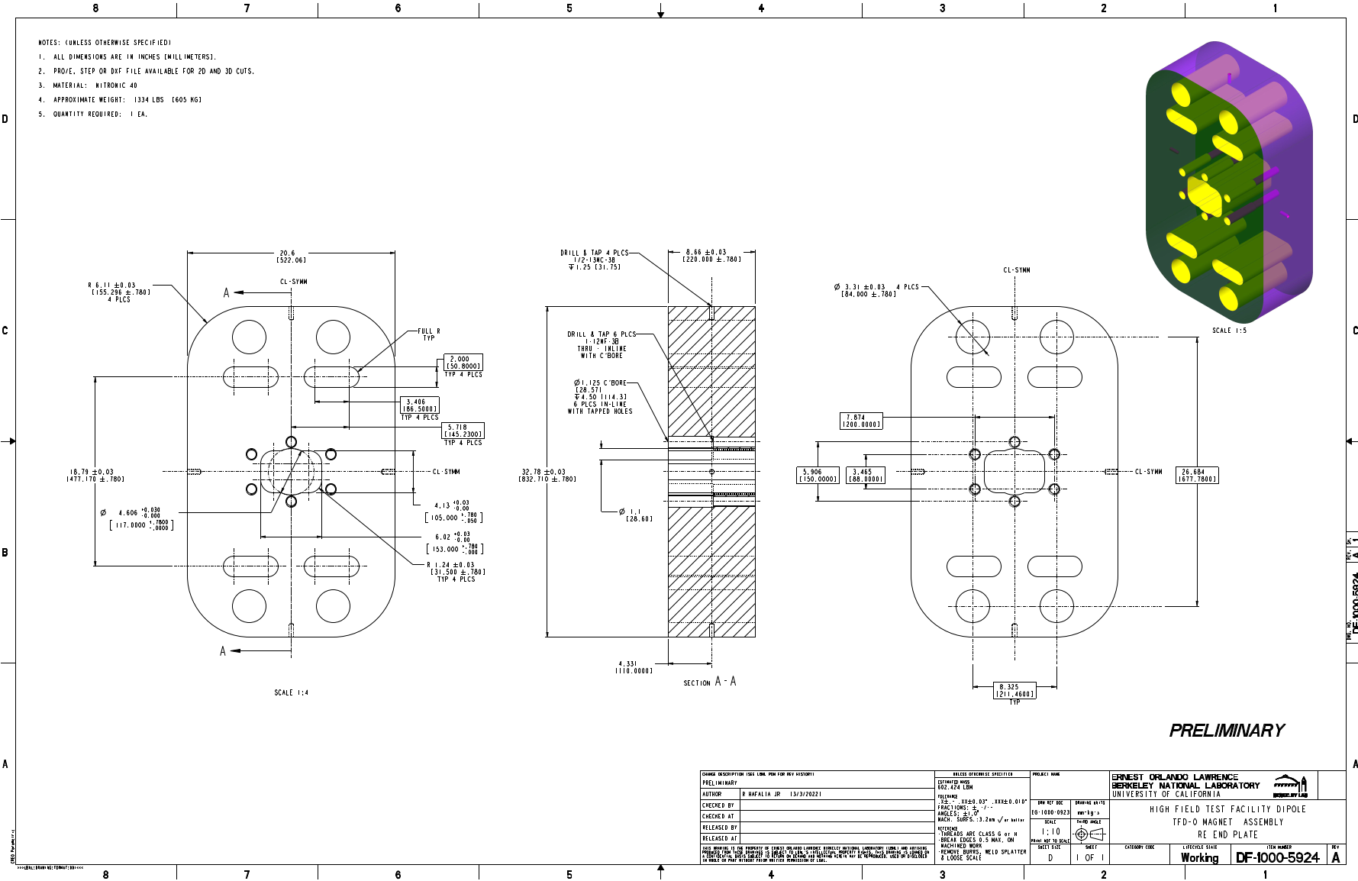
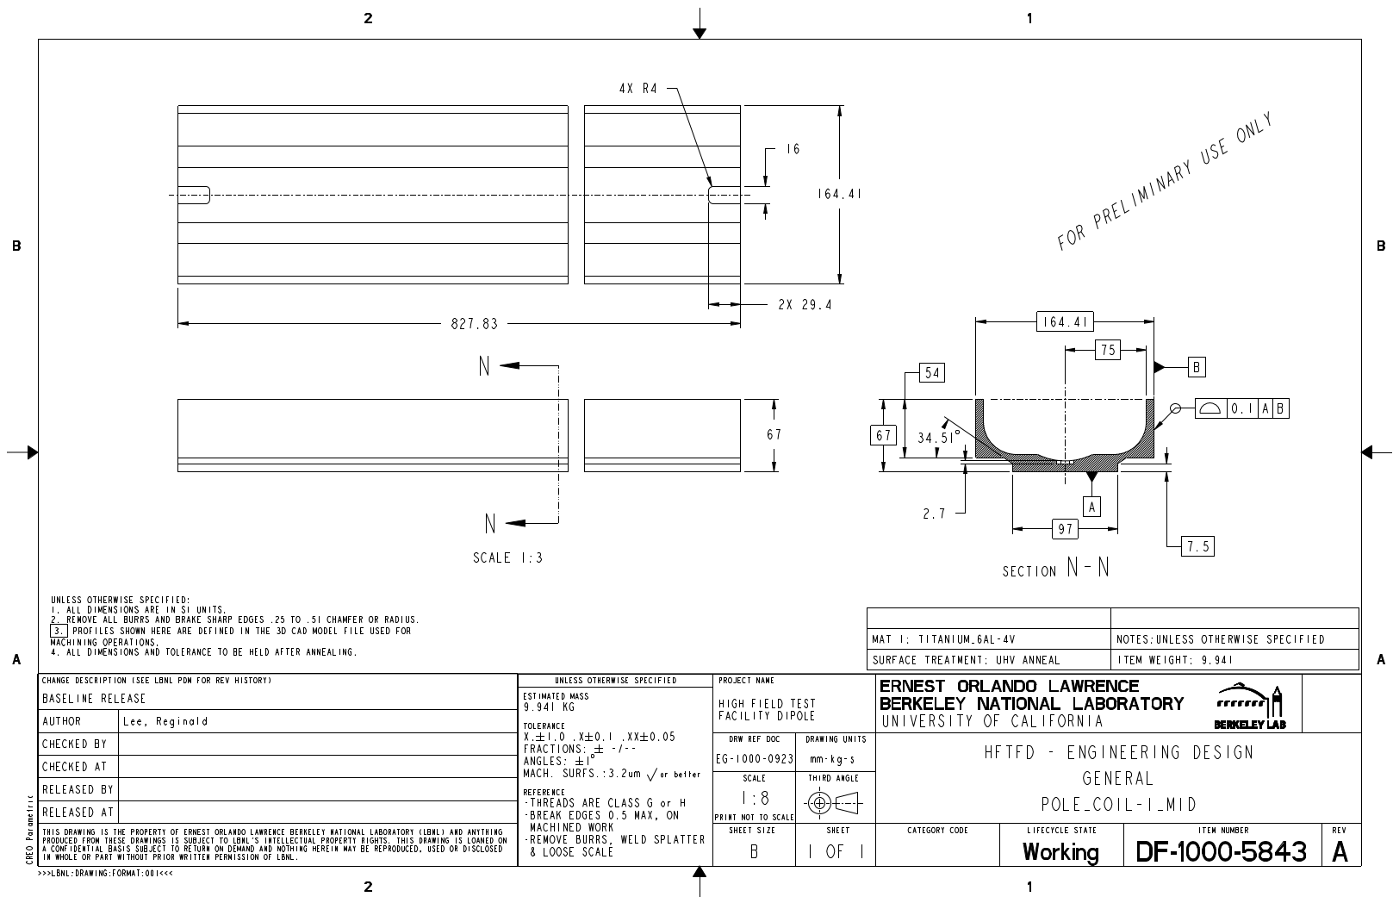
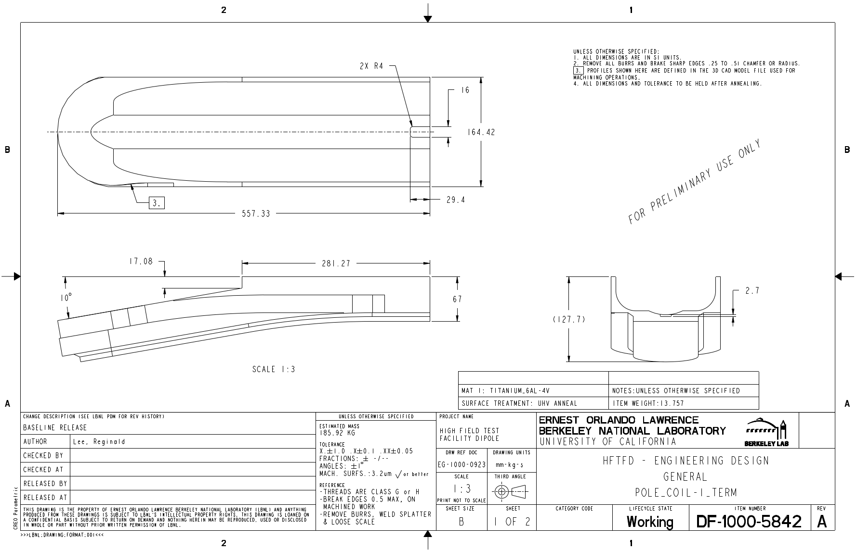
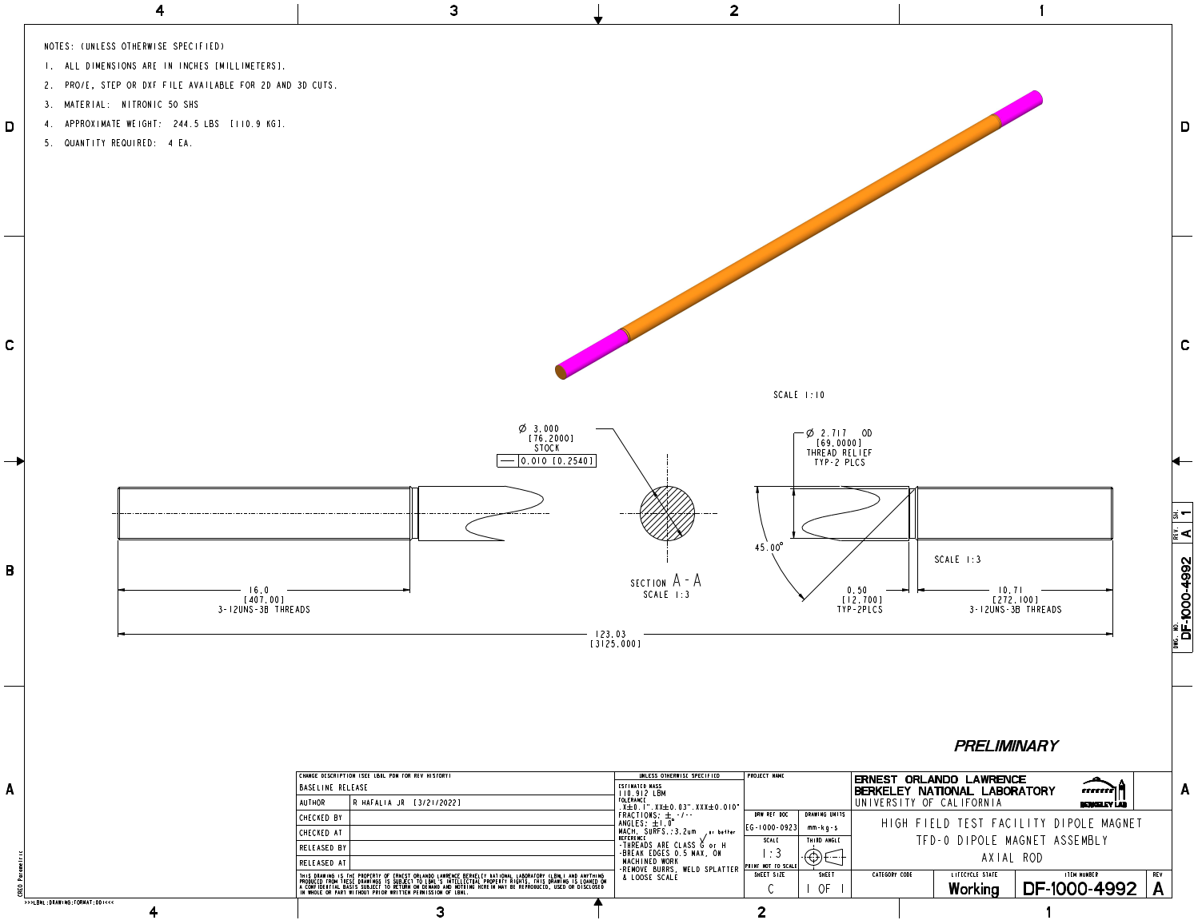
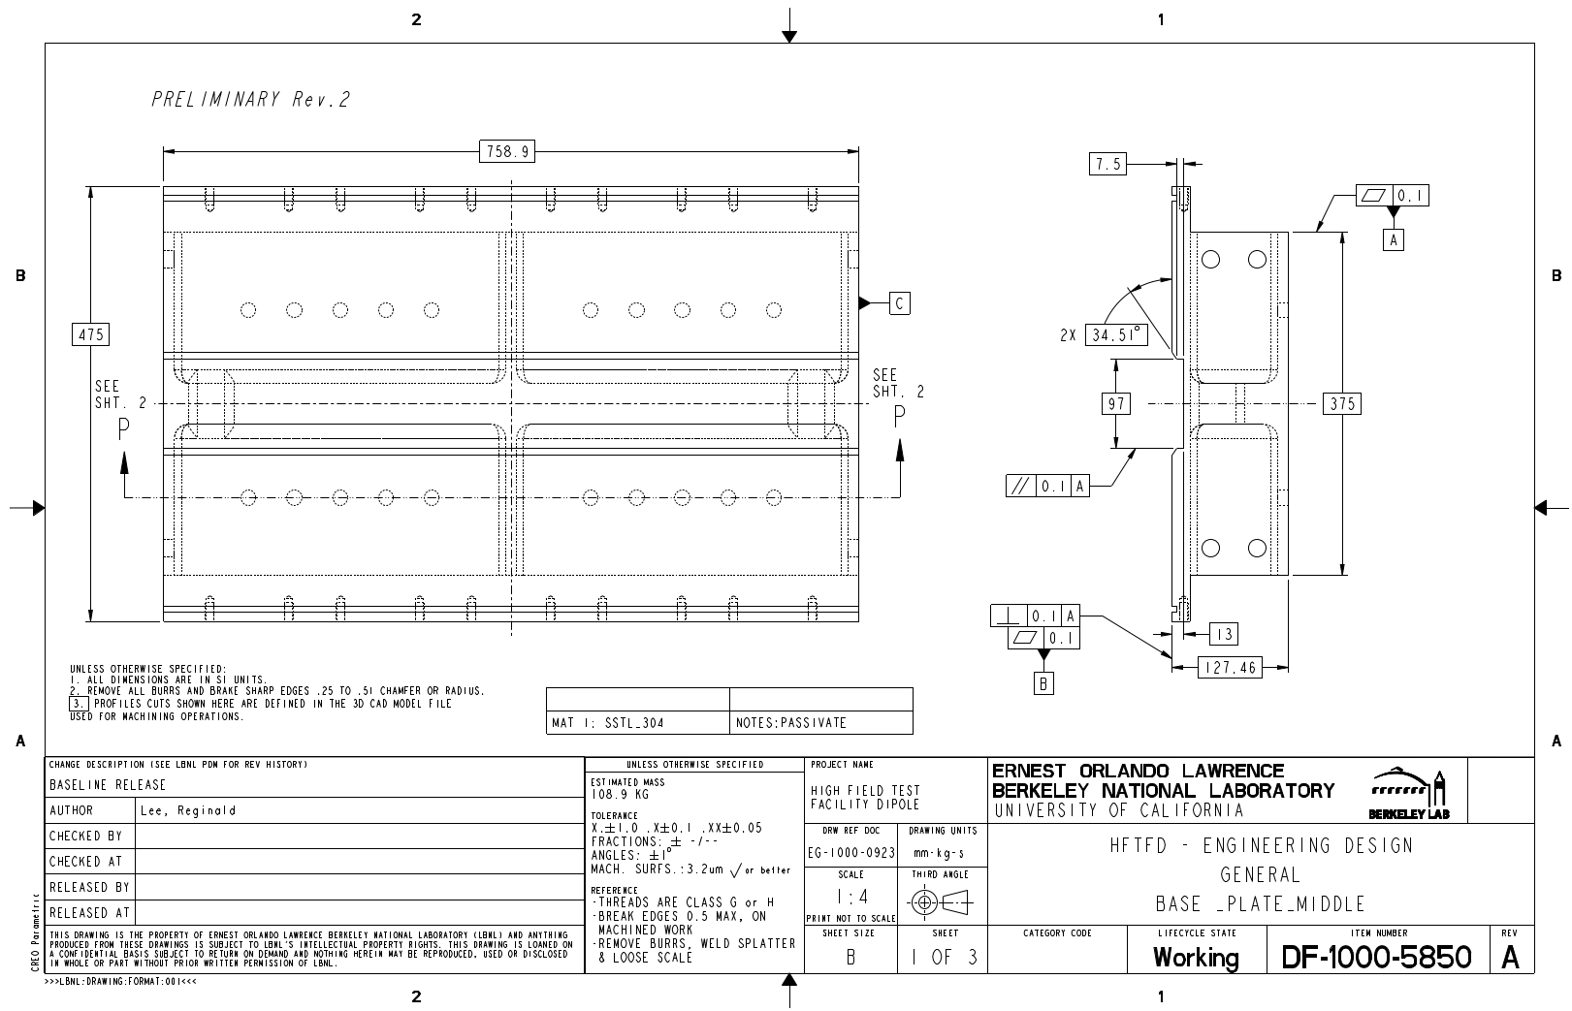
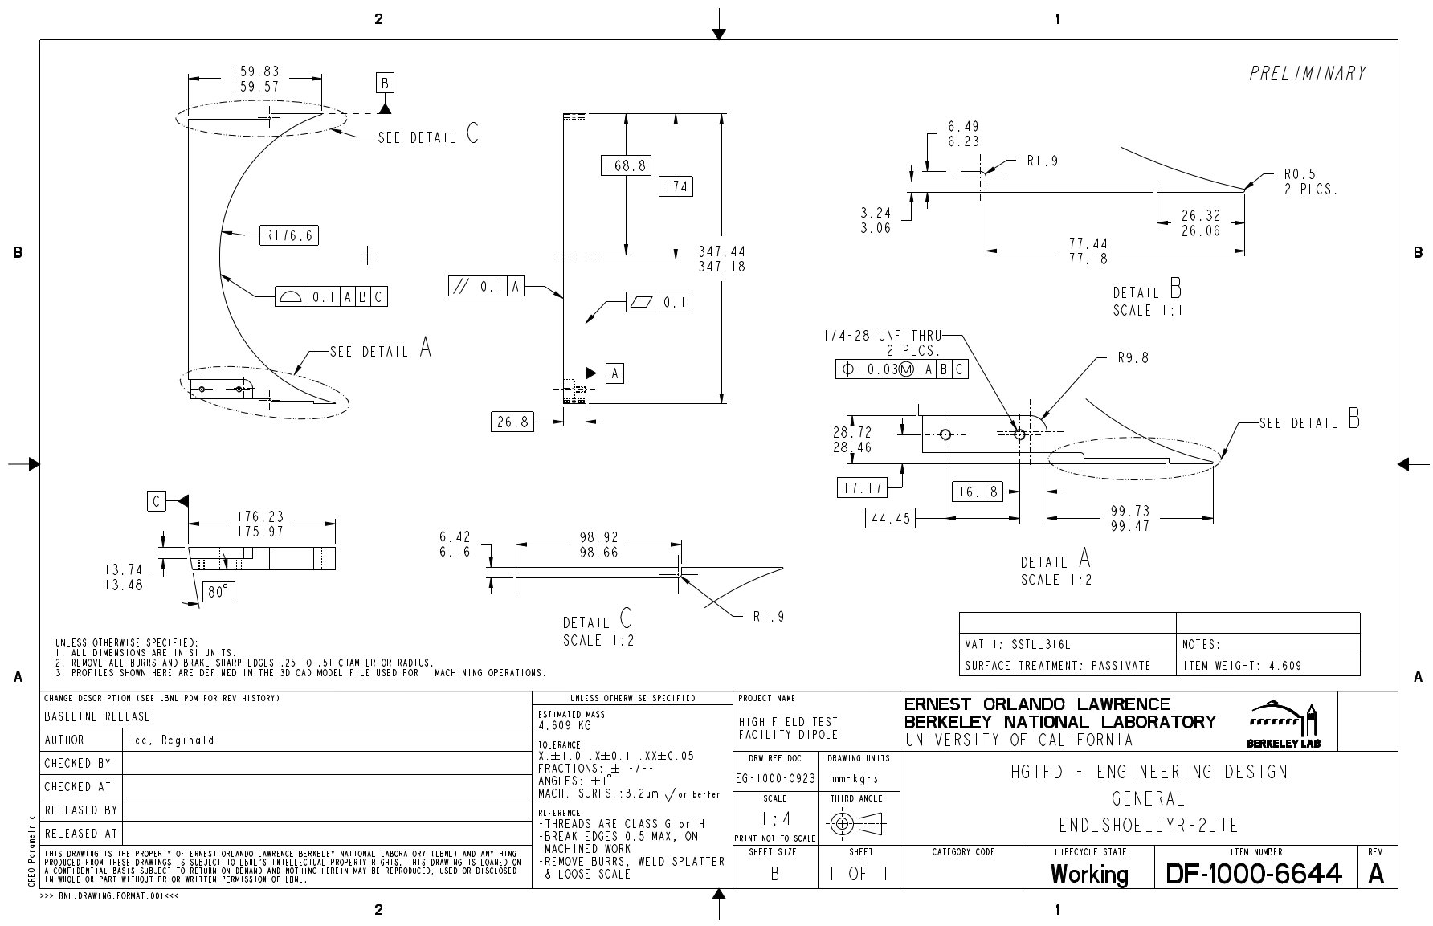
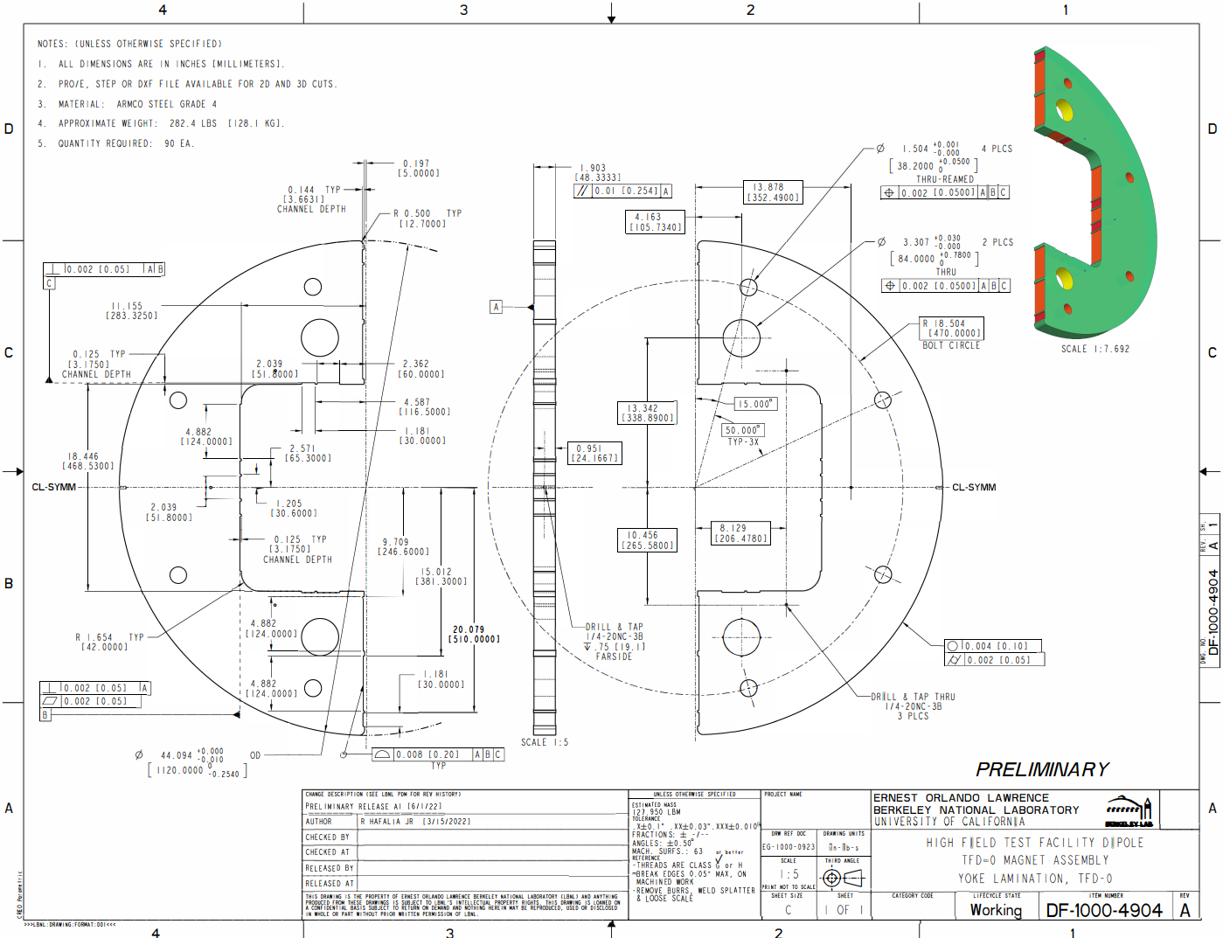
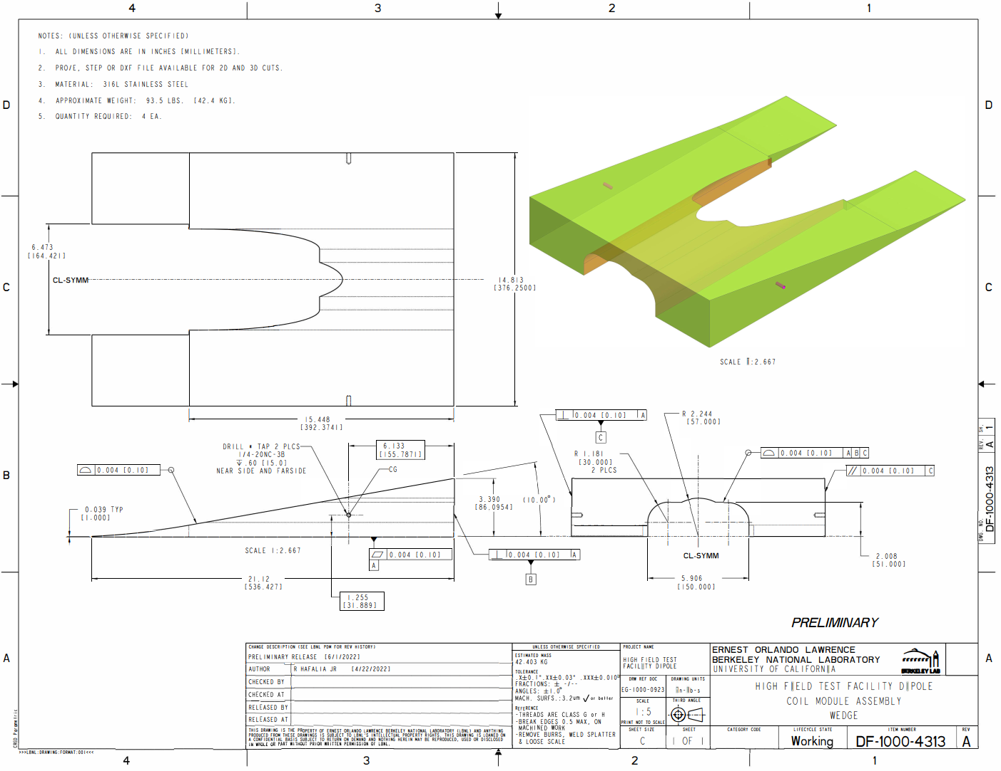
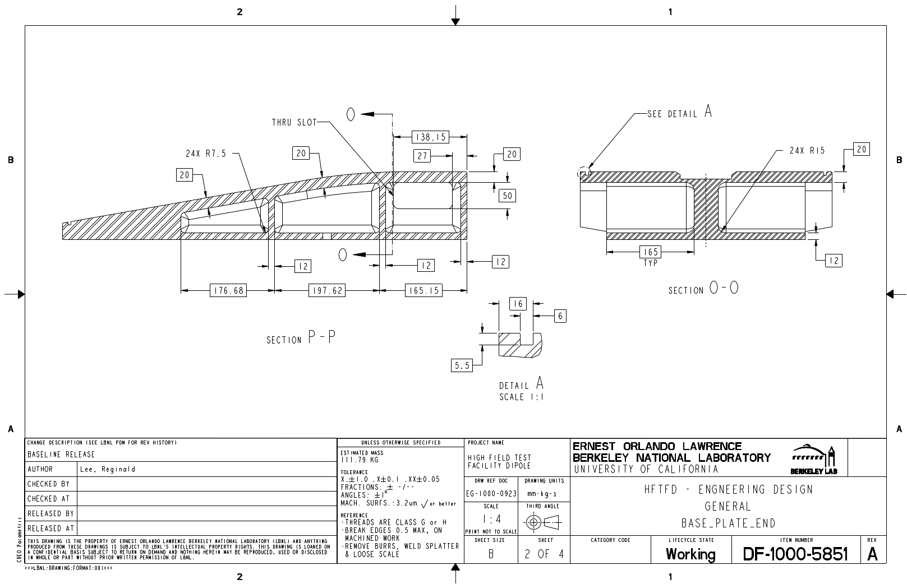
Procurement
Preliminary technical drawings have been created for cost estimation purposes and manufacturing feedback.
Improvements in the manufacturability and production cost of various parts will be implemented in the final design following feedback from vendors.

Slide 16
Outline
PLM and parameter document
Coil design
Magnet design
Procurement
Infrastructure
Summary

Slide 17
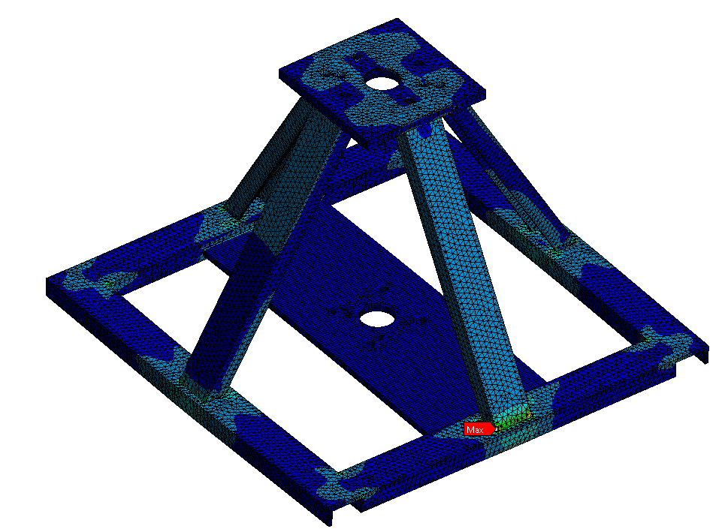
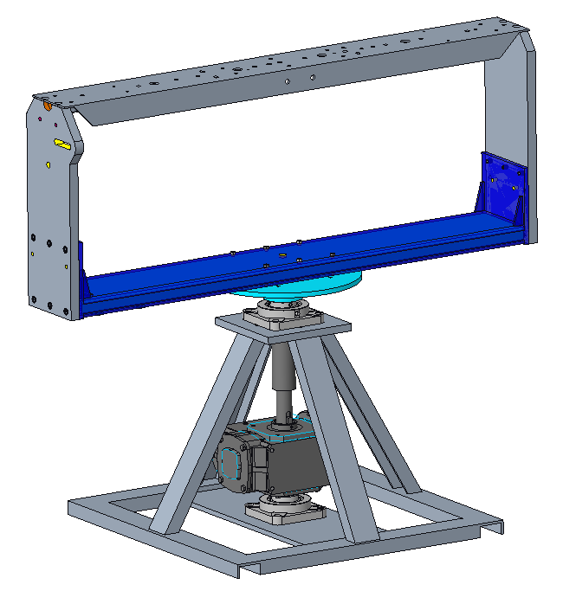
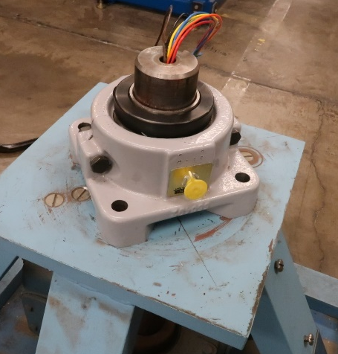
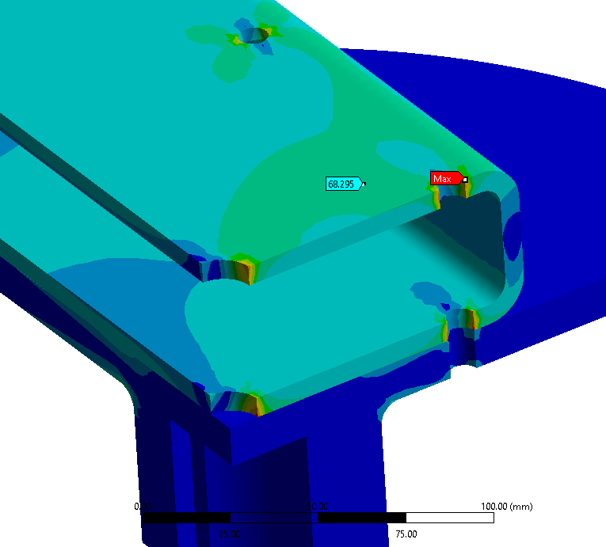
Infrastructure – Winding table
Following the FE analysis performed, the main winding table selected for the project has been updated with new components to allow for the coils to be wound.

Slide 18
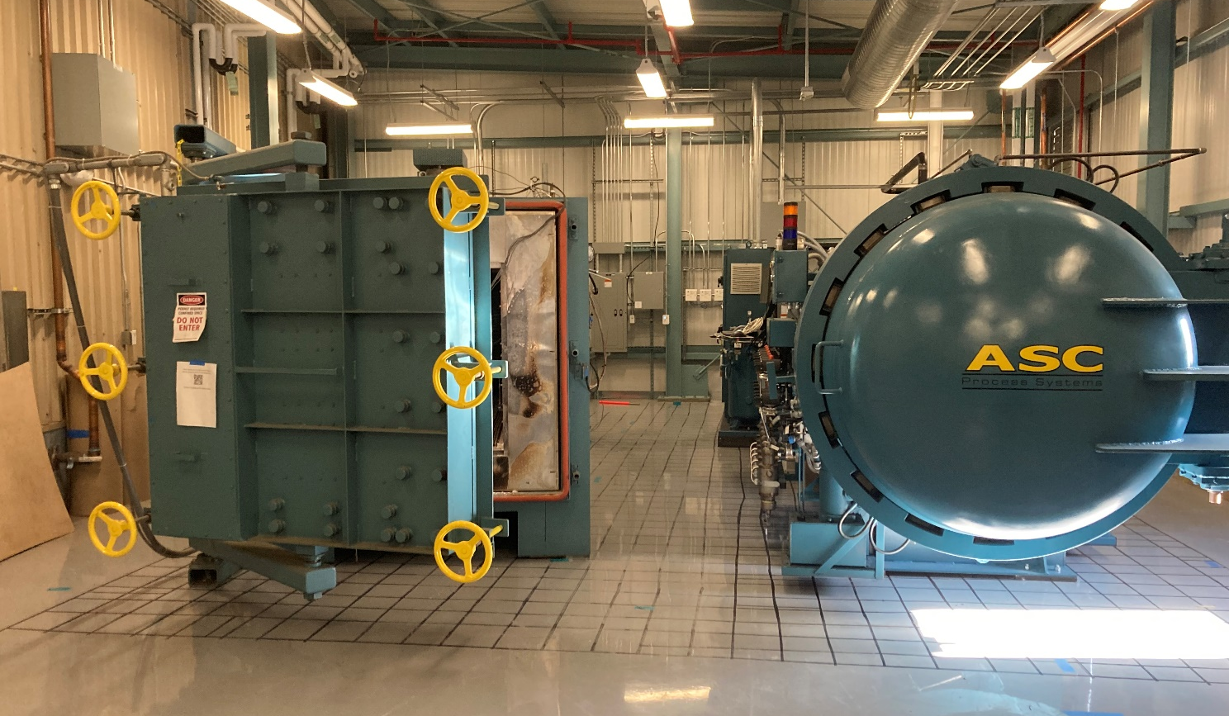
Infrastructure – Reaction furnace
The reaction furnace has been moved to its final work in B77 A.
Extensive work is still going on regarding instrumentation and powering connections.
Recommissioning tests planned for September.
Final commissioning of the reaction system to be completed with the TFD retort.

Slide 19
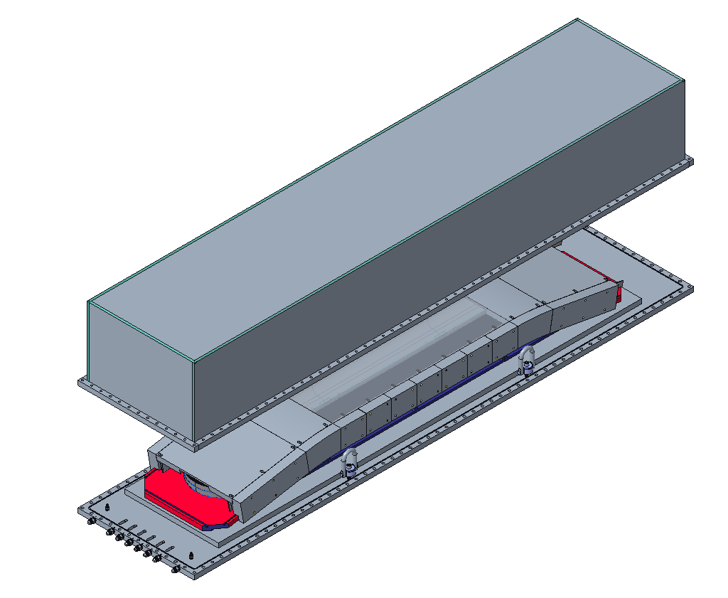
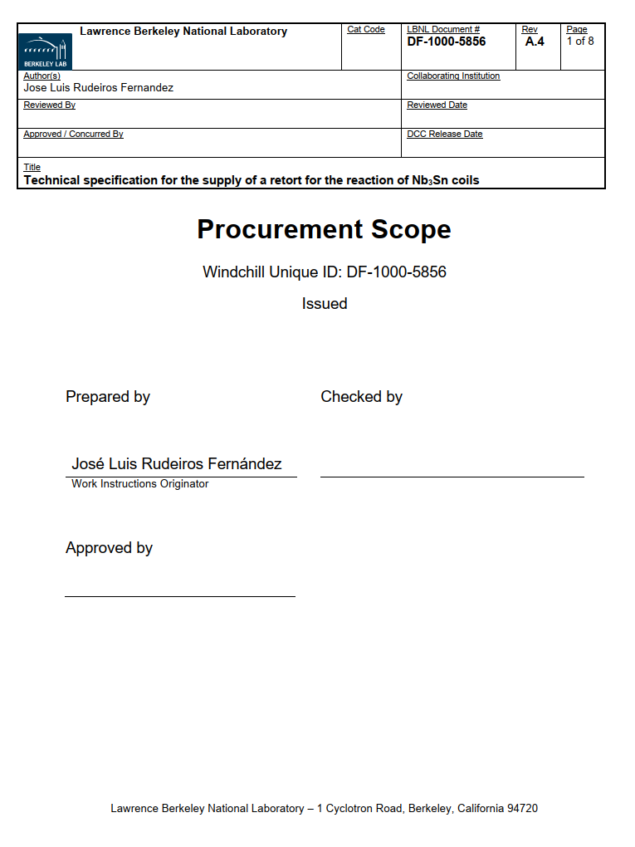
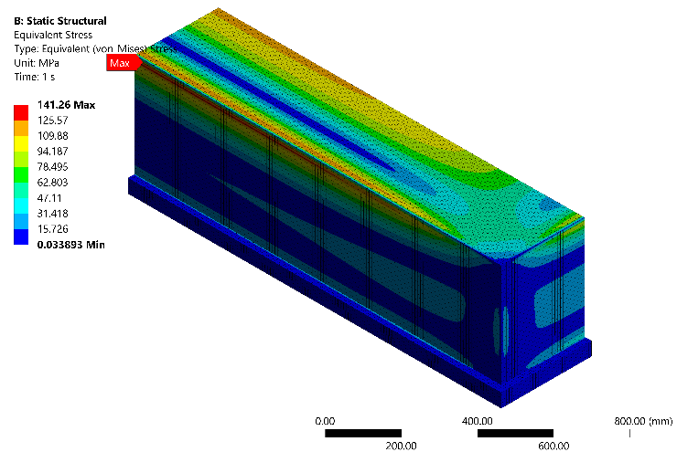
Infrastructure – Retort
A reaction retort specification has been created based on a preliminary design and FE analysis.
The retort relies on a high-temperature O-ring, and the top structure has been selected in order to simplify the sequence of operations for inserting and extracting the reaction fixture.
Quotes are expected to be received before the end of August.
Top
Reaction fixture
Base plate
High temperature o-ring

Slide 20
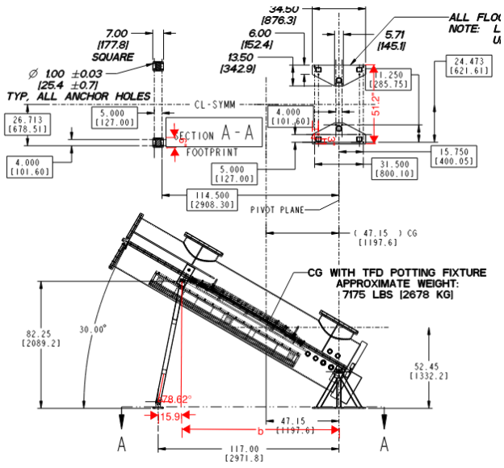
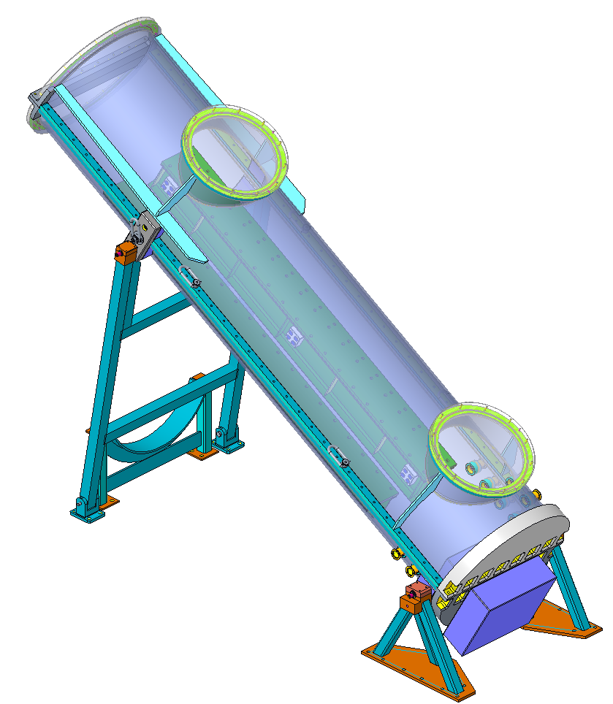
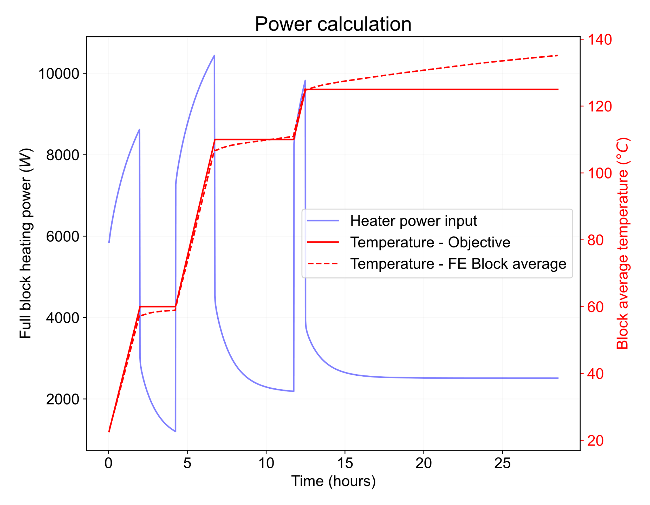
Infrastructure – Potting infrastructure
The impregnation chamber has been moved to its new location.
Seismic calculation has been completed.
Seismic anchorage is in progress.
The power requirements have been assessed based on a transient FE thermal model assuming CTD-101K as the epoxy system.
The power supply, control system, and instrumentation are being developed for three heating zones along the coil.
The vacuum system and vacuum capability of the chamber have been checked.

Slide 21
Summary
A main document (within the PLM system used in the project) is used as a central repository for all parameters used in the generations of the CAD models.
Coil, magnet, and tooling CAD design are progressing in parallel along with the final optimizations on the FE analysis side.
Based on the initial feedback from vendors, all parts and components are manufacturable, and preliminary quotes indicate that the costs are in line with the allocated budget.
The infrastructure required for the manufacturing and assembly of the different components of the magnet is being prepared.

