Slide 1



G. Sabbi, LBNL
Integrated Project Team meeting #6
August 25, 2022
TFD Status

Slide 2
Presentation Outline
Technical Update
  Wire Specification Review Feedback and Response
  Engineering design and procurements
  Magnet Fabrication Infrastructure
Risk Register
Schedule Update
  Comparison IPT6 vs. IPT5
  Next phase: cable and coil fabrication
Budget Update
  Component quotes vs. allocated budget
  Spending and funding profile
Summary

Slide 3
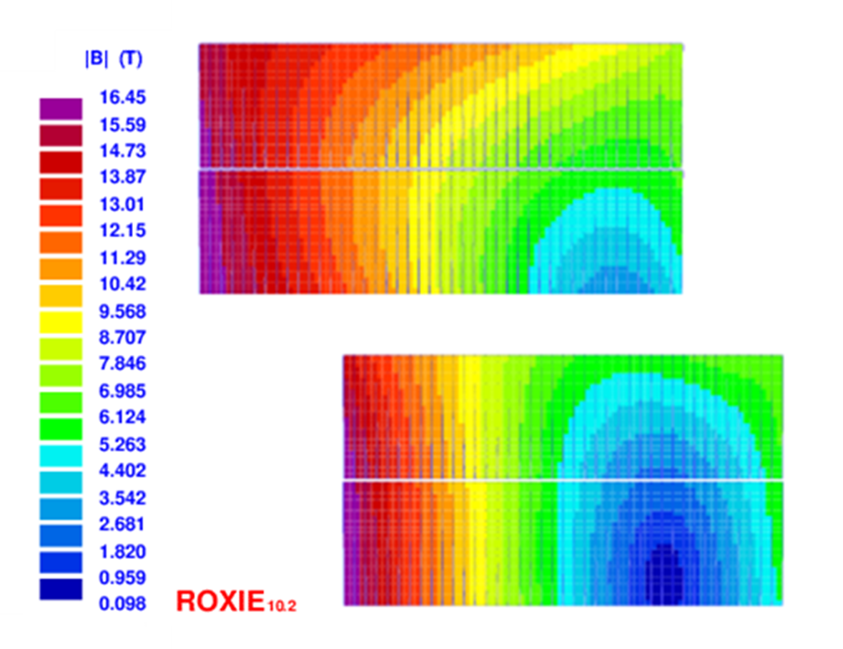
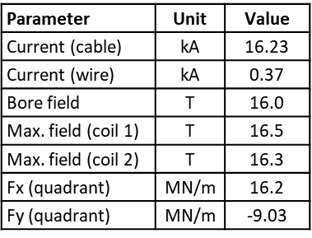
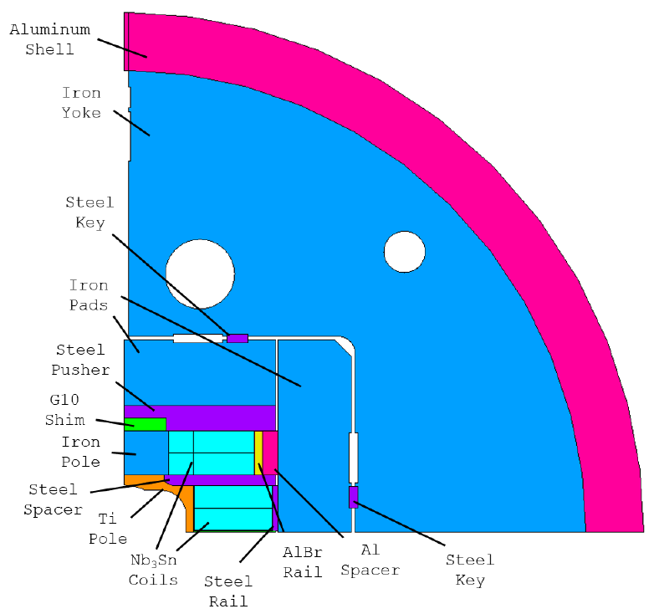
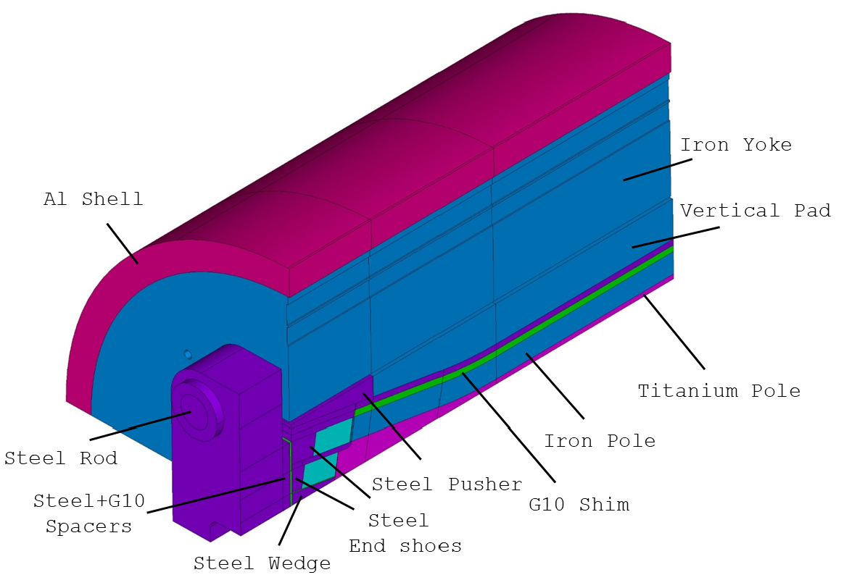
Magnet Design
Parameter | Unit | Value
Shell OD | m | 1.3
Shell length | m | 2.0
Total length | m | 2.9
44 turns/layer
40 turns/layer
D. Arbelaez, P. Ferracin, R. Hafalia, P. Mallon, D. Martins Araujo, J. L. Rudeiros Fernandez, G. Vallone et al.

Slide 4
WSR Feedback and Response
Move ahead with procurement with the present specification
=> Order placed (for 5 coil instead than 6 due based on available funding)
Add options for 40 km additional length, for 2 additional cable, within the same procurement
    => Difficult to implement as a fixed price option, however, contract includes some provisions in case we want to order additional wire
Increase the amount of informative testing, possibly both at the supplier and the verification lab
    => Verification testing at NHMFL, with some technical limitations
In parallel with procurement, and prior to finalization of magnet design, complete stability threshold measurements, and other planned measurements
    Ongoing contract with FNAL for wire/cable characterization, with some technical limitations (e.g. 1.9K) and competition for Lab time
    Exploring possible collaboration with CERN/UniGE for 1.9K testing

Slide 5
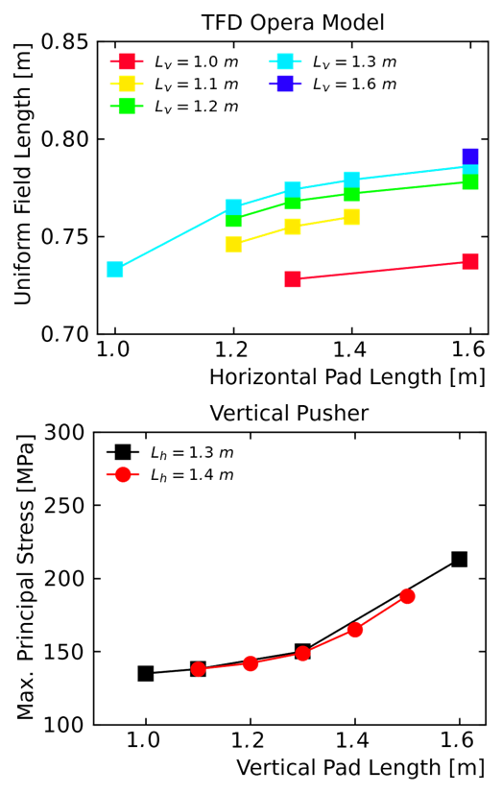
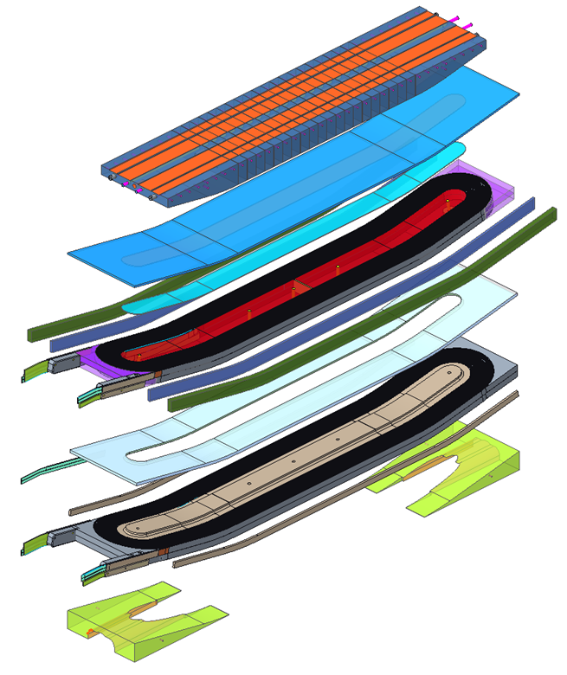
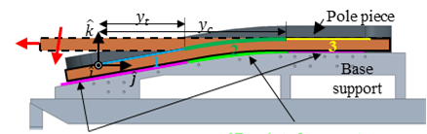
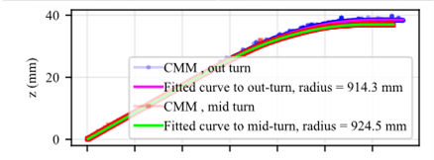
Engineering Design
Incorporating detailed features taking into account fabrication requirements
  Examples: end plates, laminated structures, insulation schemes, impregnation surfaces, optimal cable bending radii from winding tests
  Preliminary drawings of all major coil and structure components sent to vendors for feedback on fabrication (materials, tolerances) and cost
  Design/analysis re-optimization to incorporate component details
  Selection of final coil/magnet length – 750 mm uniform field (with margin)
  Design documentation
  See EOC2 presentations

Slide 6
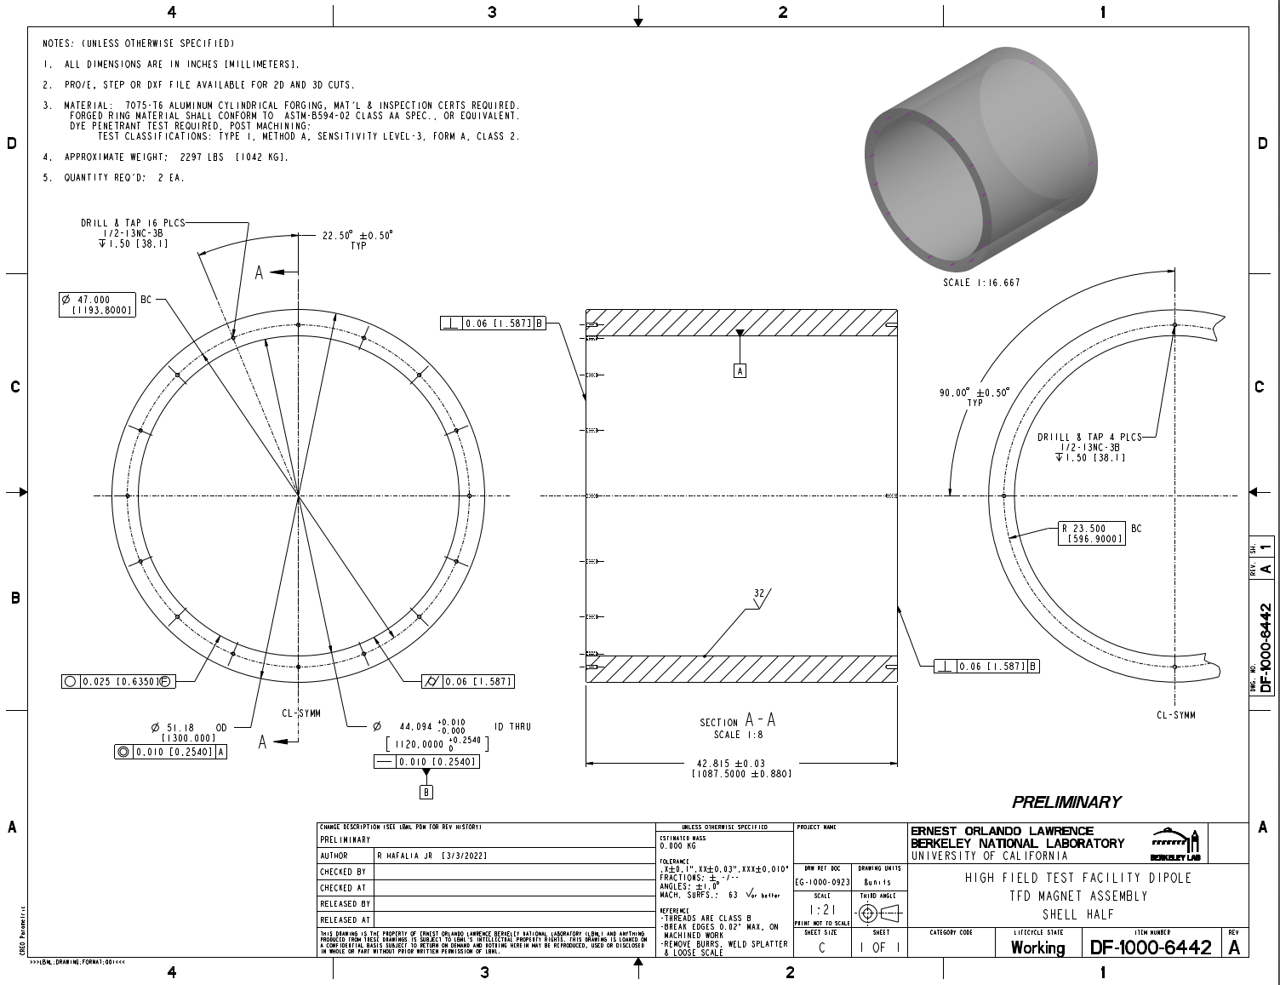
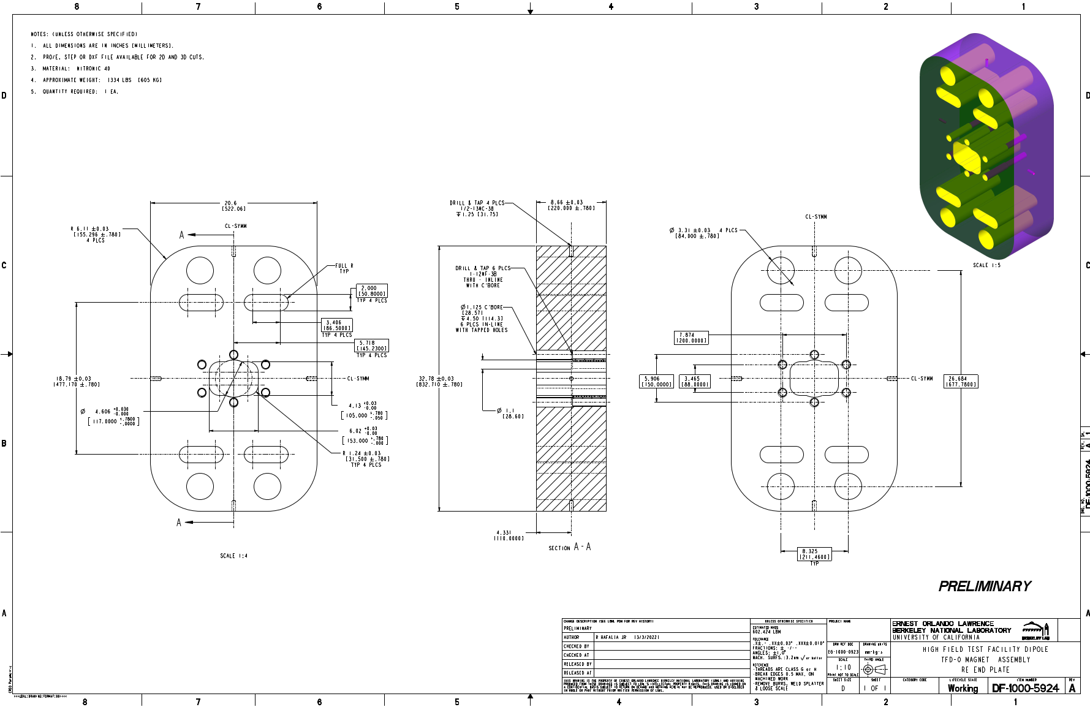
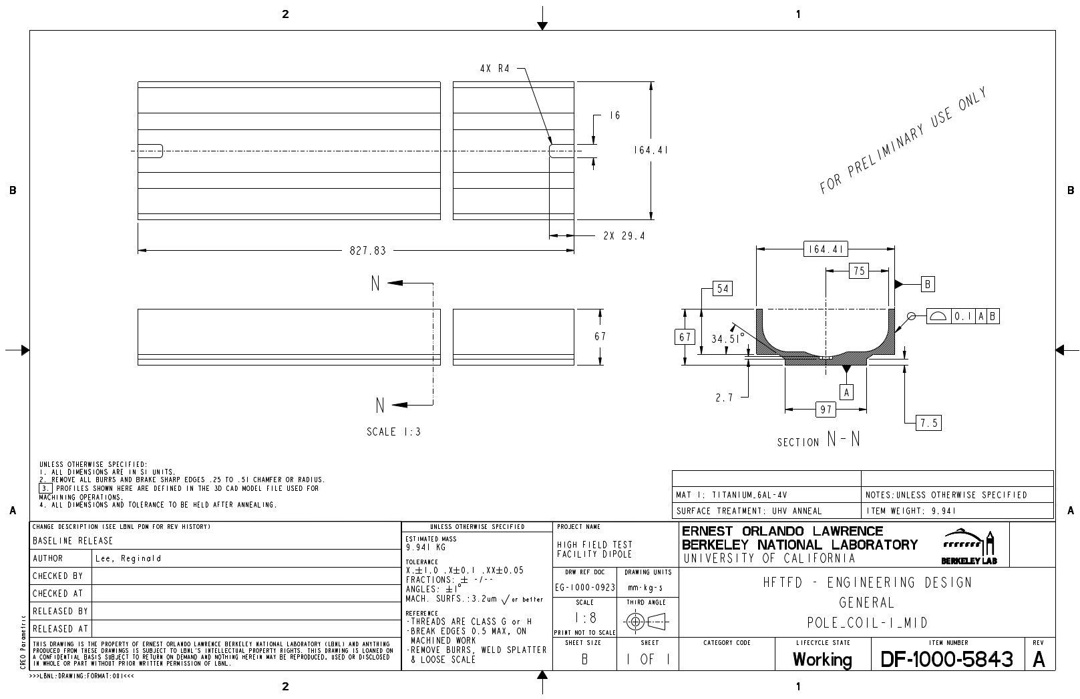
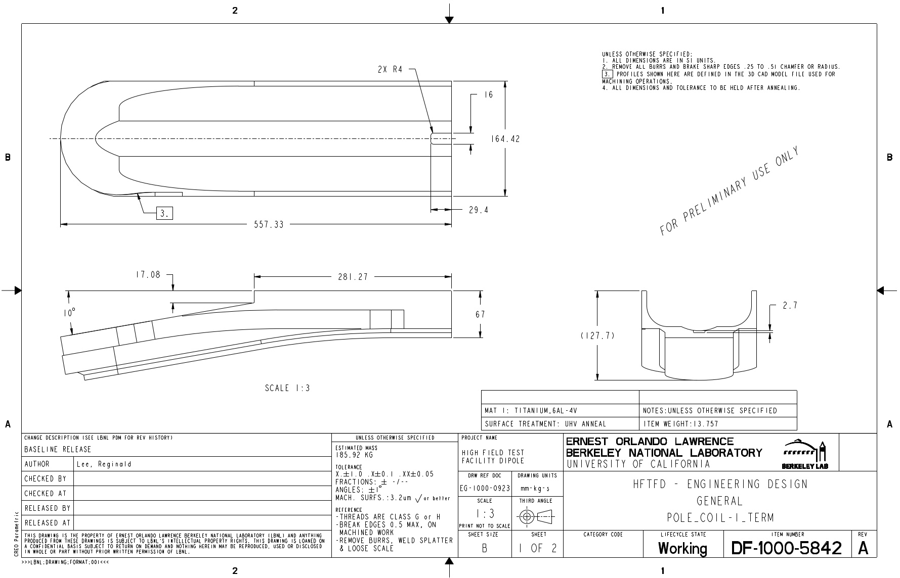
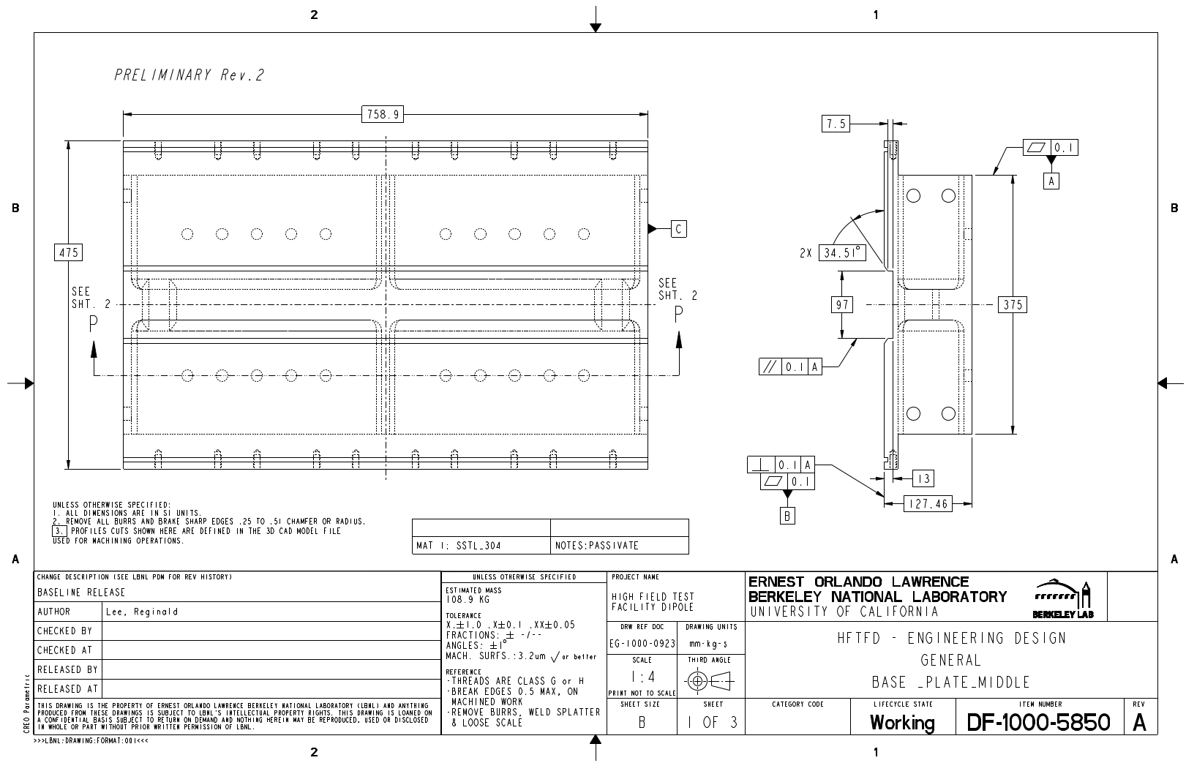
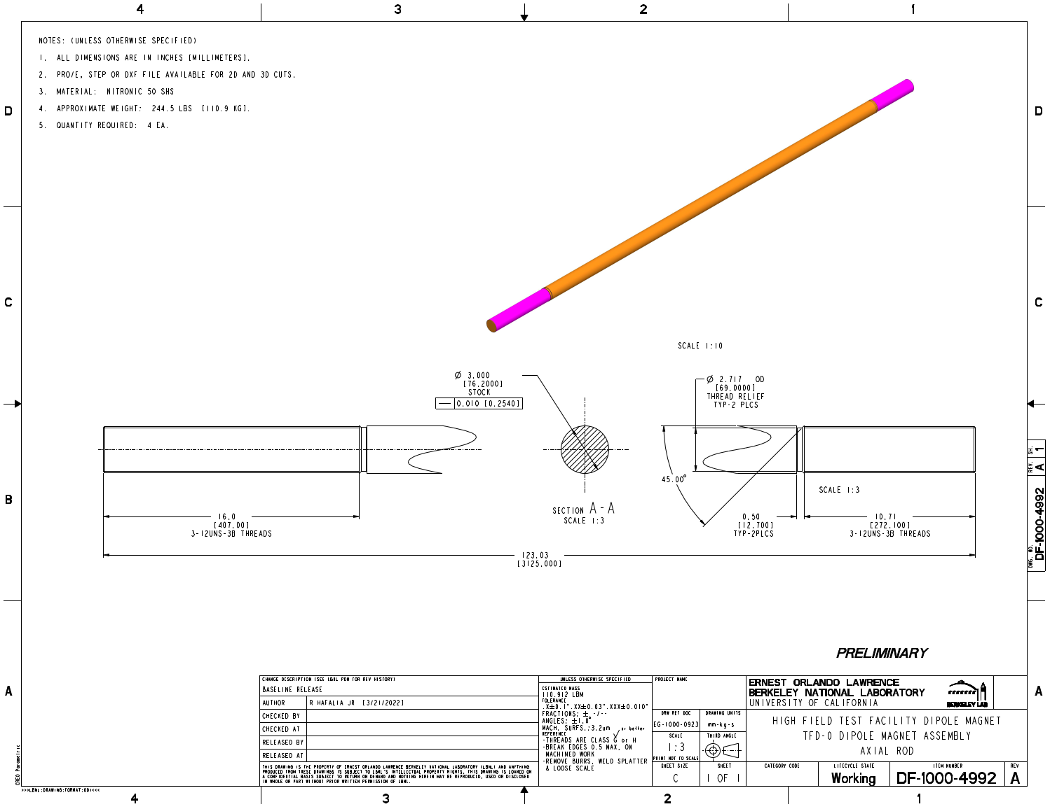
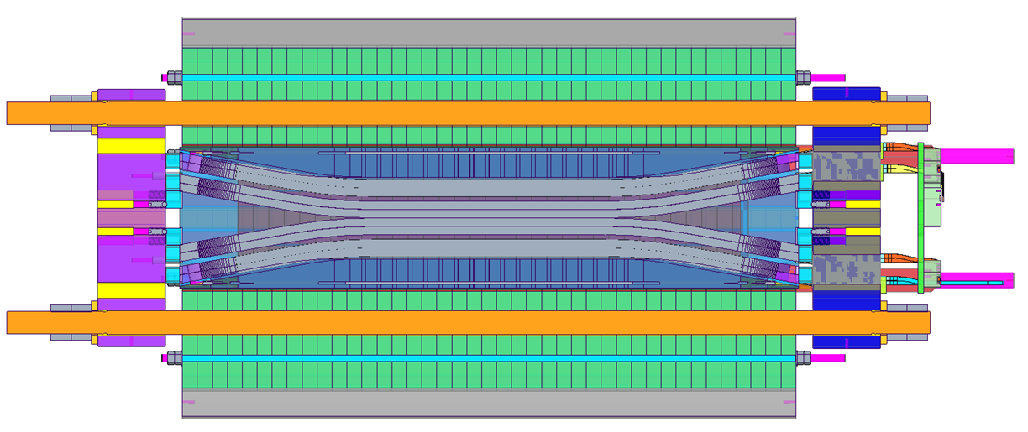
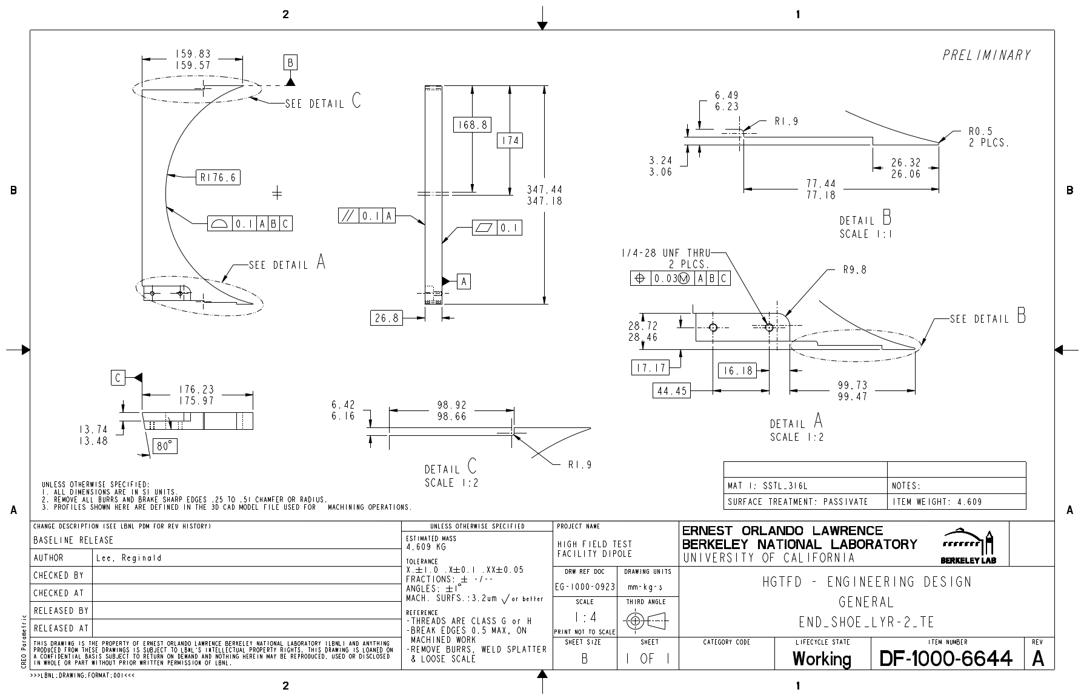
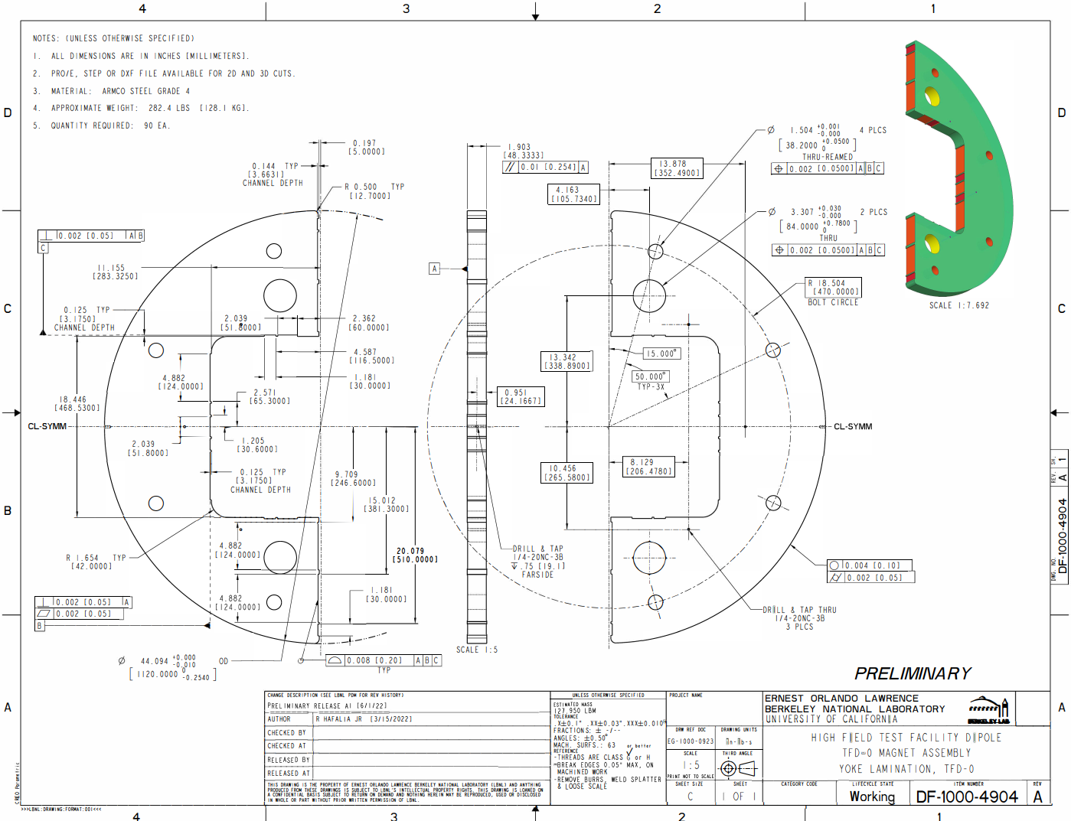
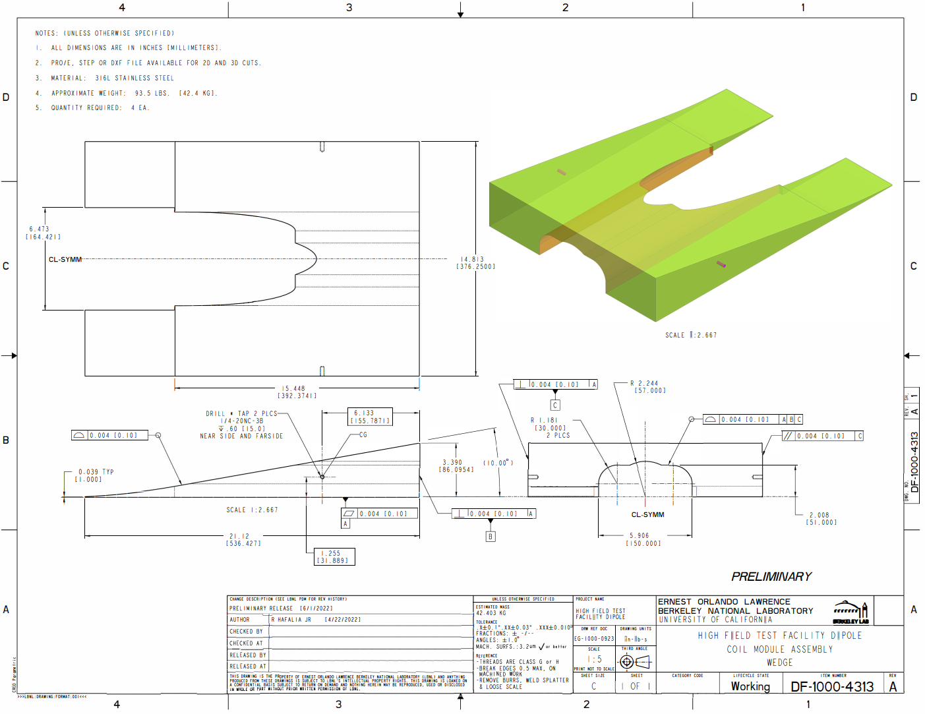
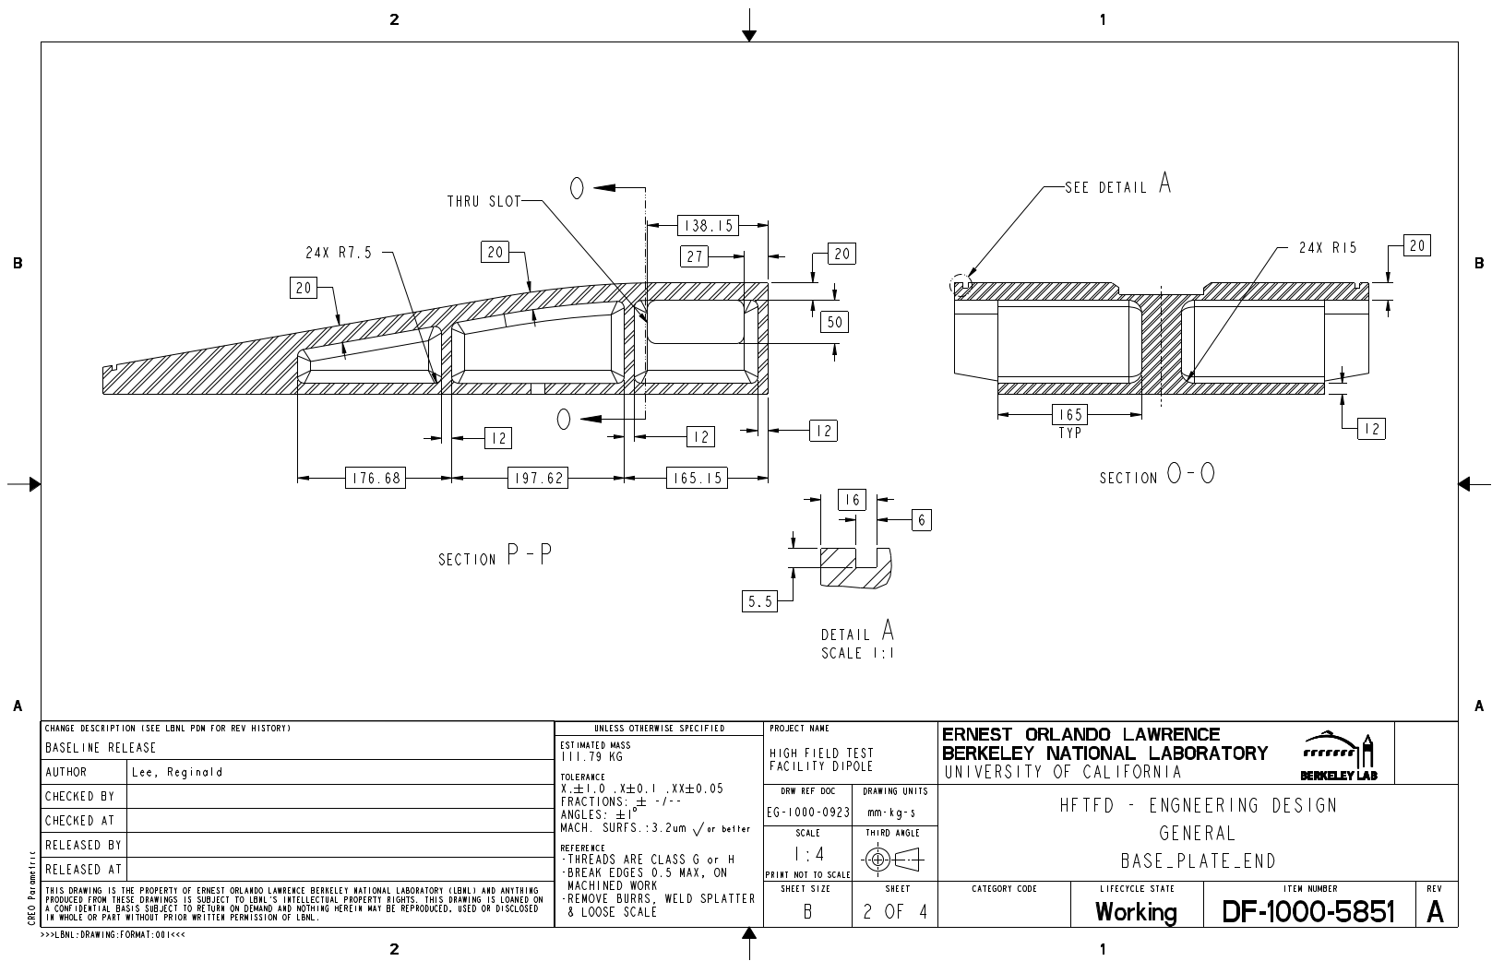
Preliminary drawings for vendor feedback
Al. Shell
End plate (lead end)
Winding pole (coil 1, middle)
Winding pole (coil 1, end)
Axial Rod
Base Plate (middle)
Coil end shoe
Iron yoke
Wedge
Base Plate (end)

Slide 7
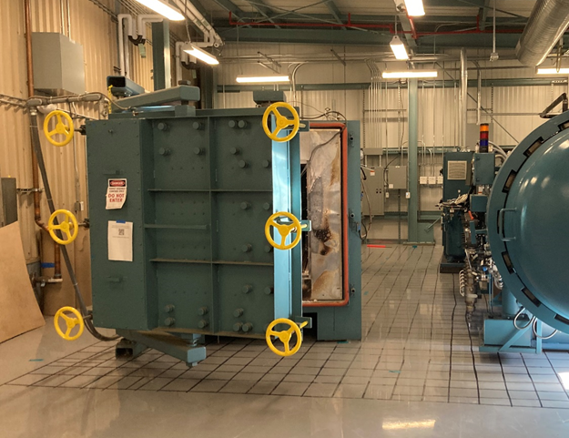
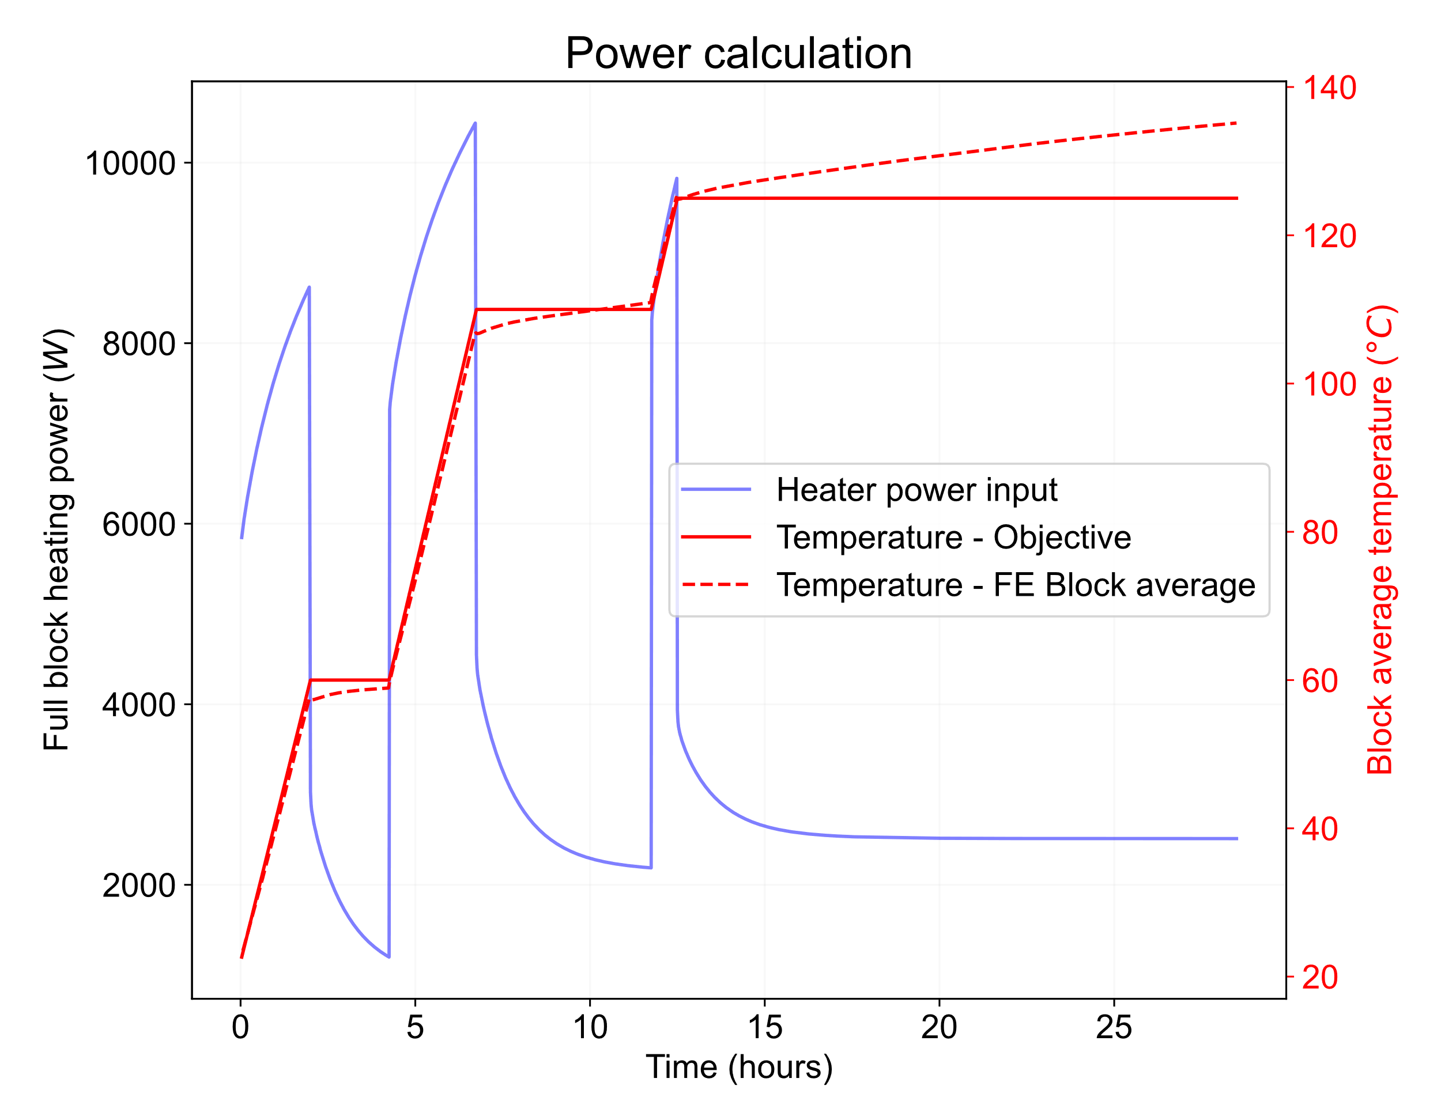
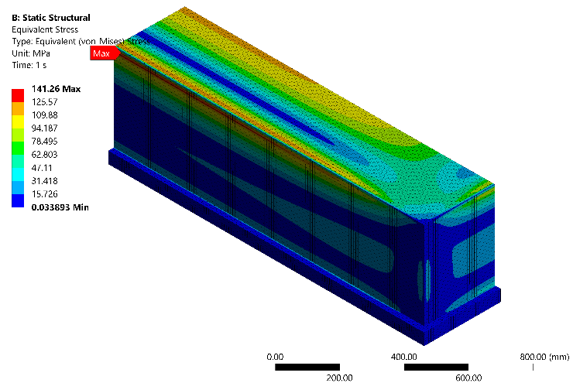
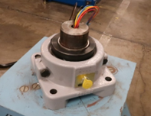
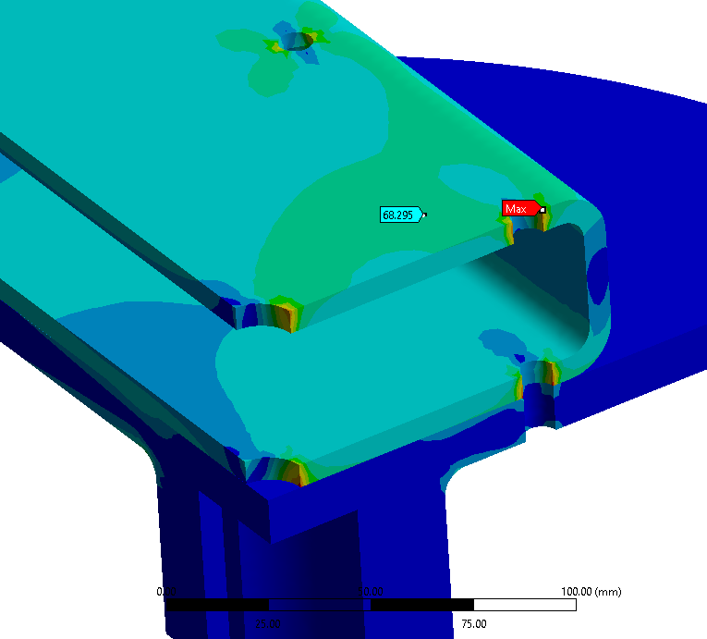
Fabrication infrastructure
Completed reaction furnace relocation to new building 77 addition
  Recommissioning tests planned for September.
The impregnation chamber has been moved to its new location in B77-103.
  Vacuum test completed, seismic anchoring in progress.
Winding table upgraded based on FE analysis for large TFD coils

Slide 8
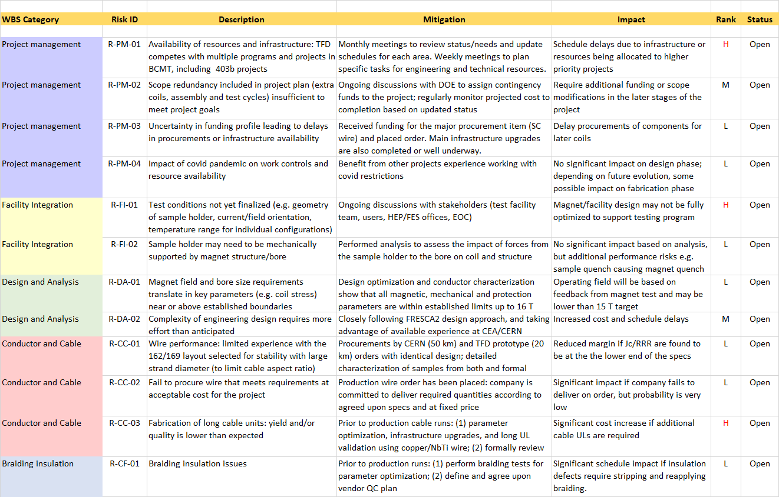
Risk Register

Slide 9
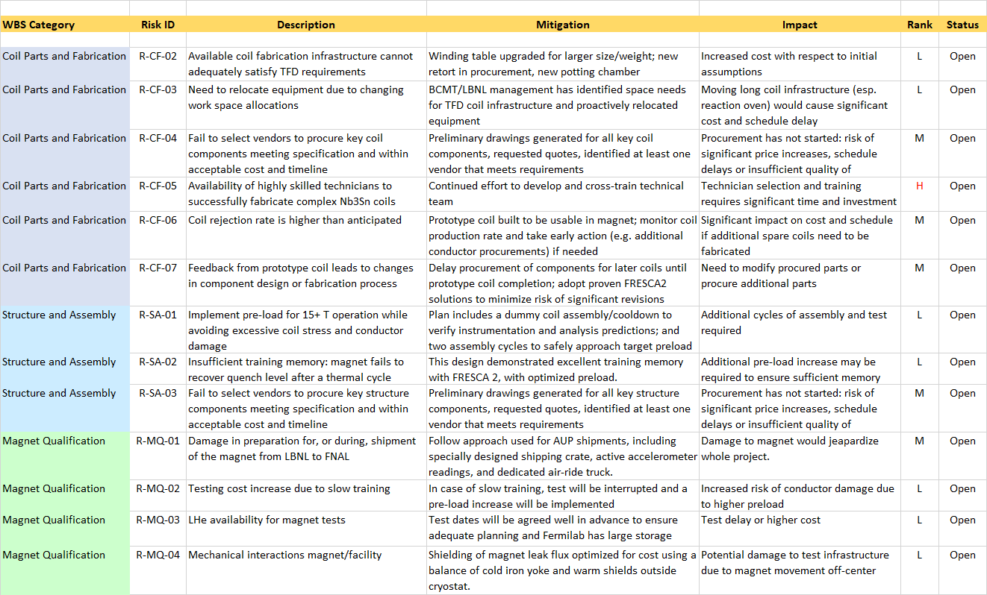
Risk Register

Slide 10
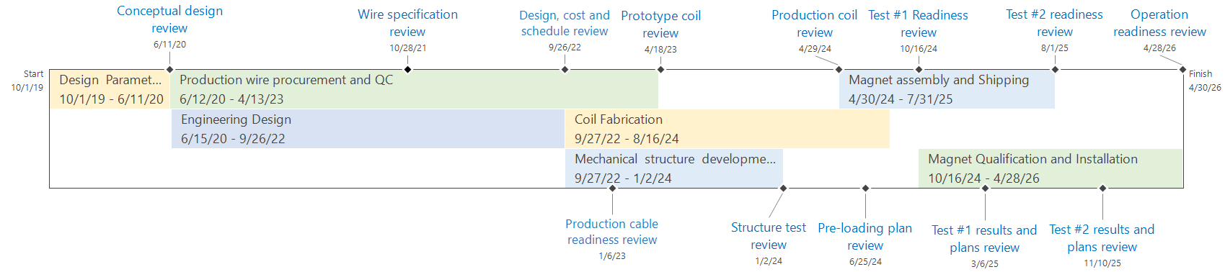
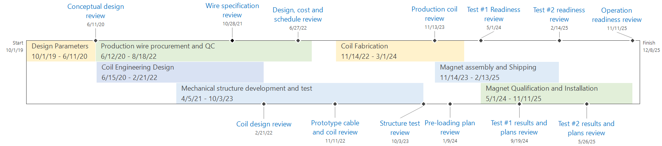
TFD Schedule: IPT6 vs. IPT5
August 2022 (EOC2/IPT6)
+4.5 months
December 2021 (IPT5 - revised after meeting to anticipate cost/schedule review as requested by DOE)

Slide 11
Design, Prototype Cable and Coil

Slide 12
IPT5 - Design, Prototype Cable and Coil

Slide 13
Production Cables and Coils

Slide 14
Structure, Assembly and Test

Slide 15
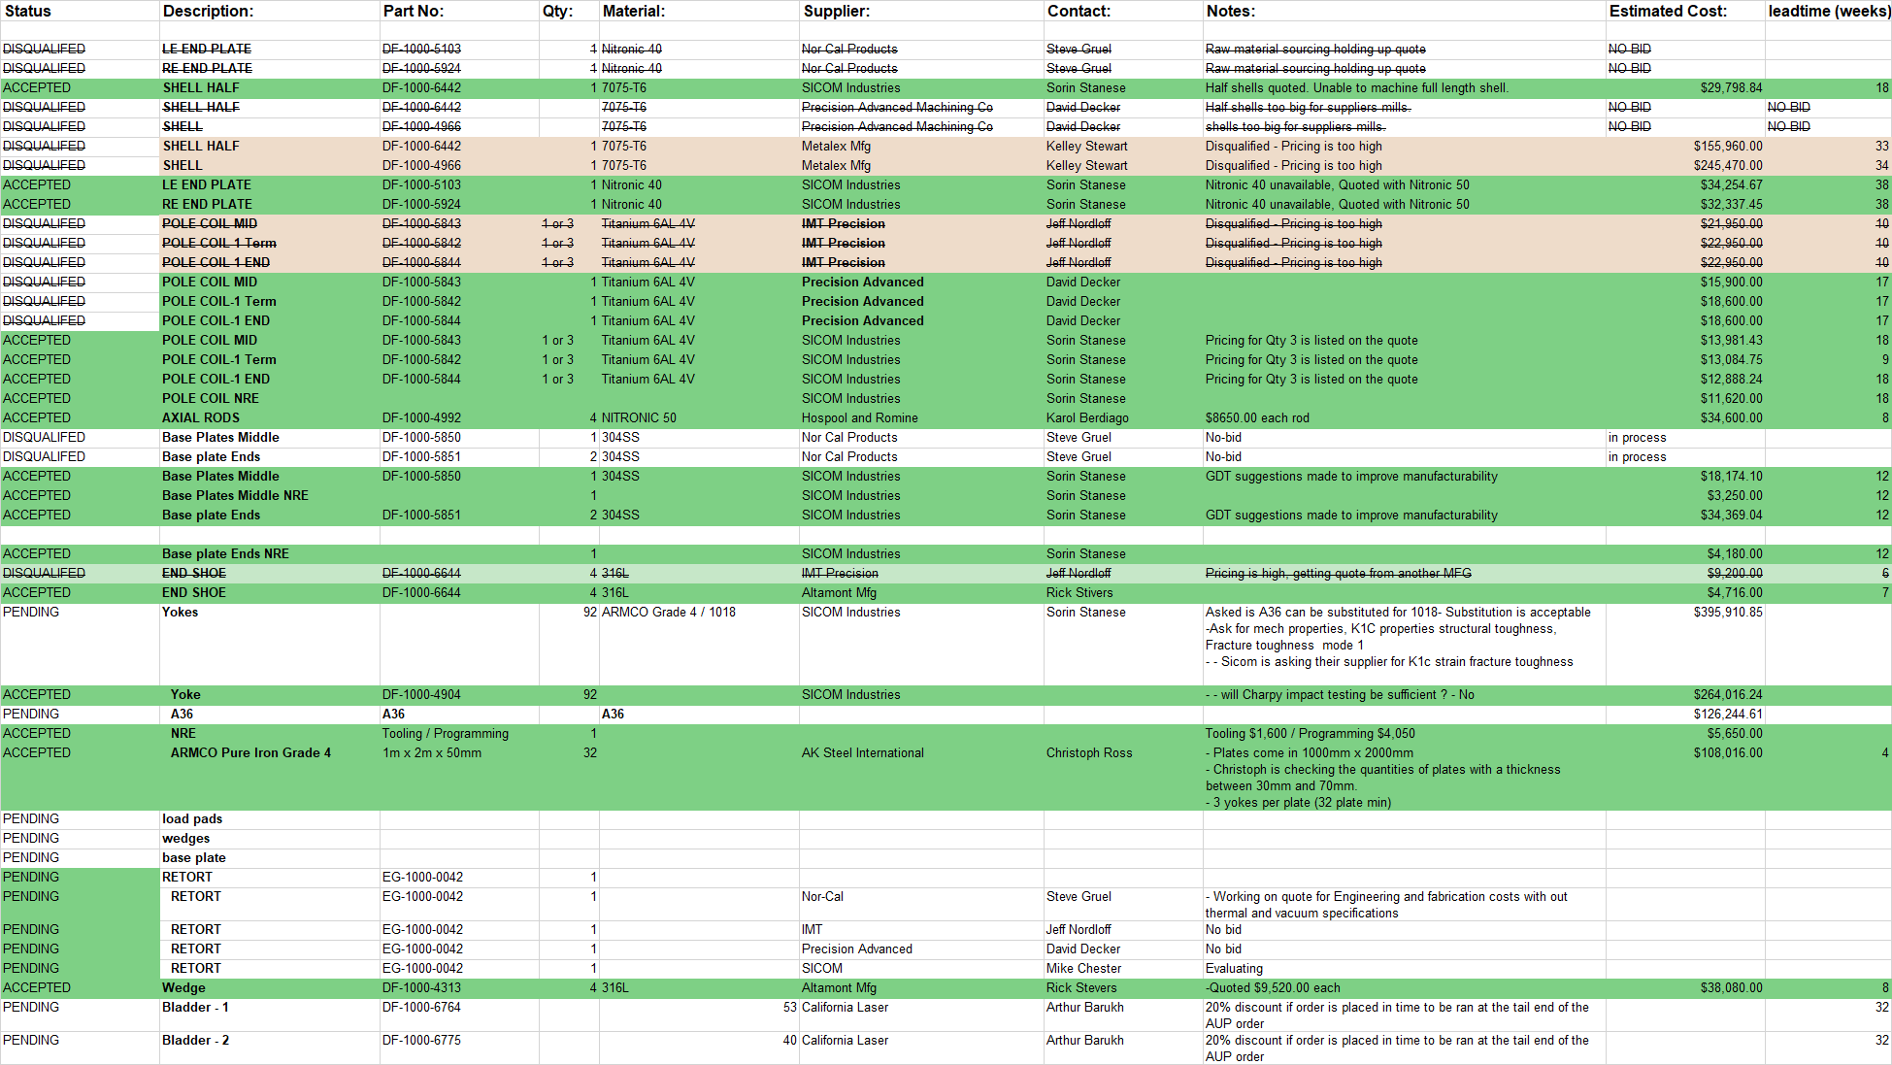
Budget update from vendor quotes

Slide 16
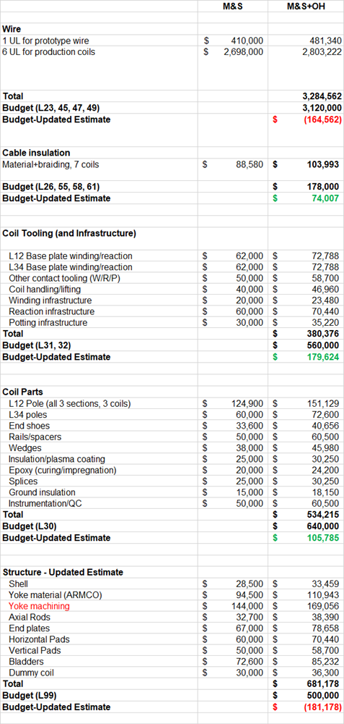
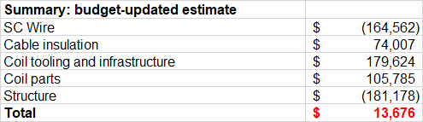
Budget update from vendor quotes
Overall procurement budget is still a good match to expected cost after some key orders have been placed and vendor quotes for major items received
  Significant uncertainty until orders are placed
Conductor cost increase ~15% from prototype coil order and production coil quote
  Order was placed for 5 coils instead than 6
  Partly compensated by shorter coil length
Coil tooling/parts lower than budgeted
Structure (iron yoke) higher than budgeted

Slide 17
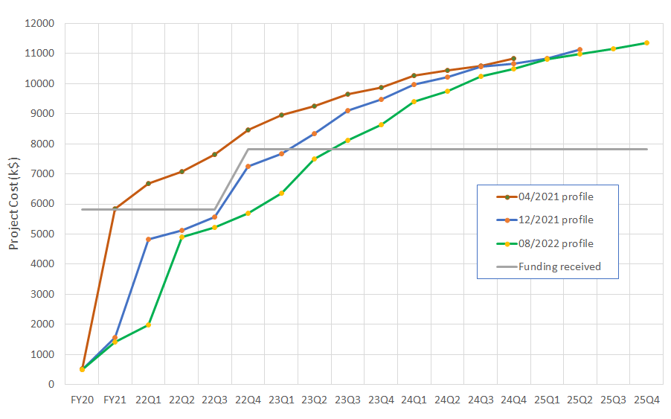
Funding Profile
Next 3 quarters: 2.4 M$
M&S: 1.4 M$ (coil tooling/parts & structure)
Labor: 1M$ (prototype coil, production cables)

Slide 18
Summary
Main updates from IPT5:
Design and analysis effort has focused on incorporating engineering requirements and fabrication/assembly considerations, including feedback from vendors on component manufacturability ans cost
Following a successful Wire Specification Review we requested a final quote for the production wire and placed the order
A risk register has been compiled to better capture and track information from project plan and feedback from reviews, IPT and EOC meetings
Procurement estimate have been updated to include new information from orders placed, final quotes, budgetary quotes – result is close to allocated budget
Engineering design and cable development schedule has been slipping, resulting in 4-5 months delay on project completion
Availability of resources/infrastructure for engineering design and magnet fabrication is a challenge

Slide 19
Additional Slides

Slide 20
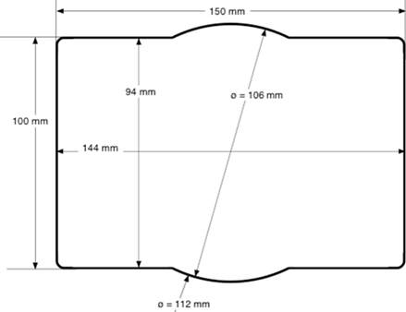
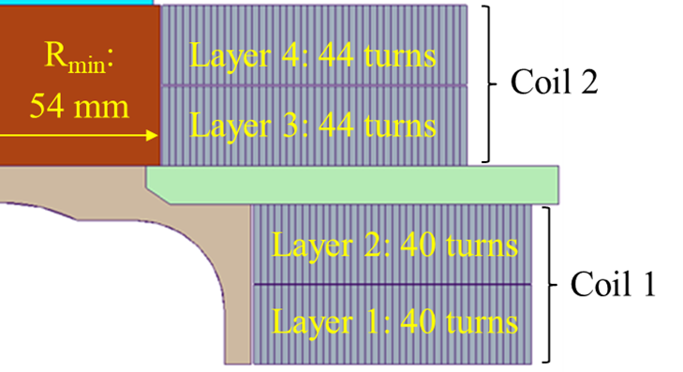
Magnet Features and Parameters (1)
Clear bore size: rectangular 144 mm x 94 mm with superimposed 106 mm radius
  From HEPdipo study (compatibility with SULTAN/EDIPO and FRESCA2 samples)
  Larger radius required at the inner corners (high field coil layout)
  Current pole piece dimension still allows for a 3 mm thick “test well”
  Presented to CDR, IPT and EOC
Field target for operation: 15 T at 1.9 K
  Practical Nb₃Sn dipole limit (user community wants highest possible field)
  Design optimization achieves 16 T without exceeding established criteria
  Presented to CDR, IPT and EOC
Maximum length (3.1 m), weight (20000 kg) stored anergy (20 MJ)
  Test facility interface document agreed upon with Fermilab and DOE/IPT
  Required early on to make progress on facility design/construction
  Presented to CDR, IPT and EOC1

Slide 21
Magnet Features and Parameters (2)
Dipole design: Rutherford cable, accelerator coil with shell-based structure
  HEPdipo study and comparison with EDIPO upgrade option
  Basic assumption from the proposal
Coil layout: block type with flared ends, non graded, “LD” layout
  Block-coil follows from EDIPO/LD1/FRESCA2 studies, FRESCA2 performance demonstration, and rectangular bore; confirmed in HEPdipo study
  Non-graded coil has lower development time/risk to reach 16 T at <85% SSL
  LD layout has lower coil stress (vs. FRESCA2) in rectangular bore
  Comparison and selection of these features was the major focus of the CDR
Design criteria (magnetic, mechanical, protection)
  Based on HL-LHC/AUP documentation, in turn derived from GARD/LARP
  Presented to CDR
No AC coils
  Lower user priority and incompatible with the “accelerator dipole” approach
  Presented to CDR, IPT and EOC

Slide 22
Magnet Features and Parameters (3)
Wire specification: RRP 162/169, 1.1 mm diameter
  Options presented to CDR, final specification formally reviewed at WSR
  WSR included feedback from wire and cable characterization by CERN, LBNL, FNAL, NHMFL, and analysis of magnet margin including strain
Cable parameters
  44 strands to match bore vertical size with 2+2 layers
  Comprehensive characterization of development cable provided a satisfactory reference (some further improvement desired)
  Results used to support wire specification at WSR
Uniform field length: 750 mm within 1% variation
  Left open until recently pending magnetic and mechanical optimization
  Balance of: user requirements, agreed limits on magnet length, weight and stored energy; magnet cost and risk
  More details in following presentations

Slide 23
CDR Feedback and Response (1)
Magnet design:
Alternatives have been properly considered and selected design minimizes risk
Main elements of the design fully endorsed by the committee: block coil, non-graded layout, shell-based structure
=> Confirmed key design choices and started design optimization
Consider increased margin to quench (conductor properties and magnetic design)
=> Margin was increased through coil design optimization and higher Jc
Consider increased shell thickness for margin (relative to using LD1 shell)
=> Shell thickness was increased; cost of new shell is acceptable
Include CLIQ protection system for added robustness and redundancy
=> Included CLIQ in baseline test facility design and operation plan
=> Detailed protection analysis performed to optimize CLIQ configuration
https://conferences.lbl.gov/event/359/

Slide 24
CDR Feedback and Response (2)
Design tools, resources and collaboration:
Continue collaboration with FRESCA2/HEPdipo teams and US conductor Labs
=> Conductor characterization at NHMFL, FNAL, CERN
=> FRESCA2 engineering feedback, CAD models from CEA and CERN
Conductor and cable:
Consider higher sub-element design for stability in large diameter wire
=> Selected 162/169 vs. 108/127 (although mainly driven by higher I_{c})
Develop a cable alternative option with more strands (48 vs 44) and a smaller wire (1 mm vs. 1.1 mm)
=> Insufficient resources/infrastructure to pursue both alternatives
Requirements and interfaces
Clarify magnet and facility requirements and get stakeholder approval
=> Seeking input of IPT and EOC committees and HEP/FES community

Slide 25
EOC1 (Magnet) Feedback and Response
Not enough statistics/confidence from wire purchased by CERN (162/169)
=> Additional data from 20 km procured by LBNL for prototype cable
15 T magnet should still be recognized as R&D and not production magnet
=> We agree and are taking this into account in design and fabrication
It is probably better that the test well not be made a big structural member, because users may need the corners for supporting of the sample.
=> Winding pole needs the rounded corners to limit bending/coil stress
    => However, role of the test well needs to be clarified
The uniform length of field of 1 m within 1% field quality is excellent
    => We are proposing 75 cm to balance performance, cost and risk
Concerned with sample support and potential interaction with magnet structure
=> Some initial discussion in analysis presentation
Document identified risks in a Risk Register along with mitigation strategies
=> Next slides

Slide 26
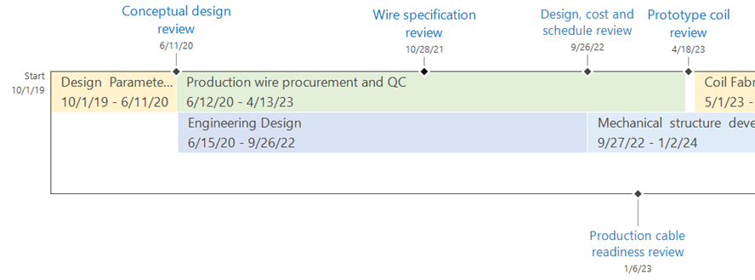
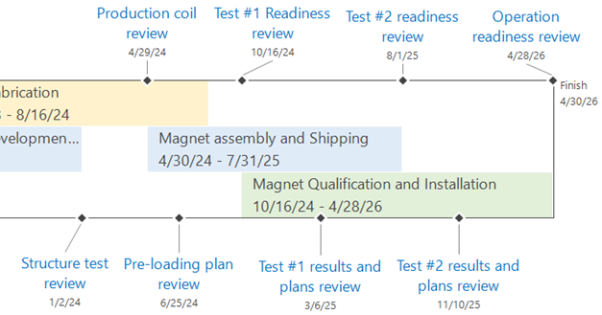
Magnet Schedule and Milestones

Slide 27
Magnet Development and Fabrication Plan
The TFD plan follows the approach used in similar high field magnet programs and projects (e.g. LARP/QXF, FRESCA2)
In particular, significant resources are allocated to magnet development and production phase has built-in “scope” contingency to mitigate risk
Development (~46% of total project cost):
  Conceptual design and analysis
  Cable development and characterization
  Nb₃Sn practice coils
  A magnet assembly and cool-down using instrumented aluminum coils to verify design calculations and strain gauge instrumentation
Production (~36% of total project cost)
  Coil fabrication (two inner and two outer), magnet assembly and test
Scope contingency (~18% of total project cost, ~51% of production cost):
  One set of spare coils (one inner and one outer double-layer)
  Two complete cycles of assembly and vertical test to allow for an adjustment of pre-load and/or replacing one or two coils with spares.

