Slide 1
20 T Common Coil Hybrid Magnet FE Analysis
J. Cozzolino 8/4/22

Slide 2
20 T Common Coil Magnet FE Analysis
Goals
To further develop the conceptual design
To study coil stresses and deflections at 20 T central field and study the structural effects of the latest array of coil support spacers and vertical separators
This is based on several previous modeling and analysis iterations.

Slide 3
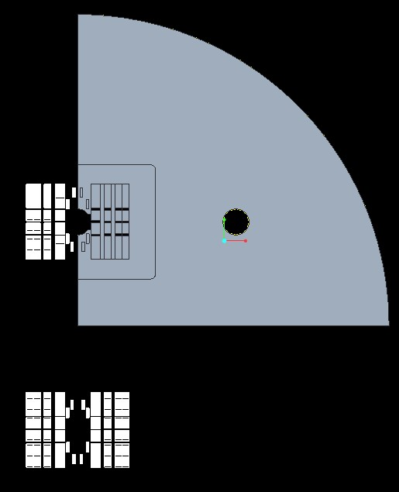
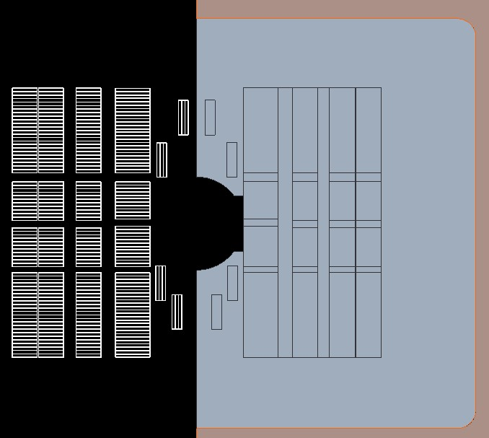
3D Creo Model from DXF File
Vertical Separators
Original DXF file

Slide 4
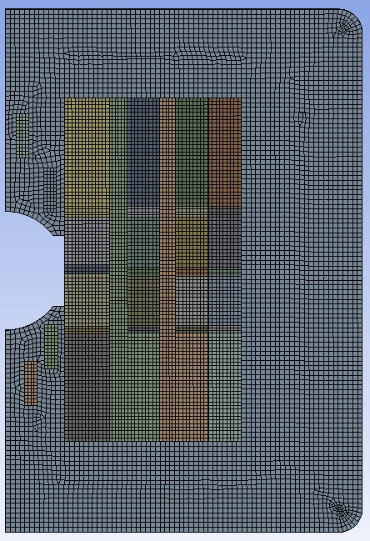
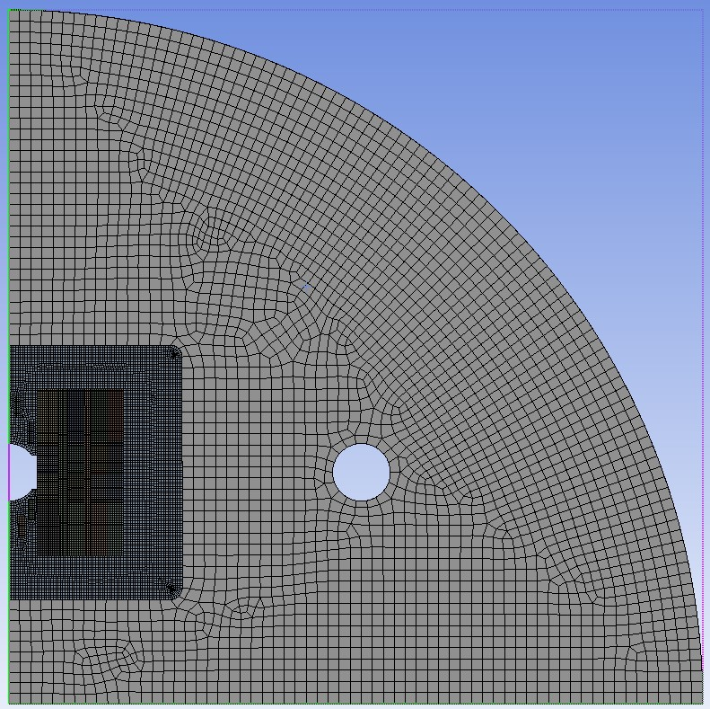
20 T Common Coil Magnet FE Analysis

Slide 5
20 T Common Coil Magnet FE Analysis
Features
HTS and LTS conductors are modeled as current blocks.
50 mm diameter clear aperture
HTS/LTS current densities = 405/530 A/mm². Material properties for all conductors are that of NB₃Sn. Isotropic E = 20 GPa. Cool-down effects have not yet been studied.
The SST collar is solid, and all contacts are line-to-line with no preloading.
Conductor-to-conductor contacts are bonded. All other contacts are frictional (µ = 0.2).
All boundary conditions are frictionless. The yoke is modeled as full-circle.
Cold mass detailed design and assembly considerations are to be dealt with at a later date.
Coil stress management
SST spacers intercept large horizontal coil forces.
SST vertical separators (7.7 and 6.5 mm thick) are either bonded to the collar or permitted to slide horizontally outward with the coils under power.

Slide 6
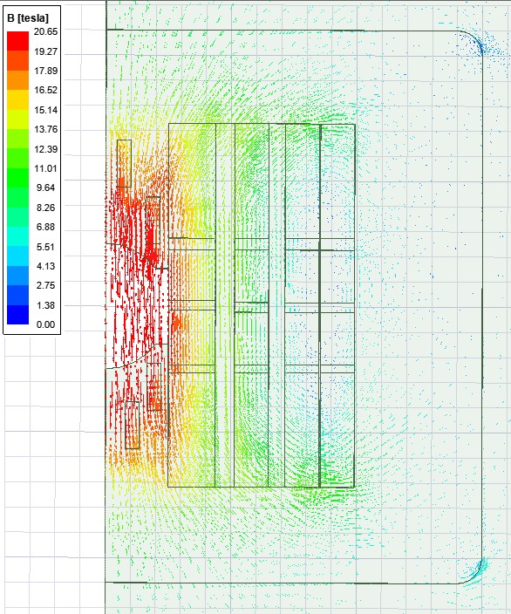
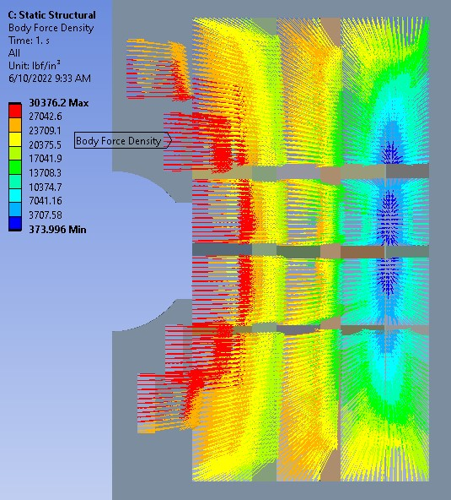
Flux Density Vectors
20 T Central Field
Lorentz Force Vectors

Slide 7
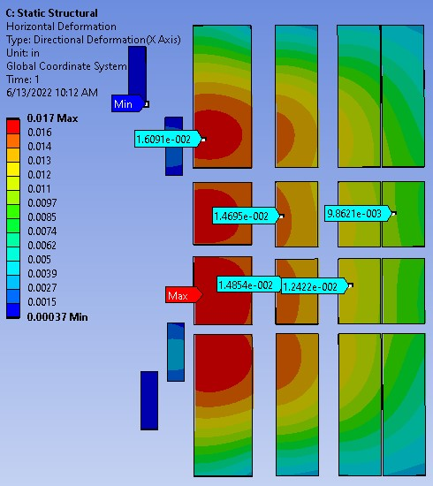
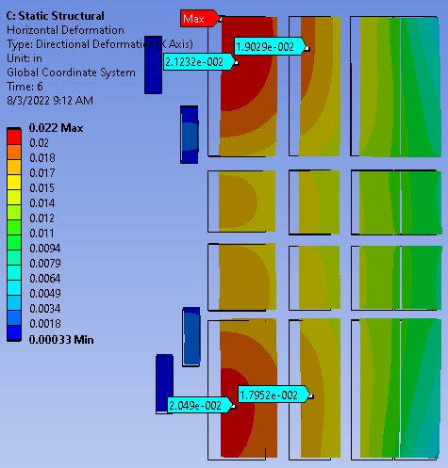
Horizontal Deflection – Fixed Vertical Separators
Horizontal Deflection – Sliding Vertical Separators
Deflections are more uniform vertically, though not considerably larger

Slide 8
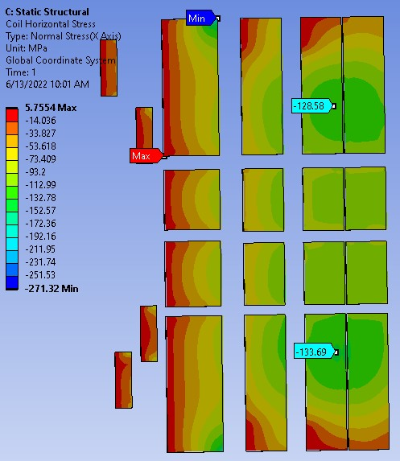
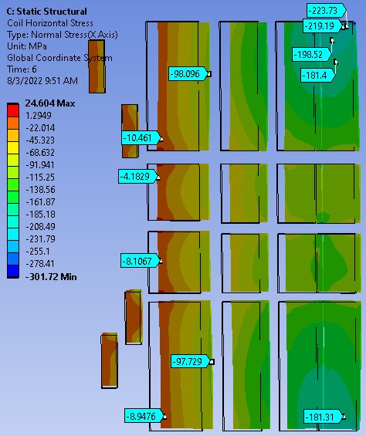
Horizontal Normal Stress – Fixed Vertical Separators
Horizontal Normal Stress – Sliding Vertical Separators
Highest compressive stress in HTS
Note: Safe stress limits for HTS/LTS are -120/-180 MPa.

Slide 9
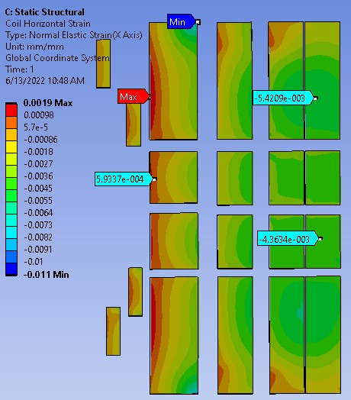
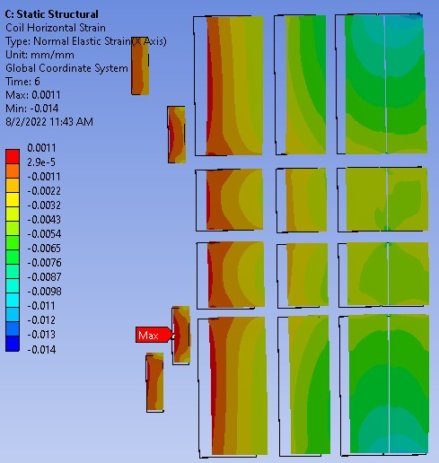
Horizontal Normal Strain – Fixed Vertical Separators
Horizontal Normal Strain – Sliding Vertical Separators

Slide 10
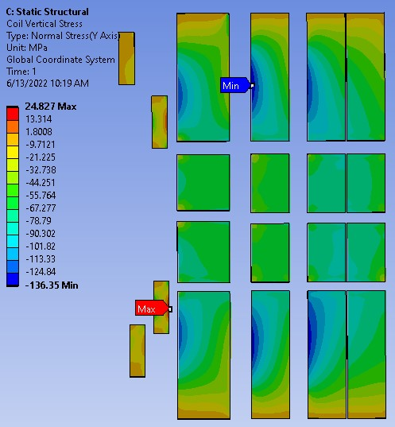
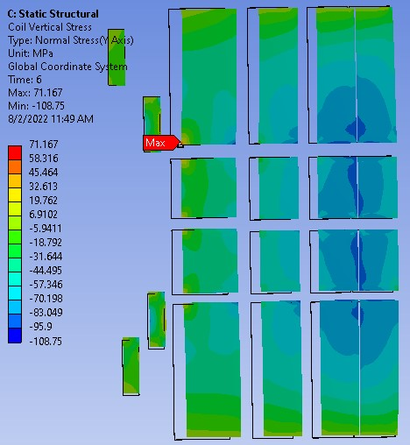
Vertical Normal Stress – Fixed Vertical Separators
Vertical Normal Stress – Sliding Vertical Separators

Slide 11
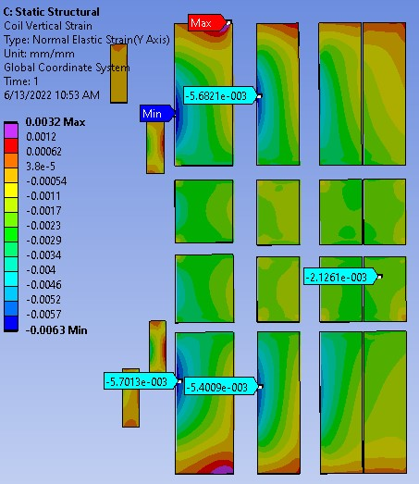
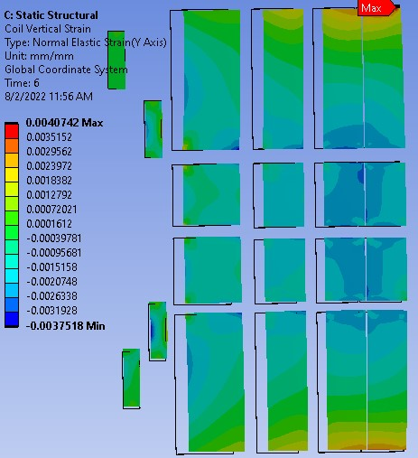
Vertical Normal Strain – Fixed Vertical Separators
Vertical Normal Strain – Sliding Vertical Separators

Slide 12
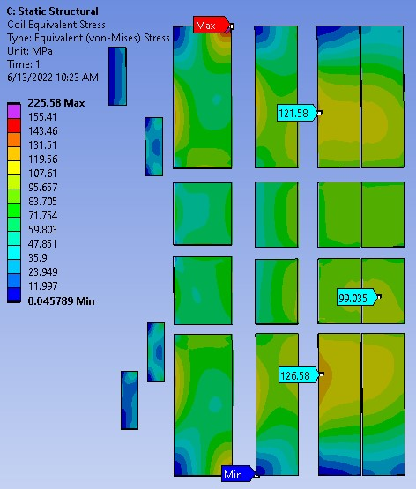
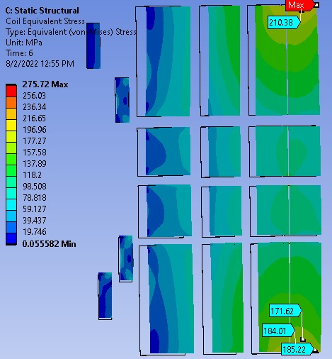
Coil Equivalent Stress – Fixed Vertical Separators
Coil Equivalent Stress – Sliding Vertical Separators

Slide 13
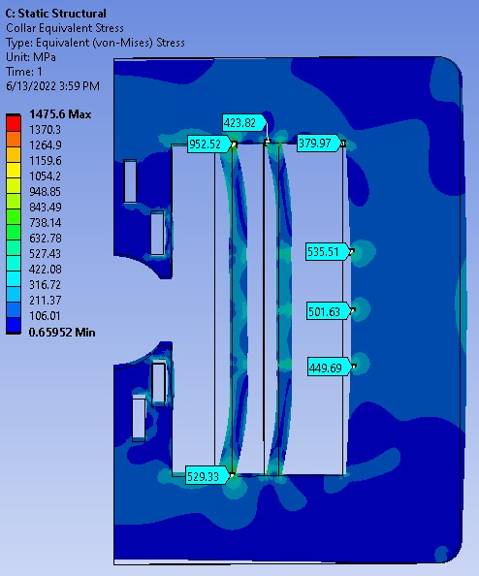
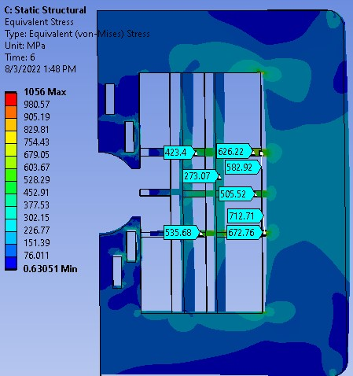
Collar Equivalent Stress
Collar with Fixed Vertical Separators
Collar with Sliding Vertical Separators

Slide 14
2
2
Next Steps:
Increase width of horizontal separators
Add low modulus material, i.e., fiberglass, in sufficient thickness to “inboard” sides of Nb3Sn coil blocks to provide cushion/springs
1
2
2
1
2
2
1
2
2

Slide 15
20 T Common Coil Magnet FE Analysis
Conclusion
This conceptual design may form the basis for a detailed design.
Coil lateral bridging has been used successfully in common coil magnet DCC-017. It would be far more critical in this application and is being developed accordingly. It is clear that conductor movement under very high forces will be a major challenge to contain.
This analysis helps affirm that coil deflections and strains have become manageable. The containment design itself is beyond the scope of this first set of analyses and will begin in the future.
High horizontal compressive stress (<-180 MPa) in the outer LTS coil will require some form of strain relief.
This would effectively move the bending fulcrum from the coil corner. This should reduce the sharp stress concentration in this region.

Slide 16
20 T Common Coil Magnet FE Analysis
Additional Slides

Slide 17
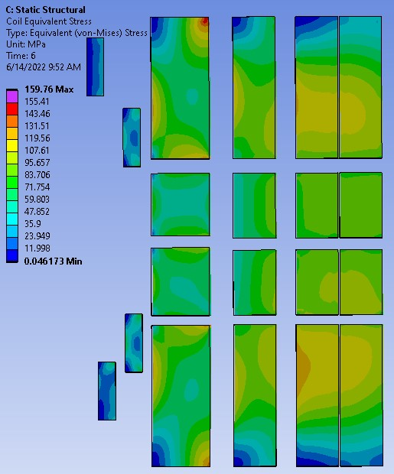
Coil Equivalent Stress
Reduced contact stiffness between HTS coil and vertical separator

Slide 18
