Slide 1

Multiphysics modeling for REBCO CORC® cables based on T-A formulation
S. Viarengo^{1,2}, P. Ferracin², Laura Savoldi¹, Fabio Freschi¹, X. Wang², L. Brouwer²
¹Politecnico di Torino, Torino, Italy
²Lawrence Berkeley National Lab, Berkeley, CA
MDP Collaboration Meeting, Virtual, 20/09/2022

Slide 2
Outline
Framework and aim of the work
Tape modeling
  REBCO design
  Critical current density evaluation
  Mathematical model
  Model setup, geometry and mesh, results
  Thermal recovery test
CORC® modeling
  VPI test in LBL
  Cable design and parameters
  CORC® thermal model
  Model setup and new boundary conditions
  2 tapes: thermal disturbance test
  6 tapes CORC® results
Conclusion and next steps
References

Slide 3
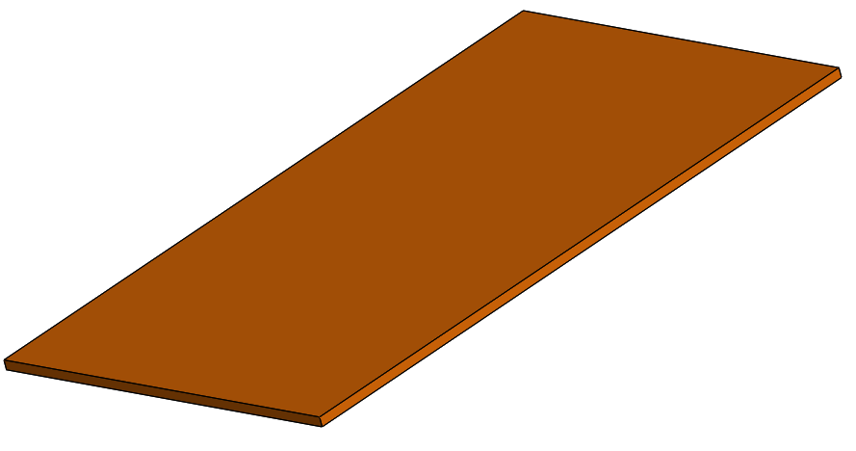
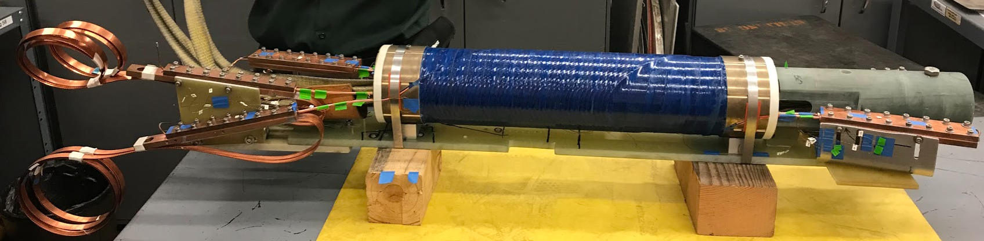
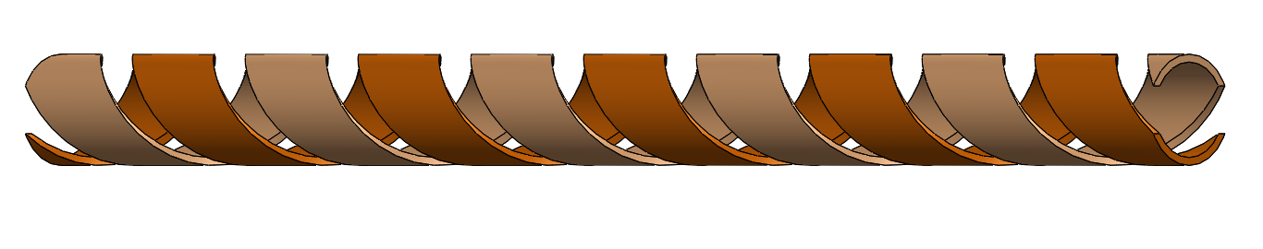
Framework and aim of the work
REBCO CORC® cable for CCT application
Multiscale approach
Jc characterization of a homogenous material for the single tape
[Status of CORC® cables and wires for use in highfield magnets and power systems a decade after their introduction, D.C. Van der Laan et al, 2019]
C2 wire layout
(Courtesy of LBL)
Validation on a straigth Conductor on Round Core Cable (CORC®)

Slide 4
Tape modeling

Slide 5
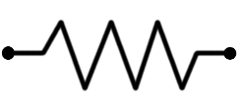
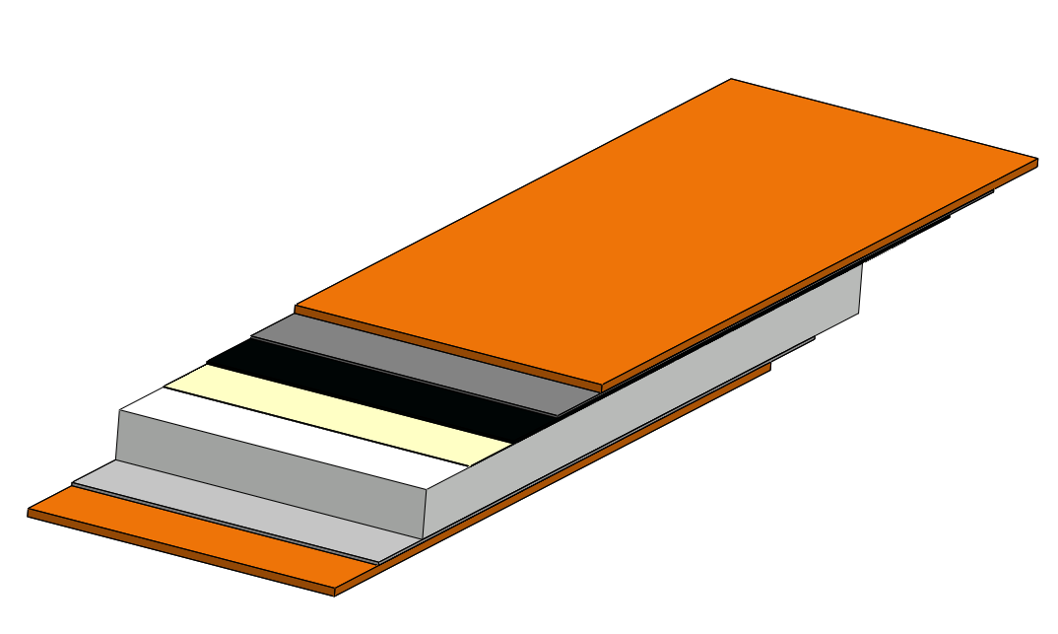
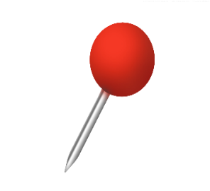


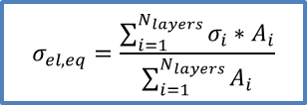
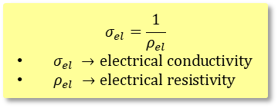

REBCO Tape design
SCS-4050 by SuperPower 2008
Power Law
Copper stabilizer
20 μm
R_{cu}
Silver layer
1.6 μm
i_{cu}
$$ρ_{el,YBCO}=\frac{E_{0}}{J_{c}}{\left(\frac{\left|J\right|}{J_{c}}\right)}^{n−1}$$
REBCO
1.6 μm
Buffer zone
0.4 μm
i_{silver}
R_{silver}
95.2 μm
Substrate
50 μm
i_{YBCO}
R_{YBCO}
2.2 mm
i
$$σ_{el, eq}=\frac{\sum_{i=1}^{N_{layers}}{σ_{i}∗A_{i}}}{\sum_{i=1}^{N_{layers}}{A_{i}}}$$
R_{substrate}
i_{sub}
$λ→thermal conductivit$y
$ρ→$ density
$c_{p} →specific heat$
$A →cross section$
Thermal-physical properties as function of temperature θ and RRR
λ, ρ weigthed on the cross section and c_{p} on the mass
R_{silver}
i_{silver}
i_{cu}
R_{cu}
$$σ_{el}=\frac{1}{ρ_{el}}$$
$σ_{el} →electrical conductivity$
$ρ_{el} →electrical resistivity$
[Two-Dimensional Anisotropic Model of YBCO Coated Conductors, Casali et. al, 2015]
[In-Field Electrical Resistance at 4.2 K of REBCO Splices, J. Fleiter and A. Ballarino, et. al, 2017]

Slide 6
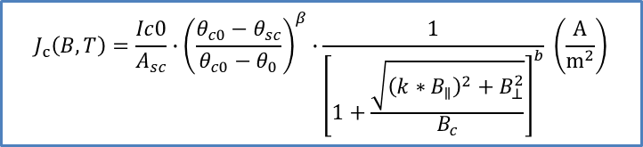

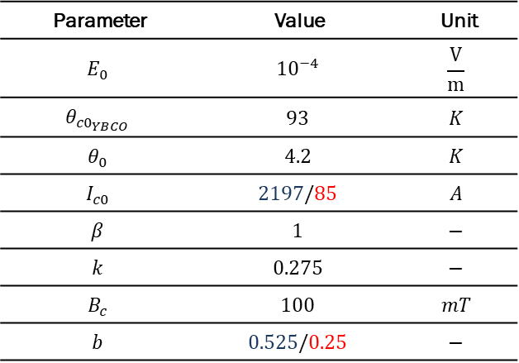
Critical current density
$$J_{c}\left(B,T\right)=\frac{Ic0}{A_{sc}}∙{\left(\frac{θ_{c0}−θ_{sc}}{θ_{c0}−θ_{0}}\right)}^{β}∙\frac{1}{{\left[1+\frac{\sqrt{{\left(k∗B_{∥}\right)}^{2}+B_{⊥}^{2}}}{B_{c}}\right]}^{b}} \left(\frac{A}{m^{2}}\right)$$
[Self-Consistent Modeling of the Ic of HTS Devices: How Accurate do Models Really Need to Be?, Grilli et. al, 2014]
Parameter | Value | Unit
$$E_{0}$$ | $${10}^{−4}$$ | $$\frac{V}{m}$$
$$θ_{{c0}_{YBCO}}$$ | $$93$$ | $$K$$
$$θ_{0}$$ | $$4.2$$ | $$K$$
$$I_{c0}$$ | $$2197/85$$ | $$A$$
$$β$$ | $$1$$ | $$−$$
$$k$$ | $$0.275$$ | $$−$$
$$B_{c}$$ | $$100$$ | $$mT$$
$$b$$ | $$0.525/0.25$$ | $$−$$
$$Err_{max}\sim 1.2\%$$
* Blue: 4.2 K, Red: 77 K
[Performance correlation between YBa₂Cu₃O_{7-δ} coils and short samples for coil technology development, X. Wang et. al, 2016]

Slide 7
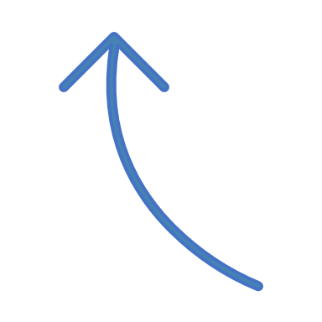










Mathematical model (1)
Thin shell approximation:
Governing equations:
  T-formulation (Tape)
  A-formulation
  (Whole domain)
  Heat conduction equation (Tape)
Air domain
$$J= ∇ ×T$$
$$∇ ×E=−\frac{∂B}{∂t}$$
$$ρ∙c_{p}∙\frac{∂θ}{∂t}=∇∙(−λ(θ)∙∇θ)+q^{′′′}$$
$$B$$
$$J$$
$${\dot{q}}_{LN_{2}}$$
$$q^{′′′}$$
Sum of two contributions:
Joule losses from T-formulation
Cooling from liquid nitrogen bath
REBCO tape
$∇ ×\left[\frac{1}{μ}\left(∇×A\right)\right]=J$
$$B=∇×A$$
[Study of magnetization loss of CORC cables using 3D T-A formulation, Y. Wang, 2019]
[3D quench modeling base on T-A formulation for high temperature superconductor CORC cables, Y. Wang, 2019]

Slide 8

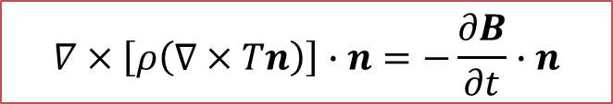

Mathematical model (2)
y
z
x
J_{x}=0
J_{z}
T
n
J_{z}
J_{y}=0
T
$$T=Tn$$
Final governing equation:
$$∇×\left[ρ\left(∇×Tn\right)\right]∙n=−\frac{∂B}{∂t}∙n$$

Slide 9
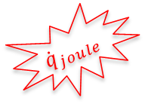

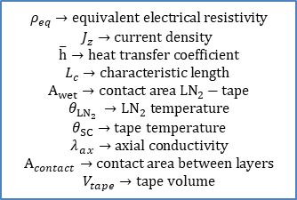

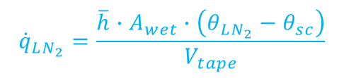

Tape thermal model
Thermal model
$$ρ∙c_{p}∙\frac{∂θ}{∂t}=∇∙\left(−λ_{ax}\left(θ\right)∙∇θ\right)+{\dot{q}}_{LN_{2}}+{\dot{q}}_{joule}\left[\frac{W}{m^{3}}\right]$$
y
z
x
$${\dot{q}}_{LN_{2}}$$
$${\dot{q}}_{joule}=ρ_{eq}∙J_{Z}^{2}$$
$${\dot{q}}_{LN_{2}}=\frac{\overline{h}∙A_{wet}∙\left(θ_{LN_{2}}−θ_{sc}\right)}{V_{tape}}$$
$$ρ_{eq}→equivalent electrical resistivity$$
$$J_{z}→current density$$
$$\overline{h}→heat transfer coefficient$$
$$L_{c}→characteristic length$$
$$A_{wet}→contact area LN_{2}−tape$$
$$θ_{LN_{2}} →LN_{2} temperature$$
$$θ_{SC}→tape temperature$$
$$λ_{ax}→axial conductivity$$
$$A_{contact}→contact area between layers$$
$$V_{tape}→tape volume$$
$${\dot{q}}_{joule}$$
Free convection
$$\overline{h}(Nu_{\left(Ra\right)},L_{c},λ_{LN_{2}})$$

Slide 10





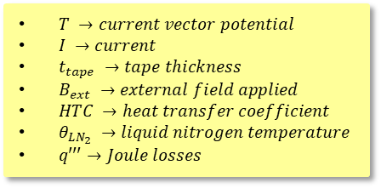

Model set up and boundary conditions
Air domain
$$HTC, θ_{LN_{2}}$$
Injection of a ramp of current on the tape cross section
Tape immersed in a bath of liquid nitrogen @ 77 K
External field applied
2D/3D simulations
$$T_{1}=0$$
$$q^{′′′}$$
$$T_{2}=I\left(t\right)$$
$$J_{z}$$
REBCO tape
$T →current vector potential$
$I →current$
$t_{tape} →tape thickness$
$B_{ext} →external field applied$
$HTC →heat transfer coefficient$
$θ_{LN_{2}} →liquid nitrogen temperature$
$q′′′→Joule losses$
$$B_{ext}$$

Slide 11
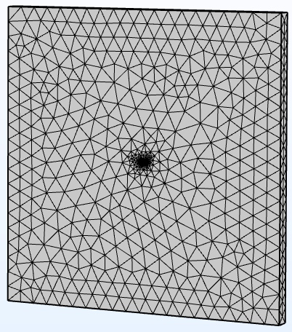
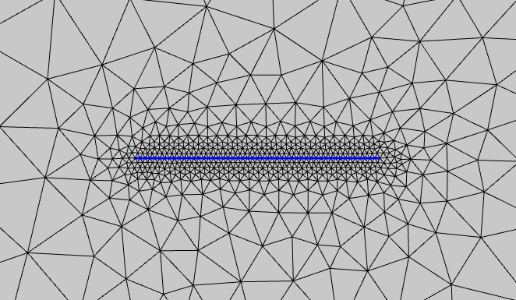
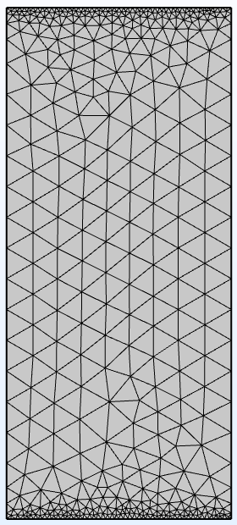
Geometry and mesh
Air domain: tetrahedral mesh
Tape domain: triangular mesh
Elements in tape width: 50
Dofs: ~ 13,000

Slide 12
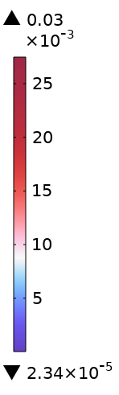
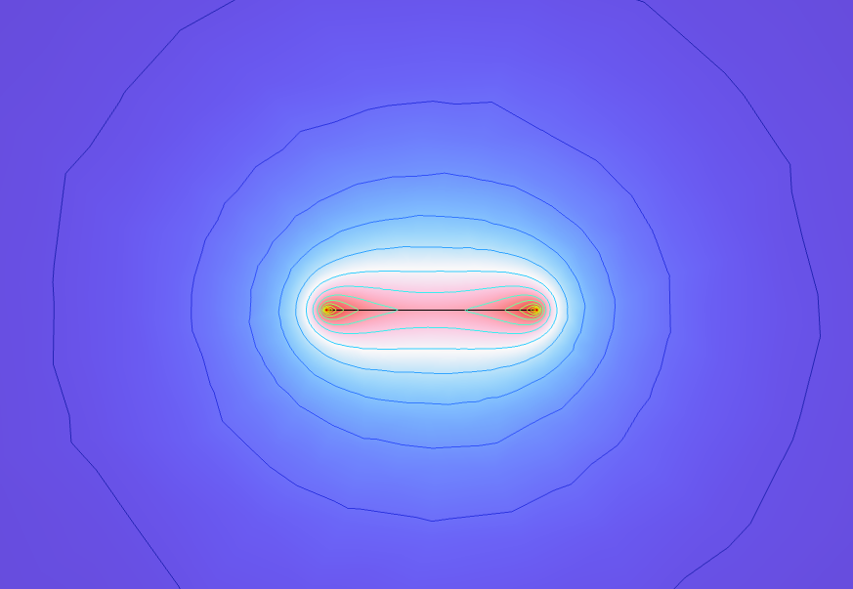


Results: V-I curve in self-field at @ 77 K
Magnetic flux induced
(T)
$$n−value=25$$
Good agreement on V-I characteristic
$$I_{crit}=82.6 A$$
$$err_{I_{c}}=1.35\%$$
$$I=40 A ≪I_{crit} →SC conditions$$
$I_{c, meas}=83.7 A$
$Nanovoltmeter used for measurements$

Slide 13

Results: V-I curves with vertical field applied at @ 77 K
Strong Ic degradation
N-value: 25
REBCO $H_{irr}\sim 8 T @ 77 K$
[Isotropic round-wire multifilament cuprate superconductor for generation of magnetic fields above 30 T, Larbalestier D.C., et. al, 2014]

Slide 14
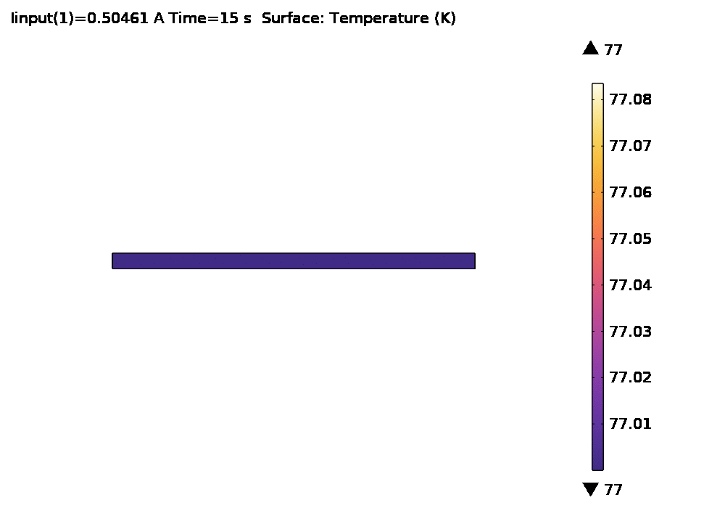
Results: thermal
Temperature map evolution
(A)
(K)
Trend in agreement with
V-I curve
Ic
!
dTmax = 80 mK

Slide 15

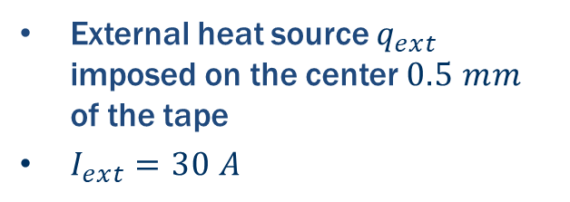
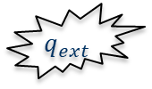
Model a recovery!
External heat source $q_{ext}$ imposed on the center $0.5 mm$ of the tape
$I_{ext}=30 A$
0.5 mm
$$q_{ext}$$
5 mm

Slide 16
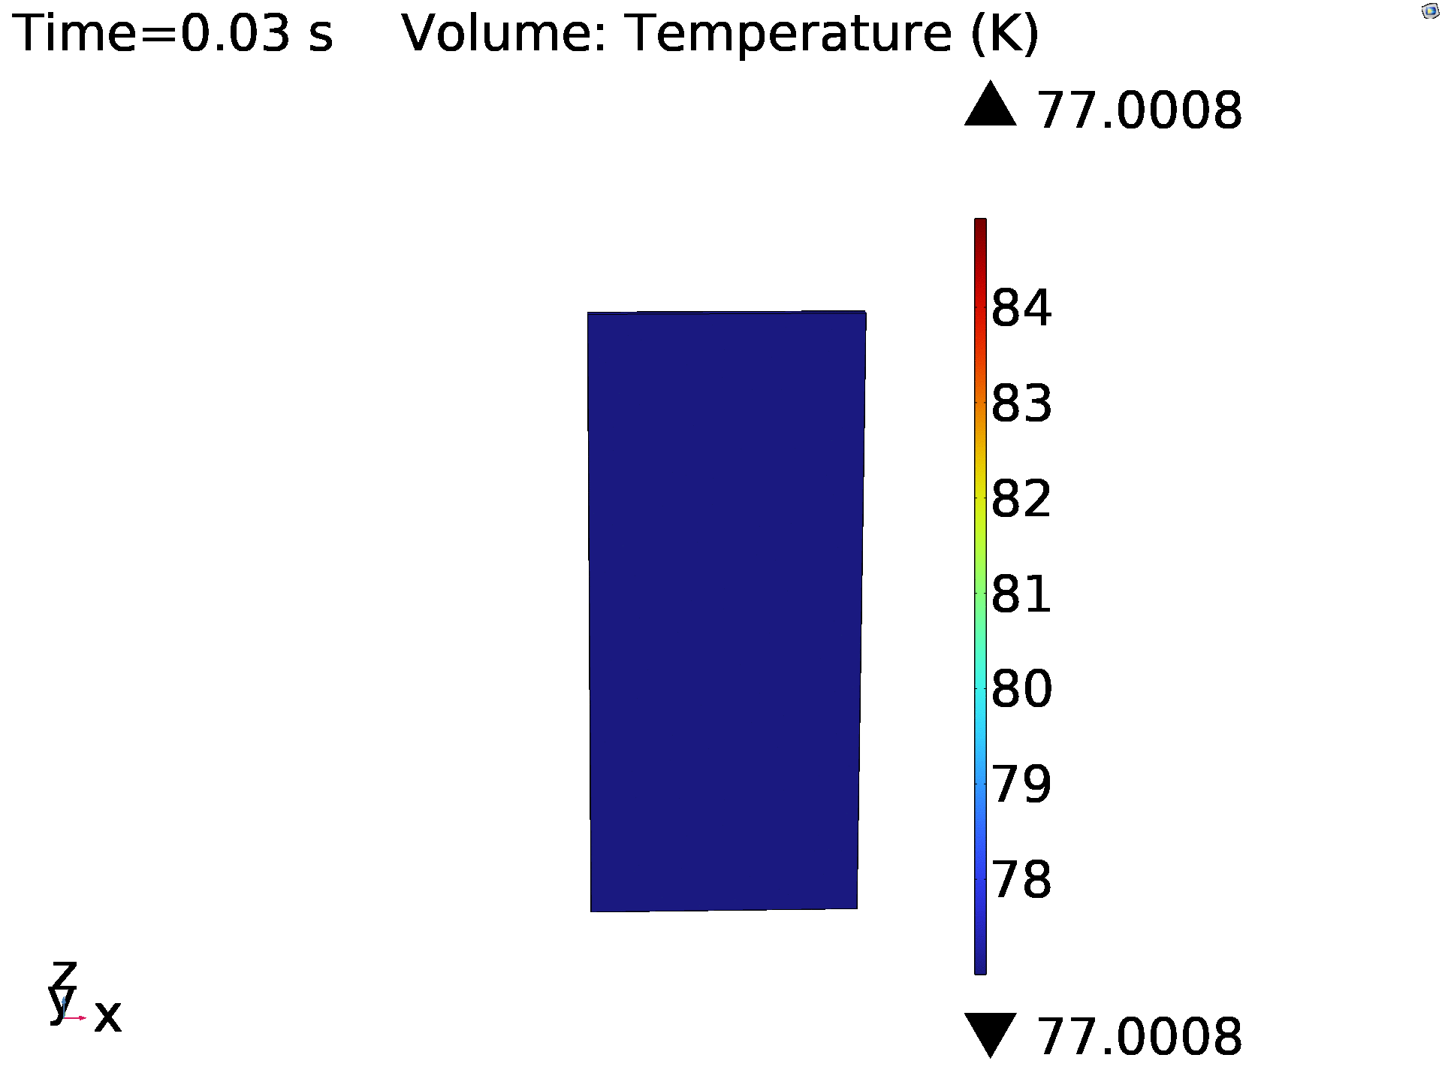
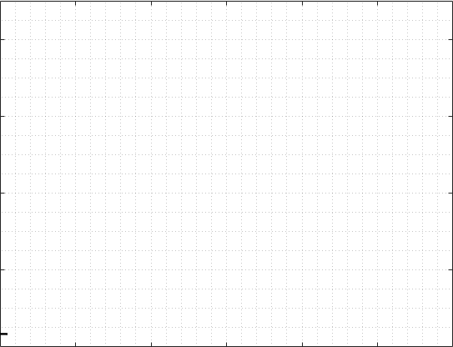

Recovery Results
$Evaluation of NPZ$
$Evaluation of MQE$

Slide 17
CORC® modeling

Slide 18
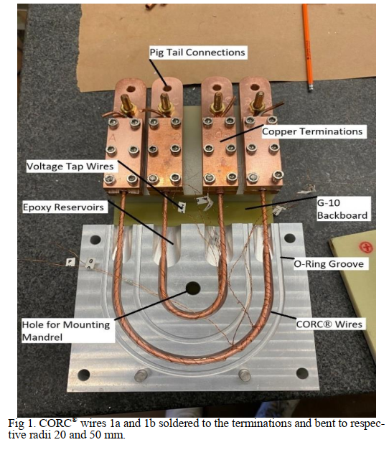
VPI test in LBNL
3 layers
2 REBCO tapes/layer (6 tapes total)
2.8 mm diameter
3 set of experiments:
  Set 1: straigth CORC® cable, before bending
  Set 2: bended CORC® cable, before epoxy impregnation
  Set 3: bended CORC® cable, after epoxy impregnation
[Developing a Vacuum Pressure Impregnation Procedure for CORC® Wires, J. Sterne et. al, MT27, 2021]
[Distributed fiber optic sensing to identify locations of resistive transitions in REBCO conductors and magnets, L. Luo et. al, MT27 2021]

Slide 19
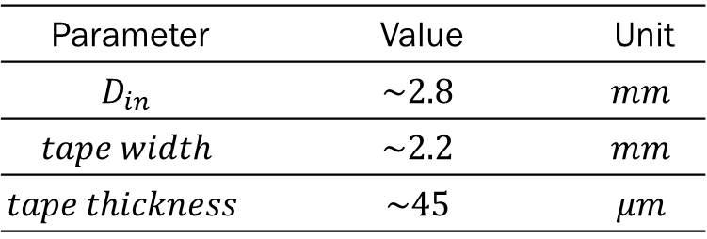
Cable layout
Copper stabilizer
5 μm
Silver layer
1.6 μm
REBCO
1.6 μm
Buffer zone
0.4 μm
45.2 μm
Substrate
20 μm
2.02 mm
Parameter | Value | Unit
$$D_{in}$$ | $$\sim 2.8$$ | $$mm$$
$$tape width$$ | $$\sim 2.2$$ | $$mm$$
$$tape thickness$$ | $$\sim 45$$ | $$μm$$
D_{in}
pitch

Slide 20
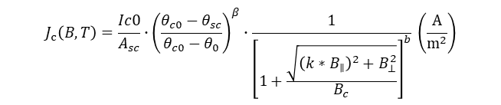


Strain dependance: critical current density
[Status of CORC® cables and wires for use in highfield magnets and power systems a decade after their introduction, Van der Laan D.C. et al, 2019]
Maximum strain:
$$ε=\frac{−t_{sub}}{t_{sub}+d_{former}+2t_{cu}}≈−0.7 \%$$
$$J_{c}\left(B,T\right)=\frac{Ic0}{A_{sc}}∙{\left(\frac{θ_{c0}−θ_{sc}}{θ_{c0}−θ_{0}}\right)}^{β}∙\frac{1}{{\left[1+\frac{\sqrt{{\left(k∗B_{∥}\right)}^{2}+B_{⊥}^{2}}}{B_{c}}\right]}^{b}} \left(\frac{A}{m^{2}}\right)$$
$$I_{c0_{wounded}}={0.75∗I}_{c0}≈63.75 A$$
20

Slide 21
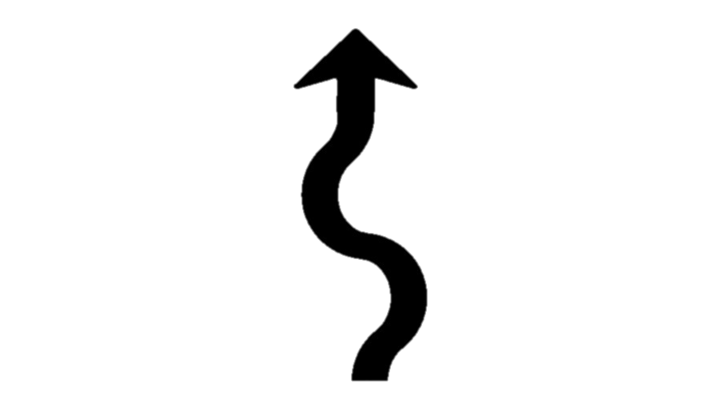
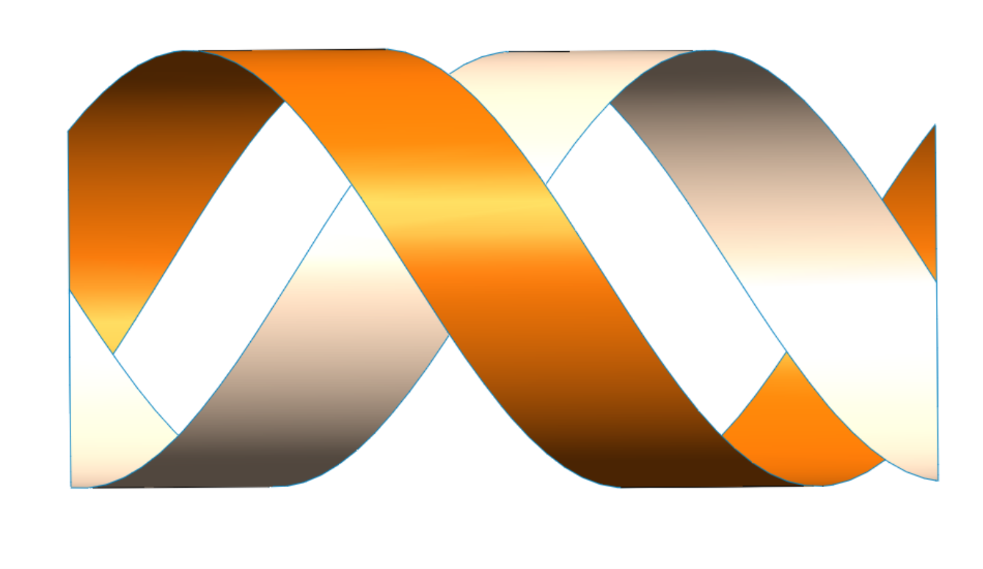
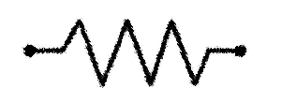




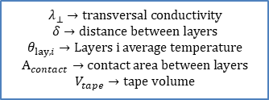



CORC® thermal model
Thermal model
$$ρ∙c_{p}∙\frac{∂θ}{∂t}=∇∙\left(−λ_{ax}\left(θ\right)∙∇θ\right)+{\dot{q}}_{joule}+{\dot{q}}_{LN_{2}}+{\dot{q}}_{layers}\left[\frac{W}{m^{3}}\right]$$
y
$${\overline{θ}}_{lay1}$$
x
$${\dot{q}}_{LN_{2}}$$
z
$$\frac{λ_{⊥}}{δ}$$
$${\dot{q}}_{layers}$$
$${\overline{θ}}_{lay2}$$
$${\dot{q}}_{layers}=\frac{\frac{λ_{⊥}}{δ}\left({\overline{θ}}_{lay1}−{\overline{θ}}_{lay2}\right)∙A_{contact}}{V_{tape}}$$
$${\dot{q}}_{joule}$$
$$λ_{⊥}→transversal conductivity$$
$$δ→distance between layers$$
$$θ_{lay,i}→Layers i average temperature$$
$$A_{contact}→contact area between layers$$
$$V_{tape}→tape volume$$

Slide 22
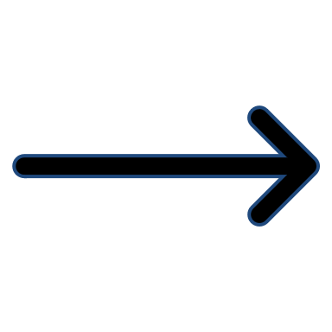






Boundary condition!
$$T_{x}$$
$$PBC$$
$$T_{0}=0$$
$$PBC$$
$$T_{x}$$
$$T_{2}=I_{tot}$$
Minimum domain: a CORC® pitch
Total current imposed in the last boundary
Periodic boundary conditions (PBC)
New BC!
Current sharing between tapes

Slide 23
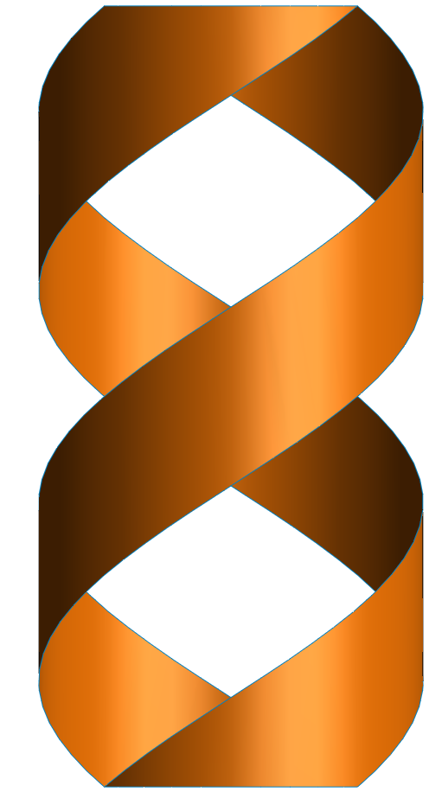
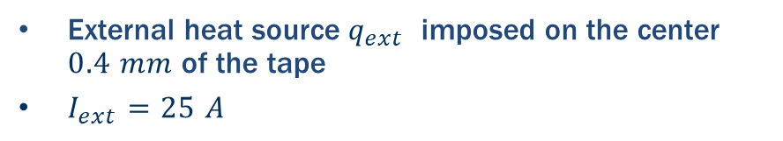

Thermal disturbance
External heat source $q_{ext}$ imposed on the center $0.4 mm$ of the tape
$I_{ext}=25 A$
$$q_{ext}$$

Slide 24
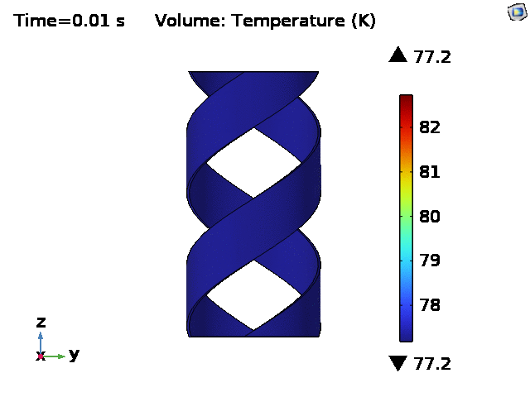
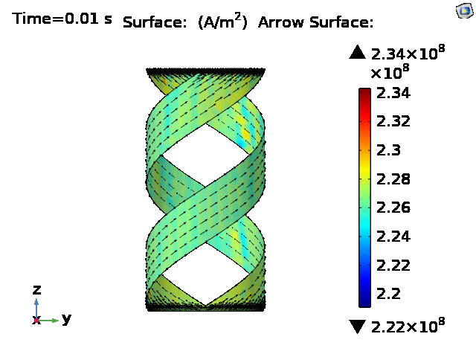
Thermal disturbance: results

Slide 25
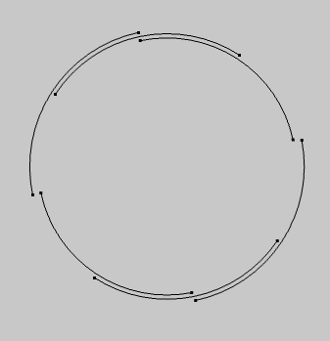
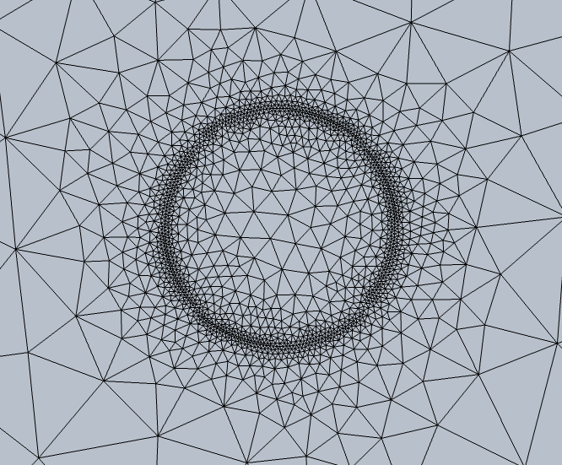
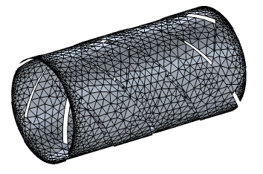
Geometry and mesh
Air: tetrahedral mesh
Tapes: Triangular mesh
Dofs ~ 91,000

Slide 26
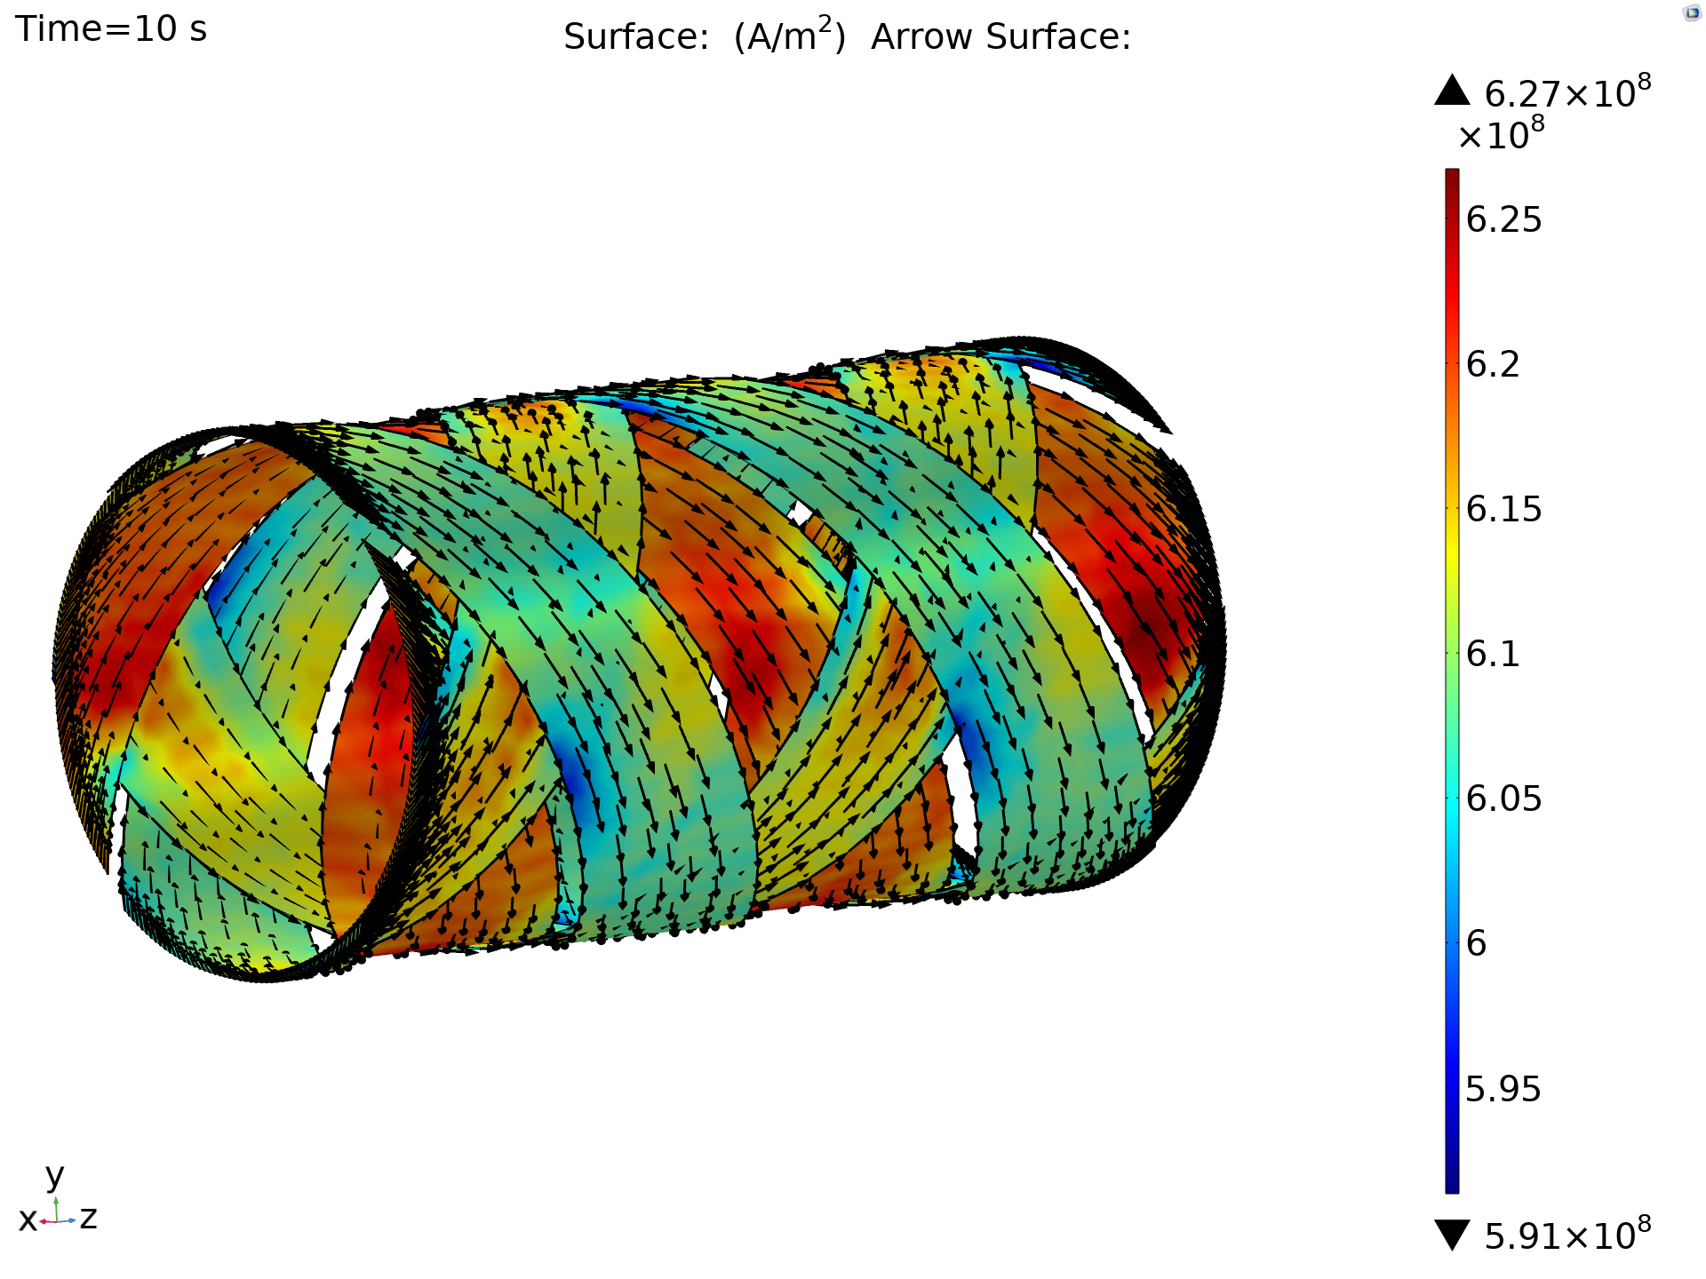
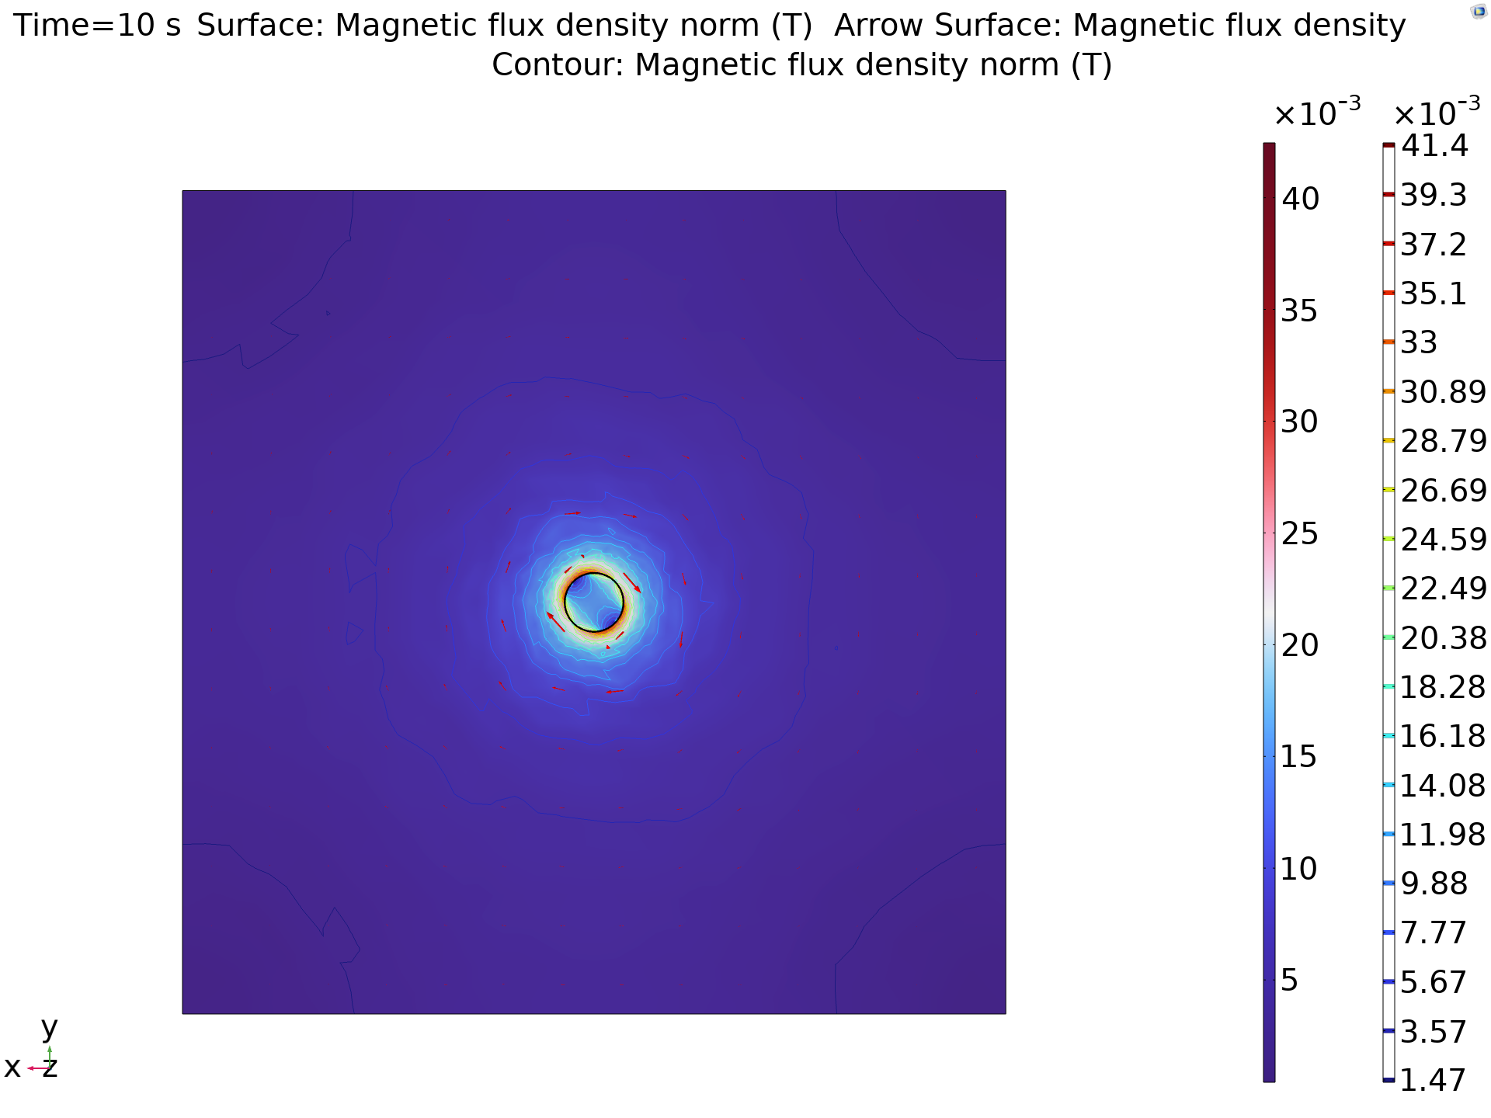
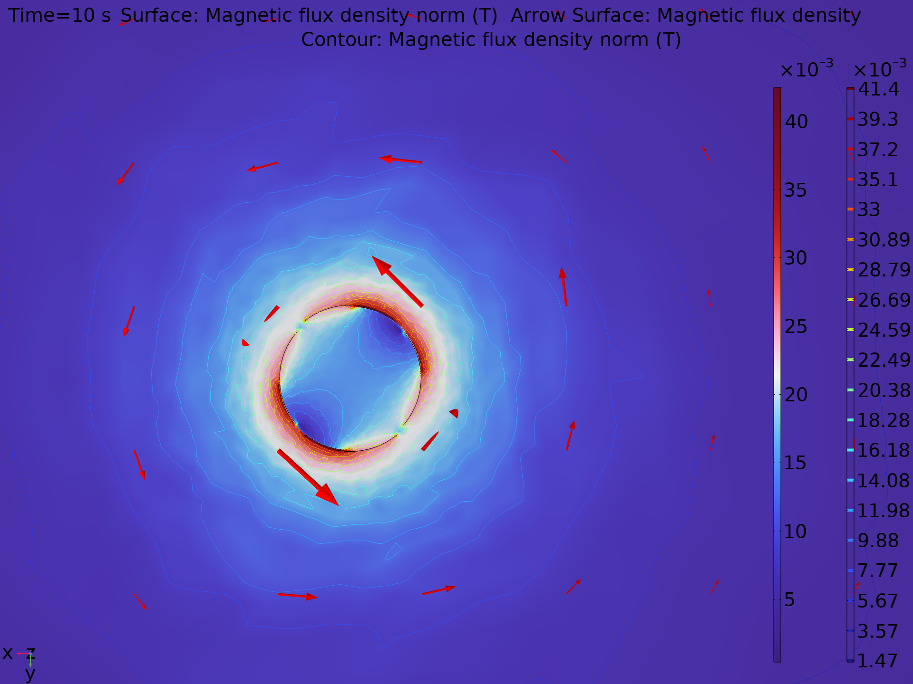
6 tapes CORC® @ 200 A (1)
Magnetic flux induced
Current density distribution
(T)
(A/m²)
!
Non-homogeneous current distribution: higher current flowing in the inner layer
$$I=200 A ≪I_{crit} →SC conditions$$

Slide 27
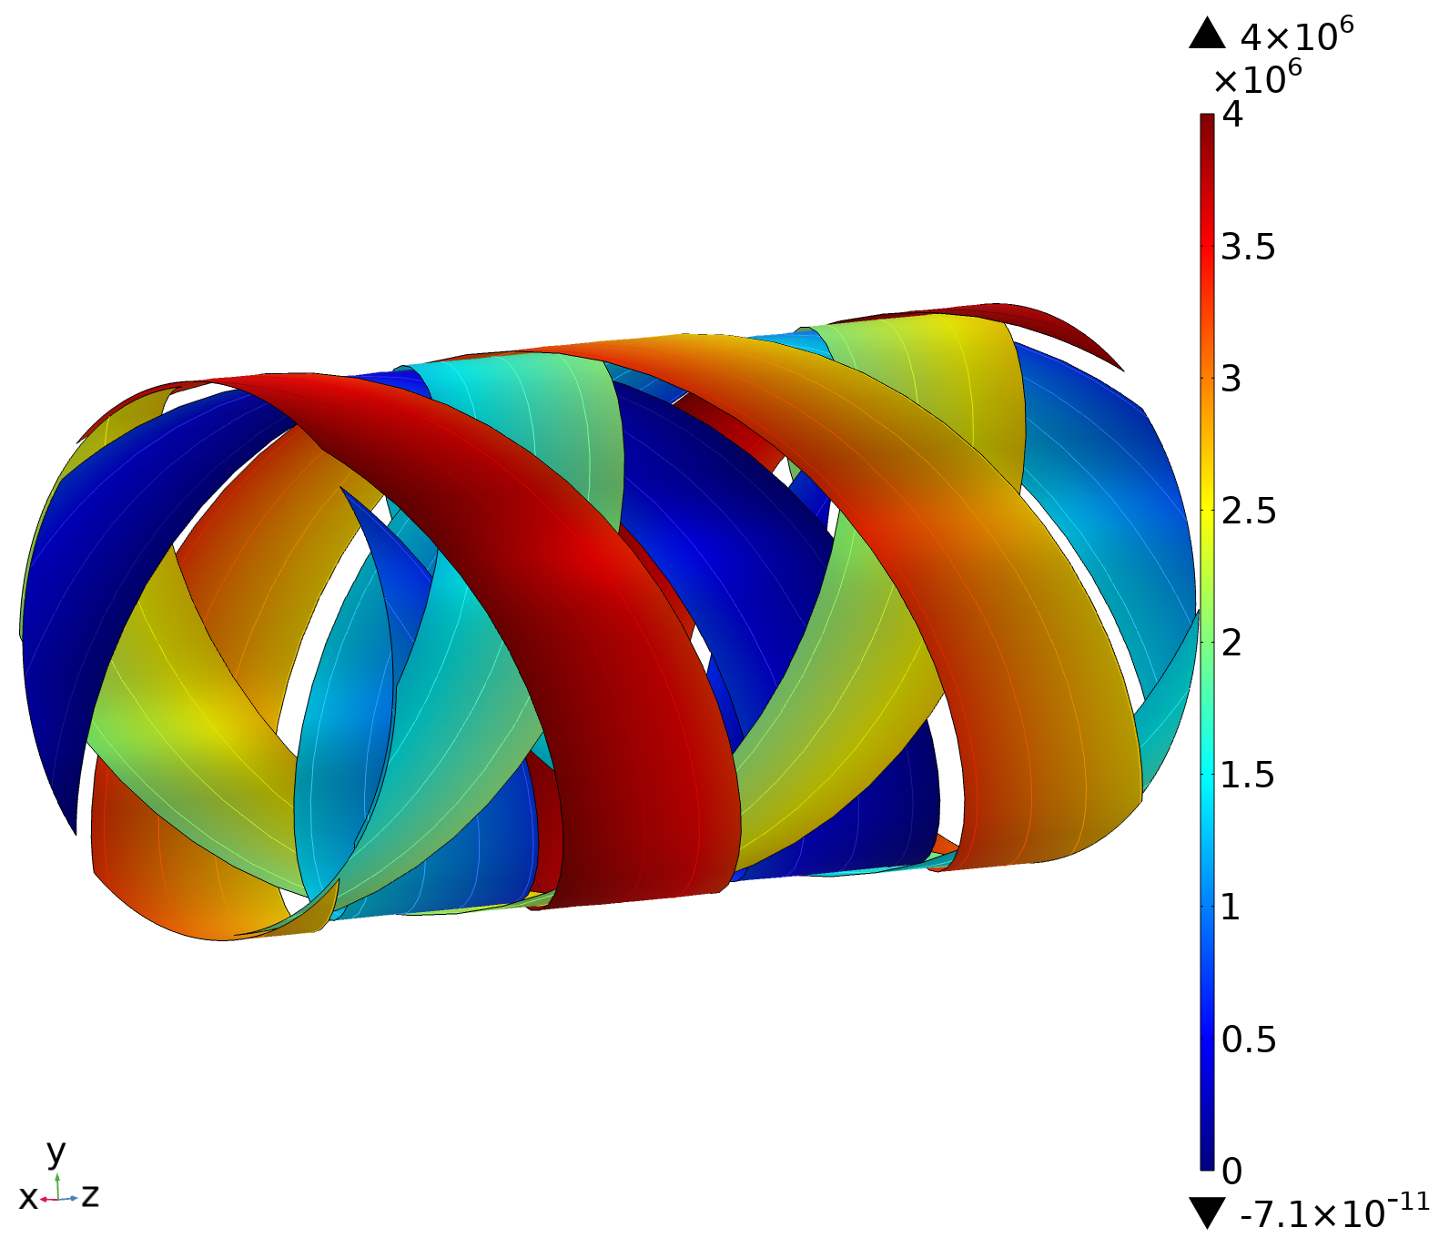
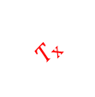

6 tapes @ 200 A (2)
T distribution
(A/m)
$$T=0$$
$$T_{x}$$
$$T=I_{tot}$$

Slide 28
Conclusions and next steps
Multiphysics (thermal and electromagnetic) full 3D CORC® model has been implemented
Current sharing between tapes and layers is guaranteed through a proper boundary condition
Model validated with respect experimental data
Improve the computational time and stabilization of the model
Evaluate the thermal stability of a CORC®
Apply the model to more than 3 layers
3D model of a bended CORC®

Slide 29


Thank you for your attention!
See you in Honolulu!

Slide 30
References
Status of CORC® cables and wires for use in highfield magnets and power systems a decade after their introduction, D.C. Van der Laan et al, 2019
Two-Dimensional Anisotropic Model of YBCO Coated Conductors, Casali et. al, 2015
In-Field Electrical Resistance at 4.2 K of REBCO Splices, J. Fleiter and A. Ballarino, et. al, 2017
Self-Consistent Modeling of the Ic of HTS Devices: How Accurate do Models Really Need to Be?, Grilli et. al, 2014
Performance correlation between YBa₂Cu₃O_{7-δ} coils and short samples for coil technology development, X. Wang et. al, 2016
Study of magnetization loss of CORC cables using 3D T-A formulation, Y. Wang, 2019
3D quench modeling base on T-A formulation for high temperature superconductor CORC cables, Y. Wang, 2019
Developing a Vacuum Pressure Impregnation Procedure for CORC® Wires, J. Sterne et. al, MT27, 2021
Distributed fiber optic sensing to identify locations of resistive transitions in REBCO conductors and magnets, L. Luo et. al, MT27 2021
Calculations of the AC losses in superconducting cables and coils: Neumann boundary conditions of T-A formulation, S. Wang, 2022
Finite-Element Analysis of the Strain Distribution Due to Bending in a REBCO Coated Conductor for Canted Cosine Theta Dipole Magnet Applications , Pierro F. et al, 2019
Isotropic round-wire multifilament cuprate superconductor for generation of magnetic fields above 30 T, Larbalestier D.C., et. al, 2014

