Slide 1


20 T – Cos(𝛳) Designs
G. Vallone¹, P. Ferracin¹, V. Marinozzi², Y. Pansari¹
03-August-2022
¹LBNL, ²FNAL
General MDP Meeting

Slide 2
Index
Introduction
Magnetic model results
Mechanical model results
  Rigid structures and stress management
  Thick intercoil study
  SMCT Study
Conclusion

Slide 3
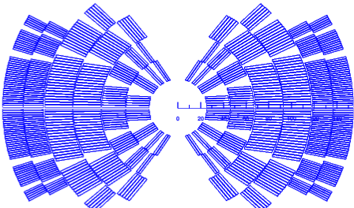
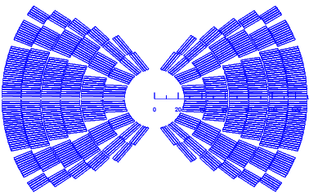
Introduction
CT I
CT II
We want to compute the mechanical stresses for 20T cos(ϑ) design
  CT I: 4 Bi2212 layers
  CT II: 2 Bi2212 layers
We select CT II as best ($) design

Slide 4
Index
Introduction
Magnetic model results
Mechanical model results
  Rigid structures and stress management
  Thick intercoil study
  SMCT Study
Conclusion

Slide 5
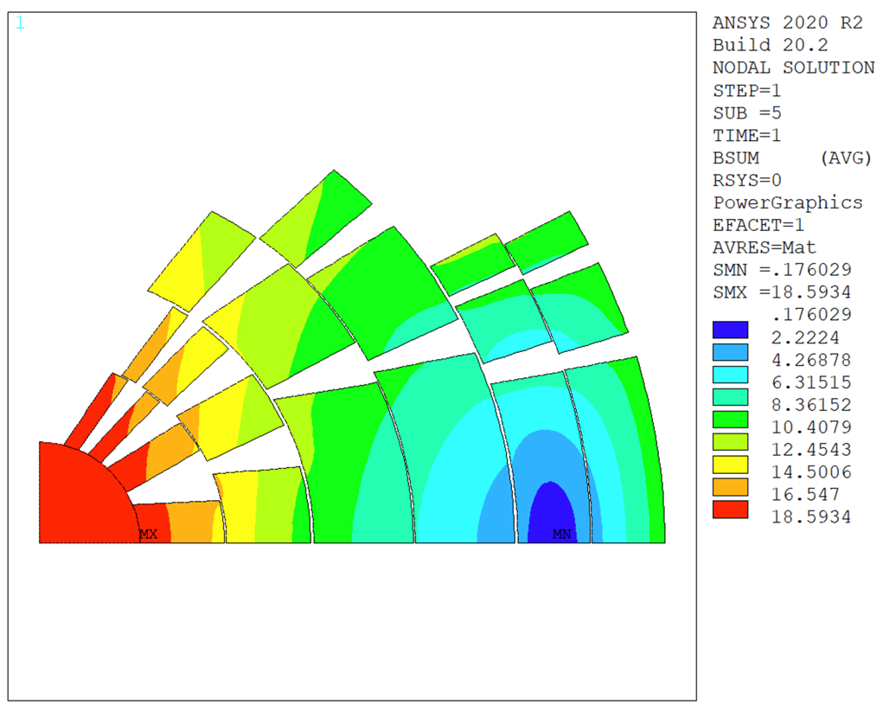
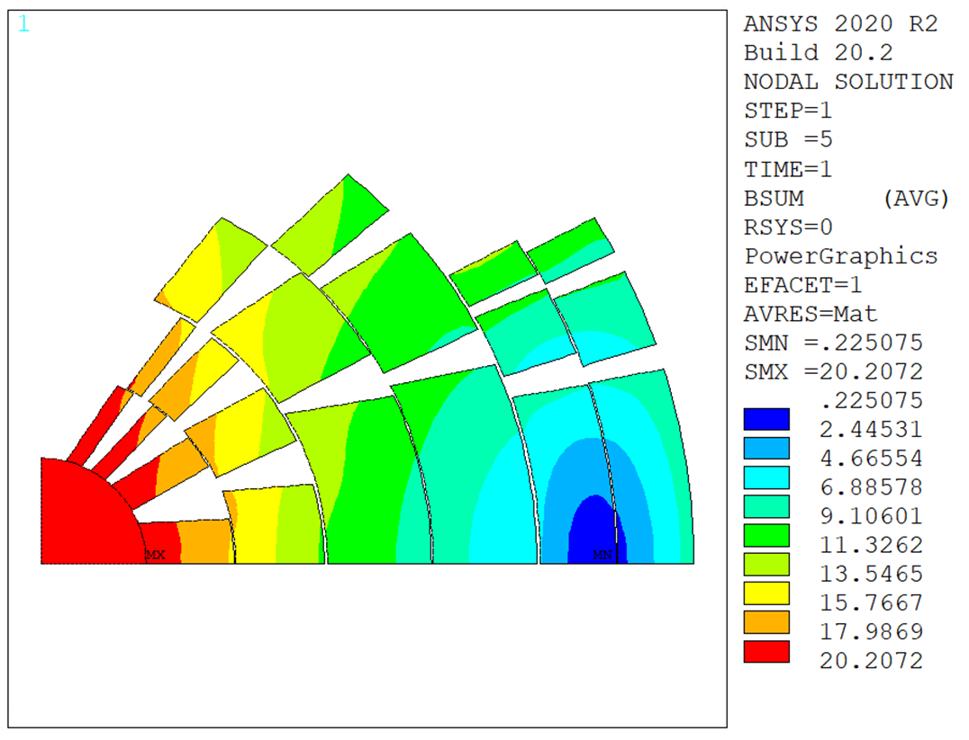
Magnetic Field
B, T
No Iron
B, T
With Iron
ANSYS magnetic model
  20 T central field at I = 13 kA, with the iron yoke
  Results consistent with Roxie model
  Used to extract e.m. forces for mechanical study

Slide 6
Magnetic Model Results
Layer | Bpeak | jo | Lorentz Stress
/ | T | A/mm2 | MPa
1 | 20.2 | 305 | -81
2 | 18.1 | 305 | -119
3 | 16.0 | 215 | -137
4 | 13.0 | 215 | -133
5 | 11.7 | 398 | -144
6 | 11.0 | 398 | -128
Reasonable Lorentz stress in all layers
Assumed mechanical limits:
  Bi2212 (layer 1, 2): 125 MPa
  Nb₃Sn (layer 3 to 6): 175 MPa

Slide 7
Index
Introduction
Magnetic model results
Mechanical model results
  Rigid structures and stress management
  Thick intercoil study
  SMCT Study
Conclusion

Slide 8
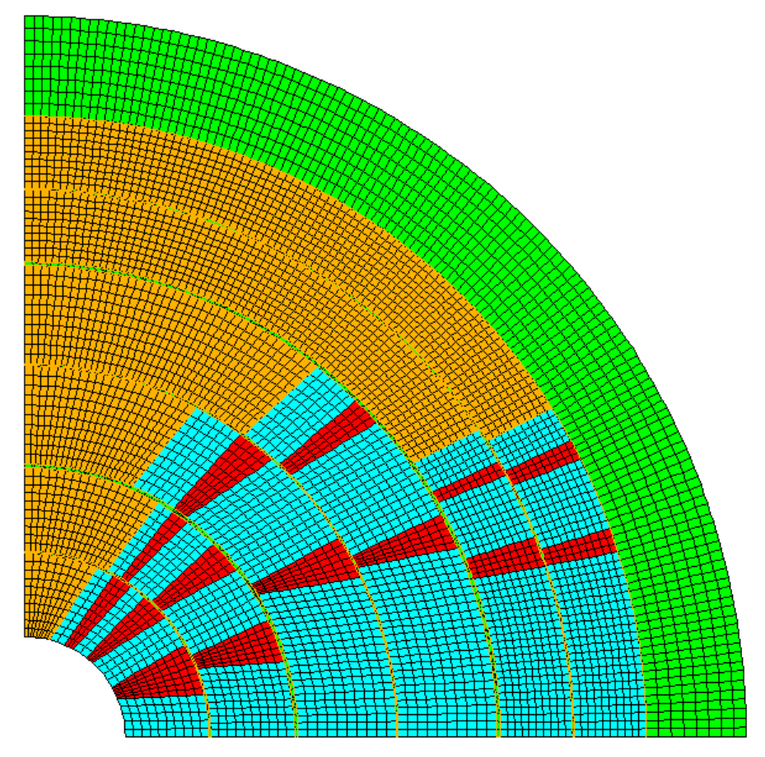
Modeling assumptions
Rigid
Structure
Separation
Allowed
Intercoil
Frictionless
Contact
Interlayer
Bonded Contact
Coil modelled as linear elastic
Rigid structure around the outer coil
Rigid winding poles, no prestress
Frictionless contact on the intercoil insulation
Glued contact on the interlayers

Slide 9
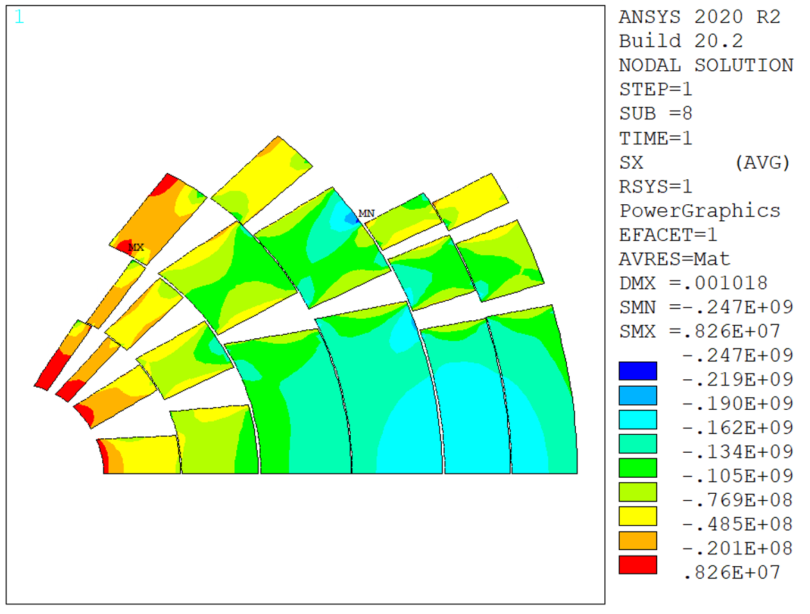
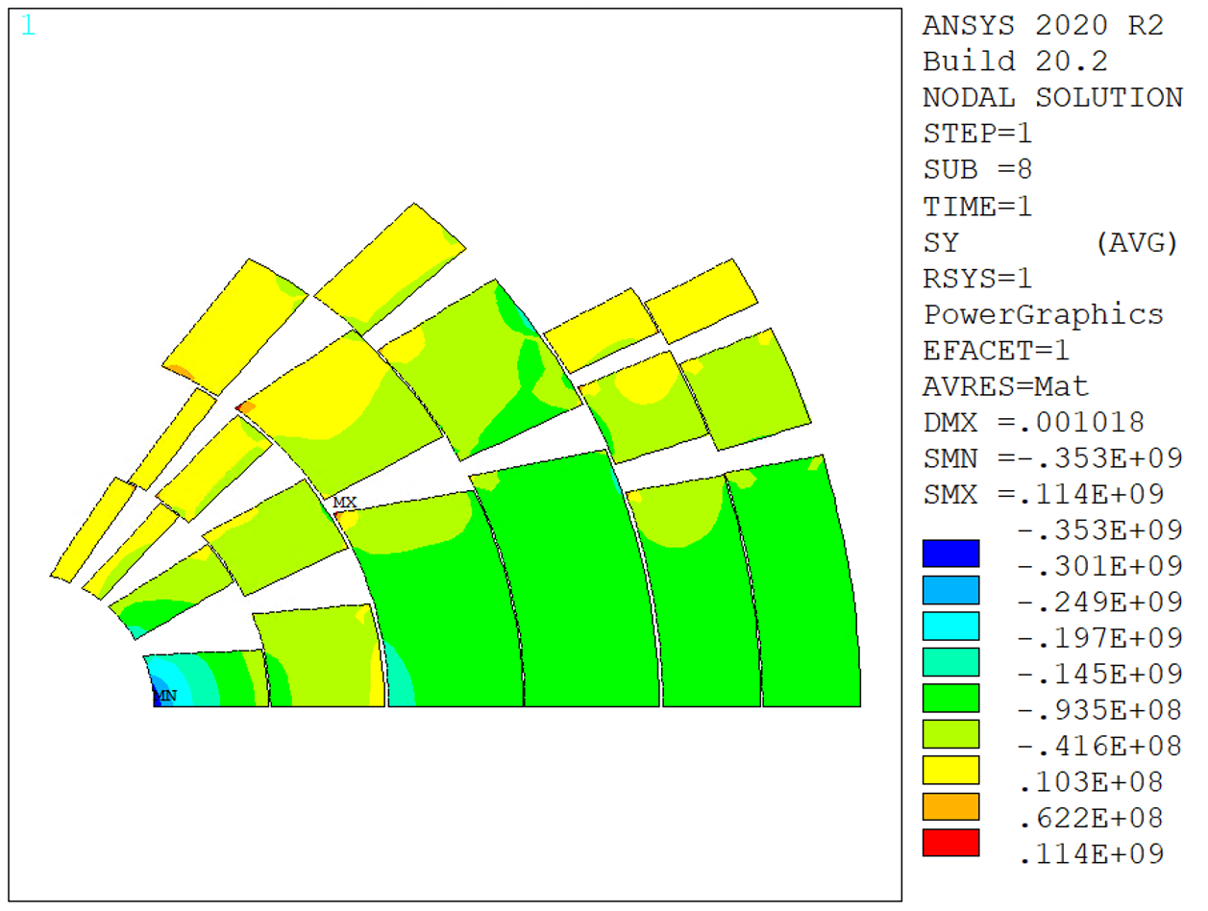
Rigid Structure
Radial
Stress
Azimuthal
Stress
Max stress, mid plane:
  Radial: 183 MPa, Azimuthal: 353 MPa
  Inner radius stress due to coil deformability
Lorentz stress on layer 1 was only 80 MPa, but bending…

Slide 10
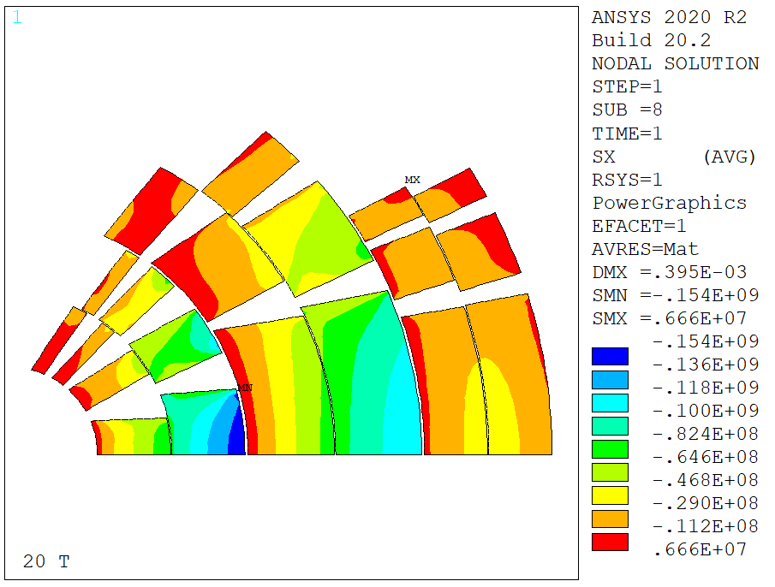
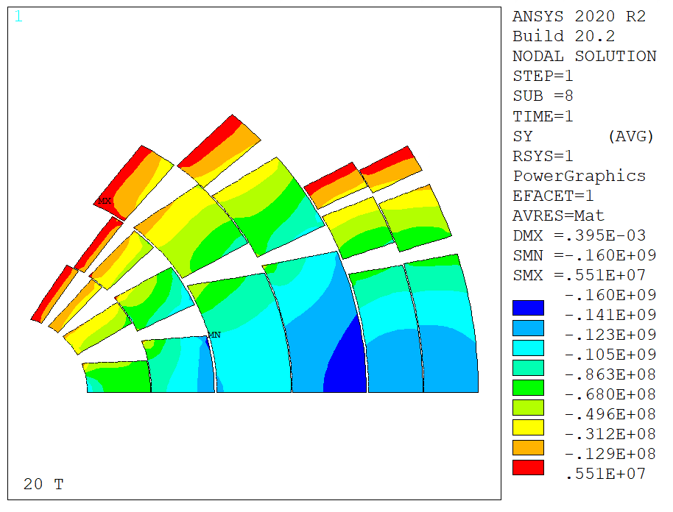
Rigid Structure, Intercepting (Fixed intercoil)
Radial
Stress
Azimuthal
Stress
Intercepting structure - intercoil fixed (u=0)
  Removes bending and accumulation of radial forces
140 MPa radial, 155 MPa azimuthal
With perfect interception between coils, layer 2 has to be stress managed
  Radial+azimuthal stresses exceed limits

Slide 11
Rigid Structure, Intercepting (Fixed intercoil+interlayer)
Radial
Stress
Azimuthal
Stress
Intercepting structure – intercoil and interlayers fixed (u=0)
Even with perfect interception between layers, layer 2 has to be stress managed
101 MPa radial, 147 MPa azimuthal

Slide 12
Result Summary - Intercepting
In red stresses that are over conductor limits
Rigid intercoil + interlayer close to Lorentz stress

Slide 13
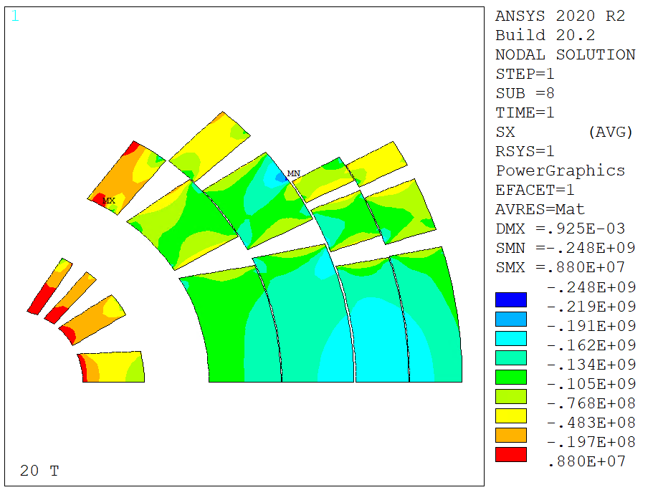
Rigid Structure, Layer 2 Stress Managed
Radial
Stress
Azimuthal
Stress
If we stress manage L2, do we need to do the same on L1?
  Is the additional stiffness from stress management enough to remove the stress peaks in L1?
  Model with L2 in stainless steel (coil and spacers)
179 MPa radial, 302 MPa azimuthal
Layer 1 has to be stress managed
  Azimuthal stresses exceed limits

Slide 14
Result Summary – Stress Management
We can repeat the exercise ‘stress-managing’ only some layers (x means stress managed)
Stress managed solutions show that in reality we might be able to stress manage only layer 1, 2, but layer 3 is very close to the limit
  Field is low, but stress might become higher when outer structure and stress management are not ‘ideal’
  On the other hand, coil 3 can work with no stress management

Slide 15
Index
Introduction
Magnetic model results
Mechanical model results
  Rigid structures and stress management
  Thick intercoil study
  SMCT Study
Conclusion

Slide 16
Steel Intercoil – Magnetic Field
Design 1, I = 13.0 kA, B = 20 T
Layer | Bpeak | jo | Lorentz Stress
/ | T | A/mm2 | MPa
1 | 20.2 | 305 | -81
2 | 18.1 | 305 | -119
3 | 16.0 | 215 | -137
4 | 13.0 | 215 | -133
5 | 11.7 | 398 | -144
6 | 11.0 | 398 | -128
Design 2, I = 13.5 kA, B = 20 T
Layer | Bpeak | jo | Lorentz Stress
/ | T | A/mm2 | MPa
1 | 20.3 | 317 | -84
2 | 18.1 | 317 | -123
3 | 15.5 | 223 | -139
4 | 12.8 | 223 | -136
5 | 11.5 | 413 | -148
6 | 10.8 | 413 | -134
Old
New
5 mm thick stainless steel intercoil shim/structure
Current ramped up to get back to 20 T
  From 13 kA to 13.45 kA
  Lower margin but this is a ‘mechanical’ test

Slide 17
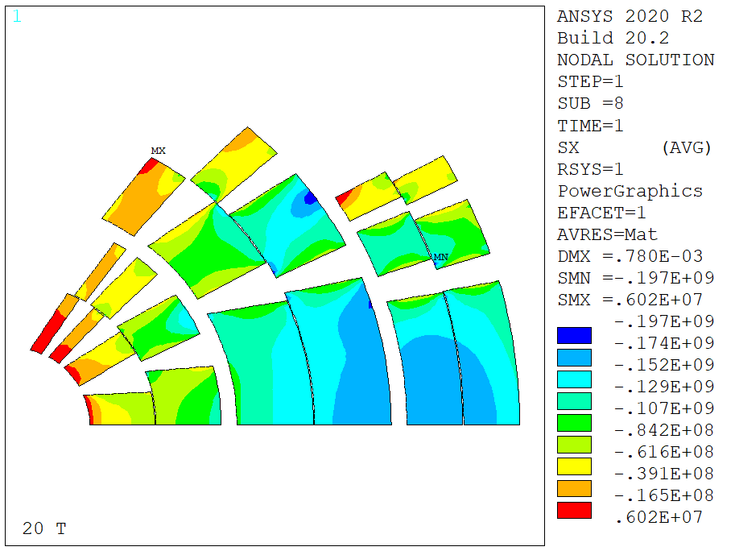
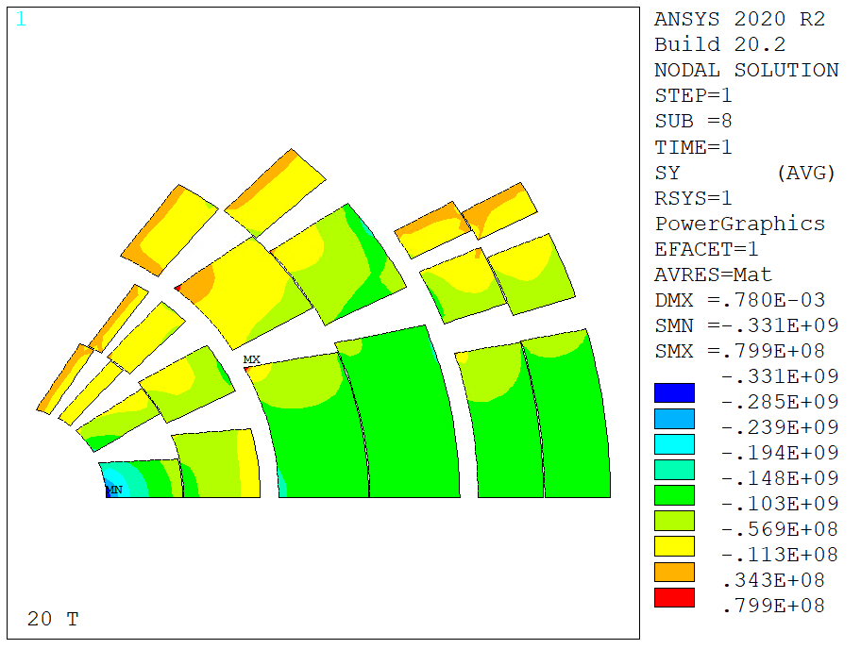
Case A – Steel ‘Open Rings’
Radial
Stress
Azimuthal
Stress
Intercoil shims open at 90°
Azimuthal: 331 MPa, Radial: 173 MPa
  Does not solve the bending problem on the first layer
  Similar results with closed rings (shells)

Slide 18
Index
Introduction
Magnetic model results
Mechanical model results
  Rigid structures and stress management
  Thick intercoil study
  SMCT Study
Conclusion

Slide 19
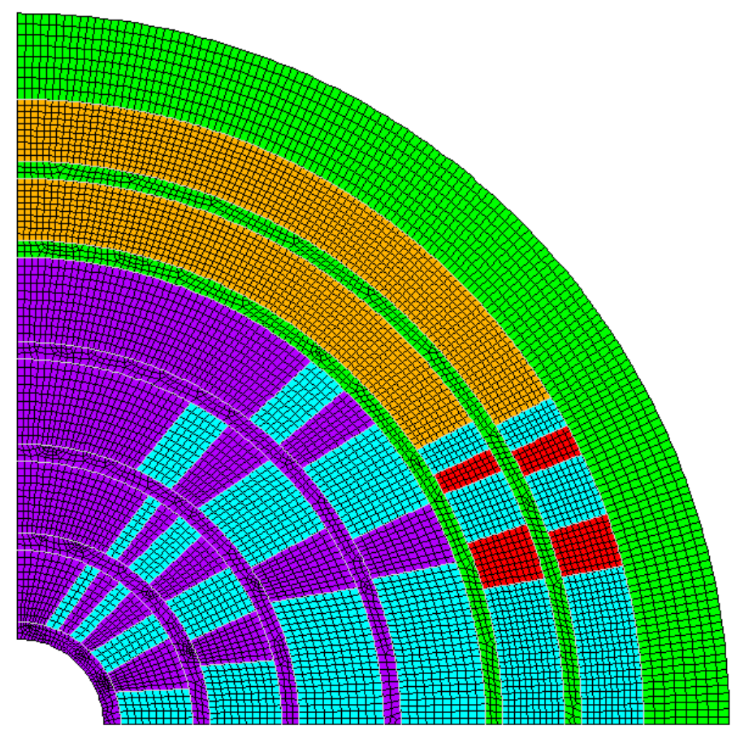
A test with an SMCT ‘Design’ - Assumptions
Rigid
Structure
Interlayer
Bonded Contact
Frictionless
Contact
A ‘test’ design obtained adding 5 mm thick stainless steel spars to the CT design
  Mandrel = spar + wedges (ribs)
  Frictionless contacts between coil and mandrels
  Frictionless contact between mandrels
  Layer 5 and 6 impregnated, with no stress management

Slide 20
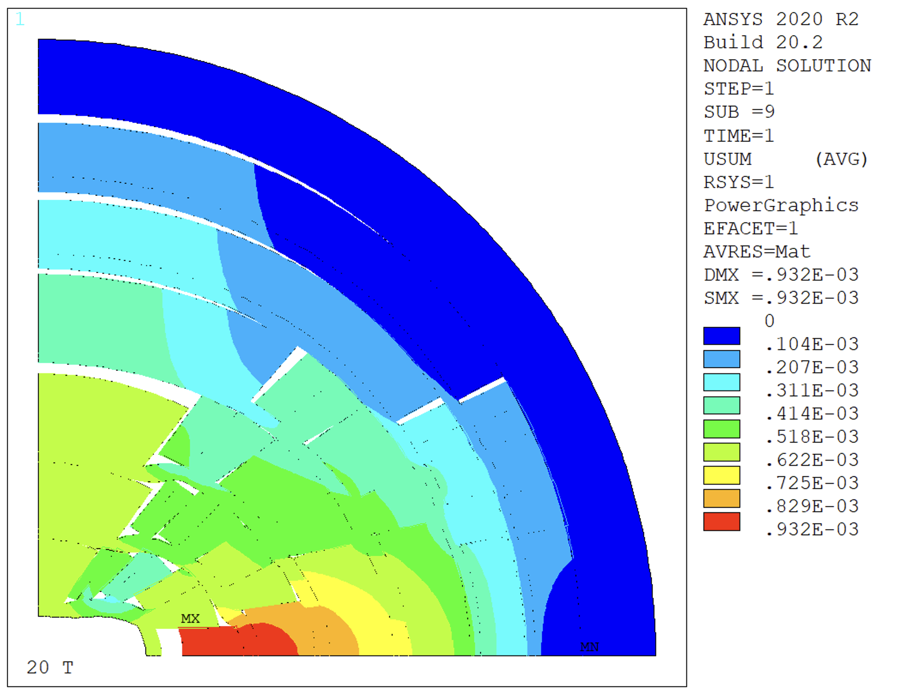
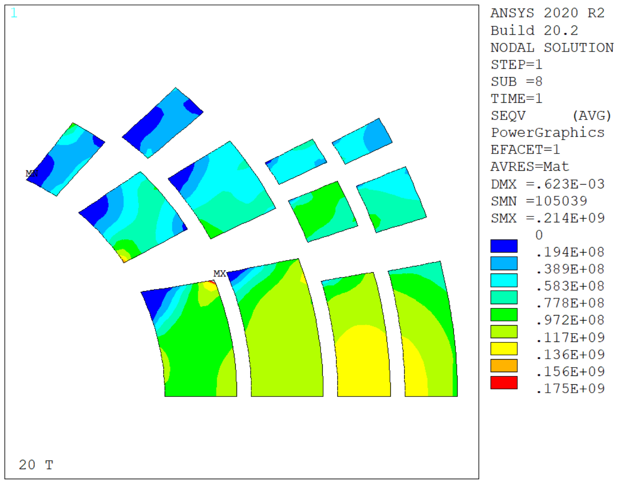
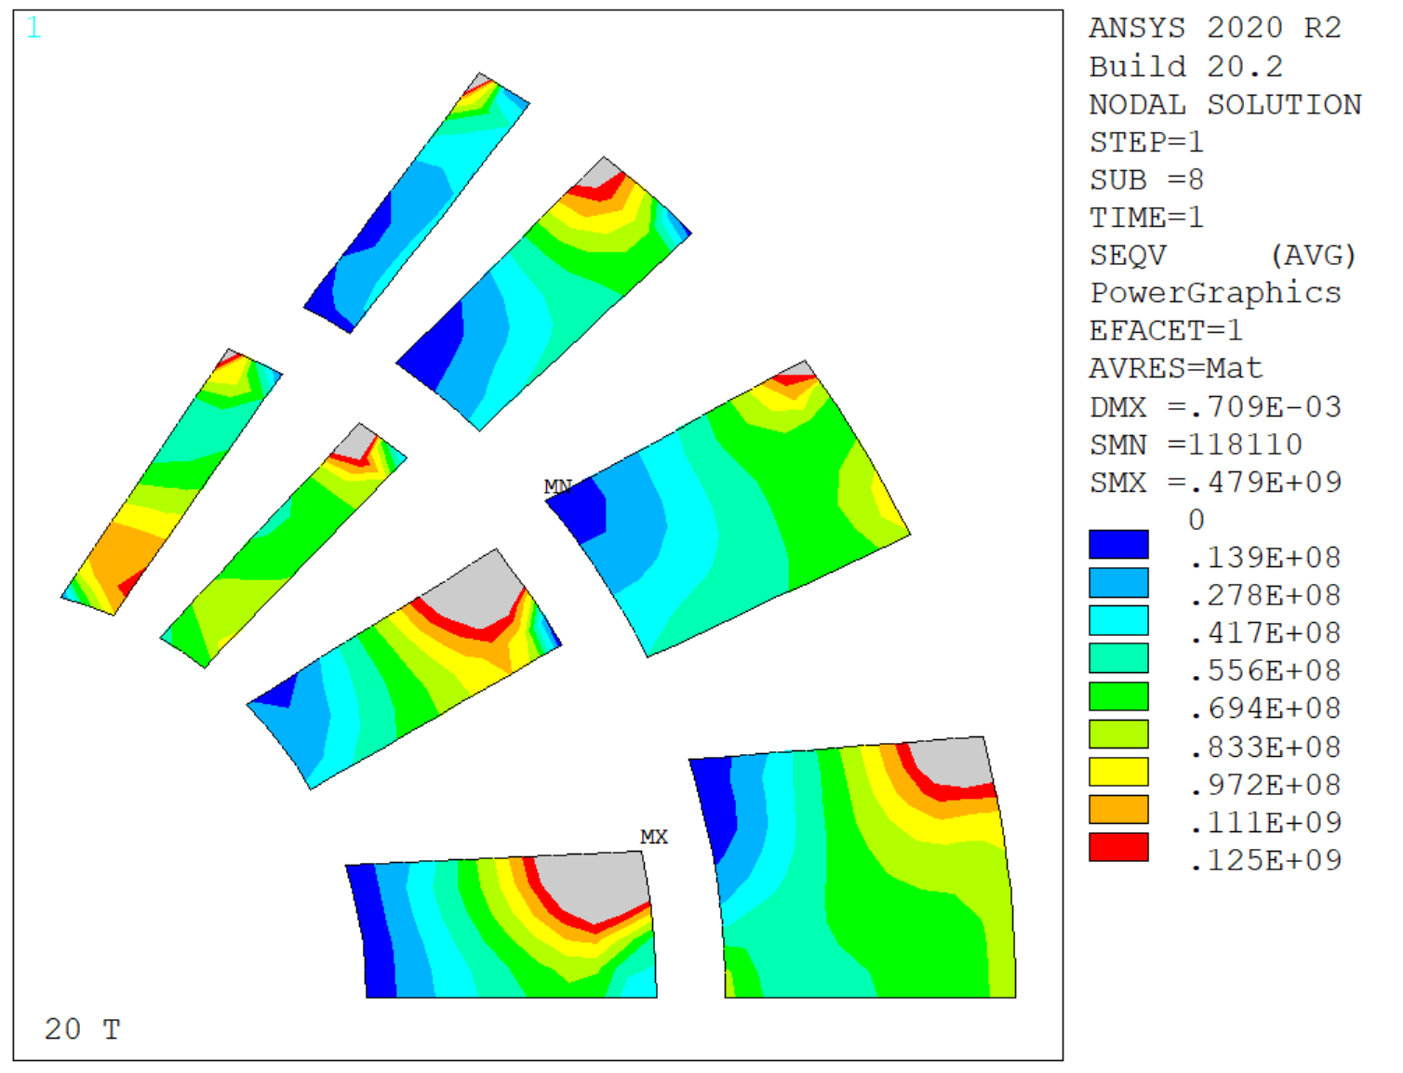
A test with an SMCT ‘Design’ - Results
Eqv.
Stress
Eqv.
Stress
Limit stresses exceeded on the inner coil upper right edges
Coil 2 and 3 are ok

Slide 21
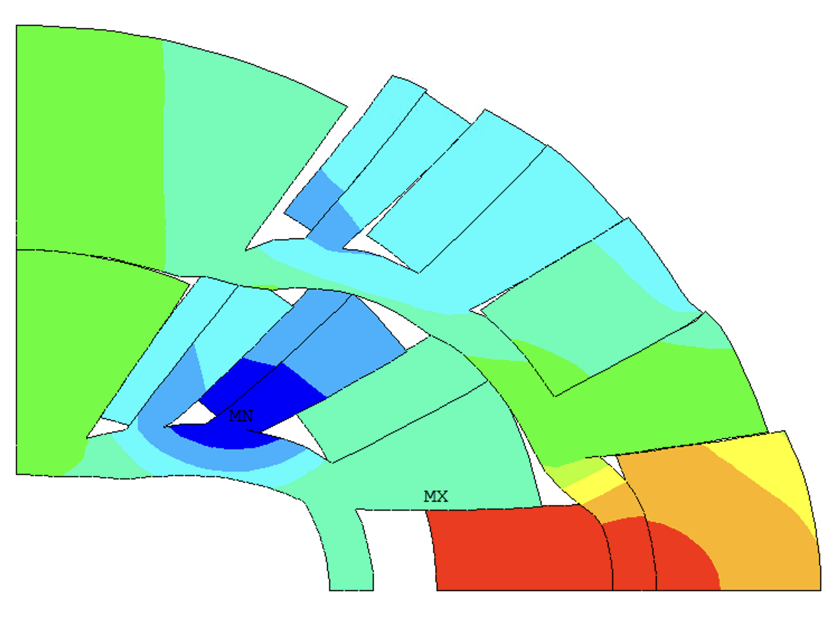
A test with an SMCT ‘Design’
Eqv.
Stress
The high stresses are due to radial forces and contact with the second layer spar
This result suggests that we need more radial support

Slide 22
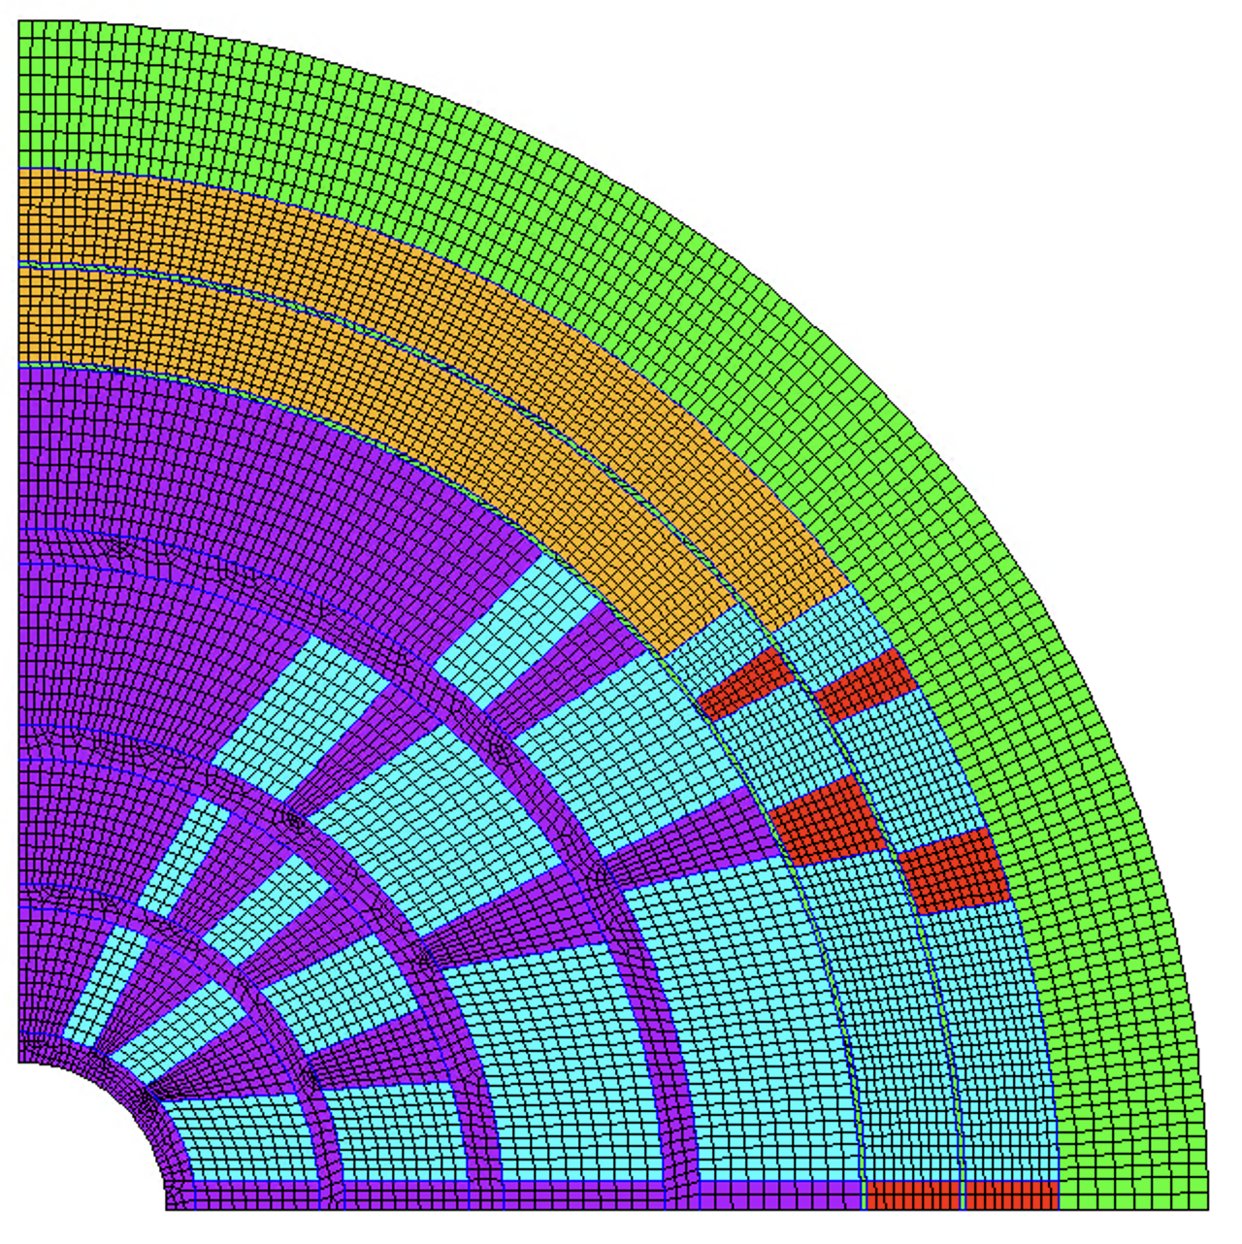
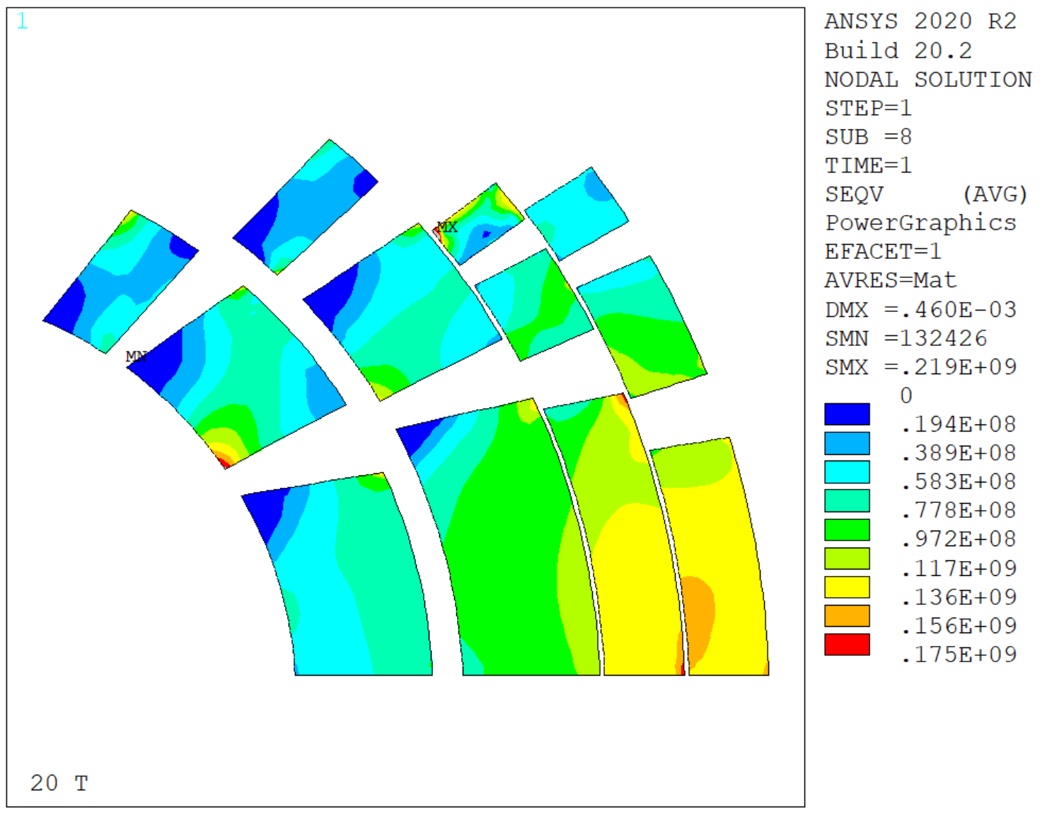
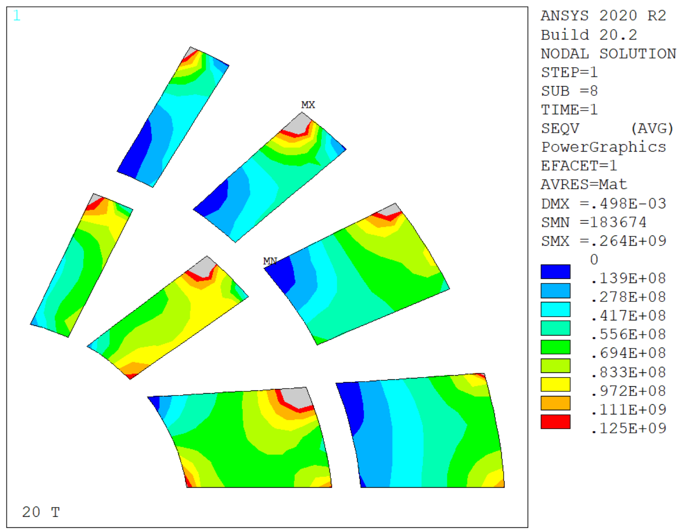
SMCT Designs – Mid-plane rib
Eqv.
Stress
Eqv.
Stress
Adding a mid-plane ‘shim/rib’
High stresses in layer 1 and 2
  The rib does not solve the issue
Layer 3 to 6 are fine

Slide 23
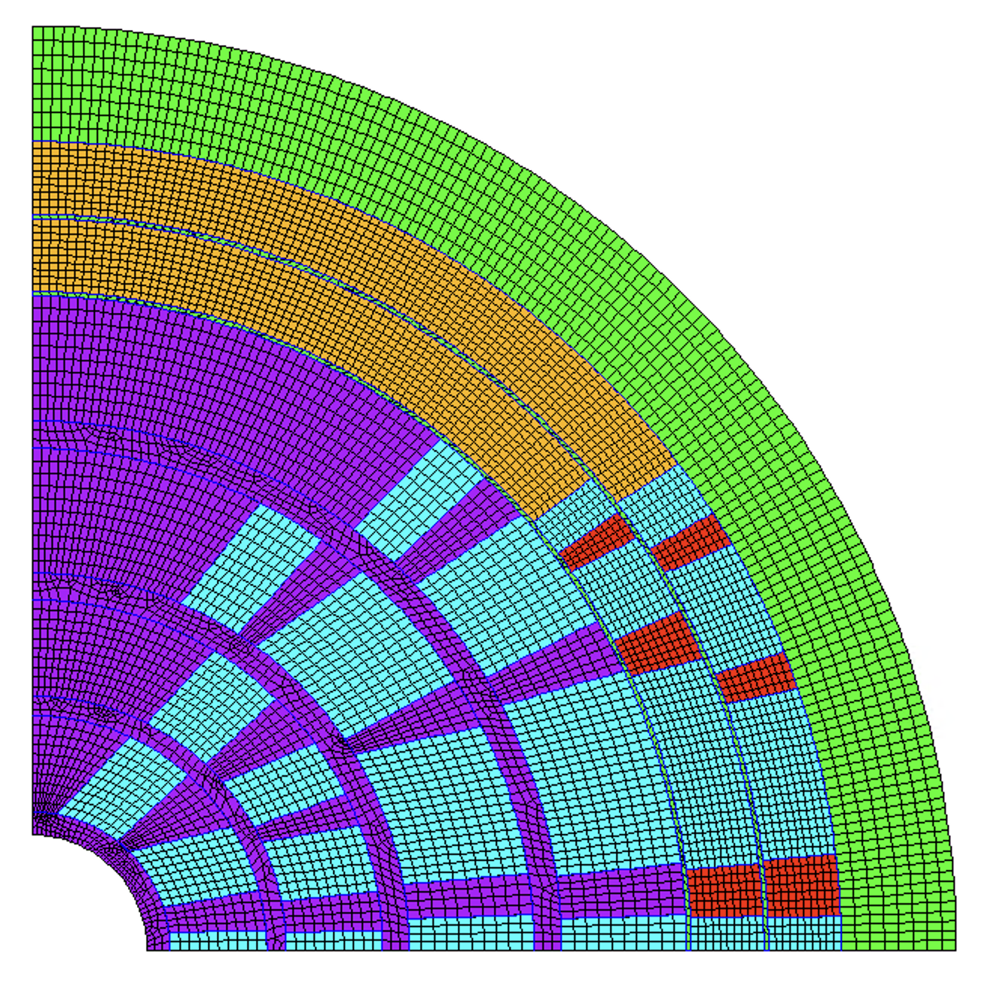
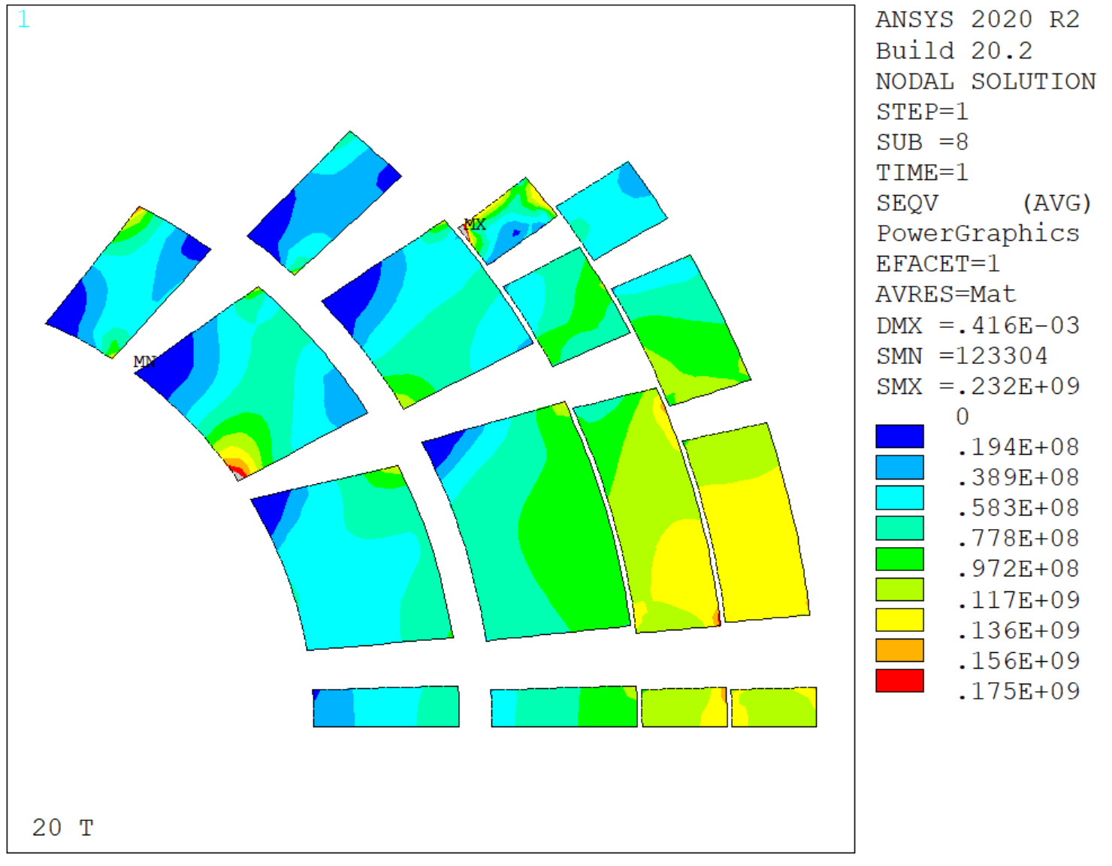
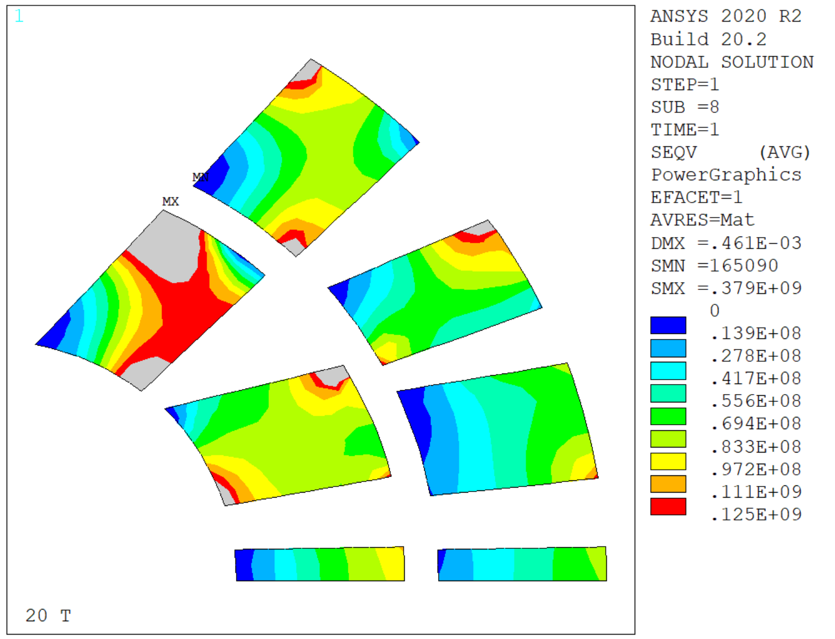
SMCT Designs – Aligned Wedges
Eqv.
Stress
Eqv.
Stress
Aligned wedges near the mid-plane
Inner coil still not working

Slide 24
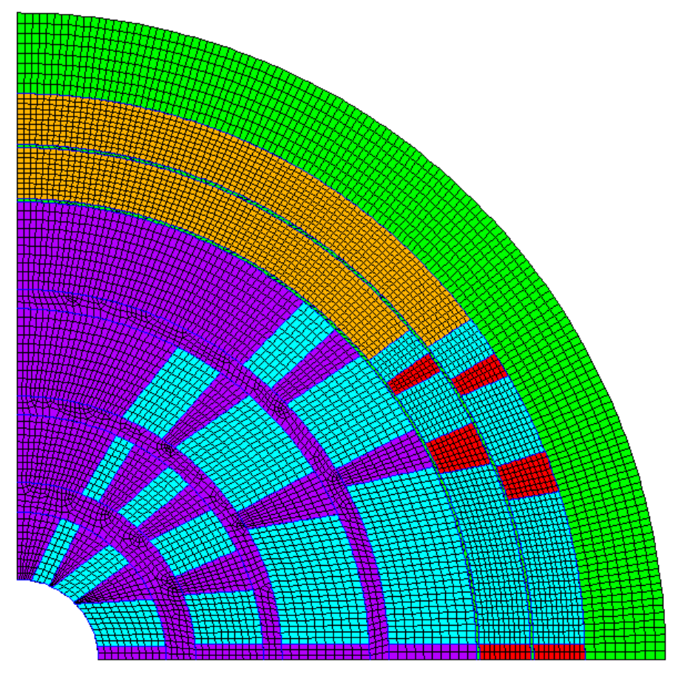
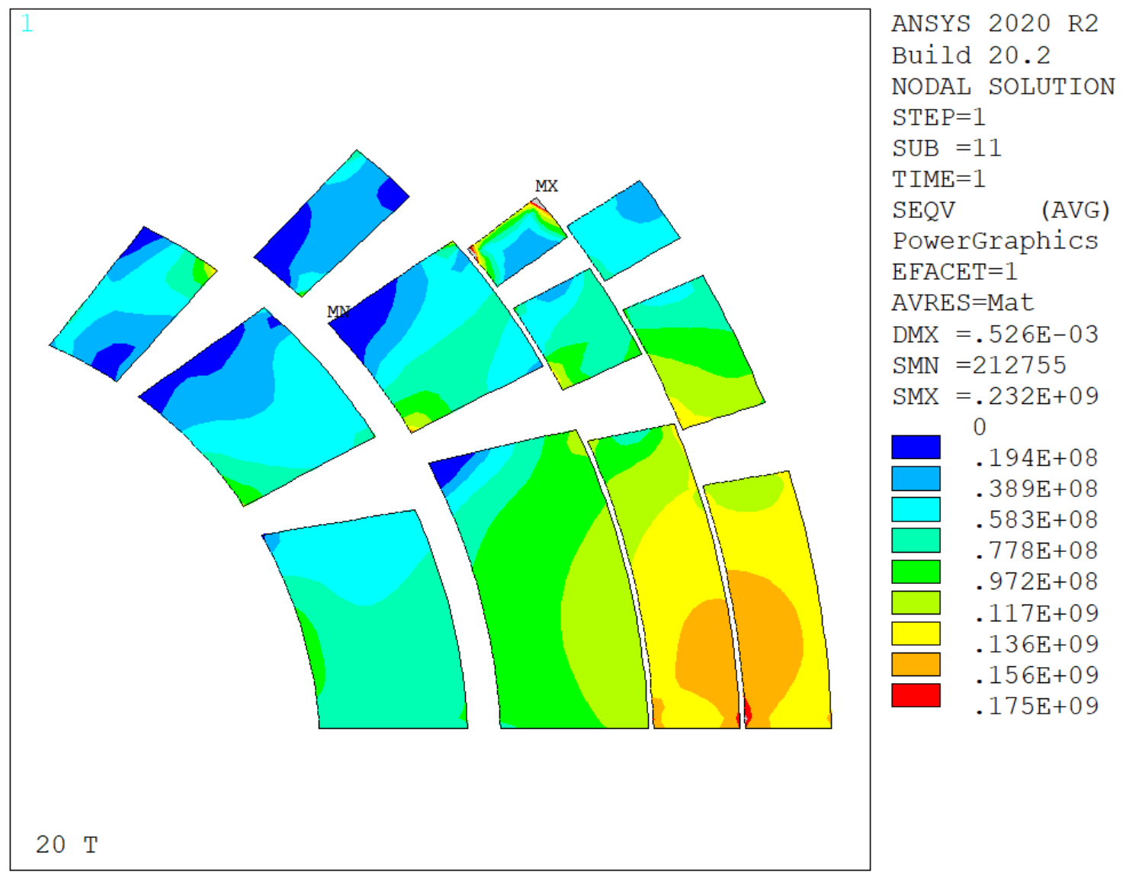
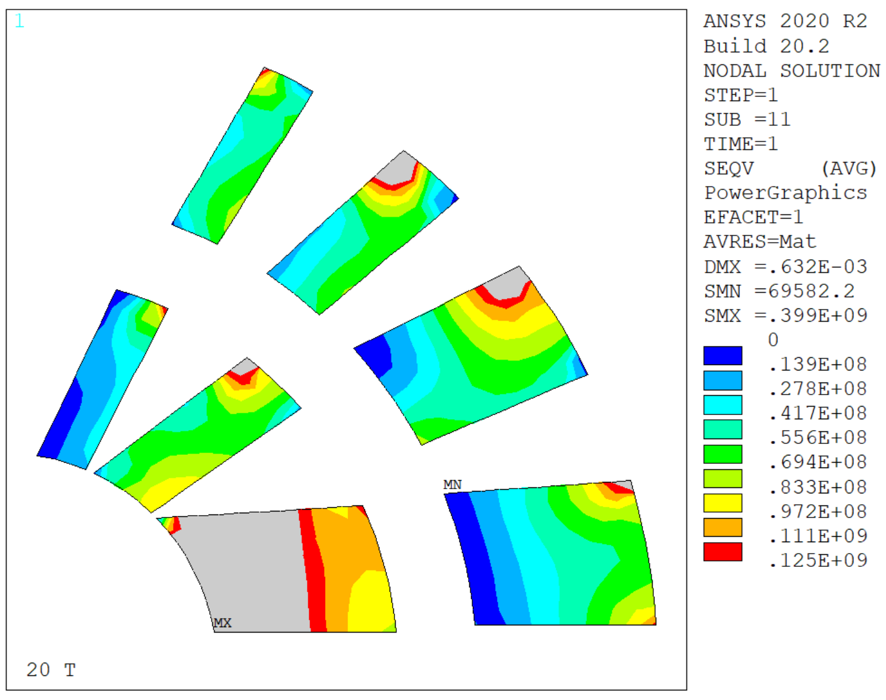
SMCT Designs – Shared Mandrel
Eqv.
Stress
New design with a shared mandrel for layer 1 and 2 (an idea by Sasha)
Stresses are worse in this configuration, but probably this is due to this particular coil design
Eqv.
Stress

Slide 25
Design Comparison
seqv.,Pa
Test
Mid Plane Rib
Aligned Ribs
None of the proposed designs solves the stress issues in the inner coil
  Probably we need more ribs in the first 2 layers
  A magneto/mechanical optimization might help
Shared Mandrel

Slide 26
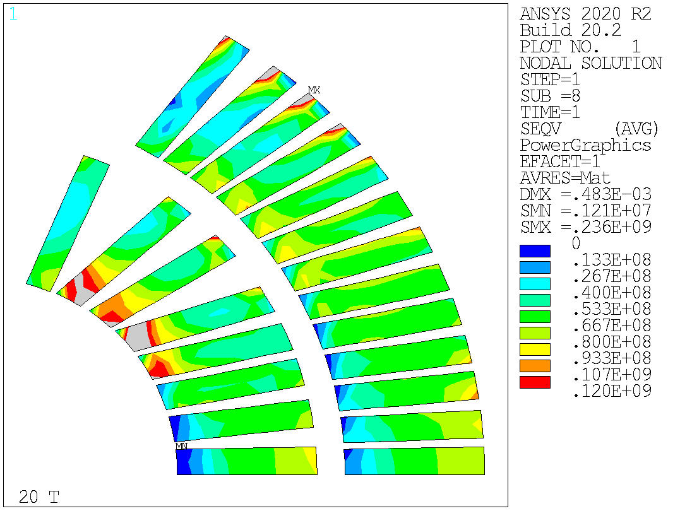
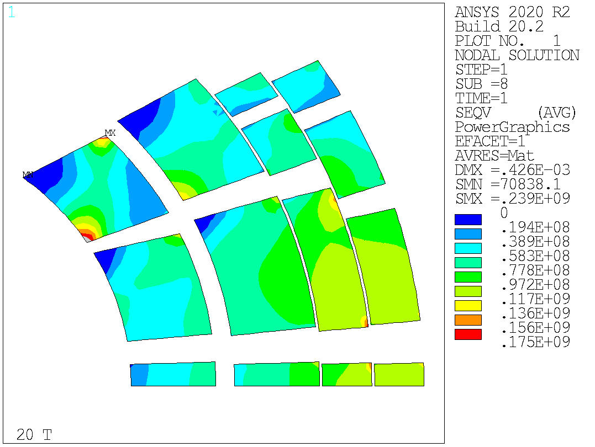
Design 19b – Equivalent Stress
HTS
LTS
Much better
  Spikes in LTS coils might be solvable
  LTS coil is not within the desired limits
    Not clear why

Slide 27
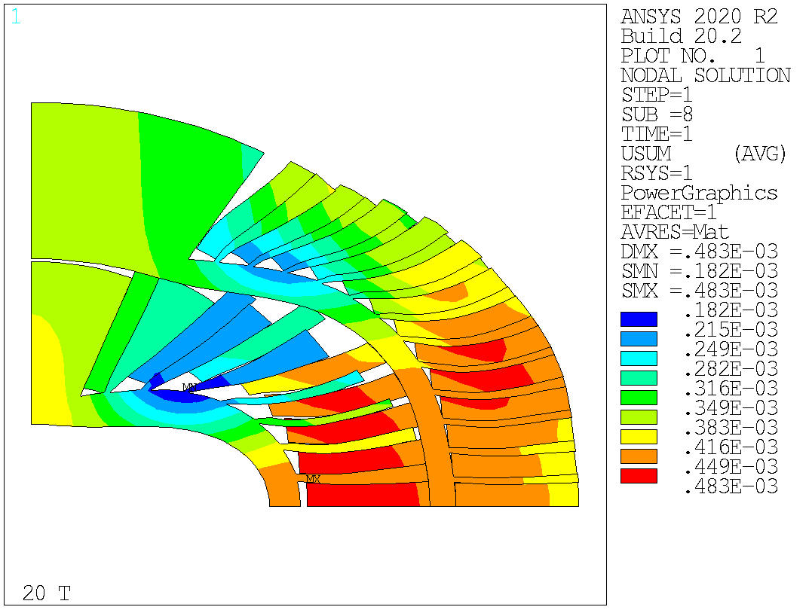
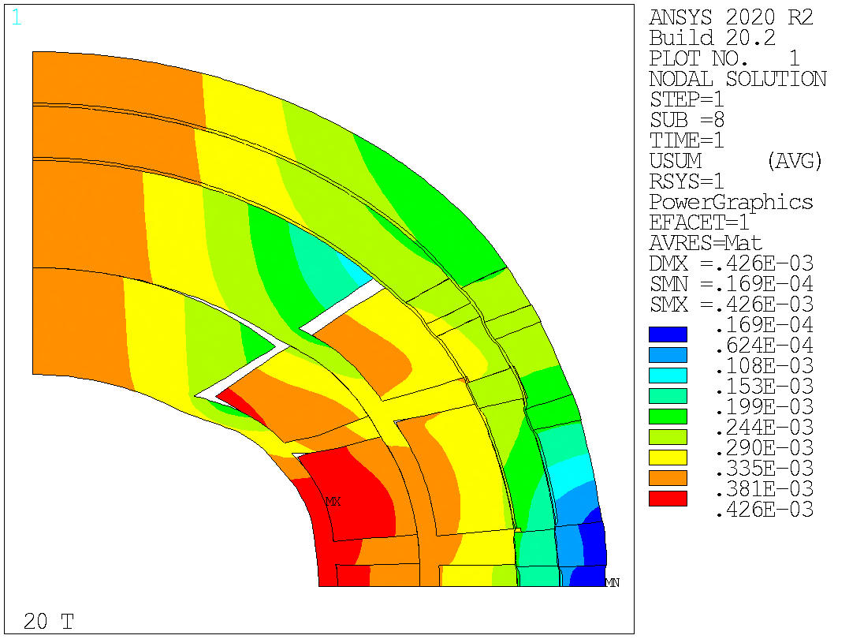
Design 19b – Total Displacement
HTS
LTS
Still not clear, to be investigated
Seems that the stress peaks are due to the larger wedges near the pole region

Slide 28
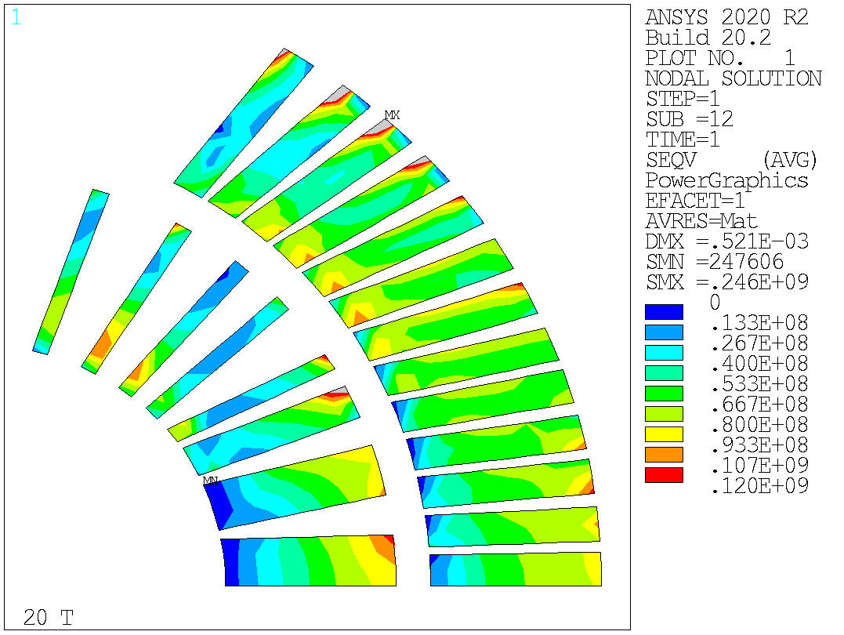
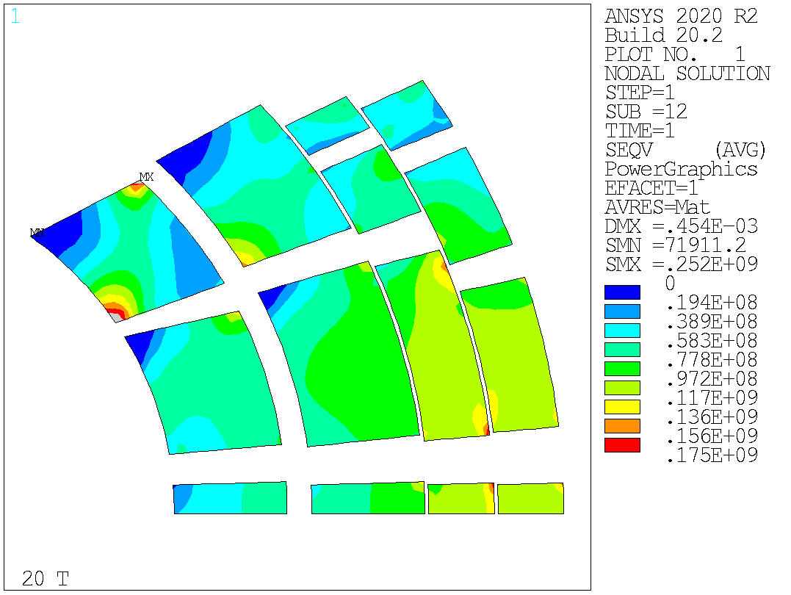
Design 21 – Equivalent Stress
HTS
LTS
Much better for the HTS coil!
  Layer 1 is almost all fine
LTS also almost fine

Slide 29
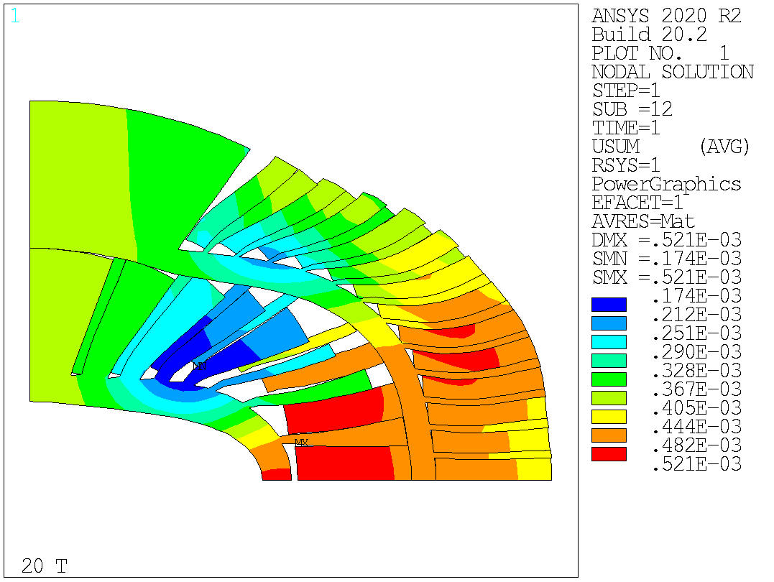
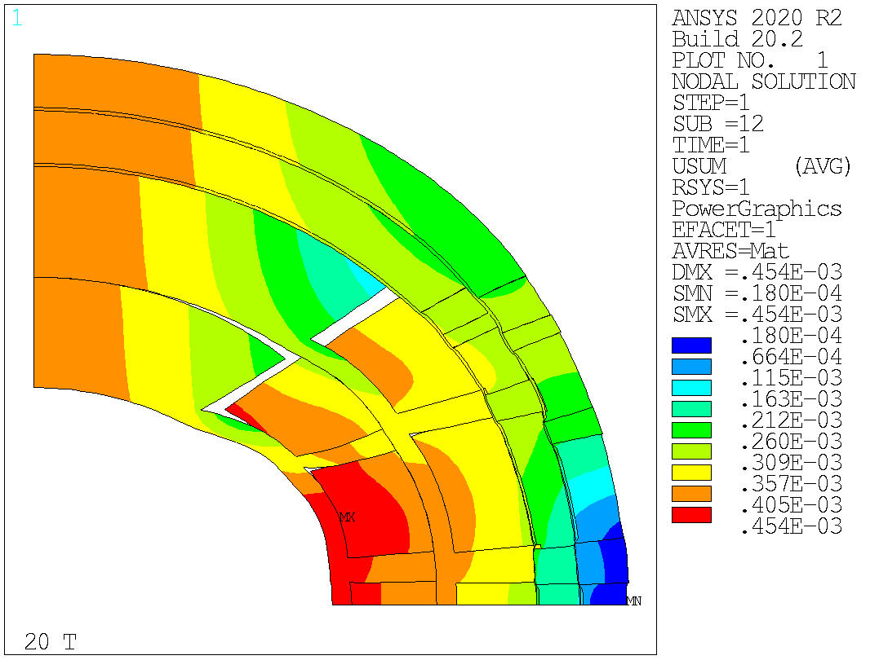
Design 21 – Total Displacement
HTS
LTS
To be discussed
Last week solution was with rigid layer 3

Slide 30
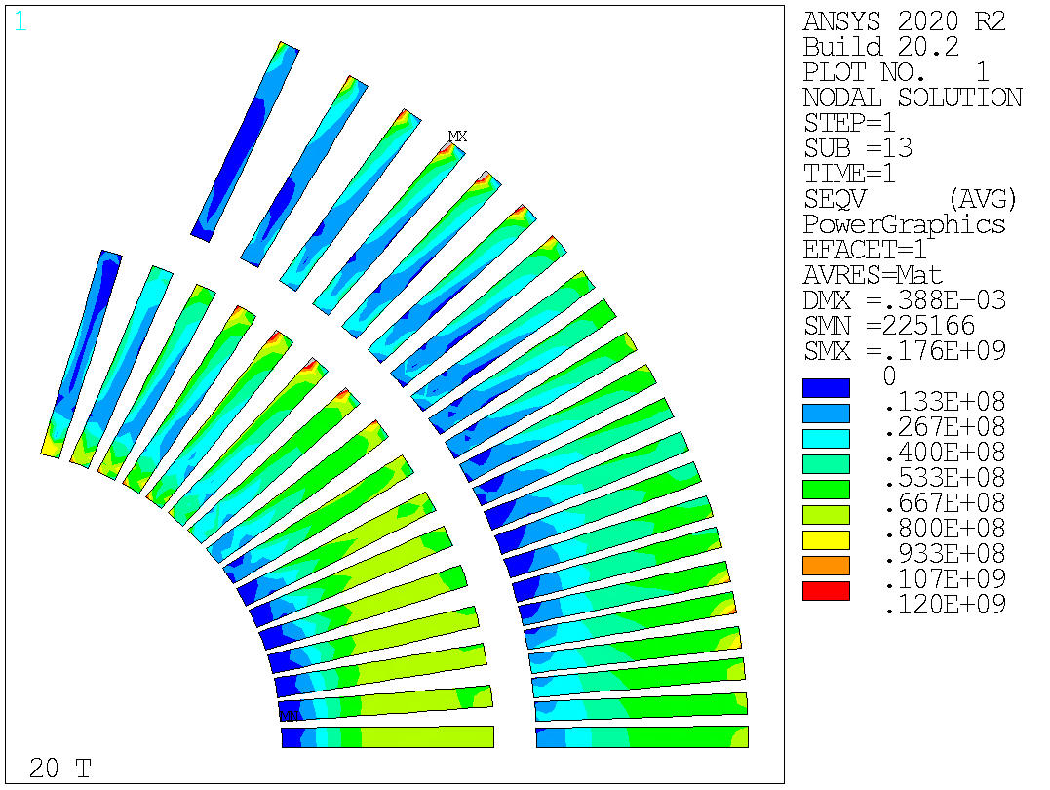
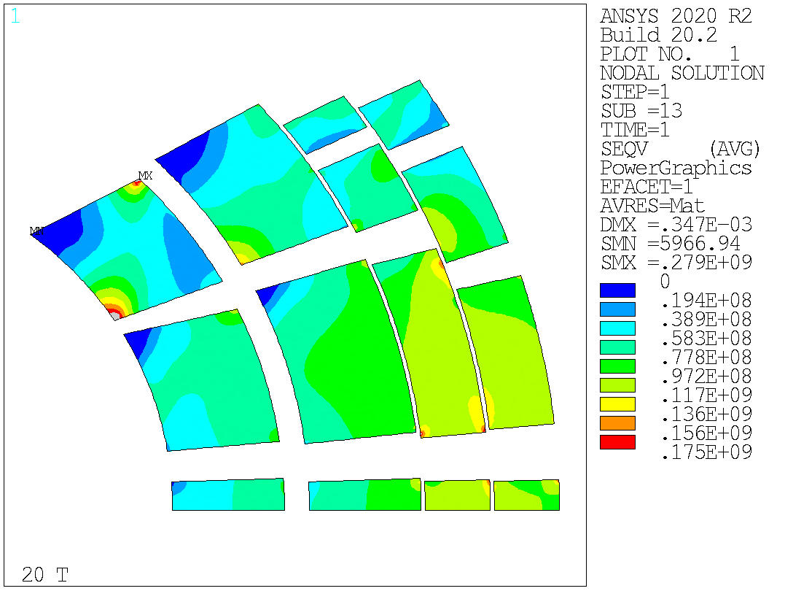
Design 22 – Equivalent Stress
HTS
LTS
Similar results in LTS layers
Smaller region where the limits are exceeded
  Peak value is lower (176 MPa vs 246 MPa), with finer mesh (contacts did not work otherwise)
We are very close

Slide 31
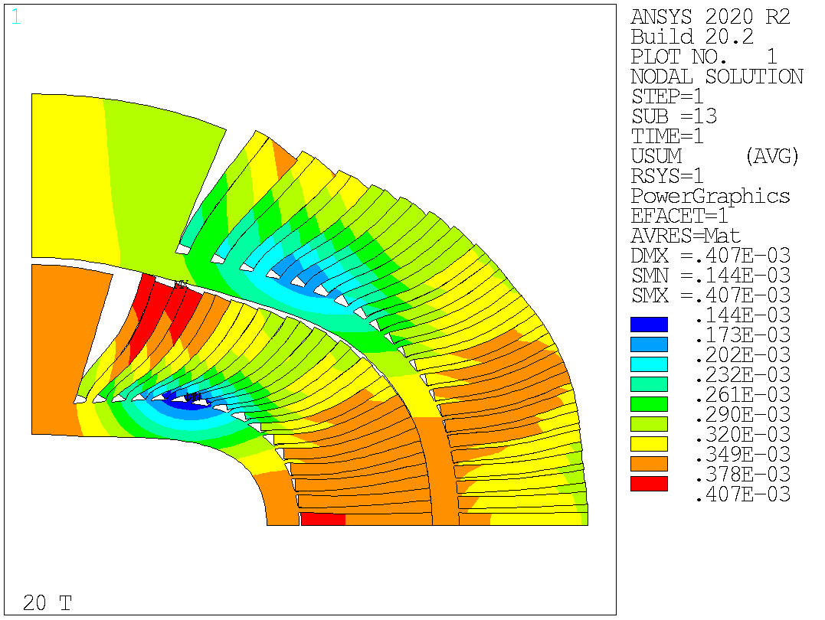
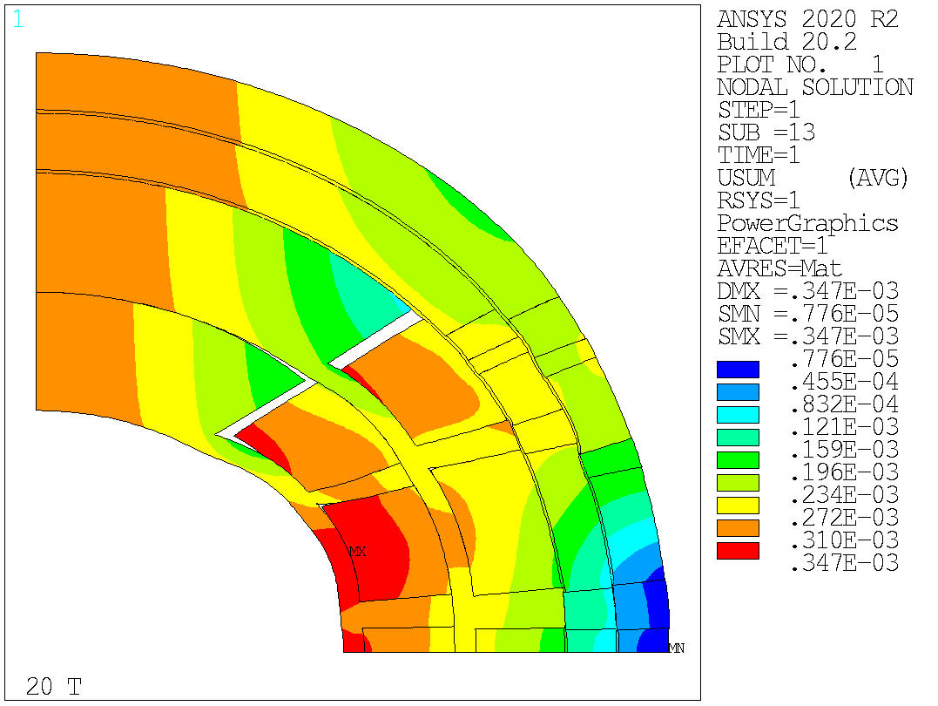
Design 22 – Total Displacement
HTS
LTS
For reference

Slide 32

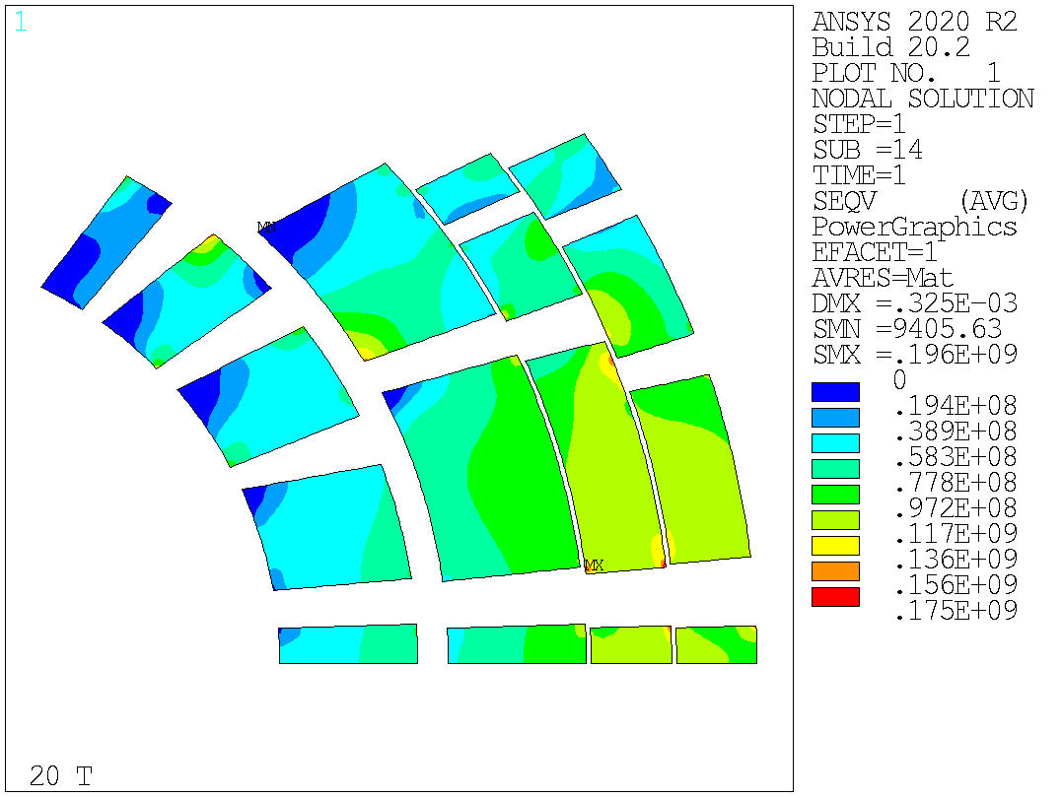
Design 23 – Equivalent Stress
HTS
LTS
Reinforced layer 3
LTS is fine
HTS still has a small region not working
  Could be fixed playing with the spar thickness? E.g. decreasing t1/t3 and increasing t2
  Might be interesting investigating it with a cable model/different material model

Slide 33
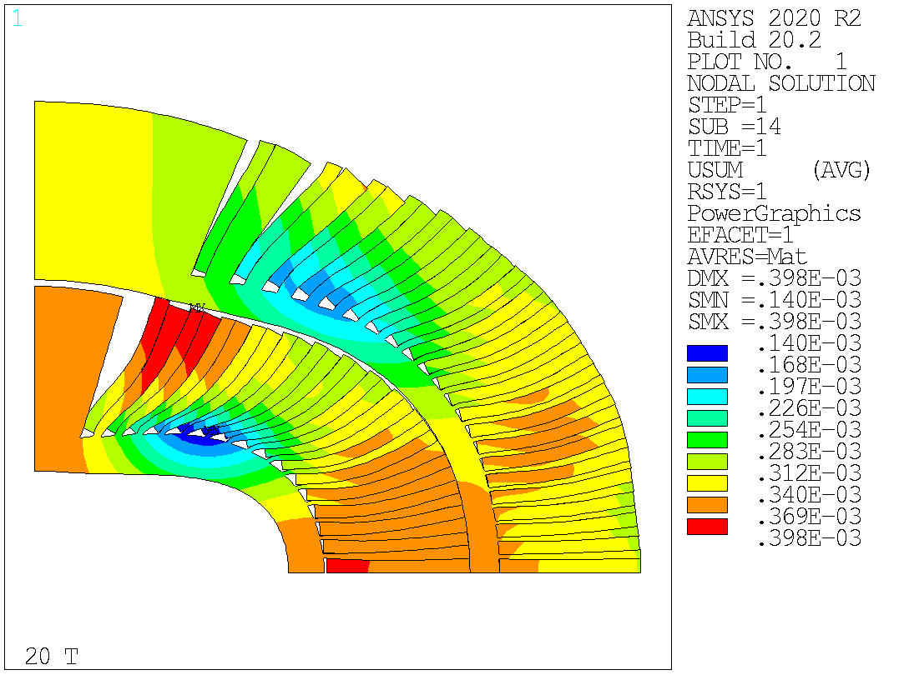
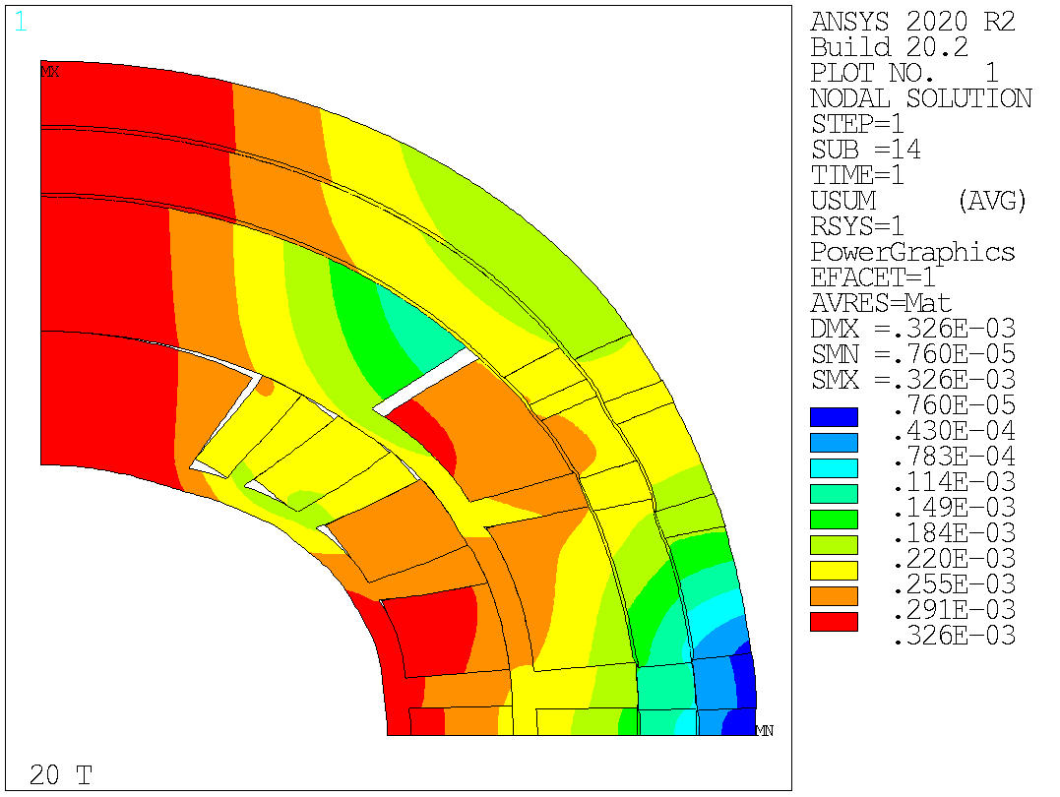
Design 23 – Total Displacement
HTS
LTS
For reference

Slide 34
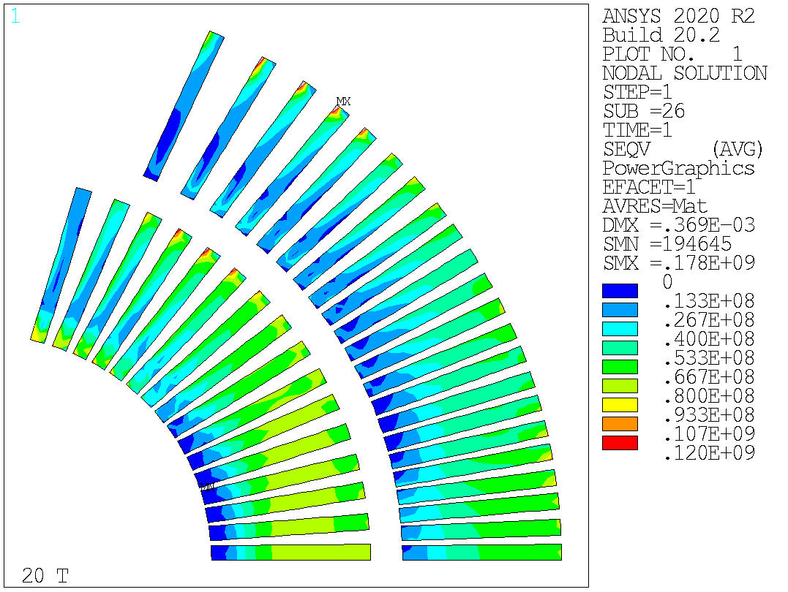
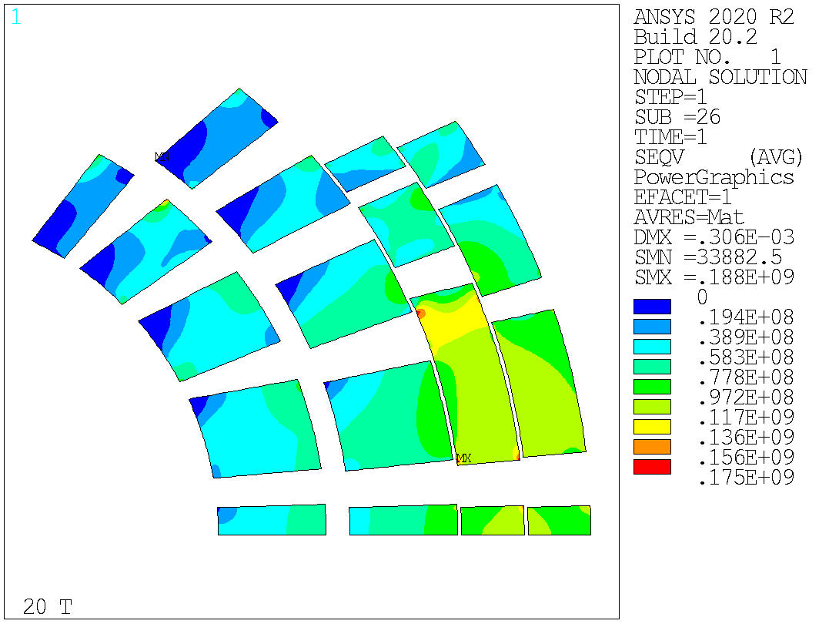
Design 24 – Equivalent Stress
HTS
LTS
Reinforced layer 4
LTS is almost fine
HTS is fine!

Slide 35
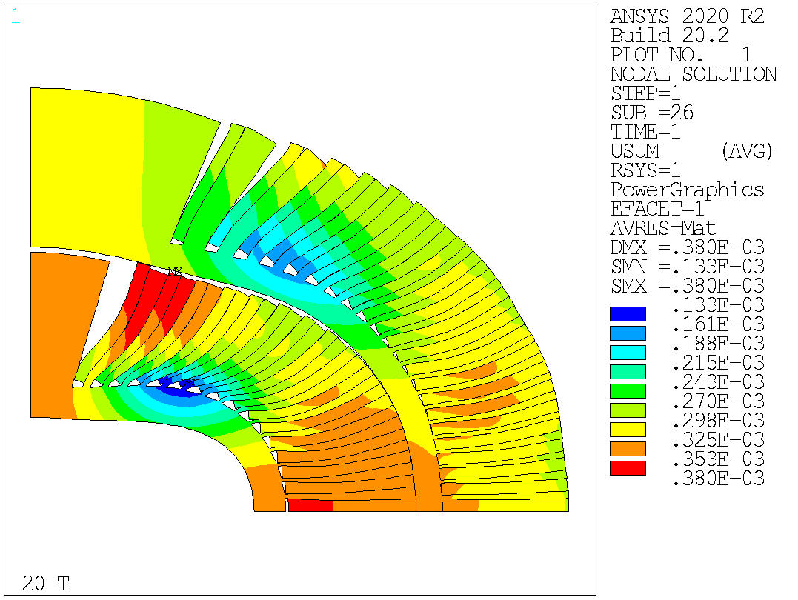
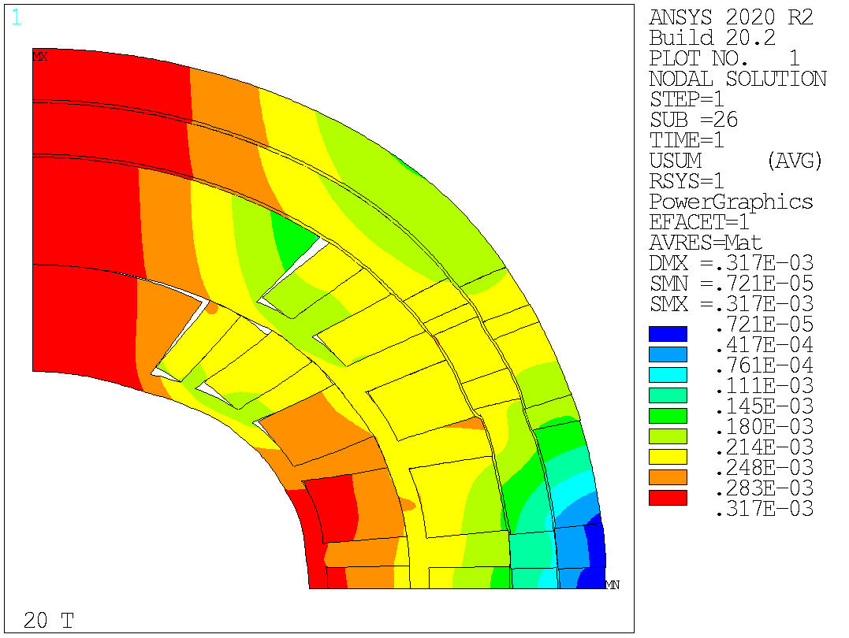
Design 23 – Total Displacement
HTS
LTS
For reference

Slide 36
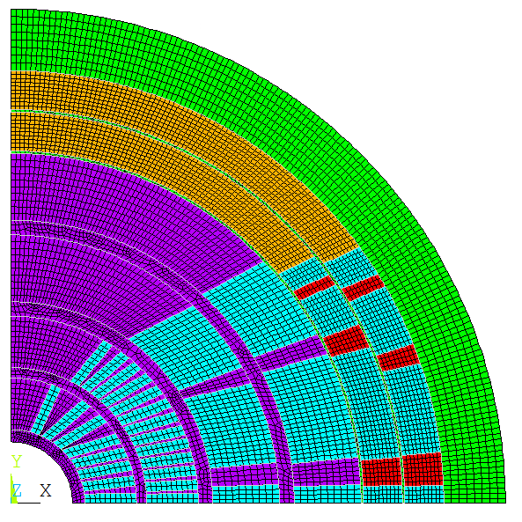
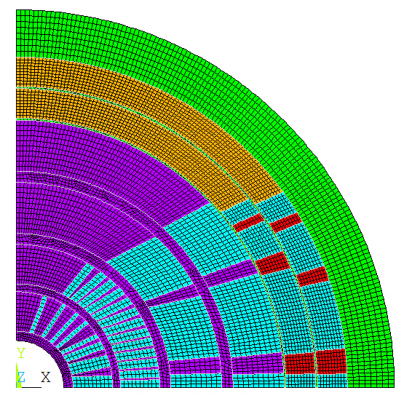
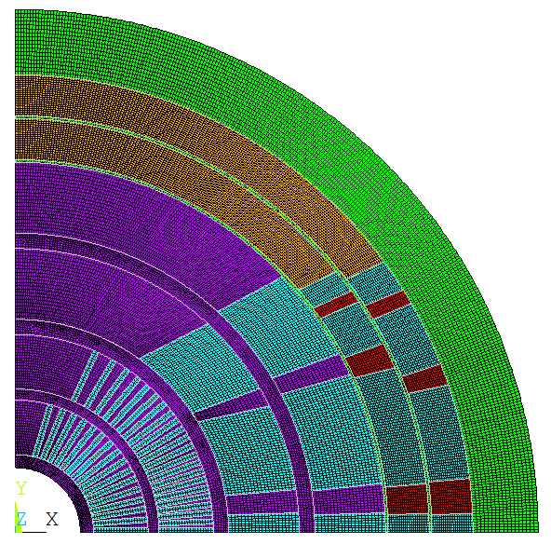
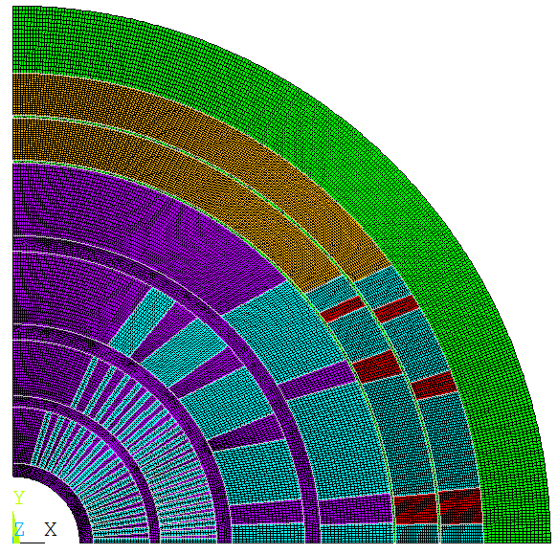
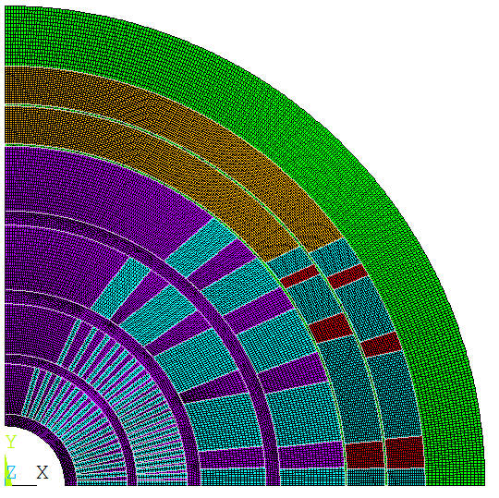
Design History
Test 1
Mid Plane Rib
Aligned Wedges
Shared Mandrel
Coil 1
2 Turns
Layer 1
3/2/1 Turns
Coil 1
CCT / 1 Turn
Layer 3
5 Blocks
Layer 3/4
5 Blocks

Slide 37
Index
Introduction
Magnetic model results
Mechanical model results
  Rigid structures and stress management
  Thick intercoil study
  SMCT Study
Conclusion

Slide 38
Conclusion
Solution with rigid intercoil shims shows that layer 2 requires stress management (both radial and azimuthal)
Solution with ‘stress-managed’ layer 2 shows that also layer 1 needs stress management
  Layer 1 sees high azimuthal stresses even when introducing thick intercoil shims
  Layer 3 is very close to the stress limits, might also need stress management
  Layers 4, 5 and 6 seem feasible also with no stress management (with a rigid structure around)
Thick steel intercoils do not provide enough stiffness to reduce the stresses in a CT design
Mixed SMCT and CT designs are being considered
  No viable solution for the moment, optimization in progress

Slide 39
Extra

Slide 40


Rigid Structure and Coil
Radial
Stress
Azimuthal
Stress
Coil modelled as linear elastic, E = 1e4 GPa
  ~226 MPa radial, 195 MPa azimuthal
  REMOVE

Slide 41


Rigid Structure, Intercepting (Rigid intercoil)
Coil modelled as linear elastic, E = 20 GPa
Intercepting structure, rigid intercoil (E=1e7 GPa)
~127 MPa radial, 248 MPa azimuthal
Should try with thicker intercoil
IN EXTRA / Non funziona il modello (contatti?)

Slide 42


Case 0 – Rigid Intercoil
Rigid 5 mm thick intercoil shells (locked on x=0)
Azimuthal: 163 MPa, Radial: 154 MPa
Not super promising – reality will be worse

Slide 43


Case B – Steel Shells
Intercoil shims closed at 90° (shell design)
Azimuthal: 325 MPa, Radial: 167 MPa
  Similar to open rings and more complicated to assembly / not worth considering

Slide 44


Case C – Steel Collars – Coil Impregnated
Intercoil shims closed at 90° (shell design)
Coils impregnated together
Still does not work

Slide 45

SMCT-CT hybrid: v17
2 layer HTS, 4 layer LTS
Strands: 0.9 – 1.1 – 0.8 mm, 40 – 44 – 35
Cable width: 20.65 – 26.82– 15.51 mm
Stabilizer/Superconductor: 3 – 1 – 1.2
Coil width: 158 mm
Current: 14200 A
Peak field: 20.8 – 16.26 – 13.36 T
Margin: 84.4 – 85.3 – 85.6 %
J_{cu} on LTS: 1479 A/mm²

Slide 46

SMCT-CT hybrid: v18
2 layer HTS, 4 layer LTS
Strands: 0.9 – 1.1 – 0.8 mm, 40 – 44 – 35
Cable width: 20.65 – 26.82– 15.51 mm
Stabilizer/Superconductor: 3 – 1 – 1.2
Coil width: 158 mm
Current: 14200 A
Peak field: 21.2 – 16.23 – 13.09 T
Margin: 84.9 – 85.2 – 84.3 %
J_{cu} on LTS: 1479 A/mm²

