Slide 1


Early Days at RHIC: The PHENIX Perspective
Hard scattering
“external” probes
Plasma dynamics
(soft) particles
Internal probes
vacuum
QGP
hadrons
leading
particle
q
q
Medium effects
Charmonia, γ
hadrons
leading particle
Barbara Jacak, UCB & LBNL
December 9, 2022

Slide 2
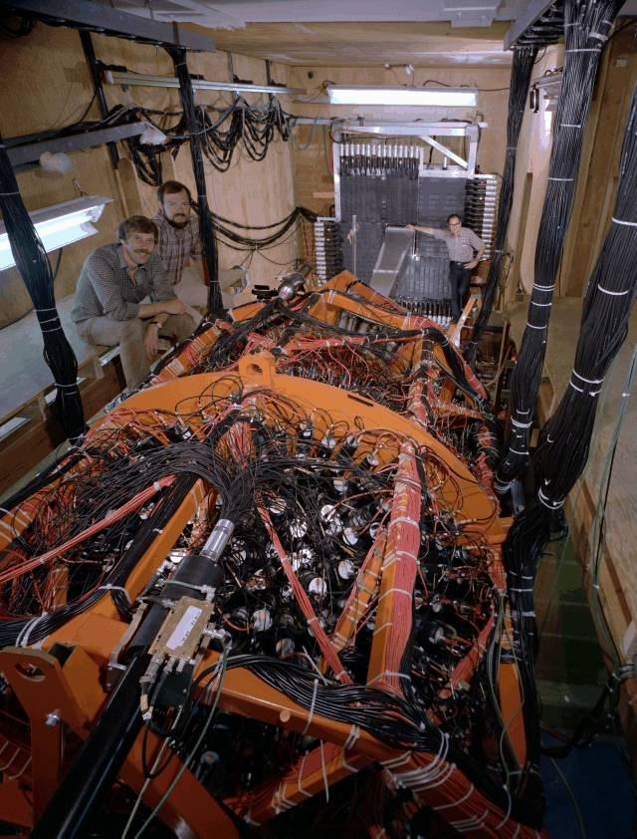
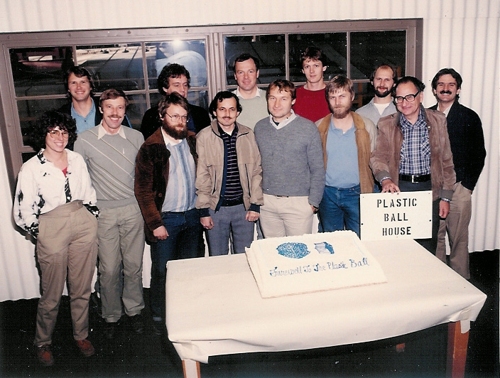
My very early days with Art
Barbara’s post Ph.D. dream:
Do a Bevalac experiment with the Plastic Ball
-> discuss with Art & he made it happen!

Slide 3
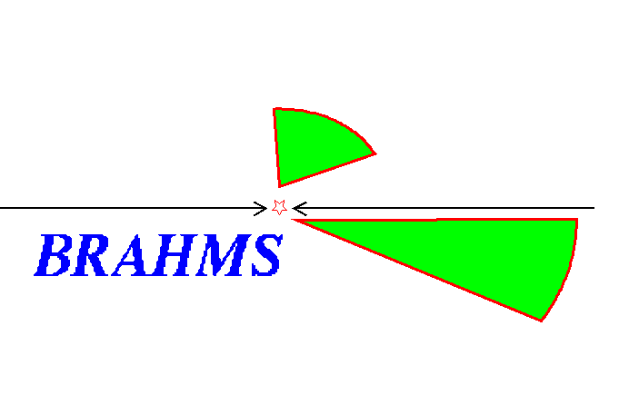
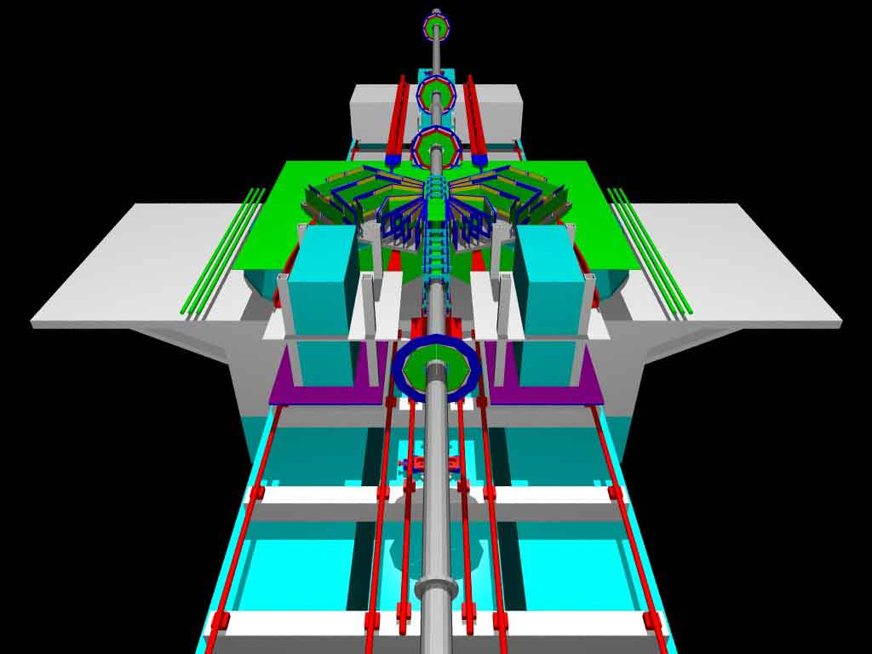

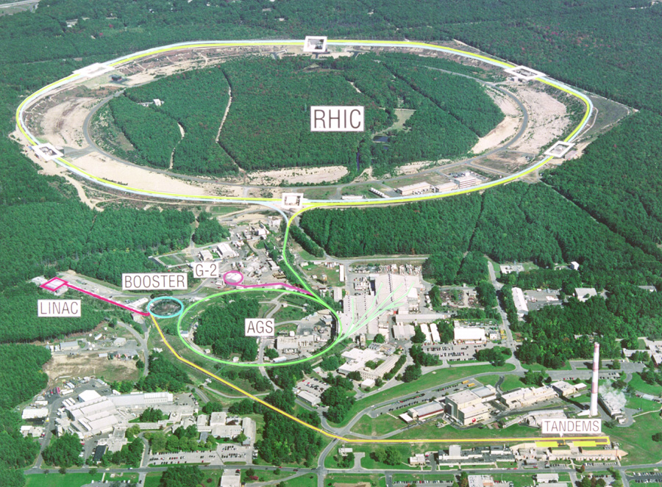
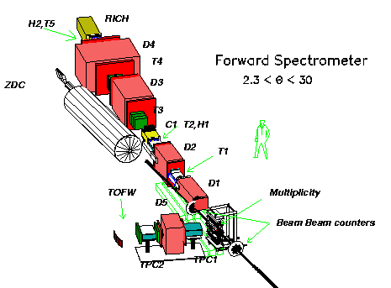
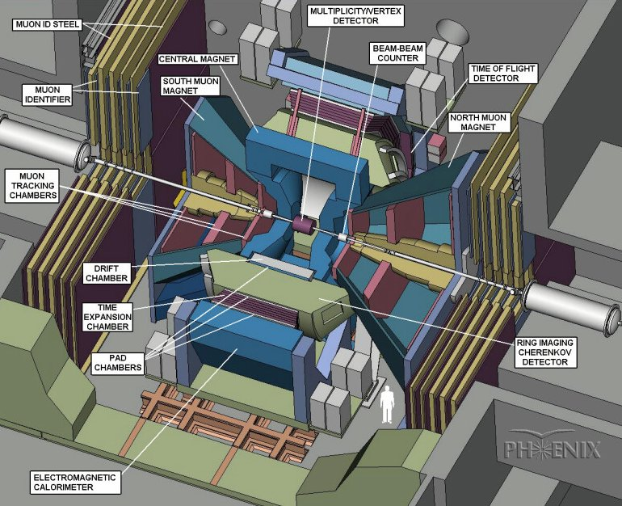
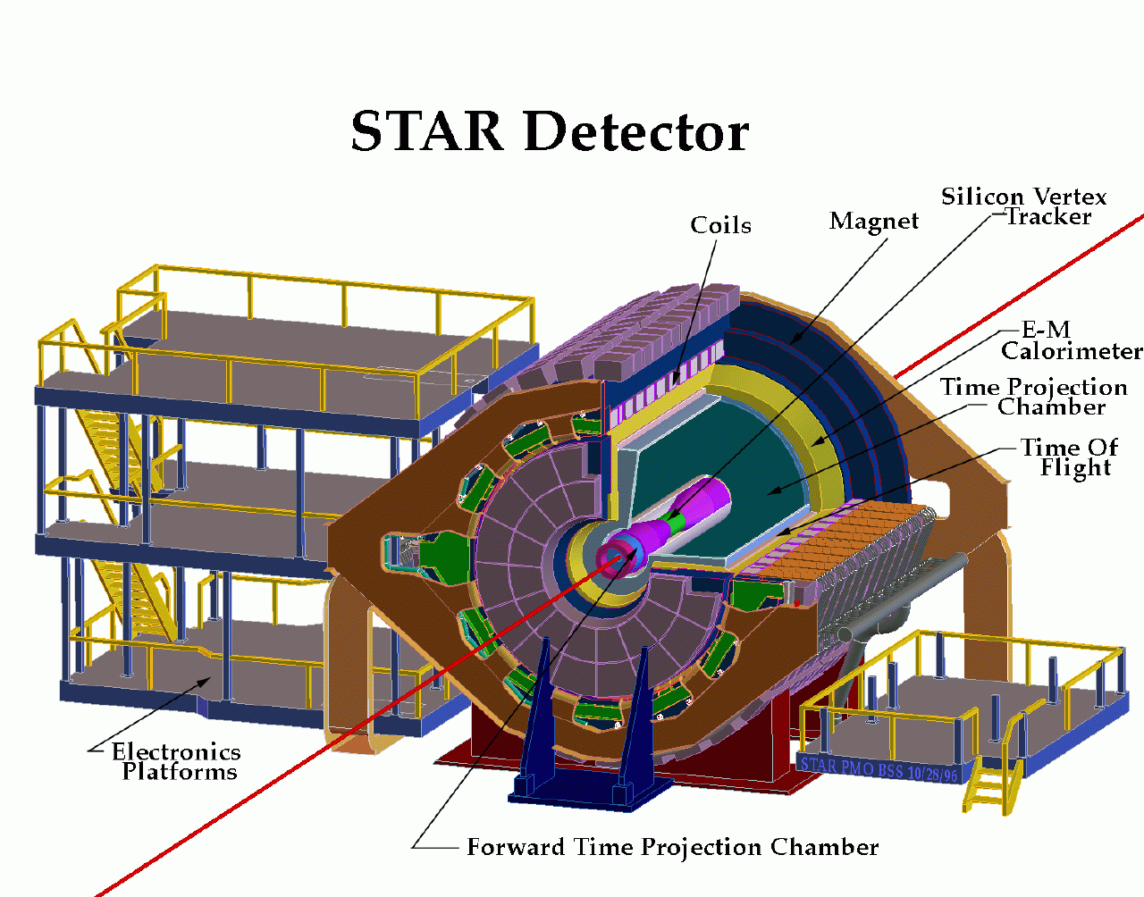

The 4 RHIC experiments
STAR

Slide 4
Detectors initially complementary
STAR: high acceptance, measure ~ all hadrons
PHENIX: high rate, measure EM probes
PHOBOS: small spectrometer to track particles in rare, unusual events
BRAHMS: small acceptance spectrometer, measure forward
Increasing overlap in approach & capabilities with time

Slide 5
What we said in 2001
BRAHMS: spectrometer pair with PID
  scan longitudinal velocities
PHENIX: leptons and photons to probe early time without subsequent strong interactions
PHOBOS: count all charged particles, sample low momentum particles to search for fluctuations and large distance phenomena
STAR: large acceptance for hadrons to study particle production and event-by-event fluctuations

Slide 6
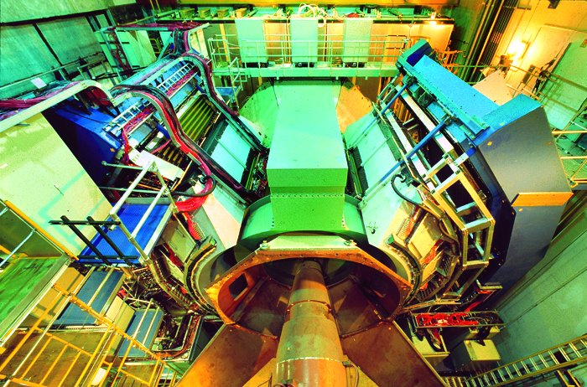
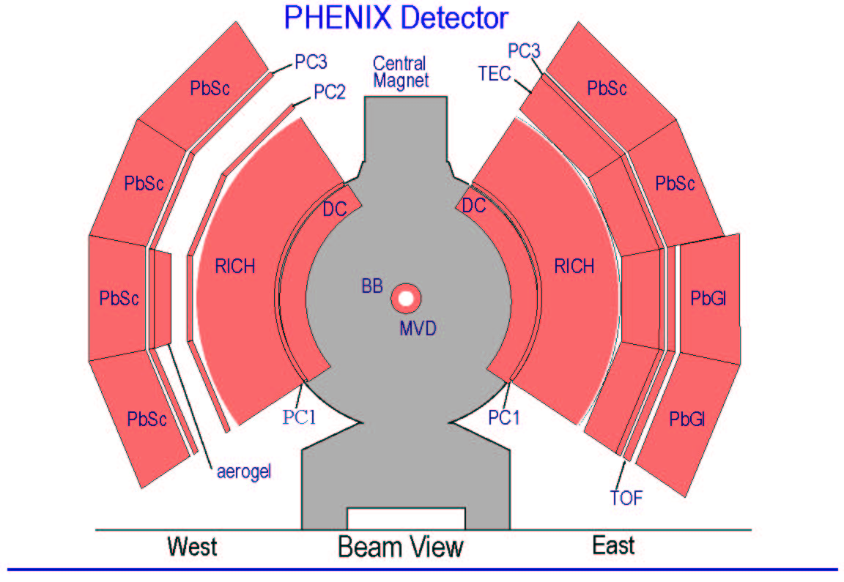
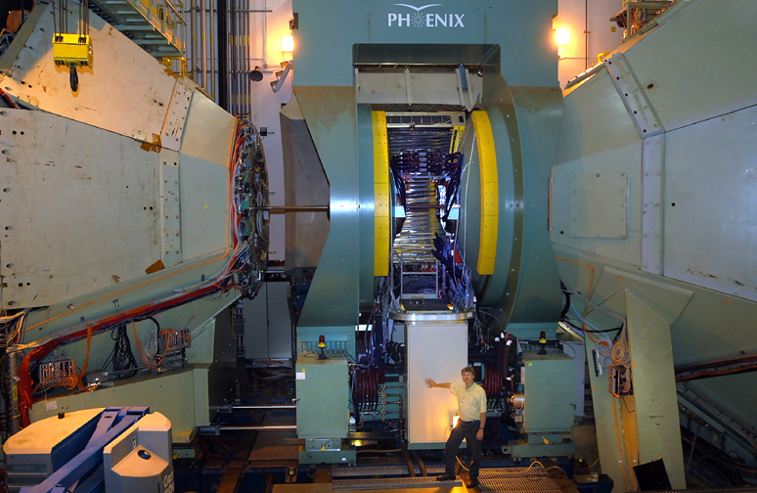
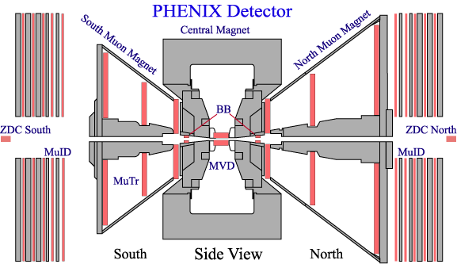
The PHENIX Detector
  Detector Redundancy
  Fine Granularity, Mass Resolution
  High Data Rate
  Good Particle ID
  Limited Acceptance
γ, e, μ, identified h
Charged Particle Tracking:
  Drift Chamber
  Pad Chamber
  Time Expansion Chamber/TRD
  Cathode Strip Chambers(Mu Tracking)
Particle ID:
  Time of Flight
  Ring Imaging Cerenkov Counter
  TEC/TRD
  Muon ID (PDT’s)
  Aerogel Cerenkov Counter
High Resolution EM Calorimetry:
  Pb Scintillator
  Pb Glass
Event Characterization:
  Multiplicity Vertex Detector (Si Strip,Pad)
  Beam-Beam Counter
  Zero Degree Calorimeter/Shower Max Detector
  Forward Calorimeter
SMD/
FCAL
FCAL
Slide from Bill Zajc

Slide 7
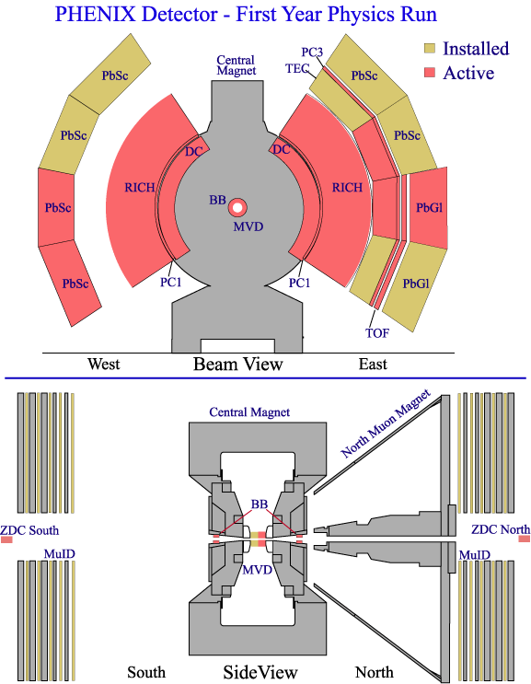
PHENIX Run-1 Configuration (2000)
Two central arms
  Mechanically
  ~complete
  Roughly half of aperture instrumented
Global detectors
  Zero-degree Calorimeters (ZDCs)
  Beam-Beam Counters (BBCs)
  Multiplicity and Vertex Detector
  (MVD, engineering run)
Slide from Bill Zajc

Slide 8
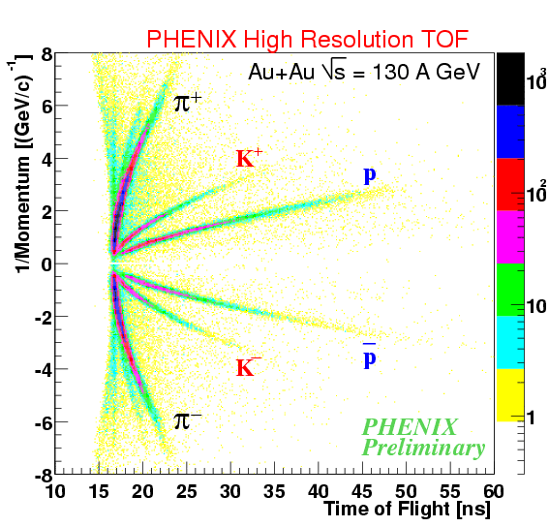
First data from PHENIX
We started with partial detector, readout, trigger
Used our tracking system in one central rapidity arm to measure charged particles
  Count them & measure the spectra
Used our EM calorimeter to measure photons and reconstruct π⁰ (also E_{T})
Used our TOF
  identify the hadrons
Used our RICH + EMcal to
  measure electrons
Yes, we checked for consistency…

Slide 9

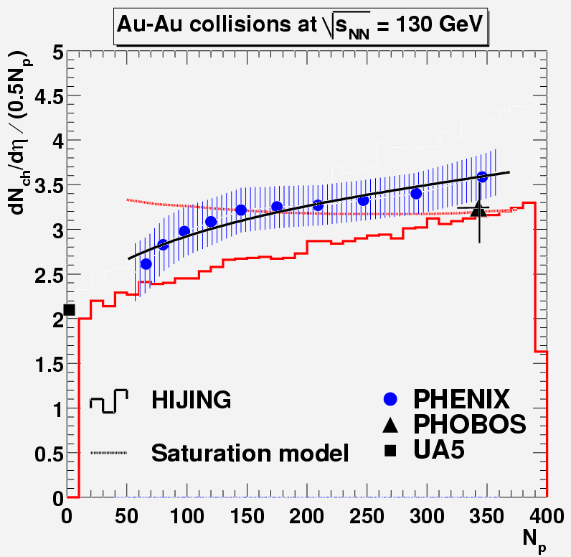

Early result: Centrality dependence of N_{ch}
dN/dη / .5N_{part}
PHOBOS produced 1st RHIC publication – on dN/dη
Kharzeev & Nardi:
~ 40% of charged particles from hard processes (!)
Experiments:
N_{ch} alone cannot distinguish Glauber from saturation models
nucl-ex/0012008

Slide 10
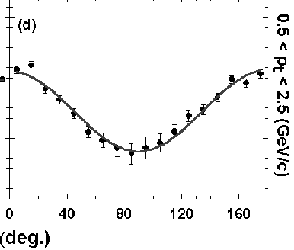
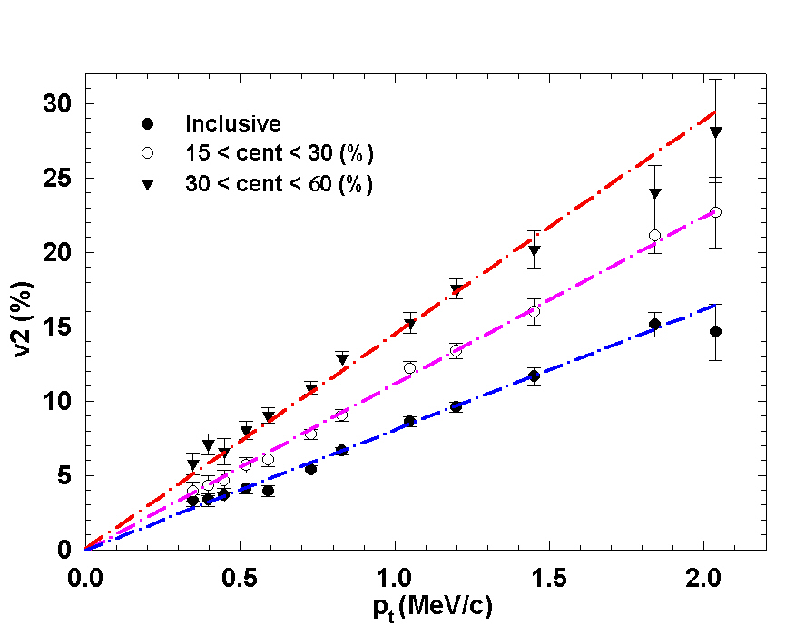
flow at PHENIX via Δφ distributions
# of pairs
Fourier analysis -> v₂²
opening angle (degrees)
z
y
x
Use data to constrain hydrodynamics:
Find that it works IF we
include a plasma phase
with only tiny viscosity per particle (or η/S)

Slide 11
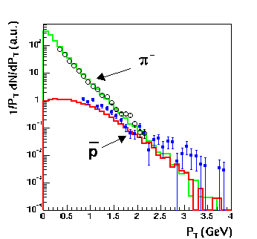
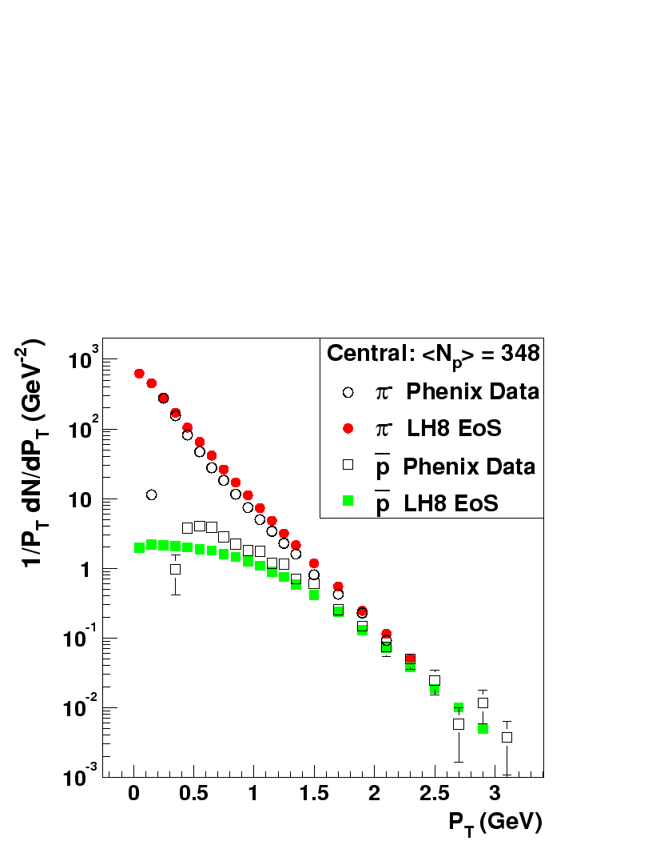
Also a transverse velocity boost
PHENIX preliminary
Curves = hydro from Derek Teaney
Agreement with data indicates presence of radial expansion
Teaney, Lauret, Shuryak
nucl-th/0110037

Slide 12
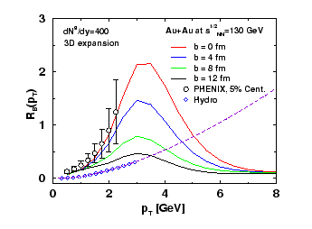
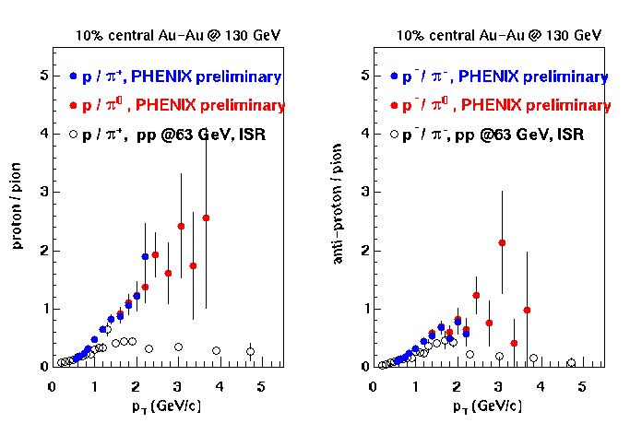
We found an excess of baryos
Radial flow boosts baryons to higher p_{T} than mesons
Jet quenching reduces π yield by ~3-5
  baryons less depleted as less likely to be leading particles in fragmenting jet
nucl-ex/0203015
Vitev & Gyulassy
Phys. Rev. C65 (2002) 041902

Slide 13
h± & π⁰ below expectation from N_{coll}
PRL 88, 022301 (2002)
1159
citations
Peripheral (60-80% of σ_{geom}):
<N binary collisions> = 20 ± 6
central (0-10%): <N bin coll> = 905 ± 96

Slide 14
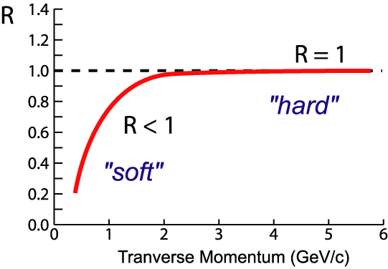
Look for jet suppression
(predicted by Wang & Gyulassy)
1. Compare Au+Au to nucleon-nucleon cross sections
2. Compare Au+Au central/peripheral
Nuclear
Modification
Factor:
nucleon-nucleon
cross section
AA
<N_{binary}>/σ_{inel}^{p+p}
AA
If no “effects”:
R_{AA} < 1 in regime of soft physics
R_{AA} = 1 at high-p_{T} where hard
scattering dominates
Suppression:
R_{AA} < 1 at high-p_{T}
AA

Slide 15
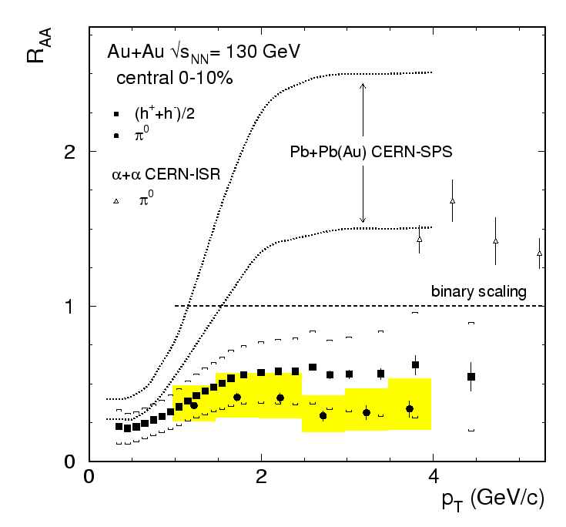
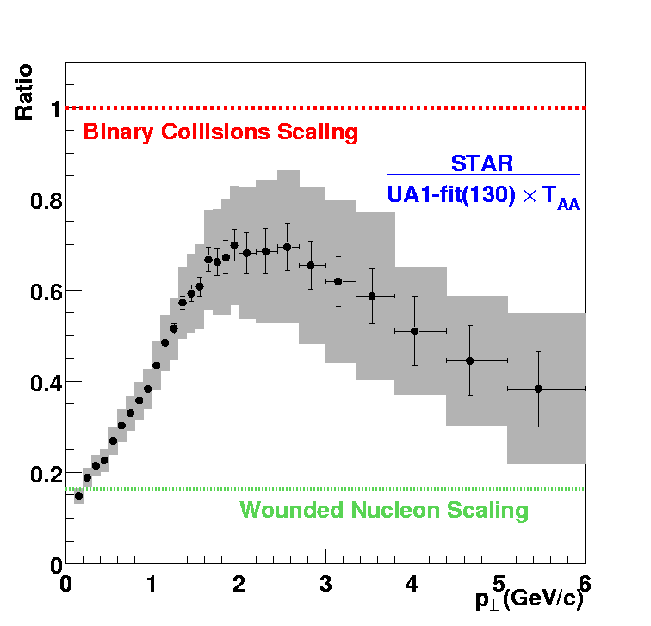
Jet suppression in 1st RHIC data!
Phys. Rev. Lett. 88, 022301 (2002)
Key discovery at RHIC!
Partonic energy loss expected in high density nuclear matter
charged
π⁰ lower
NB: h±
has baryons
Charged deficit
seen by both
PHENIX & STAR
STAR
preliminary

Slide 16
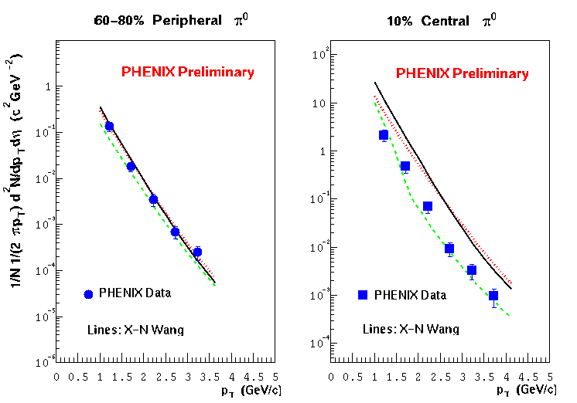
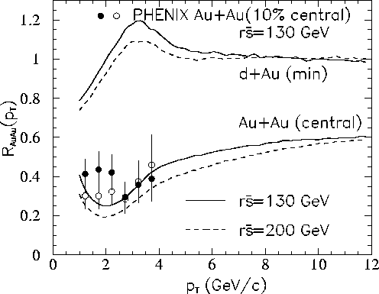
How much energy loss at RHIC?
scaled pp
energy
loss
shadowing + initial multiple scattering
We know system is not static!
including expansion:
<dE/dx> ∼7.3 GeV
for 10 GeV/c jets
X.N. Wang & E. Wang,
hep-ph/0202105

Slide 17
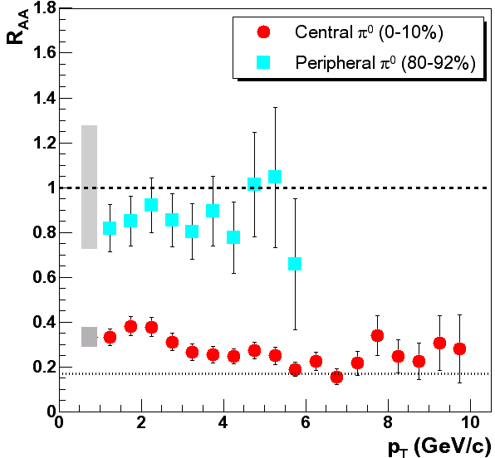
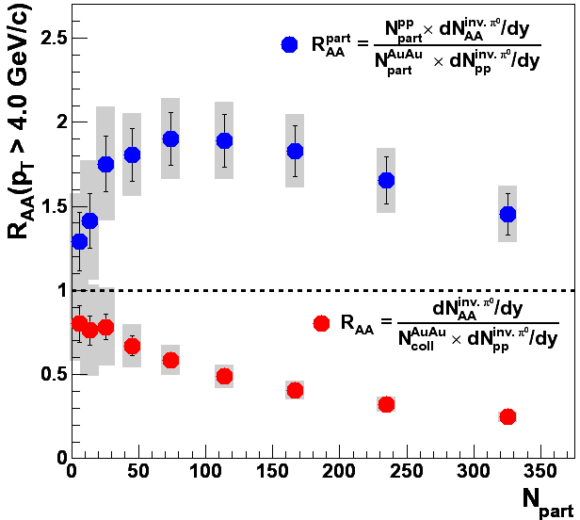
Au-Au √s = 200 GeV: higher p_{T} suppression
PRL91, 072301(2003)

Slide 18
To be sure – turn off the QGP*
* Make sure there is no significant volume

Slide 19
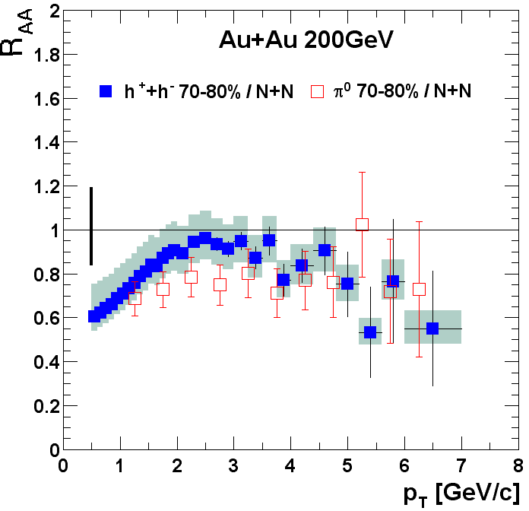
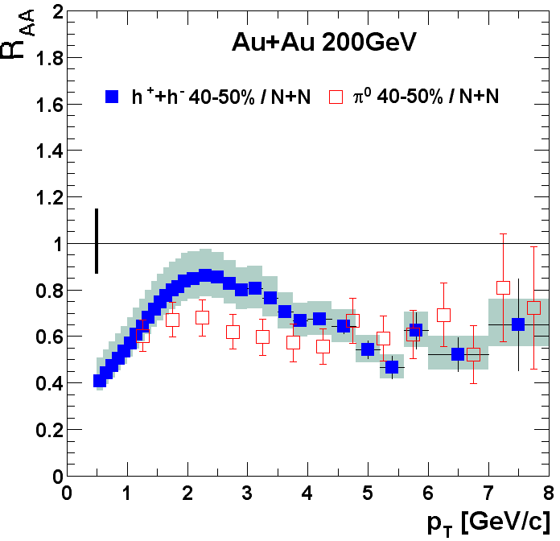
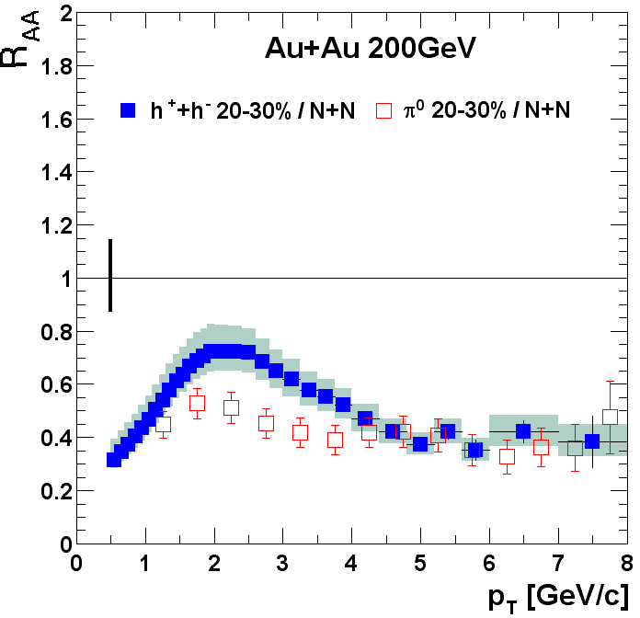
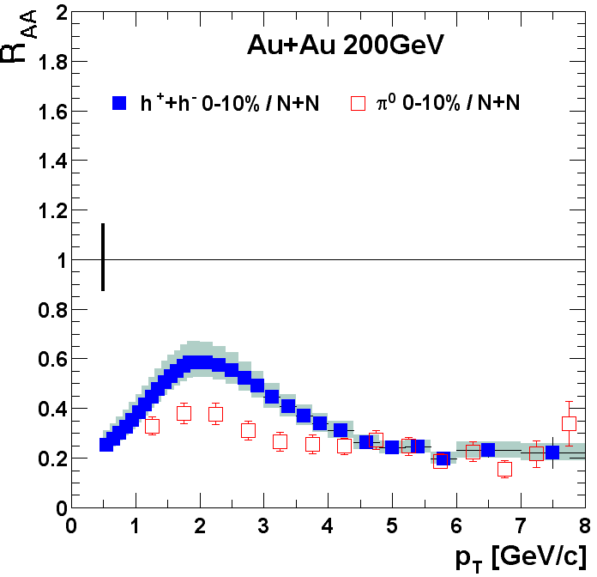
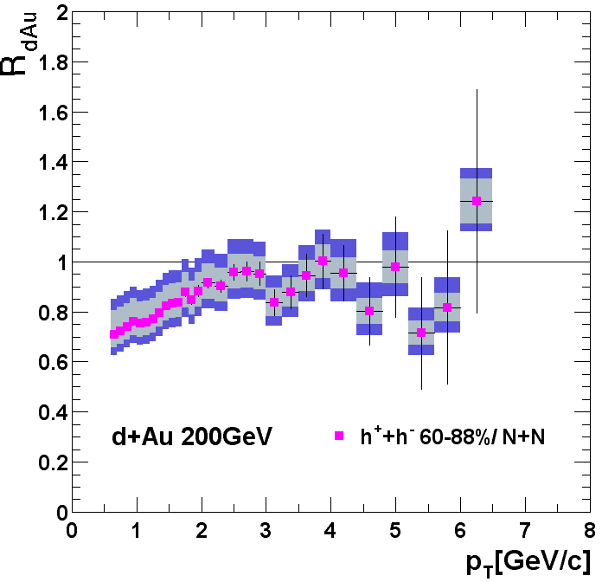
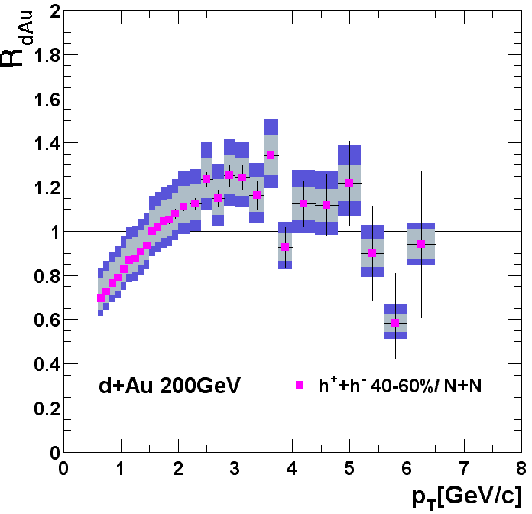
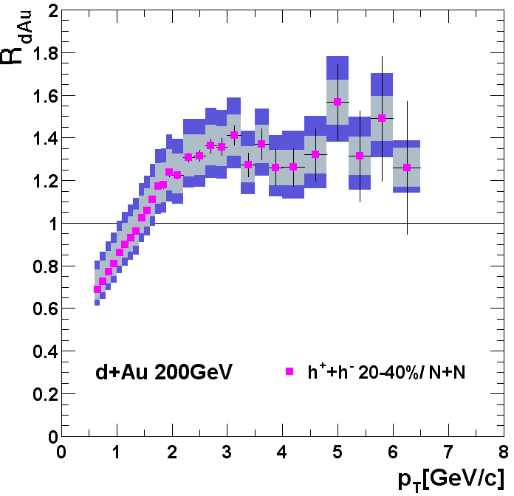
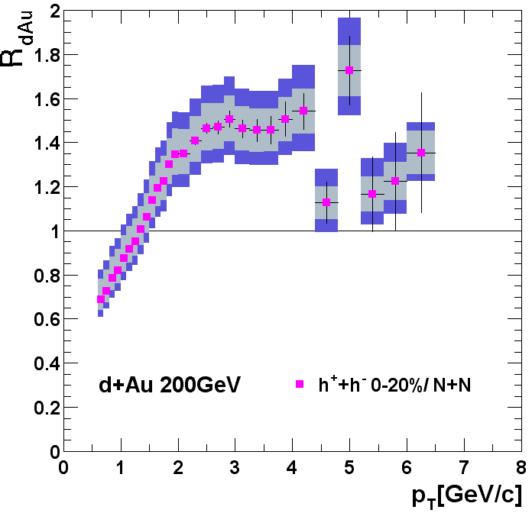
Cold nucleus provided a control
Au + Au Experiment
d + Au Control
PHENIX
preliminary
Dramatically different and opposite centrality evolution of AuAu experiment from dAu control
Jet suppression is clearly a dense medium effect

Slide 20
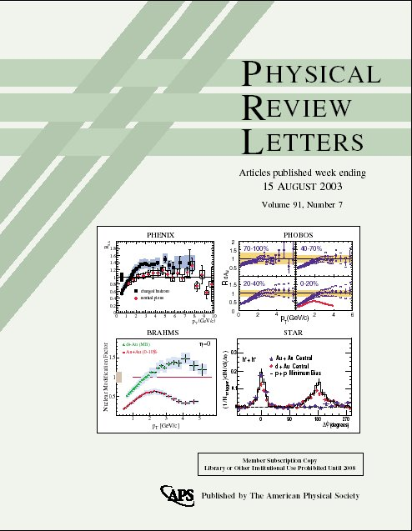
d+Au key to jet quenching discovery
Note d+Au data from all four experiments published at once!
Not “the cover of the Rolling Stone”…
But better!

Slide 21
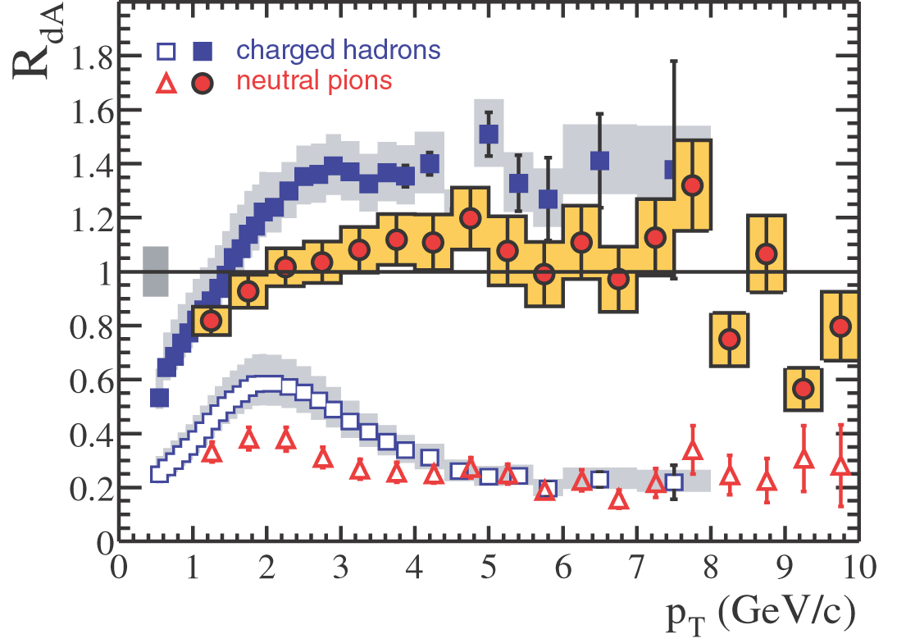
Charged hadrons & π⁰
Phys.Rev.Lett. 91 (2003) 072303
602 citations

Slide 22
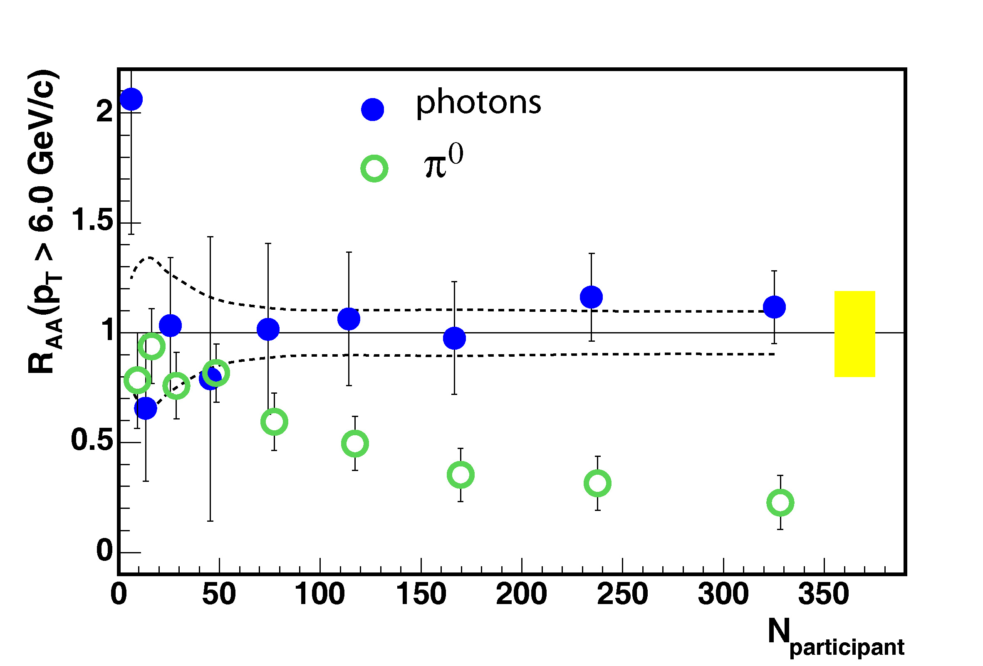

Photon yield confirms N_{coll}

Slide 23
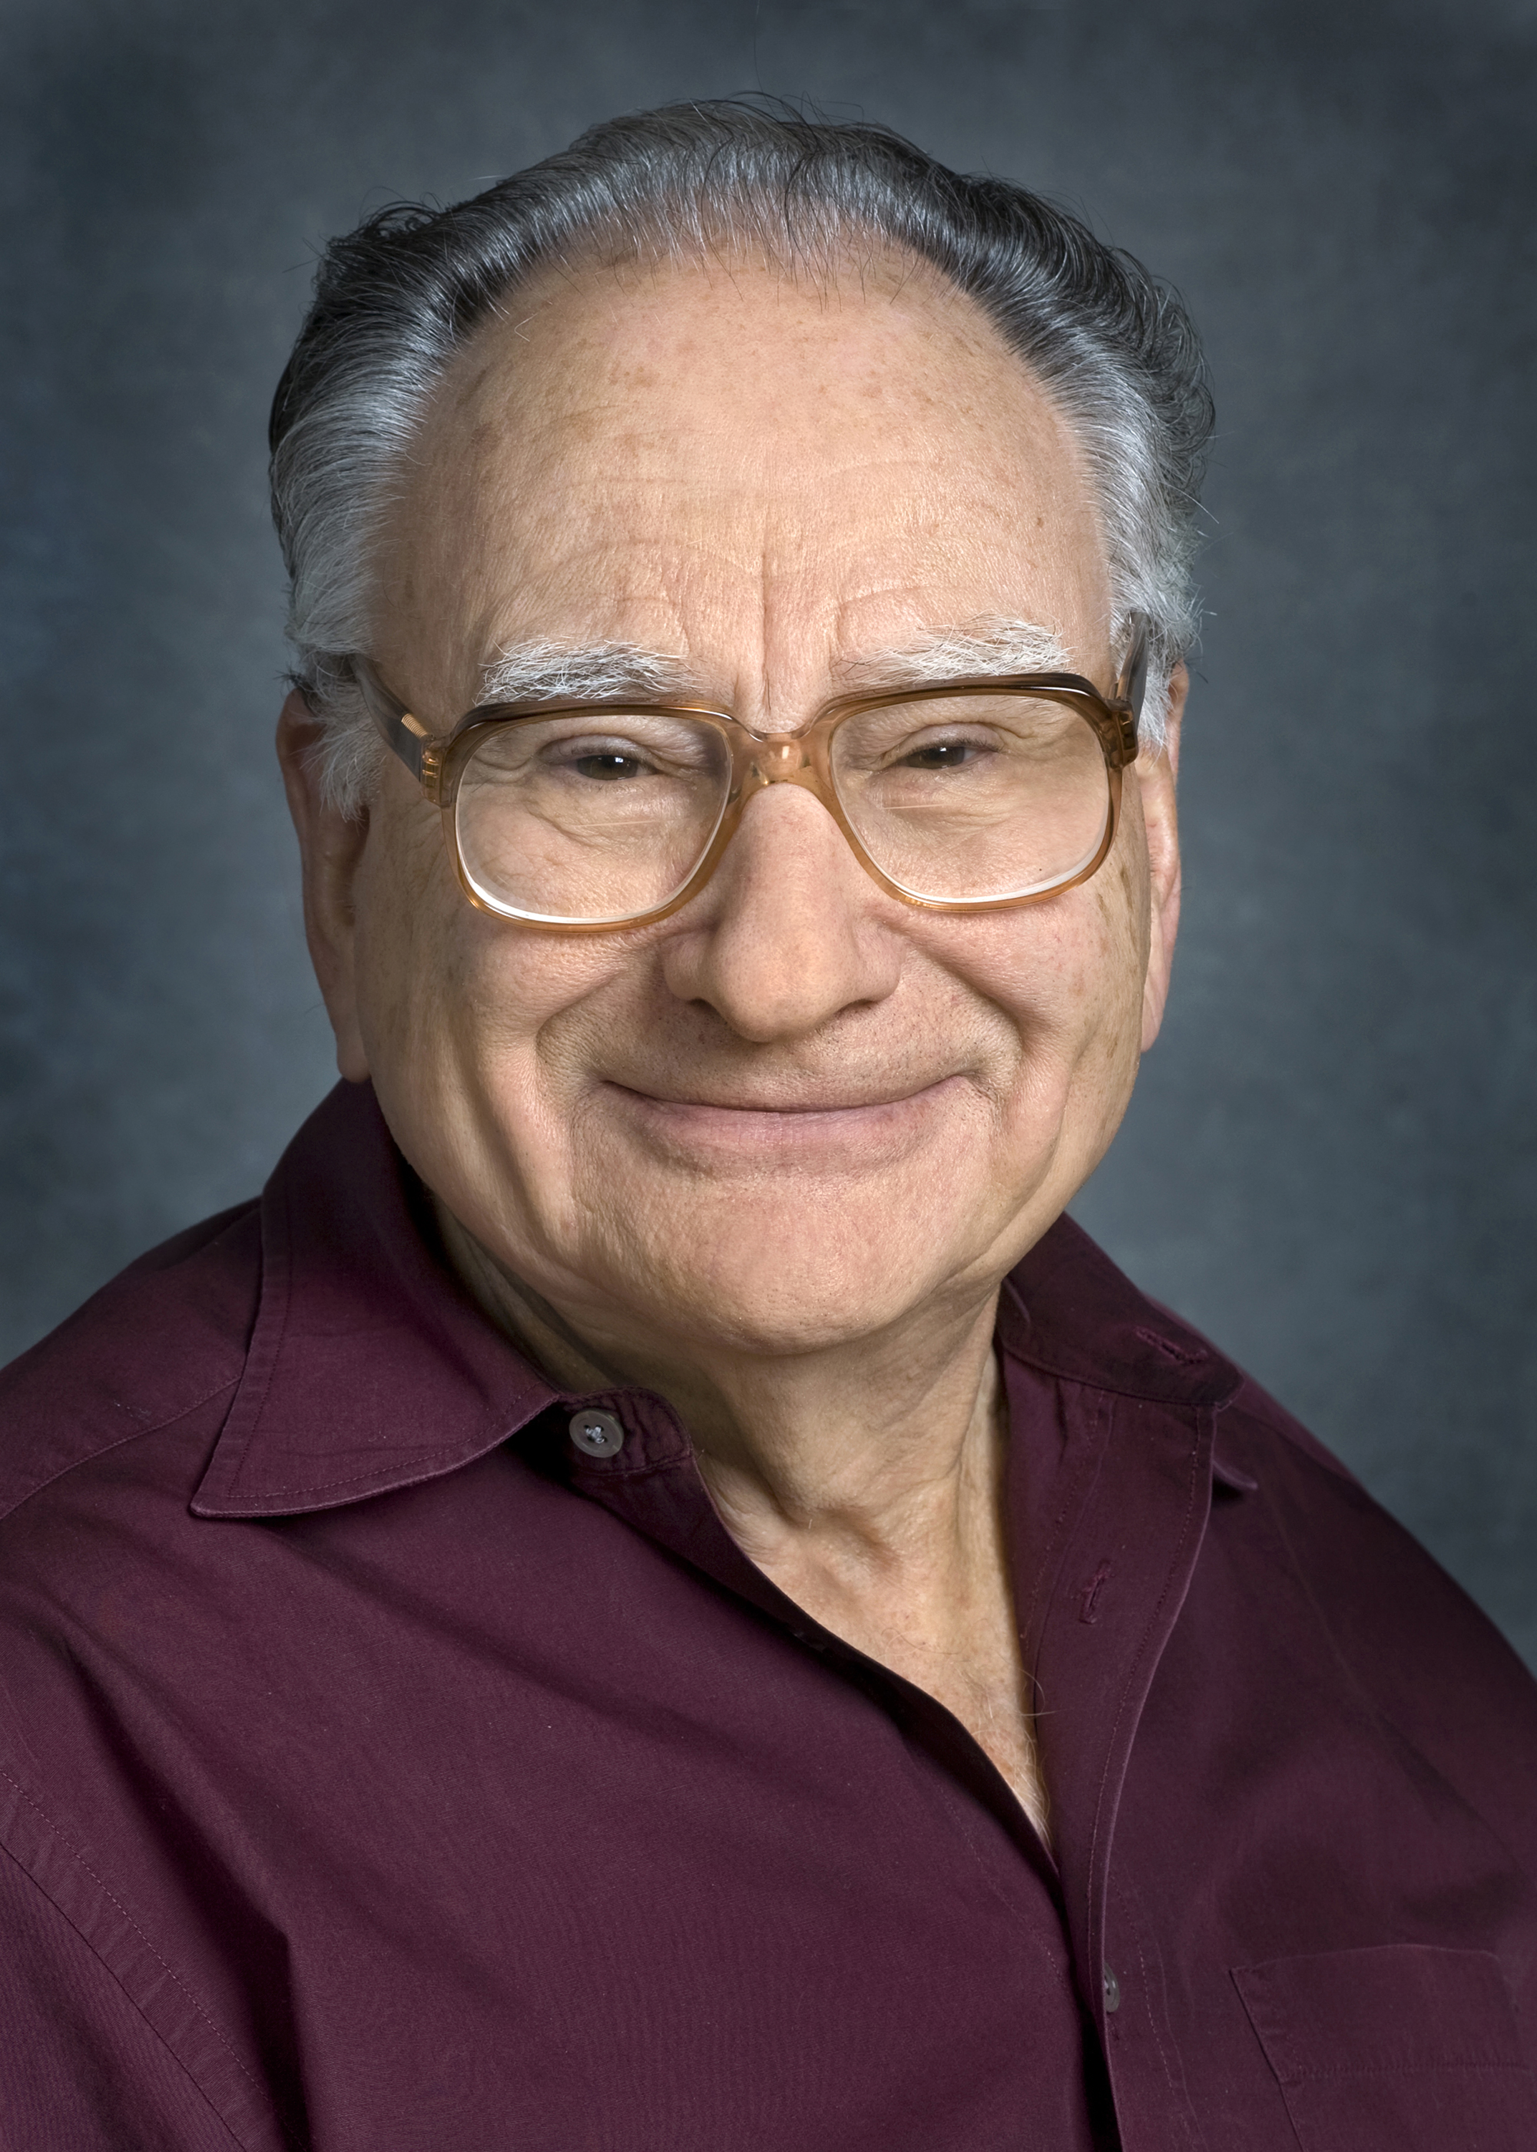
Culmination of RHIC’s Early Days
4 RHIC White papers published in 2004 in NPA
We demonstrated QGP formation
  Even though we were nervous to say this at the time
Currently have >3300 citations!
Thank you, Art, for your giant role!
from VENUS to RHIC to STAR to flow
It has been a most exciting ride
and a boatload of fun!

Slide 24
Backup

Slide 25
Compare central Au-Au to p-p
same p-p parameterization for all data
  normalize AuAu by NN collisions
  divide by p-p parameterization UA1(130)/42 mb
Again see:
  increases up to ~ 2 GeV
  saturates at R_{AA} < 1
  decrease at high p_{t}

Slide 26
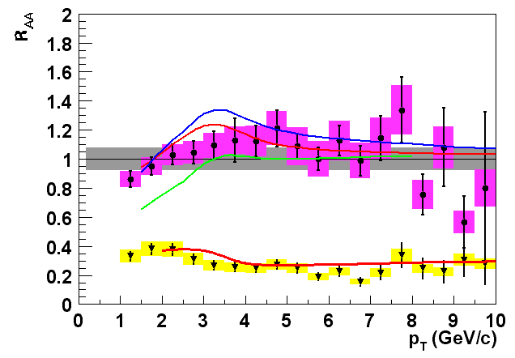
π⁰ R_{AA} vs. predictions
Theoretical predictions:
d+Au: I. Vitev, nucl-th/0302002 and private communication.
Au+Au: I. Vitev and M. Gyulassy, hep-ph/0208108, to appear in Nucl. Phys. A; M. Gyulassy, P. Levai and I. Vitev, Nucl. Phys. B 594, p. 371 (2001).
Initial state: mult. scatt.,shadowing + final state dE/dx (Au+Au)
Also: Kopeliovich, et al (PRL88, 232303,2002)
predict R_{pA}~1.1 max at p_{T}=2.5 GeV projectile as color dipole
PHENIX Preliminary
anti-shadowing
shadowing

Slide 27
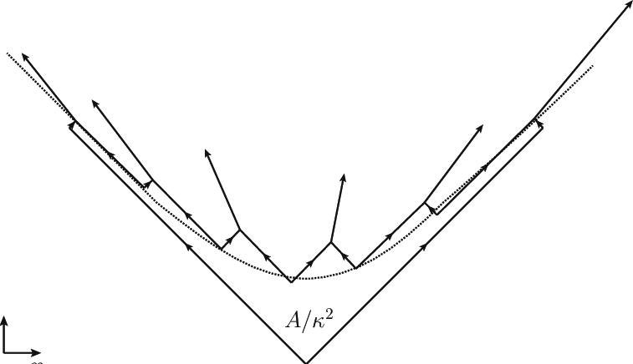
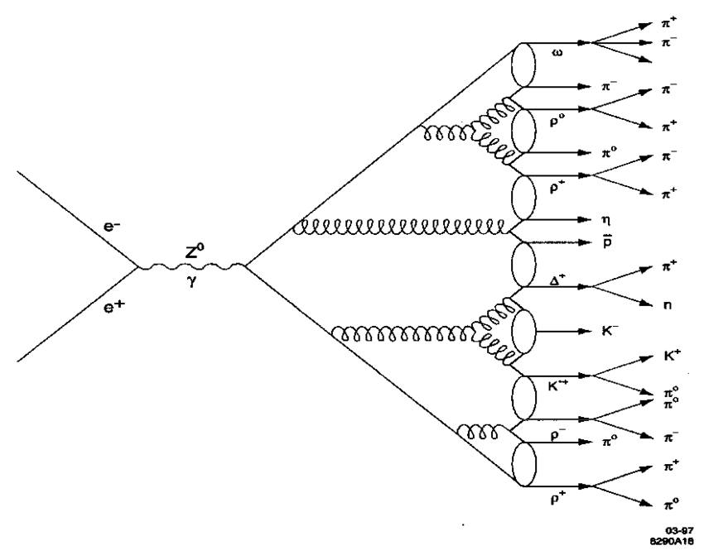
Hadronization
String breaking (e.g. Pythia)
Cluster hadronization (e.g. Herwig)
Coalescence or Statistical Hadronization?

Slide 28
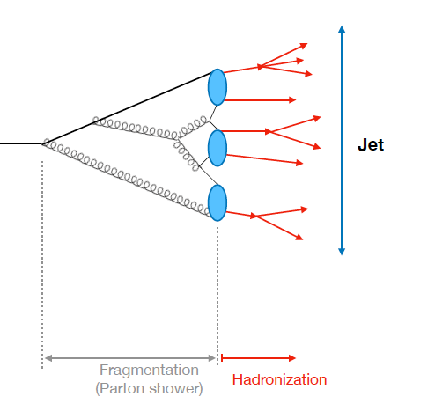
Transition to hadrons is non-perturbative
Rey Cruz Torres
Calculable in pQCD
Not calculable in pQCD
Scale of jet:
p_{T} ~ 20-500 GeV
Scale of transition: Λ_{QCD} ~ 0.5 GeV

Slide 29
Groomed jets well described by NLL QCD

Slide 30
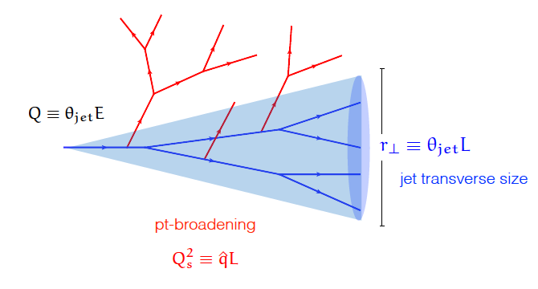
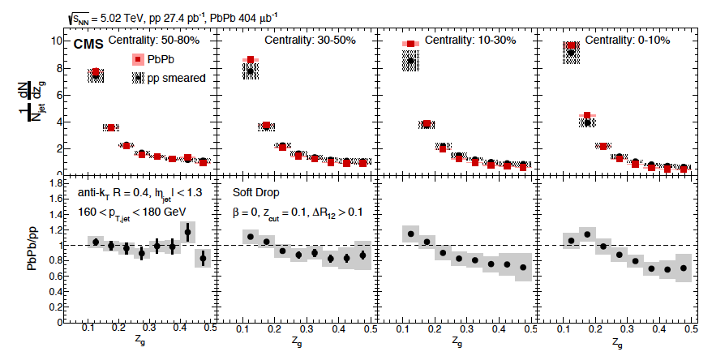
  Probe early gluon splitting
Recluster & groom jet
Use 2 leading clusters
Data to quantify energy, p_{T} transport.
See significant dependence on jet E, grooming.

Slide 31
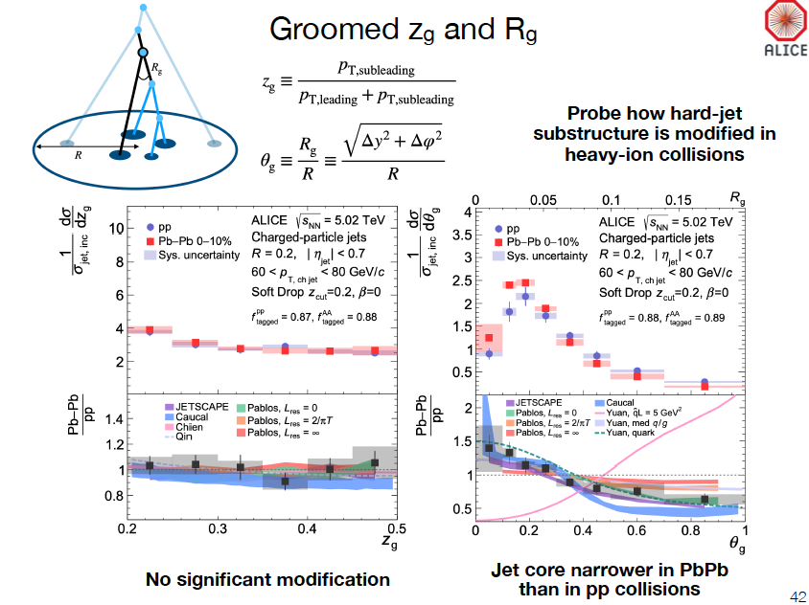

Slide 32
Why measure this observable?
Axis difference can be calculated perturbatively
Especially if jets are groomed to remove the soft particles at large angles.

Slide 33

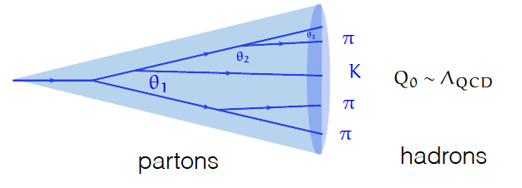
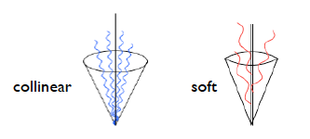
What’s in a jet?
  q,g undergo probabilistic cascade of g emissions
  Total color charge & flavor are conserved
  Successive branchings are ordered in angle
  Color coherence suppresses large angle soft radiation
Modified by color exchange with QGP

Slide 34
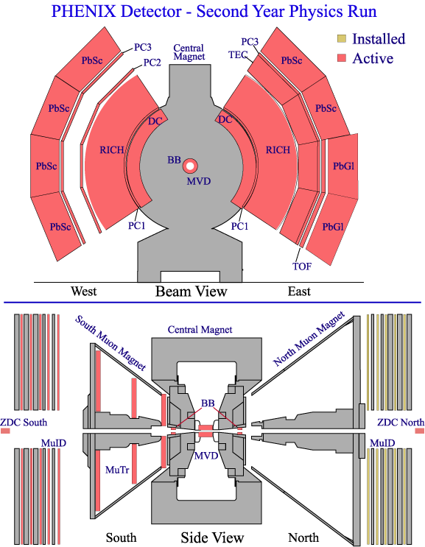

Run-2 and Beyond
Slide from Bill Zajc
2nd muon arm

