Slide 1
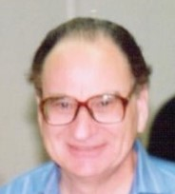
December 9-10, 2022
Symposium on collective flow in nuclear matter: a celebration of Art Poskanzer's life and career
In memory of Art Poskanzer
+ Current heavy-ion plan in Japan
Shoji Nagamiya
KEK・RIKEN
Memories from the 1970s–1980s
Our recent activities for heavy-ions

Slide 2
Art Poskanzer in 1974
I visited Berkeley in 1973 to work on muon science at the 184-inch Cyclotron. The cyclotron was, however, shut down in 1974. Instead, in 1974, the Bevalac started its operation.
I met with Art in 1974, for the first time, on the occasion of the High-Energy Heavy-Ion Summer Study held in Berkeley for the Bevalac (July 15-26, 1974).
I was very excited about this new field, so I brought a tape recorder and created a book in Japanese (71 pages of handwritten text, see the next page).
Those days, I was a member of the Physics Division (the Segre-Chamberlain group). I decided to come to this exciting field, though I had no experience.

Slide 3
Target Fragmentation by 2.1 GeV/nucleon d and ⁴He

Slide 4
Typical Data
To study
Coulomb Barrier
+ Temperature
Energy distribution for various fragments
up to 100 MeV

Slide 5
The Fall in 1974
At that time, there were no data in the central region.
  Greiner, for example, proposed a shock wave in the central region.
I was interested in covering the central region
  and designed a spectrometer.
Fall of 1974
  Chamberlain and I went to the store named Giant Hamburger on Euclid Ave. to eat Hamburger at $1 (in the cafeteria, only 30 cents on those days)
  Chamberlain encouraged me to construct the spectrometer.
Greiner in the 1974 workshop

Slide 6
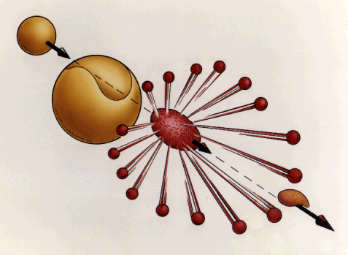
Fireball Model in 1976
Target
Spectator
(Now, RI Beams)
Participant
Projectile
Spectator
(Now, RI Beams)
G. D. Westfall, J. Gosset, P. J. Johansen,
M. Poskanzer, W. G. Meyer, H. H. Gutbrod,
A. Sandoval, and R. Stock
Phys. Rev. Lett. 37, (1976) 1202

Slide 7
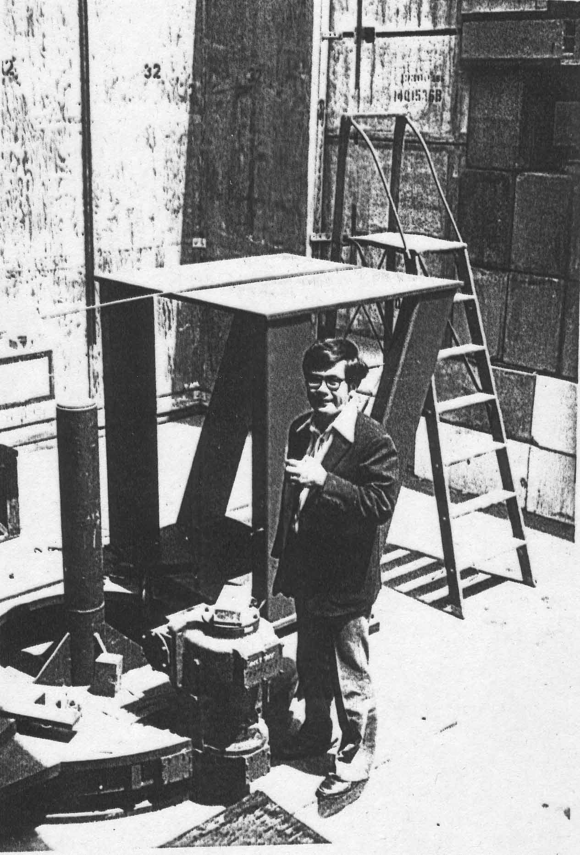
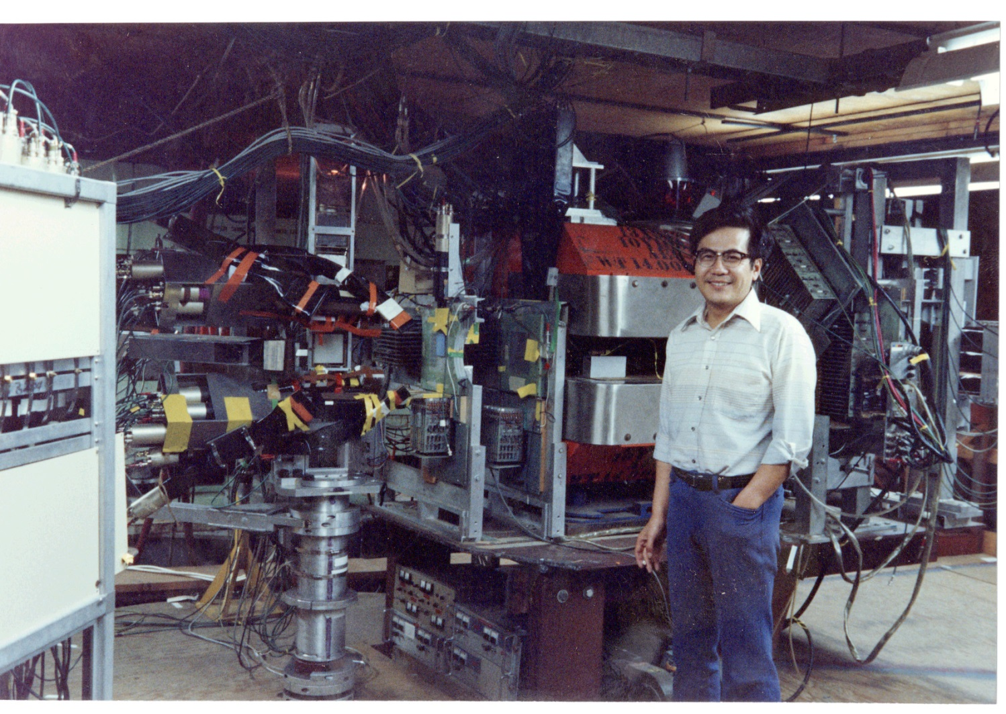
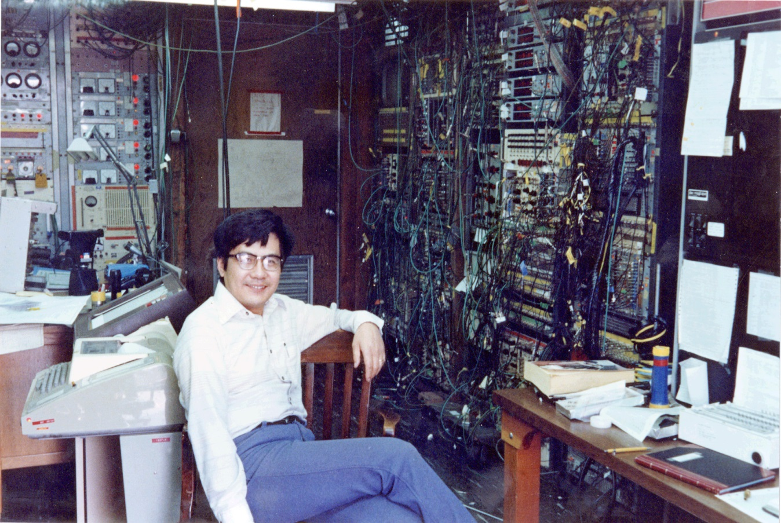
Around 1975-1976
- A new experimental hall was constructed under the support of Jose Alonso.
- Gun Mount was discovered in the warehouse (suggested by Ken Crowe).
- Heckman provided me with a magnet.
- 150 cables pulled out from the underground of the Bevalac floor.
- Wire chambers & scintillators from the group.
- The other group provided me with phototubes.
Against my dream, the US was not rich,
though people at LBL were so kind to me.

Slide 8
1978 and 1979
In August 1978, there was a Nuclear Physics Conference (INPC) in Tokyo. Art gave a plenary talk to summarize data from the Bevalac. (Our group started to collect data by that time)
  This Conference was an almost unique & major nuclear physics conference. (QM conf. in 1980, NN Collisions in 1982 , PANIC?)
In March 1979, Art encouraged me to go to Hawaii to attend the American Chemical Society Meeting to present a talk on inclusive data plus particle correlations, so I did.
  I sent him a postcard with a photo of rather sexy dancing girls from Hawaii, .
  After my return to Berkley, he came to my office, smiling, “thank you for the excellent postcard.”
  For me, Art usually did not smile, so I still remember his vividly smiling or even loudly laughing face on that day.

Slide 9
The 1980s (Art, together with Hans Gutbrod)

Slide 11
Figure provided by Hans Gutbrod

Slide 12
Only slightly, I contri-buted to the plastic balls by cooperating the production company. Whenever they visited Berkeley,
I entertained them.
Figure provided by Hans Gutbrod

Slide 13
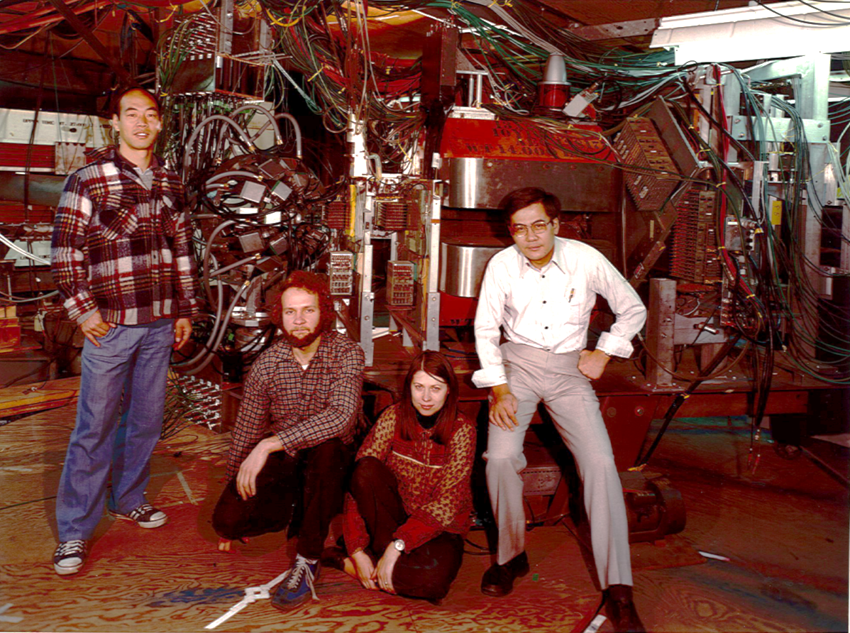
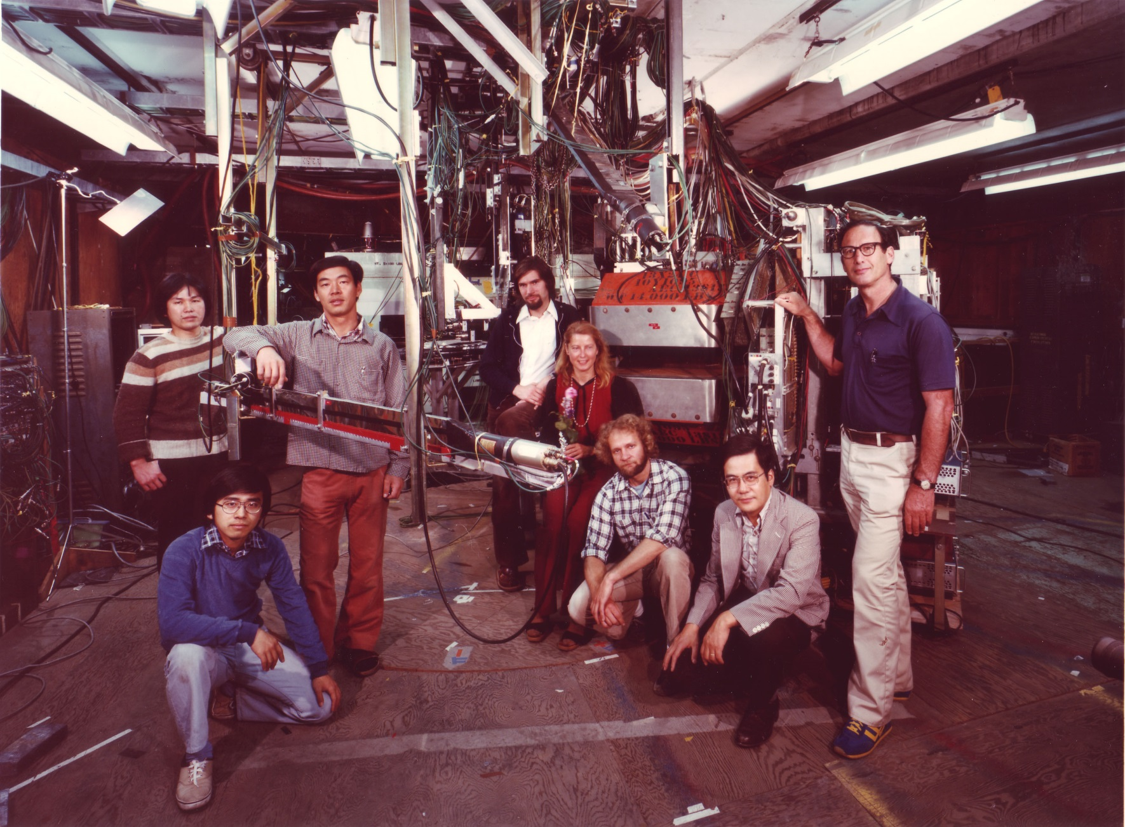
Our Group in 1978 and 1980
I. Tanihata
I. Tanihata
E. Moeller
S. Kadota
R. Lombard
H. Steiner
Myself
S. Schnetzer
M.-C. Mallet Lemire
S. Schnetzer
Myself
Y. Miake

Slide 14
Our Contribution to Flow
800 AMeV Ar + KCl
Explosion Model
Pion
Proton
S. Nagamiya, M. -C. Lemaire, S. Schnetzer, H. Steiner, and I. Tanihata
Phys. Rev. Lett. 45, (1980) 602
Pil Siemens visited my office often, almost every day.
If a blast wave is added to a thermal spectrum
→ Effect would be more significant for larger m
→ Effect would be more significant for smaller v_{thermal}
as K.E. is m(v_{flow}+v_{themal})²/2 non-relativistically

Slide 15
Our current activities
to accelerate HI at J-PARC

Slide 16
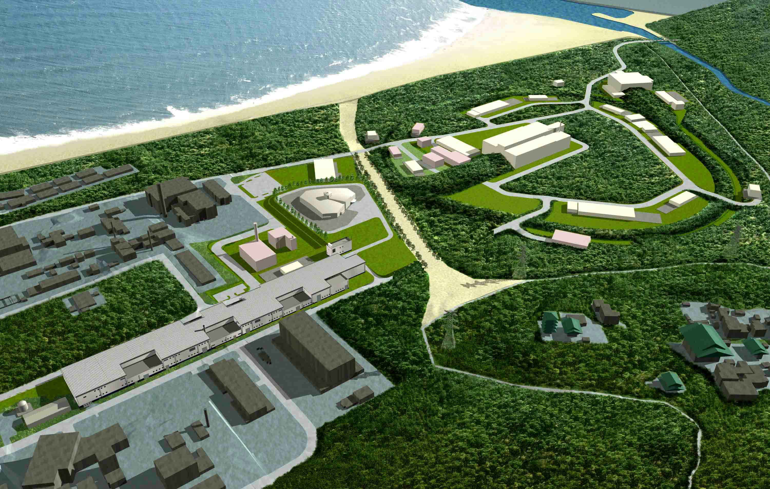

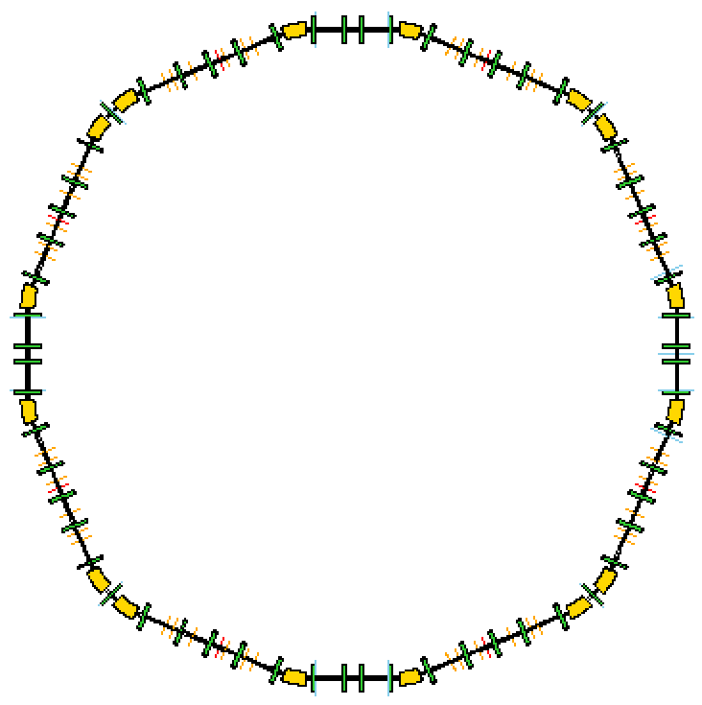

J-PARC Facility
HI LINAC
Materials and Life Science
Experimental Facility
Hadron Beam Facility
Building
HI booster
50m
Designed
Injector
Nuclear Transmutation
(Phase 2)
５００ｍ
Neutrino to Kamiokande
3 GeV Synchrotron
(25 Hz, 1MW)
30 GeV Synchrotron
(0.75 MW)
Linac
(330m)
J-PARC = Japan Proton Accelerator Research Complex
Construction: 2001-2009, High Flux Beams (0.5 MW at 30 GeV = 10¹⁴ flux/s)
2

Slide 17
Net Proton Density
AGS: 13.5 GeV/u
on fixed target
SPS: 200 GeV/u
on fixed target
RHIC: 200 GeV/u
in collider mode

Slide 18
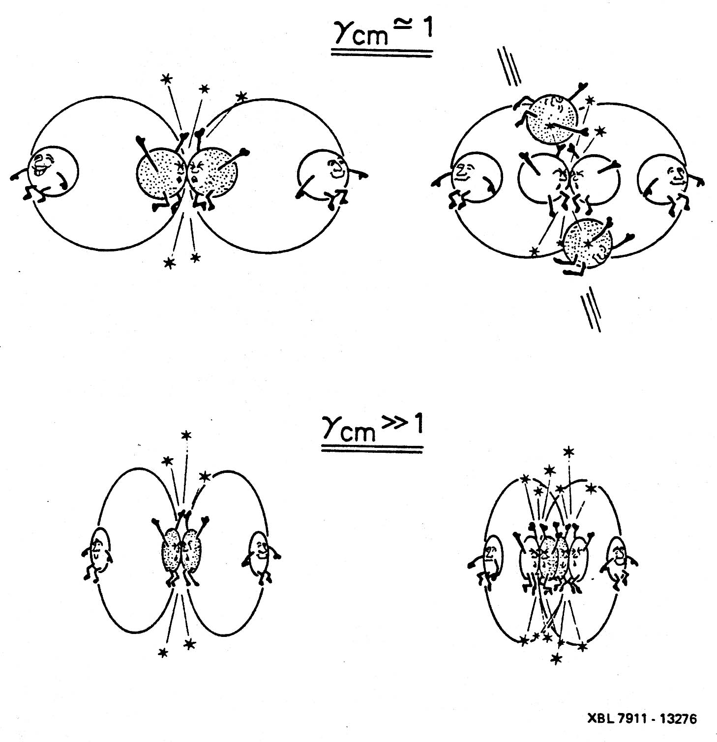
Possibility for High-Density Formation
Pb+Pb at 11 AGeV on a fixed target
T (MeV)
ρ/ρ₀
5
11 AGeV at J-PARC on a fixed target:
➜ 2γ_{cm} = 5
ρ = 2γ_{cm}ρ₀
S. Goldhaber, Nature 275 (1978) 112
Initially,
L. D. Landau, Nauk. SSSR Ser. Fiz. 17 (1951) 51
Y. Nara. Private communications, (2022)

Slide 19
Phase Diagram
STAR-BES

Slide 20
10 AMeV heavy ion
500 MeV proton or 147 AMeV heavy ion (sufficiently high to inject to 3 GeV ring )
HI LINAC
Building
HI booster
To 3GeV
Ring
50m
Nuclear Transmutation
(Phase 2)
Full Version
> $150M
Staging Idea
Use the existing KEK-PS Booster ring … FREE
Purchase a commencially available Linac … $20M

Slide 21
J-PARC Staging Idea
Staging Idea (1% interaction)
Interaction Rate assuming 1% Target
Beam energy
per nucleon on
a fixed target
10 GeV

Slide 22
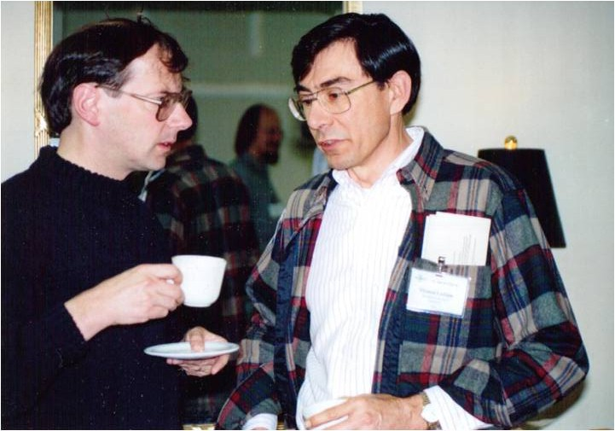
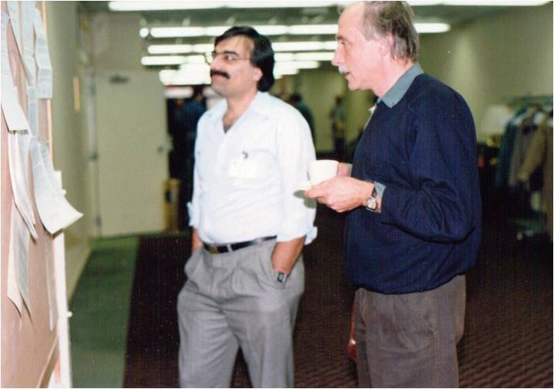
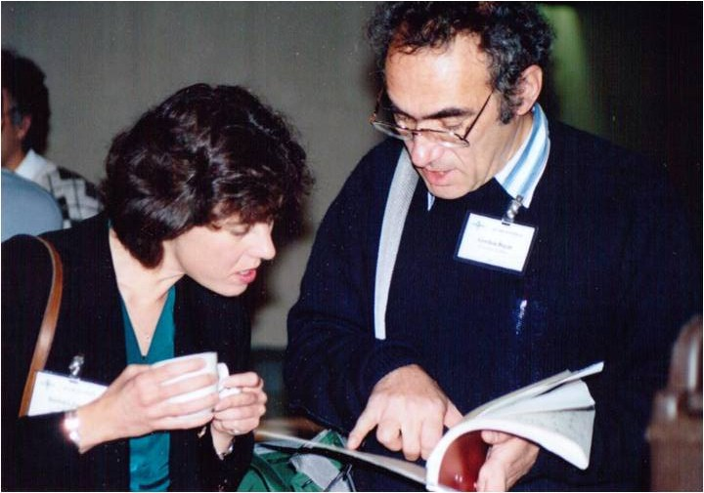
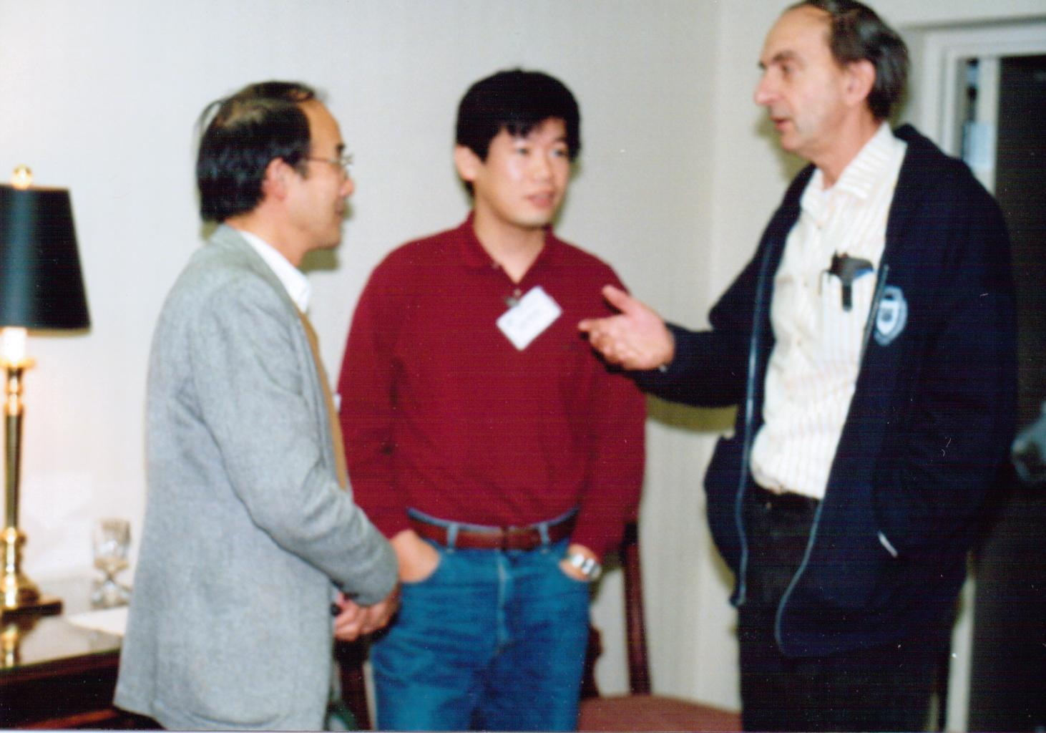
the 1990s
James Symons
Reinhard Stock
Tom Ludlam
Cyrus Baktash
Barbara Jacak
Tetsuo Hatsuda
Gordon Baym
Gerry Brown
Selected from 259 photos from QM’91

Slide 23
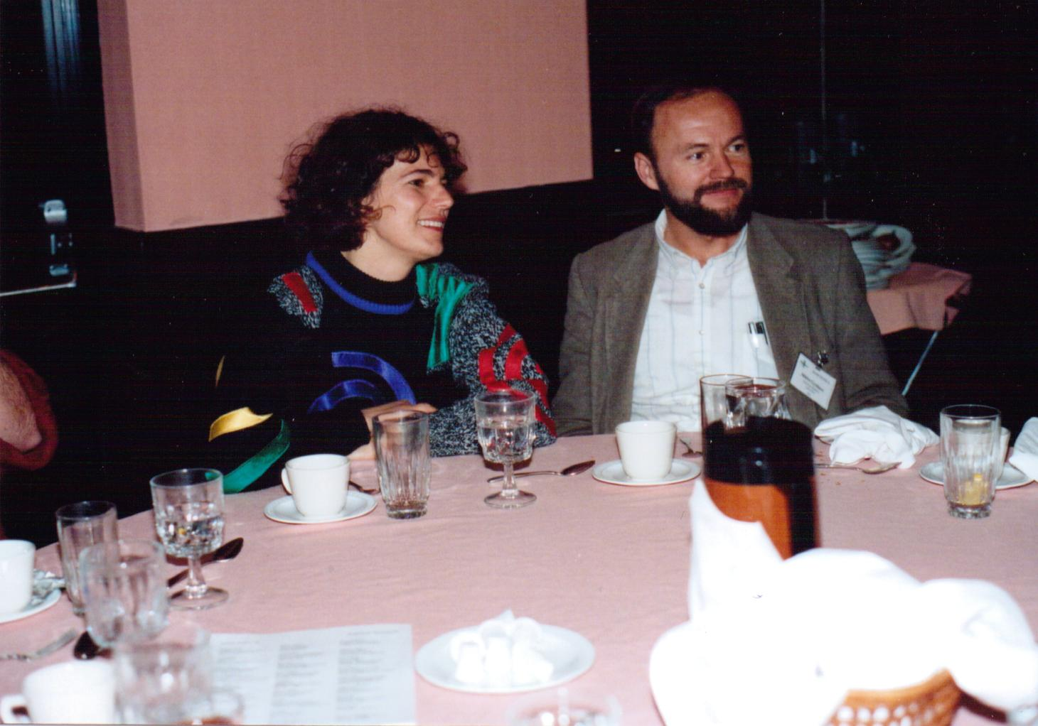
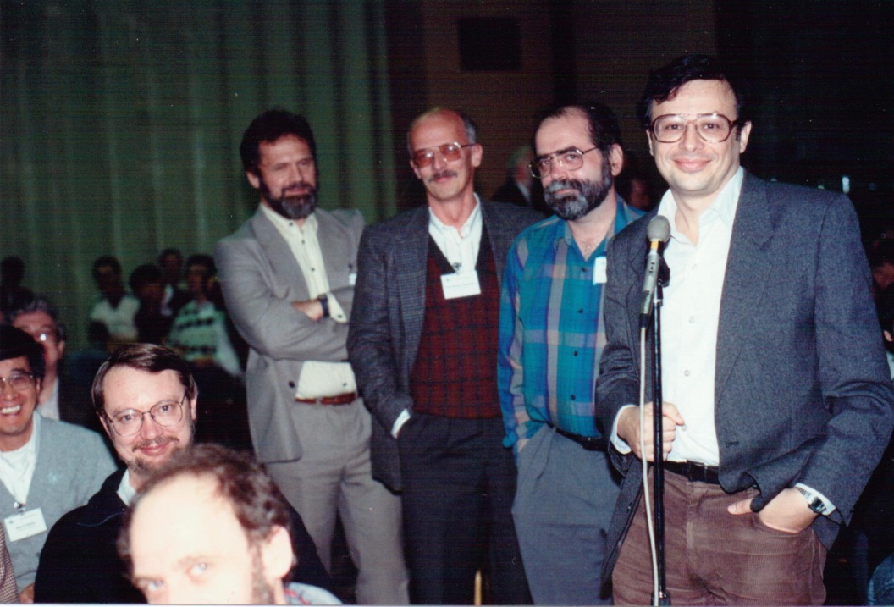
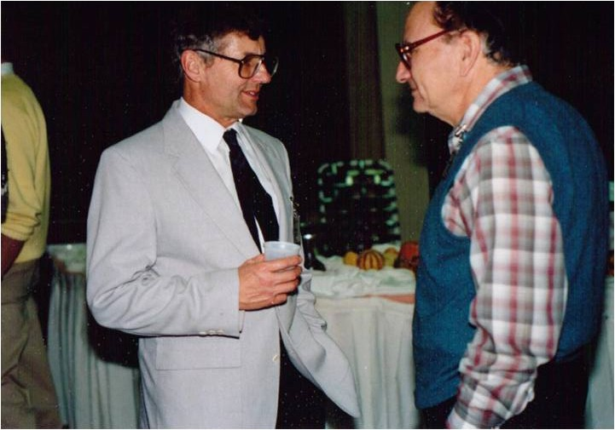
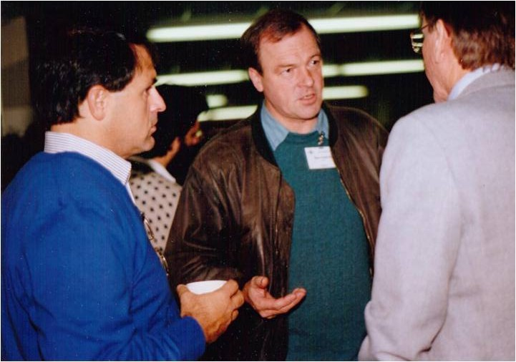
Miklos Gylassy
Peter Braun-
Munzinger
Larry McLerran
Edward Shuryak
Frank
Plasil
Art
Poskanzer
Hans Gutbrod
Sam Aronson

Slide 24
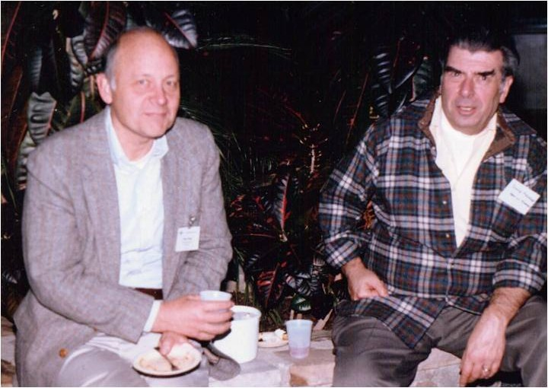
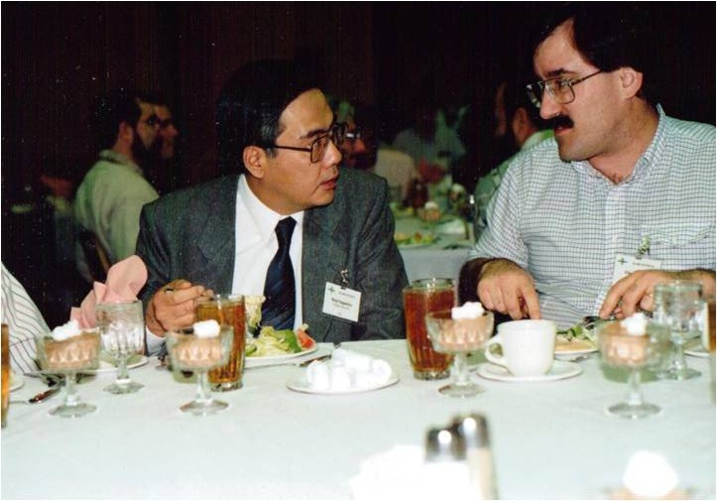
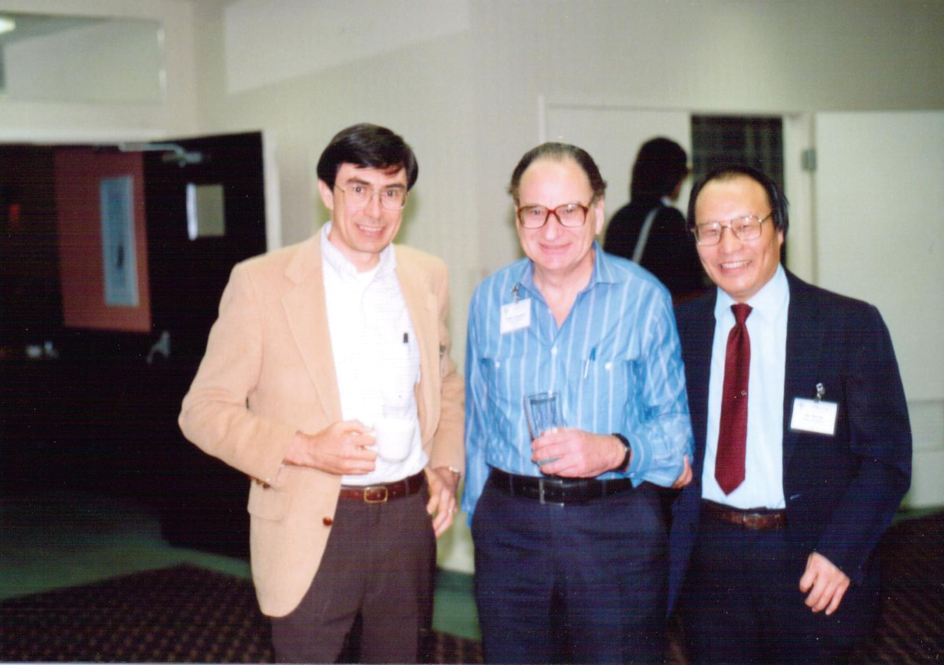
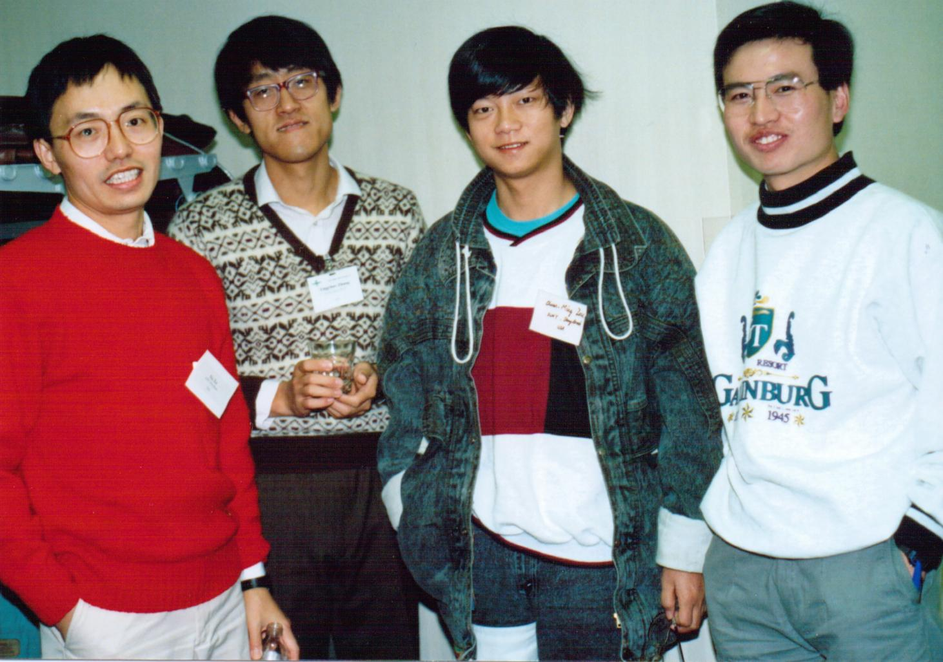
Dave Hendrie
Shoji
Nagamiya
Glenn
Young
Peter Bond
Nu Xu
Tom
Ludlam
Art
Poskanzer

Slide 25
2019 and 2021
The last mail from Art Poskanzer was in 2019, 45 years after I met him first in 1974.
The first news on Art was from Peter Jacob on 7/3/21.
Shoji (on 2019/12/15)
Good to hear from you. You will continue working for a long time. I stopped going into the Lab two years ago but still get email. Lucille and I have had our 65th wedding anniversary. We remember your kindness to our daughter Debbie. Her youngest child is now in college.
Best regards,
Art and Lucille
On June 30, Art Poskanzer died peacefully at home after a long illness, surrounded by his family, two days after his 90th birthday. … (A long mail)
Art was indeed a great scientist. I miss him very much and would like to pray for his eternal peace… from Shoji in Japan

Slide 26
Thank you

