Slide 1









MAGIC
Matter, Astrophysics, Gravitationalwaves & Ion Collisions
A. Motornenko***, Pia Jakobus**, St. Schramm†, J. Steinheimer****, H. Stoecker*, FIAS
E. Most, M.O. Kuttan, L. Weih, M. Hanauske, L. Rezzolla, ITP, V. Vovchenko, LBL
FIAS & Institut f.Theoretische Physik, Goethe Universitaet Frankfurt
*GSI Darmstadt, **now at Monash University, with B. Müller, Alex Heger
Supported by *** Stiftung PolyTechnische Gesellschaft, ****SAMSON AG and

Slide 2
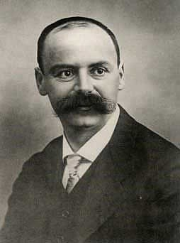
Matter, Gravity and Neutron Stars
1915 A. Einstein, born in Ulm, published GR:
Gravity governs the motion of masses
and light by curving spacetime.
1915 Karl SchwarzSchild, born1873 in Frankfurt,
found the static, point source solution of General Relativity: Black Holes!!
1916 K.S.’ last article: a “Neutron Star” type solution of GR: NS !!
SchwarzSchild died in WW I just after publishing these articles…
SchwarzSchild’s solutions of GR: black holes & neutron stars
Add Einstein‘s Gravitational Waves - we see a whole new Universe!

Slide 3
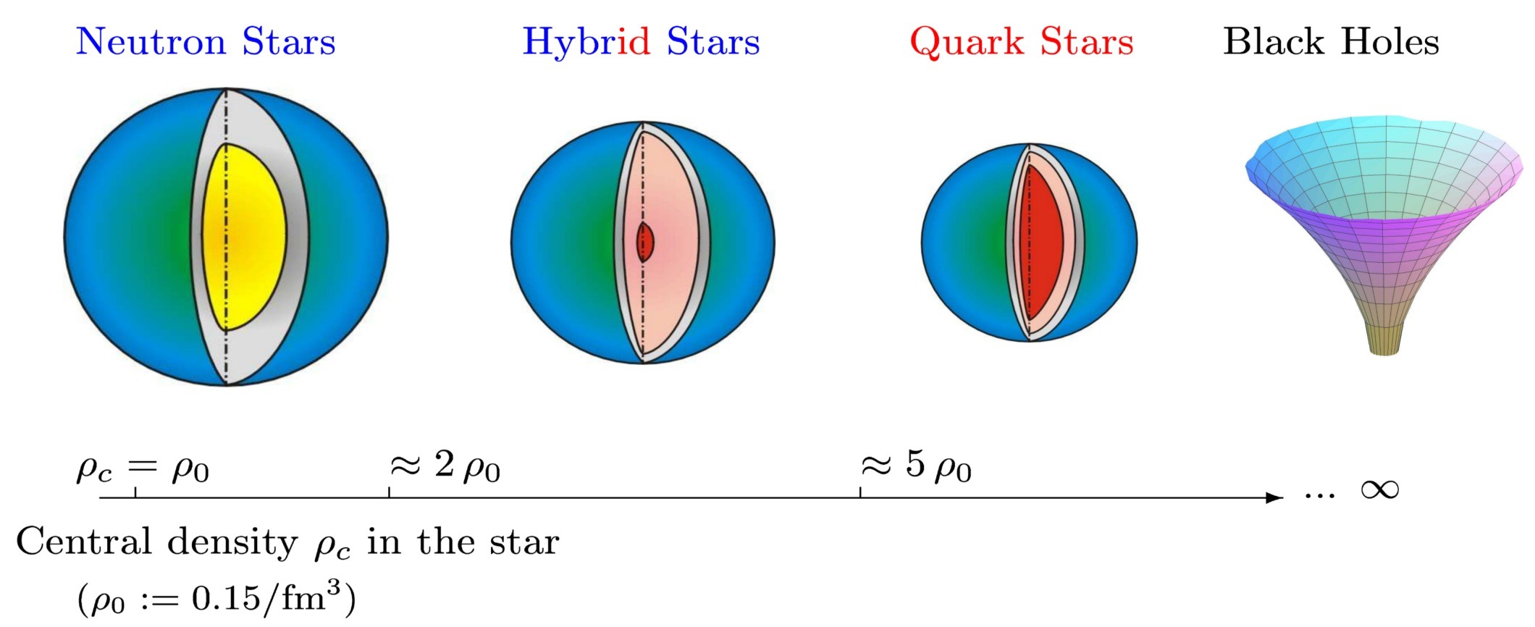
Neutron Star, Quark Star, Black hole ?

Slide 4
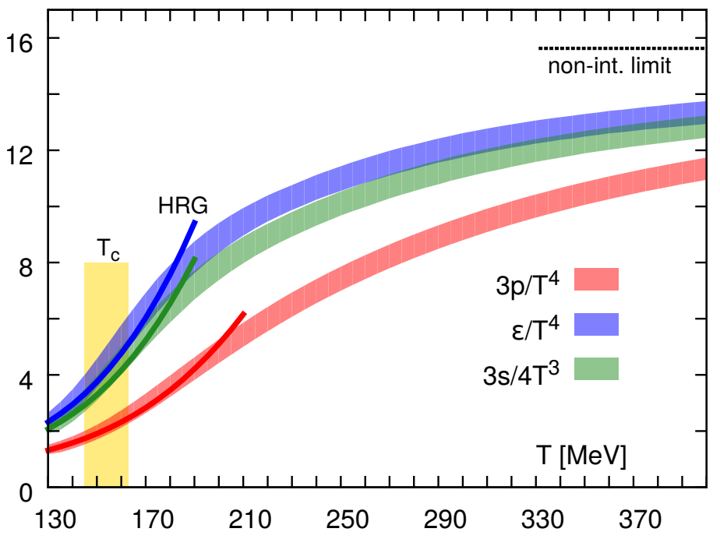
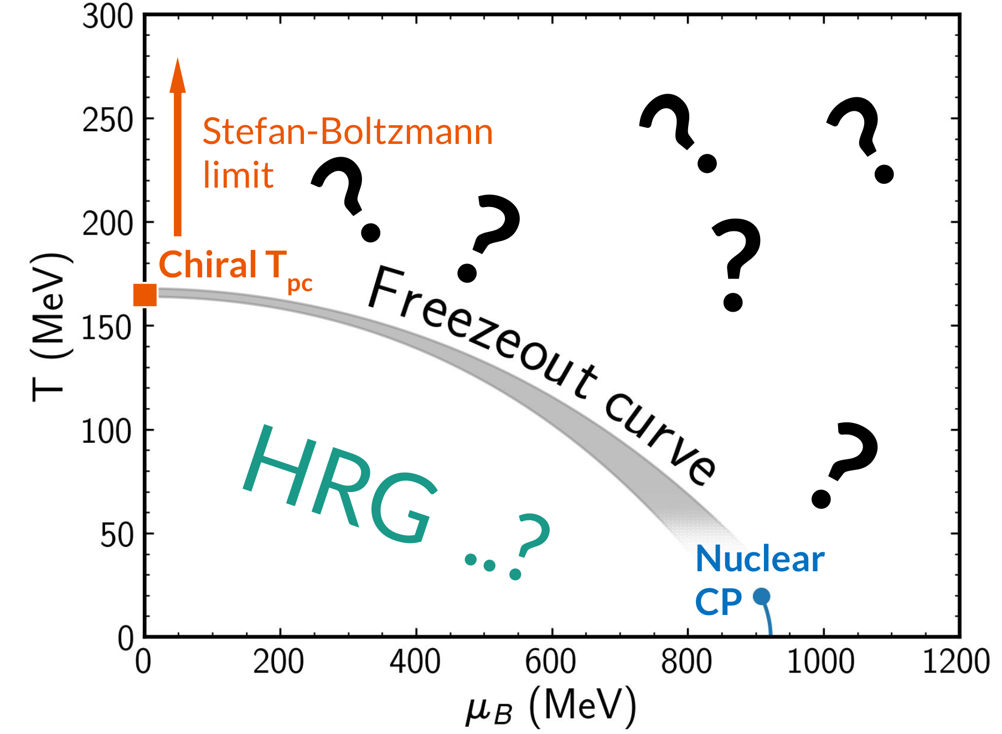
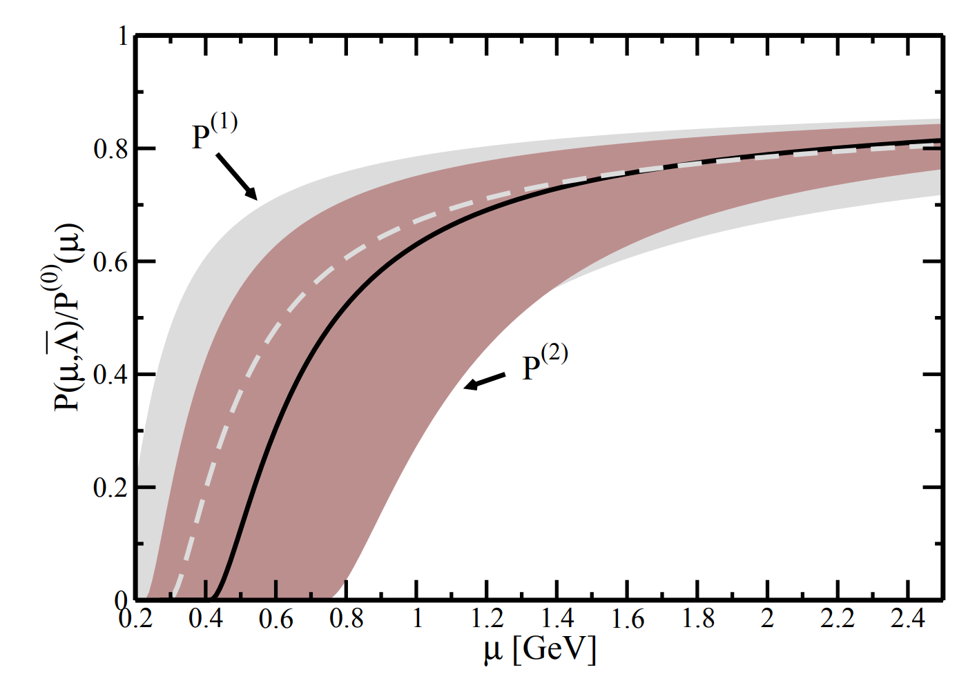
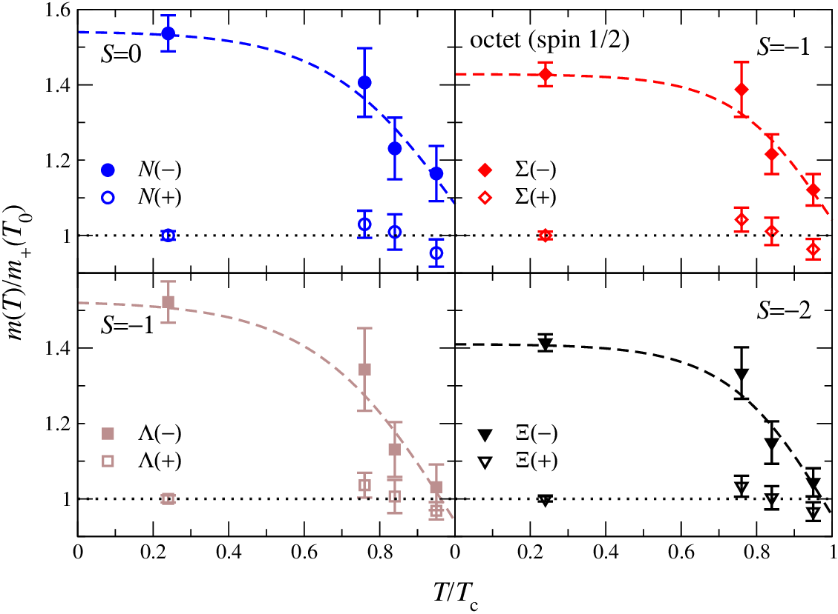
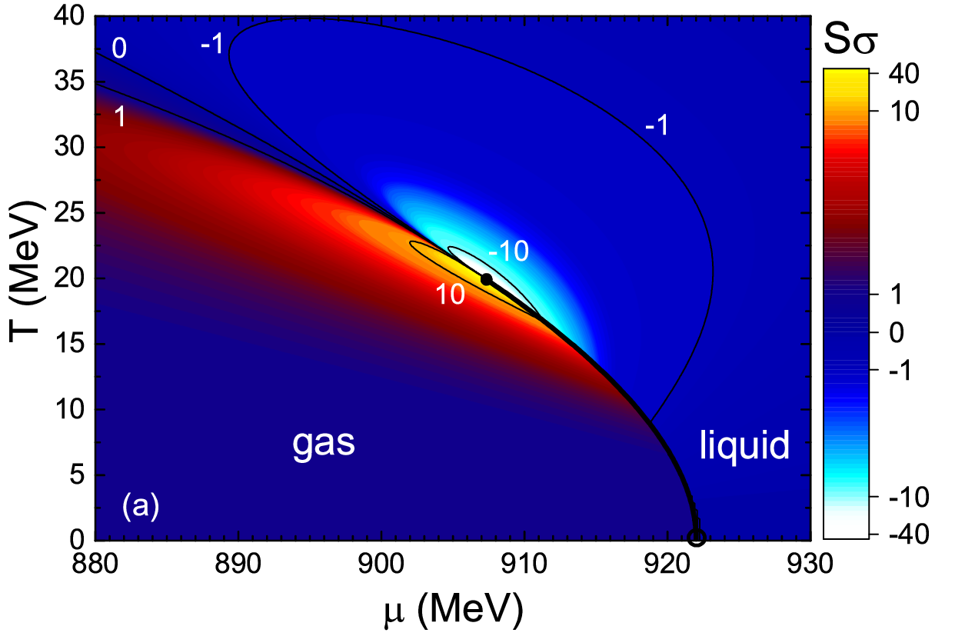
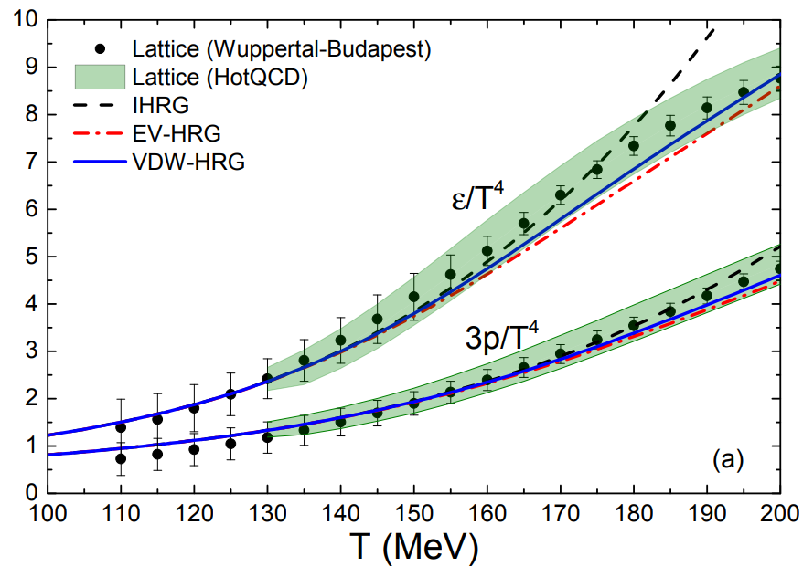
QCD phenomenology for the EoS: CMF
Stefan-Boltzmann limit μ_{B}=0 HotQCD, 1407.6387
Stefan-Boltzmann limit T=0
A. Kurkela, P. Romatschke,
A. Vuorinen, 0912.1856
Parity doubling G. Aarts et al., 1710.08294
Nuclear matter properties
J. Pochodzalla et al., Phys.Rev.Lett. 75 (1995)
V. Vovchenko et al., 1506.05763
Hadron Resonance Gas
Vovchenko,
Gorenstein,
Stoecker,
1609.03975

Slide 5

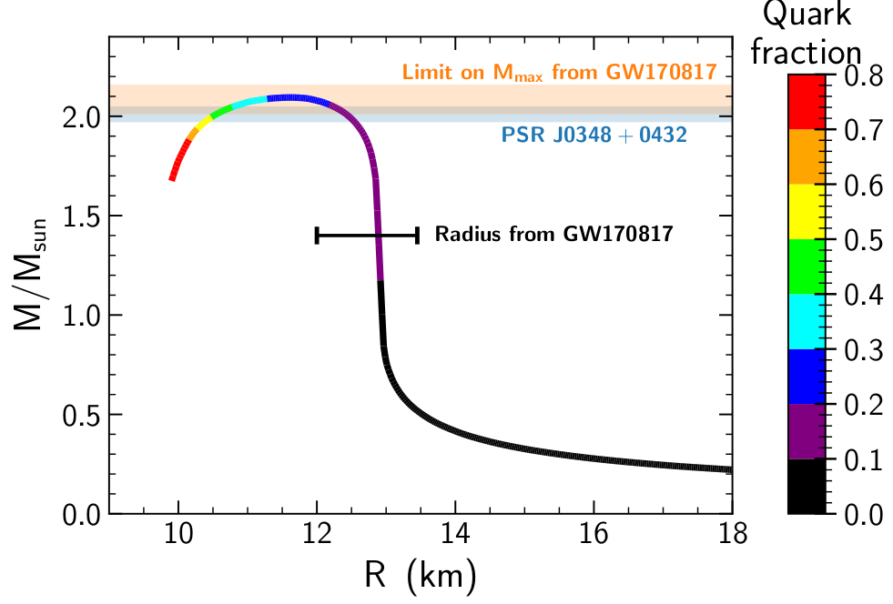
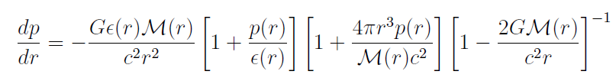
Neutron Stars Mass vs. Radius in CMF
Anton Motornenko
Features:
Maximum NS-
mass observed
=2.0xMsolar & <2.1xMsolar- limit of GW170817
Radii ~ 12-13km observed
hybrid star’s rel.EoS at high 𝝁_{B} must agree with lattice QCD data at low 𝝁_{B}
Anton Motornenko, Vovchenko, Steinheimer, Stefan Schramm, Stoecker 1809.02000, NPA (2019), QM’19 Wuhan

Slide 6
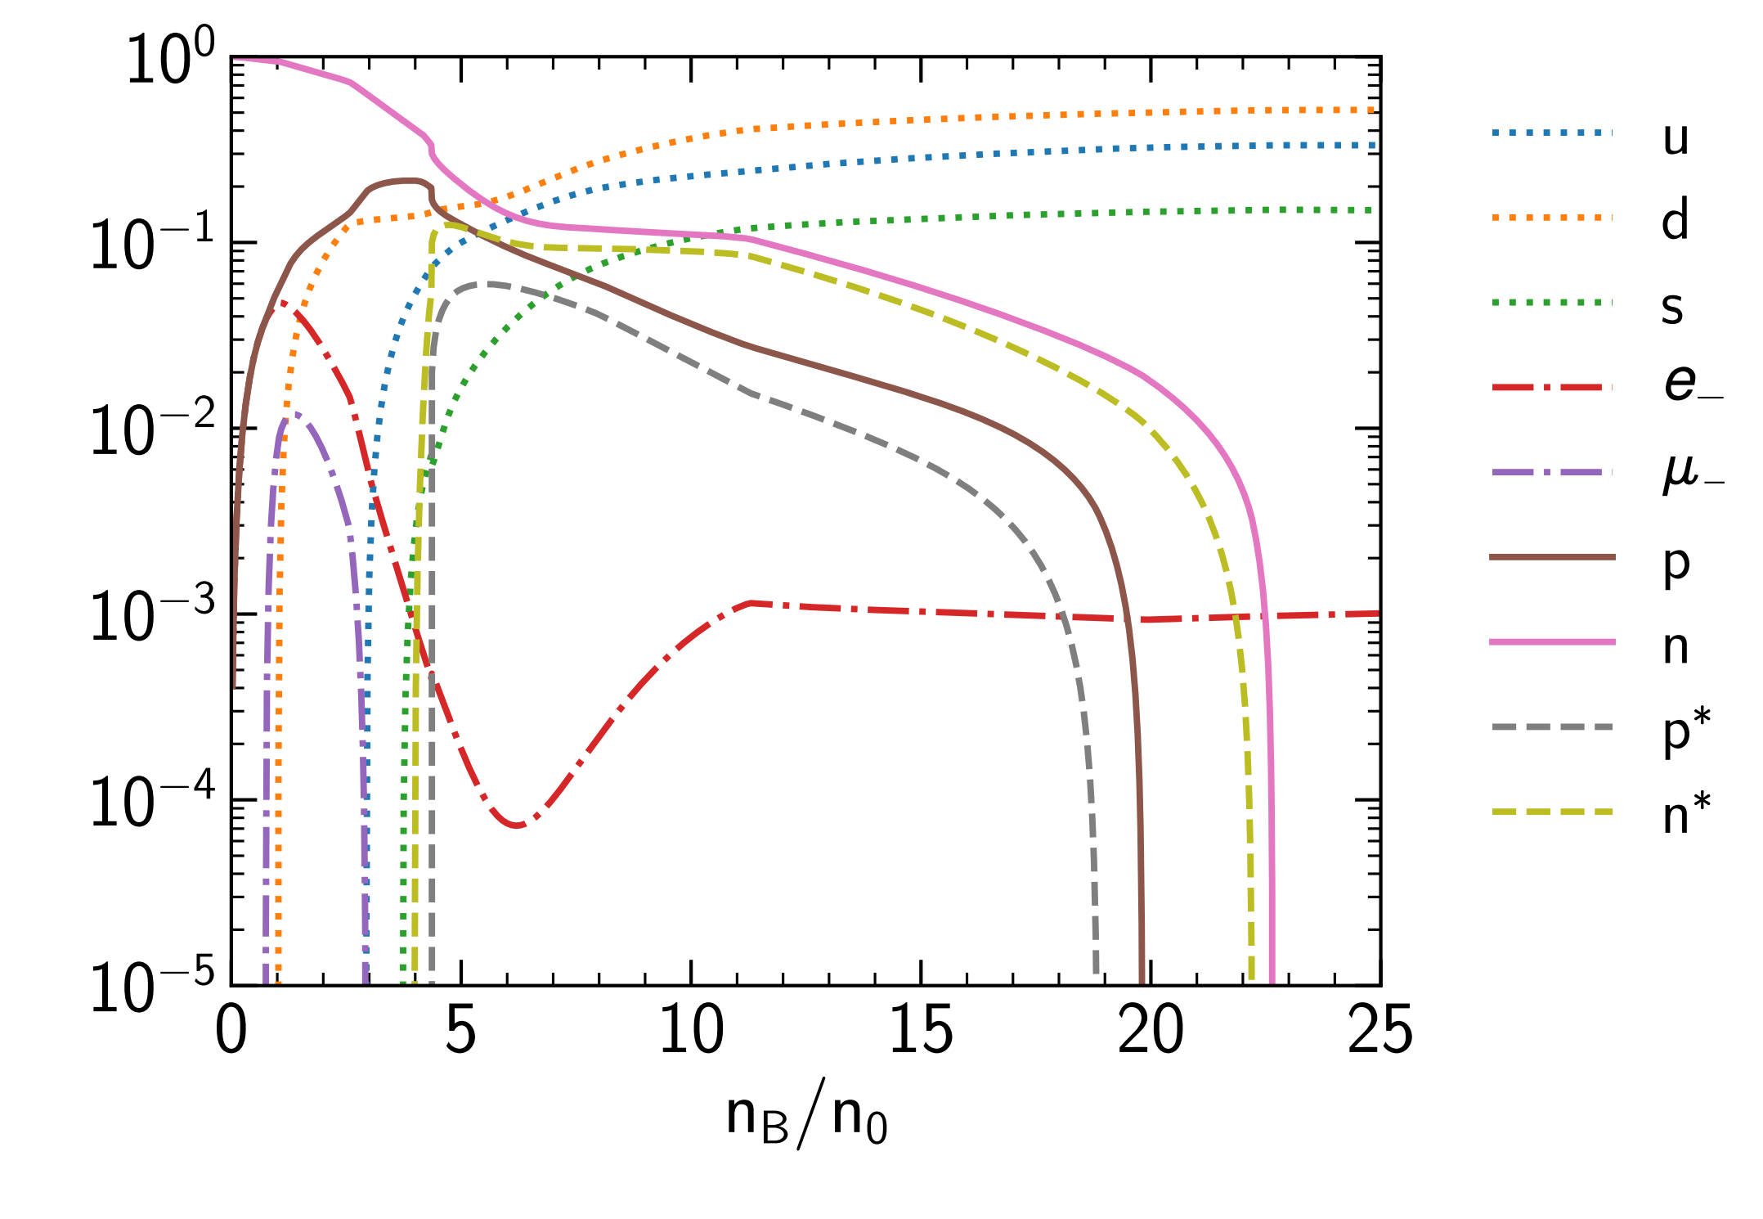
CMF - Equation of state at T=0: Neutron Stars
Equation of state for neutron stars:
T=0
Electric charge is zero
Leptons are included
No nuclear ground state
Chiral transition is at n≈4n₀
Quark matter is at n≈23n₀
Hyperons at T=0 are suppressed by hard-core repulsion (nevertheless are present at T ≠ 0)
Strange quarks are included
A. Motornenko, Jan Steinheimer
Quarks
Particle yields normalized to baryon density:

Slide 7
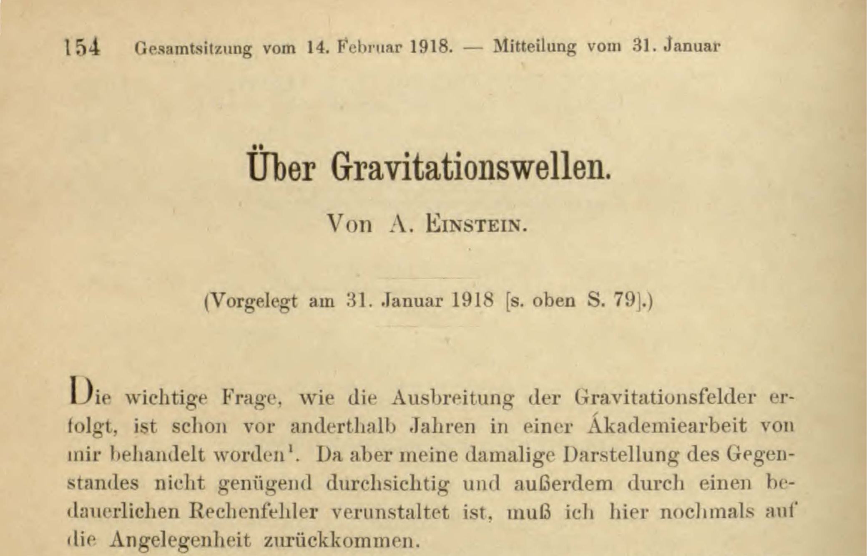
Sitzungsberichte der Königlich-Preußischen Akademie der Wissenschaften
Einstein‘s First work on Gravitational Waves, Juni 1916, was …wrong…

Slide 8
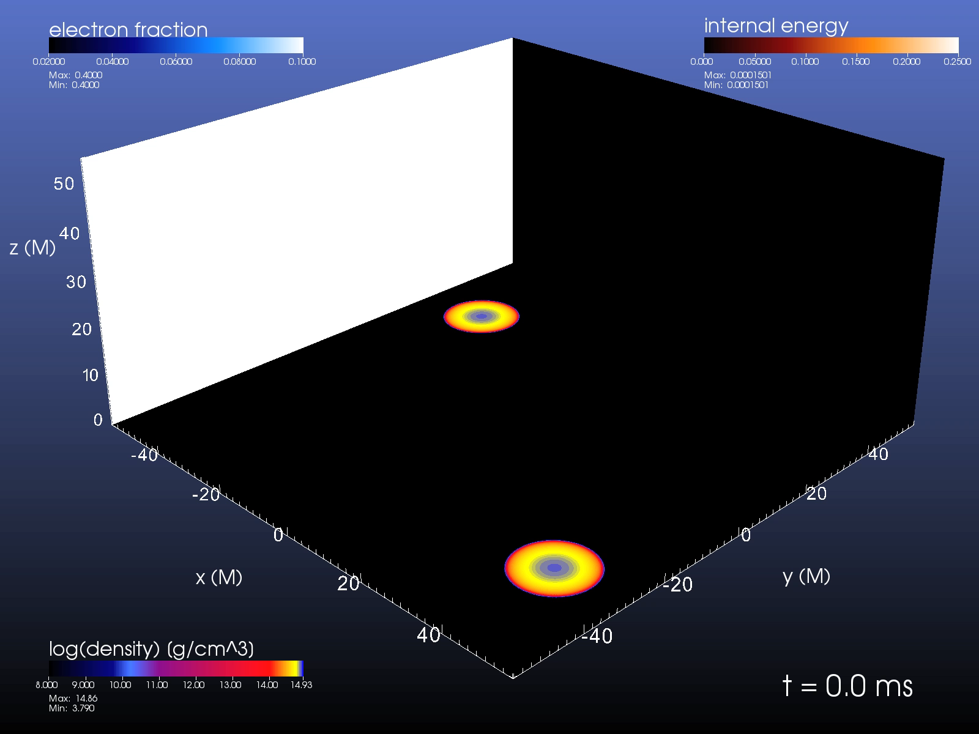

Slide 9



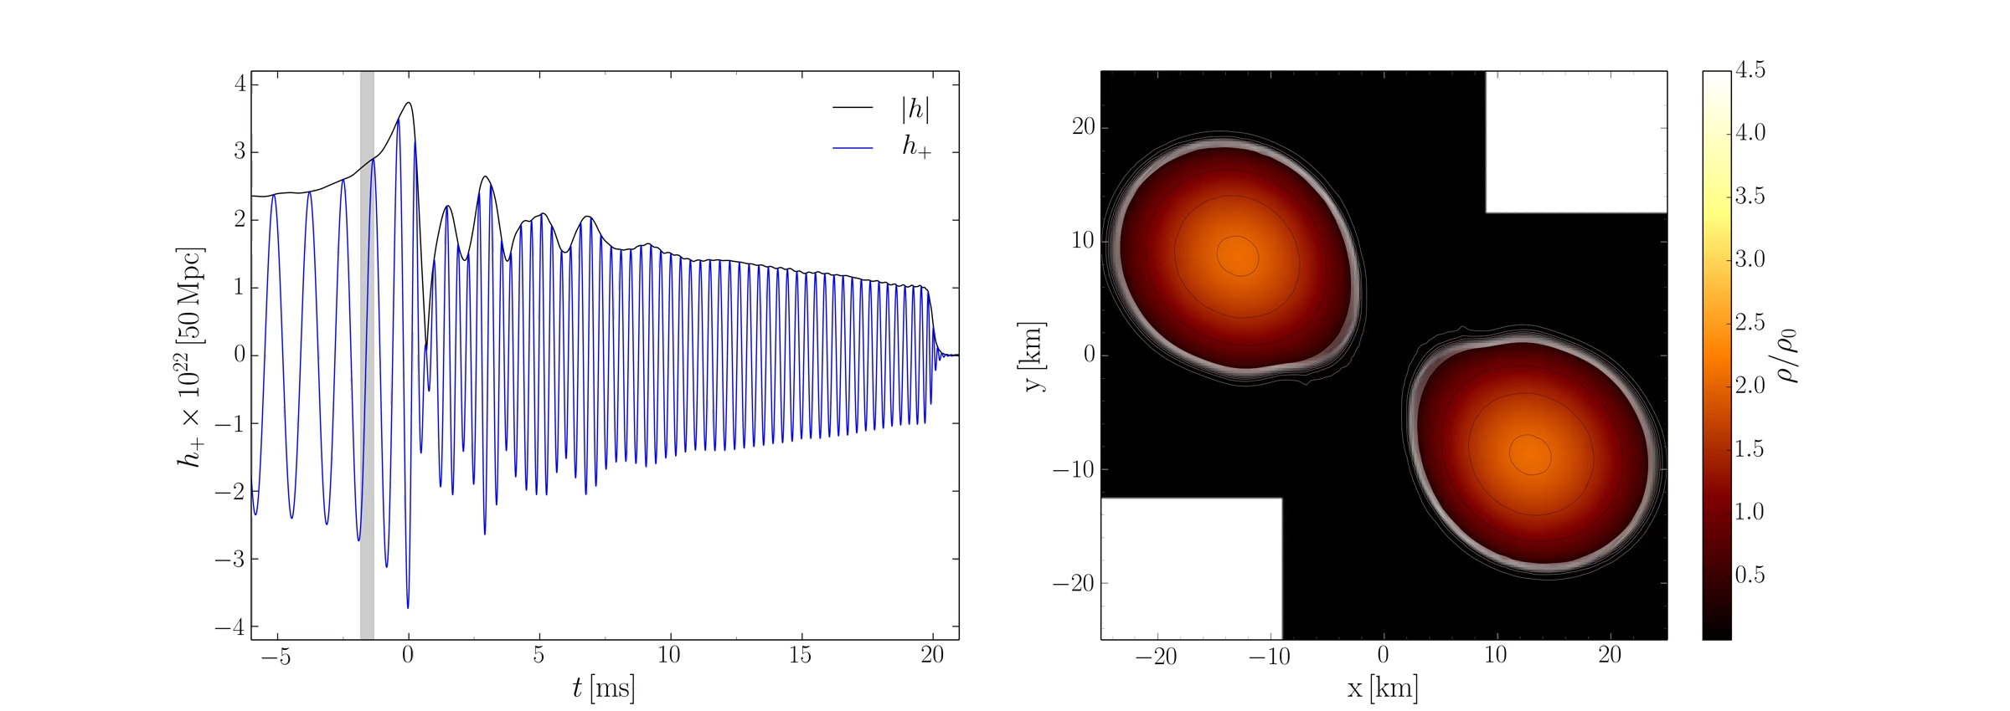
Disco-Fox, Merengue and Tango- Phase

Slide 10
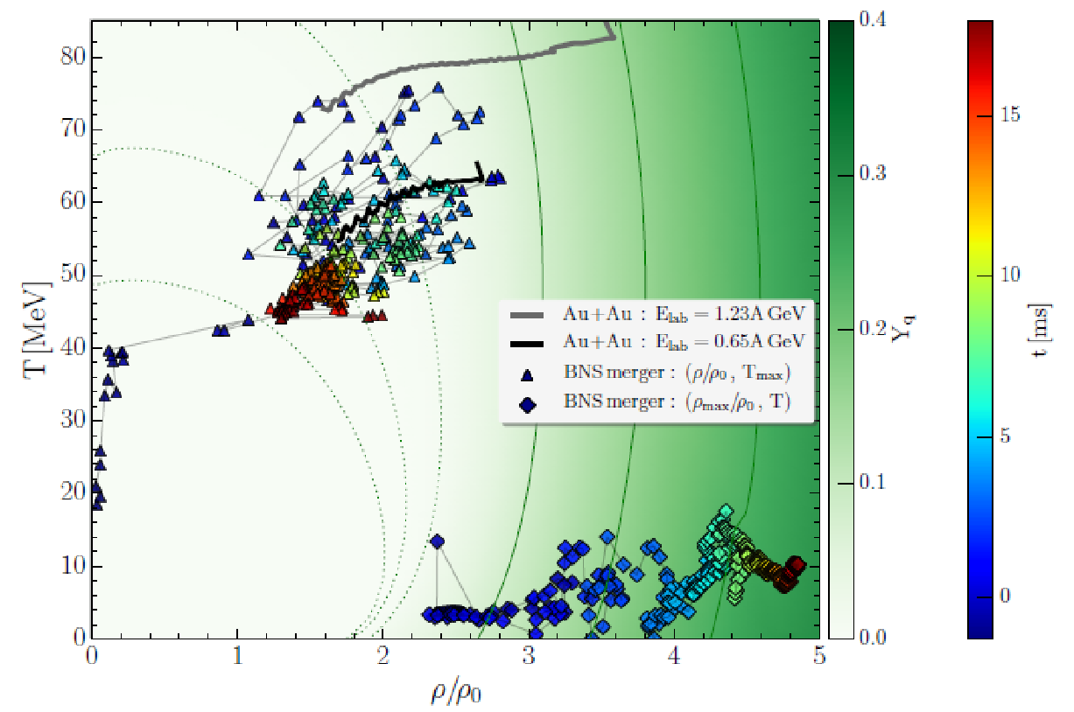
Where it’s hot and dense in neutron star mergers and HIC
Separation of hot hadronic corona and dense, cold quark matter core
Heavy ion Collisions GSI + FAiR same environment as
Bin. Neutron Star mergers

Slide 11
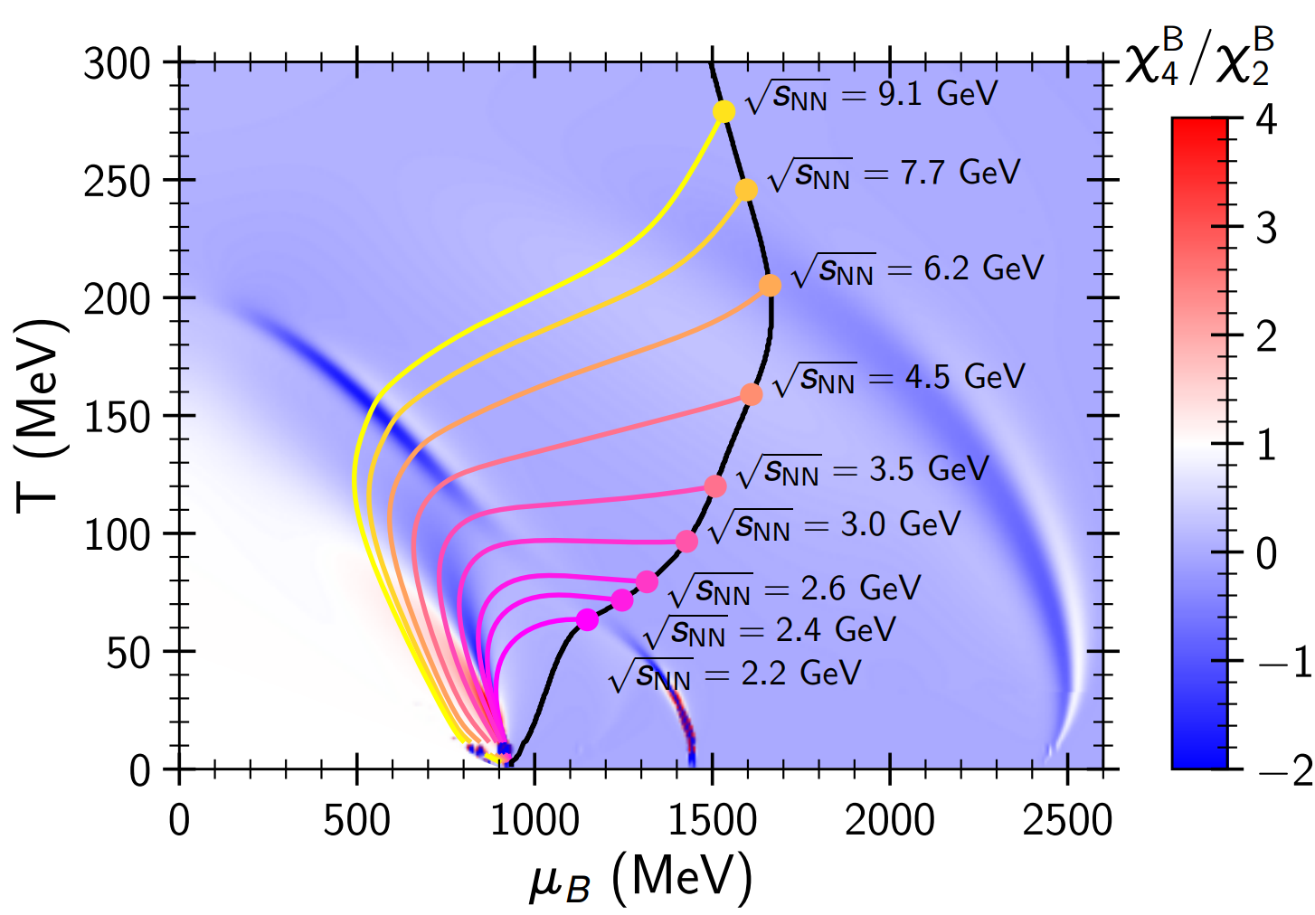
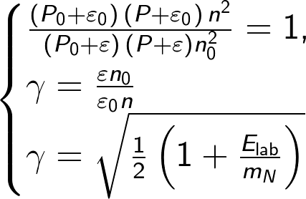
Probing phase diagram of CMF in heavy ion collisions
Isentropes (S/A = const) illustrate hydrodynamical evolution of the central region in heavy ion collision.
Initial entropy per baryon S/A, was estimated by Taub adiabat (shock wave solution):
(A. H. Taub, Phys. Rev. 74, 328 (1948))
P₀, ε₀, and n₀ correspond to the initial pressure, energy density, and baryon density in the local rest frame of each slab

Slide 12
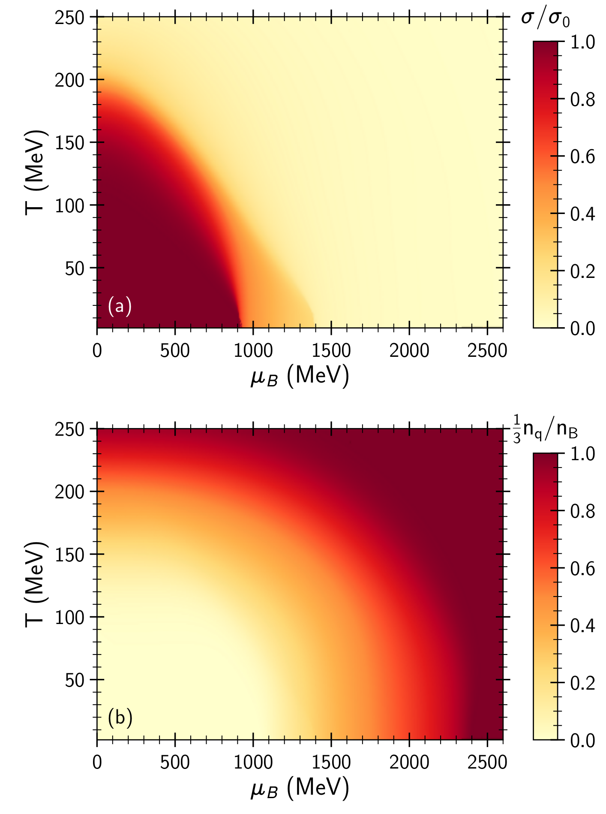
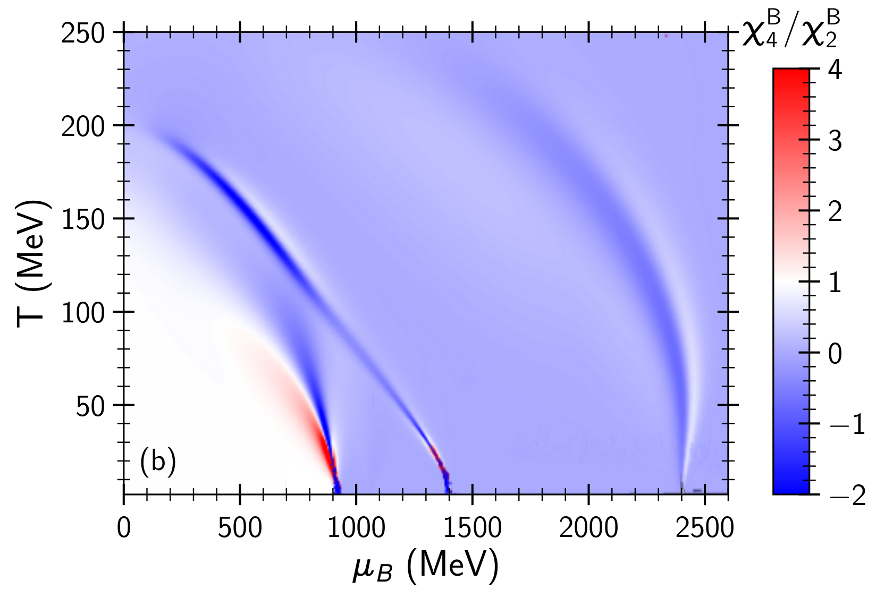
Kurtosis and the phase diagram
Quark fraction
Quark
Matter
_{Quarks+hadrons,}
_{Chiral condensate=0}
_{Chiral condensate}
Dilute
hadrons
Hadronic liquid

Slide 13
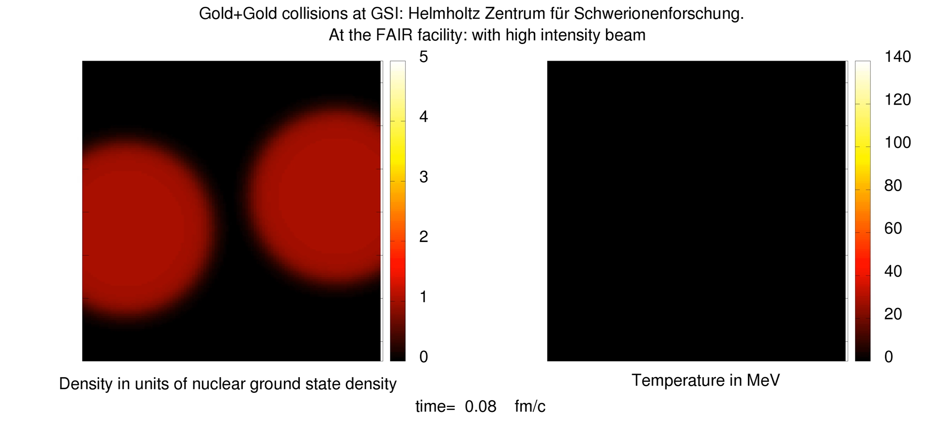
The CMF model applied in fluid dynamical simulations of HIC
Relativistic 4D Hydrodynamics for Heavy Ion Collisions@FAIR
Jan Steinheimer , FIAS Frankfurt
Special Relativistic 3+1Dim Hydrodynamics for Heavy Ion Collisions
’80-/’90-ies : G.Graebner, D.Rischke, et al., ITP, Goethe University

Slide 14
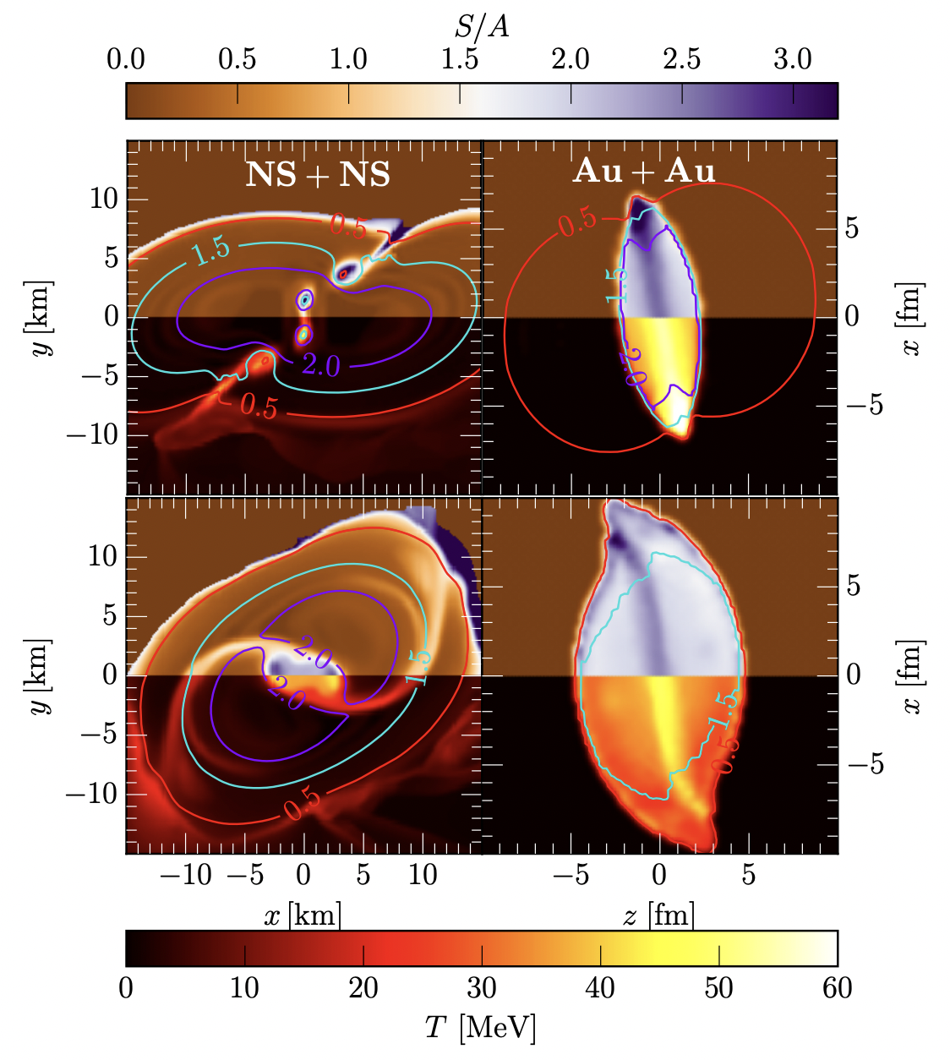
Entropy per Baryon S/A (top colormaps) and
Temperature T (bottom colormaps)
for a BNS merger (NS+NS) with total mass M_{tot} = 2.8 M_{sun} (left panels) and a
Au + Au HIC at E_{lab} = 450 MeV (right panels).
Colored lines mark density contours in units of n_sat.
snapshots in different rows refer to
t = −2, 3 ms before and after merger for the BNS, respectively, and to
t = ±5 fm/c before and after the full overlap for the HIC.
E. Most, A. Motornenko et al, PLB

Slide 15
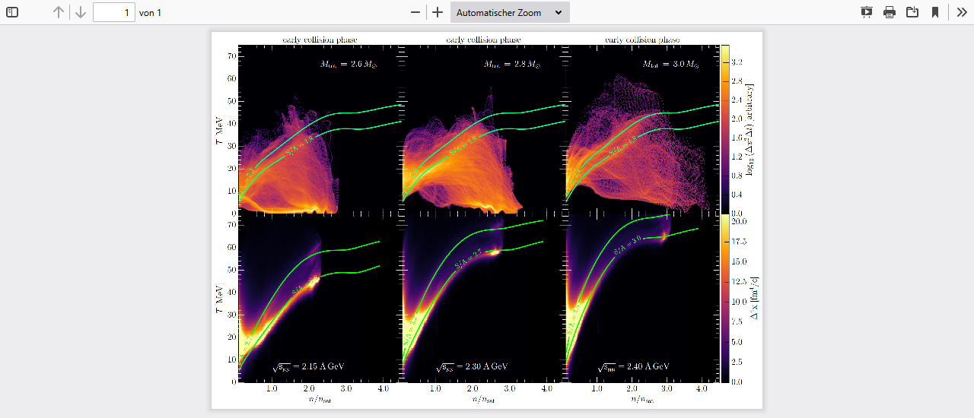
T(n), S/A in
Binary
Neutron
Star
Collision
T(n), S/A in
Binary
Heavy Ion
Collision
Neutron Star S/A > 2, increases with NS mass
GSI/FAIR S/A > 2, increases with E_LAB
Tune Kern-Kern => Stern-Stern EoS in the LAB!
E.Most, A.Motornenko, J. Steinheimer, L. Rezzolla, H.St., PLB

Slide 16
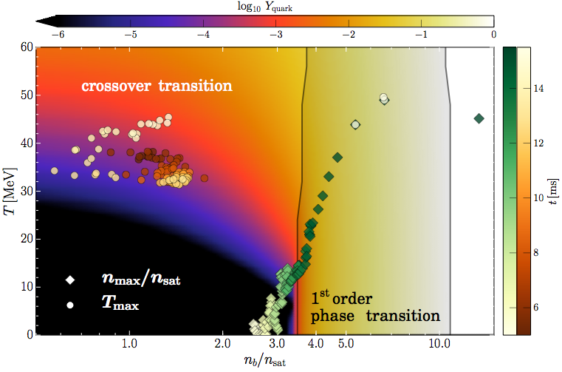
T, n Evolution in the phase diagram
Evolution of the max. temperature and density.
Quarks appear early on in Torus: T~50 MeV
Once core reaches density n/n_0 ~ 3.5, transition into SQM occurs

Slide 17
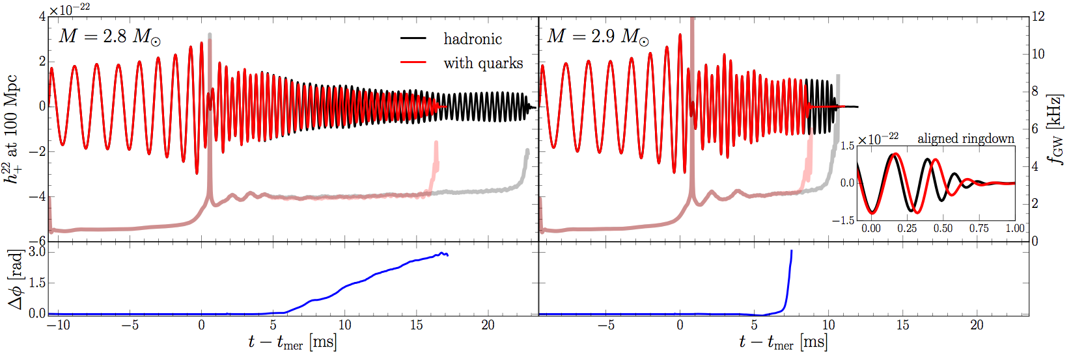
Gravitational Wave Emission from BNSM- ML!
“low-mass” binary
“high-mass” binary
In low-mass binary, after ~ 5 ms, quark fraction is large enough to change quadrupole moment and yield differences in the waveforms.
In high-mass binary, phase transition takes place rapidly after ~ 5 ms
. Waveforms are similar but ringdown is different (free fall for PT).
Mismatch hadronic inspiral and post-merger phase:
clear Signature of Quark Matter - crossing or 1.OPT ?

Slide 18
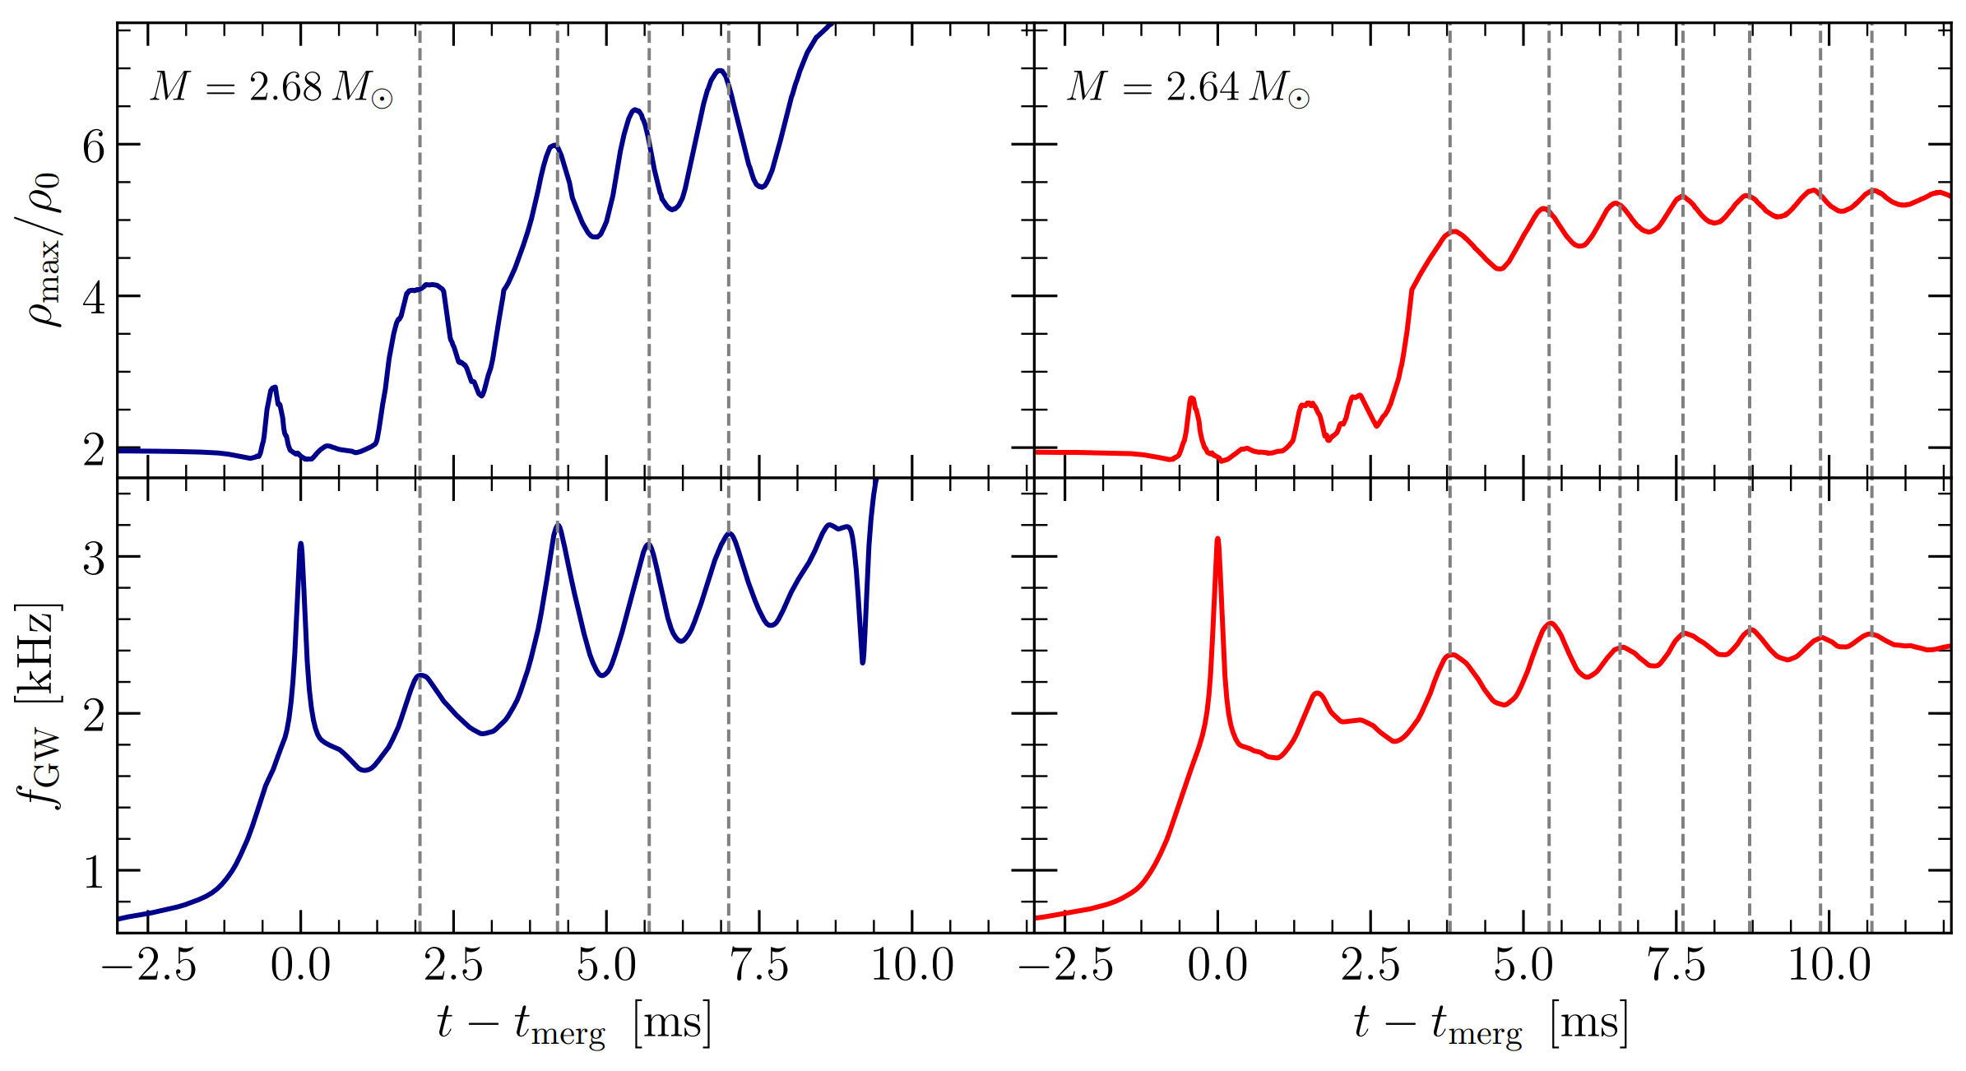
Gravitational Wave Emission from BNSM!
“high-mass” binary
“low-mass” binary
Time dependence of instantaneous GW frequencies
- perfectly in phase with maximum density peaks

Slide 19
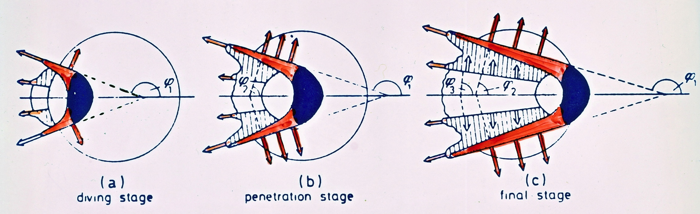
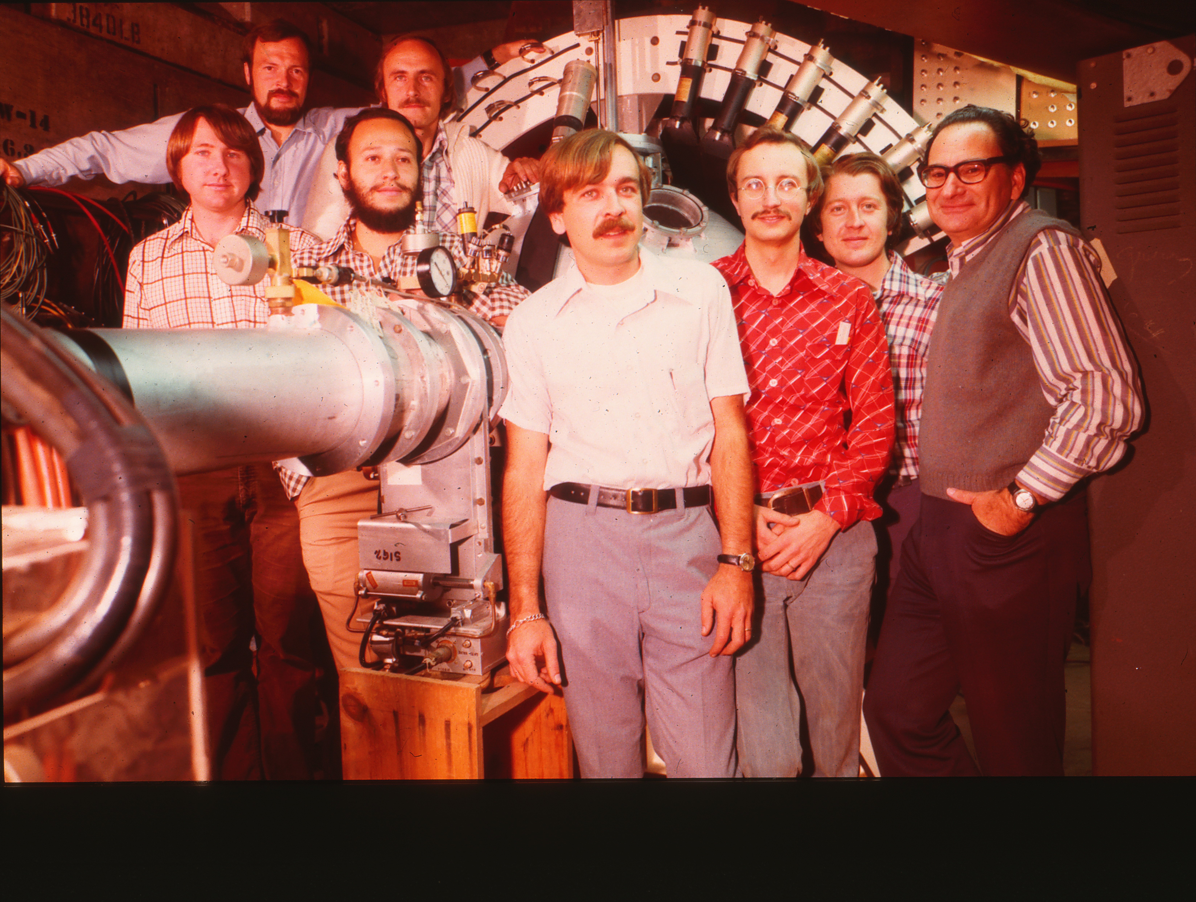
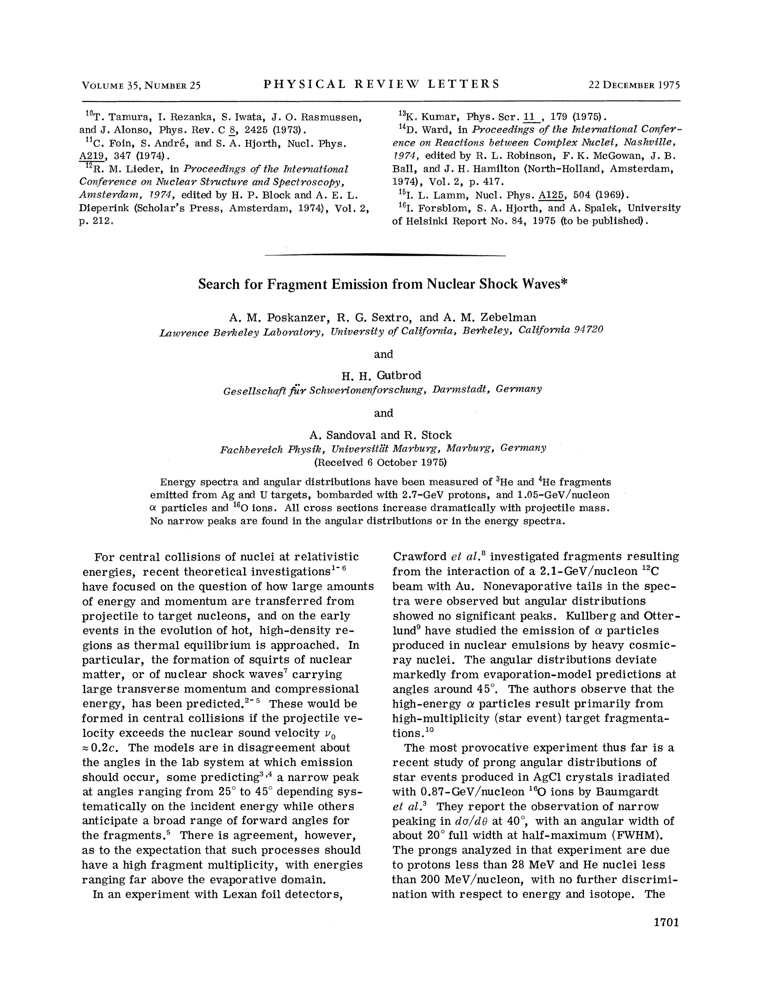
LBL Begins with Single Arm Inclusive Experiments:
Courtesy Karlheinz Kampert
GSI-LBL-Marburg collaboration
1975
Nuclear Schock Wave Peaks early reported:
Baumgardt, Schopper, AgCl Crystals
Predicted: H.Stöcker, Scheid, Greiner - still to be confirmed

Slide 20
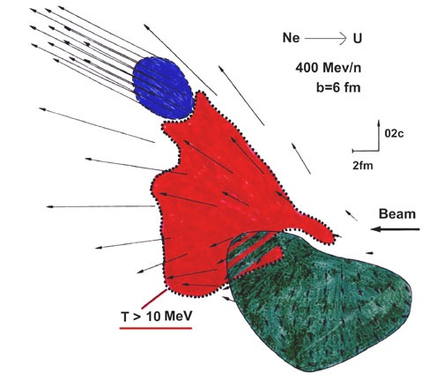
Prediction of Nuclear Collective Flow
Courtesy Karlheinz Kampert
H.Stöcker, Maruhn, Greiner, PRL 44 (1980) 725
Hydrodynamical Calculations
In A+A collisions, interactions among constituents and density distribution lead to
pressure gradient ⇒ collective flow is a
Barometer for the Equation of State (EoS) and viscosity are key ingredients

Slide 21

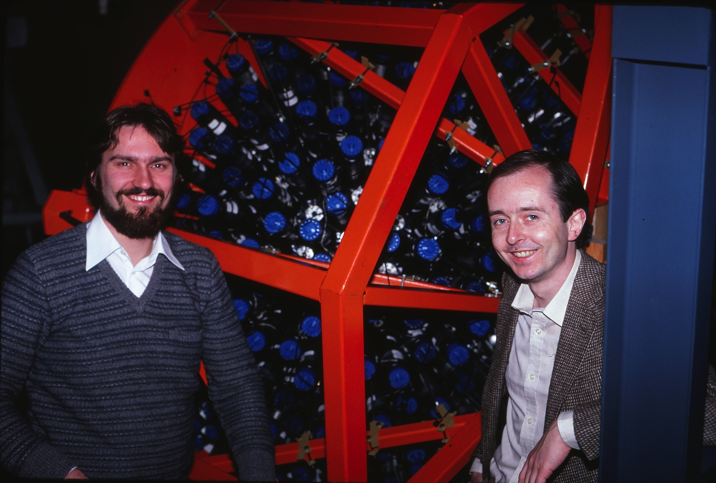
Then young theorists waiting for data…

Slide 22
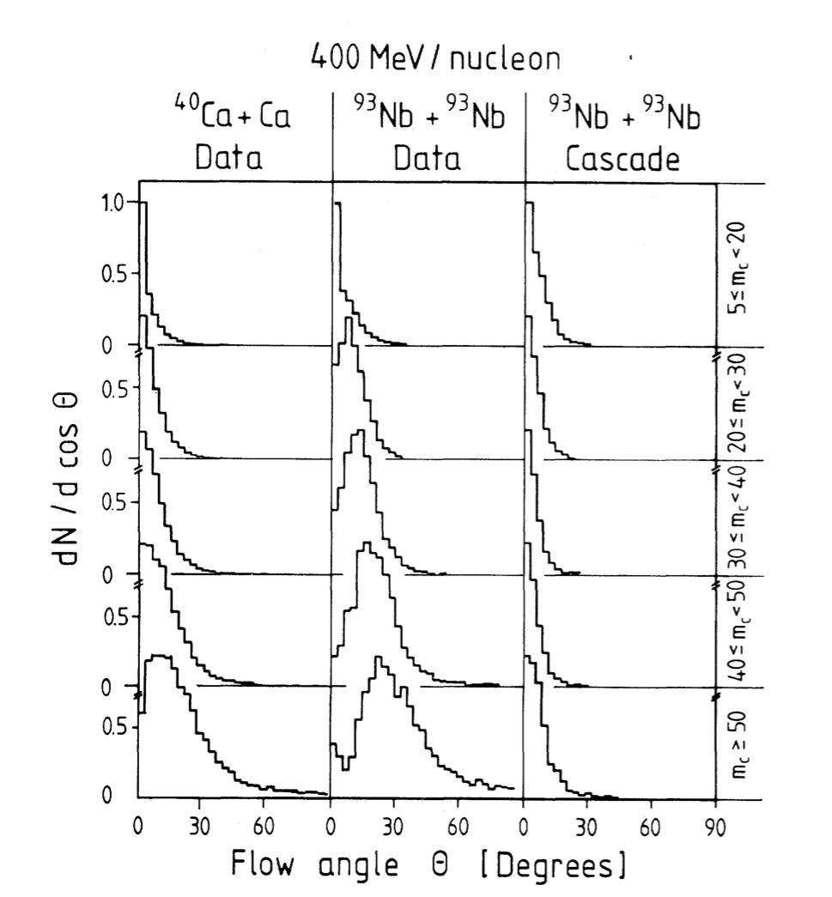
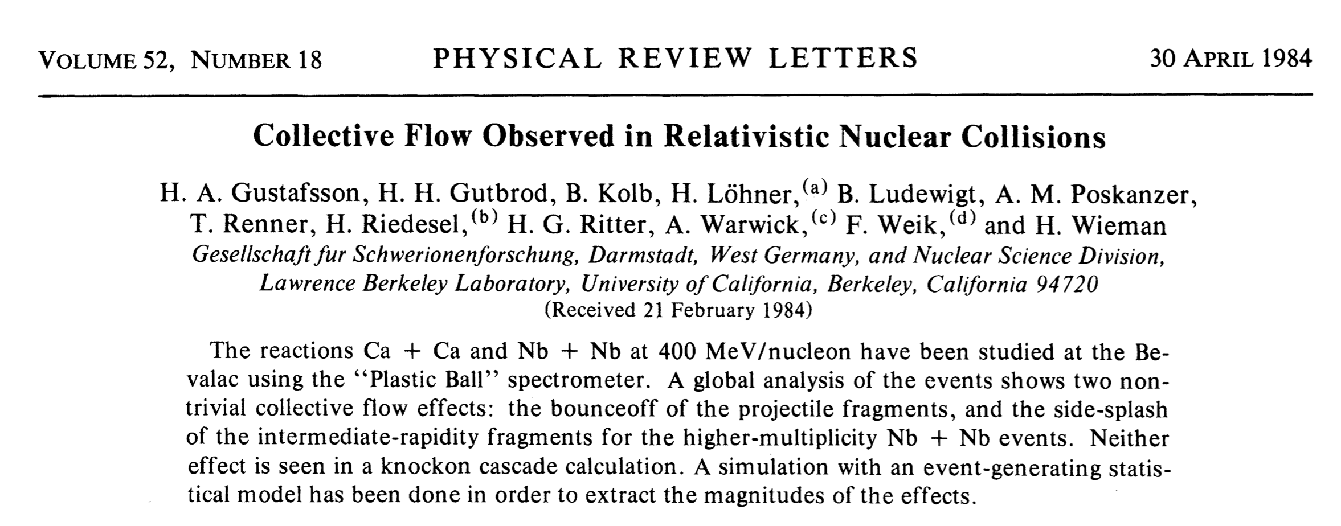
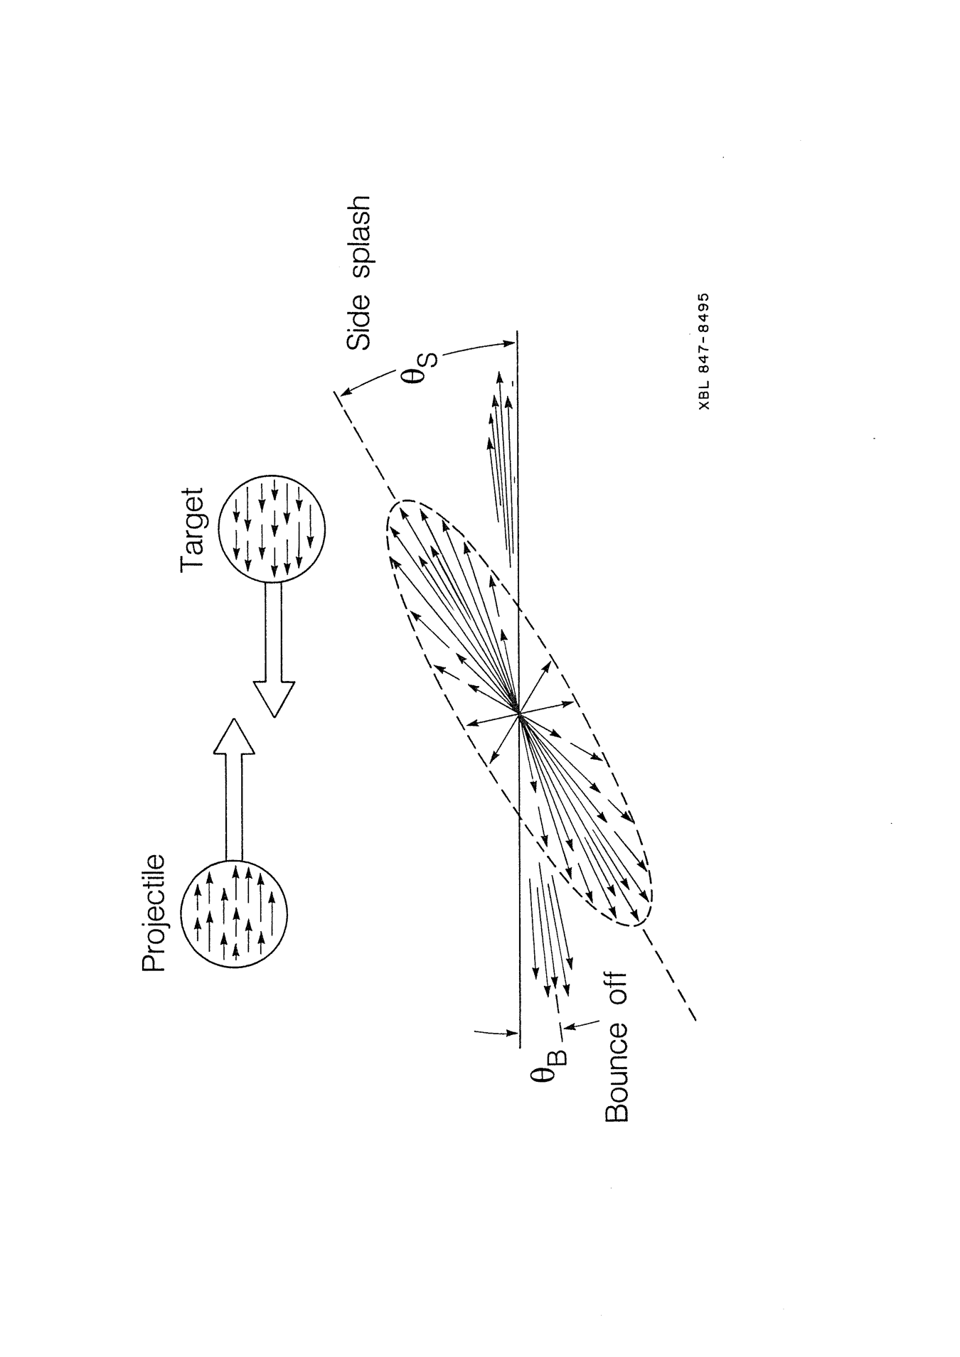
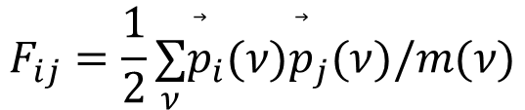
Discovery of predicted Nuclear Collective Flow
Courtesy Karlheinz Kampert
1984
Sphericity Analysis:
rotationally symmetric ellipsoid inclined wrt beam axis by flow angle Θ calculated from momenta of particles:
H.Stöcker, Maruhn, Greiner, PRL 44 (1980) 725
$$F_{ij}=\frac{1}{2}\underset{ν}{∑}{\overset{⃗}{p}}_{i}(ν){\overset{⃗}{p}}_{j}(ν)/m(ν)$$
(kinetic energy flow)
PB Data confirmed hydro flow calculations
- and ruled out intranuclear cascade

Slide 23
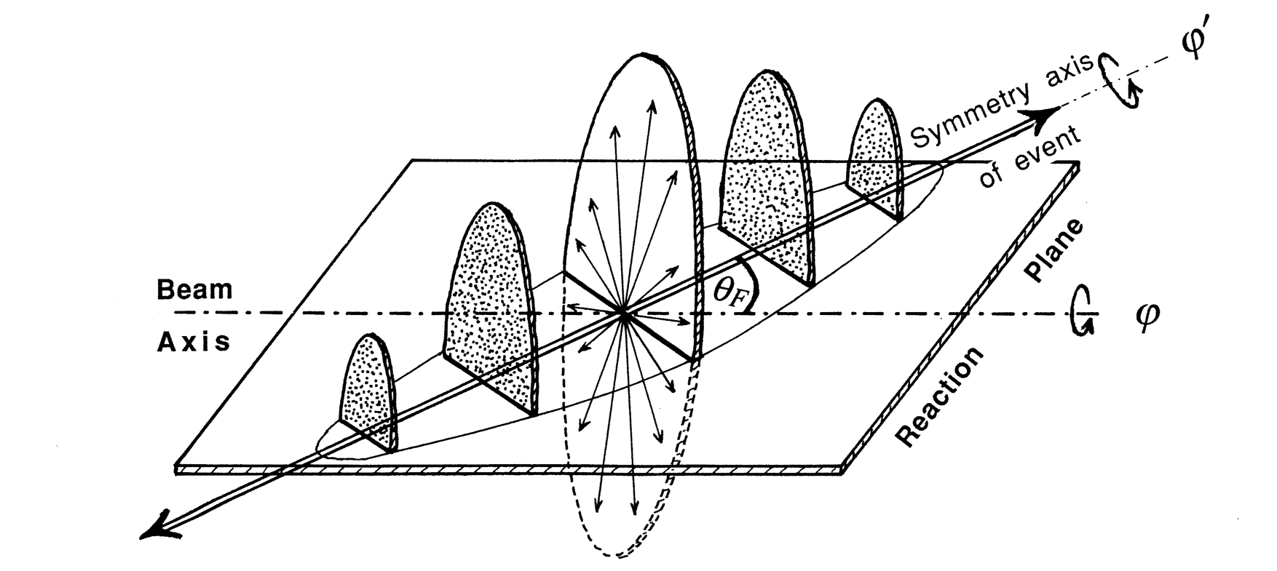
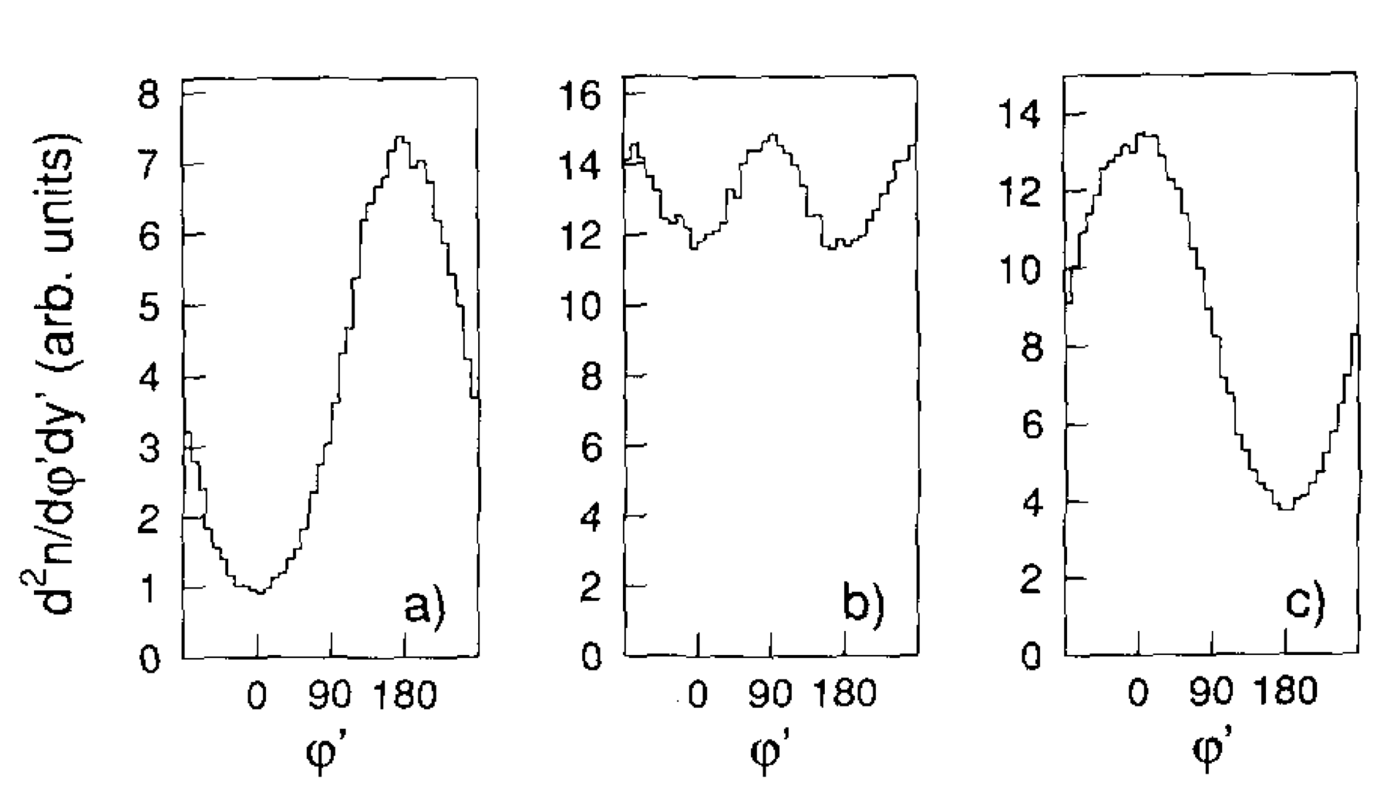


Discovery of predicted „Squeeze-Out“
1989
Aspect ratios of half-axes at $y_{mid}$
Ch. Hartnack IQMD, v2=(px^2-py^2)/pT^2
first indications by Diogene experiment
90°
H. Gutbrod, K.H.Kampert, B.W: Kolb,
A.M. Poskanzer, H.G. Ritter, H.R. Schmidt; Phys. Lett. B216 (1989) 267
Au+Au at 400 AMeV
Courtesy:
Karlheinz Kampert
90°
Note, this was the forerunner
of the Fourier expansion analysis
backward
midrapidity
forward
Opened a new window to the fireball

Slide 24
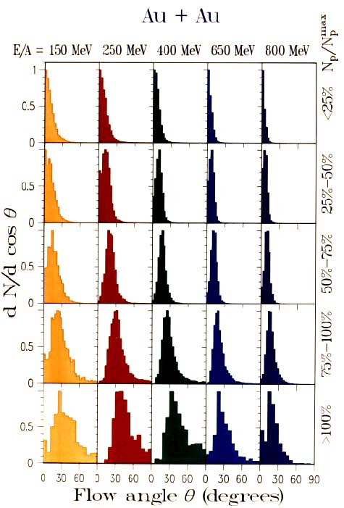
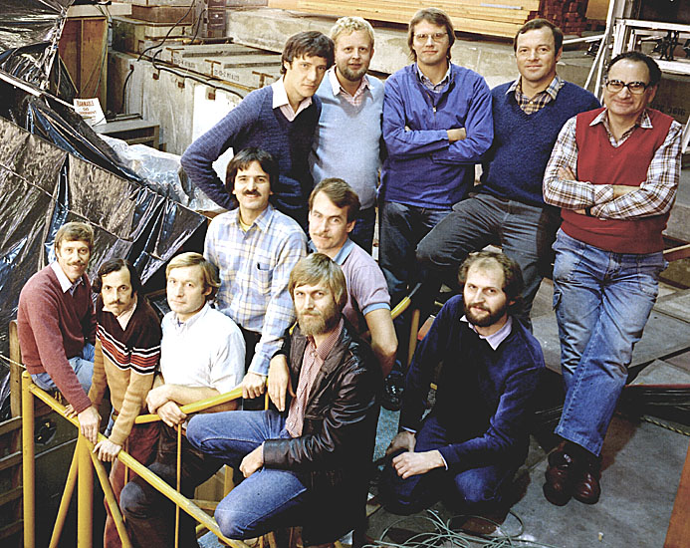
Discovery of the predicted Sidewards Flow!
1984
Courtesy Karlheinz Kampert

Slide 25
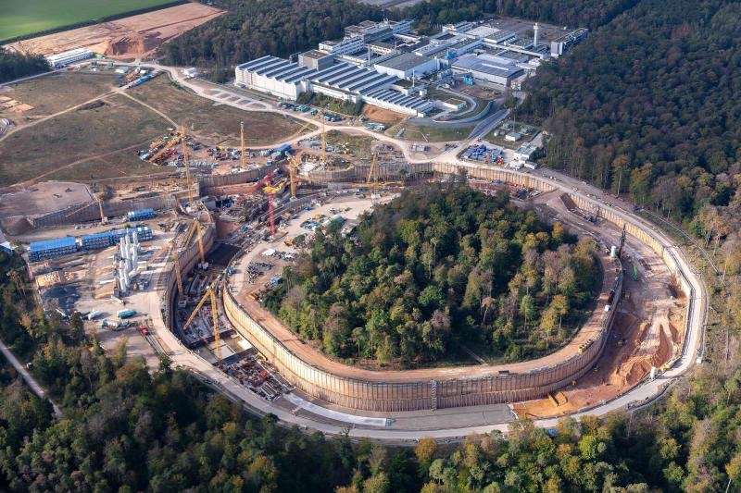
Death-Star- Machines - FAIR HIAF NICA STAR
NeutronStar matter in the Lab - Heavy Ion Collisions

Slide 26
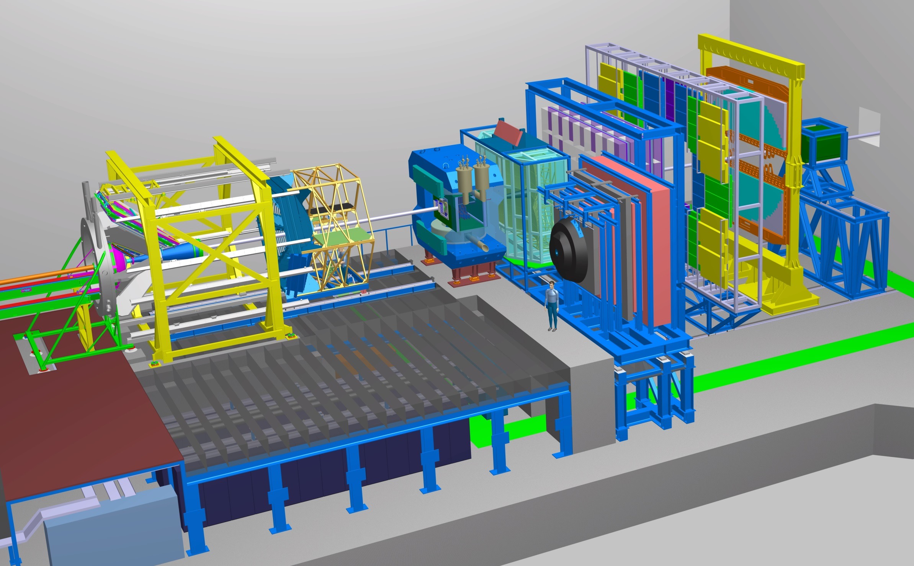
The CBM experiment
Transition
Radiation
Detector
Time of Flight
Detector
Ring
Imaging
Cherenkov
Dipol
Magnet
Silicon
Tracking
System
HADES
p+p, p+A
A+A (low mult.)
Micro
Vertex
Detector
Muon
Detector
Projectile
Spectator
Detector
DAQ/FLES HPC cluster
2/27/2018
H. Stoecker FAIR Discoveries

Slide 27
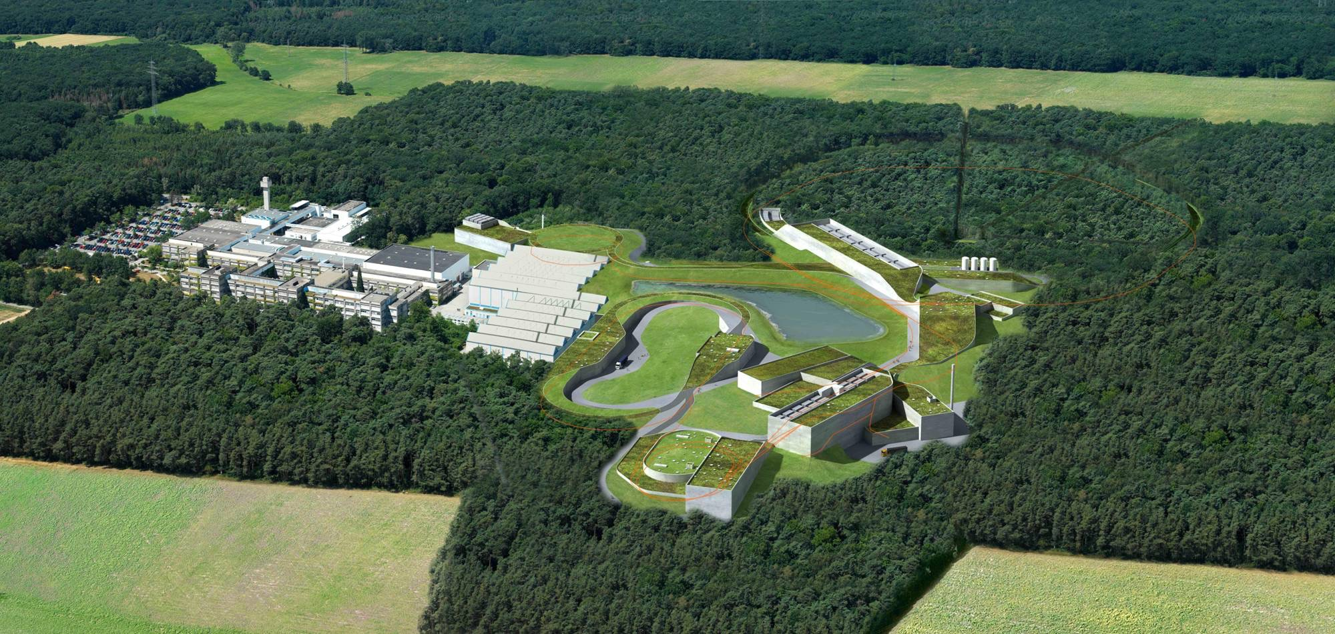



















Death-Star- Machines - FAIR HIAF NICA STAR
NeutronStar matter in the Lab - Heavy Ion Collisions
Charm and Beauty of International Collaboration
Observers
Poland
Slovenia
Russia
Rosatom
Finland
France
Germany
India
Italy
Spain
Sweden
Romania
Austria Czech
Hungary
China
H. Stoecker FAIR Discoveries
UK
11.11. 2019

