Slide 1

Key parameters for strong a-axis grain growth in narrow filament cavities of Bi-2212 round wires
F. Kametani, J. Jiang, M. Matras*, Y. Oz, A. Oloye, D. Abraimov, A. Francis, U. P. Trociewitz, E. E. Hellstrom, D. C. Larbalestier
Applied Superconductivity Center, National High Magnetic Field Laboratory, Florida State University
* Now at CERN, Switzerland

Slide 2
Superconducting magnets over 16 T need HTS
FCC performance target for Nb₃Sn
(A. Ballarino, FCC Workshop April 2016)
J_{e}(4.2K, 16T) = 600 A/mm²
Bi-2212 is the only HTS cuprate with which high J_{c} round wires can be made.
Recently J_{c} increased 70% with the new US-made powder (4MO1-03 J. Jiang)
Why is high J_{c} possible in Bi-2212 round wires?
Plots by P. J. Lee

Slide 3
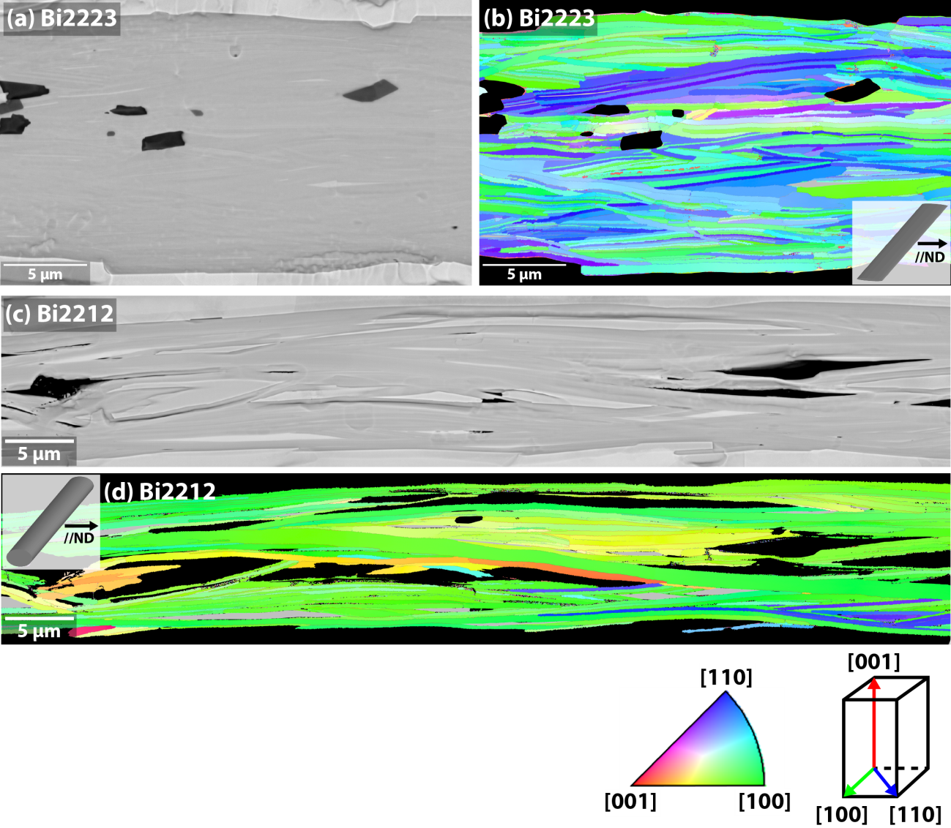
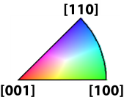
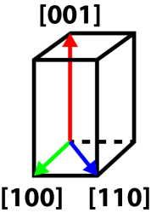
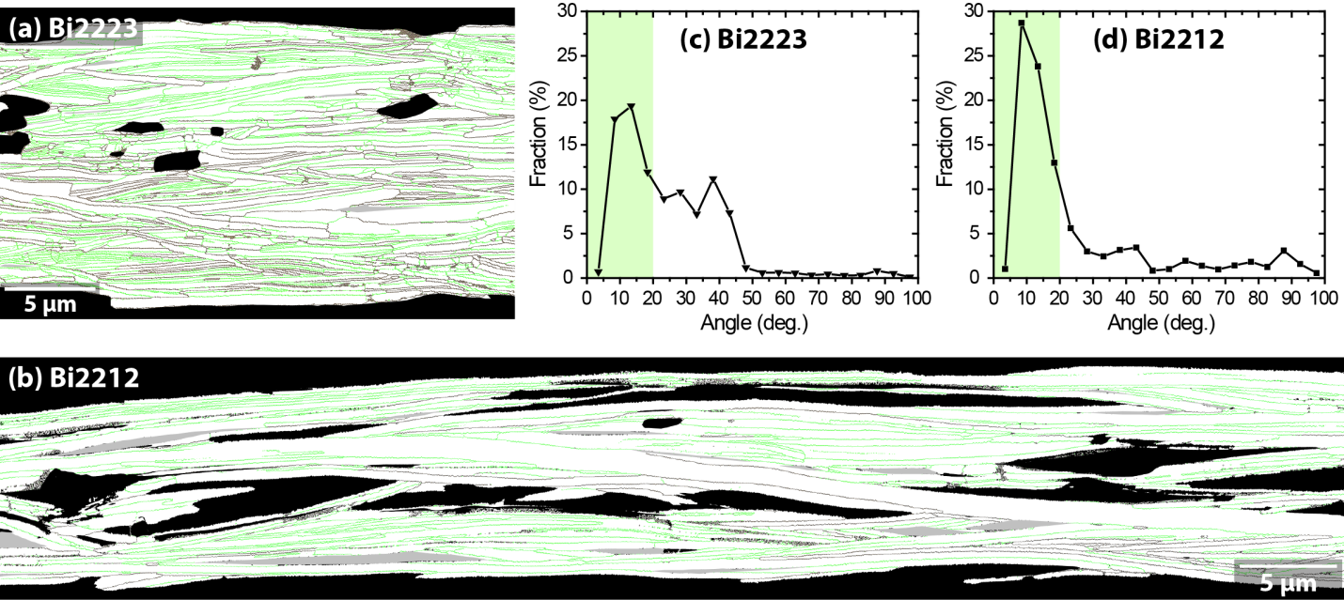
Bi-2212 grain alignment along the wire direction is the key for high J_{c}/J_{e}
SEM
EBSD IPF
Inverse pole figure color coding and crystallographic direction in Bi-2212
GB misorientation angle fraction
EBSD GB
0.3-1.0 µm thin, 50-300 µm long grains
Majority of GB misorientation are <20° by quasi-biaxial grain alignment

Slide 4
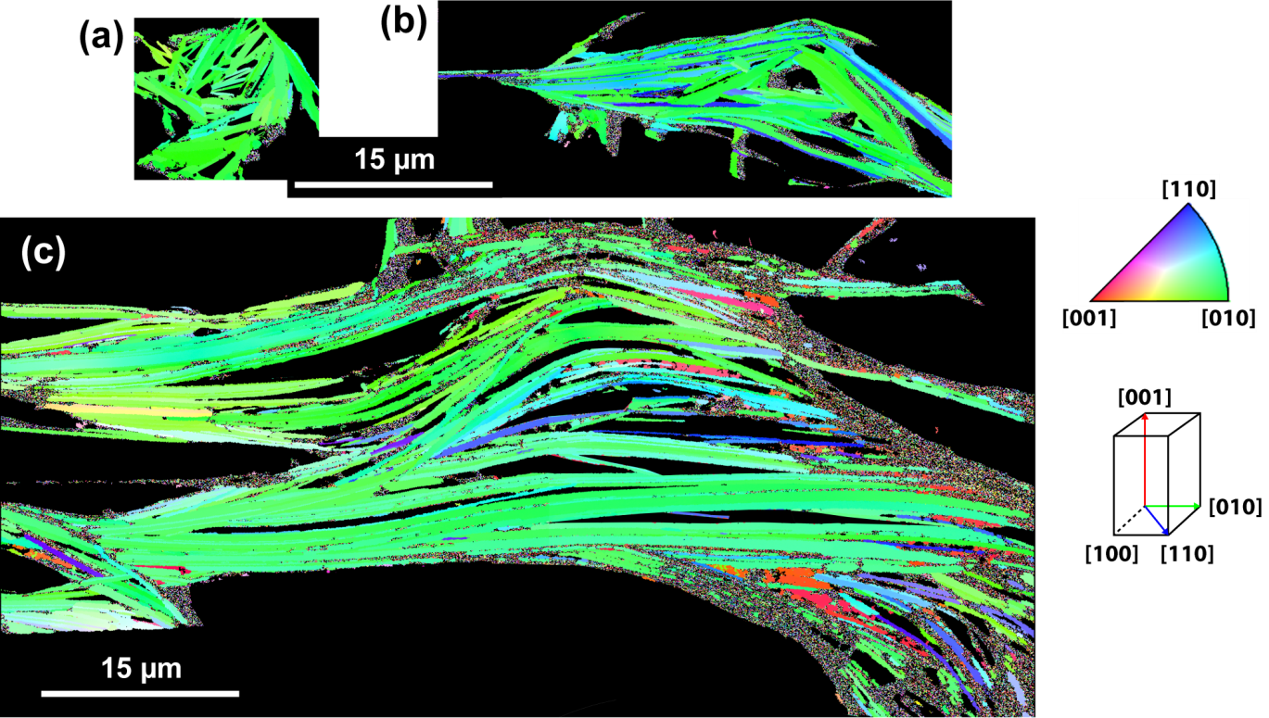
Same scale comparison of grain structure in different transverse cross-sections of filaments
Two filament bonded
Single filament
[100]
6-7 filament bonded
Wire direction

Slide 5
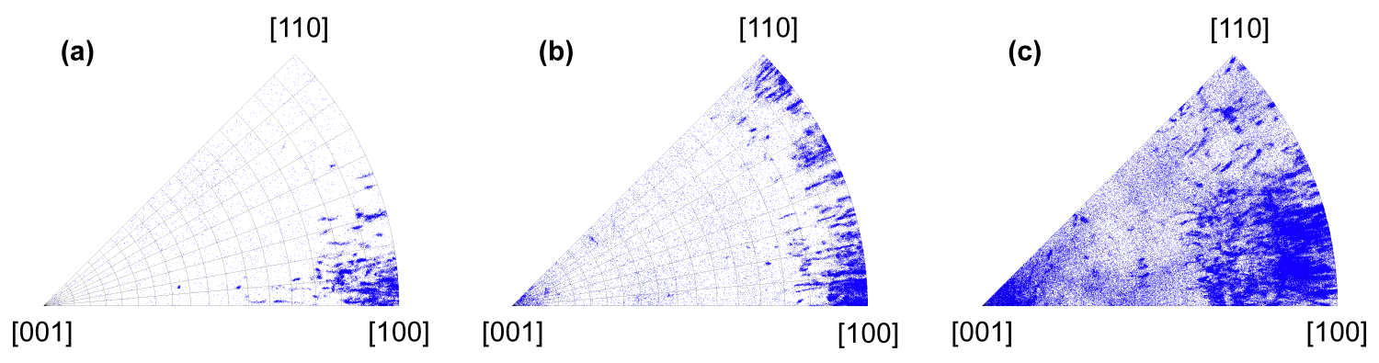
Comparison of inverse pole figures along the wire direction -
The more filament bonding, the more degradation of a-axis texture
Single filament
Two filament bonded
6-7 filament bonded
IPF along the wire direction of the IPF grain maps in the previous slide.
FWHM of a-axis texture in a single filament is <10°. When the two filaments merge in one, it allows more distribution of in-plane grain misorientation. The 6-7 filaments bonded into the large one, the grain misorientations distribute >25° in both in-plane and out-of-plane, presumably degrading J_{c} most significantly.

Slide 6
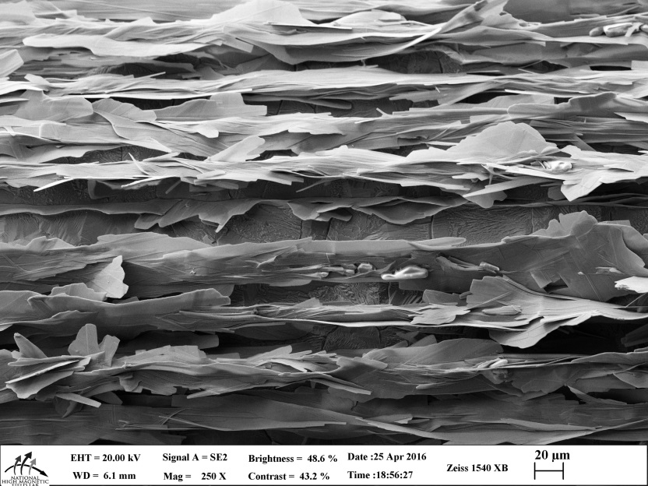
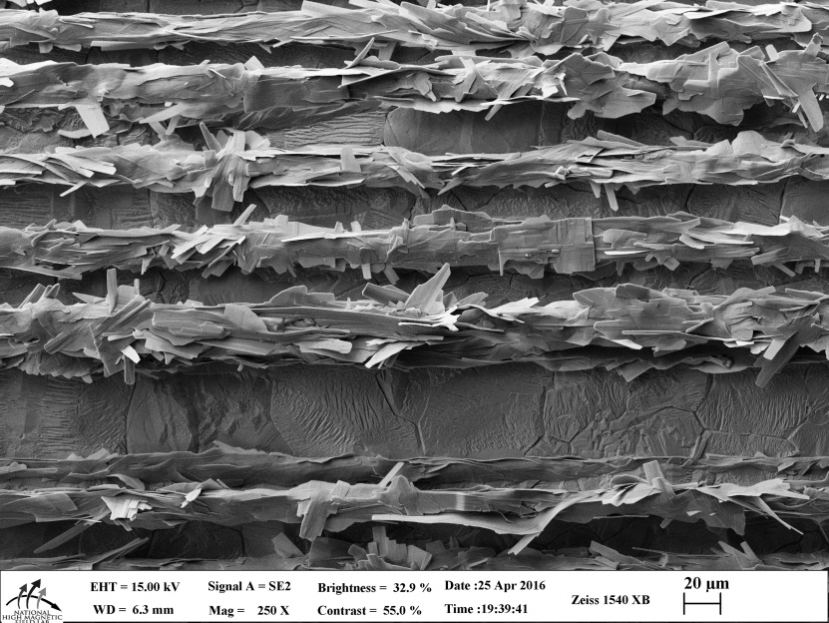
Cooling rate changes the grain size
Slow cooling
Design of Experiments (DoE) Conclusions
(37x18 and 27x7):
  Cooling rate R_{F} and Time in melt t_{melt} affect I_{C} the most
R_{F} = 1.3°C/h
Cooling rate R_{F} controls:
  Amount of second phases
  Amount of 2212
  Filament coupling
  Grain size
  Grain alignment
  2212 connectivity along the length
I_{c}(4.2K, 5T) = 380 A
Fast cooling
R_{F} = 9.7°C/h
M. Matras, PhD thesis at FSU (2016)
I_{c}(4.2K, 5T) = 110 A

Slide 7
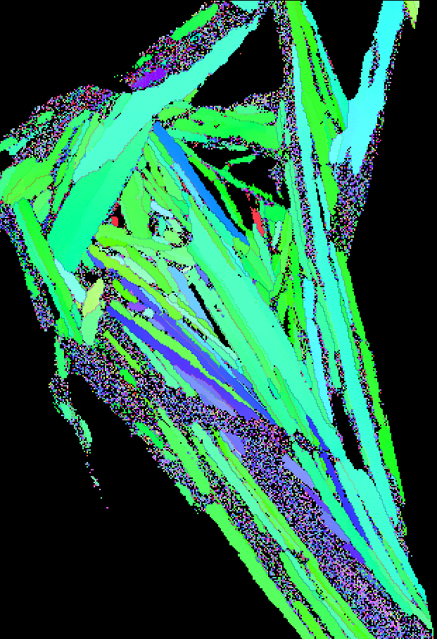
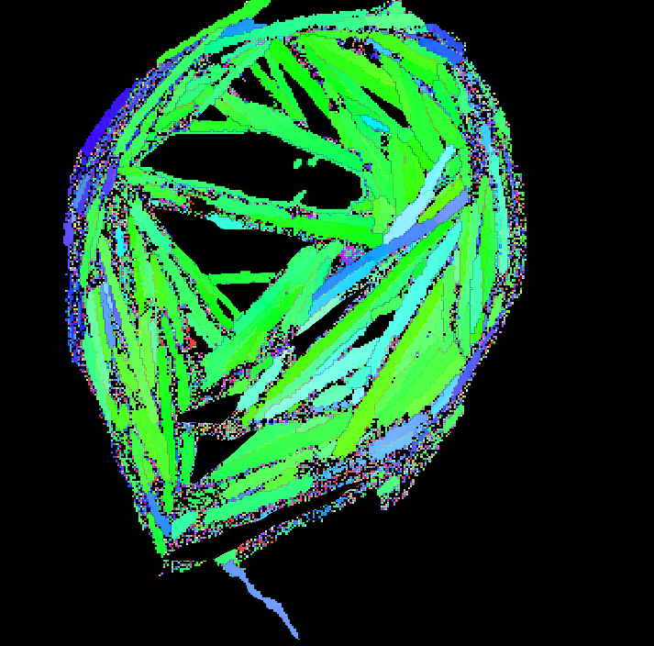
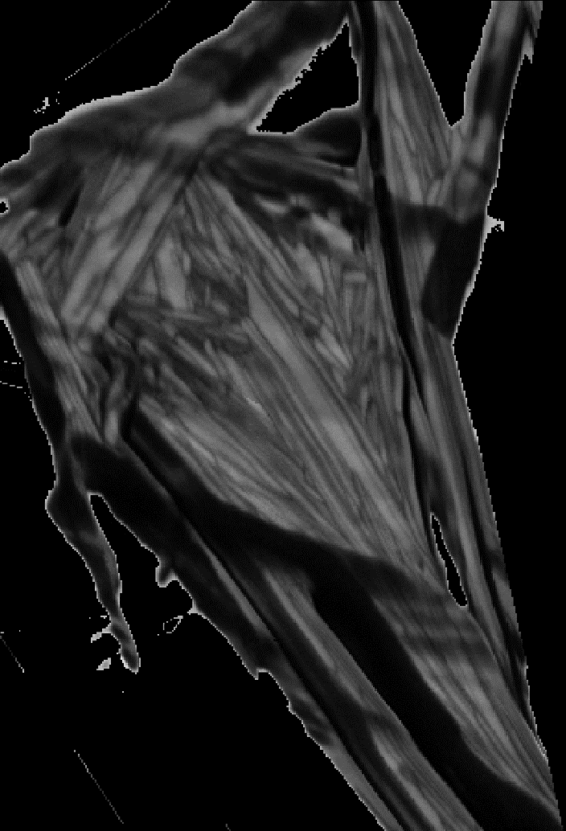
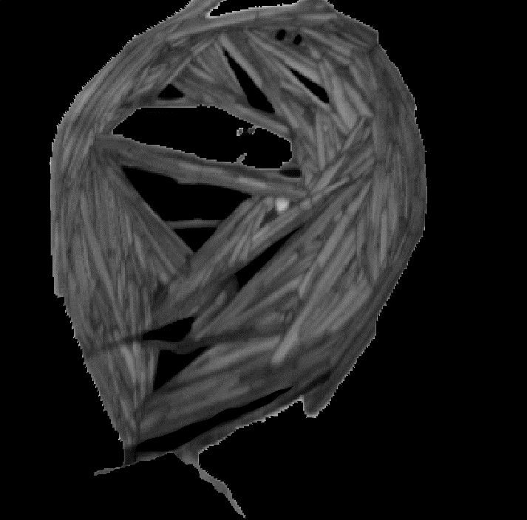
Cooling rate appears not to affect a-axis grain nucleation
Large Bi-2212 grains doesn’t form by fast cooling, perhaps spoiling the grain connectivity along the filament length
5 µm
5 µm
asdf
Fast cooling
Slow cooling
EBSD by A. Oloye

Slide 8
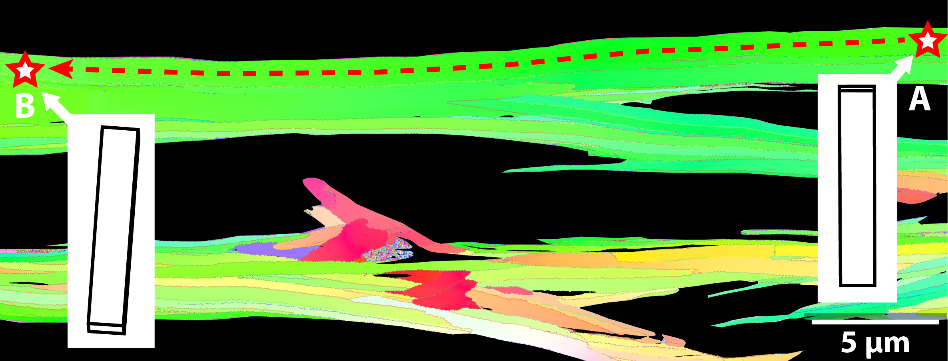
The long and thin Bi-2212 grains can plastically twist during growth
One long grain can twist and compensate the c-axis misorientation up to ~30°
Larger grains allow more twisting to decrease GB misorientation along the filament direction

Slide 9
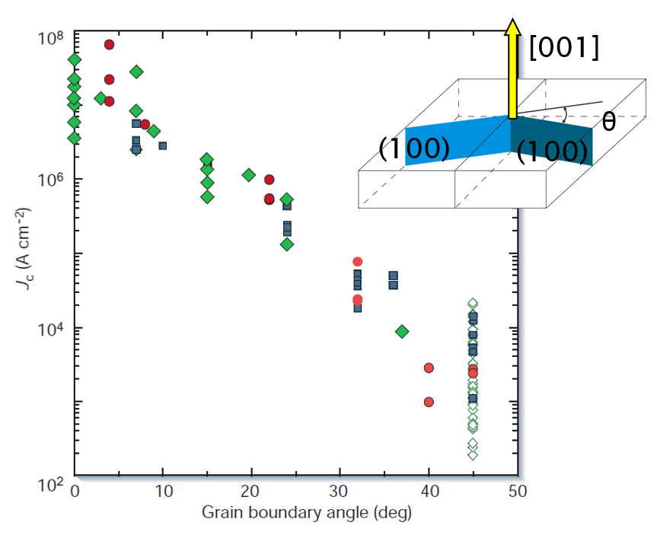
Why don’t the15° GBs in Bi-2212 show weak connectivity?
The bicrystal experiments of HTS cuprates indicates that 15° GBs are still high angle, and would be weakly coupled
But high J_{c} Bi-2212 RWs don’t show a signature of weakly coupled GBs
Is Bi-2212 special among the HTS cuprates?
Does oxygen overdoping strengthen the connectivity of grain boundaries?

Slide 10
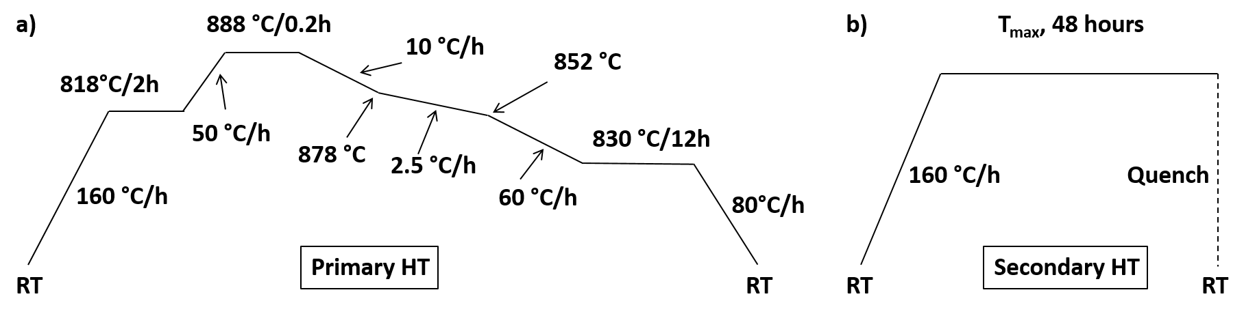
Post annealing in low oxygen atmosphere underdopes Bi-2212
Standard HT
Post annealing
1 bar pO₂
0.01 bar pO₂
Can we make the GB coupling weaker by underdoping?
Y. Oz

Slide 11
Underdoping affects T_{c}, H_{irr}, J_{c}
Post-annealing pO₂ = 0.01 bar
PO₂ = 0.01 bar
PO₂ = 0.01 bar
Y. Oz
But no J_{c} hysteresis was observed in significantly underdoped samples
Was the GB connectivity not affected by underdoping?

Slide 12
Conclusion
Bi-2212 has the unique quasi-biaxial grain structure
  Strong a-axis (NOT c-axis) texture, although prior deformation (wire drawing) can play no role in the grain growth
  Surprisingly in-plane misorientation is ~15° too
Bi-2212 quasi-biaxial texture development is dependent on filament cavities
Cooling rate affects the grain size, but doesn’t affect very much on the a-axis texture development
  The larger grain size, the more plastic twisting to decrease GB misorientation along the wire direction?
Bi-2212 under oxygen-overdoped, possibly enhancing the carrier density at the GBs, but the underdoping experiments could not alter the GB connectivity

Slide 13
Acknowledgements
Supported by the US DOE Office of High Energy Physics under grant number DE-SC0010421, and by the NHMFL, which is supported by NSF under NSF/DMR-1157490 and by the State of Florida.
All Bi-2212 round wires were fabricated by Bruker-OST

