Slide 1

Testing MDP corc-conductor based insert coil in 10 T background field of DCC017 magnet at BNL
M Kumar, P Joshi, R Gupta, et al.
D Laan, J Weiss, Z Johnson
R Tyber, L Luo, M Martchevsky, X Wang
BNL, ACT, LBNL
E-mail: mkumar@bnl.gov

Slide 2
Talk Outline
Test Facility
MDP corc sample
Testing Preparations
Run Plan

Slide 3
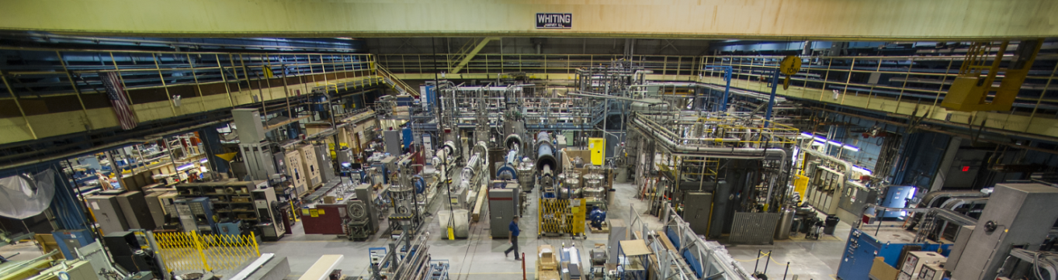
Magnet Test Facility
Five Horizontal test bay with 10kA PS and SCR energy extraction switch
Vacuum pumps for 1.8K operation
30-ton crane with hook height of 8m
Dewar
#6
Dewar
#2
Five vertical test Dewar with 30kA PS and 24kA IGBT energy extraction switch
Cryo plant with He liquefaction capacity around 260L/Hr

Slide 4
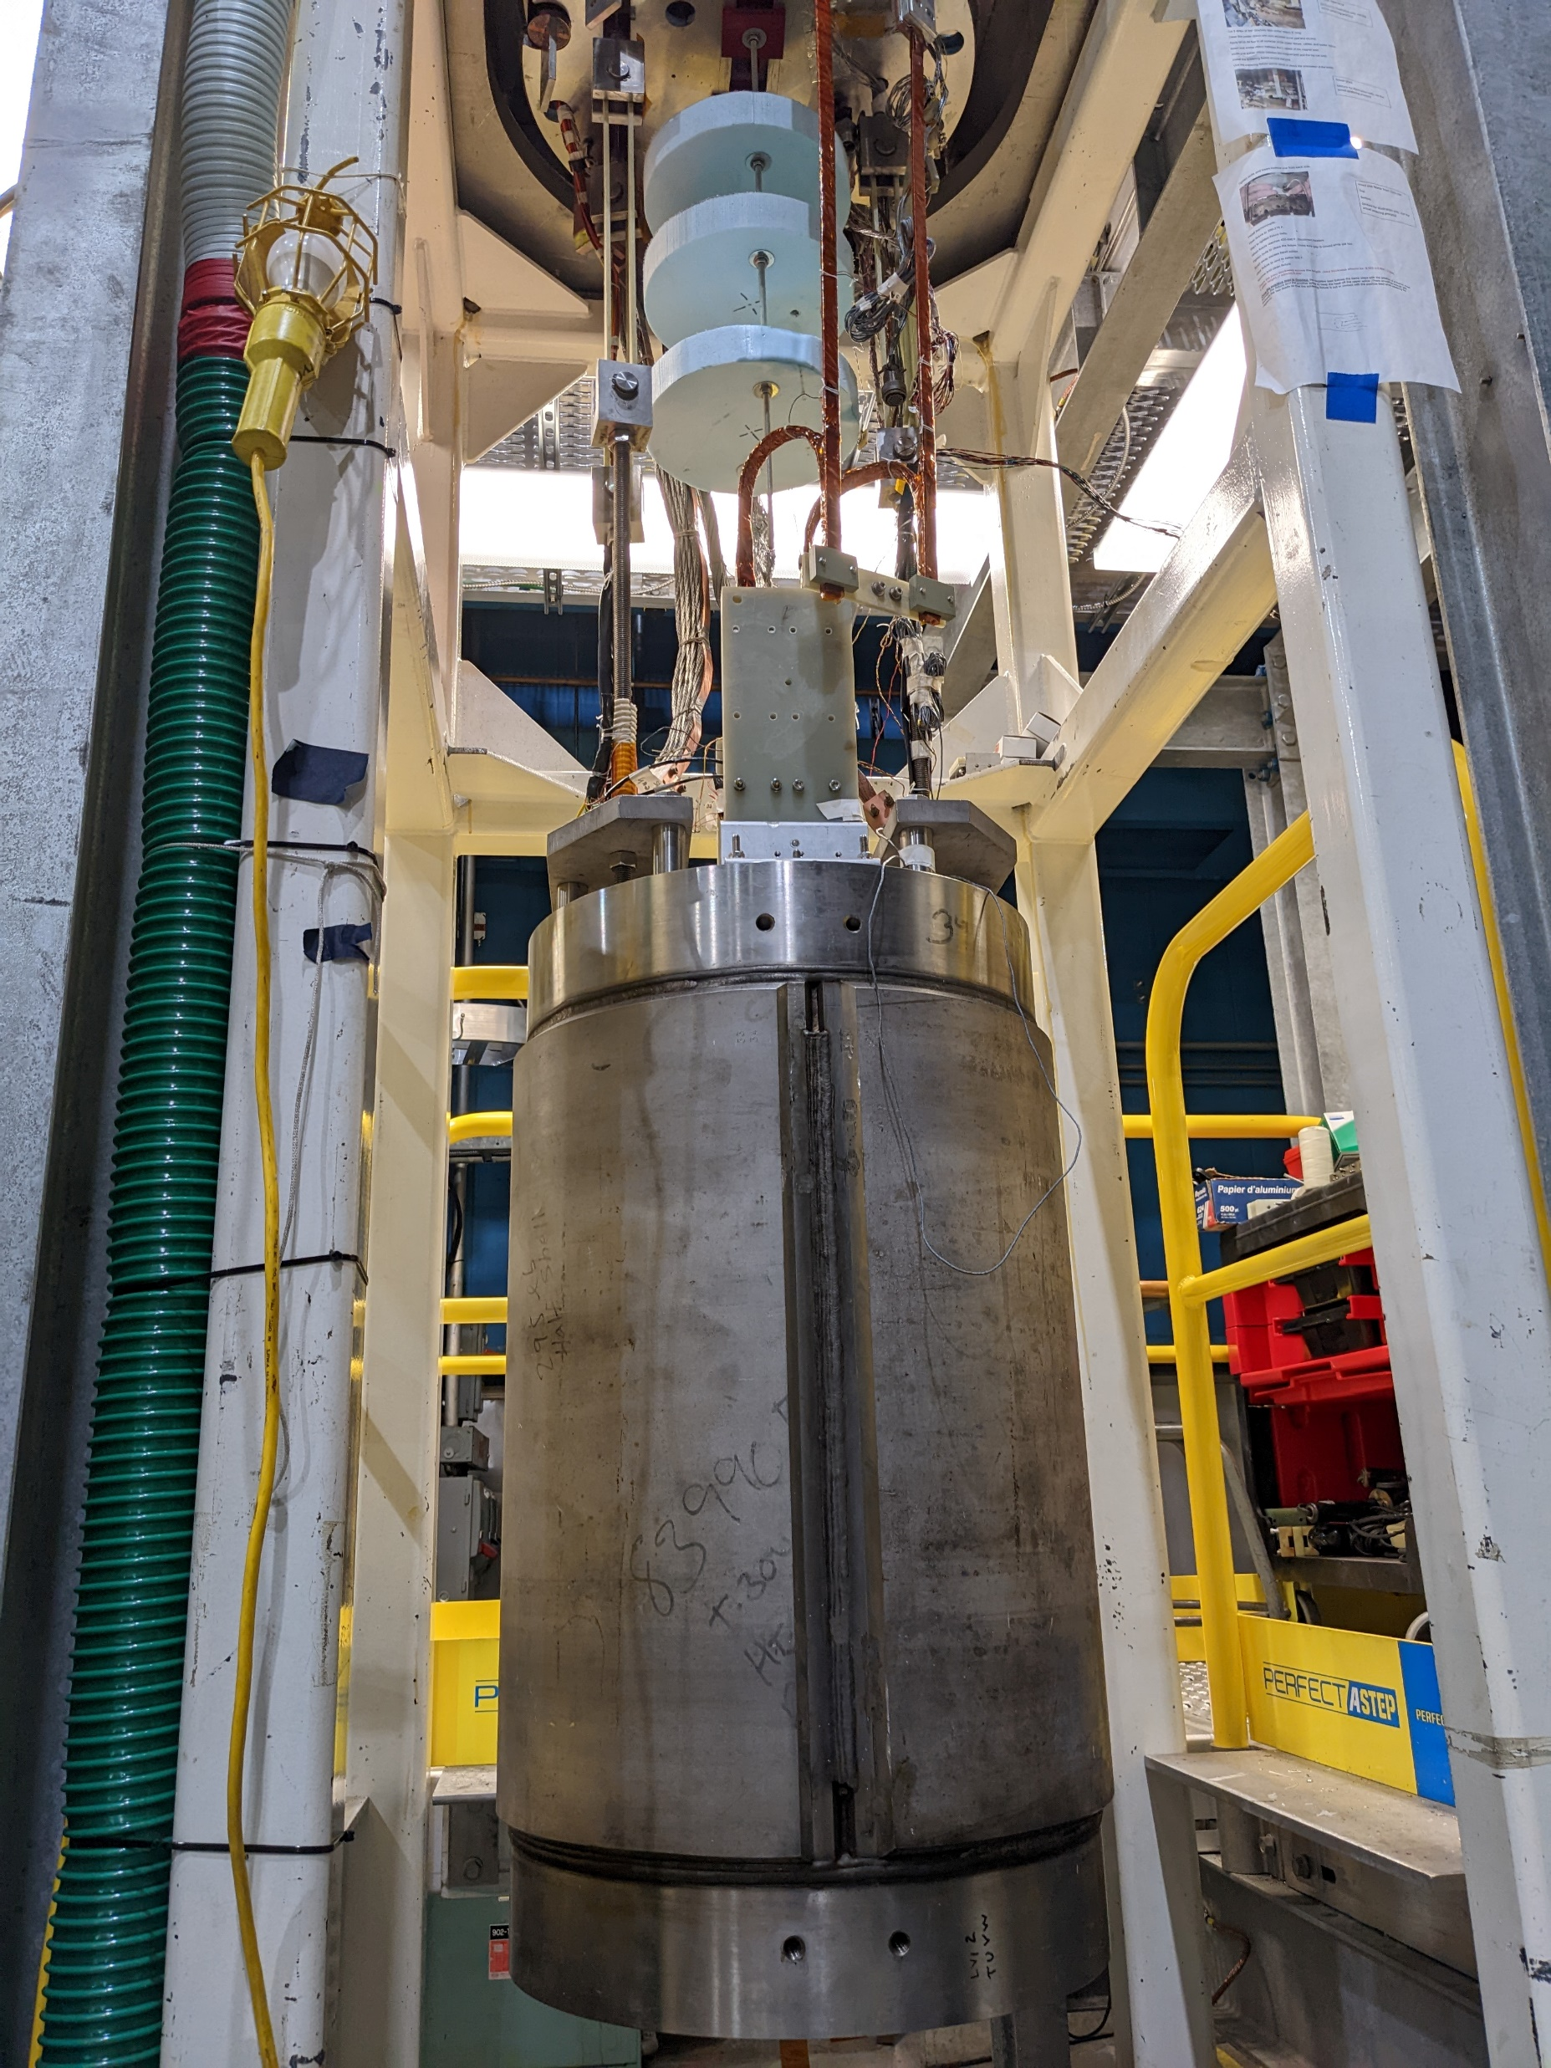
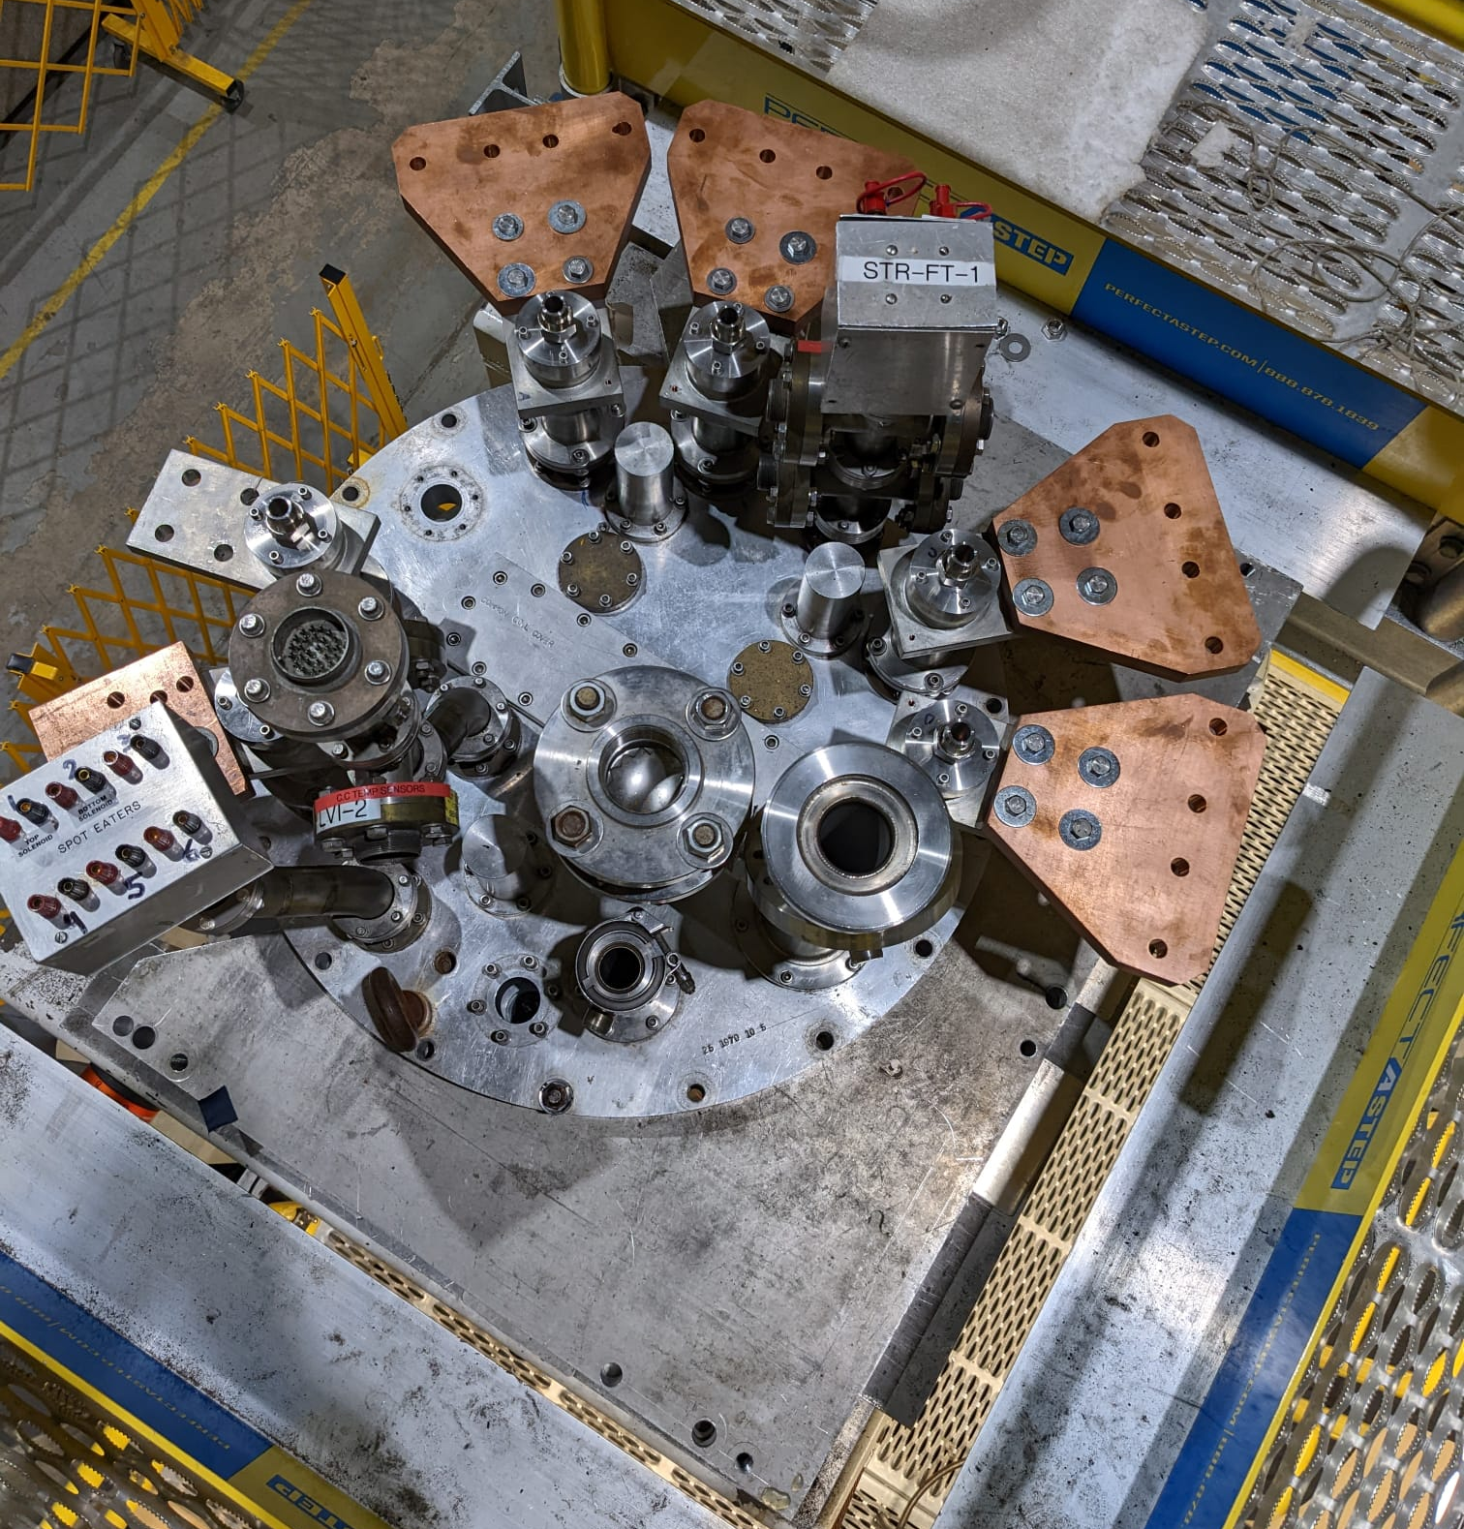
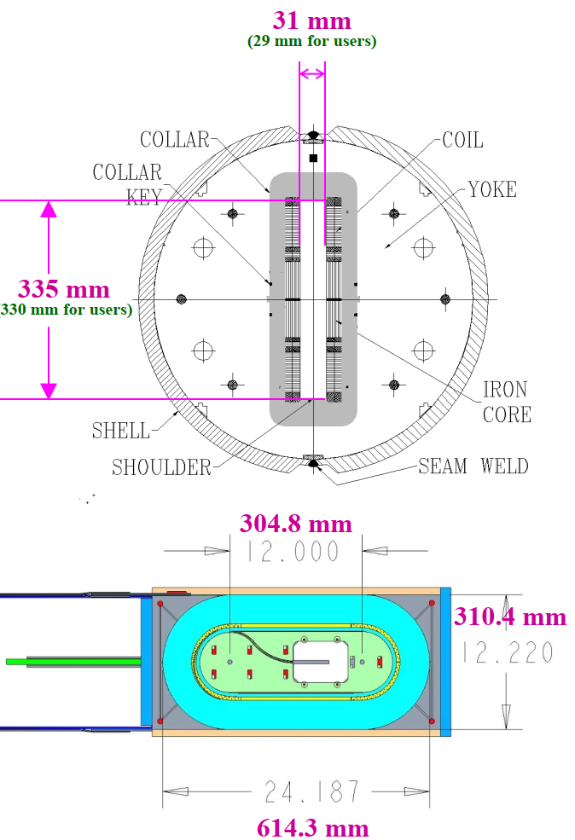
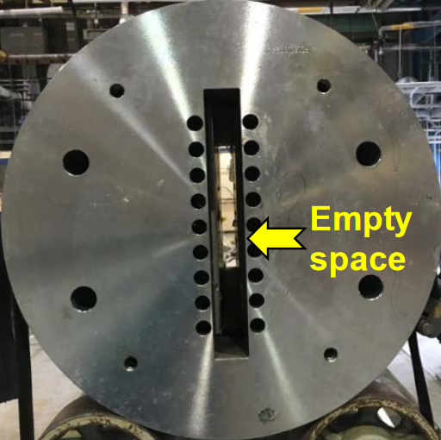
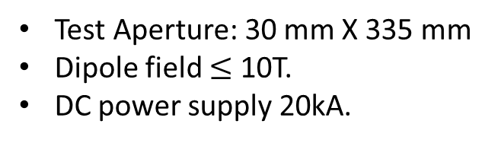
DCC017 magnet
Side View
Test Aperture: 30 mm X 335 mm
Dipole field $≤$ 10T.
DC power supply 20kA.
Top View
Bottom View
83.825
226.6
142.75

Slide 5
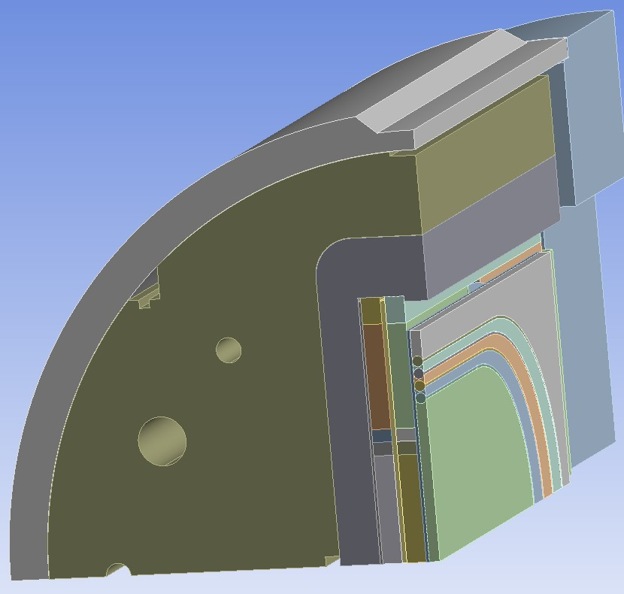
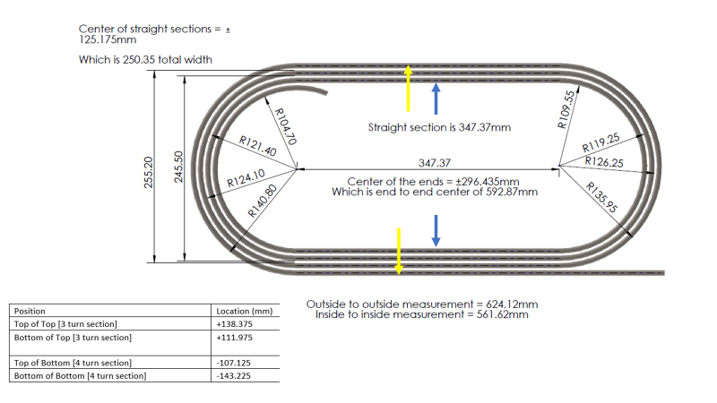
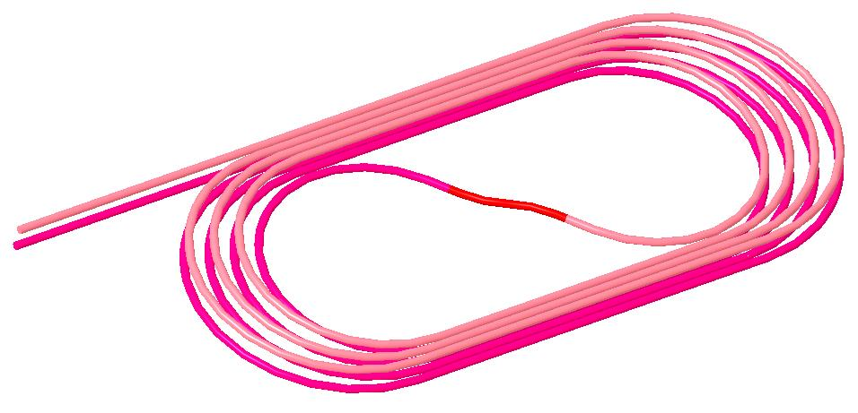
MDP corc insert coil
The MDP insert coil consists of two pancake coils in racetrack geometry and is wound with a total of eight turns (four turns per pancake coil) of CORC cables.
The short sample critical current of the conductor is 11.04 kA at 10T field and 4.2 K temperature.
The self-inductance of the magnet is 7.7 μH.

Slide 6
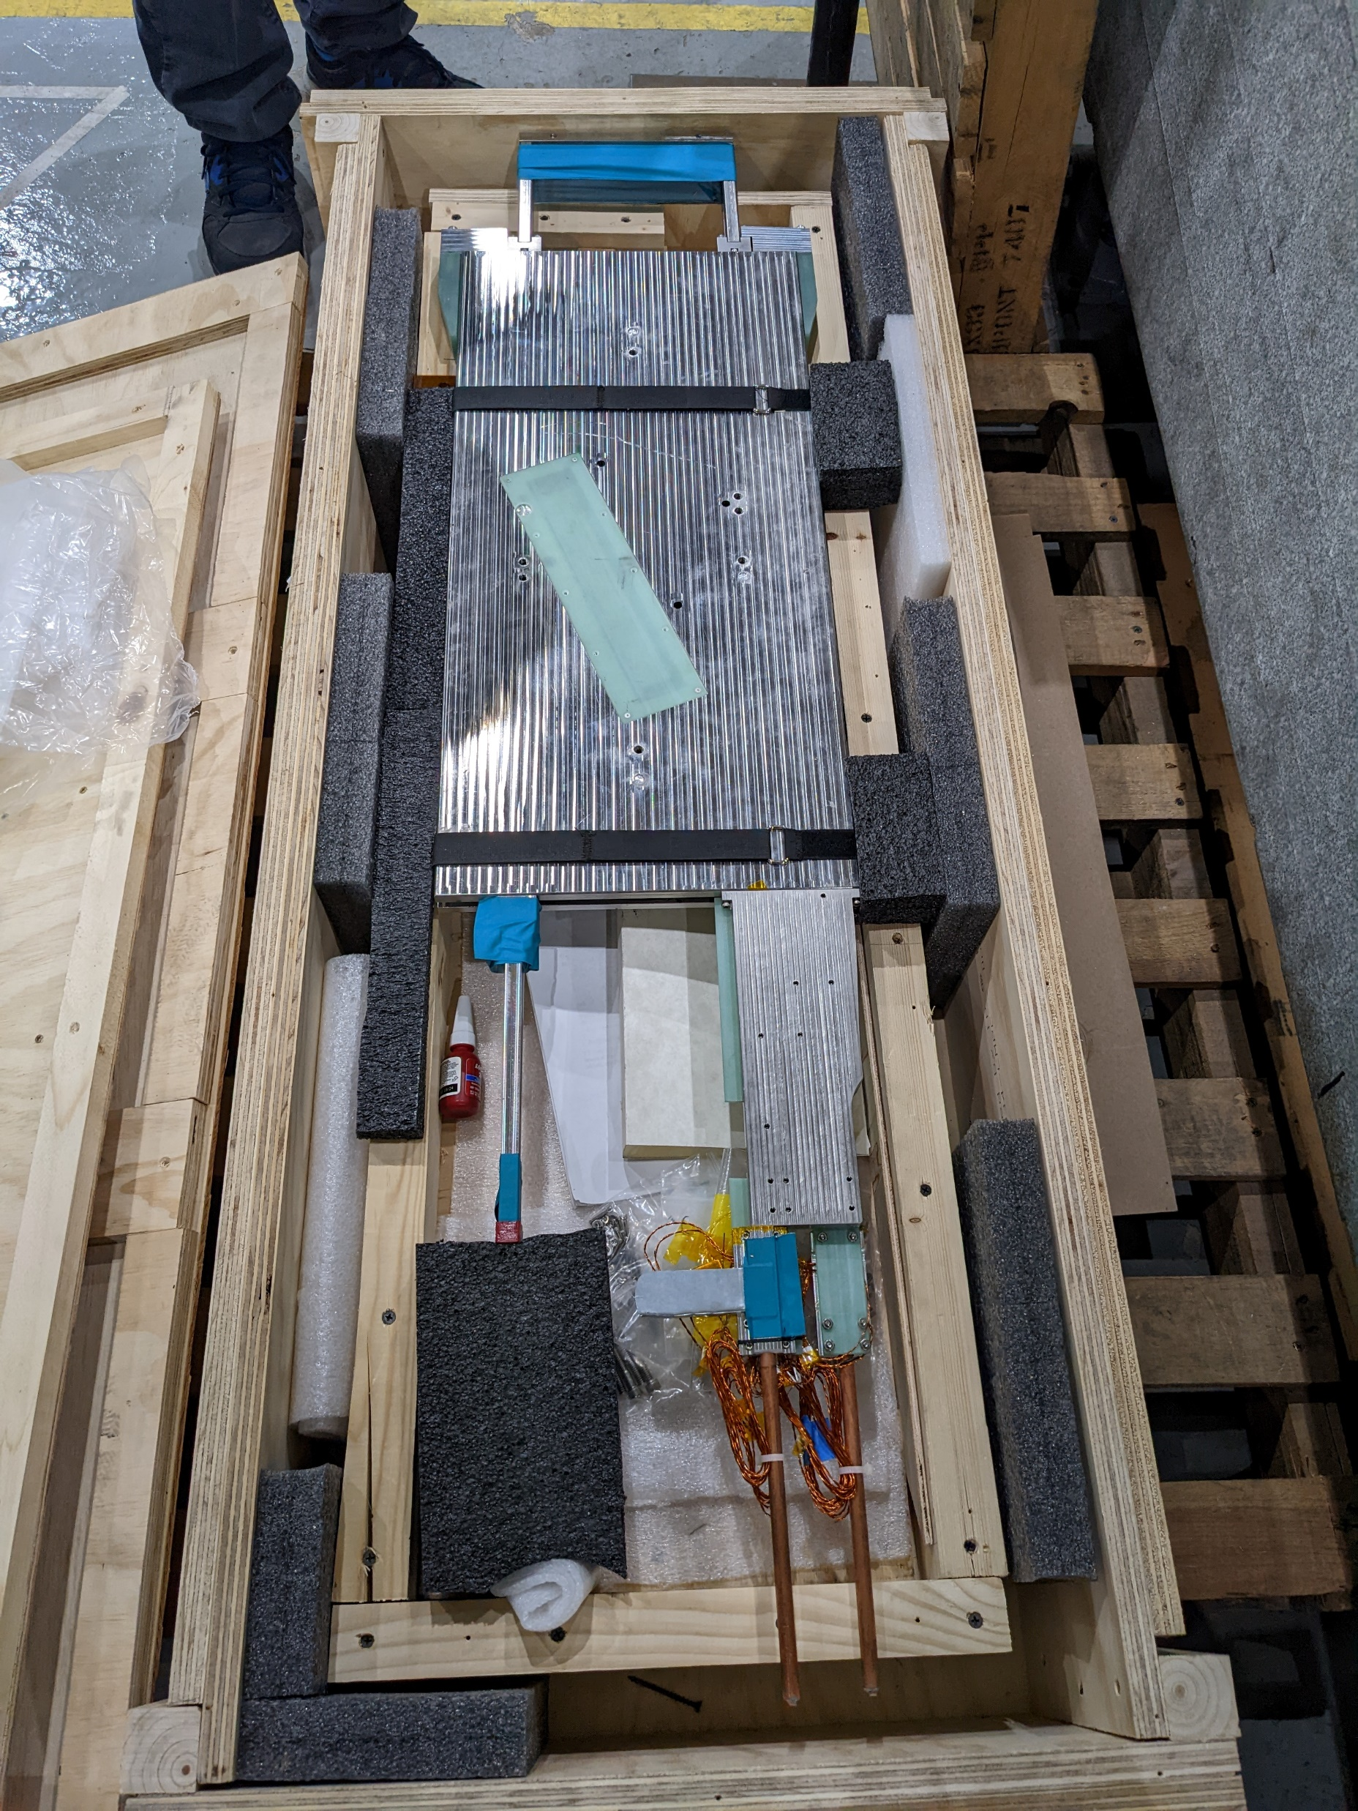
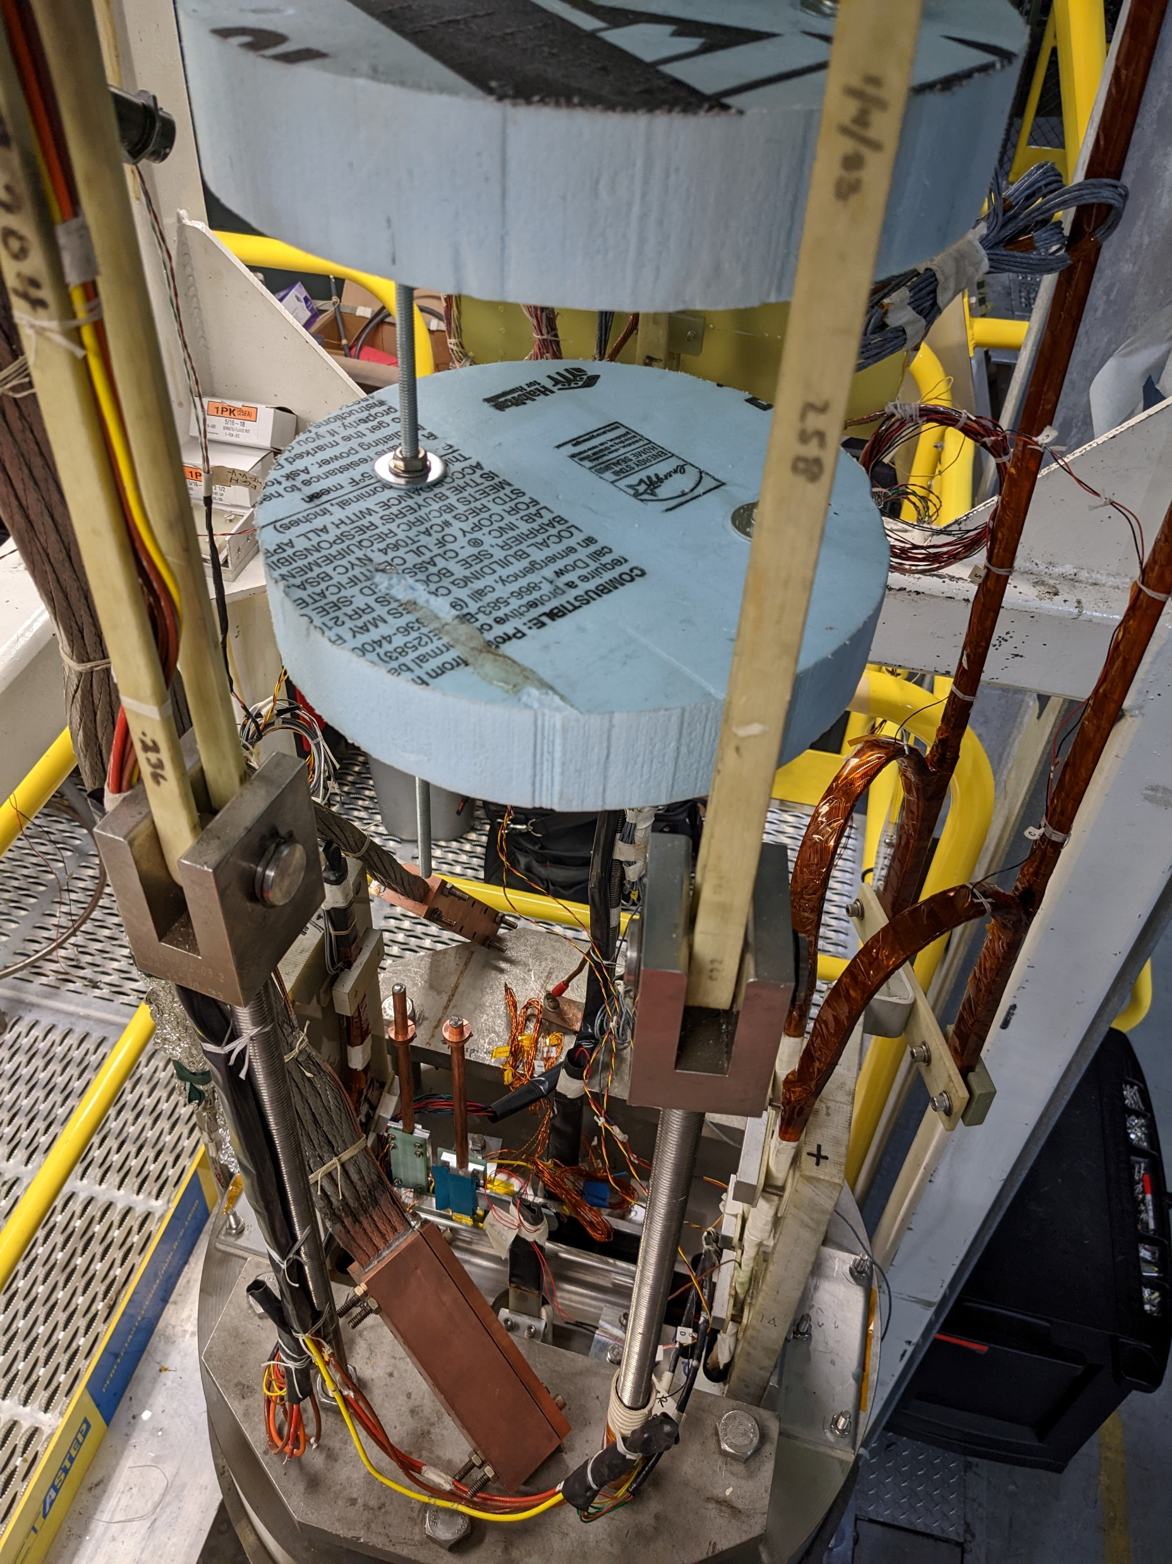
Sample reception

Slide 7
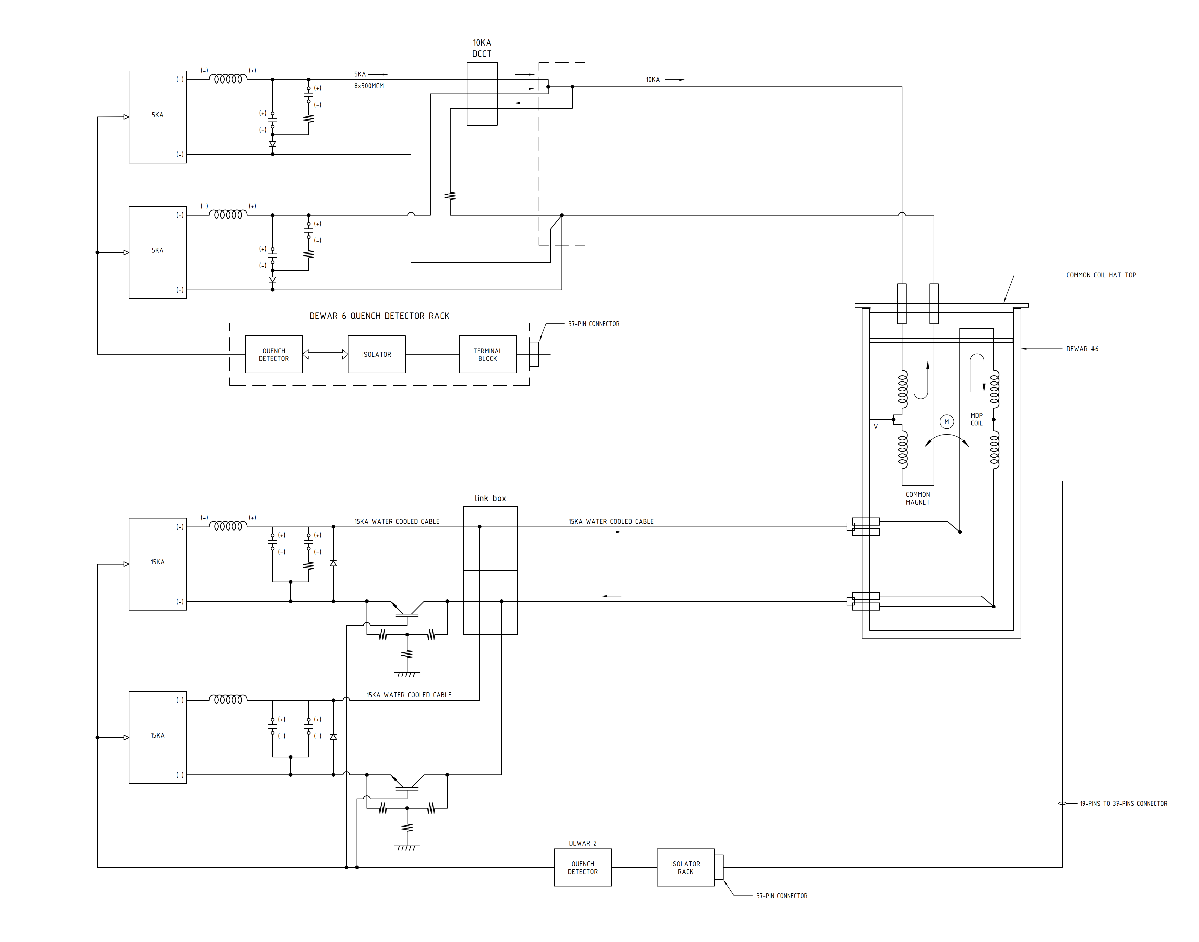
Power circuit conceptual block diagram
Fast and slow
data acquisition
QD Interaction Logic
Fast and slow
data acquisition
Isolation &
Pre-Amplification
Isolation &
Pre-Amplification

Slide 8
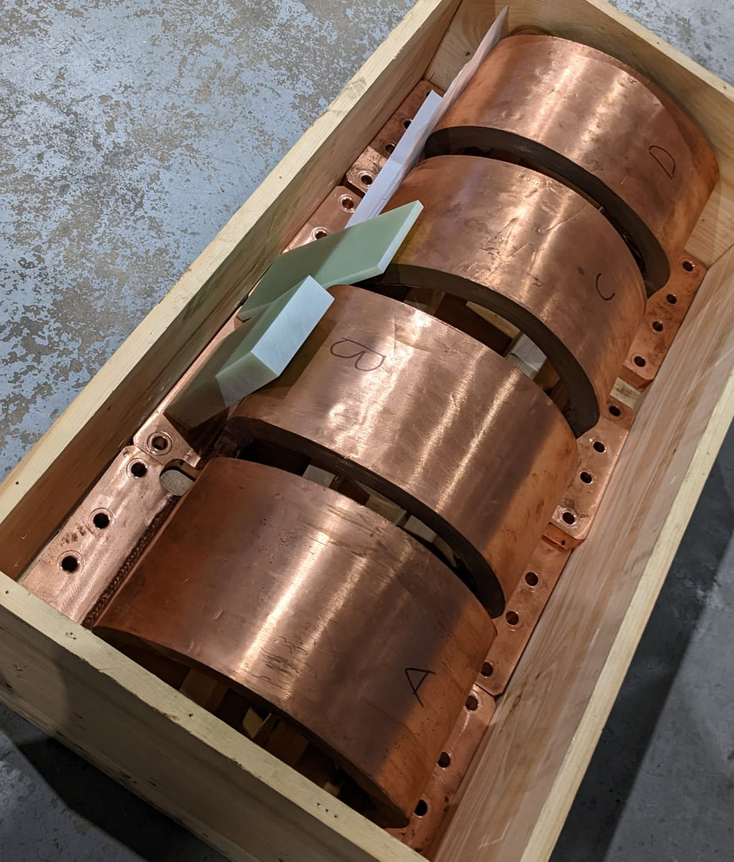
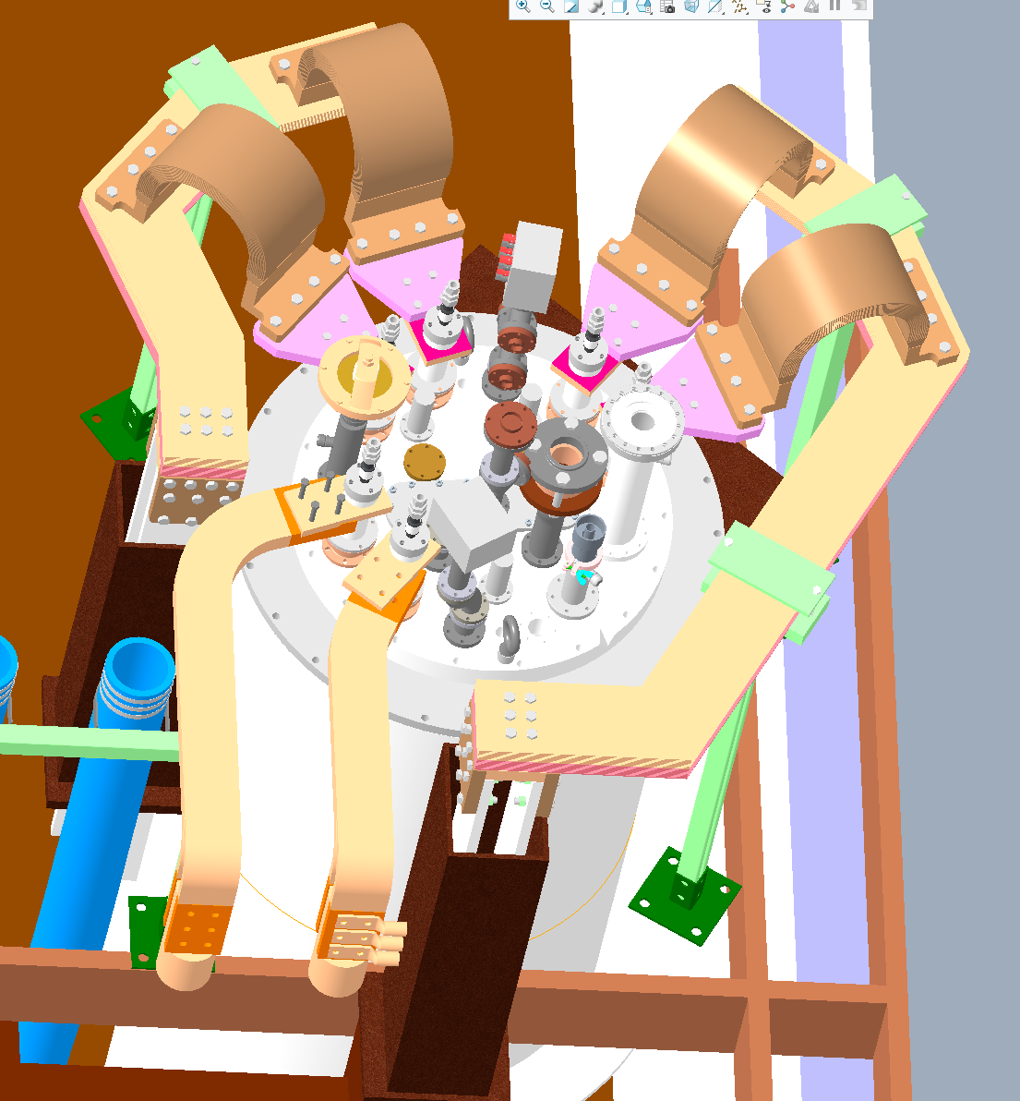
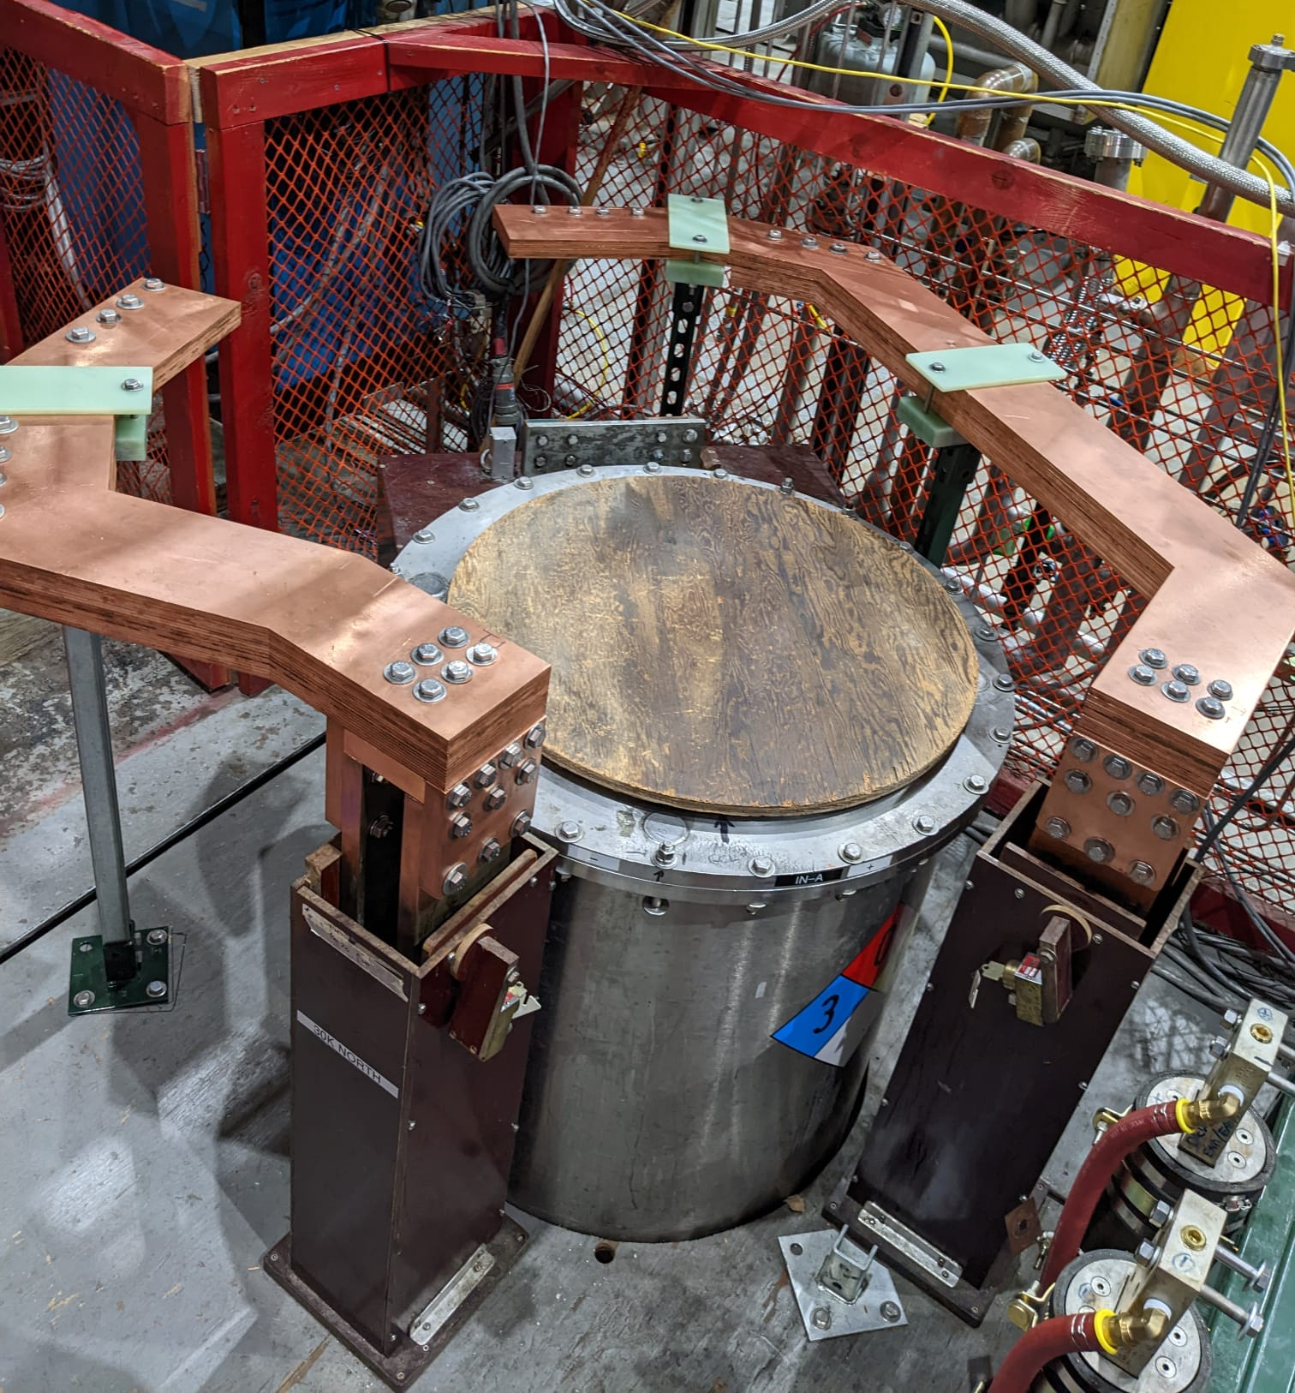
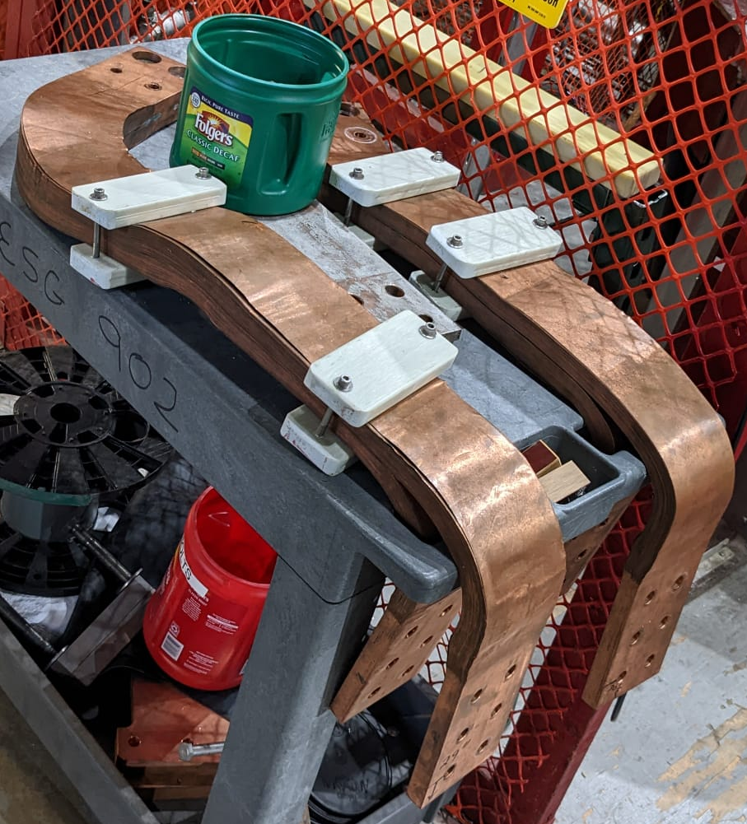
Power Leads

Slide 9
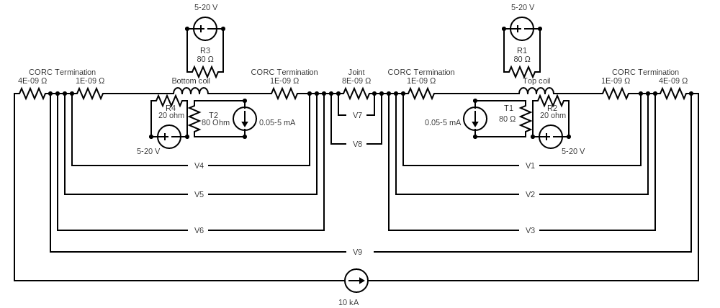
Instrumentation
Voltage taps: center taps, taps at the terminals and across the splice.
Hall probe installed in one of the coil apertures (2 hall probes at same location).
Hall probe array (14 hall element probes: 7 on each coil termination). The hall probes are connected in parallel. Powered by two voltage sources (2-4 V).
Co-wound fiber optic sensor (Optical Frequency Domain Reflectometry).
Co-wound acoustic waveguide. The voltage pins must be shorted during cool-down.
Cernox® temperature sensors (4-wire method, 2 sensors at same location) and Allan Bradley (AB) resistors (one each on the top coil and the bottom coil at the middle of the straight section in aperture #1). The AB resistors need to be calibrated during cool-down with the help of nearby Cernox sensors. The resistance of the AB resistors is about 80 Ω at room temperature. Powered by two 1 mA current sources.
Spot heaters (35-gauge nichrome wires, approximately 10 Ω) for the quench initiation: RX1, RX2, RX3, RX4. One these four spot heaters would be used for the quench initiation.

Slide 10
Rough Run Plan
Common Coil
Electrical checks: RT, 4.5 K
Hipot (500 V): RT, 4.5 K
Quench detector configuration
Quench Protection checks
The run plan:
MDP coil I_{C} Studies
  Short the terminations of the MDP coil with a 1 kA cable. Using a DCCT, monitor current flowing through it.
  Ramp the common coil magnet to 6 kA at 20 A/s. Determine direction of current in MDP short.
  Remove the short across the MDP coil.
  Then ramp the MDP insert coil at 20 A/s until the MDP insert coil quenches or we reach 15000 A.
  Repeat the steps a-d for current in the common coil 7 kA, 8 kA, 9 kA, and 10 kA (if the LTS is stable at 10 kA).
MDP coil Quench Studies
  Short the terminations of the MDP coil with a 1 kA cable. Using a DCCT, monitor current flowing through it.
  Ramp the common coil magnet to 6 kA at 20 A/s. Determine direction of current in MDP short.
  Remove the short across the MDP coil.
  Ramp the MDP coil to 0.99*I_{quench}.
  Send a trapezoidal pulse of 10 V for 1s duration to the spot heater RX1. If no quench, let all the voltage tap readings to return to baseline. Then keep increasing the pulse duration by 1 s until thermal runaway and quench occurs. Heater could be powered in the range 5 W to 40 W. If no quench occurs, ramp up the current in the MDP coil to induce a quench.
  Repeat the steps a-e for current in the common coil 7 kA, 8 kA, 9 kA, and 10 kA (if the LTS is stable at 10 kA).
MDP Coil

Slide 11
Extra slides

Slide 12
Theoretical I_{Quench} values (tentative values)
I_{CC} (A) Common Coil | B_{CC} (T) Common coil | B_{MDP} (T) MDP insert coil | B_{CC}+B_{MDP} (T) | I_{quench} (A) MDP insert coil
0 | 0.00 | 3.20 | 3.20 | 29359
5000 | 4.72 | 1.83 | 6.55 | 16781
6000 | 5.67 | 1.67 | 7.34 | 15356
7000 | 6.61 | 1.54 | 8.15 | 14148
8000 | 7.56 | 1.43 | 8.99 | 13115
9000 | 8.50 | 1.33 | 9.83 | 12225
10000 | 9.44 | 1.25 | 10.69 | 11451

Slide 13
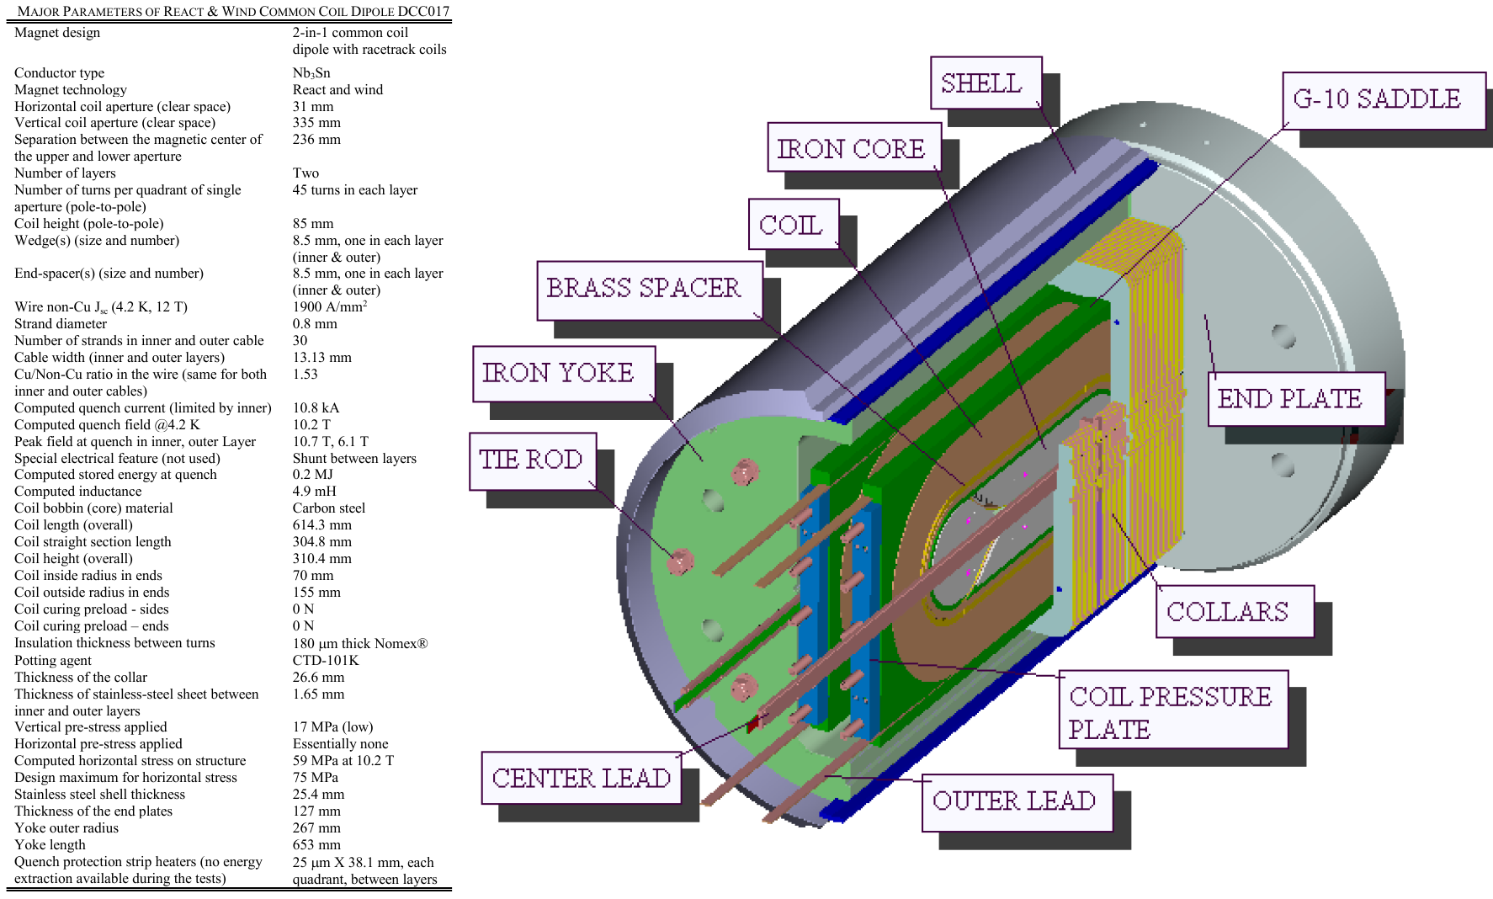

Slide 14
Power circuit conceptual block diagram
Isolation &
Pre-Amplification
Fast and slow
data acquisition
Fast and slow
data acquisition
Isolation &
Pre-Amplification
QD Interaction Logic

Slide 15
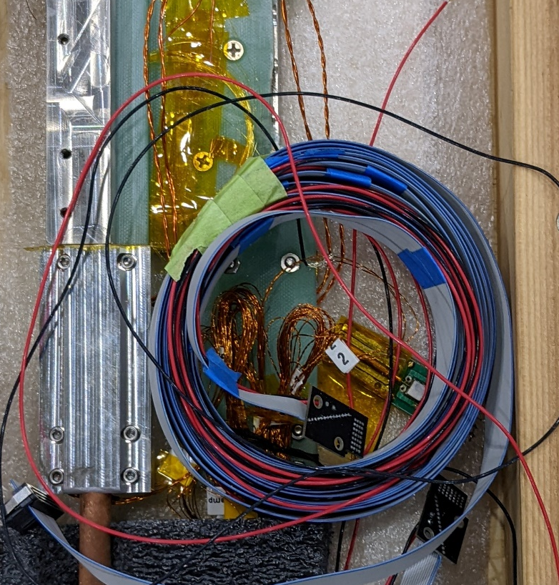
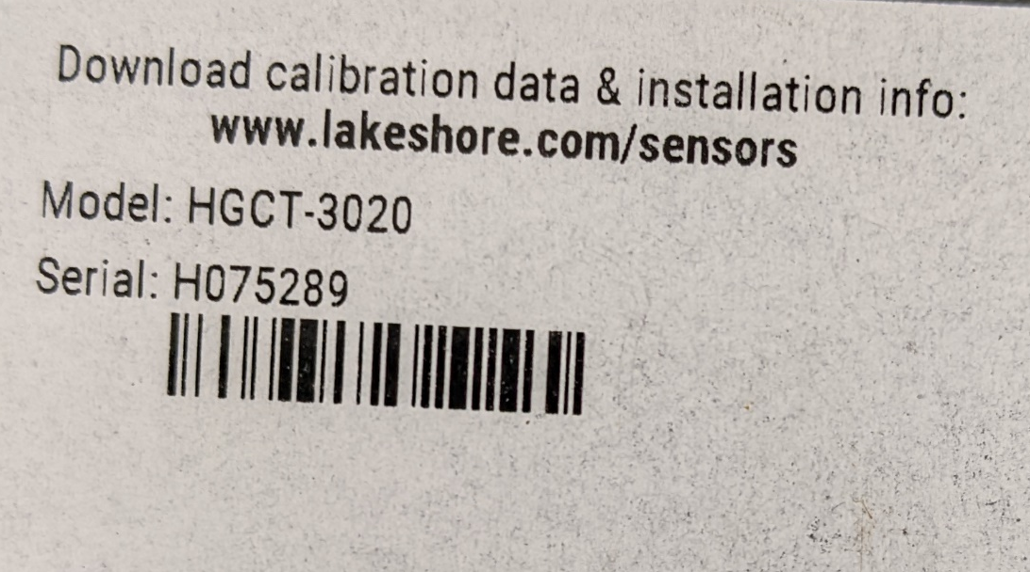
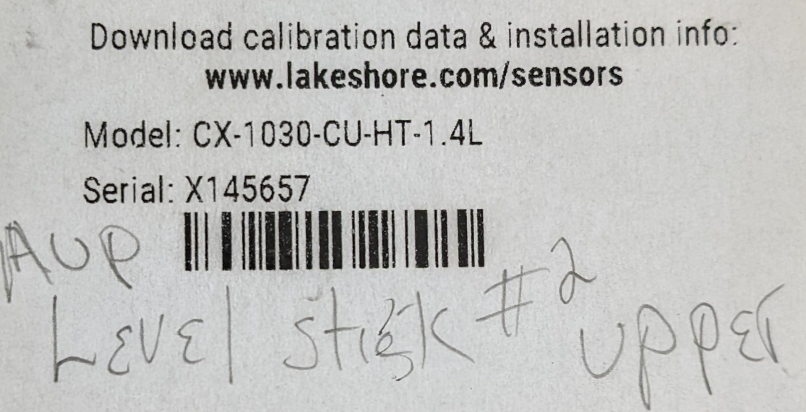
0.55-1.05 mV/kG

