Slide 1
ReBCO – Upcoming Tape Coil Tests
Ramesh Gupta
USMDP General Meeting
December 7, 2022

Slide 2
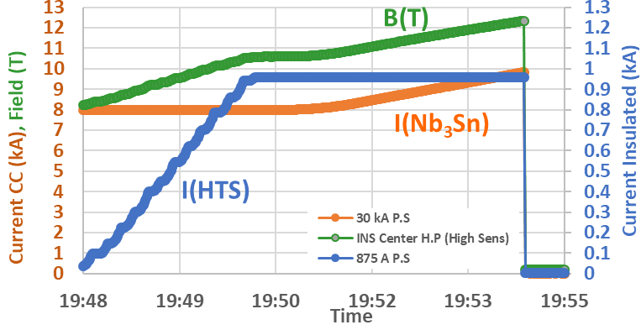
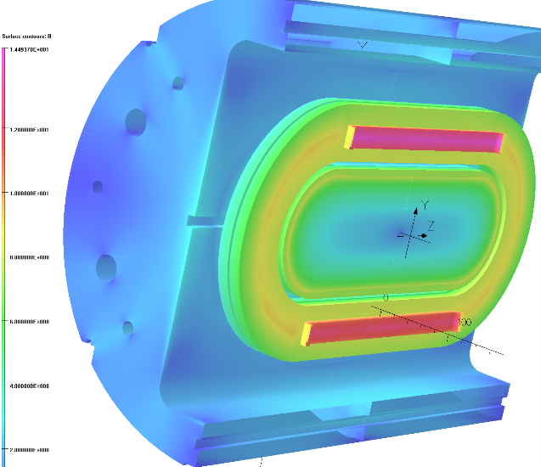
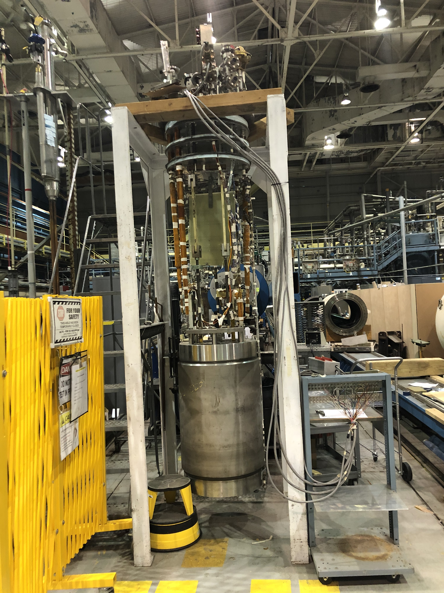
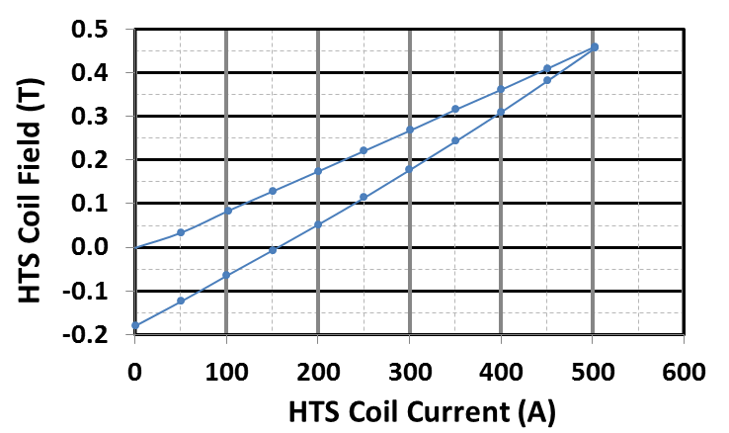
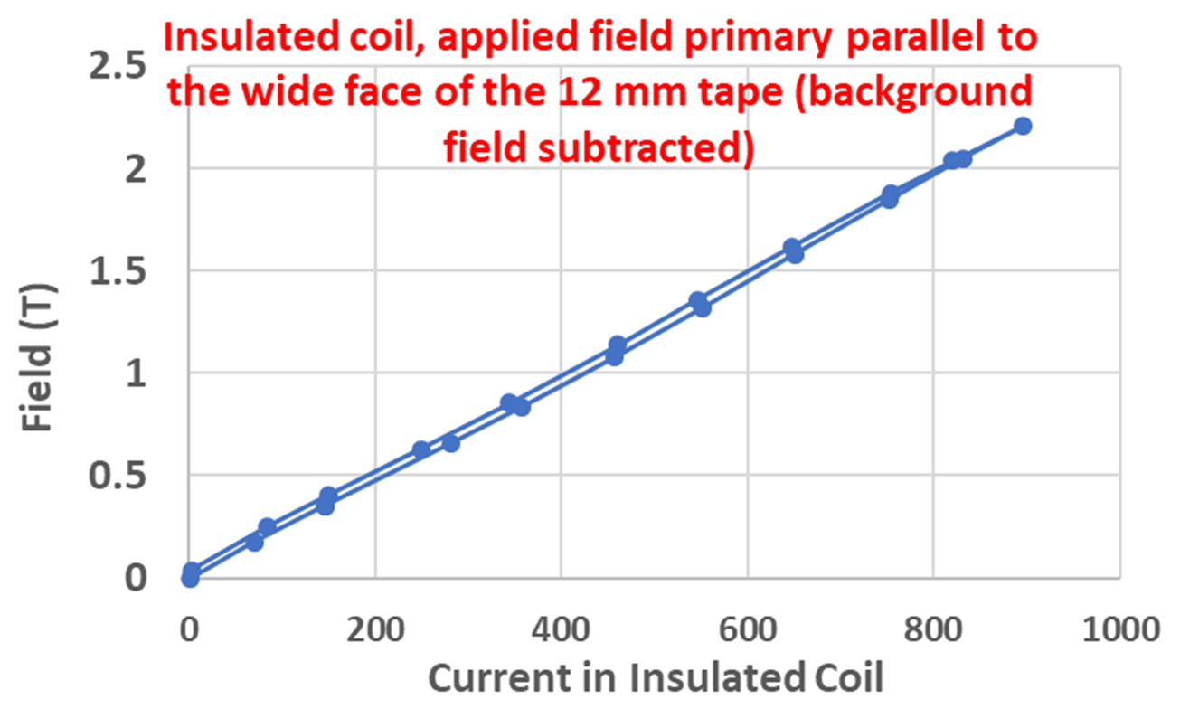
Room for Progress Over the Previous MDP Test of 12.3 T HTS/LTS Dipole
MDP 2020
USMDP “Record” HTS/LTS 12.3 T Hybrid Dipole (2020)
HTS Coil#1
Quench Studies
HTS Coil#2
PBL/BNL STTR
Magnetization Studies
Task 1:
Maximum field was not limited by HTS coils but by LTS coils
Theory: HTS coils pinching on the Nb₃Sn making it quench
Next test: Intermediate structure to minimize local strain
SBIR: Field
Perpendicular
Task 2:
Magnetization studies were not made over the full hysteresis loop (positive and negative current cycles).
Field parallel & perpendicular studies on different coils.
Next : Identical coils to be used for the full hysteresis loop.
MDP: Field
Parallel
MDP 2020

Slide 3
Upcoming Tests with ReBCO Tape
Test 1: This test will be dedicated to answering the hypothesis that the local strain on Nb₃Sn coils created by the Lorentz forces from the HTS coils, was the limiting factor in the performance.
Test 2: This test is a part of the US-Japan collaboration where two identical HTS tape coils, wound with the mineral insulation, will be inserted in the two aperture of the common coil dipole. One coil will be aligned primarily to field parallel to the wide face of the tape, and another coil aligned primarily to field perpendicular to the wide face.

Slide 4

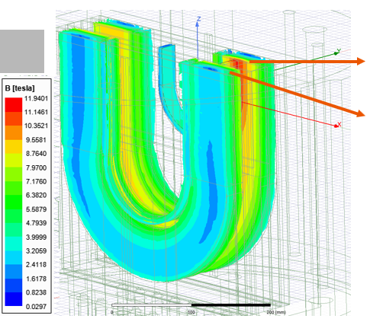
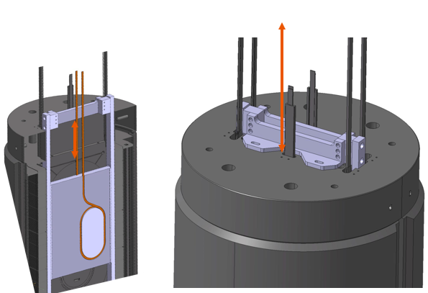
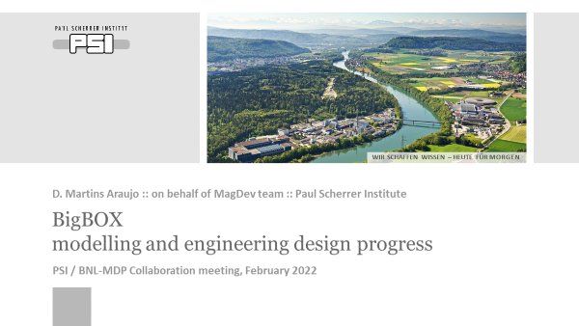
Test 1: PSI BigBoX Nb₃Sn Coil Test (MDP)
Coil in a structure to be inserted in the common coil dipole received from PSI. Test scheduled for early next year.
PSI test uses only one aperture. Taking advantage of that HTS coil in its own structure will be tested in the second aperture.

Slide 5
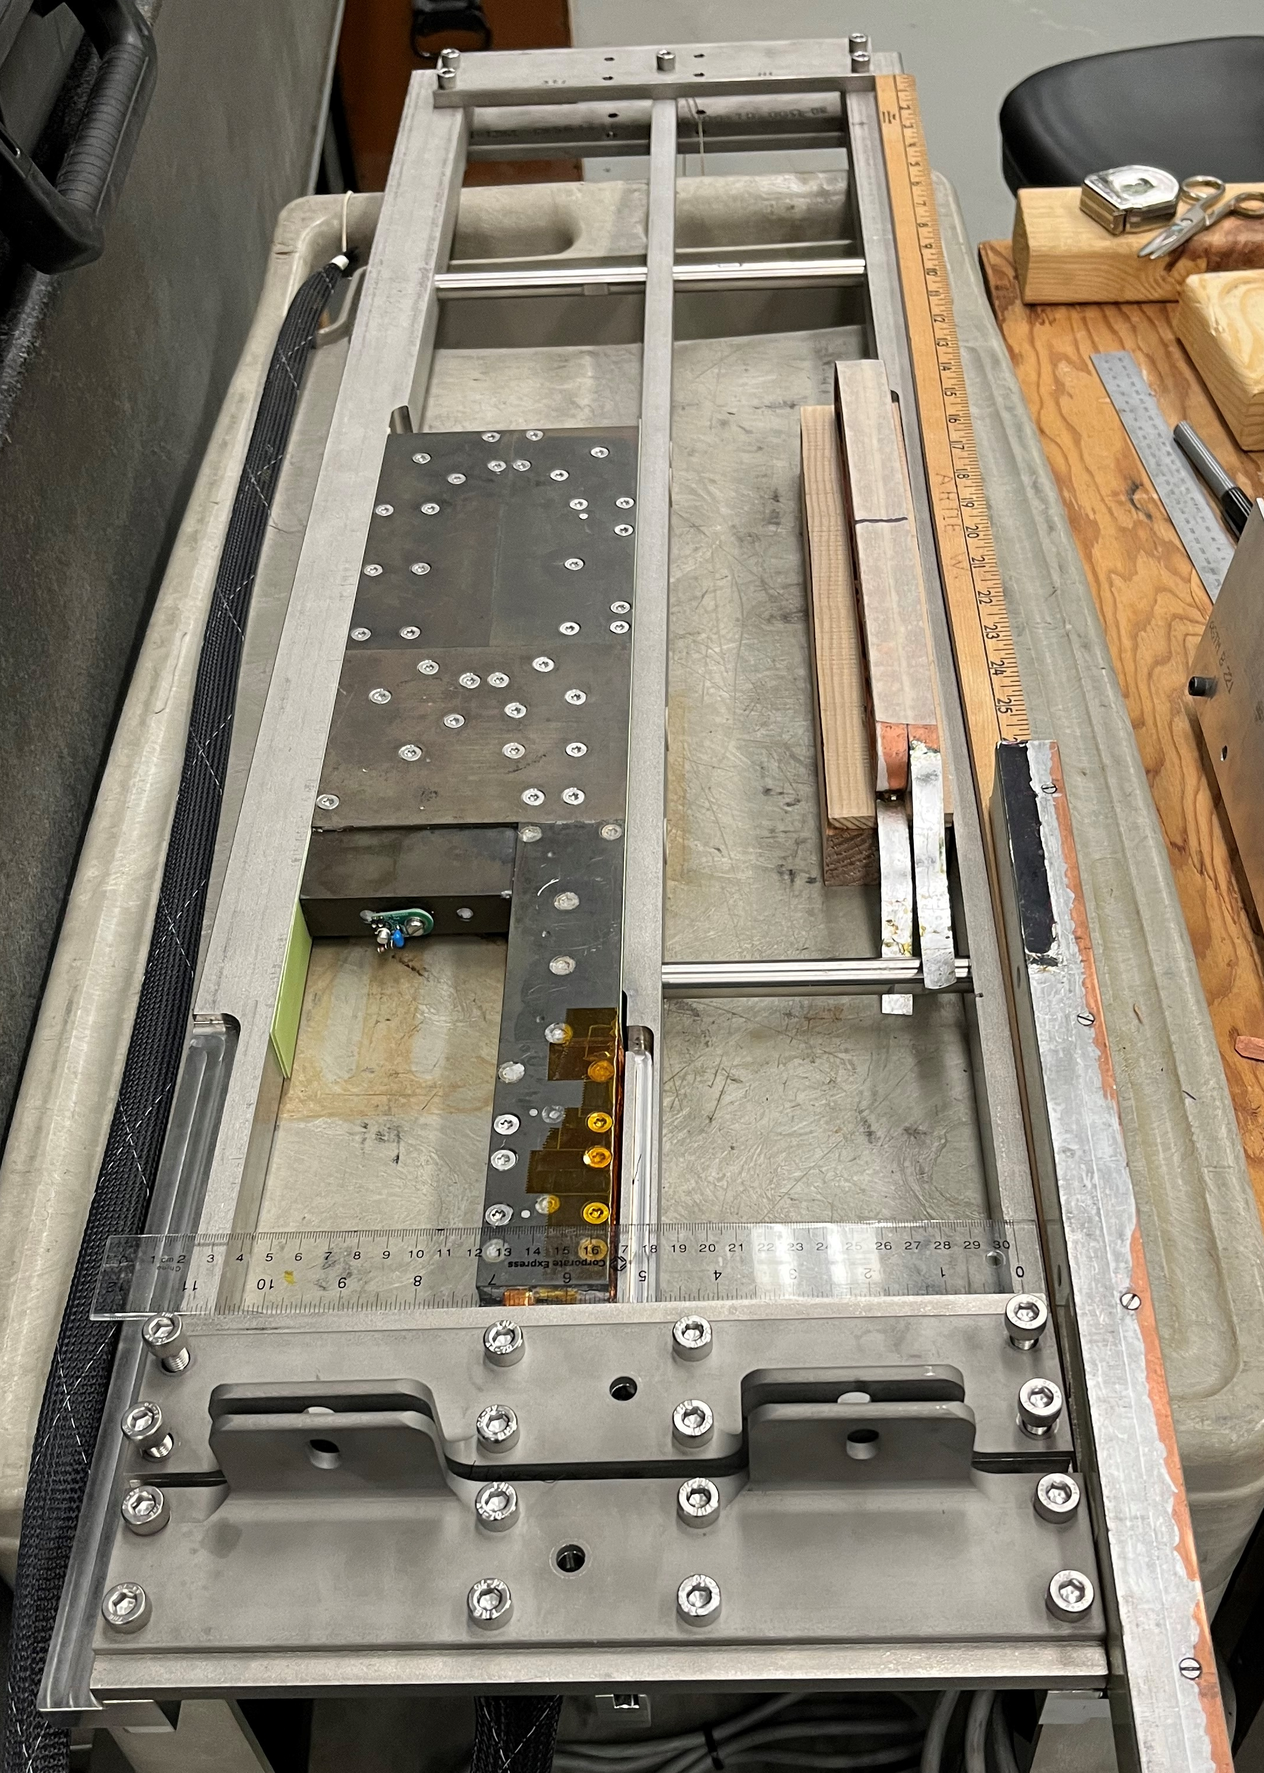
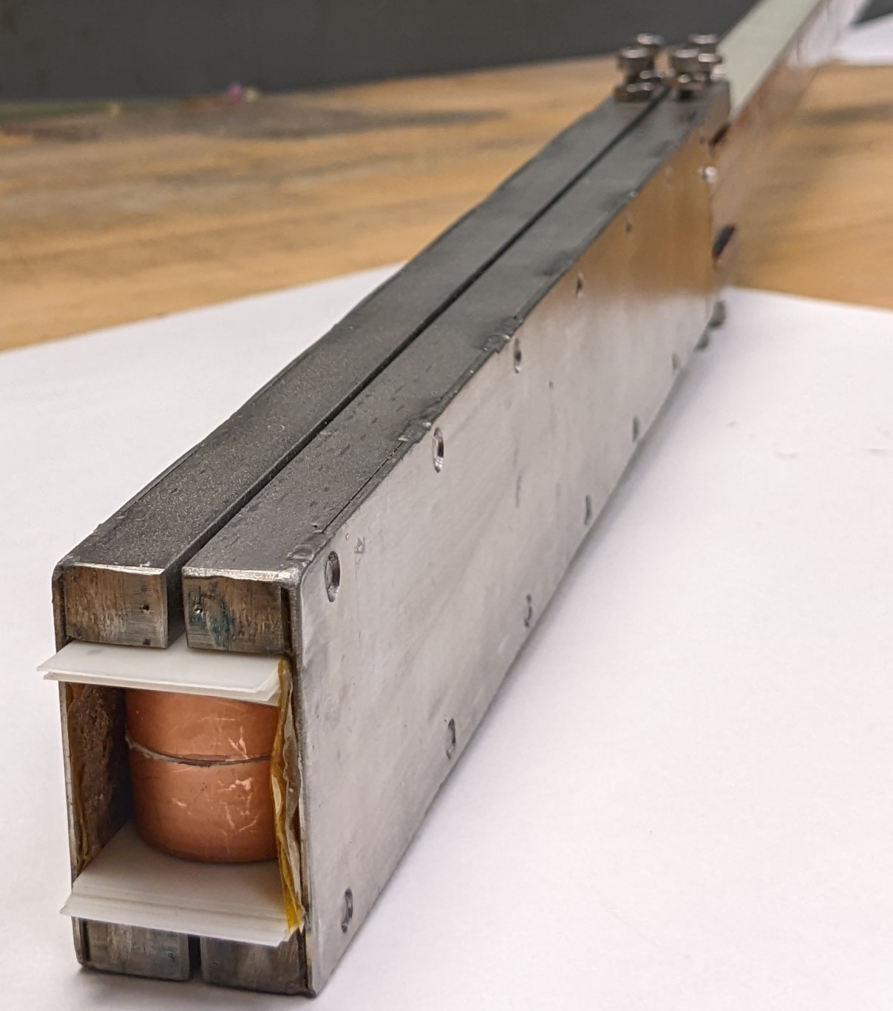
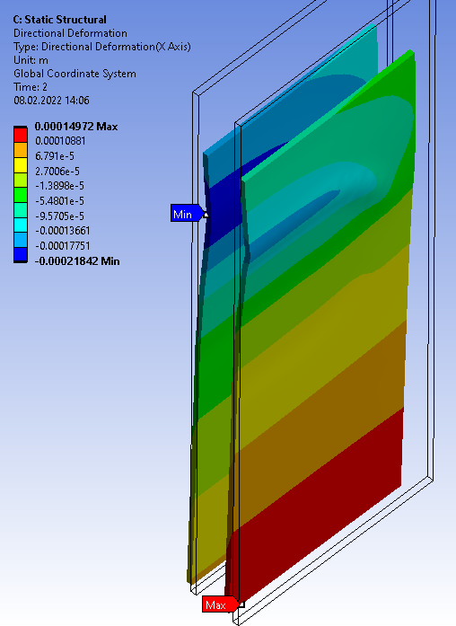
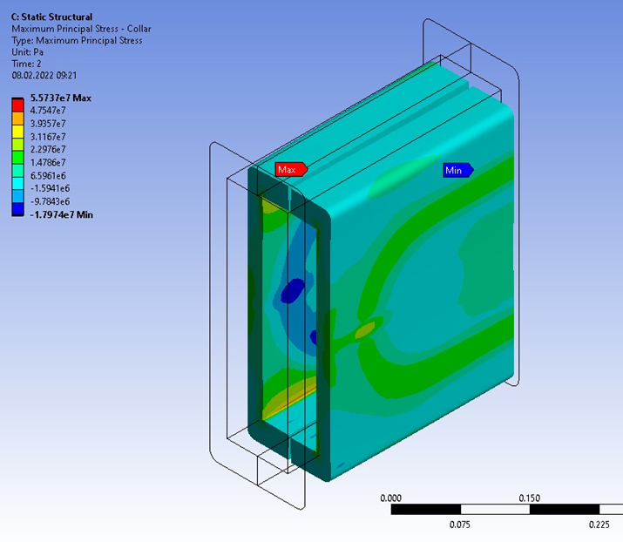
Bore 1: PSI Nb₃Sn Coil, Bore 2: BNL HTS Coil
(both coils will be in their own structure)
1
2
150 um
Question: Will these support structures reduce loss in quench current in the main Nb₃Sn coils

Slide 6
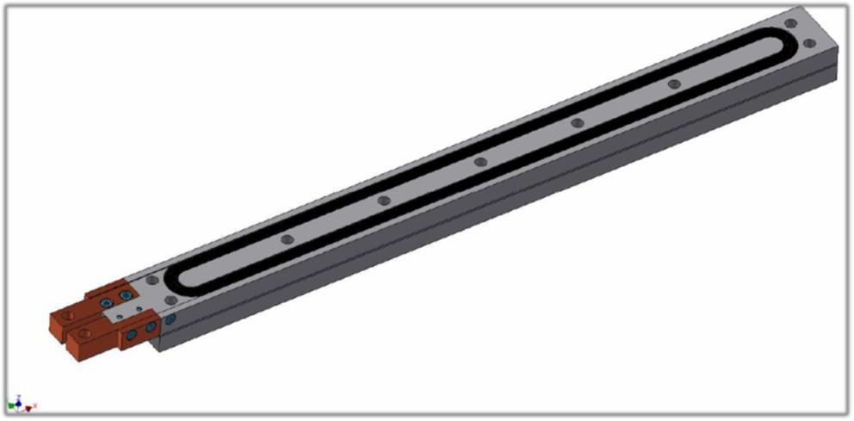
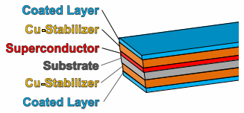
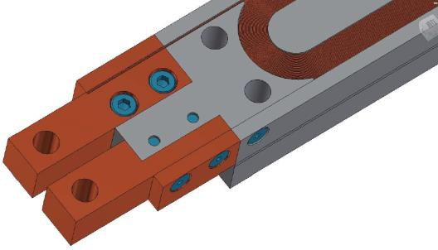
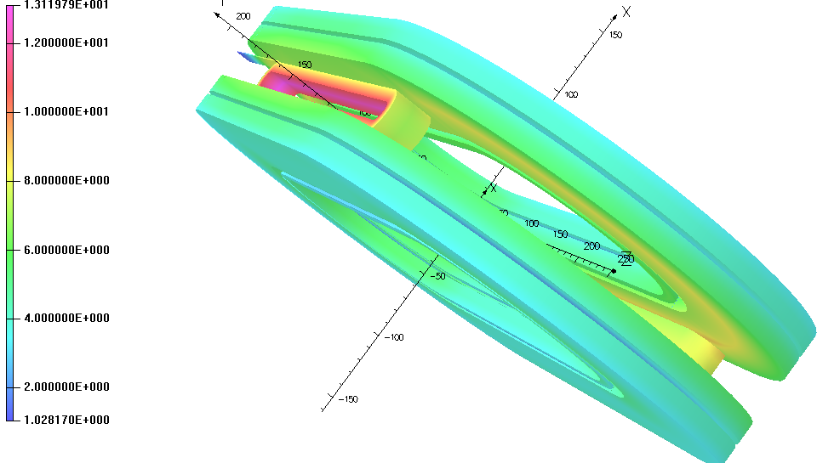
Test 2: HTS/LTS Hybrid Technology (US-Japan)
Scheduled for late Summer
Goals: New insulation,
HTS/LTS high field hybrid technology, quench protection, and magnetization studies
Two Tests in One Go:
Two HTS insert coils in two apertures of the common coil dipole:
Upper Bore: field primarily parallel
Lower bore: field primarily perpendicular
Three collaborators from KEK spent several days at BNL recently to work out the details.
A very useful visit.

