Slide 1
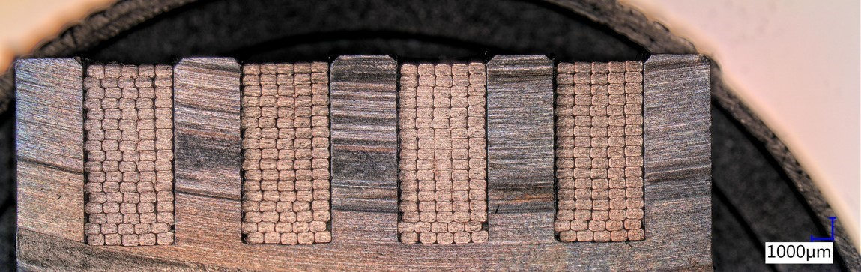
Superconducting undulators at the European XFEL
Vanessa Grattoni

Slide 2
Overview
The European XFEL: the facility and motivation for superconducting undulators (SCU)
SCUs activities at the EuXFEL
Design and Manufacturing of NbTi SCU
Work in progress here in Berkeley

Slide 3
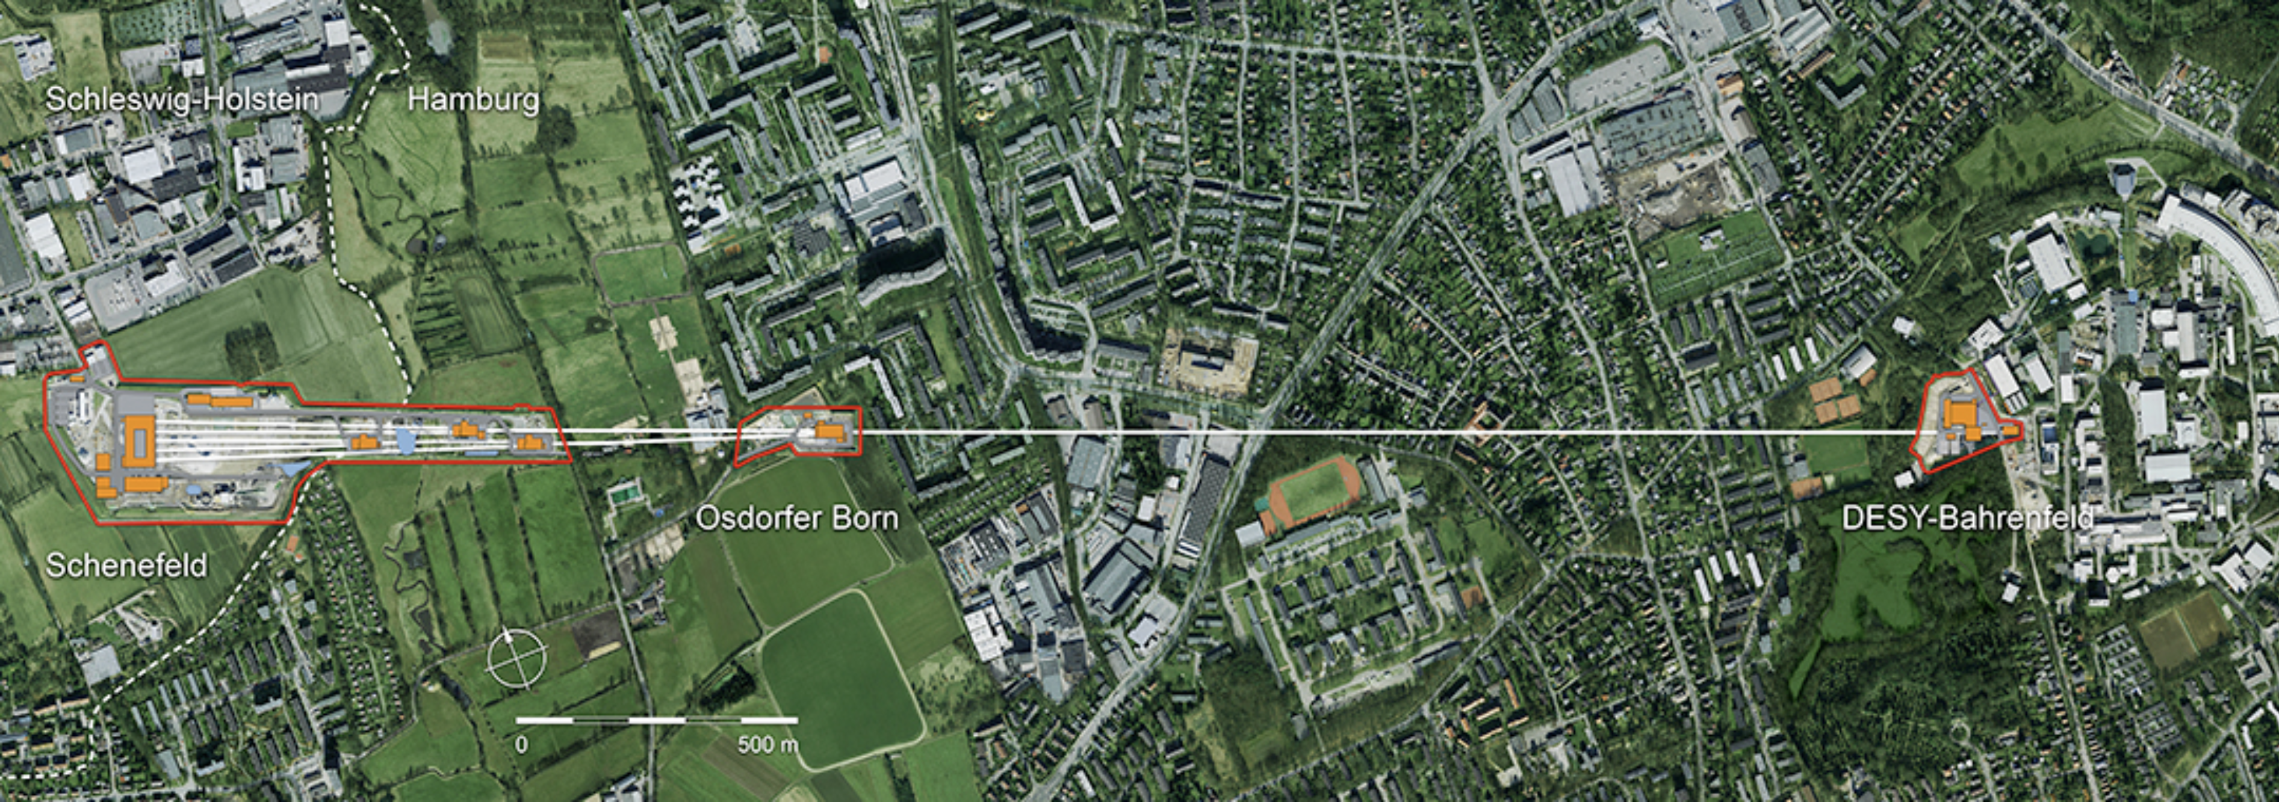
The European XFEL
3.4 km

Slide 4
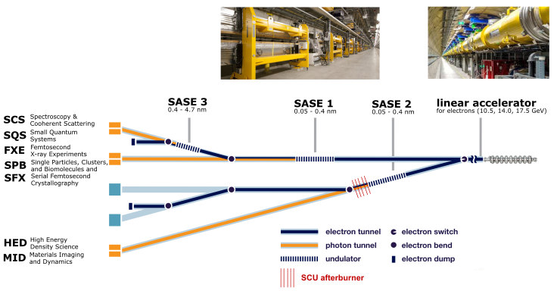
The European XFEL
x 808
(planned)

Slide 5
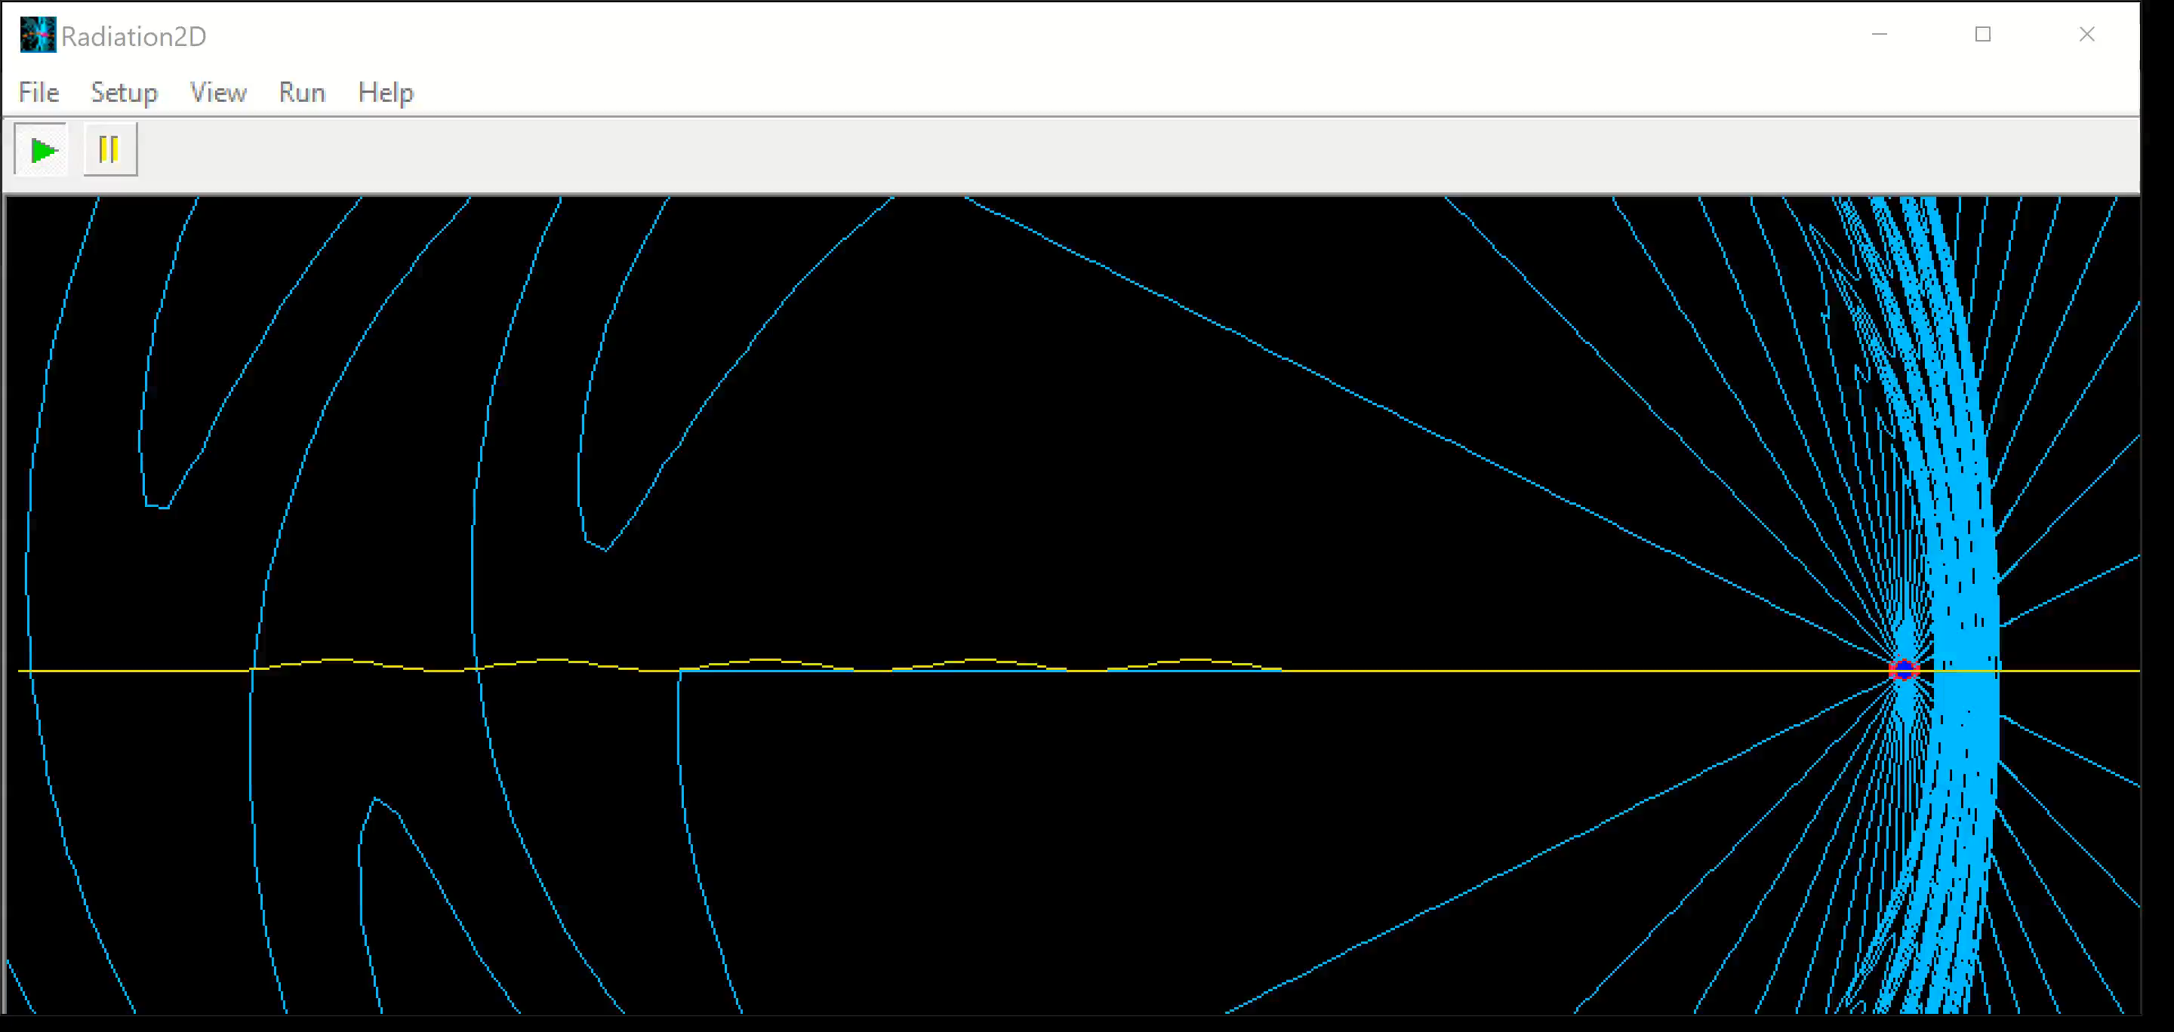
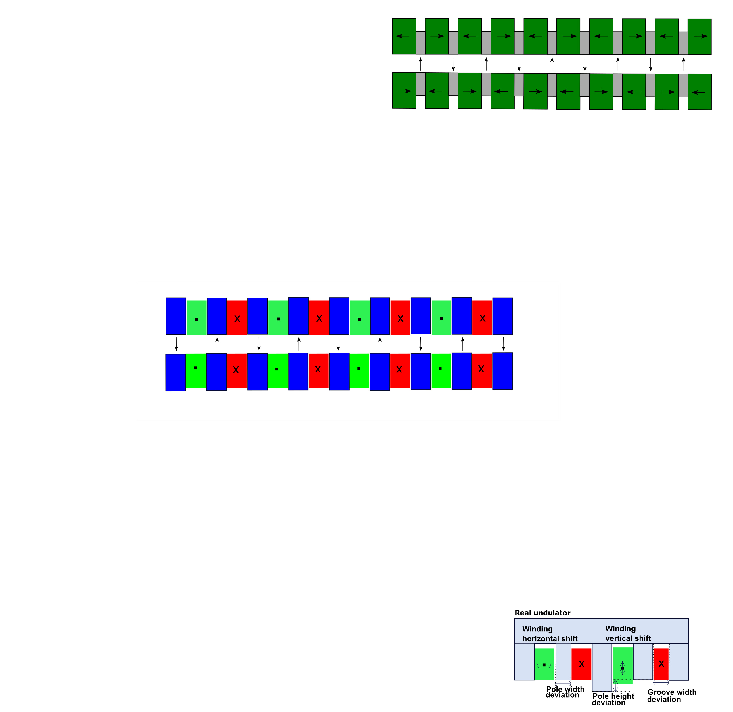

The undulator and its magnetic field
$$λ_{u}$$
Electron
trajectory
GAP
Coils with alternating polarity generates a periodic magnetic field
Simulation softare: Radiation2D
Notes:
Decide which of the two pictures is better. If you choose the orange one add that the yoke can be made from iron

Slide 6
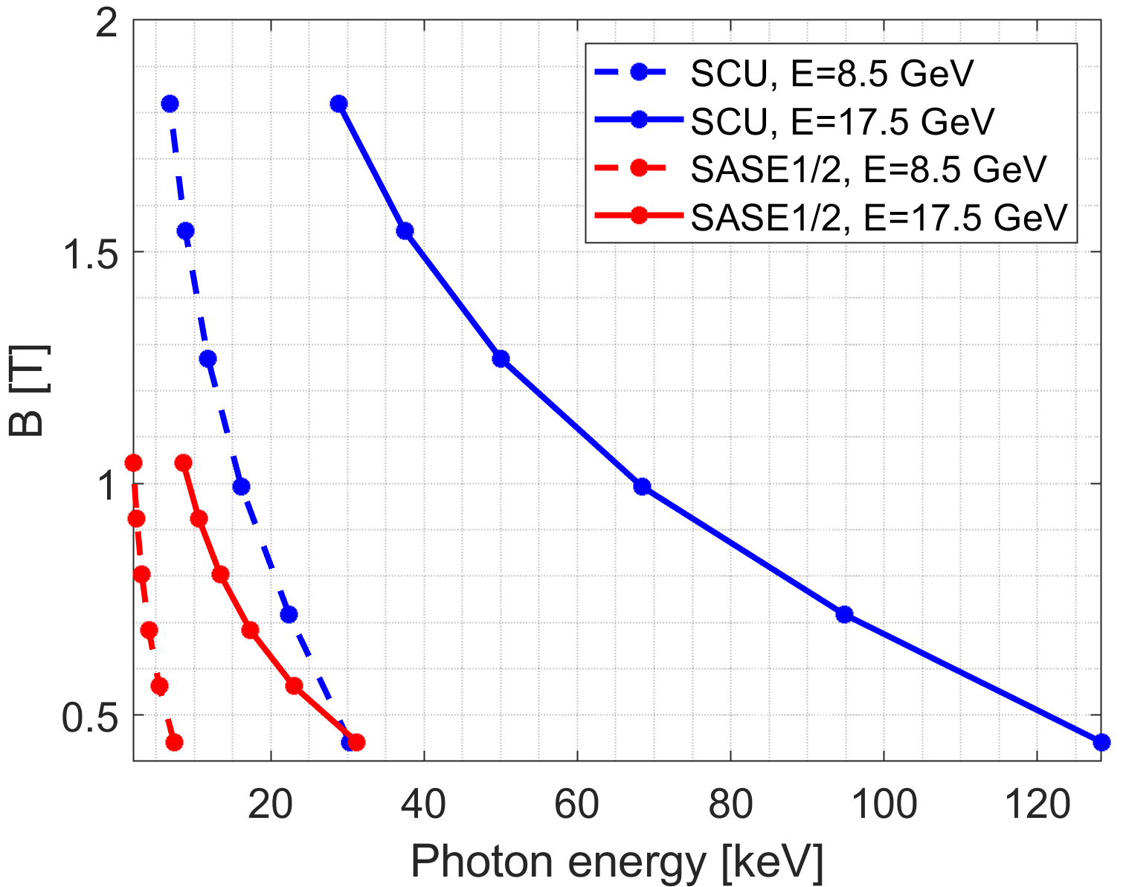

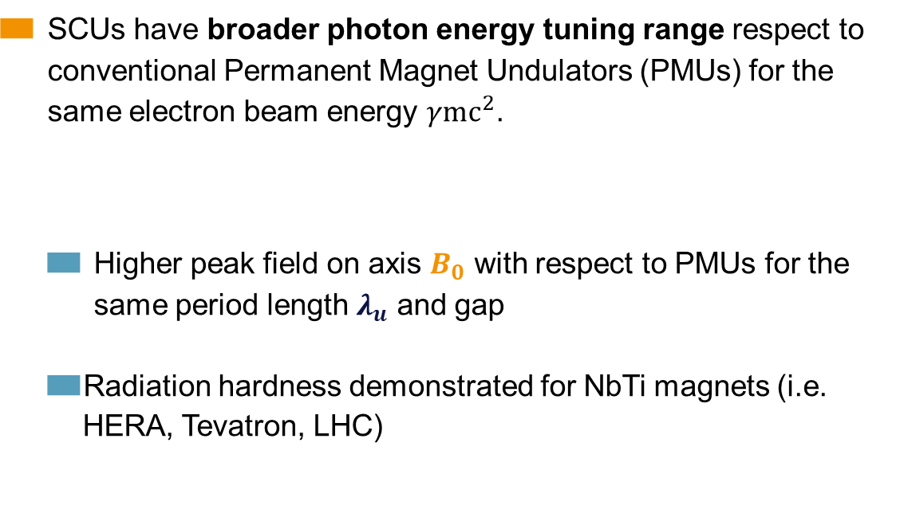

Motivation for SuperConducting Undulators (SCU)
SCUs have broader photon energy tuning range respect to conventional Permanent Magnet Undulators (PMUs) for the same electron beam energy $γ{mc}^{2}$.
  Higher peak field on axis $B_{0}$ with respect to PMUs for the same period length $λ_{u}$ and gap
  Radiation hardness demonstrated for NbTi magnets (i.e. HERA, Tevatron, LHC)
$$E_{ph}=\frac{hc}{λ_{u}}⋅\frac{2γ^{2}}{(1+{K^{2}}/2)}$$
with $K≃0.934⋅B_{0}\left[T\right]⋅λ_{u}[cm]$

Slide 7
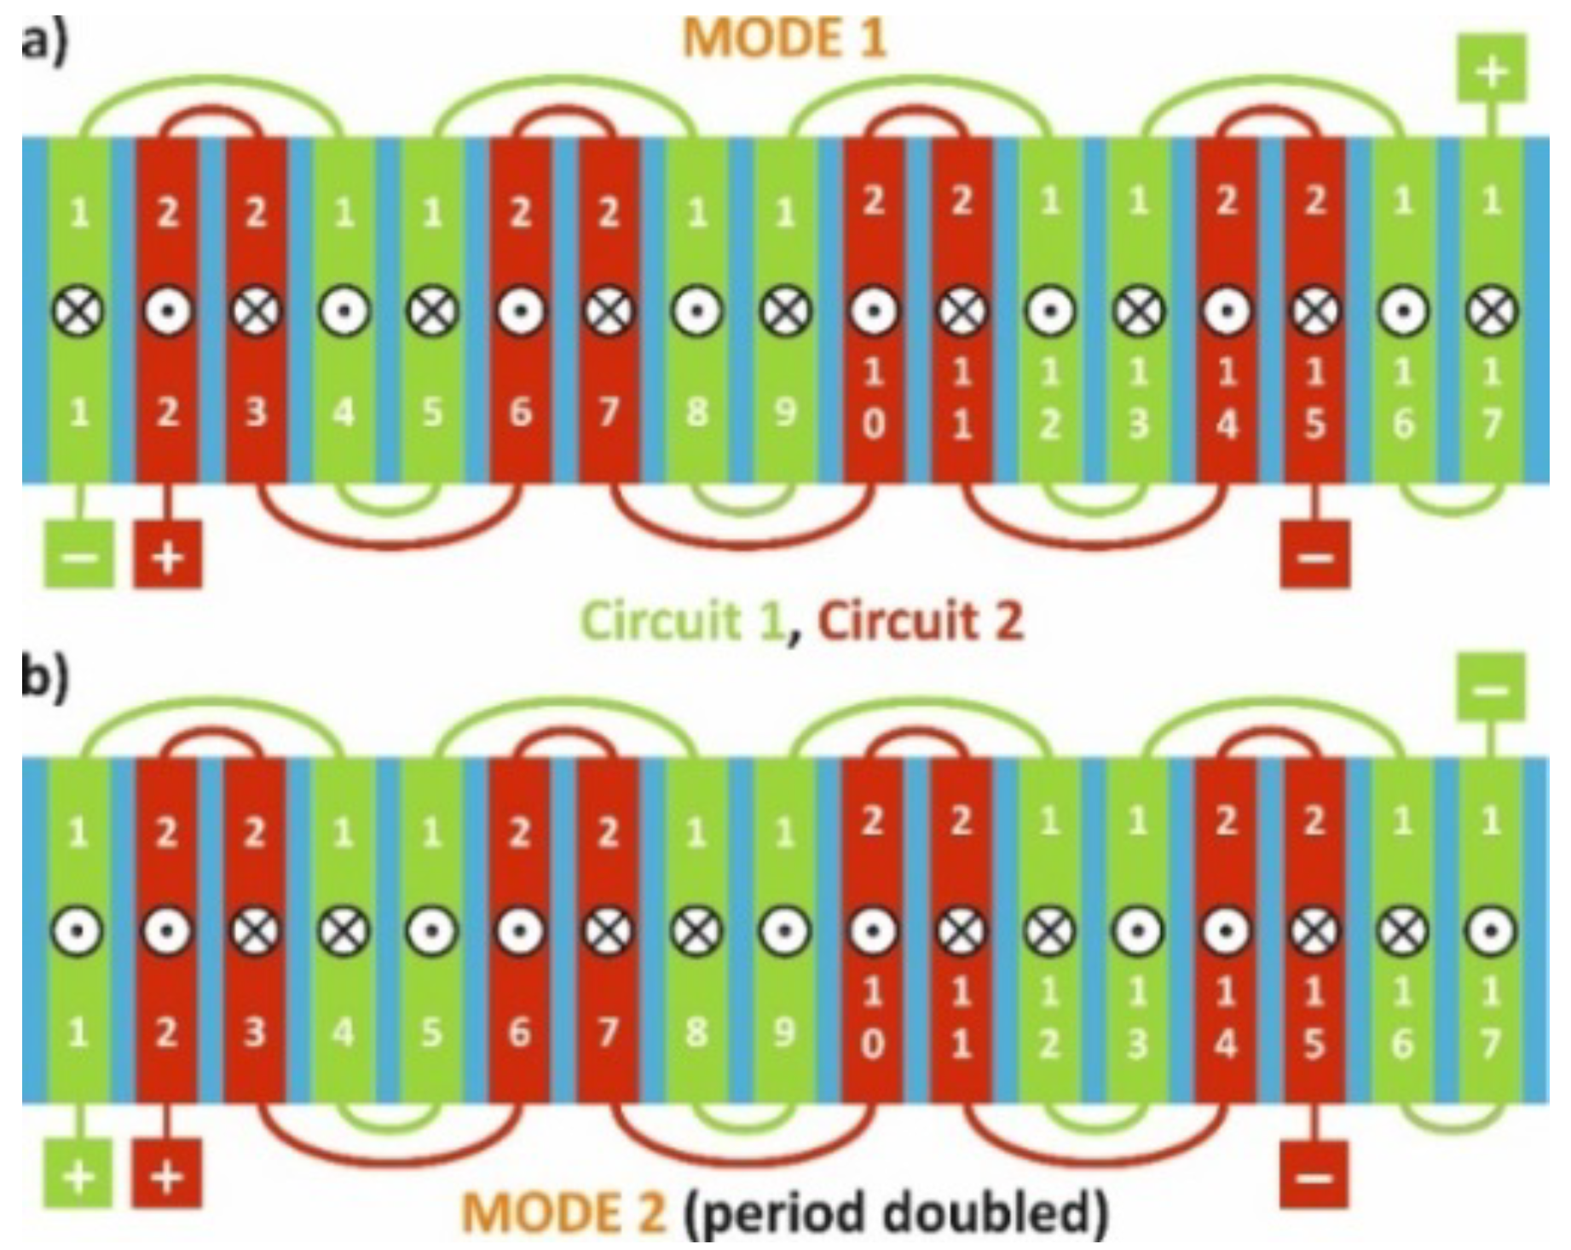

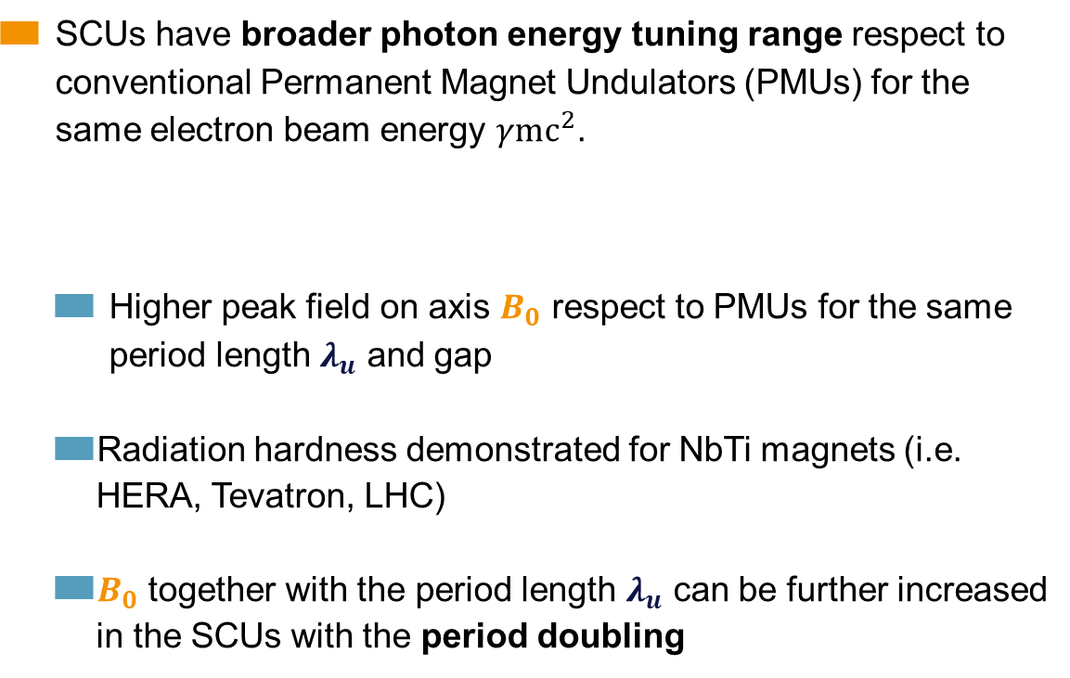

Motivation for SuperConducting Undulators (SCU)
SCUs have broader photon energy tuning range respect to conventional Permanent Magnet Undulators (PMUs) for the same electron beam energy $γ{mc}^{2}$.
  Higher peak field on axis $B_{0}$ respect to PMUs for the same period length $λ_{u}$ and gap
  Radiation hardness demonstrated for NbTi magnets (i.e. HERA, Tevatron, LHC)
  $B_{0}$ together with the period length $λ_{u}$ can be further increased in the SCUs with the period doubling
$$E_{ph}=\frac{hc}{λ_{u}}⋅\frac{2γ^{2}}{(1+{K^{2}}/2)}$$
with $K≃0.934⋅B_{0}\left[T\right]⋅λ_{u}[cm]$
$$λ_{u}$$
From MODE 1 to MODE 2 we flip the direction of the current of the circuit 1 (green).
$$λ_{u}$$
S. Casalbuoni et al 2019 J. Phys.: Conf. Ser. 1350 012024

Slide 8
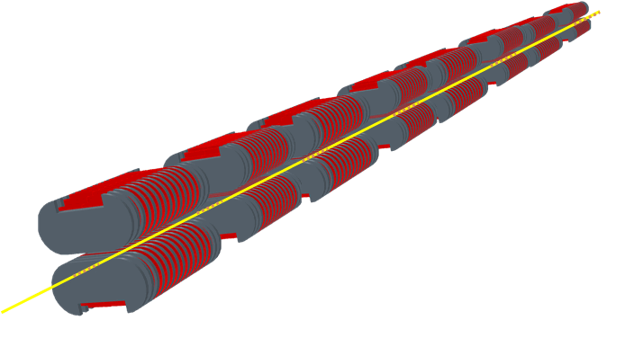
Why SCUs at the European XFEL?
SCUs have a strategic importance for the facility:
  A whole SCU beamline would enable:
    photon beam energies up to 100keV range
    wider tunability in the soft X-ray region
    to keep the same photon energy range covered now using PMUs during operation in CW mode, where the e-beam energy is reduced to 7-8 GeV

Slide 9
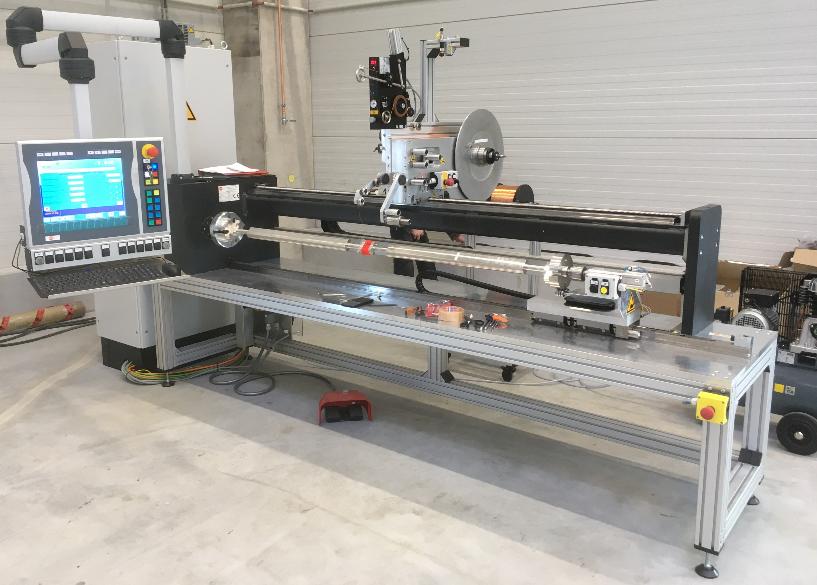
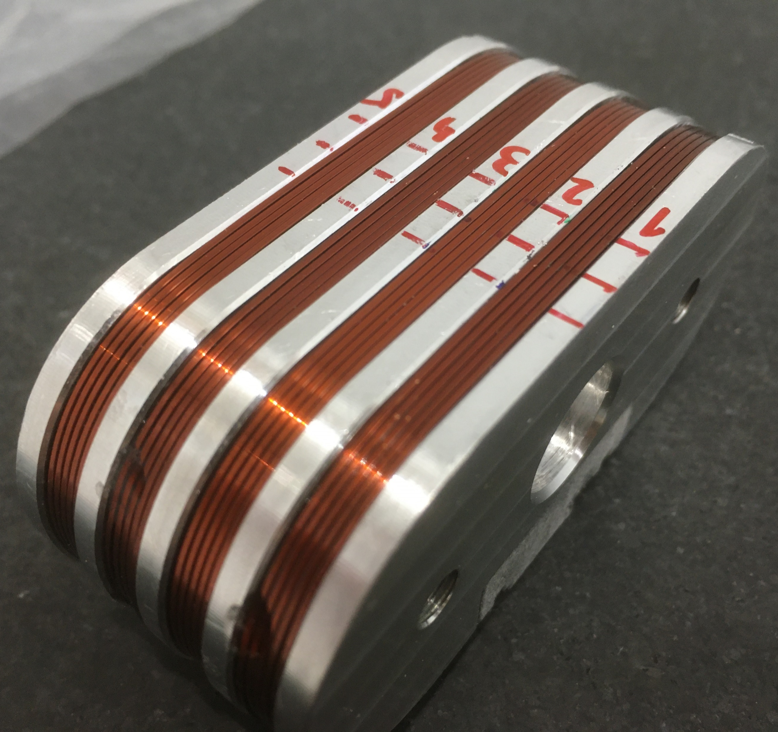
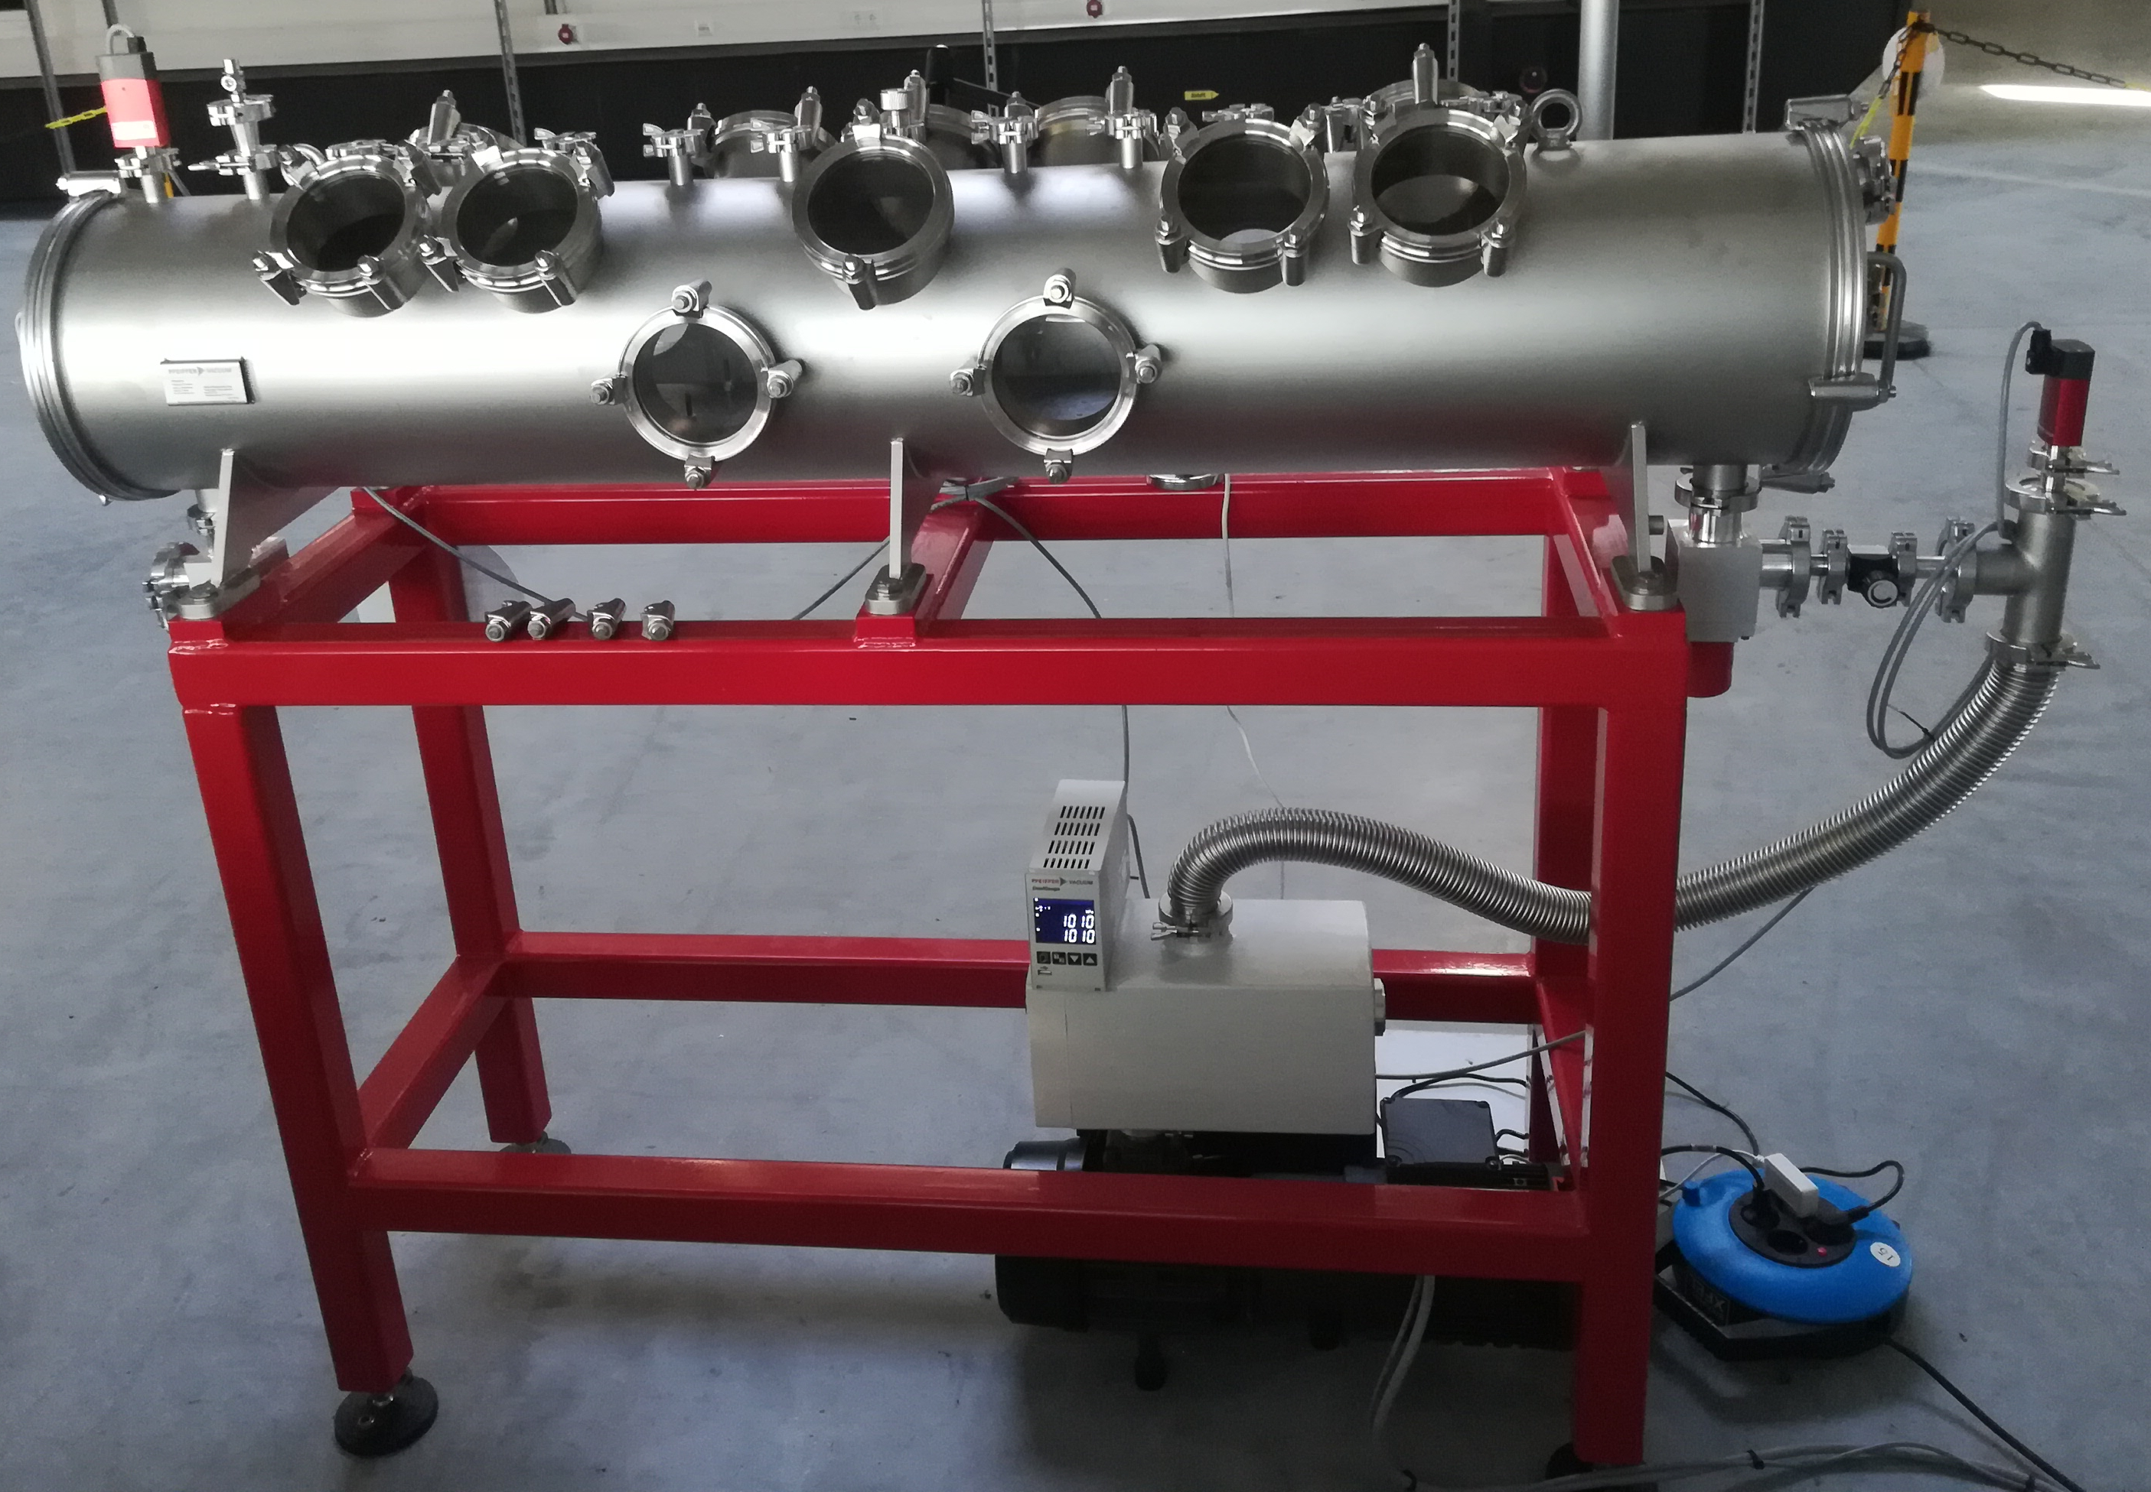
SCUs activities at EuXFEL
R&D on SCU coils

Slide 10

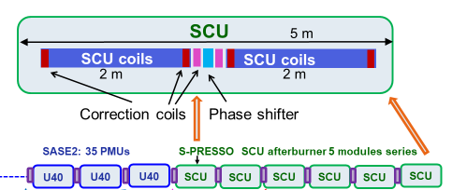
SCUs activities at EuXFEL
R&D on SCU coils
and afterburner downstream SASE2
  The afterburner will allow lasing at photon energies > 30 keV

Slide 11


SCUs activities at EuXFEL
R&D on SCU coils
and afterburner downstream SASE2
  The afterburner will allow lasing at photon energies > 30 keV
Cryomodules test stands for magnetic measurements at DESY site:
  SUNDAE1
  SUNDAE2

Slide 12
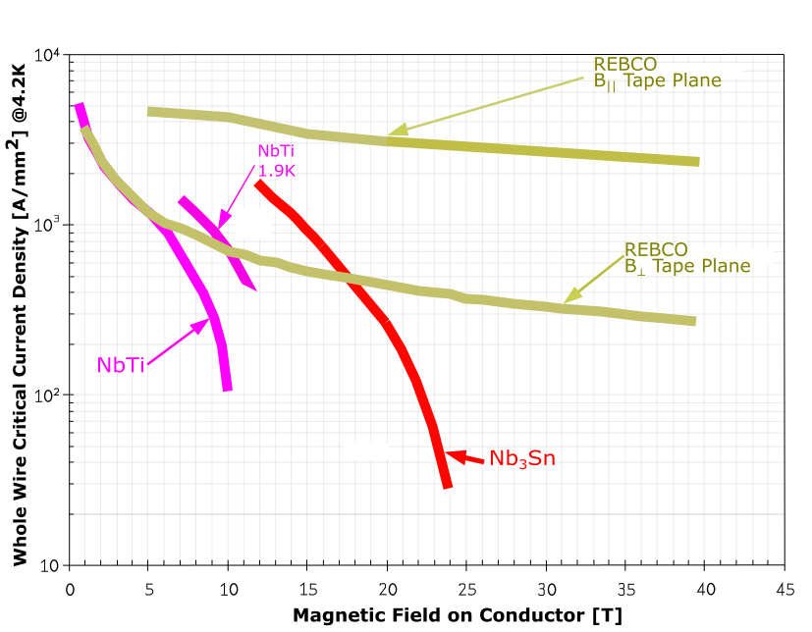
Superconducting materials for SCUs
Planned coils to be designed, manifactured and characterized:
NbTi:
  single period→ designed and parts arrived at the EuXFEL
  period doubling→ design completed
2G HTS tape and NbTi
  HybriSCUs: coil with NbTi and HTS→ magnetic design completed, mechanical design under study
  HTS SCU coil→ mechanical design under study
link to: Detailed loadline for SC materials

Slide 13
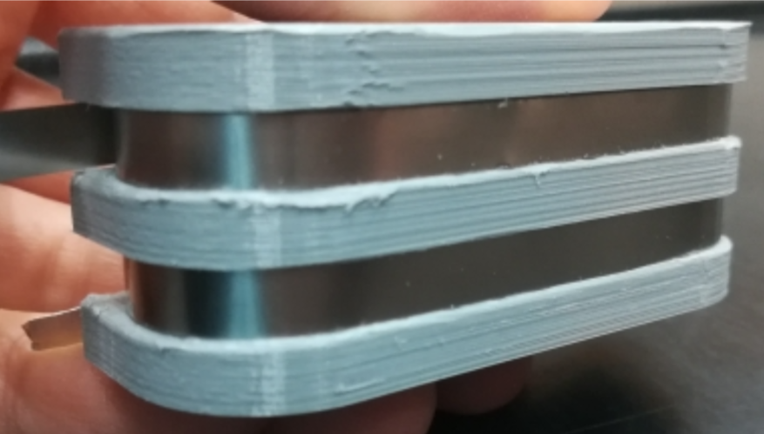
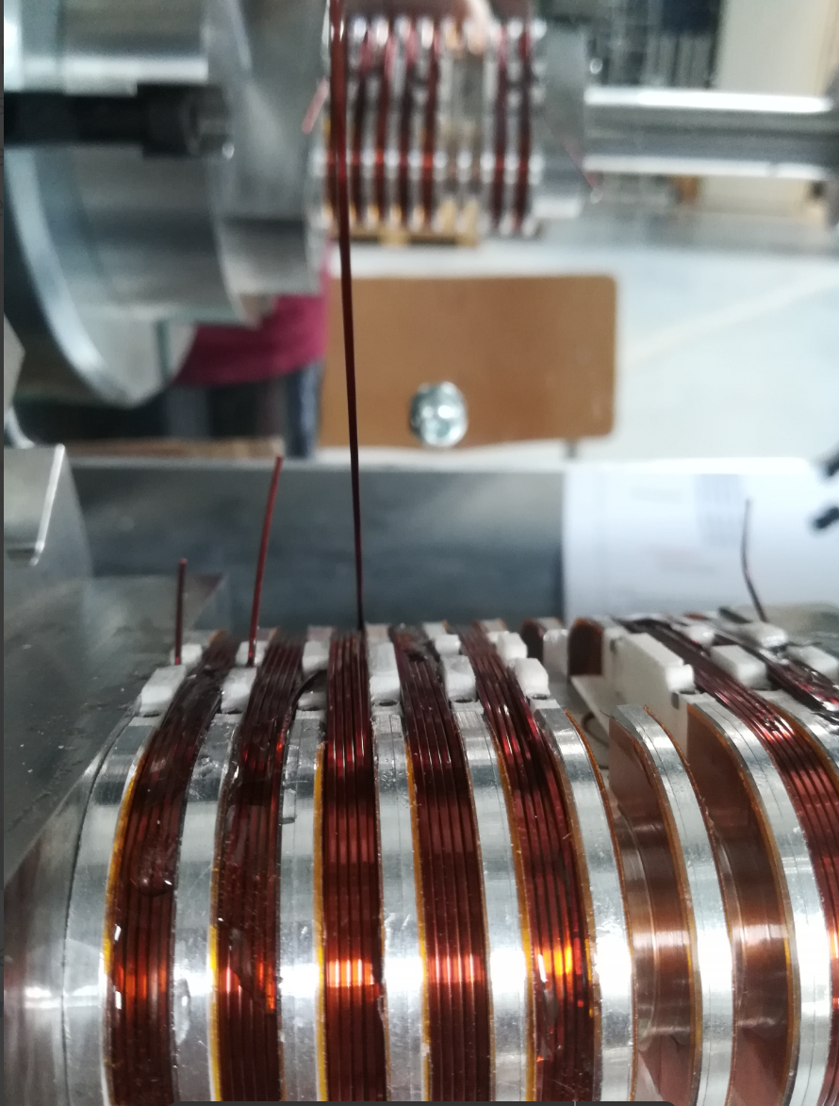
Planned coils to be designed, manifactured and characterized
Coil with NbTi
Coil with NbTi in the configuration of period doubling
Circuit2
Coil with mixed windings: NbTi and HTS
Coil with HTS
Circuit1

Slide 14
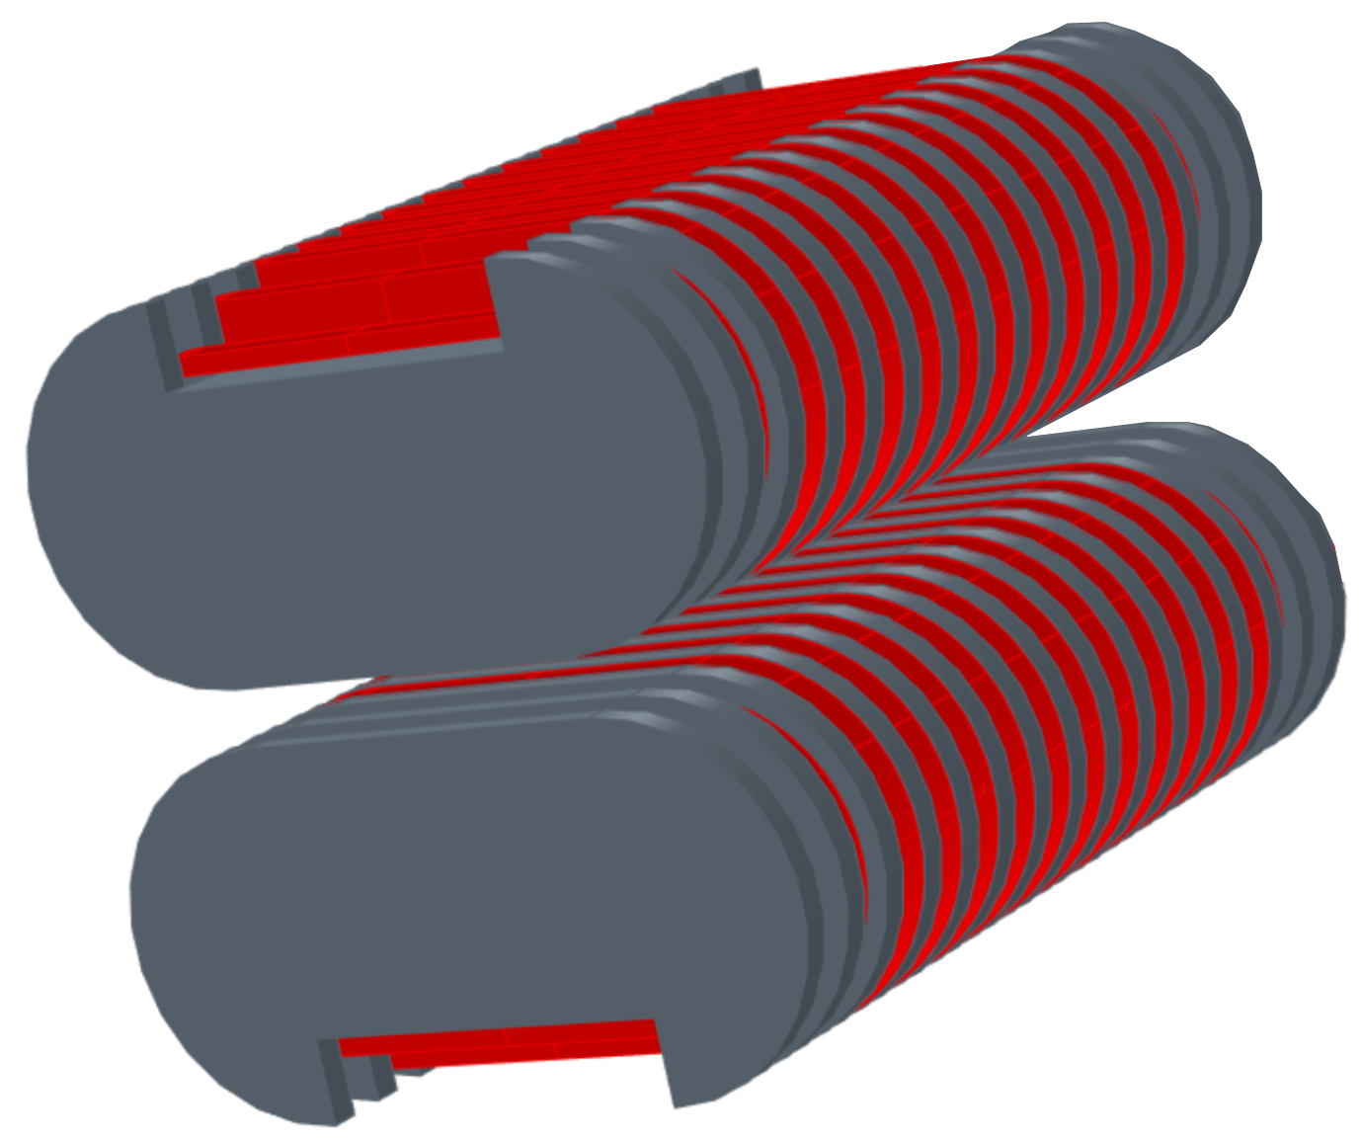
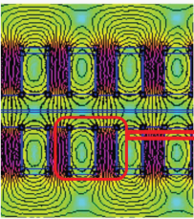
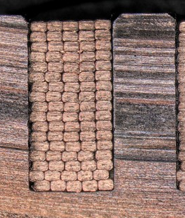
Design
Geometry definition
space for corrector coils
3.15 mm
10 mm
285 mm
gap=5mm
40 mm
8.95 mm
7.5 mm

Slide 15
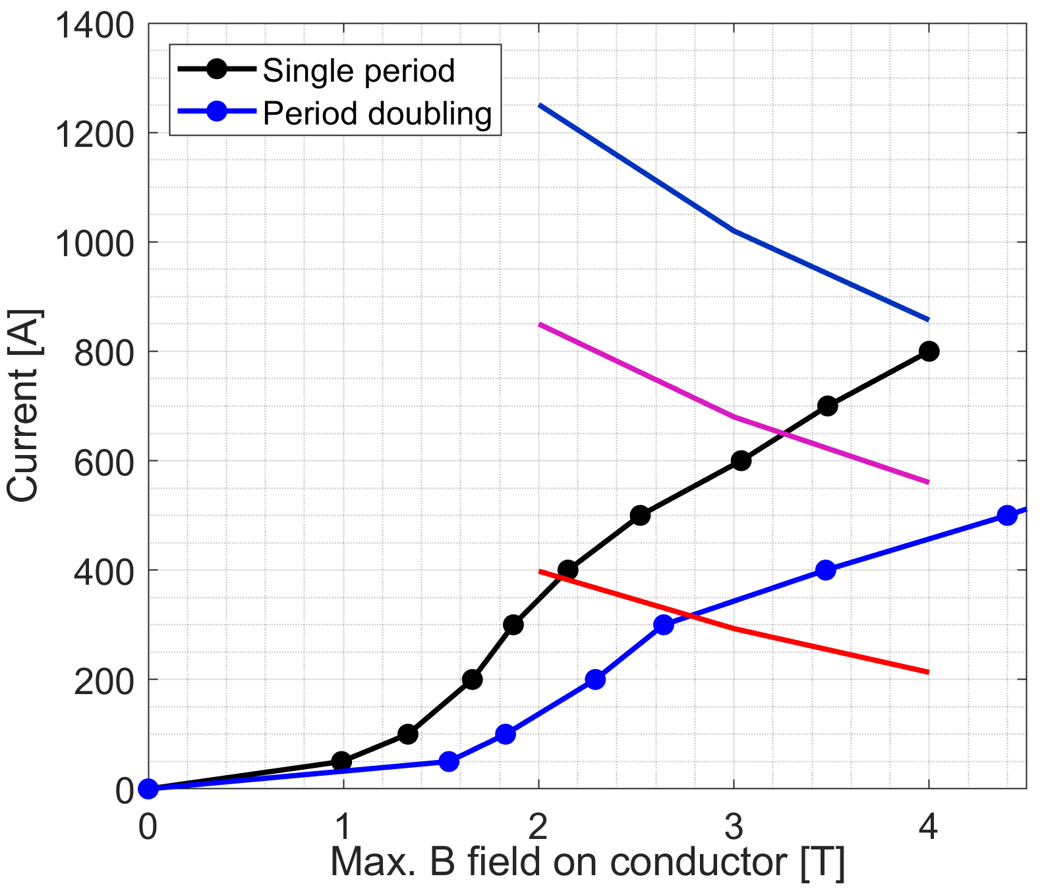
Design
Geometry definition
Evaluation of the operational current in the conductor
Temperature | Single period current (2K margin) | Period doubling current (2K margin)
4.2K | 400 A | 350 A
2.2K | 650 A | 500 A
T=2.2K
T=4.2K
Critical curves for NbTi
T=6.2K

Slide 16
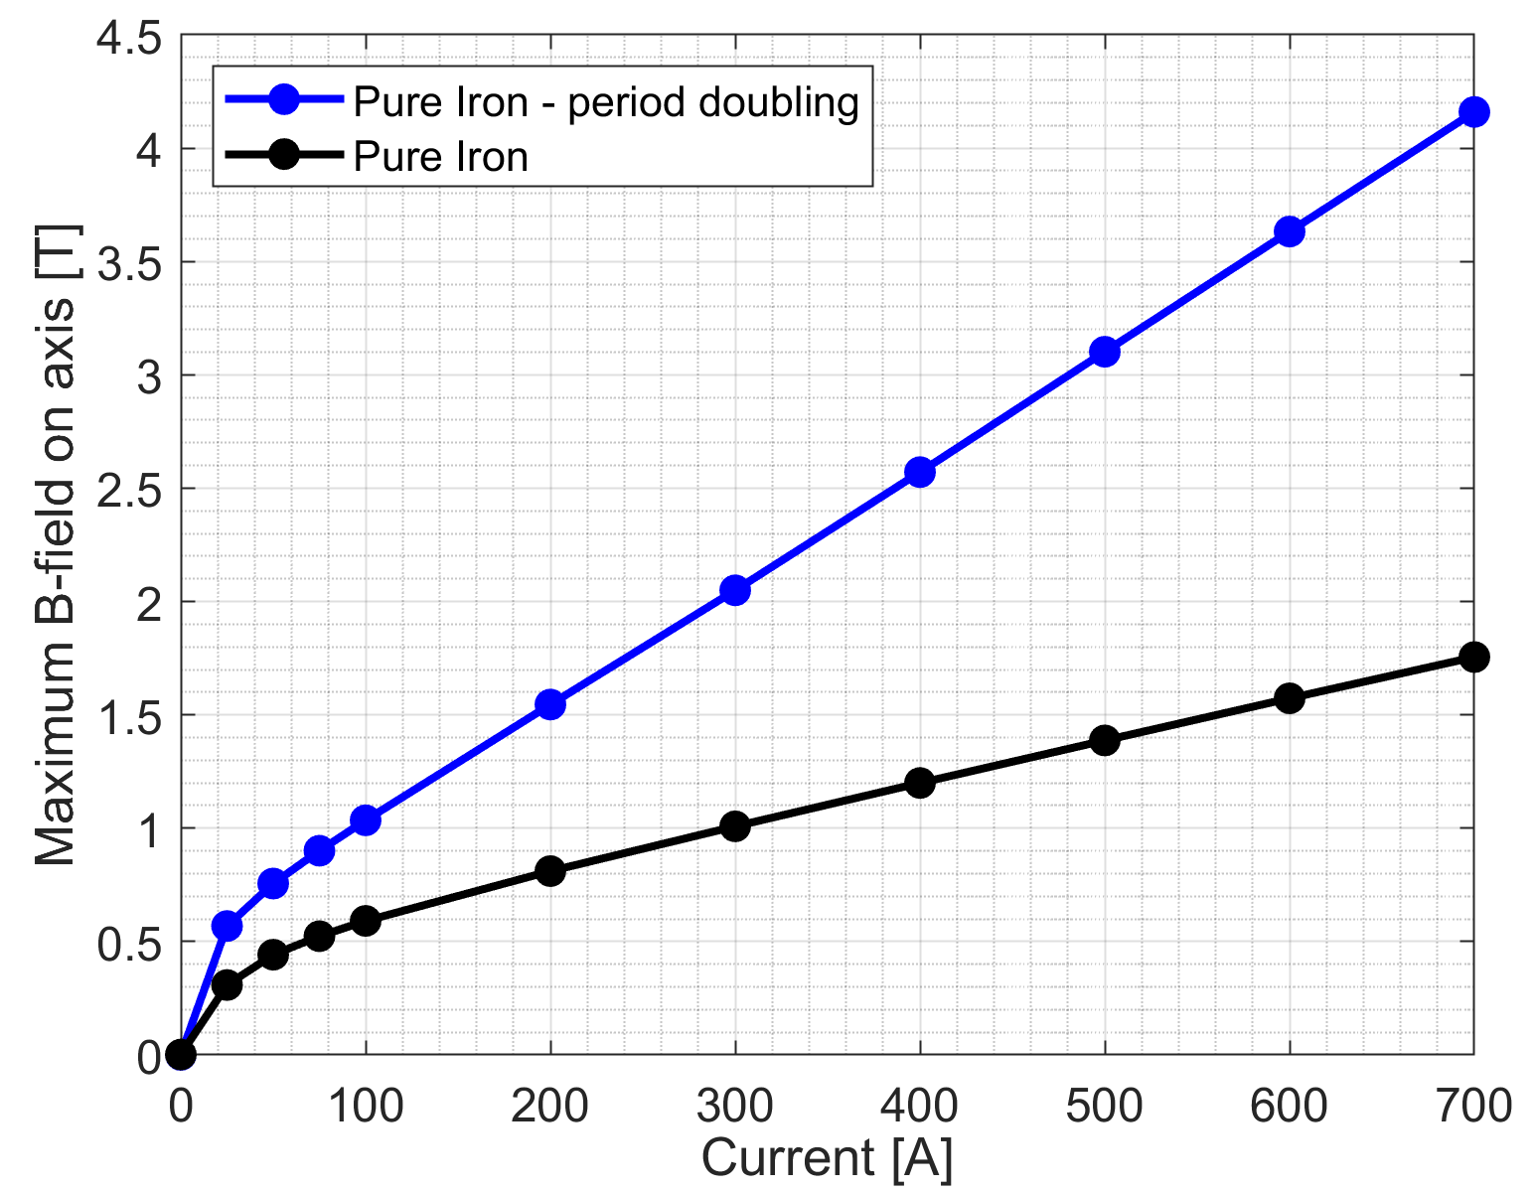
Design
Geometry definition
Evaluation of the operational current in the conductor
Evaluation of the field on axis
Temperature | Single period current (2K margin) | Period doubling current (2K margin)
4.2K | 400 A | 350 A
2.2K | 650 A | 500 A
Temperature | Single period Max. B-field on axis | Period doubling Max. B-field on axis
4.2K | 1.2 T | 2.3 T
2.2K | 1.62 T | 3 T

Slide 17
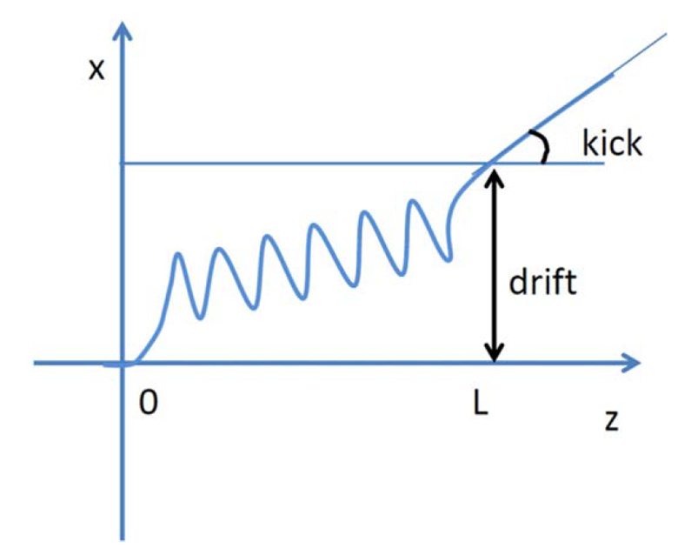
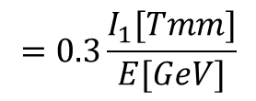
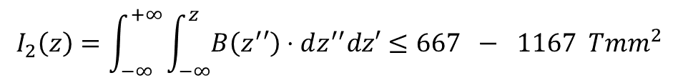
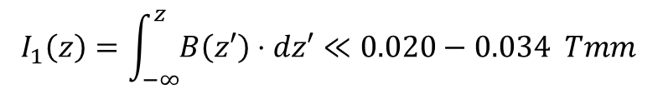

Design
Geometry definition
Evaluation of the operational current in the conductor
Evaluation of the field on axis
Definition of the current in the endfields and correction coils to achieve the first and second field integrals
$$=0.3\frac{I_{1}[Tmm]}{E[GeV]}$$
Temperature | Single period current (2K margin) | Period doubling current (2K margin)
4.2K | 400 A | 350 A
2.2K | 650 A | 500 A
$$=0.3\frac{I_{2}[Tmm^{2}]}{E[GeV]}$$
Temperature | Single period Max. B-field on axis | Period doubling Max. B-field on axis
4.2K | 1.2 T | 2.3 T
2.2K | 1.62 T | 3 T
10 GeV
17.5 GeV
$$I_{1}\left(z\right)=\int_{−∞}^{z}{B\left(z′\right)⋅dz′}≪0.020−0.034 Tmm$$
$$I_{2}\left(z\right)=\int_{−∞}^{+∞}{\int_{−∞}^{z}{B\left(z^{′}′\right)⋅dz^{′′}dz′}}≤667 − 1167 Tmm^{2}$$
  For E = 17.5 GeV the maximum allowed kick is 0.6 µrad and drift of 20µm

Slide 18
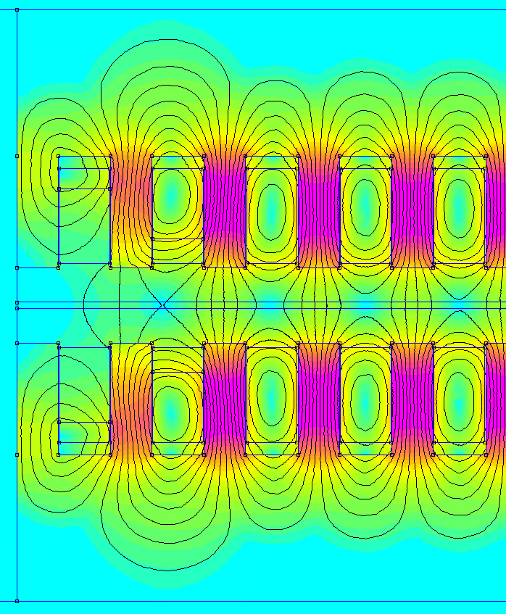
Design
End field design
  Symmetric configuration: odd number of poles
  Requirements for I1 and I2 are met with a
  -1/4,+3/4, -1 endfield configuration
10 GeV
17.5 GeV
$$I_{1}\left(z\right)=\int_{−∞}^{z}{B\left(z′\right)⋅dz′}≪0.020−0.034 Tmm$$
$$I_{2}\left(z\right)=\int_{−∞}^{+∞}{\int_{−∞}^{z}{B\left(z^{′}′\right)⋅dz^{′′}dz′}}≤667 − 1167 Tmm^{2}$$
Simulation is done with
FEMM

Slide 19
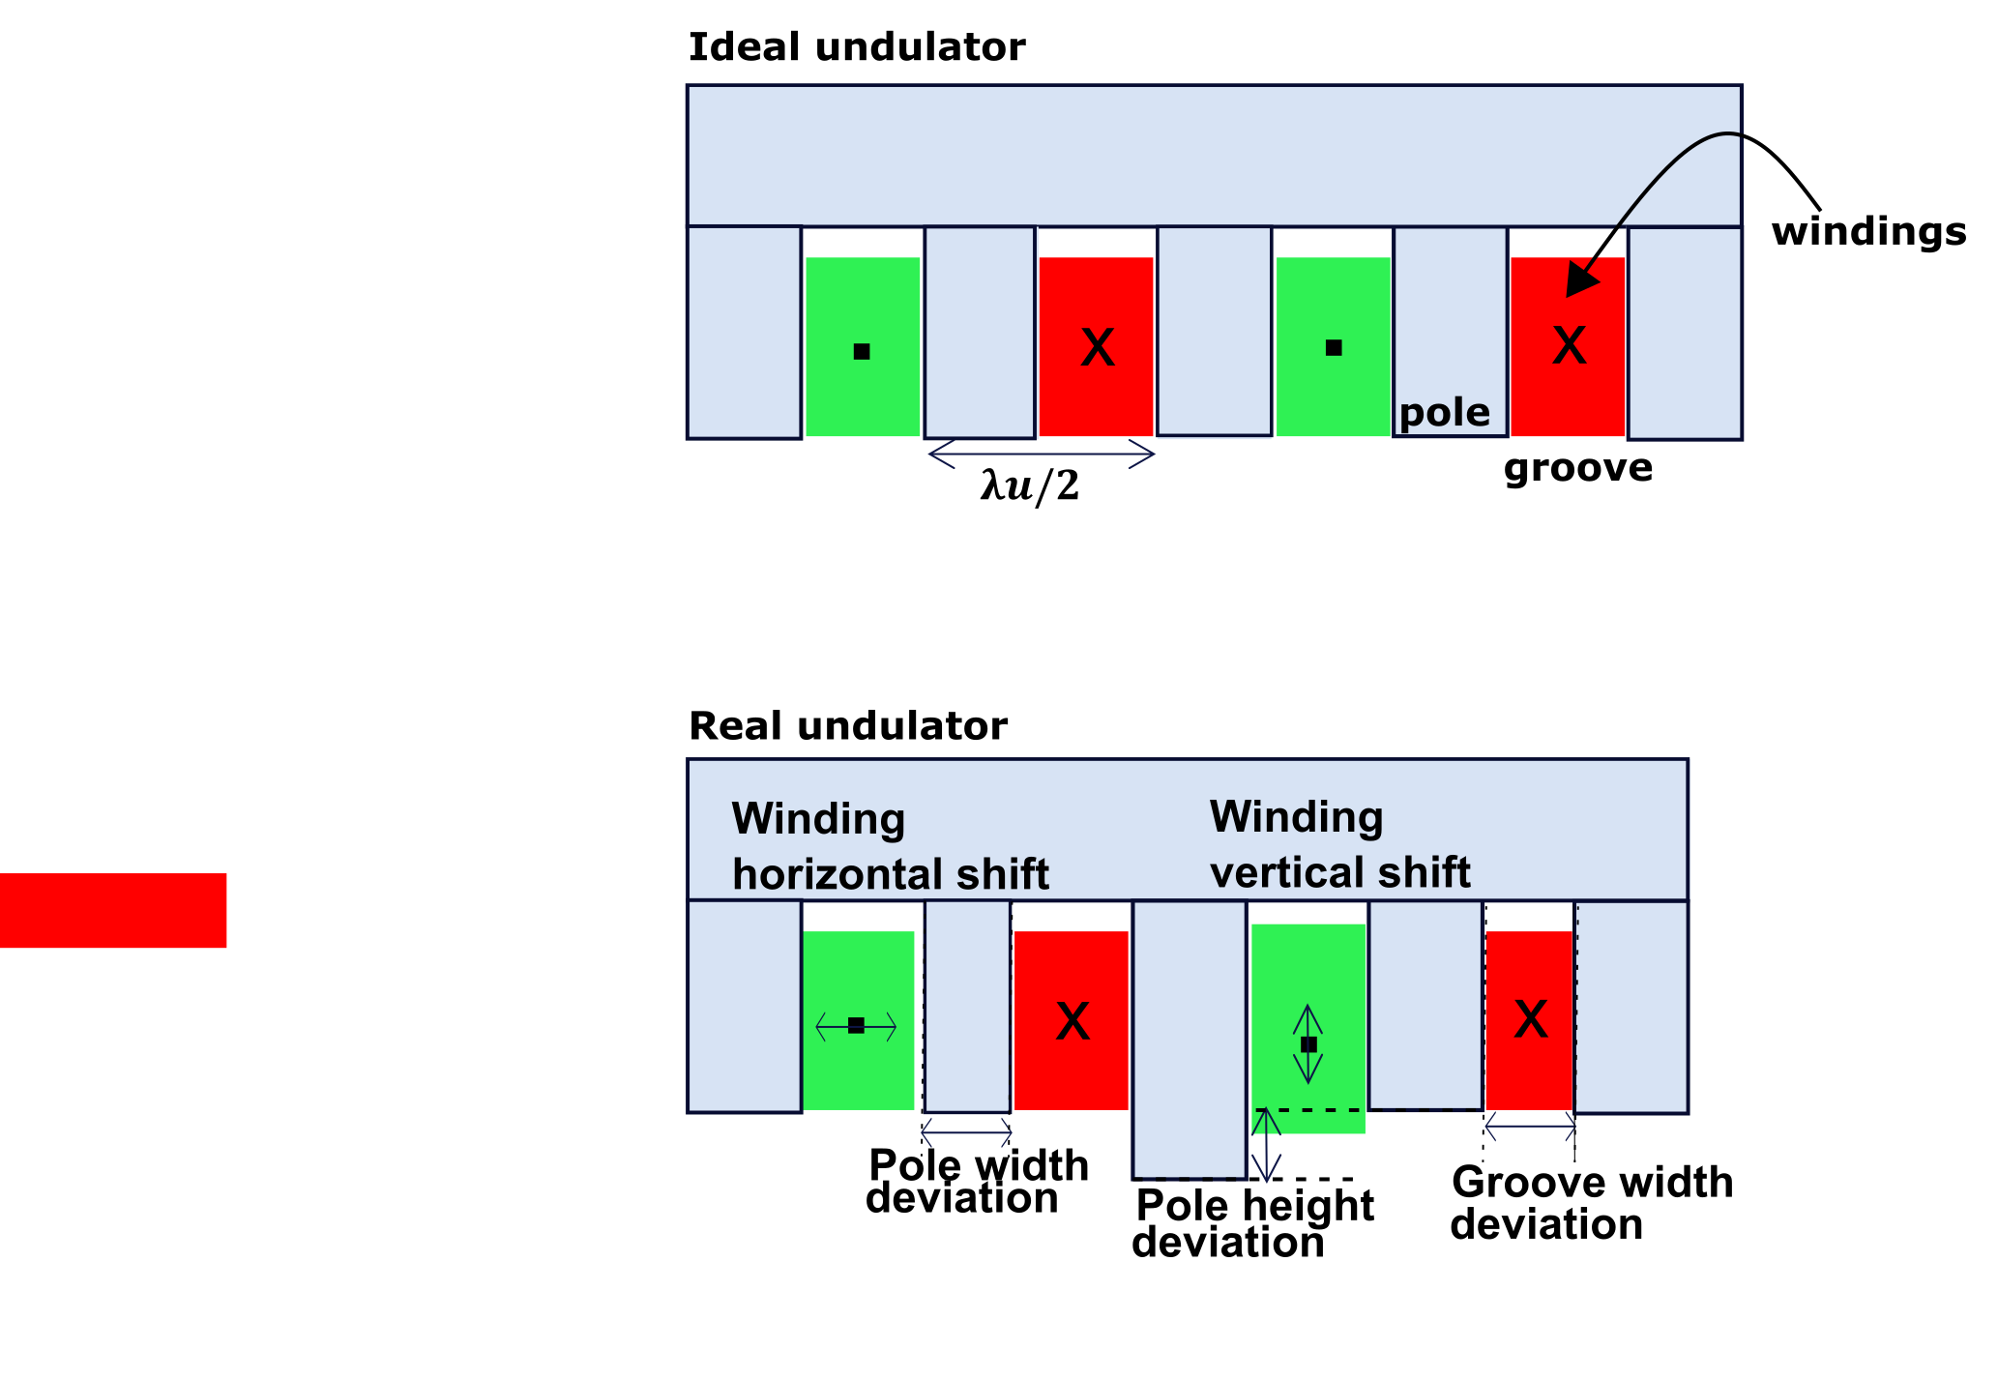
Tolerance Study
Motivation:
  a geometrical deviation from the designed geometry leads to a deviation in magnetic field → first and second field integrals → deviation in the trajectory
Characterization in FEMM of the mechanical deviations

Slide 20
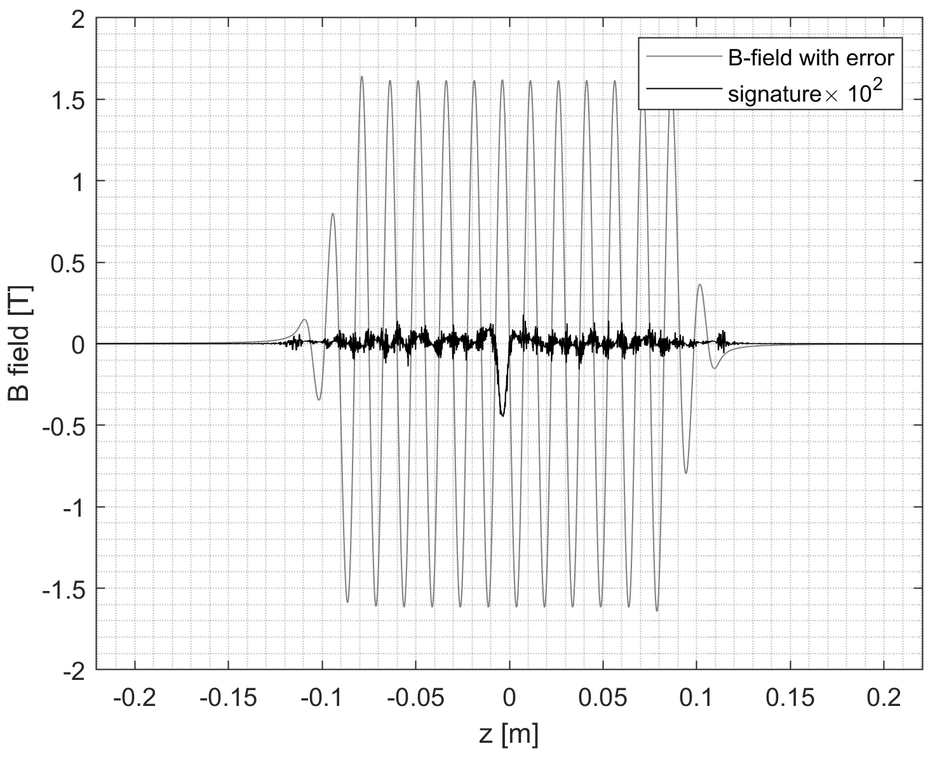
Tolerance Study
Pole height +50µm
Motivation:
  a geometrical deviation from the designed geometry leads to a deviation in magnetic field → first and second field integrals → deviation in the trajectory
Characterization in FEMM of the mechanical deviations:
  Pole height
  Winding height
  Pole and groove width

Slide 21
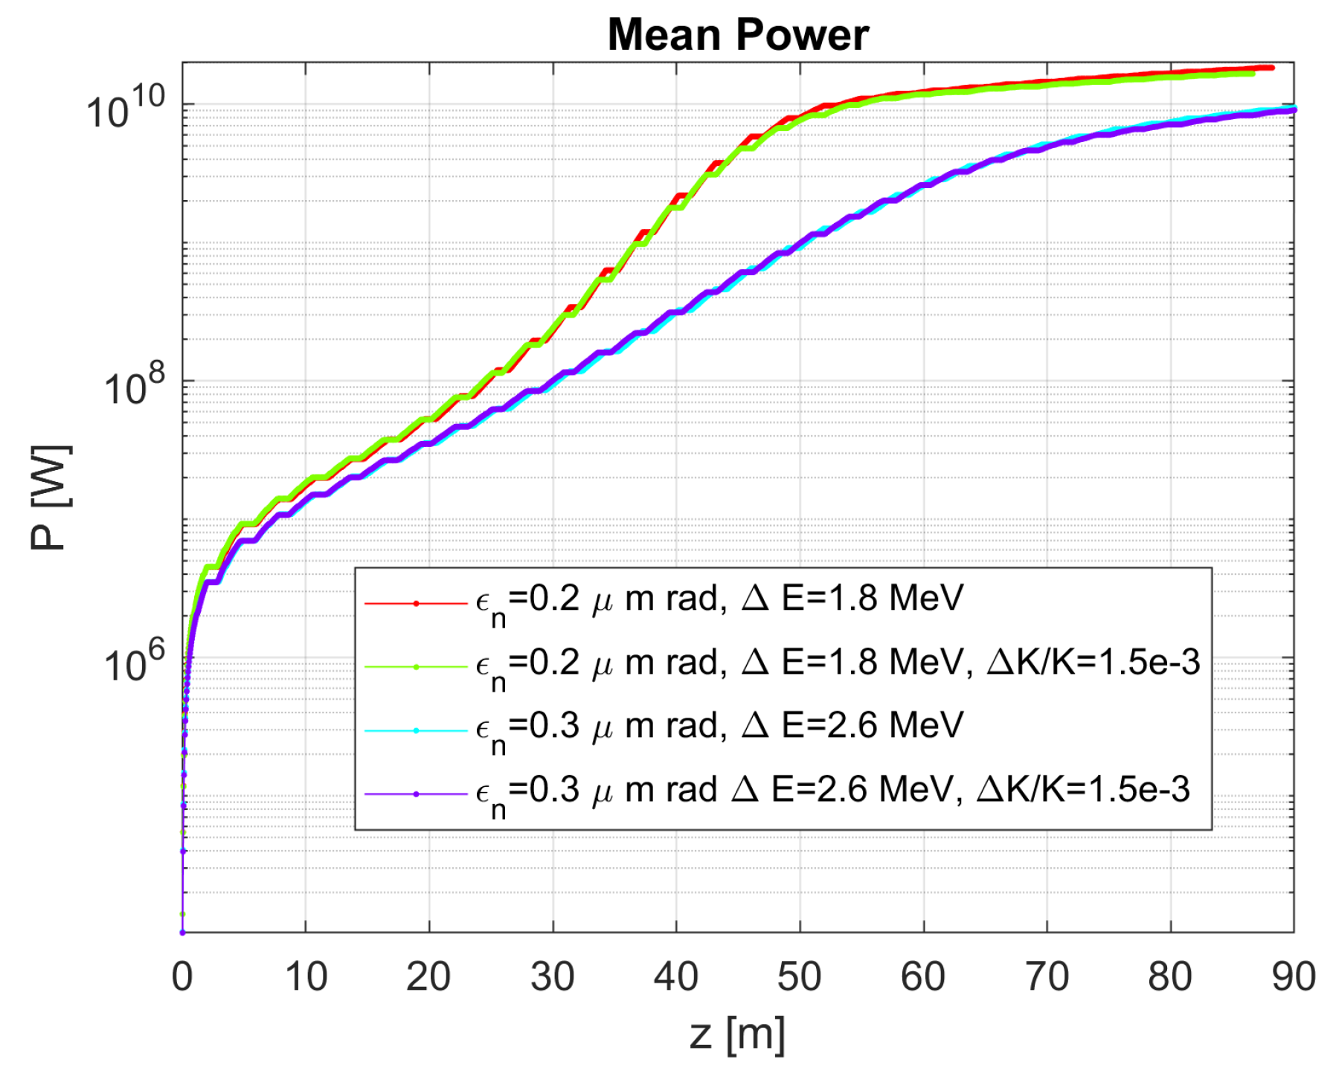
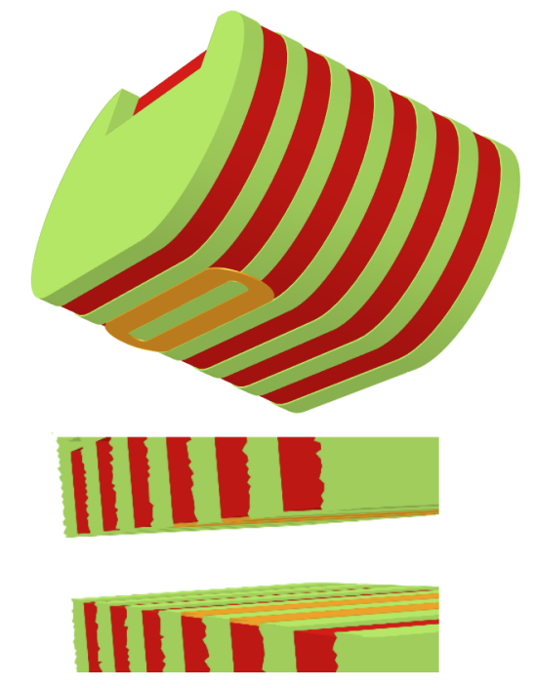
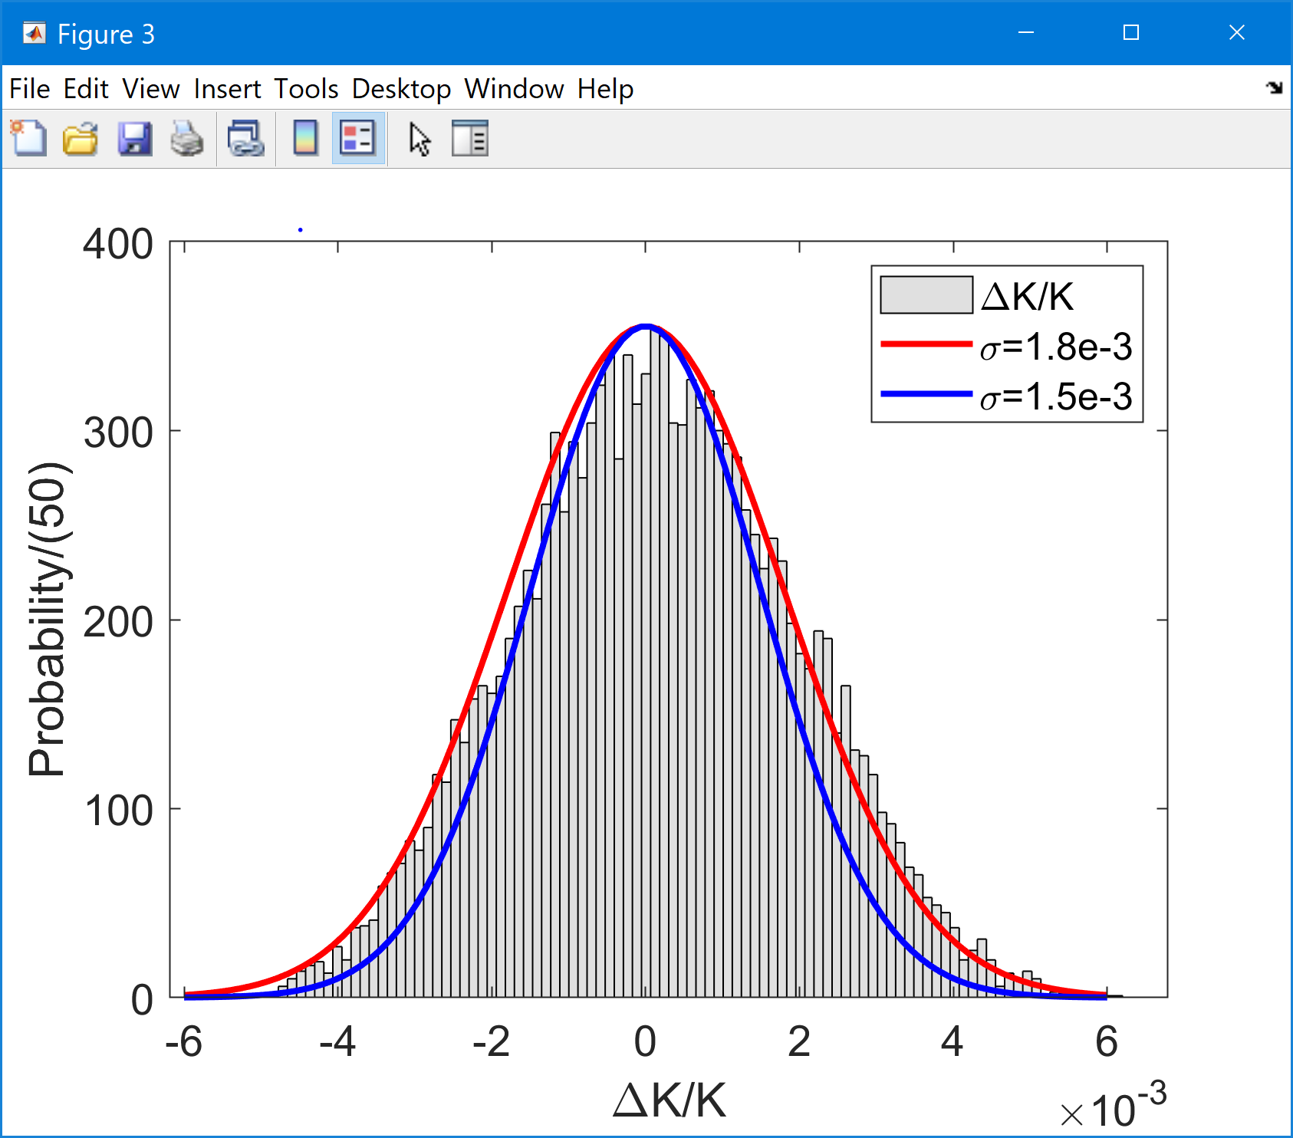


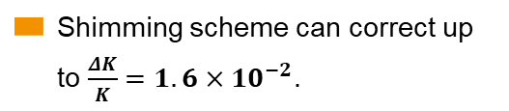
Correspondent errors to the deviation assumed in the GENESIS simulation
Output of FEL simulations: the curves have been obtained averaging on 50 SASE pulses.
For $σ\left(\frac{ΔK}{K}\right)=1.5×{10}^{−3}$, more than 95% of the mean power with respect to the ideal case can be reached.
Montecarlo simulation gives a $σ\left(\frac{ΔK}{K}\right)=1.8×{10}^{−3}$ → higher compared to simulation
Worse case considered: uniform distribution of the error in the range defined
Pole height | Winding vert. shift | Pole width | Coil width
±20 µm | ±20 µm | ±10 µm | ±10 µm
V. Grattoni et al., “Tolerance Study on the Geometrical Errors for a Planar Superconducting Undulator”, in Proc. IPAC'22, Bangkok, Thailand, Jun. 2022, pp. 2734-2736. doi:10.18429/JACoW-IPAC2022-THPOPT060
Shimming scheme can correct up to $\frac{ΔK}{K}=1.6×10^{−2}$.
*Reference:
B. Marchetti et al., “Study of the Tolerances for Superconducting Undulators at the European XFEL”

Slide 22
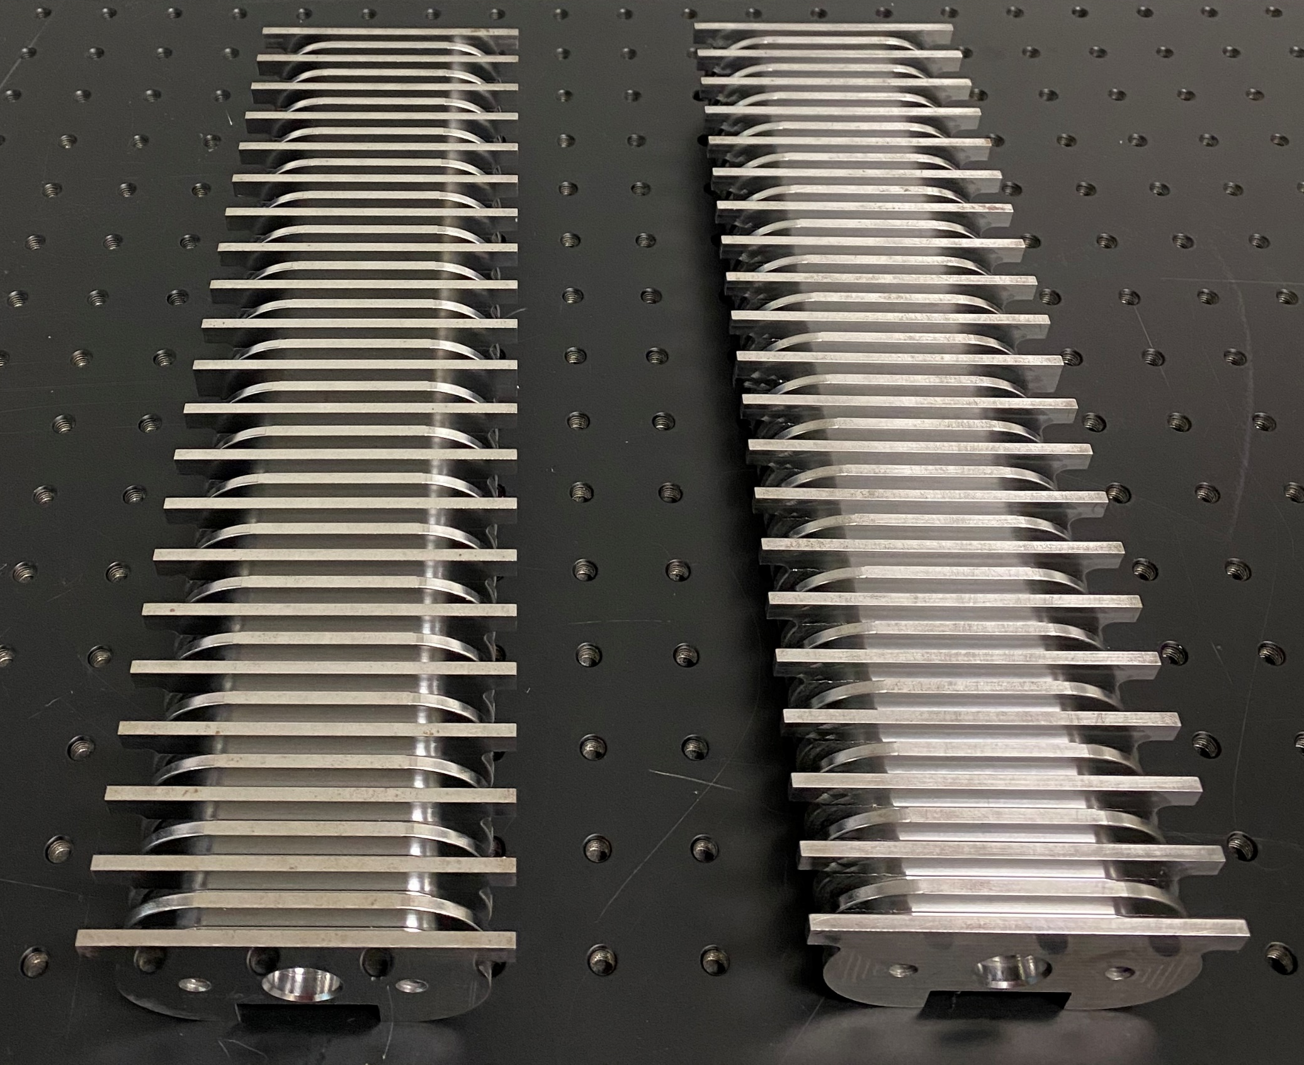
Manufacturing
Manufacturing of the yoke (done by an external company)
Application of the insulating materials to the bottom of the grooves and the pole walls
Winding the superconducting coil with the winding machine
Impregnation of the winded coil with epoxy resin
Pole height | Winding vert. shift | Pole width | Coil width
±20 µm | ±20 µm | ±10 µm | ±10 µm

Slide 23
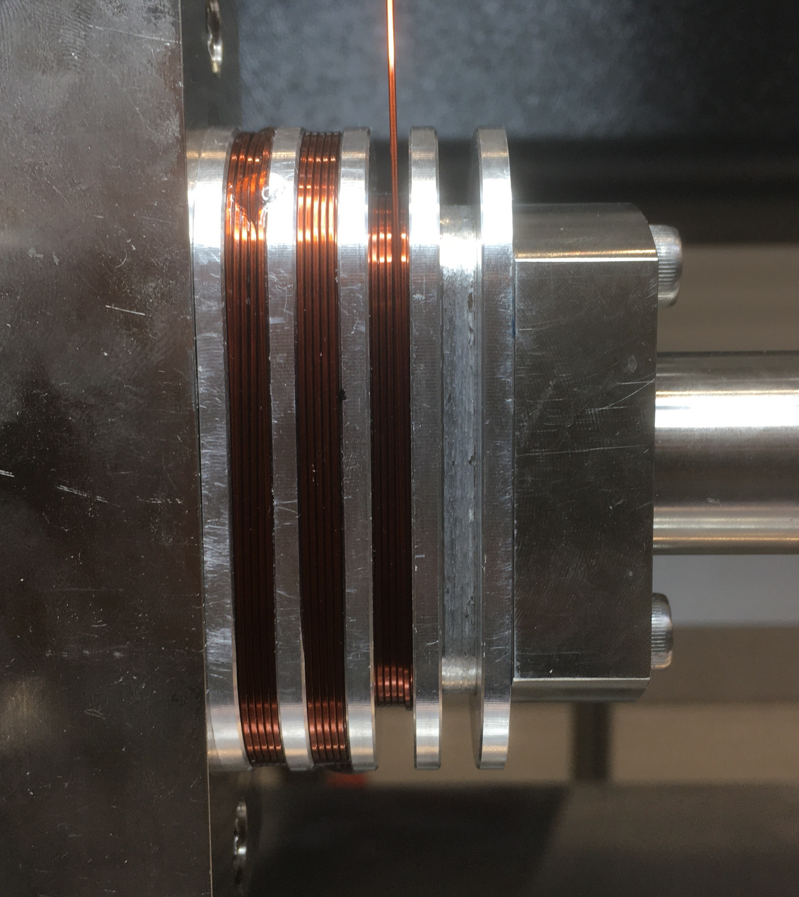
Winding process

Slide 24
Vacuum Pressure Impregnation (VPI)
VPI is needed to fill the voids between the SC wires preventing them to move once the current is flowing throught them.
The epoxy resin used for VPI should be:
  radiation resistent
  suitable for cryogenic applications
  low viscosity

Slide 25
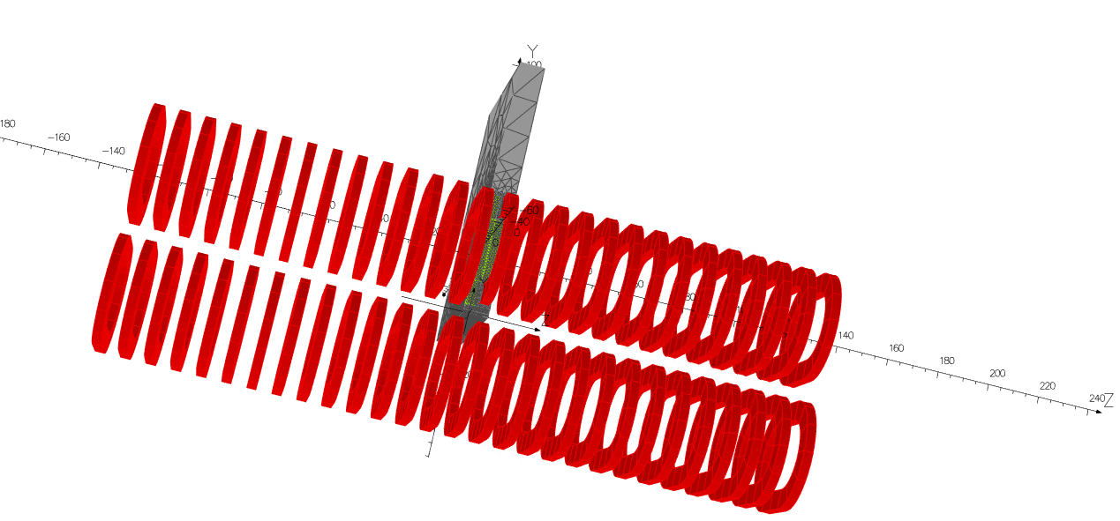
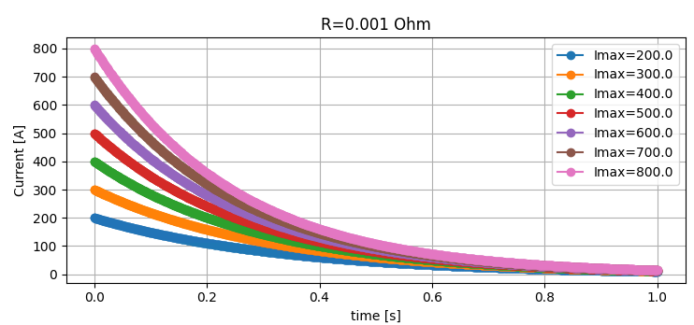
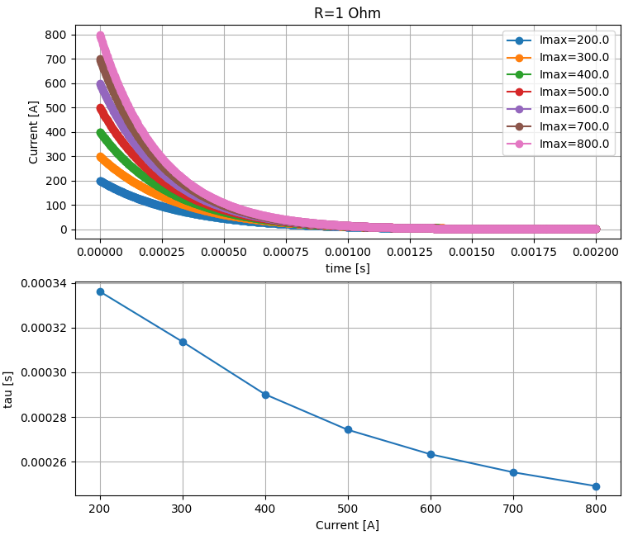
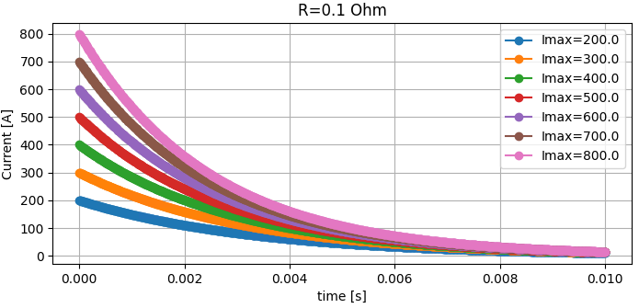

Work in progress here in Berkeley
Prepared model in OPERA-3d for inductance calculation
Estimated the current decay in an RL circuit with R variable and L from the flux linkage calculation
Under investigation: discrepancy in inductance calculation
Next steps:
  cross-check the current decay in OPERA-3d
  quench simulation in OPERA-3d

Slide 26
Conclusions
SCUs are of strategic importance for the EuXFEL
Various activities are ongoing at EuXFEL on SCUs
  R&D
  S-PRESSO and afterbruner
  Preparation of SUNDAE1 and 2
R&D on SCUs
  various coils are under development
    single period NbTi
    period doubling with NbTi
    HybriSCUs
    HTS based SCU coil

Slide 27
Thank you

