Slide 1


Objectives of stay at LBL
Prepared by Frédéric Sirois and Christian Lacroix
November 29th, 2022
Laboratory of Superconductivity and Magnetism (LSM)
Polytechnique Montréal, Montréal, QC, Canada

Slide 2
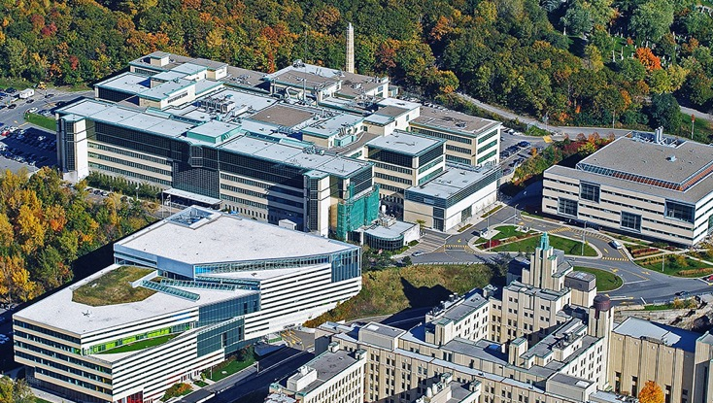
Polytechnique Montreal
~ 10,000 students
~ 300 professors
~ 260 M$ in operating budget
- Technological university founded in 1873 (150 years in 2023!)
Located on same campus as University of Montreal (but independent admin.)
In the top 3 major research institutions in Engineering in Canada (with University of Toronto and University of British Colombia)
Notes:
Critical phenomena must be taken into account

Slide 3
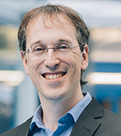
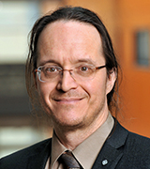
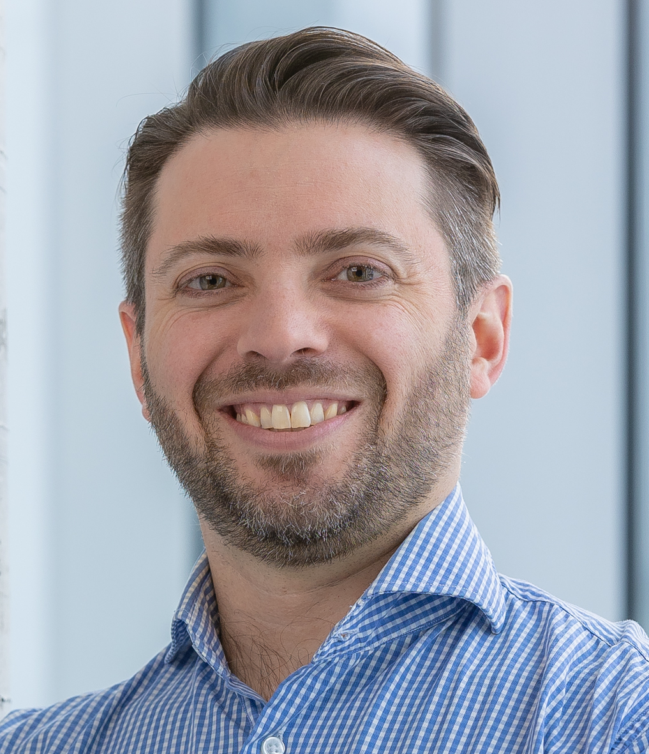
Laboratory of Superconductivity and Magnetism (LSM)
One of the many research group within Polytechnique Montreal
Managed by 3 staff members:
Frédéric Sirois
(professor)
David Ménard
(professor)
Christian Lacroix
(senior research associate)
Total staff: ~25 people (with all students and postdocts)
Operating budget: ~750 k$/year (in average) (>50% from industry)
Most budget used for industry-sponsored projects
Notes:
Critical phenomena must be taken into account

Slide 4
LSM Activities at glance
Characterization of electric, magnetic and thermal properties of superconducting and magnetic materials
  Low frequency regime up to microwave frequencies
Fabrication techniques and thin film coatings
  Sputtering, electrodeposition, …
Permanent magnets
  Processing, magnetization and applications
Nondestructive control techniques (NDT)
  Eddy current and magnetostatic methods, impedance tomography, …
Applications of HTS tapes in power devices and magnets (NEW)
  Quench protection in tapes and cables and novel tape architectures
Innovative modeling techniques in low-frequency electromagnetics
  Specialized formulations for superconductors and magnetic materials
Notes:
Critical phenomena must be taken into account

Slide 5
Timeline of C. Lacroix and F. Sirois at LBL
Christian Lacroix: from Dec. 1st to Dec. 23rd
Main topics of interest (jointly with F. Sirois):
Discuss and learn about quench protection techniques for future HTS magnets (X. Wang, M. Marchevsky, …)
Learn about experimental capabilities of LBL regarding quench protection and cable fabrication
Plan joint projects about testing the current flow diverter (CFD) concept for DC cable quench protection
Frédéric Sirois: from Nov. 28th to Feb. 7th
Main topics of interest (in addition to above):
Discuss and learn about internal modeling efforts and tools at LBL (C. Messe, L. Brouwer, …)
Jointly develop code and algorithms specialized for HTS magnets
Prepare the hosting of a Canadian Ph.D. student (Gregory Giard) next January
Notes:
Critical phenomena must be taken into account

