Slide 1
Status of the Mechanical Model
Charles Orozco
MDP Meeting
11 October 2017

Slide 2
Three Mechanical Models
The short model consists of four laminations and two clamps
8 strain gauges on the stress concentration points of the laminations
2 strain gauges on the dummy coil at 0°and 90°
Placed in an LN2 bath under four shimming configurations
The long model consists of all the laminations and clamps
The first dummy coil configuration has all coils represented by an aluminum cylinder
The second configuration uses four half cylinders, two for layers 1 and 2 and two for layers 3 and 4.

Slide 3
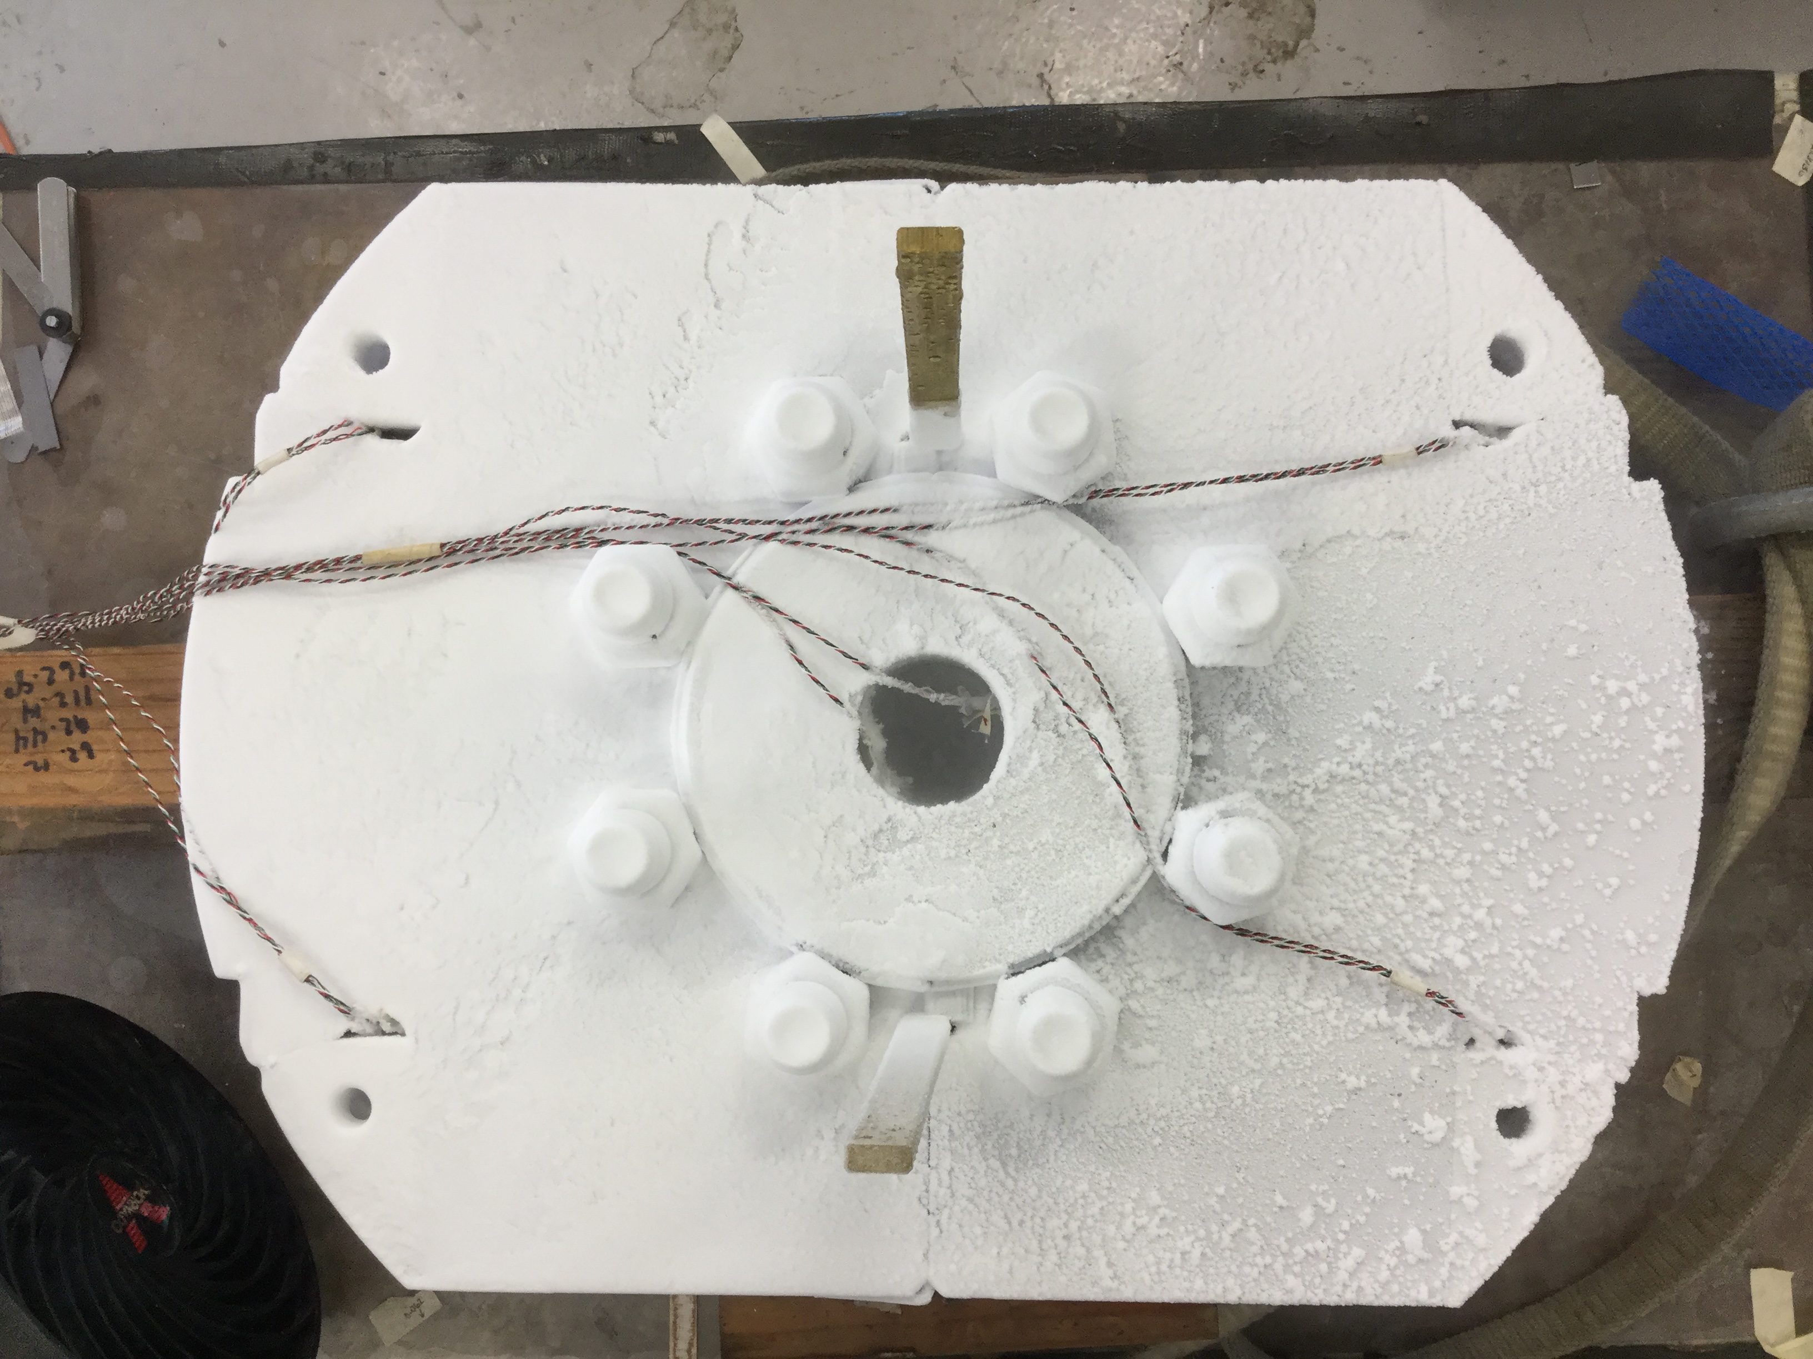
Short Mechanical Model

Slide 4
Long Mechanical Model

Slide 5
Strain Gauge Plan
Two channels ~320mm from each end
Six gauges per channel
Five azimuthal, one longitudinal
Same locations axially
Four gauges per location
Three azimuthal, one longitudinal

Slide 6
Strain Gauge Readout

