Slide 1
Strain gauges in the 15 T FNAL prototype
October 11, 2017
Stoyan Stoynev et al.
US Magnet Development Program
Fermi National Accelerator Laboratory

Slide 2
Introduction
During the latest coil readiness review for layer 1 and 2 for the 15 T magnet at FNAL a discussion on strain gauges was advised
This presentation summarizes the information on strain gauges and intention of use
Limitations and considerations are emphasized
The slides are aimed to serve as a guide for the discussion

Slide 3
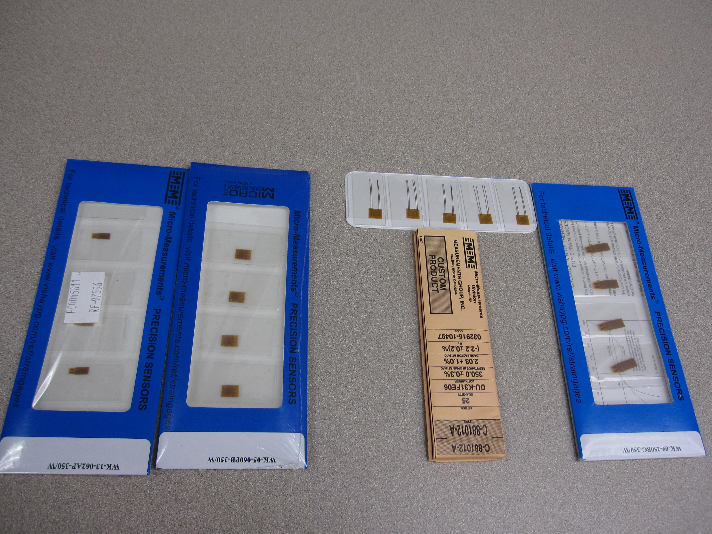
Strain gauges at FNAL
There are typical gauge types being regularly reordered or anyway available at FNAL
They are suitable and enough to cover the needs for the 15 model
Gauges suitable for
Stainless Steel
Suitable for Ti
VMTF limitation:
At VMTF we are capable
of reading no more than 64
strain gauge channels
through the standard DAQ
(typically reading at <1 Hz)
Skin, Bullets
(long)
Layer 3/4 Pole
(short)
Suitable
for coil (Cu)
Layer 1/2 pole
Similar to
WK-09-125BG-350
During loading operations
there are no specific
limitations

Slide 4
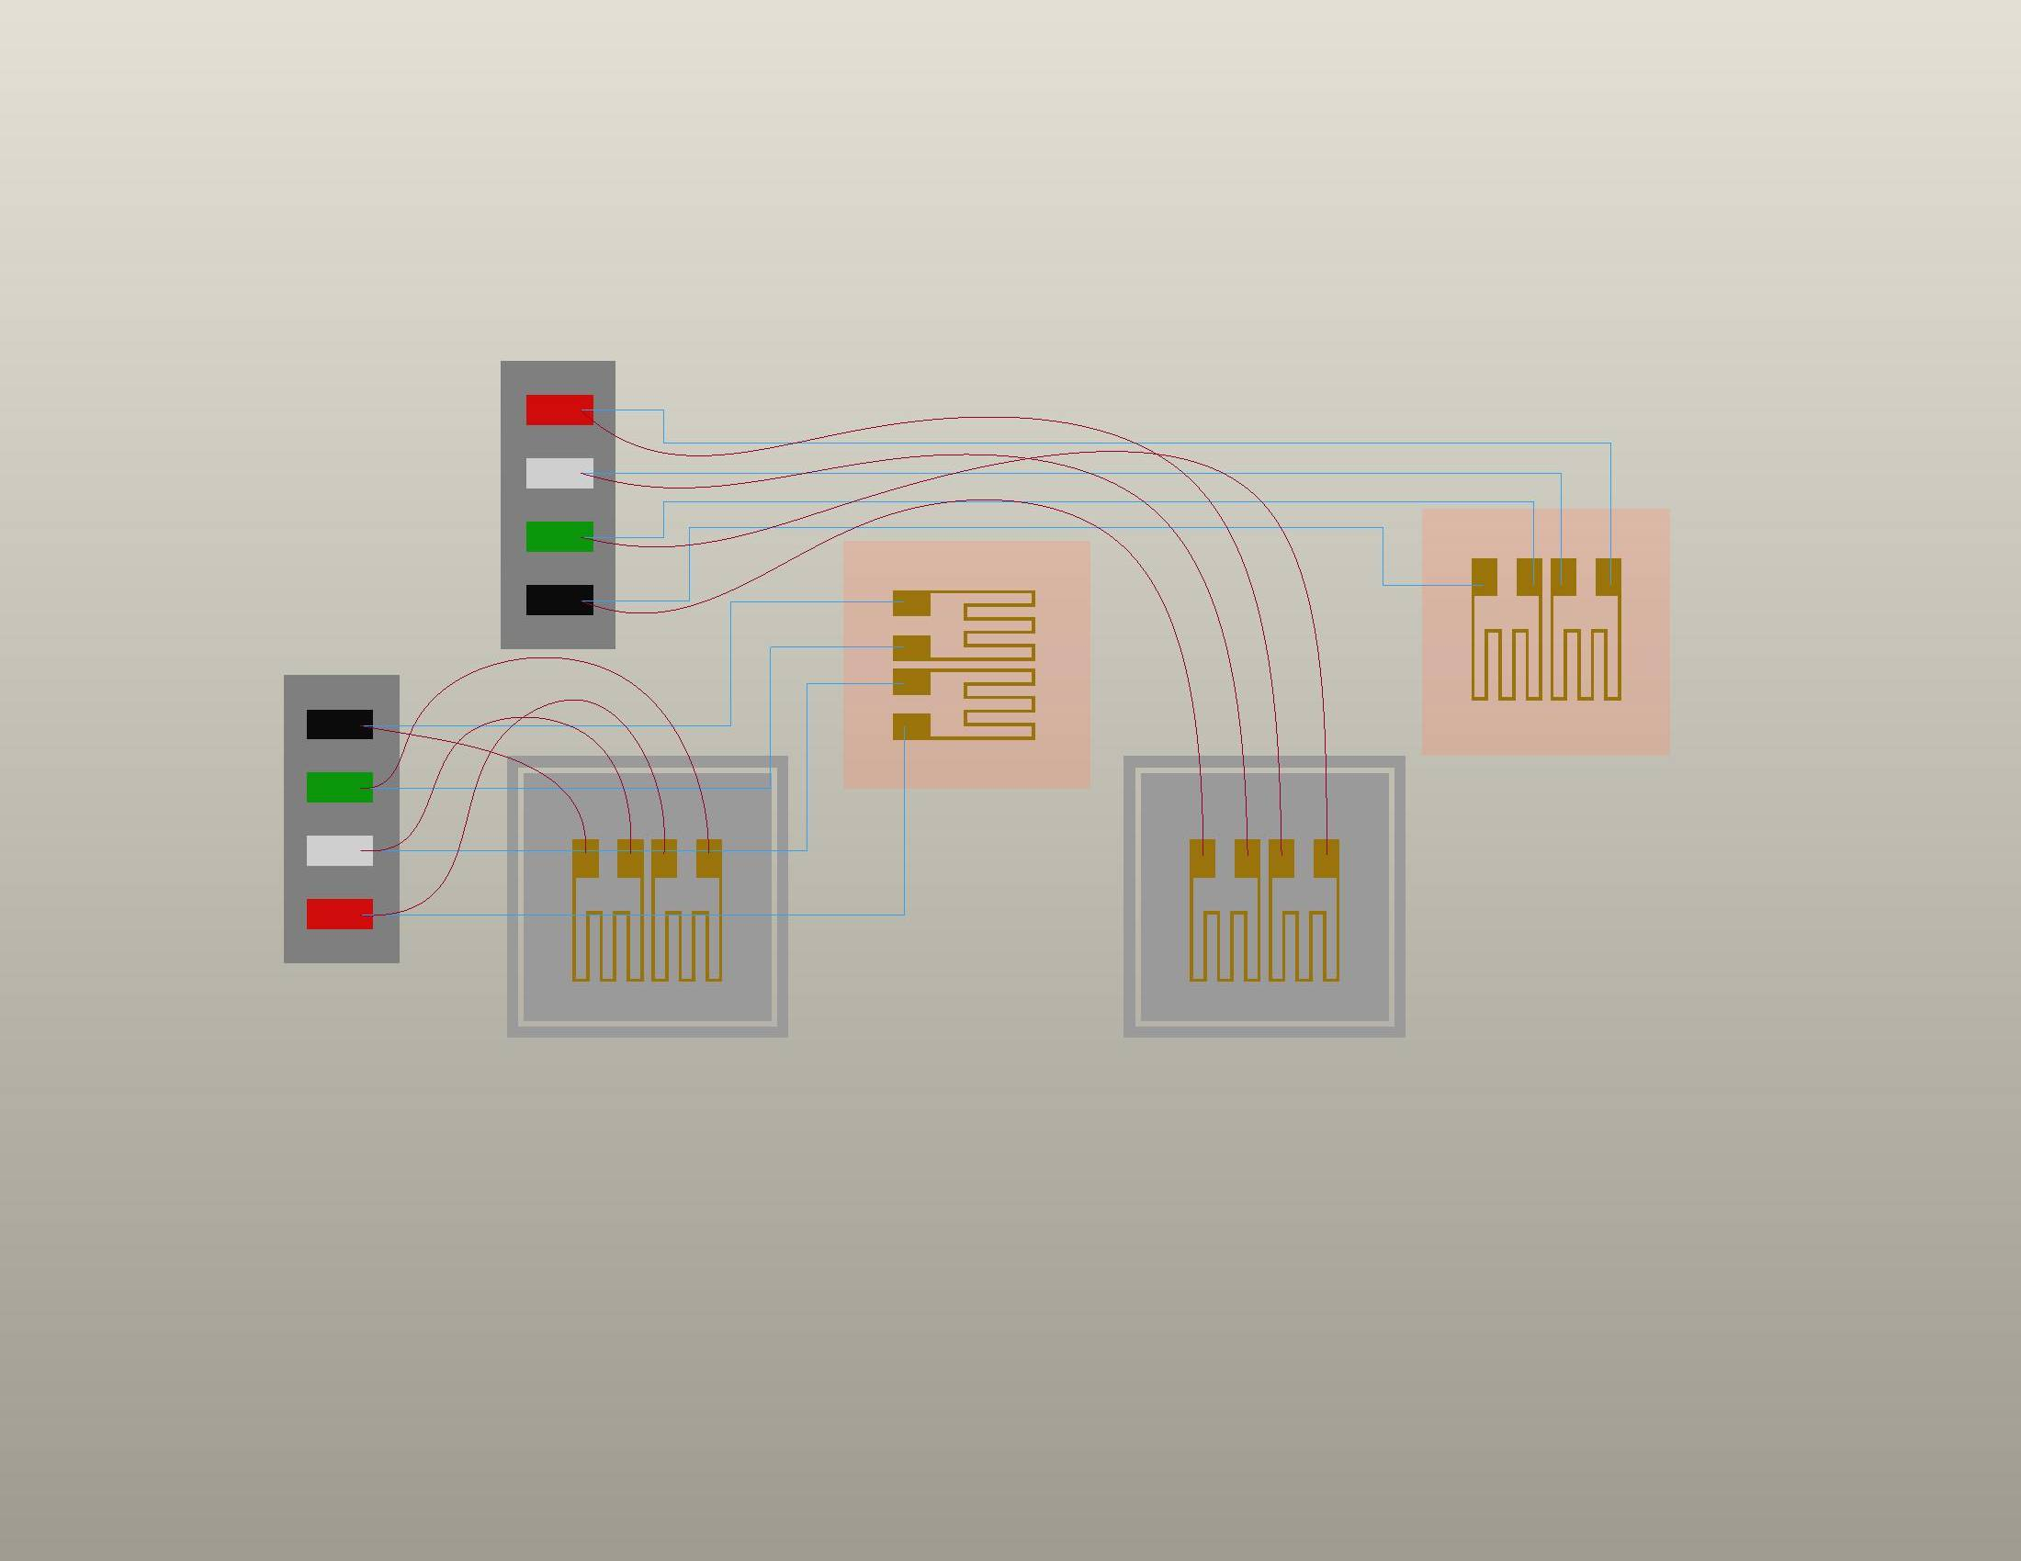
Strain gauges connections
ACTIVE GAGE
Bonded in Axial Direction
ACTIVE GAGE
Bonded in Transverse Direction
P+ (red)
S- (wht)
S+ (grn)
P- (blk)
We intend to use the
typical LBNL SG
configuration where
possible
When I later refer to a
gauge (SG) I mean gauge
channel except if stated
otherwise
TEMP-COMPENSATING GAGES
“Floating”
LBNL COIL INSTRUMENTATION
from LBNL 23N928 SPEC DWG

Slide 5
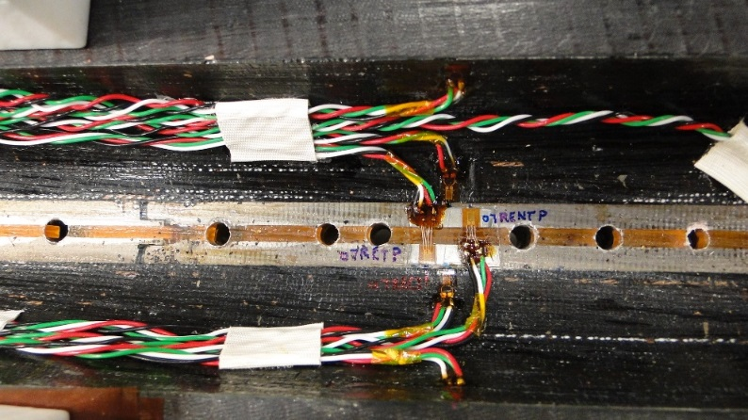
15 T magnet: Strain gauges on coil (L1)
Example from 11 T models
Coil SG positions in 15 T
Mid-plane coil SG
Pole side
coil SG
Separation between
two pole blocks
At several inches from the pole block separation
There are 8+4 SG per coil (24 in total) – 16 azimuthal and 8 axial.
Not all of them will be read – the ones in black ( ) are to be skipped (or back up)
The axial SG are optional and debatable ( ) – from review comments
So 8 (+ 8) active coil SG foreseen.

Slide 6
15 T magnet: Strain gauges on pole (L1)
Example from 11 T models
Pole SG positions in 15 T
Pole SG
Separation between
two pole blocks
SG are attached from below
There are 4 SG per coil (8 in total) – half azimuthal, half axial.
8 L1 pole SG foreseen.

Slide 7
15 T magnet: Strain gauges on pole (L3/L4)
L3
4 SG
Groove positions circled in red show will contain each one azimuthal and one axial SG
L4
2 SG
Optional but
not practical
Each groove will have one azimuthal and one axial gauge.
12 L3 and L4 pole SG foreseen for the magnet.

Slide 8
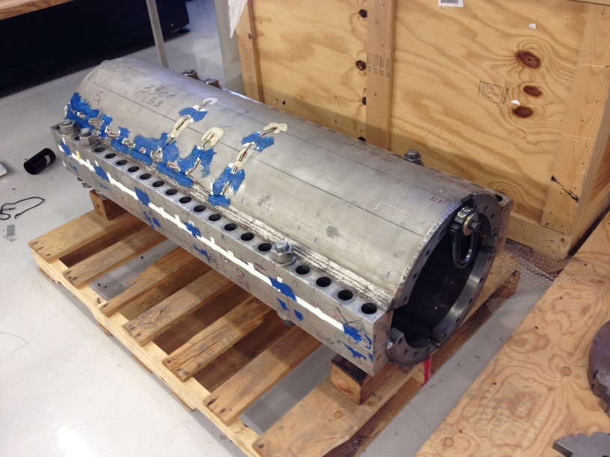
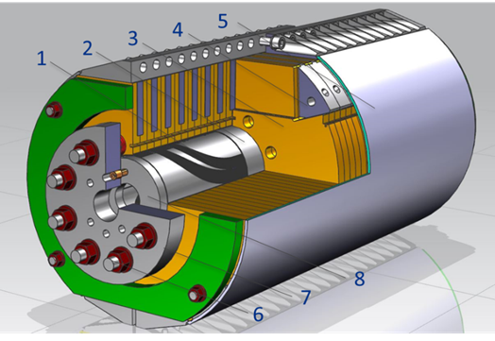
15 T magnet: Skin and bullet strain gauges
Example from 11 T models
Instrumented
skin gages
Two positions (~ 70 cm apart longitudinally) around the magnet center to be instrumented
- At 90º and 45º
- Azimuthal and axial gages
- Two opposite sides of the magnet circumference
16 skin SG foreseen.
15 T model
There are 8 bullet holes on the LE and 10 bullet holes on the RE
- A bullet is instrumented with 2 SG
- One TC on each side
- Only part to be instrumented
bullet
20 bullet SG foreseen.

Slide 9
15 T magnet: Strain gauge wiring
Layer 4 SG are directly wired to the trace strip pads in the grooves
Layer 3 SG are wired to the trace on Layer 4 through pole holes
Only 24 strips are available on the trace for SG
thus only 6 SG can be read during testing
Layer 2 has no SG
Layer 1 SG are wired manually (as in 11 T models)
The rest (skin, bullets) – as usual

Slide 10
15 T magnet: Total number of SG
To be instrumented
only if needed
 | coil | pole | skin | bullet |  | SUM
All | 16+8 | 20 | 16 | 20 |  | 72+8
Active | 8 | 20 | 16 | 20 |  | 64
During
magnet
testing
This is already a
reduced number
With this we instrument
9 out of 18 bullets; it could
be reduced to read more coil gauges
We want to read
all of them
We can probably skip
2 SG (half the axial ones)
Instrument more coil gauges?

Slide 11
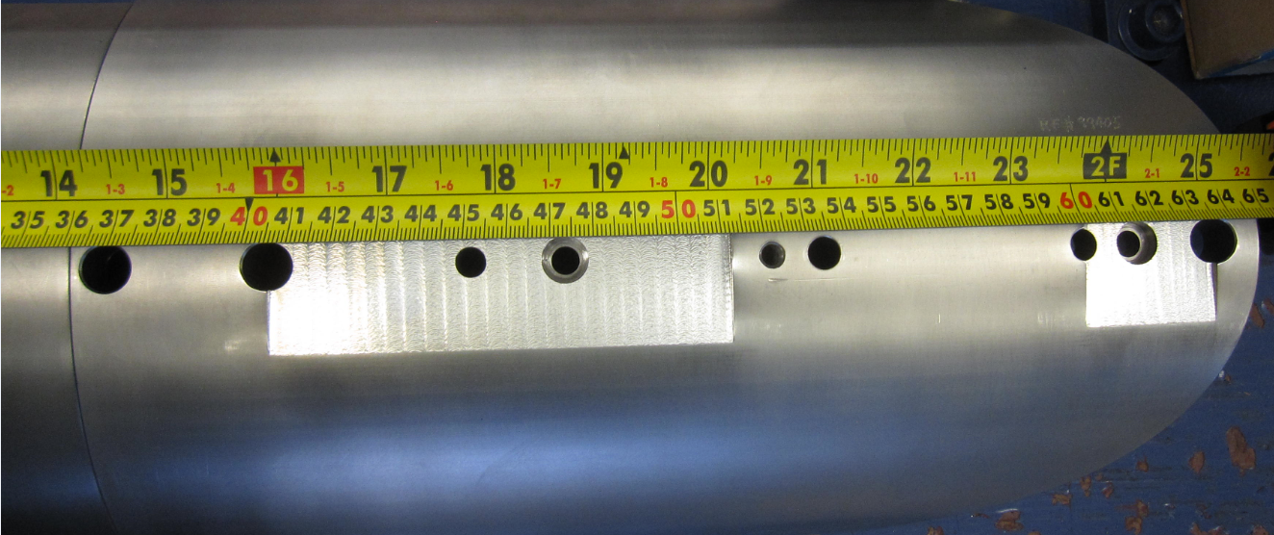
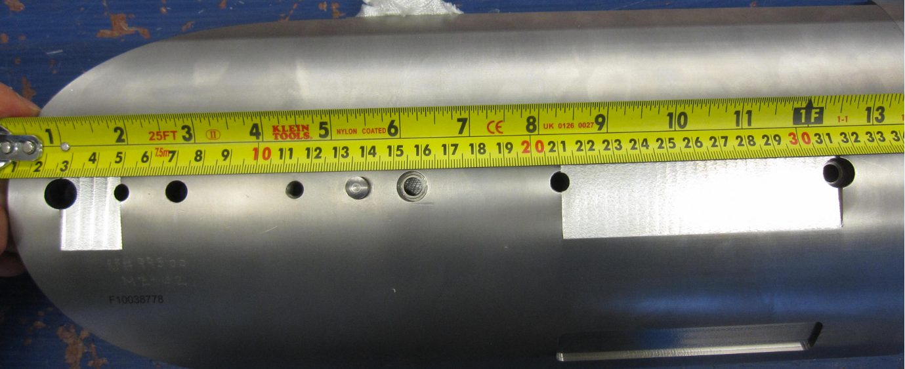
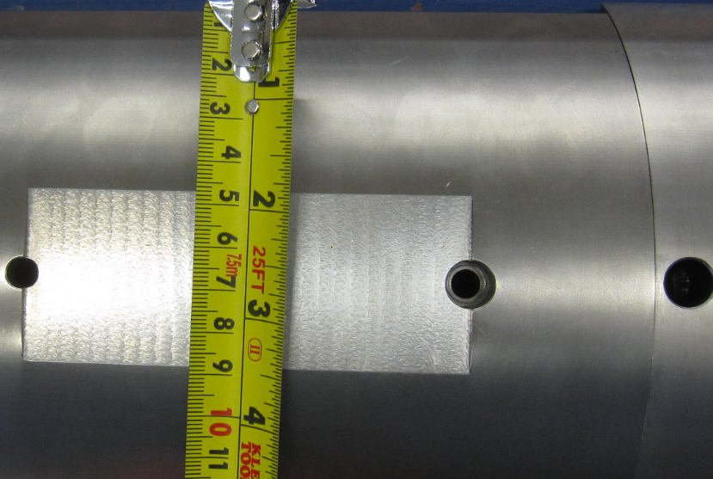
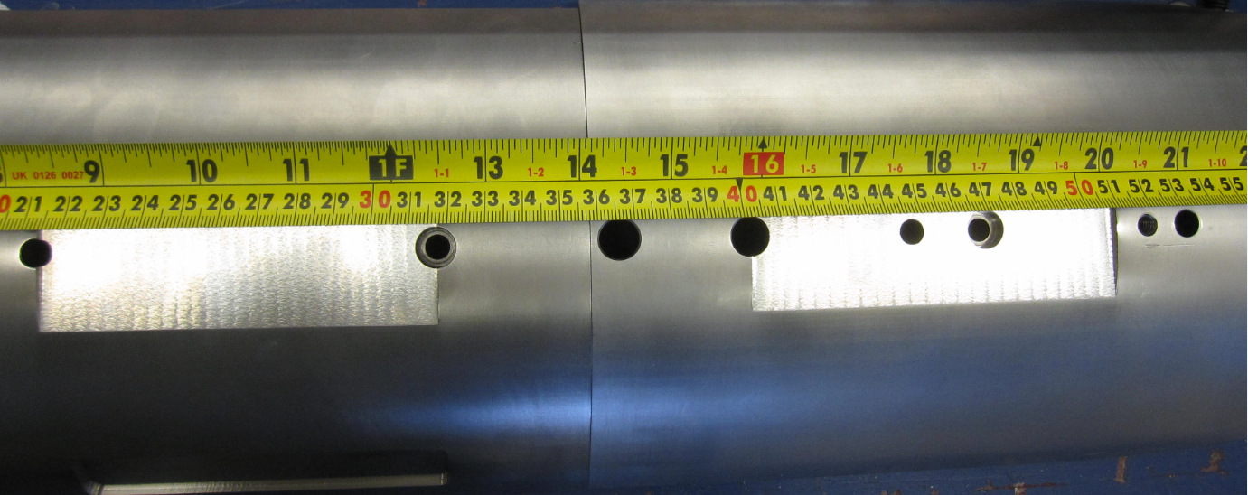
15 T magnet: L4 grooves

