Slide 1
REBCO R&D: FNAL update
Vadim Kashikhin, Vito Lombardo
January 4, 2023

Slide 2
COMB magnet development with CORC cables
Extensive studies have been conducted on short CORC® samples prior to winding the coils. It was found that winding the cables into the COMB structure resulted in a considerable loss of critical current (I_{c}), often reaching 50%, which has not been previously observed on hairpin-bent samples.
Further analysis performed by ACT revealed the issues with drying lubricant used in CORC® production and high surface roughness on latest REBCO tapes, which hampered the bending performance.
The next generation of CORC® cables have been optimized by ACT to accept tapes with high surface roughness using new lubricant formula, winding method, and production parameters that allowed to reach ~80% I_{c} retention. Additional improvement was reported at ASC22.
The CORC activities are currently on hold due to a more urgent SBIR task (next slides), but the plan is to use the existing CORC cable, which is affected by the lubricant/tape issues for practice winding (and test it only in LN₂) and order a CORC cable produced using new method for the first (CORC) demonstration magnet.

Slide 3
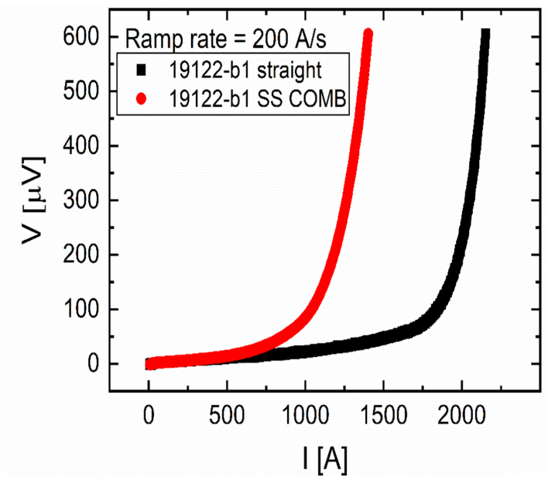
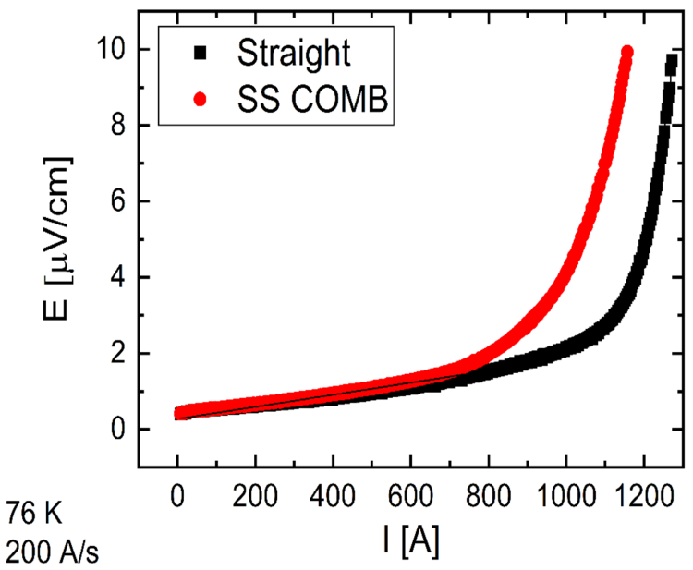
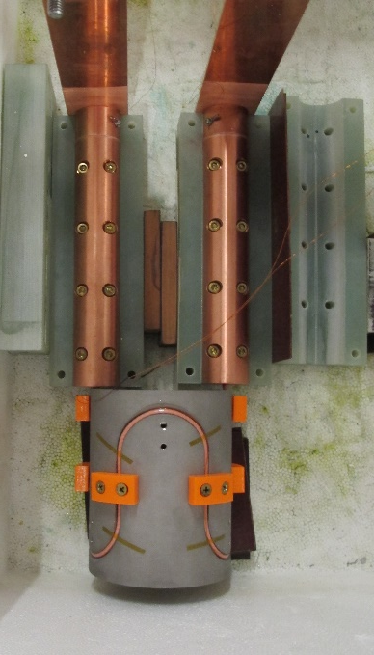
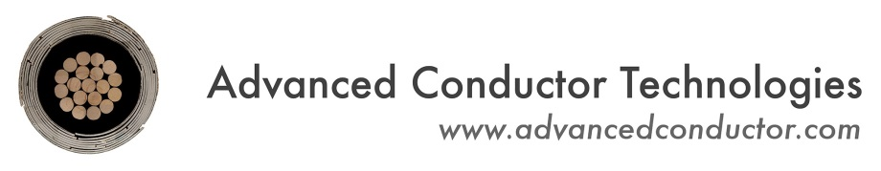
CORC cable testing in LN₂ at ACT
Critical current of CORC cables before and after winding into COMB structure. ~56% I_{c} retention in the early CORC designs (left) improved to ~80% I_{c} retention in the next generation cables (right).

Slide 4
STAR in COMB SBIR highlights
AMPeers received Phase-I SBIR award on fabrication of STAR wire and testing it in the COMB structure at FNAL.
The contract between FNAL and AMPeers was signed in December.
  Started bi-weekly meetings between FNAL and AMPeers teams.
  The plan is to move with the magnet design quickly and order parts to have them ready when the STAR cable arrives in the middle of February.
  An undergrad student helps (part-time) with these activities starting January.
  Then the plan is to fabricate the magnet and test it in LN₂ before the SBIR Phase-II application deadline in April.

Slide 5
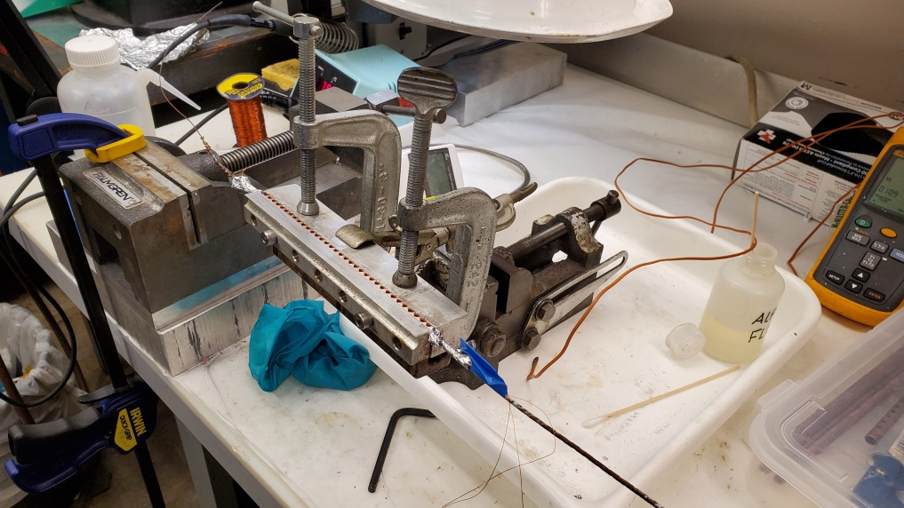
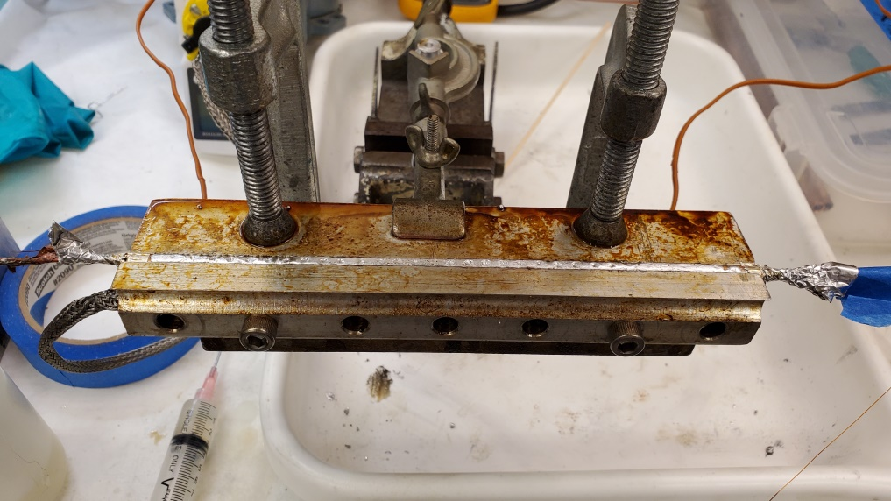
Terminals on STAR wires: technology transfer from LBNL
Two FNAL REBCO team members visited LBNL in November to learn the procedure for installing the terminals on STAR wires, which has to be different from CORC procedure due to patent restrictions.
Heating station parts were ordered and are being assembled.
The plan is to install two terminals at FNAL on a short STAR wire sample and test them in LN₂ before doing it on the long cable.

Slide 6
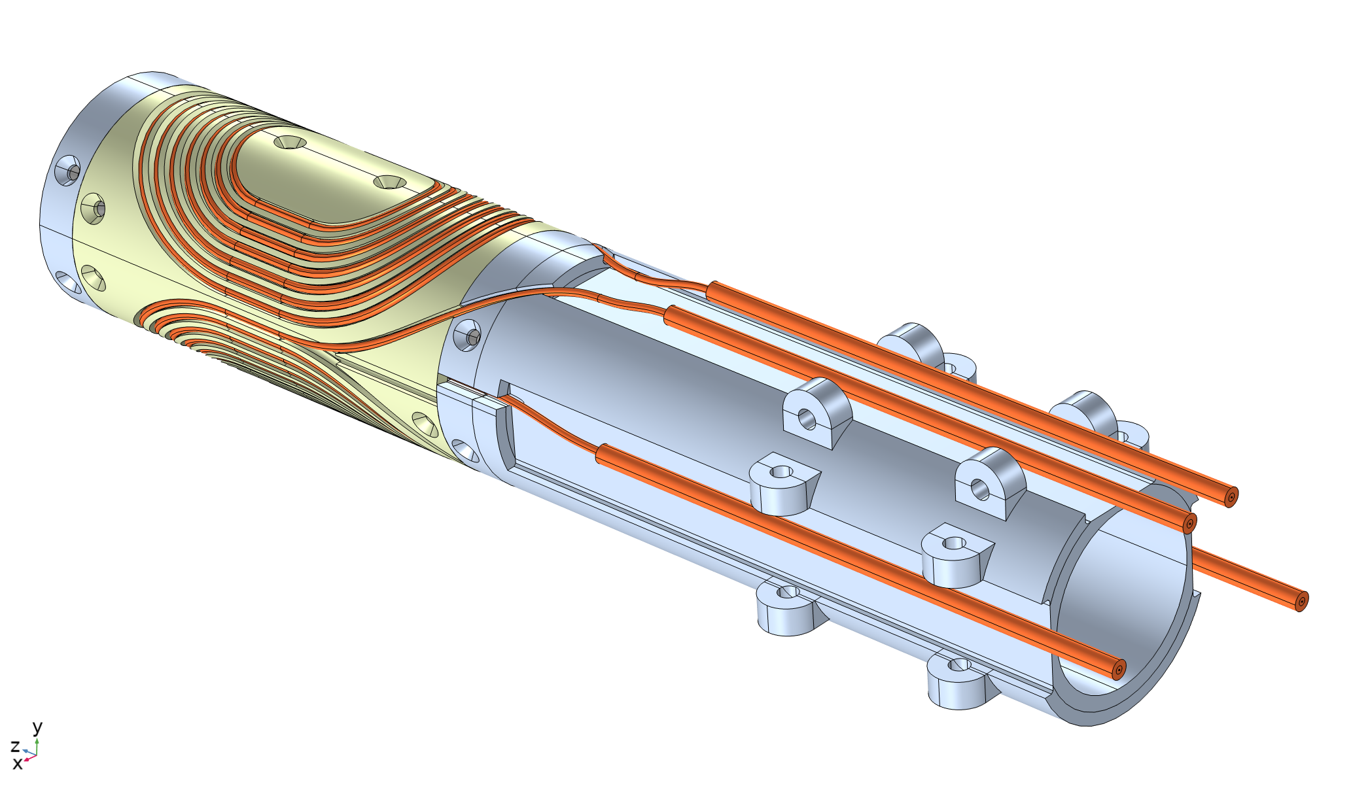
Coil/structure design
60 mm clear bore
Two half-coils, with two layers each
5 m of STAR wire per half-coil, including the leads
The STAR wire is not insulated – COMB structures should not be electrically conductive
The channel is oversized to allow the use of high-strength thermo-plastics

Slide 7
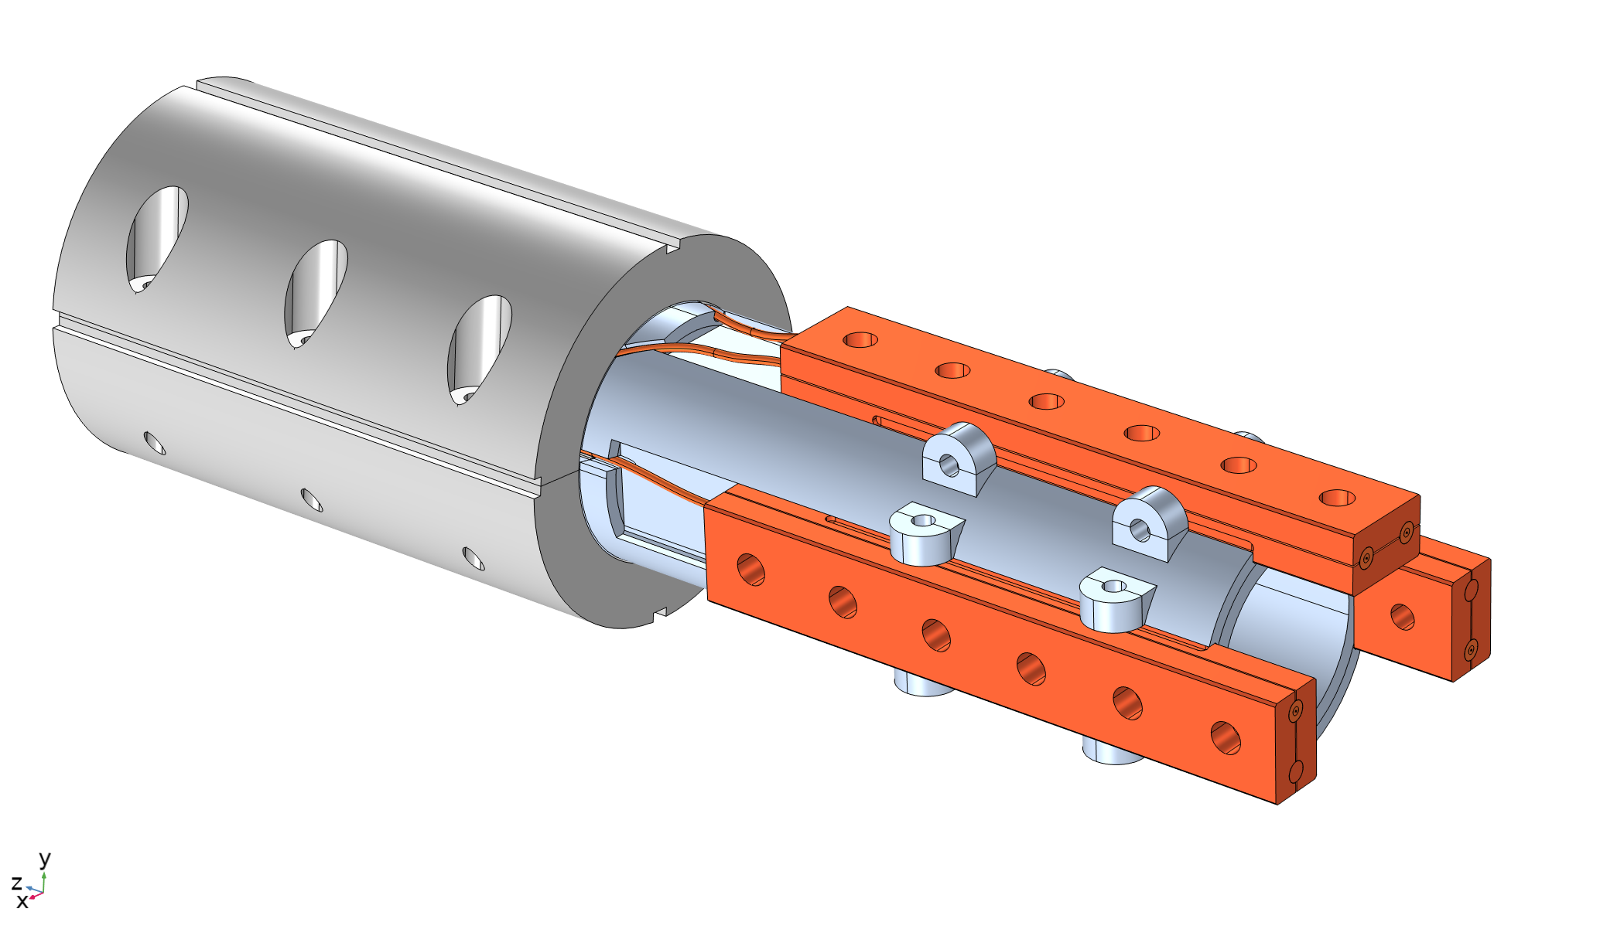
Iron yoke and terminals
Iron yoke is sized for LN₂ test with the expected bore field of 0.2-0.3 T
Can fit into HFDA or 11-T dipole yokes, which will be needed if LHe test is performed (in Phase-II) due to 4-5 T bore field
There are 3 copper adapters with the middle point between the top and bottom coils
It allows to test each half-coil separately and together

