Slide 1
PhD program on Bi-2212 cos-theta dipole insert – Pisa University
Alessio D’Agliano
APS-TD – MDP meeting Advisor: E. Barzi
01/04/2023 Group: I. Novitski, A. Zlobin, D. Turrioni

Slide 2
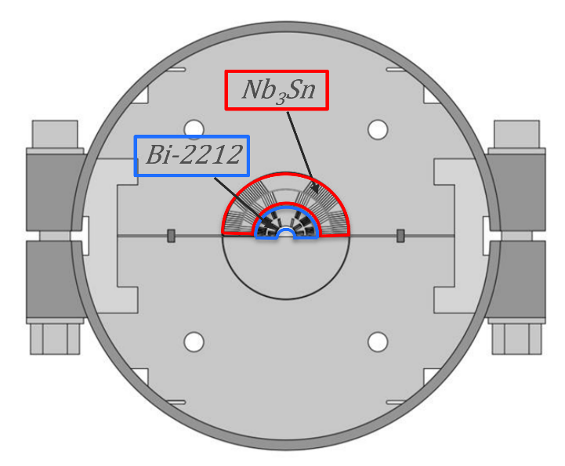
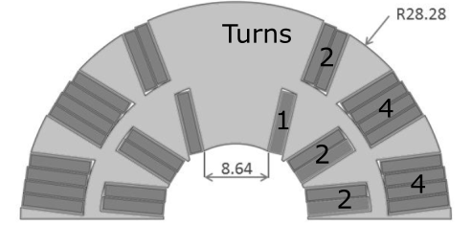
Bi-2212 insert – Main goal
Within the US-MDP, the aim is to overcome the limits of Nb₃Sn technology, based on the use of a high temperature superconductor (HTS) identified as Bi₂Sr₂CaCu₂O_{8-x}.
The main goal for Fermilab team: reach 20T magnetic field with a fully assembled accelerator hybrid magnet, upgraded with Bi-2212 insert.

Slide 3
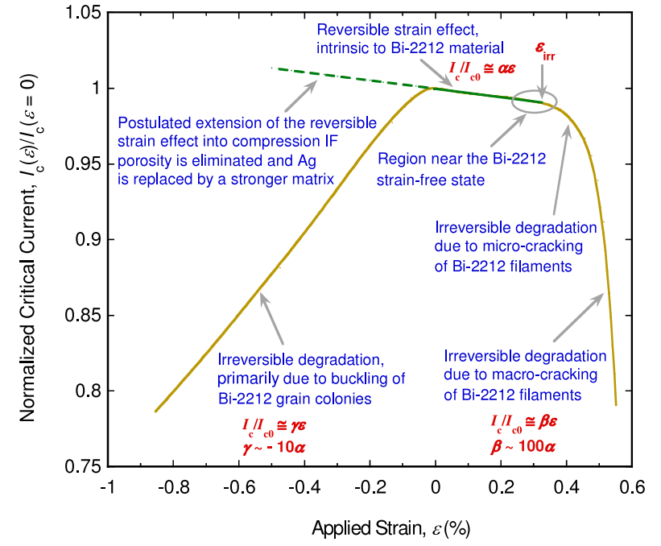
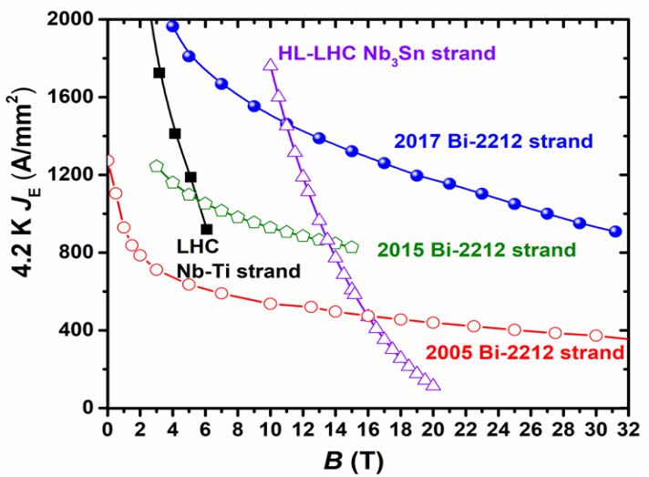
Why Bi-2212?
Ic Sensitivity to Tensile/Compressive Strain
2017 curve is the best performance obtained by Bruker-OST with the new Engi-Mat powders.
BUT
‘Reversible effect of strain on transport critical current in Bi2Sr2CaCu2O8+x superconducting wires: a modified
descriptive strain model’ N Cheggour, X F Lu, T G Holesinger, T C Stauffer, J Jiang and L F Goodrich. Article in Superconductor Science and Technology · December 2011

Slide 4
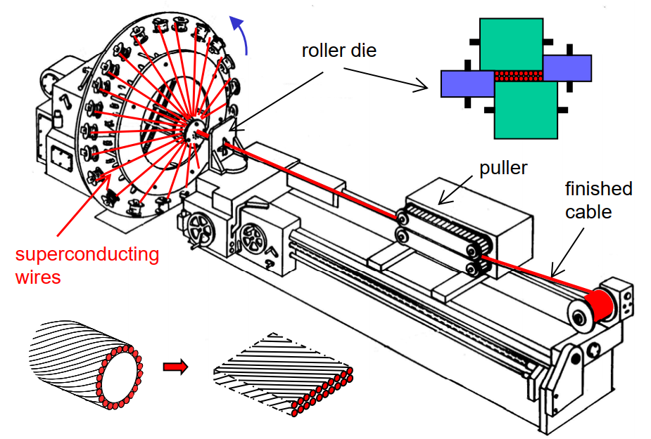
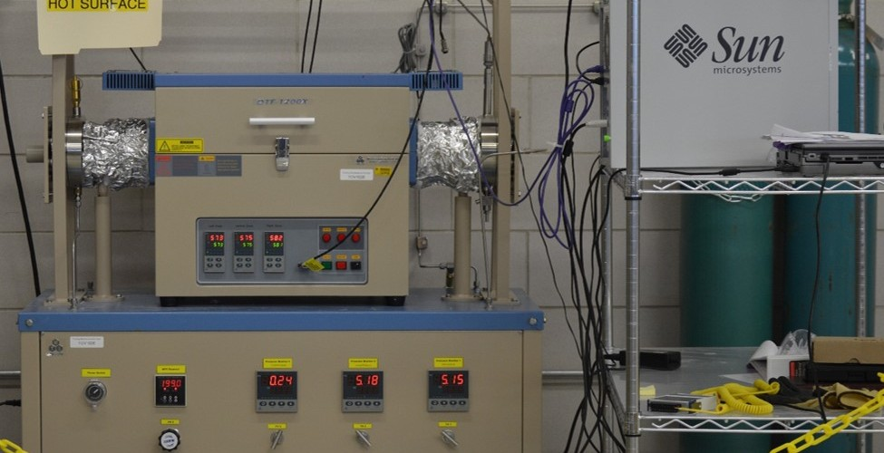
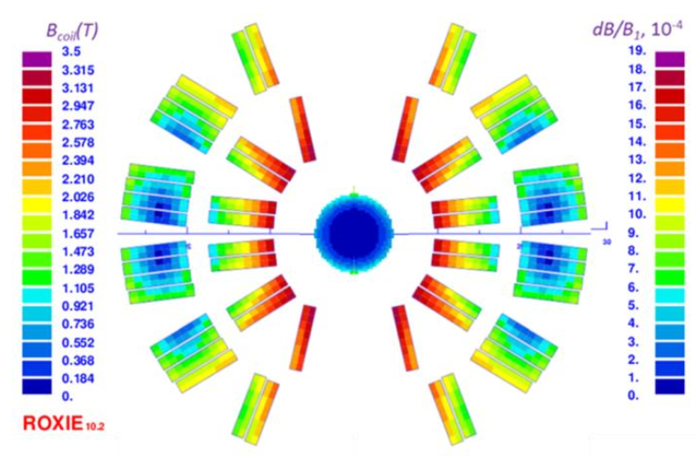
The Bi-2212 insert project
will include:
experiments on cable winding:
new strand geometry, new Bi-2212 Rutherford cable, winding tools, windability issues, mandrel design.
Insulation and high temperature heat treatment:
Bi-2212 insulation materials, furnace calibration, SMP study, in order to avoid leaks.
Impregnation and strand characterization tests:
Experiments and comparison between CTD101, Matrimid, Telene, ad-hoc procedure for the Bi-2212 insert.
FEM and analytical analyses to reproduce the experimental results:
use results from experiments and FEM model to design actual Bi2212 insert dipole, validate new geometries, stress management.

Slide 5
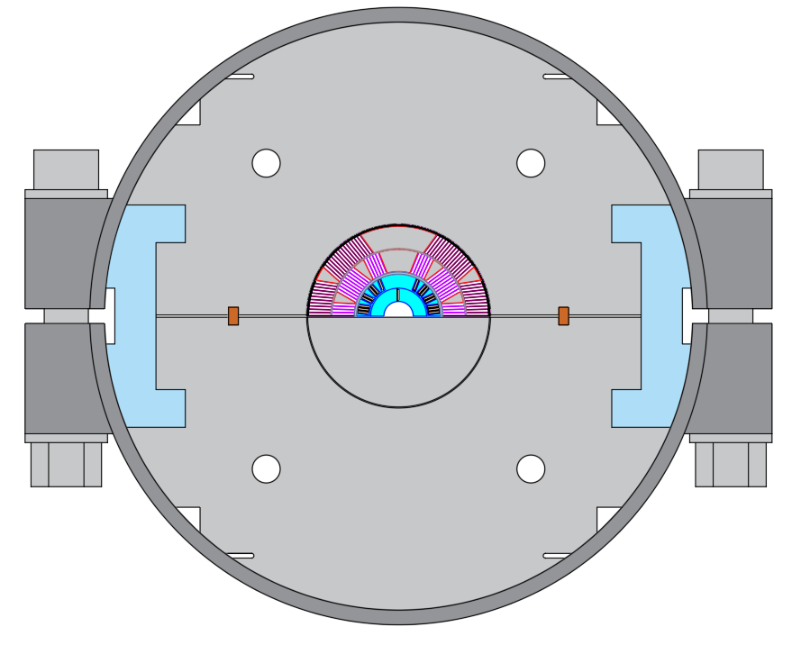
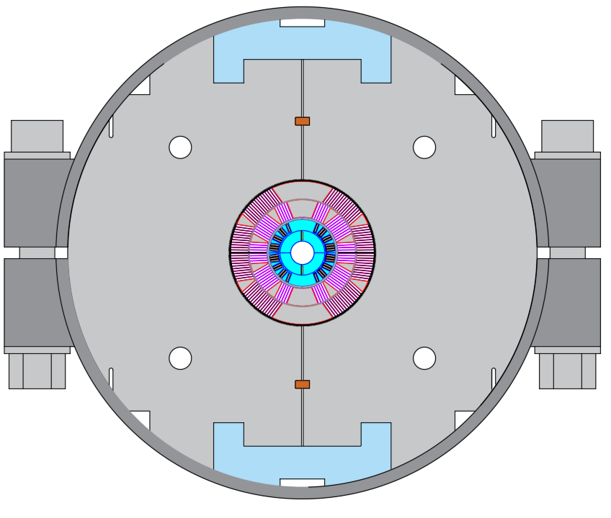
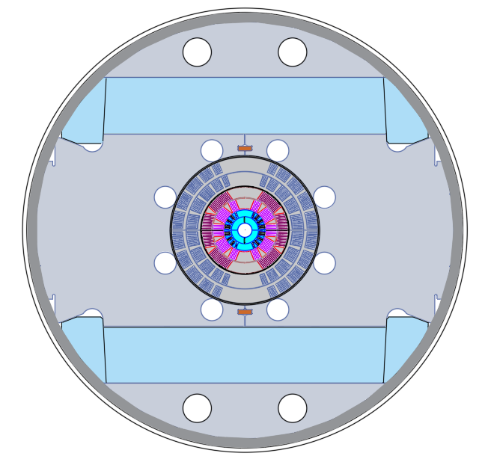
Milestones for the Stress-Managed Cosine-Theta (SMCT) effort within the Bi-2212 area of the MDP
Milestone # | Description | Status | Updated Target | PhD contributions
AIIa-M1b | Study strand damages due to cabling, transverse pressure dependence, thermal loads. | In progress | Jun-23 | Simulation on Ansys APDL, Workbench, Sperimental results in the lab. HT studies.
AIIa-M2b | Design and fabricate the first small-aperture Bi-2212 coil using LBNL cable. Coil test independently and inside a 60-mm aperture 2-layer Nb₃Sn dipole coil in mirror configuration. | In progress | Sep-23 | Coil after death detailed destructive structural analysis. Tool design for the realization process (heat treatment, impregnation) and scheduling of the latter.
AIIa-M3b | Design and fabricate the 2nd small-aperture Bi-2212 coil using optimized Bi-2212 cable, coil structure, materials and technologies. Coil test independently and inside a 60-mm aperture 4-layer Nb₃Sn dipole coil in mirror configuration. | Not started | Dec-23 | Development of the new Bi-2212 strand geometry. Coil structure validation with analytical and experimental results. Impregnation materials R&D work.
AIIa-M4b | Fabricate another small-aperture Bi-2212 coil using optimized Bi-2212 cable and coil structure. Bi-2212 coil test independently and inside a 60-mm aperture 4-layer Nb₃Sn dipole coil. | Not started | Dec-24 | Use of all the previous knowledge and analytical model to upgrade the new coil version and analyse test results.
AIIa-M2b
AIIa-M3b
5
AIIa-M4b

Slide 6
PhD project timeline - task
FY 2023
FY 2024
FY 2025
FY2026
Q2
Q3
Q4
Q1
Q2
Q3
Q4
Q1
Q2
Q3
Q4
Q1
Task 1. Experimental studies on wound Rutherford cables insulated with available and new insulation materials to eliminate Bi2212 leaks.
Task 2. Extend winding experiments by using different winding techniques for both 1-layer (combined and separate coils) and 2-layer coil designs.
Task 3. Use Bi2212 wire optimized for cabling by Bruker to develop and study Rutherford cables of appropriate geometry for Bi2212 dipole inserts.
Task 4. Perform Bi2212 dipole design studies with Finite Element Modeling (FEM). Use FEM methods established for Nb₃Sn for sub-modeling of composite Bi2212 wires and cables pre-heat treatment, and for sub-modeling of superconducting wires and cable stacks under various geometrical conditions and strain post-heat treatment.
Task 5. Use FEM to contribute to designing actual Bi2212 insert models, validate new geometries and stress management concepts. Design coil and tooling components for chosen designs.
Task 6. As part of strain management studies, verify progress of Bi2212 strands and cables by accurate critical current measurements of Bi2212 cables under transverse pressure.

Slide 7
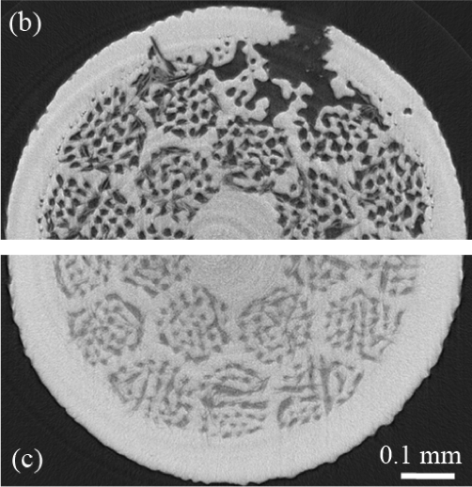
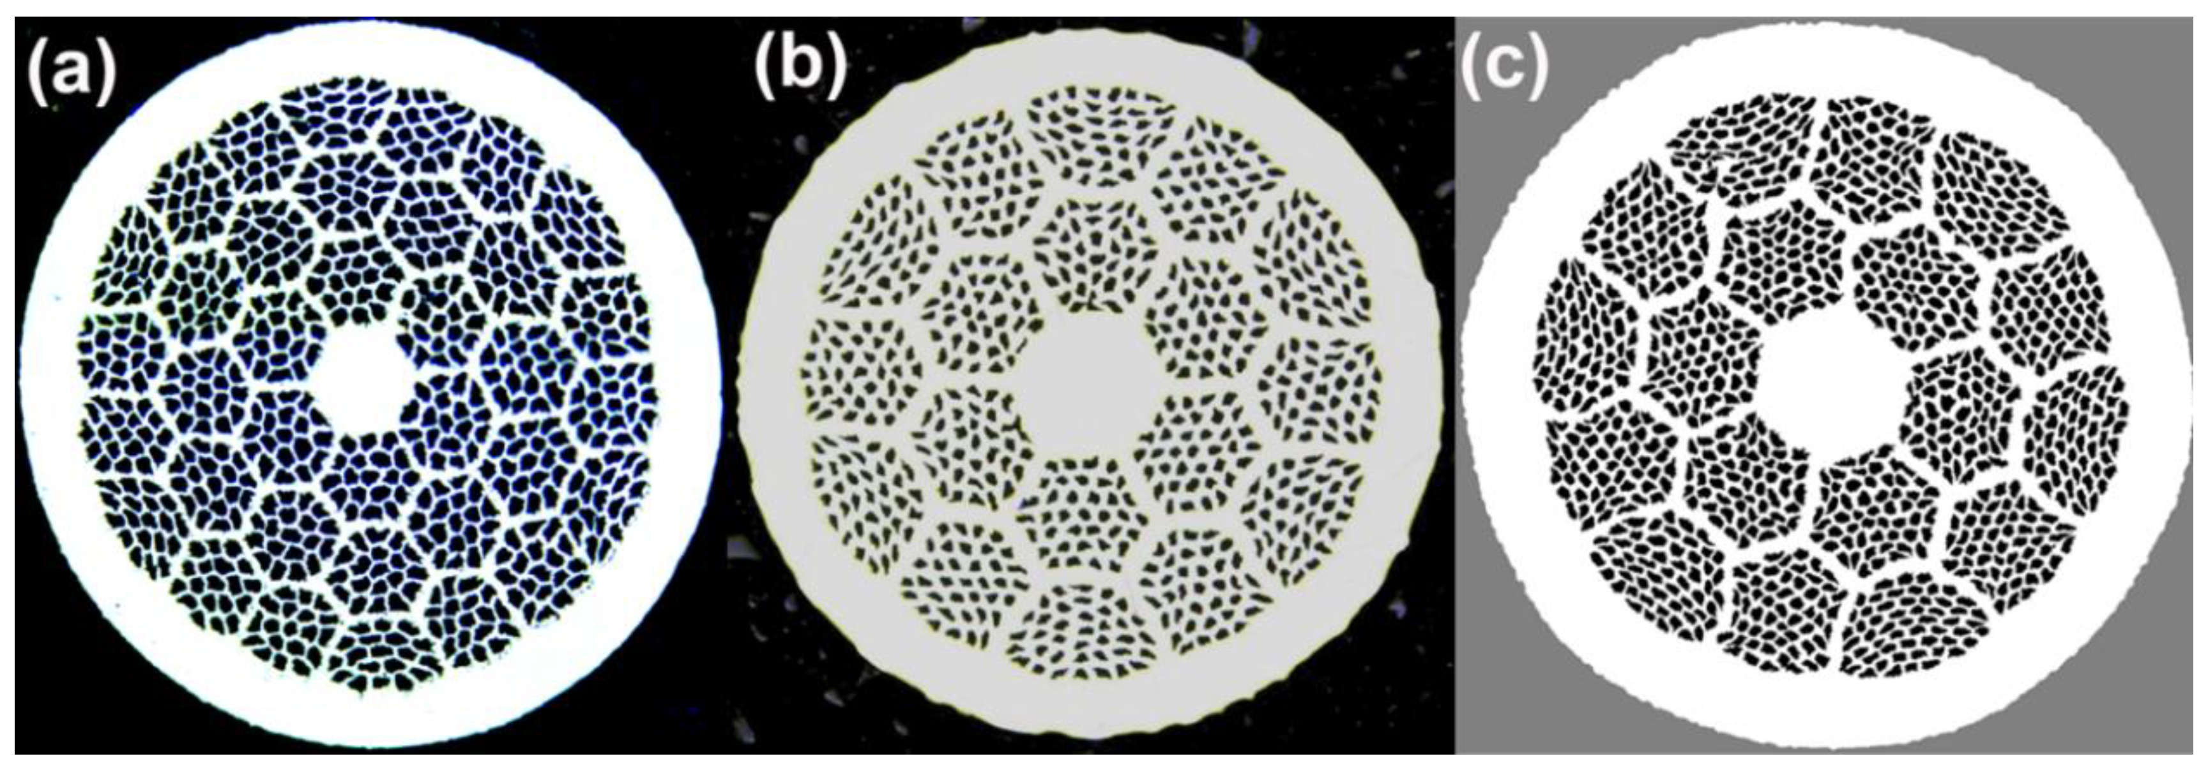
What so far – New strand geometry
Leaks are unacceptable in accelerator magnets due to the risk of shorts, for instance.
collaboration with OST-Bruker and other capable industry to design billets more adequate for Rutherford cabling.
Solutions have been taken in account from our group and other different research laboratories (LBNL, NHMFL), the common aim is to reinforce Ag matrix considering:
Trade-off between reduction of BiSCCO fill factor during the realization process vs critical current degradation during HT reaction.
Images from: D.C. Larbalestier, J. Jiang, U.P. Trociewitz, F. Kametani, C. Scheuerlein, M. Dalban-Canassy, M. Matras, P. Chen, N.C. Craig, P.J. Lee, E.E. Hellstrom, “Isotropic round wire multifilament cuprate superconductor for generation of magnetic fields above 30 T”, Nature Materials, Vol. 13 (2014), 10.1038/nmat3887

Slide 8
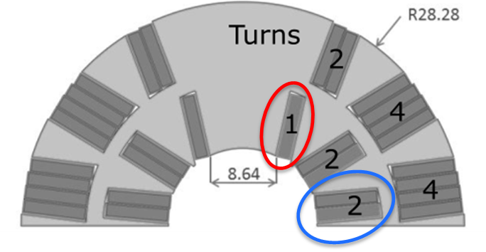
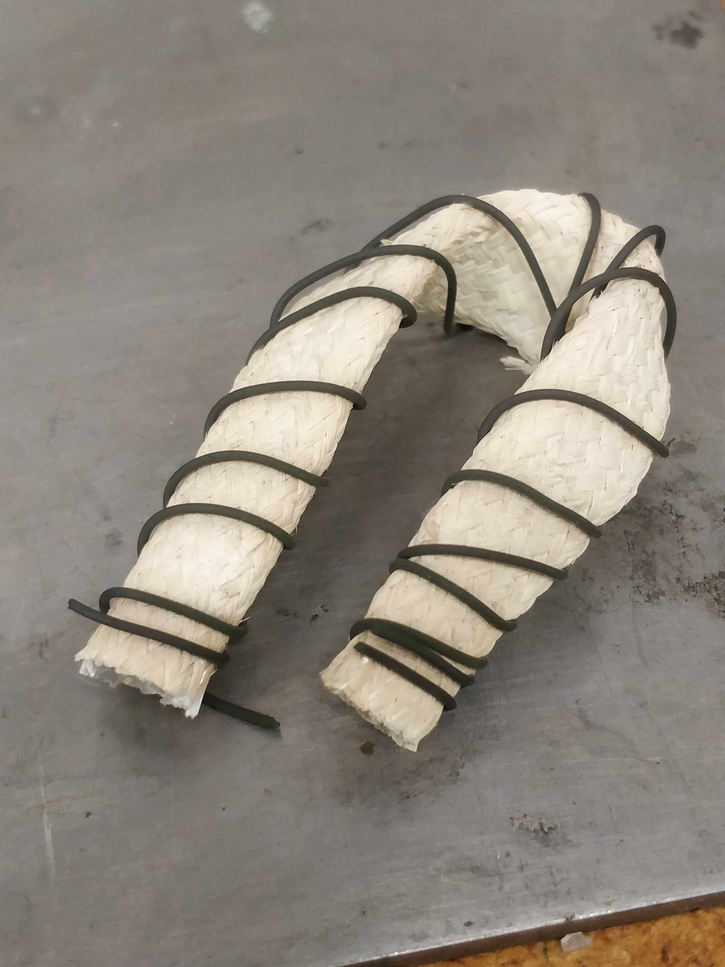
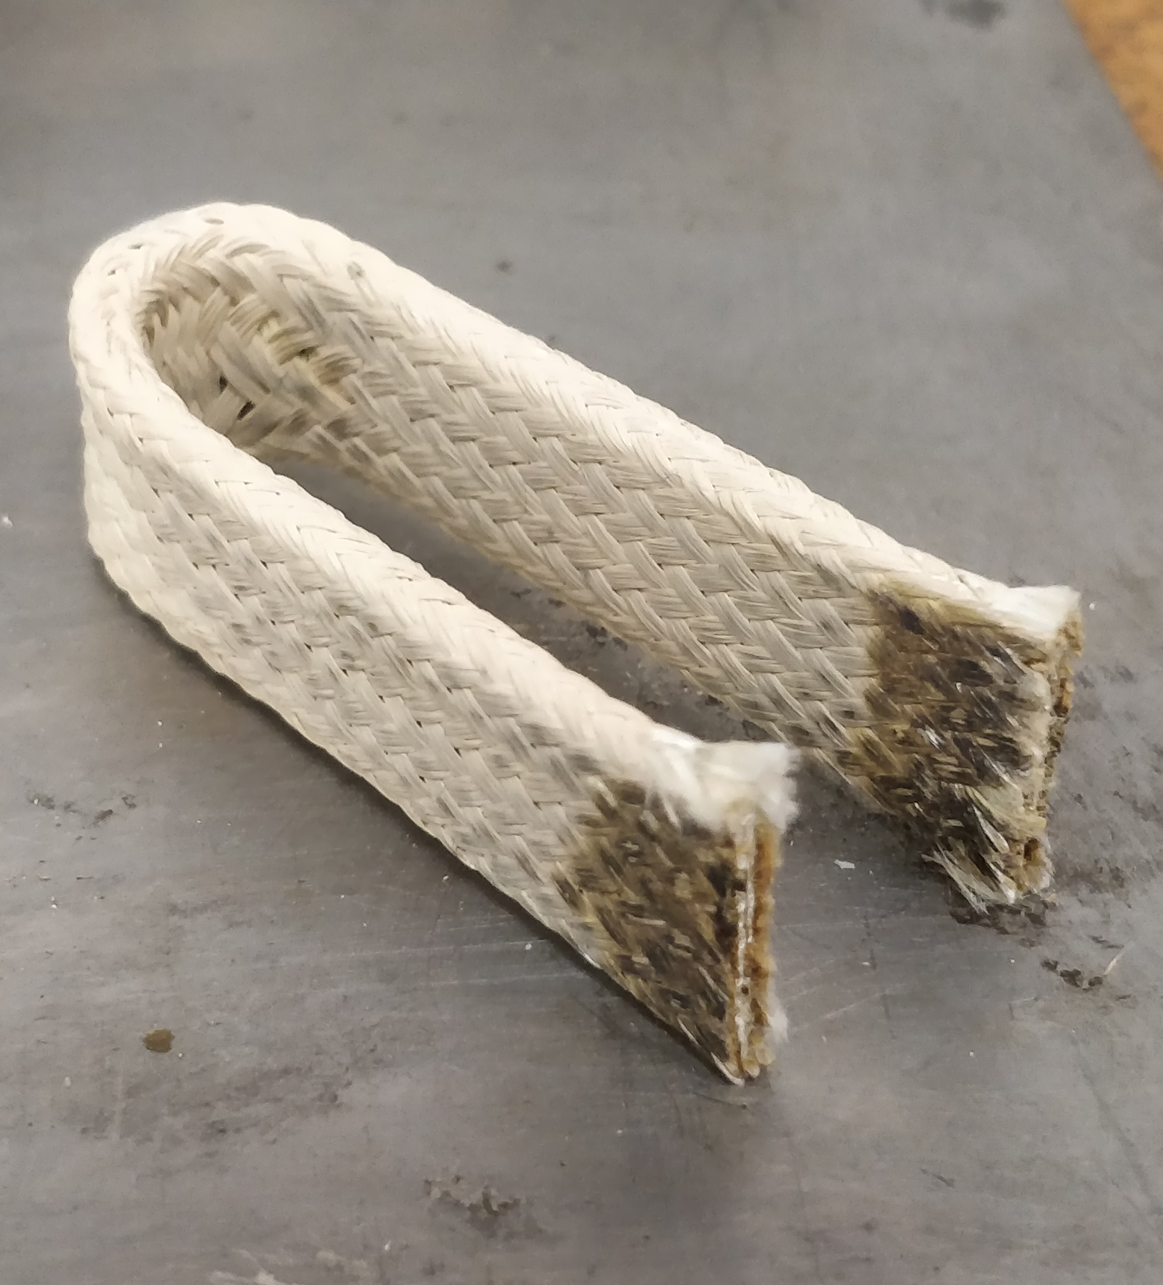
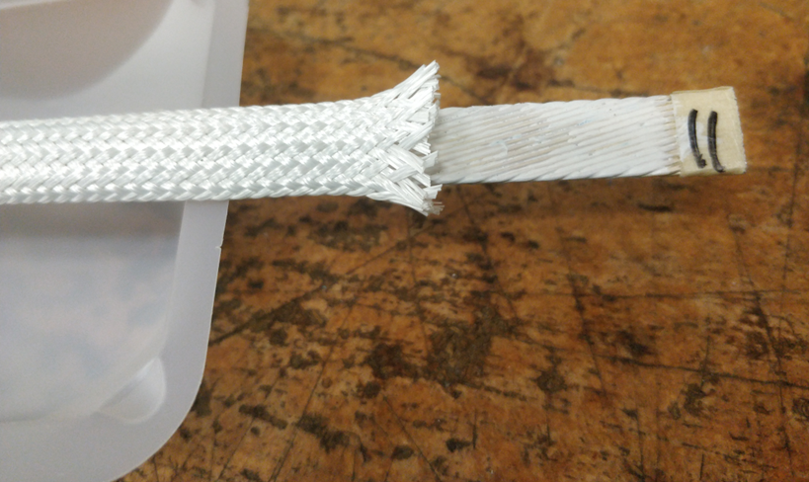
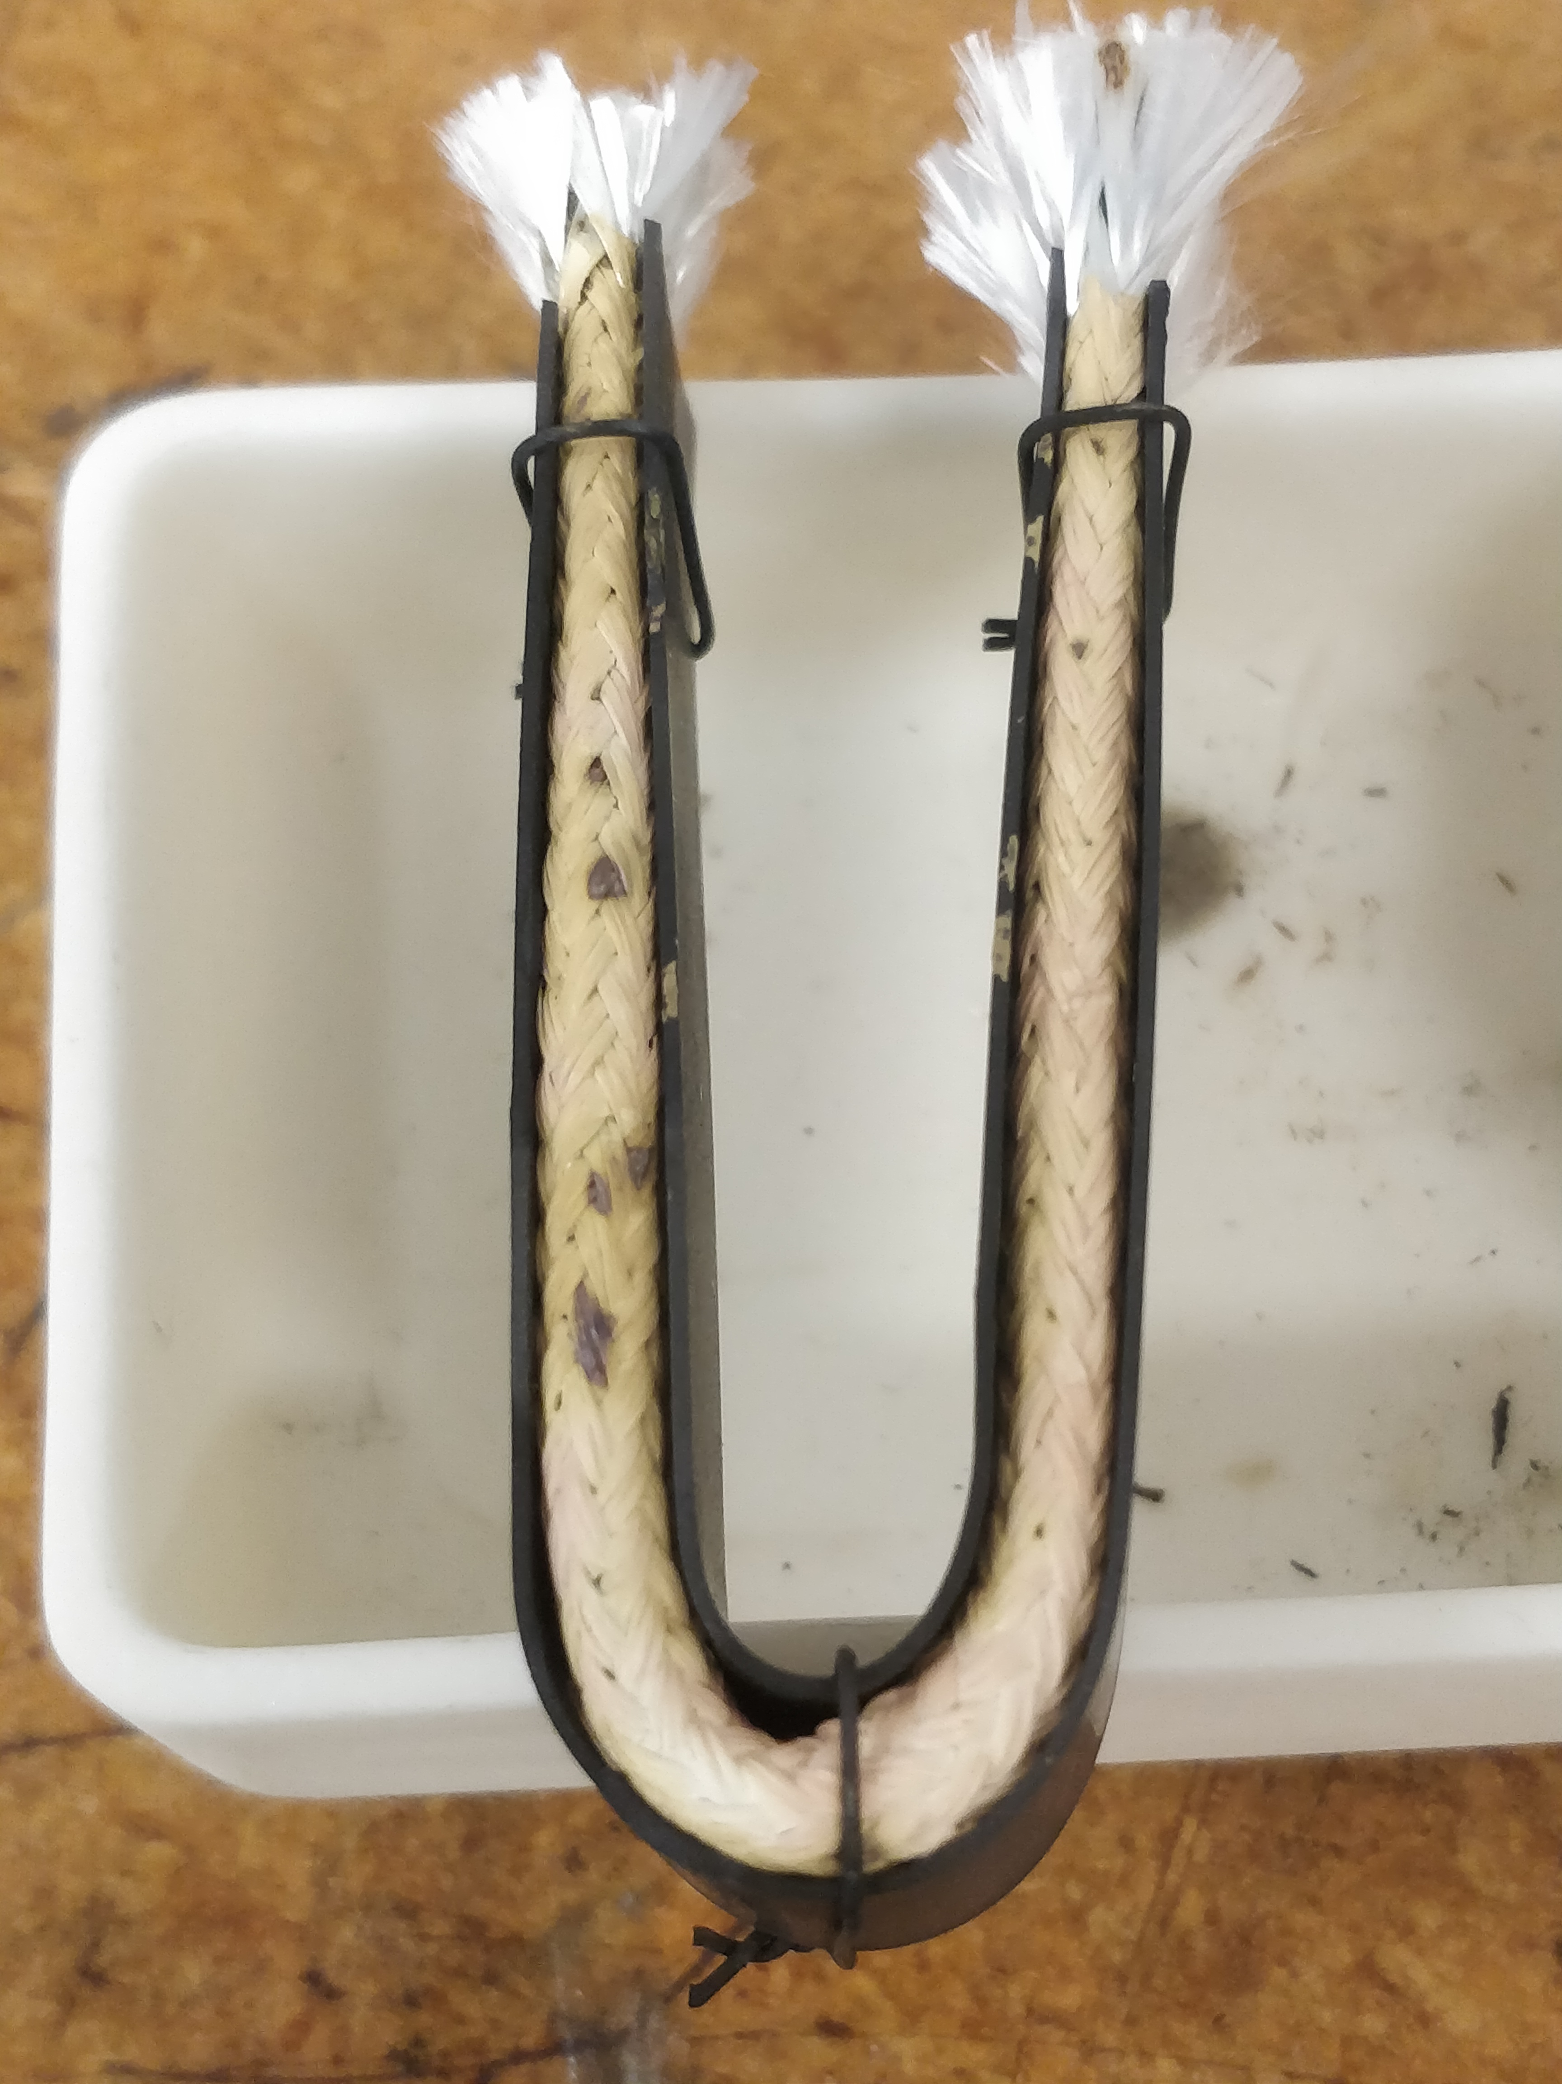
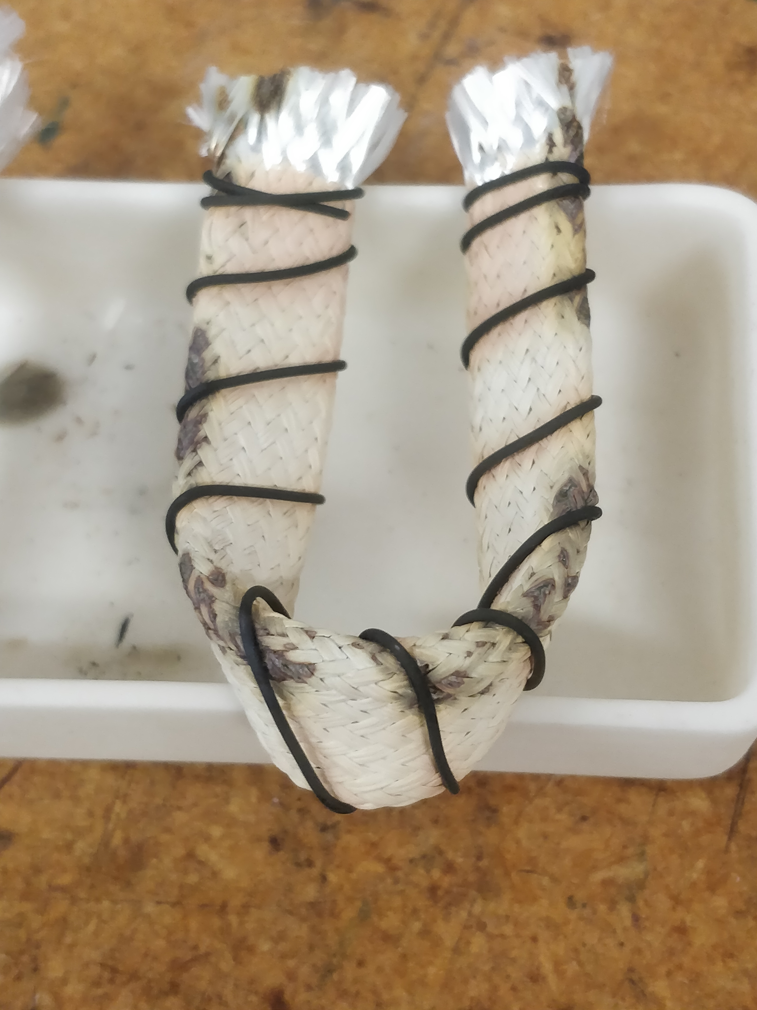
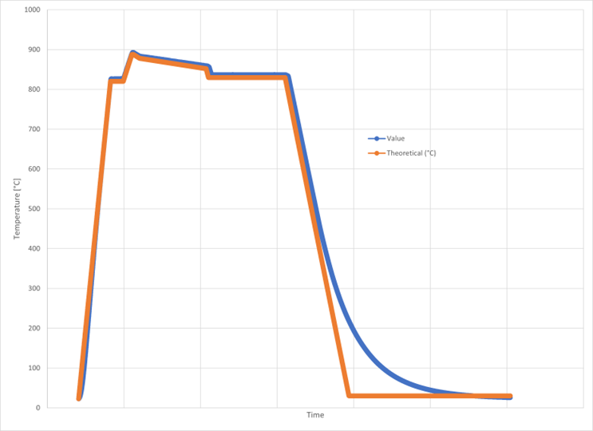
What so far – Insulation and HT
Bi-2212 insulation materials in order to avoid leaks.
Process:
Clean cable with isopropyl alcohol
Perform winding
Paint with TiO₂ slurry
Put mullite sleeve and paint it too with TiO₂
Enclose specimen within Inconel strips
Mullite
TiO₂
Max. T_{m} = 888 °C, 12.5 min
Bi2212 Rutherford Cable
10 mm width, 1.554 avg. thikness
Bruker-OST optimized temperature profile characteristic:
1 bar
Oxygen flux
Inconel tape
Tot. Time: ~ 3 days process

Slide 9
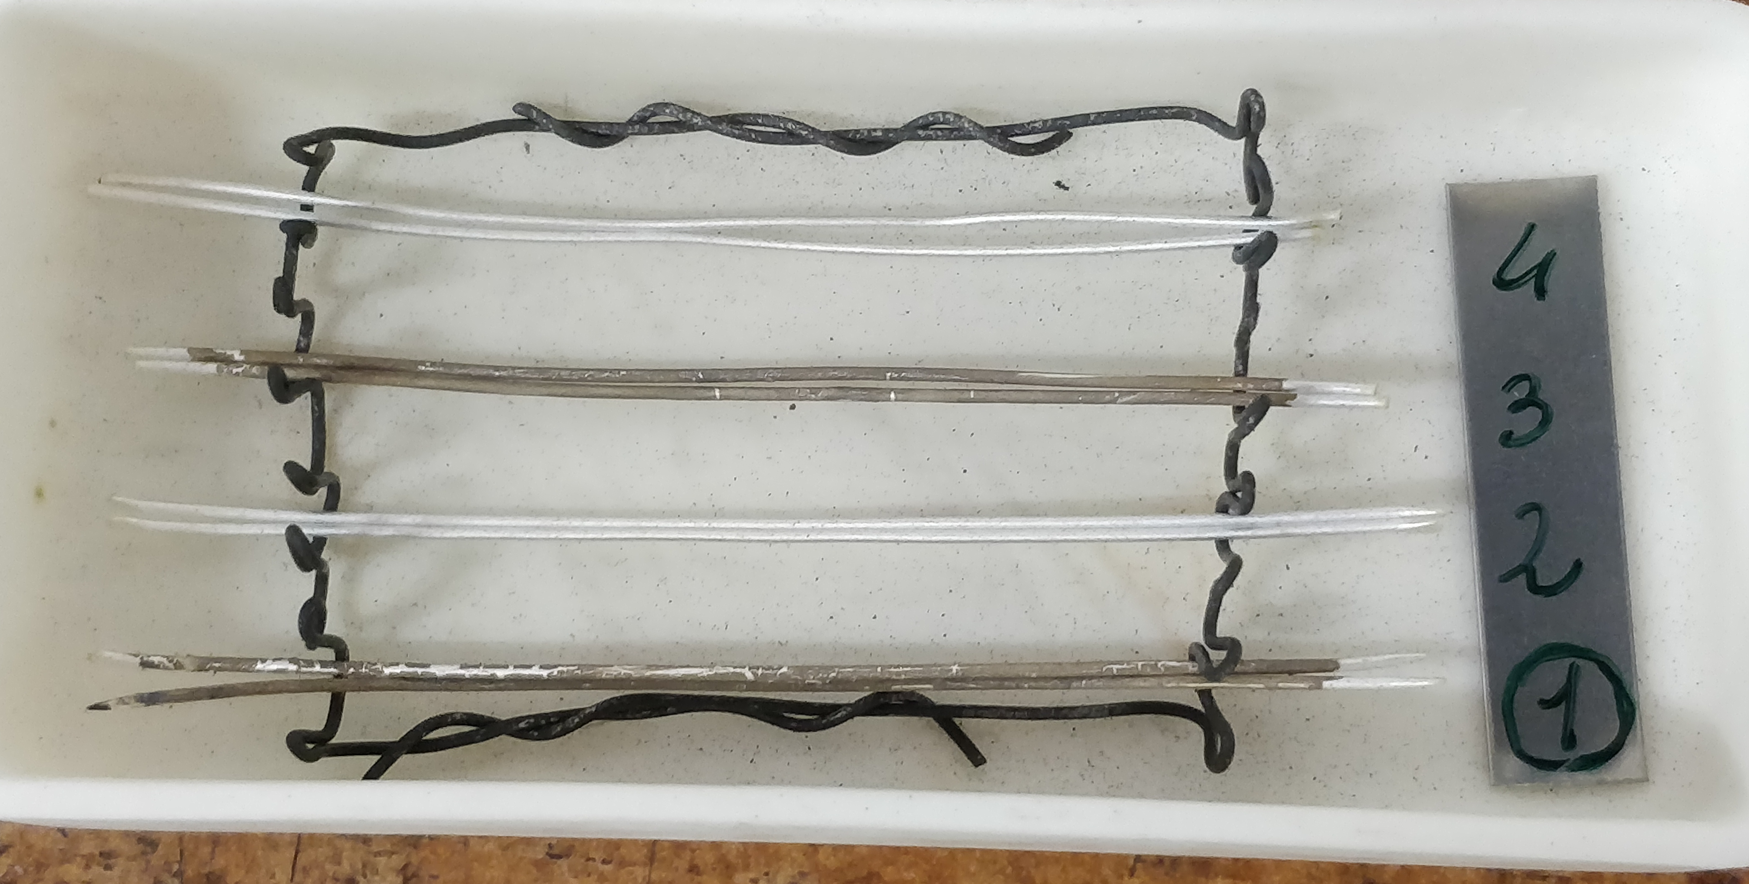
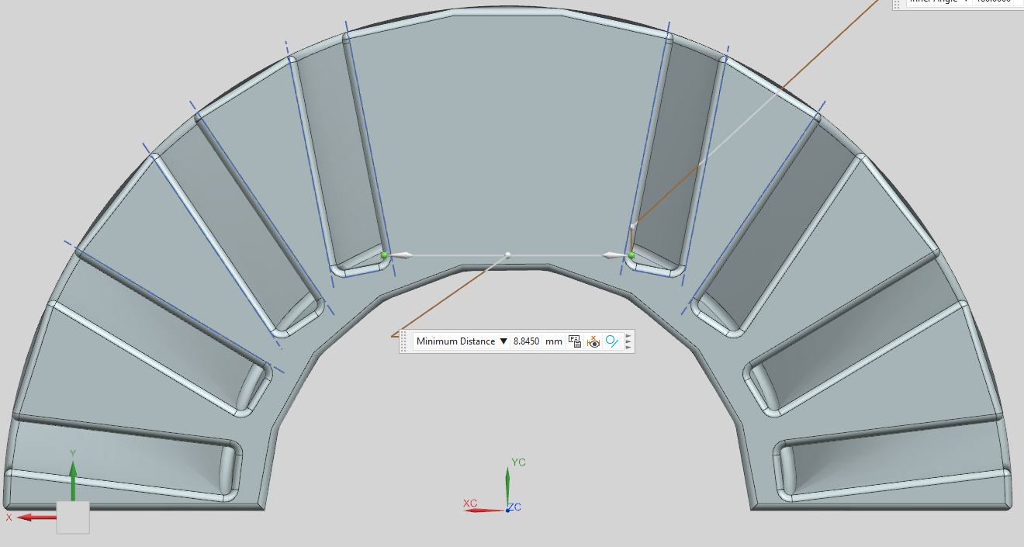
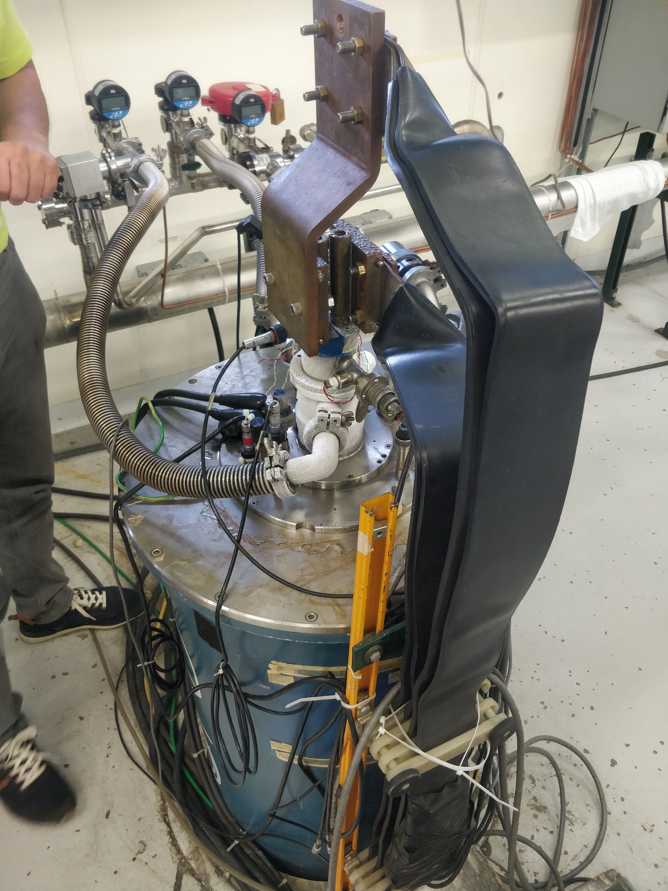
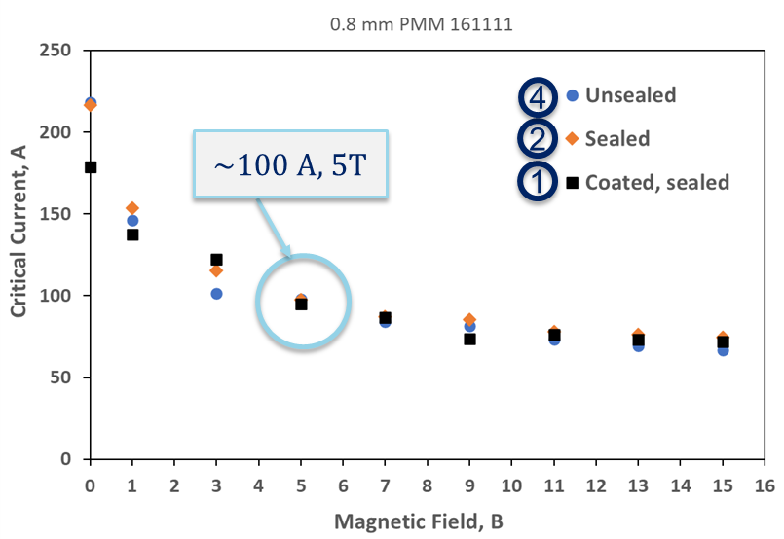
What so far – Witness test results
Bi-2212 strands, painted with TiO₂ slurry and reacted in the oven were tested in the cryogenic bin.
8.84 mm
The witness test in the Oxford cryogenic bin could reveal to us not only the magnitude of critical current the Bi-2212 strands could carry, but also, comparing with the predictions, give information on the quality of the reaction carried out.

Slide 10
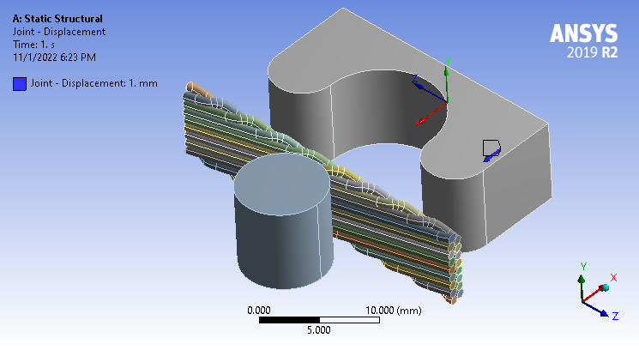
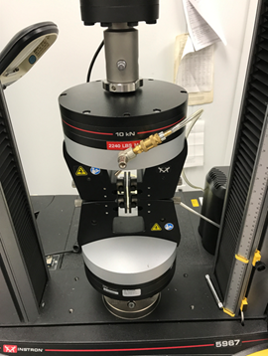
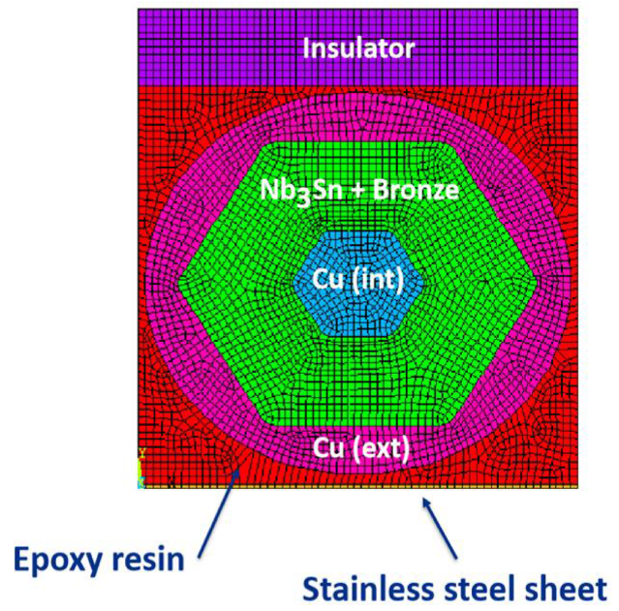
FEM analysis and model
Displacement
Combining Solidworks 3D models with Ansys Workbench and APDL potential, will be curried out:
investigation on cabling ‘easy bend’ and ‘hard bend’ issues to validate experimental results;
calibration and modeling of coil stress management elements;
analytical verification of the design of prototype insert coil tooling components;
modeling 2D Bi-2212 strand for mechanical and thermal characterization and validation of the new geometry.
Silver
(17 bodies)
Rigid
To be replaced by BiSCCO and Silver

Slide 11
Thank you!

