Slide 1
Status of Bi-CCT1 coil fabrication
Laura Garcia Fajardo and the Bi-2212 CCT team at LBNL.
Special thanks and recognition to Mechanical Technicians from LBNL:
Mark Krutulis, Chet Spencer and Derek Hochvert
Special thanks to our colleagues at NHMFL:
Daniel Davis, Ulf Trociewitz, and Jun Lu
General MDP Meeting
01/18/2023

Slide 2
Outline
Introduction: Main characteristics of Bi-CCT1
Fabrication of the mandrels
Winding of the outer layer
Winding of the inner layer

Slide 3
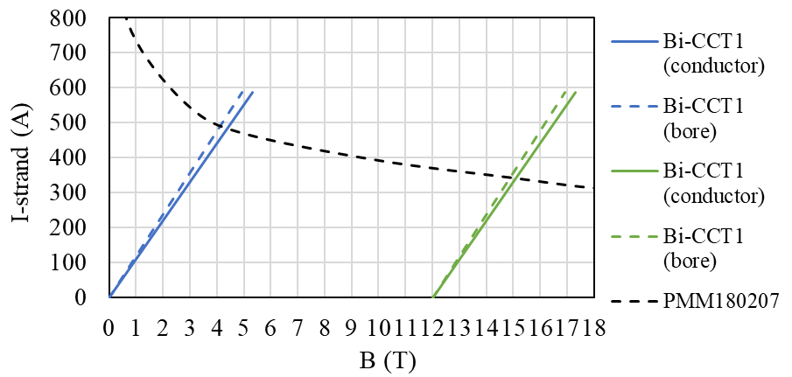
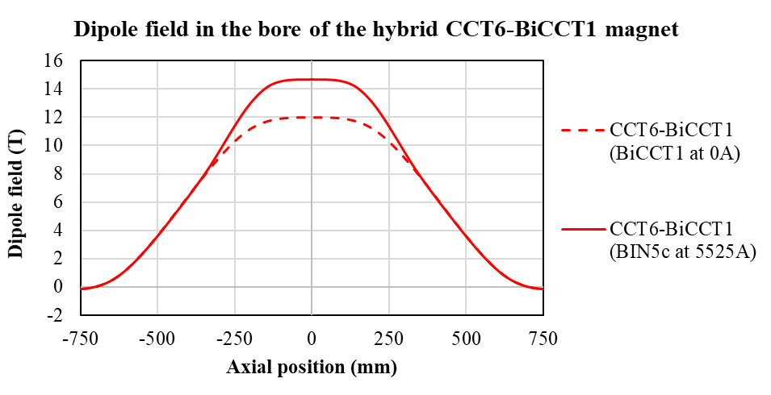
Main characteristics of Bi-CCT1
Bi-CCT1 magnet:
Bi-2212 two-layer CCT magnet, 40 mm clear bore, 85 cm long
Coils will be reacted using the RENEGADE overpressure processing heat treatment furnace at NHMFL
Main goals of Bi-CCT1:
Bi-CCT1 should produce 4 T dipole field in standalone configuration (at SSL)
Bi-CCT1 should produce additional 2.7 T (at SSL) in the 12 T background field produced by CCT6
Conductor characteristics:
17-strand Rutherford cable (7.8x1.44 mm), 0.8 mm diameter strand
Rutherford cable is painted with TiO₂ in an attempt to decrease Bi-2212 leaks during HT
Rutherford cable is then insulated with Mullite sleeve
The insulated Rutherford cable painted with TiO₂ slurry during the winding process (same process as BIN5a, BIN5b and BIN5c coils) to avoid electrical shorts
Approximate region where BiCCT1 is

Slide 4
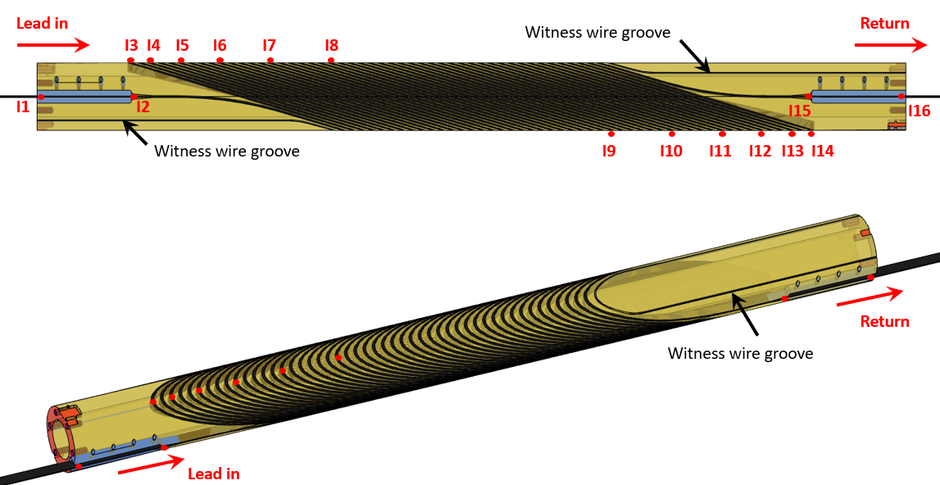
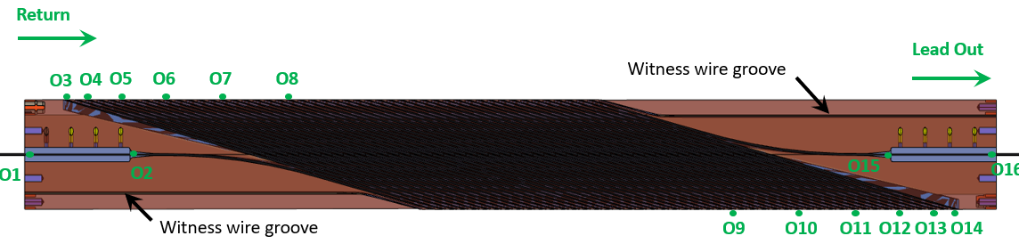
Main characteristics of Bi-CCT1
There will be six voltage taps at each pole side of each coil (I3 to I14 in the inner layer and O3 to O14 in the outer layer), plus two voltage taps at each splice region
Mandrel characteristics
Layer | Mandrel bore diameter (mm) | Spar thickness (mm) | Coil outer diameter (mm)
Inner | 40 | 4.5 | 66.2
Outer | 70 | 4.5 | 96.2

Slide 5
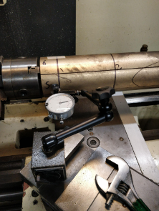
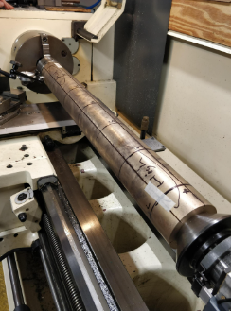
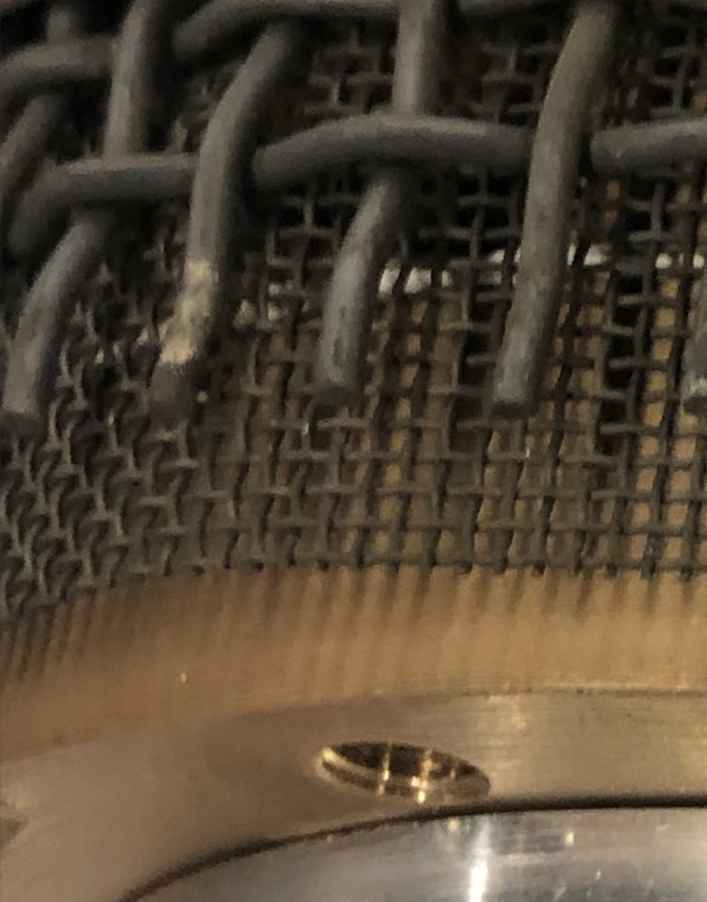
Fabrication of the mandrels
The inner and outer layers were machined and sent to NHMFL for pre-oxidation
Upon arrival, the inner layer (ILa) showed a large bending such that it could not be inserted inside the outer layer (measurements in the next slide)
A dummy mandrel wrapped with a thin and a thick Inconel 600 mesh as structural support was oxidized
The Inconel meshes were effective for preventing the bending of the dummy mandrel
A second inner layer (ILb) was machined and sent to NHMFL for pre-oxidation using the same support approach as for the dummy mandrel
The Inconel mesh approach ensured the straightness of the mandrel (measurements in the next slide)
CCT dummy mandrel post Mellon pre-oxidation: 820 C for 4 h in flowing O₂ with a thin and thick Inconel 600 mesh
Thin and thick Inconel 600 mesh

Slide 6
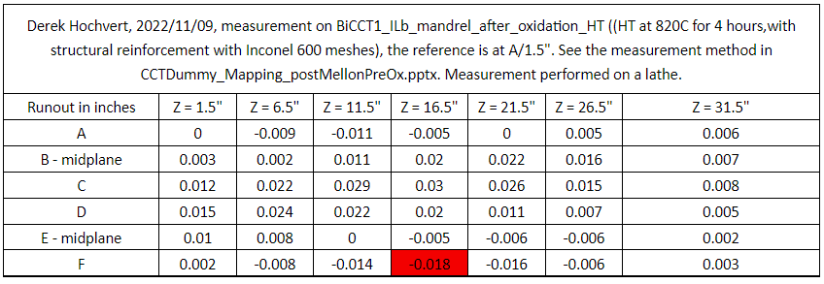
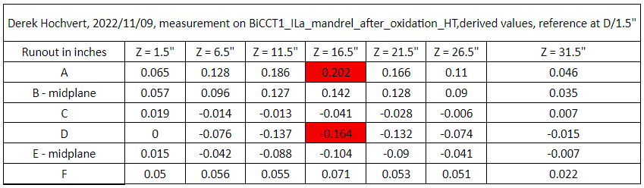
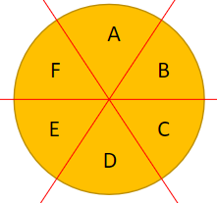
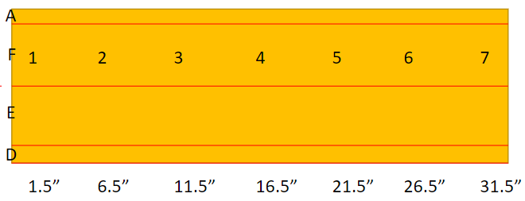
Fabrication of the mandrels
Inner layer (b) after oxidation, the thin and thick Inconel 600 meshes were used as support structure
Inner layer (a) after oxidation, no Inconel support structure was used
Measurement schematics:
End gripped by lathe chuck
End supported by live center

Slide 7
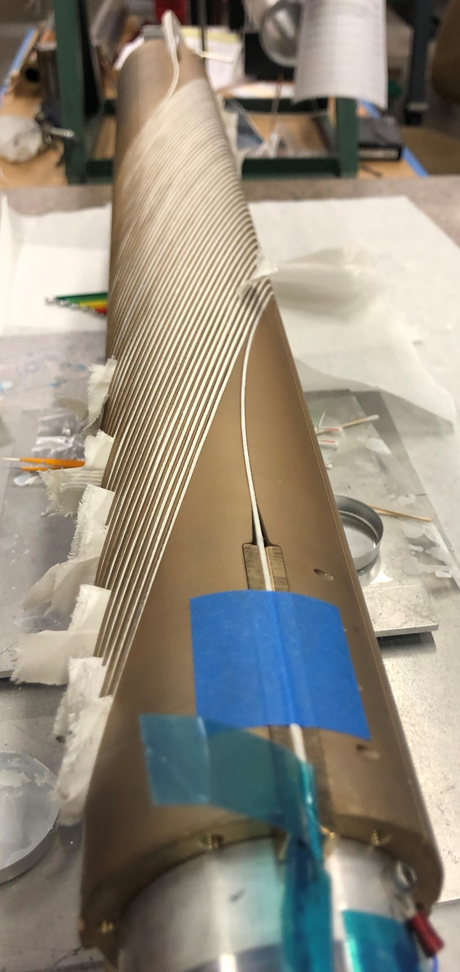
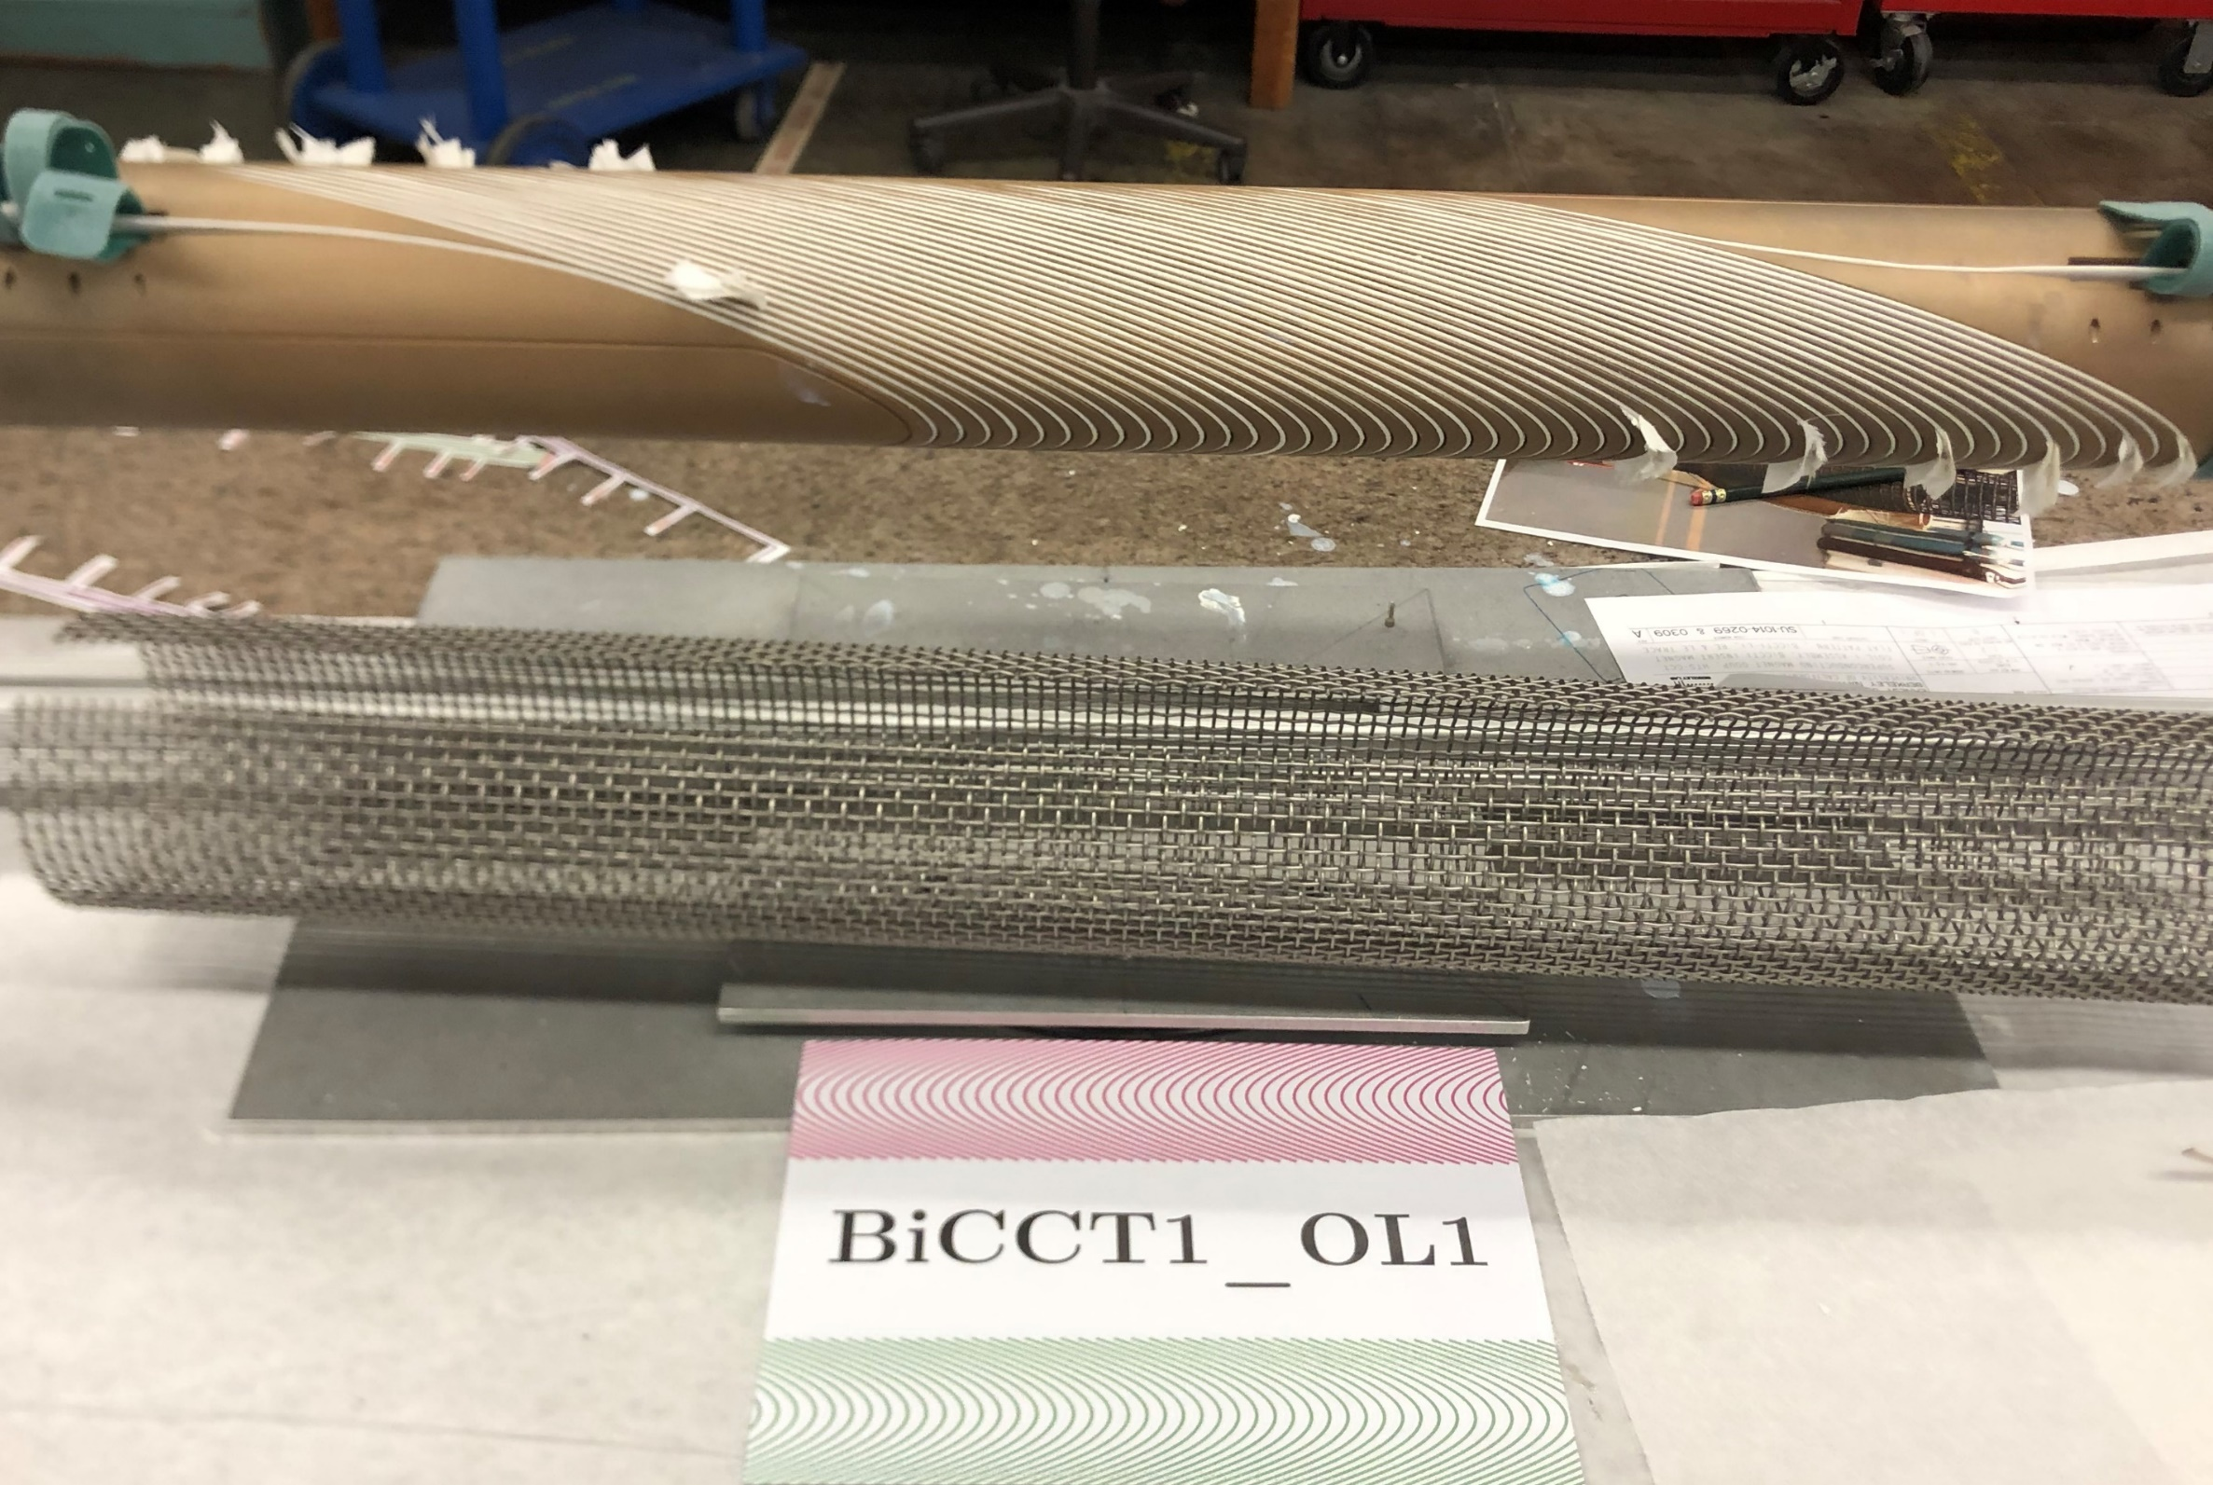
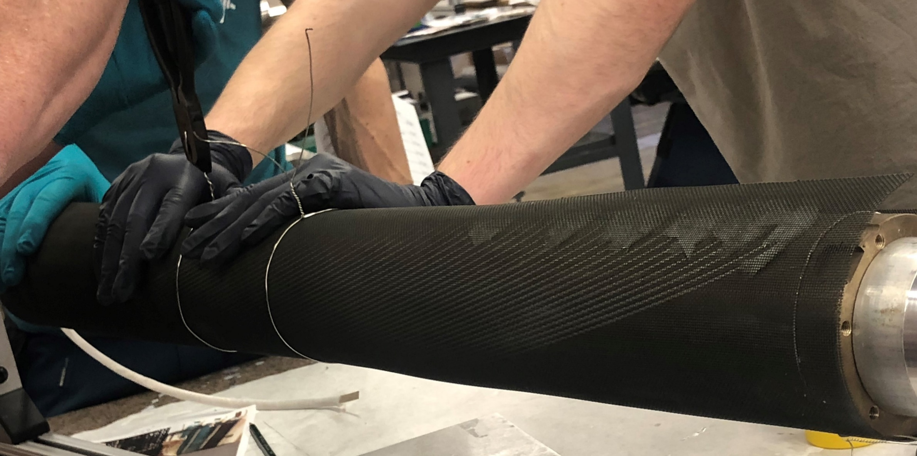
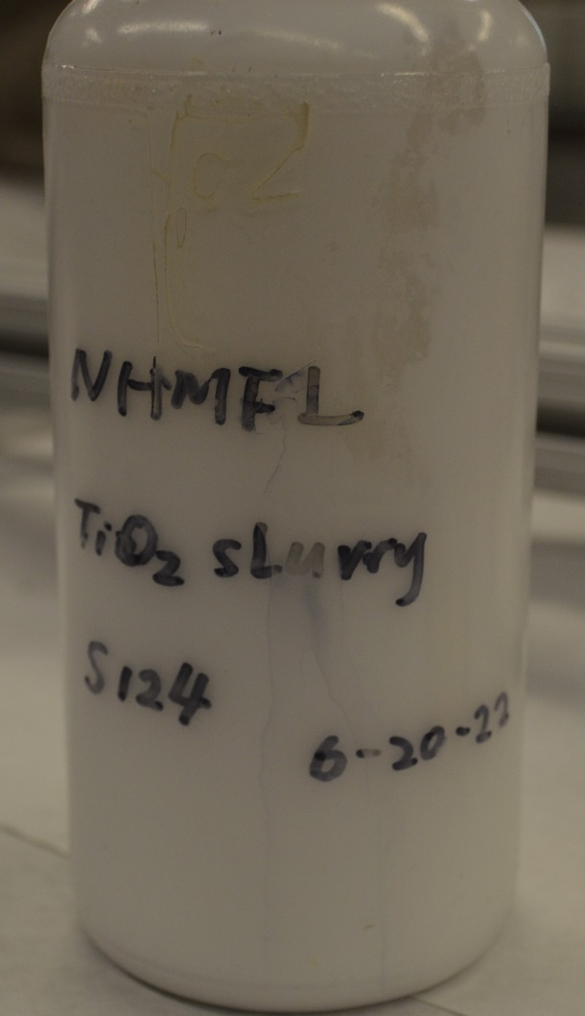
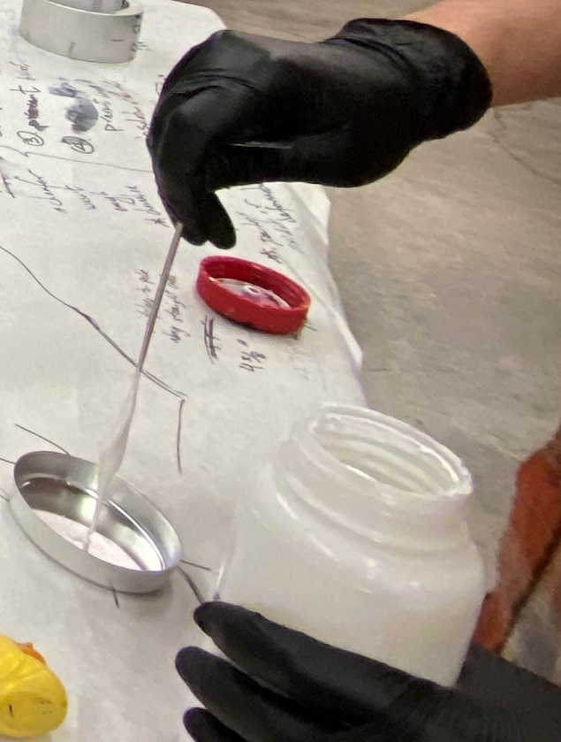
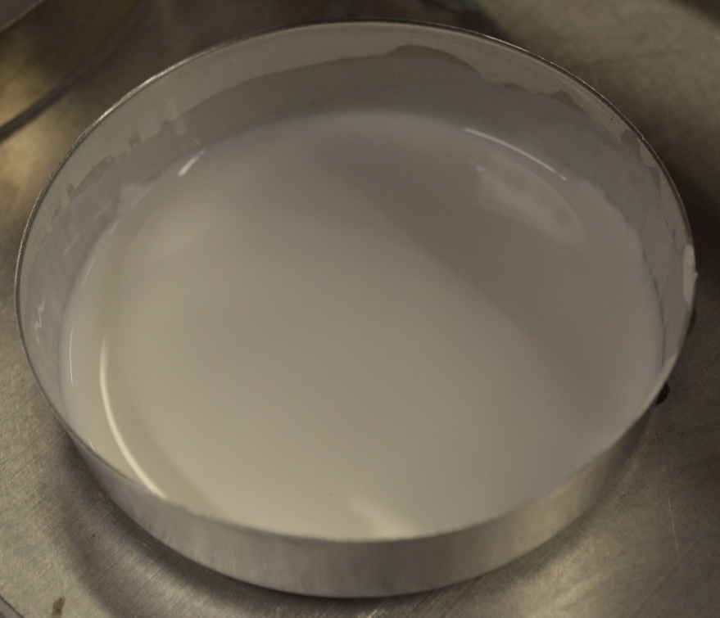
Winding of the outer layer
Outer Layer:
The outer layer was relatively easy to fabricate, nothing different from the previous BIN5a, BIN5b and BIN5c coils
The winding was done totally by hand, twisting and bending the cable with the fingers
The cable was painted with the TiO₂ slurry during the winding process for improving electrical insulation
Pure silver voltage tap flags were installed in the established locations
Witness samples were placed in the dedicated grooves
The mandrel was wrapped in oxidized thin and thick Inconel 600 meshes, and sent to NHMFL for heat treatment

Slide 8
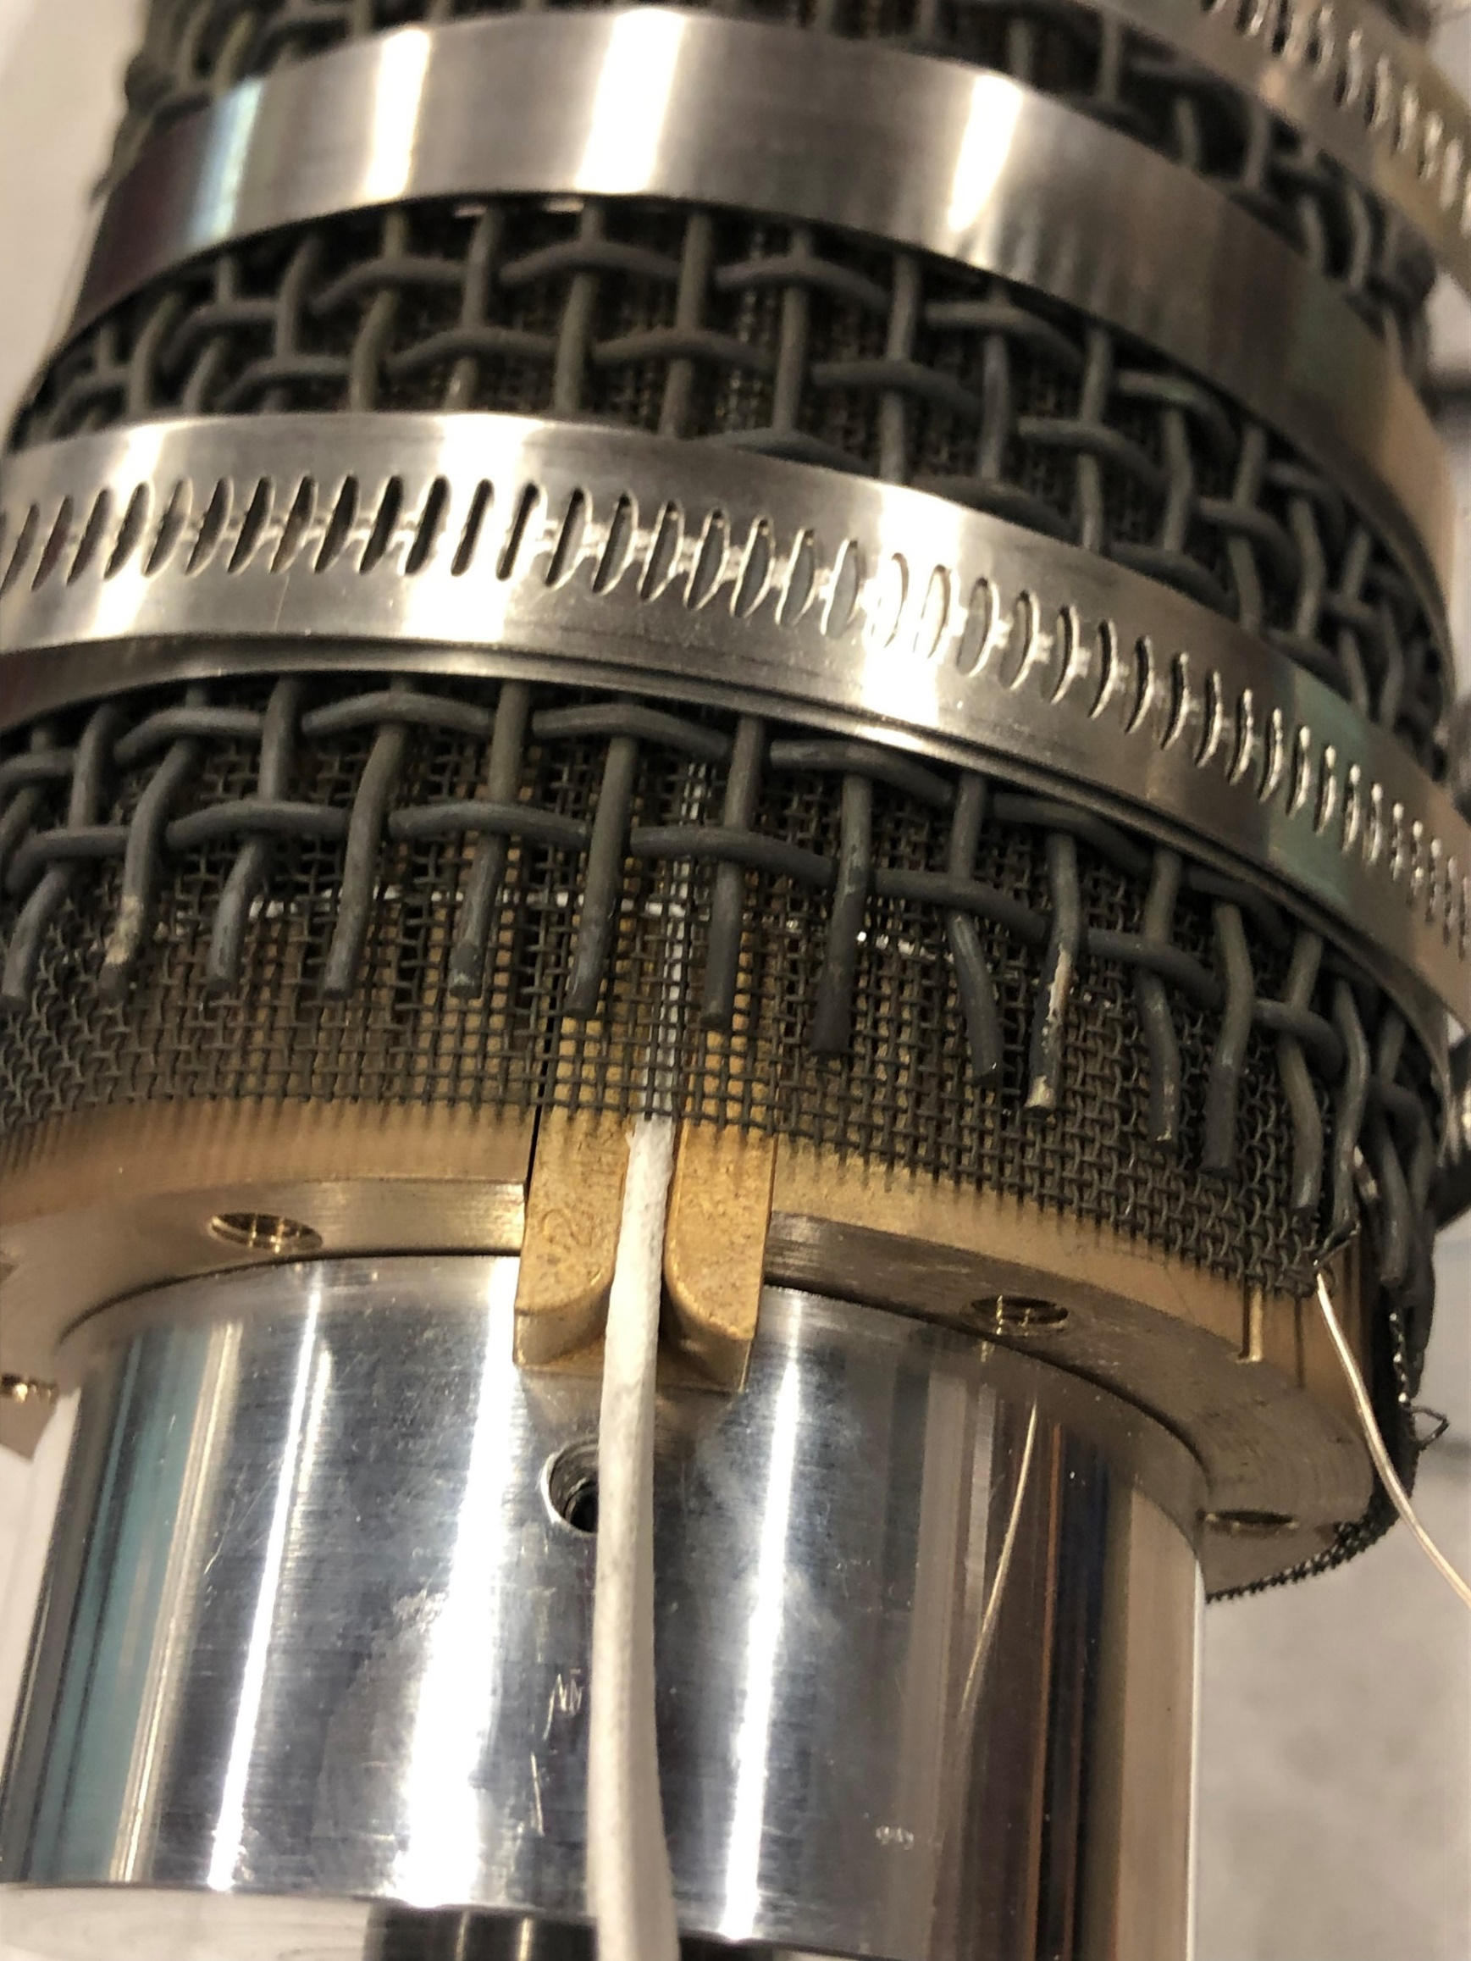
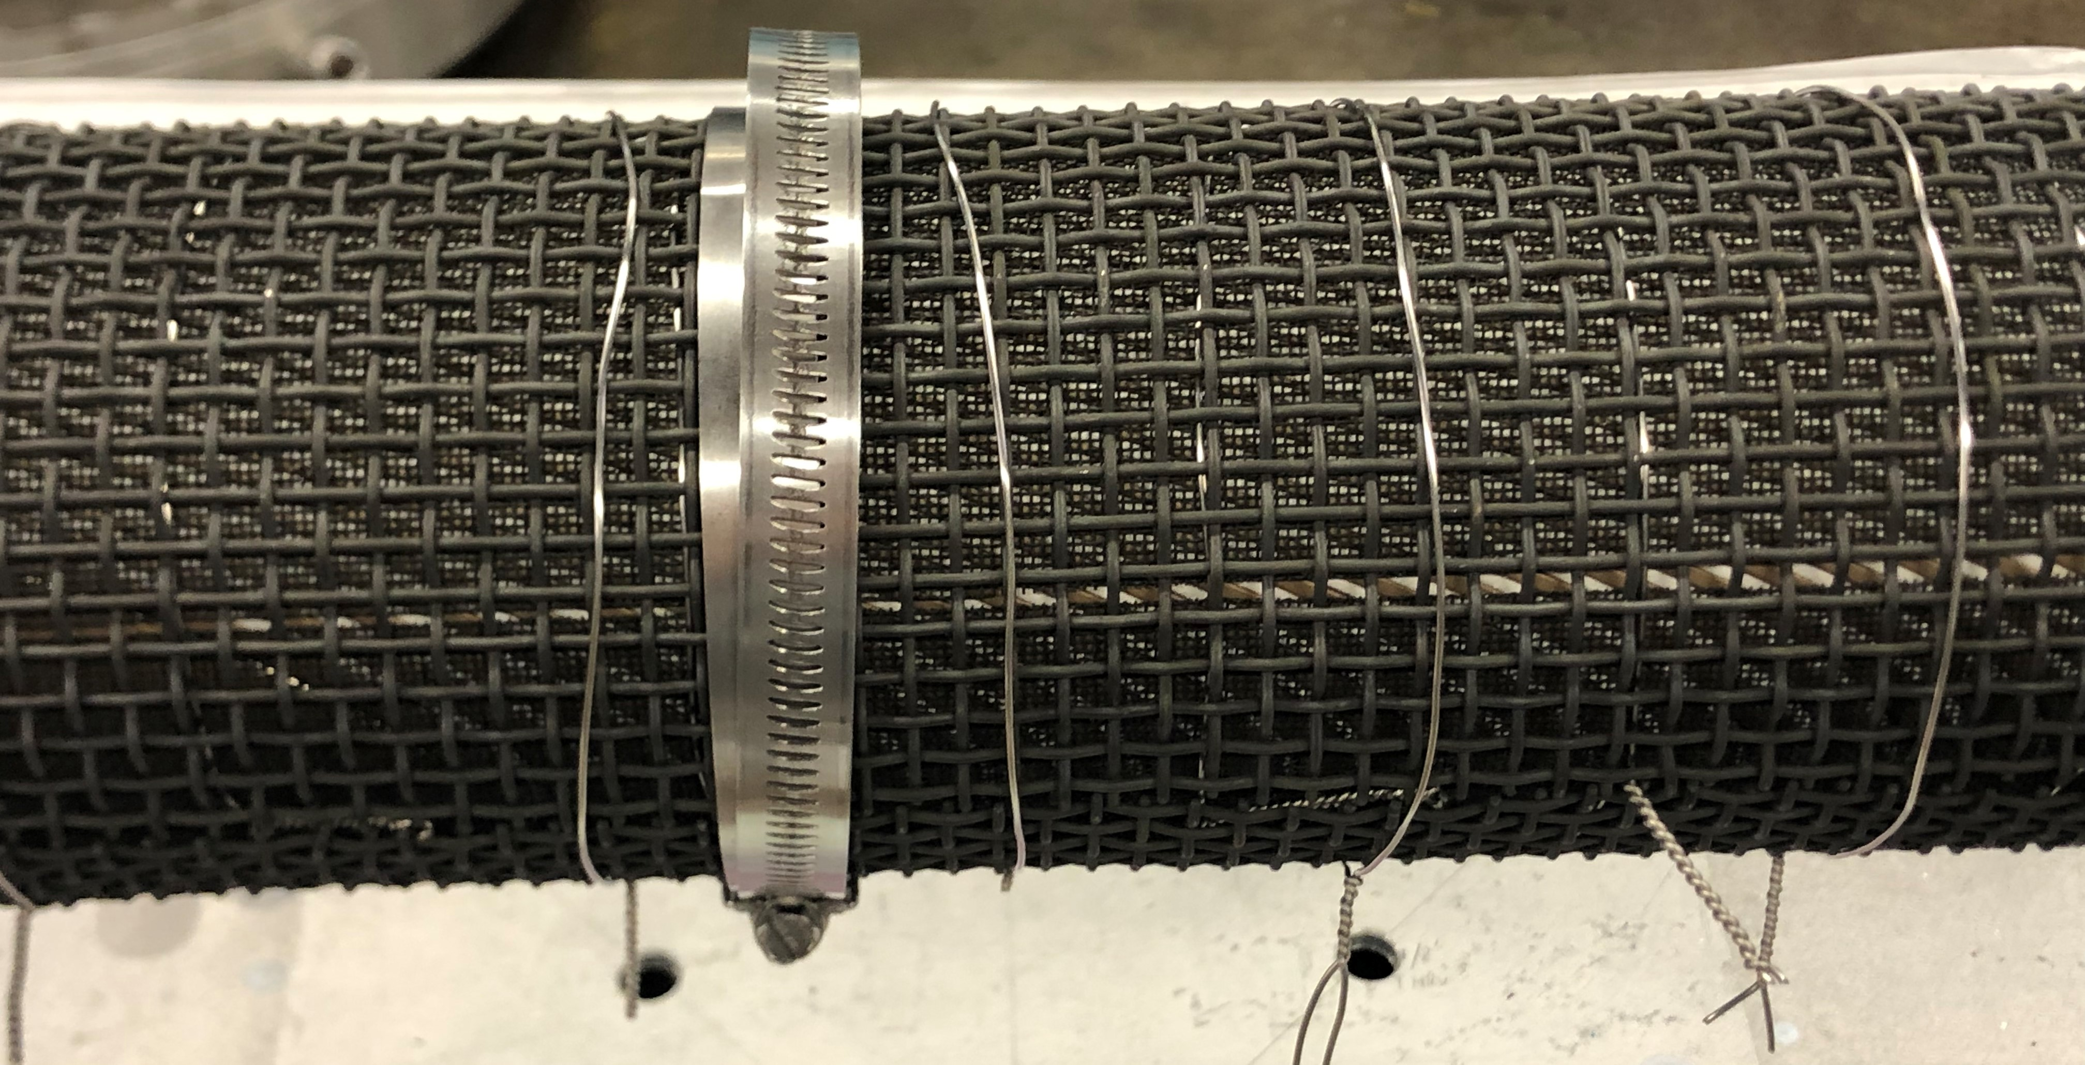
Winding of the outer layer
Thin and thick Inconel 600 meshes

Slide 9
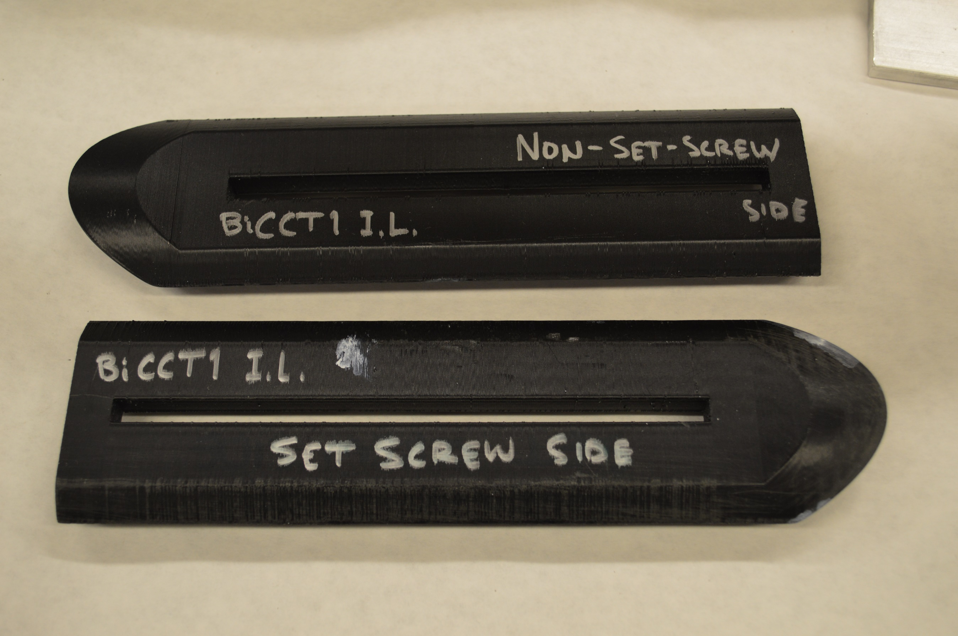
Winding of the inner layer
Inner Layer:
The inner layer was more difficult to wind due to the smaller radius of the mandrel and due to tighter channels (need to check machining tolerance after machining and before pre-oxidation).
By twisting and bending the cable with the fingers, irreversible de-cabling and mullite damage would occur near the pole region. After this incidents we decided to wind first with a test cable in order to address the challenges
The test cable was slightly thicker than the real cable, which posed an additional challenge. In addition the test cable was not painted with TiO₂ before placing the mullite sleeve
The solution for the effective twisting and bending of the cable without de-cabling, was achieved by using auxiliary 3D printed pieces with the shape of the channel surface at the pole region (a technique previously used in the winding test of CCT6)
Additional winding procedure improvements were introduced that determined to the success of the task (paint and lay, tension mullite sleeve before painting, etc.)
Auxiliary 3D printed pieces that helped twisting and bending the cable at the pole region, and prevented irreversible de-cabling

Slide 10
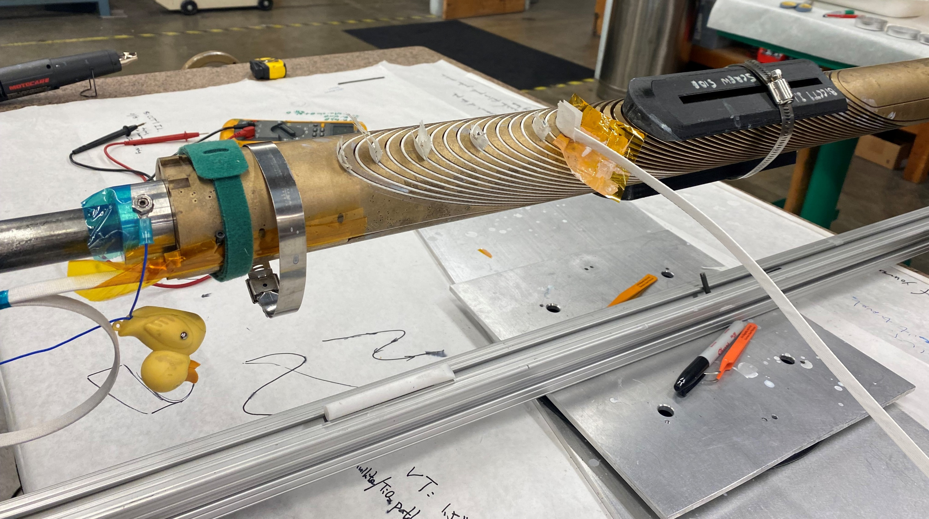
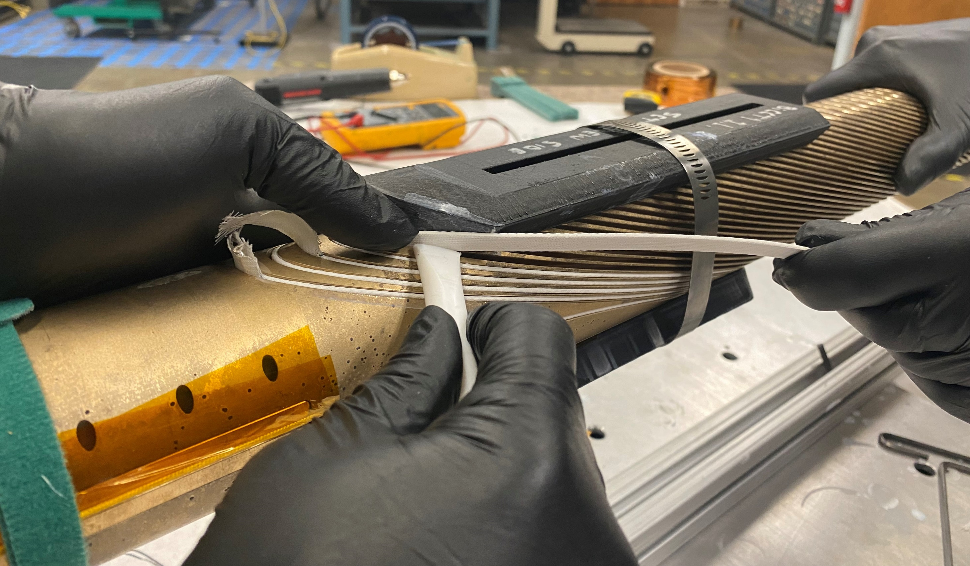
Winding of the inner layer
This Teflon piece is used to prevent the cable from being scratched by the outer edge of the channel, and to push the cable into the channel
This side of the 3D printed piece acts like an extension of the channel’s wall. By laying the cable against this wall and applying tension, the cable takes the desired shape. Then, it is progressively pushed into the channel
Tension is being applied to the cable during the winding process
When not winding, a piece of Kapton foil is placed between the cable and the mandrel to prevent damage to the mullite

Slide 11
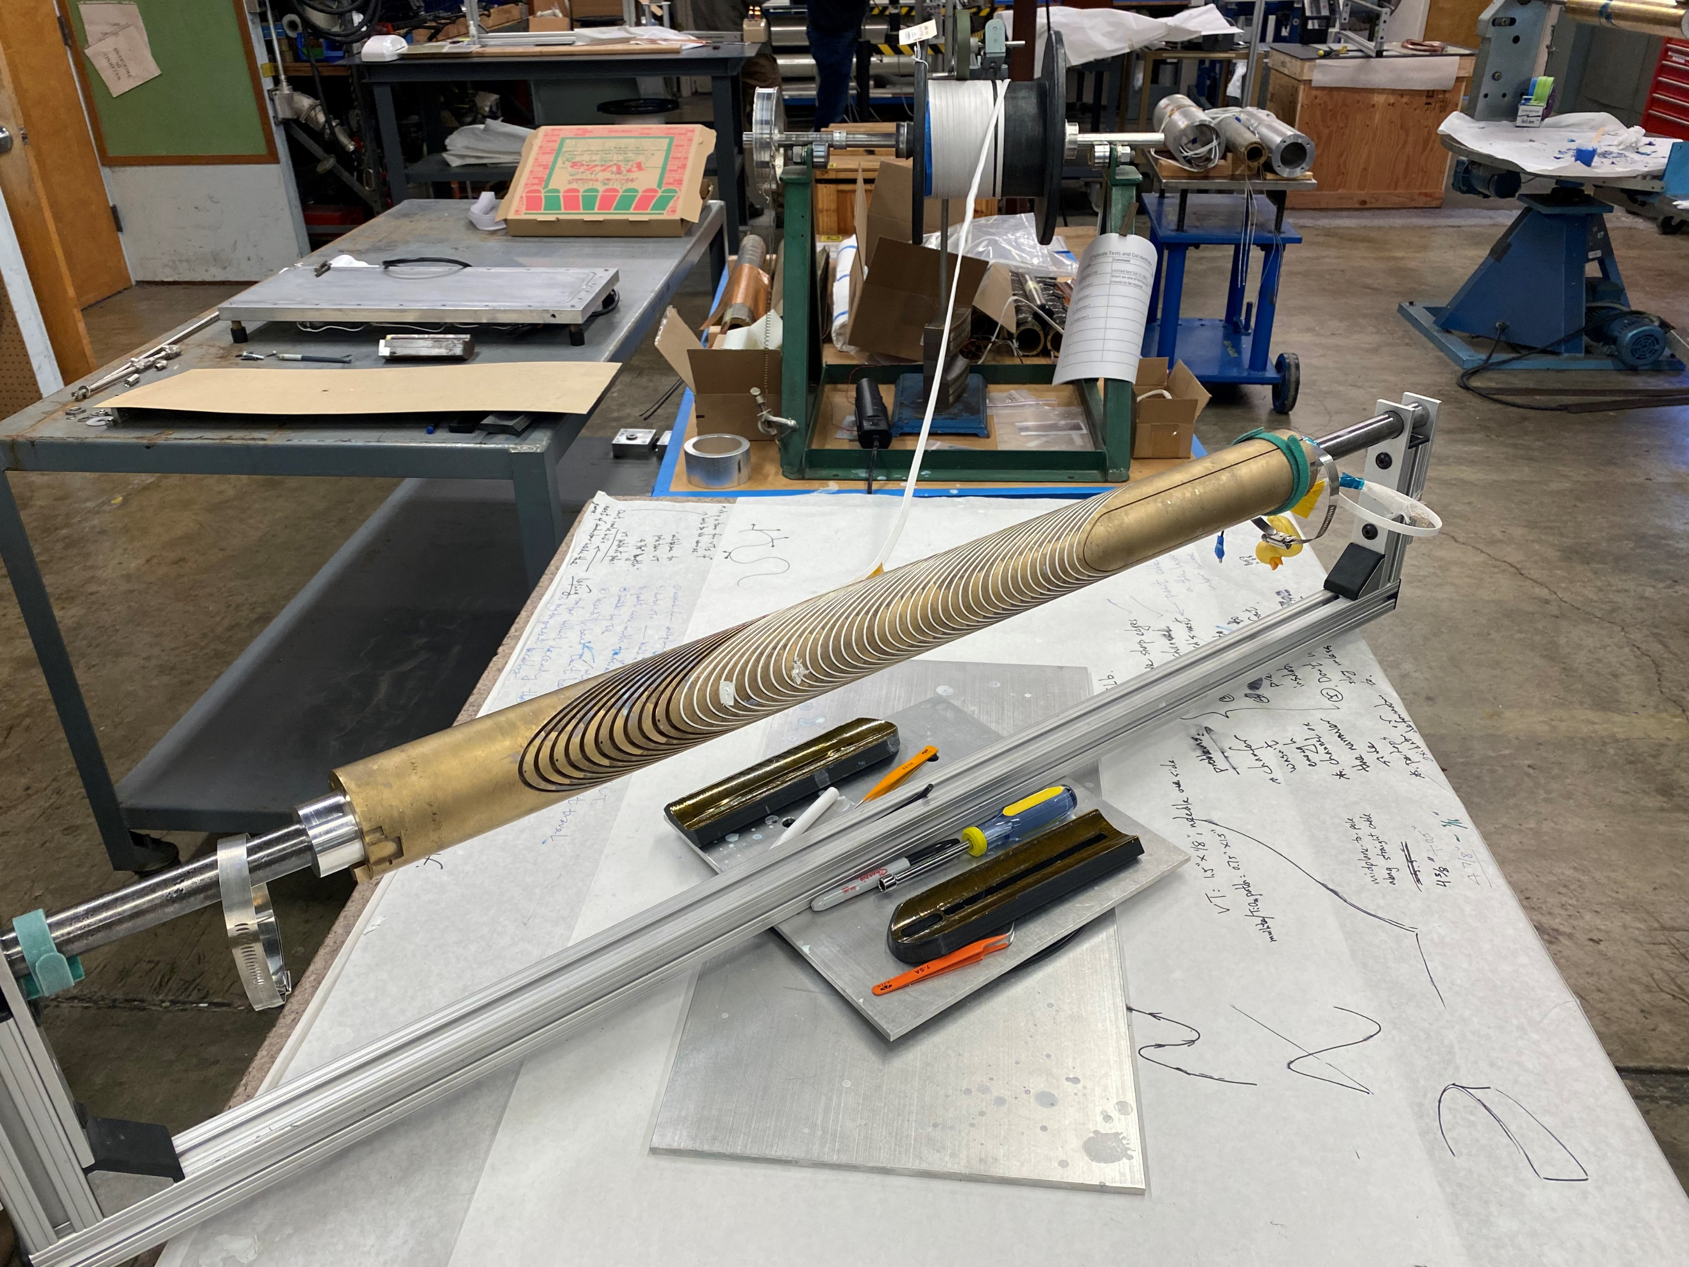
Winding of the inner layer
Status of the winding process of the inner layer as of 01/18/2023 at noon:
More than half of the coil has been successfully wound

Slide 12
Conclusion
The Inconel 600 meshes wrapped around the Bi-CCT1 mandrels prevented excessive bending during pre-oxidation, and should also be effective during the heat treatment of the coils
The outer layer, which has a larger radius, was successfully wound by hand without difficulties, and is ready for heat treatment
The inner layer needed auxiliary 3D printed pieces to bend and twist the cable at the pole region. However, the winding process is in progress and seems promising
In future Bi-CCT coils, a winding test will always be done in a shorter 3D printed or machined mandrel before fabricating the actual mandrels
In future Bi-CCT coils, the tolerance of the channels will be checked after the machining process

