Slide 1


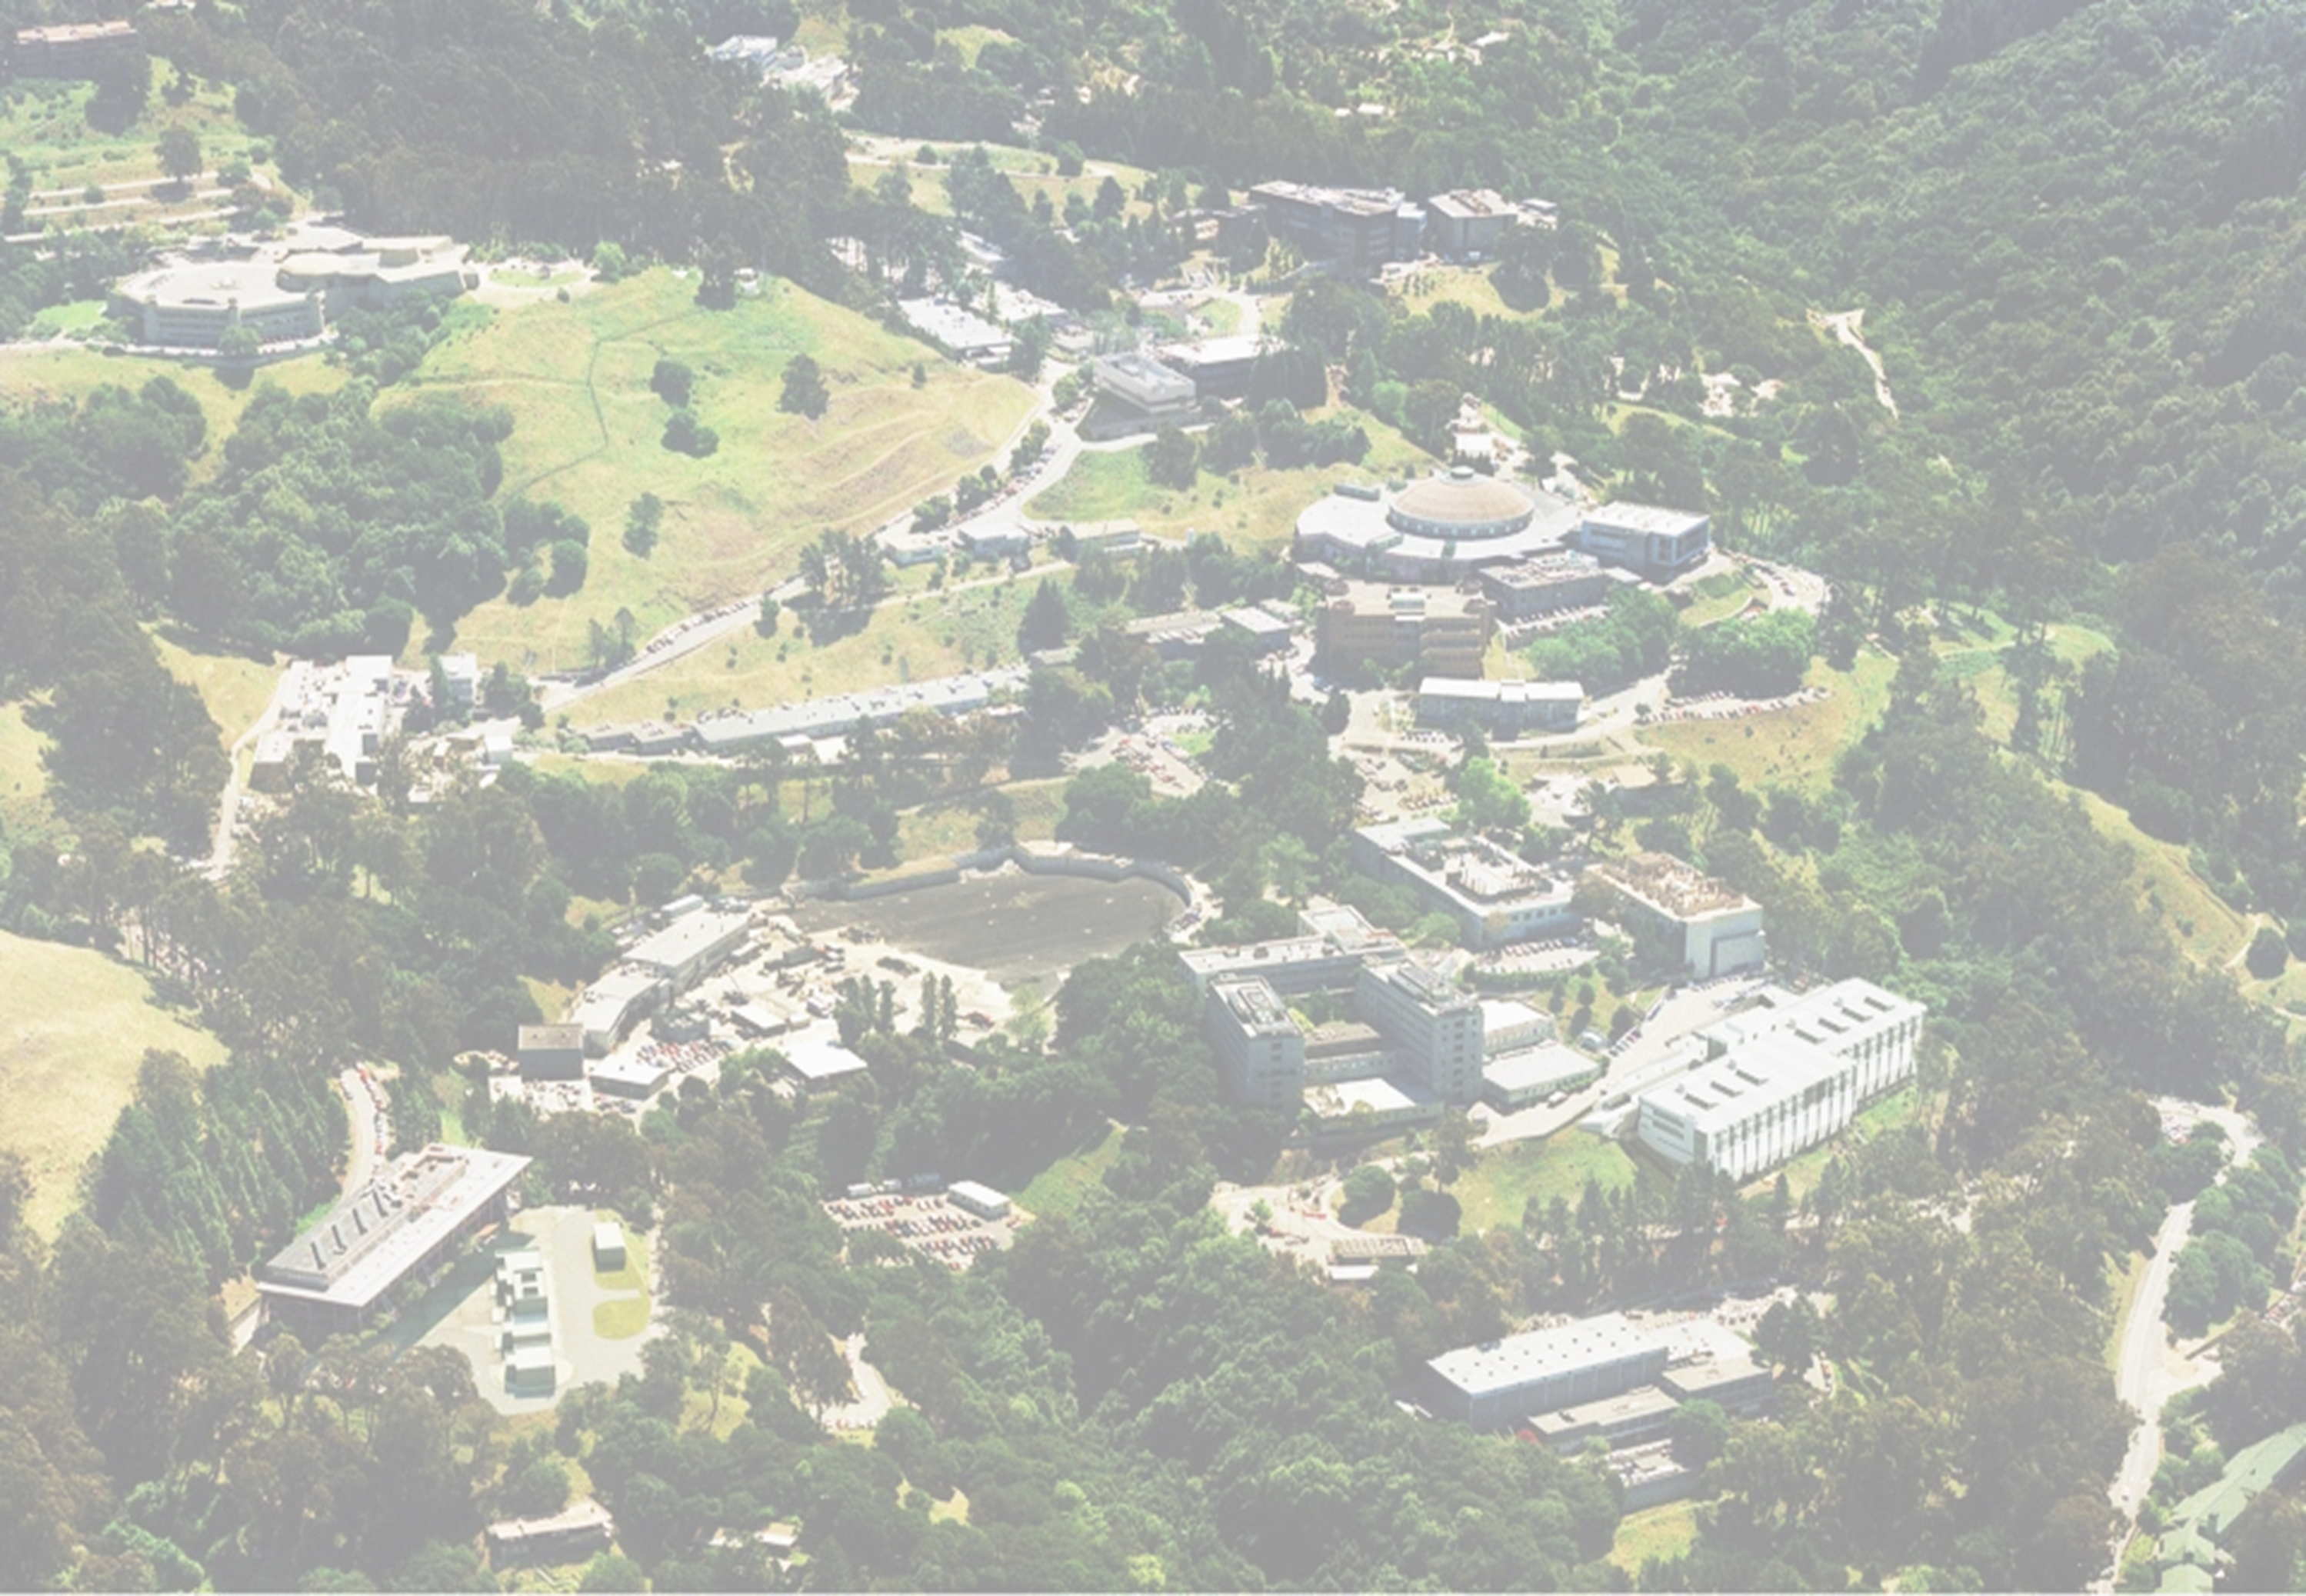
G. Sabbi, LBNL
Integrated Project Team meeting #7
January 20, 2023
TFD Status

Slide 2
Presentation Outline
Budget Updates
  Procurement quotes vs. allocated budget
  Testing at Fermilab
  Magnet fabrication effort
Schedule Update
  Comparison IPT7 vs. IPT6
Engineering Design and Documentation
Test facility interfaces
Summary

Slide 3
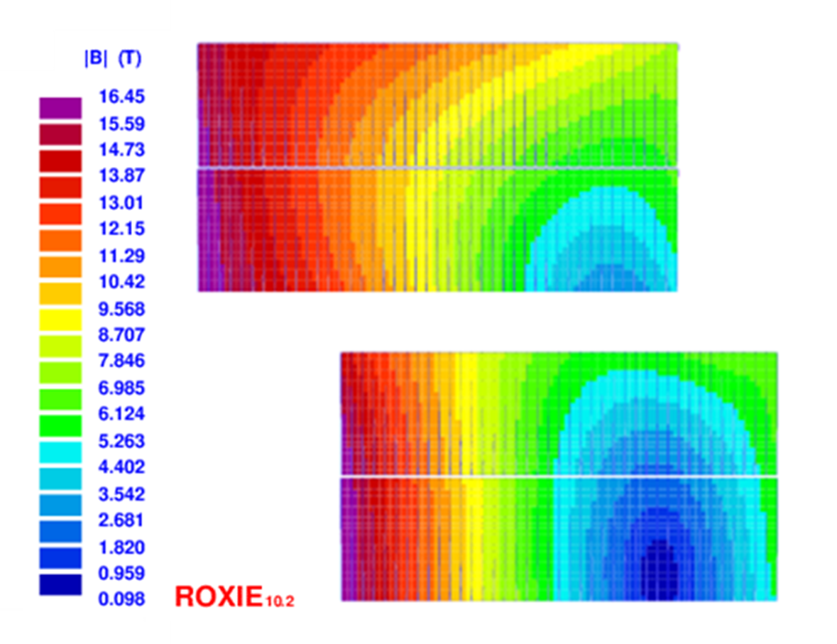
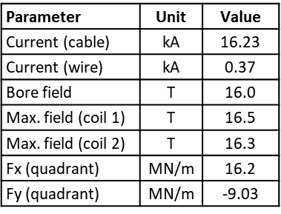
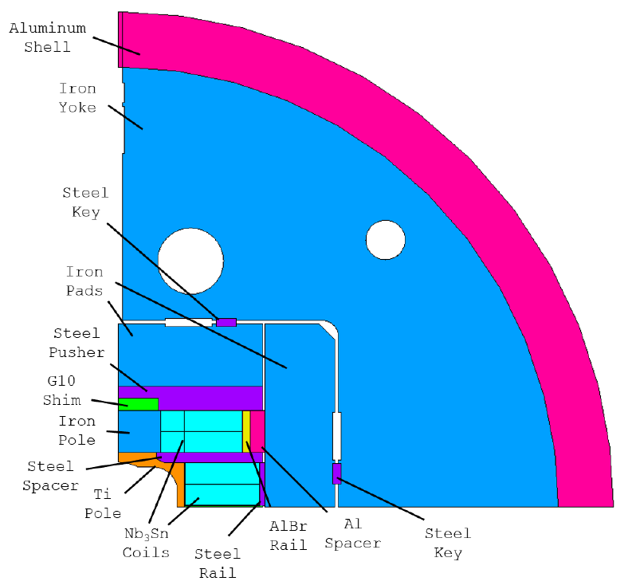
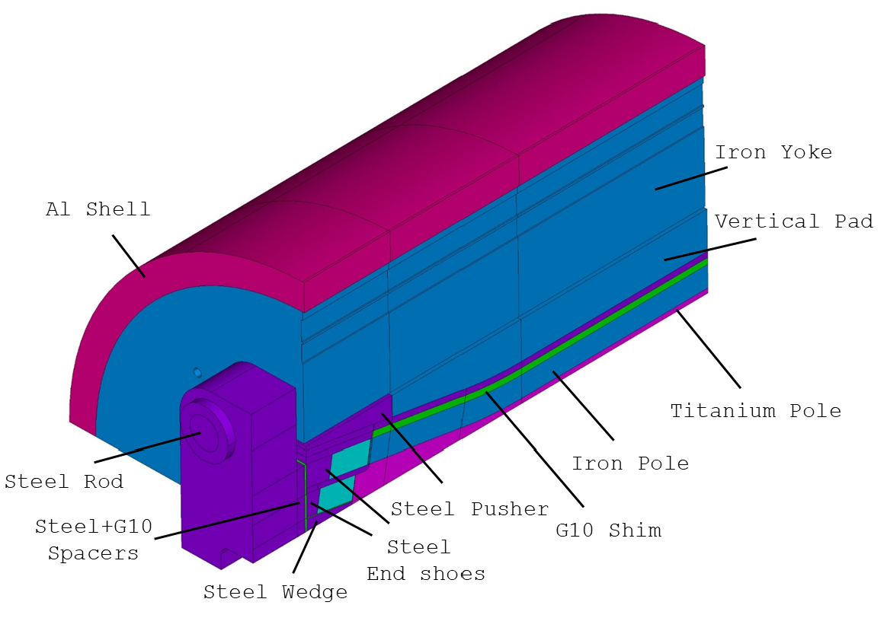
Magnet Design
Parameter | Unit | Value
Shell OD | m | 1.3
Shell length | m | 2.0
Total length | m | 2.9
44 turns/layer
40 turns/layer
D. Arbelaez, P. Ferracin, R. Hafalia, P. Mallon, D. Martins Araujo, J. L. Rudeiros Fernandez, G. Vallone et al.

Slide 4
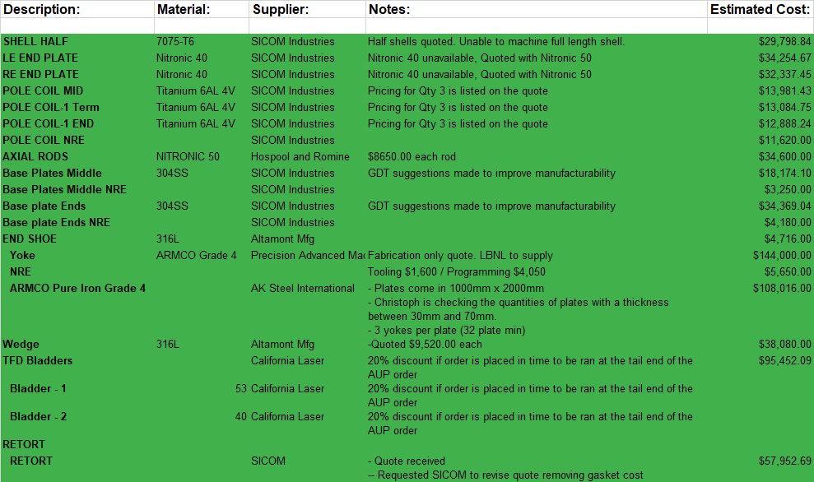
Vendor Quotes/Estimates

Slide 5
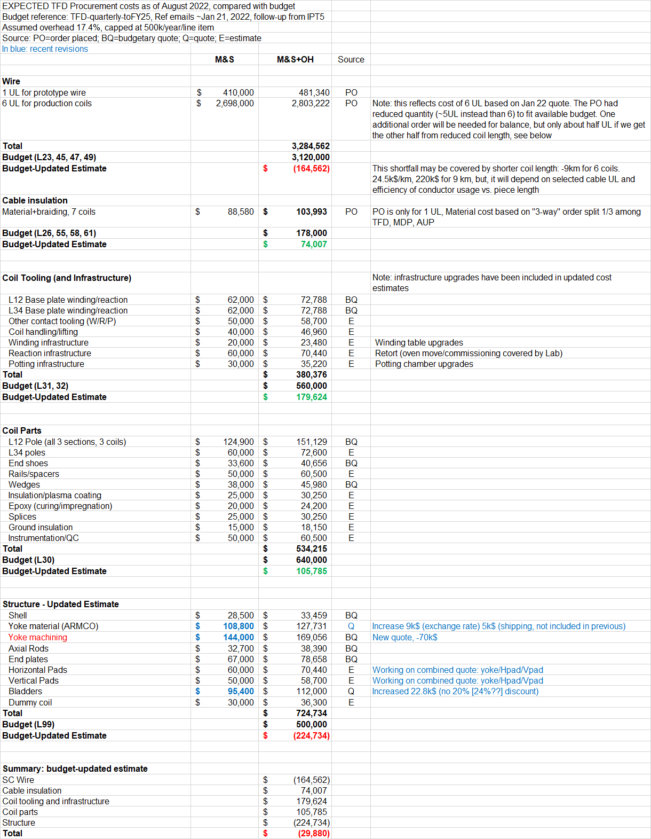
Summary and Budget Update
Updated 12/9/2022
Wire: +164k$
Cable insulation: -74k$
Coil tooling: -179k$
Coil parts: -106k$
Structure: +224k$
Total: -30k$

Slide 6
Magnet Test at Fermilab
FNAL test scope:
Cool down with dummy coils
  effort may be covered by facility commissioning funds
Two vertical tests: Fermilab provided estimate based on agreed requirements

Slide 7
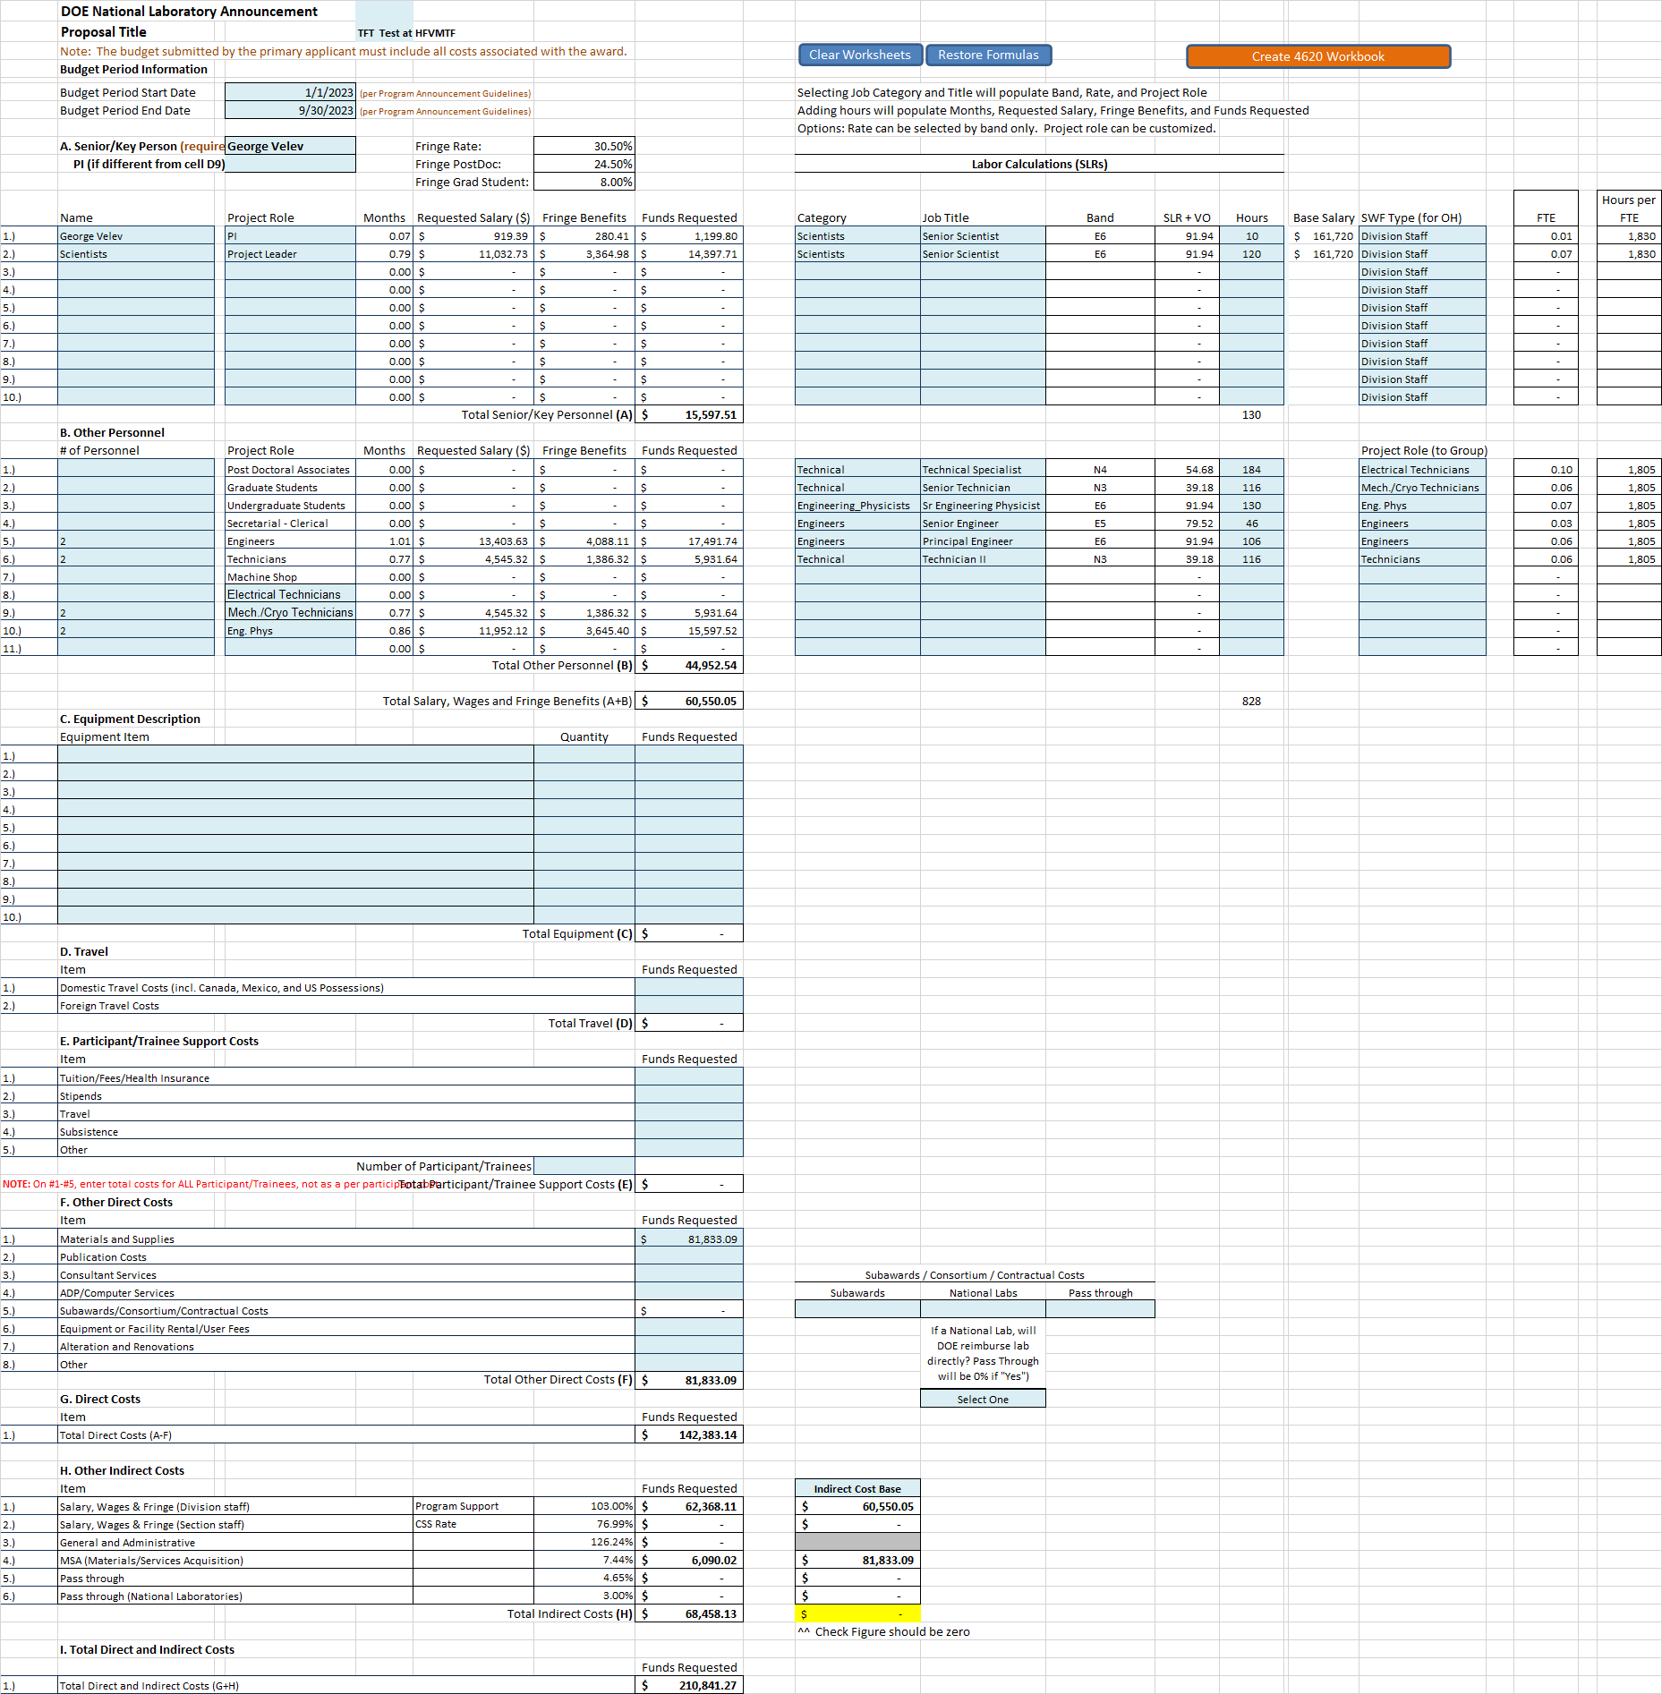
Magnet Test at Fermilab
Reference: TFT_Test-PAMS Budget-TFT _Test_at_HFVMTF-FY23
Summary
Included:
Cold test with TC
Setup
TC1: 2.5 wks
TC2: 1 wk
15-20 quenches
Basic analysis
Total requested (k$):
Labor: 142.4
M&S: 81.8
Total: 210.8
Previous (EOC2) budget:
  Test 1: 198.8 k$ (w/TC)
  Test 2: 173.3 k$ (no TC)
Budget was revised to reflect FNAL estimate
Detailed analysis covered separately
Need to add contingency

Slide 8
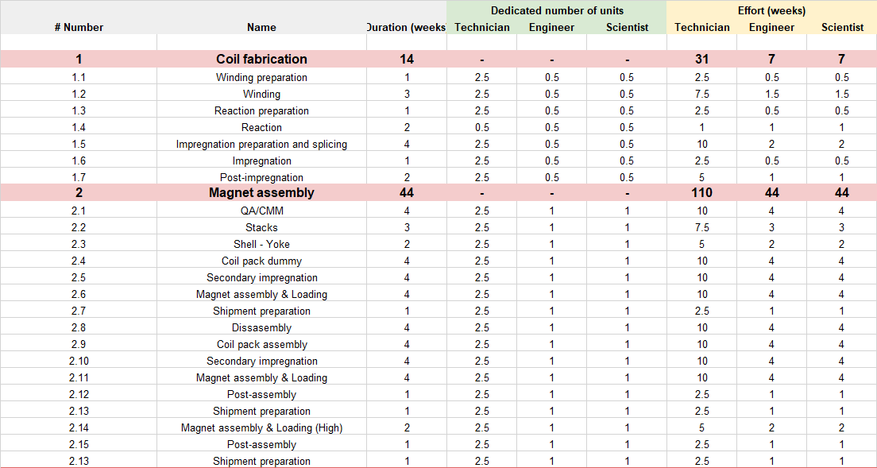
Magnet fabrication effort
Updated “bottom up” effort estimate by engineering team is consistent with TFD budget allocations

Slide 9
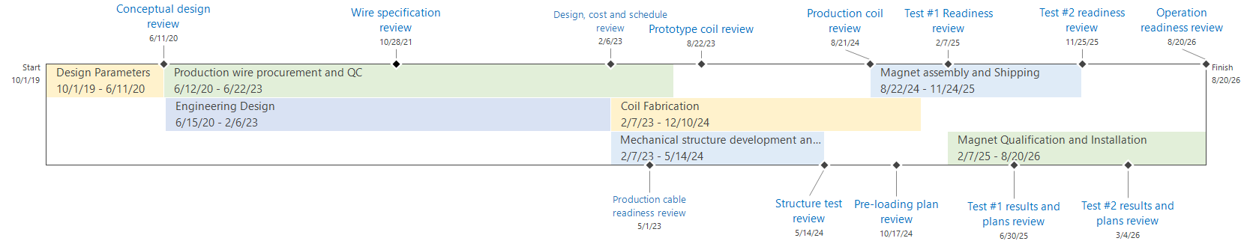
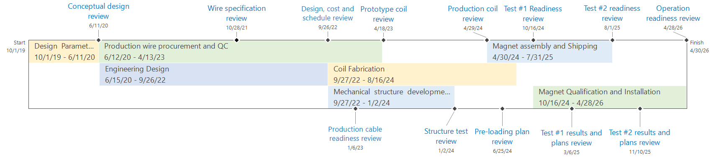
TFD Schedule: IPT7 vs. IPT6
January 2023 (IPT7)
+4 months
August 2022 (EOC2/IPT6)

Slide 10
Design, Prototype Cable and Coil

Slide 11
Production Cables and Coils

Slide 12
Structure, Assembly and Test

Slide 13
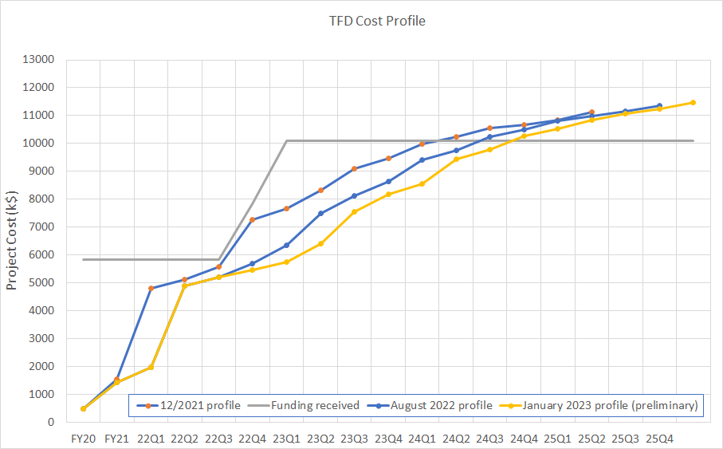
Funding Profile

Slide 14
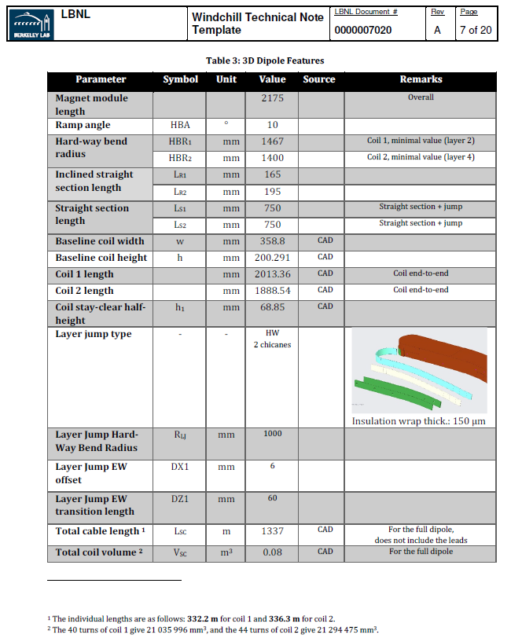
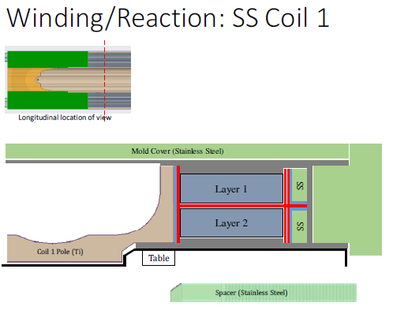
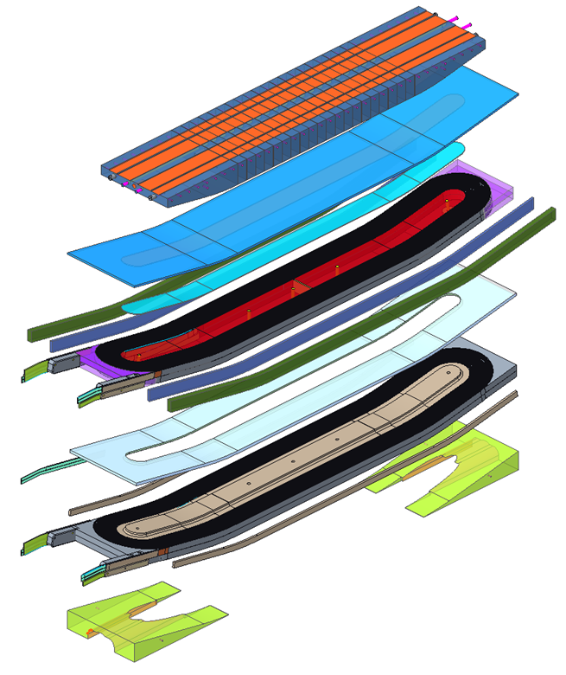
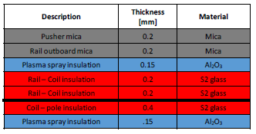
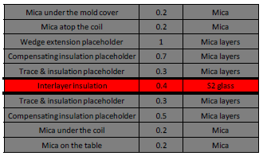
Engineering Design and Documentation
Continued work to implement full CAD model and fabrication drawings
  End plates, laminated structures, insulation schemes, impregnation surfaces

Slide 15
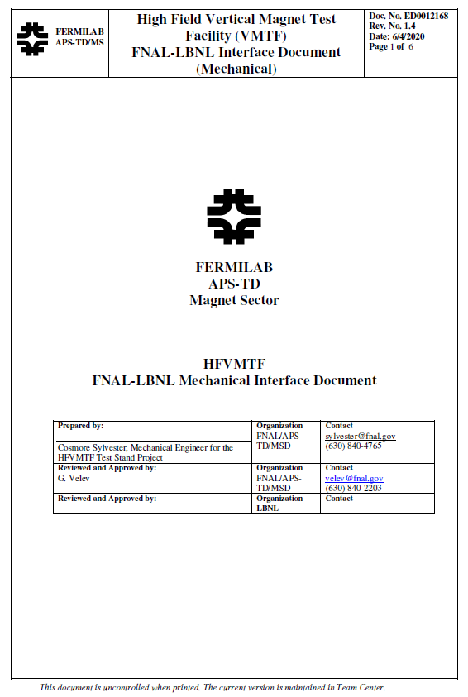
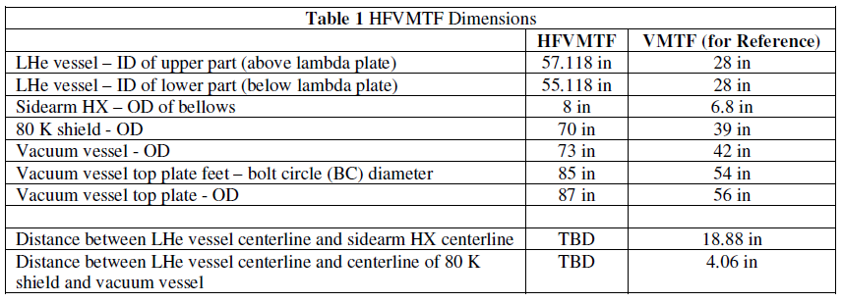
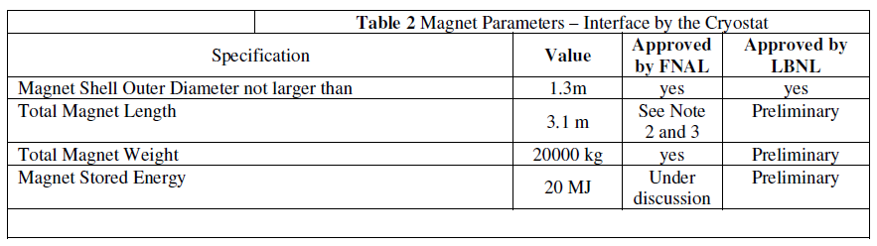
Test Facility Interfaces and Specifications
Interface document to defined agreed upon parameters and capture additional details or changes
  Example: final coil length, magnet dimensions and weight were provided in November 2022 – about 10% additional margin for sample holder design, magnet mechanical support, quench protection etc.
  Under discussion: use of CLIQ for protection
Evolve in a formal agreement as both magnet and facility design are finalized

Slide 16
Summary
Main updates from IPT6:
Continued work with vendors and LBNL/FNAL team to reconfirm procurement and effort estimates for magnet fabrication and testing – overall there are no significant changes to allocated budget
Following a successful Wire Specification Review we requested a final quote for the production wire and placed the order. First production batch (about 1.5 coil worth) was completed and accepted
Design and analysis effort has focused on incorporating engineering requirements and fabrication/assembly considerations, including feedback from vendors on component manufacturability and cost
Engineering design has been slipping, resulting in additional 4 months delay on project completion
Additional work is also needed in preparation for cable production runs
Availability of resources/infrastructure for engineering design and magnet fabrication is a challenge

Slide 17
Additional Slides

Slide 18
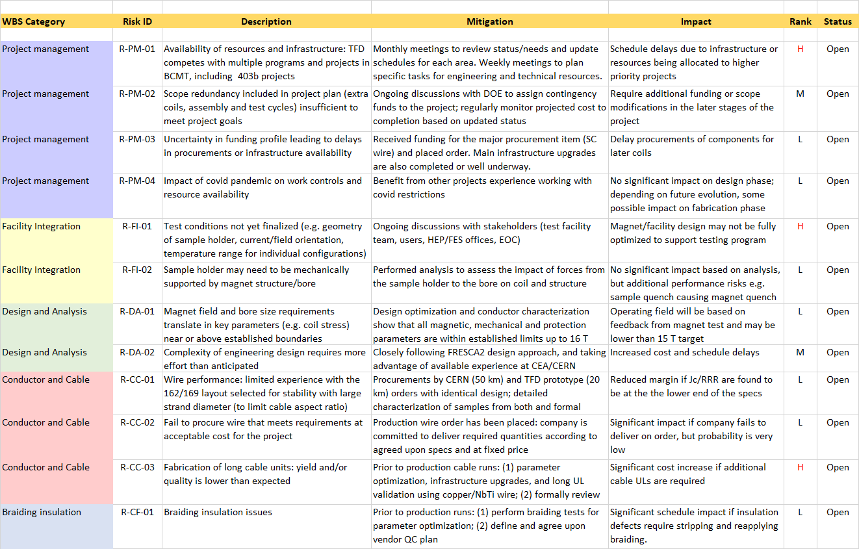
Risk Register

Slide 19
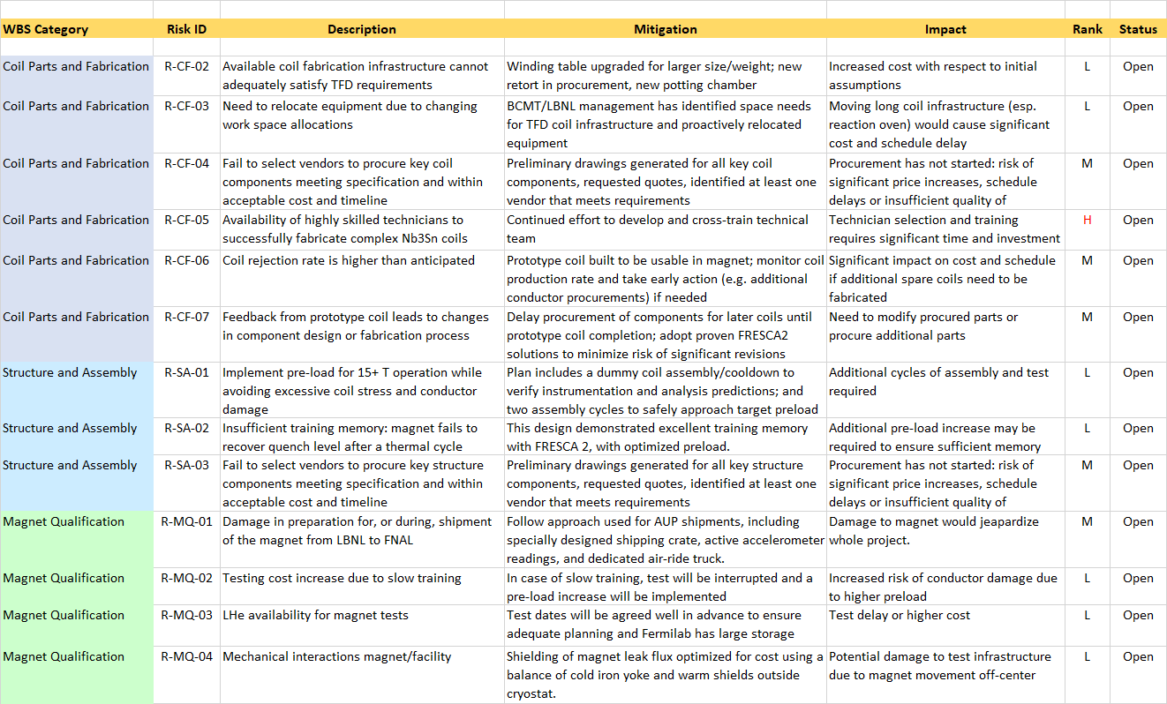
Risk Register

Slide 20
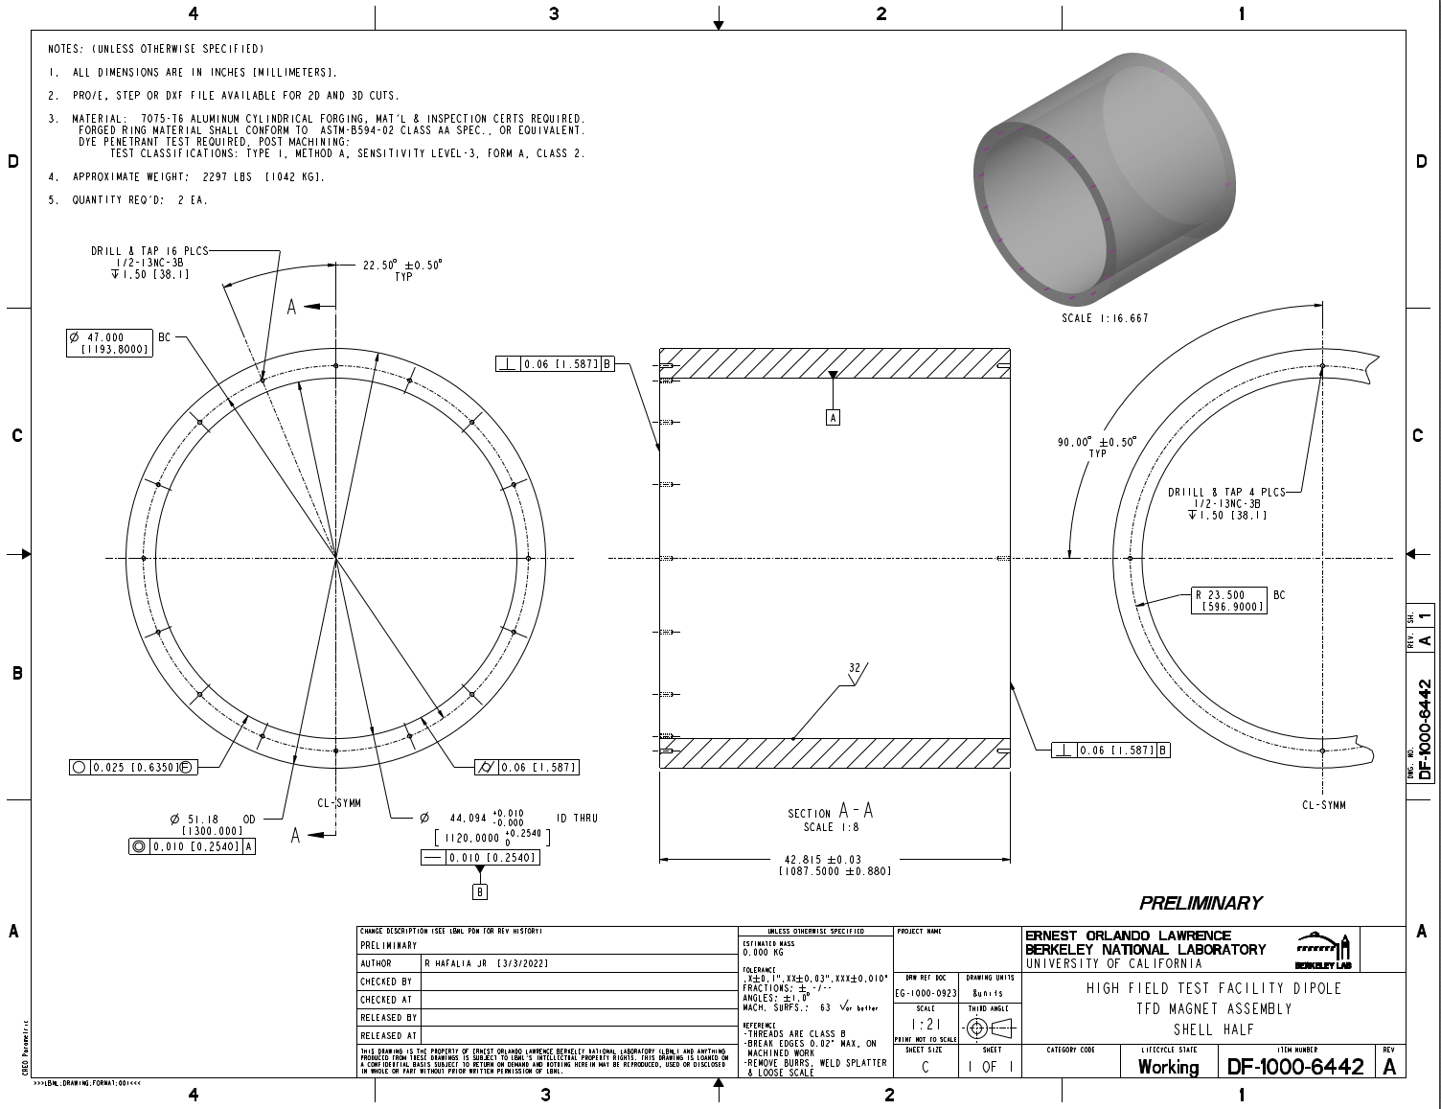
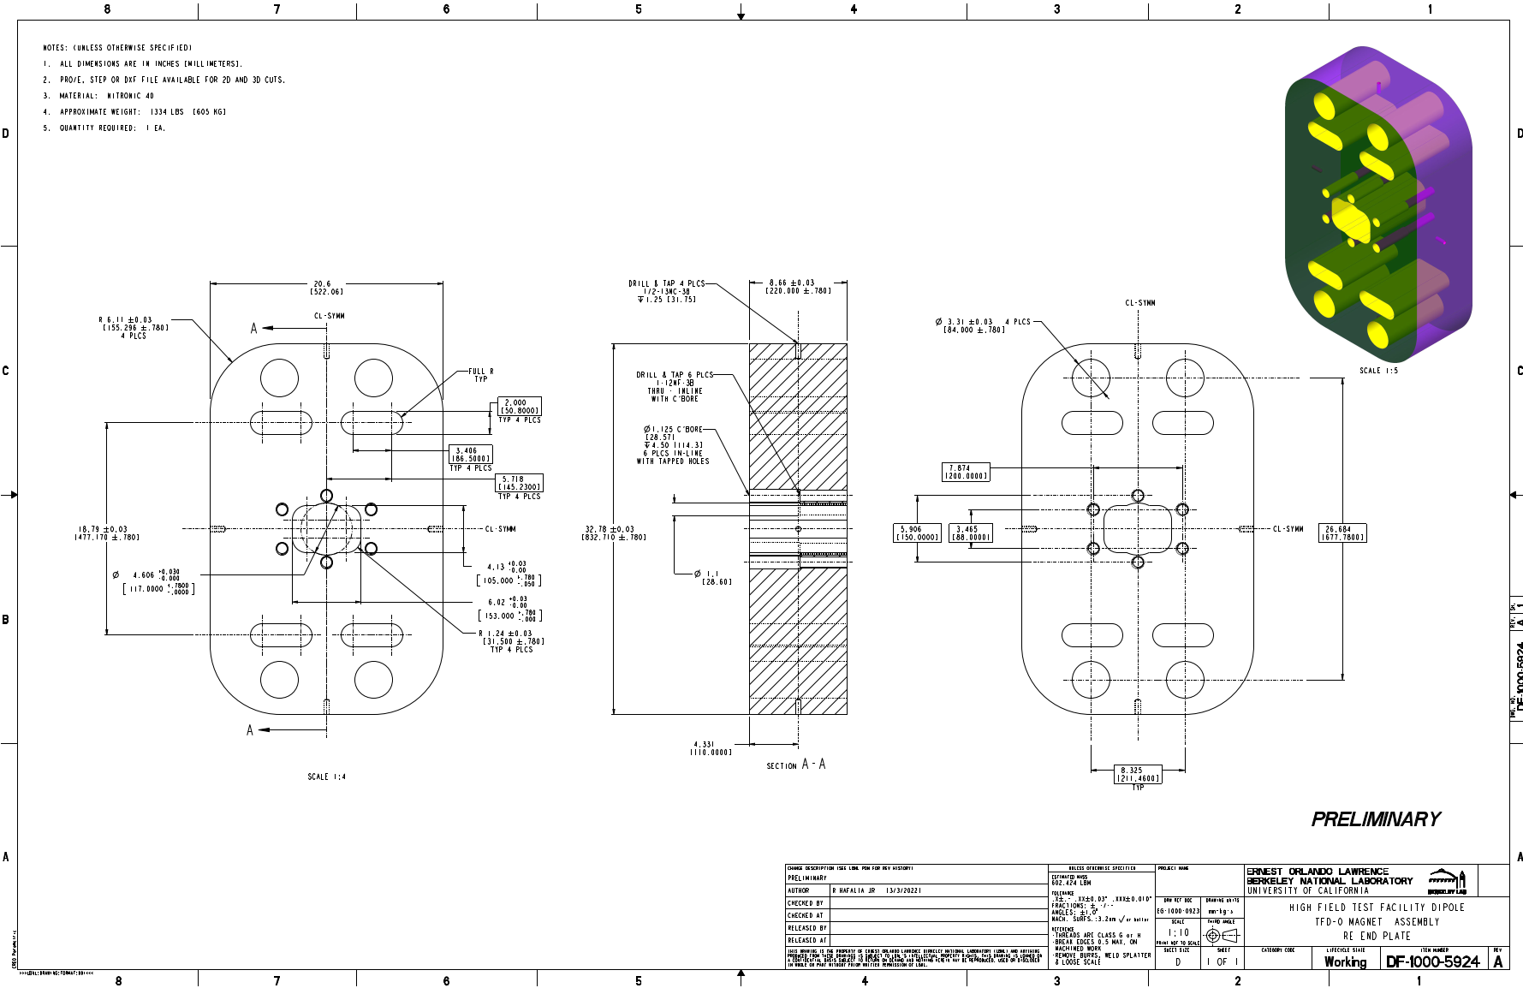
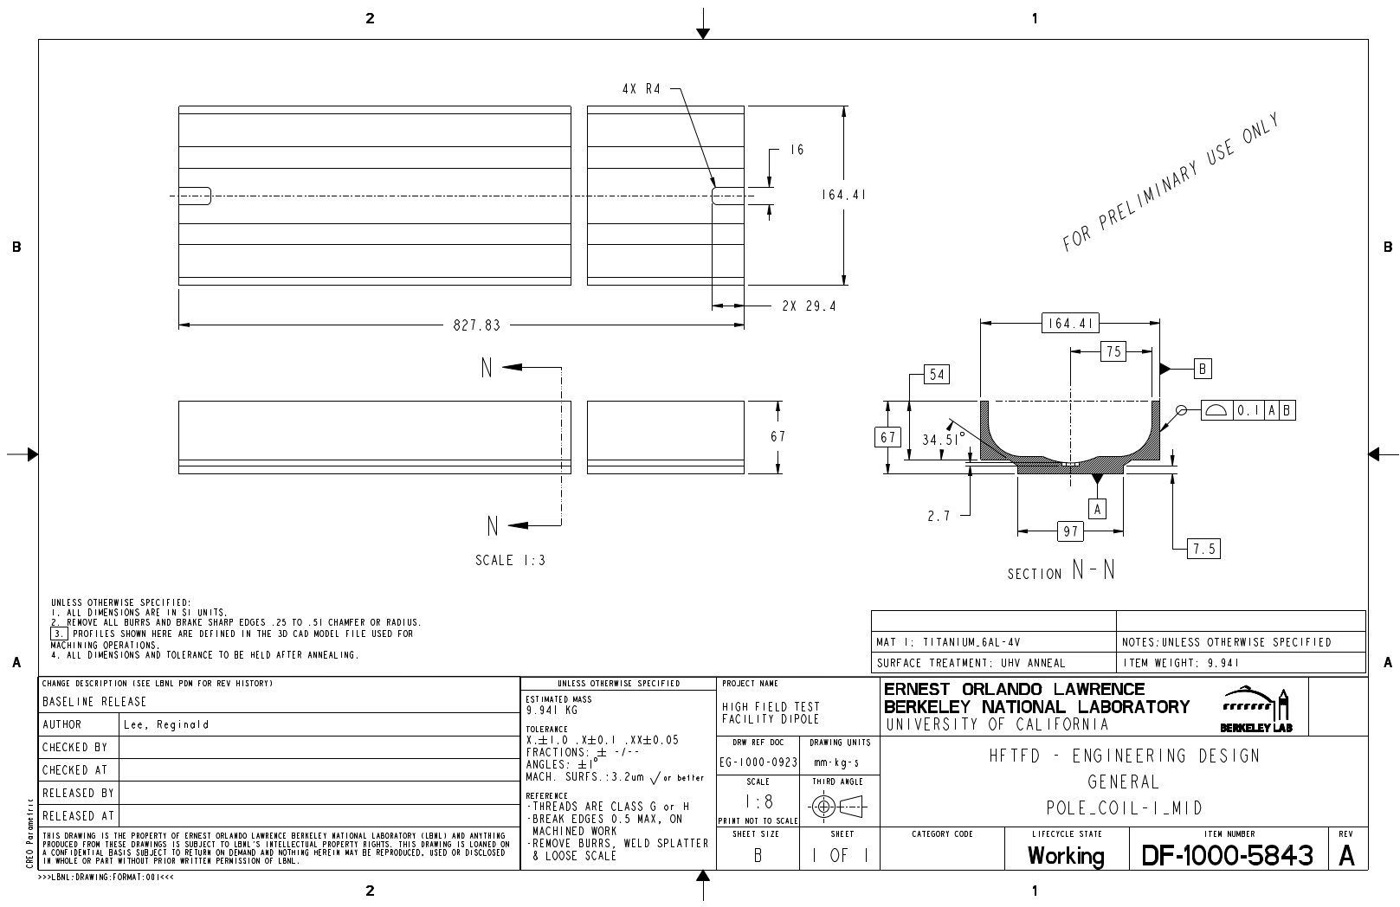
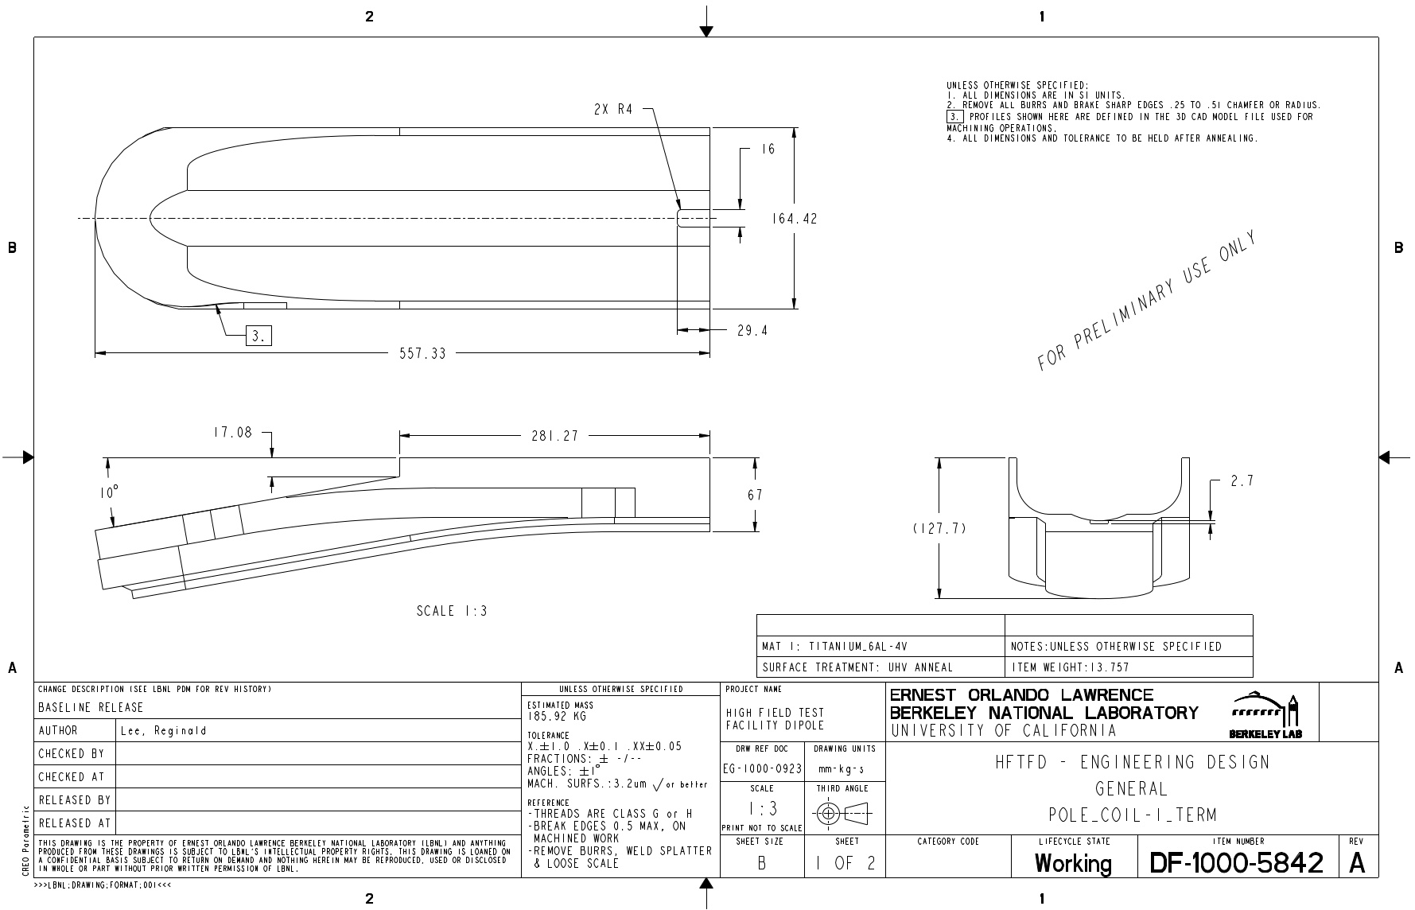
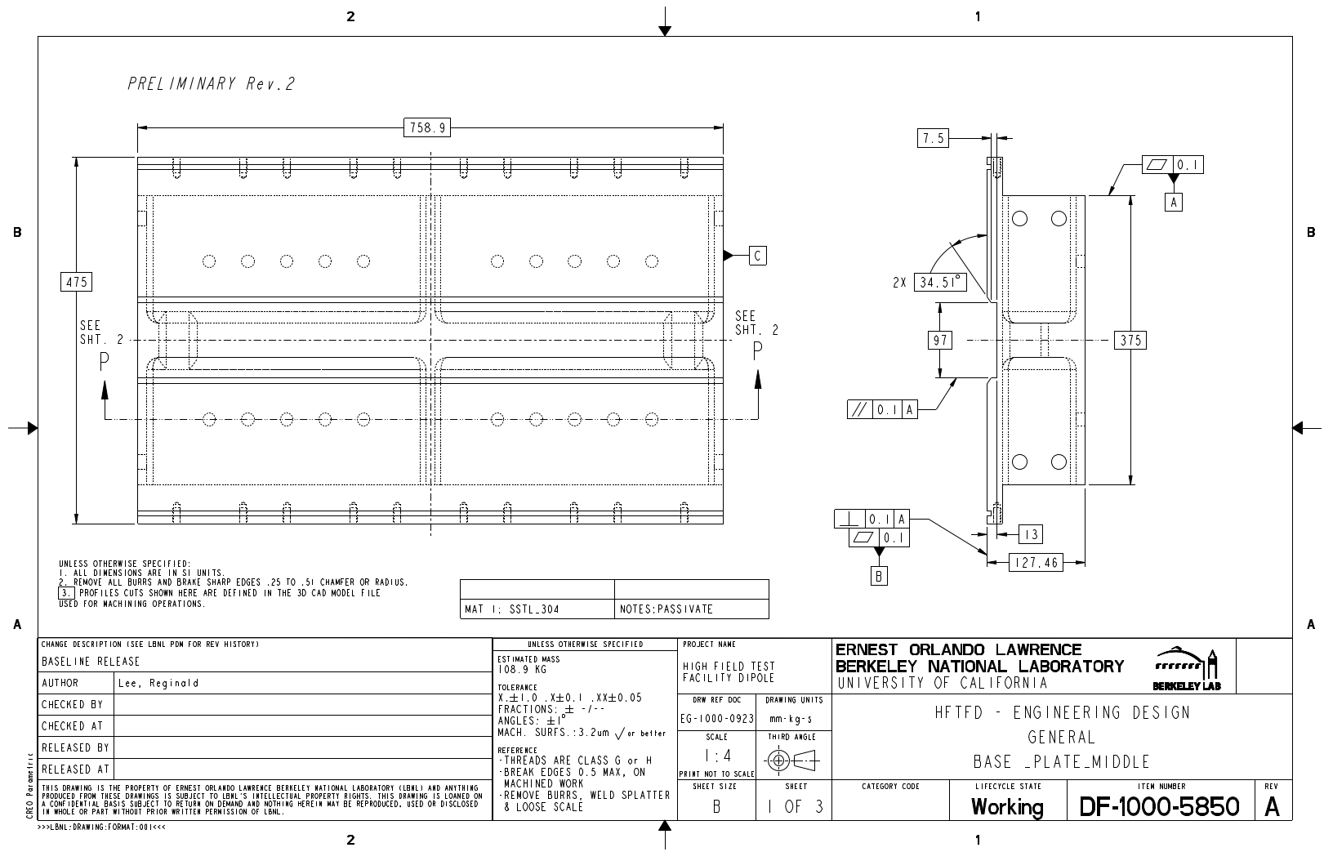
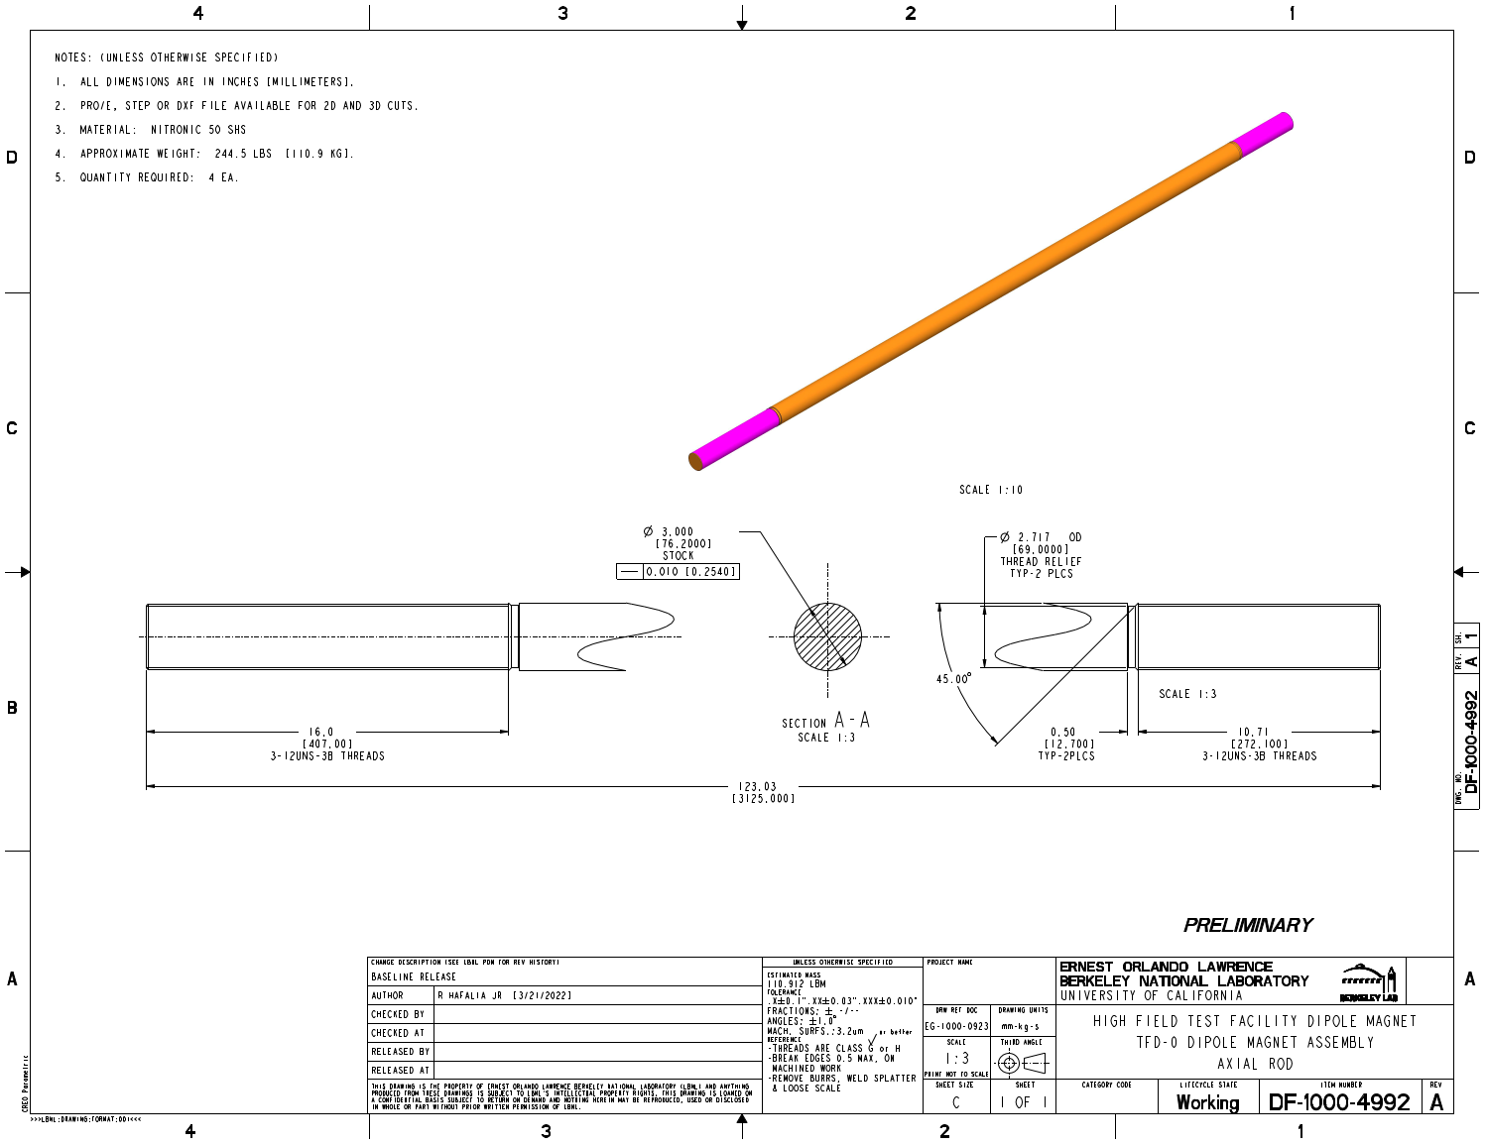
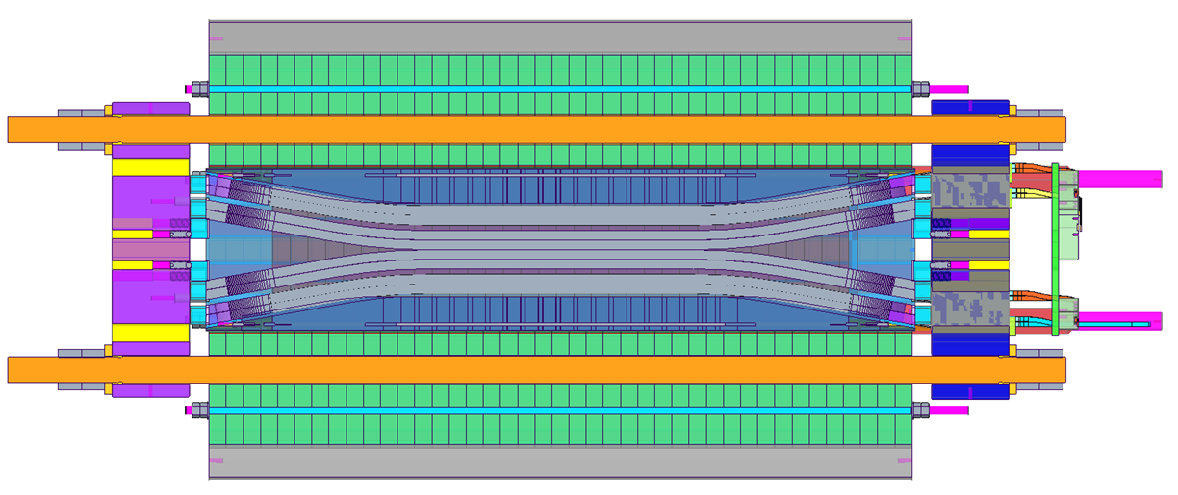
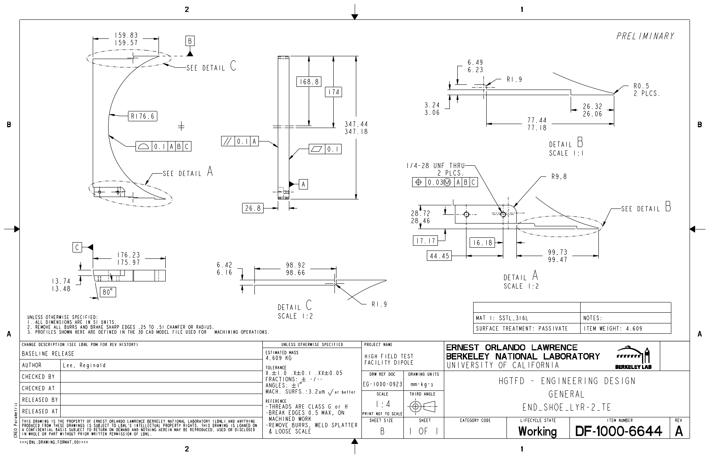
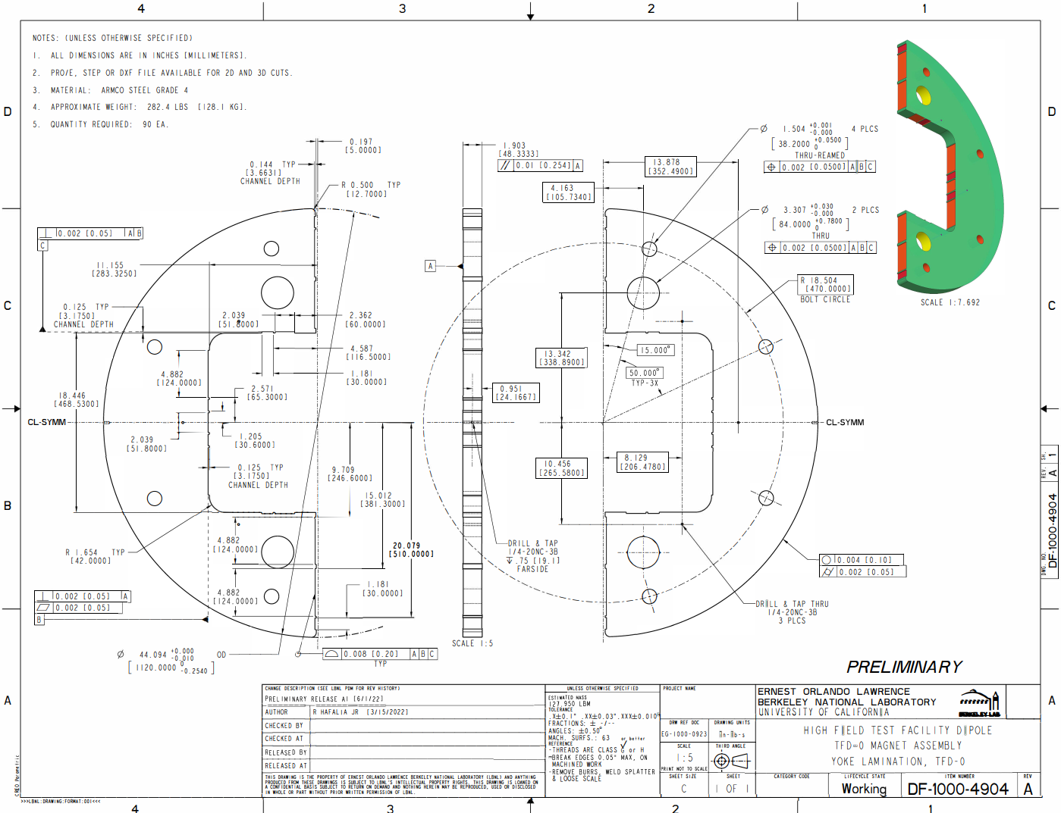
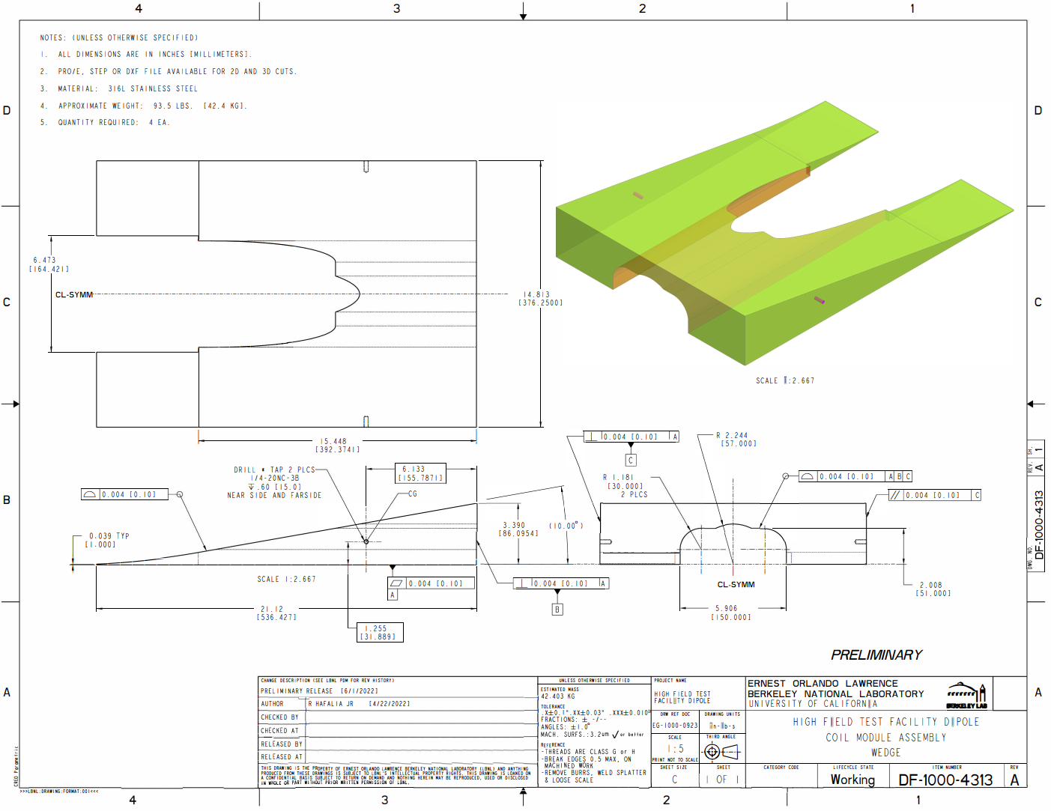
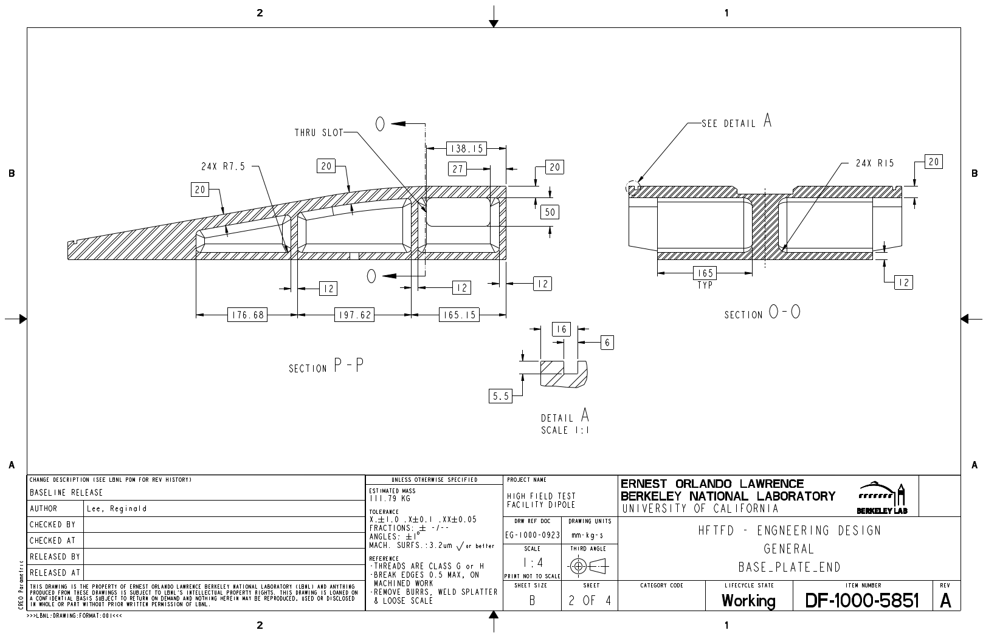
Preliminary drawings for vendor feedback
Al. Shell
End plate (lead end)
Winding pole (coil 1, middle)
Winding pole (coil 1, end)
Axial Rod
Base Plate (middle)
Coil end shoe
Iron yoke
Wedge
Base Plate (end)

Slide 21
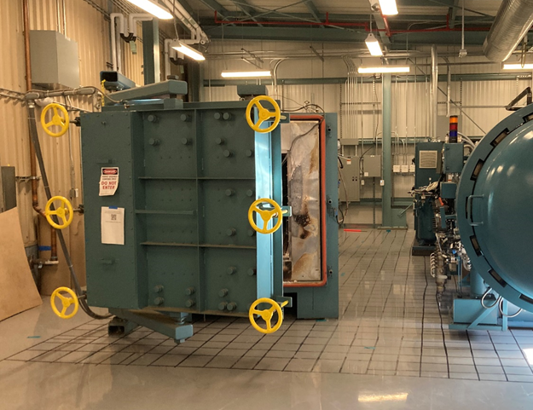
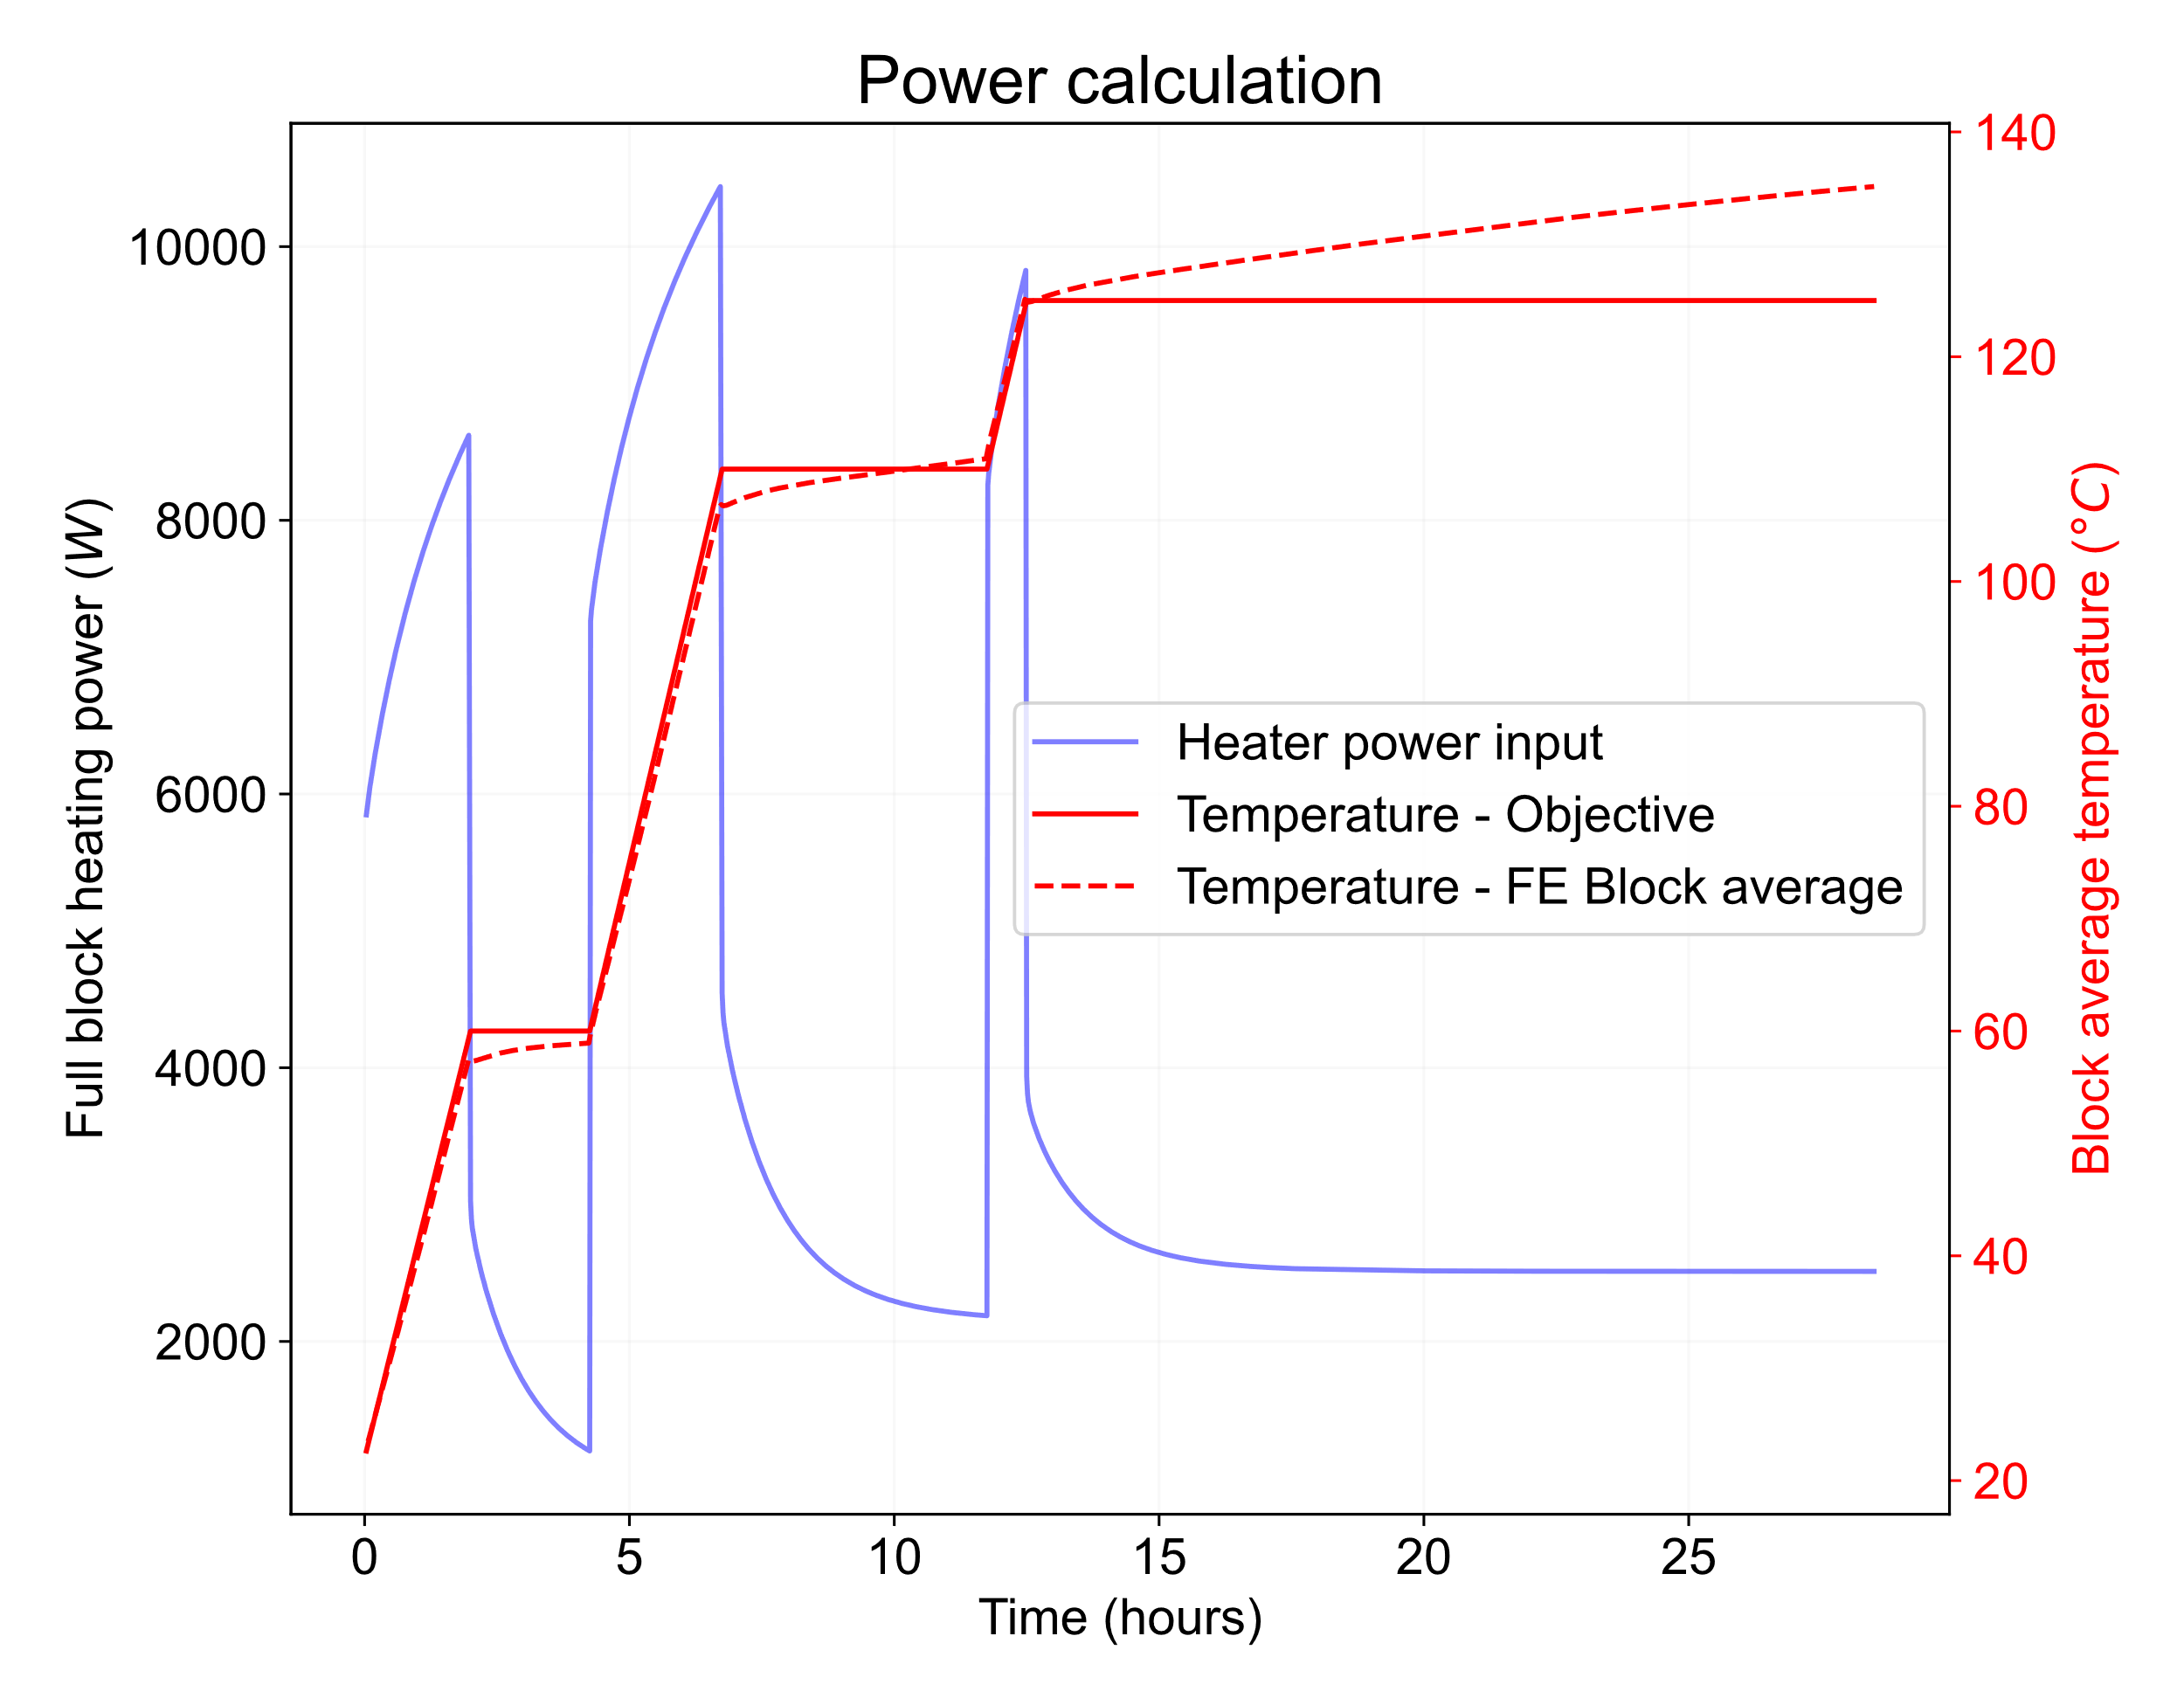
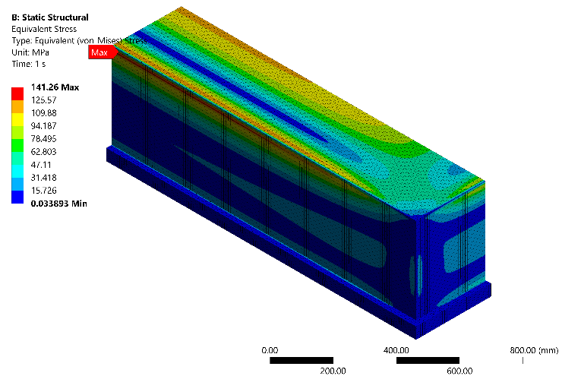
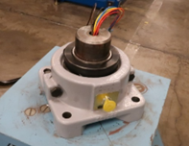
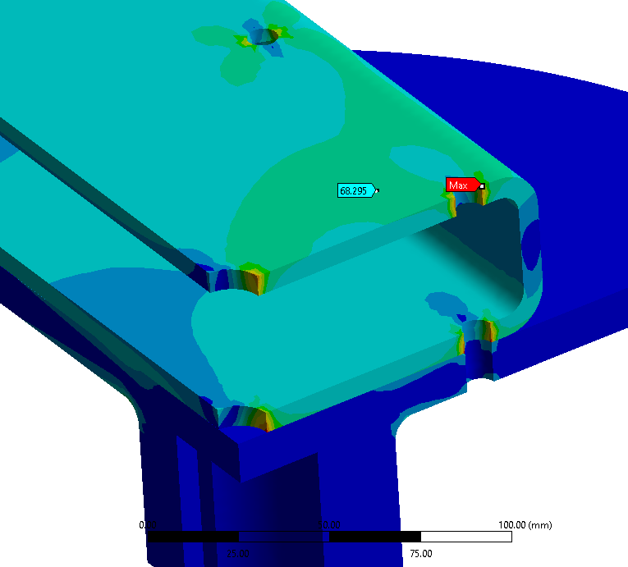
Fabrication infrastructure
Completed reaction furnace relocation to new building 77 addition
  Recommissioning tests planned for September.
The impregnation chamber has been moved to its new location in B77-103.
  Vacuum test completed, seismic anchoring in progress.
Winding table upgraded based on FE analysis for large TFD coils

Slide 22
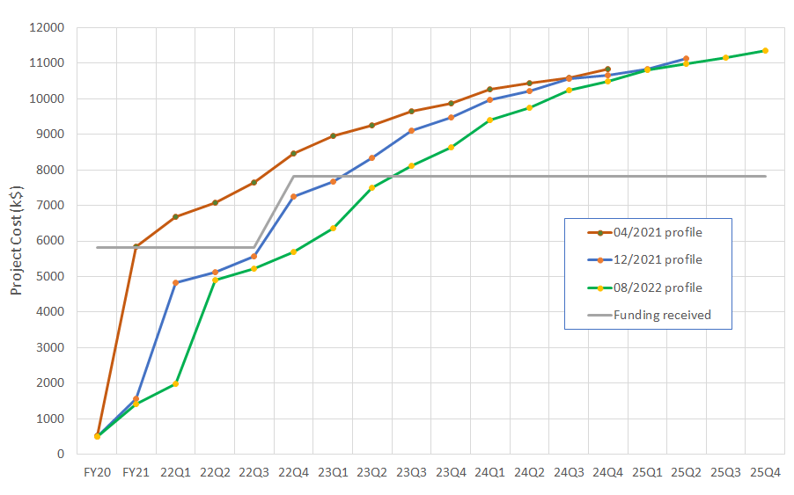
Funding Profile – IPT6
Next 3 quarters: 2.4 M$
M&S: 1.4 M$ (coil tooling/parts & structure)
Labor: 1M$ (prototype coil, production cables)

Slide 23
Design, Prototype Cable and Coil (IPT6)

Slide 24
Production Cables and Coils – IPT6

Slide 25
Structure, Assembly and Test – IPT6

