Slide 1
Summary from the users workshop
G.Velev

Slide 2
Introduction
November 21-22, we had a workshop with the FES user community.
In my opinion the workshop was very successful: 33 registered, ~ 40 people in one time during the meeting
The agenda included
  First day: Introduction to the test facility
  Second day: Input from the user community and discussion
  Link to the workshop: https://indico.fnal.gov/event/57027/
Next slides summarizes the requests from the community
After the workshop we had two meetings:
  First: FNAL team - internal to discuss the requests
  Second: join FNAL and LBNL teams
Next slides summarizes the requests (most of the inputs are from Zach Hartwig,
Nicolai Martovetsky talks and discussion) and output from internal meetings

Slide 3
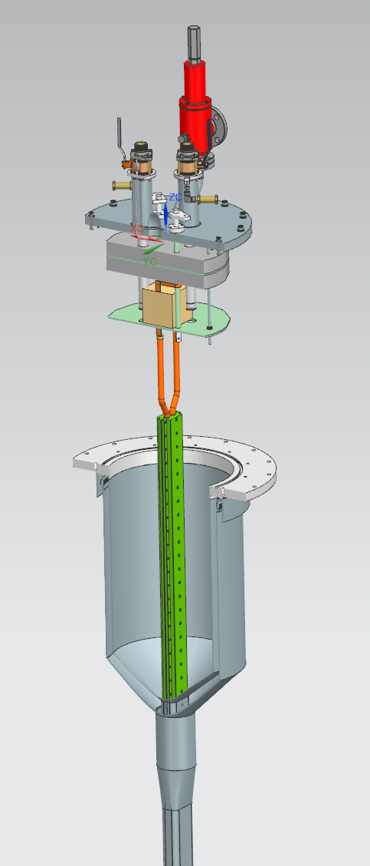
Introduction – cont.
Three type of recommendation/requests
  General facility capabilities
  Instrumentation and data acquisition
  User support and resources – to early to be discussed
We graded them by difficulties
Abbreviations:
  P - in the plan
  E – easy to implement
  M - moderate to implement
  D - difficult but not impossible
  VD – very difficult, maybe impossible with this facility
For recommendation/requests which can be implemented and not in the plan - needs discussion how to proceed
Anticryostat Top Plate
Sample Insert
Anticryostat

Slide 4
Recommendations: General facility capabilities
Cable current: 0 – 100 kA (SC) and 0 – 50 kA (DC)
  [E-M] SC transformer w/ sufficient volt-seconds to last 8 hours if secondary voltages achieved – 30 min continues operation, 8 h DC characterization, SULTAN: when SC transformer is drained takes 4-5 h to charge, to define to the user that if they come at 8 that they have 8 h useful time
  [M-D] DC power supply (up to 50 kA or more) for full quench evolution (dynamics, detection) - 50 kA - sinusoidal from 0 to 50 kA
  Fast SC/DC power supply to maximize IxB cycles per test session (1000’s cycles minimum)
  [P] Ability to reverse sample current for opposite IxB force direction - lifting force from the join, self field is in the different direction, forces, and this coming from misalignment.
Cable temperature: 4 – 50 K
  [M] Supercritical helium (not bath-cooled) with programmable mass flow rates
  [M] Flexibility in cryogenic routing (series vs. parallel in cables, top vs. bottom inlets, etc.) - how to connect the sample – using Tevatron pre-cooler, 2.5 g per second, 8g per leg
  [M-D] Mechanism to cycle sample 4-300-4 K rapidly (1-2 times a day?) for thermal testing - 4.5 K - 100ºK, SULTAN warm sample between Friday on Monday, heaters for sample maybe needed

Slide 5
Recommendations: General facility capabilities
[M] For REBCO cooling should be much stronger, because no or minimal neutron shielding is expected, 10 -15 g LHe flow
External field: 0 – 15 T
  [D] Ability to raise samples and place joints in-field for testing - sample moving – SULTAN has 4 extenders of lengths 40, 160, 330, and 670 mm. They can be stacked to yield various lengths; however, a total of 830 mm should not be exceeded – warming the sample is part of the process…
  [P] Ability to change fields rapidly during testing session to maximize test time – sufficient – to ramp the magnet with 20-30 A/S (max ~ 150 A/s)
  [D- VD] Fast ramp (1-2 T/s) for pulsed external field testing of joint and
  conductor stability (e.g. for Central Solenoids) is essential but not achievable in this facility - external applied field, not practical to be implemented in the current magnet design, this means an additional specialized magnet to be built and maybe with new high voltage power supplies.

Slide 6
Recommendations: General facility capabilities
Quench testing capabilities(High priority)
  [M-D] DC power supply capable of ~50 kA -> full evolution of quench - can we use the 30 kA? 50 kA to have? SULTAN have 15kA. This is needed to study current dependence during the quench. 50 kA leads?
  [M-need more investigation] Different quench methods (sample warm-up, AC loss induction, surface heaters)
  [E-M] Quench instrumentation (next slide); helium instrumentation
[D- VD] AC loss testing capability (High Priority) - not practical to do so
  Frequencies for fusion are ~1 HZ but other fields may benefit from up to 200 Hz - +/- 0.4 T not AC loss, not give you full penetration in the stack , 20V 0.15H 150 A/s
  Implement fast-ramp power supply for cable current? Possible to implement oscillating external B-field?

Slide 7
Recommendations: General facility capabilities
Users will want flexibility to perform Ic (e.g. I vs. V) and Tc (e.g. T vs. V) characterizations
  [M] Excellent control of helium needed (including heaters on inlets): T stability for Ic measurements, at 4 K ~ 10 bar, Tevatron pre-cooler, 2.5 g per second, 8g per leg
[E-M] Flexibility for user-designed cable assemblies
  Clever design of assembly can multiply facility utility (e.g. VIPER cable test at SULTAN)
  External magnet and test well must be sufficiently large and flexible to accommodate - Same as EDIPO
[P] Option to facility-provided sample assemblies
  Not all users may have resources/expertise to design and build assemblies
  FNAL could consider providing “standard assemblies” to users to decrease barrier-to-test - the envision is to have set of assemblies

Slide 8
Recommendations: Instrumentation and data acquisition
[E-M] Provide a standard “base” instrumentation layout for all tests
  [E] User samples: Voltage taps (high-field, joints), Cernoxes, etc.
  [E] Facility: Voltages (e.g. sample-facility joints), Cryogenics (p,m-dot, etc), B-field, etc.
Flexibility to accommodate user-requested/supplied instrumentation
  [E-M] - depends on the number] Additional voltage taps and Cernoxes specific to user sample
  [M] Surface heaters (with larger gauge wires and in-house power supplies)
  [E] Strain gauges (w/ 3 or 5 wire cable runs), acoustic sensors, fiber optics, hall probes, etc.
  [E-M] Sample cryogenic measurements (pressure, mass flow, etc.)
  [P] Ensure clear instrumentation wire/cable routing from sample to 300 K feedthroughs
  [P- E] Ensure standard feedthroughs (e.g. D-sub) for all facility and user instrumentation
  [P- E] Ensure sufficient spare feedthroughs/flanges beyond “base” instrumentation
  [P- E] Ensure sufficient spare low- (~0.1Hz) and high-rate channels (~100 Hz) in DAQ
  [E-M] Ensure users can bring their own I&C systems for specialized testing needs
  [E-M] Ensure user I&C can tie into facility I&C (esp. timing/synchronization signals)
INTERNAL

Slide 9
Recommendations: User support and resources – too early to be discussed
Maintain a comprehensive, up-to-date facility manual with all necessary specifications (geometry, interfaces, operational parameters, instrumentation, etc.) for facility users
Generate a post-test summary report (including sample and facility data) and basic set of analyses on sample performance from FNAL to users
Ensure it is straightforward to obtain FNAL-User agreements. Protection of user data and IP-sensitive science and engineering aspects likely critical for privately-funded users.
The following should be provided to maximize user experience and test benefit:
  A clear costing structure for testing + additional labor from FNAL at user’s request (and ensure it is
  competitive with SPC EDIPO-II/SULTAN!)
  A clear scheduling system based on samples delivered at some threshold of readiness
  Detailed shipping/receiving instructions (esp. for international users)
  Access to expert FNAL technicians for sample preparation and installation
  A secure workshop area where users can prepare their own sample (w/ FNAL technicians if needed)
  Dedicated area for users in facility control room (observe/guide test program, analyze data in real time)

Slide 10
Summary
We got the requests (“wish list”) from the potential users.
Not everything can be done - users asked for test facility that can do everything
We concentrating on:
  the supercritical helium cooling with programmable mass flow rates
  progressing on the design of the transformer
  design of the sample holder.
Other request are in process –
  like raise samples and place joints in-field
  Using the 30kA existing PS to power the samples directly
None of these were initially costed especially the supercritical helium cooling.

