Slide 1




ALICE-USA Computing Project
Status and Plan
ALICE-USA Grid Operations Review Meeting @ LBNL
May 15, 2022
Irakli Chakaberia

Slide 2
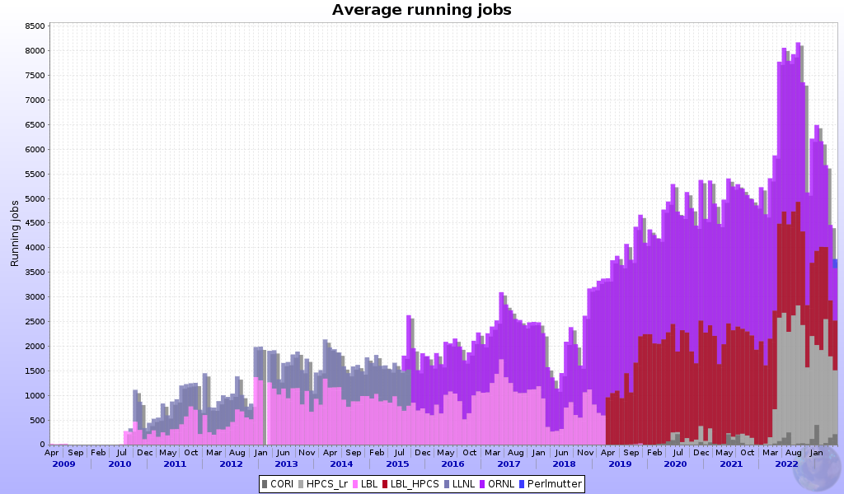
Brief History
Original Project Proposal - 2009
In operational since 2010
3-Year Project Review Cycle
  Initial plan requested in 2014
  Latest review in July 2021
Project Execution & Acquisition Plan (PEAP)
  Multi-year plan containing resource delivery, milestones, budget estimates, operations guide
  updated annually & submitted to DOE
  Latest one submitted in October 2023
ALICE-USA Computing Website: https://sites.google.com/lbl.gov/alice-usa-computing/meetings?authuser=1
Perlmutter
Lawrencium
NERSC-Cori
ORNL
LNLL
HPCS
PDSF

Slide 3










US Department of Energy Supported ALICE-USA Group
The project’s main goal is to fulfills DOE funded MoU-based ALICE USA obligations for
  11 Institutions
  46 M&OA
Operates ALICE grid facilities at 2 DOE labs
ALICE-USA Computing core group meets monthly, every third Tuesday of the Month
We keep very close contact on our SLACK channel
We try to hold two annual ALICE-USA Computing meetings
  Spring meeting at LBL
  Fall meeting at ORNL

Slide 4
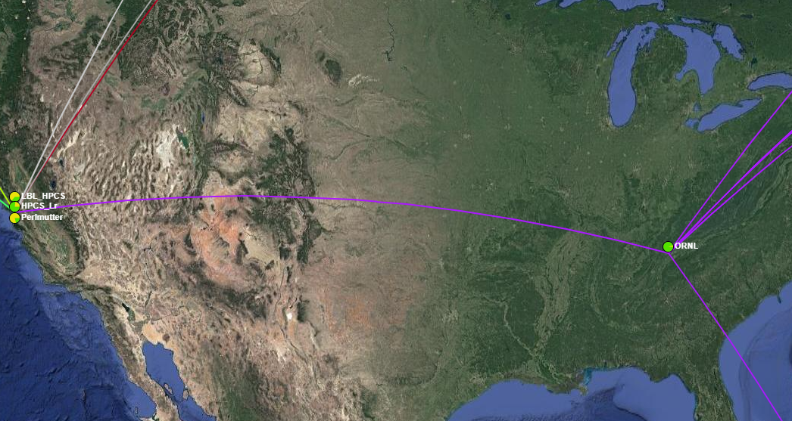
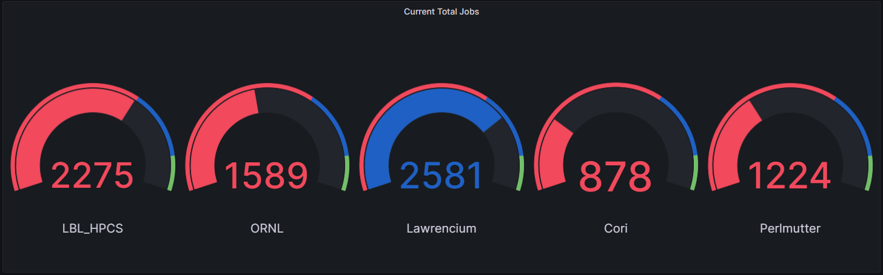

ALICE-USA T2 Sites
Project currently operates two sites at ORNL and LBNL

Slide 5
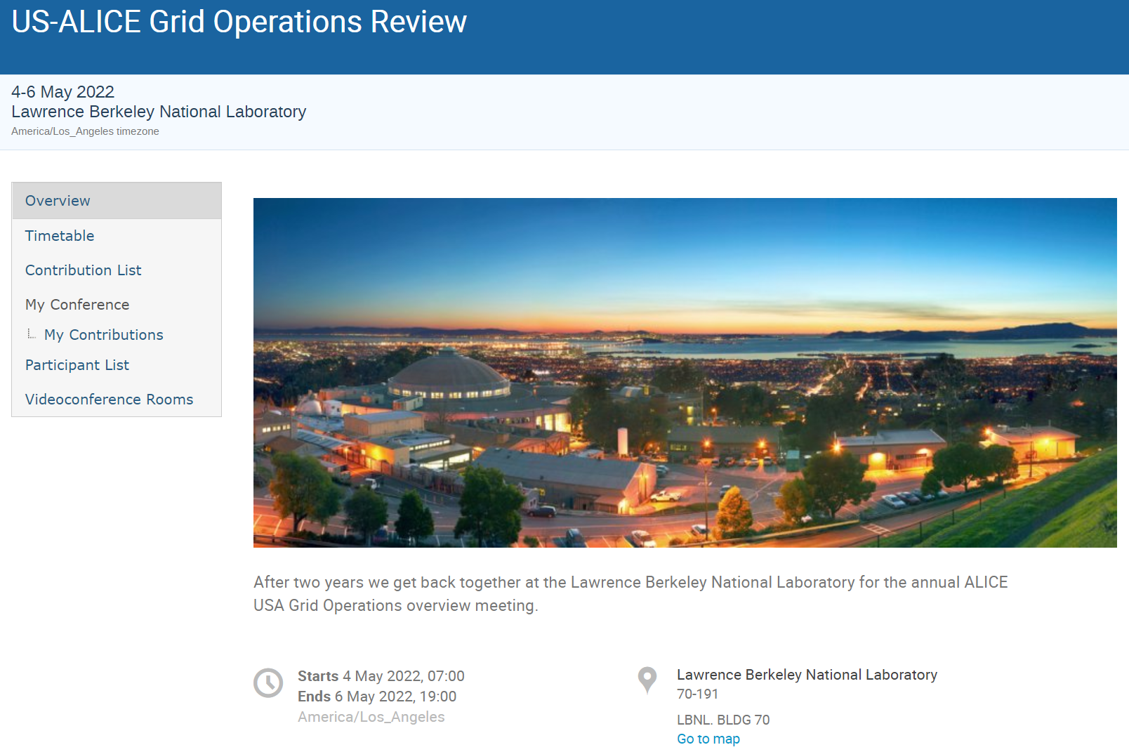
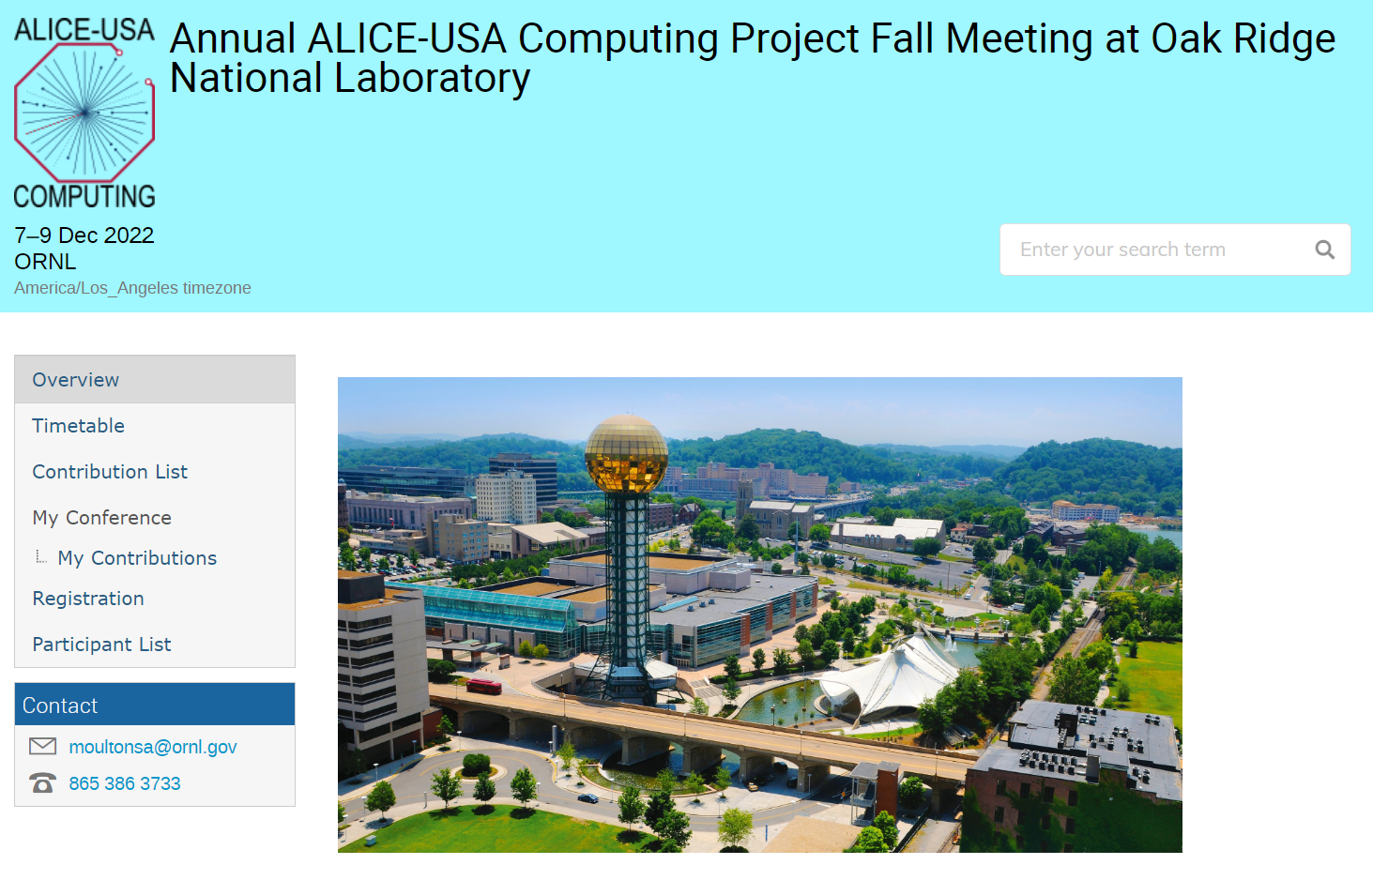
US-ALICE Review Meetings
US Grid Operations review in May 2022
ALICE-USA Computing Meeting at ORNL in December 2022

Slide 6
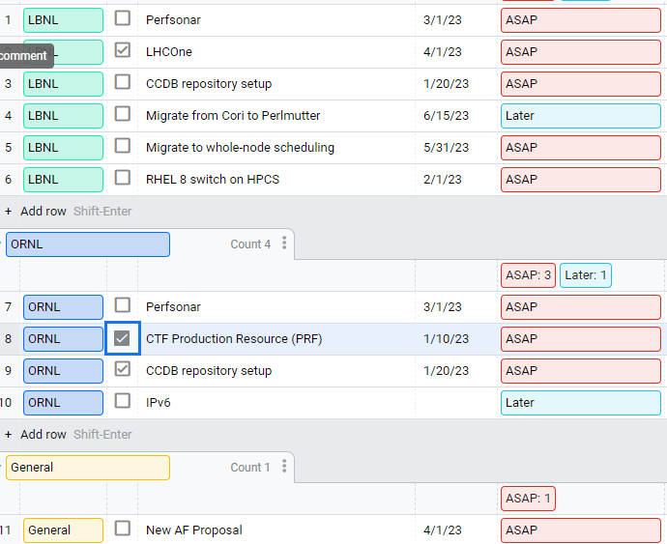
Task Tracking
After last meeting at ORNL we identified additional tasks not outlined in the key deliverables in PEAP
We set up a task tracking for the group
Some tasks are completed
  LBL SE is on LHCOne
  ORNL added two EOS instances
  Migration to Perlmutter can be considered a success

Slide 7
Status of operations | RRB 2022

Slide 8
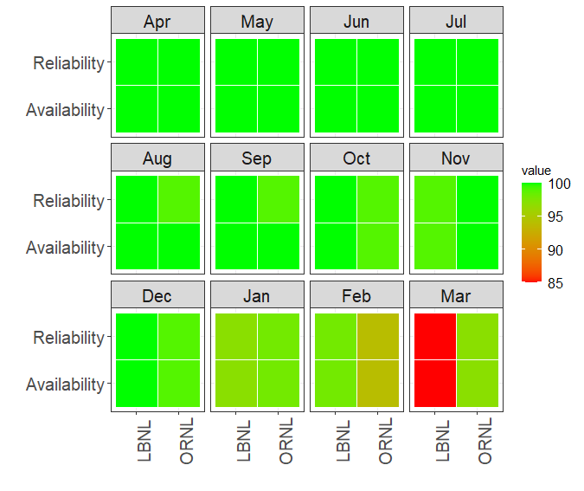
WLCG Summary
Target Availability for each site is 97.0%.
Availability Algorithm:
@ALICE_CE * @ALICE_VOBOX * all AliEn-SE
Since April 2022 we have reported only 24 hours downtime for the LBL_HPCS (and Lawrencium) site [in October].
LBNL had some challenges in March
RRB 2022 Numbers

Slide 9
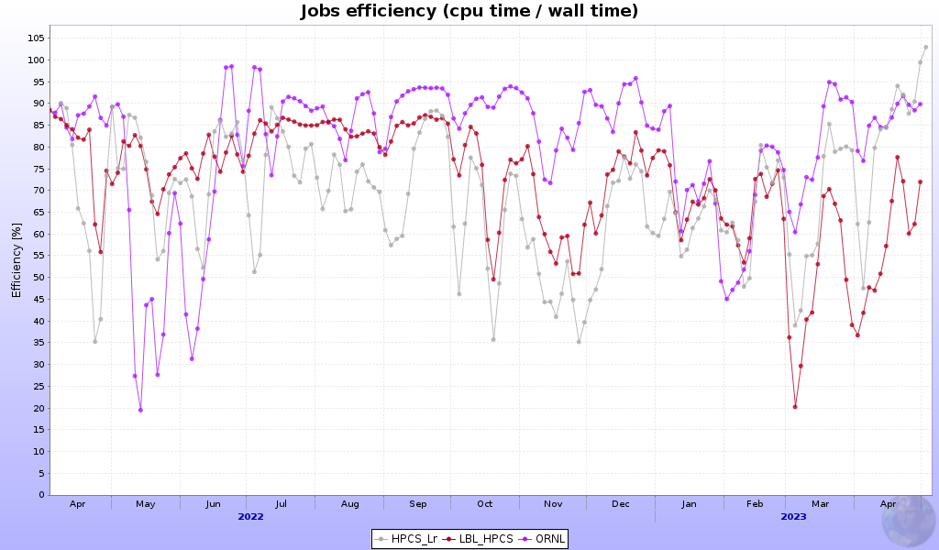
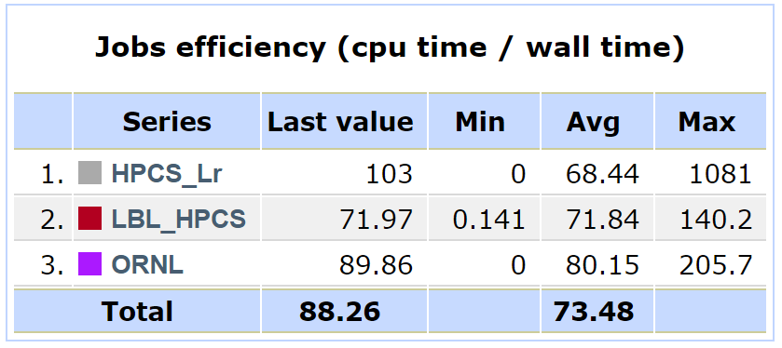
MonAlisa Summary | RRB 2022
Average job CPU efficiency over this period is shown in the table
JobMix defines the average CPU efficiency delivered
Adding more nodes to Lr
ORNL Switched to
whole-node scheduling

Slide 10
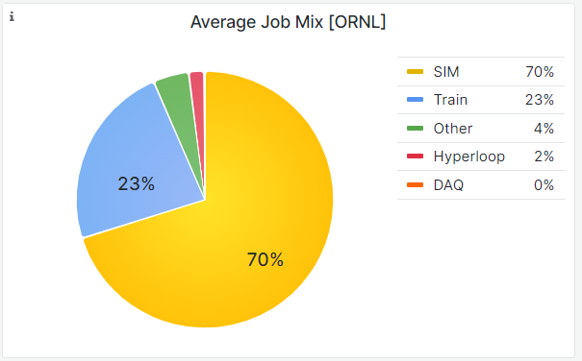
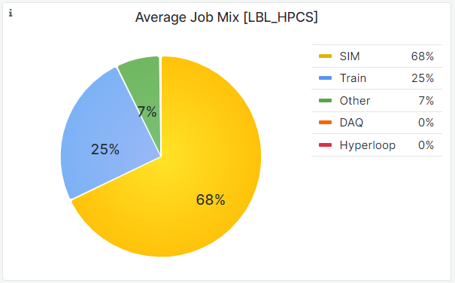
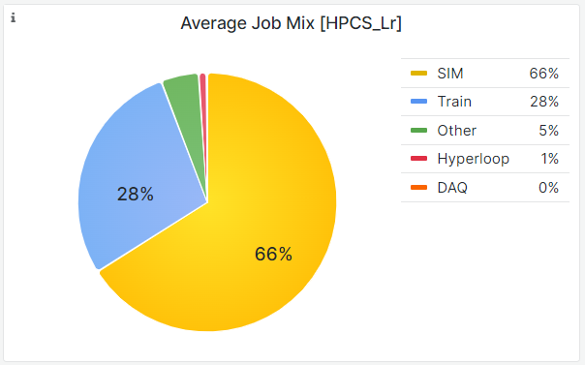
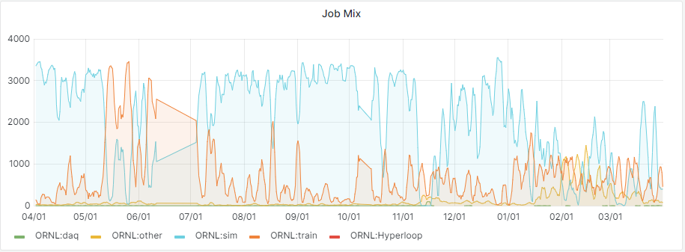
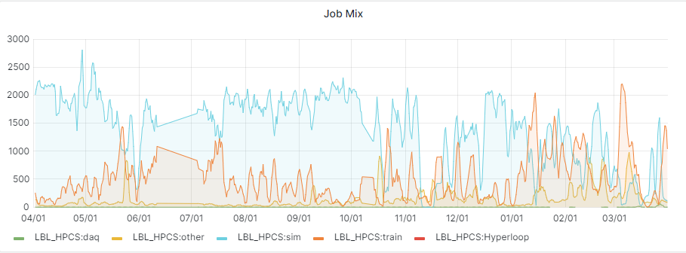
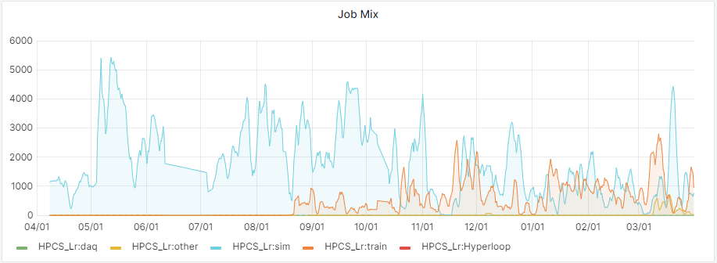
Job Mix
We only recently separated “Hyperloop”, so part of it is in “Other”

Slide 11
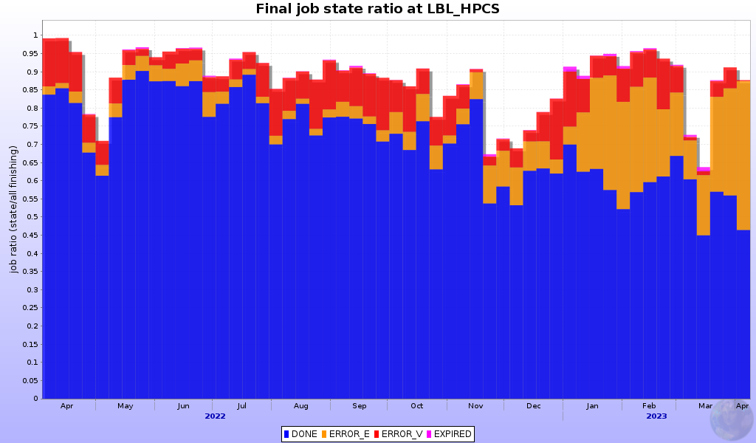
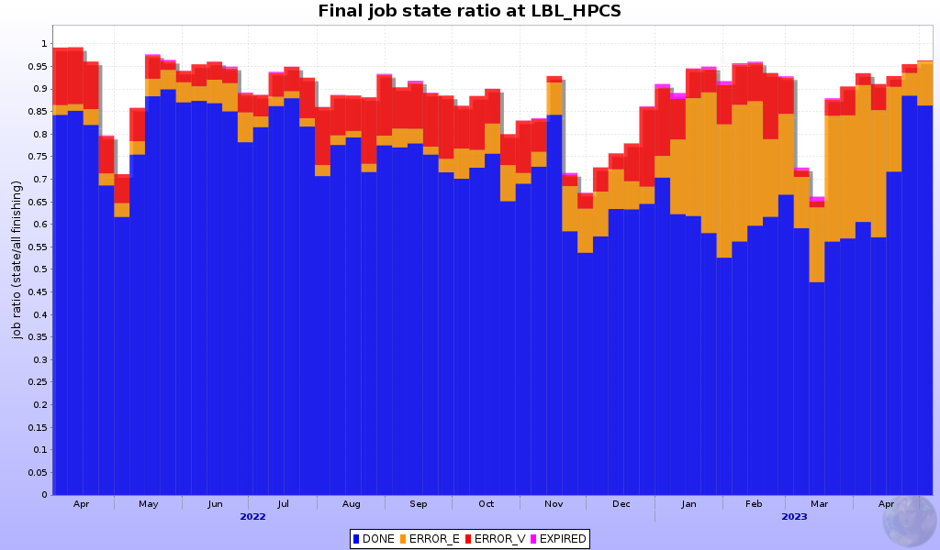
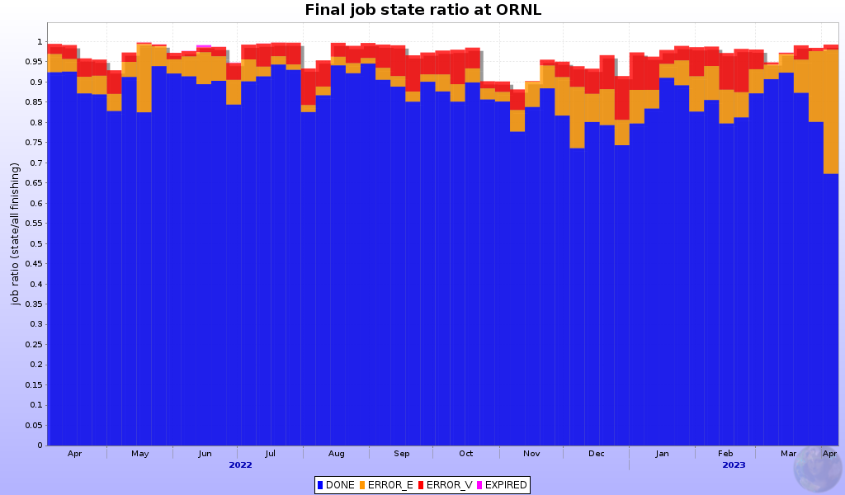
Some of the issues
This year we had increase in ERROR_E type of failures
We have seen CVMFS failures at LBL
Strangely only ALICE mount would fail
Currently we have a cron job in place that remounts CVMFS
And we had an EOS meltdown
Combination of these two caused problems on both LBL_HPCS and Lr clusters
Fortunately, the issue was resolved

Slide 12
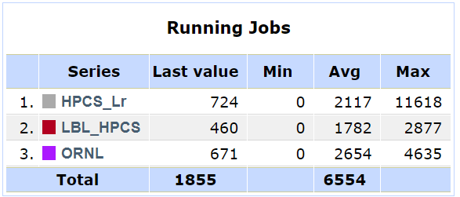
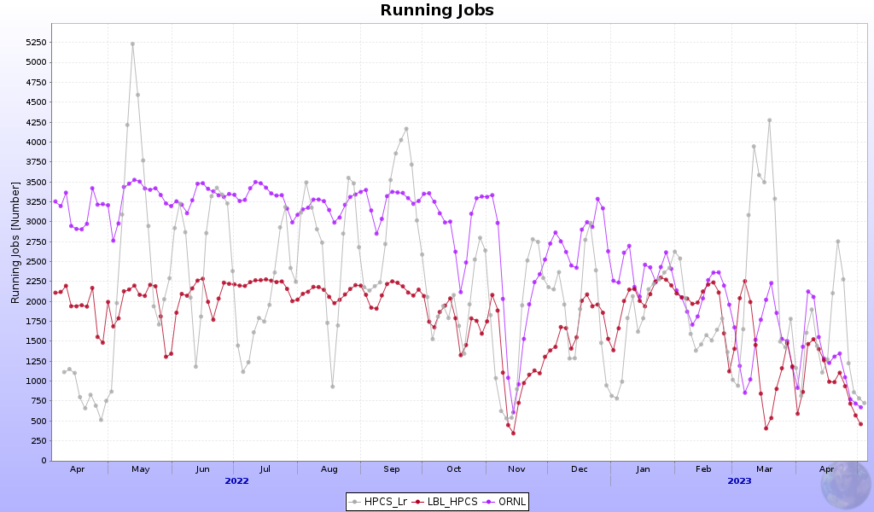
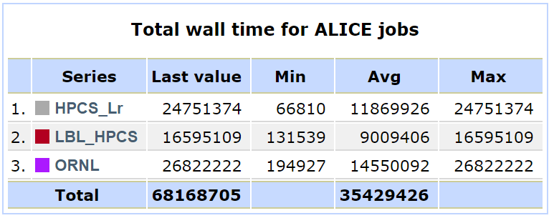
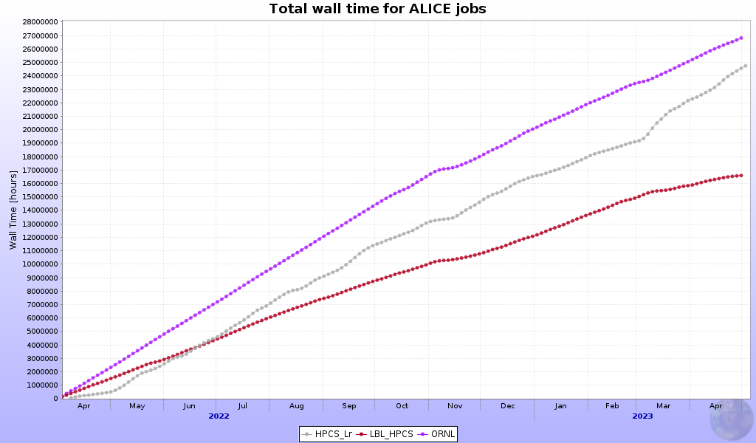
CPU Performance | RRB 2022
Slightly under pledges
Lawrencium fills the gap
Almost no downtime
ORNL whole-node
scheduling
Adding nodes to Lr
ORNL Pledge
LBNL Pledge

Slide 13
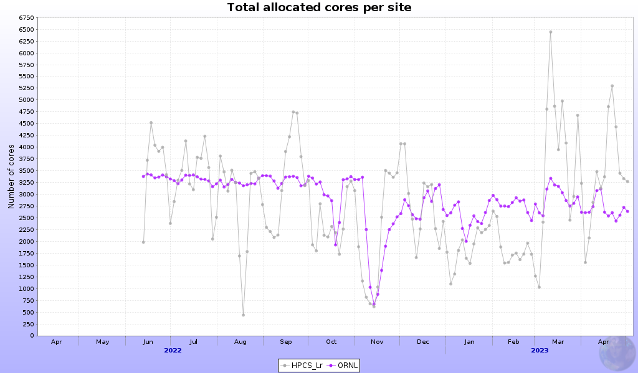
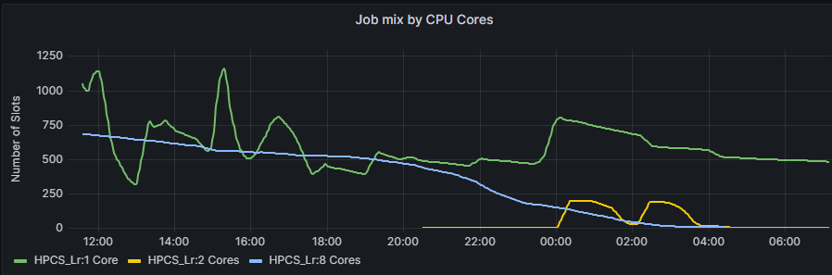
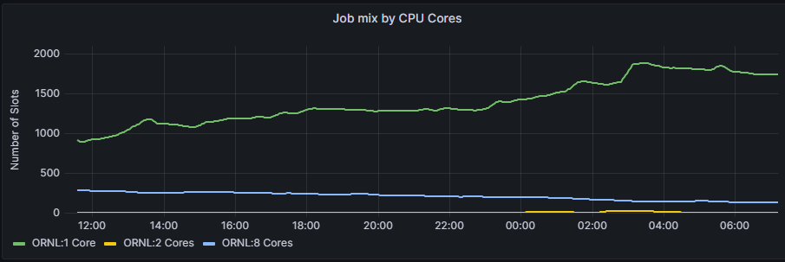
Multi-core jobs
ORNL and Lr run whole-node, hence central services schedule mix of multi-core and single-core jobs

Slide 14
2022 RRB CPU Delivery vs. Obligations
Due to some budget uncertainties the FY2021-2022 hardware acquisition was postponed
  LBNL CPU is awaiting deployment
  LBNL storage is being procured
  ORNL CPU is racked and nearly ready to be used
  ORNL storage is deployed
This causes slight under delivery for the ALICE-USA sites starting RRB2022
Lawrencium puts us over the pledge
Below are the number for the RRB 2022
CPU Obligations | kHS06
ALICE-USA | 82
LBNL HPCS T2 | 41
ORNL T2 | 41
US Resources | CPU/Core [HS06/Core] | ALICE-USA Obligation [MHS06 x hr] | CPU Delivered [MHS06 x hr] (ML reporter) | Delivered per Obligation [%] (ML reported)
HPCS_Lr | 12.0 | 359.16 | 268.78 | 74.8
LBNL | 16.7 |  | 266.04 | 74.1
ORNL | 11.5 | 359.16 | 291.04 | 81.0
Total |  | 718.32 | 825.87 | 114.97%

Slide 15
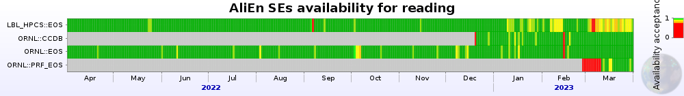
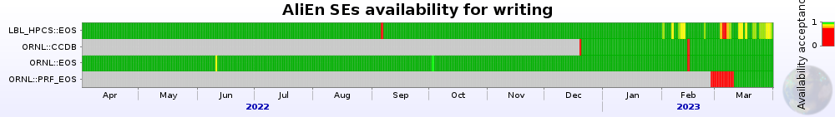
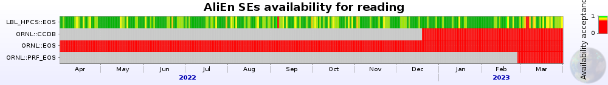
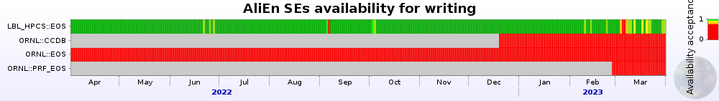
Storage Performance | RRB 2022
IPv4/IPv6
SE availability – nearly perfect
  With a caveat in March
IPv6 has been up at LBNL since early RRB2021
IPv6 at ORNL is still looming on a horizon
IPv6 Only
 | READ | WRITE
LBNL | 98.1 | 98.8
ORNL | 98.6 | 99.8

Slide 16
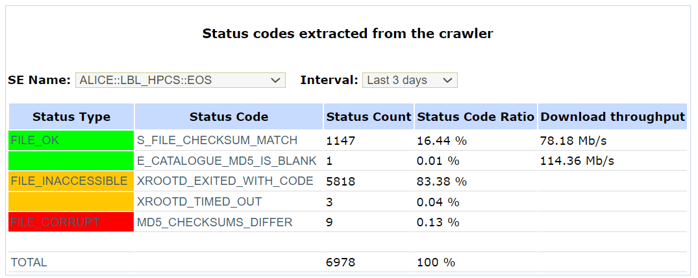
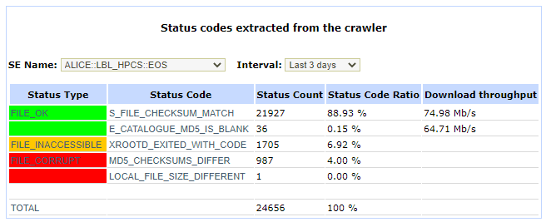
EOS Issues at LBL
Sometime this year problems with EOS started to trickle in
We have seen high numbers of corrupted/inaccessible files at EOS and discussed/debugged it during the last meeting at ORNL
The problem got worse sometime in February-March with successful checksum rates falling to 16%
Many jobs were failing, and John got deep into debugging the issues
Fixing EOS also fixed the problem with files

Slide 17
Project Execution and Acquisition Plan 2023

Slide 18
ALICE-USA Obligations and Acquisition Strategy
ALICE-USA collaboration share of resources in respect to WLCG / C-RCG recommendations for the next few years and planned hardware acquisition strategy table
Year | FY2021 | FY2022 | FY2023 | FY2024 | FY2025
ALICE Requirements
CPU (kHS06) | 852 | 1013 | 1164 | 1338 | 1579
Disk (PB) | 91 | 104 | 121 | 138 | 163
ALICE-USA Participation
ALICE M&O-A | 561 | 571 | 566 | 566 | 566
ALICE-USA M&O-A | 46 | 46 | 46 | 46 | 46
ALICE-USA/ALICE (%) | 8.20% | 8.06% | 8.13% | 8.13% | 8.13%
ALICE-USA Obligations
CPU (kHS06) | 69.9 | 81.6 | 94.6 | 108.7 | 128.3
Disk (PB) | 7.5 | 8.4 | 9.8 | 11.2 | 13.2
Resource | Installed | FY2022 |  | FY2023 |  | FY2024 |  | FY2025
LBNL HW & Costs
CPU change (+/- kHS06) |  | -2.0 | +10.0 | -7.0 | +11.0 | -3.0 | +10.0 | 0.0 | +10.0
CPU Installed (kHS06) | 35 | 43 |  | 47 |  | 54 |  | 64
Disk change (+/- PB) |  | 0.0 | +2.0 | 0.0 | +0.0 | -1.6 | +2.1 | 0.0 | +0.9
Disk installed (PB) | 2.75 | 4.75 |  | 4.75 |  | 5.25 |  | 6.15
ORNL HW & Costs
CPU change (+/- kHS06) |  | -10.0 | +16.0 | -11.0 | +17.0 | 0.0 | +7.0 | 0.0 | +10.0
CPU Installed (kHS06) | 35 | 41 |  | 47 |  | 54 |  | 64
Disk change (+/- PB) |  | -2.75 | +3.0 | 0.0 | +2.0 | 0.0 | +1.2 | 0.0 | +0.9
Disk installed (PB) | 2.75 | 3.00 |  | 5.00 |  | 6.20 |  | 7.10

Slide 19
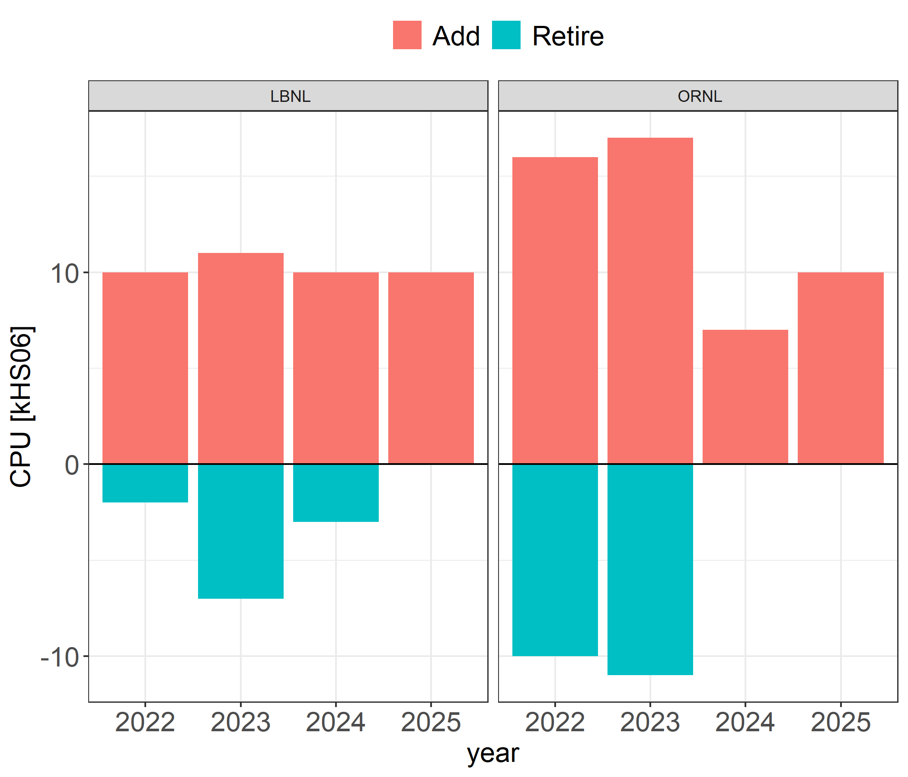
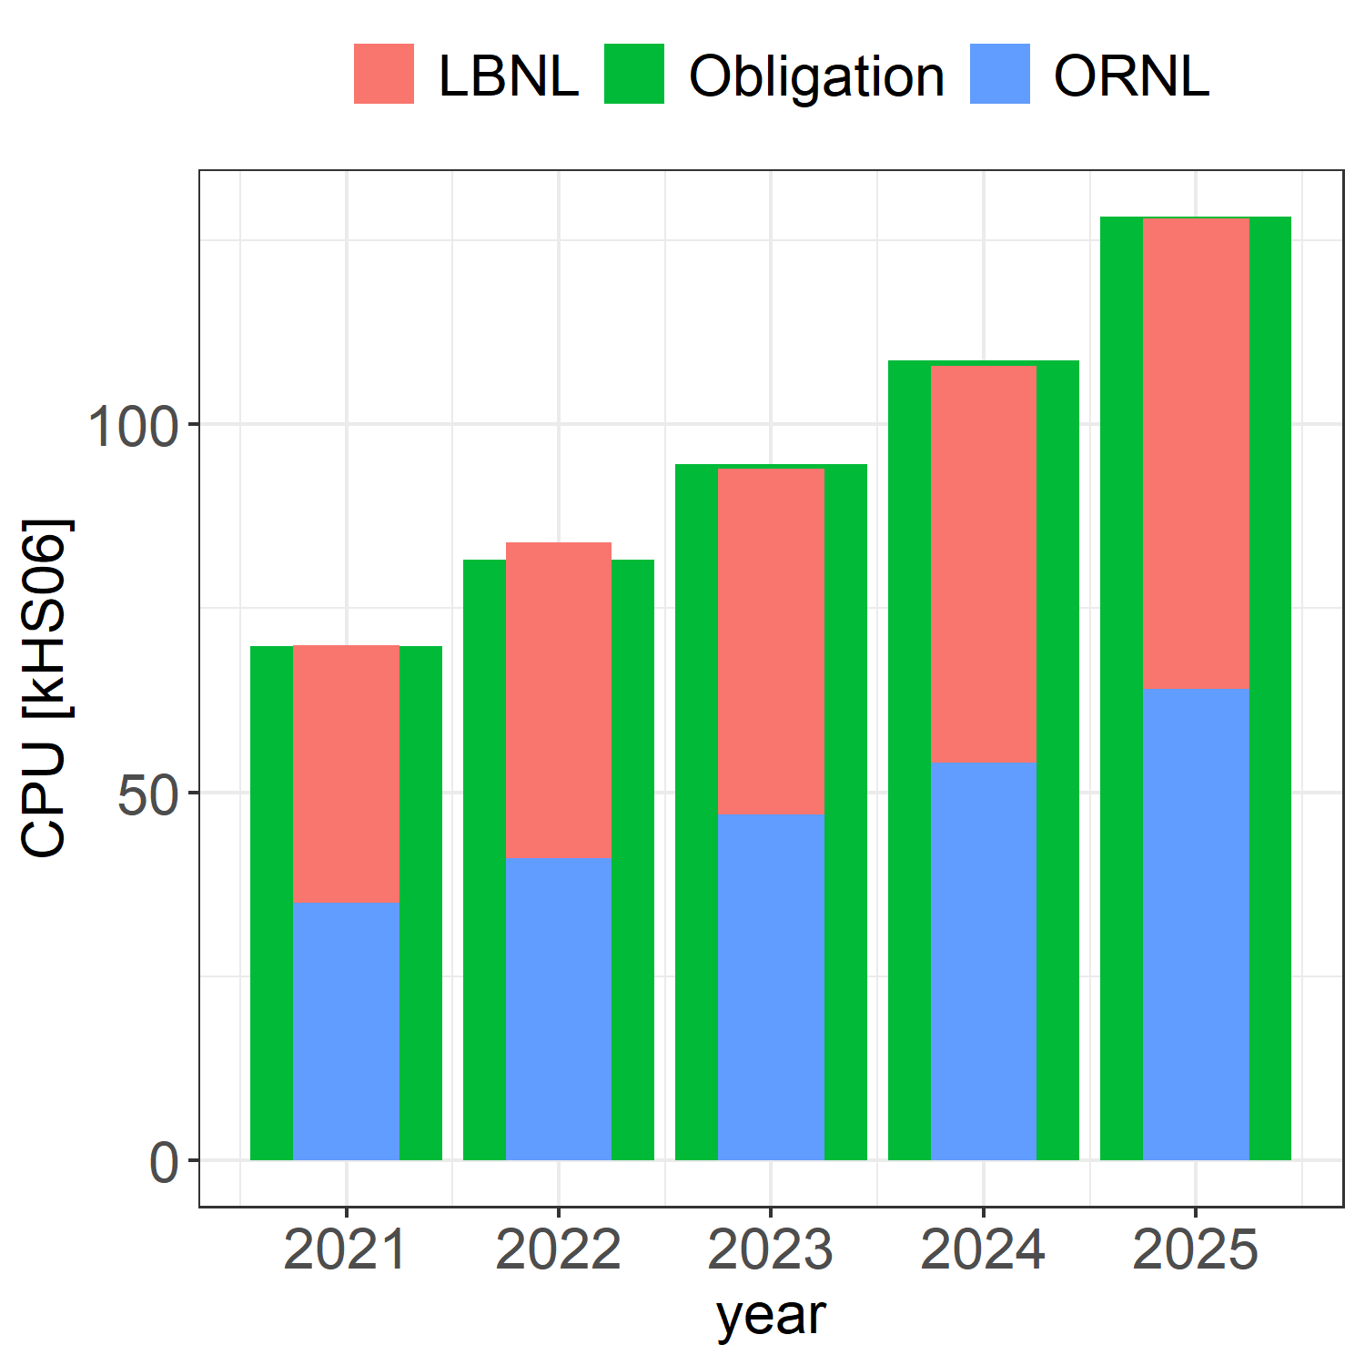
CPU Acquisition
We are gradually retiring out of warranty hardware
HS06 for the planned CPU acquisition is roughly estimated based on the measurements we made on similar nodes

Slide 20
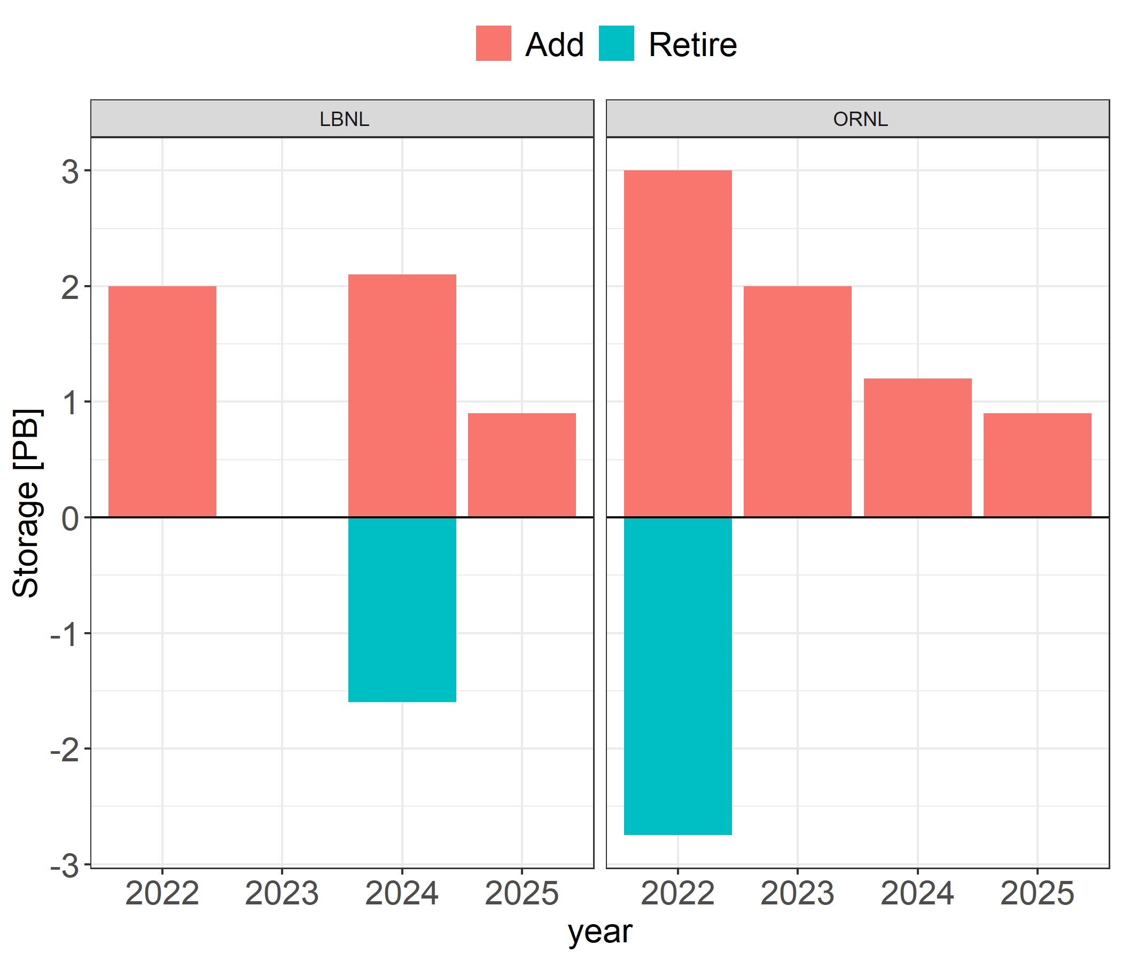
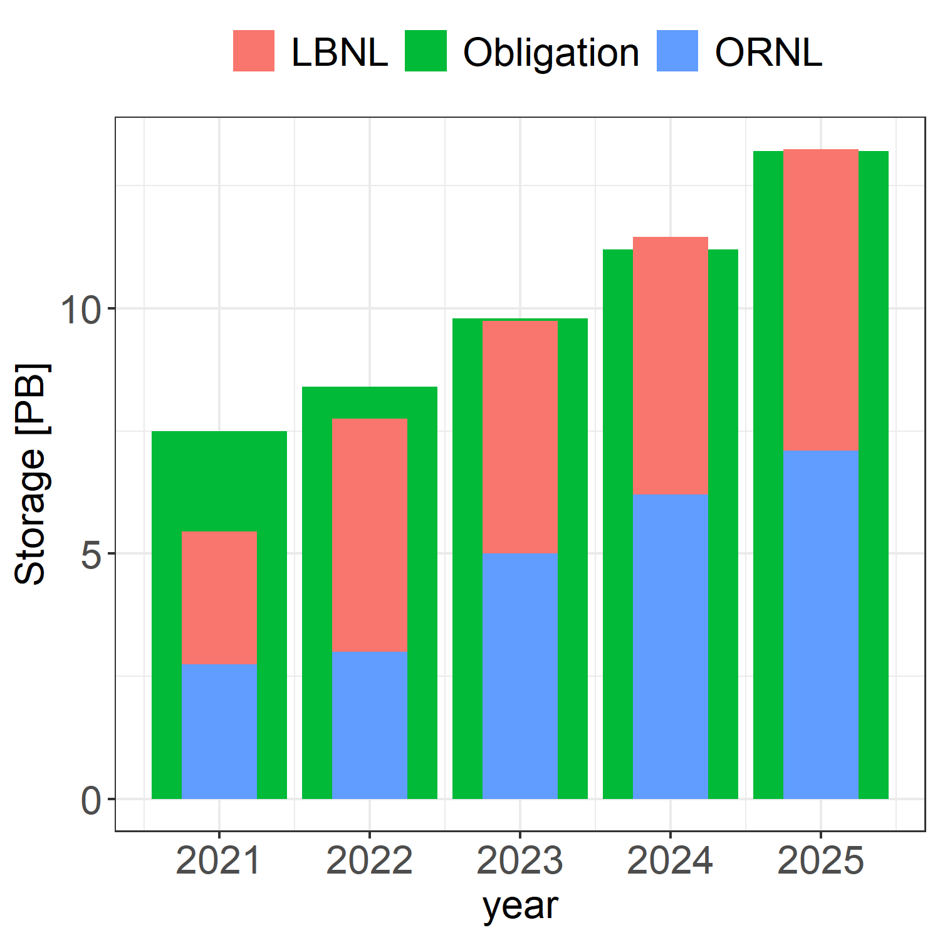
Storage Acquisition
Our storage utilization has been on a lighter side
We keep evaluating the utilization and purchase the new storage based on it and optimized for the available budget

Slide 21
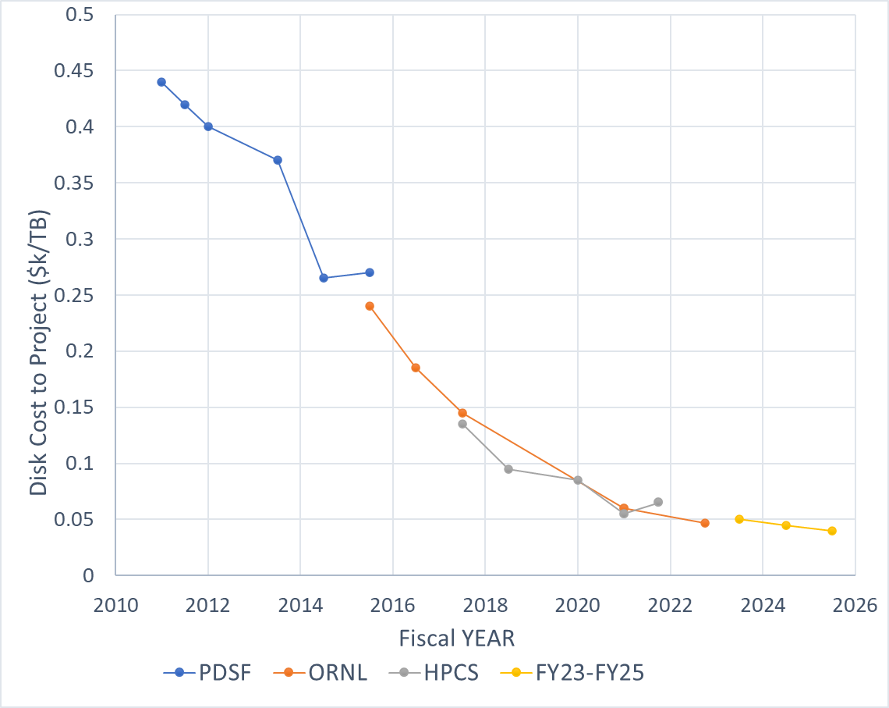
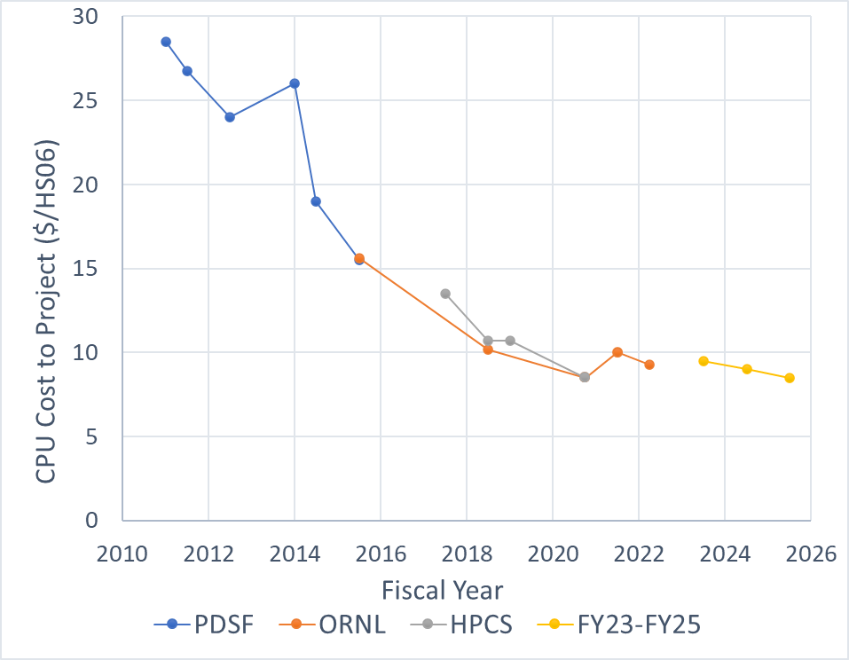
Cost trends for the CPU and Storage
CPU unit cost per HS06 is based on extrapolating the CPU clock frequency
We’ll measure the real HS06 values as soon as the new hardware is deployed

Slide 22
Delivered Resources by Year
The result of the above-described plan is shown in this table
We plan to proceed with both storage and CE plan as outlined in the PEAP 2023 update
Resource | FY2021 | FY2022 | FY2023 | FY2024 | FY2025
ALICE-USA Obligations
CPU (kHS06) | 69.9 | 81.6 | 94.6 | 108.7 | 119.9
Disk (PB) | 7.5 | 8.4 | 9.8 | 11.2 | 12.4
ALICE-USA Plan
CPU (kHS06) | 70.0 | 84.0 | 94.0 | 108.0 | 128.0
% CPU obligation | 100.2% | 102.9% | 99.4% | 99.3% | 106.7%
Disk (PB) | 5.5 | 7.8 | 9.8 | 11.5 | 13.3
% Disk obligation | 73.7% | 92.5% | 99.1% | 102.1% | 107.1%

Slide 23
PEAP 2023 Quarterly Milestones – Q1-Q2
Q1 FY2023
Submit 2023 WLCG pledges
Restore HTTPS support in EOS at ORNL – Low urgency
Present prototype AF configuration to ALICE grid team
Prepare storage for the prototype AF
ORNL: IPv6 support, upgrade perfsonar system and register with OSG
Hold Fall project meeting at ORNL or virtually
Receive and review 2023 ERCAP allocations at NERSC
Migrate ALICE Grid at NERSC from Cori to Perlmutter
Q2 FY2023
Test and move to whole-node scheduling at ORNL
Attend EOS community workshop
Deploy LBNL/HPCS perfsonar, register with OSG, and upgrade dashboard
Attend OSG All Hands meeting – in July
Set up analysis facility prototype at LBNL
Initiate the larger usage of NERSC by the ALICE-USA physicists to run jobs with access to T2 storage
Hold annual ALICE-USA/CERN resource review meeting at LBNL
Purchase and deploy new CPU for the 2023 RRB year as needed

Slide 24
PEAP 2023 Quarterly Milestones – Q3-Q4
Q3 FY2023
Update Analysis Facility Proposal to DOE
Report status of ALICE-USA grid operations at annual ALICE T1/T2 Workshop
Review updated ALICE requirements for 2024-2025
Test and move to whole-node scheduling at LBNL
Q4 FY2023
Update PEAP for FY2024
Purchase and deploy remaining disk storage as needed depending on utilization
Submit FY2024 ERCAP request for NERSC HPC CPU allocation

Slide 25

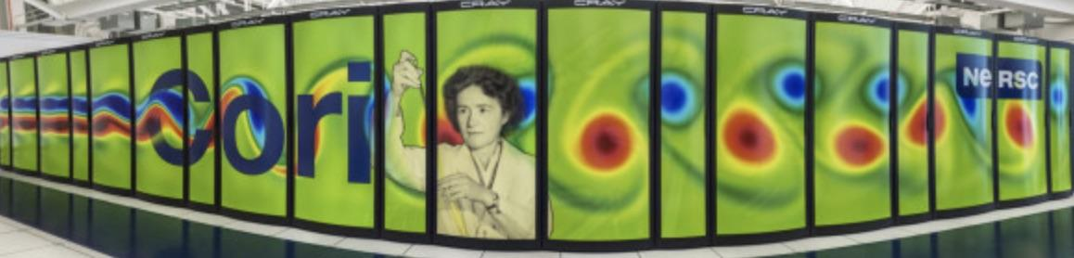

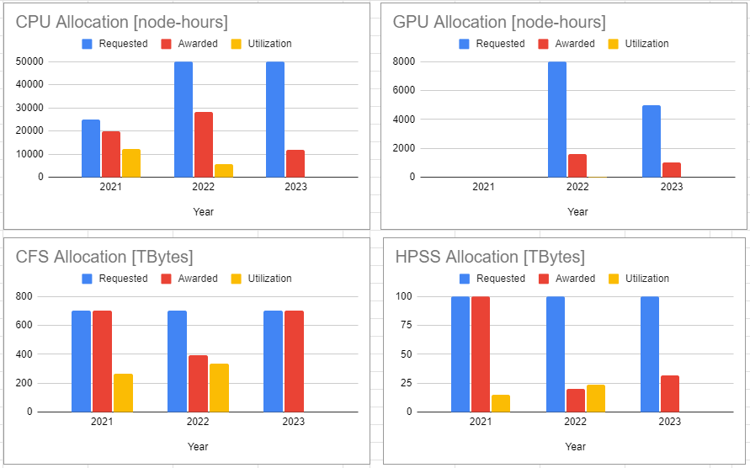
NERSC Allocation
As part of the project, we request allocation on NERSC HPCs
Cori – retiring May 31, 2022. Initially announced to retire in February 2023
Sergiu has done an extensive work to move the workflow to Perlmutter
Due to the low utilization last year, we were allocated third of the requested resource
Explicit request of GPU in 2023

Slide 26
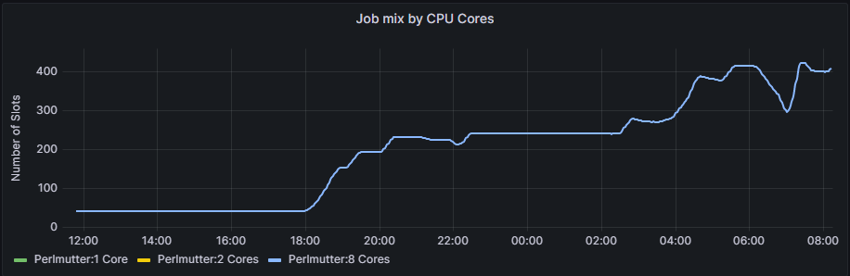
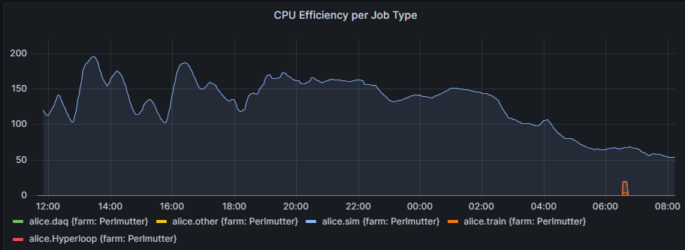
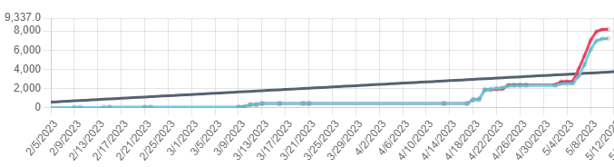
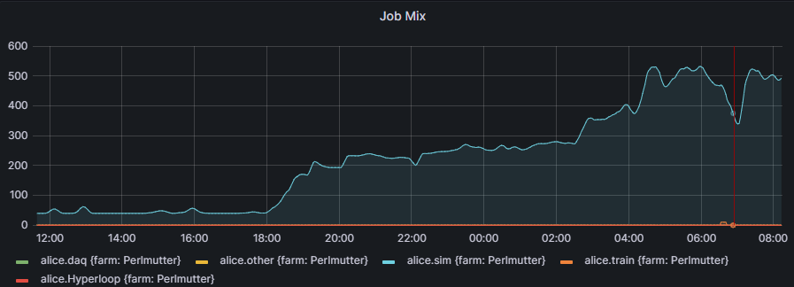
Perlmutter
Credit goes to Sergiu!!!
Superfacility API is used for job management
Initially attempted to use SPIN
Later we added a new VO box on T2 to submit jobs to Perlmutter
300 TB of scratch space
Currently awaiting `ulimit` increase
Very quickly exhausted existing allocation
I will request additional resources up to the initial request

Slide 27
Summary
ALICE-USA Computing project grows along with ALICE to meet it’s ALICE-USA obligations
Both T2 sites, operate with very high availability, reliability, and efficiency
We secured funds for 2022 scheduled upgrades and postponed ones from 2021
Further extended ppportunistic resources of Lawrencium which is a highly dependable resource that supplements the ALICE-USA pledged resources to meet the requirements
Sergiu successfully implemented SFAPI to submit jobs to Perlmutter

Slide 28

Questions

