Slide 1
ORNL Status Update
Pete Eby
ebypi@ornl.gov
Steve Moulton
moultonsa@ornl.gov
Slides:
May 16th 2023 @ LBNL

Slide 2
Operational Summary 2022 - mid 2023
High availability of SE and CE
  Quiet year, stable operations
T2 organizationally moved under Jonathan Wilson, RDSE Team Lead for Nuc Phys
Full SE and CE Hardware refresh are well in progress
ORNL::PRF_EOS deployed
CCDB EOS area created
Migration from eos4 to eos5 occuring

Slide 3
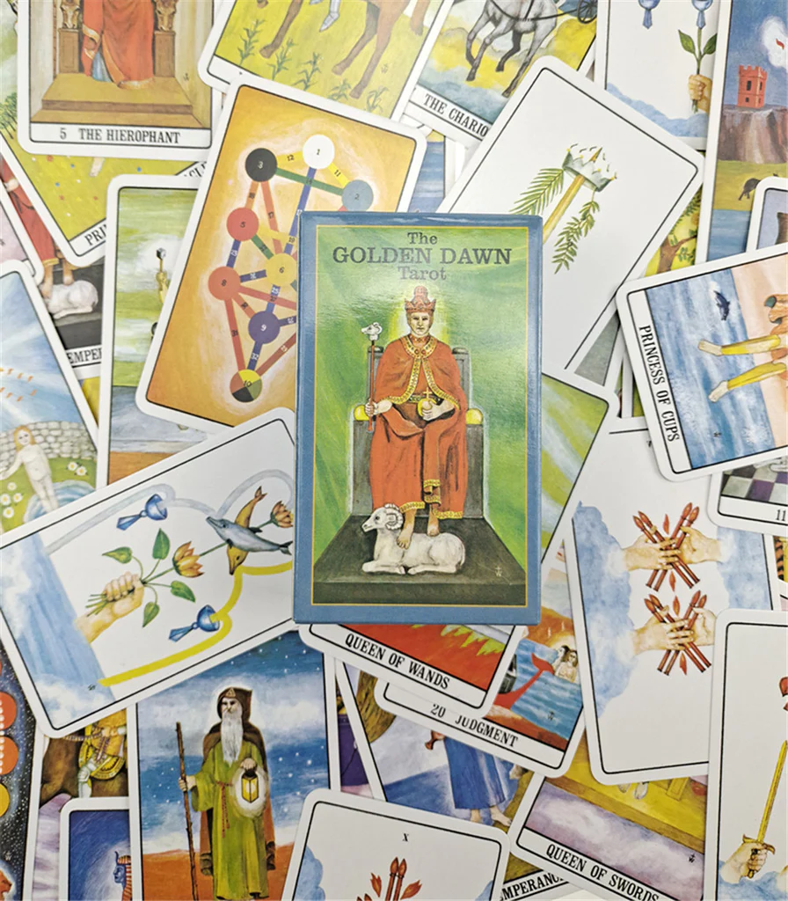
SE Overview and Planning

Slide 4
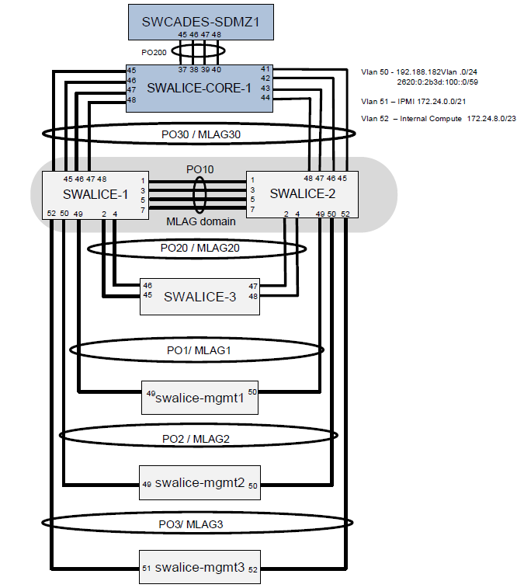
Network Topology
ORNL ESNet Uplinks now 400G
Likely swing T2 core switch from CADES and directly to ORNL border rtrs.

Slide 5
Network Overview
PRF_EOS FSTs are 20Gbit bonded (802.3ad)
New ORNL::EOS FSTs are 25G (SFP28)
Uplink is currently 40Gbit
  Swing uplinks to ORNL border routers
Upgraded primary switch - swalice-core-1 (no change)
  Arista 7280SR2-48YC6
  48 SFP+ ports are 1/10/25G and the 6 ports 100GbE that can be configured as 6 x 100GbE, 24x 25GbE, 6x 40GbE, or 24x 10GbE.
  Shard buffer depletion issue resolved (on core switch)
10G/1G Leaf switches getting a bit old

Slide 6
SE Hardware Refresh - Quickstart Option
(Last fall slide)
SE
  Start small:
  New EOS deployment (ornl::prf_eos)
  Reuse cern-10 and 60 disks jbod
  Purchase and add two new MGMs.
  Migrate additional FSTs/JBODs later -- eventually replace cern10/JBOD if appropriate.
So this idea lead to…

Slide 7
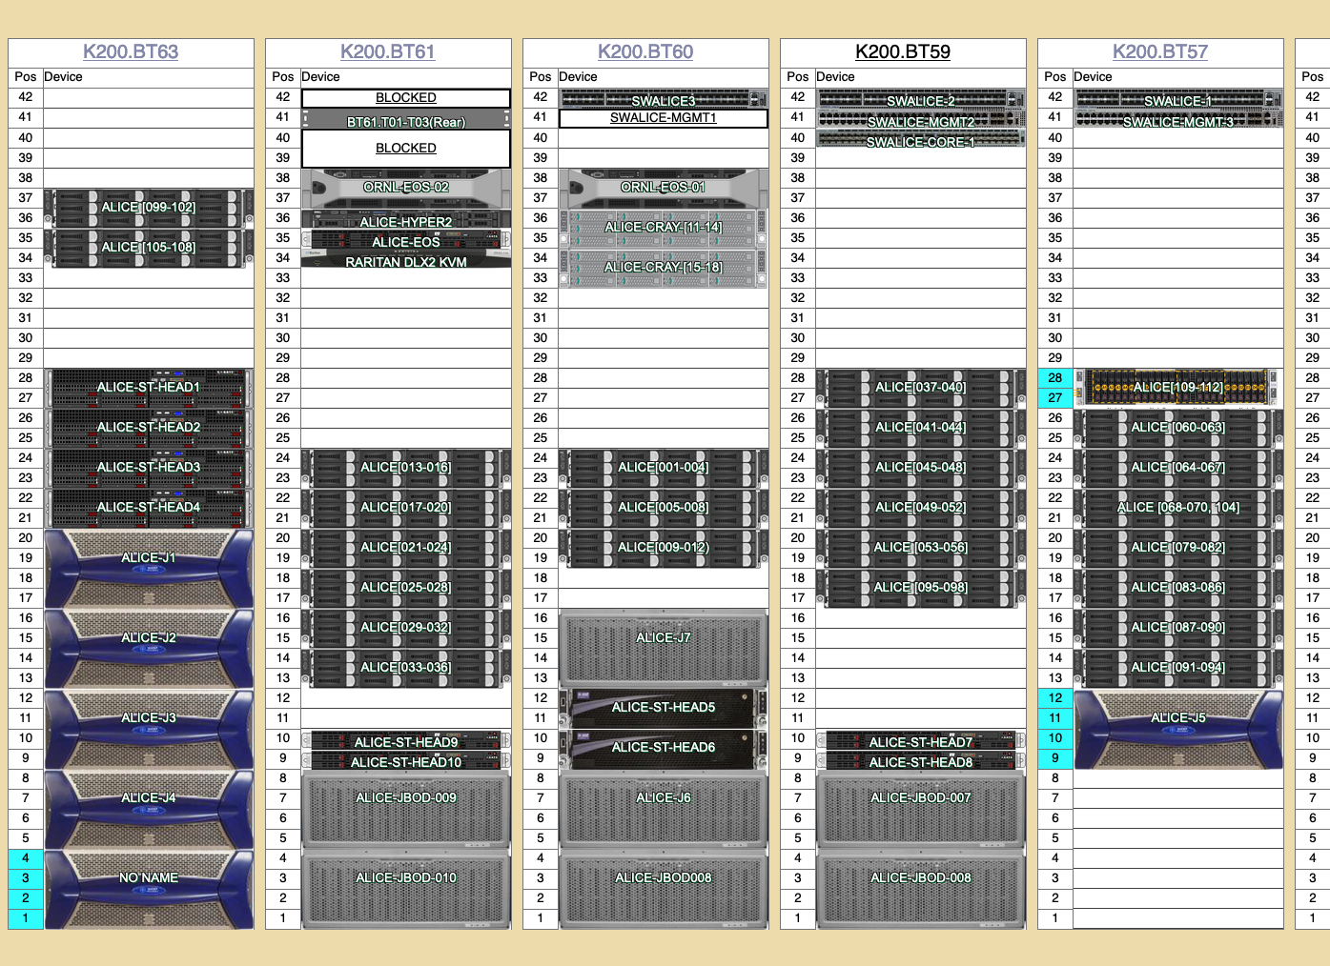
ORNL T2 Rack Layout (2022)

Slide 8
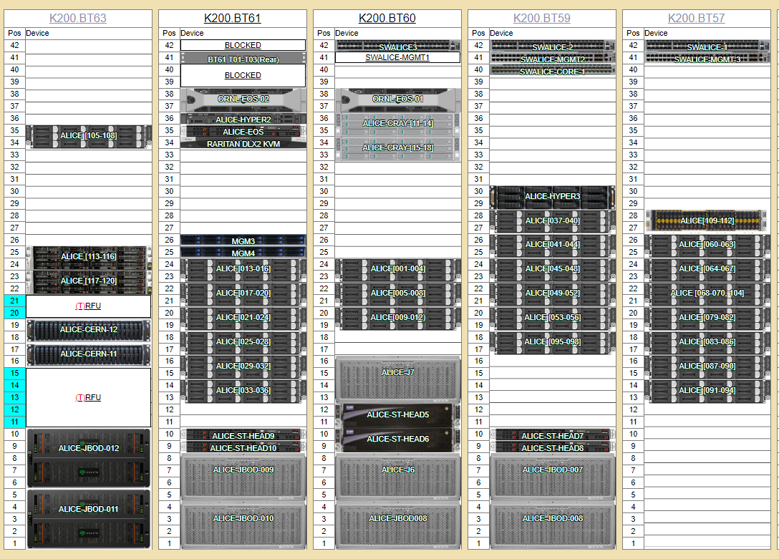
ORNL T2 Rack Layout (2023)

Slide 9

ORNL::PRF_EOS - The End is the Begining
Repurposed cern-09..10 FSTs (ca 2018 hardware)
  HGST JBODS and Helium drives (7TB and 9TB)
Installed MGMS and FSTs eos 5.1.14
Own quarkdb 5.1.11 cluster (three nodes)
Final capacity expected to be ~3.5PB +/-
  Could provision one or two units for testing env
  to which external collaborators could access

Slide 10
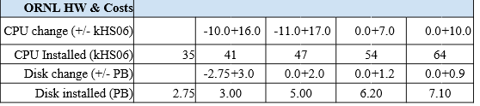
2023 PEAP Update ORNL Resource Pledges
Installed
FY2022
FY2023
FY2024
FY2025
Depending on drive capacities in FST to be added mid 2023, and SE utilization, can we be a little low in 2023 and a little more in 2024?

Slide 11

ORNL::EOS (Old and New hardware)
3PB new hardware racked (2x 1.5PB new FSTs)
  5PB avail in this env, will migrate ~2PB to PRF leaving 3PB
  on all new hardware
Plan to +1.5PB this summer, thus total production SE capacity >4PB

Slide 12
ORNL::EOS (New Hardware)
New eos-fst-11,12 FSTs
  Supermicro (Silicon Mechanics)
  25G uplink (can increase if indicated)
  Seagate 84 disk JBODS
    Exos 18TB SAS drives (17TB usable in os/eos)
    12G SAS, multipath to each fsid device
  Presents as 1.5PB in eos
  Single disk fsids - continuing this design
  RHEL8

Slide 13
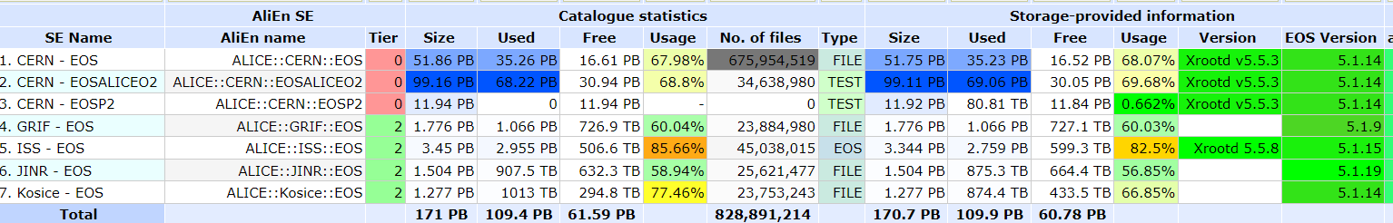
EOS5 Experiences
Elvin “I would strongly encourage you to use EOS5 for any new deployment and also move away as soon as possible from EOS4 for older ones. All our physics instances at CERN are running EOS5 since end of last year and we are happy with the stability. EOS4 is now in maintenance mode and there are no more fixes or improvements going to that branch only critical fixes.
Current ALICE EOS5 Instances

Slide 14
EOS5 Experiences
Correct eos diopside & quark repos
  Quarkdb docs not updated for eos5
  Elvin “Yes, for diopside you should use only the following tag:
https://storage-ci.web.cern.ch/storage-ci/eos/diopside/tag/testing/el-8/x86_64/
The QuarkDB repo is no longer relevant since now we build and distribute quarkdb together with EOS. QuarkDB info is not anymore stiped from the libraries and binaries so there is no longer a separate debuginfo package.
eos-quarkdb from diopside should call
/usr/lib/systemd/system/xrootd@.service ExecStart /opt/eos/xrootd/bin/xrootd

Slide 15
EOS5 Experiences
Alimon Storage provided statistics not populating
  tcpdump appears to show eos_rpm_vers reaching vobox
  [root@voboxslr ~]# tcpdump -i eth0 -nnvvXSs 500 src 192.188.182.26 and dst port 8884 | grep -i ver # from ornl-eosprf-01
tcpdump: listening on eth0, link-type EN10MB (Ethernet), capture size 500 bytes
0x0190: 0000 000f 656f 735f 7270 6d5f 7665 7273 ....eos_rpm_vers
. . .
0x0050: 7665 725f 7872 6f6f 7464 5f53 6572 7669 ver_xrootd_Servi
Where is newer mlsensor?
Using http://linuxsoft.cern.ch/wlcg/centos7/x86_64/mlsensor-1.2.6-1.el7.noarch.rpm

Slide 16
EOS5 Experiences
xrdfs spaceinfo was returning zero space used
  Sergiu noted this appeared to be ldap config, wherein he changed the ldap entry to / given it is aliased. Subsequently the storage provided information on space usage appeared

Slide 17
EOS5 Experiences
eos-fst-12 not available for writes “Unable to get free space”
  eos-community thread created
eos-fst-11 when started crashes mgm
  Nothing logged by fst or mgm
  Config appears identical to eos-fst-12
  Critical operational bug, will address with Andreas

Slide 18
ORNL::EOS Next Steps
Issues to resolve
  Activation of eos-fst-11 crashes mgm
  Unable to write to eos-fst-12 - thread on eos-community
  eos5 systems not submitting “storage provided statistics” to alimon, despite mlsensor and apmond
    tcpdump shows packets arriving at vobox
    New mlsensor package available? From where?
Then, complete migration
  Drain warp-ornl-cern-05..08 (~1PB)
  Install two new MGMs (rhel8, eos5)
    Migrate from eos4 mgms to eos5 mgms
    Requires porting eos config to quarkdb
  Upgrade/migrate to quarkdb5

Slide 19
EOS Recommendations
Better document configuration and verification (JAliEn testSE ALICE::ORNL::PRF_EOS) of alicetokenauth for eos4/5 as misconfiguration results in no auth and such is not particularly obvious to site admins out of the gate -- at least such as been our experience in the past and with the recent issue.
During deployment I've noted and clarified with Elvin a few confusing points due to outdated docs, ambiguity on correct repos and changes in quark packages, configs, etc. (I'll work with Elvin on providing feedback on this points.)
EOS5 details and experience (ORNL and others) might be an interesting topic for the next T1/T2 if desired. Should there be an ALICE EOS5 doc area?

Slide 20

EOS Institutional Exploration
https://arm.gov evaluating future storage options
30 year project
~6PB but rapidly growing (multispectral radar, etc.)
Fixed sites and mobile facilities
  MOSAiC project and R/V Polarstern - largest polar expedition of all time
  SGP long term Southern Great Plains experiment site
Other Environmental Science project (NASA DAAC) share storage needs.
Looking for more than “Object Storage, S3 and done” solution
  Evaluating gen storage platforms for ten+ year operational plan
  EOS fusex could provide NFS and posix for legacy apps
  Explore Jalien data catalog to abstract storage elements and mounts

Slide 21
CE Overview and Planning

Slide 22
OSG Reporting Issue / Need for HT Condor
Upgrading to OSG3.6 will break reporting to OSG
  We have already been patching the xml_utils.py with a simple modification, which has historical allowed reporting to function.
  ORNL is running OSG3.5 which provides
  [root@osg gratia_patch]# rpm -qa | grep gratia-probe-slurm
gratia-probe-slurm-1.24.0-1.osg35.el7.x86_6
OSG git repo branches comparison between 1.24.0-1 to latest shows no changes to xml_utils.py, though of course many changes to 185 files. Pinpointing the explicit changes may take a little dev effort. Is there someone familiar with the stack who may be available to assist?

Slide 23
OSG Reporting Issue / Need for HT Condor
If we can patch gratia and continue to report directly to OSG it keep the job submission workflow a little leaner, and the stack easier to debug.
Implementing HT Condor could (potentially) provide the ability for other project (EIC, etc.) to submit through OSG to our resources. However, this possibility is remote at this time.

Slide 24
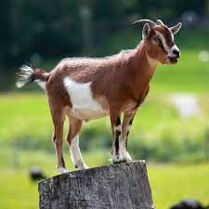
ORNL T2 Compute Element
Model | Physical Cores | Count | Memory | Memory / Job Slot | Age
Supermicro SYS-2029BT-HTR 2022 | 48 | 4 | 384Gb | 4 Gb | 1
Silicon Mech R4420.v8 * 2023 | 48 | 8 | 256Gb | 2.6 Gb | <1
Cray S2600KPR | 36 | 8 | 256Gb | 3.6 Gb | 4
Dell PowerEdge C6220 | 16 | 35 | 64Gb* | 2.4 Gb | 8
Dell PowerEdge C6220 II | 16 | 54 | 64Gb* | 2.4 Gb | 7
All are in quad chassis.
Dell counts not even due to node failures.
Hyperthreading enabled on all nodes.

Slide 25
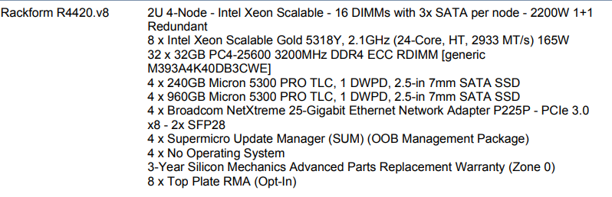
2023 Compute Nodes
Provisional ORNL ALICE HS06 Results 2022 (alice-110) and CE hs06 projections are here

Slide 26
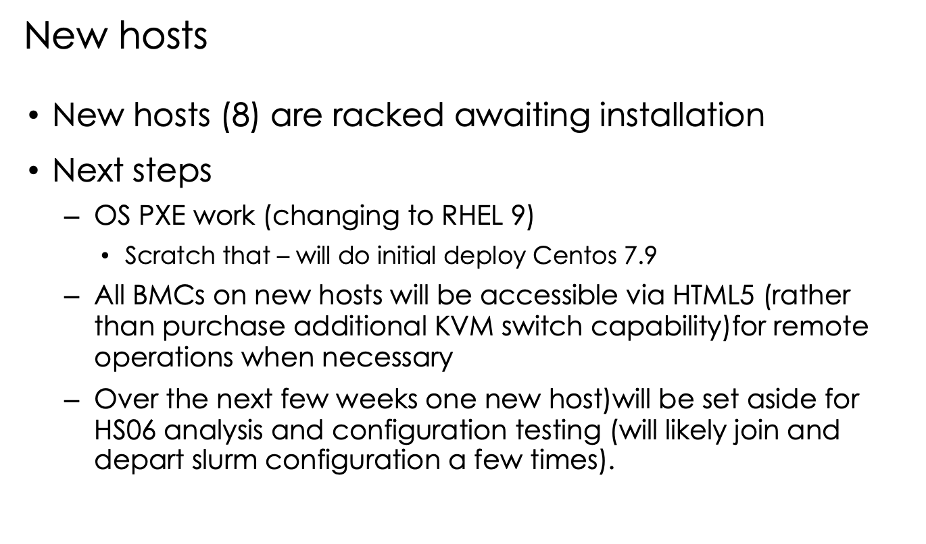

Slide 27

OS/Licensing Options
Not clear yet which direction to take. If we decide RH8:
Nodes can reach ORNL RedHat server and repos
HPC nodes $19/year - can probably use on all systems
Non-HPC nodes workstation license $100 / year (reference cost).
Input from ALICE?
  CERN going with CentOS streams per this and that?

Slide 28
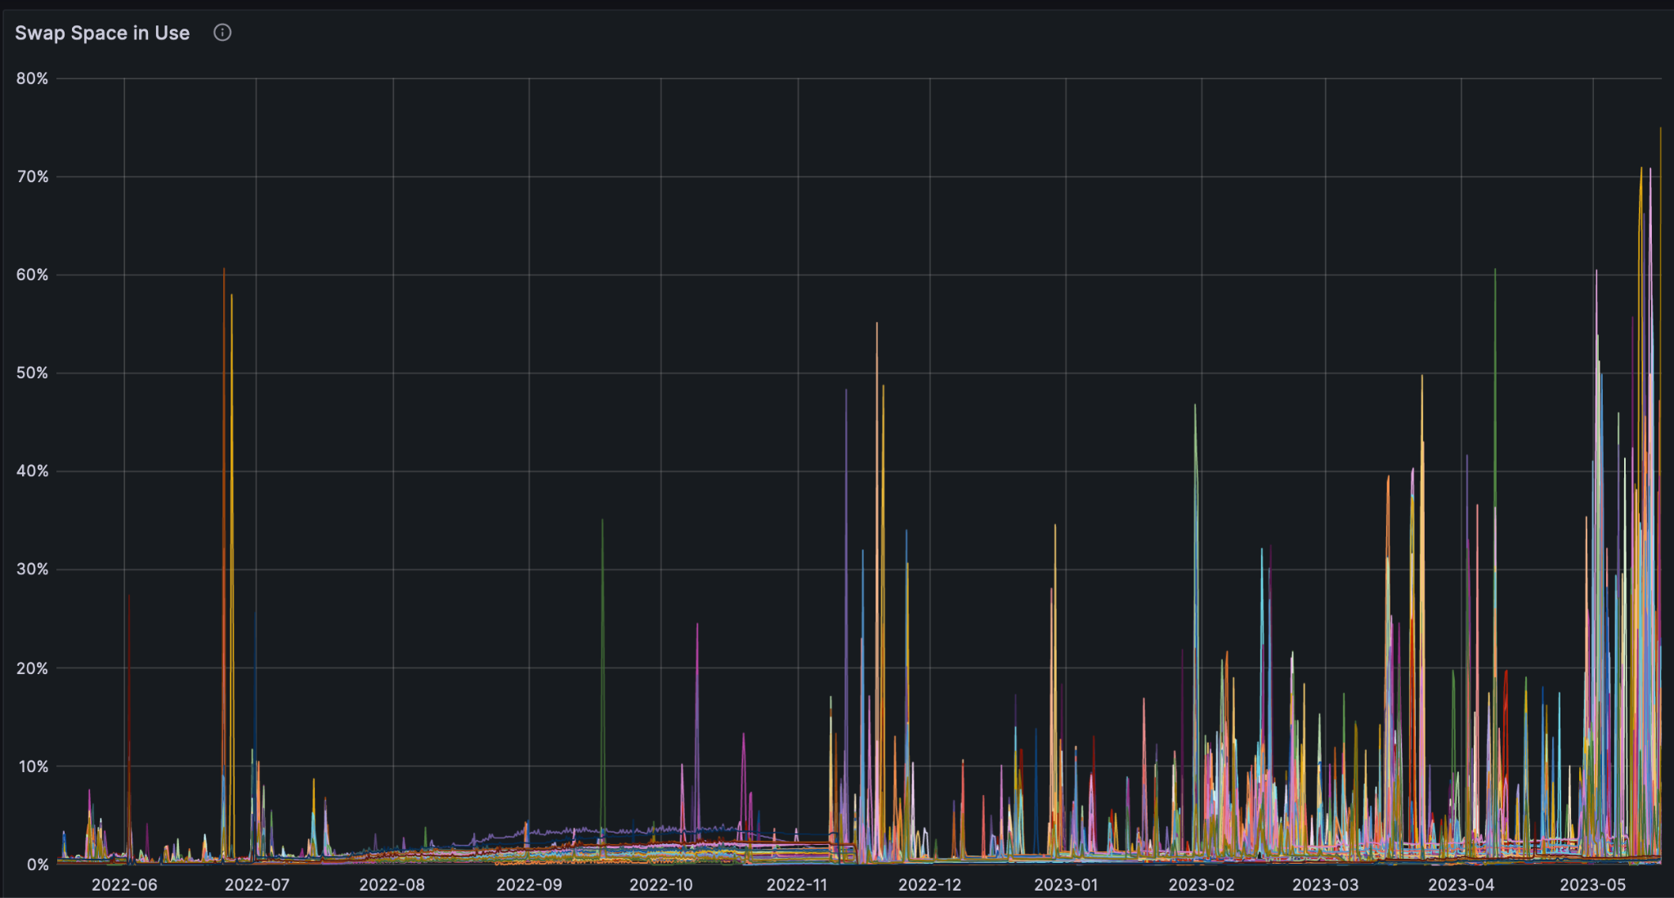
Swap usage last 365 days
swap exaustion not shown due to sampling granularity. five to ten OOMs per day over last two weeks

Slide 29
Operational Notes II
Slurm update as soon as it is available to address CVEs.
  ORNL T2 not SchedMD customer
IPv6 deployment planned for June, pending no problems
8 core jobs. No problems seen.

