Slide 1
MQXFA Test Results Overview & MQXFA07/08 Analysis
G. Ambrosio, P. Ferracin, G. Vallone and the MQXFA team
MDP meeting Feb. 1, 2023

Slide 2
Acknowledgement
US HL-LHC Accelerator Upgrade Project (AUP)
BNL: K. Amm, M. Anerella, A. Ben Yahia, H. Hocker, P. Joshi, J. Muratore, J. Schmalzle, H. Song, P. Wanderer
FNAL: G. Ambrosio, G. Apollinari, M. Baldini, J. Blowers, R. Bossert, R. Carcagno, G. Chlachidze, J. DiMarco, S. Feher, S. Krave, V. Lombardo, C. Narug, A. Nobrega, V. Marinozzi, C. Orozco, T. Page M. Parker, S. Stoynev, T. Strauss, M. Turenne, D. Turrioni, A. Vouris, M. Yu
LBNL: D. Cheng, P. Ferracin, L. Garcia Fajardo, E. Lee, M. Marchevsky, M. Naus, H. Pan, I. Pong, S. Prestemon, K. Ray, G. Sabbi, G. Vallone, X. Wang
NHMFL: L. Cooley, J. Levitan, J. Lu, R. Walsh
CERN: HL-LHC Project
G. Arnau Izquierdo, A. Ballarino, M. Bajko, C. Barth, N. Bourcey, B. Bulat, M. Cruovizier, A. Devred, H. Felice, S. Ferradas Troitino, L. Fiscarelli, J. Fleiter, M. Guinchard, O. Housiaux, S. Izquierdo Bermudez, N. Lusa, F. Mangiarotti, A. Milanese, A. Moros, P. Moyret, C. Petrone, J.C. Perez, H. Prin, R. Principe, E. Ravaioli, T. Sahner, S. Sgobba, P. Tavares Coutinho Borges De Sousa, E. Todesco, J. Ferradas Troitino, R. Van Weelderen, G. Willering

Slide 3
Outline
MQXFA magnets
Fabrication and test status
Analysis of magnets with limited performance
MQXFA07 and MQXFA08
Lessons learned and corrective actions
MQXFA endurance and resilience
Conclusions

Slide 4
20 MQXFA Magnets for HL-LHC Inner Triplets
10 Q1/Q3 Cryo-assemblies (including 2 spares)
2 magnets in each cryo-assembly

Slide 5
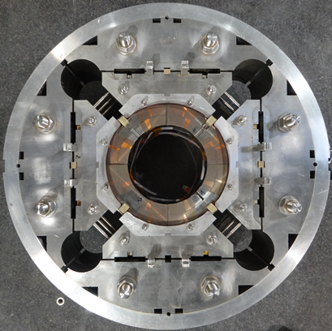
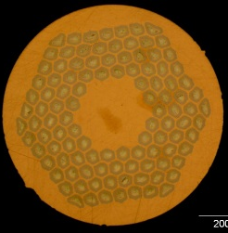
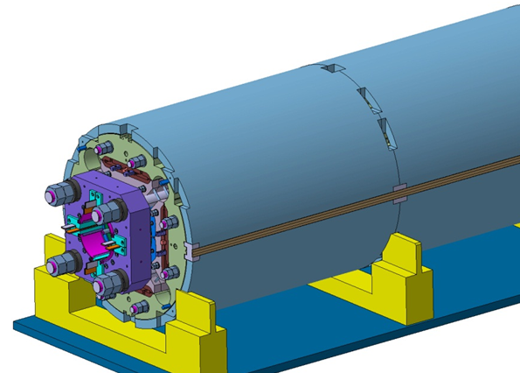
MQXFA/B Design
Parameter | Unit | MQXFA/B
Coil aperture | mm | 150
Magnetic length | m | 4.2/7.15
N. of layers |  | 2
N. of turns Inner-Outer layer |  | 22-28
Operation temperature | K | 1.9
Nominal gradient | T/m | 132.2
Nominal current | kA | 16.23
Peak field at nom. current | T | 11.3
Stored energy at nom. curr. | MJ/m | 1.15
Diff. inductance | mH/m | 8.26
Strand diameter | mm | 0.85
Strand number |  | 40
Cable width | mm | 18.15
Cable mid thickness | mm | 1.525
Keystone angle |  | 0.4
Nb₃Sn Conductor
RRP 108/127
P. Ferracin et al., “Development of MQXF, the Nb₃Sn Low-β Quadrupole for the HiLumi LHC ” IEEE Trans App. Supercond. Vol. 26, no. 4, 4000207
G. Ambrosio et al., “First Test Results of the 150 mm Aperture IR Quadrupole Models for the High Luminosity LHC” NAPAC16, FERMILAB-CONF-16-440-TD
E. Takala et al., “Mechanical Comparison of Short Models of Nb3 Sn
Low-β Quadrupole for the Hi-Lumi LHC” IEEE TAS. Vol. 31, no. 5, 4000306

Slide 6
MQXFA Fabrication Status
9 magnets have been assembled: MQXFA03-11
1 magnet has been disassembled after preload
MQXFA09
8 magnets have been tested
MQXFA03-08 and MQXFA10-11
1 magnet has been dis-assembled after test & re-assembled with a new coil
MQXFA08 ➔ MQXFA08b
MQXFA03 during final preparation at LBNL
K. Ray et al., “Applied metrology for the assembly of Nb₃Sn MQXFA quadrupole magnets for the HL-LHC AUP” 3LPo1A-02

Slide 7
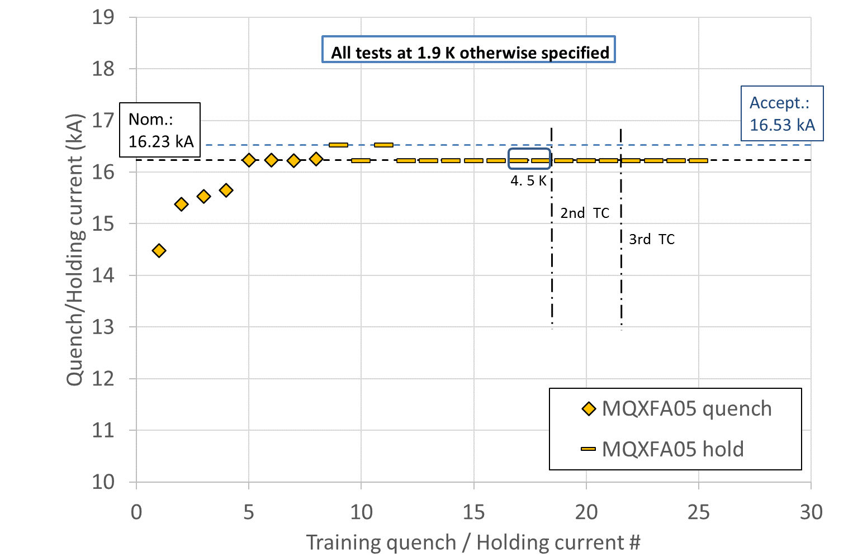
MQXFA Vertical Test
MQXFA magnets are vertically tested at BNL
Test plan demonstrates:
Holding at Acceptance Current: Nominal + 300 A
Temperature margin: Nominal curr. at 4.5 K
Memory after thermal cycle
Other requirements (next slide)
MQXFA @ BNL
7

Slide 8
Vertical Test Summary
Magnets are accepted for use in LMQXFA Cold Mass if they meet all Vertical Test Requirements
Hold current at nominal current + 300 A
Field Quality
Integrated gradient
Ramp to/from I_nom at ±30 A/s
100 A/s ramp down w/o quench (max for power supply)
Temperature margin
Training memory
Splice resistance (less than 1 nΩ)
All electrical requirements
S. Feher et al., “AUP first pre-series Cryo-Assembly Design Production and Test Overview” 2LOr2A-04

Slide 9
Vertical Test: Training
MQXFA03-06 and MQXFA10-11 reached and held Acceptance Current and met all requirements tested at BNL
6 out of 8 magnets tested

Slide 10
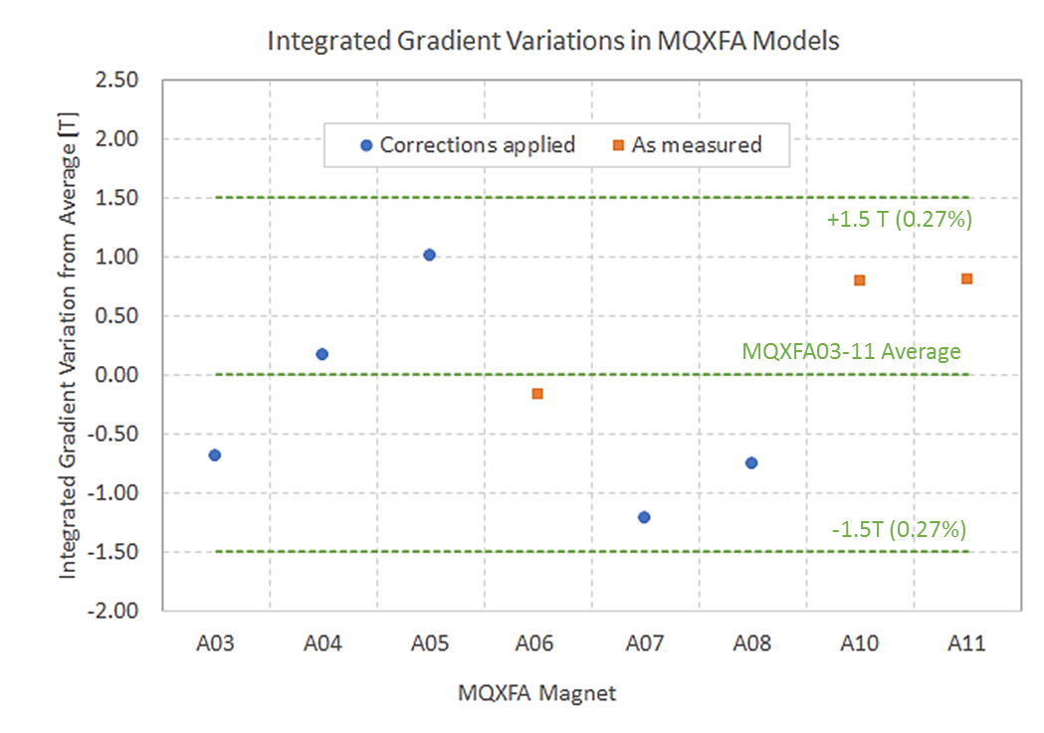
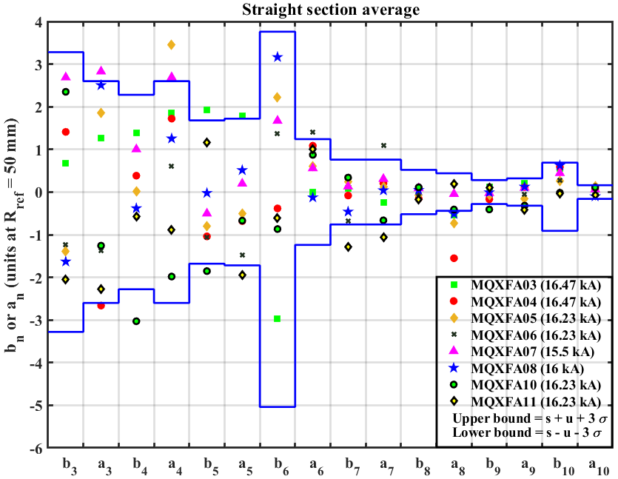
Integrated Gradient & Field Quality @ BNL
Courtesy of G. Sabbi and A. Ben Yahia
Field Quality in Straight Section vs expectation
Average IG at 16.23 kA: 561.92 T
In order to obtain a consistent comparison, correction factors were applied to several magnets to account for measurements taken at different currents as well as changes in the measurement setup and coil design
Before b6 correction in cross-section
Mechanical data and analysis:
L. Garcia Fajardo et al., “Analysis of the mechanical performance of the 4.5 m long MQXFA Pre-Series magnets for the Hi-Lumi LHC Upgrade” 3LPo1A-01

Slide 11
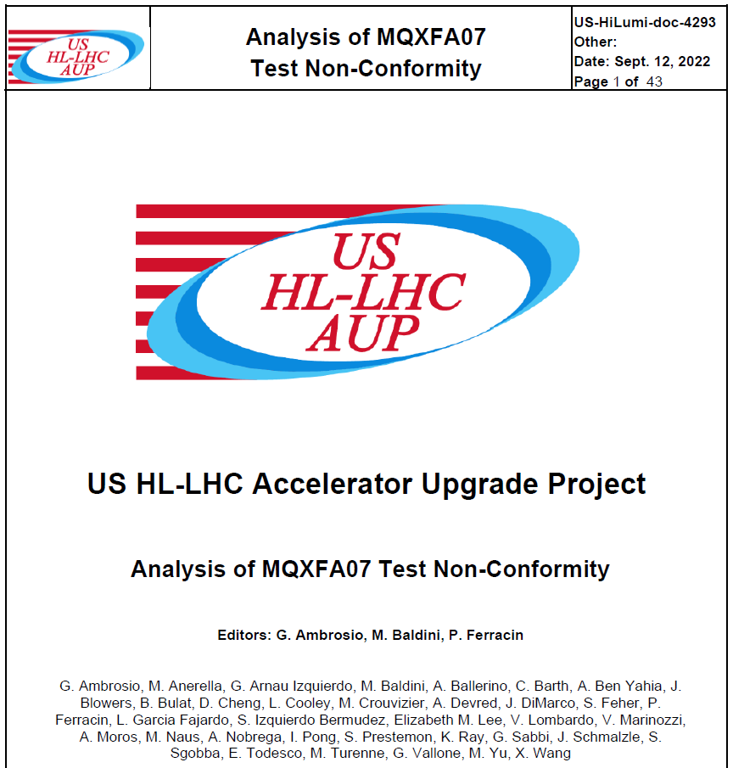
Outline
MQXFA magnets
Fabrication and test status
Analysis of magnets with limited performance
MQXFA07 and MQXFA08
Lessons learned and corrective actions
MQXFA endurance & resilience
Conclusions
US-HiLumi-doc-4293
CERN EDMS #2777612
https://inspirehep.net/literature?q=FERMILAB-TM-2789-TD

Slide 12
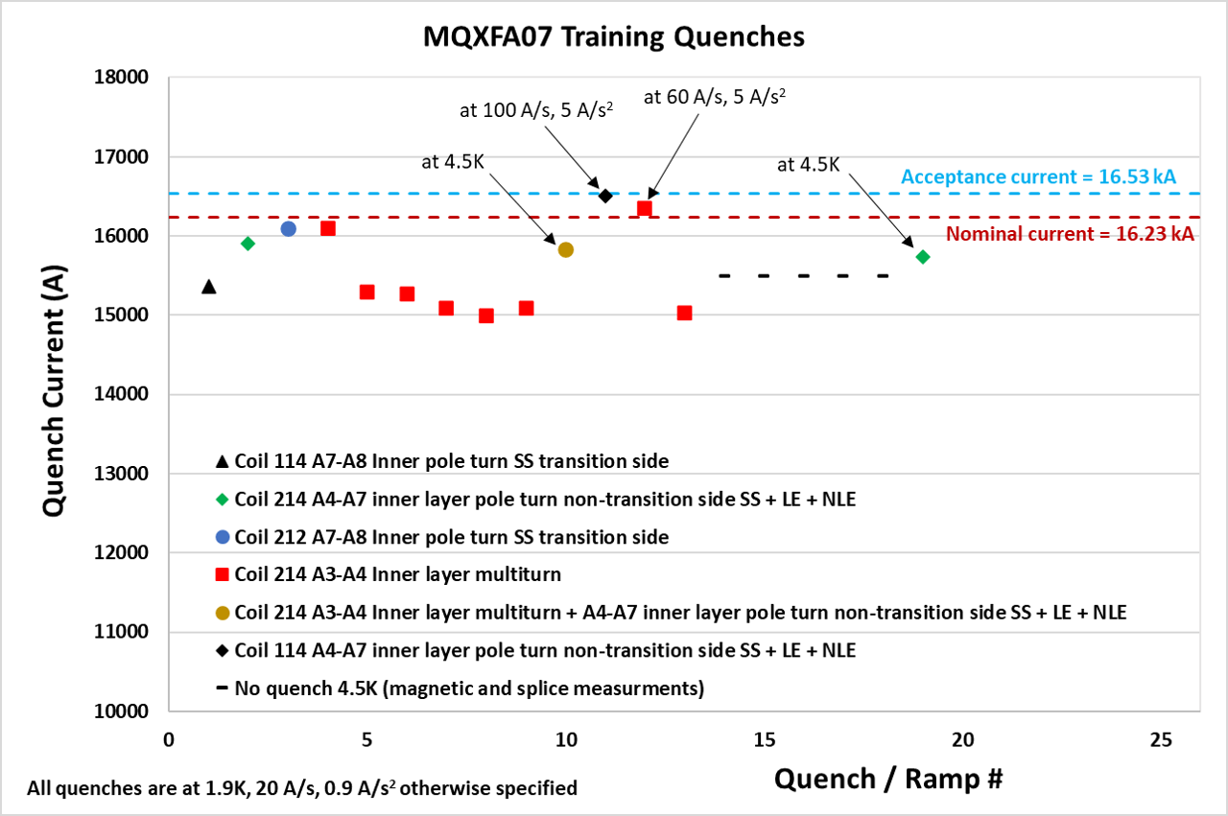
Location based on Quench Antenna and Voltage Taps
Courtesy of J. Muratore and A. Ben Yahia
Reverse temperature dependence
Reverse ramp-rate dependence
Same features and location in MQXFA08

Slide 13
Limitation “Mechanism”
Instability triggered by a local issue, likely affecting only some strands, that pushes more current in adjacent strand(s)
Field in quenching turn is between 6 and 9 T
Similar mechanism in other magnets:
MQXFS03 showed a reversible component
LARP Long Quadrupole #2 showed “enhanced thermo-magnetic instability” in mid-plane block
With flux jumps
B. Bordini, et al., IEEE Trans. Appl. Superc., vol. 22, 2012, # 4705804
A. K. Ghosh, IEEE Trans. Appl. Superc., vol. 23, 2013, # 7100407
…
H. Bajas et al., “Test Results of the Short Models MQXFS3 and MQXFS5 for the HL-LHC Upgrade”, IEEE Trans. Appl. Superc. Vol 28, # 4007006 (2018)
Ref: G. Ambrosio et al., “Progress in the Long Nb₃Sn Quadrupole R&D by LARP”, IEEE Trans Appl, Superc. Vol 22, # 4003804 (2012)

Slide 14
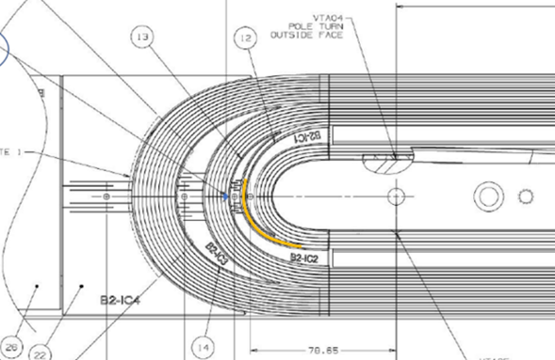
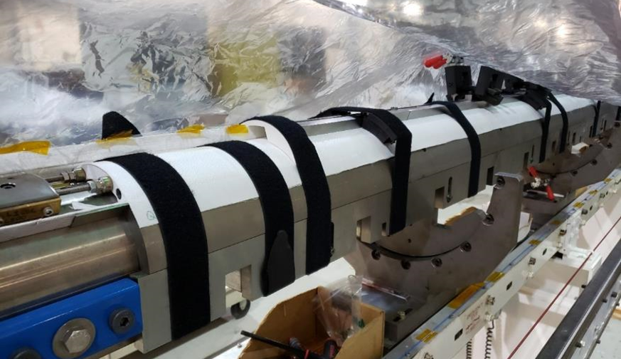
Coil Fabrication Analysis
A few discrepancies during fabrication:
Some strands popped out during winding, were fixed, popped out overnight and were fixed a second time (BNL DR AM-164)
Limiting coil was affected by COVID lockdown
14 weeks stop after winding & curing of inner layer
No other NCR nor traveler data anomaly
Courtesy of J. Schmalzle
Inner layer coil showing in yellow the position of coil-214 cable affected by DR AM-164
coil 214 as it was setup for the lab shutdown

Slide 15
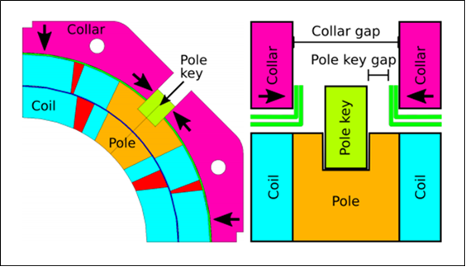
Structure Analysis & MQXFA07 Disassembly
Master
keys
Bladder
location
Yoke
Gap key
Pad
Pole key
Q2
Q1
Q3
Q4
Cooling
holes
Collar
Axial rod
location
Load
key
Al shell
A pole-key gap asymmetry was found during MQXFA07 and MQXFA08 disassembly:
- Gaps closed in quadrant 3
- Gaps open in other quadrants
Courtesy of P. Ferracin and D. Cheng

Slide 16
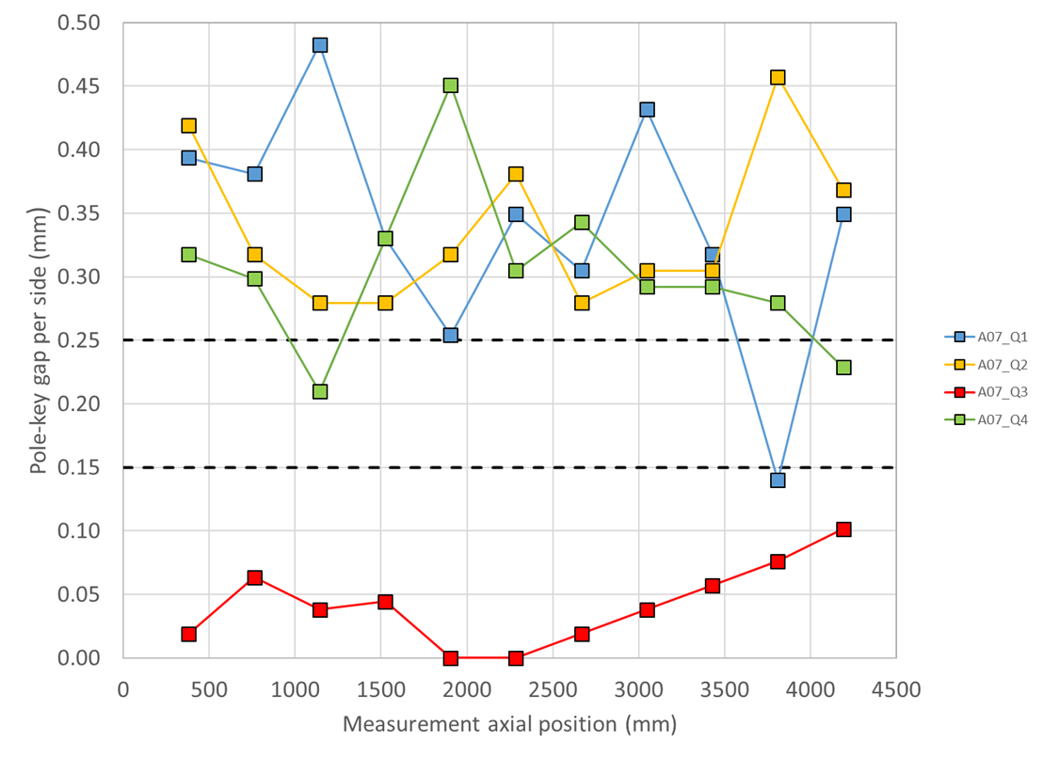
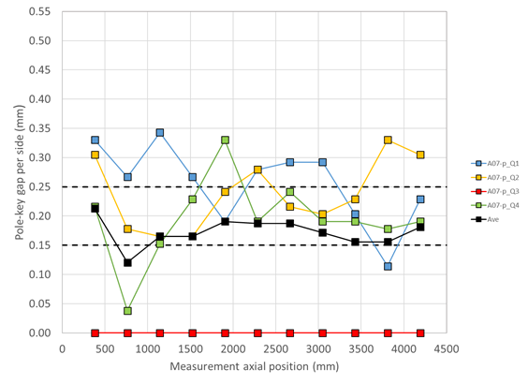
Pole-key gaps in MQXFA07
Courtesy of P. Ferracin and D. Cheng
The measured pole-key gaps were not as uniform in MQXFA07 and MQXFA08 as in past magnets; this is particularly apparent on the limiting coils (Q3 for both magnets)
Only the total average (on the 4 keys) was targeted in the specification. The underlying assumption was that the gaps would be redistributed across coils during loading.
Investigation of the effect of this non-uniformity on the mechanical performances with 2D and 3D FE models
See next slides by P. Ferracin and G. Vallone
LL1

Slide 17
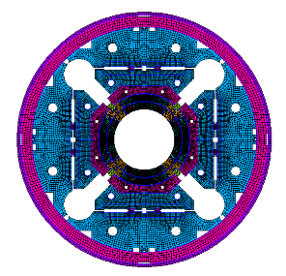
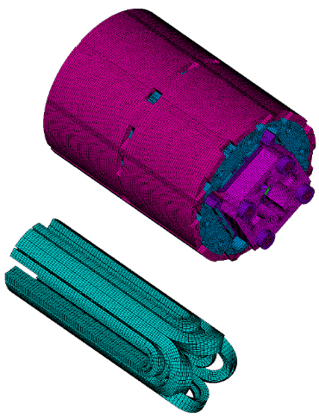
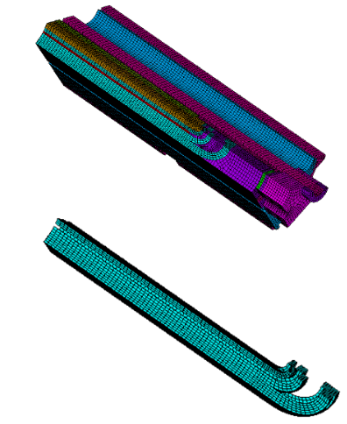
Finite element analysis Effect of a close pole key gap
Three different finite element models:
360-degrees, full cross-section 2D model
360-degrees, full cross-section 3D model (MQXFS)
45-degrees, octant 3D model (MQXFS)
G. Ambrosio - MQXFA magnets - MDP mtg 2/1/23

Slide 18
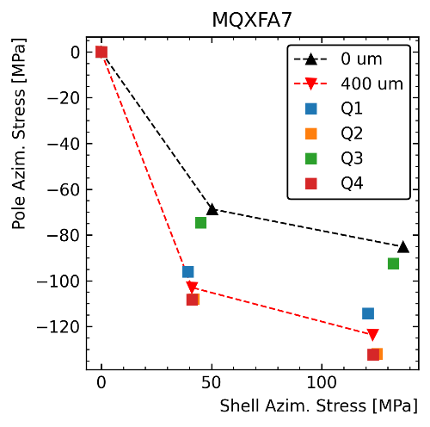
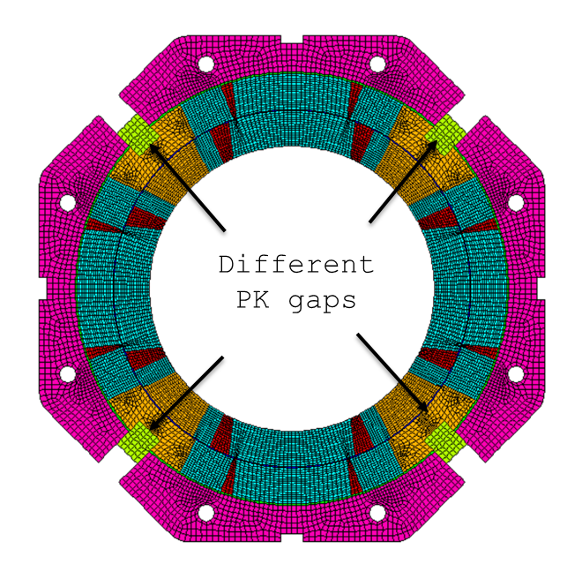
Finite element analysis 360-degrees, full cross-section 2D model
Q2
Q1
Q3
Q4
With a close pole key gap in Q3, the azimuthal pre-stress is:
Significantly lower (~30 MPa reduction) in the Q3
‘Medium’ on the opposite side (Q1)
“Maximum” on the two remaining quadrants
No ‘dangerous’ stress/strain increase on the coil
This effect is not measured by the strain gauges
However, measurement on a single axial location in RE
No ‘dangerous’ stress/strain on the coils
MQXFS1 (short model) went over I_{ult} with 85 MPa preload at cold
G. Ambrosio - MQXFA magnets - MDP mtg 2/1/23

Slide 19
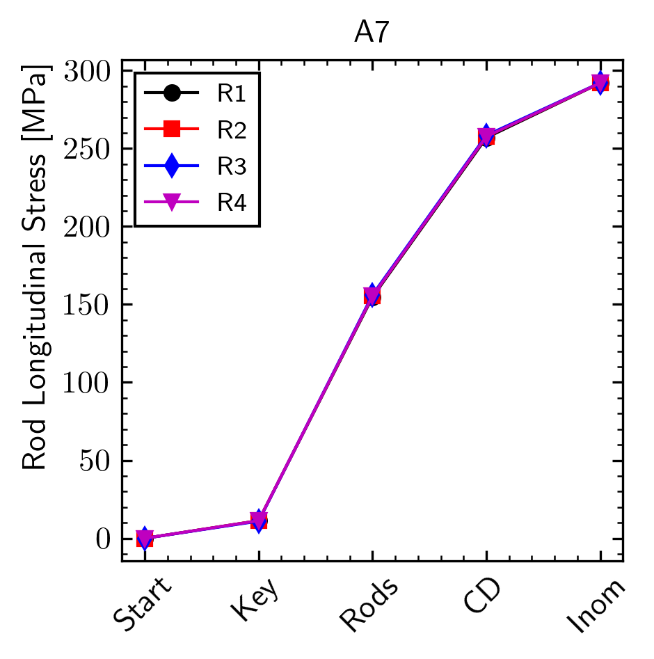
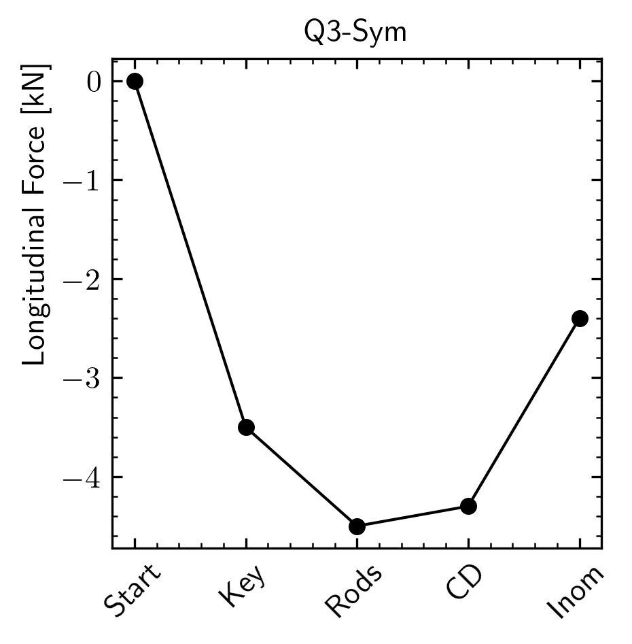
Finite element analysis 360-degrees, full cross-section 3D model
Axial behavior:
No difference in the rods stress, but less force axial pre-load on the Q3 coil
Lower azimuthal pre-stress results in less friction coil-structure → “axially softer coil”
G. Ambrosio - MQXFA magnets - MDP mtg 2/1/23

Slide 20
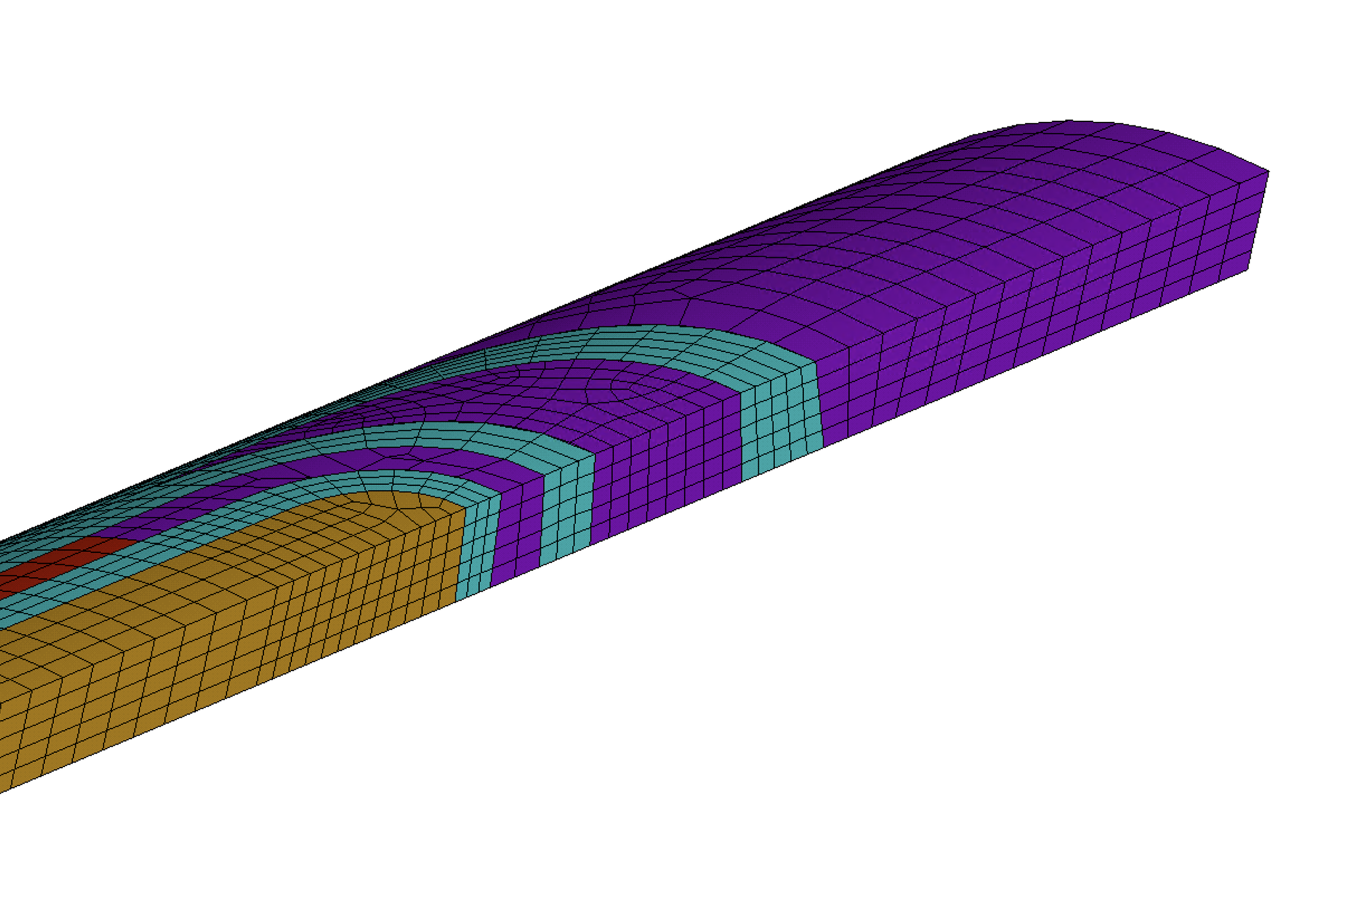
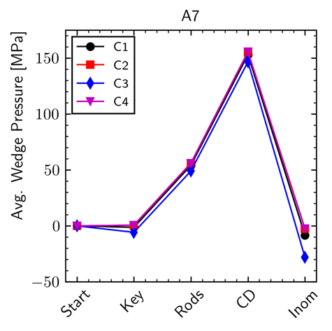
Finite element analysis 360-degrees, full cross-section 3D model
“a3a4 LE area”
Contact between wedge and end spacer in L1
Considering bonded conditions
Tension occurs in Q3 during excitation
Debonding models show interfacial failure
G. Ambrosio - MQXFA magnets - MDP mtg 2/1/23

Slide 21
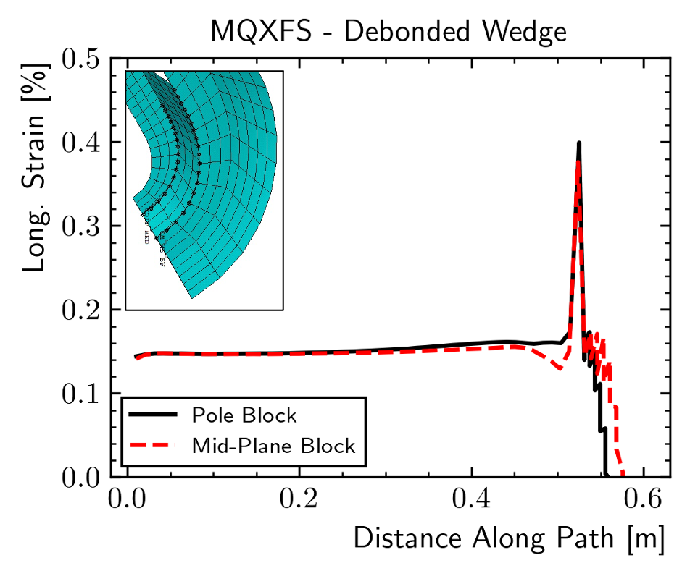
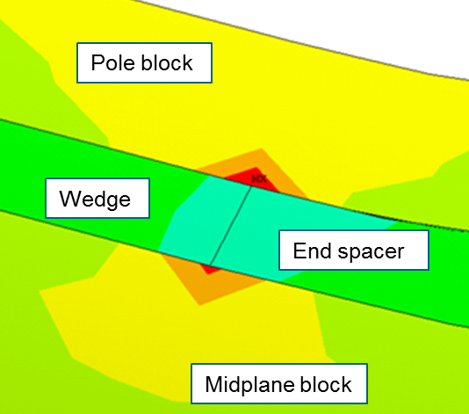
Finite element analysis 45-degrees, octant 3D model
More detailed analysis using the octant model
Not bonded, as if epoxy cracking has already occurred
The gap between wedge and end-spacer induces a spike in axial strain in the coil which can reach the 0.4% level
Larger increase in the pole block turn
LL2
G. Ambrosio - MQXFA magnets - MDP mtg 2/1/23

Slide 22
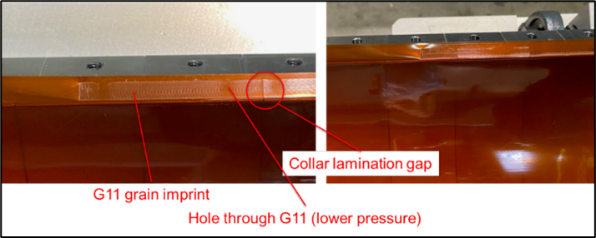
Magnet Dis-assembly
Pressure imprint on the Kapton in Q3 pole-key gaps
Absent in the other coils

Slide 23
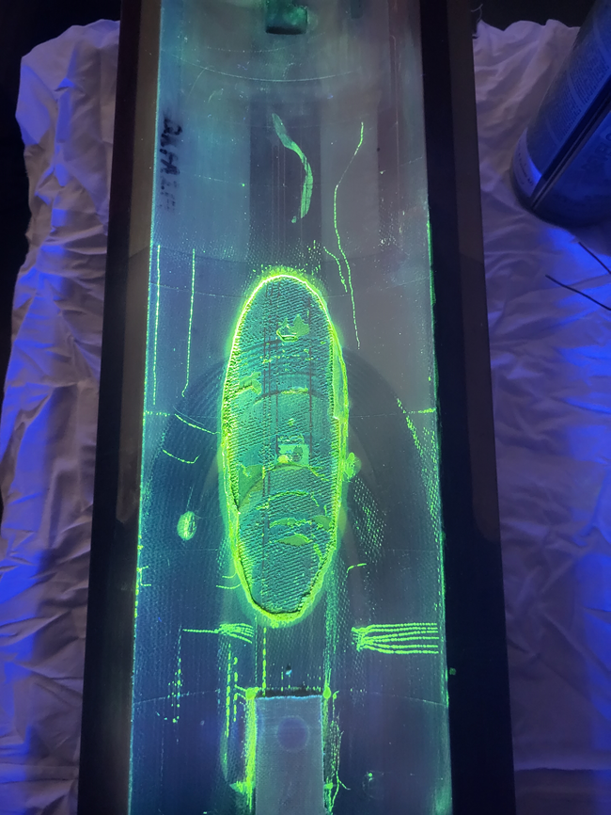
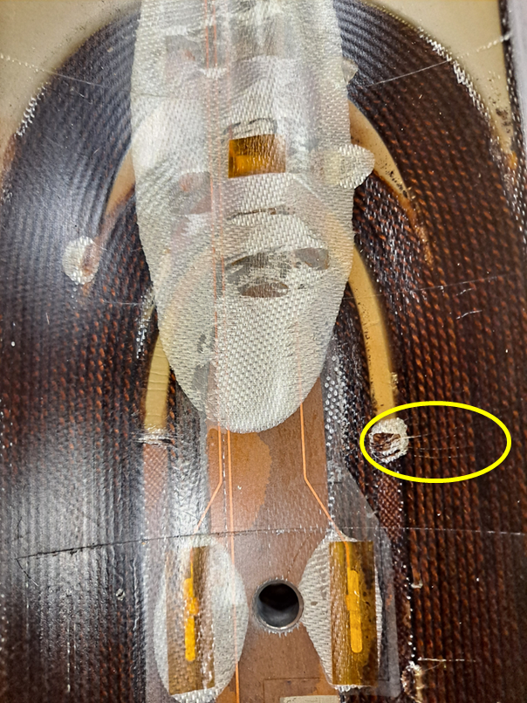
Unusual marks at wedge-spacer interface in the lead end of coil 214 (in Q3)

Slide 24
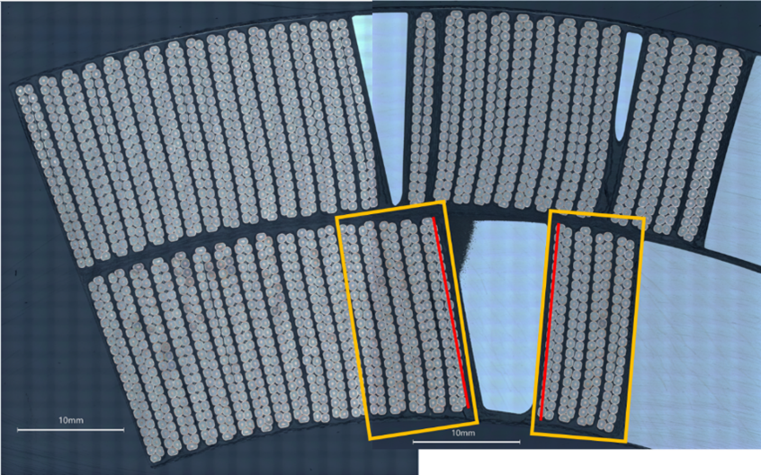
Micrographic Analysis of Coil 214 Lead End
CT-scan, dye-penetrant test and metallurgical analysis by CERN teams
Outstanding collaboration!
S. Sgobba et al., “Advanced Examination of Nb₃Sn Coils and Conductors for the LHC luminosity upgrade: Computed Tomography and Materialographic Analyses”, this session
Analysis started with sample #1: wedge-spacer interface
By B. Bulat, CERN
No anomalies found in cross-section #1.
Therefore, we did longitudinal sections
By M. Crouvizier, A. Moros, S. Sgobba, CERN

Slide 25
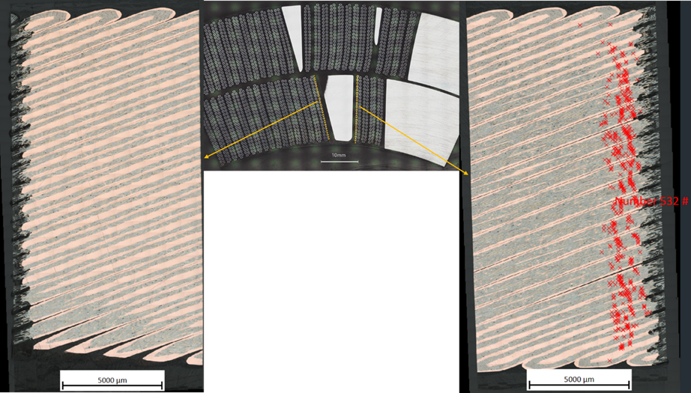
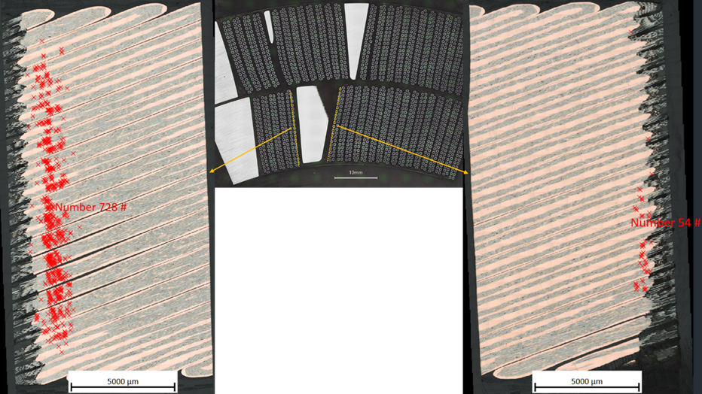
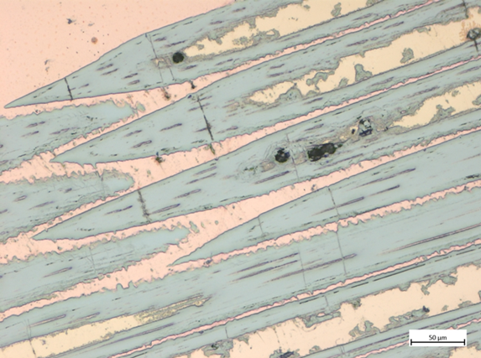
Metallurgical inspection: the smoking gun!
Longitudinal cuts on cables adjacent to the end-spacer/copper-wedge transition
Localized field of broken filaments (red dots), especially at pole block
By M. Crouvizier, A. Moros, S. Sgobba, CERN
# | Samples adjacent to W-S transition from coil 214 Lead End | Number of cracked filaments
1 | Layer-jump side, cable in midplane block, side adjacent to W-S transition | 0
2 | Layer-jump side, cable in pole block, side adjacent to W-S transition | 532
3 | Non-layer-jump side, cable in midplane block, side adjacent to W-S transition | 54
4 | Non-layer-jump side, cable in pole block, side adjacent to W-S transition | 728
5 | Same cable of sample 4, side opposite to the W-S transition | 0

Slide 26
MQXFA08 Analysis
Same features as in MQXFA07
Metallographic analysis of lead end shows broken filaments at wedge-spacer interface
By M. Crouvizier, A. Moros, S. Sgobba, CERN
S. Sgobba et al., “Advanced Examination of Nb₃Sn Coils and Conductors for the LHC luminosity upgrade: Computed Tomography and Materialographic Analyses”, this session

Slide 27
Based on these findings, we understand that coil 214 pole-key gaps were closed at cold, whereas those of other coils were open. During magnet energization this difference caused tensile strain at wedge-spacer interfaces in coil 214 ends. In early ramps to quench (possibly before or during ramp #4) the bonding between the copper wedge and the resin (filled with S-e glass) gave away in the lead end increasing the strain on the strands closest to that interface. The “increased” strain degraded some strands and triggered the enhanced self-field instability behavior. This mechanism caused quench #4 and all subsequent quenches at 1.9 K and 20 A/s.
These quenches with hot-spot close to the wedge-spacer interface may have exacerbated this mechanism increasing the local strain and strand damage, and therefore causing the current drop (~1 kA) from quench #4 to #8.

Slide 28
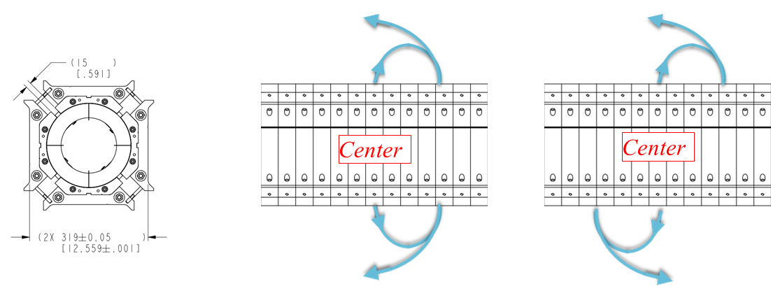
Covid impact
Changes to assembly procedures caused by COVID requirements
#1: change in bolting procedure for increasing tech distance
#2: the technician who had been leading the coil-pack assembly operations was removed from that task (starting from MQXFA06) because not vaccinated.
COVID lockdown
➔ Stop in fabrication of coil 214 after Inner-Layer was cured may have weakened wedge-spacer bond
Less supervision caused by COVID
➔ increased probability of non-uniform pole-key gaps and other differences.
Courtesy of P. Ferracin and D. Cheng

Slide 29
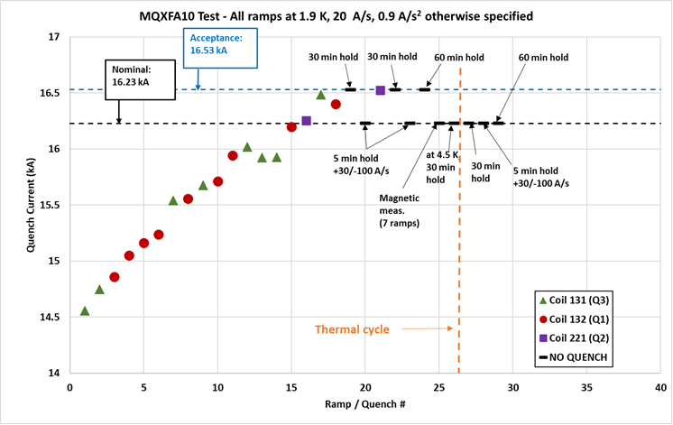
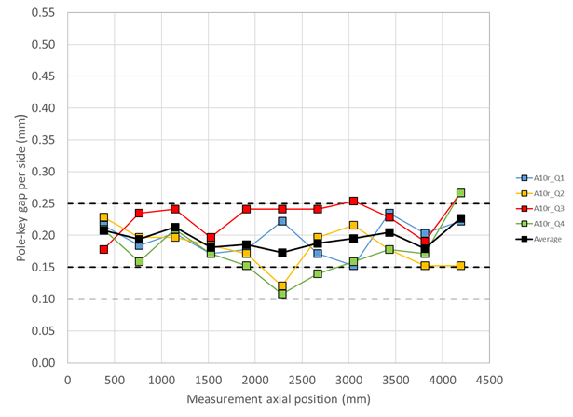
Preventive Actions
In order to prevent reoccurrence of this issue,
Design change for larger pole-key gaps:
From 200 μm to 400 μm - average pole key gap per side
Revised MQXFA Series Magnet Production Specification:
Added spec for minimum gap on each coil at each longitudinal location: 300 μm per side
D. Cheng et al., “The challenges and solutions of meeting the assembly specifications for the 4.5 m long MQXFA magnets for the Hi-Luminosity LHC” 2LOr2A-02
MQXFA10 Pole-key gaps
MQXFA10 Quench History
Courtesy of P. Ferracin
Courtesy of A. Ben Yahia

Slide 30
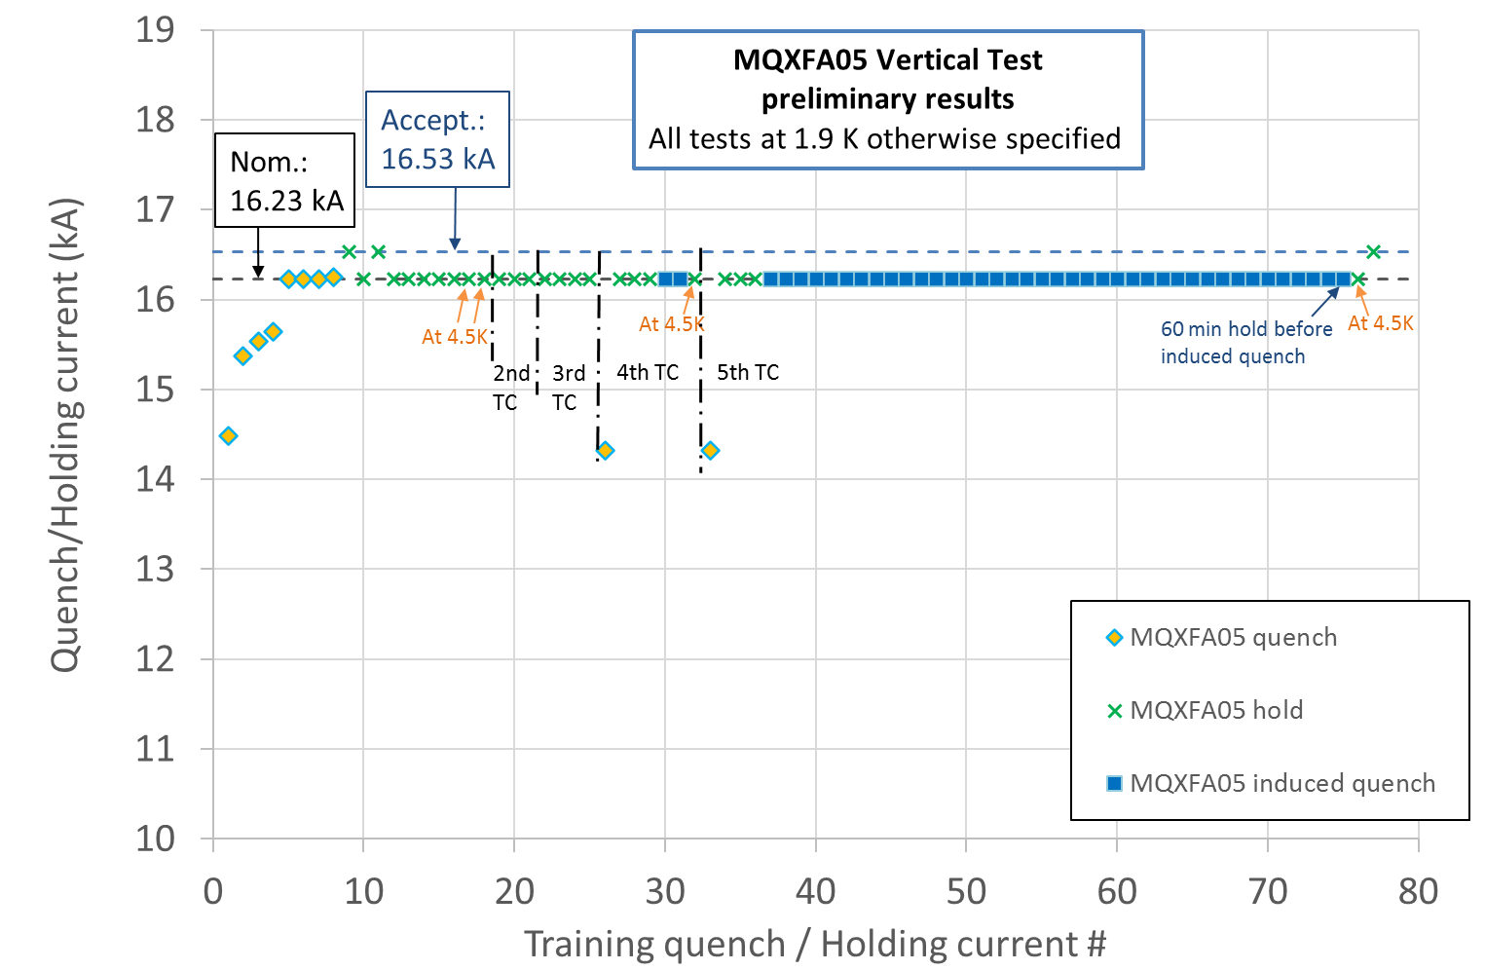
Endurance Tests
Previous endurance tests were successfully performed on short models
MQXFA05 met requirements after 5 thermal cycles, 52 quenches and 79 powering cycles
5 Thermal cycles
52 quenches (10 spontaneous + 42 induced)
79 power cycles (52 quenches + 27 cycles w/o quench) above 10 kA.

Slide 31
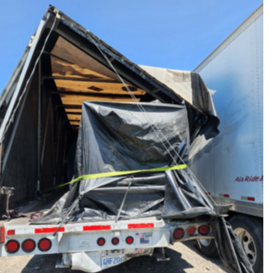
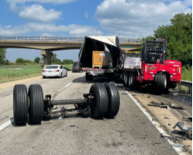
MQXFA11 “Resilience Test”
The truck transporting the MQXFA11 magnet from LBNL to BNL was rear ended by another truck.
The main hit took place on the right back corner. During the incident the truck rear axle disengaged as displayed below. Nobody was injured.
The magnet was moved to FNAL. Upon arrival a visual inspection was performed followed by electrical checkout, metrology survey, analysis of the fiber optic sensors and accelerometer data analysis
Max shock: 6 or 10 g vertical (depending on the device in the same accelerometer unit)
Duration: 5 ms
All tests and analyses were OK. Magnet was shipped to BNL
Courtesy of T. Cruise
Courtesy of J. Blowers

Slide 32
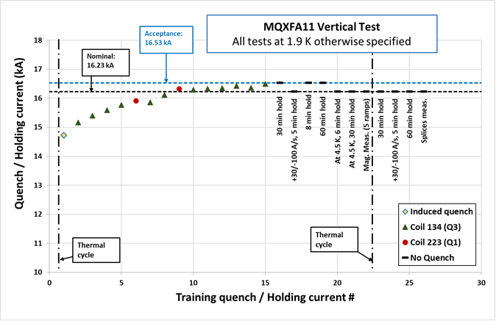
MQXFA11 “Maverick” Quench History
Courtesy of A. Ben Yahia

Slide 33
Conclusions
6 out of 8 successful MQXFA vertical tests
MQXFA07/08 “smoking gun” was found
Mechanism is understood
Covid restrictions and lockdown contributed to the degradation mechanism
Design change (larger gaps) and Specification revision (minimum gaps spec.) are going to prevent reoccurrence in future magnets
MQXFA10 & MQXFA11 demonstrated that this issue is over
MQXFA05 demonstrated Endurance
MQXFA11 demonstrated Resilience

Slide 34
Backup Slides

Slide 35
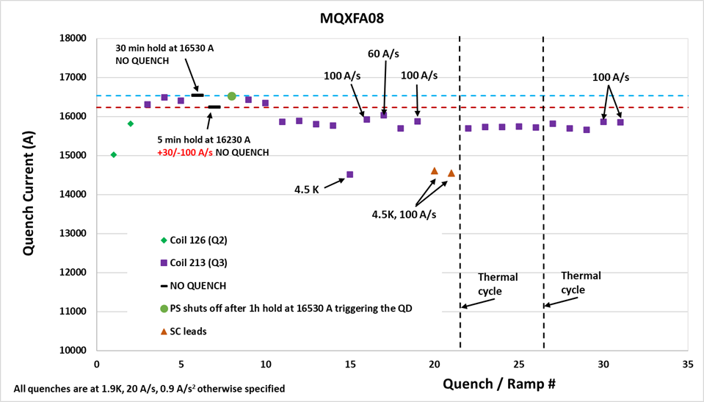
MQXFA08 Quench History
Fixed 42-nohm splice to test facility
Connected voltage taps to coil 213 LE

Slide 36
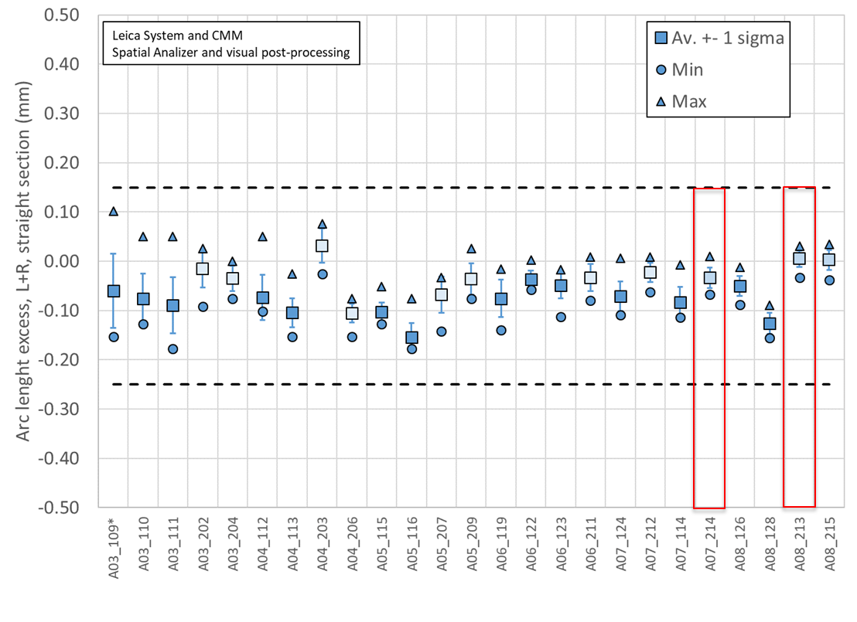
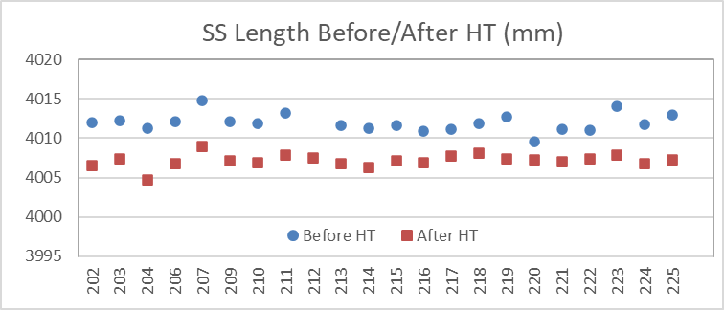
Assessment of MQXFA Data & Travelers
Completed assessment of travelers for Coil Fabrication at BNL, and Magnet Assembly at LBNL:
Assessment of coil parameters, which are being tracked, did not show any anomaly
Coil traveler assessment did not show any issue in addition to known DRs
Assessment of magnet assembly & preload data in next slides

Slide 37
Copper wedge
Resin with S-2 glass
End spacer & ceramic coating
Left: coil section after samples were extracted for metallographic inspection.
Center: color scheme used to show the position of filament cracks with respect to the W-S transition in the following figure. A: End spacer + ceramic coating ≈ 0,5 mm; B: resin (filled with S-2 glass) between end spacer and wedge ≈ 1,5 mm; C: copper wedge.
Right: color scheme applied on sample with broken filaments.
By M. Crouvizier, A. Moros, S. Sgobba, CERN

