Slide 1
TFD Superconducting Wire and Cable
Ian Pong (ipong@lbl.gov)
On behalf of the Cabling Team
Lawrence Berkeley National Laboratory

Slide 2
Outline
First cables “Development”
Second cable “Prototype”
Nb₃Sn wire for “Production”
What diagnostics we have
What was observed and our interpretation
Plan for the next step
Lessons learnt from MQXFA cable production
Conclusion

Slide 3
First Cables “Development”
W10OL1301 – used 108/127 strands.
W12OL1302 – used 162/169 strands.
Publication: https://doi.org/10.1109/TASC.2021.3094410
Key findings:
  Pre-cabling annealing significantly reduced residual twist
  Facet period is comparable to MQXFA cables
  Metallographic results are very promising
  XS RRR is above spec with comfortable margin
  Hardware – roller keyway slot cracked (lesson learnt, improved)

Slide 4
XS RRR of W12OL1302

Slide 5
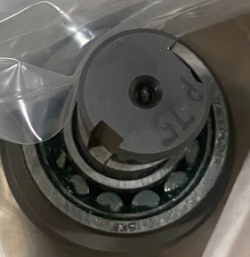
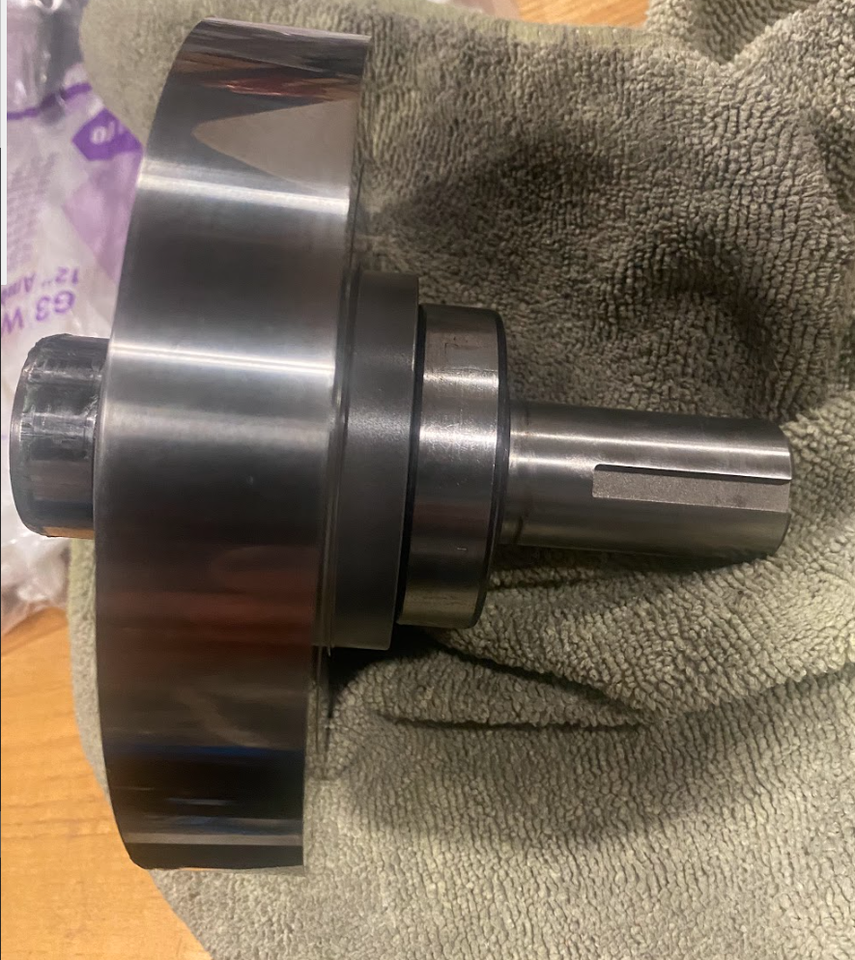
Roller Keyway Redesign
Before
After

Slide 6
Second Cable “Prototype”
W12OL1303 – used 162/169 strands, made ~380 m
Special seminar on 2022 05 18
Mapping: 5 billets, 8 spools

Slide 7
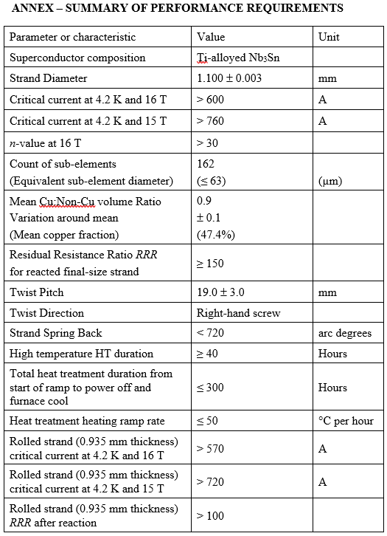
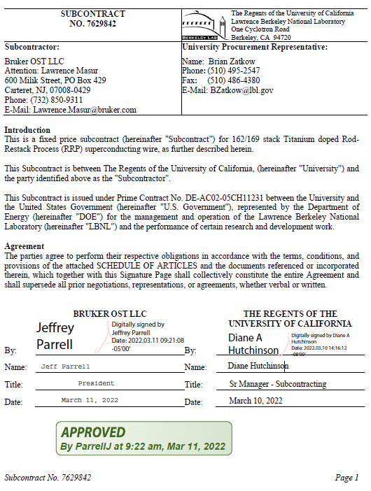
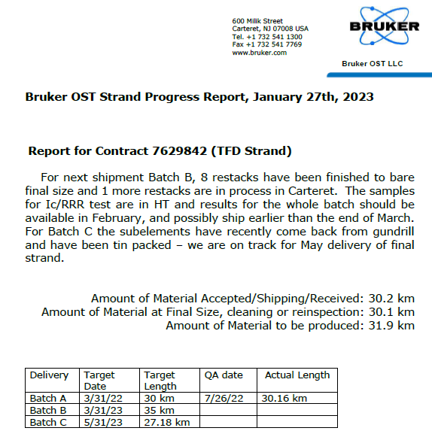
Nb₃Sn Wire for “Production”
2021 10 28 Wire Specification Review
Project chose BOST RRP® 162/169 Design
TFD production wire spec
LBNL PO 7629842

Slide 8
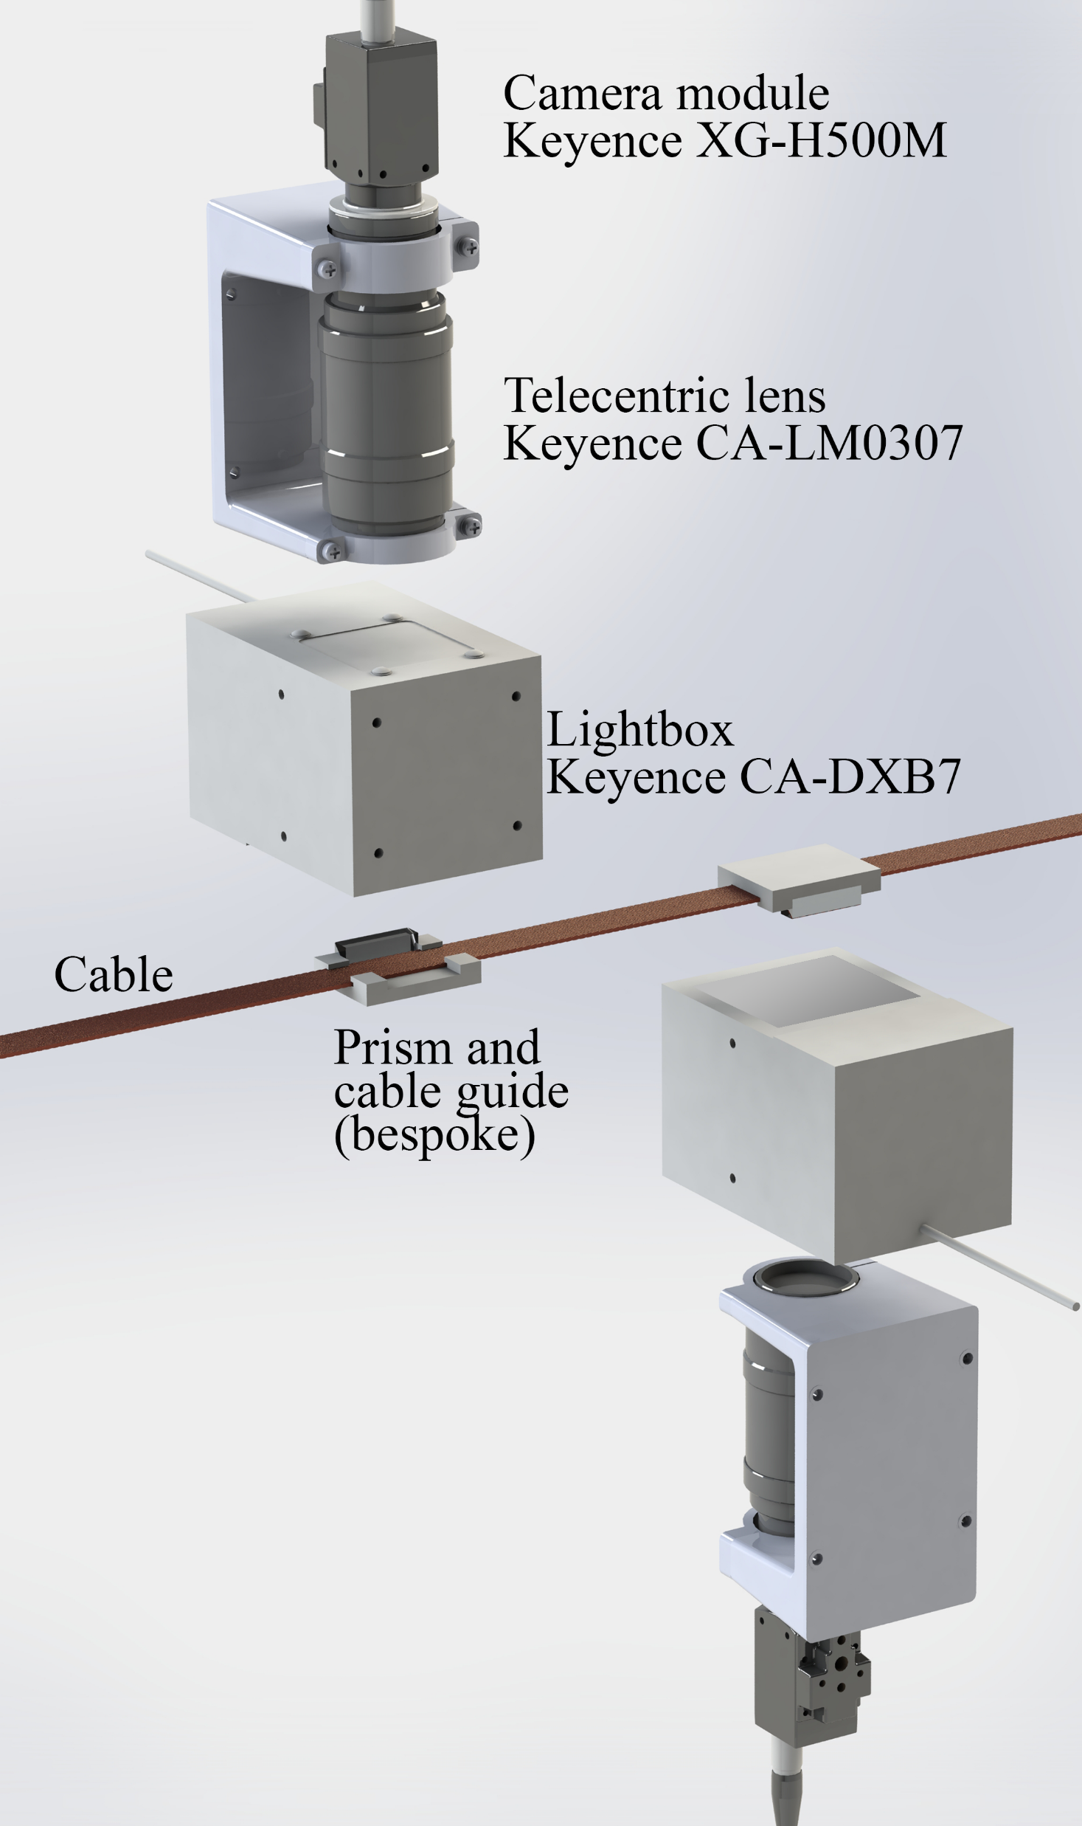
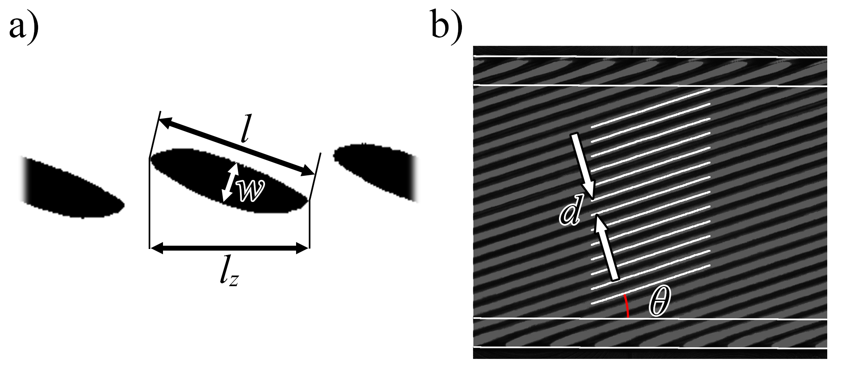
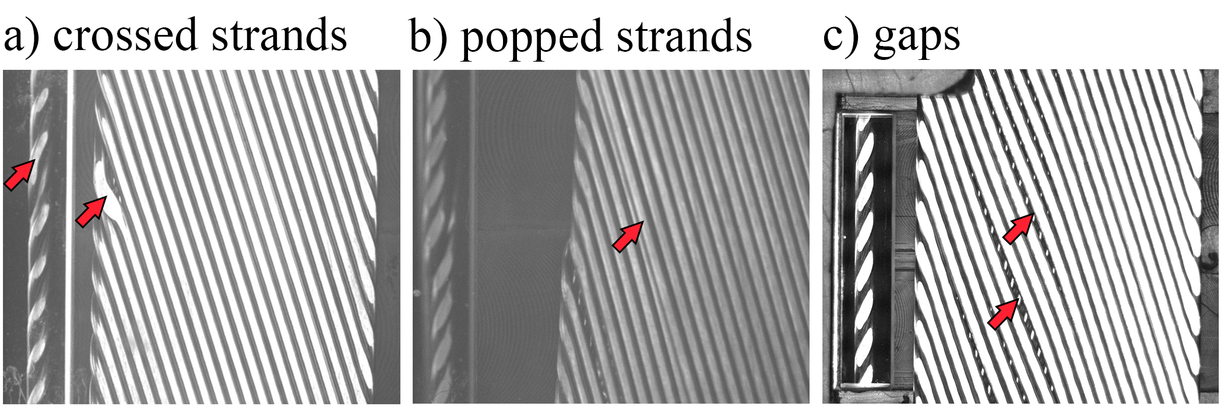
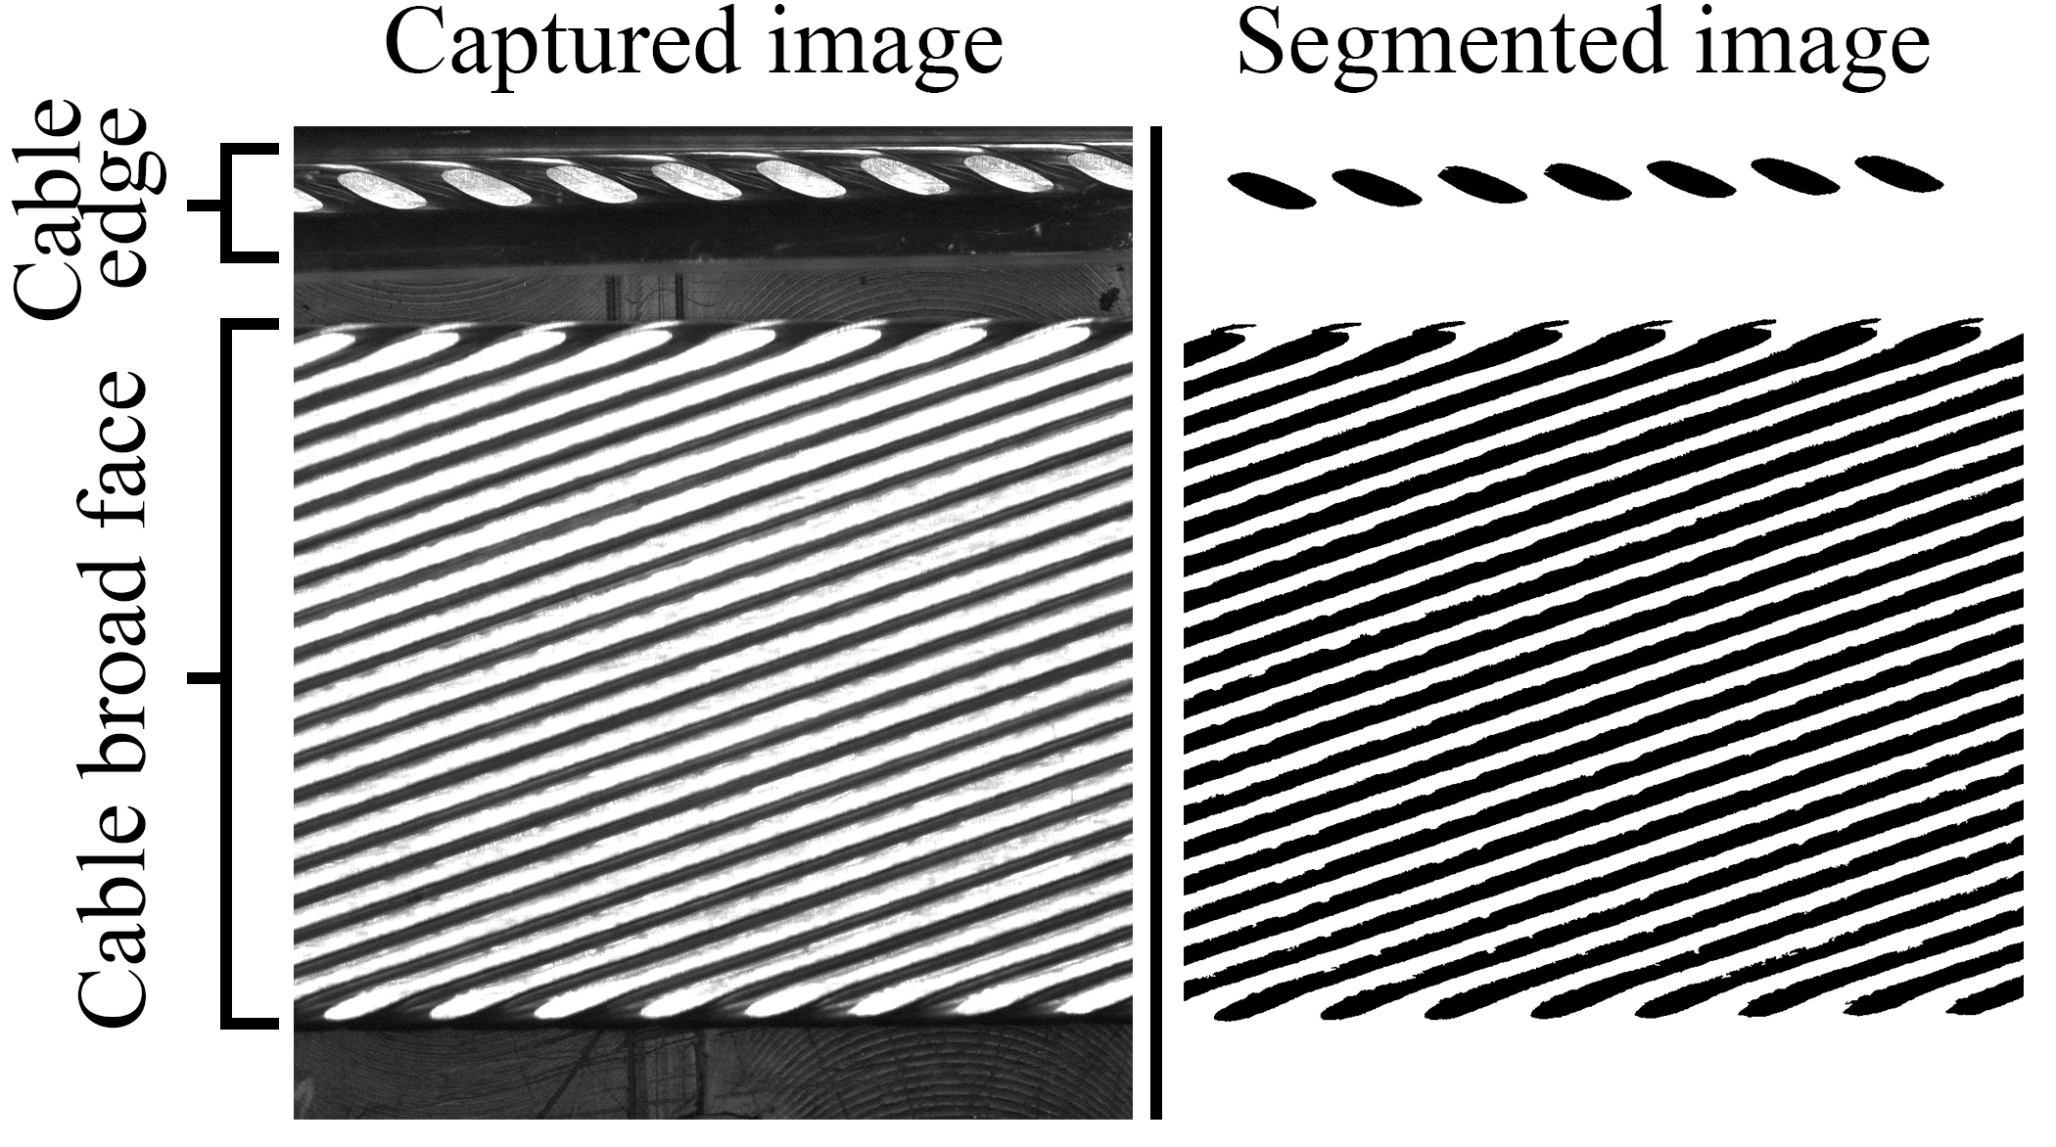
Cabling Diagnostics
Keyence Image Analysis
Publication: ASC 2022 IEEE TAS
CME
Turkshead tension
Operator!

Slide 9
Observations and Interpretation (1)
One billet (20516) had observably low RRR, found to contain mid-piece defects
There is a spread of springback property on annealed wire
During startup, strong springback of cable upon exiting aperture
Top roller closed down considerably (~0.33 mm on ~1.89 mm) to achieve cable target thickness
Samples feel mechanically stable when close to target thickness
Mandrel axis became mis-aligned with aperture axis
Mandrel also found to be asymmetric

Slide 10
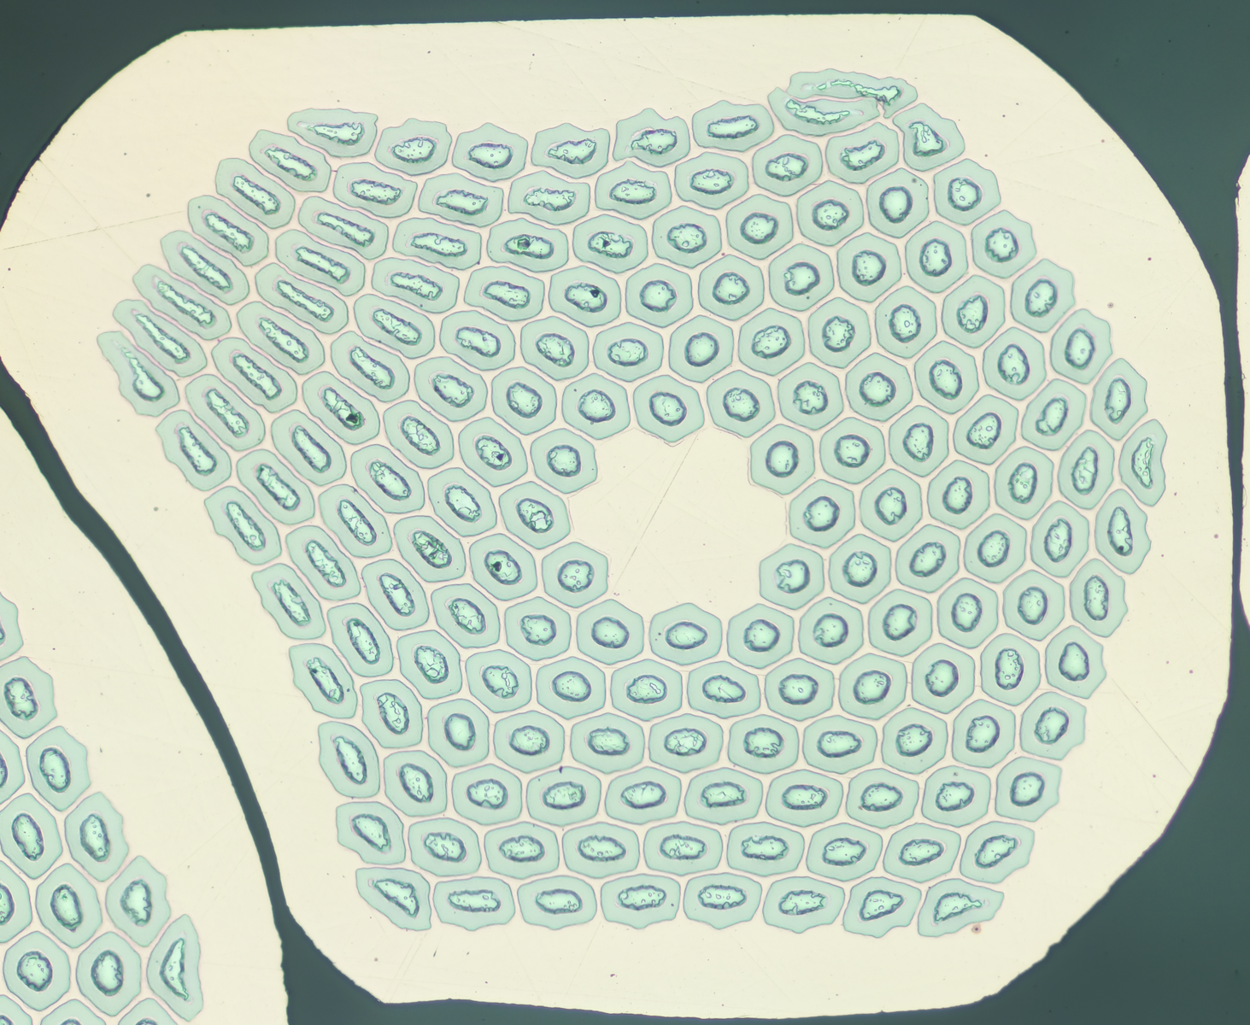
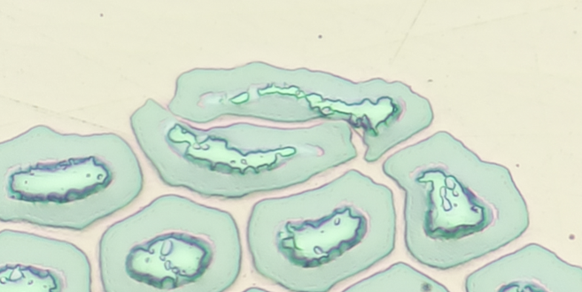
WO11S20506A03A Mid-Length Defect
Not seen at free end
Seen in same strand # away from cable edge (not imaged), i.e. not caused by cabling
Wire manufacturing defect
Risk: Cu poisoning. Avoidable lowering of RRR

Slide 11
Springback & Self-Bend of Wire in W12OL1303

Slide 12
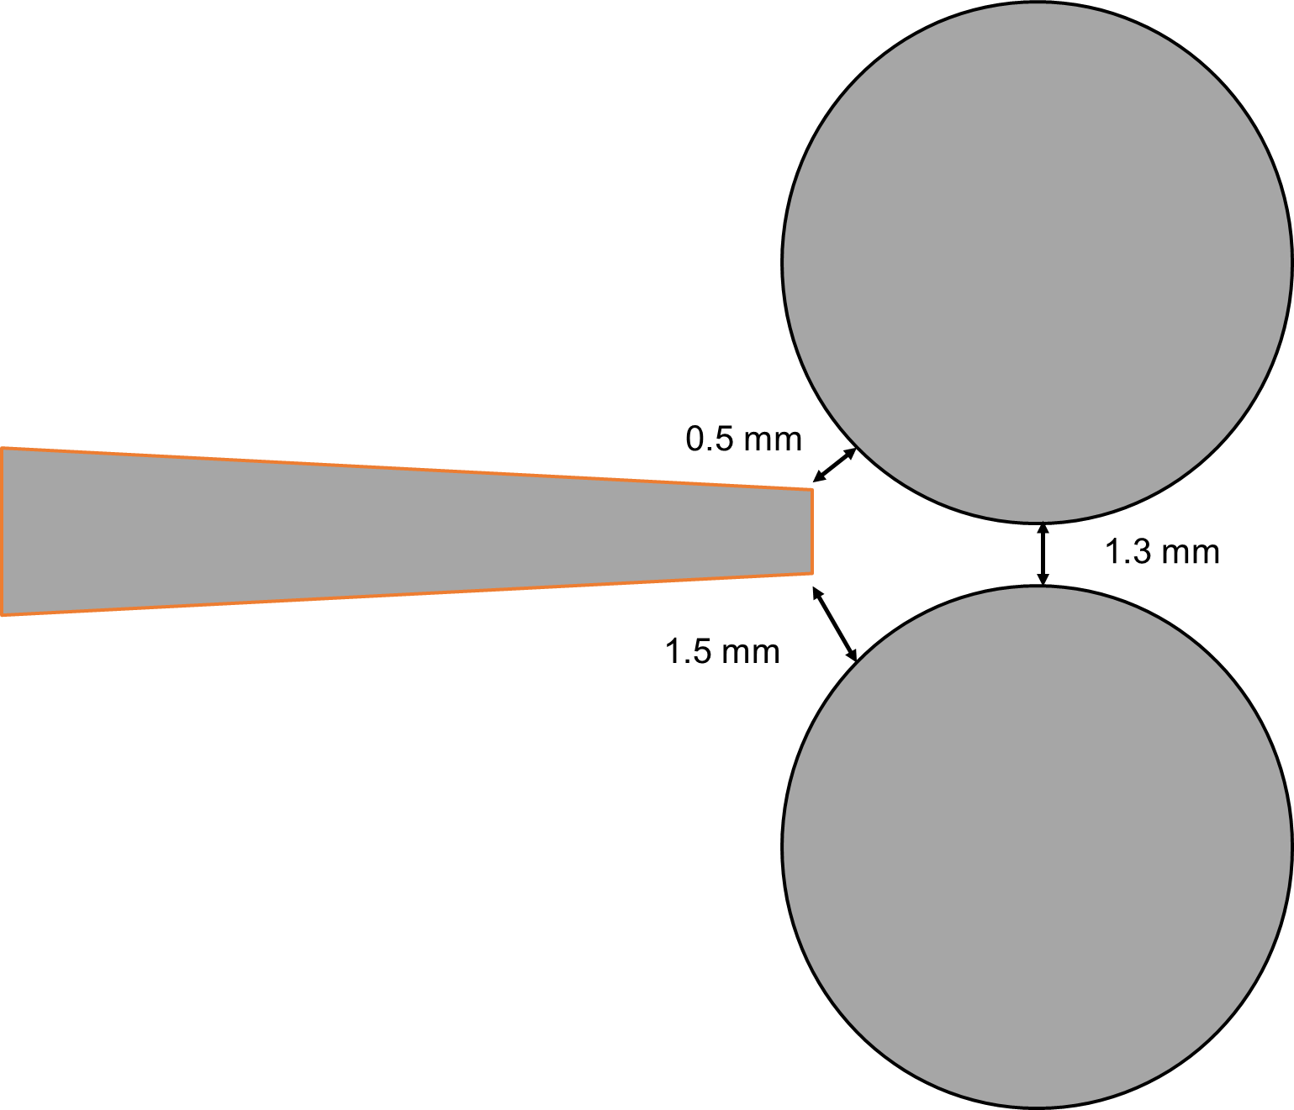
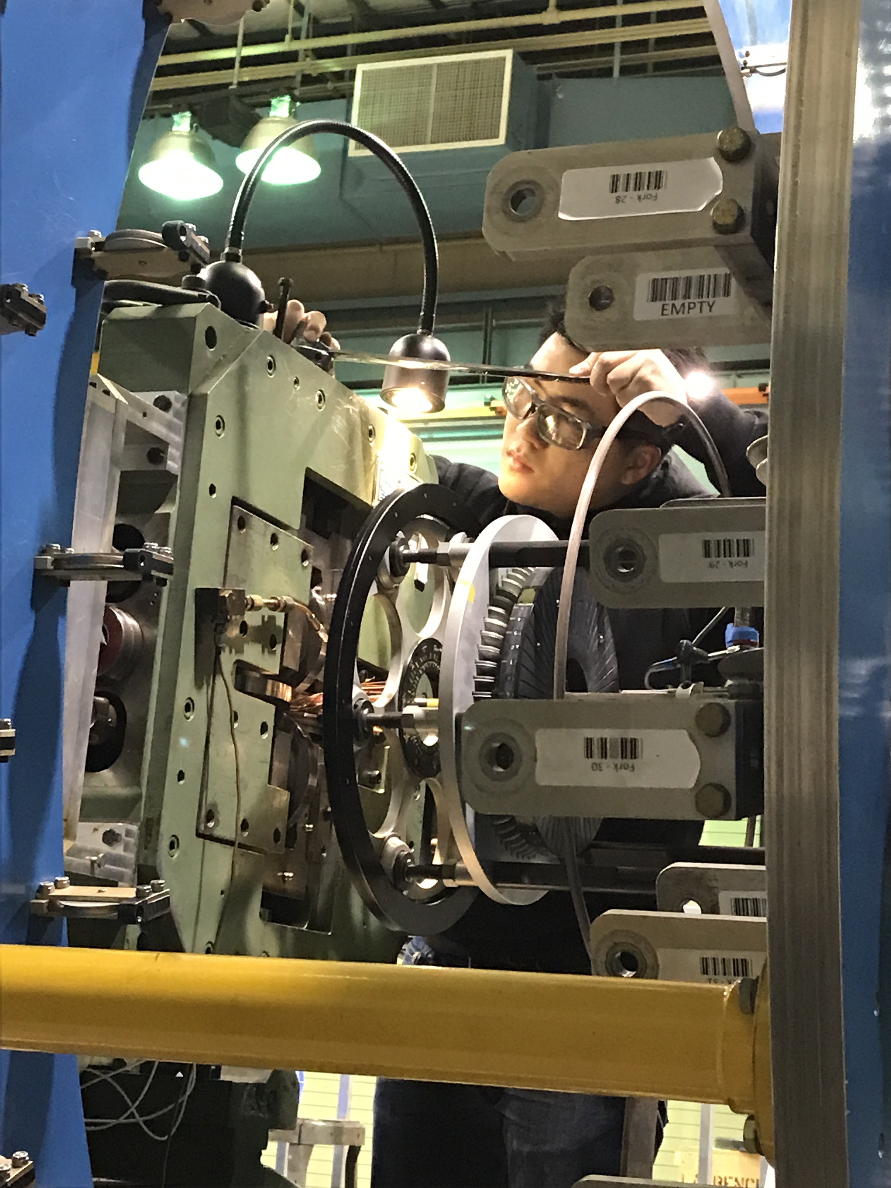
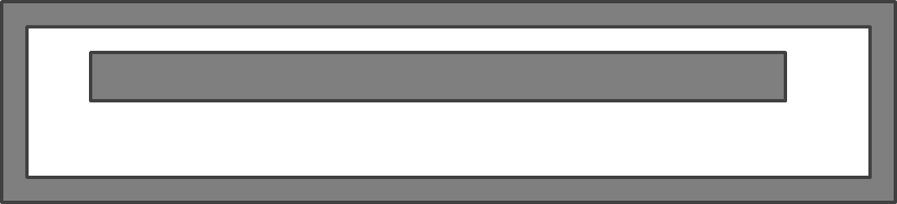
Post-cabling Observation: W12OL1303

Slide 13
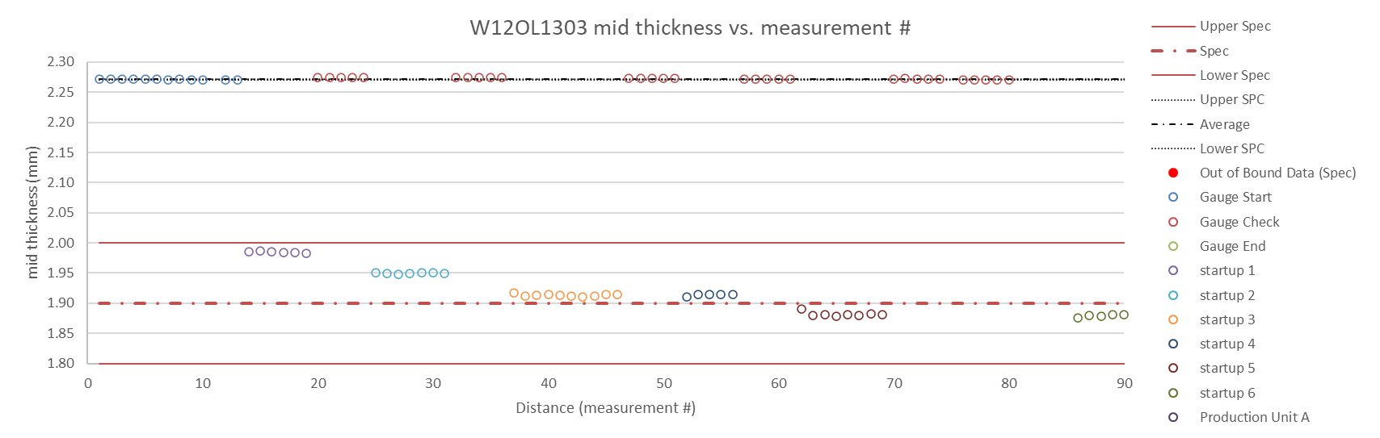
CME Thickness: W12OL1303

Slide 14
Observations and Interpretation (2)
1303-1 thickness ~1.985 mm – large gaps on top face, unstable
1303-3 thickness ~1.913 mm – gaps remain, but now stable
Facet length continues to increase during startup
Top face has “large” gaps throughout – large as noticeable symptom, but would still have been within equivalent spec
Divergence appears to worsen with decreasing cable thickness, consistent with Turkshead asymmetry findings
Despite large facets, RRR is still good with comfortable margin

Slide 15
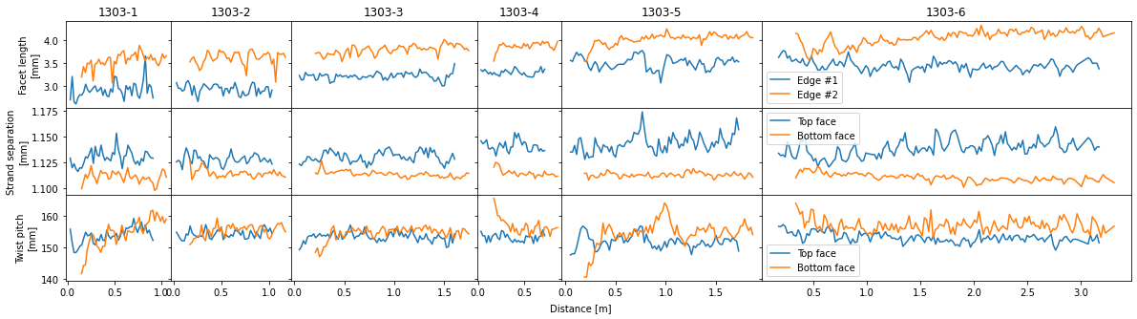
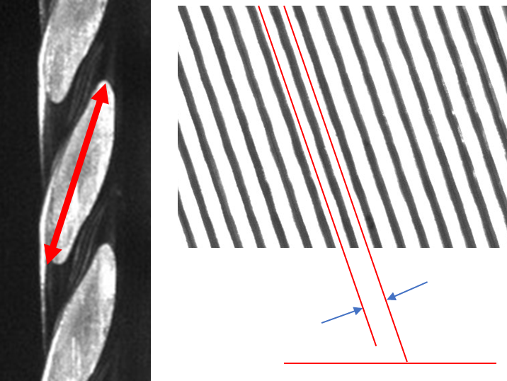
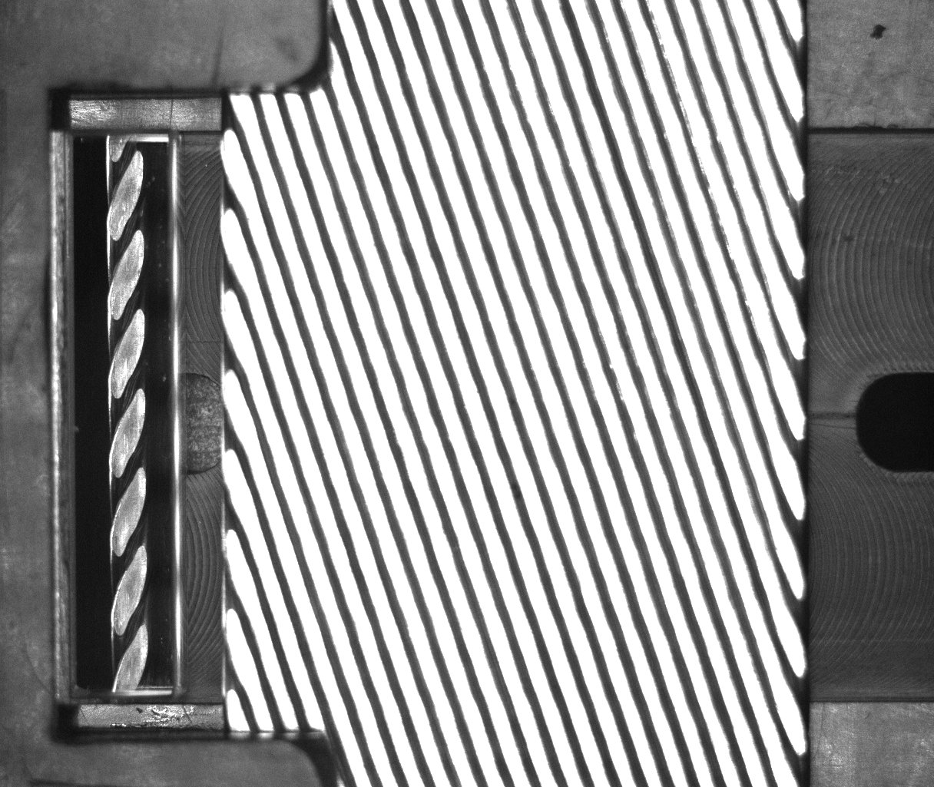
Startup Image Analysis
Cable pitch = 155 mm
44 strands
Overlapping facet length = ~4 mm

Slide 16
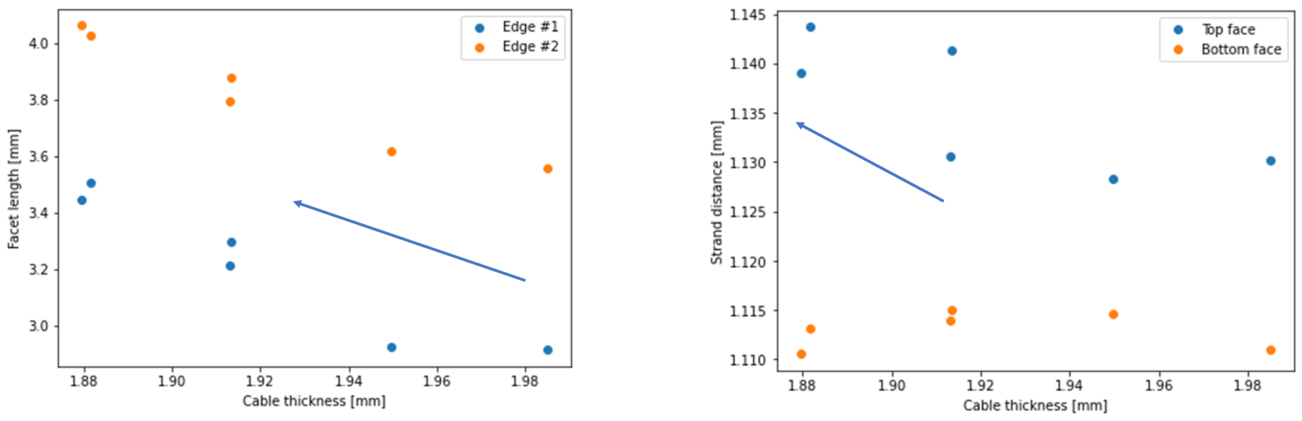
Startup Parameters

Slide 17
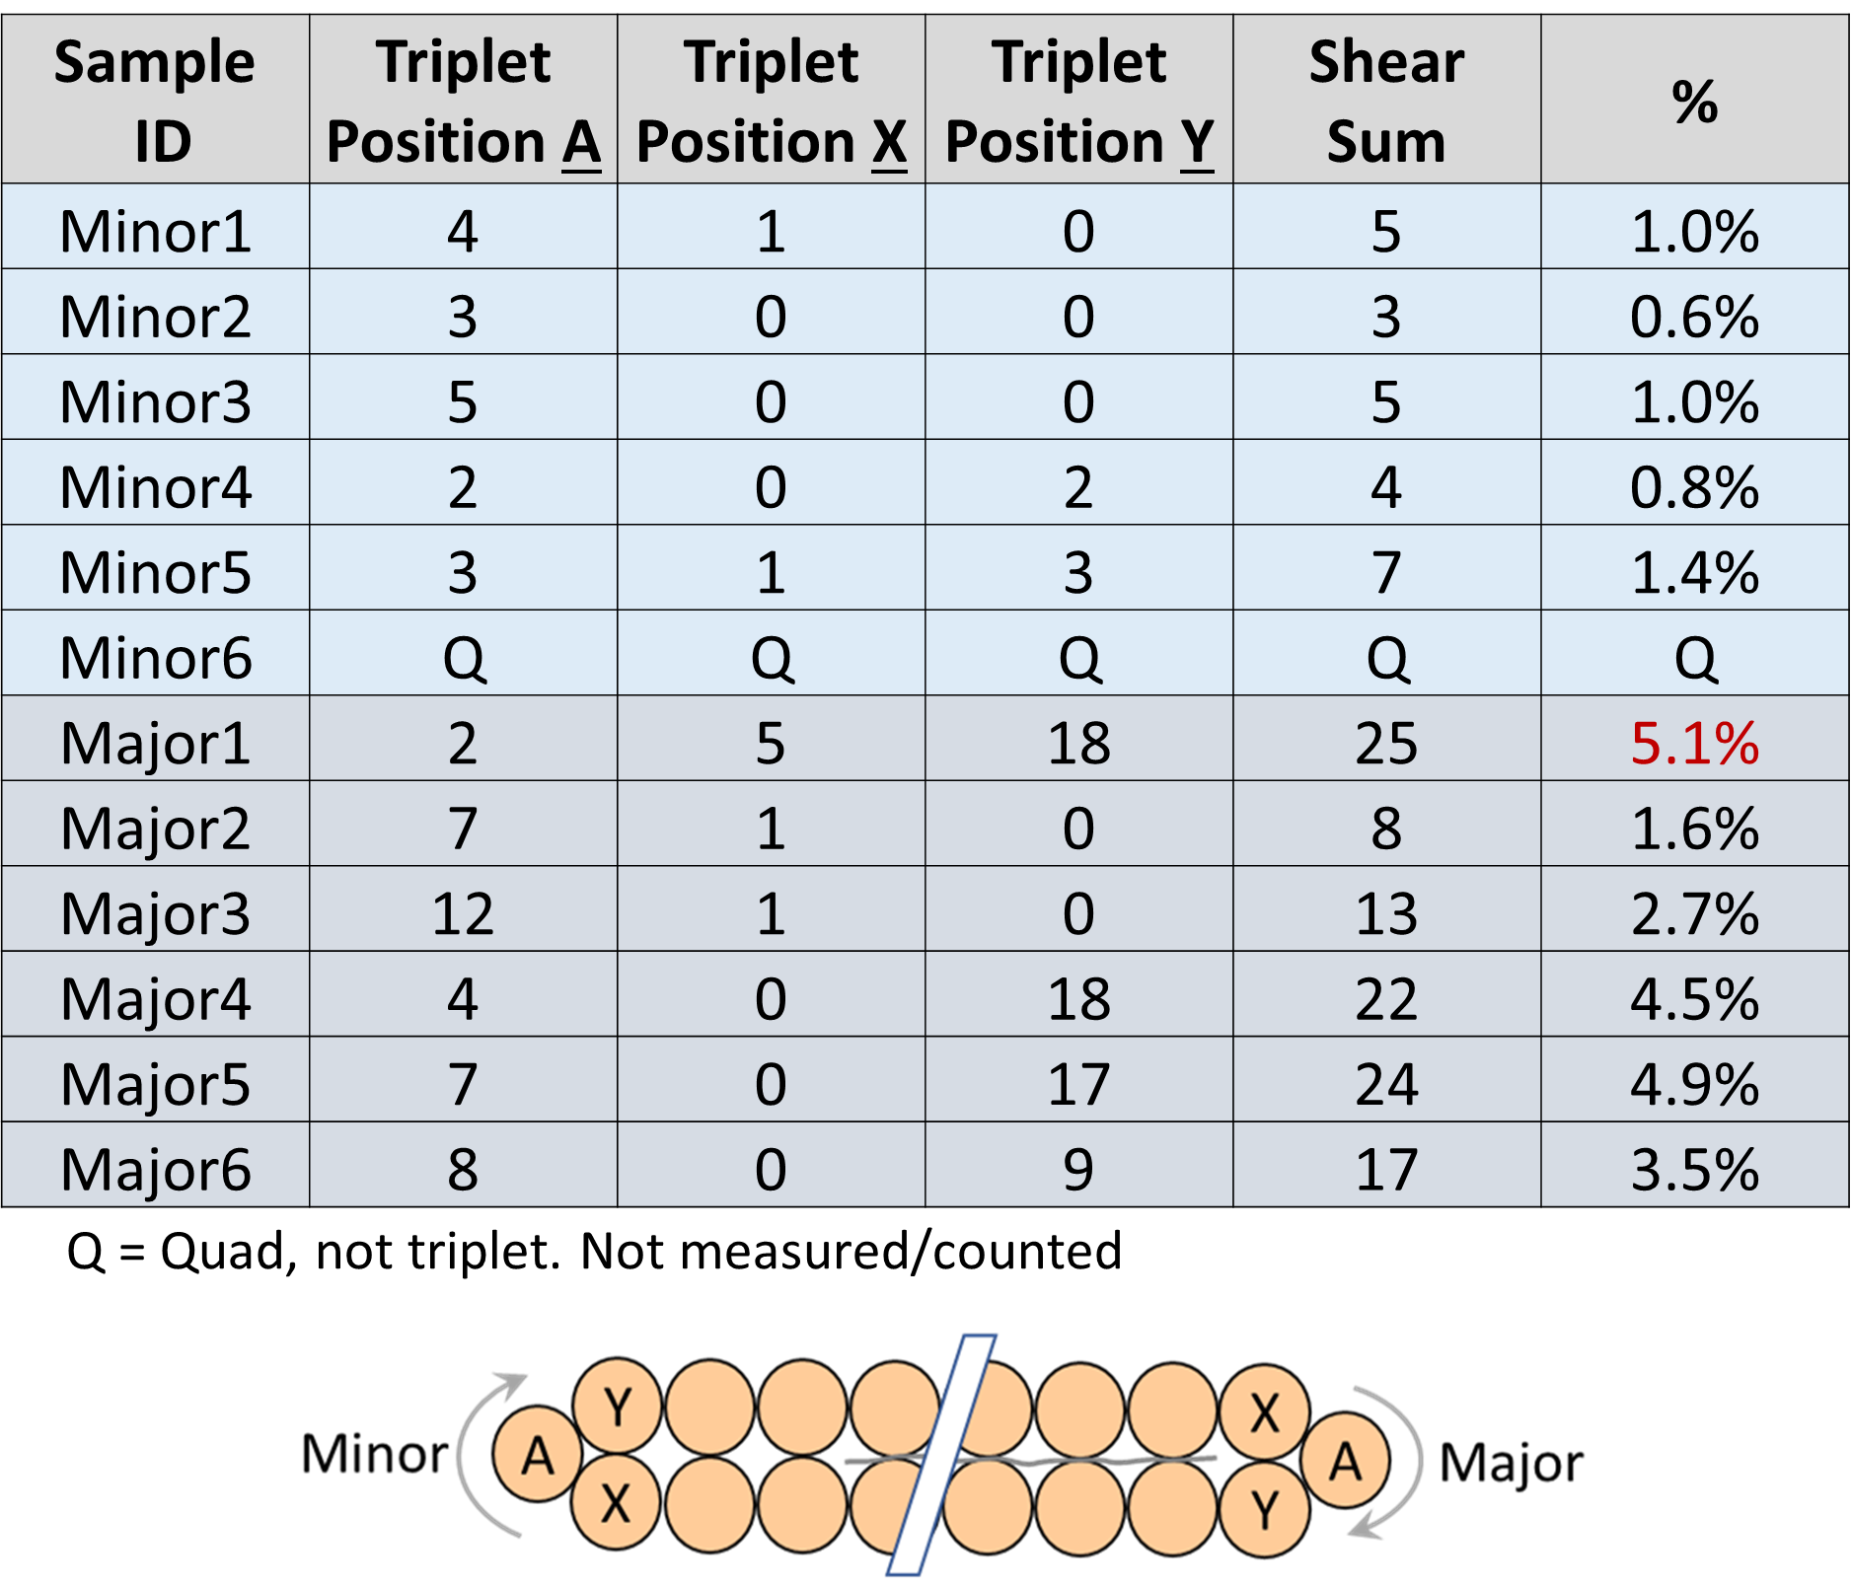
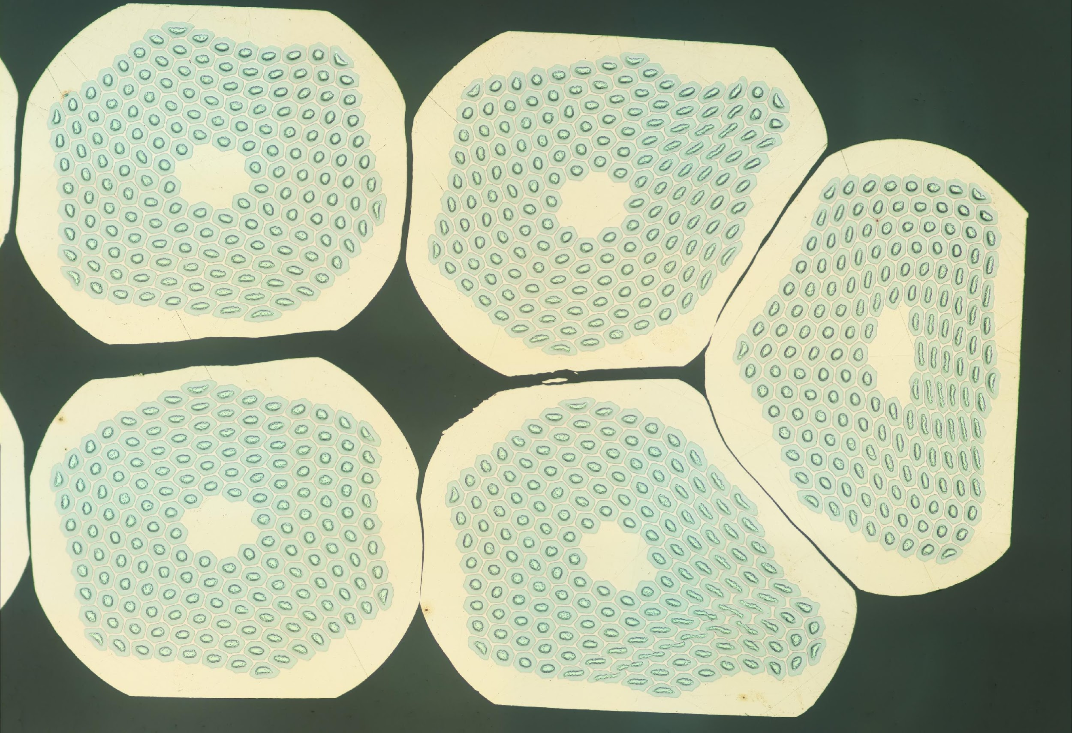
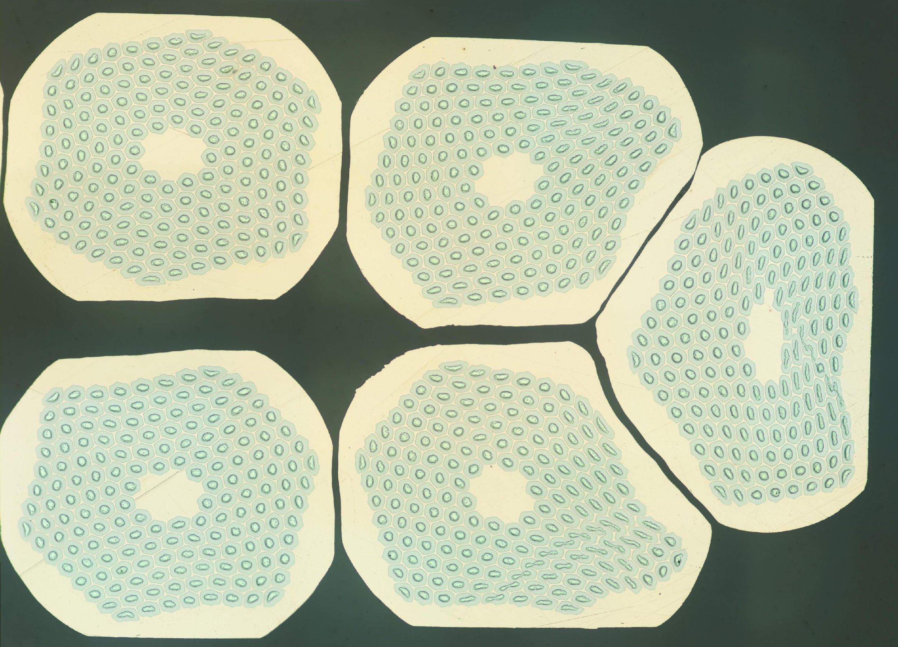
1303-3 Metallography

Slide 18
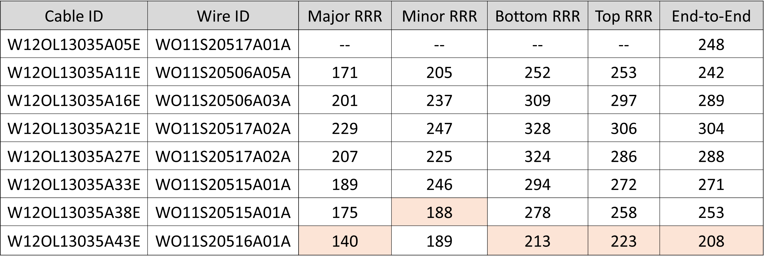
1303-5 RRR
Strand from billet #20516 was lowest individual strand, consistent with vendor RRR data

Slide 19
Production Run 1303-A

Slide 20
Observations and Interpretation (3)
During production, conventional CME data are very stable
Image analysis shows notable periodic correlation with rollers and cable pitch length
Half pitch on top face is significantly shorter, is less compact and resulting in gaps
It is plausible that the top roller ran at a different speed relative to the cable compared to the bottom roller due to friction
Mandrel asymmetry → the cable biased towards the top roller
FFT analysis shows stronger correlation on top broad face
Despite very large facets, RRR is still acceptable with margin

Slide 21
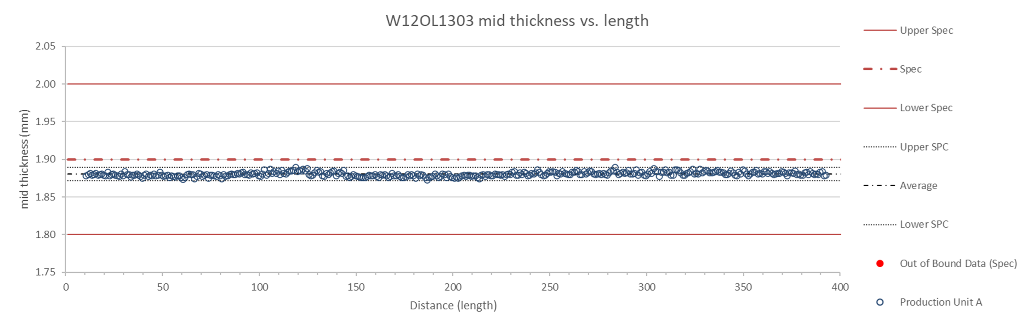
CME – Thickness

Slide 22
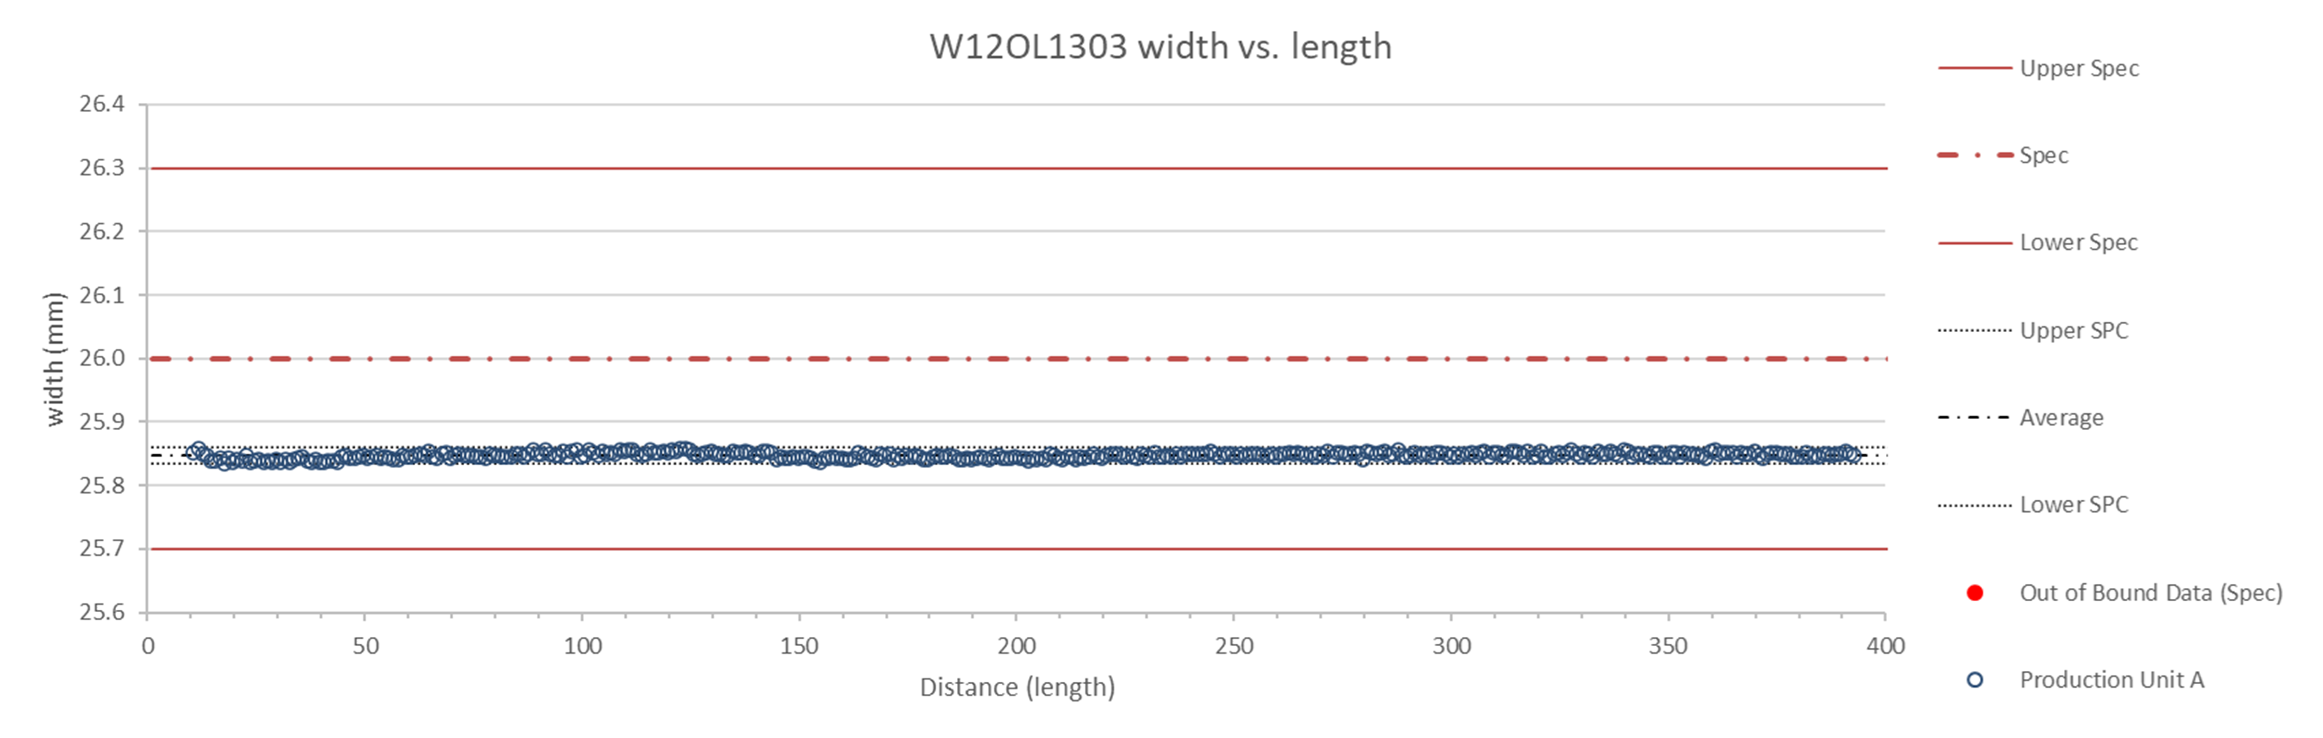
CME – Width

Slide 23
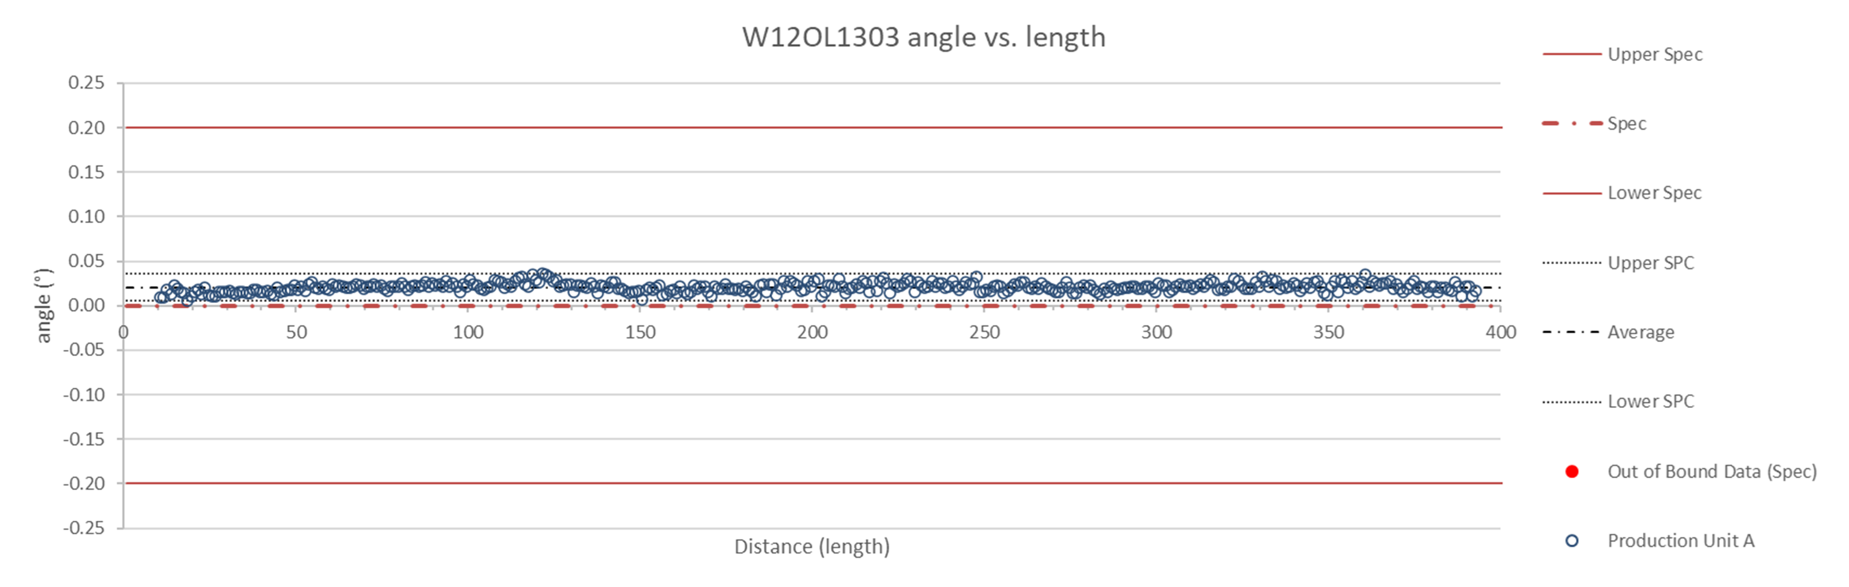
CME – Angle

Slide 24
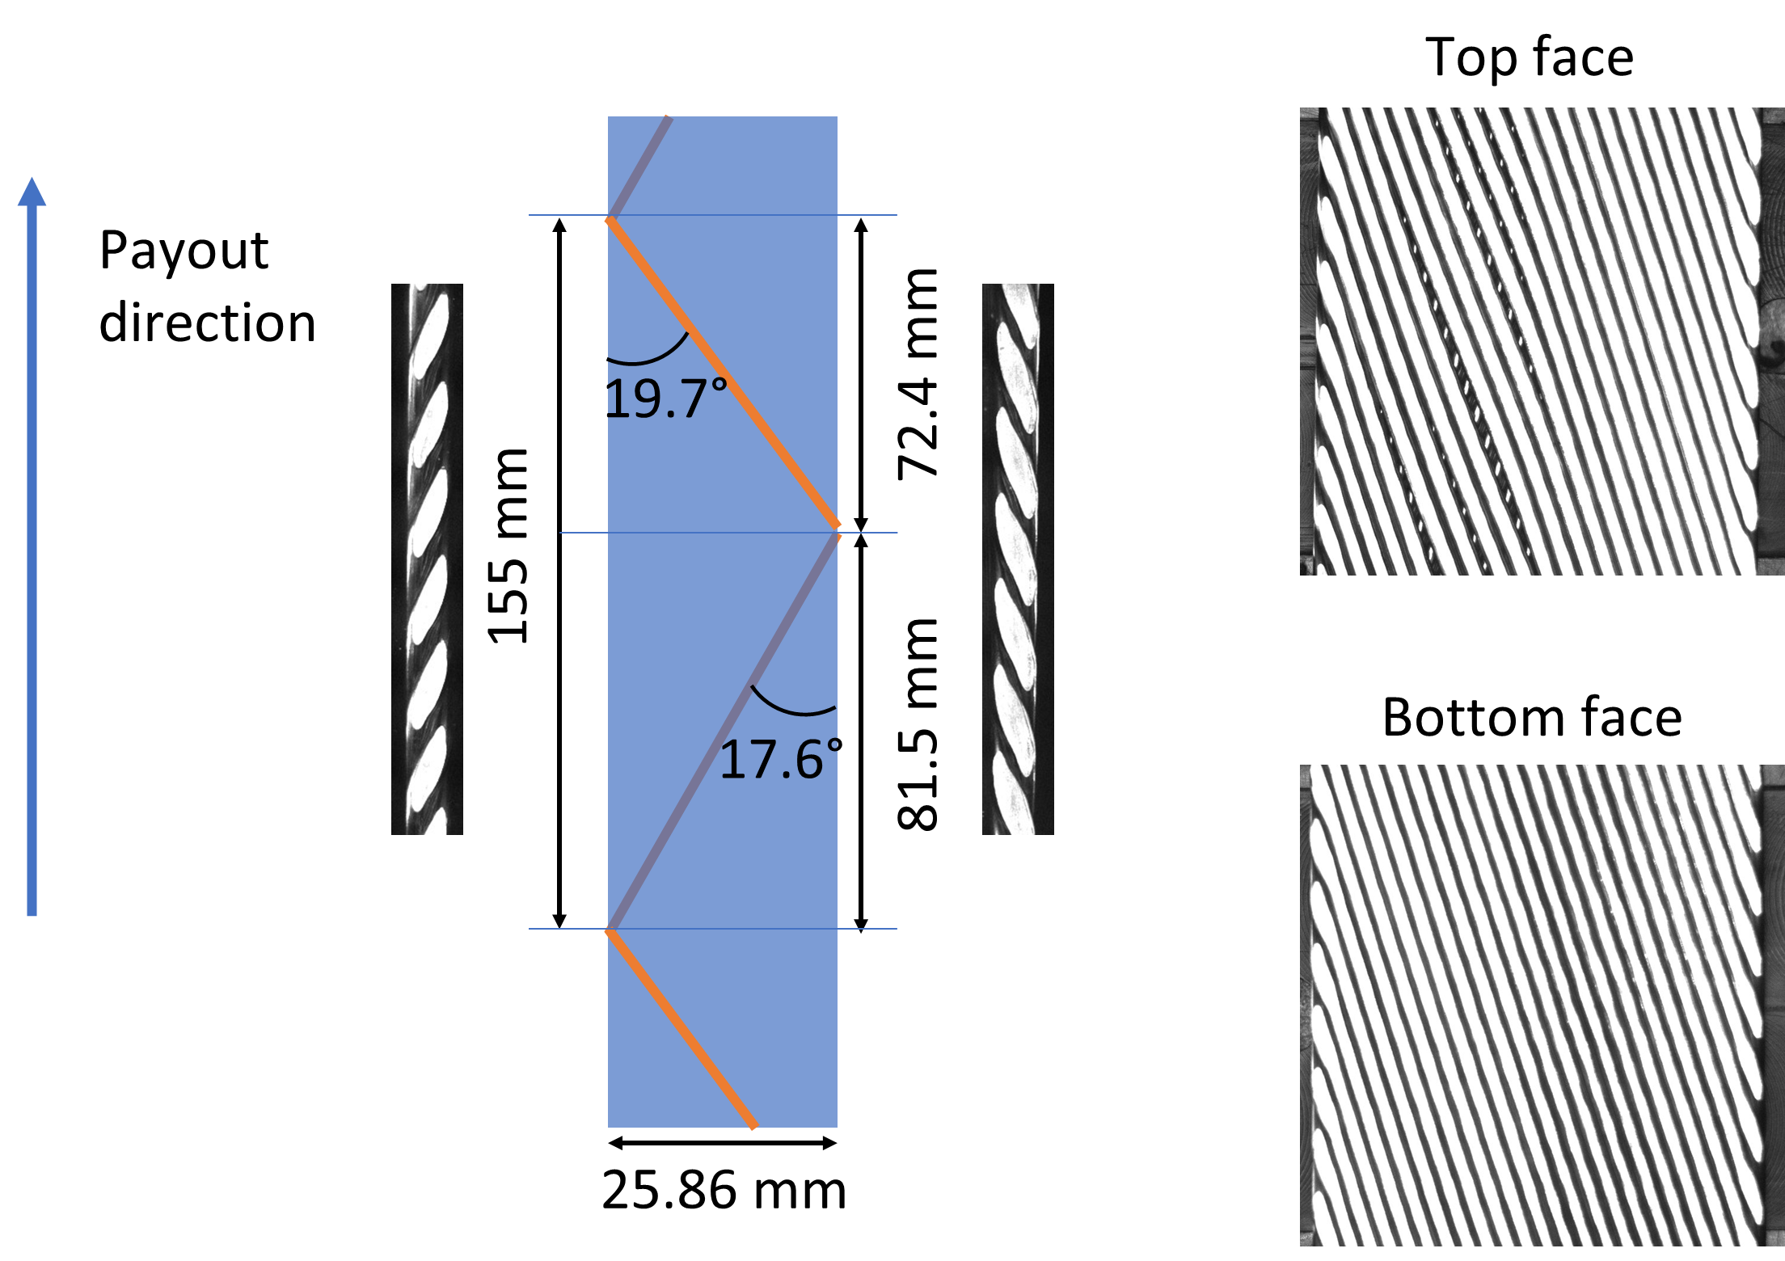
Keyence – Parameters Explained

Slide 25
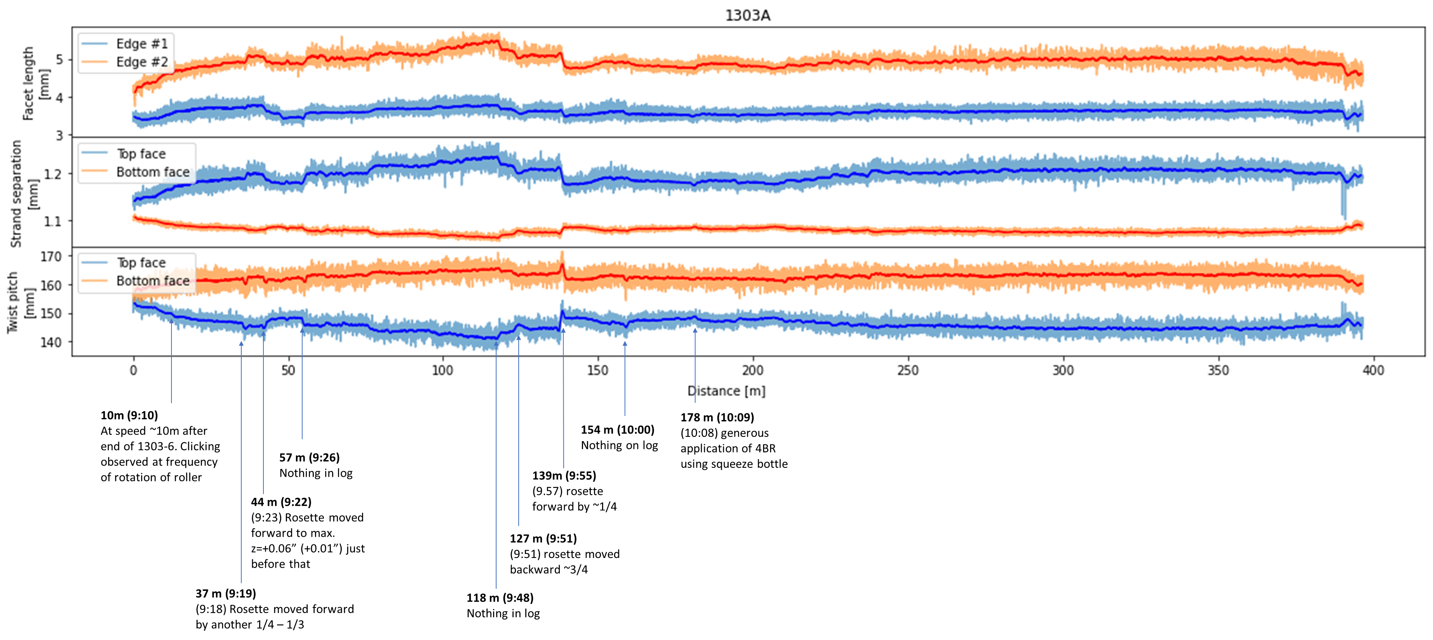
Keyence – Overview

Slide 26
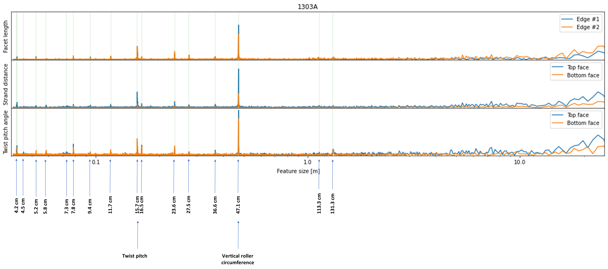
Keyence – Periodicity

Slide 27
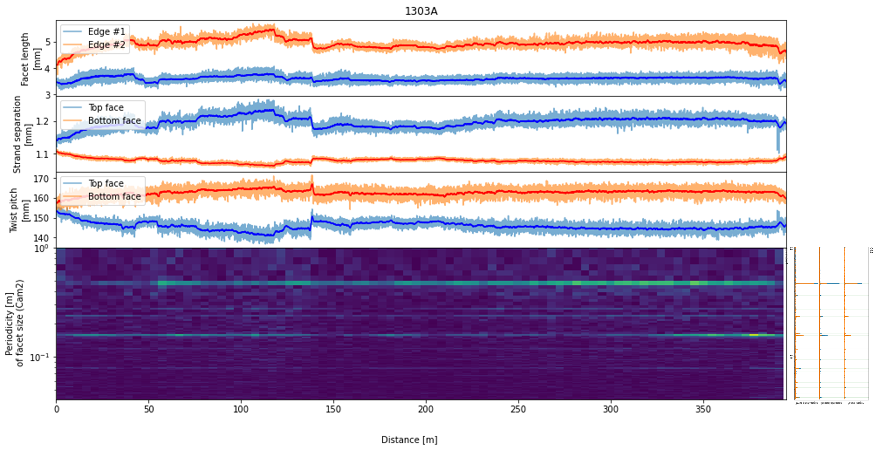
Keyence – Periodicity vs. Length

Slide 28
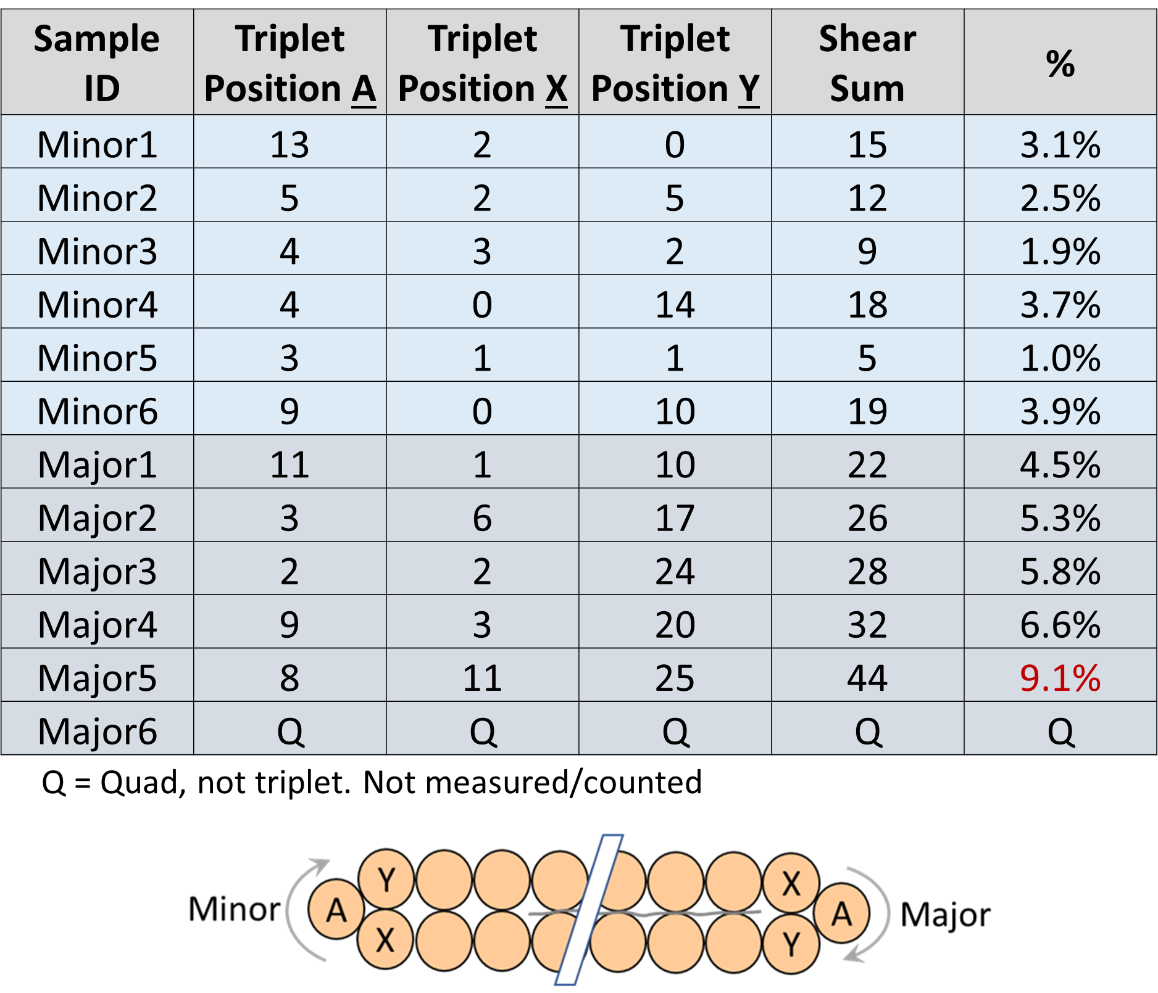
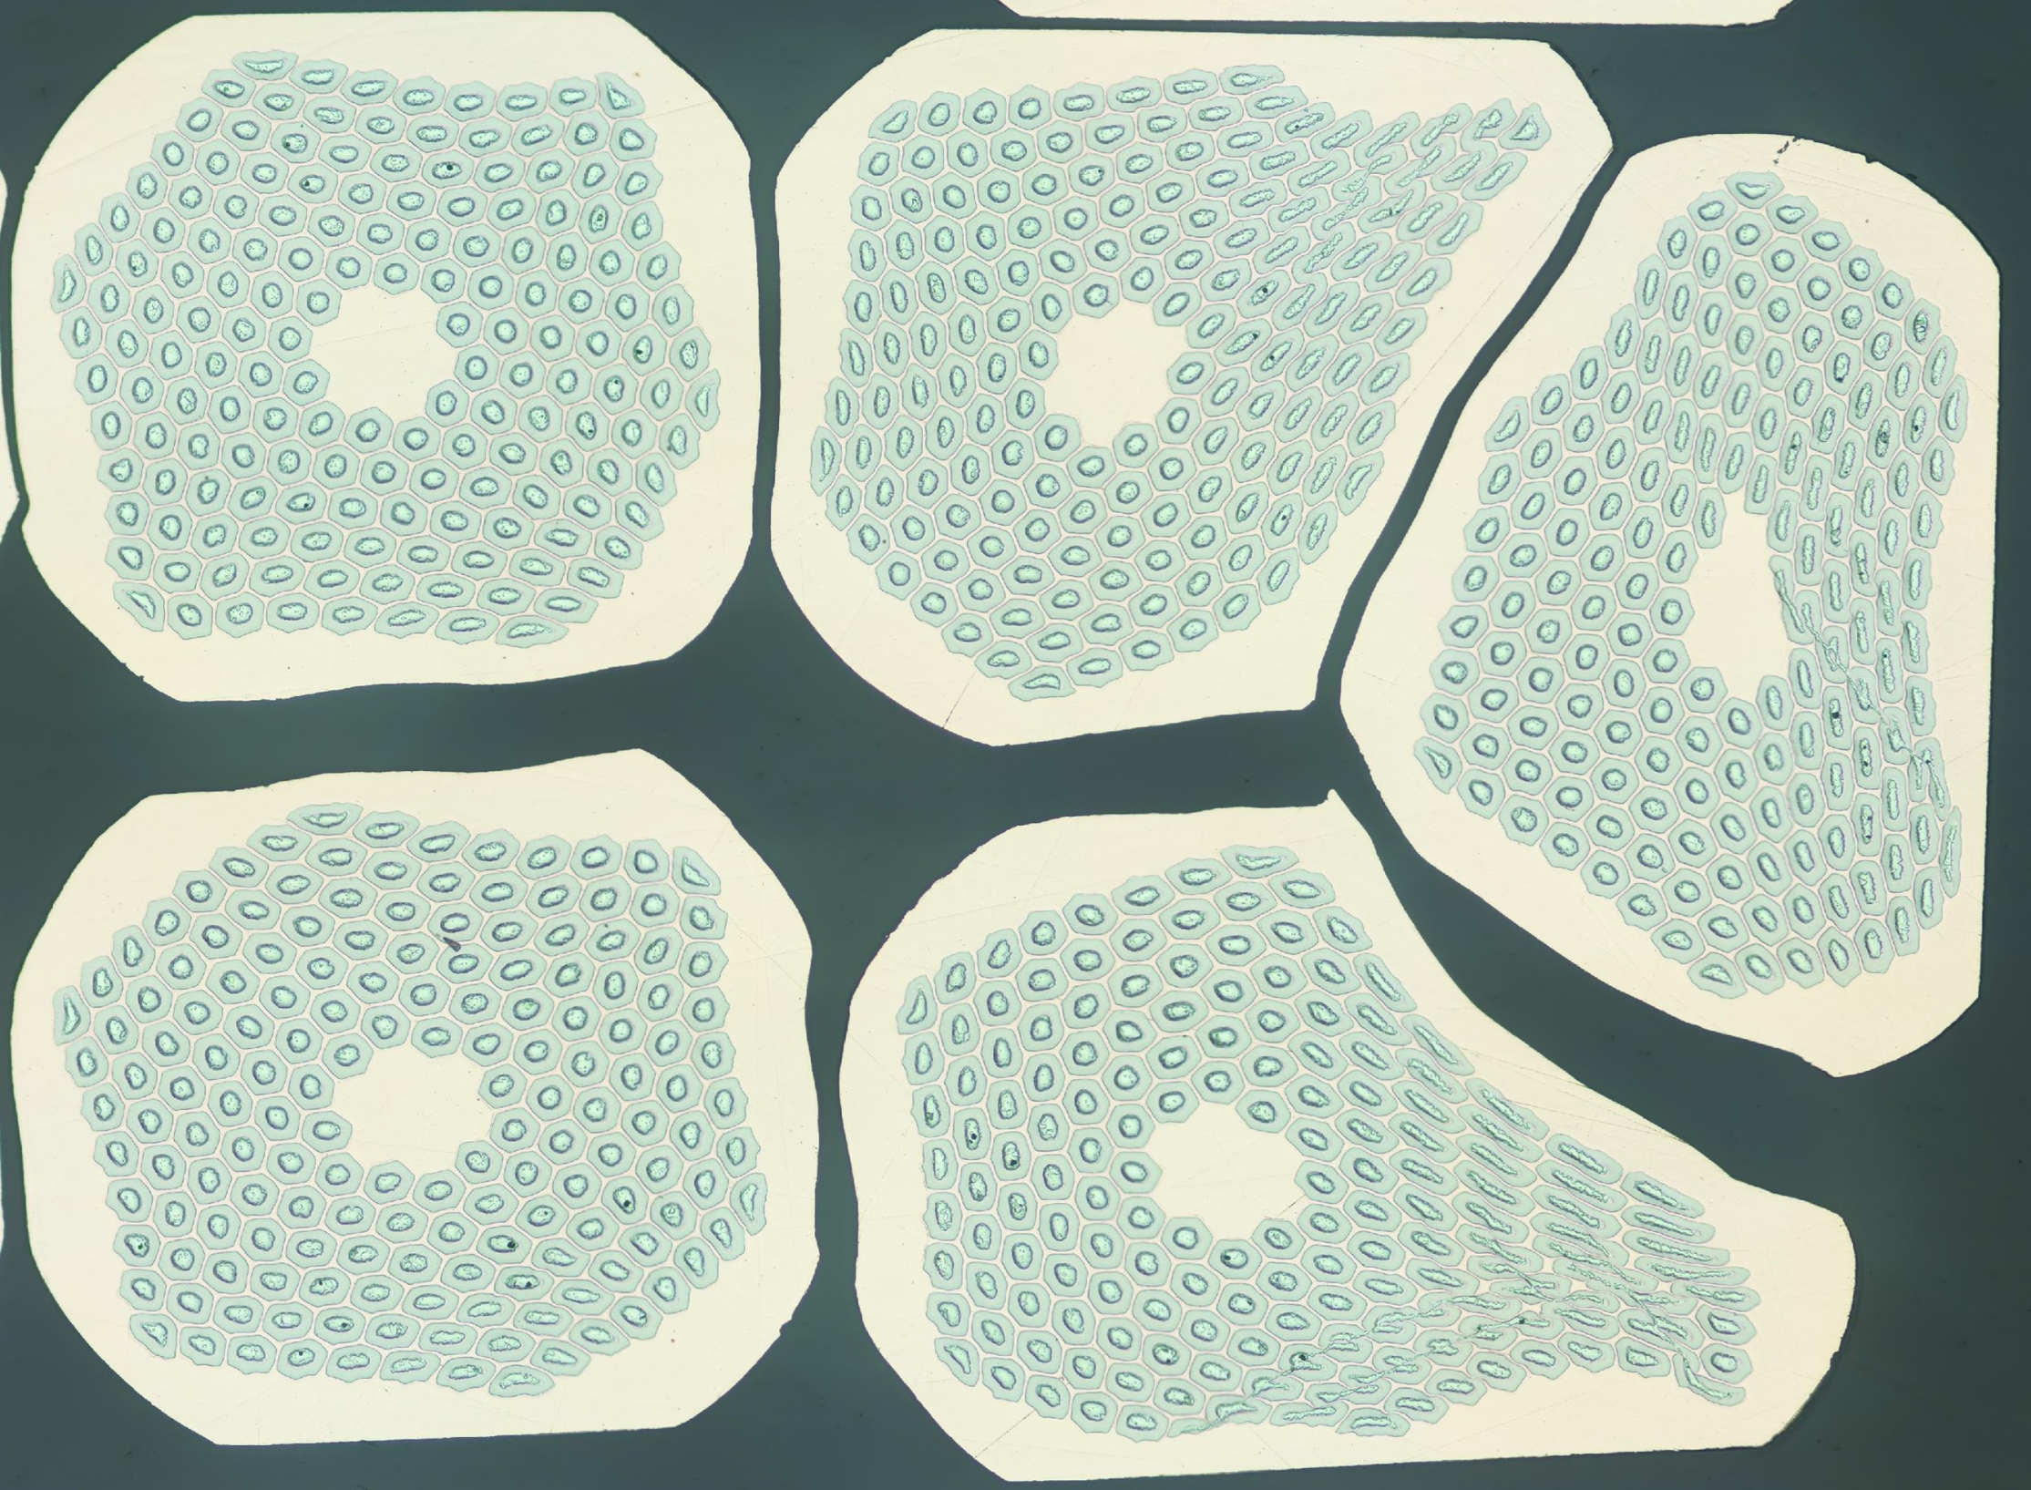
1303-A Metallography

Slide 29
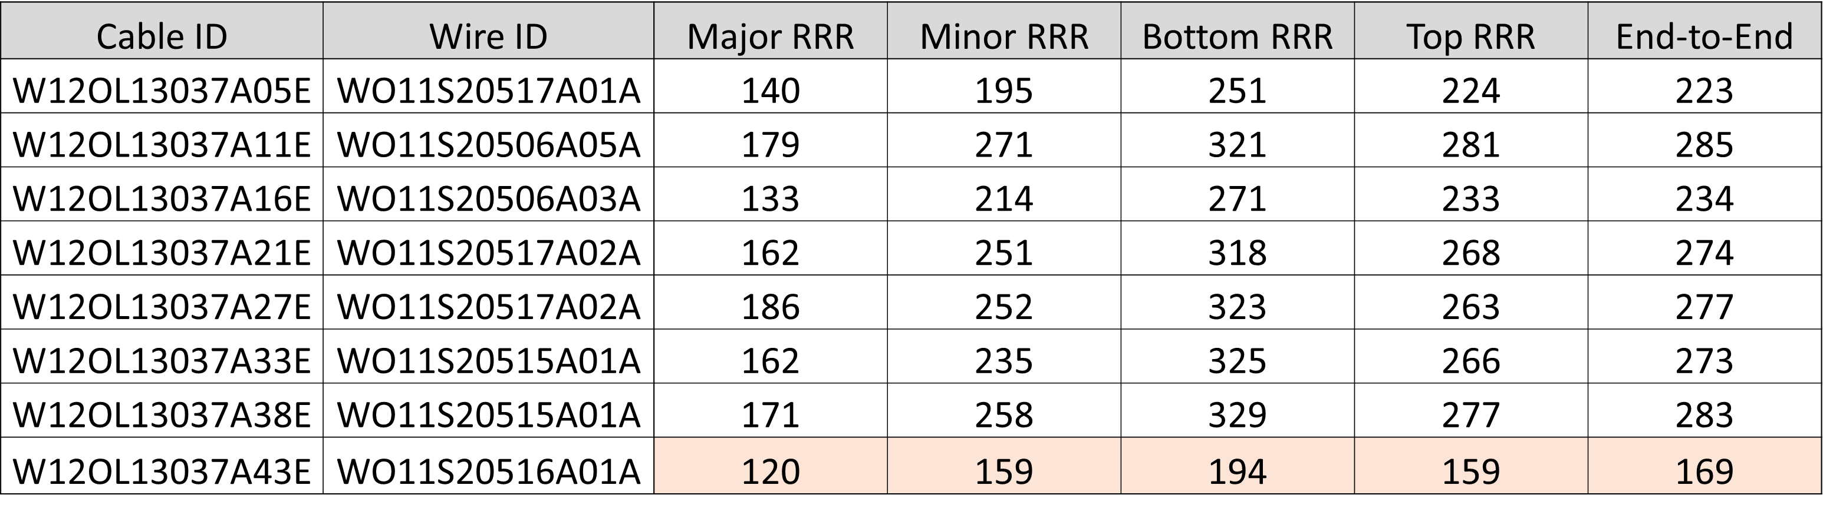
1303-A RRR
Strand from billet #20516 was lowest individual strand, consistent with vendor and startup RRR data. Effect of defective subelement is unclear

Slide 30
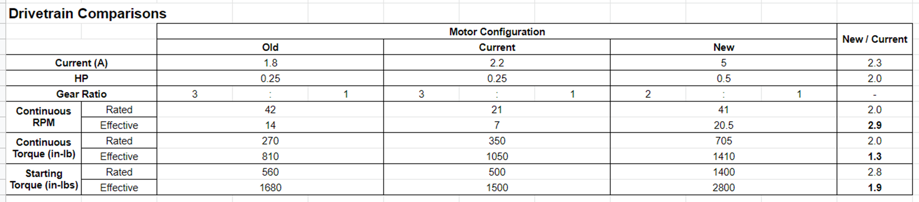
Plans for the Next Step (1) – Motor Upgrade
Moving to ½ hp motors with different gear ratio
  Higher full operating speed
  Higher starting and continuous torque
  Increased safety factor of drivetrain
    motor stall current is limiting factor – minimize risk of mechanical risk to drivetrain

Slide 31
Plan for the Next Step (2) – Dummy Cable
Using Cu strand, fabricate a dummy cable to validate the aperture tuning and mandrel alignment
Improved monitoring system such as roller speed DAQ
Provisionally planned for May/June

Slide 32
Lessons Learnt from MQXFA Cable
Metallography interpretation
  Publication ASC 2022 IEEE TAS
Subtle wire behaviour difference procured from the same spec can impact cabling properties despite identical hardware
RRP® strands are fairly resilient to RRR cliff

Slide 33
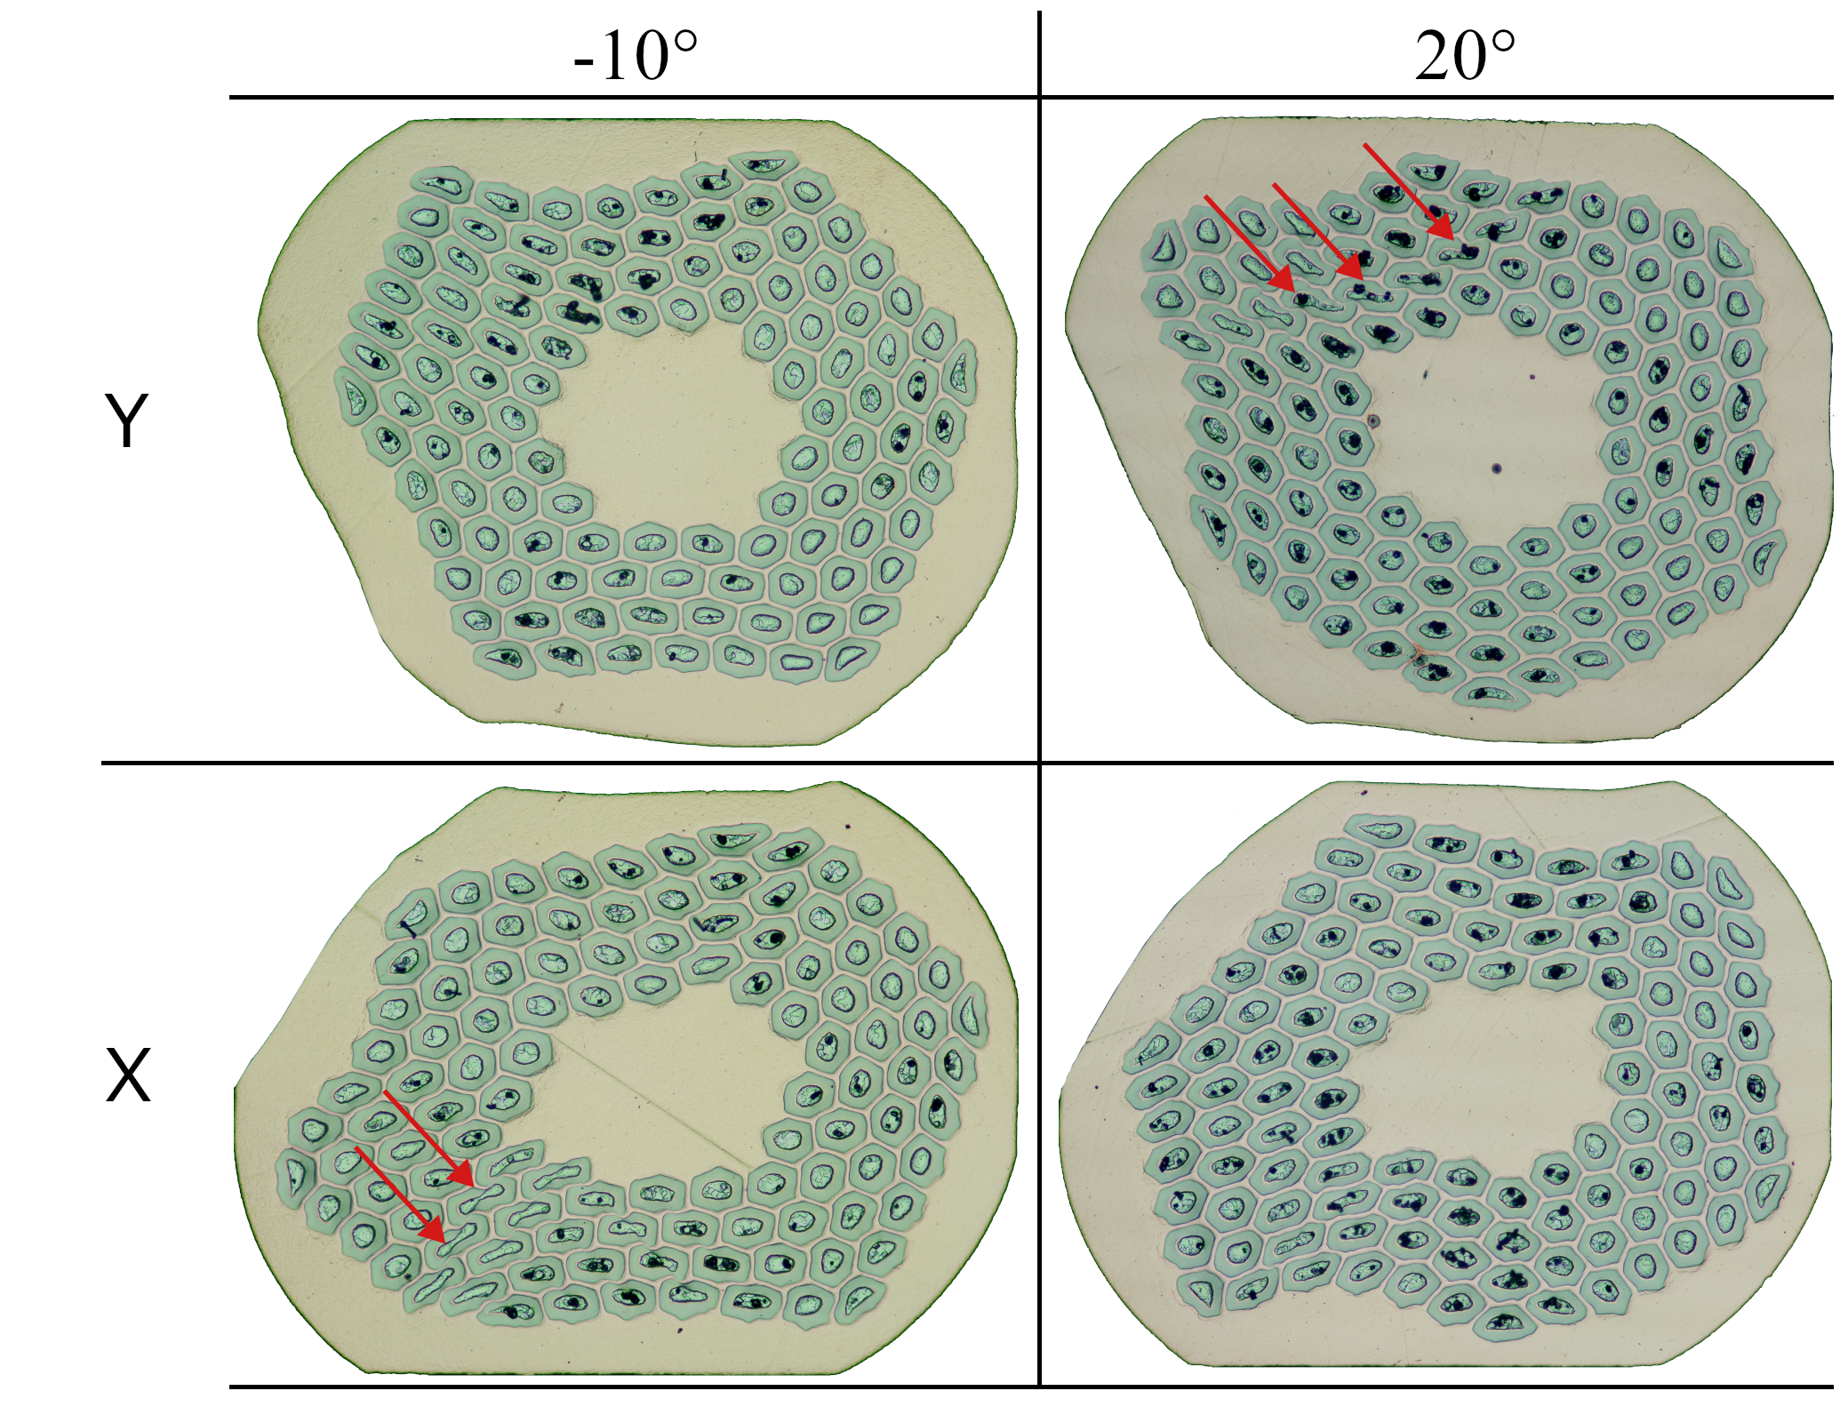
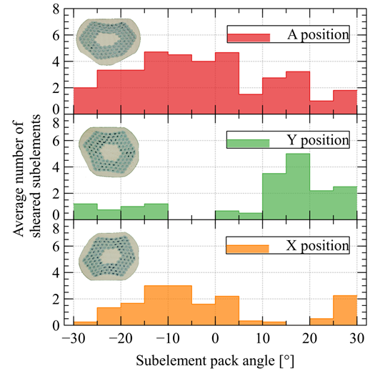
Sheared Subelement – Upcoming Paper

Slide 34
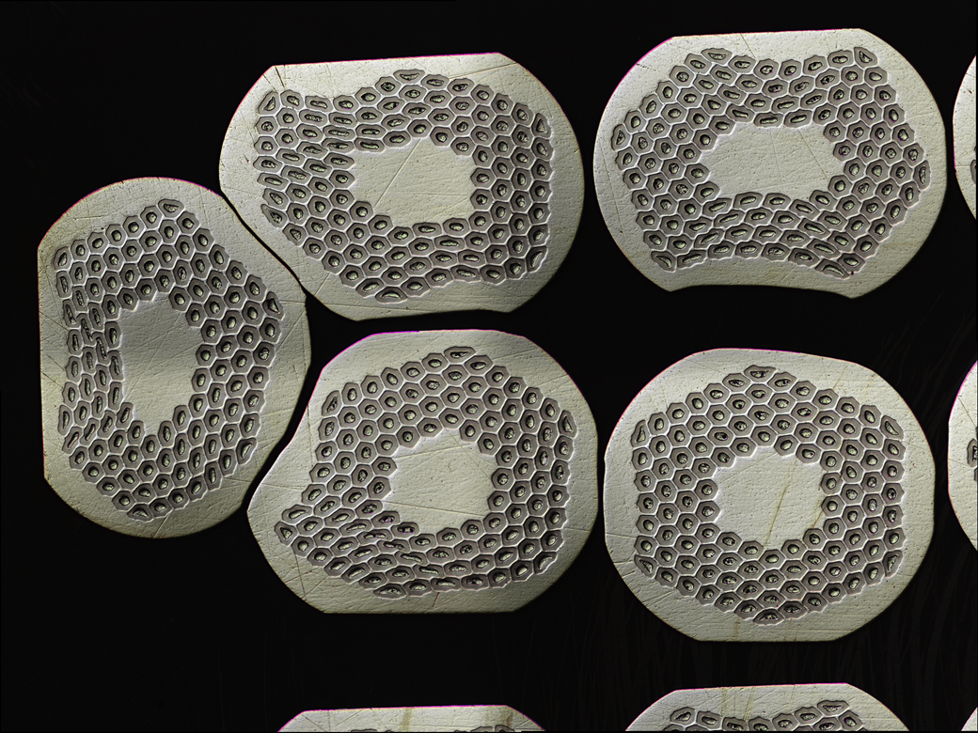
Strand Deformation Behaviour

Slide 35
Conclusion
The cable target thickness gives mechanical stability
The cable target width does not over compact at cable edge
Rollers design is appropriate for a flat cable (no keystone)
Pre-cabling annealing ensures low residual twist
Systematic facet size and RRR measurements show that the HT applied to the Development and Prototype cables is appropriate for the wire used. There’s comfortable RRR margin
Lessons learnt are being applied and a plan to fabricate a Cu cable will mitigate risk and provide further confidence

