Slide 1



Diego Arbelaez, LBNL
TFD Preliminary Design Review
February 16, 2023
Magnet Design Overview

Slide 2
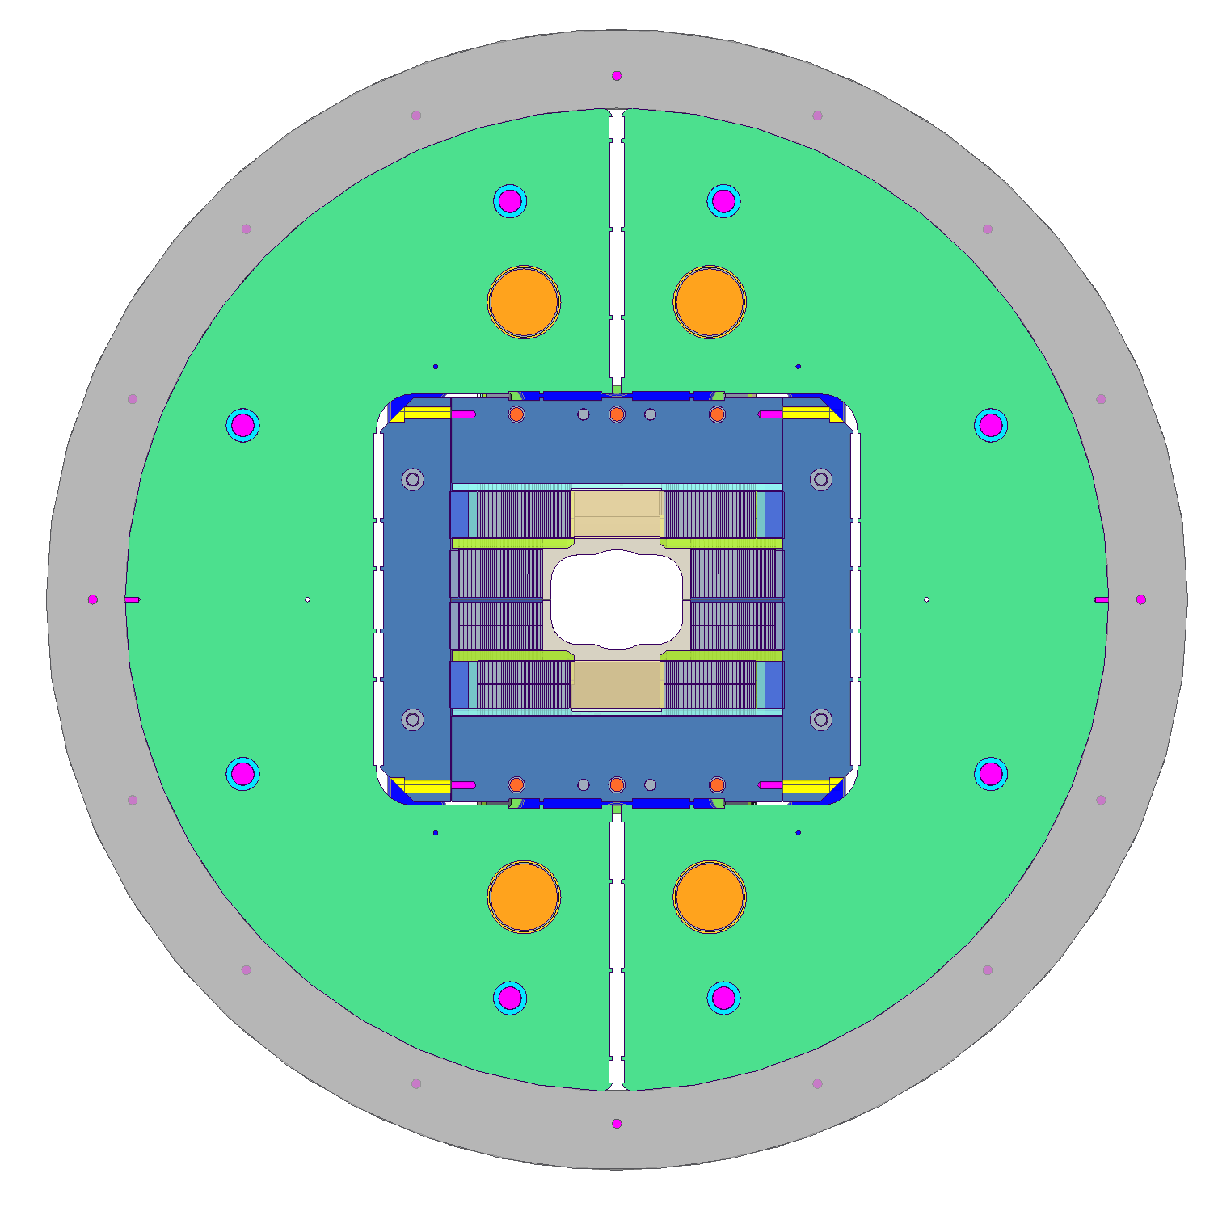
Basic Design Parameters
Target field:
  Operation target: 15 T at 1.9 K
  Design target: 16 T with 15% margin at 1.9 K
  Straight section (within 1% variation) > 750 mm
Magnet clear bore size:
  150 mm x 102 mm rectangular aperture with superimposed 114 mm diameter
Nb₃Sn coils layout:
  Block coil design with flare ends and rectangular bore.
  Coil 1: 40 turns/layer, Coil 2: 44 turns/layer. (Non-graded coils).
Mechanical design:
  Aluminum shell-based structure using key-and-bladder technology, with axial pre-load.
Cable test facility magnet for testing inserts and cables in a high dipole filed.

Slide 3
Technical Background
The Test Facility Dipole design is based on studies and development of large aperture, high field dipoles over the past 15+ years:
  LARP studies of HL-LHC “Dipole First” IR (LBNL/FNAL/BNL, 2003-04)
  EFTA Dipole (EDIPO) Design Study (EFDA/CEA/CRPP/FZK/LBNL, 2004-06)
  LD1 magnet design (2009-12) at LBNL
  FRESCA2 magnet development (CERN/CEA/EuCARD, 2010-2018)
  HEPdipo design study (CERN/PSI/F4E/LBNL, 2017+)
We are taking full advantage of these efforts and experience to accelerate the TFD development and decrease risk in a broad range of areas, in particular:
  Winding layout and parameters (LARP, EFDA, LD1/HD, FRESCA2, HEPdipo)
  Coil tooling, parts, and fabrication process (FRESCA2, LD/HD)
  Magnetic, mechanical, protection models and analysis (FRESCA2, HEPdipo)
However, while building on this experience we are also optimizing the design to reflect the specific TFD requirements, in particular the higher field target

Slide 4
Timeline
Design started from work performed on HEPDipo, presented at MT26, 2019:
  https://ieeexplore.ieee.org/document/8982034
Conceptual design presented at the CDR on 06/11/2020:
  https://conferences.lbl.gov/event/359/
Magnetic and mechanical analysis presented at ASC2020:
  https://ieeexplore.ieee.org/abstract/document/9376992
Initial developments on engineering design presented at MT27, 2021:
  https://ieeexplore.ieee.org/abstract/document/9733270
Strain effects on the magnet critical surface were evaluated including reversible and irreversible effects. Presented at the Wire Specification Review (10/28/2021):
  https://conferences.lbl.gov/event/759/

Slide 5
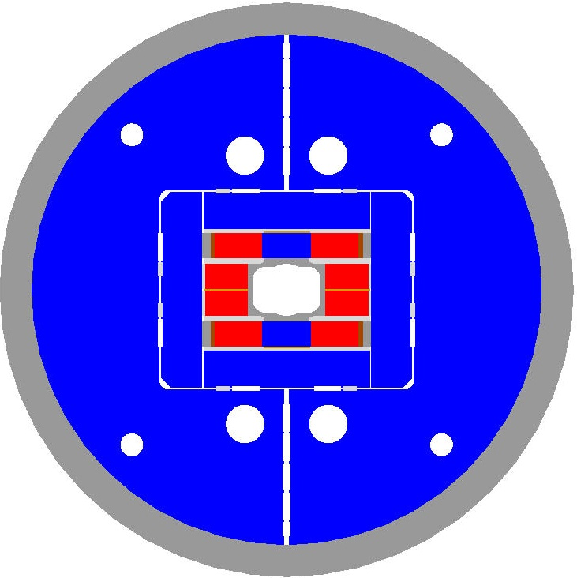
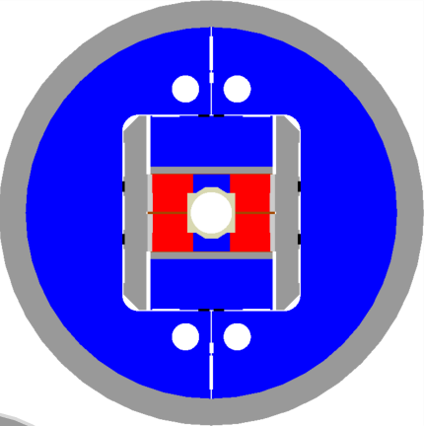
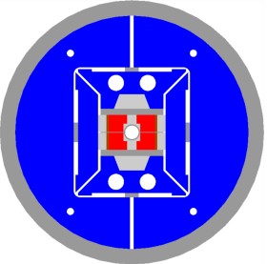
Comparison of “traditional” block-type magnets
“traditional”
Cosθ
1300 mm
TFD
LHC dipole
HD2
FRESCA2
570 mm
18100 kg

Slide 6
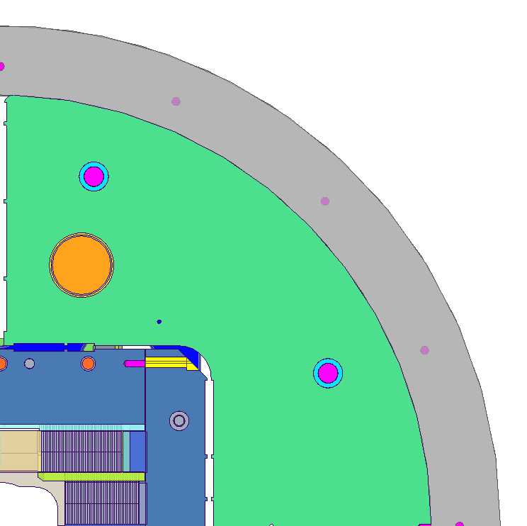
Magnet Cross-Section and Main Design Features
The preloading at room temperature through the bladders placed between the iron yokes reduce the peak stress within the coil.
The inclusion of a G10 shim reduces the overall force on the pole and within the pole to coil interfaces.
The location of the keys is based on the reduction of the peak tension stress at the pole to coil interface. (see Giorgio’s talk)
A series of smartshims will be place within the midplane of the magnet, coil 1 to coil 2 interface and coil 2 to vertical iron pad in order to guarantee perfect contact geometry.
Aluminum shell
Iron yoke
Iron yoke rods
Magnet rods
Steel keys
Laminated iron pads
Steel pusher
G10 shim
Iron pole
Steel spacer
Ti pole
Steel rail
AlBr rail
Al spacer

Slide 7
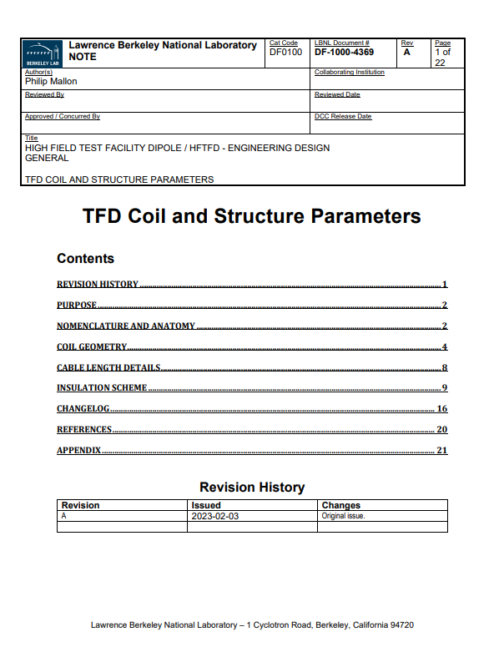
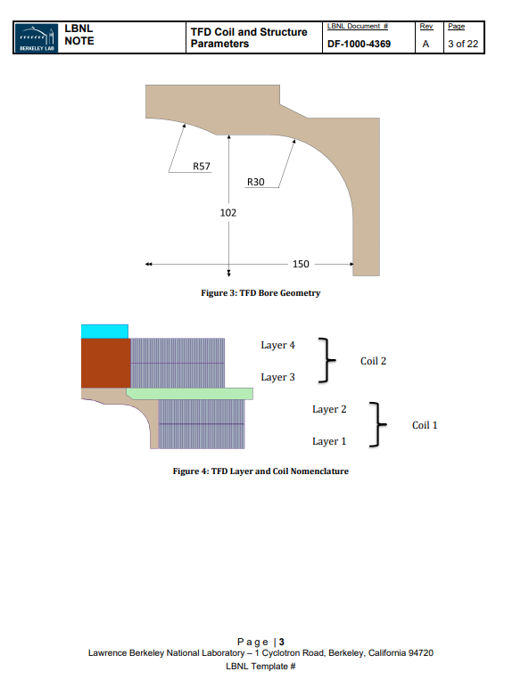
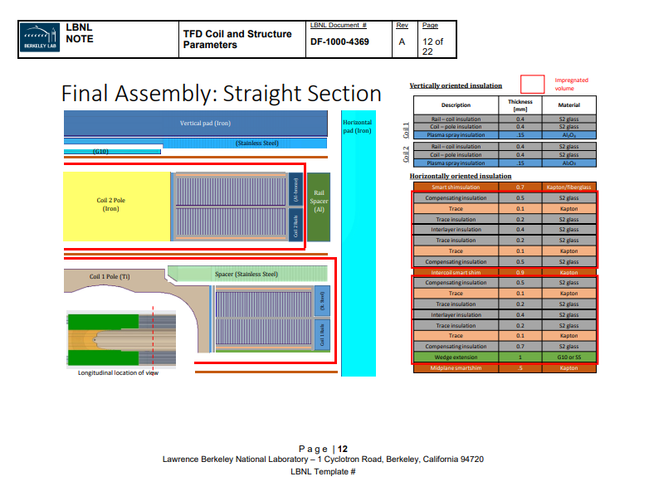
Design Parameters and Documentation
Design parameters are captured in the TFD Coil and Structure Parameter Document
  Basic cable parameters
  Coil geometry parameters
  Geometry of key parts
  Reaction and impregnation layouts
  Insulation and interface layouts
Version control of CAD models / drawings and documents is handled through Windchill

Slide 8
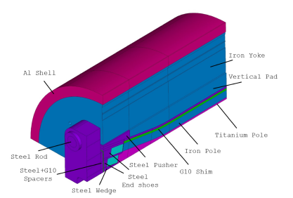
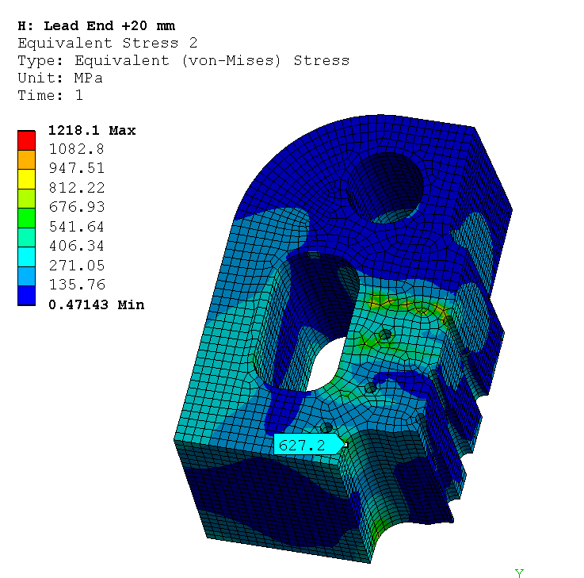
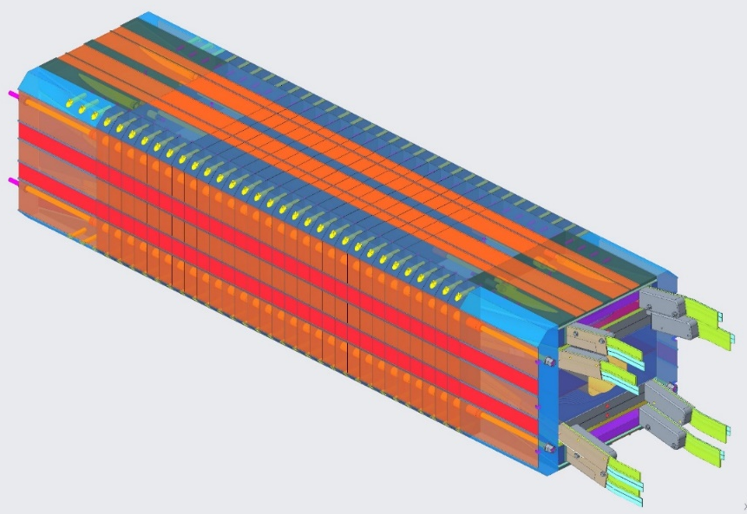
Progress Since CDR
3D FEA Model
CDR
  2D Cross-section optimization
  Quench protection*
  Conceptual CAD of magnet structure
  Preliminary 3D analysis
PDR
  3D optimization
  Detailing of cross-section features including insulation layers and reaction / potting layouts
  Detailing of structure design
  Winding testing and prototyping – feedback to coil parameters
  Development of coil reaction and potting process and further detailing of the design
Engineering Design
* No heaters will be used a part of quench protection system (dump resistor + CLIQ)
* Quench protection was further reviewed at Wire Specification Review (10/28/2021): https://conferences.lbl.gov/event/759/

Slide 9
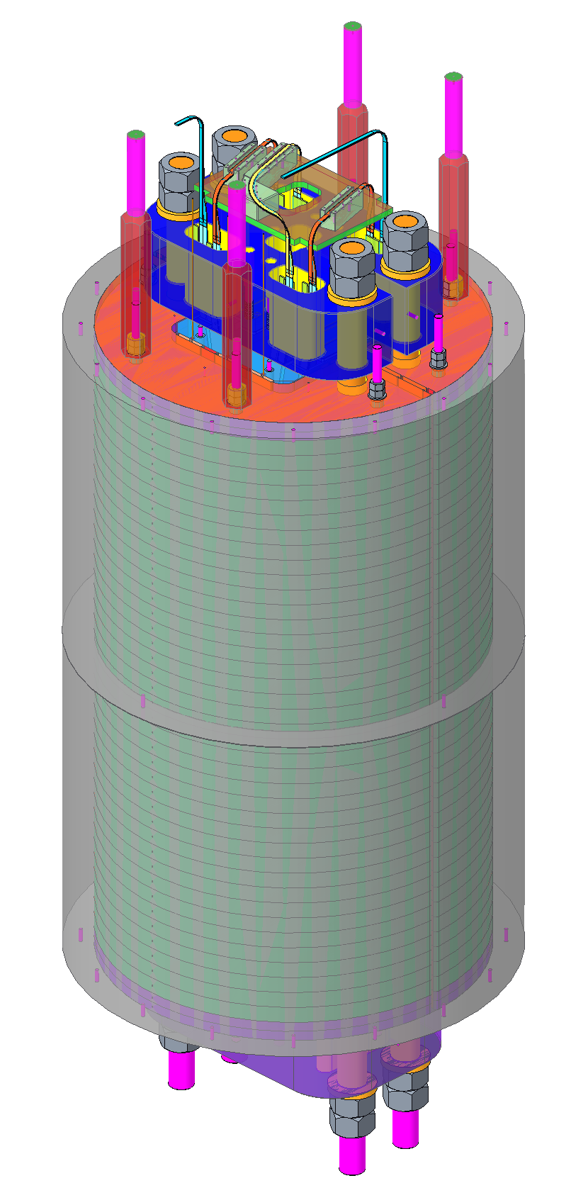
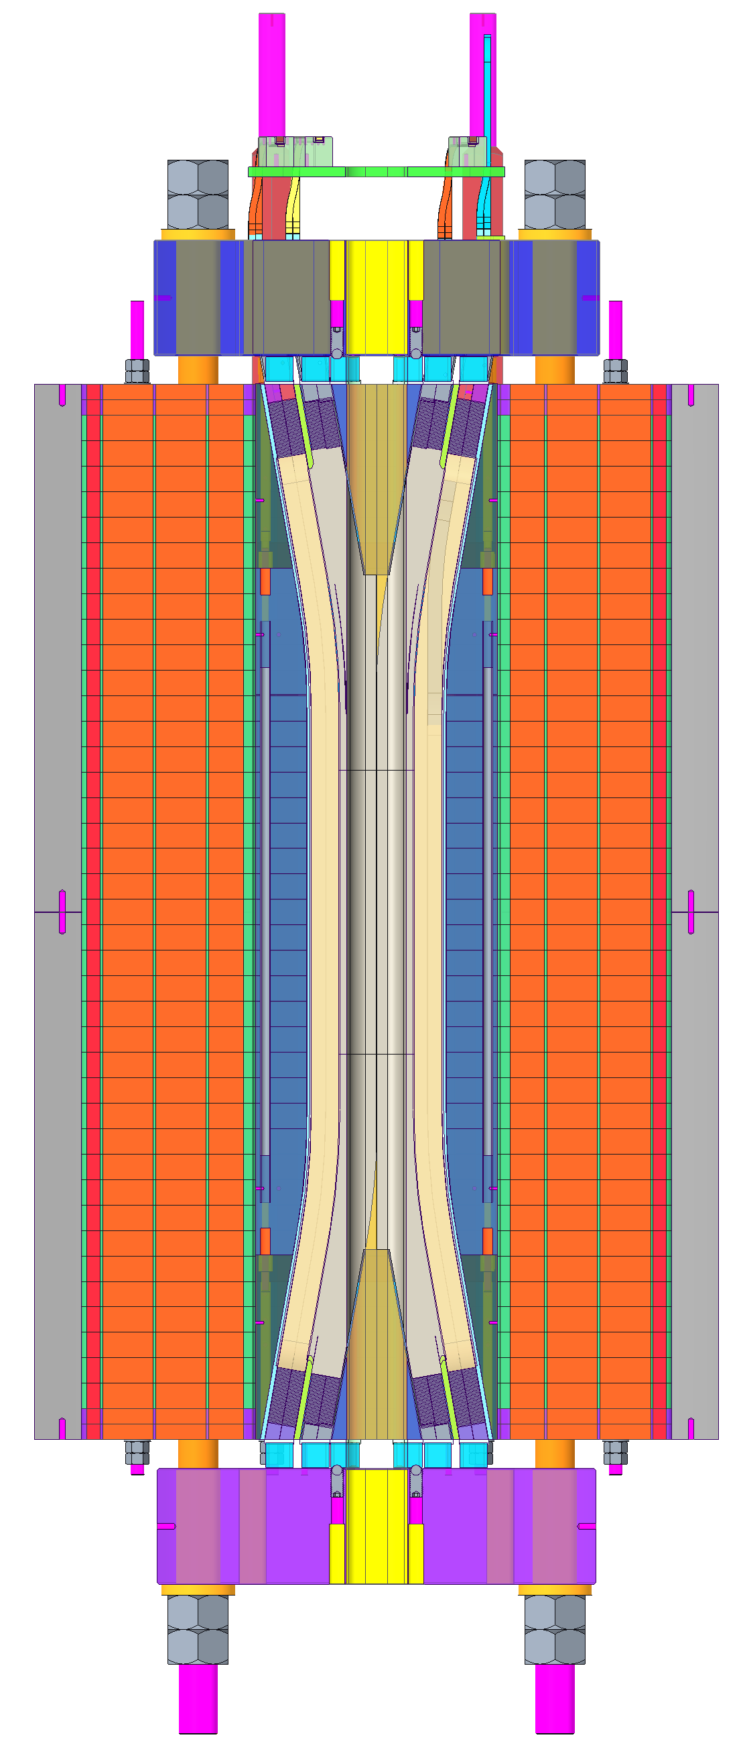
Structure Design Overview
Updates to conceptual structure design are driven by the 3D finite element analysis as well as practical considerations
  Segmentation of yoke and load pads (Iron and stainless steel sections)
  Split shell configuration
  End plate design
  End shoe length optimization
  Wedge and wedge transition optimizaton
  Optimization of key and bladder locations
Magnet Structure
Analysis details covered by G. Vallone
CAD Design details covered by R. Hafalia

Slide 10
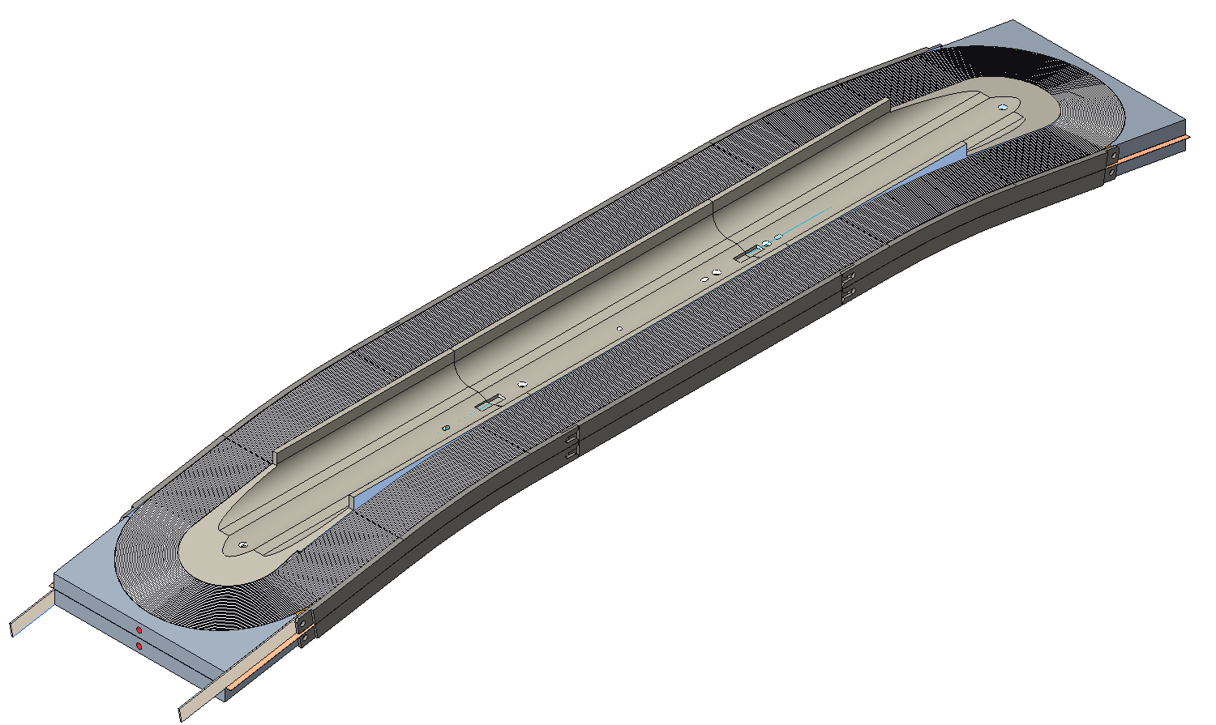
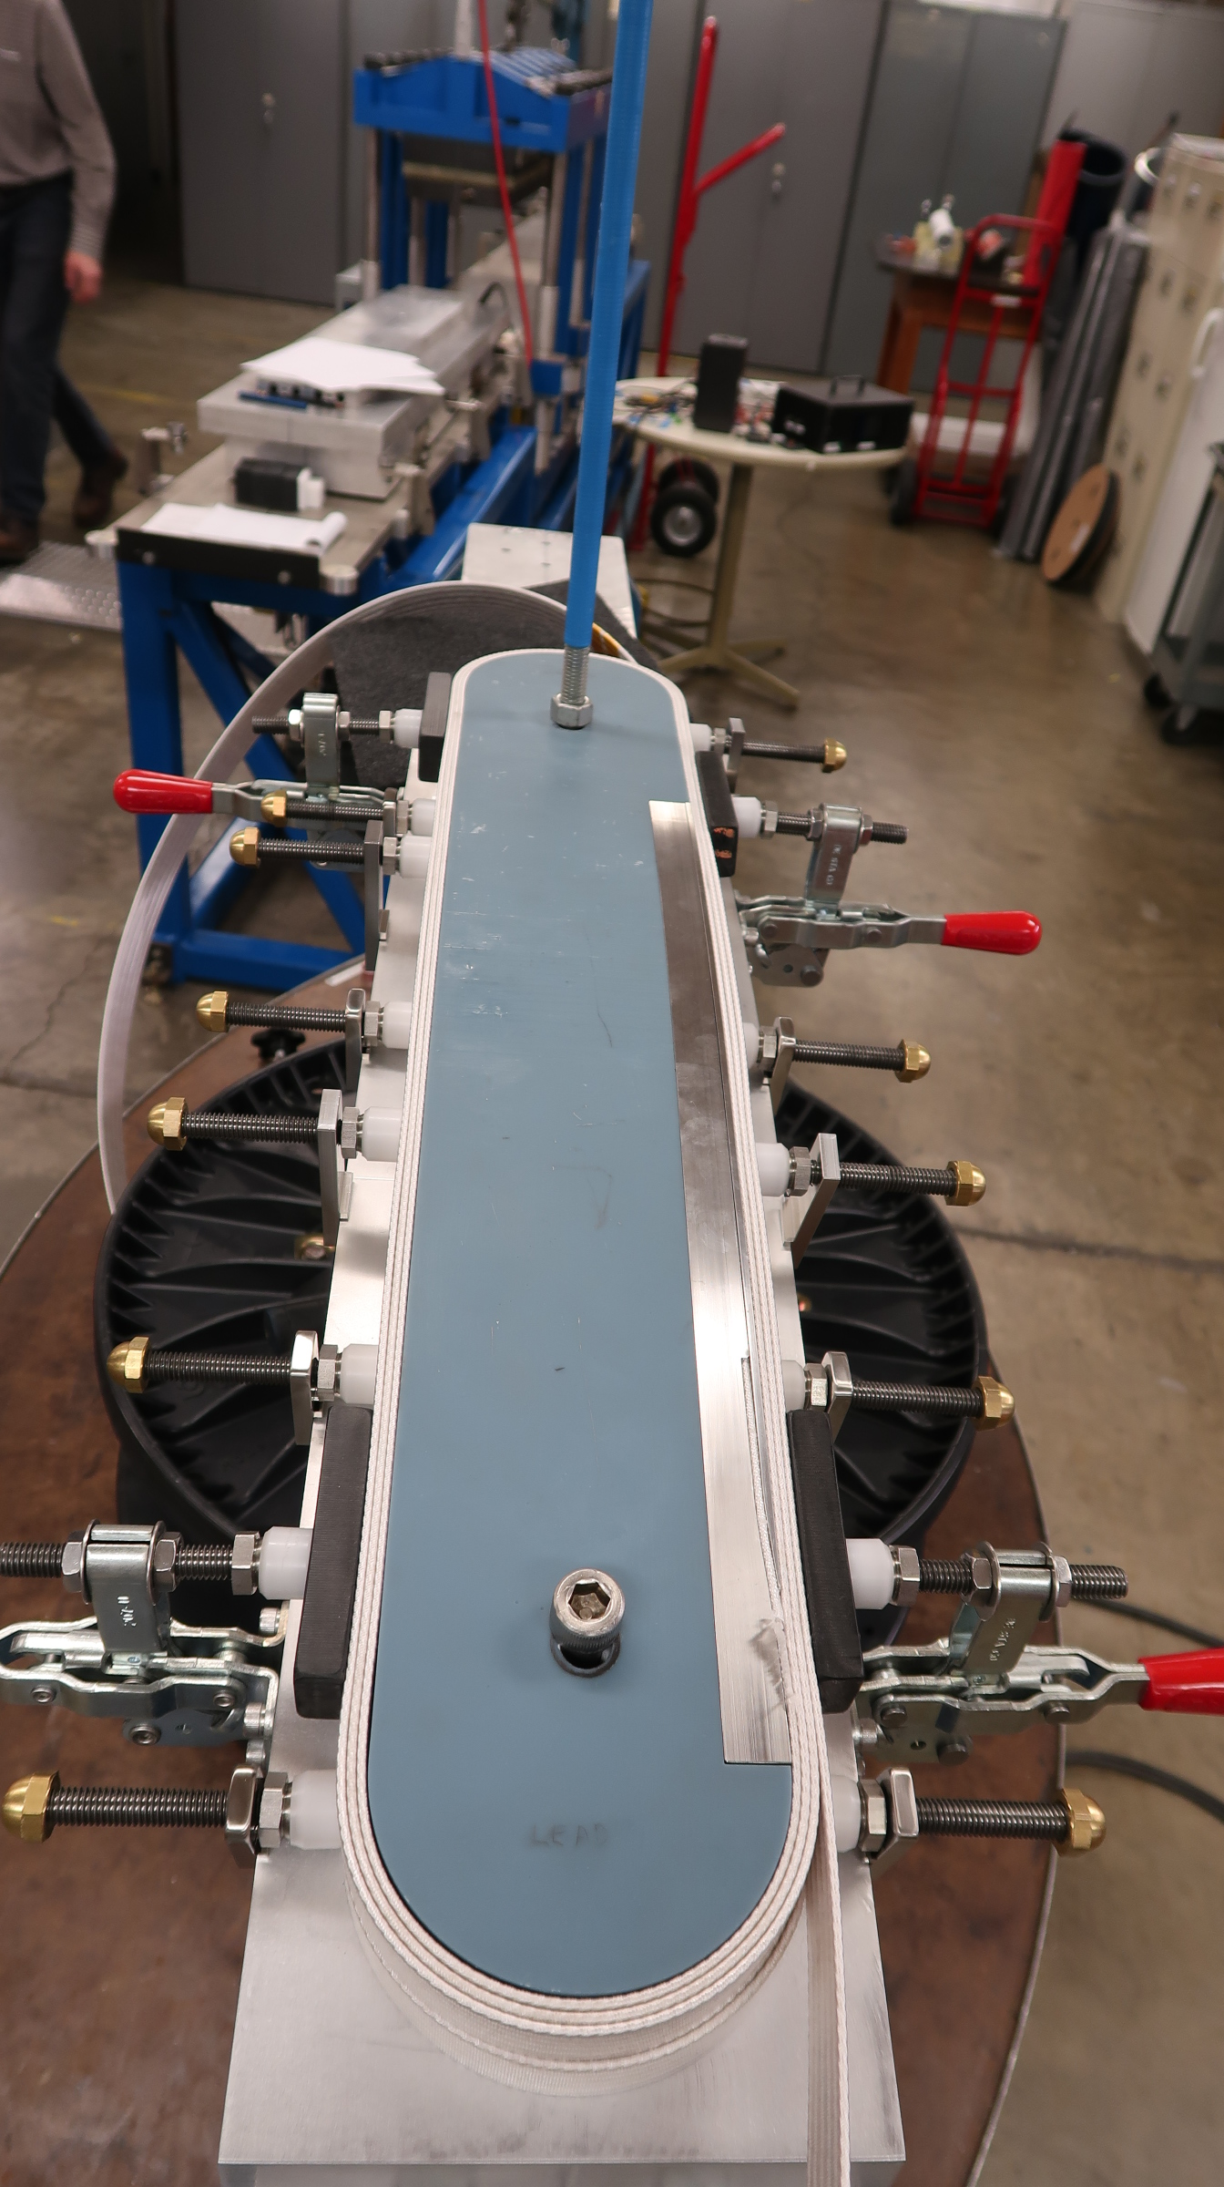
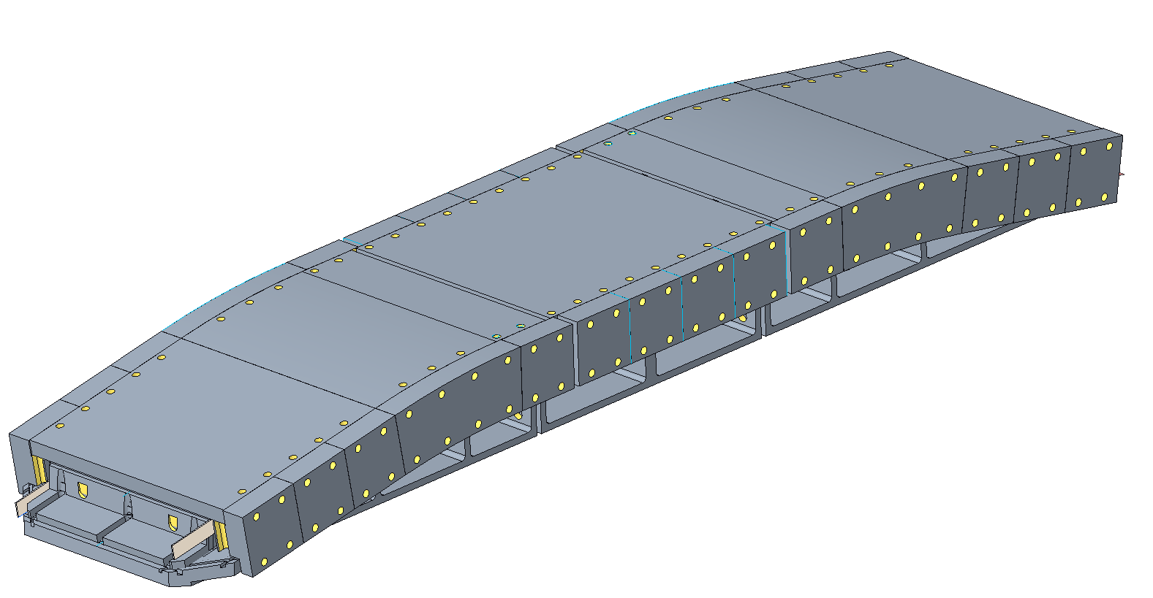
Coil Design Overview
Coil design and parameter selection – Feedback from prototyping and testing
  Hard way bend geometry
  Layer jump design
Coil parts design
  Pole
  End shoes
  Rails
Fabrication steps and tooling use mostly FRESCA2 experience as a starting point (deviations from FRESCA2 covered by P. Ferracin)
  Winding
  Reaction
  Impregnation
Current focus on finalizing inner coil design
Coil Design
Winding Test
Reaction Tooling
Details Covered by J.L. Rudeiros Fernandez

Slide 11
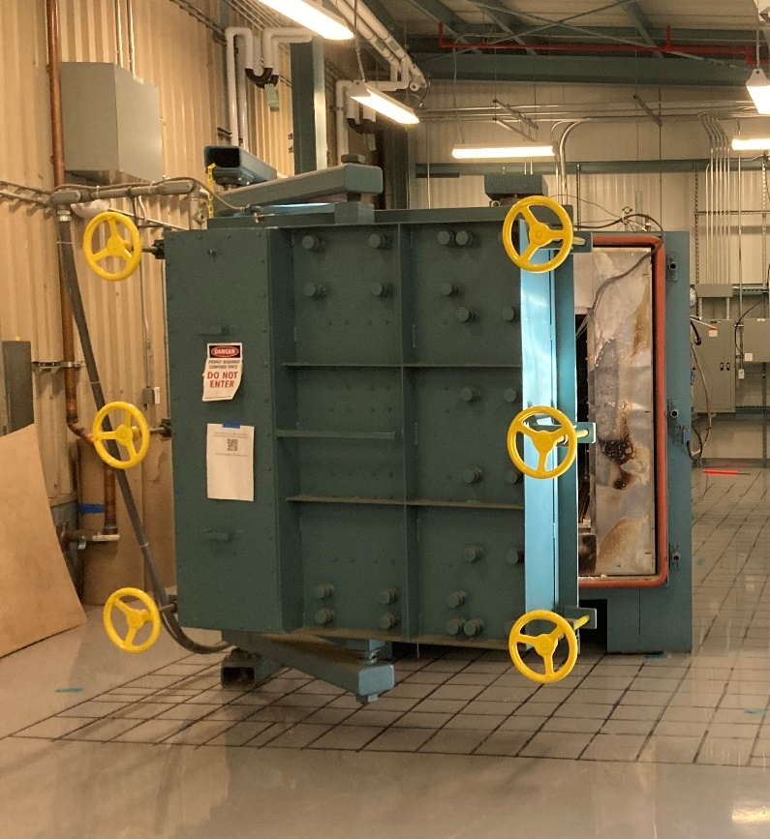
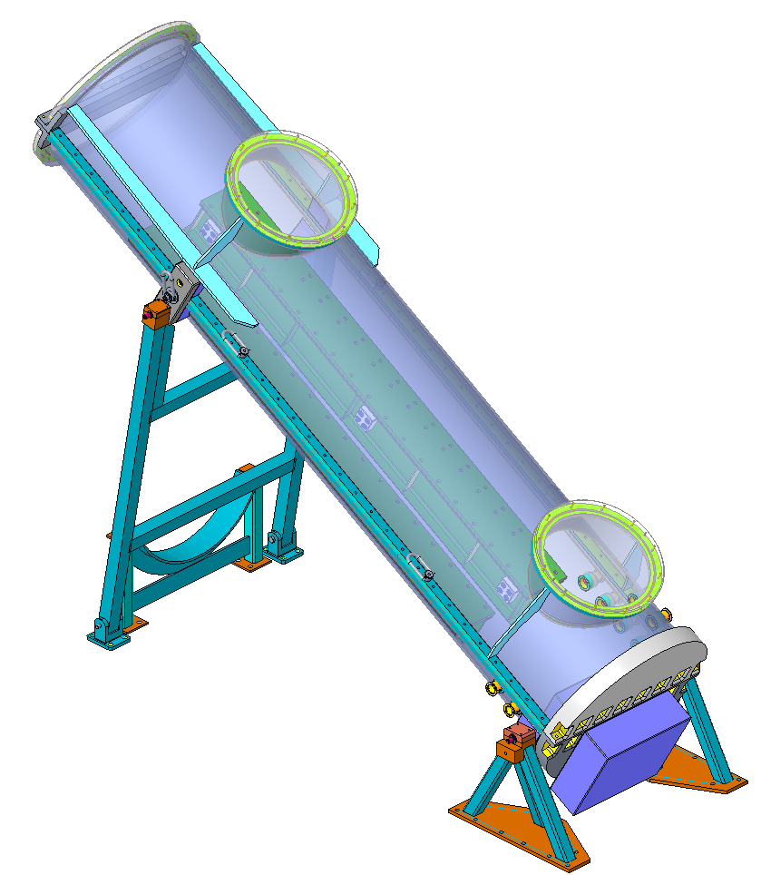
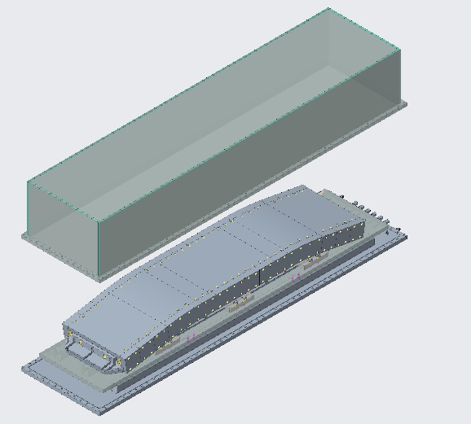
Infrastructure Overview
Reaction furnace
Impregnation chamber
Winding table bearing has been replaced to handle the weight of the coil and associated tooling
Reaction furnace has been moved to a new location in building 77A
Potting chamber has been moved to building 77A – Upgrading power distribution chassis and implementing 3 zone temperature control
Expect to start recommissioning effort for furnace and potting tooling over the next ~2 months
Developed preliminary retort design
Retort

Slide 12
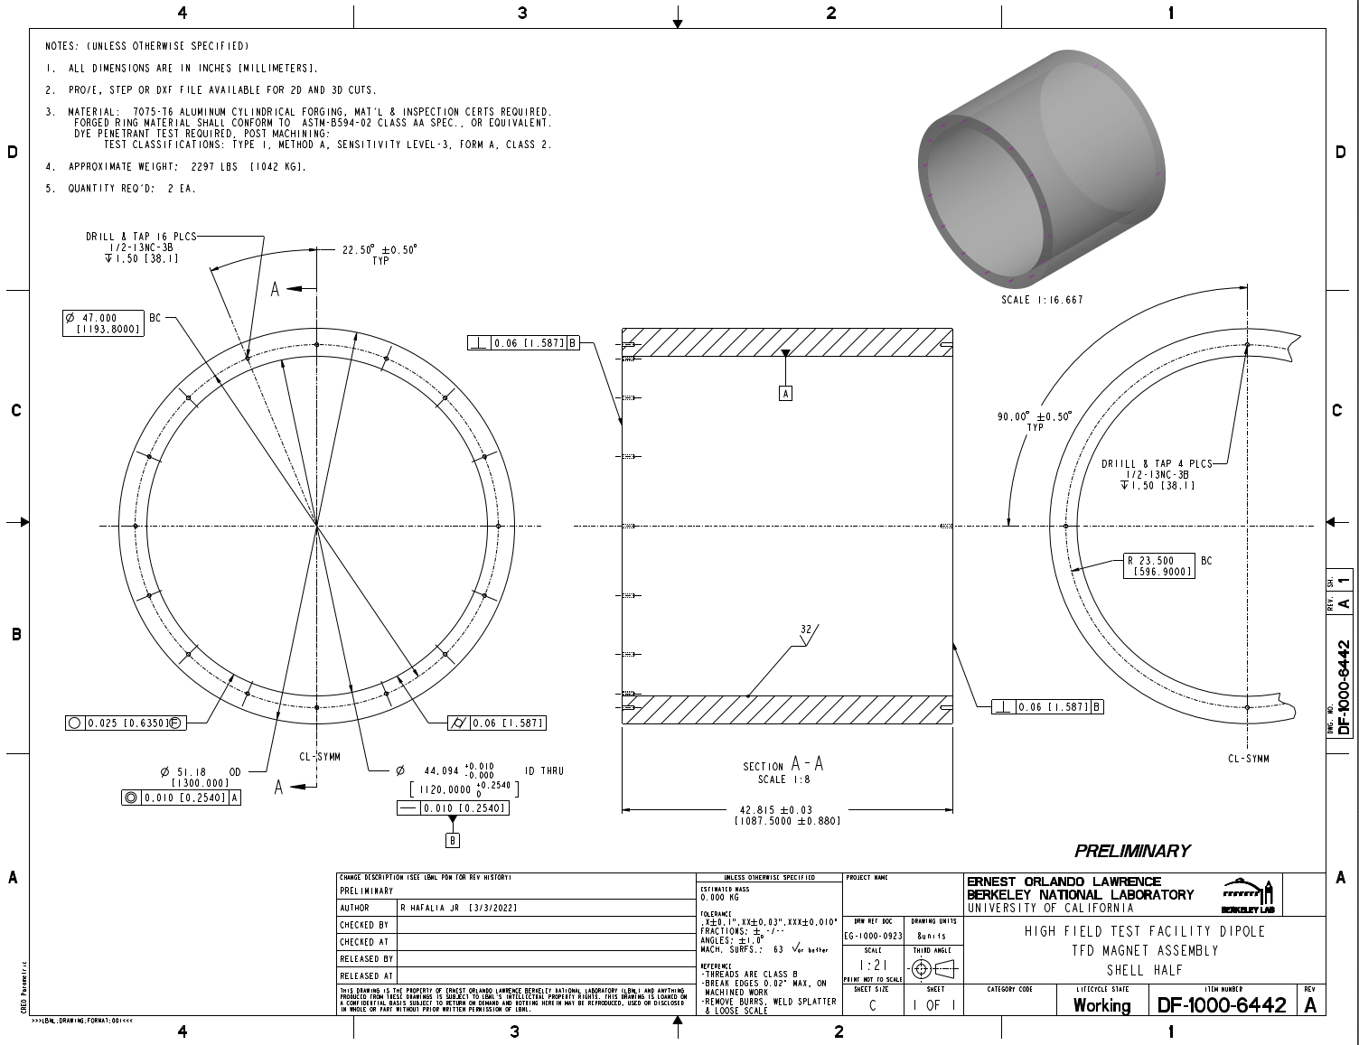
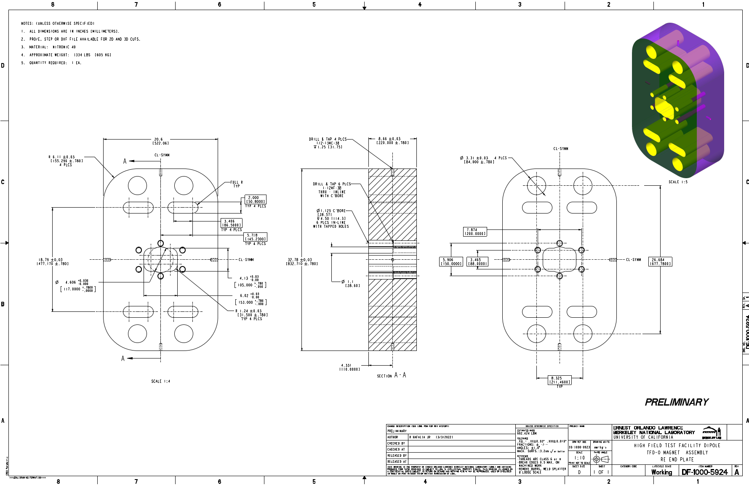
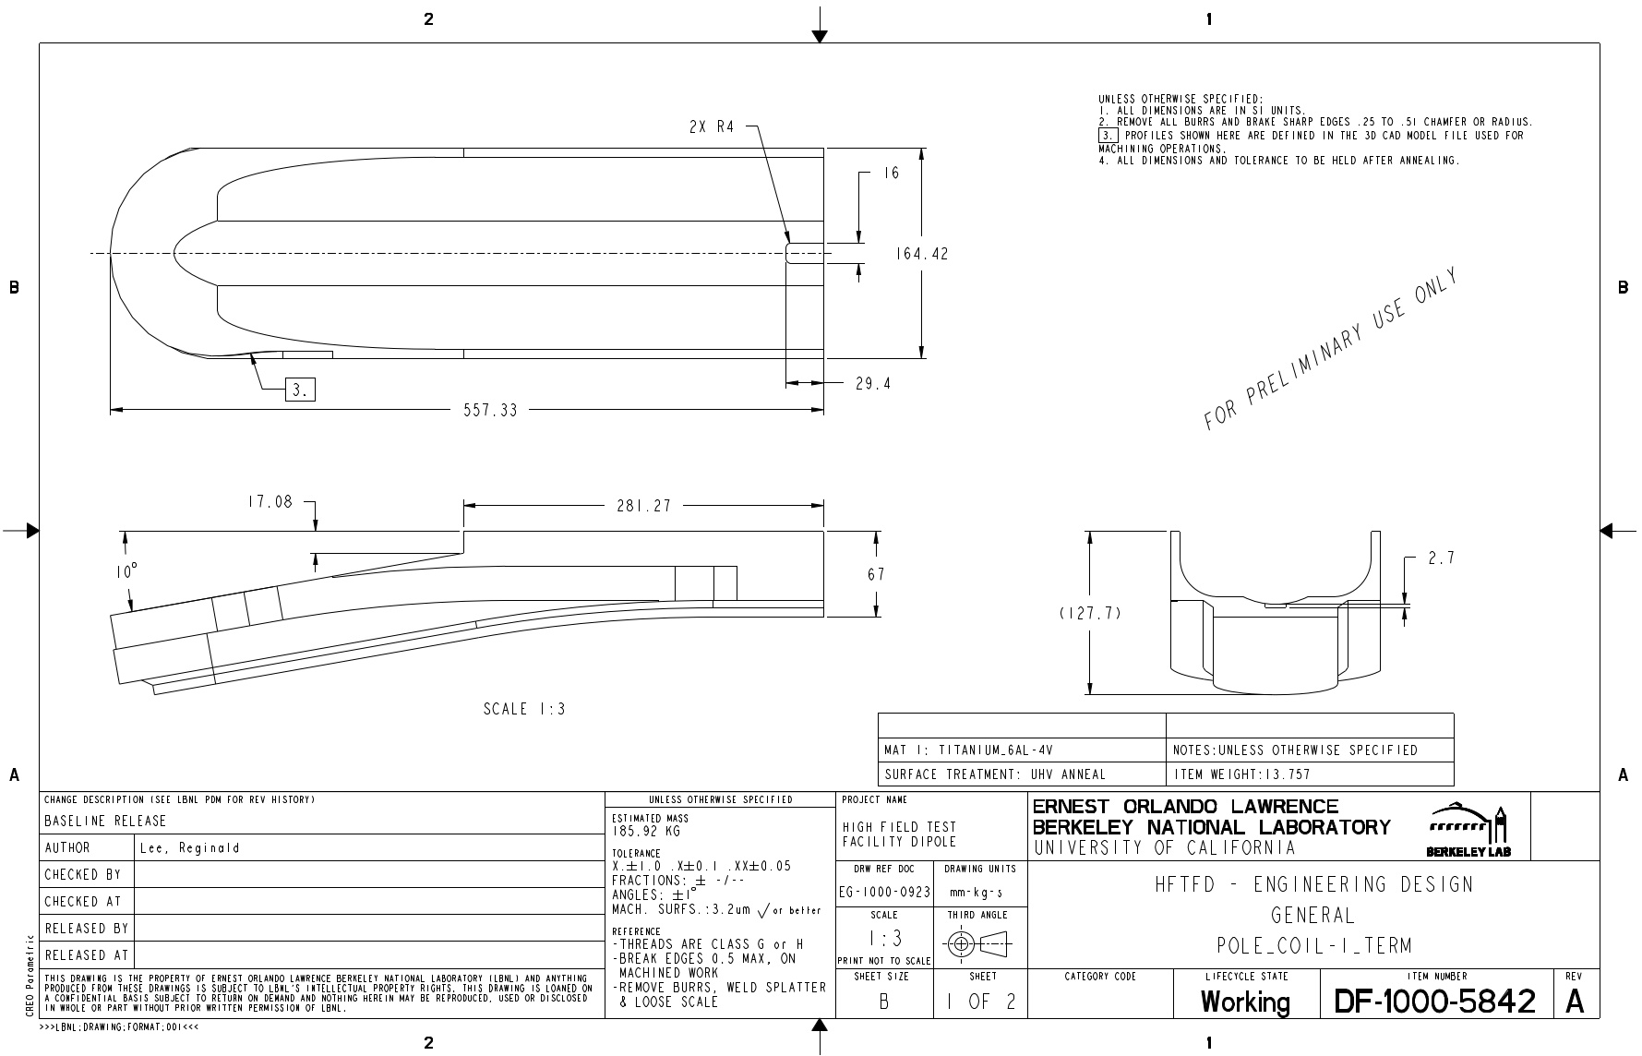
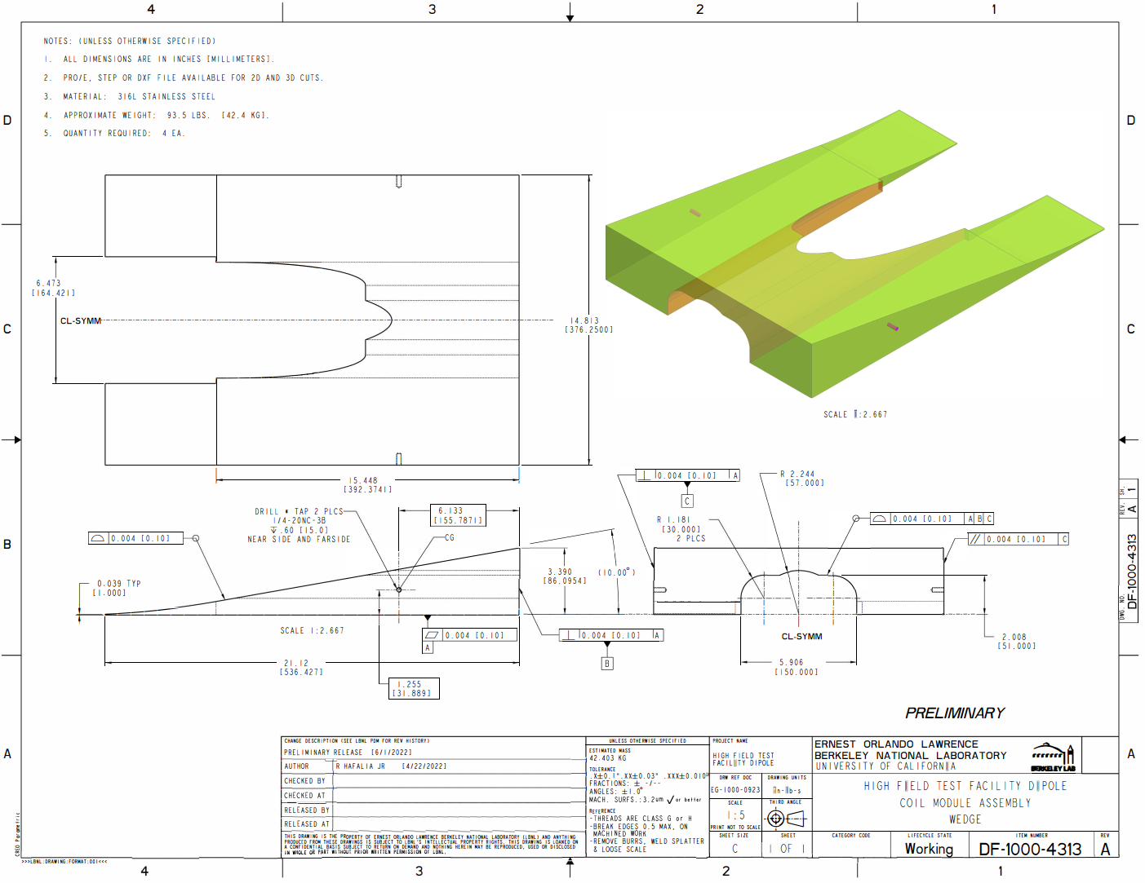
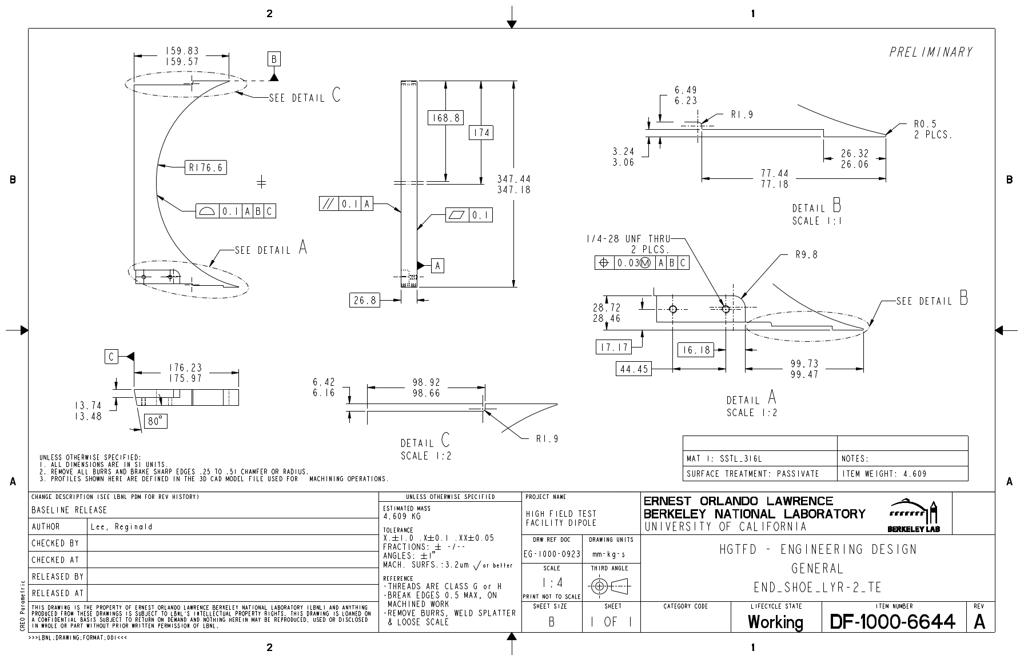
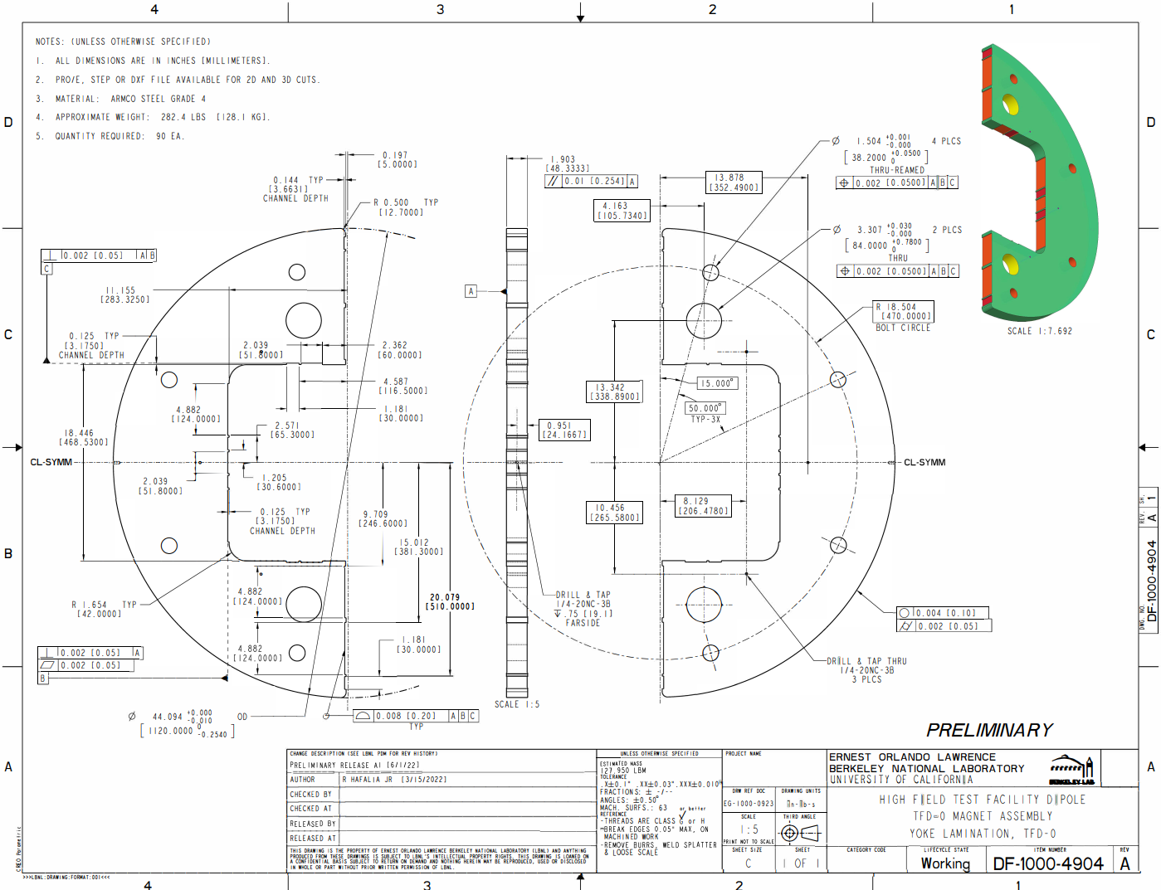
Design Status and Next Steps
Structure design is well advanced – ready to proceed to final design / drawings
Coil and tooling design (inner coil)
  Reaction tooling is well advanced – still need further work on coil splice / end shoe design and layer-jump cover plate design before moving to final design / drawings
  Impregnation tooling concept is developed but more design work is needed before moving to final design / drawing phase
Preliminary drawings of many parts have been created for quoting purposes
Current focus is on inner coil design with the goal of finalizing drawings to procure parts for a practice coil
Design of outer coil will take place once inner coil is completed
Plan to use AUP experience for assembly tooling and procedures wherever possible
Al. Shell
End plate (lead end)
Winding pole (coil 1, end)
Wedge
End Shoe
Iron yoke

Slide 13
Summary
Magnet design has advanced significantly since the conceptual design review
  Extensive finite element analysis of 3D structure
  Design optimization of structural components
  Coil winding testing to finalize coil parameters
  Coil and coil part design and insulation layout
  Advancement of reaction and potting tooling design
Large fraction of magnet design if sufficiently advance to start final drawings
Some areas still need further attention before preparing final design / drawings
  Splice region (plan to use HD magnet approach)
  Layer jump (will copy design from winding test)
  Potting tooling – working to advance design (similar to HD approach)
Infrastructure is being prepared for fabricating the practice coil

