Slide 1



UNIVERSITY OF
CALIFORNIA

Slide 2
Test Facility Dipole
Design Analysis
G. Vallone, D. Arbelaez, N. Cheggour, P. Ferracin, A. Hafalia, R. Lee, P. Mallon, JL. Rudeiros Fernandez, GL. Sabbi, M. Solis, D. Turrioni
PDR Review
16 February 2023

Slide 3
Outline
Design Overview
Coil Mechanical Analysis
3D Design Optimization
Critical Current Computation
Fine Tuning
Conclusion

Slide 4
Outline
Design Overview
Coil Mechanical Analysis
3D Design Optimization
Critical Current Computation
Fine Tuning
Conclusion

Slide 5
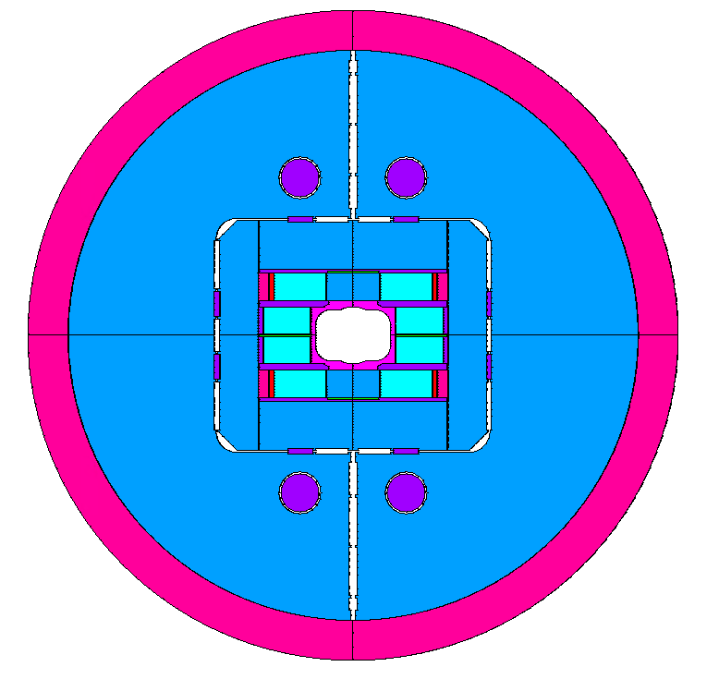
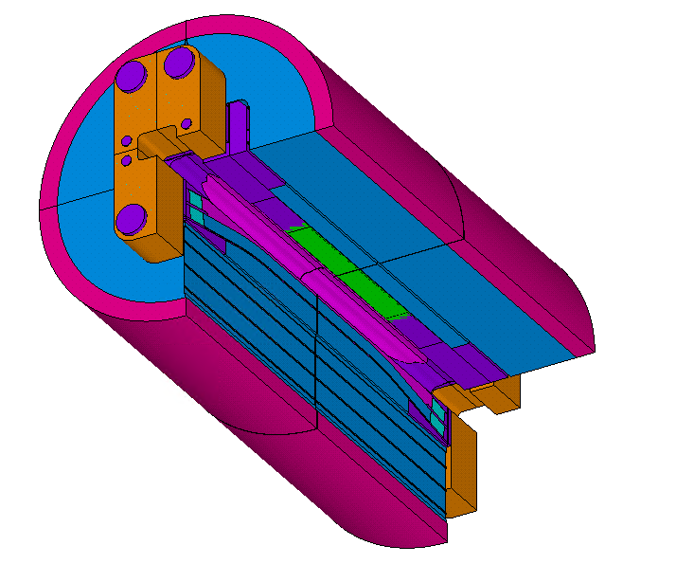
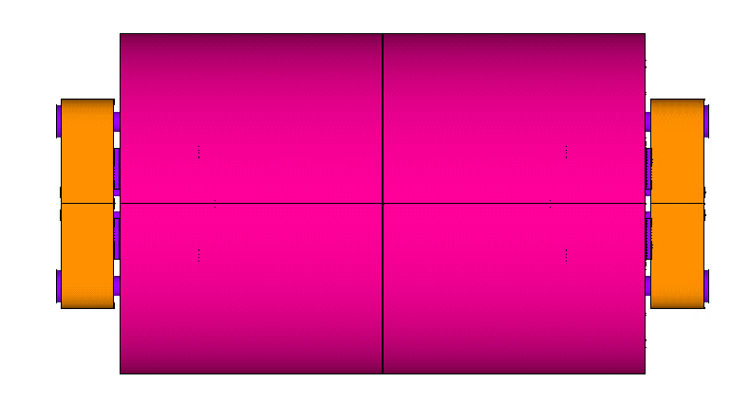
TFD Design Overview (1)
L_{y} = 2.0 m
Φ = 1.3 m

Slide 6
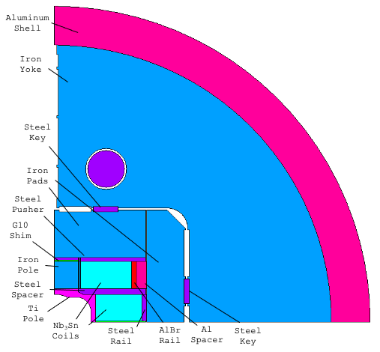
TFD Design Overview (2)
Highlights:
    ‘LD01’ coil configuration
    G10 shim in the boat
      Reduces stress in the pole
      Limits the pole bending, reducing the tension ‘spikes’ at the pole/coil interface
    Key position defined to limit the max. tension at the pole/coil interface
    Aluminum bronze rail with Al shim
      A ‘soft’ layer between the coil and the horizontal pad allows to remove local high stress zones in the coil
    Different shimming for inner and outer coil
    Yoke bladder loading
      Limits the coil peak stress at room temperature

Slide 7
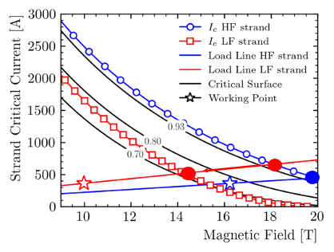
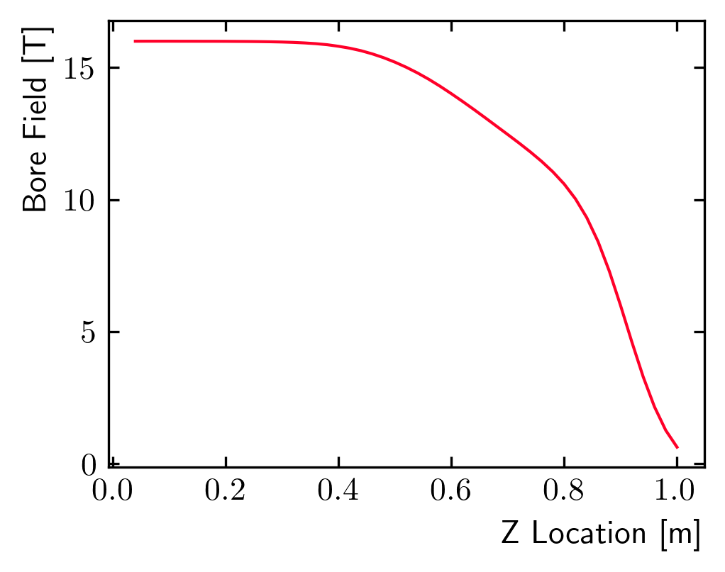
Magnetic Design
  Design target:
    16 T with 15% margin on the load line at 1.9 K
    Uniform field length > 0.75 m
  Results:
    Margin: 20% at 16 T, including strain effects
    Uniform field length equal to 0.78 m

Slide 8
Design Criteria
  Requirements:
    Material limits:
      Based on the MQXF design criteria
      Consider fragile fracture for materials with K_{Ic}<100 MPa m^{1/2}
    Coil limits:
      R.T.: Von Mises < 175 MPa everywhere
      Cold: Von Mises < 150/180 MPa (low field/ high field regions)
    Prestress:
      20 MPa max. tension (bonded model)
        Failure criteria for the epoxy bonding
        Neglect the ‘corner spikes’ (~1 contact element, 1 mm)
  Design ‘performance’ is evaluated for a 16 T target field:
    Load line margin
    Coil stress (high/low field)
    Field quality for consistent comparison of different options

Slide 9
Timeline
Design started from work performed on HEPDipo, presented at MT26, 2019:
    https://ieeexplore.ieee.org/document/8982034
Conceptual design presented at the CDR on 06/11/2020:
    https://conferences.lbl.gov/event/359/
  Magnetic and mechanical analysis presented at ASC2020:
    https://ieeexplore.ieee.org/abstract/document/9376992
  Initial developments on engineering design presented at MT27, 2021:
    https://ieeexplore.ieee.org/abstract/document/9733270
  Strain effects on the magnet critical surface were evaluated including reversible and irreversible effects. Presented at the Wire Specification Review (10/28/2021):
    https://conferences.lbl.gov/event/759/
    Also presented at ASC2022, paper (IEEE) under review
Development from a conceptual design to a ‘manufacturable’ design, with engineering considerations. Presented at the EOC2, 19/08/2022:
    https://conferences.lbl.gov/event/1036/

Slide 10
Outline
Design Overview
Coil Mechanical Analysis
3D Design Optimization
Critical Current Computation
Fine Tuning
Conclusion

Slide 11
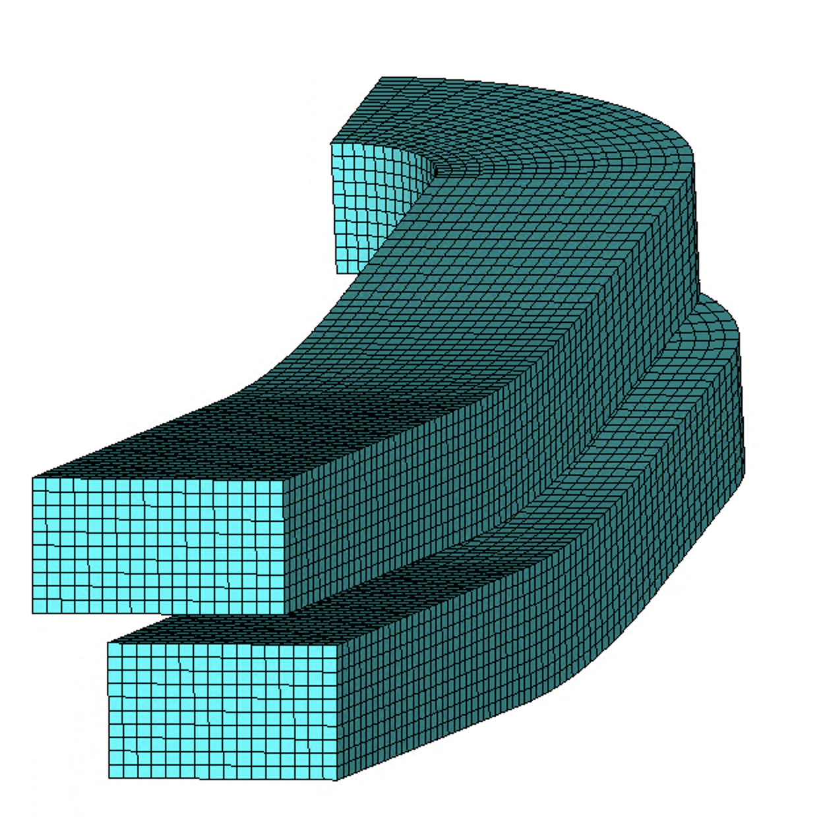
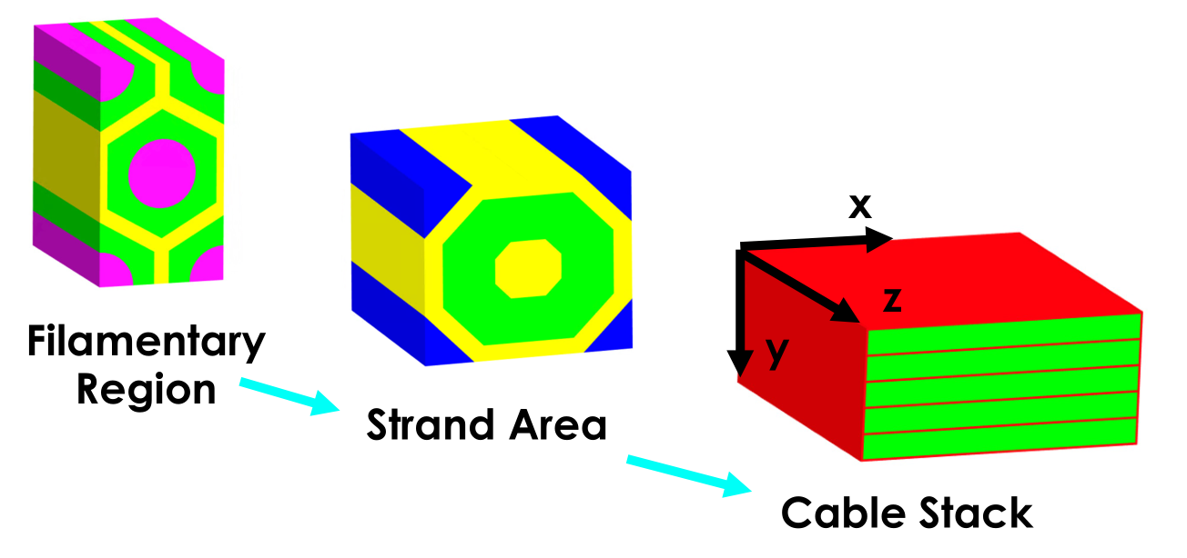
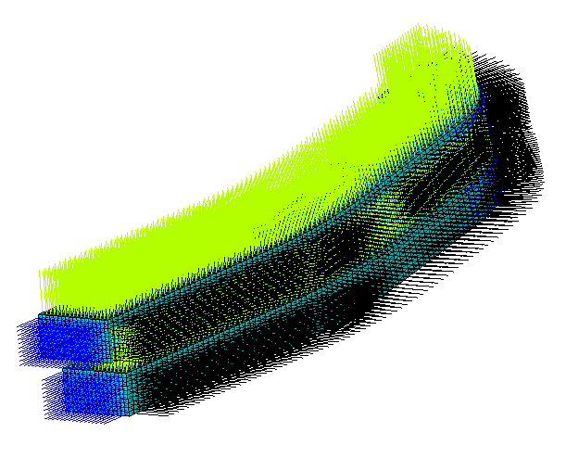
Coil Material Properties
  Coil modeled using an elastic isotropic material, with:
    25 GPa modulus, 3.8 mm/m integral thermal contraction
    This allows for consistent comparison with magnets built in the past
  Additional checks performed considering the ‘best available’ material model
    Elasto-plastic, anisotropic with properties extracted from RVE models
    Material limits from experiments

Slide 12
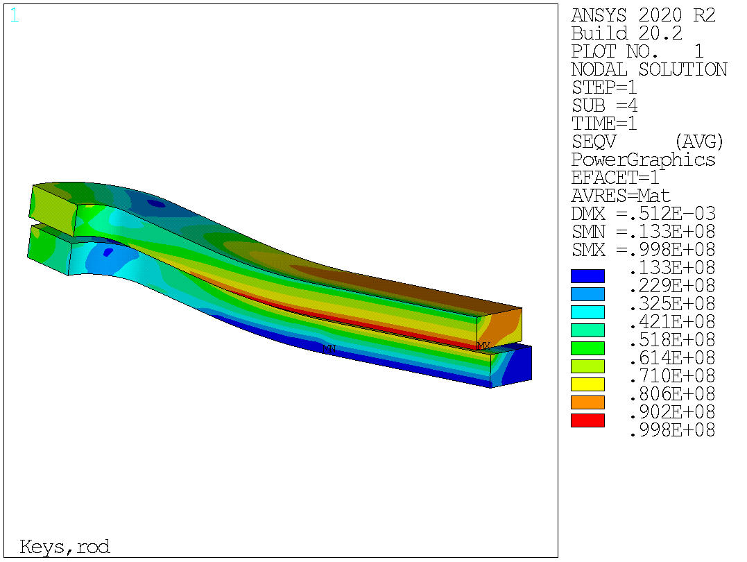
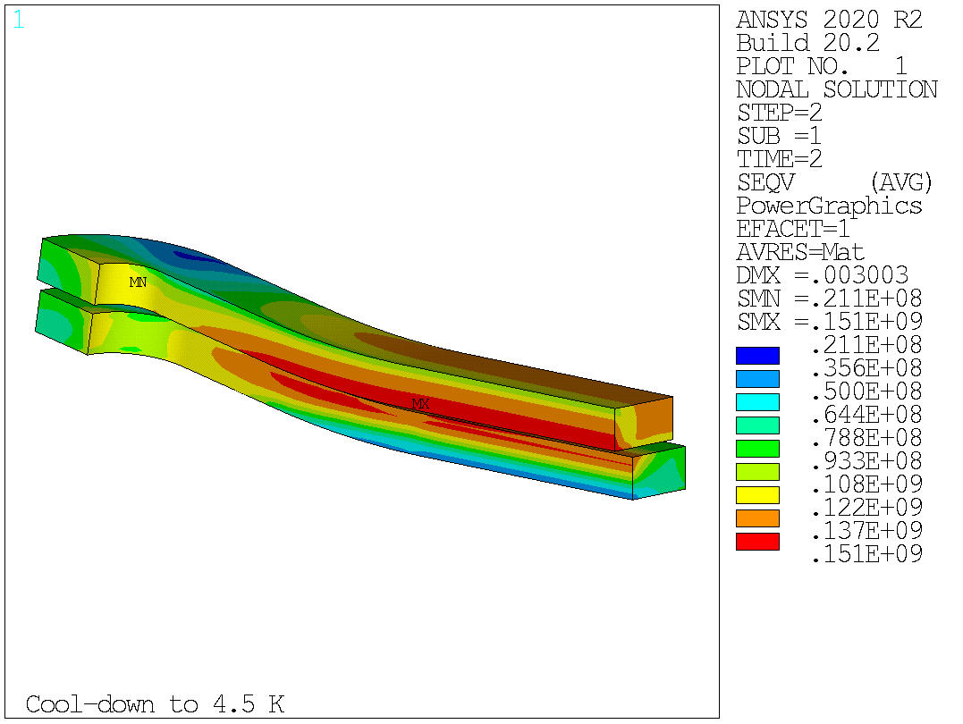
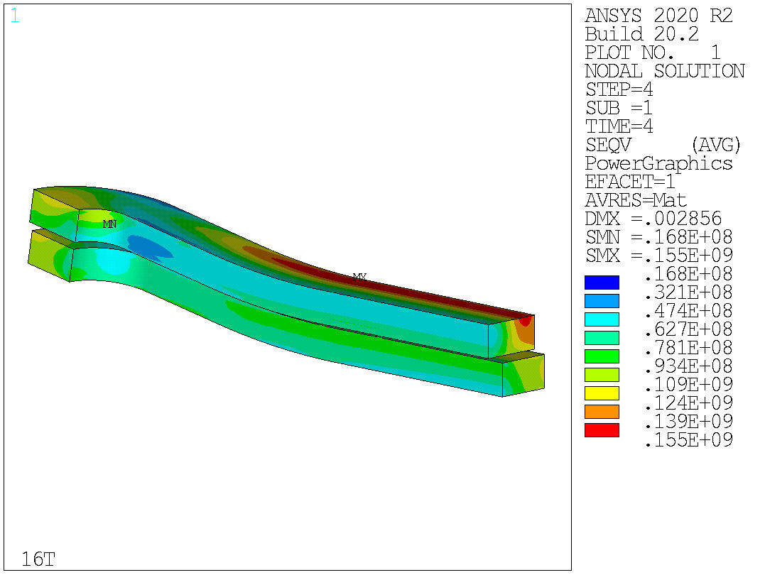
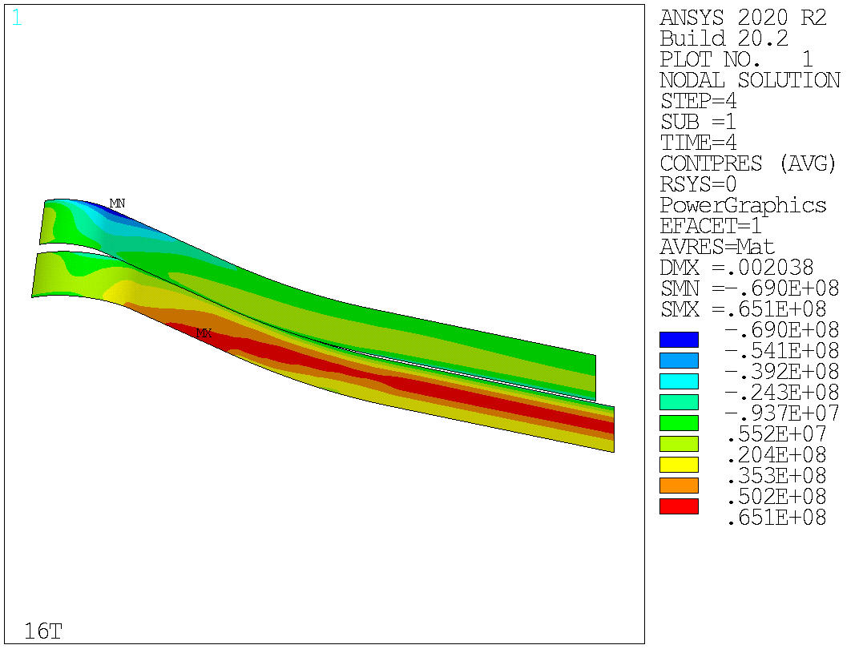
Design Results – Coil Eqv. Stress
σ_{vm}
σ_{vm}
σ_{vm}
Current design satisfies the mechanical constraints on the coil limits
With full prestress for 16 T operation:
      Peak stress below 100 MPa at room temperature
      151 MPa on the high field region after cooldown
      155 MPa in the low region at 16 T
  Small region with tension in the end region
Contact Pressure

Slide 13
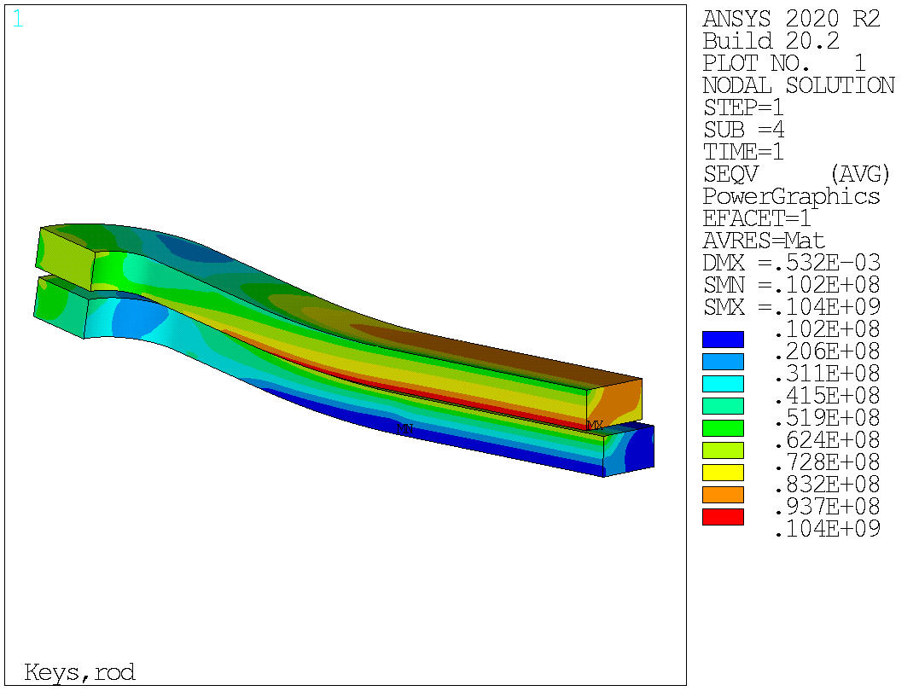
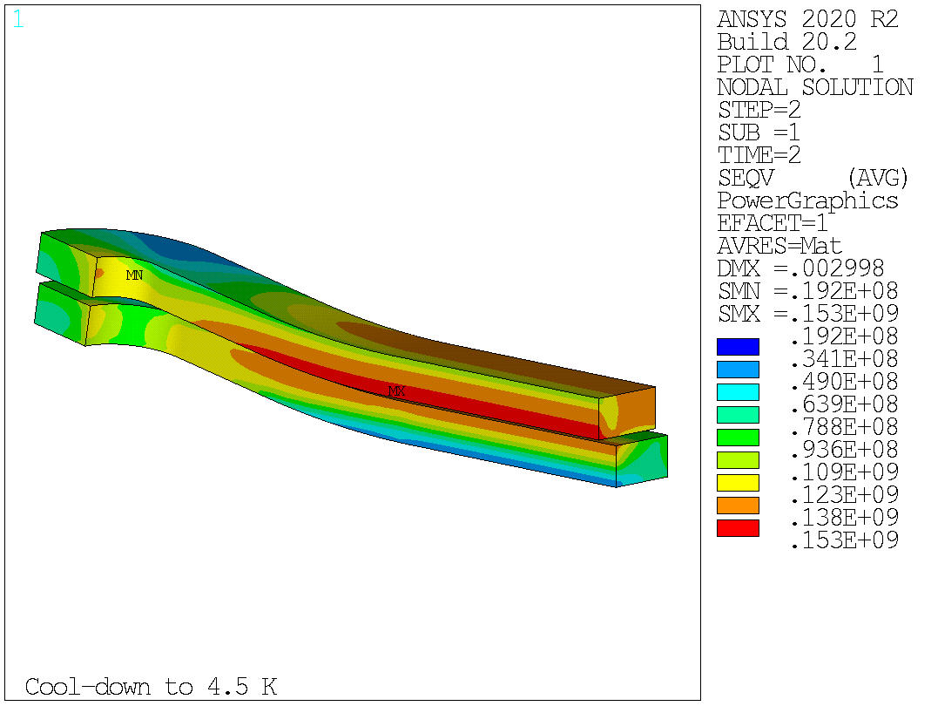
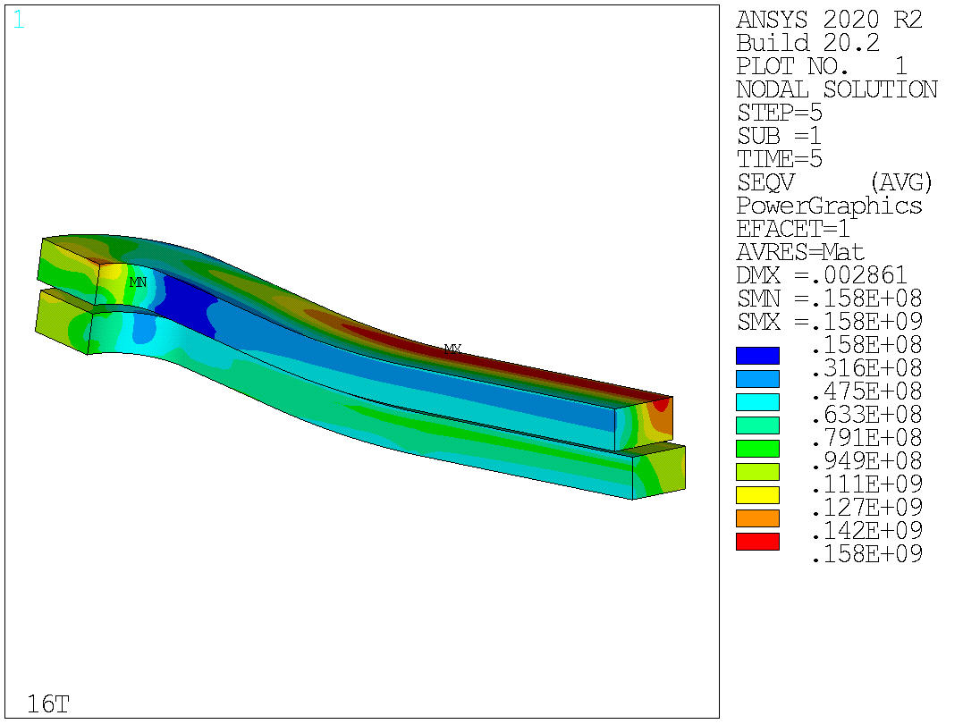
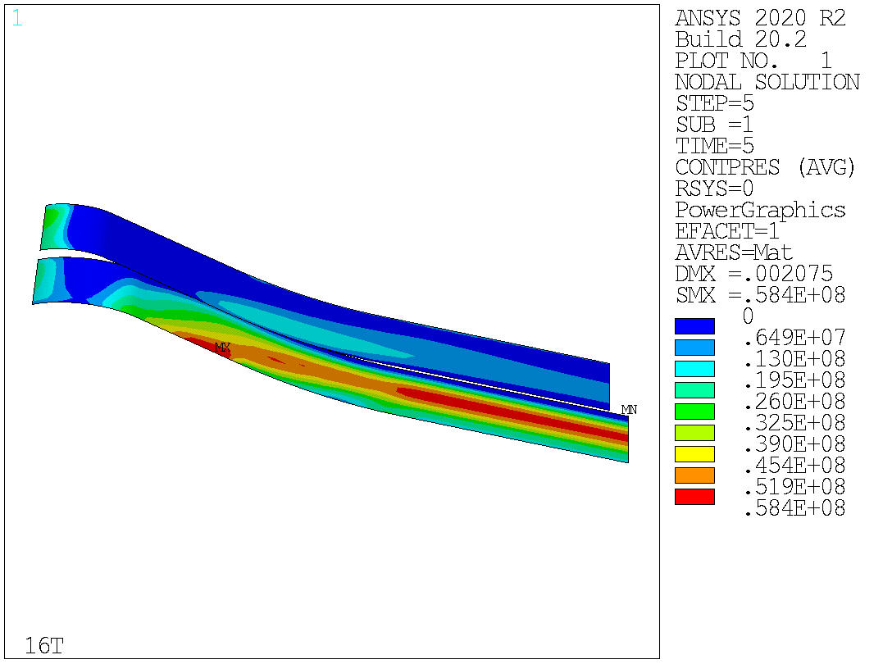
Design Results – Eqv. Stress - Debonded
σ_{vm}
σ_{vm}
σ_{vm}
We need to check if the excessive tension can result in coil damage after detachment
Debonding between the coil and the pole allowed
    ‘Large’ detached regions (limit is 0 now…)
    Peak stress stays below the threshold
  Peak stress below the threshold also modeling the progressive failure at the pole-coil interface with cohesive elements
σ_{vm}

Slide 14
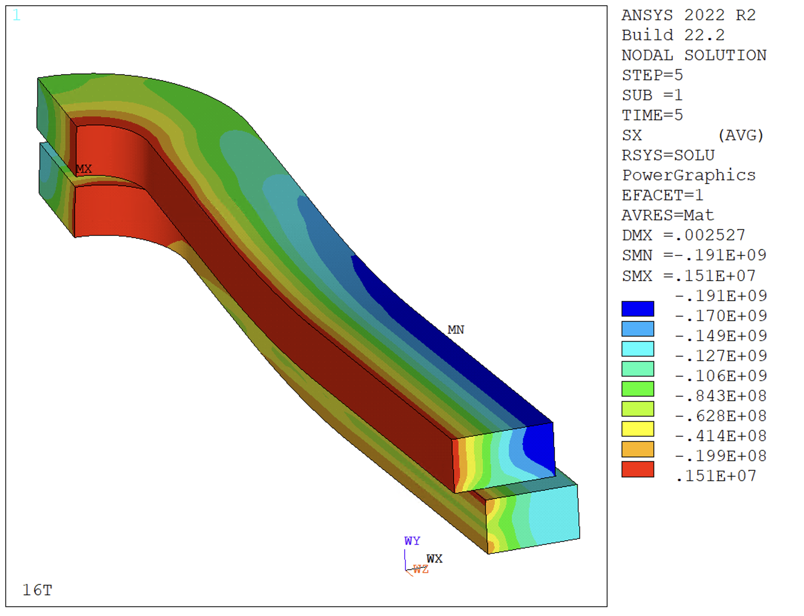
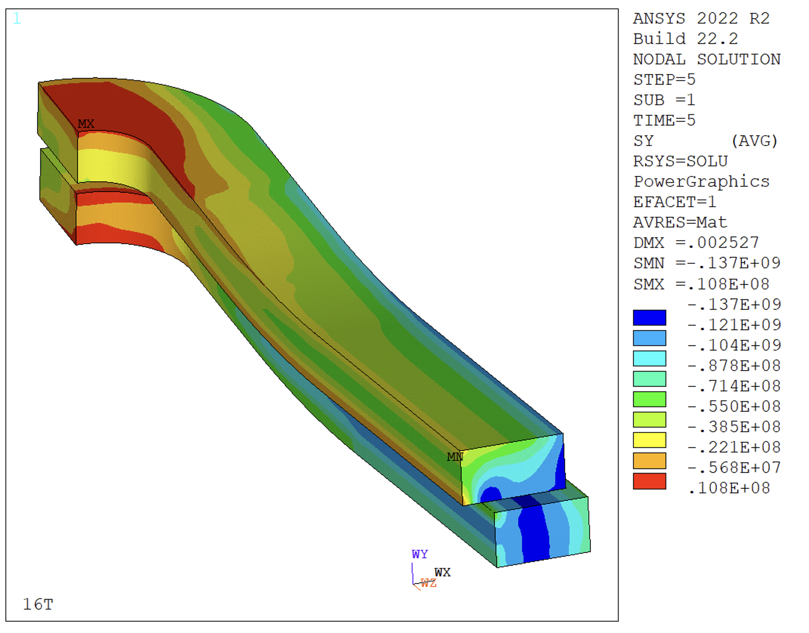
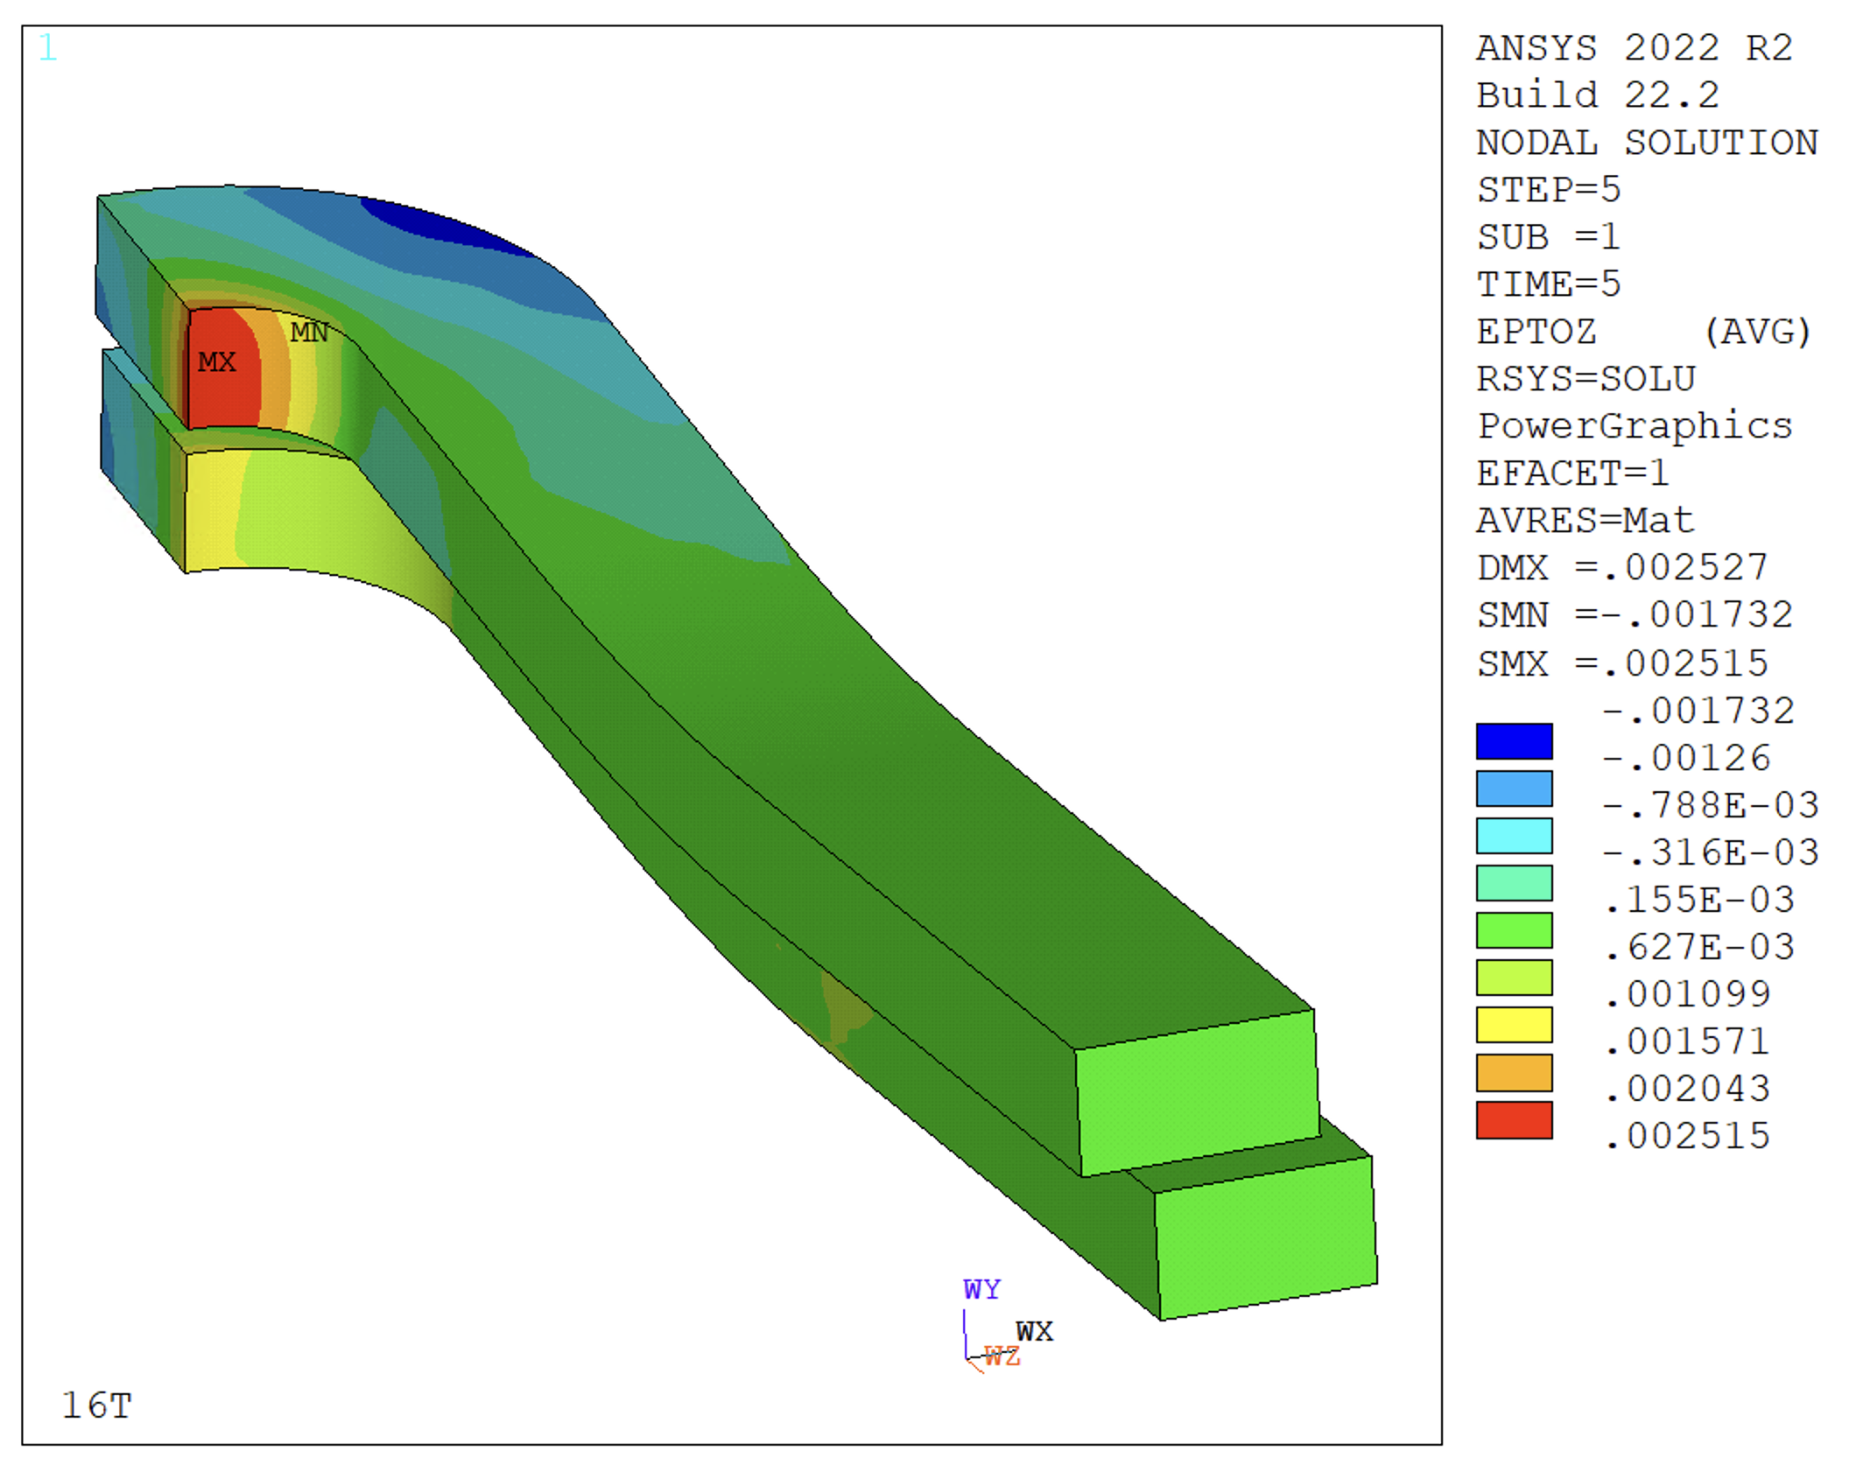
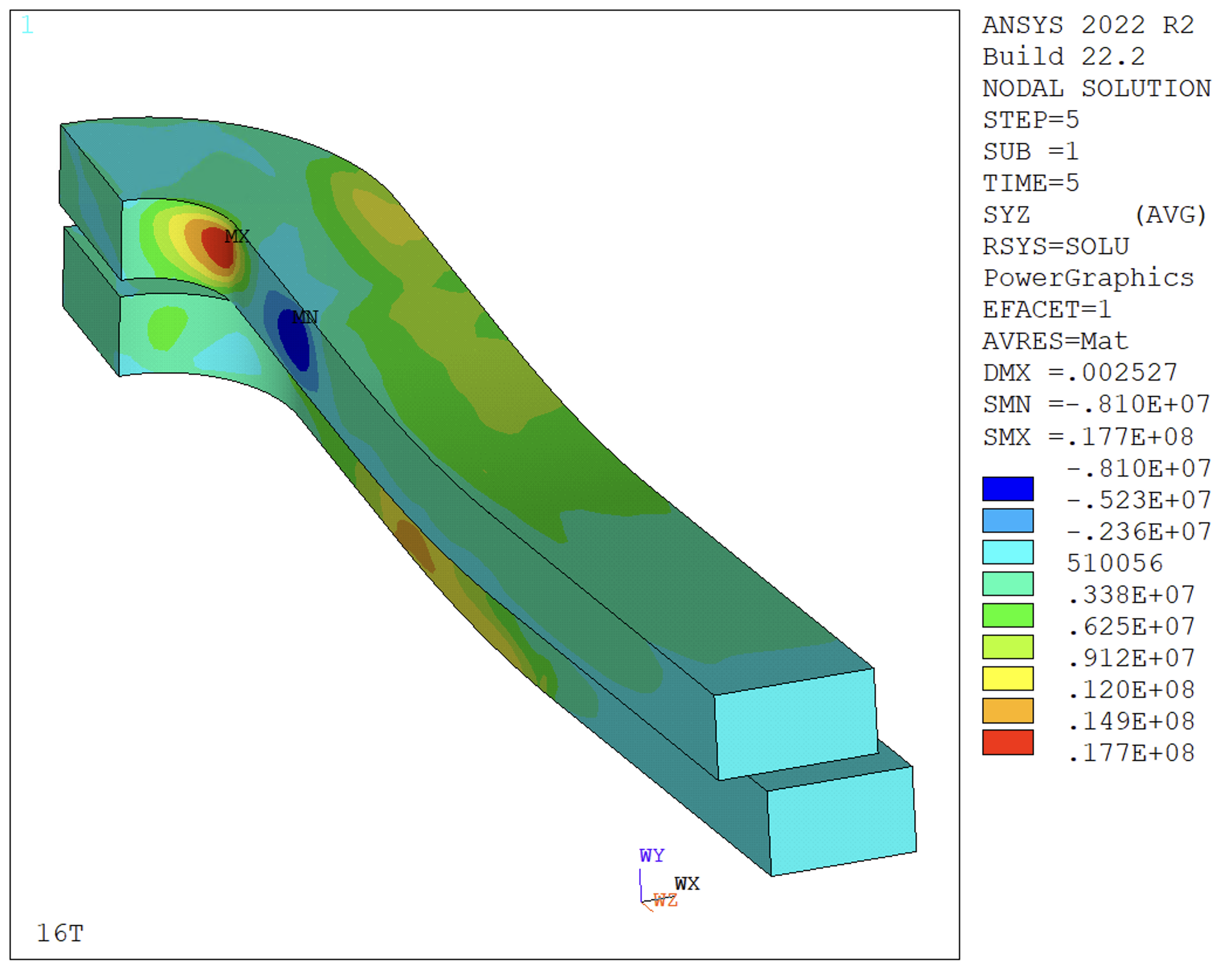
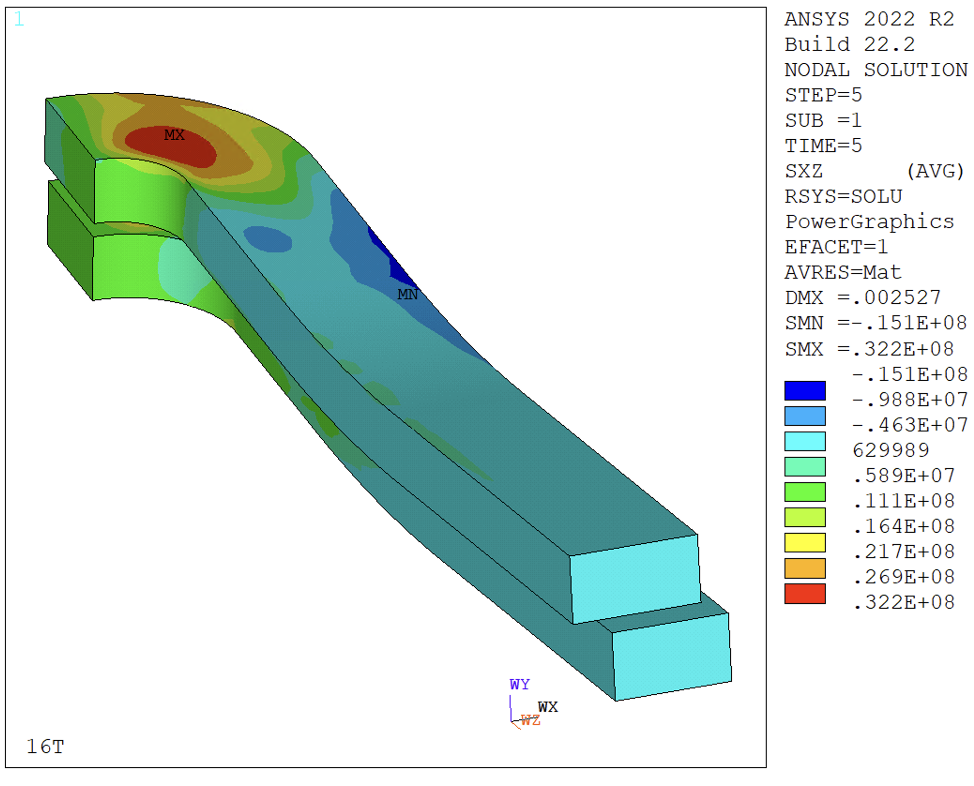
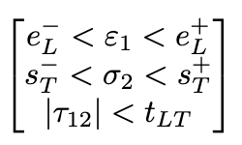
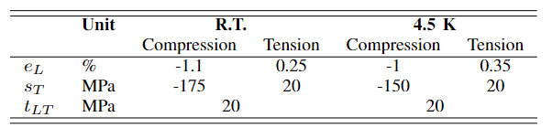
Coil Strength – Additional Checks
σ_{xx}
σ_{yy}
ԑ_{zz}
  ‘Best possible’ strength check:
    Anisotropic properties from RVE
    Limits from measurements on strands/cables
    x,y,z follow the cable coordinate system along the coil
  Considering a prestress for 15 T (shown), limits (s_{T}) exceeded at 16 T
    Not clear how these checks would look on other successful magnets
    This is not part of our design criteria
    Within limits lowering prestress (e.g. 14 T)
σ_{yz}
σ_{xz}

Slide 15
Outline
Design Overview
Coil Mechanical Analysis
3D Design Optimization
Critical Current Computation
Fine Tuning
Conclusion

Slide 16
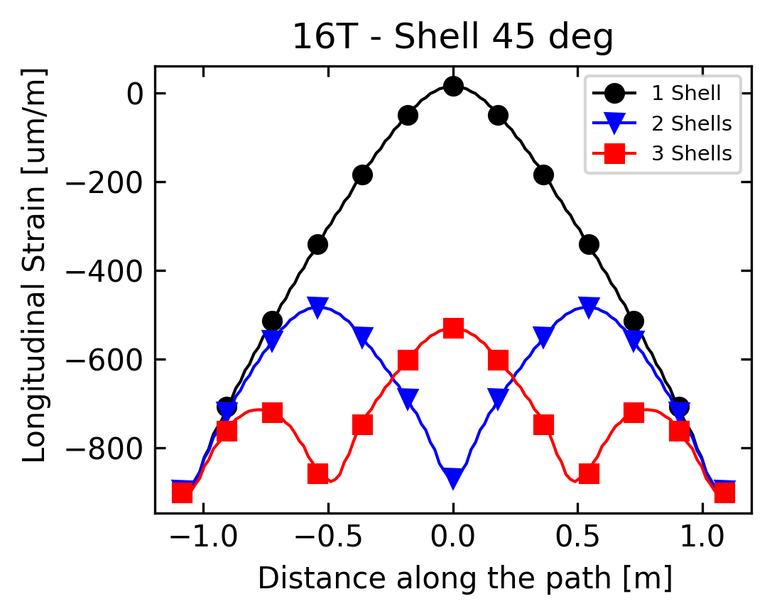
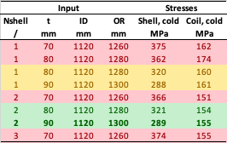
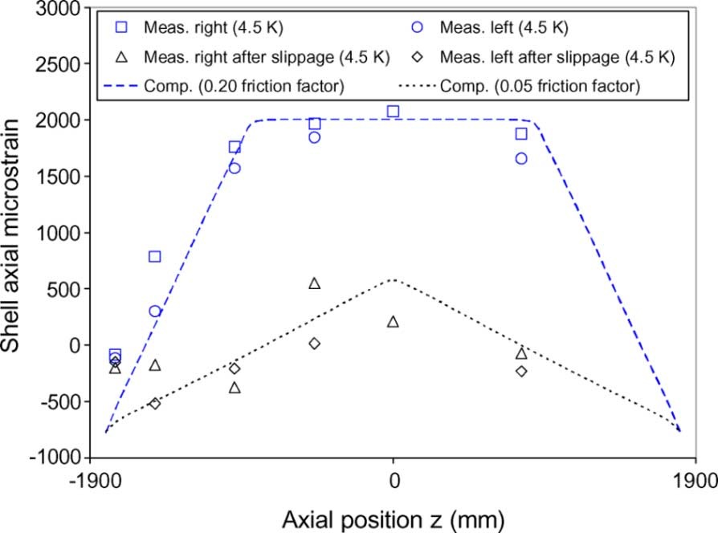
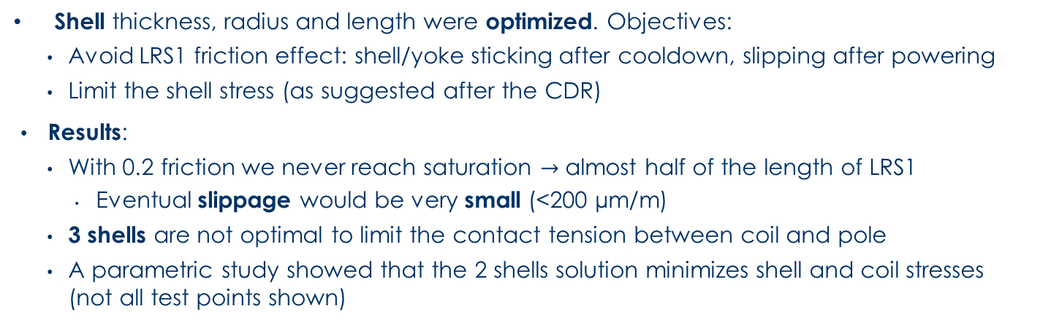
Shell Design
Shell thickness, radius and length were optimized. Objectives:
    Avoid LRS1 friction effect: shell/yoke sticking after cooldown, slipping after powering
    Limit the shell stress (as suggested after the CDR)
  Results:
    With 0.2 friction we never reach saturation $→$ almost half of the length of LRS1
      Eventual slippage would be very small (<200 µm/m)
    3 shells are not optimal to limit the contact tension between coil and pole
    A parametric study showed that the 2 shells solution minimizes shell and coil stresses (not all test points shown)

Slide 17
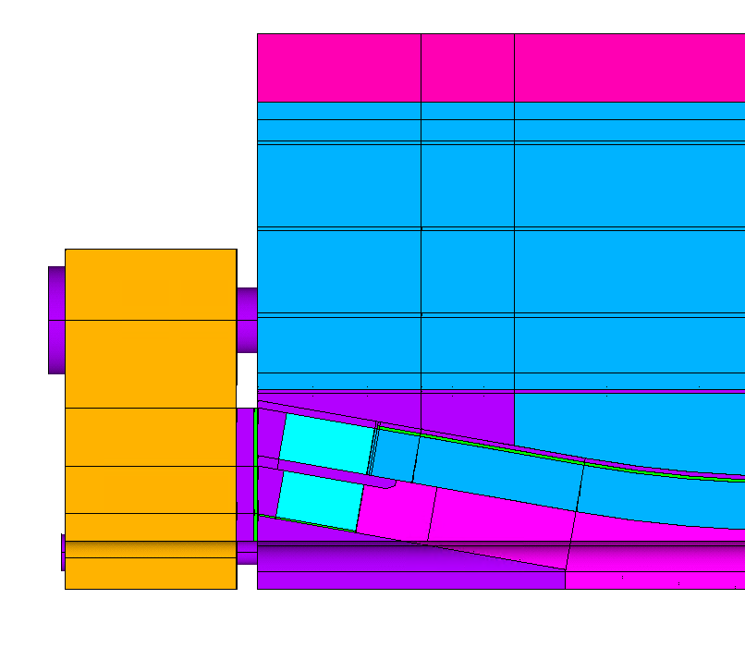
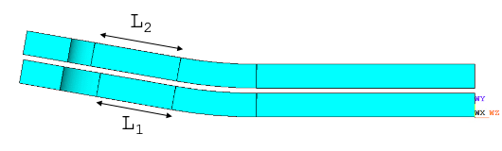
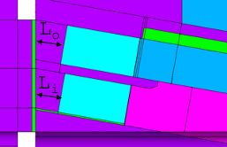
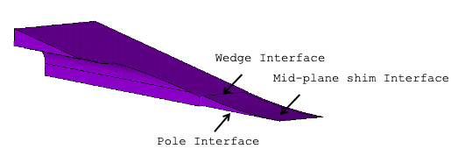
End Region Optimization
Coil ramp length
Iron pads
length
Longitudinal load system
End spacer thickness
Several solutions for the end-region optimized to maximize field, minimize coil stress, avoid coil/pole debonding…
…respecting fabrication/manufacturability constraints
Wedge design

Slide 18
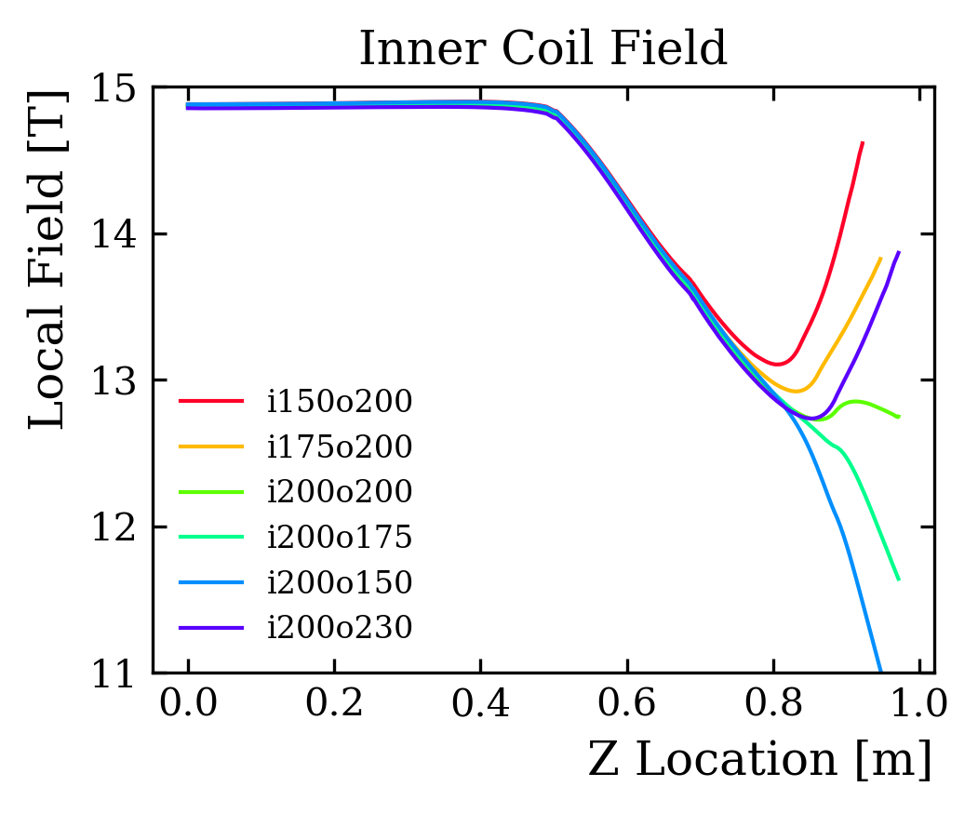
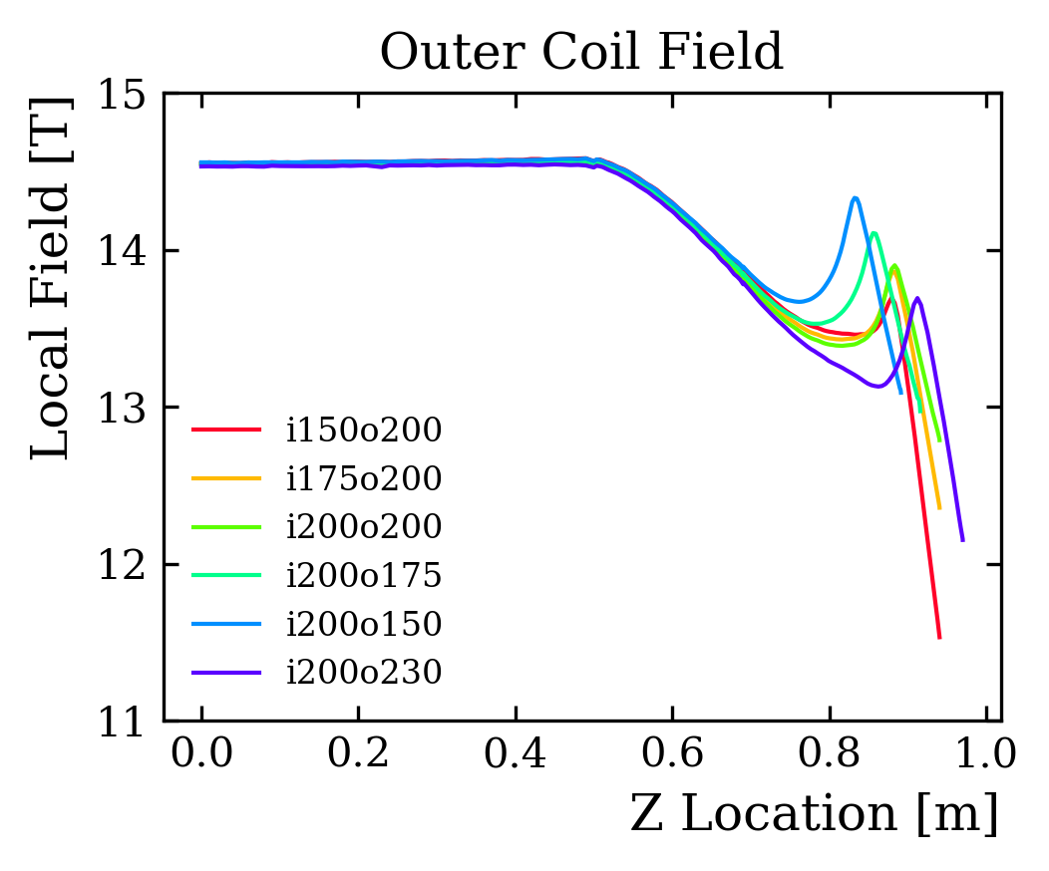
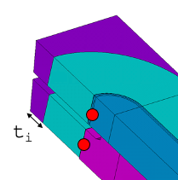
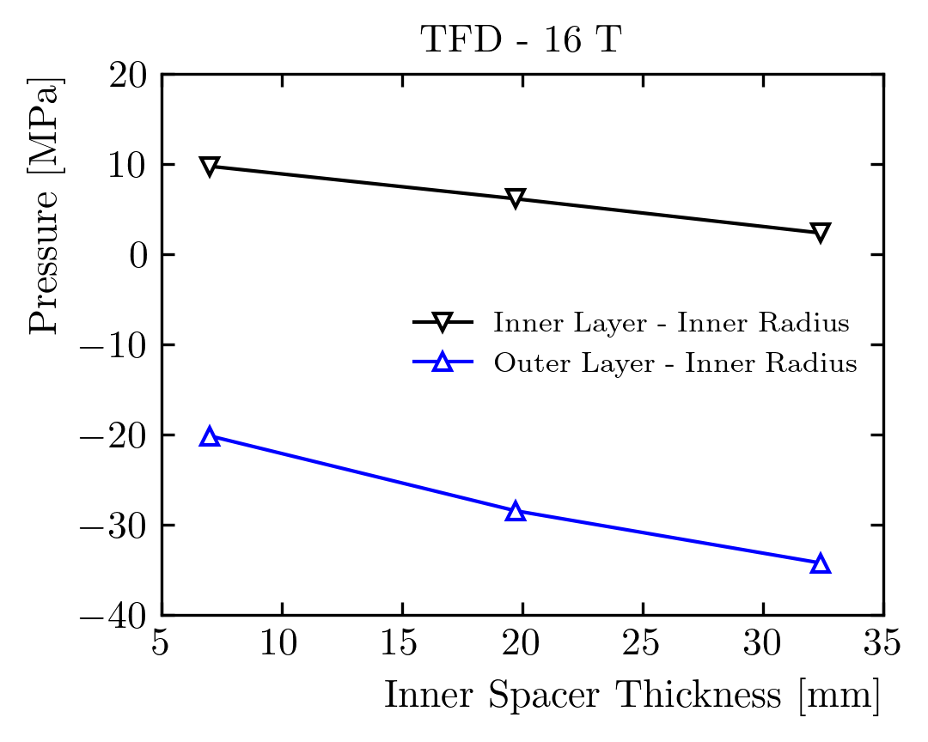
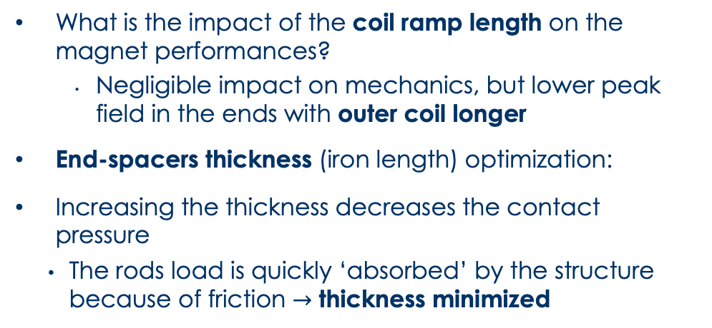
Coil End Design
What is the impact of the coil ramp length on the magnet performances?
      Negligible impact on mechanics, but lower peak field in the ends with outer coil longer
End-spacers thickness (iron length) optimization:
Increasing the thickness decreases the contact pressure
    The rods load is quickly ‘absorbed’ by the structure because of friction $→$ thickness minimized

Slide 19
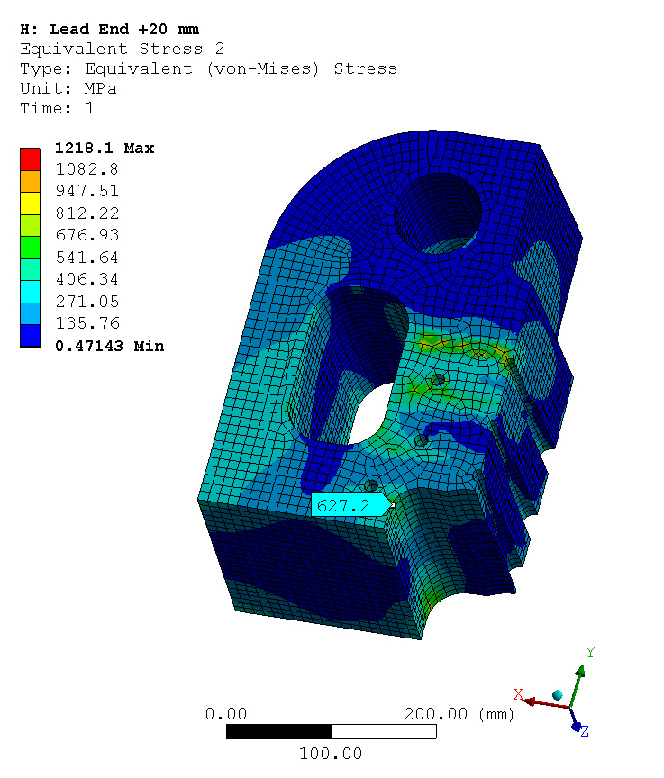
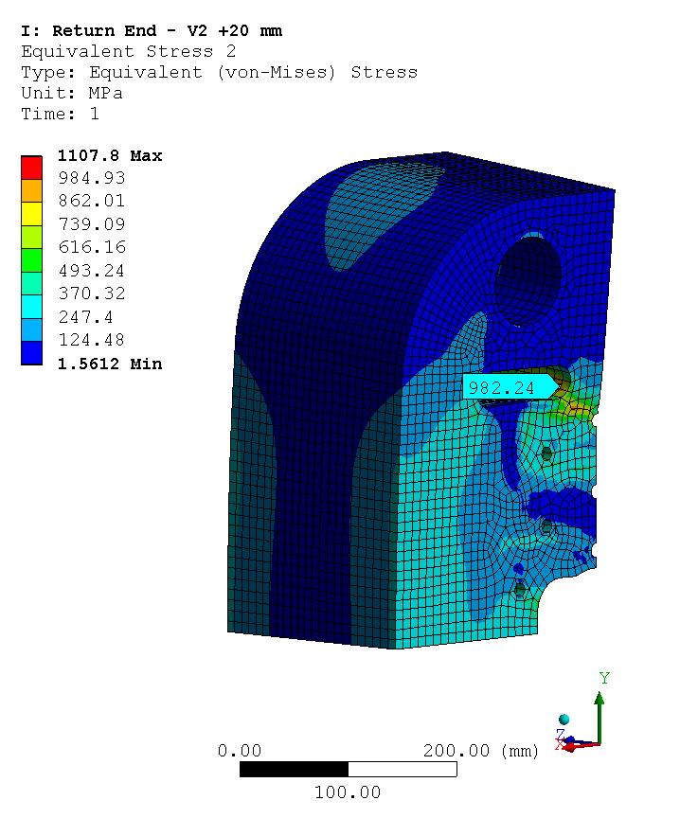
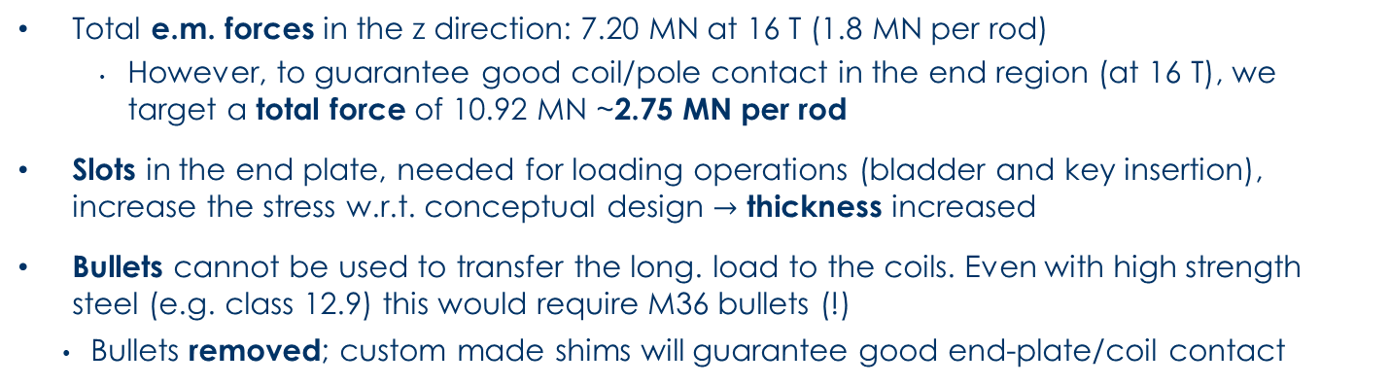
Longitudinal Prestress System
Step | Fz [MN]
Loading | 9.05
Cold | 10.62
15 T | 10.89
16 T | 10.92
Radius | Stress | Safety Fact.
mm | MPa | /
6 | 8135 | 0.14
8 | 4576 | 0.24
10 | 2928 | 0.38
12 | 2034 | 0.54
14 | 1494 | 0.74
16 | 1144 | 0.96
18 | 904 | 1.22
20 | 732 | 1.50
Lead End
Return End
Bullet Sizing
Total e.m. forces in the z direction: 7.20 MN at 16 T (1.8 MN per rod)
      However, to guarantee good coil/pole contact in the end region (at 16 T), we target a total force of 10.92 MN ~2.75 MN per rod
Slots in the end plate, needed for loading operations (bladder and key insertion), increase the stress w.r.t. conceptual design $→$ thickness increased
Bullets cannot be used to transfer the long. load to the coils. Even with high strength steel (e.g. class 12.9) this would require M36 bullets (!)
    Bullets removed; custom made shims will guarantee good end-plate/coil contact

Slide 20
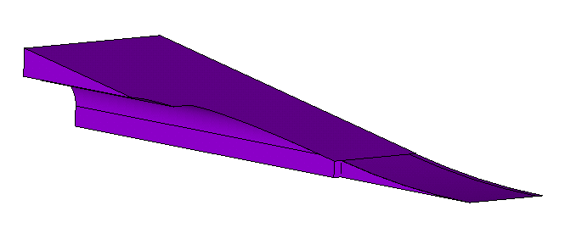
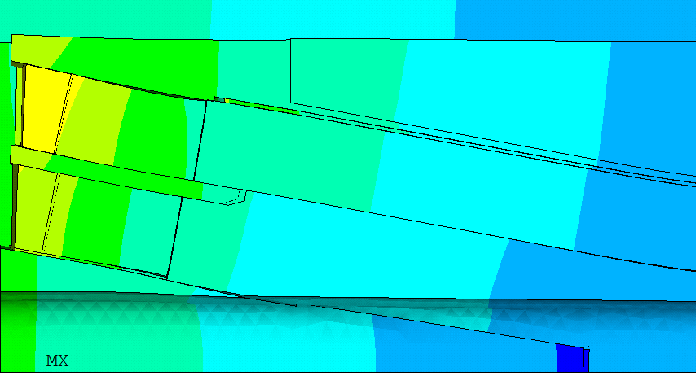
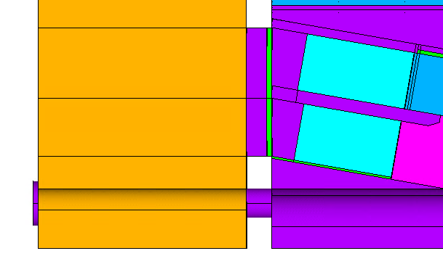
Wedge Optimization
Wedge
Wedge
Interface
Mid-plane shim
Interface
Triangle
Pole Interface
Wedge/Pole Gap
Options considered for wedge design:
    Triangle and wedge in one steel piece, non-bonded
    Triangle in GFRP, bonded
    Triangle in GFRP, as additional component
    Option II discarded because computations show that the triangle would debond during loading
    Option III discarded as a gap between the wedge/triangle would open during operation
Non impregnated wedge is kept in place by ‘soft’ bullets:
    Bullet size/material optimized minimizing the wedge/pole gap, and limiting the impact on coil prestress
Wedge
bullet

Slide 21
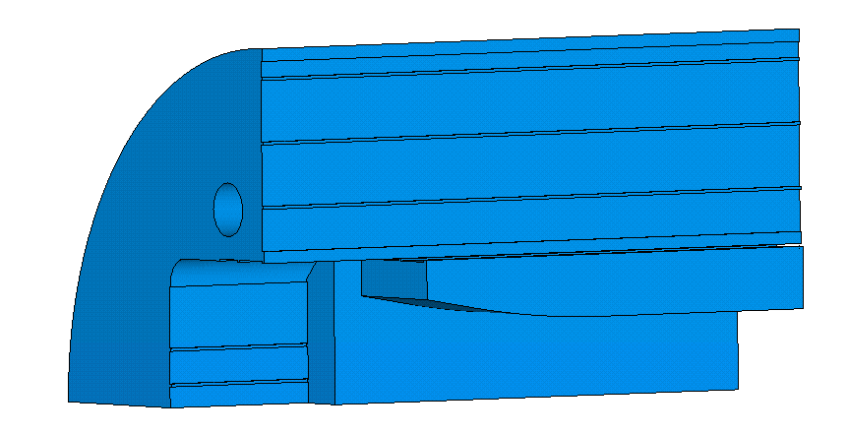
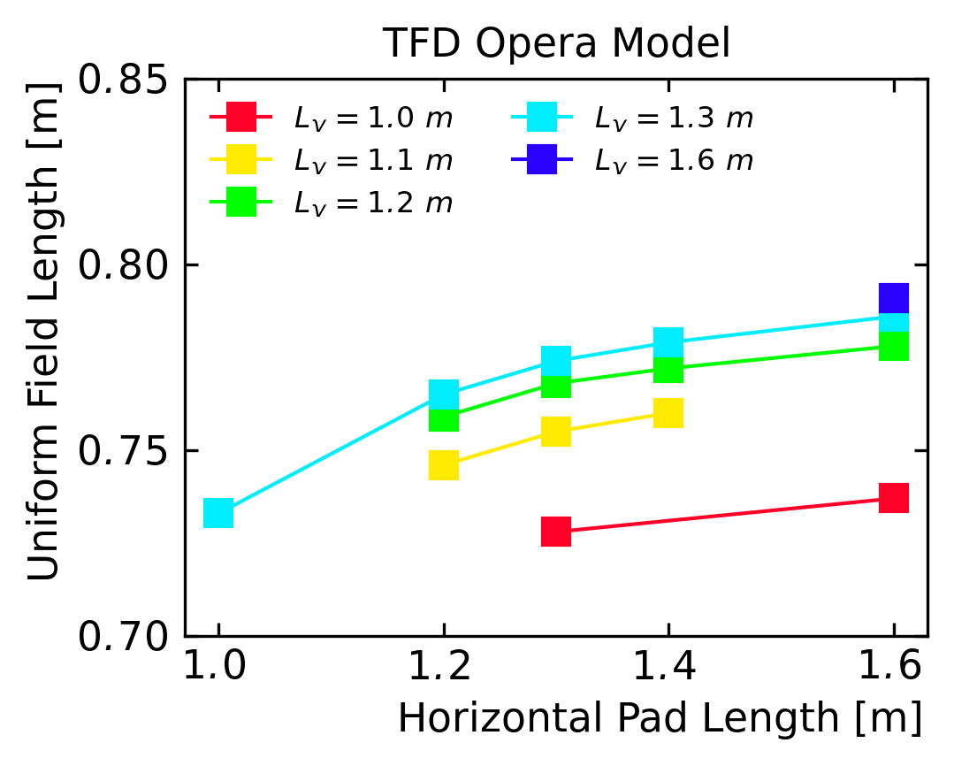
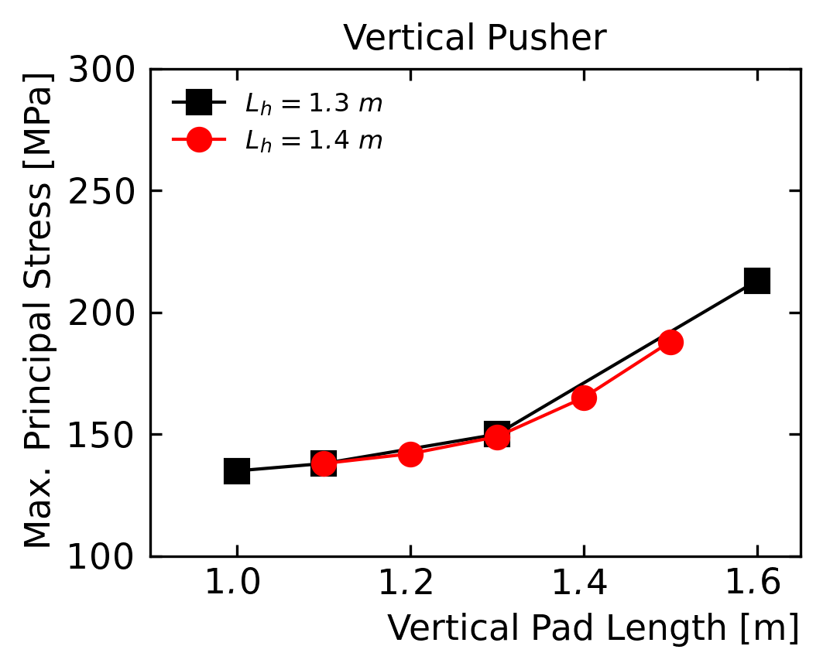
Iron - Vertical and Horizontal Pad
L_{v}
L_{h}
Parametric study of the iron length of the pads
      Maximize uniform field length (> 0.75 m)
      Minimize iron stress
  Vertical pad impact saturates at around 1.3 m
Max. principal stress on pads independent
    Horizontal pad stress ‘knee’ at 1.4 m (not shown)
    Vertical pad stress ‘knee’ at 1.3 m
  Final magnetic length: 0.78 m

Slide 22
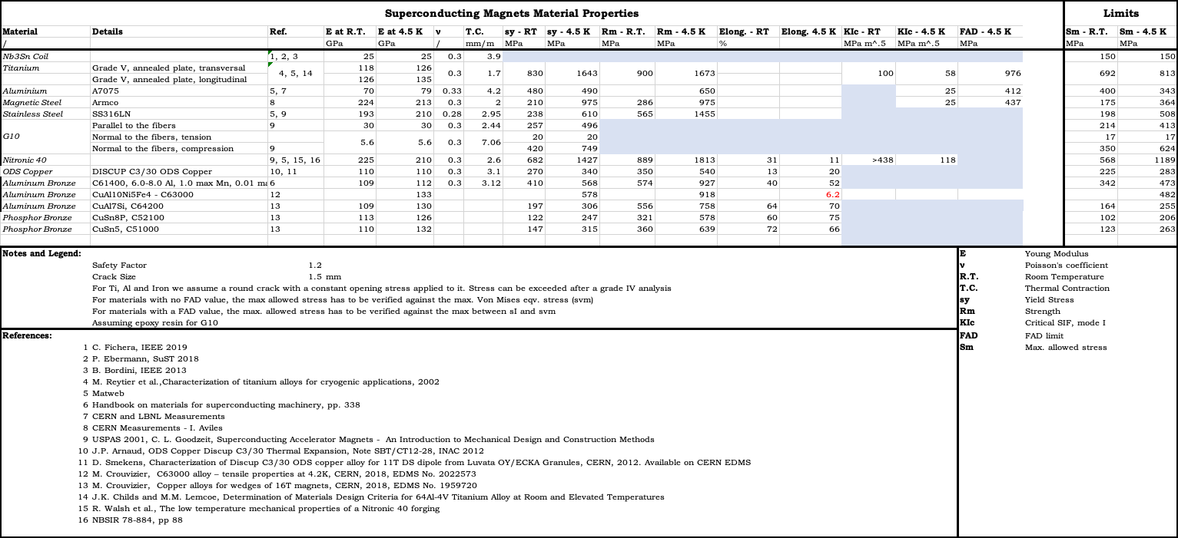
Structural Checks
Structural checks on all the magnet components performed
Available in this slide deck (see Appendix B)

Slide 23
Outline
Design Overview
Coil Mechanical Analysis
3D Design Optimization
Critical Current Computation
Fine Tuning
Conclusion

Slide 24
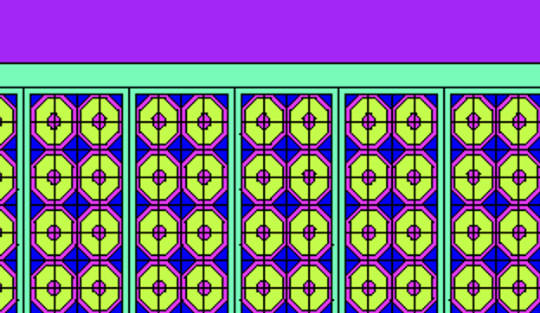
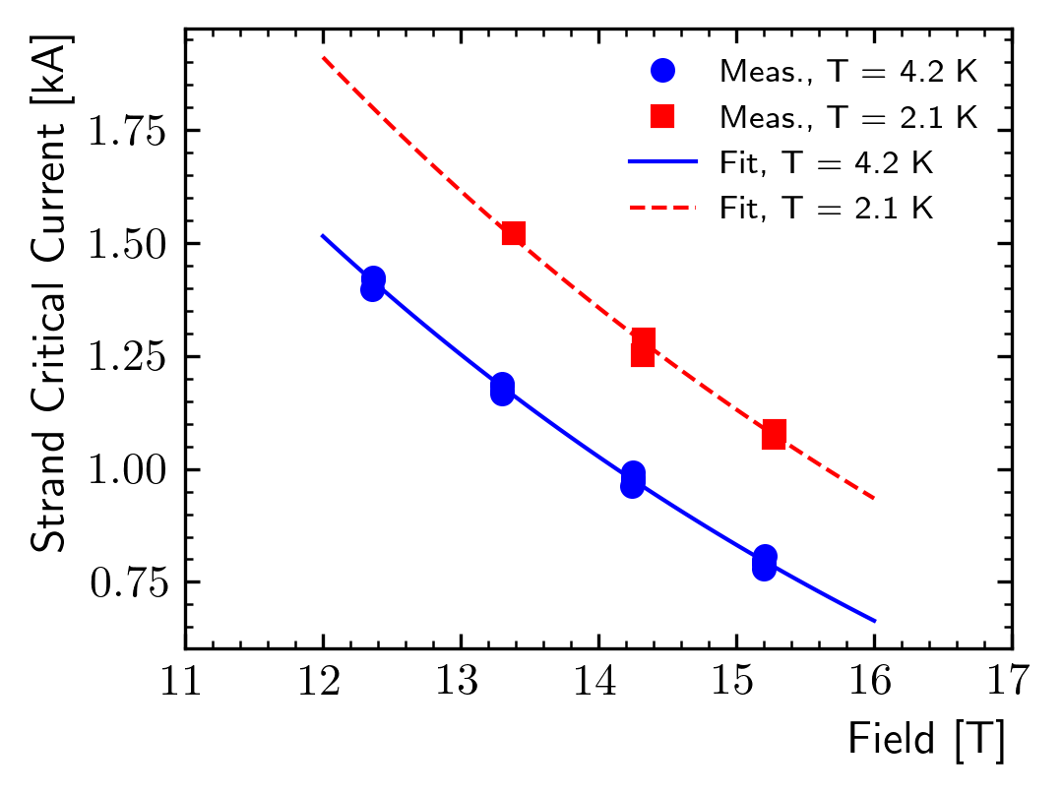
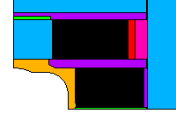

FE ‘Strand’ Model
  Strain effects on the magnet critical surface were evaluated including reversible and irreversible effects, following a methodology previously tested on MQXF
    FE model with detailed cable geometry from cable/strand parameters
      Remaining modeling assumptions same as in the standard ‘block’ model
    Critical surface parametrization from strand measurements
    Critical current computed using the exponential strain function
  First presented at the Wire Specification Review, see:
    https://conferences.lbl.gov/event/759/

Slide 25


Results – Assembly + Cooldown
N. Cheggour
For assembly and cool-down, we focus on potential irreversible degradation
$s{\left(ε\right)}_{irr}$ is the strain function at $ε_{l}=ε_{irr,0}$, equal to 0.85
    We assume this as ‘limit’ for irreversible degradation onset
The critical area is the lower side of the upper coil, with $s{\left(ε\right)}_{CD}$= 0.83
    Slightly over the limit
    This is with full prestress for 16 T, and the plan is to start with a lower prestress
Notes:
TFD_contour_seps_cd.png

Slide 26


Load Line Margin
We compute the current limit for each strand, as a function of field and strain
    Detailed ‘strand’ model of the magnet (2D)
  Load line margin:
    20% in the high field / low stress region
    32% in the low field / high stress region.
      This would be 44% with no strain effects
Notes:
TFD_contour_seps_cd.png

Slide 27
Outline
Design Overview
Coil Mechanical Analysis
3D Design Optimization
Critical Current Computation
Fine Tuning
Conclusion

Slide 28


Fine Tuning – Key Position
Design A
(Baseline)
Design B
Can we reduce the pole/coil contact tension in the end region?
    Design B: moving the vertical pad key to the left

Slide 29




Design B – Equivalent Stress
The design variation satisfies the mechanical constraints on the coil equivalent stress and contact pressure
With full prestress for 16 T operation:
      Peak stress below 110 MPa at room temperature
      152 MPa on the high field region after cooldown
      162 MPa in the low region at 16 T

Slide 30




Design B – Horizontal Stress
The design variation solves the issue in the end region of the pole/coil interface
But we pay with a significant horizontal stress increase:
    R.T.: 156 MPa
    CD: 179 MPa
    15 T: 202 MPa
    16 T: 205 MPa

Slide 31


Impact of the Prestress
What is the horizontal stress for the 2 designs when targeting a certain field?
  Parametric analysis:
    Prestress is lowered accordingly to the target field, allowing a max tension of 20 MPa
    For design A tension in the ramp/end region is allowed
    Bonded and debonded cases considered
  Design B horizontal stress is 15/20 MPa larger

Slide 32
Outline
Design Overview
Coil Mechanical Analysis
3D Design Optimization
Critical Current Computation
Fine Tuning
Conclusion

Slide 33
Conclusion
The magnet design reaches a 16 T field with 20% margin on the load line, an eqv. stress of 100 MPa at room temperature, and 155 MPa at cold, with limited tension at the coil/pole interface
    Multiple checks were performed on the coil strength, with traditional and more ‘advanced’ strategies
We have evaluated the load line margin including strain effects, using a ‘strand’ model of the winding
Design details were defined evaluating their impact on magnetic and mechanical performances:
      Coil design: ramp length, spacer thickness
      Longitudinal loading system: end-plate sizing, load transfer to coil and wedge
      Wedge design
      Iron pad length
Design fine tuning in progress:
    Some tension in the end region, which can be reduced moving the vertical key, increasing the coil horizontal stress

Slide 34
Appendix A
Extra Slides

Slide 35
Prestress Criteria
Traditional Prestress ‘Criteria’, pole/coil interface model and limits:
    No tension (bonded model) / no detachment (friction model)
      In our case seem unfeasible (stresses on the coil/structure)
    Average pressure >0 (friction model) – FRESCA II
    20 MPa avg. tension (bonded model)
      Results might not be representative of the real coil condition, especially if the tension ‘region’ is ‘wide’
      Not clear if there is any empirical evidence that this works
    20 MPa max. tension (bonded model) – selected criteria
      Failure criteria for the epoxy bonding
      Generally the ‘corner spikes’ (~1 contact element, 1 mm) were neglected
    Note: bonded models did not consider a limit shear stress

Slide 36

Coil Material Properties - Anisotropic
  Material model applied with generalized Hill

Slide 37

Design Results – Coil Eqv. Stress
Design A, contact pressure/tension between the pole and the coil

Slide 38




Design Results – Coil Eqv. Stress
Cohesive elements applied at the pole-coil interface
Equivalent stress is fine

Slide 39





Coil Strength – Additional Checks
σ_{xx}
σ_{yy}
ԑ_{zz}
‘Best possible’ (to us) strength check:
    Anisotropic properties from RVE
    Limits from measurements on strands/cables
    x,y,z follow the cable coordinate system along the coil
Within the limits considering a prestress for 14 T (shown), exceeded at 15 T
    Not clear how these checks would look on other successful magnets
    This is not our design criteria
σ_{yz}
σ_{xz}

Slide 40



Sample Holder Load Cases
F_{s}
F_{s}
Displacements
Design was created assuming no mechanical interaction between the magnet and the test well
    At the moment, it is not clear if this will be the case
We investigated potential usage scenarios:
    E.g. non-centered fusion cables: 200 kN symmetric load. Only quadrant model available but should be as conservative as possible
    Negligible impact: displacements < 4; stresses < 1 MPa
Stresses

Slide 41


Irreversible Degradation
Critical
area
For assembly and cool-down, we check against irreversible degradation
$s{\left(ε\right)}_{irr}=0.85$ (irreversible degradation onset) is the strain function at $ε_{l}=ε_{irr,0}$
The critical area is the lower side of the upper coil, with $s{\left(ε\right)}_{CD}$= 0.83
    Slightly over the limit
    However, this is with full prestress for 16 T, and the plan is to start with a lower prestress
Notes:
TFD_contour_seps_cd.png

Slide 42

Peak Stress as a Function of the Field
Peak stress at different fields with ~no prestress at room temperature
    Some prestress still applied during cooldown, due to differential thermal contractions
    Around 10 MPa of difference between the two designs, but the peak value is acceptable also with design A

Slide 43
Appendix B
Structural Checks

Slide 44
Material Properties
Von Mises eqv. stress used for non-fragile material
Higher between Von Mises and S1 for the fragile materials (very conservative)
Coil limits at cold: Von Mises < 150/180 MPa (low field/ high field regions)

Slide 45
Fragile Material – Example (Iron)
Assuming constant stress along the crack path
    Conservative
    Not relevant for local spikes – should use weight functions (grade IV analysis)
Cracks try to become ‘round’, we assume a/c = 1 (implies quasi-static load)
Limit ~500 MPa for a 1 mm round crack
    With a reasonable safety factor (1.5) we get ~330 MPa
  Note: c = half crack width. a is the ‘crack length’ for an ‘edge’ crack, otherwise would be 2a

Slide 46



End Shoes
  Stainless steel
    Limits: R.T.: 198 MPa, C.D. 508 MPa
  High strength steel
    E.g. Nitronic 40, yield: R.T.: 680 MPa, 4.5 K:1400 MPa
  Stainless steel would have to endure some plasticization
  Might remove the edge extending the shoes (shorter rails)?

Slide 47



Inner Rail
  Aluminium bronze
    Limits: R.T.: 342 MPa, C.D. 473 MPa
  Small spike in the ends, overall is ok

Slide 48



Outer Rail
  Aluminium bronze
    Limits: R.T.: 342 MPa, C.D. 473 MPa
  ok

Slide 49



Outer Rail Spacer
  Aluminum
  Limits: R.T.: 400 MPa, C.D. 343 MPa
  ~ok, peak should be verified with local model

Slide 50



Coil Spacer
  Stainless steel
    Limits: R.T.: 198 MPa, C.D. 508 MPa
  Very close to the limit
  Improved thanks to iron optimization
  That edge requires some optimization (R.T)
    We should discuss possible rounds/chamfers

Slide 51



Loading keys
  Stainless steel
    Limits: R.T.: 198 MPa, C.D. 508 MPa
  Might accept some plasticization
  Should run a model with plastic ss to check against plastic strain

Slide 52



Vertical Pusher – G10
  Limit depends on the direction
  Should plot sx/y/z
  Needs separate analysis but stresses are low

Slide 53



Vertical Push
  Stainless steel
    Limits: R.T.: 198 MPa, C.D. 508 MPa
  Not super happy about end region at R.T.
  Fine at cold, just small plasticization on the corner (and contact can be improved)

Slide 54



Horizontal Pad - Steel
  Stainless steel
    Limits: R.T.: 198 MPa, C.D. 508 MPa
  Needs higher strength at room temperature, might consider high strength stainless steel
  Or accept plasticization

Slide 55


Horizontal Pad - Iron
  Iron
    Limits: R.T.: 175 MPa, C.D. 364 MPa
  Plasticization near the end at room temperature
  Should check FAD near the key
    S1 is low

Slide 56


Vertical Pusher
  Iron
    Limits: R.T.: 175 MPa, C.D. 364 MPa
  All ok

Slide 57



Iron Yoke
  Limits: R.T.: 175 MPa, C.D. 364 MPa
  sI < seqv (important for fragile criteria at cold)
  Stress at warm exceeded near the keys
    Would avoid plasticization at warm – might propagate cracks later
    However, this under compression at cold

Slide 58



Aluminum Shell
  Limits: R.T.: 400 MPa, C.D. 343 MPa
  sI < seqv (important for fragile criteria at cold)
  Stress at cold > 343 MPa – safety factor < 1.2
    Very close, not much margin but is unlikely that we will load the magnet to this stress
    Margin should be higher if verified with full FAD

Slide 59



Wedge
  High strength steel
    E.g. Nitronic 40, yield: R.T.: 680 MPa, 4.5 K:1400 MPa
  Will cut the last part of the wedge

