Slide 1



Ray Hafalia, LBNL
TFD Preliminary Design Review
February 16, 2023
TFD Magnet Structural Design
And Assembly Tooling

Slide 2
Major Subassemblies
1.0 Coil Winding & Reaction Fixture
2.0 Coil Reaction Fixture-in-Retort [Conceptual]
2.0 Coil Module
3.0 Coil Pack
4.0 Shell – Yoke Structure
5.0 Magnet Top Assembly

Slide 3
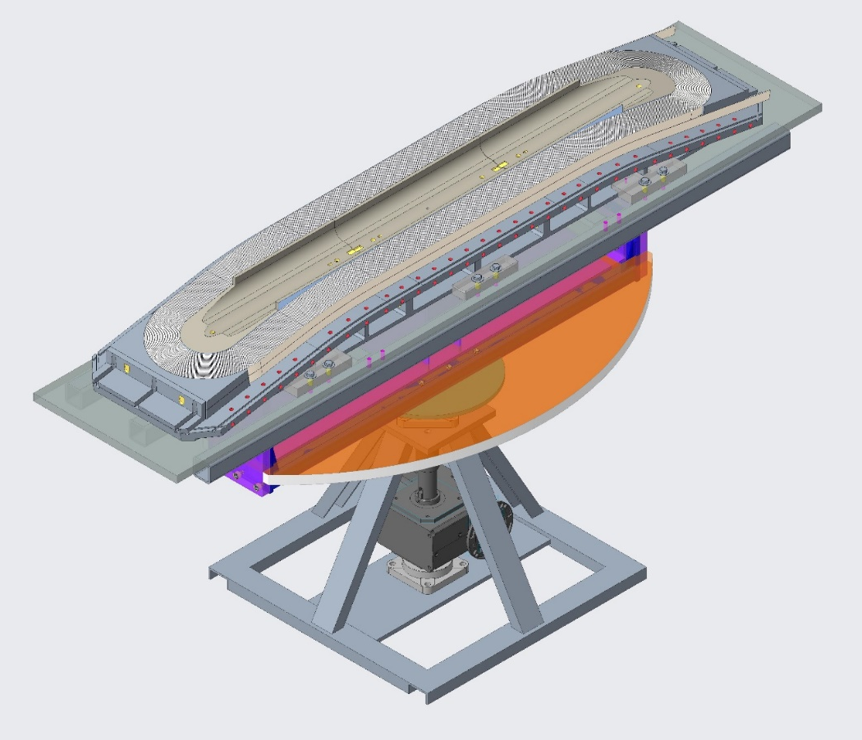
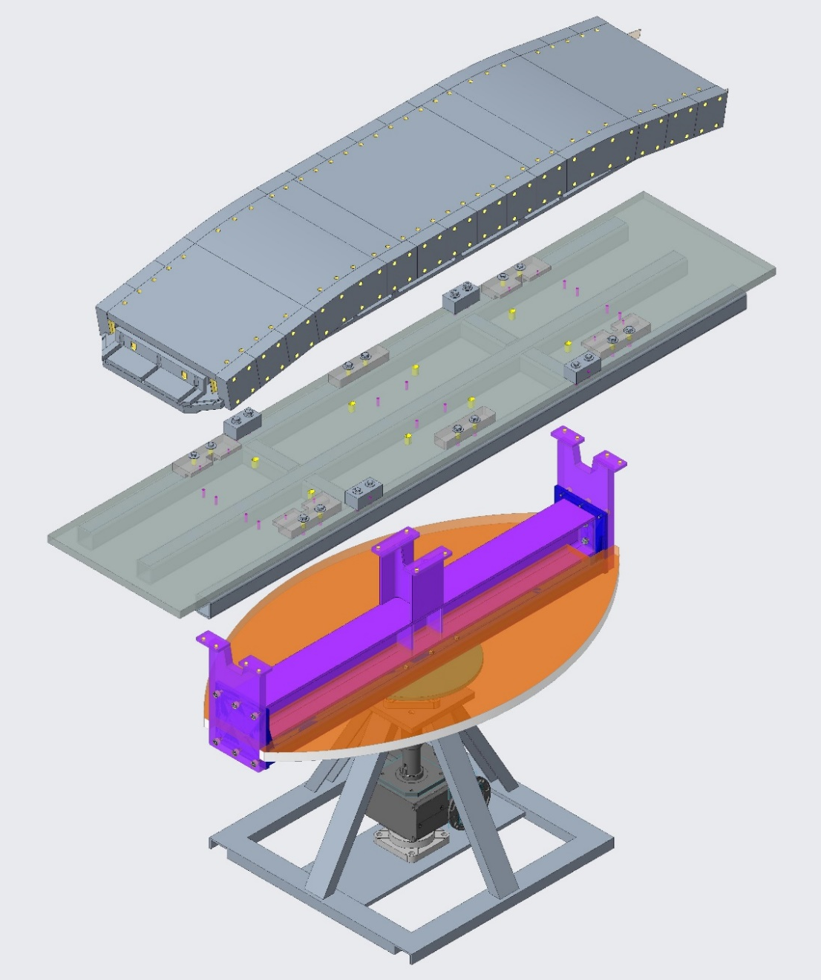
Coil Winding and Reaction Fixture
[To be covered, in detail, in “Coil Parts & Fabrication Tooling”, Jose Luis]
Coil 1 Reaction Fixture
Weight: 2195 KG [4841 lbs].
Reaction Base Plate Assy
Weight: 430 KG [948 lbs].
Upgraded Winding Table
Reinforced existing infrastructure.
[Concept shown]

Slide 4
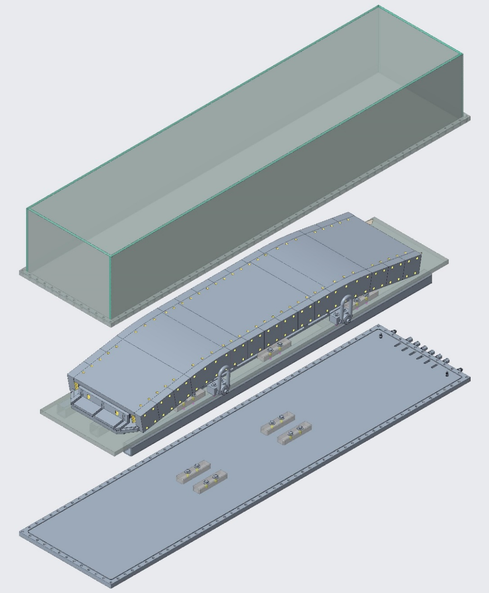
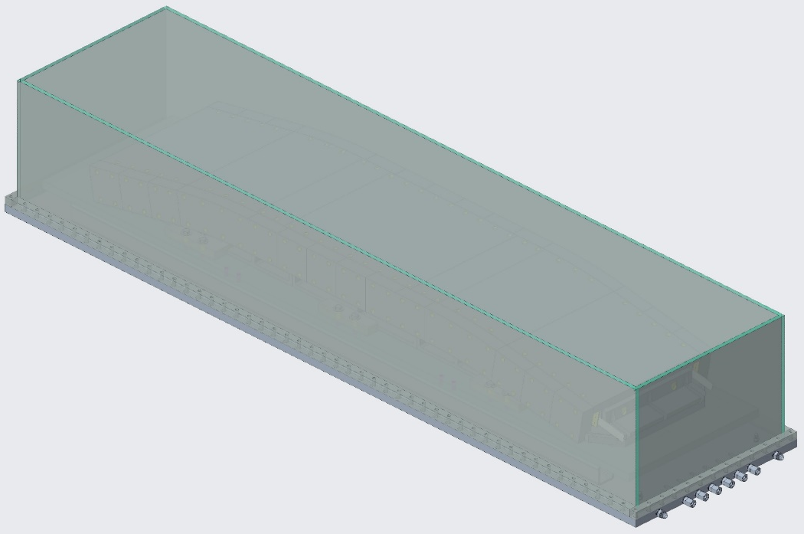
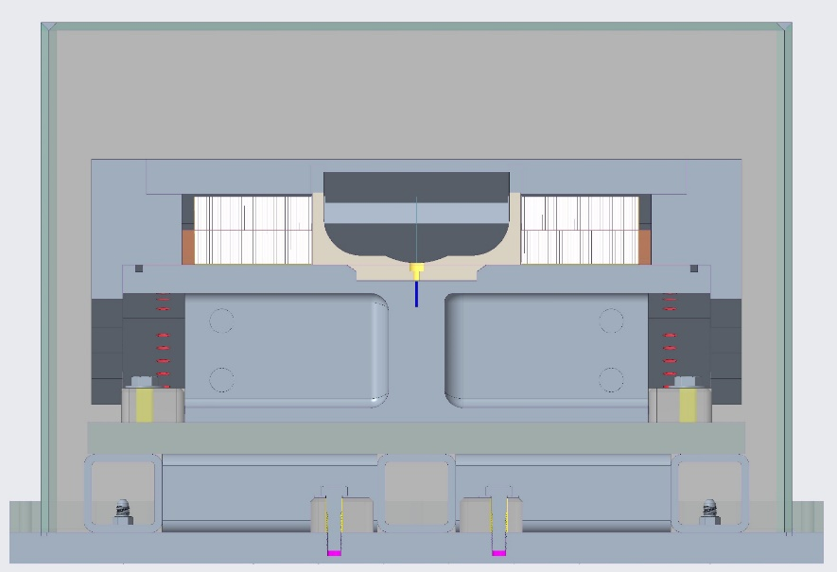
Coil Reaction Fixture in Retort
[Preliminary design, as initially shown by Diego]

Slide 5
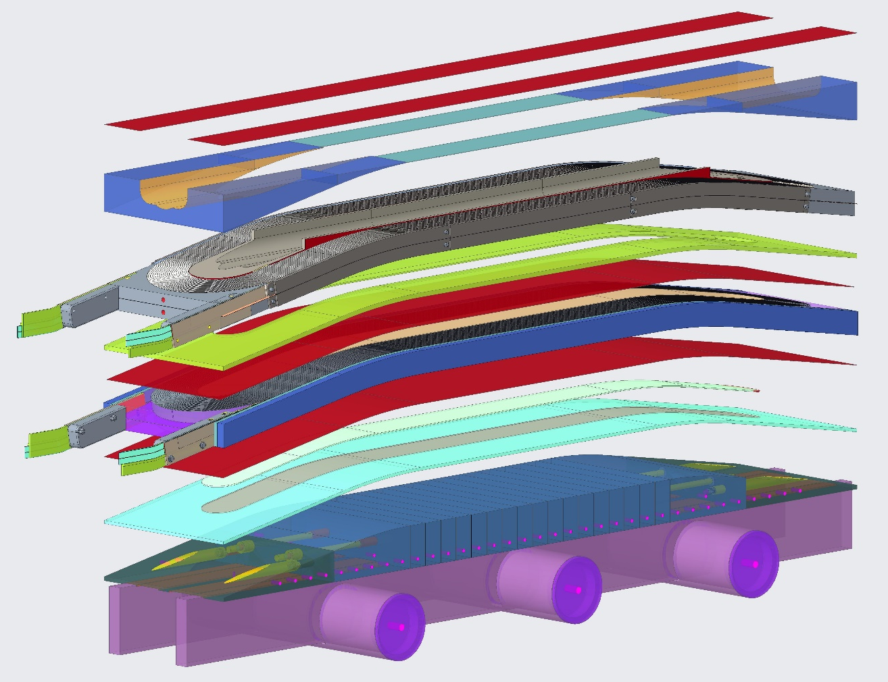
Coil Module
Mid-Plane Smart Shims
Wedge (Stainless Steel)
Coil 1
Inter-Coil Spacer (Stainless Steel)
Inter-Coil Smart Shim
Coil 2
Vertical Load Pad Spacer (Stainless Steel)
Vertical Load Pad
Assembly Support Fixture [Conceptual]

Slide 6
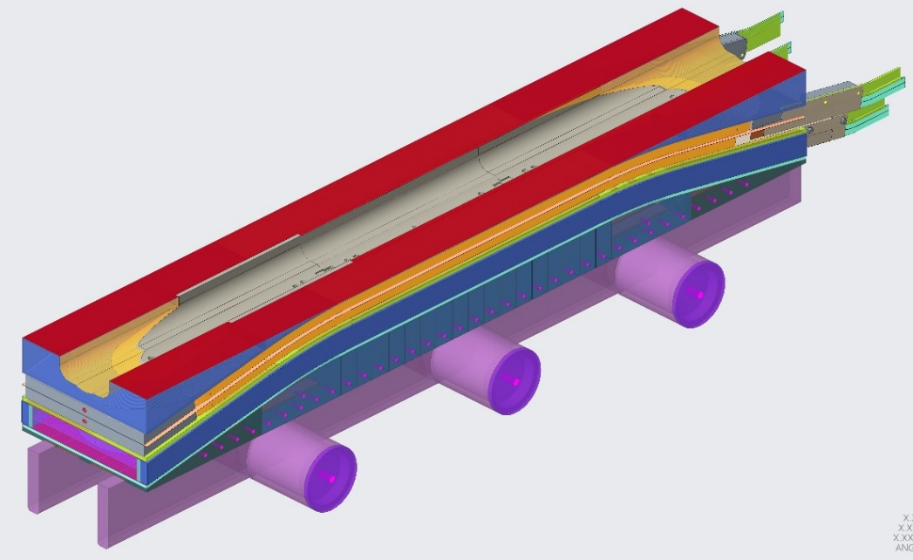
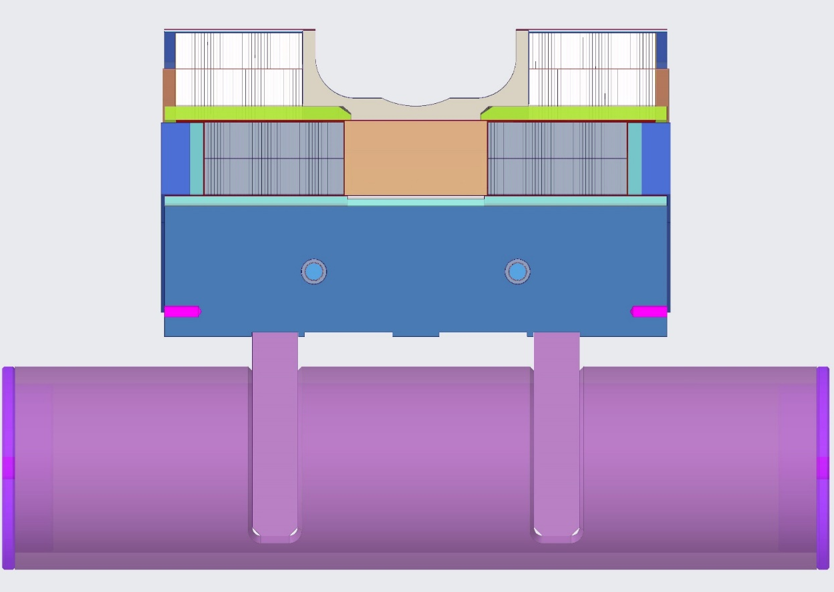
Coil Module
Coil Module Weight: 1213 kg [2675 lbs]

Slide 7
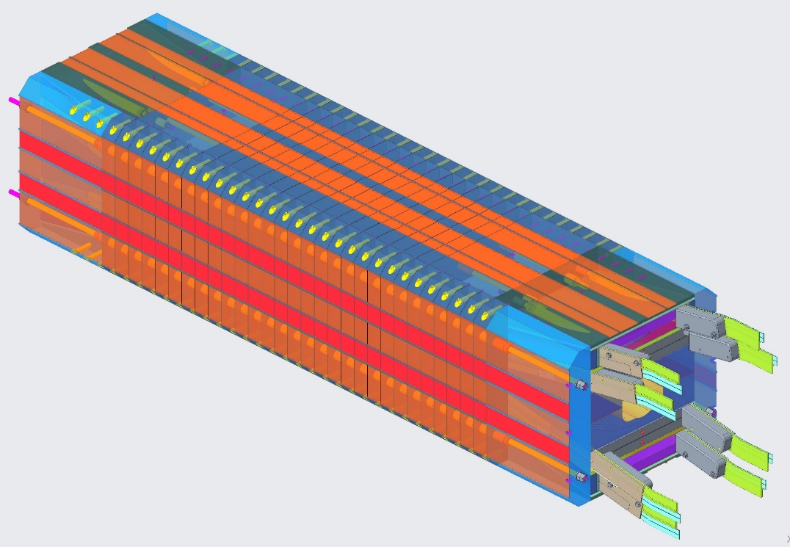
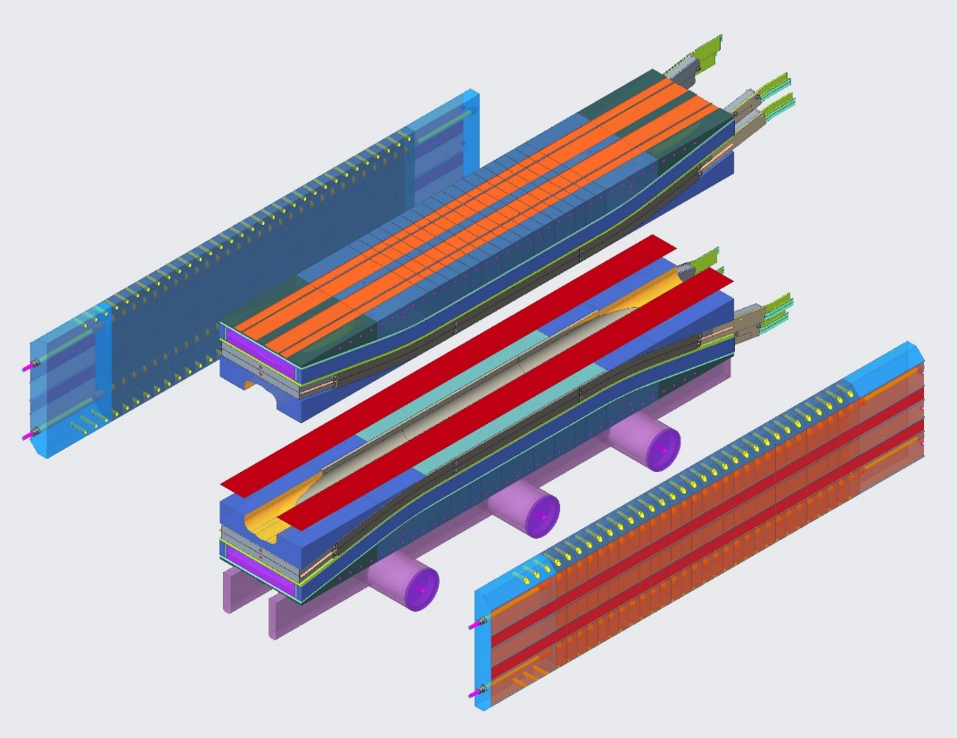
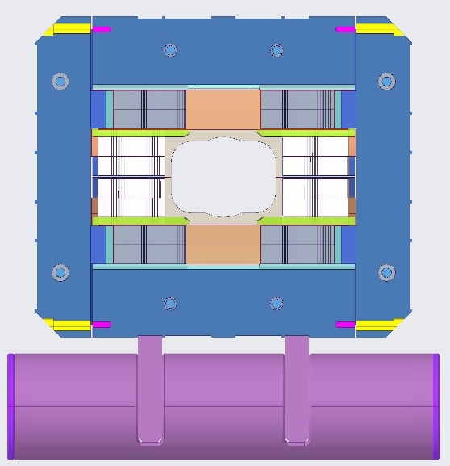
Coil Pack
Horizontal Load Pads
Vertical Load Pads
Coil Modules
Coil Pack Weight: 3496 kg [7709 lbs]
Mid-Plane Smart Shims
Assembly Support Fixture

Slide 8
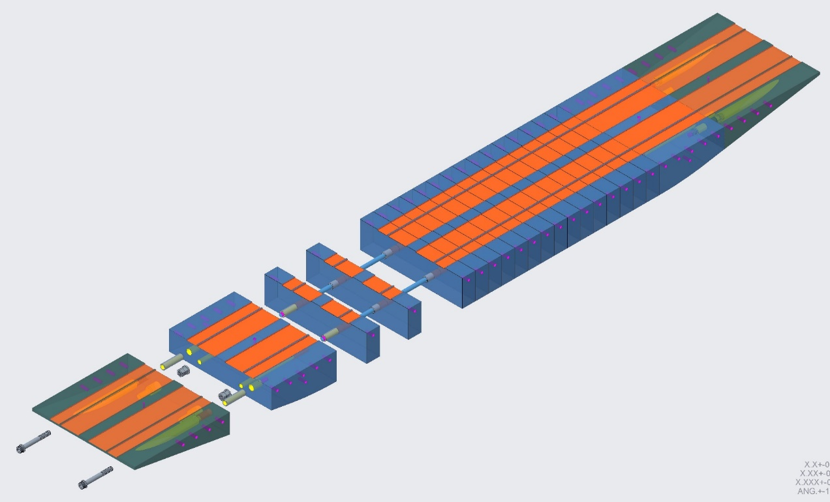
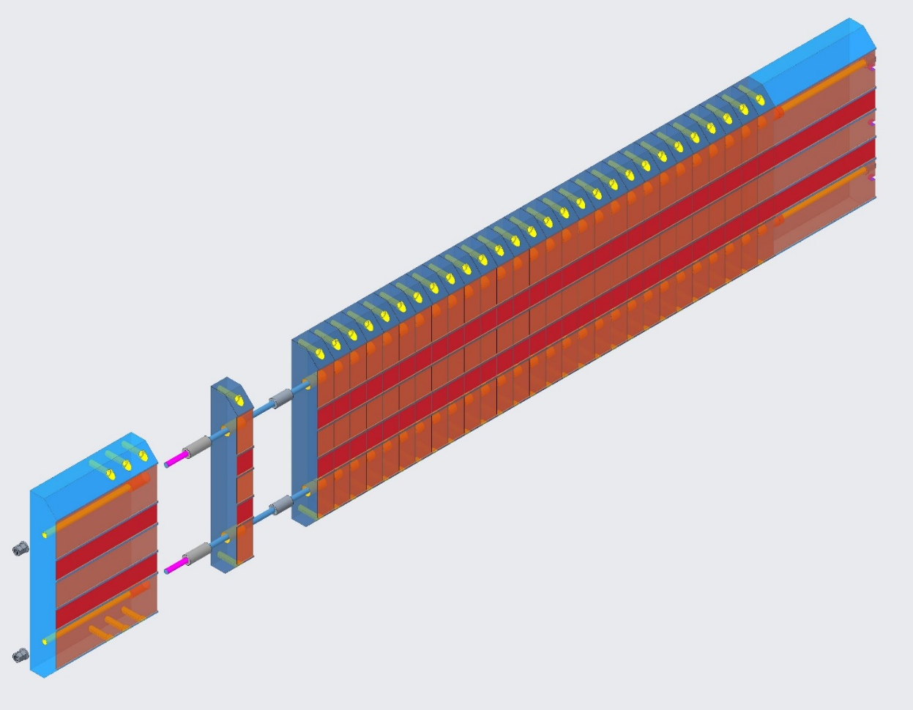
Coil Pack
End Caps
Stainless Steel
Vertical Load Pad Assembly
Weight: 431 kg [951 lbs]
Center Laminations
ARMCO Steel (Ferrous)
Bushings
Stainless Steel
End Caps
Stainless Steel
Center Laminations
ARMCO Steel (Ferrous)
Horizontal Load Pad Assembly
Weight: 535 kg [1180 lbs]

Slide 9
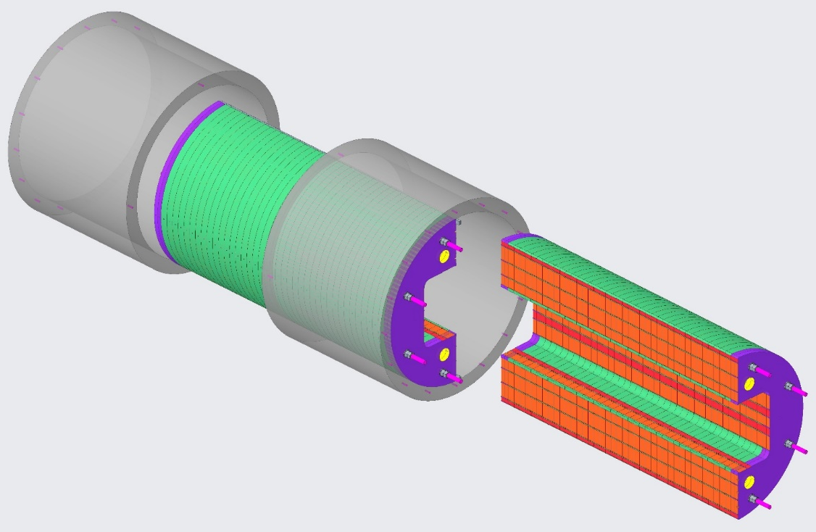
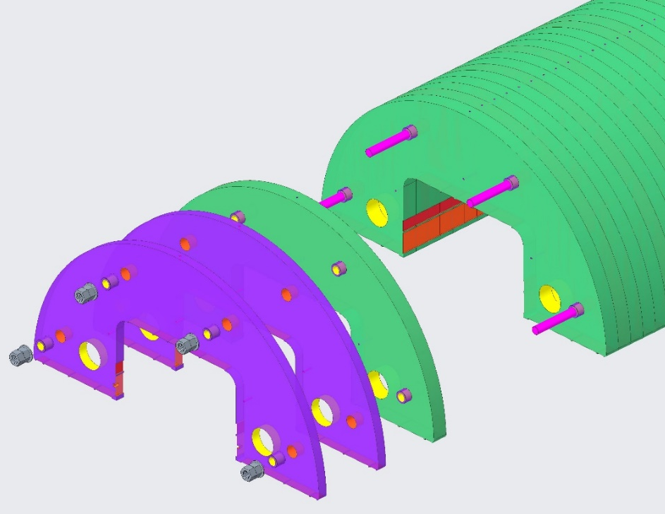
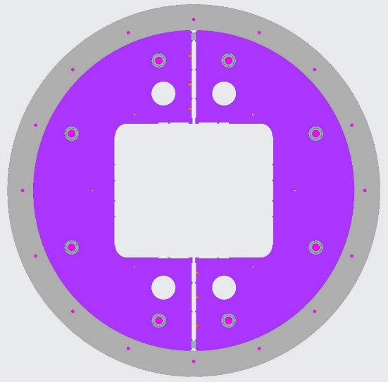
Shell & Yoke Structure
Shell & Yoke Structure
Assembly Weight: 12798 kg [28215 lbs ]
Bushings
Stainless Steel
Aluminum Shell (2)
7075-T6 Aluminum
Weight (ea.): 957 kg [2109 lbs ]
Yoke Stack (2)
ARMCO Steel Laminations
Weight (ea.): 5435 kg [11982 lbs ]
Yoke Gap Keys (2)
Stainless Steel
Note: All ARMCO Steel laminations are of the same thickness. The 2 outer laminations at both ends are machined thinner to bring the overall length of the assembly to 2.00 meters

Slide 10
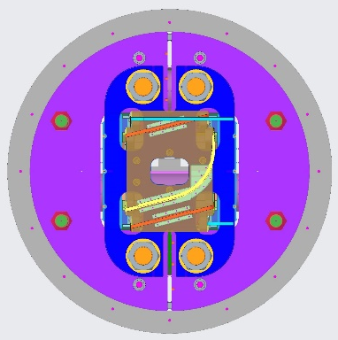
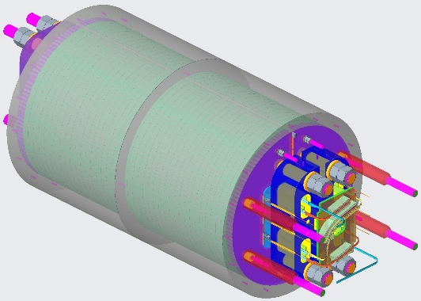
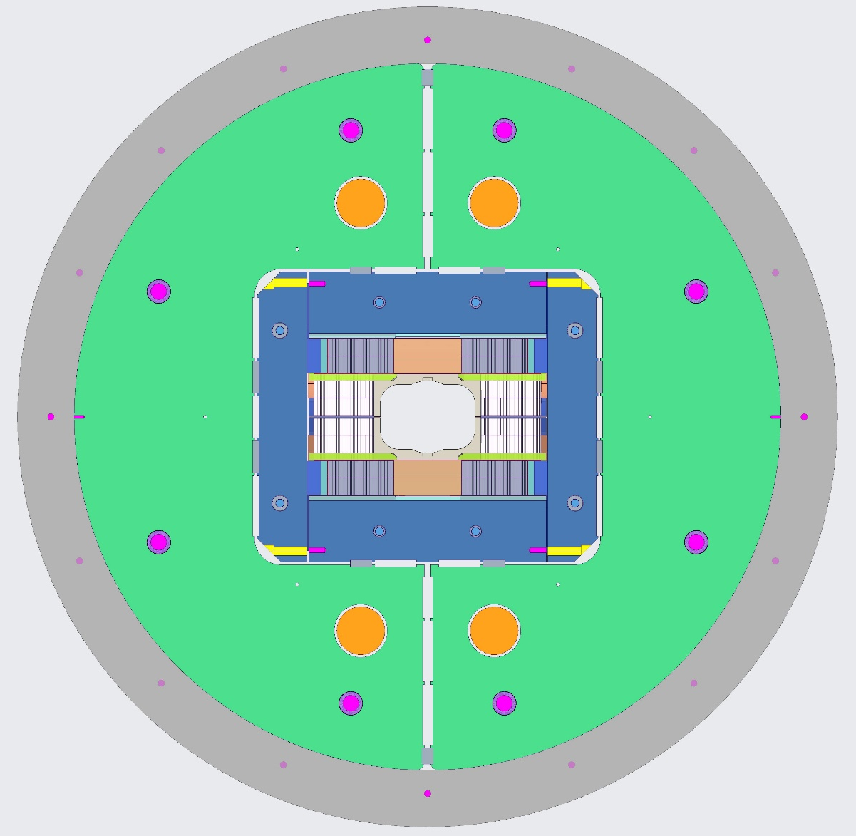
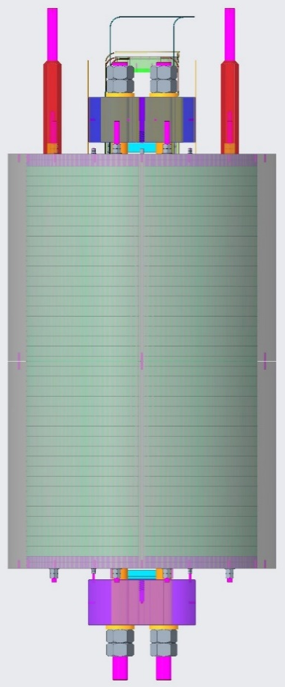
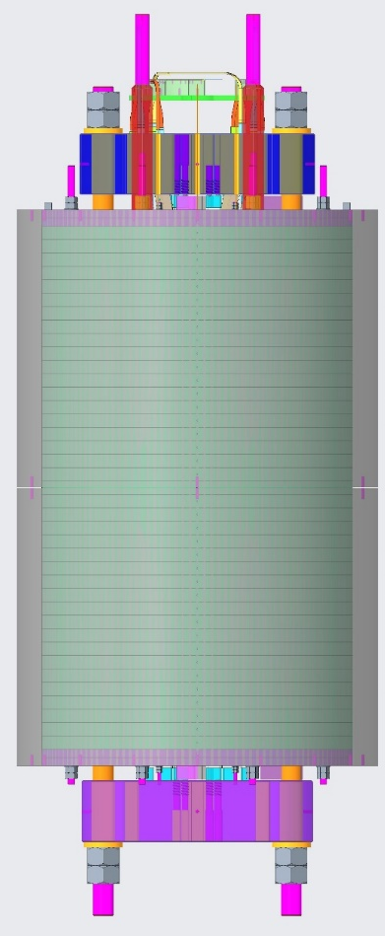
Magnet Top Assembly
Vertical Load Keys
Horizontal Load Keys
TFD Magnet Top Assembly
Weight: 18100 kg [39910 lbs ]

Slide 11
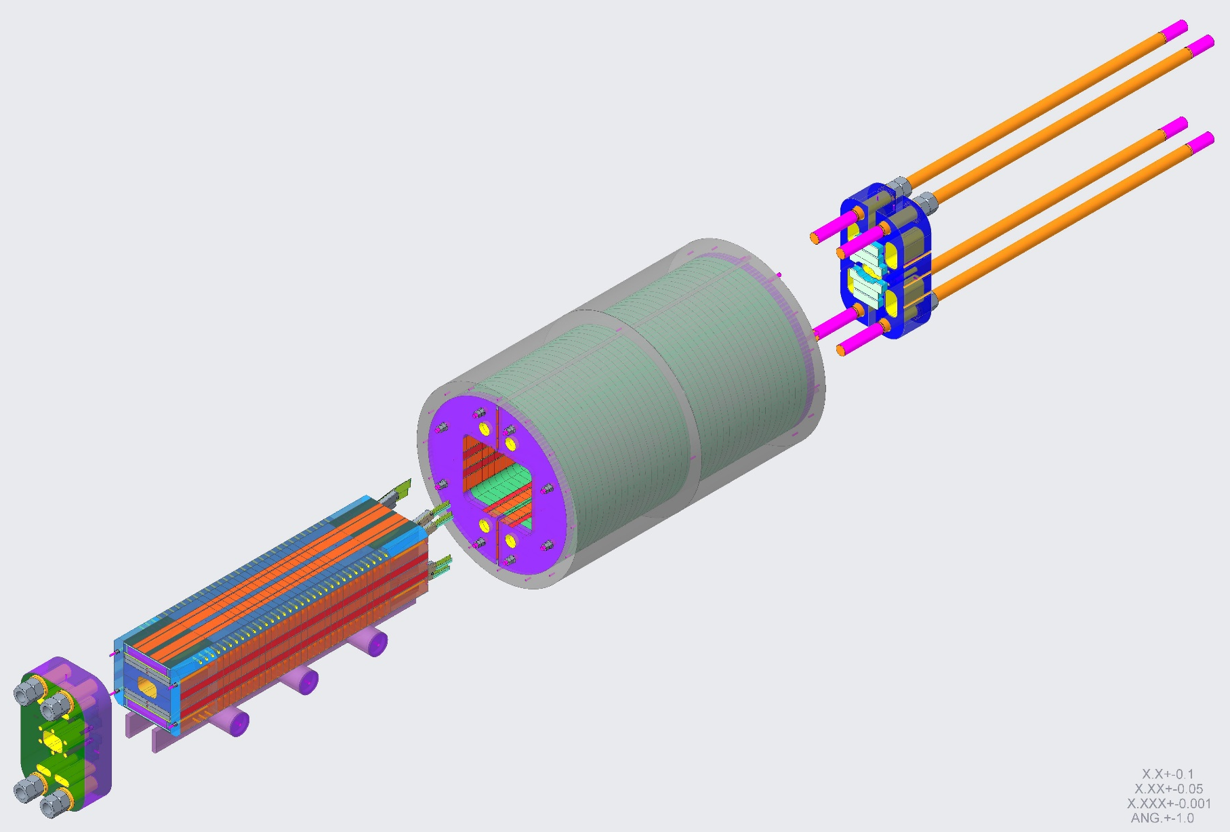
Magnet Top Assembly
LE End Plate
Nitronic 40
Weight: 525 kg [1157 lbs]
Shell & Yoke Structure
Weight: 12798 kg [28215 lbs ]
Axial Rods (4)
Stainless Steel
Weight (each): 106 kg [234 lbs]
RE End Plate
Nitronic 40
Weight: 609 kg [1343 lbs]
Coil Pack Assembly
Weight: 3496 kg [7709 lbs]

Slide 12
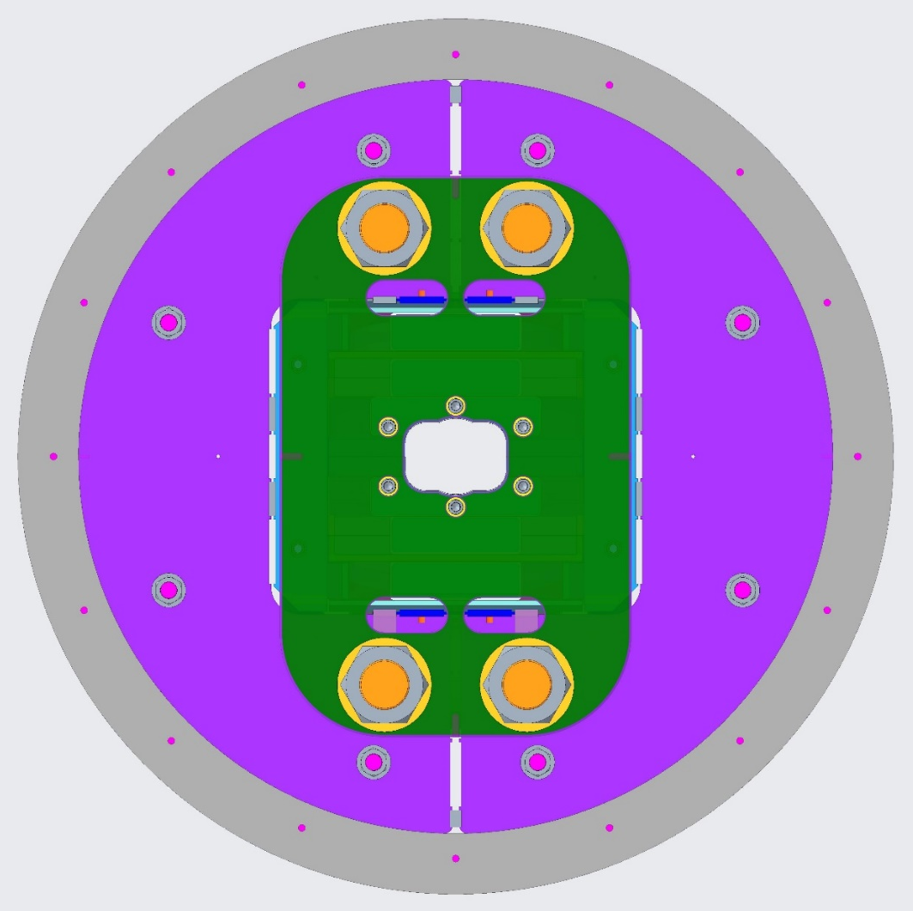
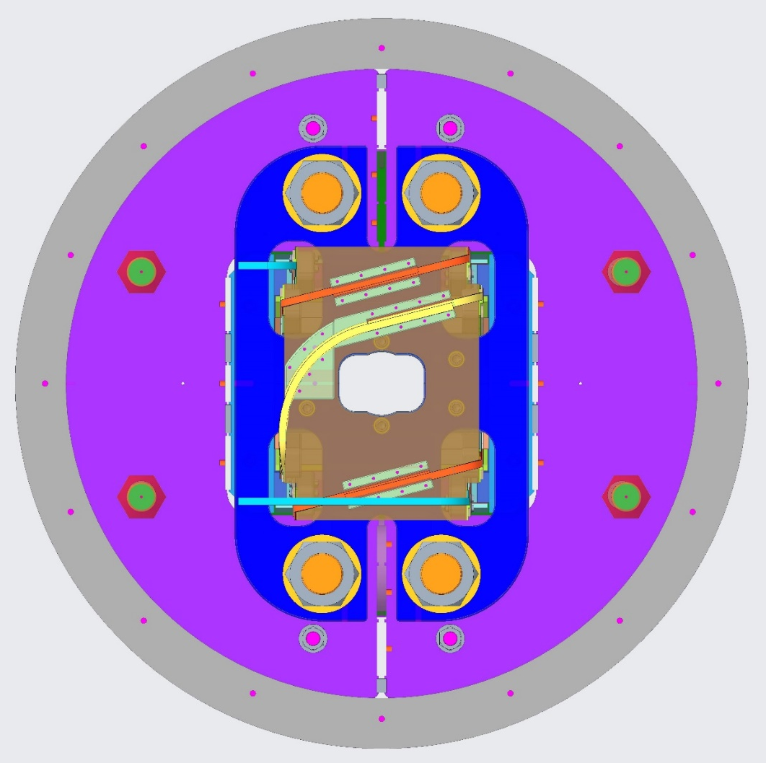
Magnet Top Assembly
Vertical Bladders and Keys
Horizontal Bladders and Keys
Vertical Preload of Coil Pack
Bladder operations are performed from the return end of magnet.
Horizontal Preload of Coil Pack
Bladder operations are performed from the lead end of magnet.

Slide 13
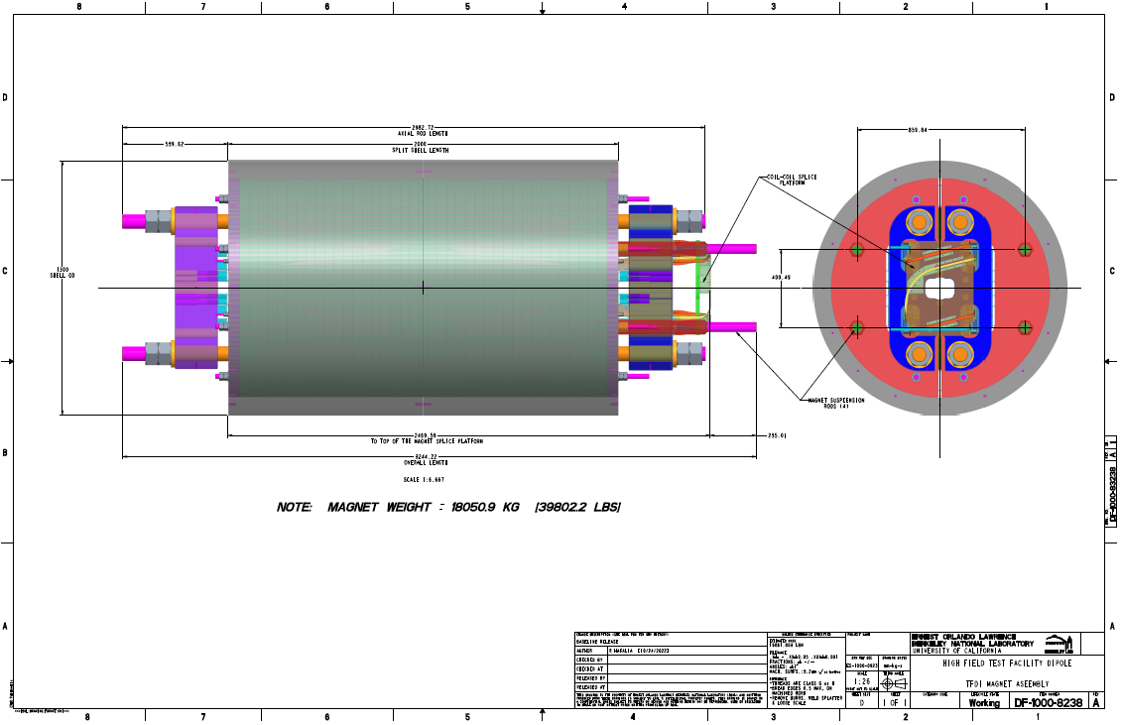
Reference Assembly Drawing for HFVMTF
[Slide supplied by GianLuca]

Slide 14
End Presentation

Slide 15
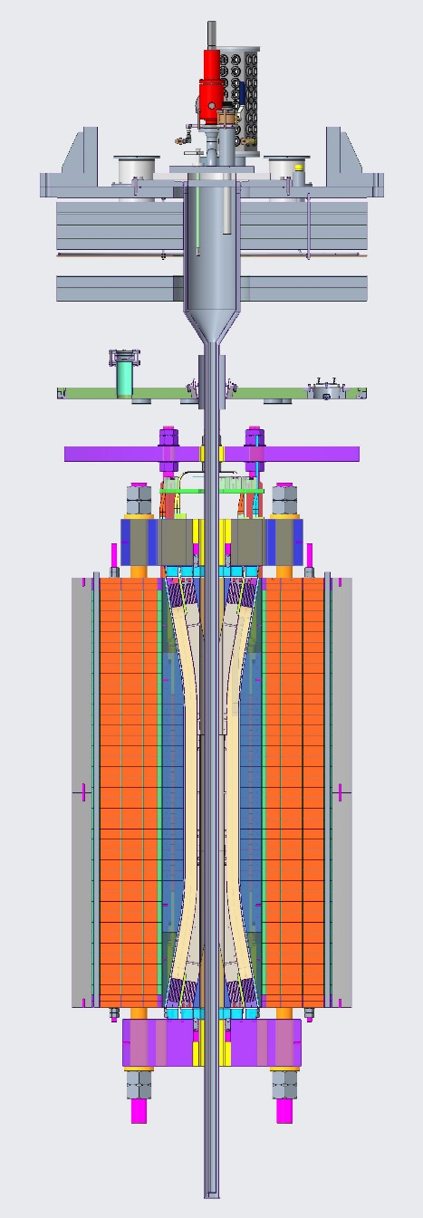
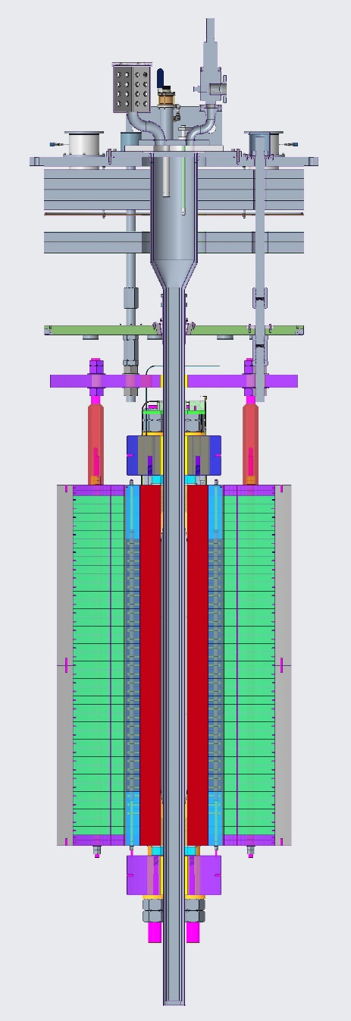
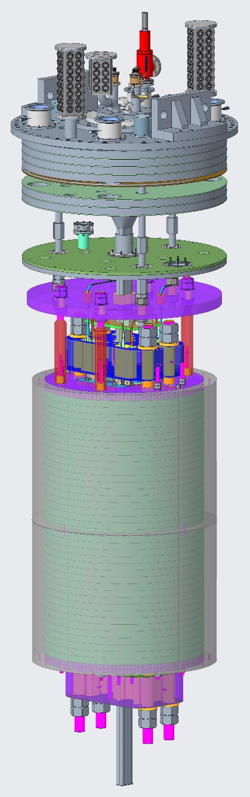
Magnet Installation in the HFVMTF Cryostat Header
Extra Slide

