Slide 1



P. Ferracin
TFD Preliminary Design Review
February 16, 2023
Coil design and fabrication:
Comparison with previous experiences and projects

Slide 2
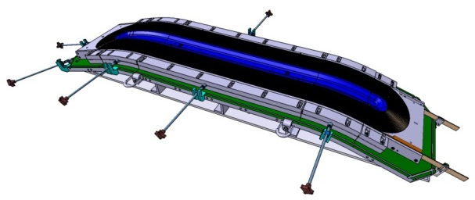
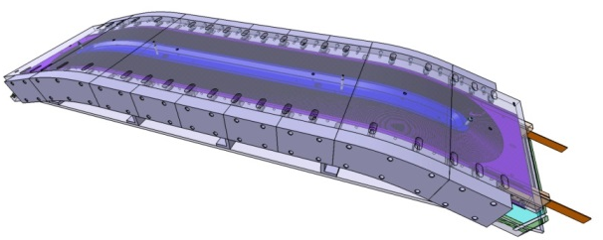
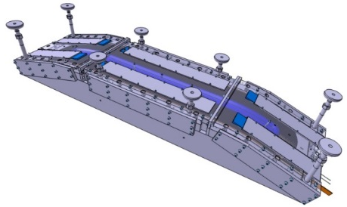
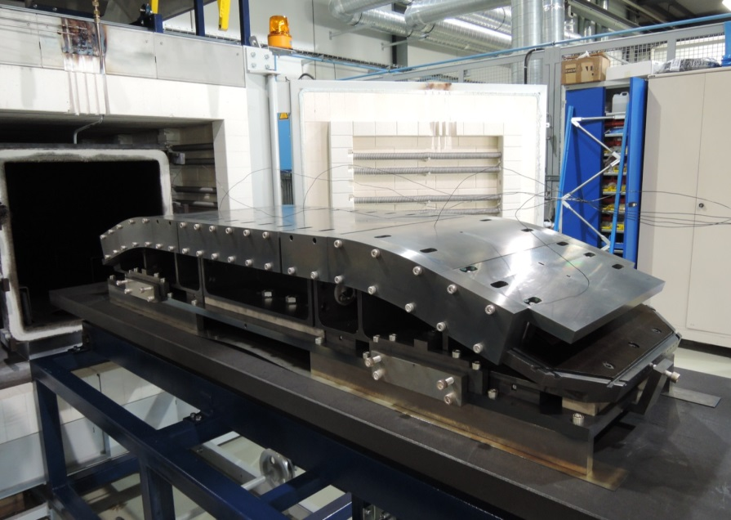
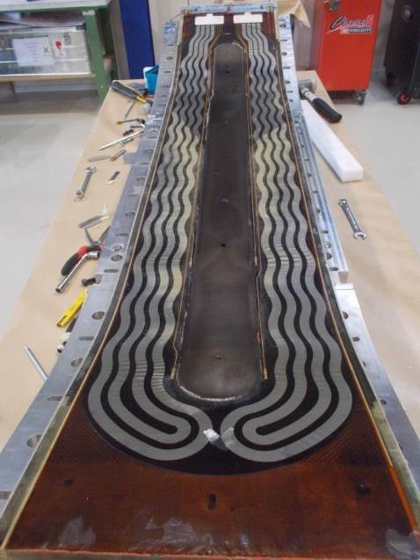
Introduction
FRESCA2 coil fabrication tooling and process used a reference for the TFD design
  CAD models transferred from CEA/CERN to LBNL (thanks!) and carefully reviewed
FRESCA2
FRESCA2
FRESCA2

Slide 3
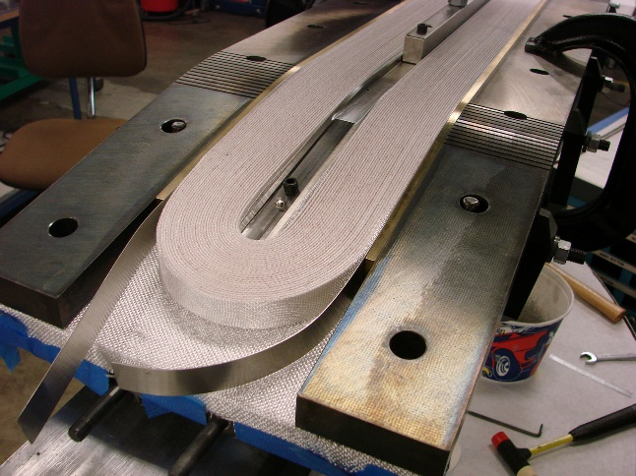
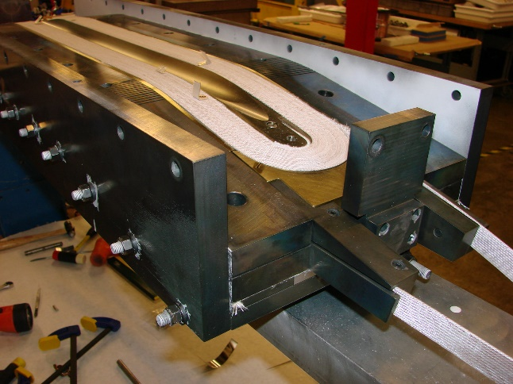
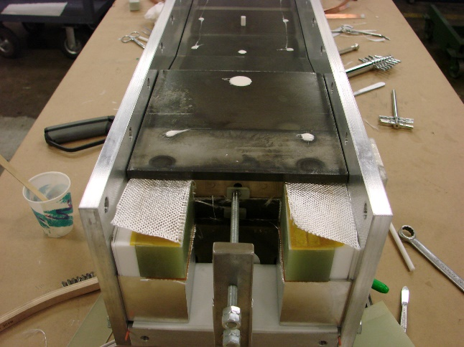
Introduction
Some modifications are proposed for the TDF tooling/process, based on experience from
  FRESCA2 fabrication and test
  Previous or current projects
    HD2, HQ/MQXF, and MDP program
HD2
HD2
HD2

Slide 4
Outline
Pole & tooling gaps during winding, reaction impregnation
End-shoes and side rails
Impregnation process
Wedge and wedge extension
Inter-coil spacer
Contact surfaces during assembly

Slide 5
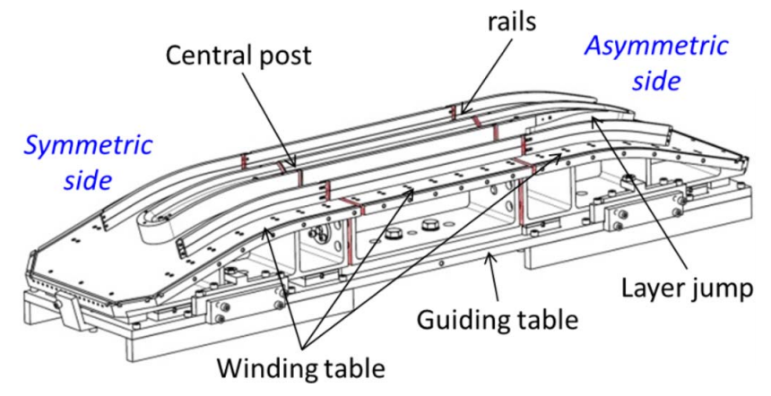
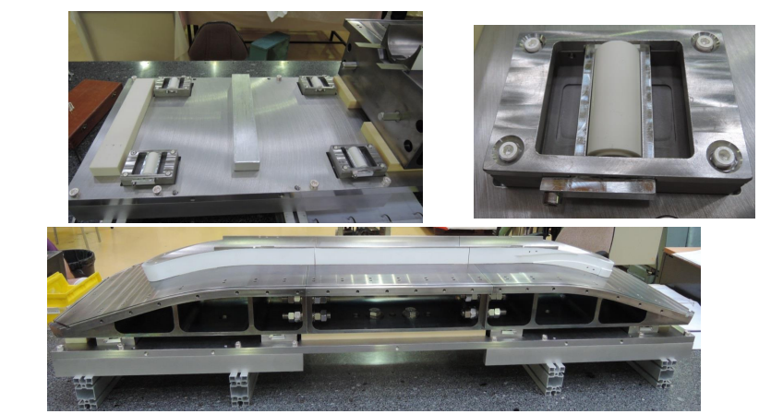
Pole and tooling gaps
A design with gaps developed but never implemented in HD2
The FRESCA2 concept
  Identical gaps inserted before reaction on pole, rails , and tooling (winding base) → 3 sub-elements
  Sliding of winding base allowed by system of “ceramic balls and rollers”
  No significant sliding observed
    “excessive friction or stuck parts were suspected”
    4 turns instead of 42, and no provisions for the
  Final configuration: 1 mm gaps, closed after winding
FRESCA2
FRESCA2

Slide 6
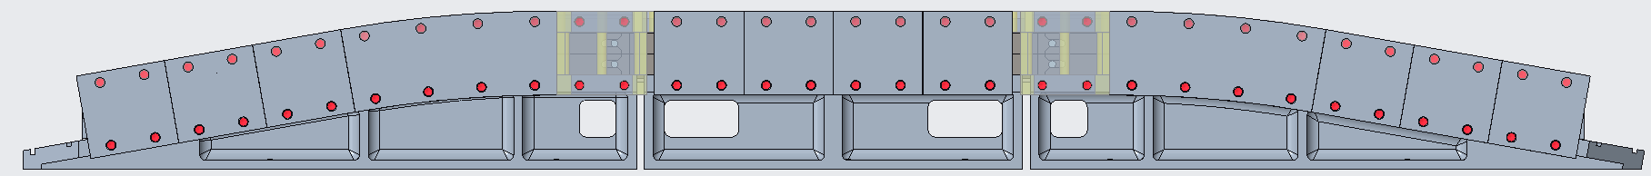
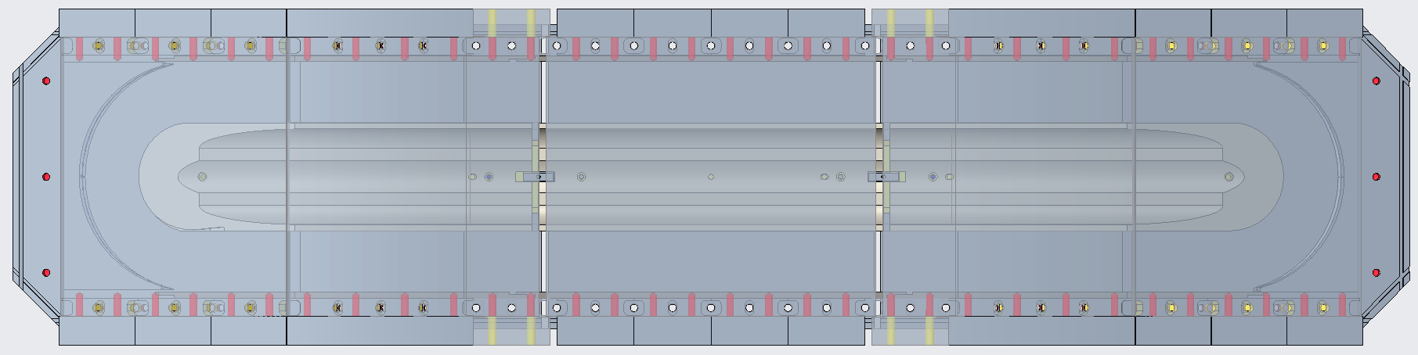
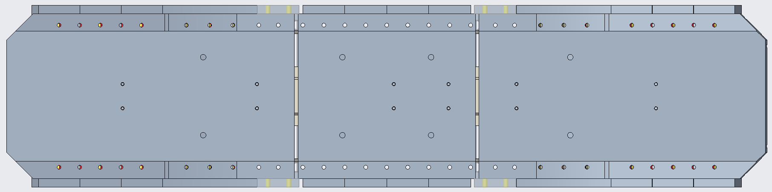
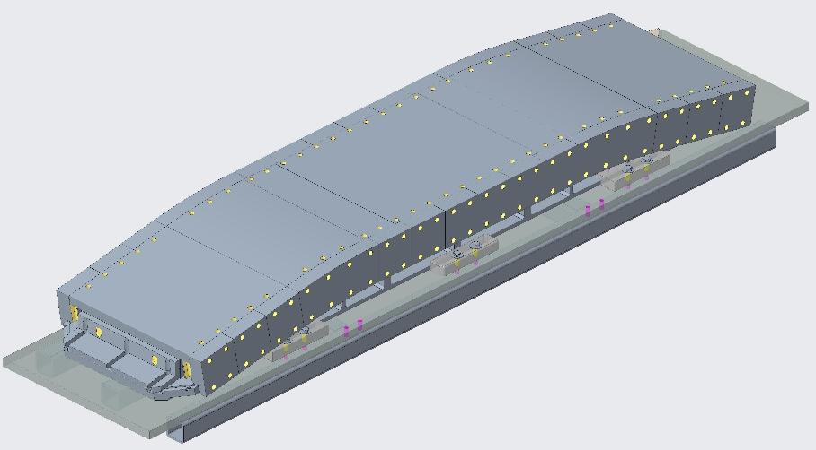
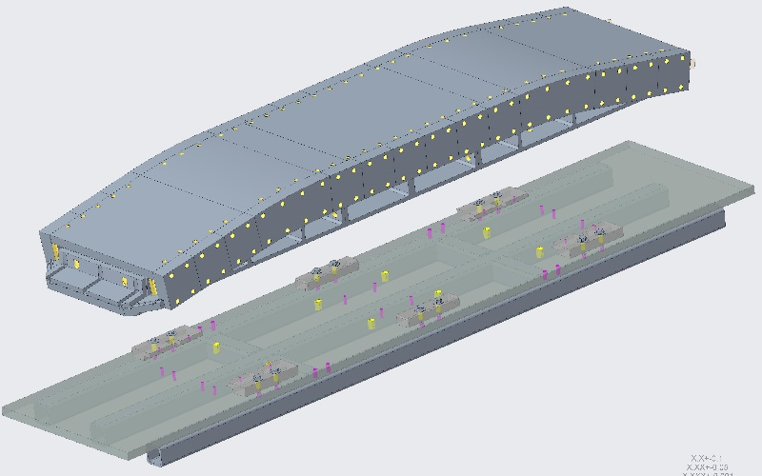
Pole and tooling gaps
The TFD concept
  In general, same concept as FRESCA2
TFD
Side view
TFD
Top view
TFD
Bottom view
But … sliding plates with Mica layers instead of rollers

Slide 7
Pole and tooling gaps
The TFD concept
  Unlike FRESCA2, different gaps between pole (iron/Ti) and winding table (SS)
    Table treated as the internal component, like pole and wedges in HQ/MQXF
      Larger gap to avoid elongating the coil during reaction
        We will try to match expansion table and pole
  Gap size will be determined with full practice coil
    Large gap introduced in practice coil to determine final gap
TFD
Side view
TFD
Top view
TFD
Bottom view

Slide 8
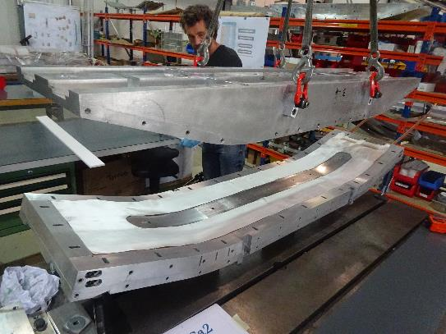
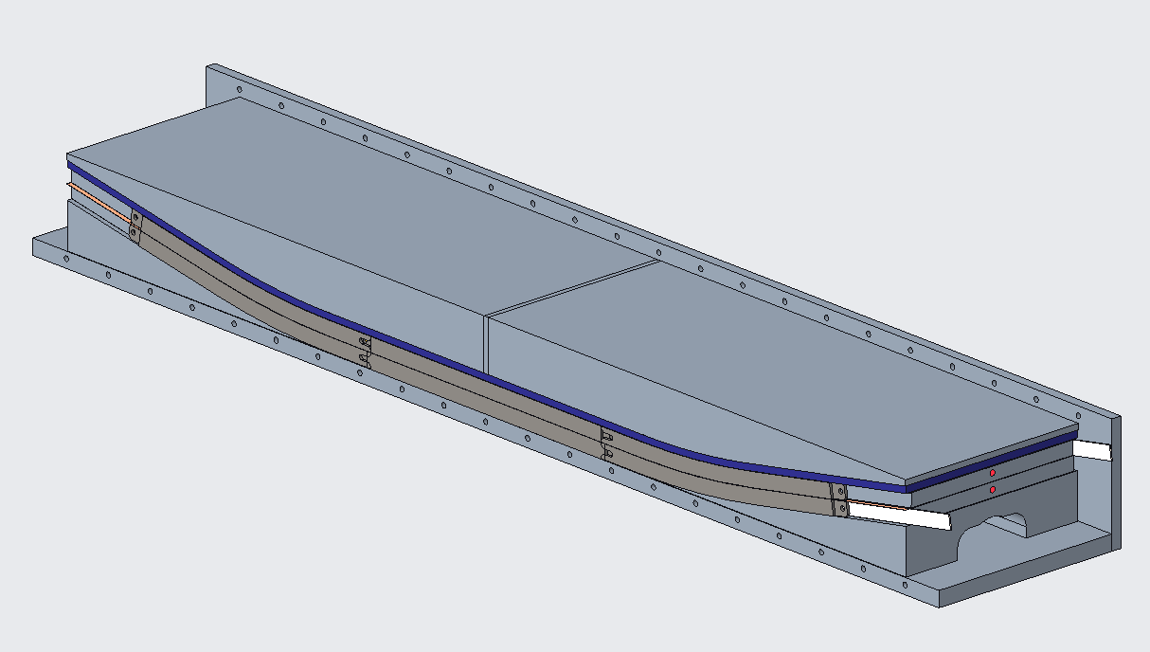
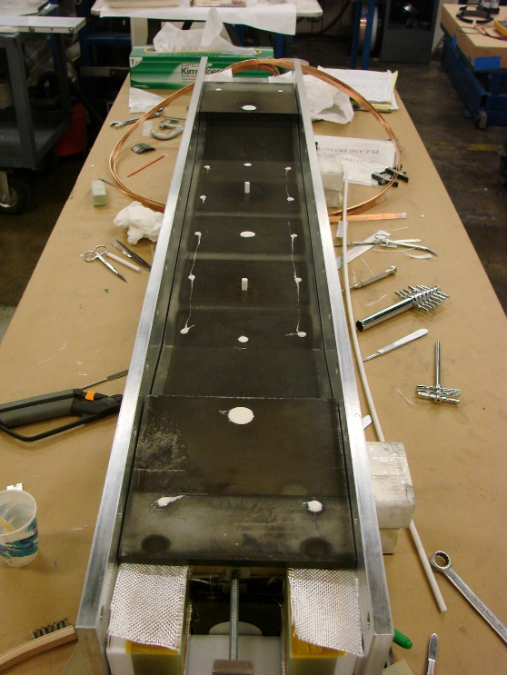
Pole and tooling gaps
In FRESCA2 and HD2 the “impregnation filler” (filler) is a solid piece
In TFD practice coil, it will be split in two parts and shimmed to match the coil geometry after reaction
  May be replace by single part in production coils
FRESCA2
HD2
TFD

Slide 9
Outline
Pole & tooling gaps during winding, reaction impregnation
End-shoes and side rails
Impregnation process
Wedge and wedge extension
Inter-coil spacer
Contact surfaces during assembly

Slide 10
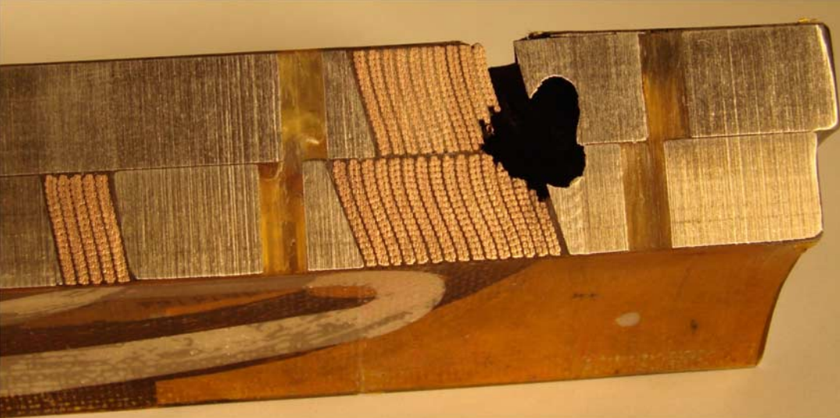
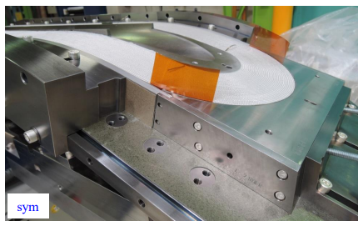
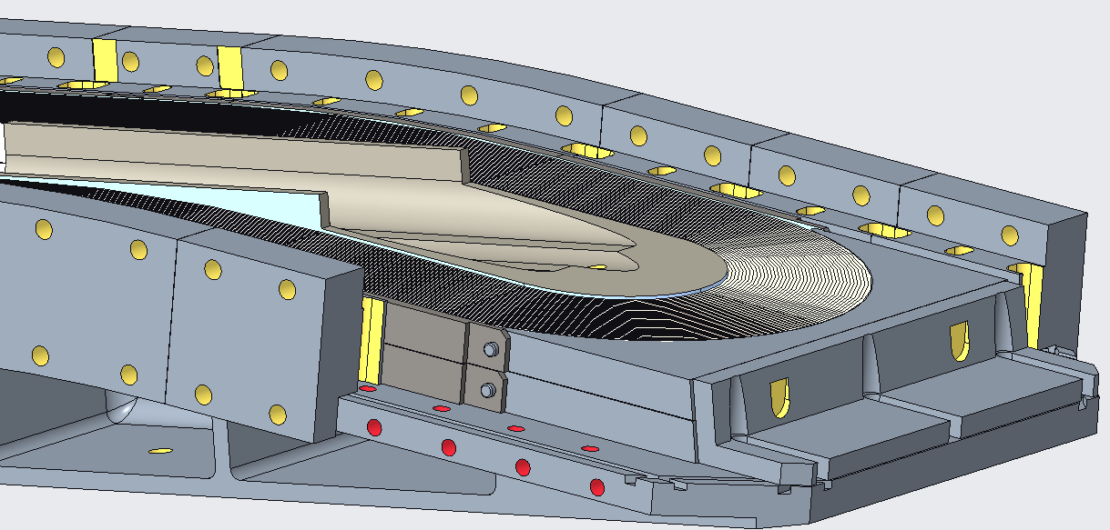
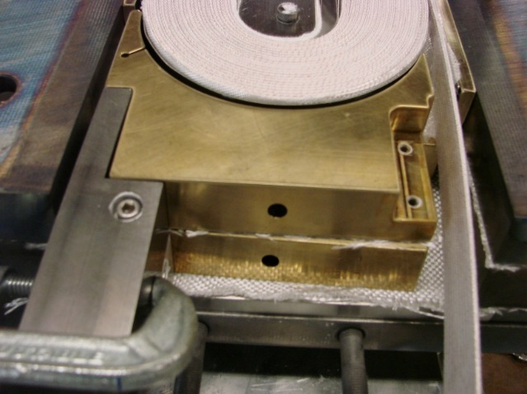
End-shoes and side rails
In TFD
  Double end-shoe and double rail
    To add insulation between layers
      Reduce risks of layer-to-layer shorts
  Both end shoes and rails not removed/replaced after winding
    To protect glass and to ease the trimming
Same approach use in HD2
  Single rail/shoe not an option due to coil design
In FRESCA2, single end-shoe and rails
HQ
TFD
FRESCA2
HD2

Slide 11
Outline
Pole & tooling gaps during winding, reaction impregnation
End-shoes and side rails
Impregnation process
Wedge and wedge extension
Inter-coil spacer
Contact surfaces during assembly

Slide 12
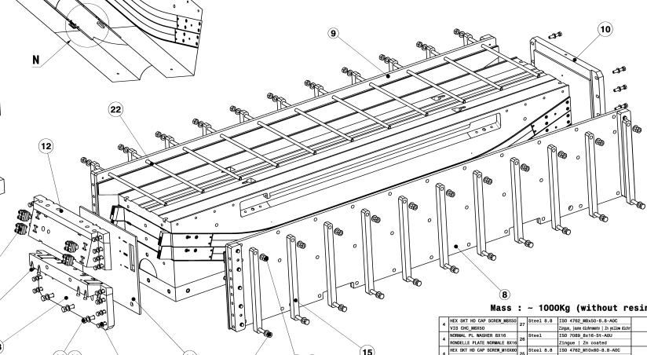
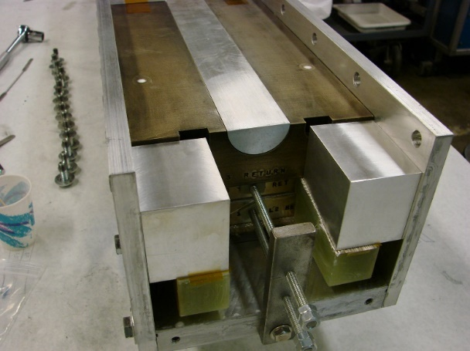
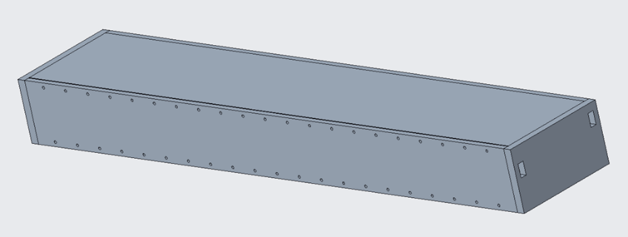
Impregnation
In FRESCA2, wedge not impregnated
  Then, “second” room temperature impregnation (smart shims)
In HD2, wedge impregnated with the coil, and mold released
  Better contact surfaces
In TFD, same process as HD2, and similar tooling as FRESCA2 second impregnation
  Decision based on results of mechanical analysis
FRESCA2
FRESCA2
HD2
TFD
TFD

Slide 13
Outline
Pole & tooling gaps during winding, reaction impregnation
End-shoes and side rails
Impregnation process
Wedge and wedge extension
Inter-coil spacer
Contact surfaces during assembly

Slide 14
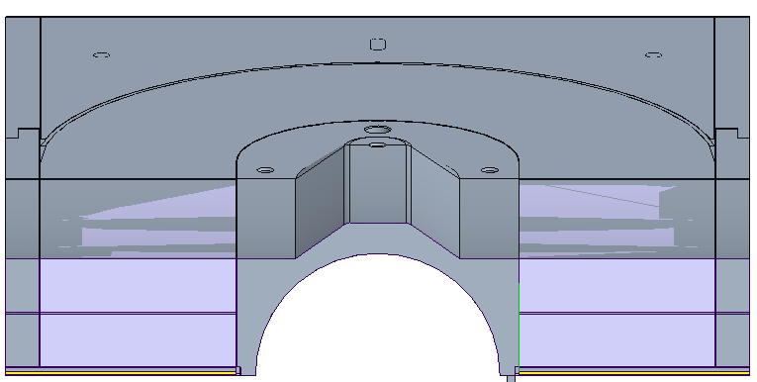
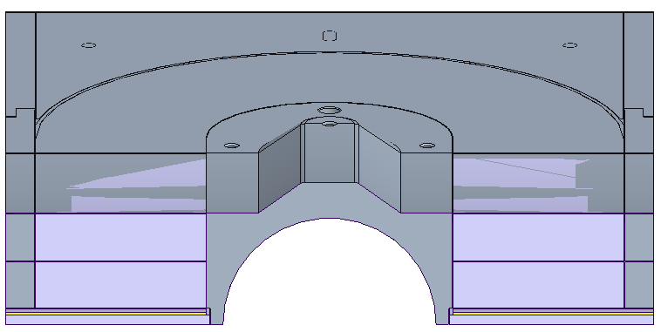
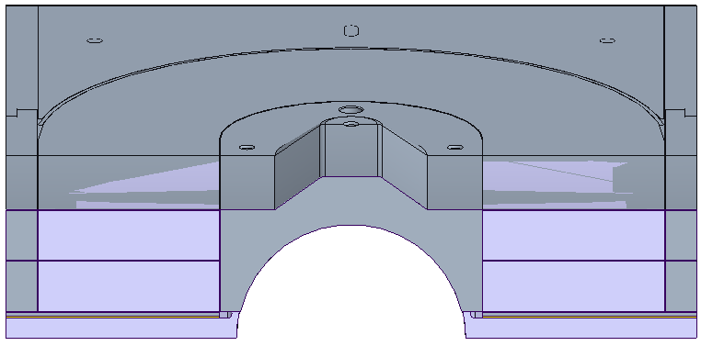
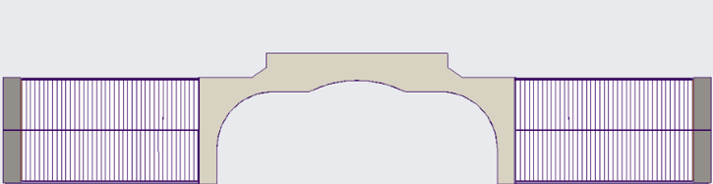
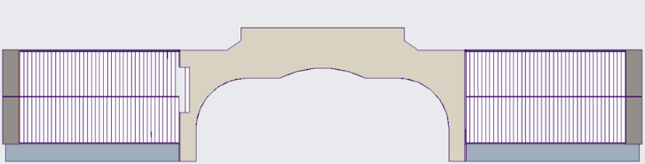
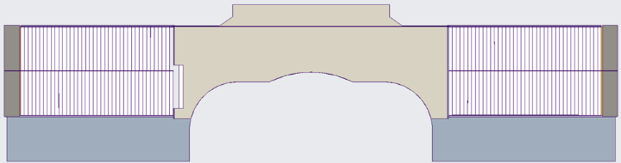
Wedge - extension
Same solution in TFD and FRESCA2
  Wedge and extension under the rails and contained by the pole
    In the ends, wedge transition under the pole
  Best option also according to mechanical analysis in order to avoid stress discontinuities
TFD
FRESCA2
TFD

Slide 15
Outline
Pole & tooling gaps during winding, reaction impregnation
End-shoes and side rails
Impregnation process
Wedge and wedge extension
Inter-coil spacer
Contact surfaces during assembly

Slide 16
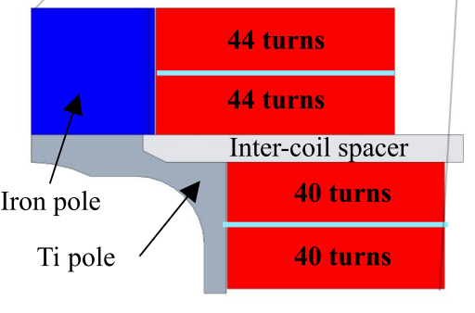
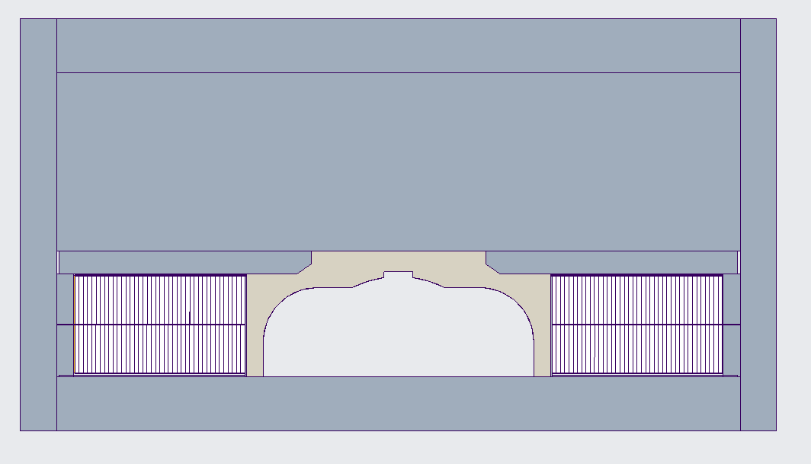
Inter-coil spacer
New structural element (see mech. Analysis)
  Vertical interception of Lorentz forces
  Improved stress distribution
Impregnated with inner coil and mold released (same as wedge)

Slide 17
Outline
Pole & tooling gaps during winding, reaction impregnation
End-shoes and side rails
Impregnation process
Wedge and wedge extension
Inter-coil spacer
Contact surfaces during assembly

Slide 18
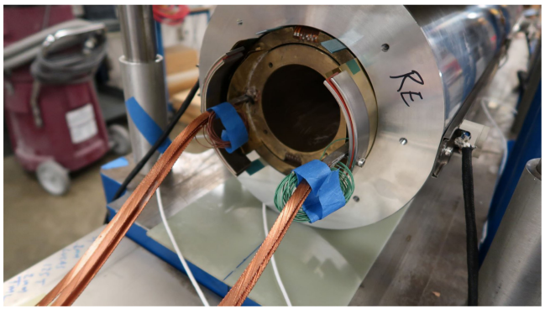
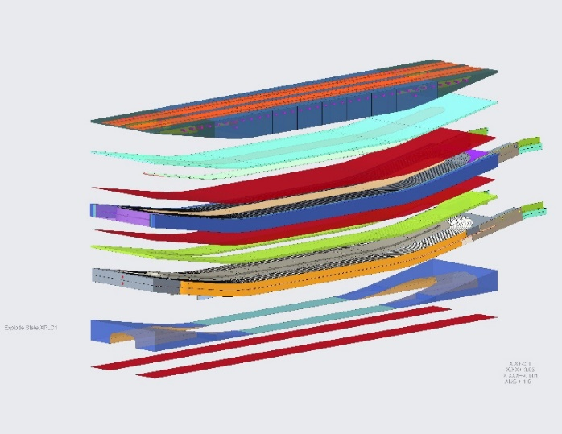
Contact surfaces during assembly
In FRESCA2, double impregnation
In TFD
  Kapton bags filled with epoxy as smart shims
    Easier to disassemble, less tooling
    Experience from base program (CCT)
TFD

Slide 19
Thanks

Slide 20
Appendix

Slide 21
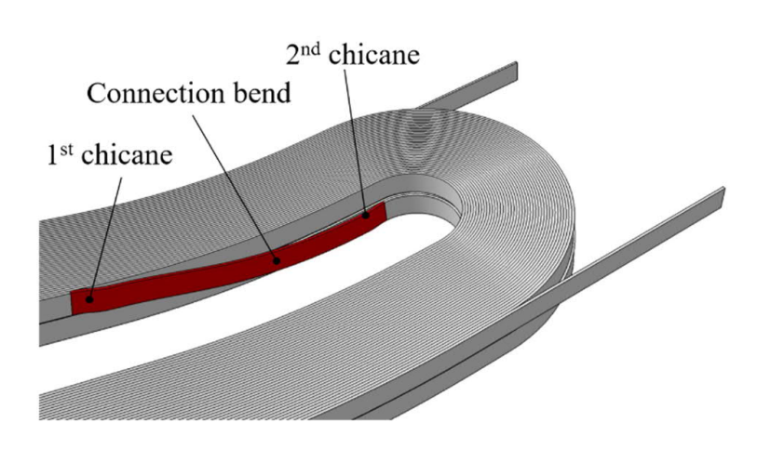
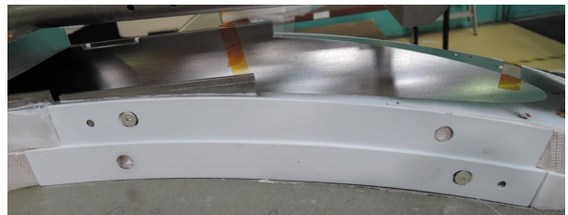
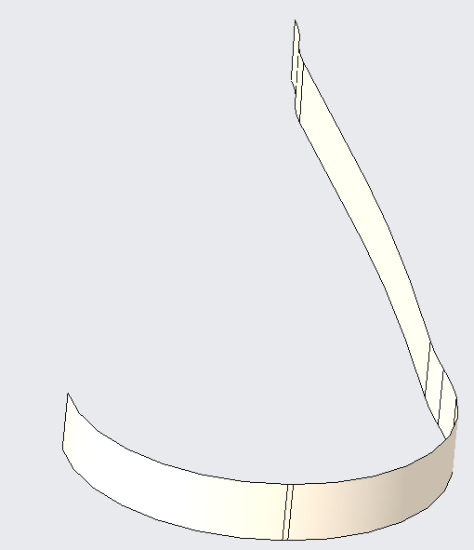
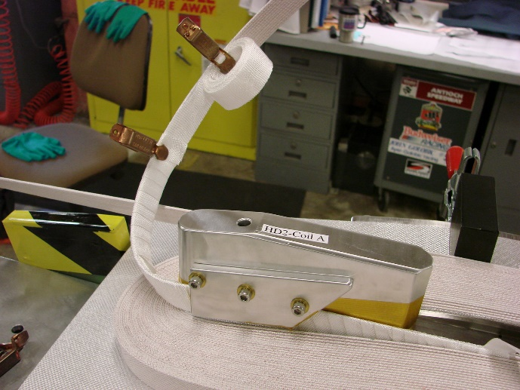
Layer jump
Same as FRESCA2
  Double “chicane”
  Covered by bolted plate
Not used in HD2
  Not relevant because in HD2 block are not aligned
FRESCA2
FRESCA2
HD2

