Slide 1
High Temperature Superconductor Cable Test Facility
Coil components and fabrication tooling
José Luis Rudeiros Fernández, Diego Arbelaez, P. Ferracin, R. Hafalia, P. Hayes, R. Lee, P. Mallon, G. Sabbi, M. Solis, G. Vallone
Lawrence Berkeley National Laboratory
February 16, 2023
LBNL, Berkeley, CA

Slide 2
Outline
Introduction
Winding support structure
Winding base
Placement of the pole
Winding
Preparation for reaction
Reaction
Preparation for impregnation
Impregnation
Summary

Slide 3
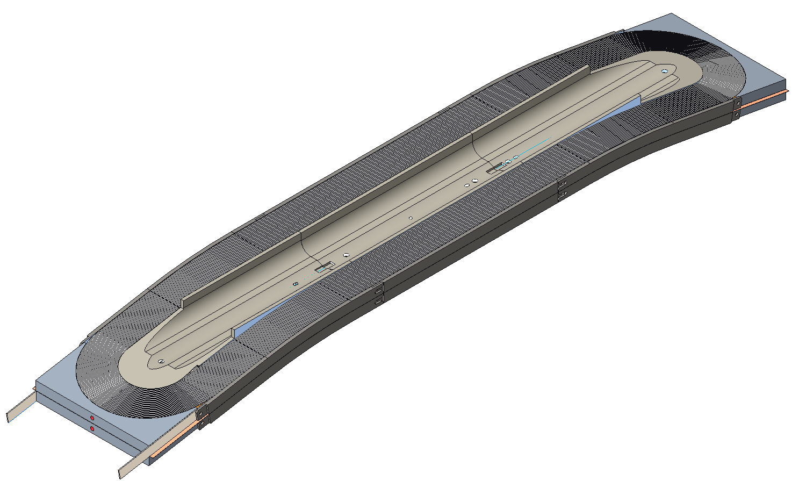
Introduction
Presentation of main components, manufacturing tooling, and fabrication sequence of coil 1.
Components, fabrication tooling, and process expected to feedback into coil 2.
Aluminum shell
Iron yoke
Iron yoke rods
Magnet rods
Steel keys
Laminated iron pads
Steel pusher
G10 shim
Iron pole
Coil 2
Coil 1
Steel spacer
AlBr rail
Al spacer
Ti pole
Steel rail

Slide 4
Outline
Introduction
Winding support structure
Winding base
Placement of the pole
Winding
Preparation for reaction
Reaction
Preparation for impregnation
Impregnation
Summary

Slide 5
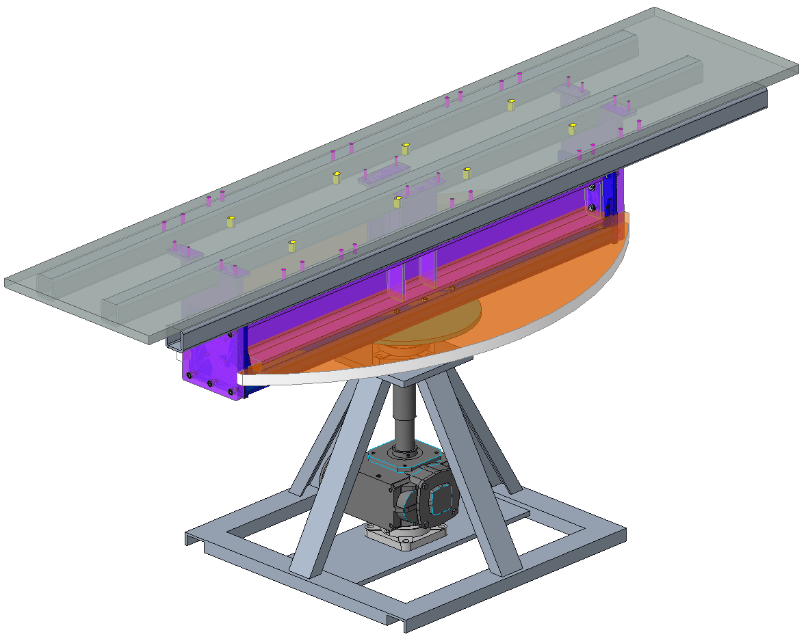
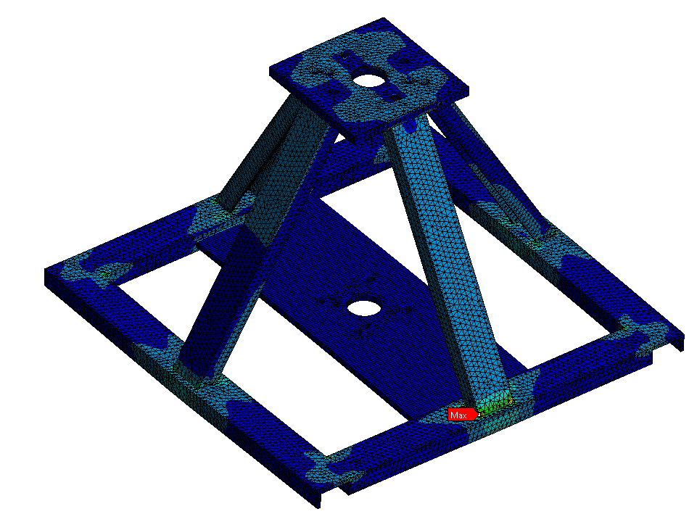
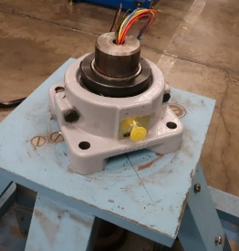
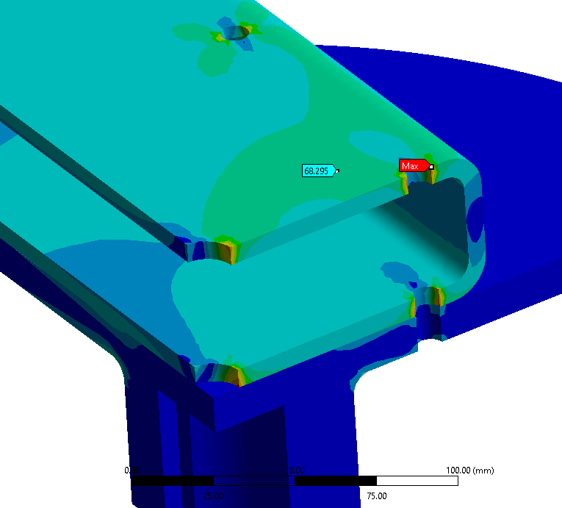
Winding support structure
Coil fabrication
Preparation for winding
Following the FE analysis performed, the main winding table selected for the project has been updated with new components to allow for the coils to be wound.
Winding support structure
Winding table

Slide 6
Winding support structure
Coil fabrication
Preparation for winding
Two layers of mica are placed on the top of the winding support structure to improve sliding.
Winding table

Slide 7
Outline
Introduction
Winding support structure
Winding base
Placement of the pole
Winding
Preparation for reaction
Reaction
Preparation for impregnation
Impregnation
Summary

Slide 8
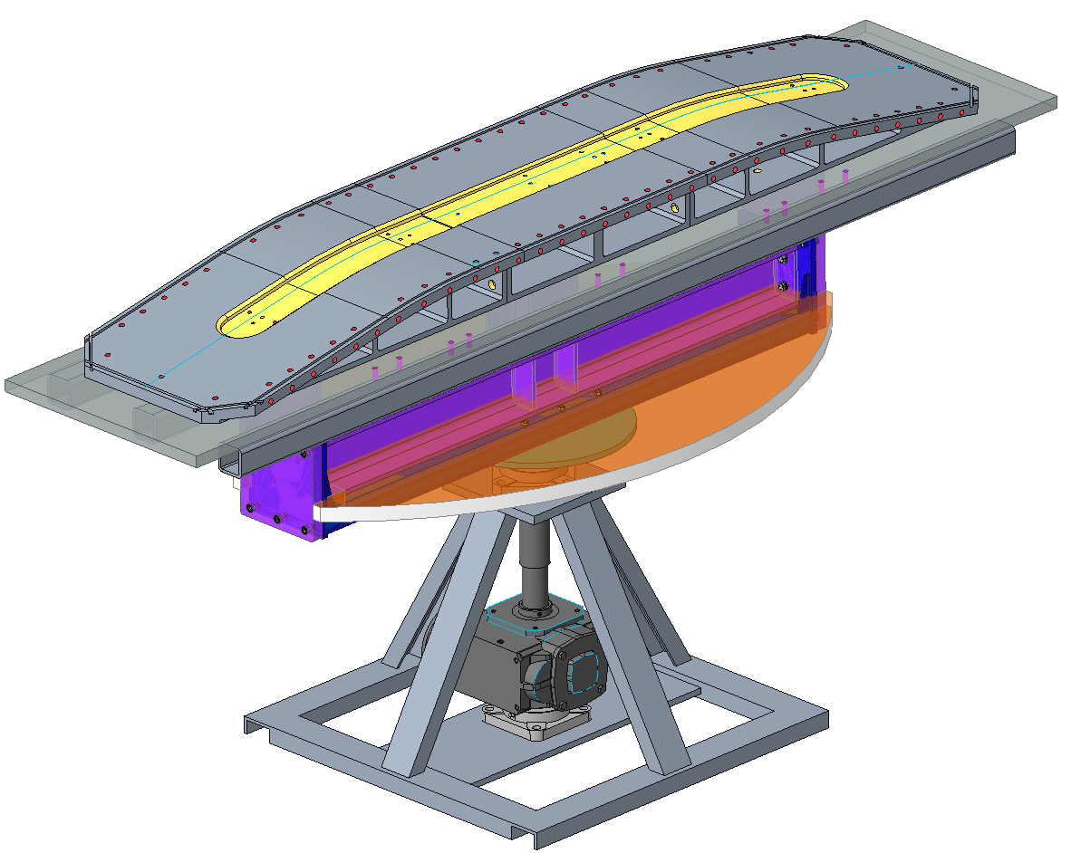
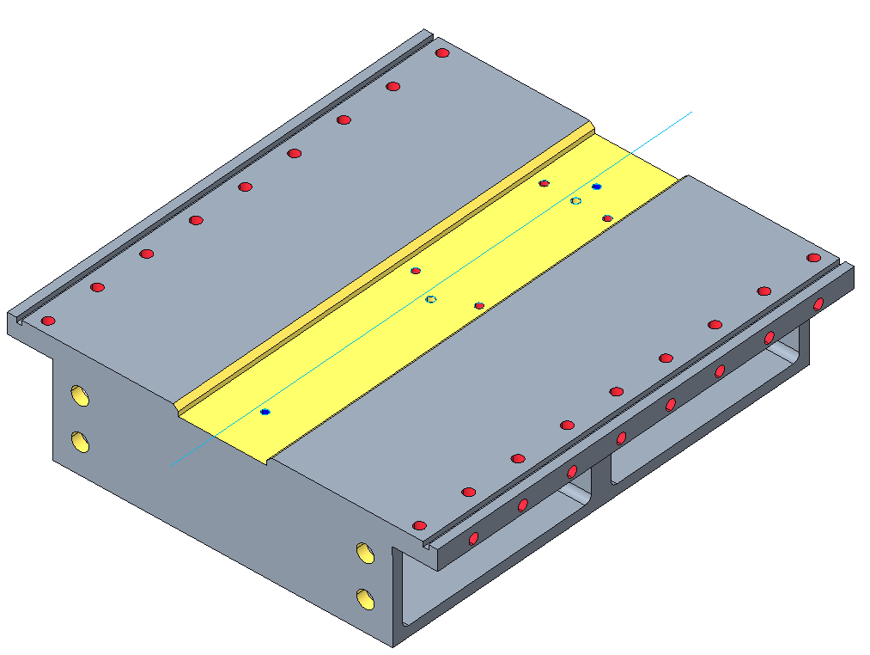
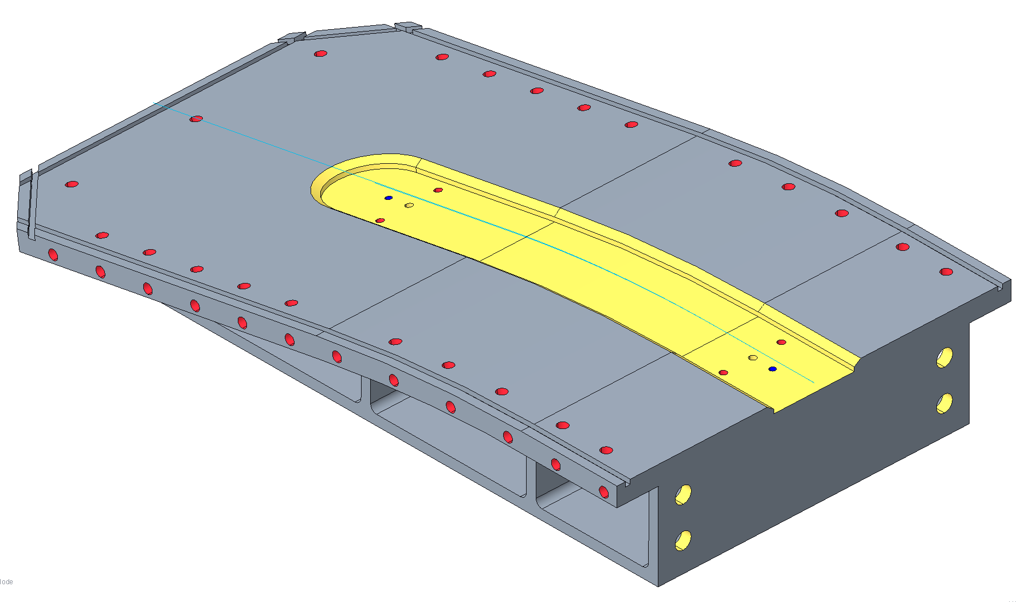
Winding base
Coil fabrication
Preparation for winding
The winding base is divided into three different parts with a similar structure to FRESCA2.
The parts are placed and aligned on top of the mica layers.
During winding, the three winding bases are fixed to the support structure.
The three parts are separated according to a gap* computed to account for:
Reduction of the gap due to the relaxation of winding tension.
Allow the coil to move freely during the reaction process.
Prevent the stretching of the coil during the reaction due to higher thermal expansion of the table material
*To be discussed later

Slide 9
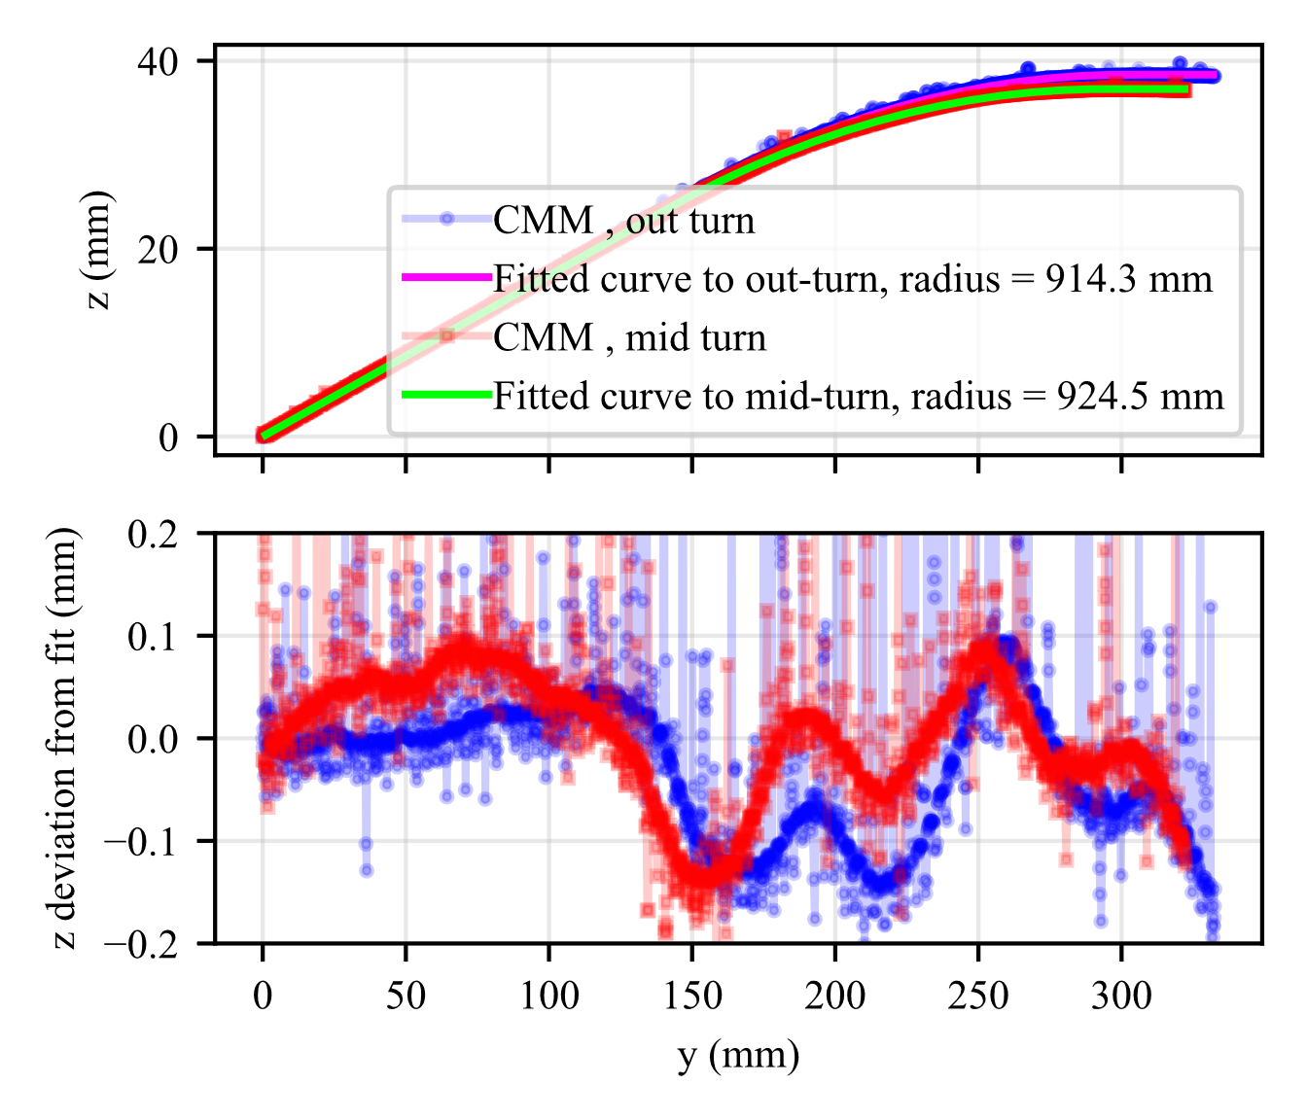
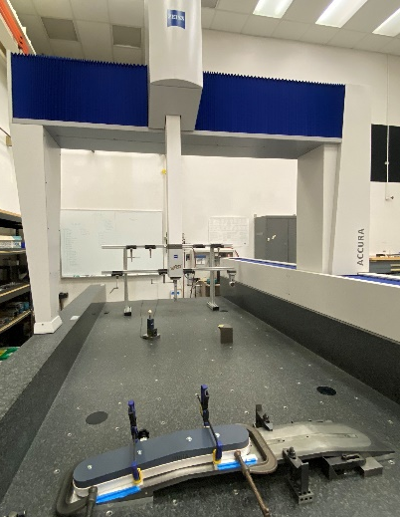
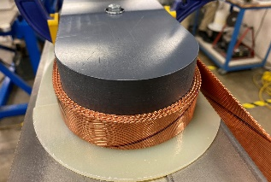
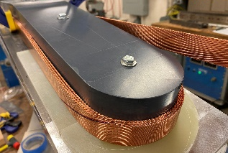
Winding base – development
Coil fabrication
Preparation for winding
Winding tests
A series of winding tests were performed in order to determine the optimal hard bend radius of the cable in the transition-to-ramp region (1400 mm).
$$\hat{k}$$
$$y_{t}$$
$$y_{c}$$
Pole piece
2
3
$$\hat{i}$$
1
Base support
$$\hat{j}$$
Supports
3D printed support
*Rudeiros Fernández, JL, et al. "Engineering Design of a Large Aperture 15 T Cable Test Facility Dipole Magnet." IEEE Transactions on Applied Superconductivity 32.6 (2022): 1-5.

Slide 10
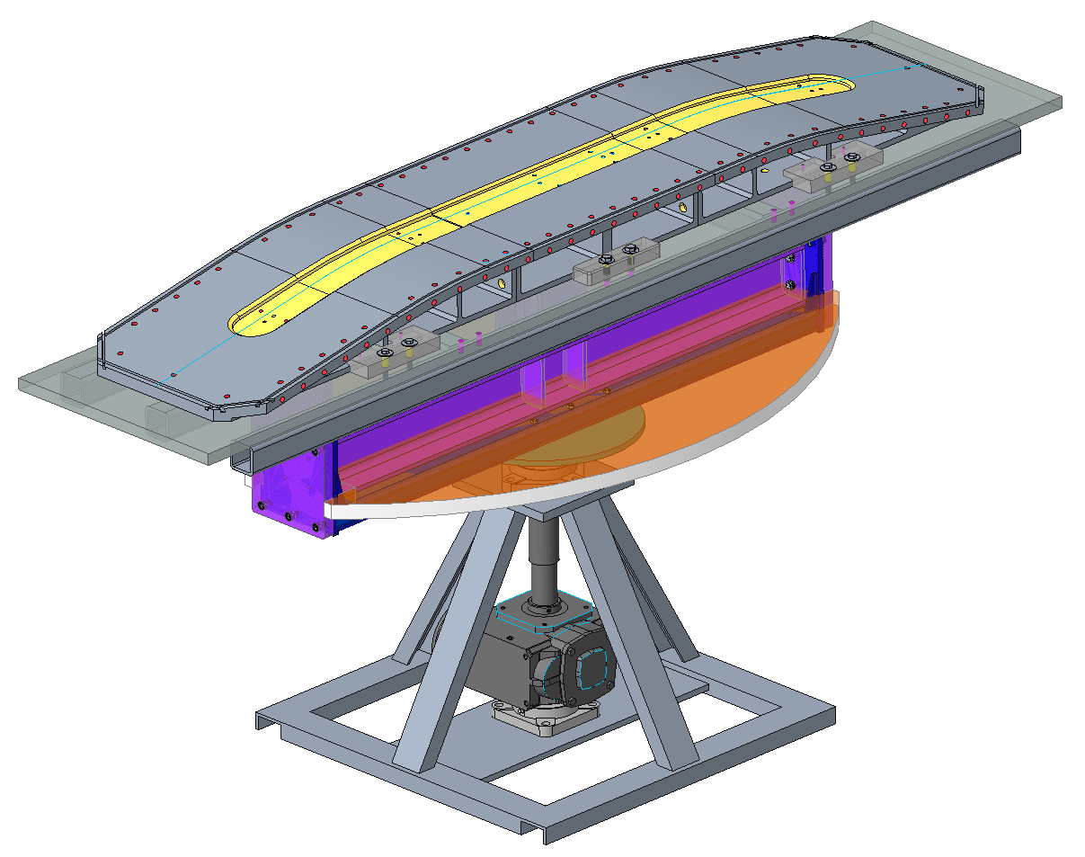
Winding base
Coil fabrication
Preparation for winding
Two layers of mica are placed on top of the winding base parts to improve the sliding of the coil during reaction.
Three parts on each side are placed to constrain certain degrees of freedom of the winding base in relation to the support structure.

Slide 11
Outline
Introduction
Winding support structure
Winding base
Placement of the pole
Winding
Preparation for reaction
Reaction
Preparation for impregnation
Impregnation
Summary

Slide 12
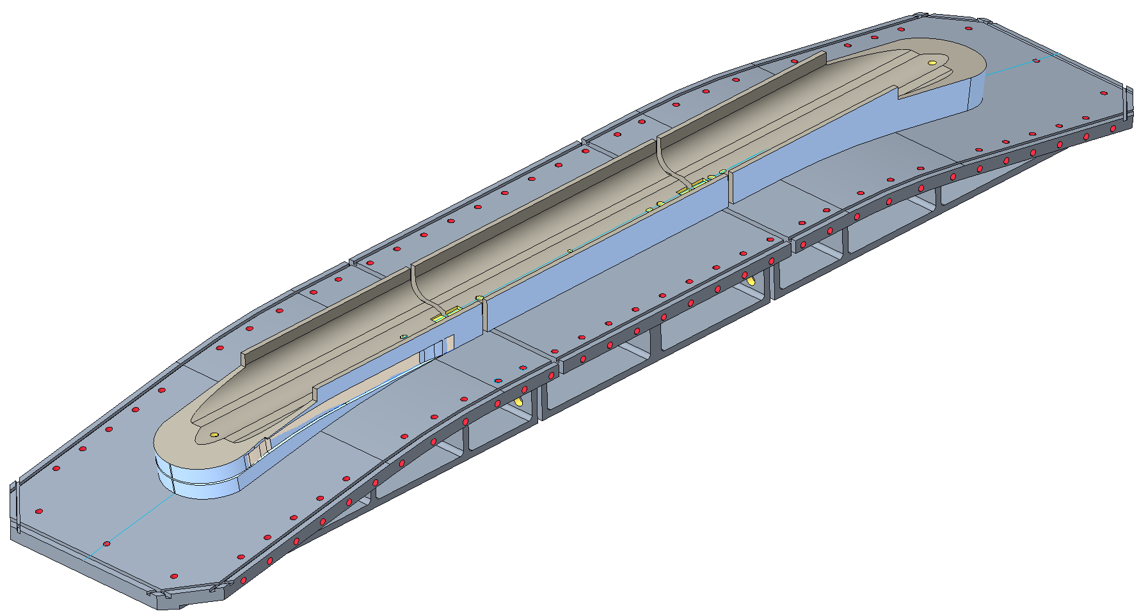
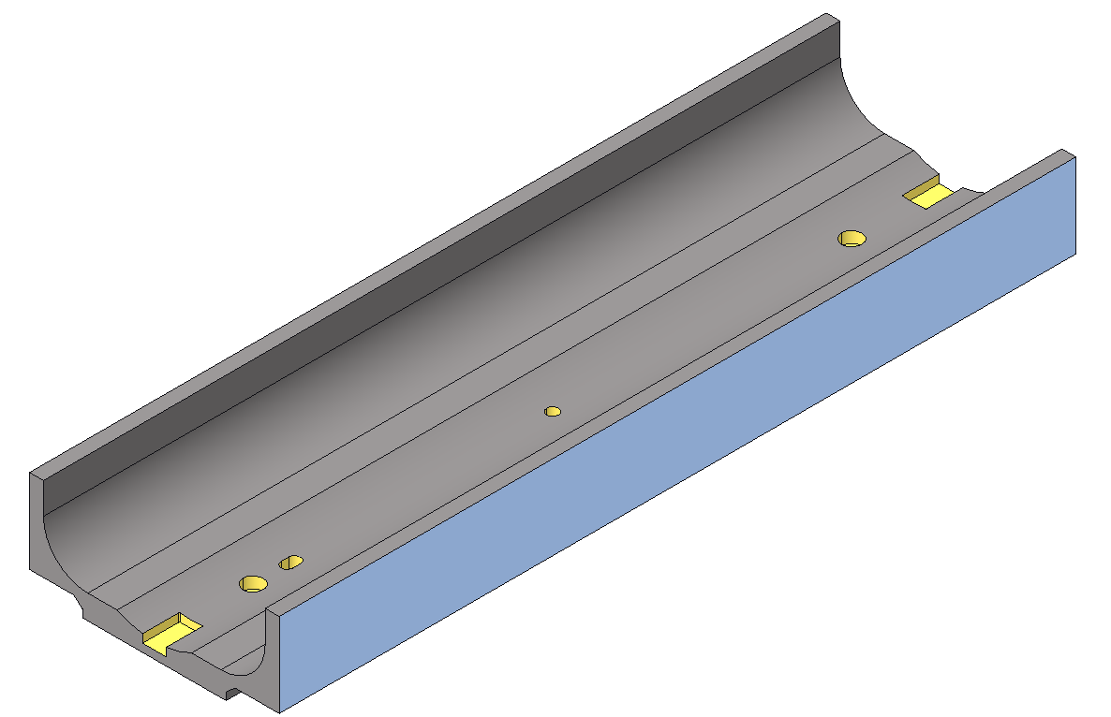
Placement of the pole
Coil fabrication
Preparation for winding
$${Gap}_{pole}$$
$${Gap}_{table}$$
The pole is divided into three different parts with a similar structure to FRESCA2.
The parts are placed on top of the winding base and aligned to them.
During winding, the three pole parts are fixed to the respective winding base part.
The three pole parts are separated according to a gap* computed to account for:
Reduction of the gap due to the relaxation of winding tension.
Allow the coil to move freely during the reaction process.
Prevent the stretching of the coil during the reaction due to the thermal expansion of the pole.
Plasma-sprayed insulation (Al₂O₃)
*To be discussed later

Slide 13
Placement of the pole – estimation of required gaps
Coil fabrication
Preparation for winding
$$L_{p2}$$
$${Gap}_{pole}$$
$$L_{p1}$$
Central plane
Central plane
Pole extremity
Pole center
Cable
$$L_{cable}$$
Table extremity
Table center
$$L_{t2}$$
$${Gap}_{table}$$
$$L_{t1}$$
Main parameters
$C_{c,wt}$ Contraction due to the relaxation of winding tension (about 0.05%)
$C_{c,r}$ Contraction due to reaction (about 0.3%)
$C_{e,cable}$ Expansion of the cable at 650 °C (about 0.2 %)
For the prototype coil, an initial gap in the pole will be established at 5 mm in order to ensure the gap does not close completely.
The material of the winding base (and all similar components) is planned to be a series 400 stainless steel (significantly lower thermal expansion in relation to 316 series, i.e. 10 vs 16 ppm/°C )
Gap conditions
$$\left\{\begin{aligned}{Gap}_{pole,0}≥L_{cable}\left(1−C_{c,wt}\right)C_{c,r} \sim 3 mm \\ {Gap}_{pole,r}≥α_{Ti}\left(L_{p1}+L_{p2}\right)∆T −L_{cable}C_{e,cable}\sim 3.85 mm\end{aligned}\right.$$
Pole
$$\left\{\begin{aligned}{Gap}_{table,0}≥L_{table}\left(1−C_{c,wt}\right)C_{c,r} \\ {Gap}_{table,r}≥α_{ss}\left(L_{p1}+L_{p2}\right)∆T −L_{cable}C_{e,cable}\sim 8 mm∗\end{aligned}\right.$$
Table
*Assuming SS 316

Slide 14
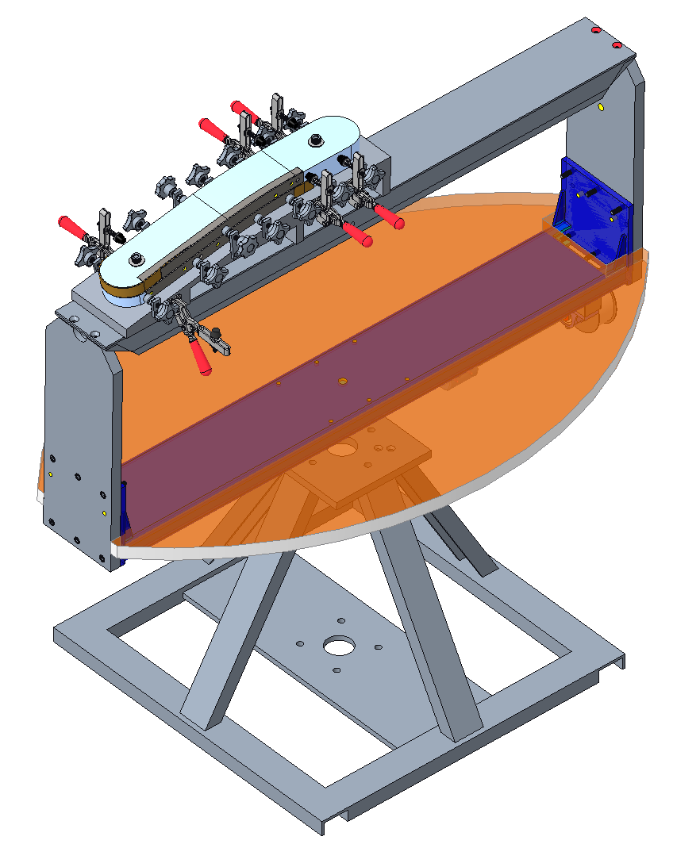
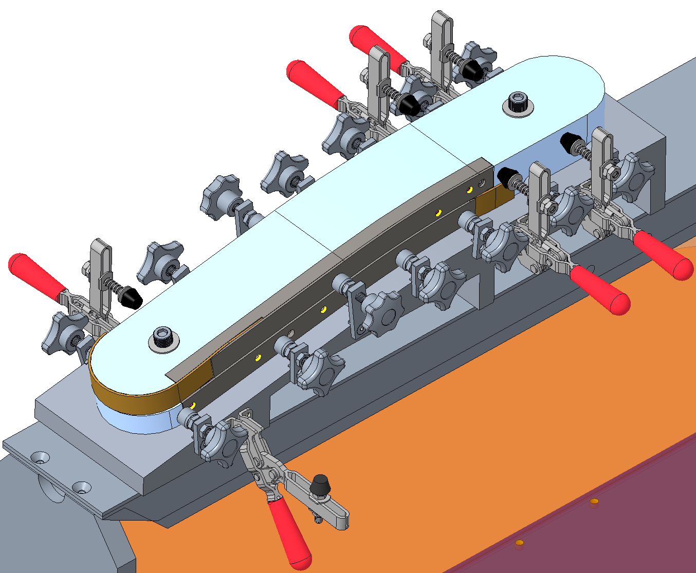
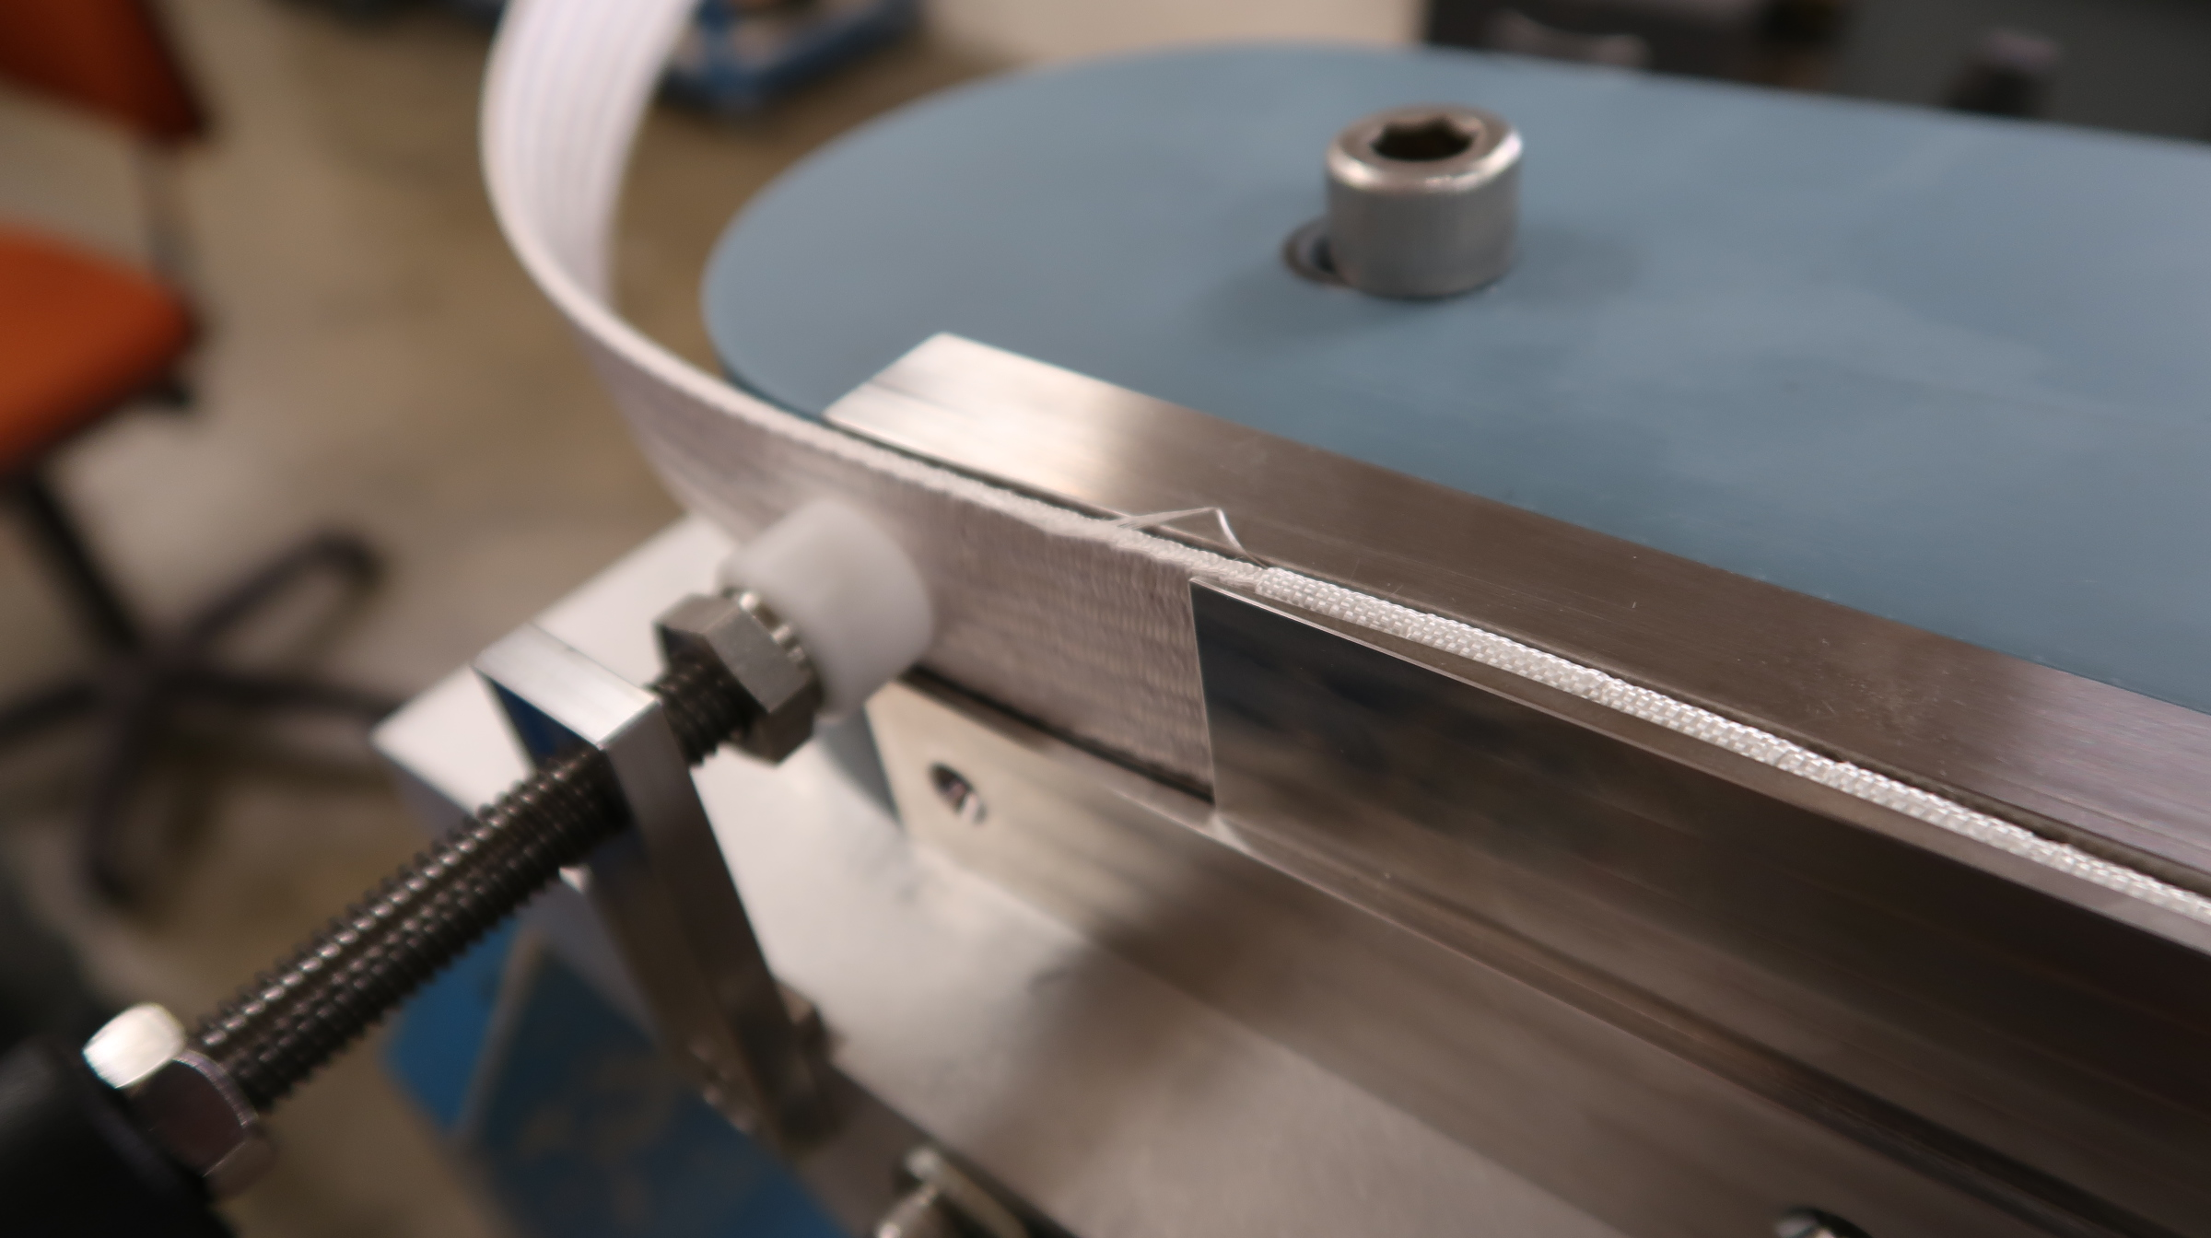
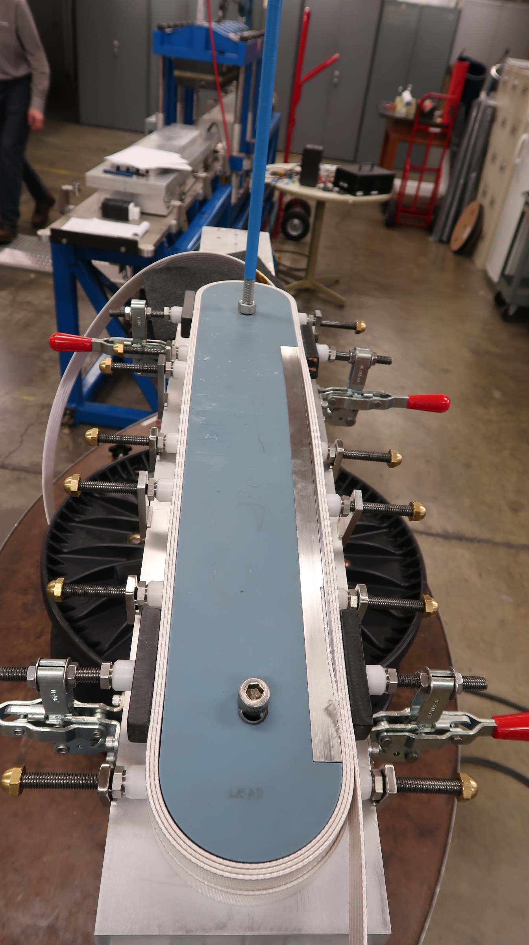
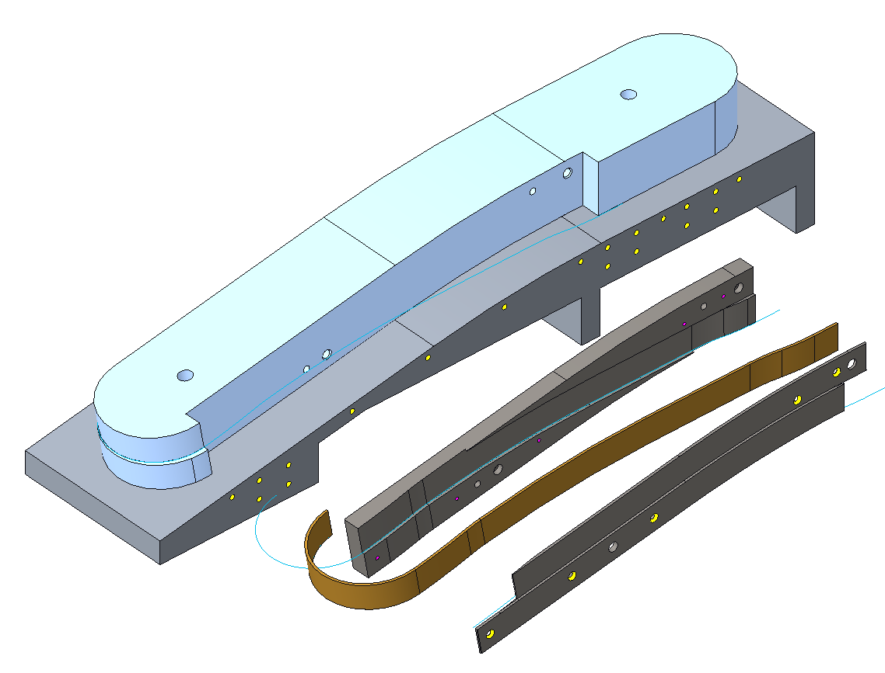
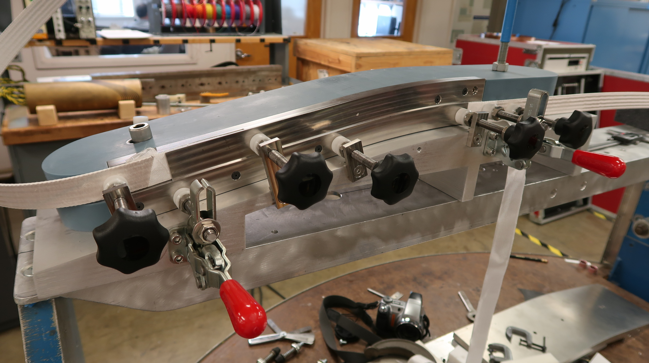
Placement of the pole – Pole and layer jump development
Coil fabrication
Preparation for winding
Layer jump tests
The design of the layer jump region was also validated through a series of tests.
Winding table
3D printed bluestone pole
Base support
Steel insert
Cable geometry
Steel shim
1st chicane
Layer transition
2nd chicane
*Rudeiros Fernández, JL, et al. "Engineering Design of a Large Aperture 15 T Cable Test Facility Dipole Magnet." IEEE Transactions on Applied Superconductivity 32.6 (2022): 1-5.

Slide 15
Outline
Introduction
Winding support structure
Winding base
Placement of the pole
Winding
Preparation for reaction
Reaction
Preparation for impregnation
Impregnation
Summary

Slide 16
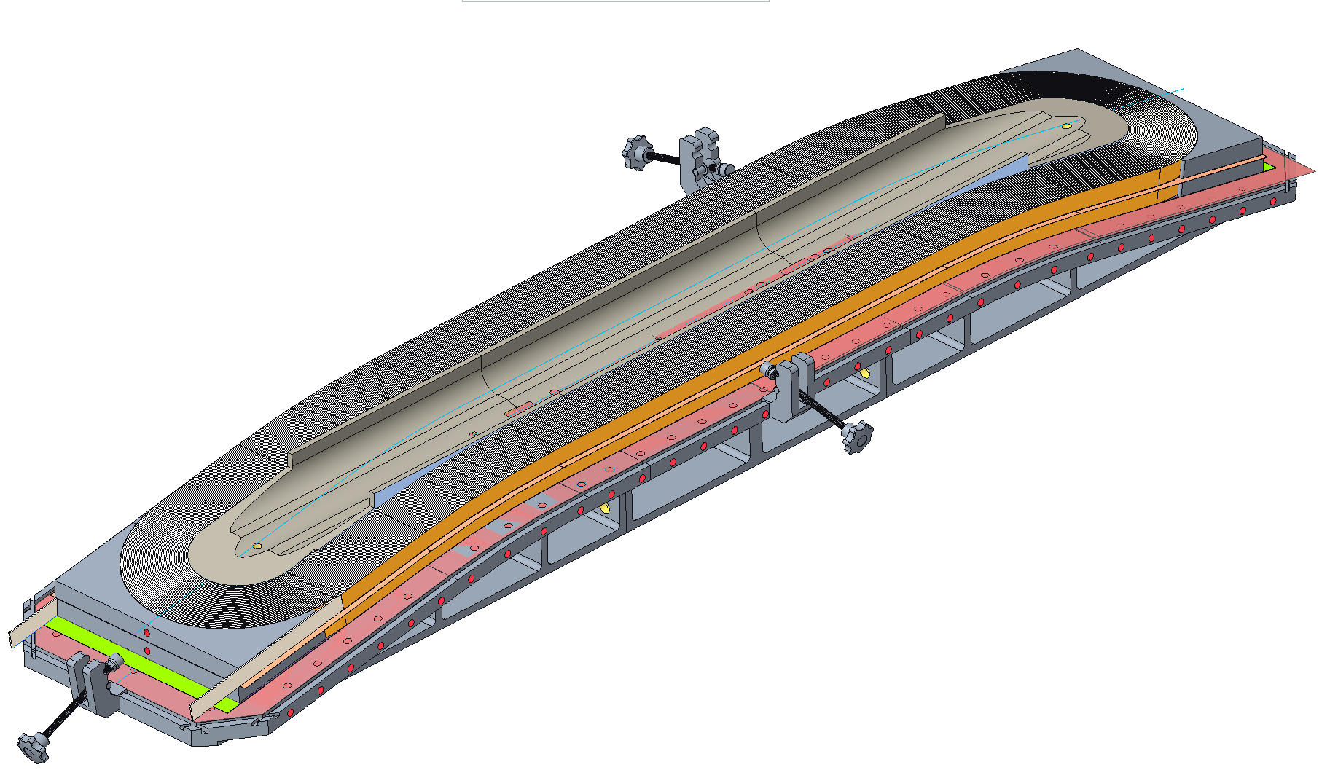
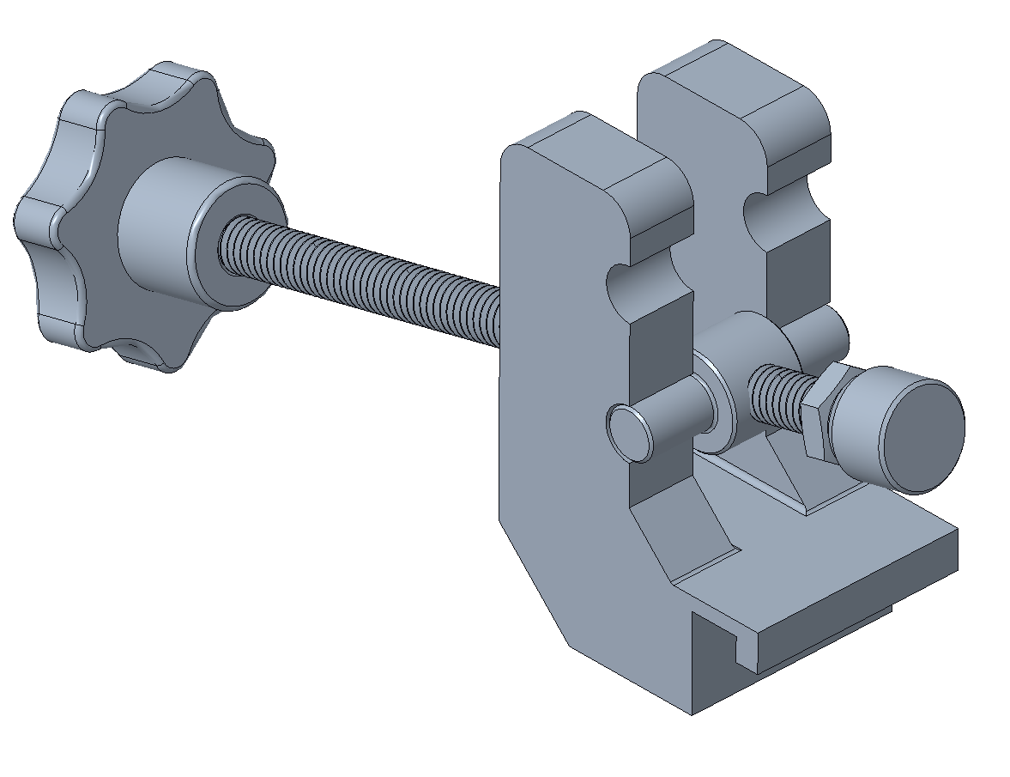
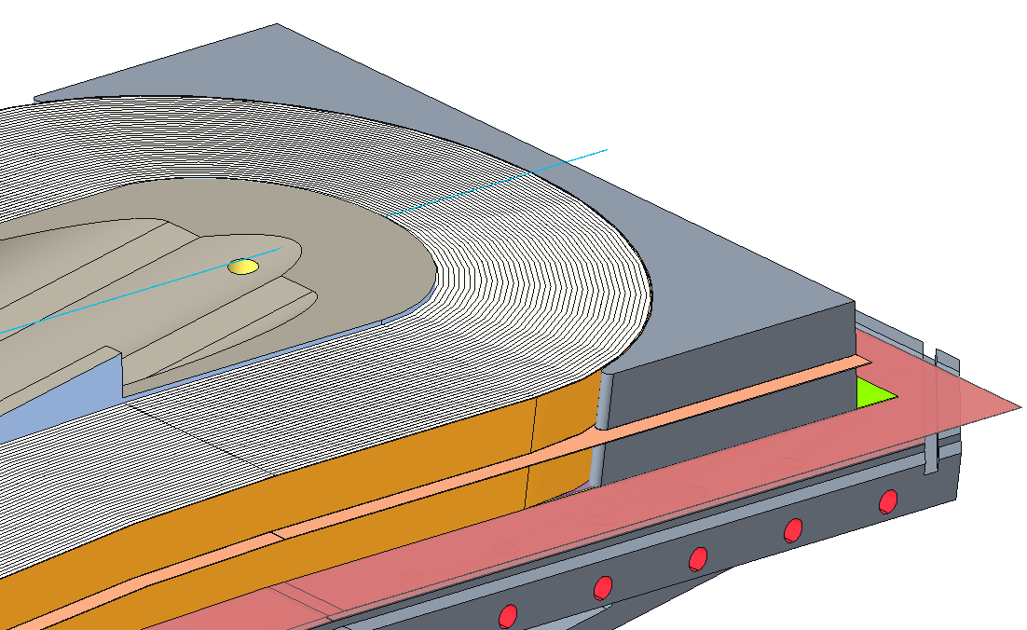
Winding
Coil fabrication
Preparation for winding
Winding
During winding, the cable is held in place by a few rails (not in the illustration) that are pushed by a series of clamps that are locked into the outer groove included in the winding bases (like FRESCA2).
The end shoes are split, with an S2-glass interlayer insulation in between.
*No gaps are represented

Slide 17
Outline
Introduction
Winding support structure
Winding base
Placement of the pole
Winding
Preparation for reaction
Reaction
Preparation for impregnation
Impregnation
Summary

Slide 18
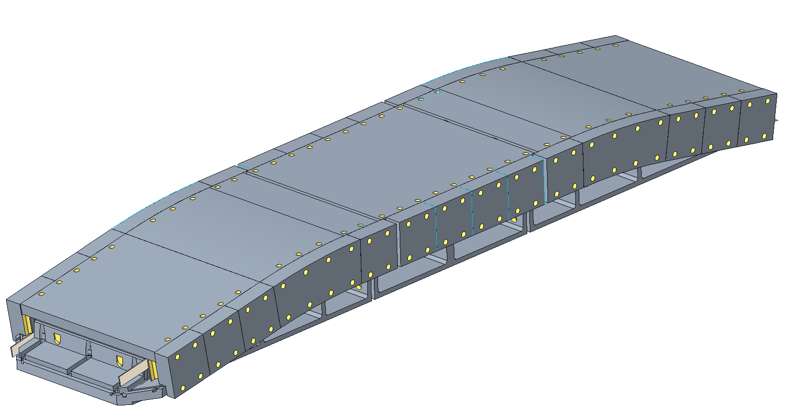
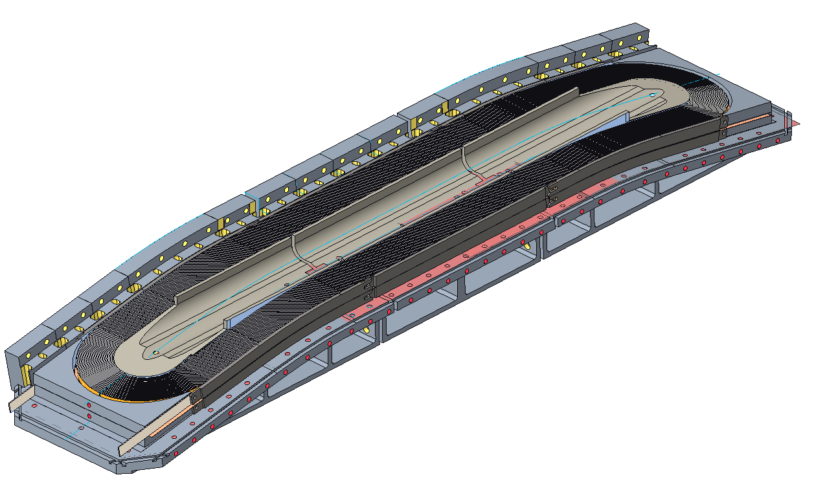
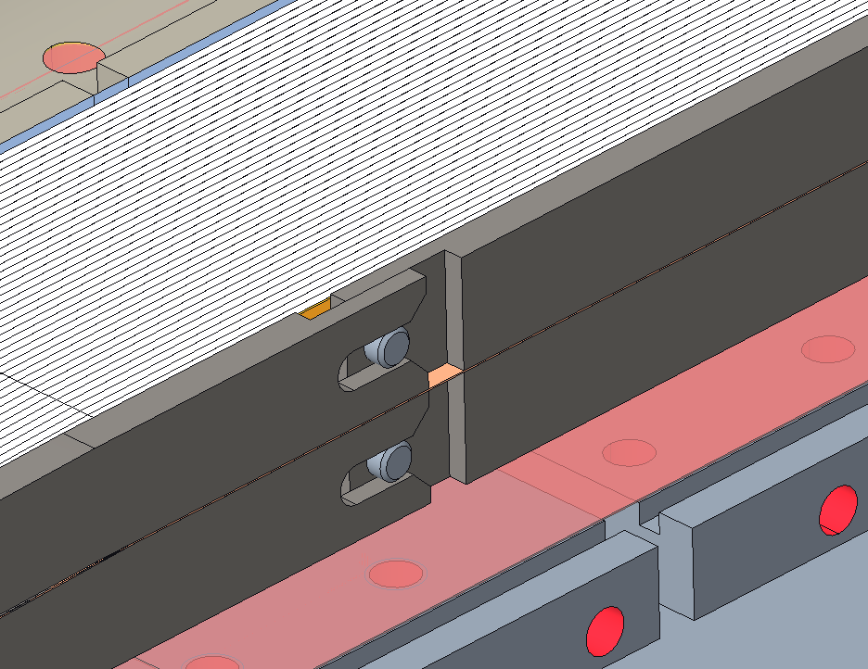
Preparation for reaction
Coil fabrication
Preparation for winding
Winding
Preparation for reaction
After winding, the winding base is unlocked from the support structure, and the winding tension is relaxed.
The side rails (plasma sprayed in the inner surfaces) are put in place.
The side blocks are added until the coil is enclosed.
After placing the bore-filler the assembly is closed with a series of top plates.
The assembly is closed with bolted connections between the side pushers and base and top plates.
Pusher to hold contact with the end shoes during reaction.
Double mica layer bridging the table gap.

Slide 19
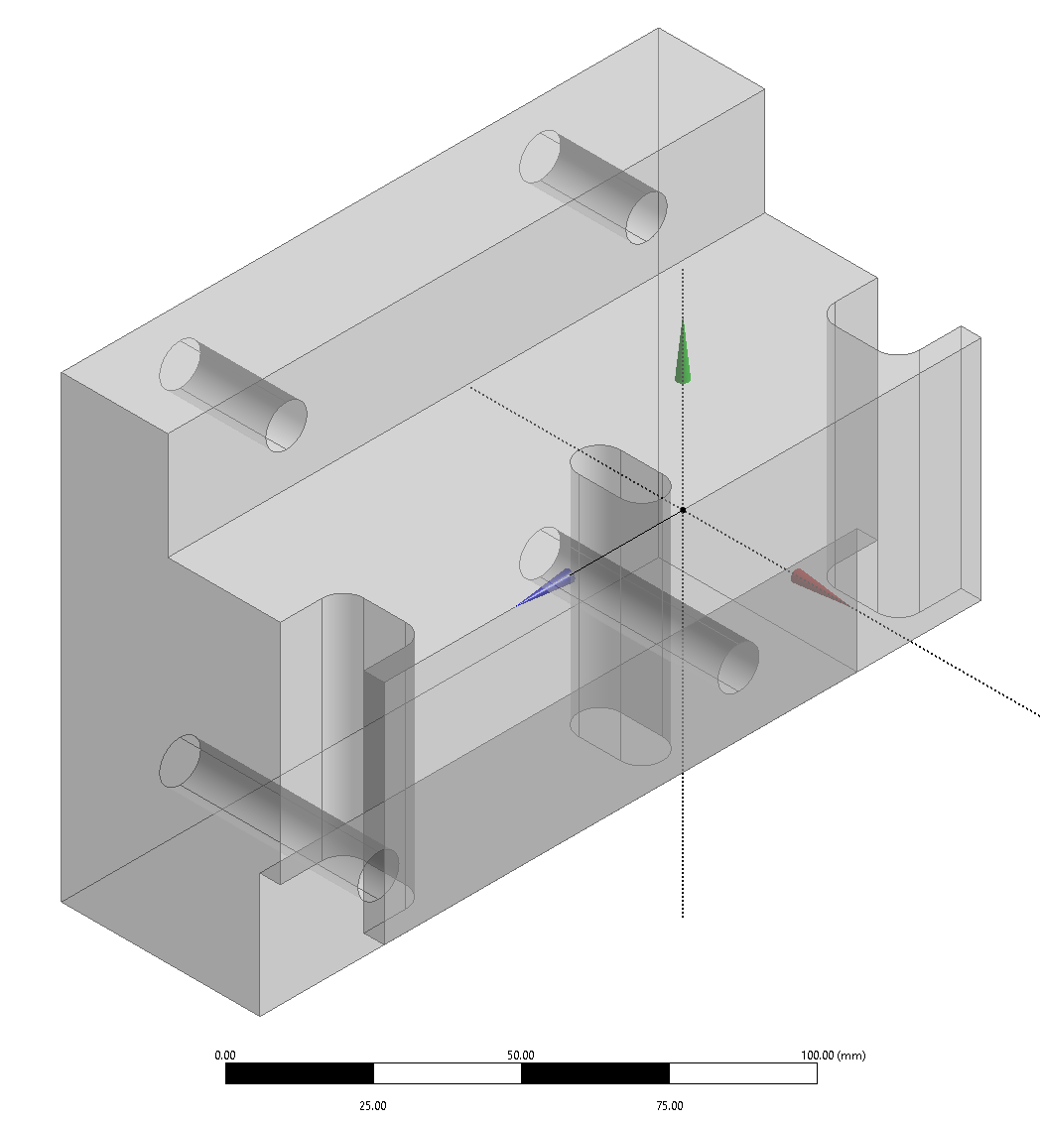
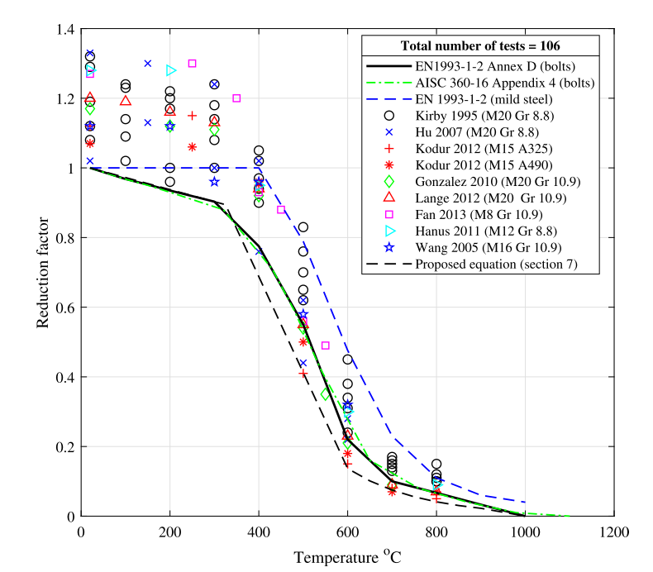
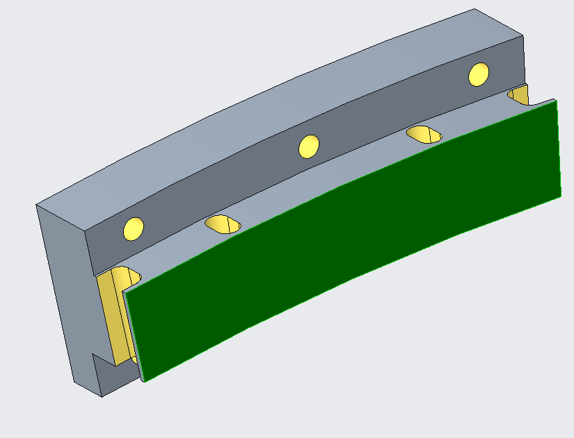
Preparation for reaction – dimensioning of side pushers
Coil fabrication
Preparation for winding
Winding
Preparation for reaction
Design specification:
Stress in the bolt/rod for 5 MPa pressure on the block while at 700 °C.
Tensile strength (considering grade 8 bolts) = 1000 MPa
Reduction factor = 0.1 => Strength at 700 °C = 100 MPa
Rod size = 1/2-20 UNF
Shaheen, M. A., Foster, A. S. J., Cunningham, L. S., & Afshan, S. (2020). Behaviour of stainless and high strength steel bolt assemblies at elevated temperatures — A review. Fire Safety Journal, 113(March), 102975. https://doi.org/10.1016/j.firesaf.2020.102975

Slide 20
Outline
Introduction
Winding support structure
Winding base
Placement of the pole
Winding
Preparation for reaction
Reaction
Preparation for impregnation
Impregnation
Summary

Slide 21
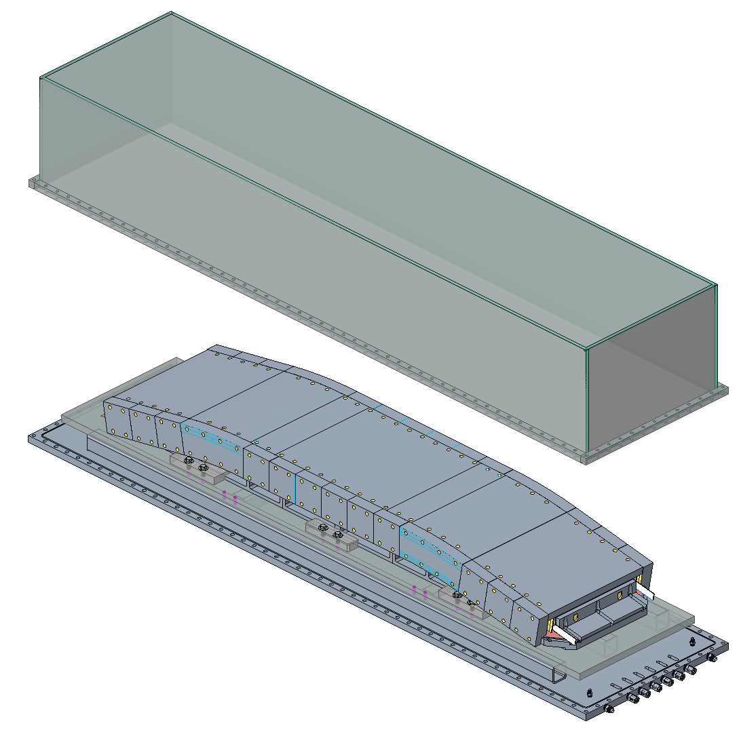
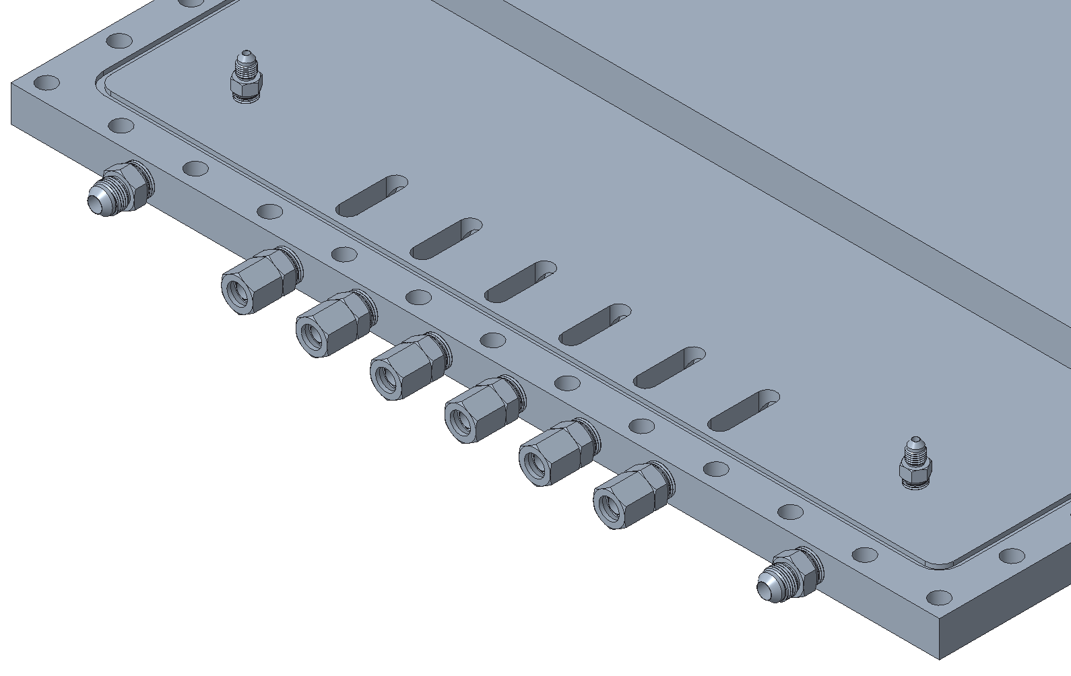
Reaction
Coil fabrication
Preparation for winding
Winding
Preparation for reaction
Reaction
Retort top
Groove for high temperature o-ring
TCs main feedthroughs
Gas
Retort base

Slide 22
Reaction – analysis of degrees of freedom
Coil fabrication
Preparation for winding
Winding
Preparation for reaction
Reaction
Bolt
Pin / Key
$$y$$
Pusher/ Contact surface
Color represents the degrees of freedom intended for the specific constraint
$$z$$
$$x$$
Winding base to winding support structure
$$y$$
$$x$$
$$z$$
$$y$$
Poles to winding bases
$$y$$
$$x$$
$$z$$
$$x$$
$$z$$
Pole to pole
$$y$$
$$z$$
$$x$$

Slide 23
Outline
Introduction
Winding support structure
Winding base
Placement of the pole
Winding
Preparation for reaction
Reaction
Preparation for impregnation
Impregnation
Summary

Slide 24
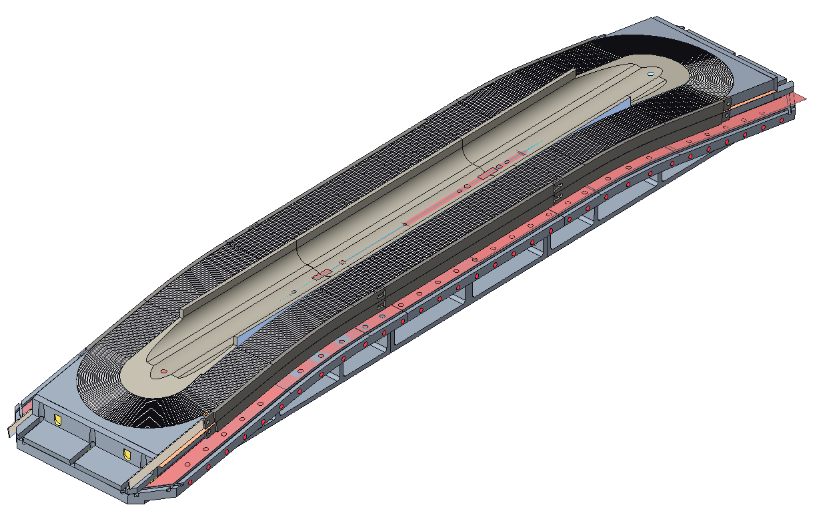
Preparation for impregnation
Coil fabrication
Preparation for winding
Winding
Preparation for reaction
Reaction
Preparation for impregnation
After the reaction, the top parts are removed, and the splicing process starts.
The current plan is to splice two NbTi cables to each Nb₃Sn lead.
After the splice is completed, the transfer to the impregnation mold starts.
The impregnation system is designed to accommodate slight variations in the size of the coils after the reaction.

Slide 25
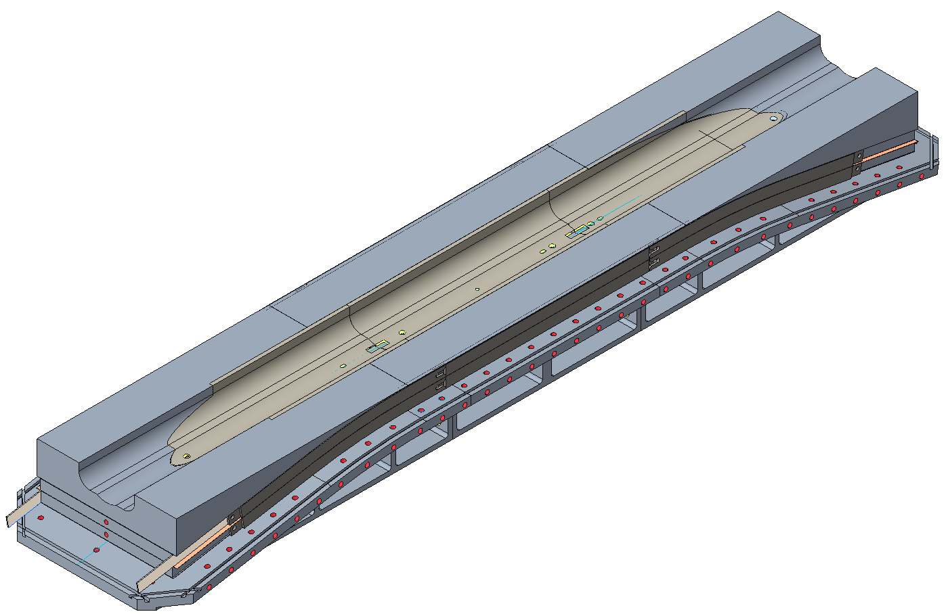
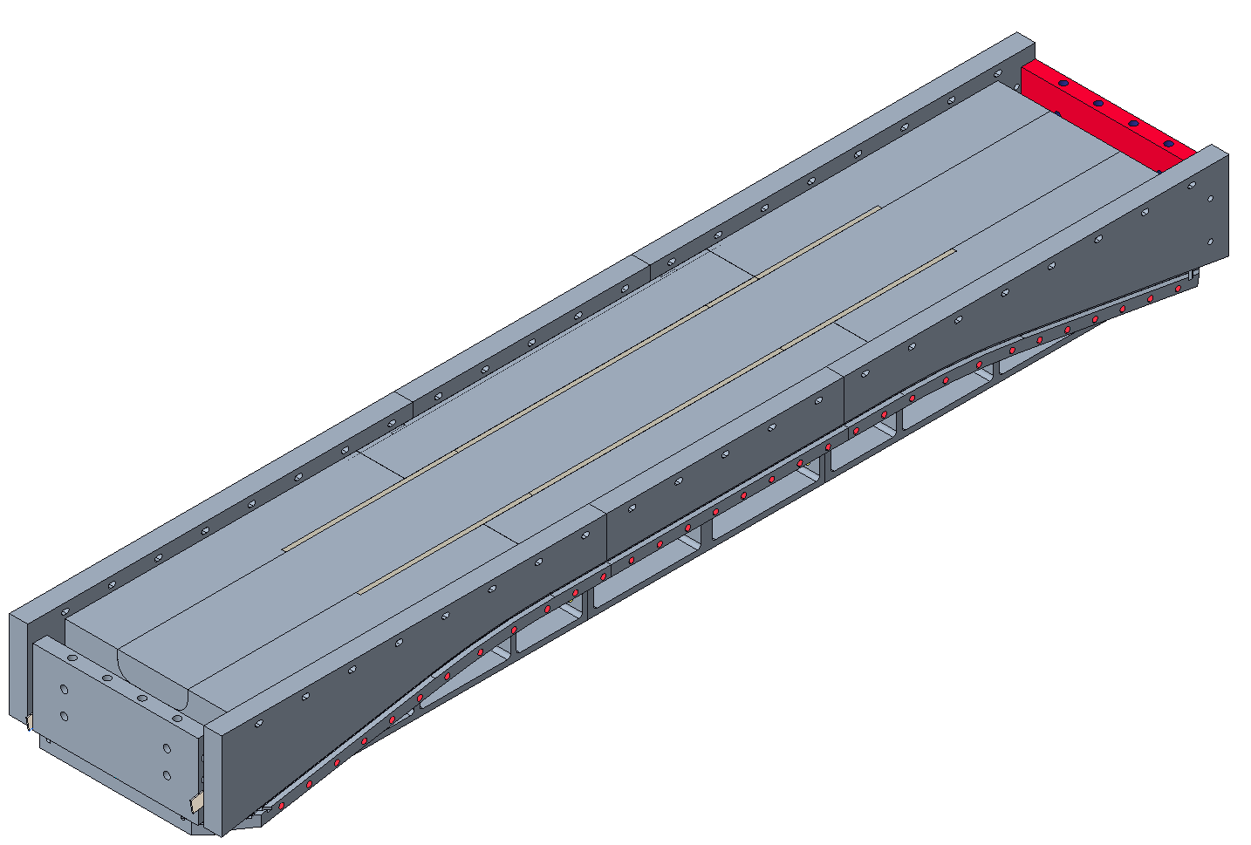
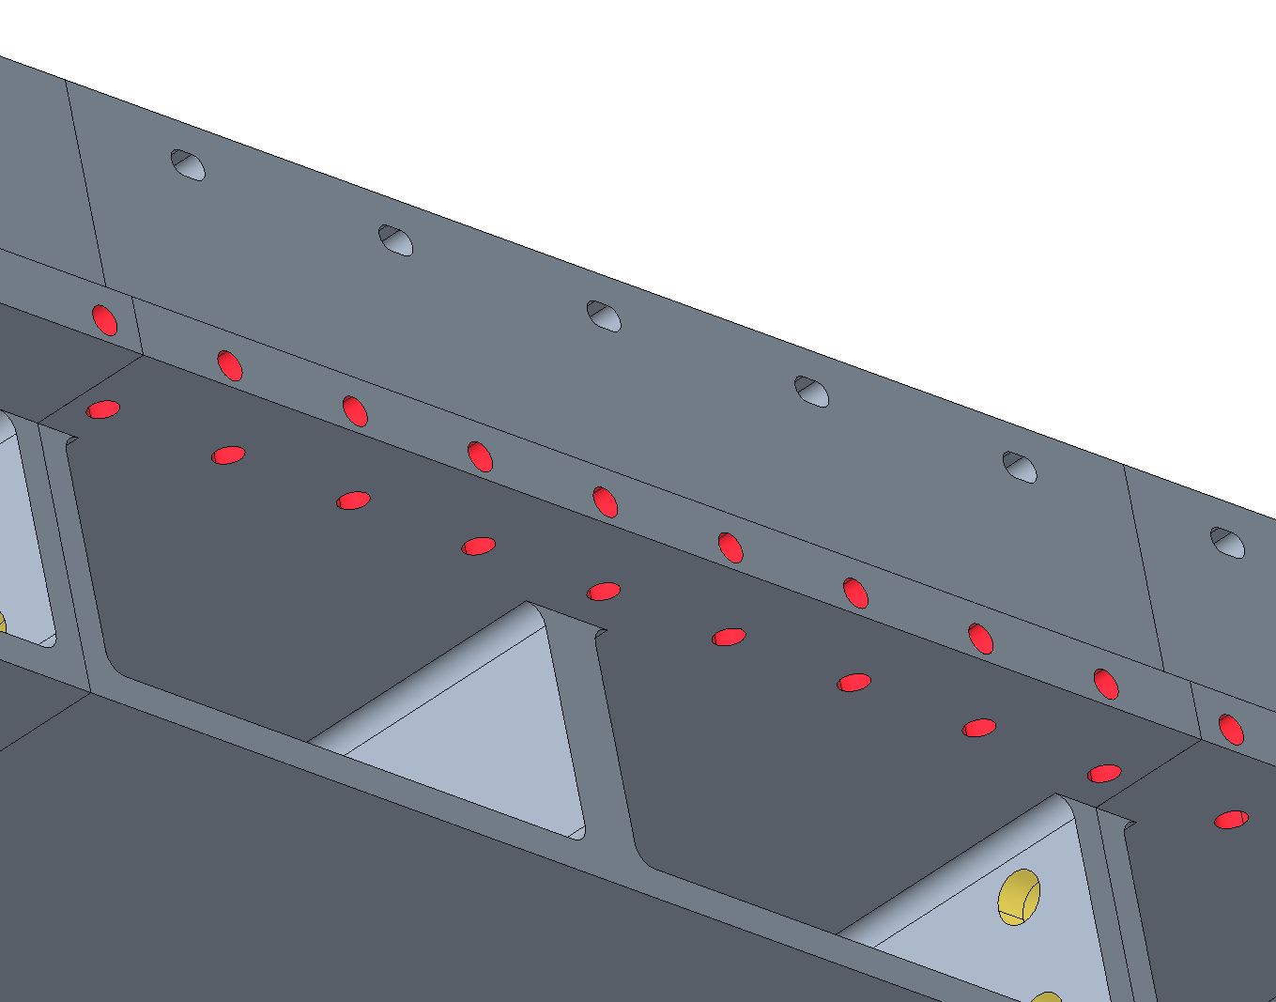
Preparation for impregnation
Coil fabrication
Preparation for winding
Winding
Preparation for reaction
Reaction
Preparation for impregnation
The first step is to lock together the three winding base parts together.
The wedge and wedge extension are placed on top of the coil.
The next step is to attach the lateral support plate to allow for the turning of the assembly.
The end pushers are connected to the lateral supports and to the wedge, and the end shoes to prevent any motion during rotation.
Wedge extension
Wedge
Bolt connections to the lateral support plates.
Pole filler
Three parts on each side are placed to constrain the coil in relation to the winding base block

Slide 26
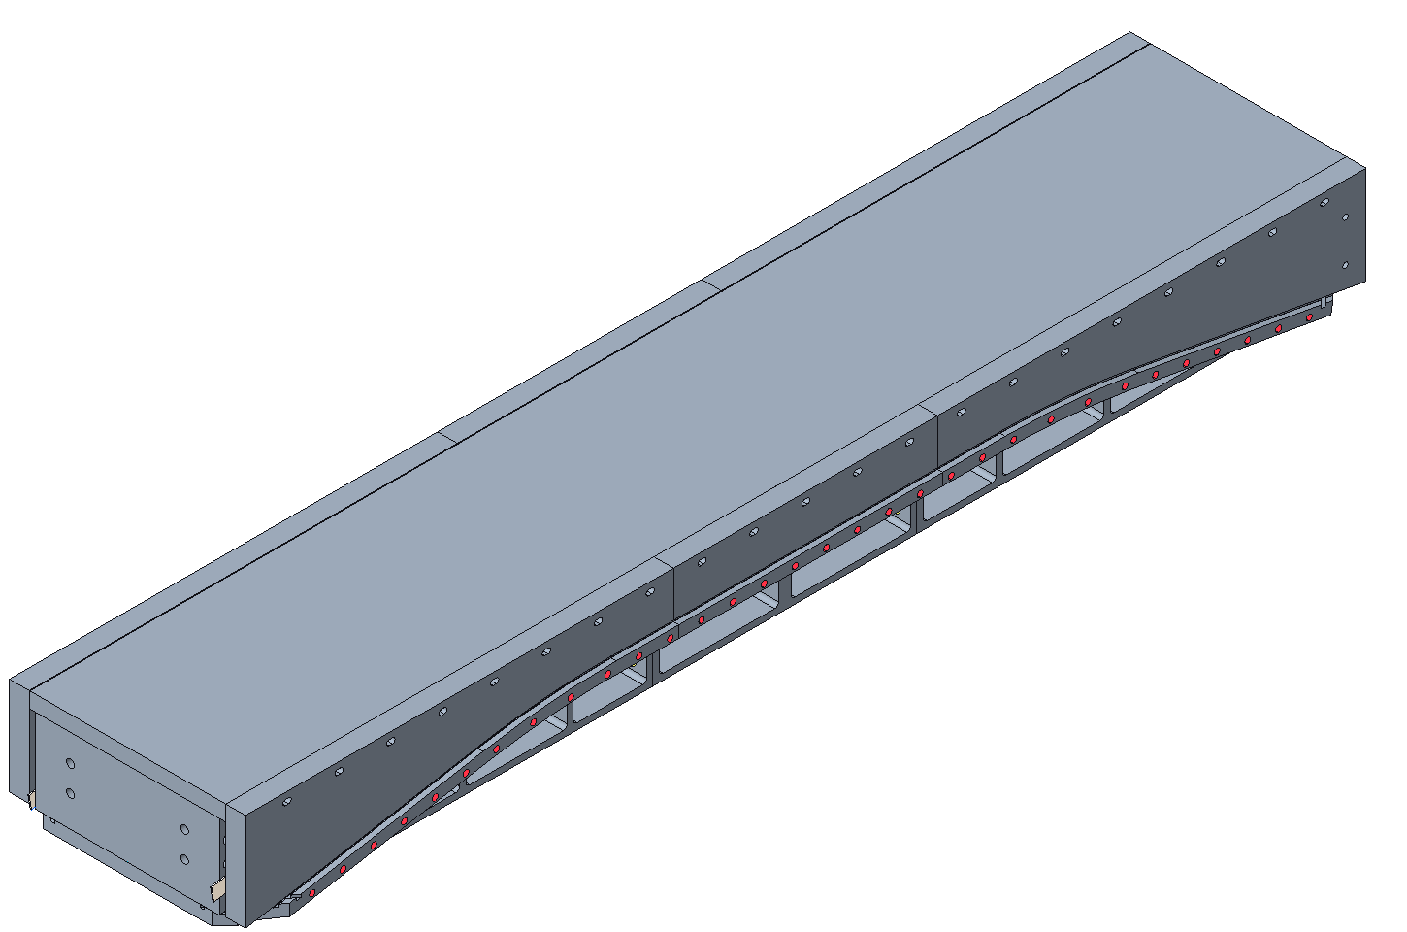
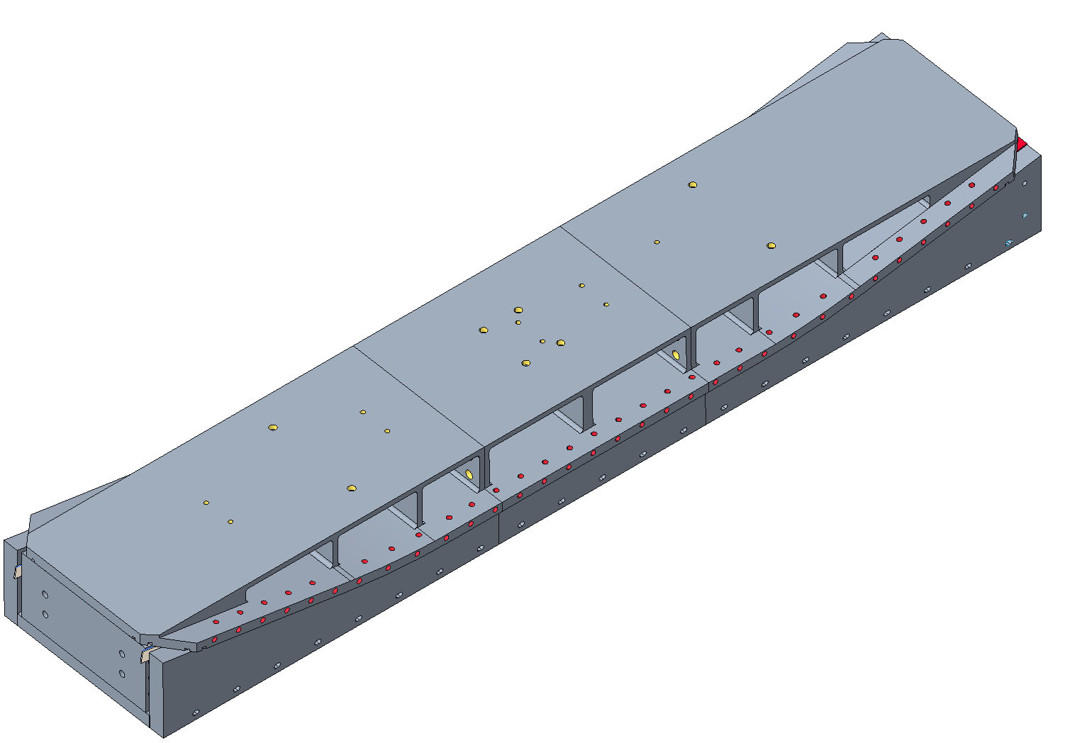
Preparation for impregnation
Coil fabrication
Preparation for winding
Winding
Preparation for reaction
Reaction
Preparation for impregnation
Impregnation bottom plate
The pole filler and top plate are placed on top of the coil.
After connecting all components, the assembly is rotated 180 degrees.

Slide 27
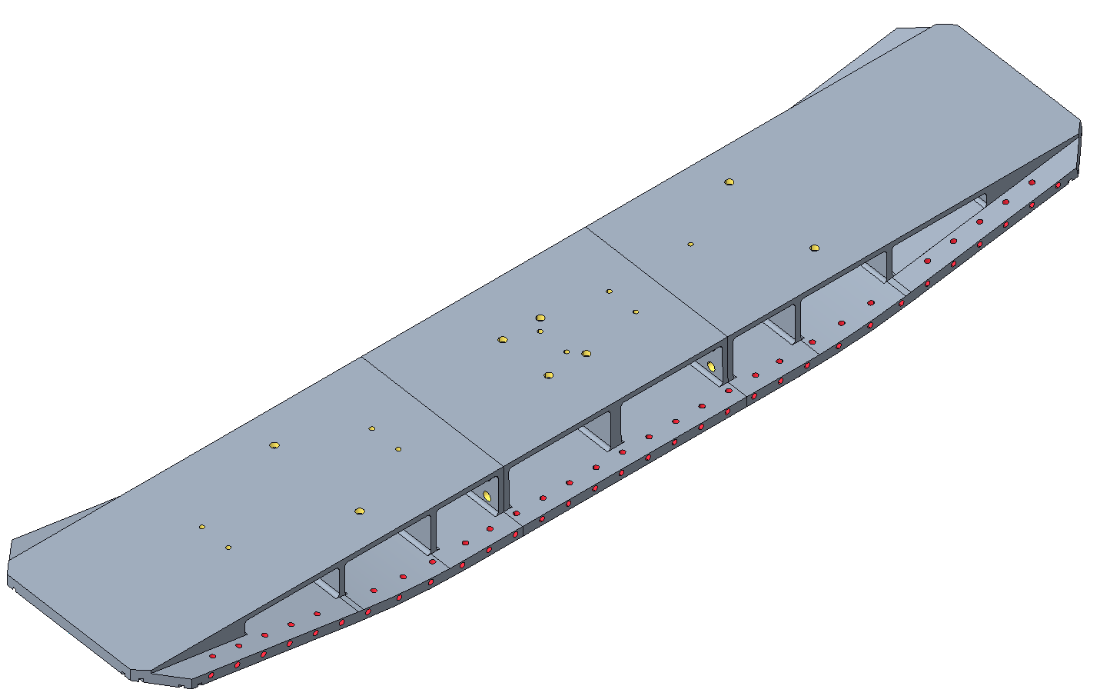
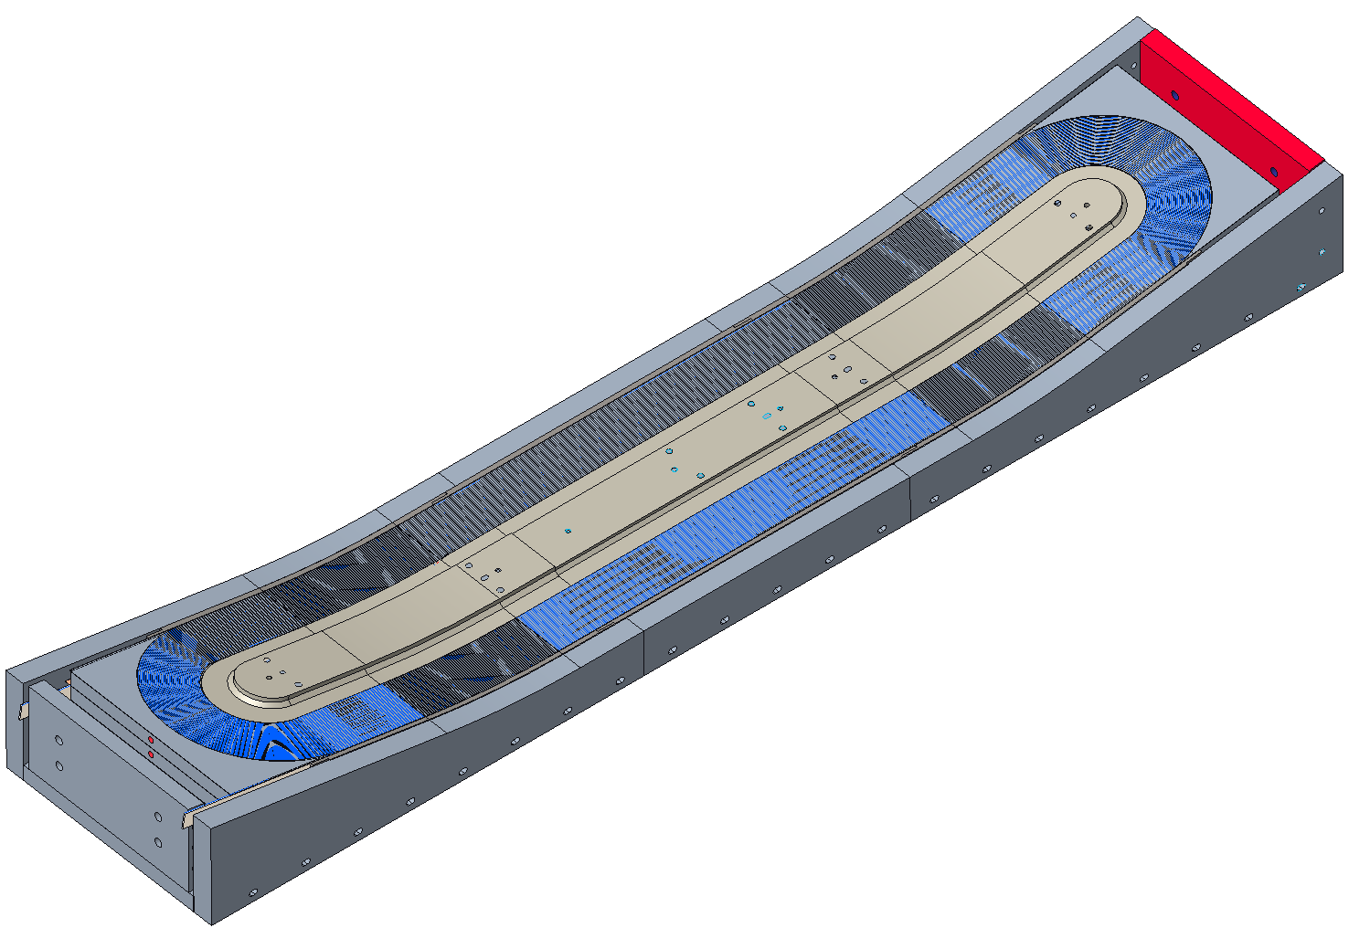
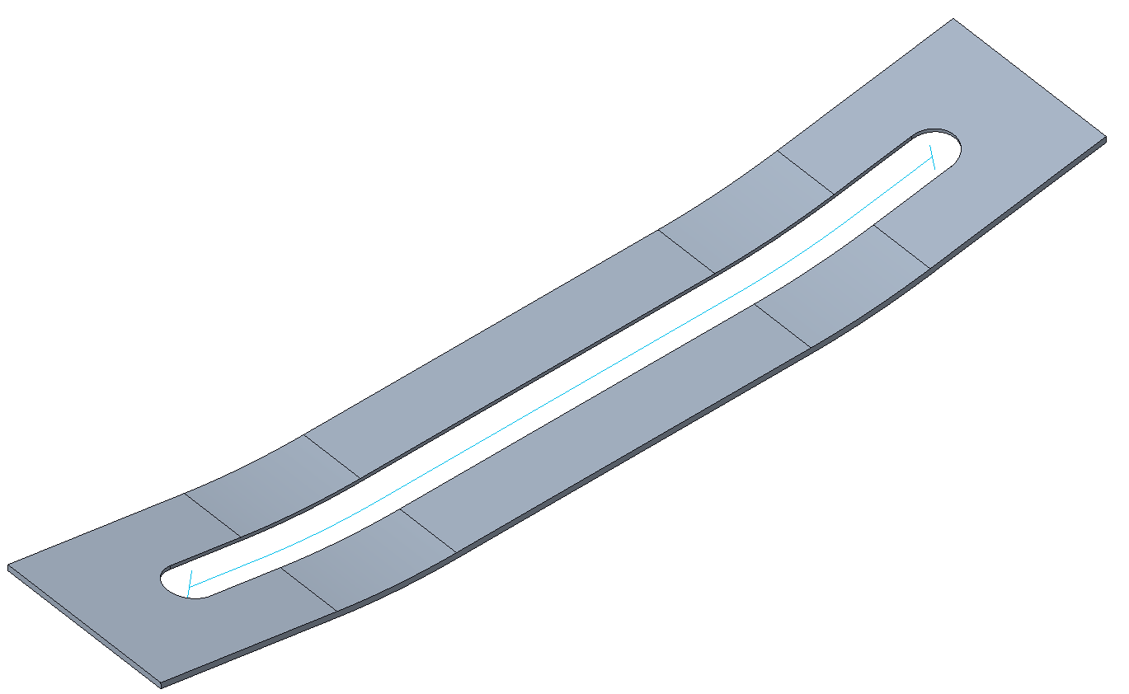
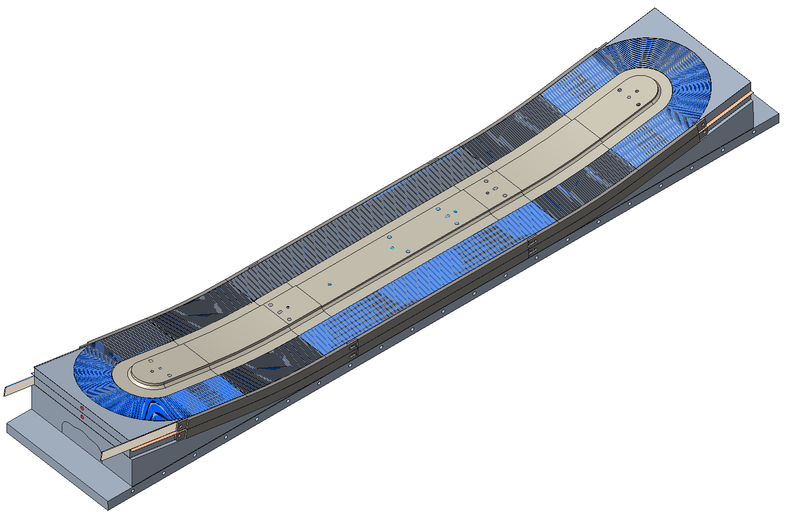
Preparation for impregnation
Coil fabrication
Preparation for winding
Winding
Preparation for reaction
Reaction
Preparation for impregnation
The bolts connecting the lateral supports to the winding base are removed.
The table is removed.
The lateral supports are removed.
The steel spacer is placed on the coil.

Slide 28
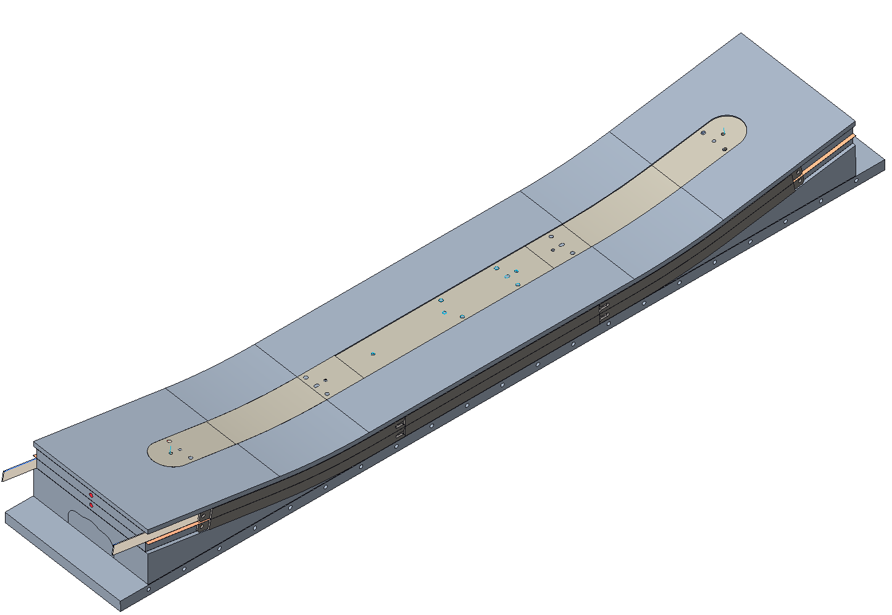
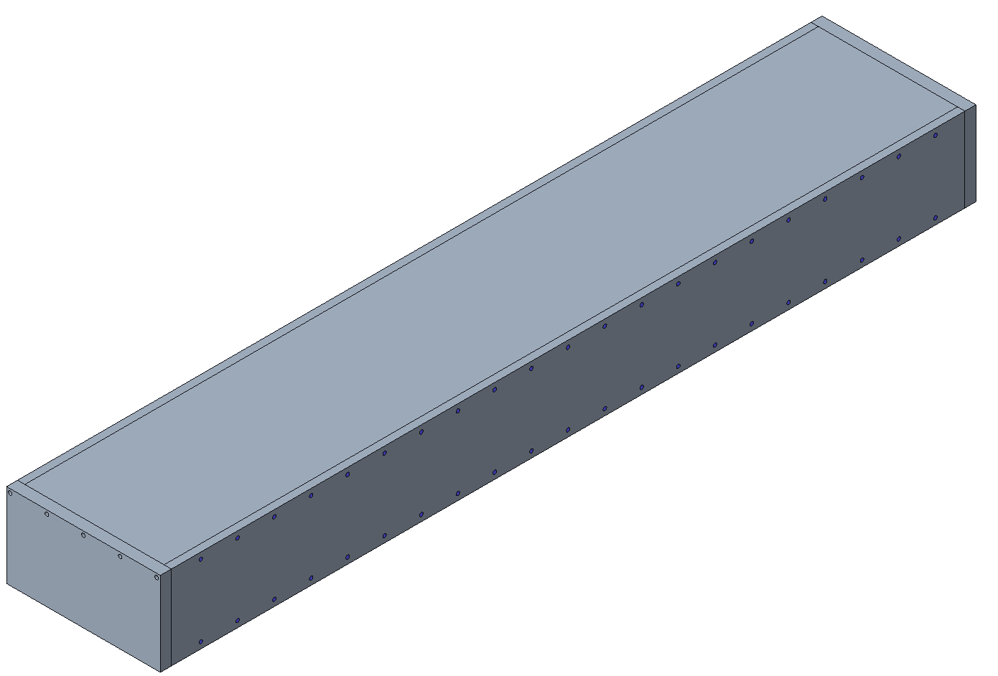
Preparation for impregnation
Coil fabrication
Preparation for winding
Winding
Preparation for reaction
Reaction
Preparation for impregnation
The main filler pieces (i.e. the boat) are placed. The division of the fillers allows for the accommodation of small variations in the size of the coils after the reaction.
With the lateral plates, end plates, and top mold plates, a close cavity ready for impregnation is created.

Slide 29
Outline
Introduction
Winding support structure
Winding base
Placement of the pole
Winding
Preparation for reaction
Reaction
Preparation for impregnation
Impregnation
Summary

Slide 30
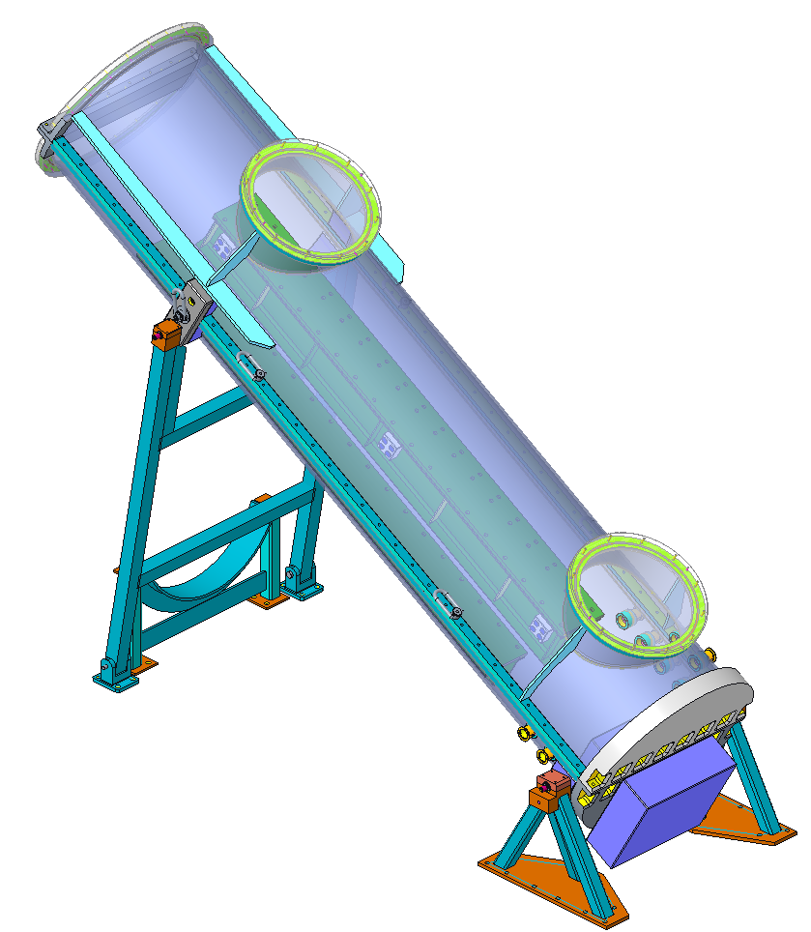
Impregnation
Coil fabrication
Preparation for winding
Winding
Preparation for reaction
Reaction
Preparation for impregnation
Impregnation
The impregnation mold is fixed to the impregnation chamber.
The magnet will be impregnated in an inclined position with CTD 101K.
Impregnation chamber

Slide 31
Summary
The design of the main coil components and tooling required for manufacturing is in an advanced state.
Winding and layer jump tests have been carried out to validate features required for the fabrication of the coil.
Based on the initial feedback from vendors, all parts and components are manufacturable, and preliminary quotes indicate that the costs are in line with the allocated budget.

Slide 32
Additional info

Slide 33
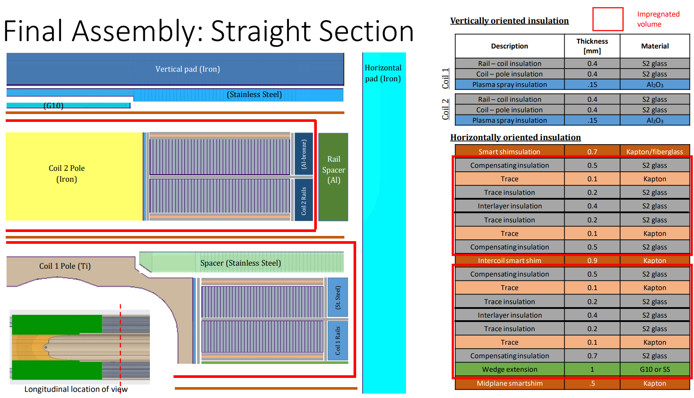
Additional info

