Slide 1



G. Sabbi, LBNL
TFD Preliminary Design Review
February 16, 2023
Facility Interfaces and Risk Register

Slide 2
Presentation Outline
TFD-HFVMTF Interfaces
  Interface development and documentation
  Magnet integration in cryostat
  Magnet tests in HFVMTF prior to final installation
  Quench protection
  Interactions between magnet and sample holder
Risk register
  Overview
  Specific examples relevant to PDR
Summary

Slide 3
TFD-HFVMTF Interfaces
Main interfaces between TFD and HFVMTF:
  Mechanical/electrical installation in cryostat
  Quench protection system
  Interactions between magnet and sample
Several intermediate qualification tests are planned and will provide opportunities to verify and optimize key interfaces prior to final installation:
  TFD mechanical model with dummy coils:
    Magnet goals: test assembly/loading; compare strain gauge data with mechanical analysis (assembly, cool-down)
    Facility goals: test mechanical installation in cryostat; DAQ (strain gauges); magnet temperature uniformity during cool-down
  Two magnet cold tests, including thermal cycles
    Magnet goals: demonstrate and optimize quench performance
    Facility goals: magnet mechanical and electrical installation; powering, instrumentation/DAQ, quench protection

Slide 4
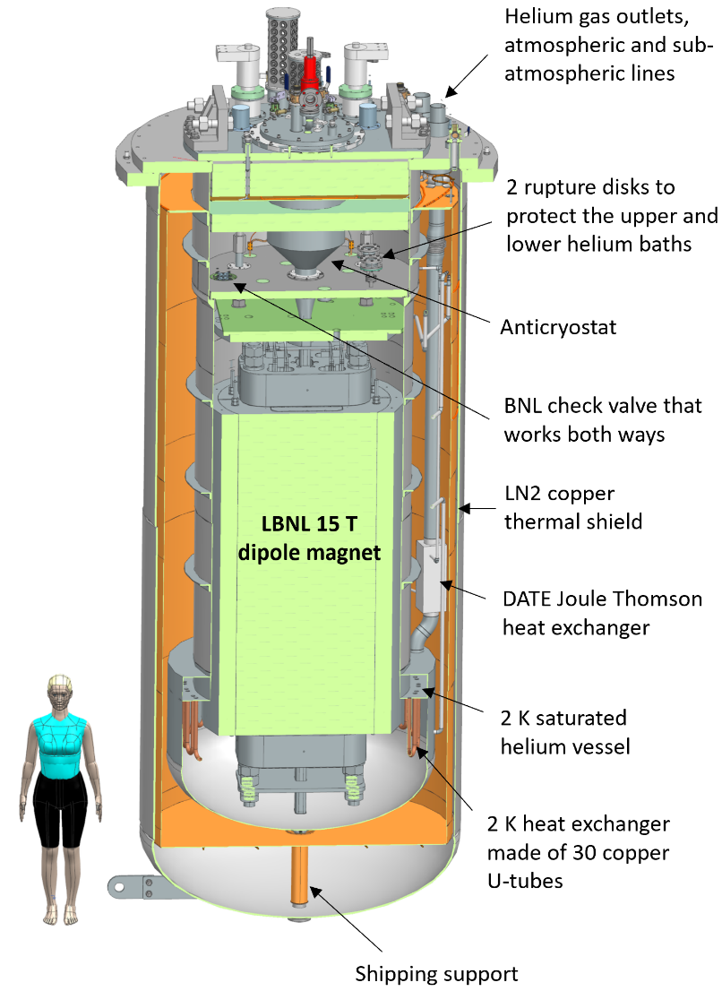
HFVMTF Parameters
Parameter | Value
Background Dipole Field | 15 T
Minimum Operational Temperature | 1.9 K
Maximum Magnet Diameter | 1.3 m
Maximum Magnet Length | 3.0 m
Maximum Stored Energy | 20 MJ
Maximum Weight | 20 t
Test Sample Temperature | 4.5-50.0 K
Max. Test Sample Current (direct) | 16 kA
Max. Test Sample Current (transformer) | 100 kA
Reference: G. Velev et al., “Status of the High Field Cable Test Facility at Fermilab”, ASC 2022

Slide 5
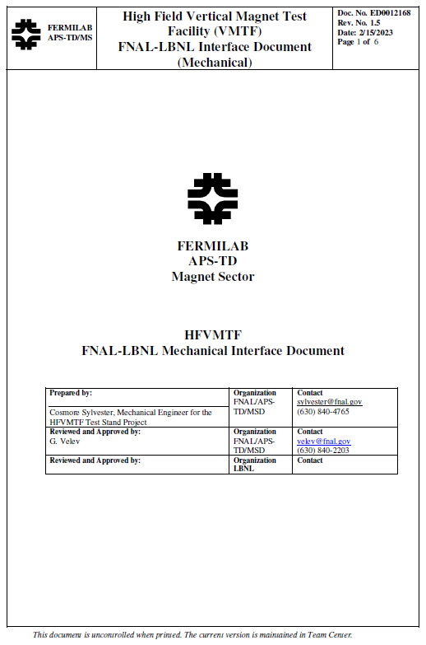
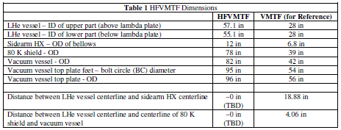
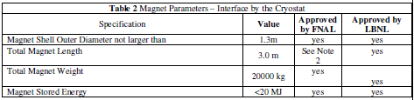
FNAL-LBNL Interface Document
Interface document to record agreed upon parameters and capture additional details or changes. Some examples:
  Coil length finalized in August 2022 – about 10% reduction in total magnet length and weight
  Quench protection system: Energy extraction is sufficient, may be couple with CLIQ for redundancy
Evolve in a formal agreement as both magnet and facility design are finalized

Slide 6
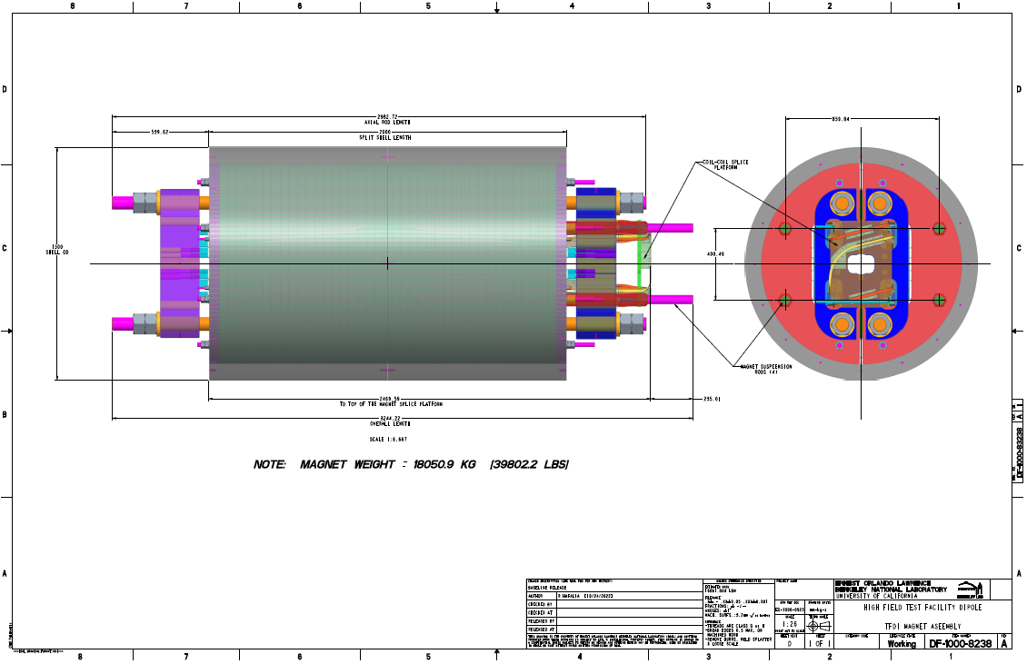
Reference Assembly Drawing for HFVMTF
Detailed CAD model provided to FNAL for magnet integration in HFVMTF
R. Hafalia, LBNL

Slide 7
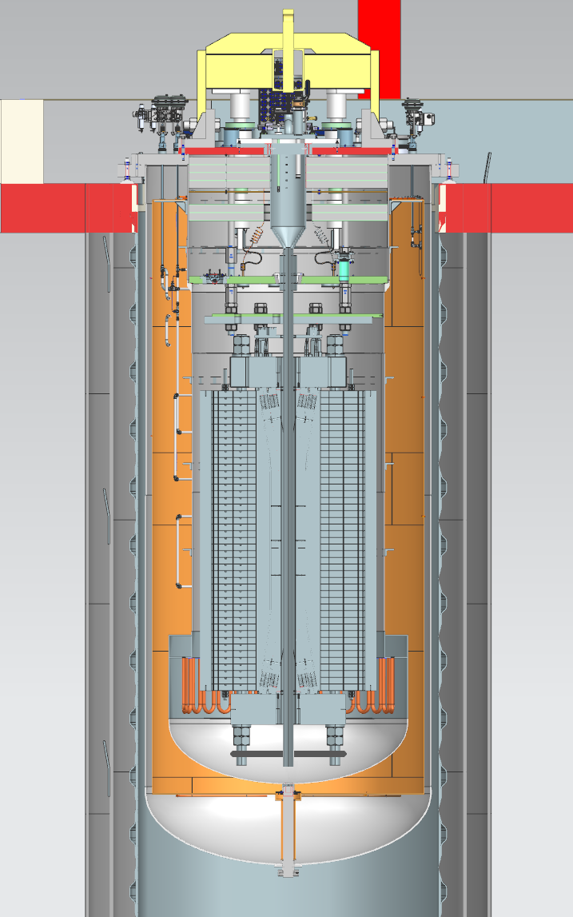
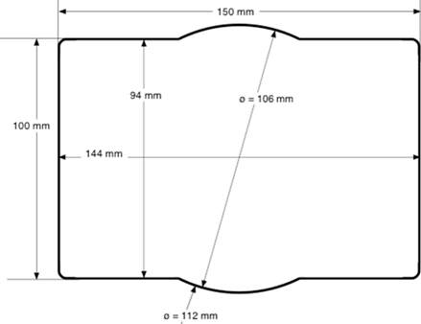
Magnet Integration in HFVMTF
Reference: HFVMTF Cable Test Facility User Workshop, Fermilab, Nov. 21-22, 2022 https://indico.fnal.gov/event/57027/
Design of cryogenic, powering and diagnostics systems is complete and procurements have started
  Provisions were made to limit off-centering forces due to fringe field interacting with external magnetic elements
Design of sample holder(s) and anti-cryostat are still in the conceptual stage, and require feedback from users
  TFD bore geometry is based on EDIPO and FRESCA2
R. Bruce, S. Koshelev,
V. Nikolic, T. Tope, G. Velev et al. (FNAL)

Slide 8
TFD Cool-down Test in HFVMTF
Magnet development objectives:
  Perform/demonstrate magnet assembly steps in particular shell-yoke sub-assembly, magnet loading, strain gauge installation/wiring
  Perform/demonstrate handling of assembled magnet and shipping to FNAL
  Confirm mechanical analysis in particular shell and coil stress from warm to cold
Test facility objectives:
  Perform/demonstrate magnet receiving, connection to header, installation in cryostat
  Partial cryogenic operation
  Instrumentation (strain gauges): electrical connection, DAQ, data reduction, formatting, and transfer to LBNL
Requirements:
  Cool-down to ~77K
  Read shell and dummy coil strain gauges during cool-down and warm up
  Maximum temperature difference top to bottom: 50K

Slide 9
First TFD Cold Test in HFVMTF
Magnet development objectives:
  Quench performance with moderate preload, basis for optimization in second assembly cycle
Test facility objectives:
  First magnet test in new facility: installation and wiring, performance of all systems cryogenics, powering, protection, DAQ
Requirements:
  Instrumentation/diagnostics: 40 VT, 6 SG stations; quench antenna if anti-cryostat is installed
  Pre-test: hi-pots, system-triggered quenches at low-medium current to check protection system performance, quench integral vs expectations, etc.
  Anti-cryostat/sample holder installed if determined by FNAL
  Quench protection: CLIQ system may be installed pending review of extraction system redundancy. If CLIQ is used, AUP unit is adequate.
  Assume 15 training quenches
  After training: ramp rate dependence and temperature dependence (1-2 quenches at 4.5K, pending analysis); splice resistance measurements
  Thermal cycle depending on results

Slide 10
Second TFD Cold Test in HFVMTF
Magnet development objectives:
  Demonstrate target field and minimum/no retraining (max 1-2 quenches) after TC with final preload and coil configuration
Test facility objectives:
  Implement/demonstrate final configuration for cable testing (quench protection, anti-cryostat/sample holder installation and mechanical support etc.)
Requirements:
  Final protection configuration, either CLIQ (w/dedicated unit) or redundant dump
  Assume 15 training quenches
  Ramp rate and temperature dependence (1-2 quenches at 4.5K)
  One thermal cycle with 2-3 quenches
  Instrumentation/diagnostics: 40 VT, 6 SG stations, quench antenna

Slide 11
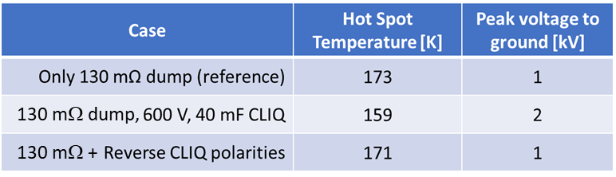
Quench Protection - Reference Case
Protection analysis and parameters:
Magnet design and quench conditions
  Magnetic length: 1.7 m
  Field and current: 16 T, 15.5 kA
  Stored energy: 12 MJ
  Inductance : 97.2 mH (57.2 mH/m)
Voltage limit: ±1 kV (symmetric ground)
  Dump resistor: 130 mΩ (2 kV)
CLIQ parameters: 40 mF, 600 V (AUP)
No Quench Heaters
Detection + validation time: 15 ms
Conductor parameters:
  RRR=100, Copper fraction: 0.8
  Twist pitch 14 mm
  Transposition length: 109 mm
  Matrix cross resistance: 10 µΩ
Main results:
Energy extraction is sufficient to provide a safe discharge
Hot-spot temperature 173K
Need fully redundant extraction system, or a second system
Baseline plan is to include CLIQ together with extraction
We maintain the same voltage limit of ±1 kV
With this constraint, T_{HS} is not improved when adding CLIQ but CLIQ will protect the magnet in case of extraction failure, although T_{HS} is higher (327 K, similar to HiLumi failure cases)
Reference: G. Velev et al., “Design and Construction of a High Field Cable Test Facility at Fermilab”, IEEE TASC Vol. 31/5, August 2021, Art. # 9500304, https://ieeexplore.ieee.org/document/9390336

Slide 12
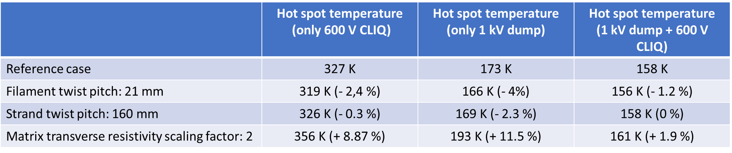
Quench Protection - Sensitivity Analysis
Parameter | Unit | Ref. Analysis | Range studied | Spec | Notes
Copper ratio |  | 0.8 | 0.8-1.2 | 0.9 | T_{HS} about 30-40 K lower for Cu/NCu=1.2 vs 0.8
Detection time | ms | 15 | 15-45 | 15 | T_{HS} about 25-30 K higher for 45 ms
R_{dump} | μΩ | 150 | 75-150 | 150 | Half voltage but T_{HS} may increase up to 50-100K
CLIQ Voltage | V | 600 | 300-1000 | 600 | 300 V insufficient. 1000 V performance is equivalent to dump but increases voltage and requires a special unit
Twist pitch | mm | 14 | 14-21 | 19 ± 3 | Slight improvement in T_{HS} for longer twist pitch
Transp. length | mm | 109 | 109-160 | 155 | Slight improvement in T_{HS} for increased transp. length
RRR |  | 100 | 100-200 | >100 | T_{HS} ~20 K lower for RRR 300 vs.100 (HEPdipo study)
Transv. Res. | µΩ | 10 | 10-20 | 10 | No significant effect for combined dump + CLIQ. 20-30K increase of T_{HS} for dump only or CLIQ only
V. Marinozzi, FNAL

Slide 13
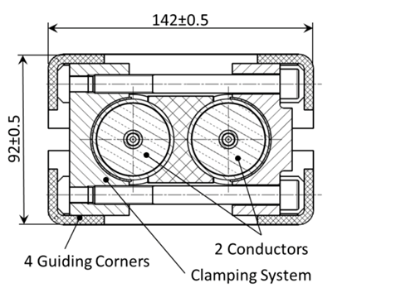
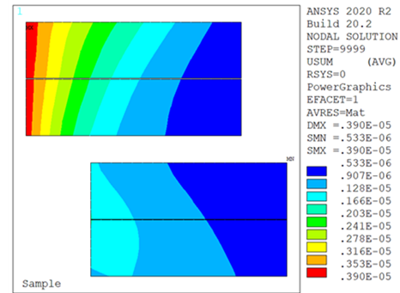
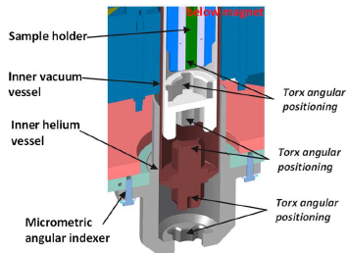
Sample Holder Mechanical Interface
Main open question from the magnet design standpoint is the degree of support that might need to be provided to the sample holder from the magnet structure
  SULTAN/EDIPO sample holder can go in contact with the test well – however this approach has limited applicability to TFD/HFVMT (magnet cooling by LHe bath vs. CICC, and desired temperature range up to 50K)
  FRESCA2 sample holder is housed in an anti-cryostat supported at the top and bottom – however maximum E.M. torque is limited to 5 kNm: rotation <2° w.r.t. magnetic axis
Preliminary analysis shows that in principle the TFD bore can provide support with minimal effect on coil displacements or stress
  However, it is difficult to predict how quench performance might be affected
SULTAN/EDIPO sample holder
FRESCA2 “anti-rotation” device
TFD preliminary analysis

Slide 14
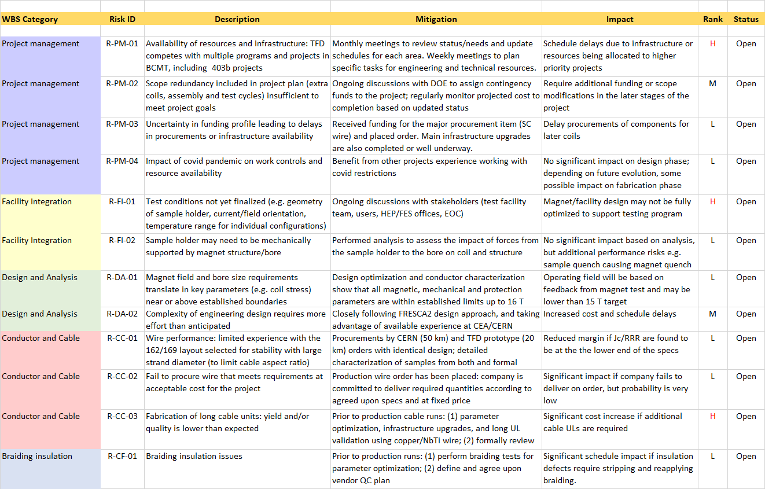
Risk Register (1/2)

Slide 15
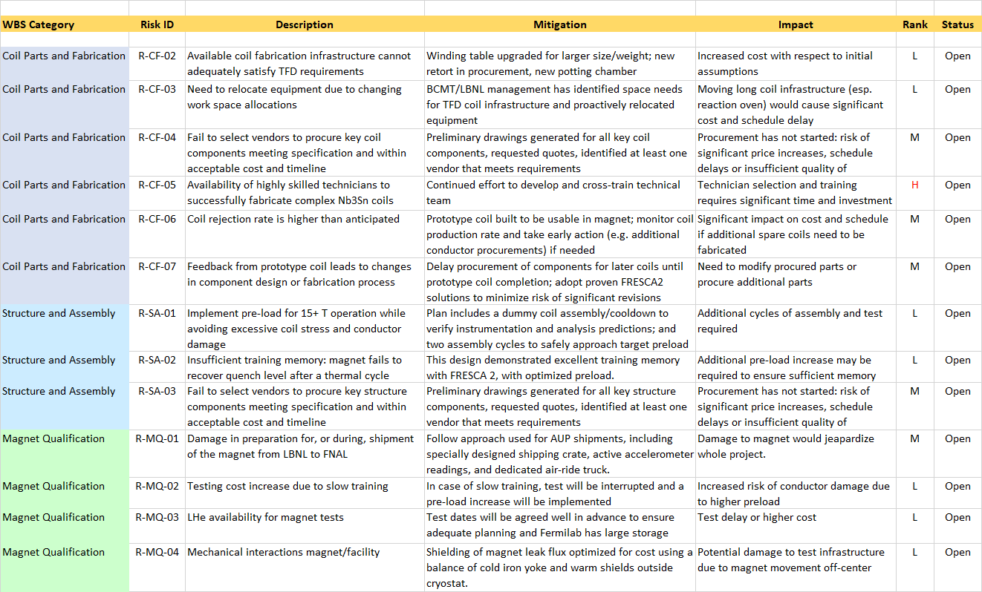
Risk Register (2/2)

Slide 16
Risk Analysis (1/3)
WBS Category | Risk ID | Description | Mitigation | Impact | Rank
Design and Analysis | R-DA-01 | Magnet field and bore size requirements translate in key parameters (e.g. coil stress) near or above established boundaries | Design optimization and conductor characterization show that all magnetic, mechanical and protection parameters are within established limits up to 16 T | Operating field will be based on feedback from magnet test and may be lower than 15 T target | L
Design and Analysis | R-DA-02 | Complexity of engineering design requires more effort than anticipated | Closely following FRESCA2 design approach, and taking advantage of available experience at CEA/CERN | Increased cost and schedule delays | M
Conductor and Cable | R-CC-01 | Wire performance: limited experience with the 162/169 layout selected for stability with large strand diameter (to limit cable aspect ratio) | Procurements by CERN (50 km) and TFD prototype (20 km) orders with identical design; detailed characterization of samples from both and formal review (WSR). | Reduced margin if Jc/RRR are found to be at the the lower end of the specs | L
Conductor and Cable | R-CC-03 | Fabrication of long cable units: yield and/or quality is lower than expected | Prior to production cable runs: (1) parameter optimization, infrastructure upgrades, and long UL validation using copper/NbTi wire; (2) formally review results | Significant cost increase if additional cable ULs are required | H

Slide 17
Risk Analysis (2/3)
WBS Category | Risk ID | Description | Mitigation | Impact | Rank
Coil Parts and Fabrication | R-CF-04 and R-SA-03 | Fail to select vendors to procure key coil/structure components meeting specification and within acceptable cost and timeline | Preliminary drawings generated for all key components, requested quotes, identified at least one vendor that meets requirements | Procurement has not started: risk of significant price increases, schedule delays or insufficient quality of components | M
Coil Parts and Fabrication | R-CF-05 | Availability of highly skilled technicians to successfully fabricate complex Nb3Sn coils | Continued effort to develop and cross-train technical team | Technician selection and training requires significant time and investment | H
Coil Parts and Fabrication | R-CF-07 | Feedback from prototype coil leads to changes in component design or fabrication process | Delay procurement of components for later coils until prototype coil completion; adopt proven FRESCA2 solutions to minimize risk of significant revisions | Need to modify procured parts or procure additional parts | M
Structure and Assembly | R-SA-01 | Implement pre-load for 15+ T operation while avoiding excessive coil stress and conductor damage | Plan includes a dummy coil assembly/cooldown to verify instrumentation and analysis predictions; and two assembly cycles to safely approach target preload | Additional cycles of assembly and test required | L

Slide 18
Risk Analysis (3/3)
WBS Category | Risk ID | Description | Mitigation | Impact | Rank
Project Management | R-PM-02 | Scope redundancy included in project plan (extra coils, assembly and test cycles) insufficient to meet project goals | Ongoing discussions with DOE to assign contingency funds to the project; regularly monitor projected cost to completion based on updated status | Require additional funding or scope modifications in the later stages of the project | M
Facility Integration | R-FI-01 | Test conditions not yet finalized (e.g. geometry of sample holder, current/field orientation, temperature range for individual configurations) | Ongoing discussions with stakeholders (test facility team, users, HEP/FES offices, EOC) | Magnet/facility design may not be fully optimized to support testing program | H
Facility Integration | R-FI-02 | Sample holder may need to be mechanically supported by magnet structure/bore | Performed analysis to assess the impact of forces from the sample holder to the bore on coil and structure | No significant impact based on analysis, but additional performance risks e.g. sample quench causing magnet quench | L
Magnet Qualification | R-MQ-01 | Damage in preparation for, or during, shipment of the magnet from LBNL to FNAL | Follow approach used for AUP shipments, including specially designed shipping crate, active accelerometer readings, and dedicated air-ride truck. | Damage to magnet would jeapardize whole project. | M
Magnet Qualification | R-MQ-04 | Mechanical interactions magnet/facility | Shielding of magnet leak flux optimized for cost using a balance of cold iron yoke and warm shields outside cryostat. | Potential damage to test infrastructure due to magnet movement off-center | L

Slide 19
Summary
Magnet performance targets and design constraints have been defined based on user input and in agreement with the Fermilab test facility team
Interfaces are being tracked and will evolve in formal documents as the designs of magnet and facility are finalized
Several planned intermediate tests will allow to verify key aspects of the installation and operation in HFVMTF prior to final installation
Main magnet features and specifications have been defined taking into account previous studies (e.g. HEPdipo) and further analysis for TFD
A risk register has been compiled to better capture and track information from project plan and feedback from reviews, IPT and EOC meetings
Main concerns are in the areas of resource/infrastructure availability for engineering design and fabrication, and full definition of the sample test configurations and their possible implications on the magnet design

