Slide 1
Preliminary quench protection study of the 20 T costheta
V. Marinozzi
2-21-2023

Slide 2
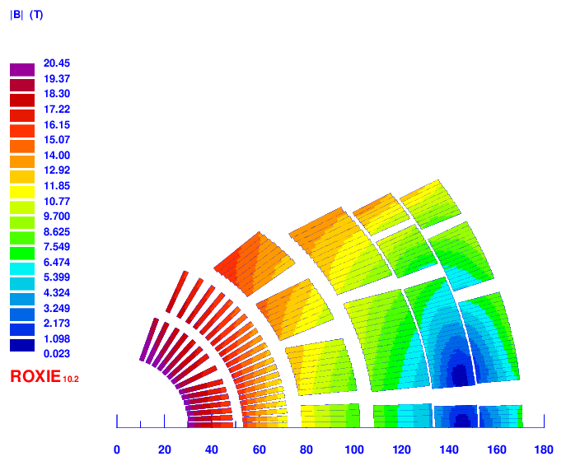
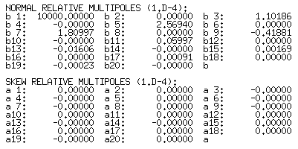
Design recap (v26)
2 layer HTS, 4 layer LTS
Strands: 0.9 – 1.1 – 0.8 mm, 36 – 40 – 40
Cable width: 18.59 – 24.38 – 17.73 mm
Stabilizer/Superconductor: 3 – 1 – 1.2
Coil width: 138 mm
Current: 13500
Peak field: 20.45 – 15.95 – 13.6 T
Margin: 87 – 84 – 83 %
J_{cu} on LTS: 1230 A/mm²

Slide 3
Assumptions
Simulations done with STEAM-LEDET
20 T current (13500 A)
1 m long magnet
1 kV dump resistor (500 V to ground): 74 mΩ
HiLumi CLIQ unit (1 kV, 40 mF)
No QH

Slide 4
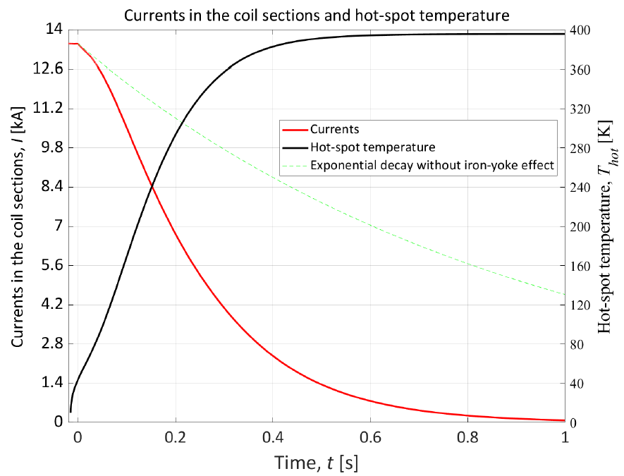
Only dump
HST: 395 K
MIITs: 29.5 MA²s
Peak voltage to ground: 550 V

Slide 5
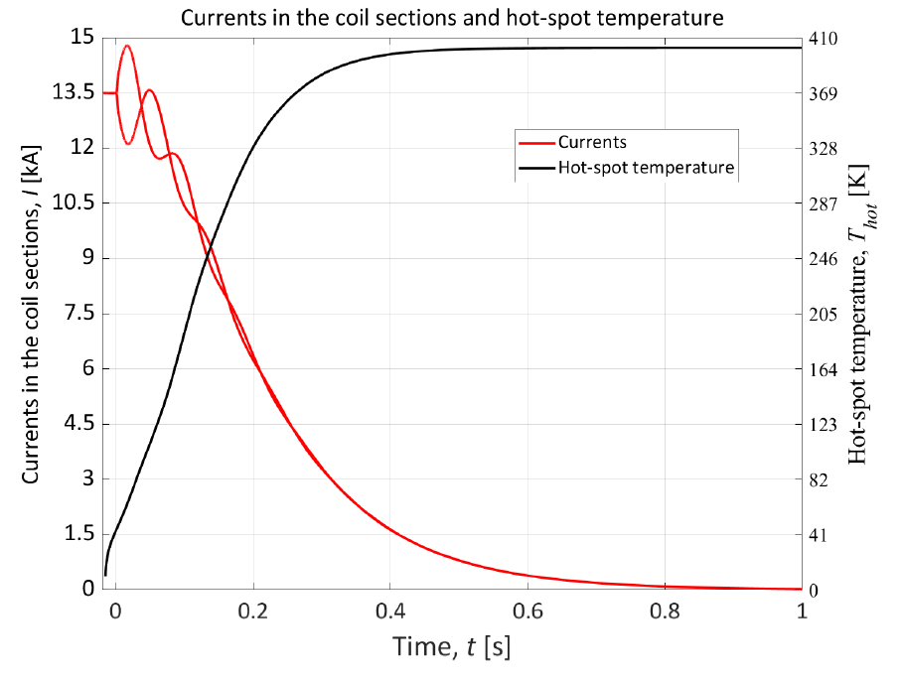
Only CLIQ (not optimized)
HST: 402 K
MIITs: 29.7 MA²s
Peak voltage to ground: 600 V

Slide 6
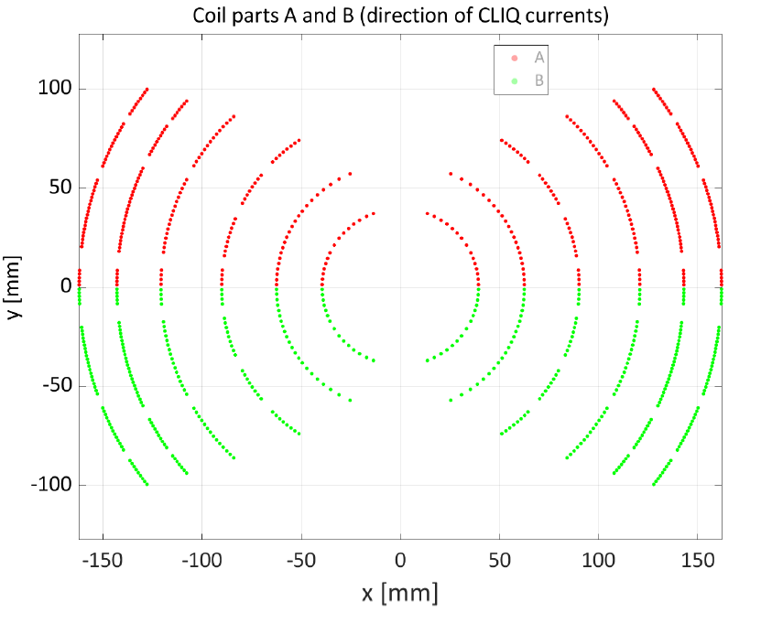
CLIQ current distribution

Slide 7
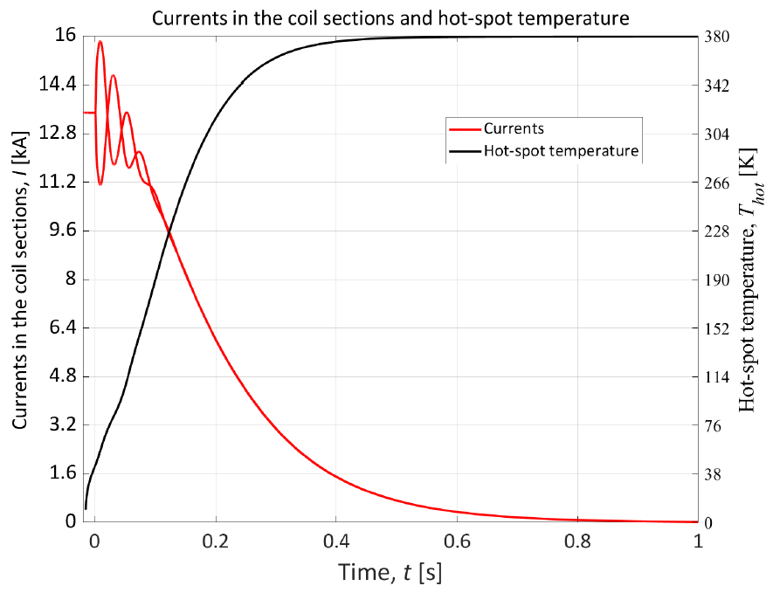
Only CLIQ (optimized)
HST: 379 K
MIITs: 28.7 MA²s
Peak voltage to ground: 600 V

Slide 8
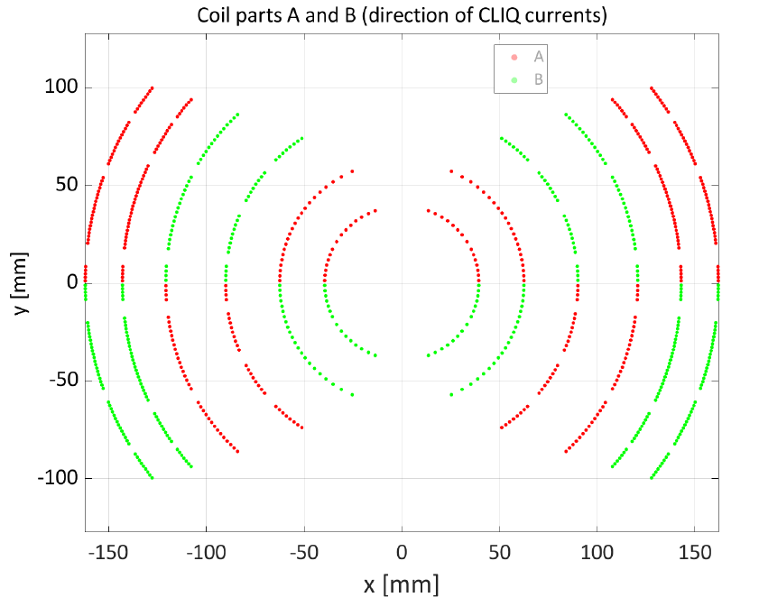
CLIQ current distribution

Slide 9
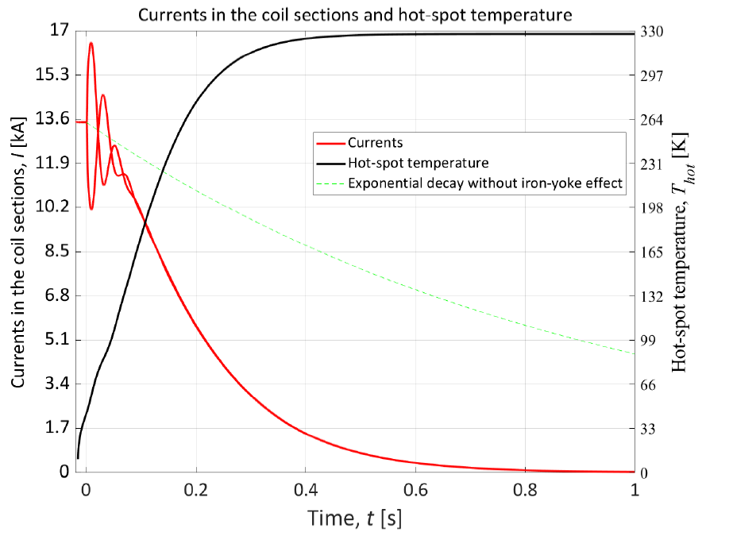
CLIQ plus dump (optimized)
HST: 328 K
MIITs: 26.5 MA²s
Peak voltage to ground: 1200 V

Slide 10
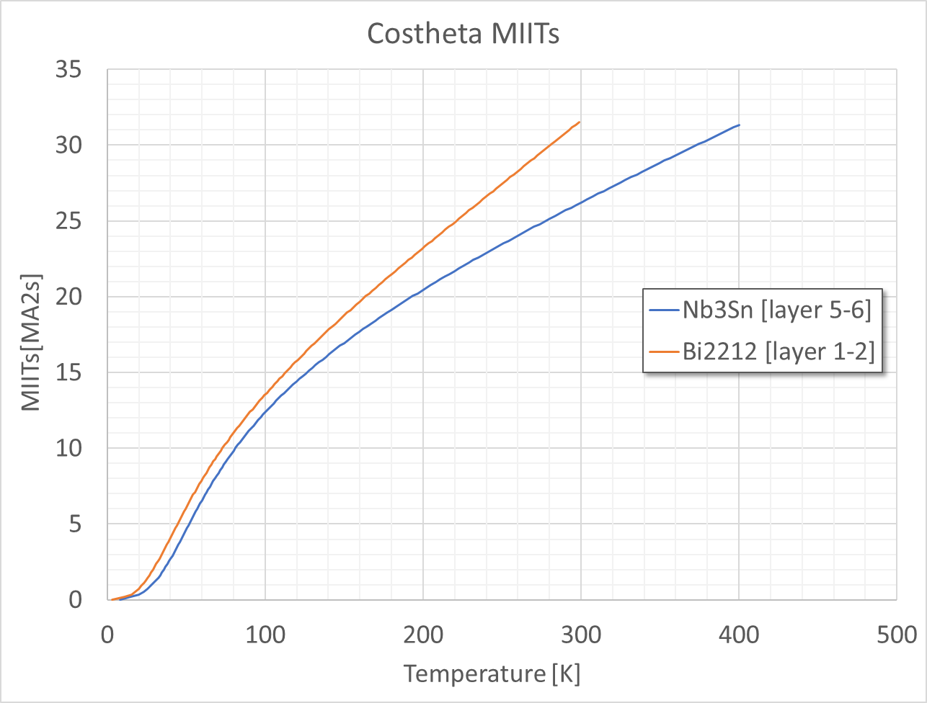
MIITs?
Matpro less conservative?

Slide 11
Conclusions
Challenging protection
Short model can ideally be protected with CLIQ and dump
Quench heaters analysis to be done
CLIQ optimization
Now HiLumi one only as a reference

