Slide 1
Uni-layer magnets
J. L. Rudeiros Fernandez, P. Ferracin

Slide 2
Table of contents
01
Two special cases of a system of infinitely long current lines
02
Uni-layer magnets
03
Discussion
04
Conclusions
J. L. Rudeiros Fernandez et al.

Slide 3
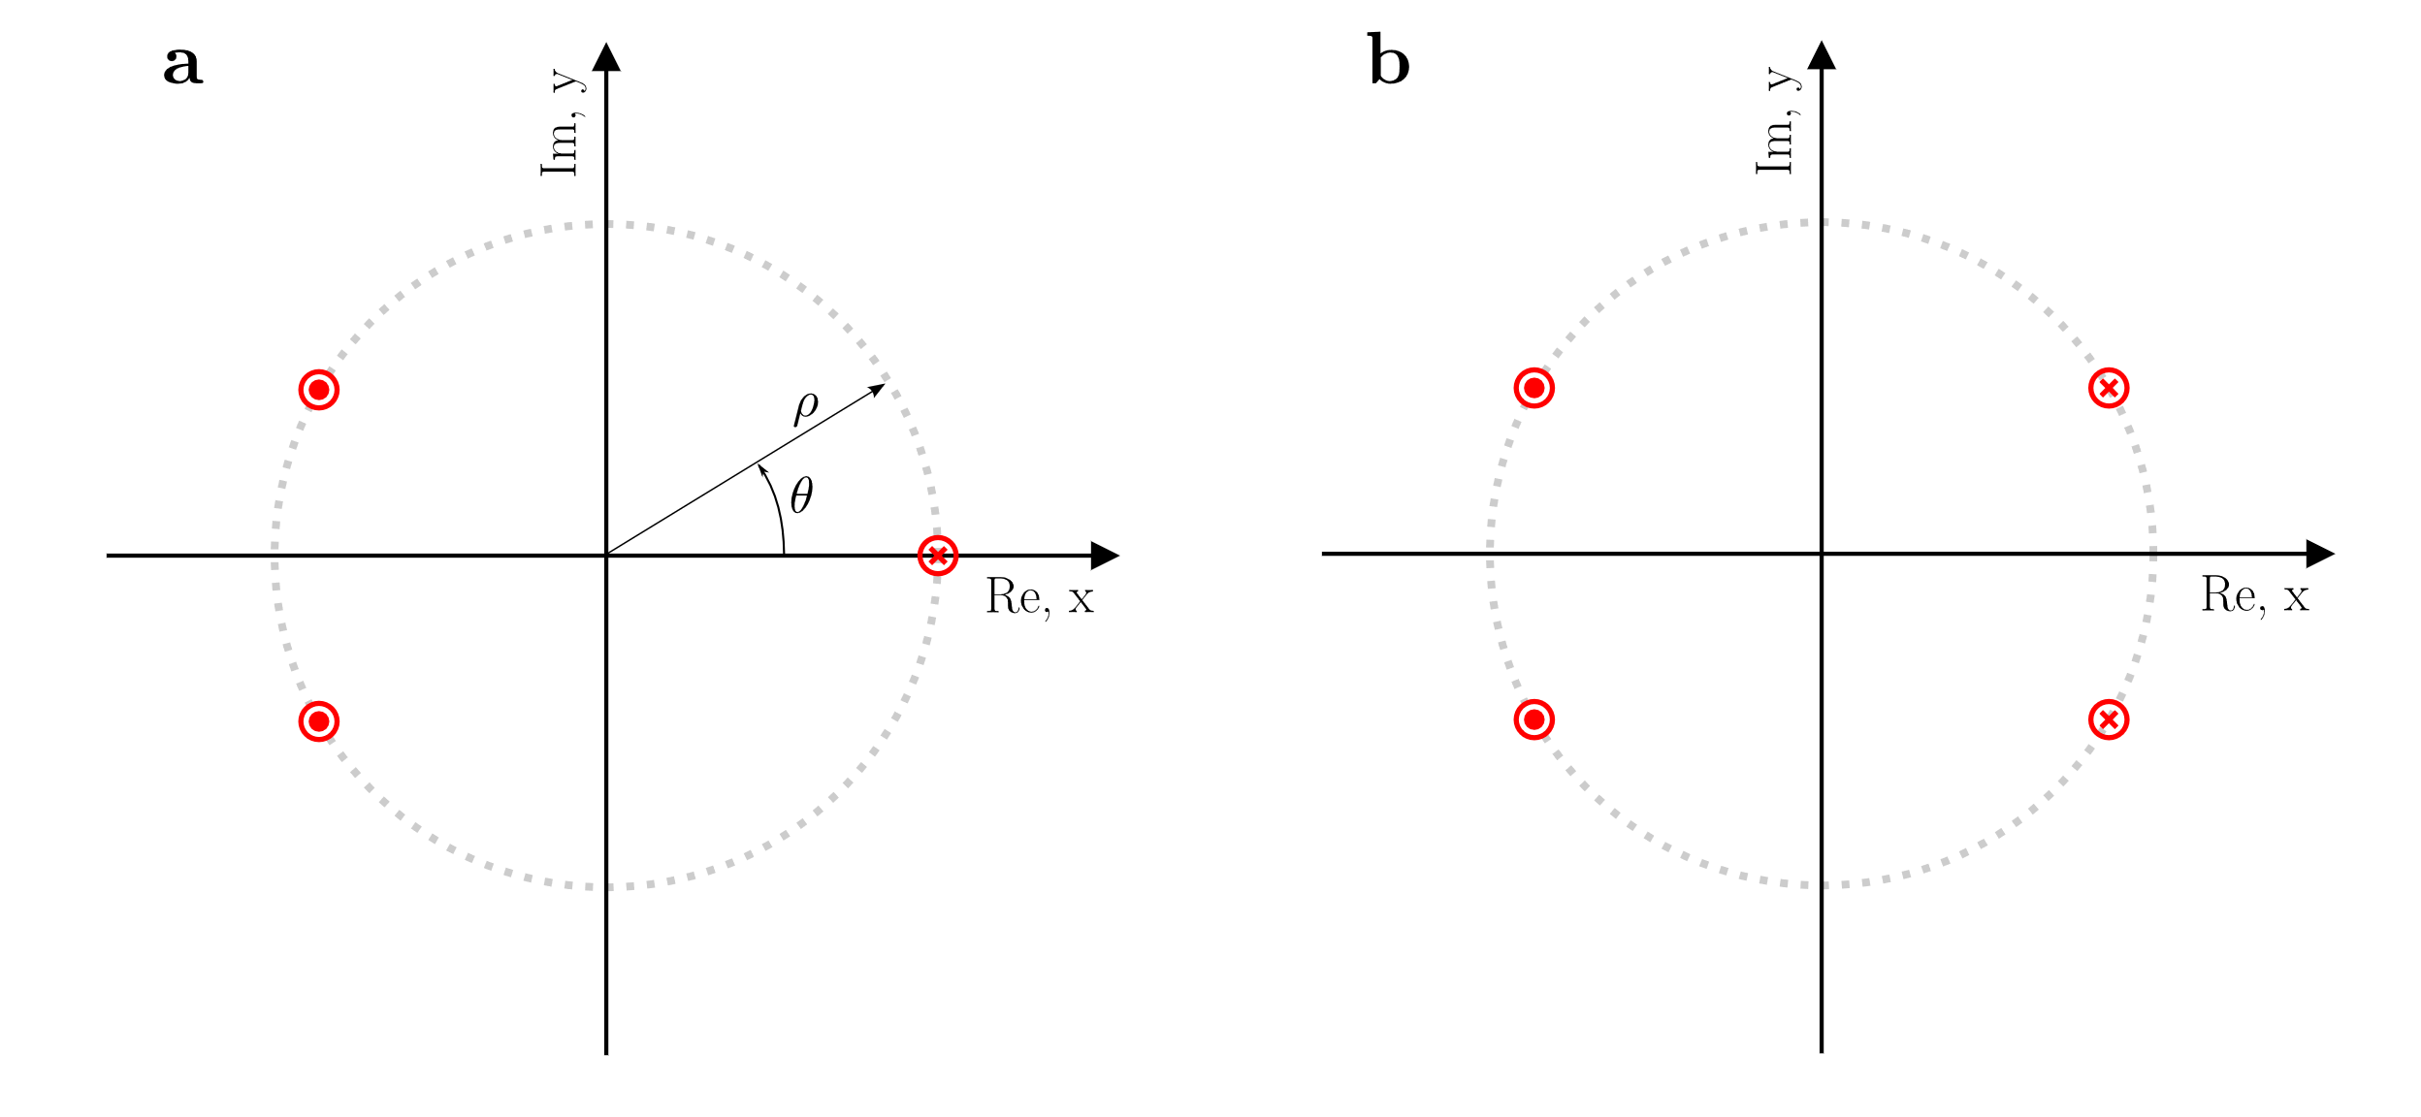
1. Two special cases of a system of infinitely long current lines
J. L. Rudeiros Fernandez et al.

Slide 4
1. Two special cases of a system of infinitely long current lines
J. L. Rudeiros Fernandez et al.

Slide 5
Table of contents
01
Two special cases of a system of infinitely long current lines
02
Uni-layer magnets
03
Discussion
04
Conclusions
J. L. Rudeiros Fernandez et al.

Slide 6
2. Uni-layer magnets
Definition
An idealized Uni-layer magnet can be defined as a magnet that generates a B field within a straight region of space by a system of current lines, all parallel to the z-axis (along the straight section of the magnet) of a Cartesian coordinate system (i.e. perpendicular to the xy-plane), that lay within a single continuous surface, and that are connected by a single continuous path that does not cross itself.
y
Asymmetric
Symmetric
z
x
J. L. Rudeiros Fernandez et al.

Slide 7
2. Uni-layer magnets
J. L. Rudeiros Fernandez et al.

Slide 8
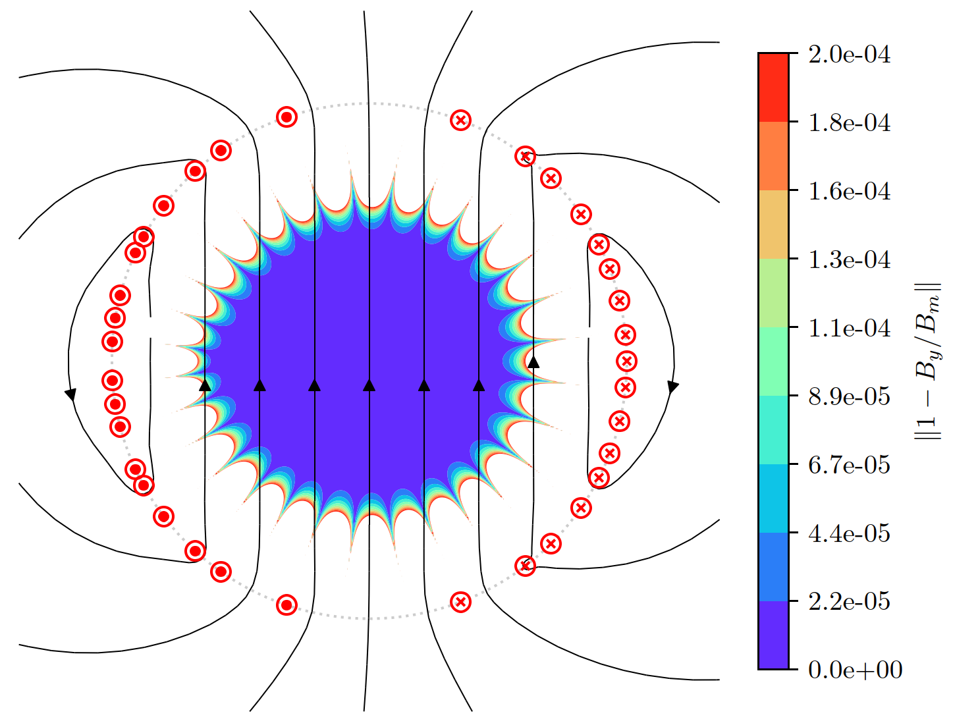
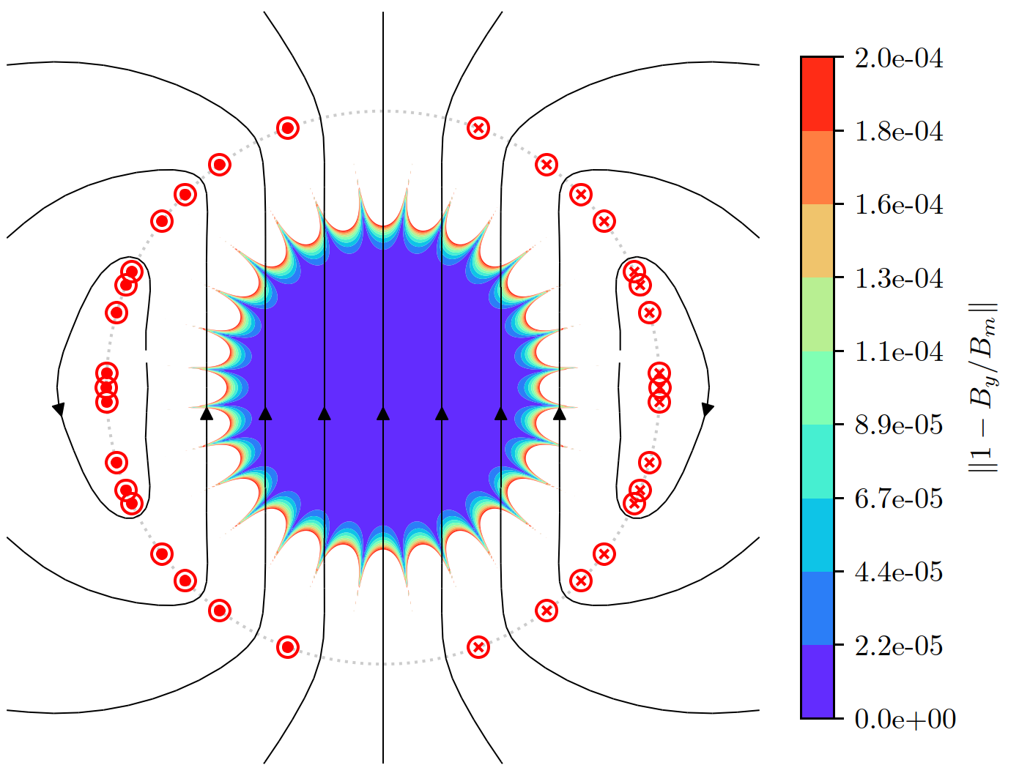
2. Uni-layer magnets
Example asymmetric solution
Example symmetric solution
J. L. Rudeiros Fernandez et al.

Slide 9
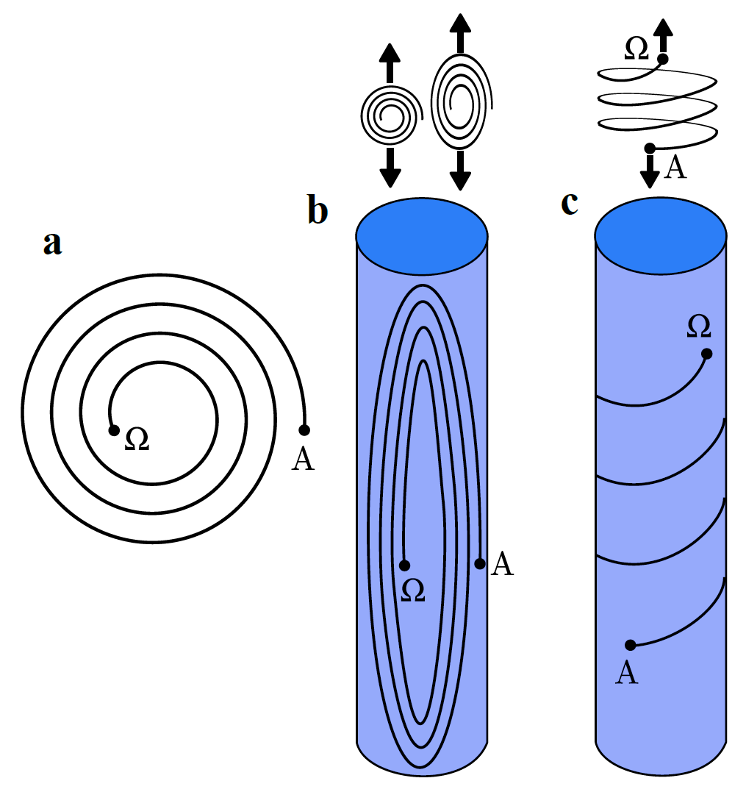
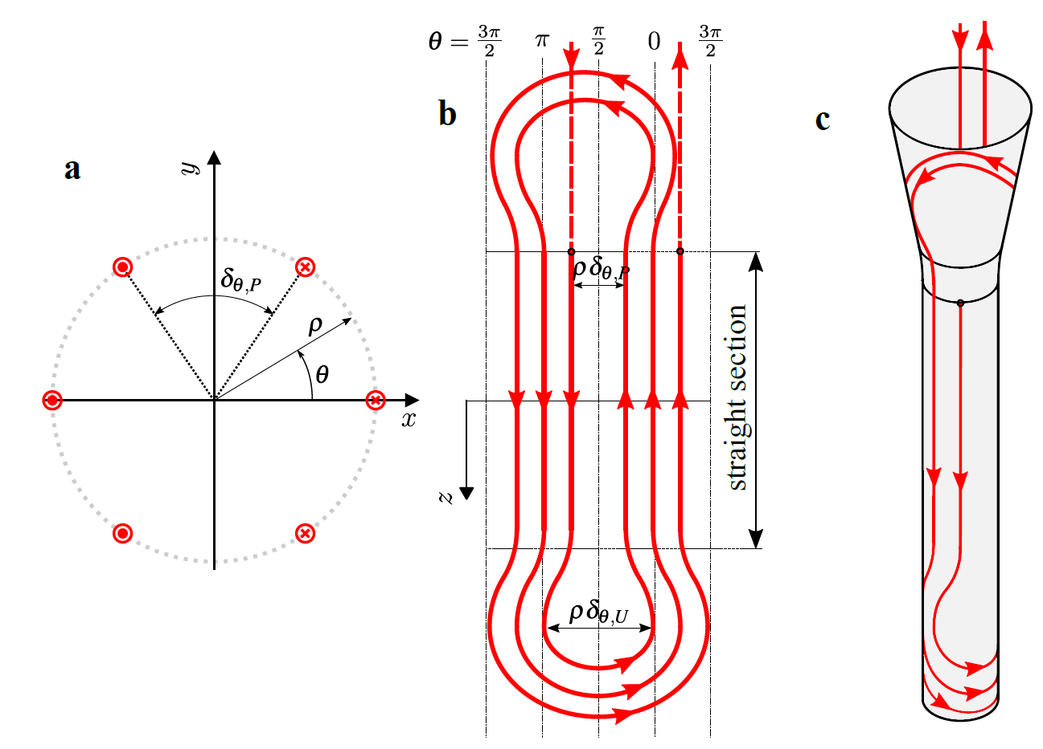
2. Uni-layer magnets
Example symmetric
J. L. Rudeiros Fernandez et al.

Slide 10
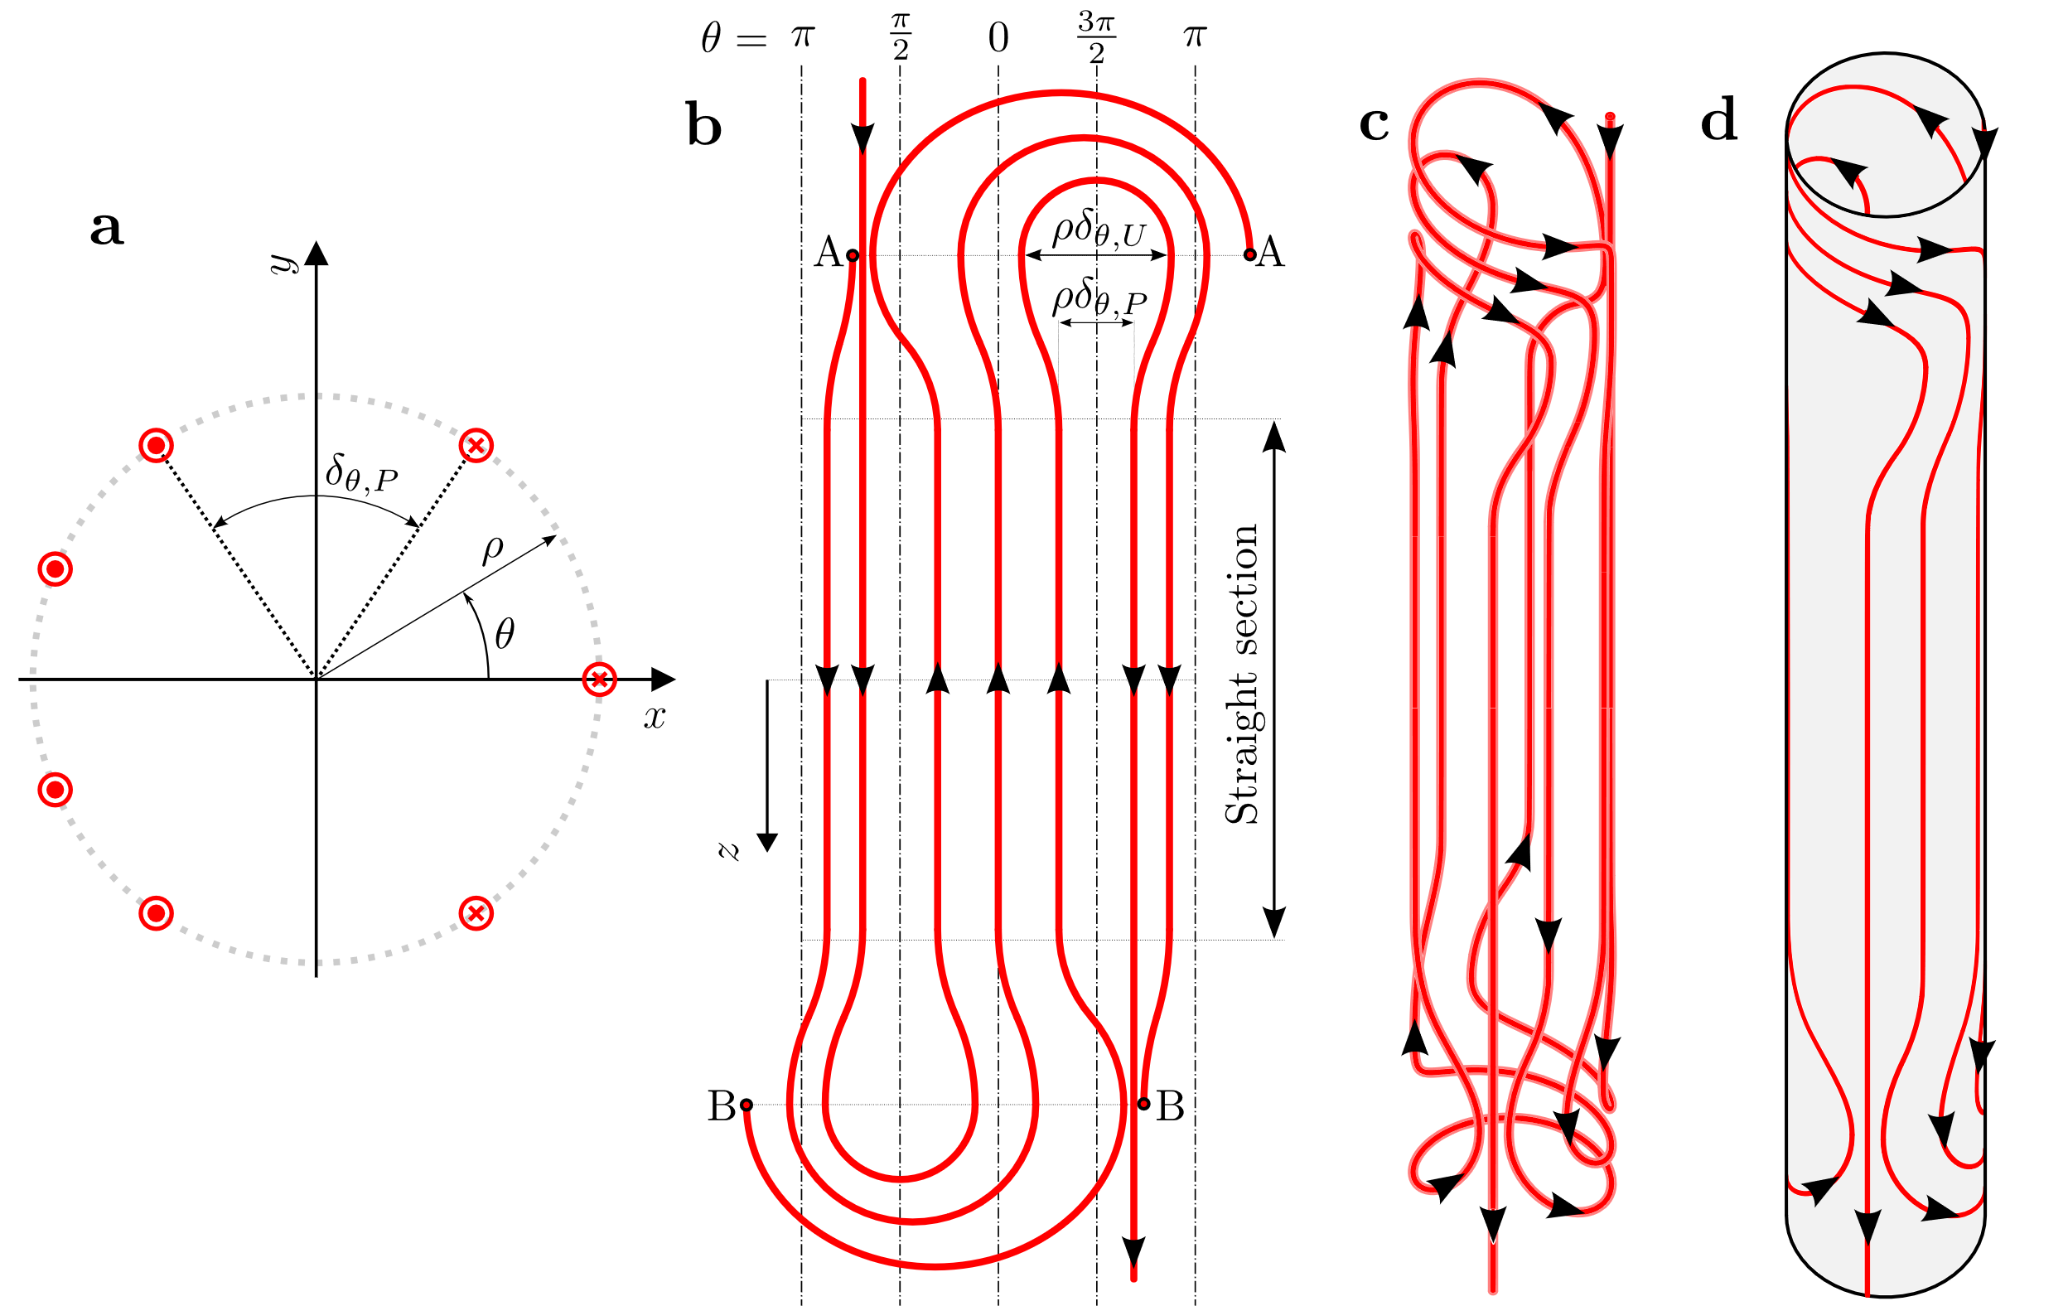
2. Uni-layer magnets – Surface and winding configuration
Asymmetric dipole
schematic winding
J. L. Rudeiros Fernandez et al.

Slide 11
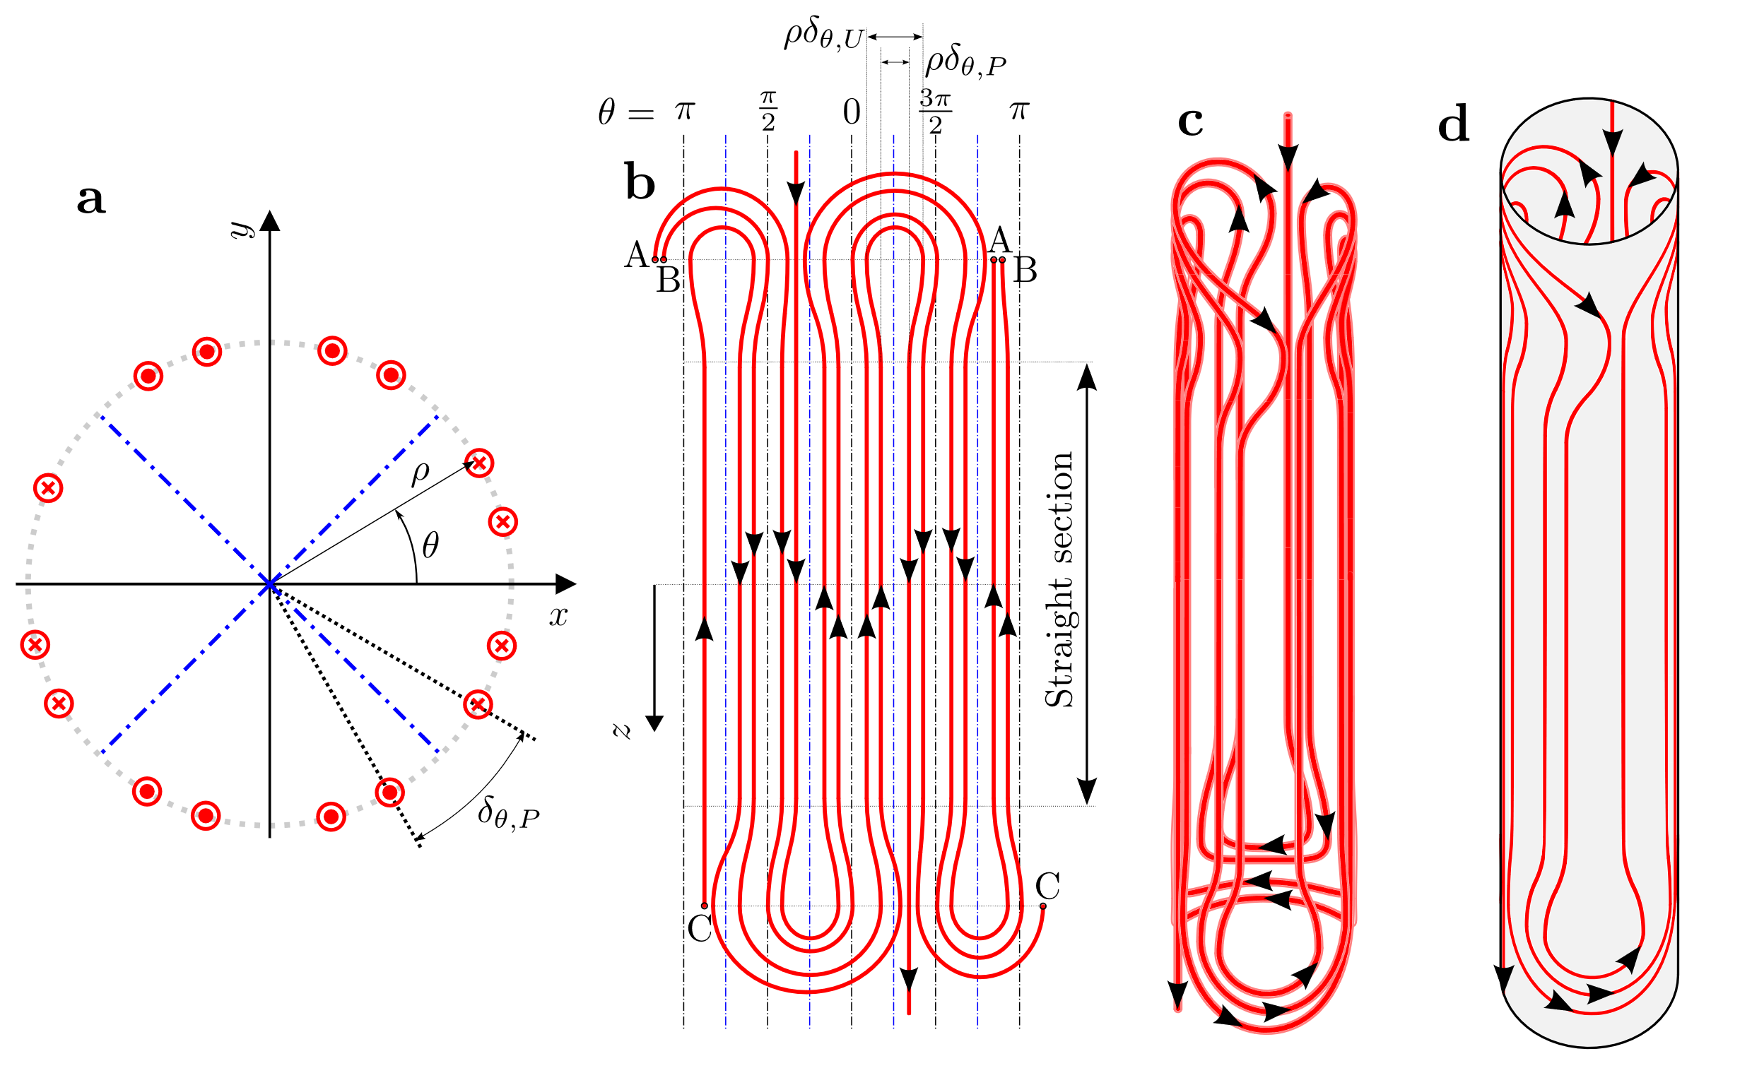
2. Uni-layer magnets – Surface and winding configuration
Asymmetric quadrupole
schematic winding
J. L. Rudeiros Fernandez et al.

Slide 12
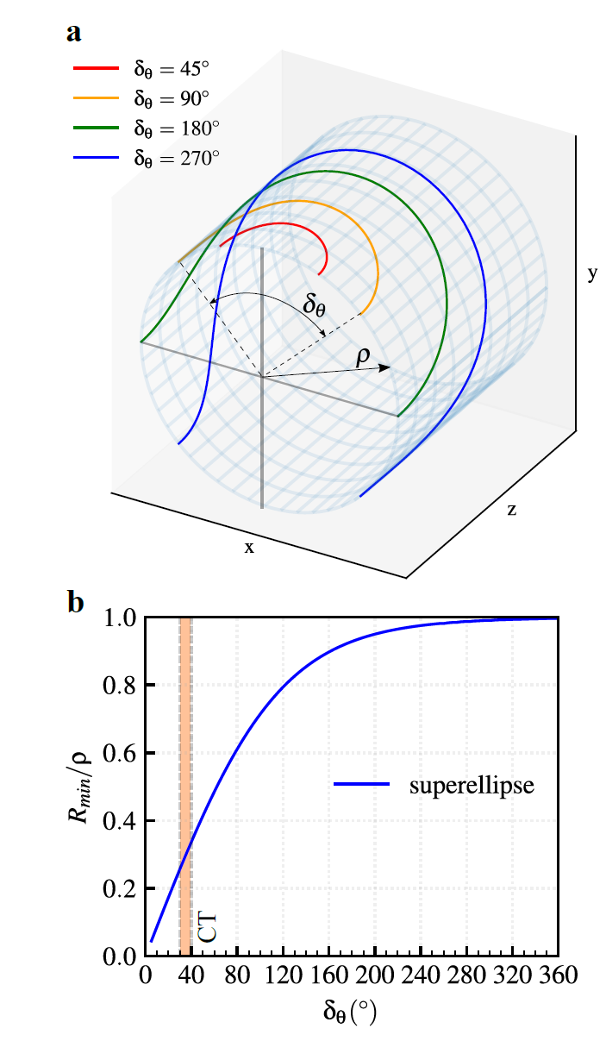
2. Uni-layer magnets – radius of curvature
J. L. Rudeiros Fernandez et al.

Slide 13
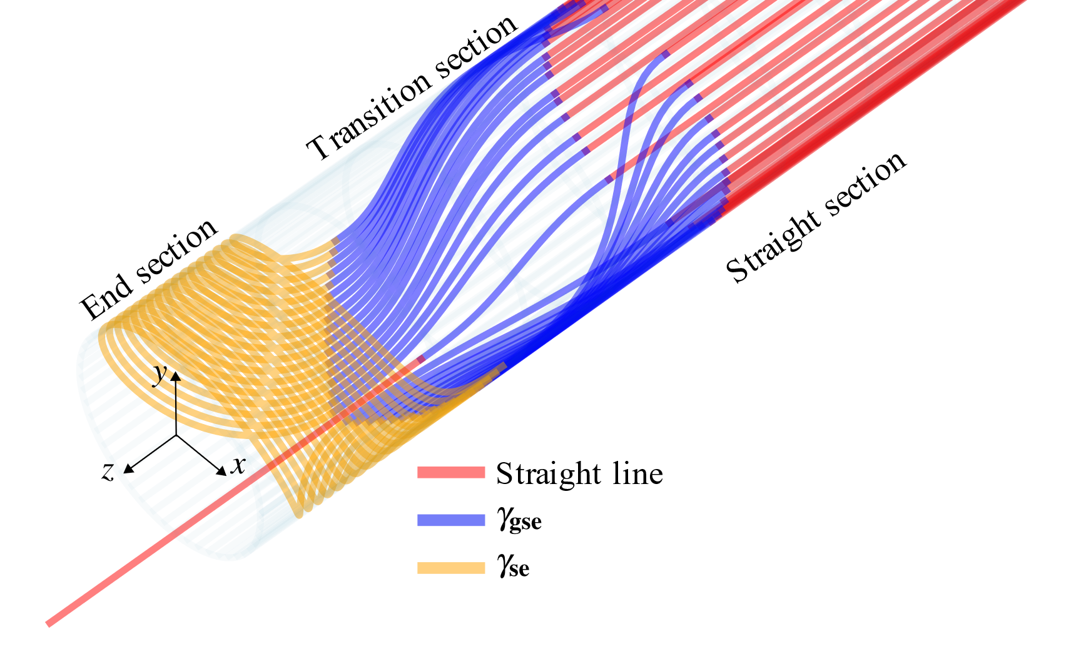
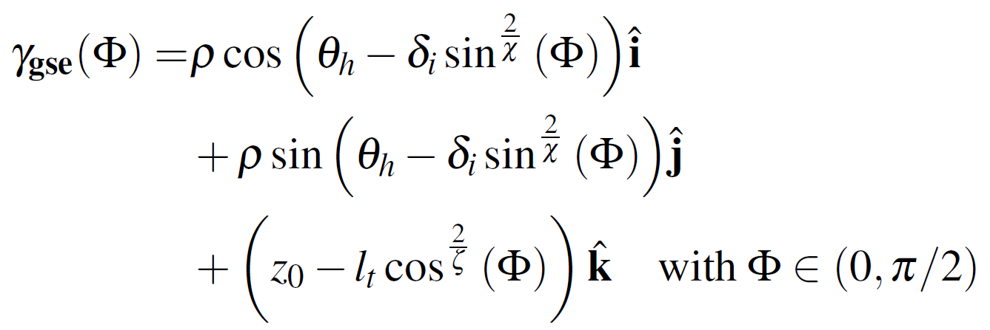
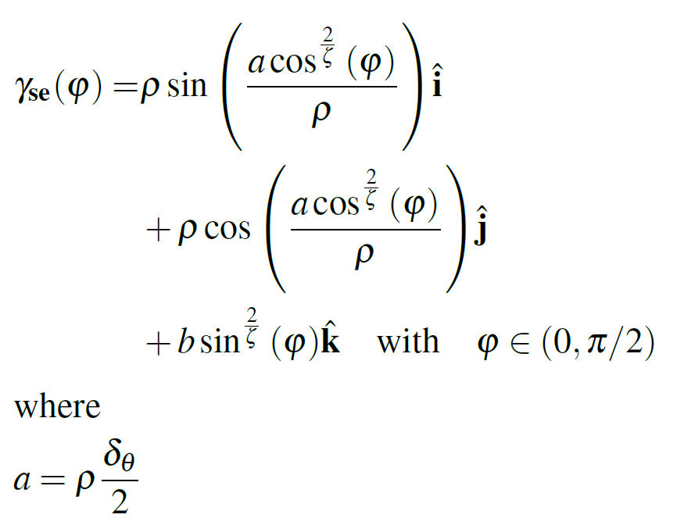
2. Uni-layer magnets – example solutions
J. L. Rudeiros Fernandez et al.

Slide 14
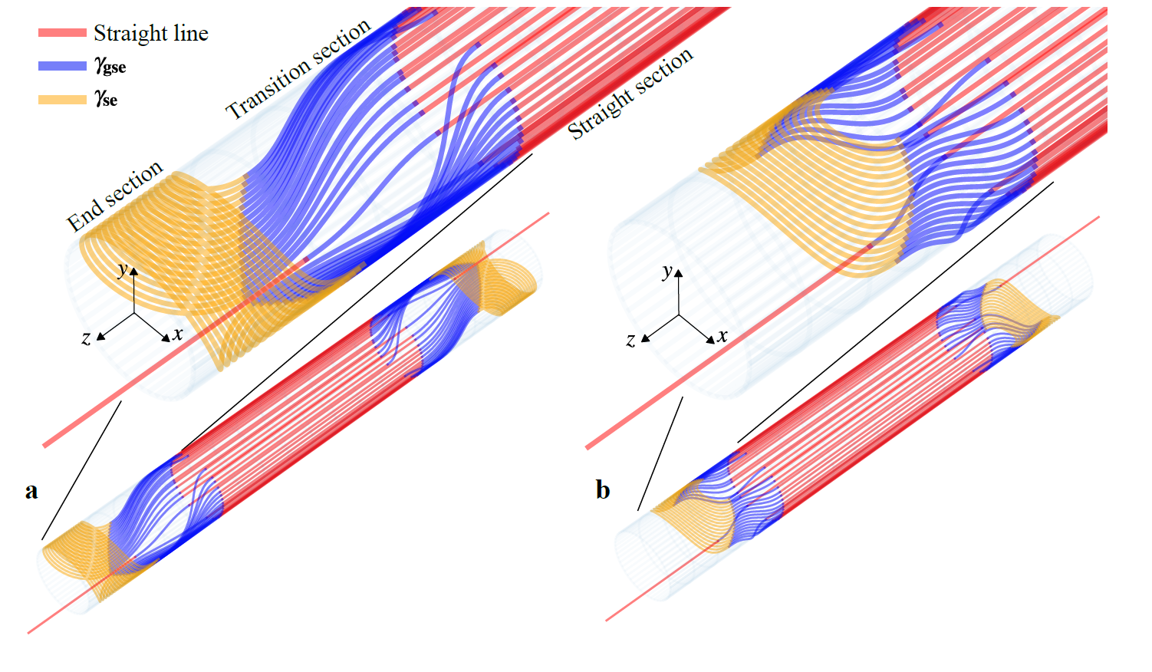
2. Uni-layer magnets – example solutions
J. L. Rudeiros Fernandez et al.

Slide 15
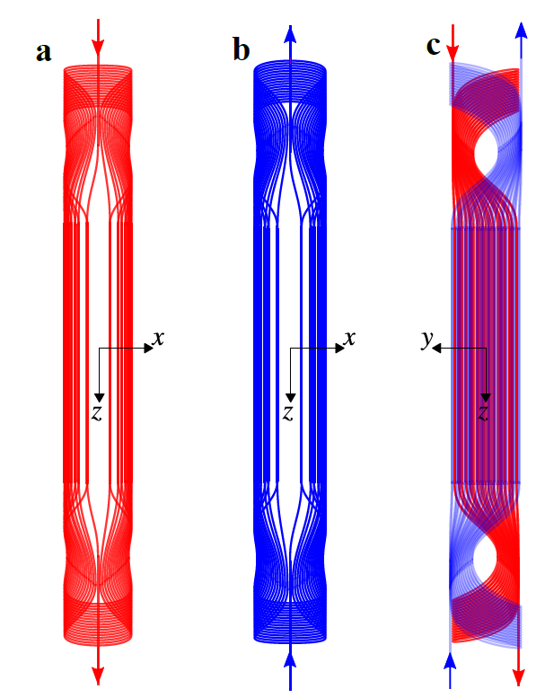
2. Uni-layer magnets – multi-Uni-layer
J. L. Rudeiros Fernandez et al.

Slide 16
Table of contents
01
Two special cases of a system of infinitely long current lines
02
Uni-layer magnets
03
Discussion
04
Conclusions
J. L. Rudeiros Fernandez et al.

Slide 17
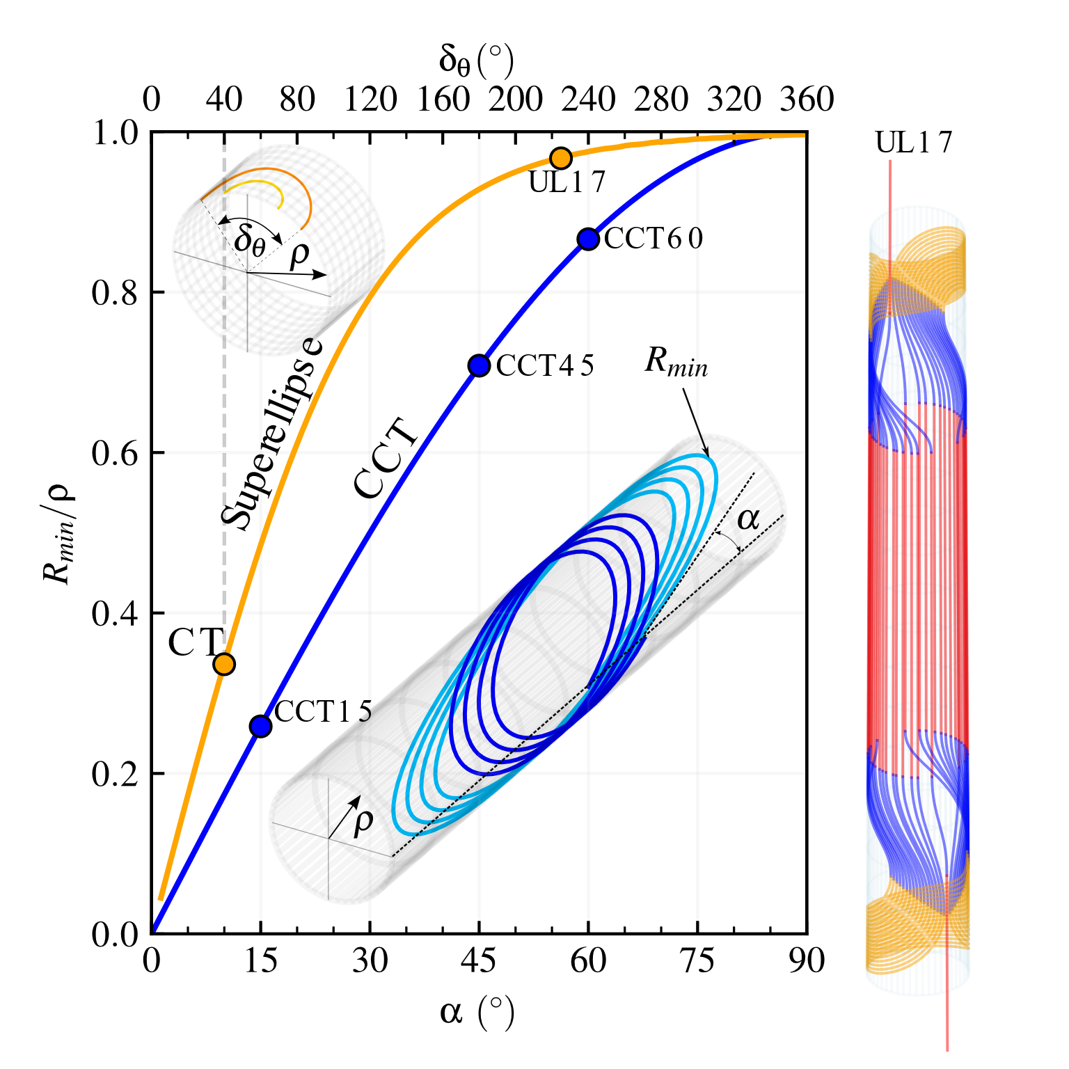
3. Discussion
Same conductor.
Same length of the conductor.
Same current.
Smallest possible aperture diameter (i.e. 2ρ) that can be wound without degrading the conductor assuming a minimum bending radius of R_{min,c} = 25 mm (i.e. similar to CORC® wire).
Coil design | Smallest possible aperture (mm) | Dipole field transfer function for the same constant length of conductor across all coil designs (T/kA) | Central field ratio (B_{m}/B_{m,UL17})
UL (UL17) | 51 | 0.218 | 1
CT (δ_{θ} = 40◦) | 147 | 0.075 | 0.34
CCT (α = 15◦) | 192 | 0.051 | 0.23
CCT (α = 45◦) | 71 | 0.081 | 0.37
CCT (α = 60◦) | 58 | 0.064 | 0.29
J. L. Rudeiros Fernandez et al.

Slide 18
3. Discussion
Same conductor.
Same length of the conductor.
Same current.
Minimum radius of curvature R_{min} required in the conductor to wind a coil with an aperture of 50 mm.
Coil design | Minimum radius of curvature (mm) | Dipole field transfer function for the same constant length of conductor across all coil designs (T/kA) | Central field ratio (B_{m}/B_{m,UL17})
UL (UL17) | 24 | 0.222 | 1
CT (δ_{θ} = 40◦) | 8.5 | 0.222 | 1
CCT (α = 15◦) | 6.5 | 0.197 | 0.89
CCT (α = 45◦) | 17 | 0.115 | 0.52
CCT (α = 60◦) | 21 | 0.075 | 0.34
J. L. Rudeiros Fernandez et al.

Slide 19
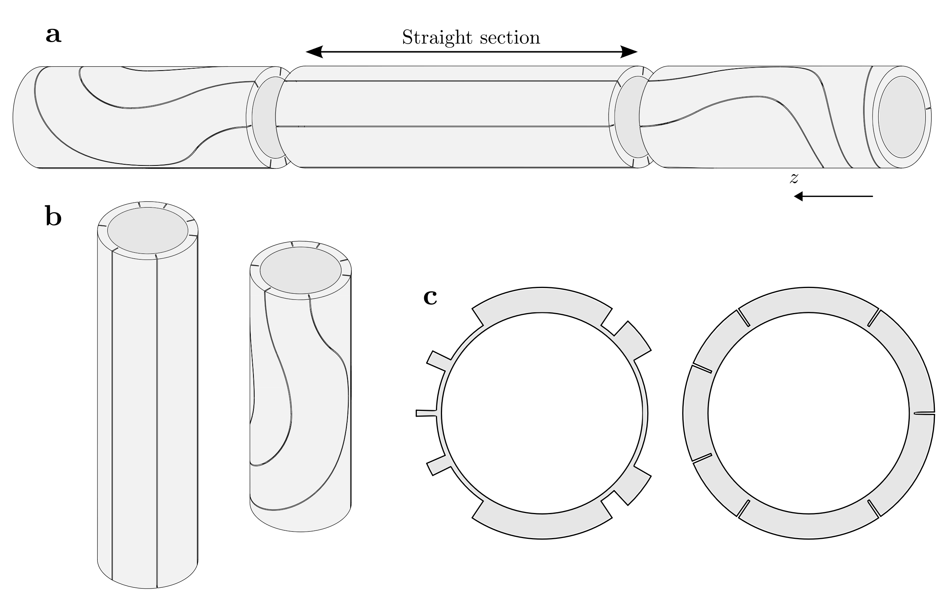
3. Discussion - Fabrication
J. L. Rudeiros Fernandez et al.

Slide 20
4. Conclusions
The novel concept of Uni-layer magnets has been presented.
The asymmetric Uni-layer magnet presents significant advantages over other concepts, merging the advantages of the costheta and CCT concepts, providing a high-quality field in terms of harmonics, within a single-layer (no internal layer jumps), using a single continuous conductor, and with a higher minimum radius of curvature required in the conductor during winding.
This new concept is especially advantageous in the domain of stress-managed magnets for HTS conductors.
J. L. Rudeiros Fernandez et al.

Slide 21
Thank you!!!
J. L. Rudeiros Fernandez et al.

