Slide 1
Breakout Group Intro
Lee Bernstein
June 28, 2023
UC-Berkeley/LBNL

Slide 2
Breakout Group Introduction
The objective of this activity is to produce a roadmap of tangible outcomes that we can use going forward.
To this end, we will break out into 2 groups:
  One will focus on nuclear data priorities for safeguards;
  The other will focus on priorities for other applications.
  We have access to two other rooms to allow us to meet separately
At the end of the session representatives from both groups will present for 15 min each.
  We will use these in roadmap development.

Slide 3
Preliminary Thoughts on Microcal Uses for other Applications
Lee Bernstein
June 28, 2023
UC-Berkeley/LBNL

Slide 4
Discussion Slides

Slide 5
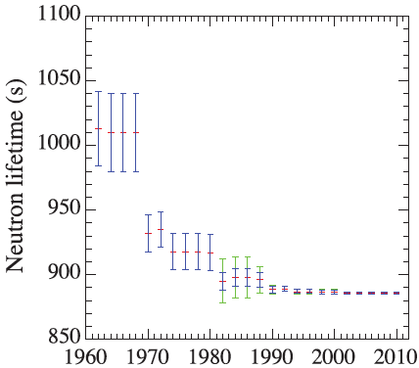
The value of the neutron lifetime is an example of “The Data Dilemma”
If you don’t have data, you get to make it up
If you have one data set, it must be correct
If you have two data sets, they are both wrong
  And everyone is just going to pick their favorite
When you have many data sets, you get to make it up again
3% error followed by 3-sigma shift
1% error followed by 3-sigma shift
It’s not enough to make the most accurate measurement since it will be viewed within the historical context
Thanks to Morgan White (LANL)

Slide 6
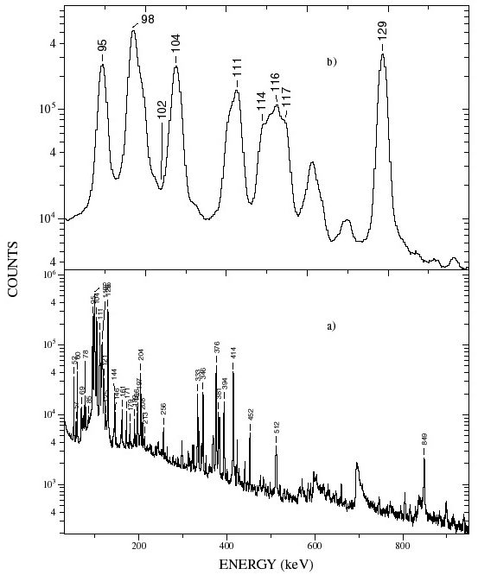
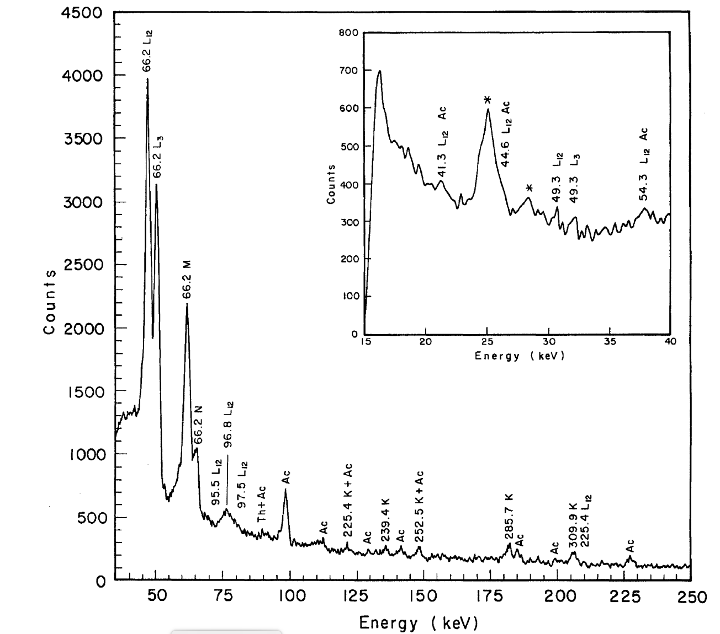
Could µcals be used to see the lowest in-beam (n,x) transitions in actinides?
Actinide (n,x) reactions are most important for Nuclear Energy, Stewardship Science, Nonproliferation
Examples: ²³⁹Pu(n,2n), ²³⁸U(n,n’)
X-rays
L.M. Fraile et al., Nuclear Physics A 686 (2001) 71–108
²³⁸Pu 4 → 2
²³⁹Pu + n
GEANIE - 2001

Slide 7
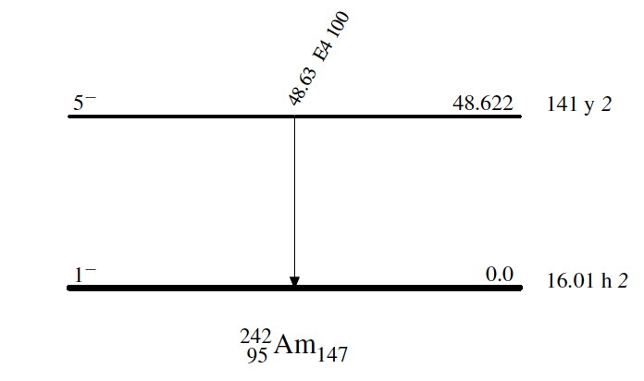
^{242m}Am(n,f) cross section (vs. ²³⁵U)
48.63 keV E4
5⁻
141 y
α=7x10⁵
1⁻
16 h

Slide 8
More Discussion Slides

Slide 9
There are many processes that allows the transfer of E and J between a nucleus and its environment
γ-decay
Time Reverse: Photo-absorption
IC-decay
Time Reverse: Atomic-electron interactions
NEEC, NEET, IES*
e_{free/bound}
e_{free/bound}
µCals could
help here
N
N*
N
N*
Photons
HEDP
electrons
photons
Nucleus
World
Atom
Photons

Slide 10
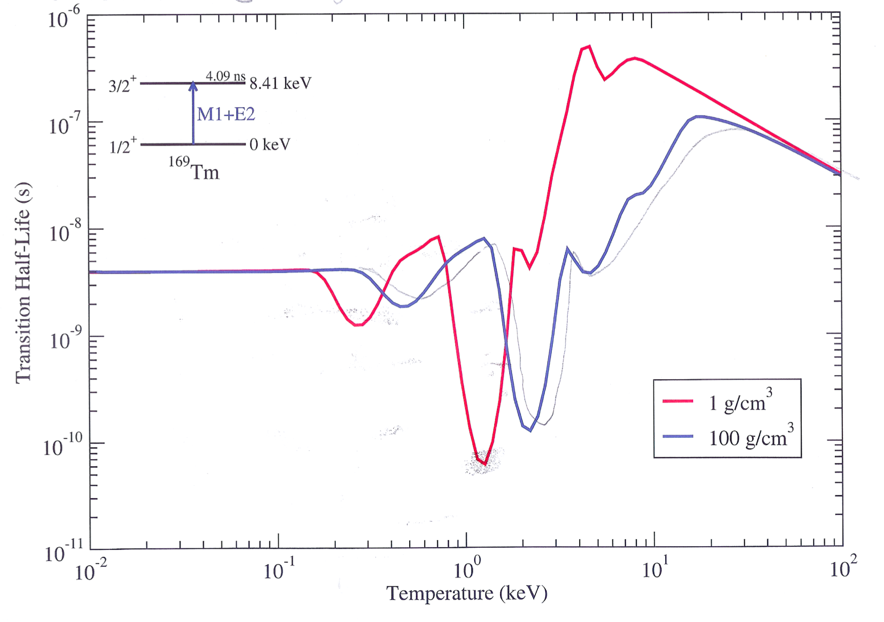
In some rare cases the environment might be able to effect the decay constant – Nuclei in high energy density plasmas
NEEC, NEET and IES are all dependent on the plasma environment
100,000,000 K

Slide 11
Backup slides

Slide 12
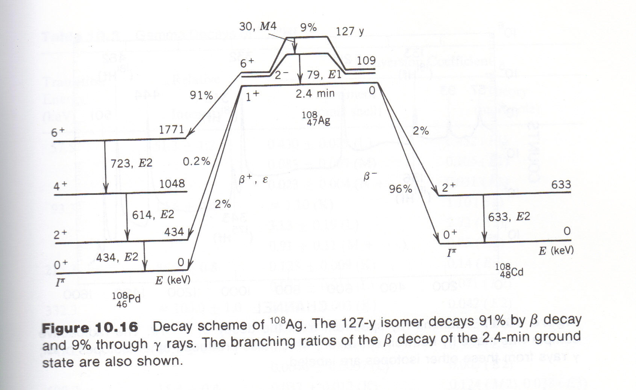
X
440 y
Krane

Slide 13
The IC coefficient (α) depends on the multipolarity (L) of the transition and the atomic environment (Z, n_{atom})
α is much bigger in high-Z nuclei
α is much bigger for large ΔL

Slide 14
0⁺ → 0⁺ transitions can’t proceed via γ-ray emission, but they can via IC
2⁺
How many particles are participating in the 2⁺ → 0⁺
E2 transition ?
834 keV
3.1 ps
0⁺
691 keV
0.42 µs
E2
E0
Why does the 0⁺ → 0⁺
E0 take so transition take so long?
0⁺
0 keV
⁷²Ge

Slide 15
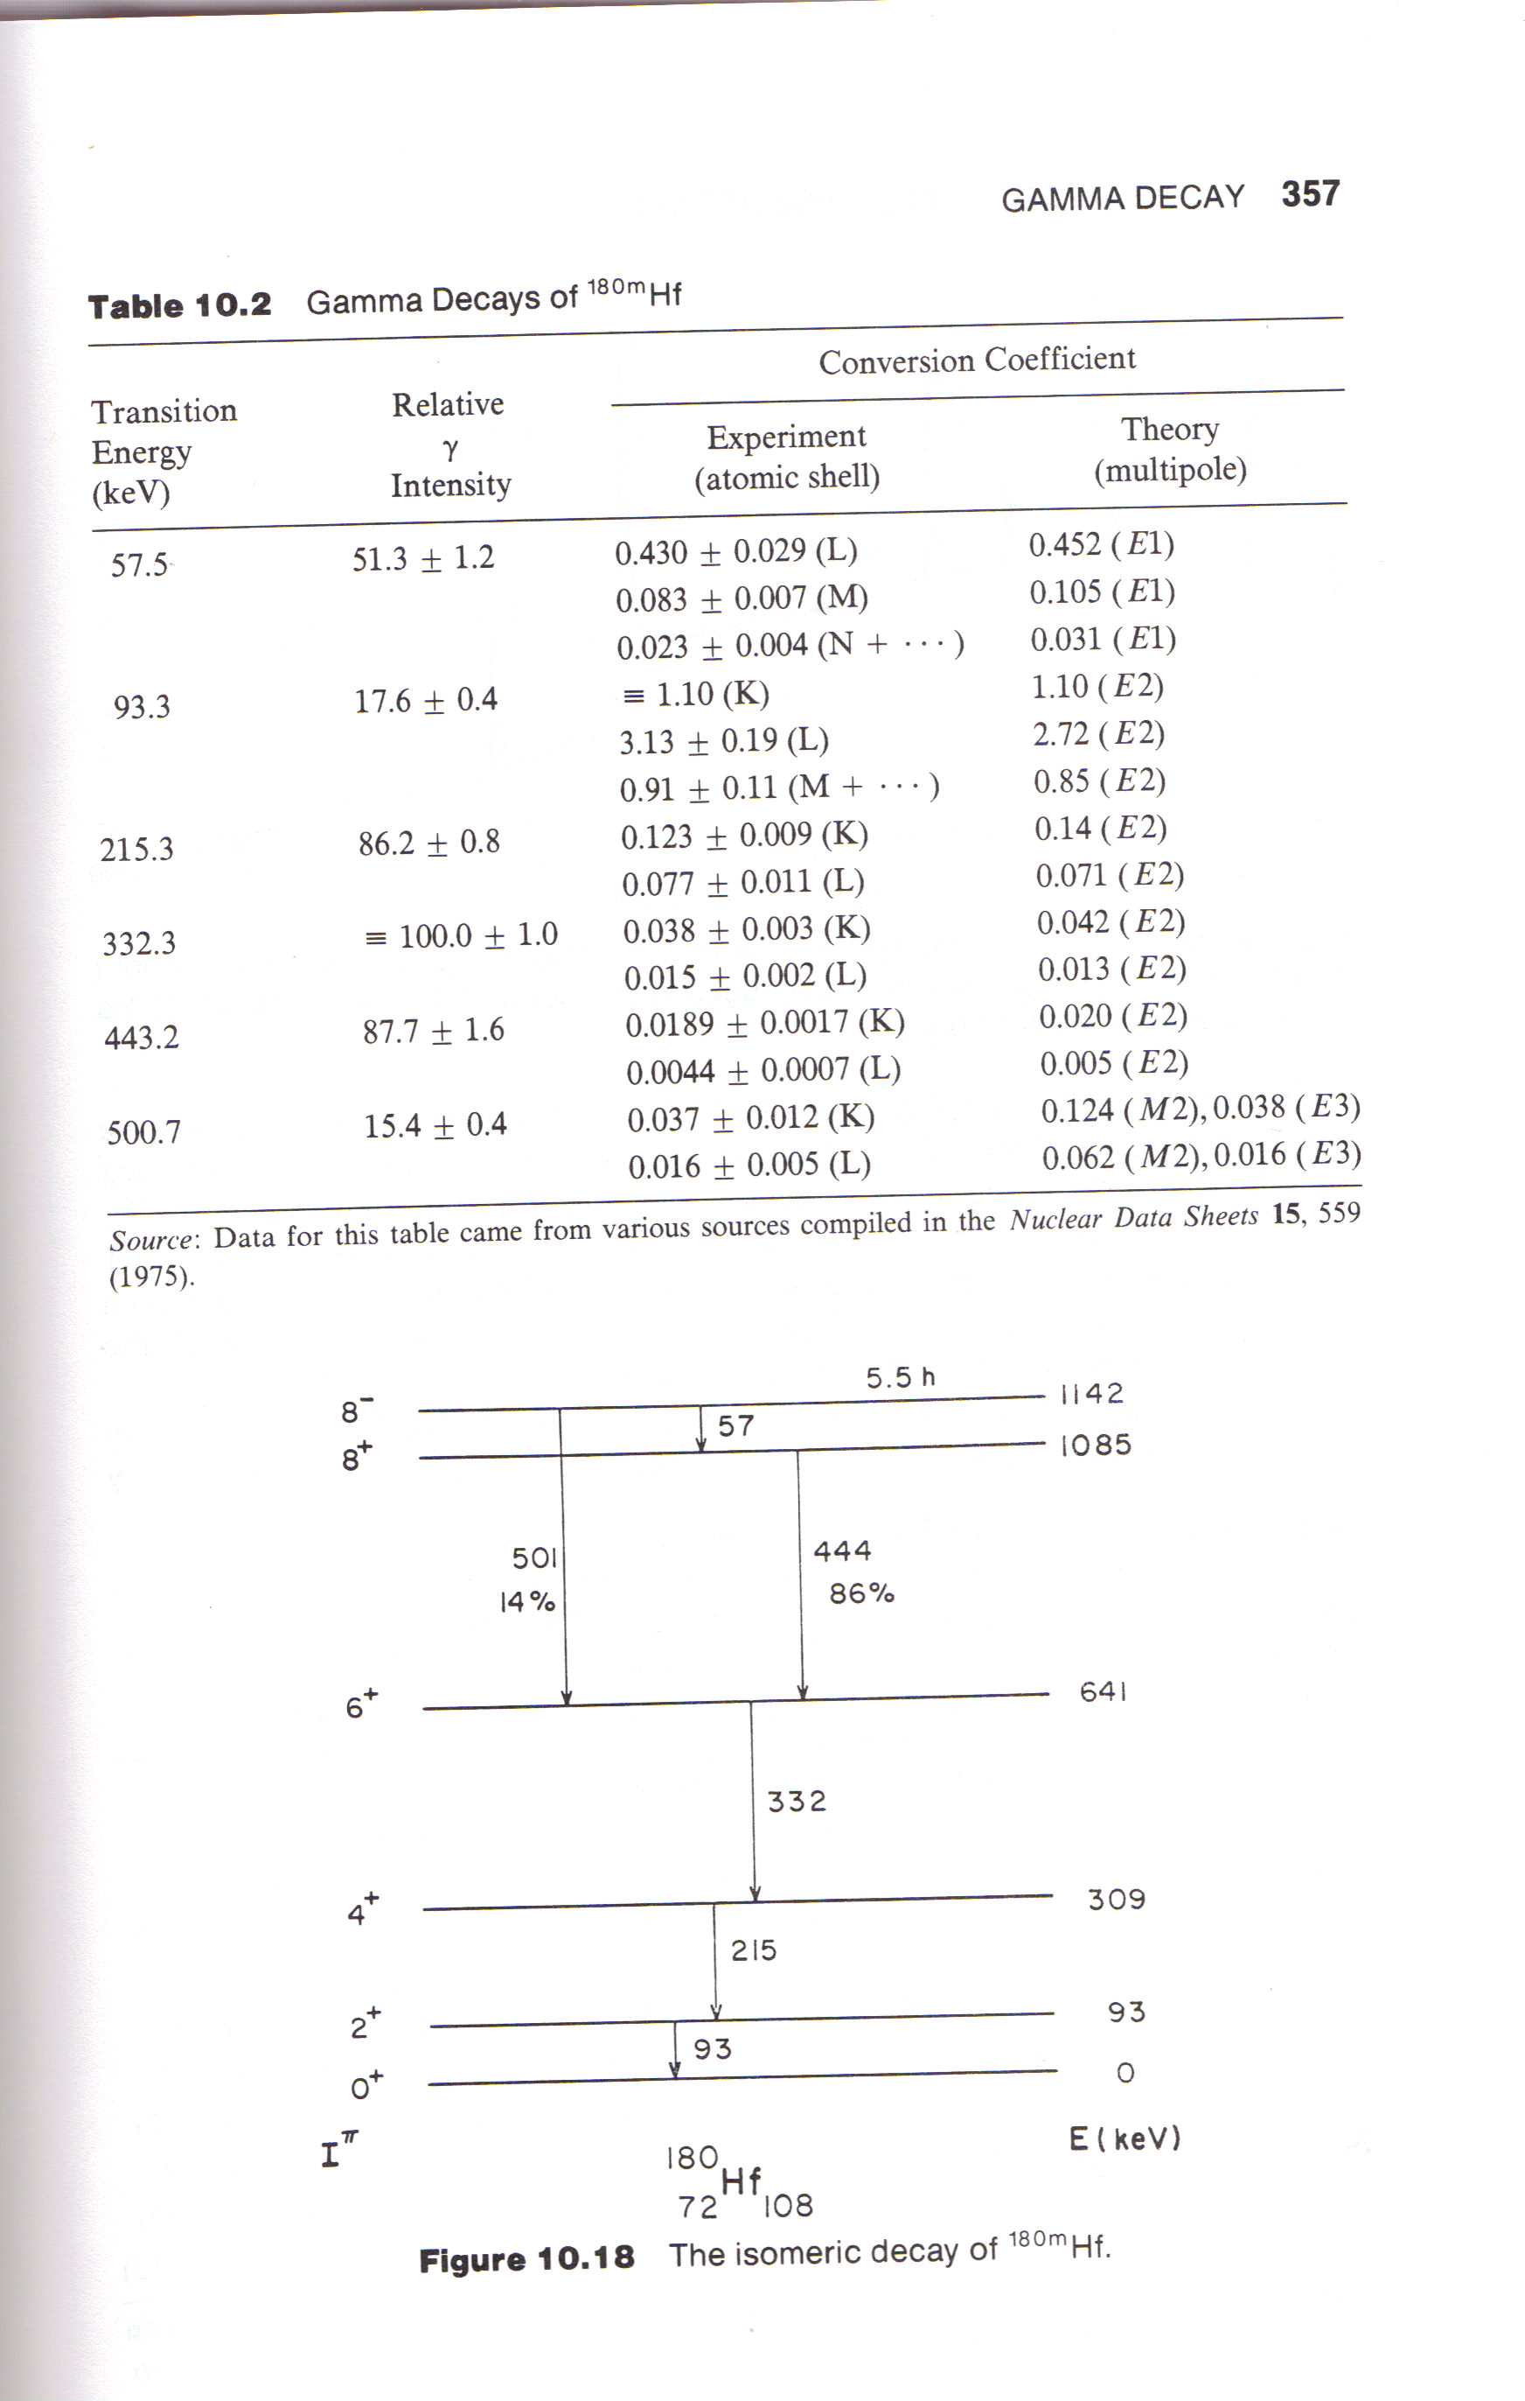
IC coefficient calculations can be made with high accuracy, especially for lower multipole transitions
Krane
This means that IC can be used to determine multipolarity

Slide 16
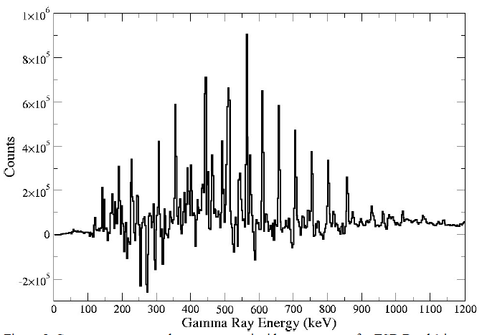
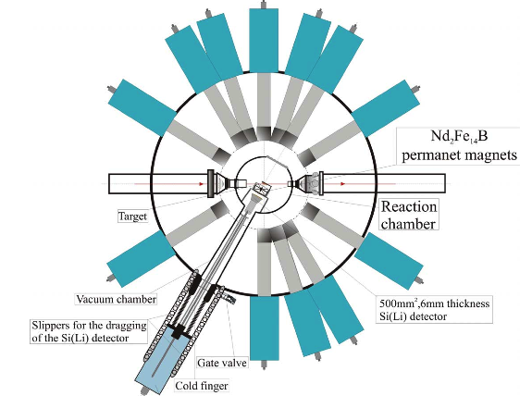
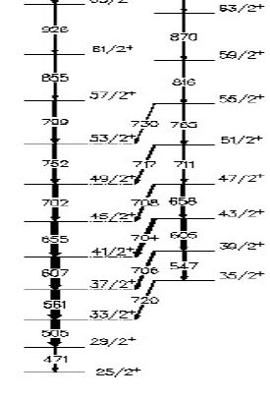
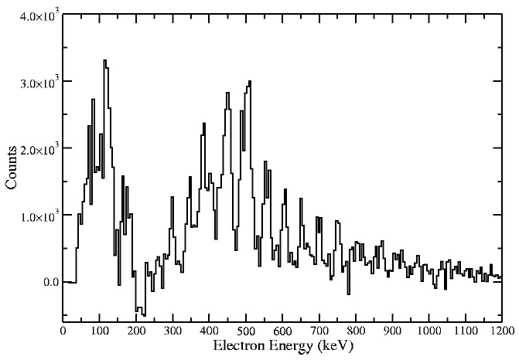
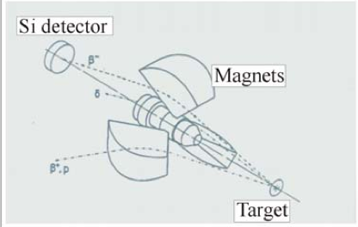
The combination of IC and γ-decay can help determine the multipolarity of EM transitions
Measuring the ration of emitted electrons and γ-rays determines multipolarity.
γ-ray spectrum
e⁻ spectrum
The e⁻ energy is shifted down by the atomic binding energy

