Slide 1
Quench protection of a 20 T hybrid dipole magnet
Vittorio Marinozzi
03-21-2023

Slide 2
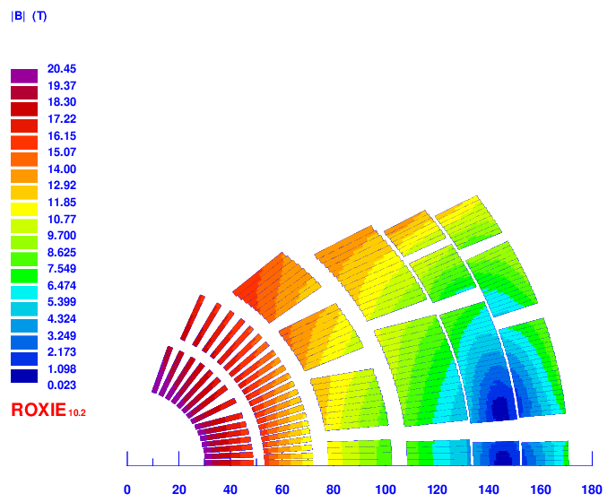
Analyzed magnet
20 T cos-theta
6 layers (2 Bi2212 + 4 Nb₃Sn)
Current: 13.5 kA
Inductance: 63 mH/m
Stored Energy: 4.4 MJ/m
Other hybrid magnets have similar parameters
Common-coil is double aperture
Margin and mechanics are ok
Nb₃Sn
Nb₃Sn
Bi2212
V. Marinozzi, et al., Conceptual Design of a 20 T Hybrid Cos-Theta Dipole Superconducting Magnet for Future High-Energy Particle Accelerators, IEEE Trans. on Appl. Supercond., 2023

Slide 3
Why is protection challenging
High magnetic field, large stored energy
Slow detection in HTS
Large current density in copper (~1.3 kA/mm²)
Many layers and interfaces (peak voltages)

Slide 4
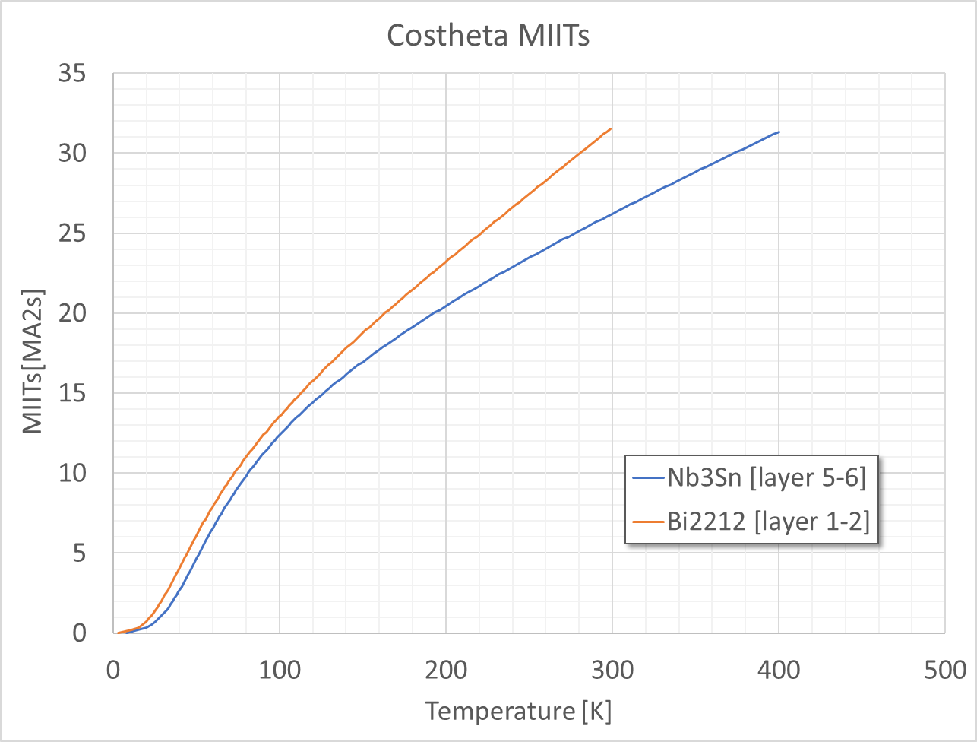
Conductor parameters and MIITs
Parameter | Layer 1-2 | Layer 3-4 | Layer 5-6
Material | Bi2212 | Nb₃Sn | Nb₃Sn
Stabilizer | Ag | Cu | Cu
RRR | 100 | 100 | 100
Stabilizer/Superconductor | 3 | 1 | 1.45

Slide 5
Assumptions for quench simulation
Simulations made with STEAM-LEDET
Simulations made for a short magnet (1 m)
Hot spot temperature computed with adiabatic assumptions
Fixed quench detection time: 15 ms
Dump resistor of 74 mΩ, dimensioned to have 1 kV between magnet leads (500 V to ground with symmetric grounding)
CLIQ unit based on existing CLIQ unit used for AUP magnets
1 kV
40 mF
No quench heaters

Slide 6
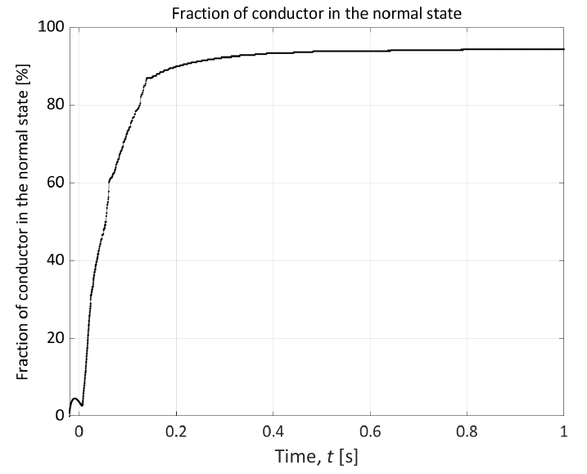
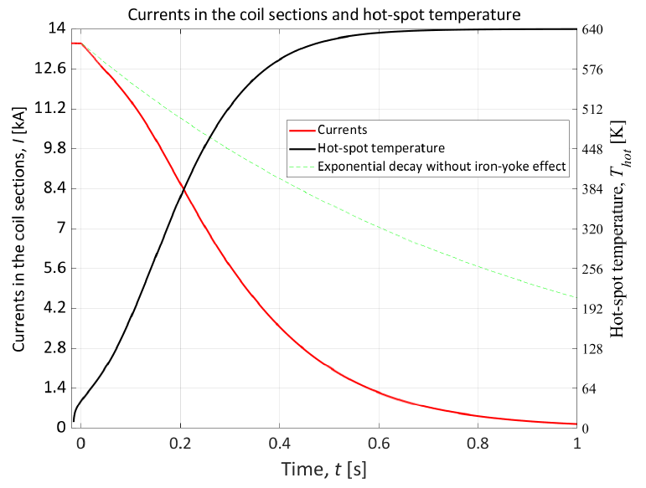
Protection of a 1 m magnet with dump resistor
Peak temperature is 640 K in LTS, 280 K in HTS

Slide 7
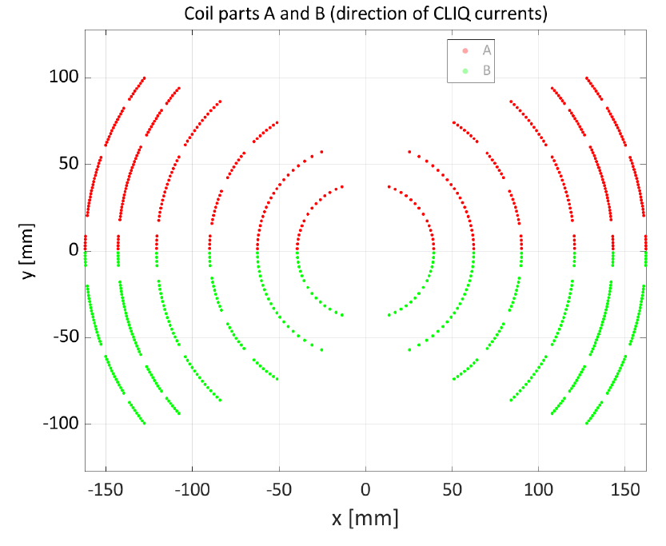
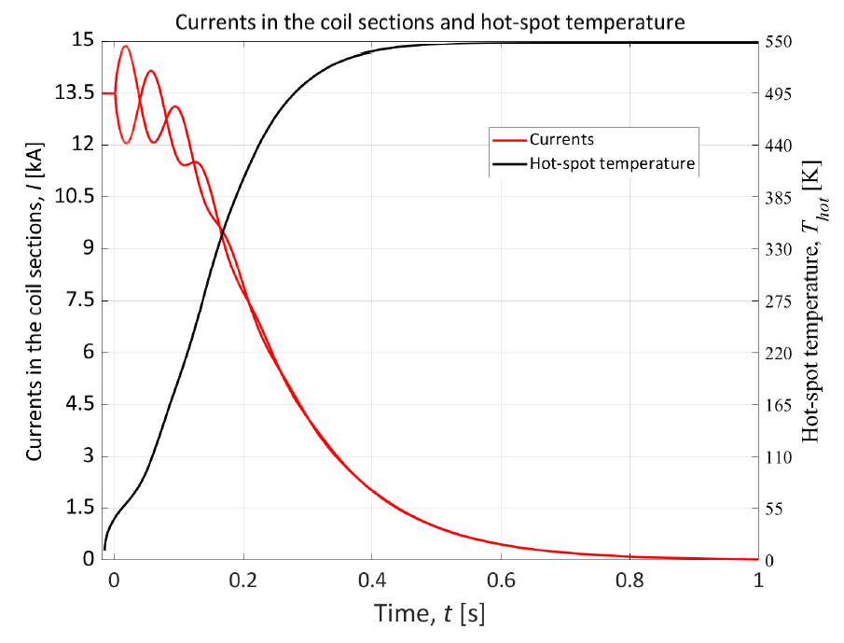
Protection of a 1 m magnet with CLIQ
Peak temperature is 550 K in LTS, 250 K in HTS

Slide 8
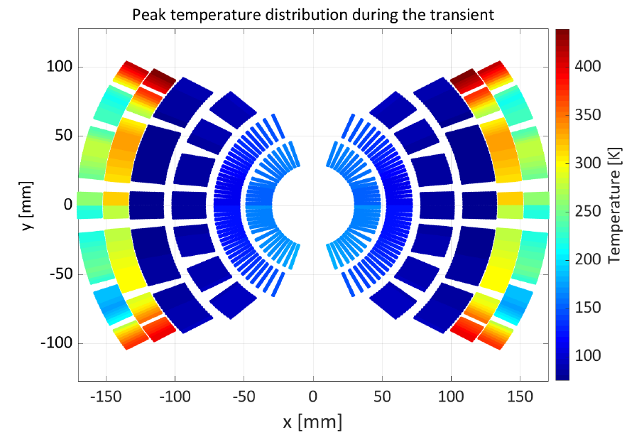
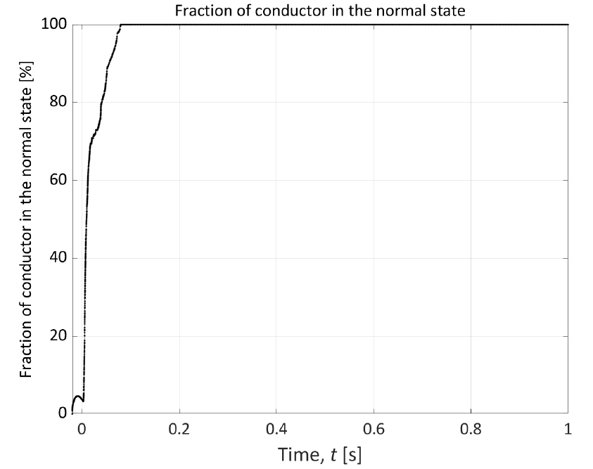
Why high temperature in LTS
4 inner layers are cold due to low resistivity respect to layers 5-6

Slide 9
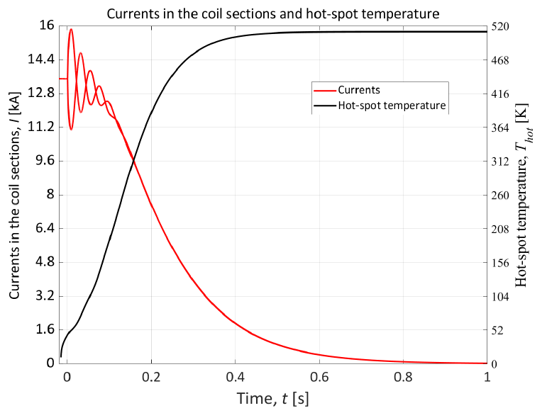
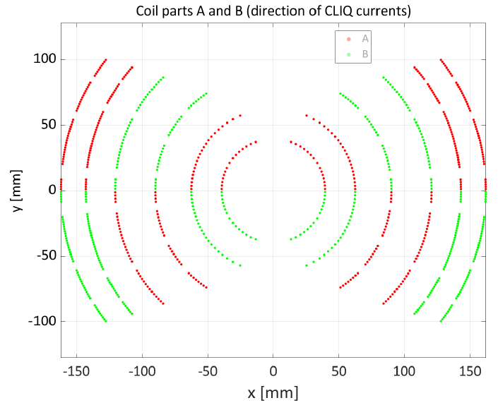
Optimizing CLIQ
Cliq can be optimized by improving current change directions
40 K less, still too high temperature

Slide 10
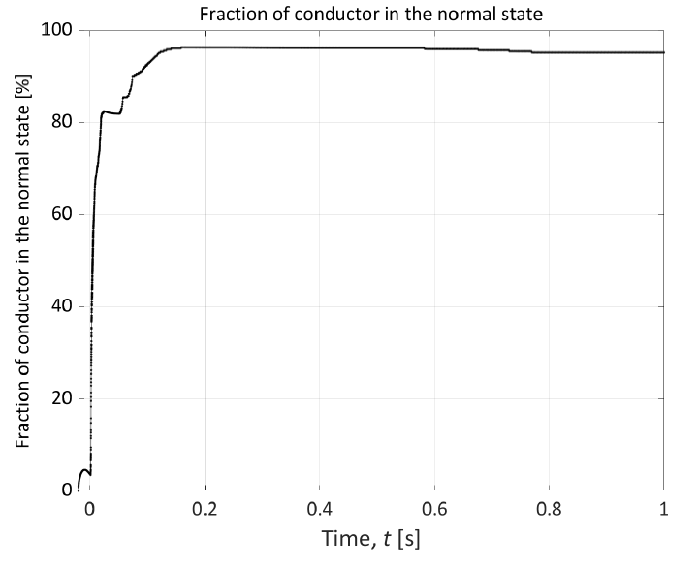
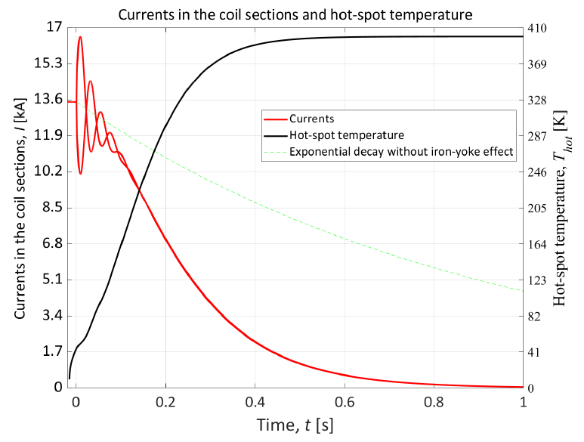
Optimizing CLIQ with dump resistor
74 mΩ dump resistor can improve CLIQ efficiency furthermore (~80 % of the magnet quenched instantaneously), resulting in 400 K in LTS (~100 K reduction)

Slide 11
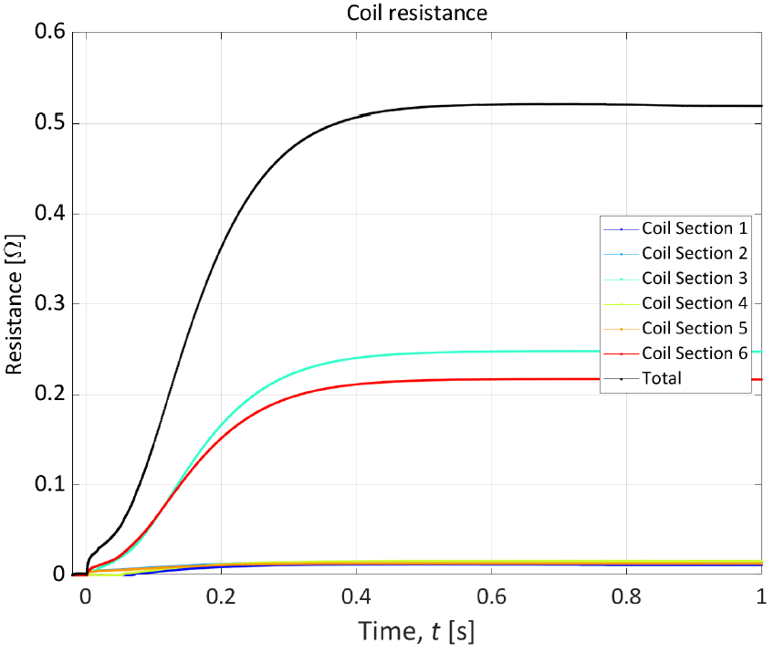
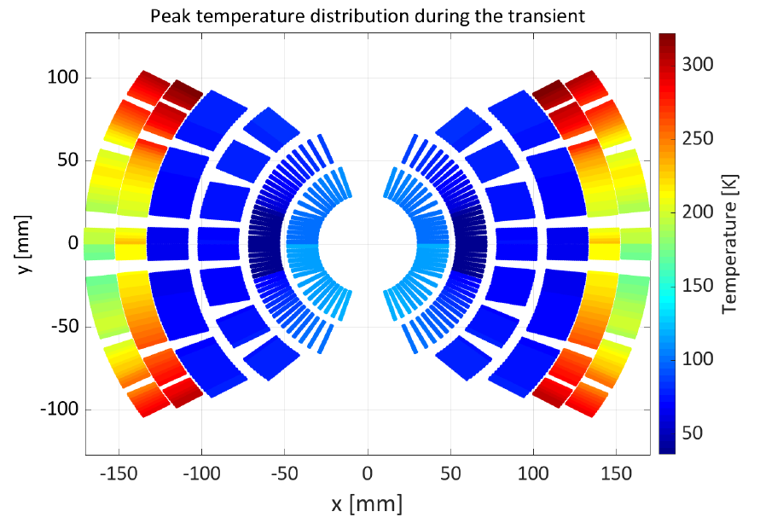
Temperature distribution with CLIQ + dump
Still, innermost layers are cold with respect to layers 5-6
The difficulty is not quenching the magnet, but heating it up to develop resistance
Layers 5-6
Layers 1-4

Slide 12
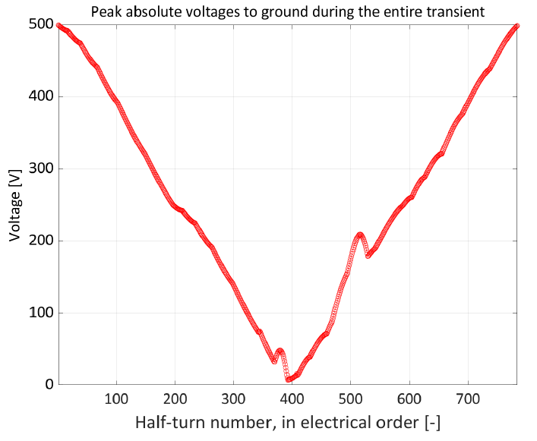
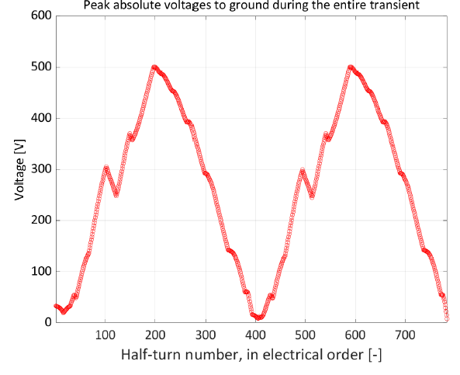
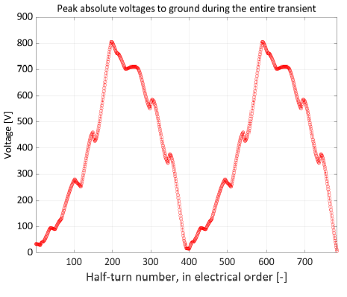
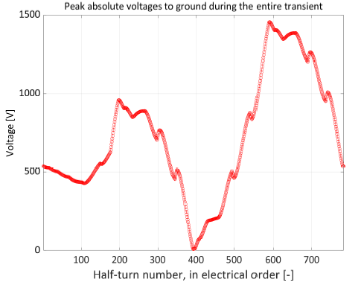
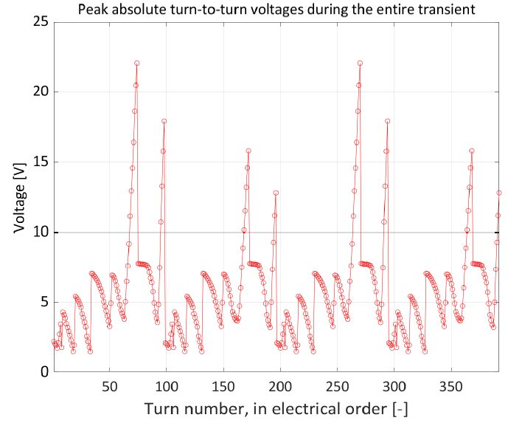
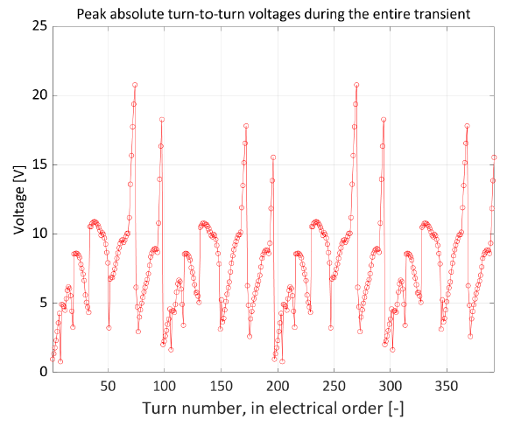
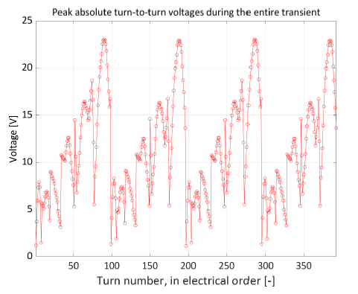
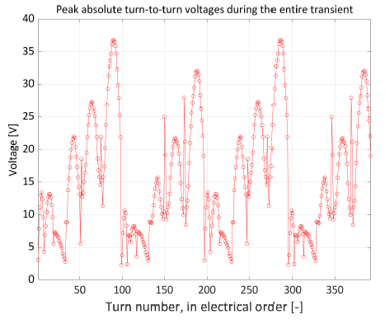
Peak voltages to ground and turn-turn
Dump
CLIQ
CLIQ optimized
CLIQ + dump
To-Ground
Turn-turn

Slide 13
Quench Protection resume
Parameter | Dump | CLIQ | Optimized CLIQ | CLIQ + Dump
HTS Hot Spot temerature [K] | 280 | 250 | 230 | 190
LTS Hot Spot temerature [K] | 640 | 550 | 510 | 400
Peak voltage to ground [V] | 500 | 500 | 800 | 1500
Peak turn-turn voltage [V] | 23 | 21 | 23 | 37

Slide 14
Possible solutions for improvement
The main problem is that the four innermost layers don’t heat up due to low resistivity
Solution 1: reduce RRR (or reduce amount of stabilizer) in layers 1-4
Cons: instabilities, cable production
Solution 2: increase dimension of layer 5-6 conductor
Cons: cost increase, size increase, maybe mechanics
Also, RRR of layer 5-6 conductor can be increased to reduce resistivity
Solution 3: reduce conductor size in layer 1-4
Cons: not much margin to play with, mechanics, inductance increase if adding turns
Separate HTS and LTS circuits
Out of Working Group assumptions (series powering)
Voltages?

Slide 15
Conclusions and next steps
The quench protection of the 20 T hybrid cos-theta looks very challenging
Difficult to keep the hot spot temperature within 350 K for the LTS
The most optimal is 400 K
Still work in progress, lot of margin for improvement!
The HTS is protectable (< 300 K) (but detection technique is to be defined)
Peak voltage reaches 1.5 kV in the most efficient scenario, turn-turn voltage is ok
A long magnet will likely have larger peak voltages
Next steps
Optimization of the magnetic design to improve quench protection
Increase of layer 5-6 conductor size looks the more promising
Parametric study of the temperature with respect of conductor RRR
Further CLIQ optimization (not HiLumi based)
Quench heaters addition
Evaluation of detection techniques and detection time for the HTS
Protection of other hybrid magnets (Block-Coils, Common-Coils)

