Slide 1
The short model program of Nb₃Sn quadrupoles for the HiLumi LHC and its potential
Paolo Ferracin, Giorgio Ambrosio, Susana Izquierdo Bermudez, Ezio Todesco
on behalf of the MQXF collaboration
International Particle Accelerator Conference (IPAC)
Venice, Italy
May 7-12, 2023

Slide 2
Acknowledgements
US HL-LHC Accelerator Upgrade Project (AUP)
  BNL: K. Amm, M. Anerella, A. Ben Yahia, H. Hocker, P. Joshi, J. Muratore, J. Schmalzle, H. Song, P. Wanderer
  FNAL: G. Ambrosio, G. Apollinari, M. Baldini, J. Blowers, R. Bossert, R. Carcagno, G. Chlachidze, J. DiMarco, S. Feher, S. Krave, V. Lombardo, C. Narug, A. Nobrega, V. Marinozzi, C. Orozco, T. Page M. Parker, S. Stoynev, T. Strauss, M. Turenne, D. Turrioni, A. Vouris, M. Yu
  LBNL: D. Cheng, P. Ferracin, L. Garcia Fajardo, E. Lee, M. Marchevsky, M. Naus, H. Pan, I. Pong, S. Prestemon, K. Ray, G. Sabbi, G. Vallone, X. Wang
  NHMFL: L. Cooley, J. Levitan, J. Lu, R. Walsh
CERN
  S. Izquierdo Bermudez, E. Gautheron, G. Kirby, A. Foussat, J. Carlos Perez, F. Rodriguez Mateos, N- Lusa, E. Ravaioli, M. Bednarek, J. Ferradas Troitino, F. Mangiarotti, M. Bajko, A. Devred, H. Felice, D. Perini, G. Willering, S. Ferradas Troitino, H. Prin, A. Milanese, J. Ferradas Troitino, E. Takala, R. Principe, A. Ballarino, D. Tommasini, B. Bordini, J. Fleiter, C. Barth, S. Hopkins, F. Savary, D. Duarte Ramos, Y. Leclercq, M. Struik, L. Fiscarelli, S. Russenschuck, C. Petrone, G. de Rijk, L. Rossi, P. Fessia, S. Riebe, H. Garcia Gavela, L. Carlos, S. Fleury, G. Vandoni, L. Quain Solis, A. Dallocchio, P. Moyret, S. Sgobba, A. Moros, M. Crouvizier, B. Bulat, M. Guinchard and its team, et al.

Slide 3
Outline
Introduction and program goals
Magnet design
Program overview
Performance overview
Additional studies and outcomes
Conclusions

Slide 4
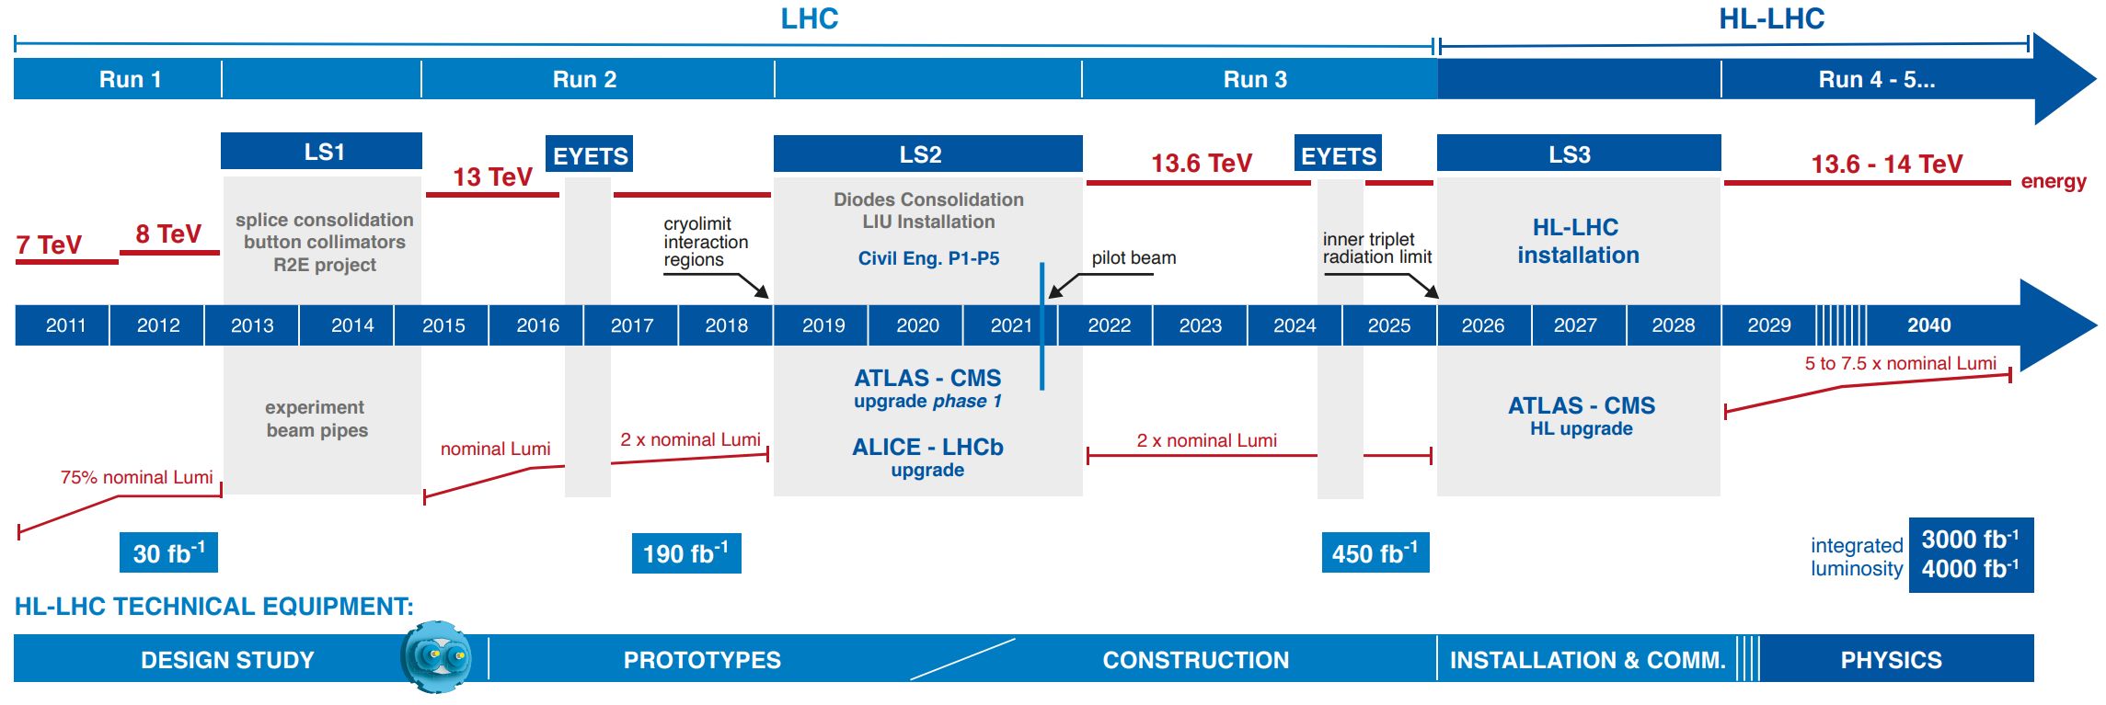
Introduction
From LHC to HL-LHC
HL-LHC goals
  Extend LHC life time by 15+ years
  Prepare the machine for producing in that period 10 times more data as compared to the nominal LHC operation period
Overall status of the HL-LHC project (TUYG1) by O. Bruning

Slide 5
Introduction
HL-LHC Interaction Region
New inner triplet quadrupole
  Larger aperture to reduce the beam size: from 70 to 150 mm
  Nb-Ti to Nb₃Sn → only 8 m longer than in the LHC (23 m → 31 m)
LHC
132.2
HiLumi LHC

Slide 6
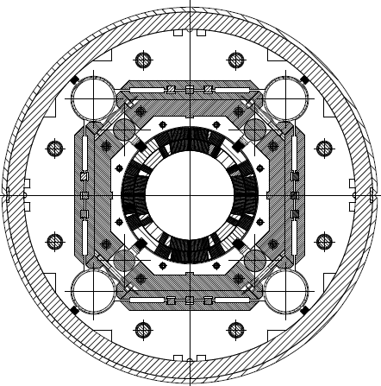
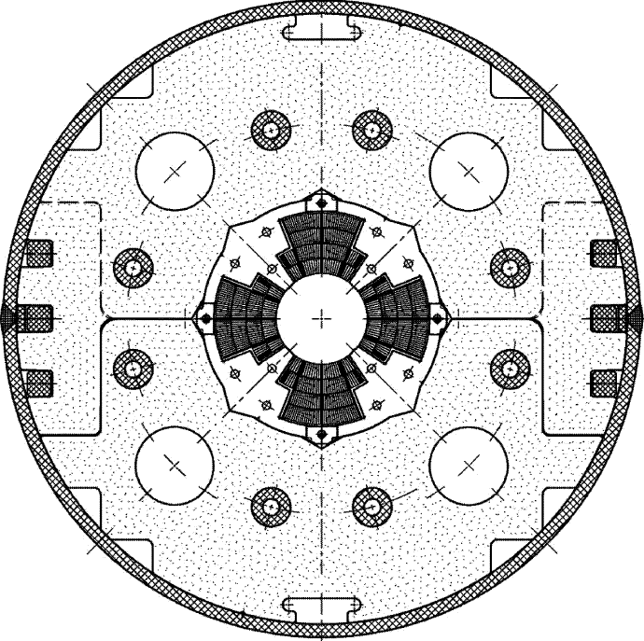
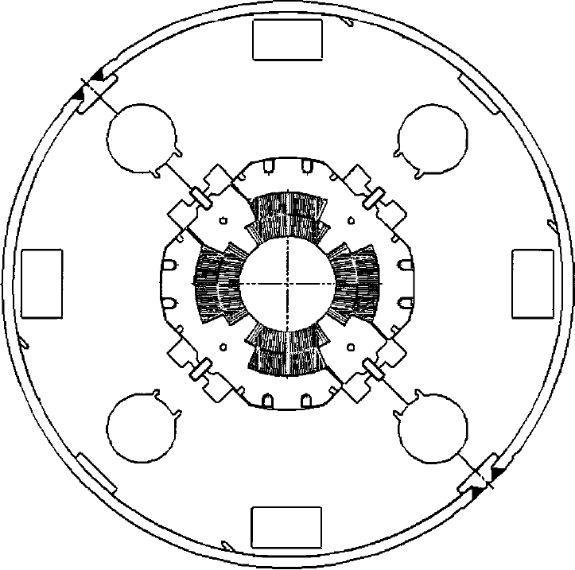
Introduction from LHC to HL-LHC low-β quadrupoles
Everything significantly increased
  strand…cable…coil…structure
From 70 mm to 150 mm aperture
From Nb-Ti at 8.6 T to Nb₃Sn at 11.3 T
~4 times the e.m. forces in straight section
LHC low-β quadrupoles
HL-LHC low-β quadrupoles

Slide 7
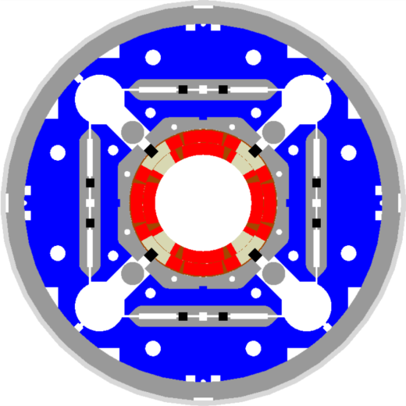
Introduction
LHC dipole vs HL-LHC low-β quadrupole
  Nb-Ti
  8.3 T
  σ_{θ_e.m.}= 50-60 MPa
  Nb₃Sn
  11.3 T
  σ_{θ_e.m.}= 100-110 MPa

Slide 8
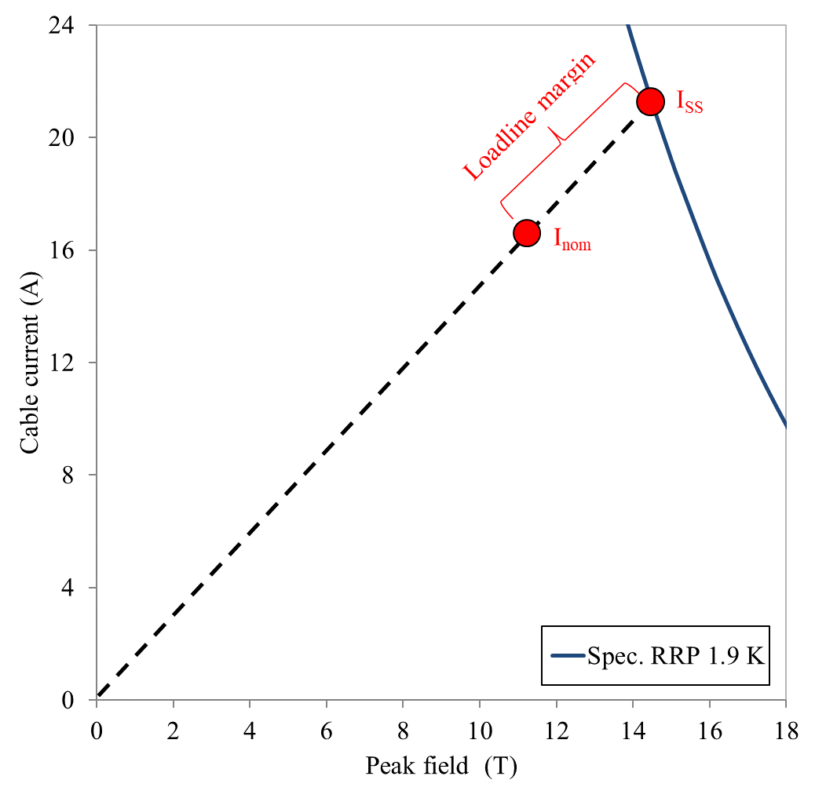
Introduction
HiLumi low-β quadrupole MQXF
Nominal conditions (7 TeV operation)
  G_{nom}=132.2 T/m
  11.3 T B_{peak_nom}
  ~77% of I_{ss}
Ultimate conditions (7.5 TeV operation)
  G_{ult}=142.1 T/m
  12.1 T B_{peak_ult}
  ~83% of I_{ss}
I_{ult}

Slide 9
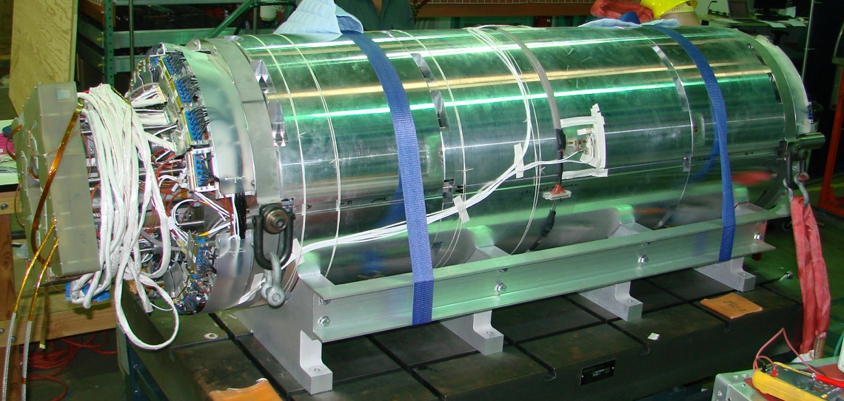
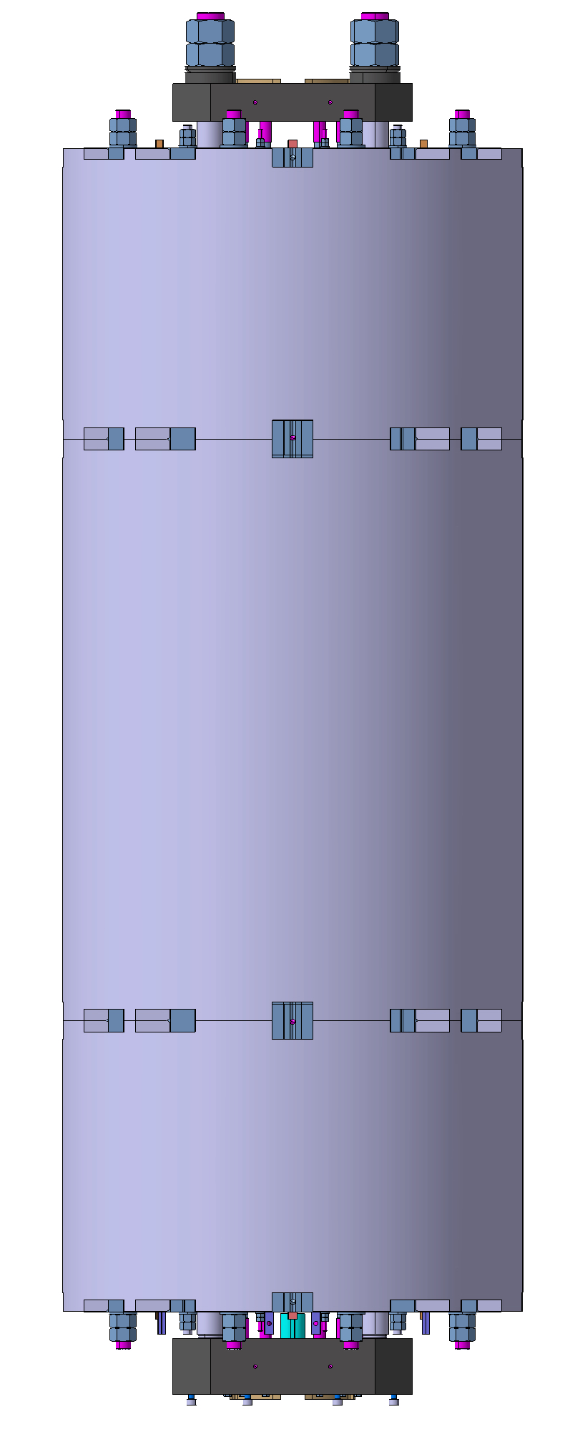

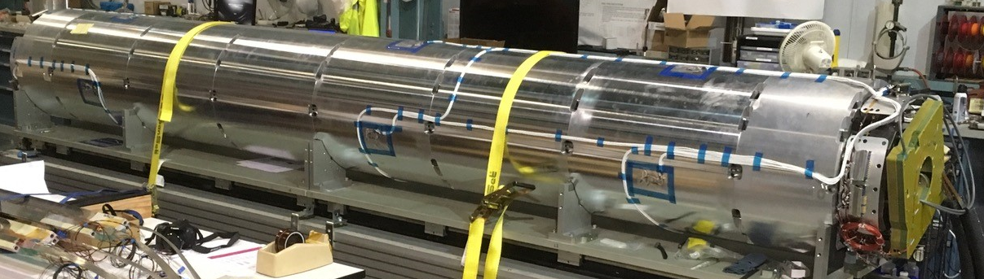
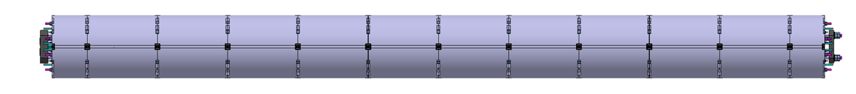
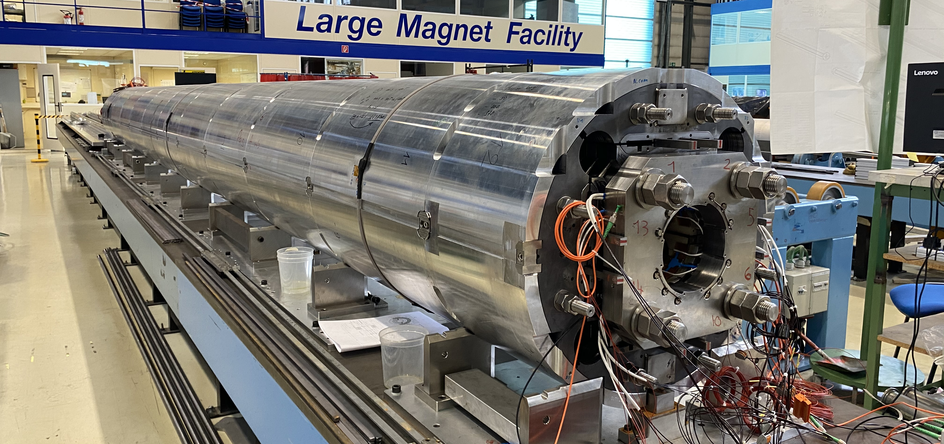
Introduction
HiLumi low-β quadrupole MQXF
Joint CERN-LARP short model development program (MQXFS) to validate the design
MQXFS
(1.2 m)
MQXFS
AUP MQXFA
G.Apollinari, MOPL040
MQXFA
(4.2 m)
Different lengths, same design, very similar assembly procedure and loading target
CERN MQXFB
A. Milanese, WEPM060
MQXFB
(7.2 m)

Slide 10
Outline
Introduction and program goals
Magnet design
Program overview
Performance overview
Additional studies and outcomes
Conclusions

Slide 11
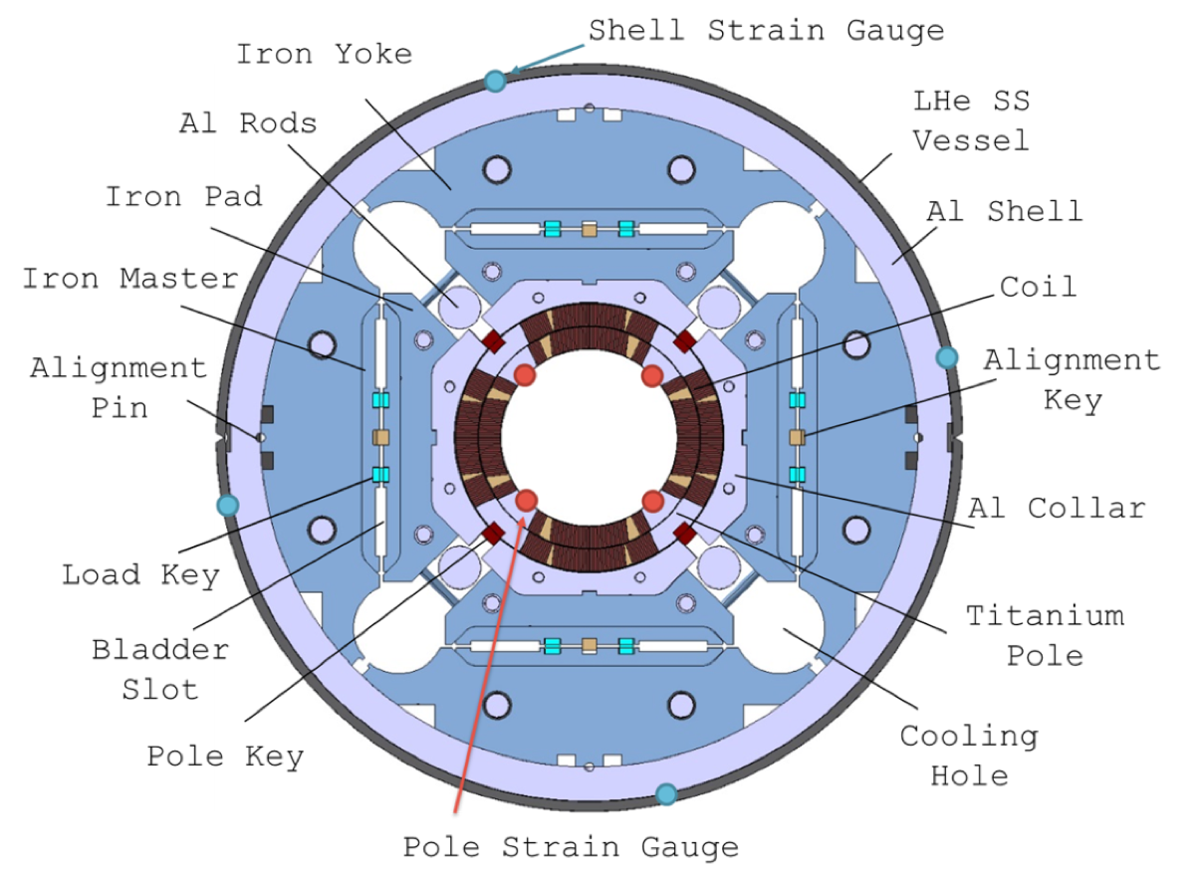
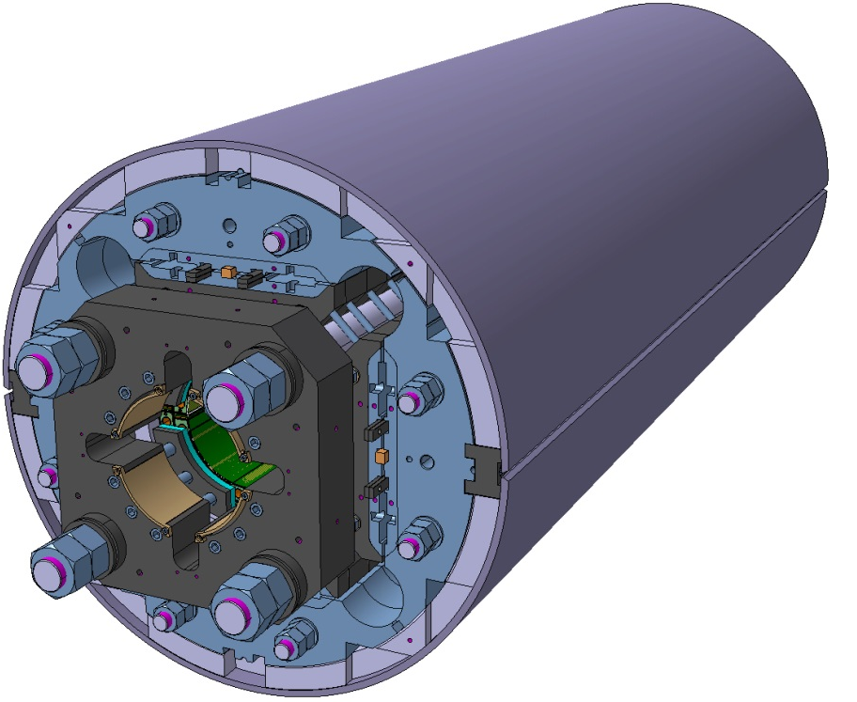
Magnet design
150 mm aperture
Double layer coil wound with 18 mm wide cable
Support structure based on aluminum shell pre-loaded with bladders and keys
Axial support with end-plate and axial rods
Al/SS

Slide 12
Outline
Introduction and program goals
Magnet design
Program overview
Performance overview
Additional studies and outcomes
Conclusions

Slide 13
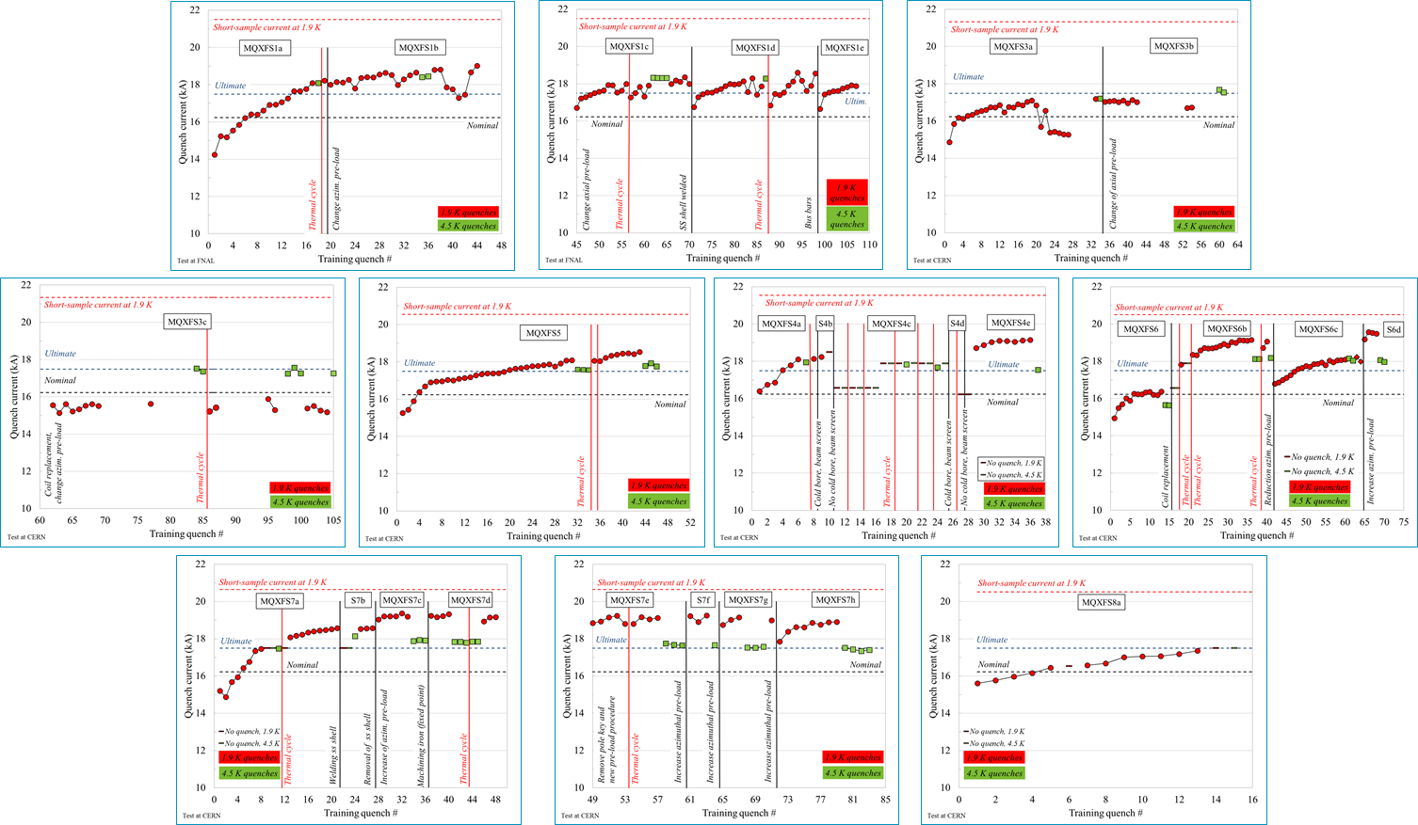
Program overview
7 magnets
  2 LARP/AUP-CERN
  5 CERN
27 coils tested
  4 conductors
46 tests
  7 “virgin”
  20 modifications
  19 thermal cycles

Slide 14
Program overview
Timeline
RED indicates conform magnets
11.3 T B_{peak_nom}
12.1 T B_{peak_ult}
MQXFS1: ≥ 12.9 T
MQXFS3: ≥ 11.8 T
7 models built, 6 conform
MQXFS5: ≥ 12.7 T
MQXFS4: ≥13.1 T
T₀: aperture and cable selection
MQXFS6: ≥13.3 T
MQXFS7: ≥13.2 T
MQXFS8: ≥12.0 T
2013
2014
2015
2016
2017
2018
2019
2020
2021
2022
2023
14

Slide 15
Outline
Introduction and program goals
Magnet design
Program overview
Performance overview
Additional studies and outcomes
Conclusions

Slide 16
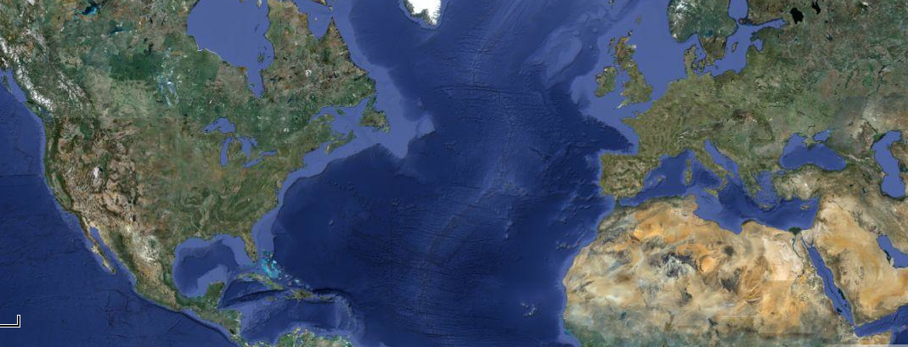
The early magnets
MQXFS1: the first one
Designed and fabricated by multiple laboratories
MQXFS1
FNAL
Coil 3-5
CERN
LBNL
Coil 3-5
BNL
Coils 103-104
Structure 1

Slide 17
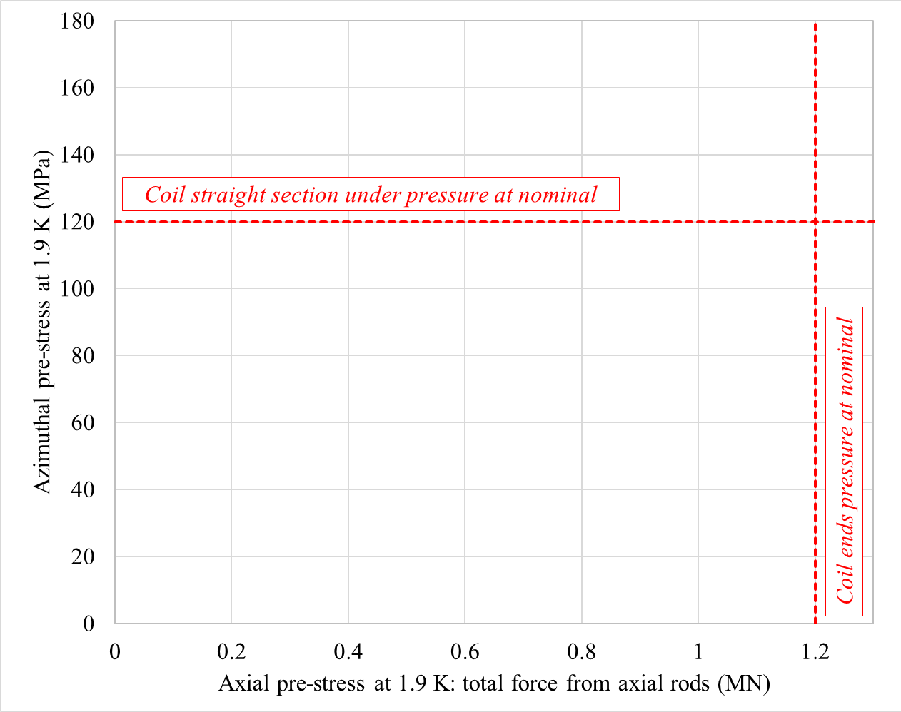
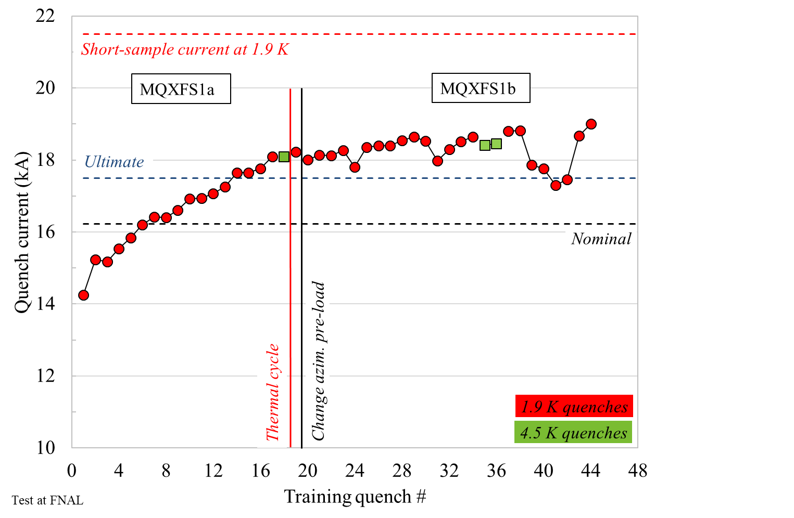
The early magnets
MQXFS1: the first one
1a: ultimate passed, relatively long training, perfect memory
  Validation of coil fabrication and mechanical design
Then 1b, explore different pre-load conditions
  Still ok, but more erratic

Slide 18
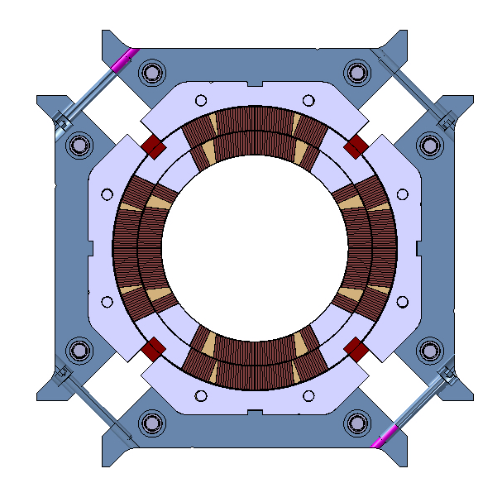
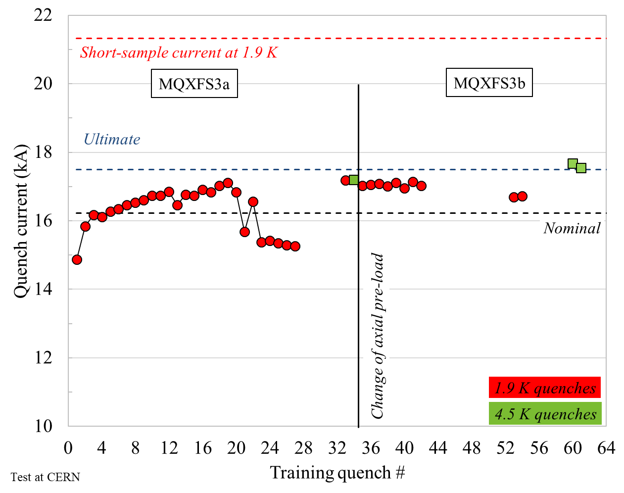
The early magnets
MQXFS3: the second one
S3a: still higher azimuthal pre-load
  Good start, but then de-training
S3b: higher axial pre-load
  Improvement but still limited at 1.9 K
Visual inspection: broken pole key

Slide 19
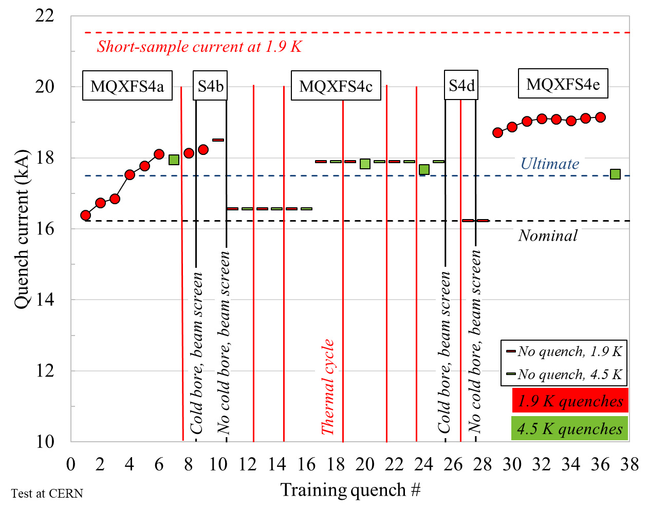
The early magnets
MQXFS4
Pre-load
  We targeted “nominal” for azimuthal and axial and pole key gap
Excellent training and memory →
  Set as reference for sub-sequent short and long magnets

Slide 20
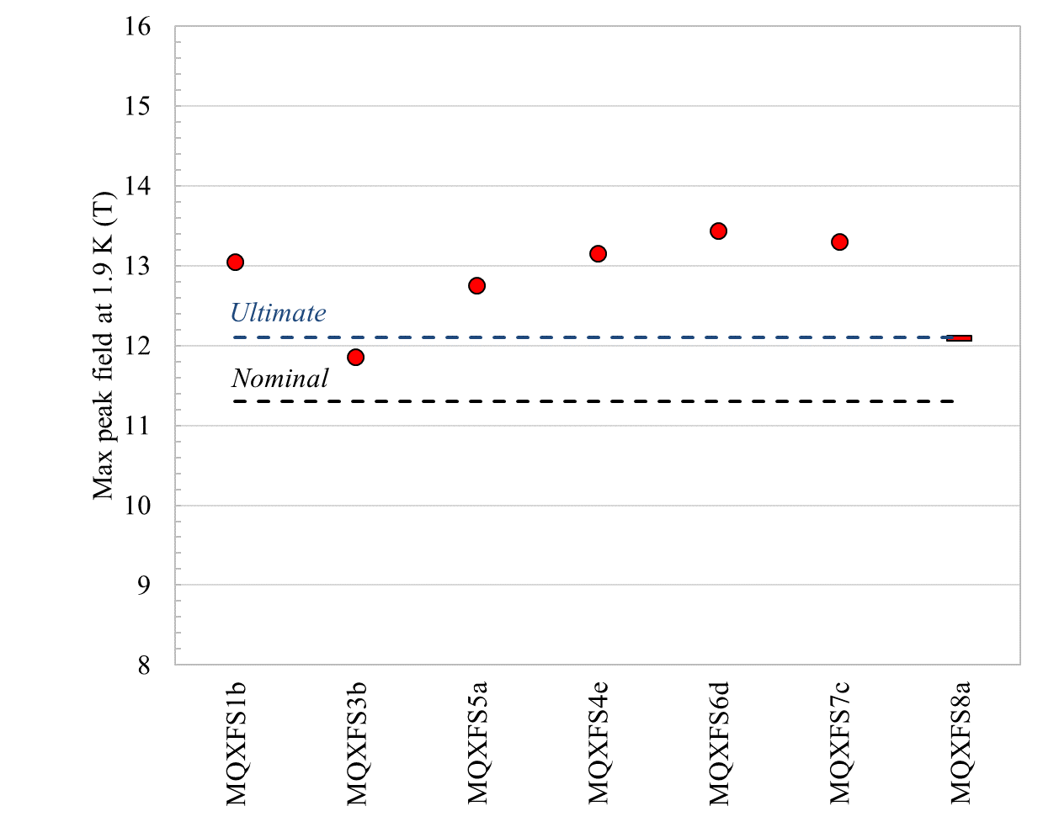
Performance overview
Maximum field (T)
All the magnets passed nominal
All but S3 passed ultimate (S8 training not completed)
The 13 T level reached, with the exception of S3
  1.5 T more than needed at nominal

Slide 21
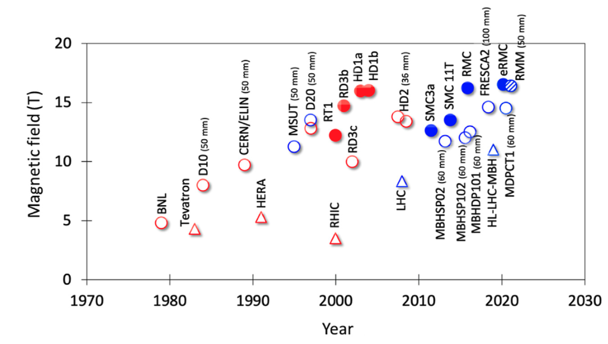
Relevance to current magnet programs
US MDP
HTS/Nb₃Sn program (~20T)
MQXF
13T
CERN HFM & US MDP
Nb₃Sn program (12-14T)
By L. Bottura

Slide 22
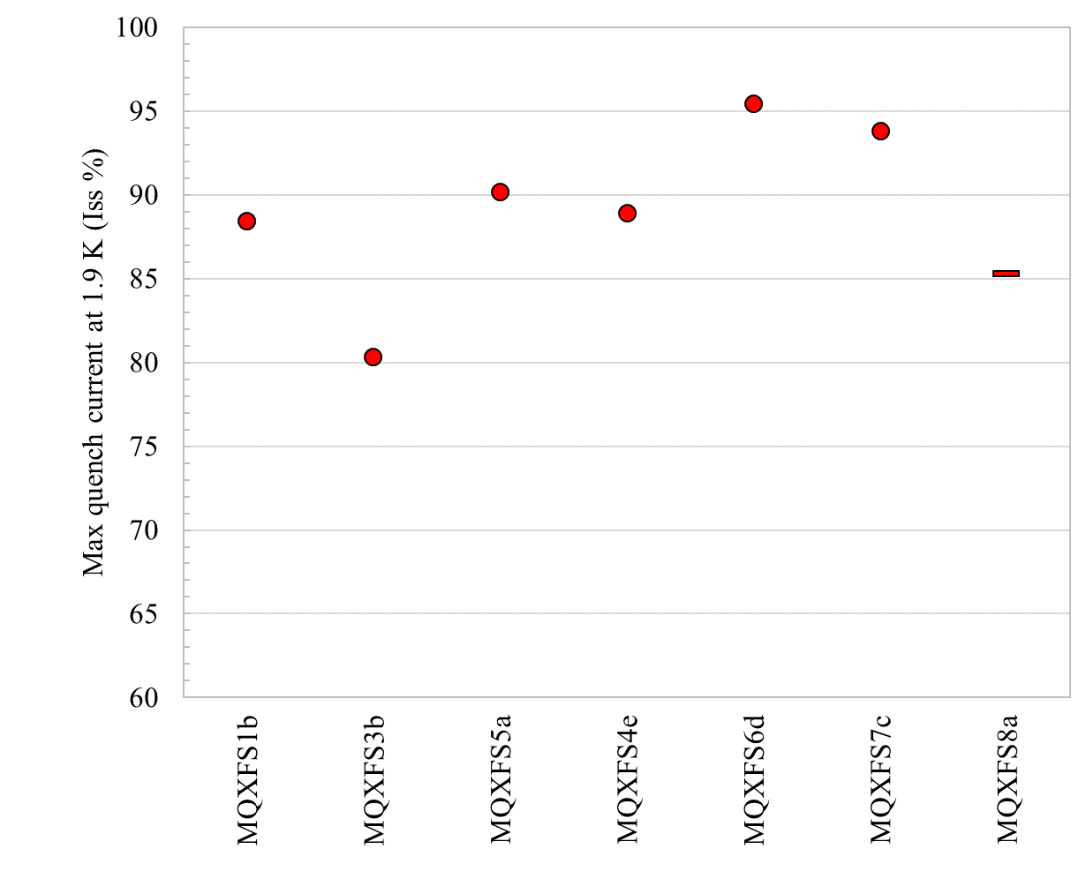
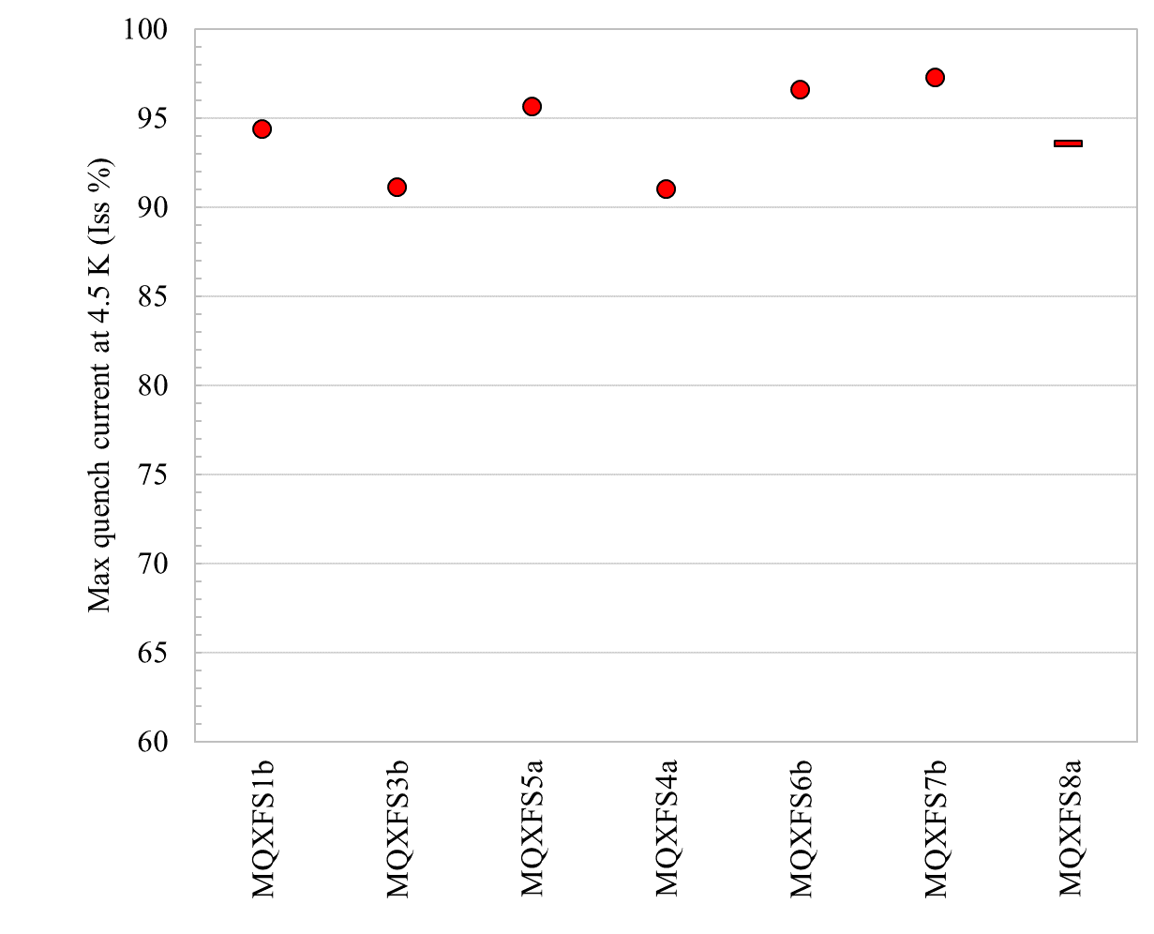
Performance overview
Maximum current (I_{ss} %)
The 90-95% level reached at 1.9 K and 4.5 K
  S3 at 1.9 K limited at 80% at 1.9 K
  S8 training not completed
1.9 K
4.5 K

Slide 23
Outline
Introduction and program goals
Magnet design
Program overview
The early magnets
Performance overview
Additional studies and outcomes
Conclusions

Slide 24
Endurance
Long-term behavior investigated in MQXFS4
No degradation after 11 thermal cycles (a to e) and 1000 current cycles (c)
  Endurance tested successfully on other short models and long magnet
No re-training after thermal cycle

Slide 25
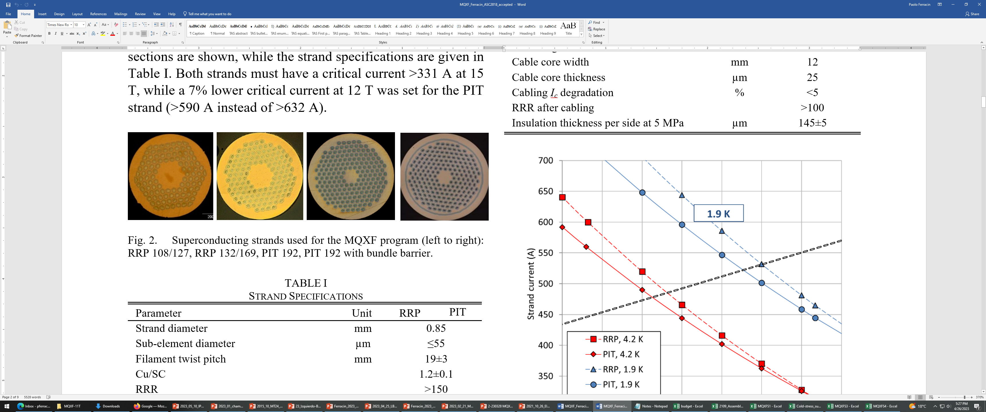
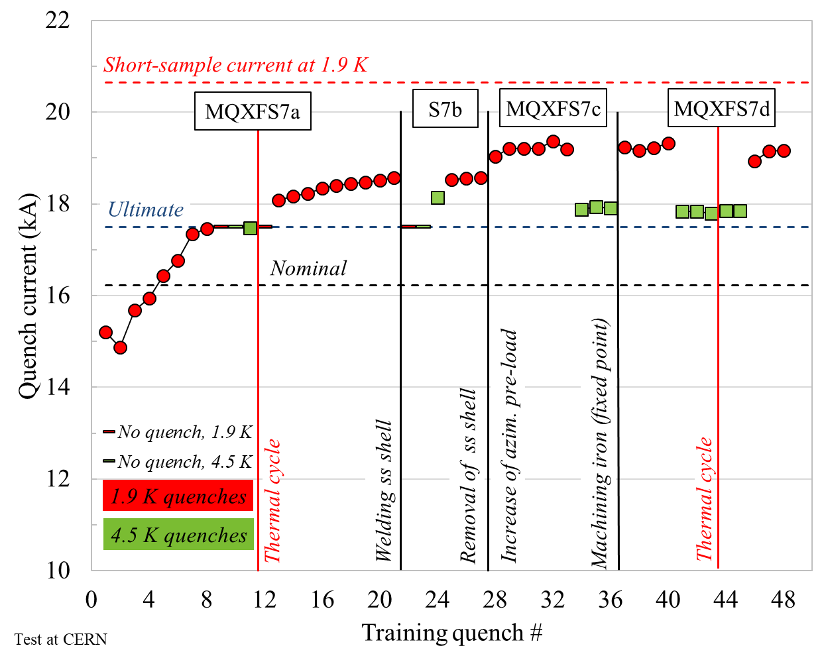
Superconductor validation
RRP 108/127
RRP 132/169
4 Bruker-OST strands used during the short
  RRP 108-127 chosen for the project
    Sufficiently small filament and lower cost
  In addition
    RRP 132/169, PIT 192, and PIT 192 with bundle barrier
Ultimate passed with all strands (also mixed)
PIT 192
PIT 192 bundle

Slide 26
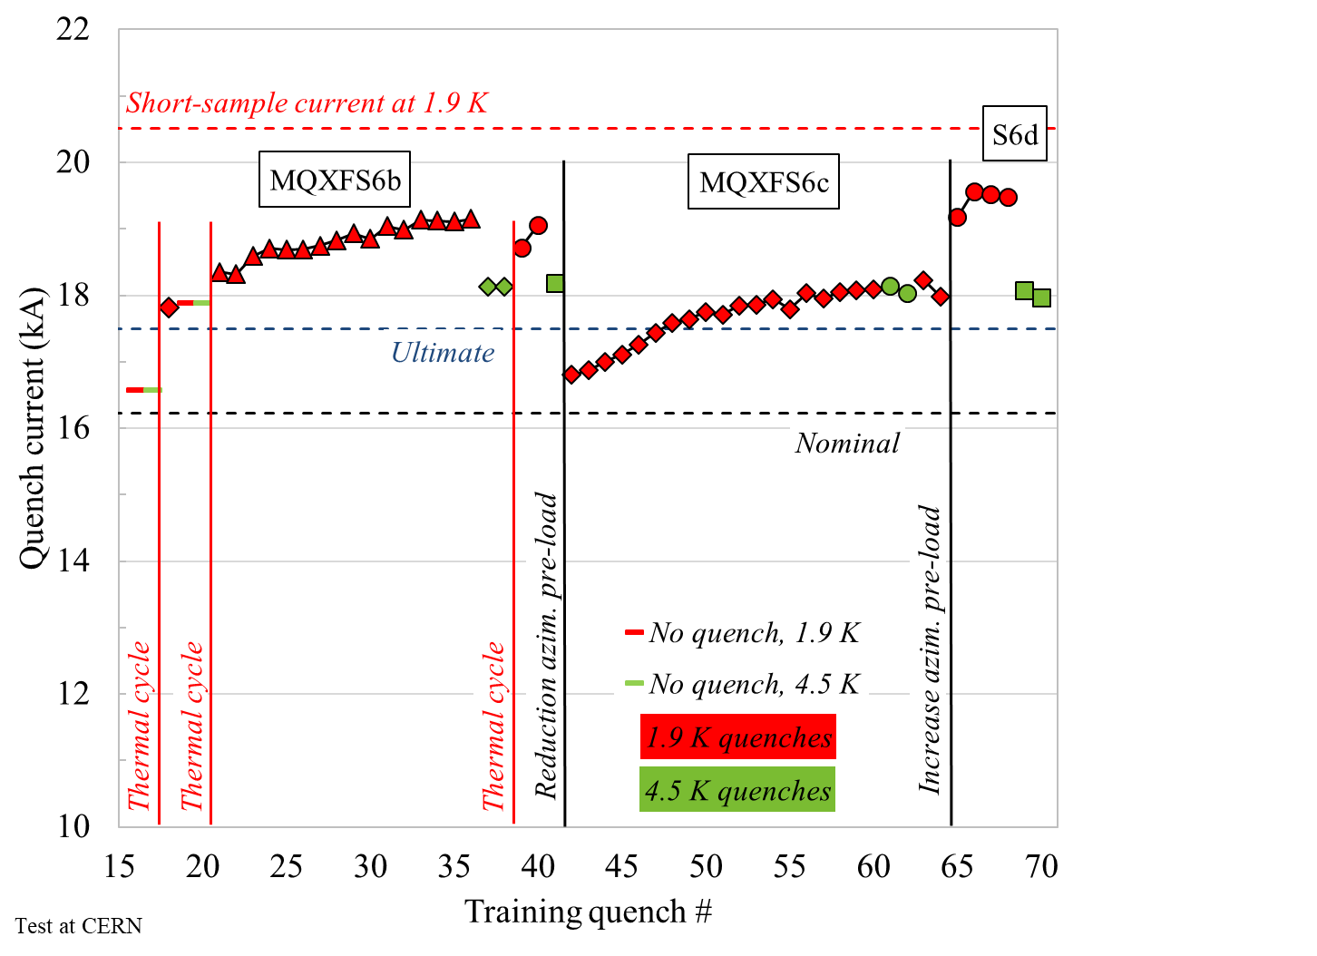
Training/plateau vs. pre-stress (I)
Impact of pre-stress on training/plateau investigated with MQXFS6
Wide pre-load window to reach ultimate current (-75 to -120 MPa)
Indication that larger preload is beneficial to reach higher plateau 90% of I_{ss}

Slide 27
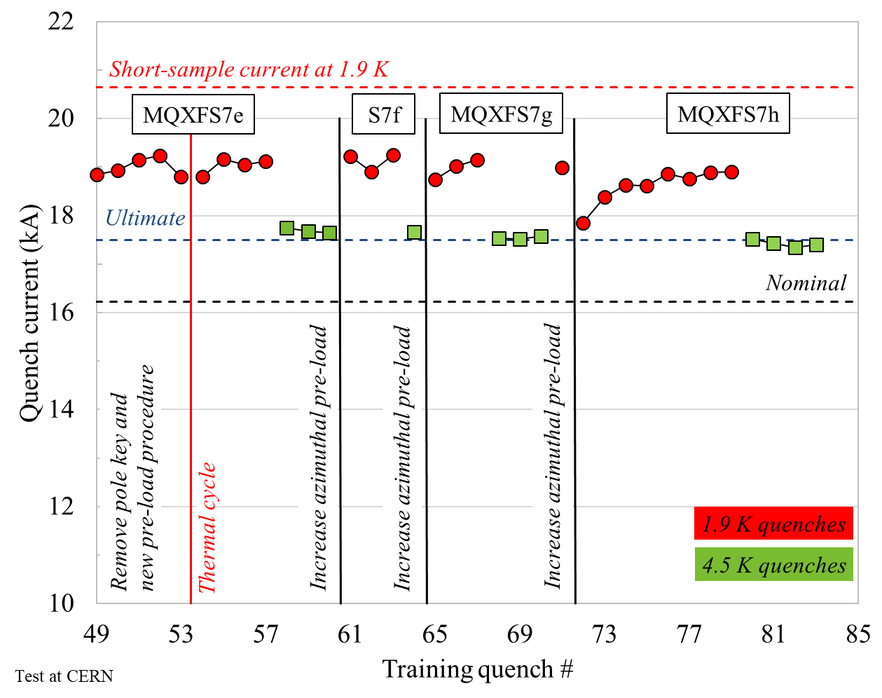
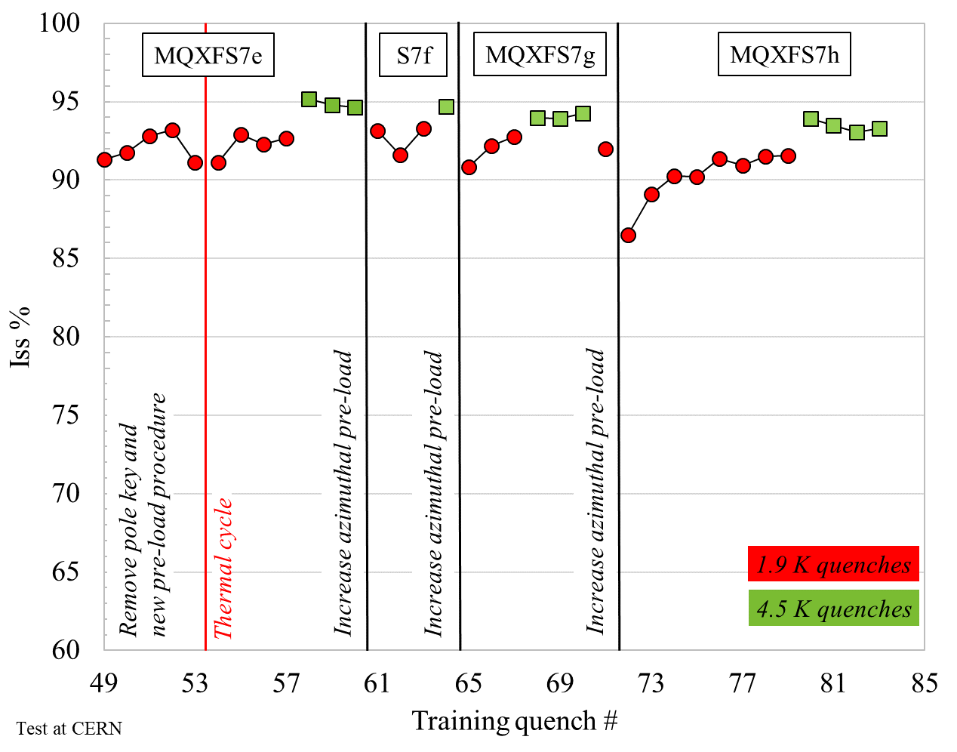
Training/plateau vs. pre-stress (II)
Impact of pre-stress on training/plateau further investigated with MQXFS7
Wider pre-load window to reach ultimate current (-75 to -170 MPa)
  …to be continued

Slide 28
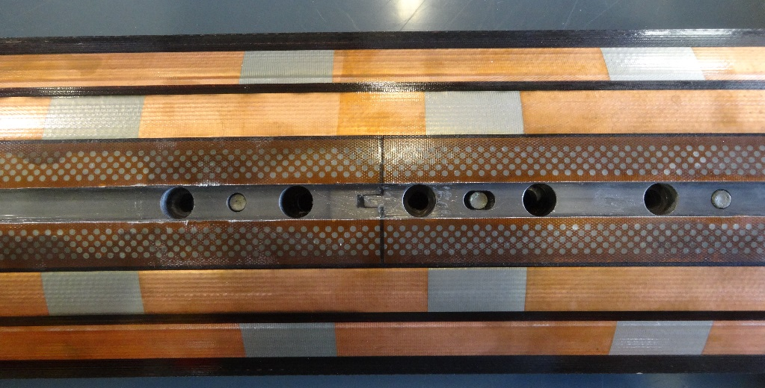
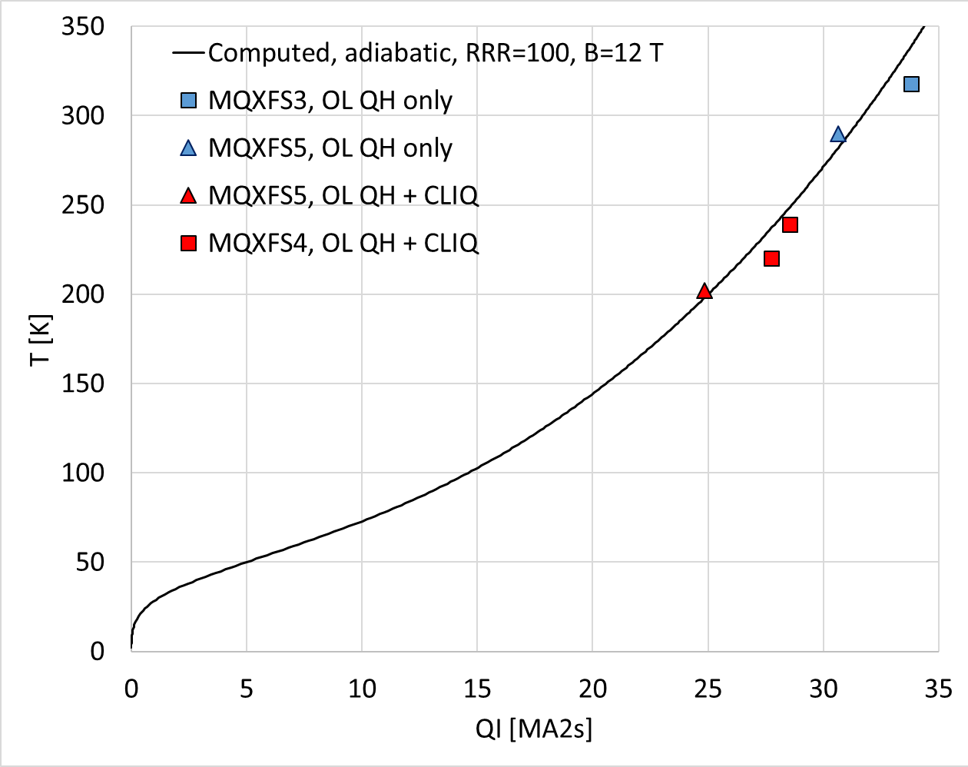
Quench protection
Stored energy density in the coil is 50% higher than for LHC dipoles
Two systems
  Outer layer quench heaters
  Coupling-Loss Induced Quench (CLIQ) System
Both performing as expected
  T_{peak} < 350 K with QH only and < 250 K with both
In MQXFS4 no sign of degradation to I_{ult} high QI test reaching a T_{hot} ≈ 400 K

Slide 29
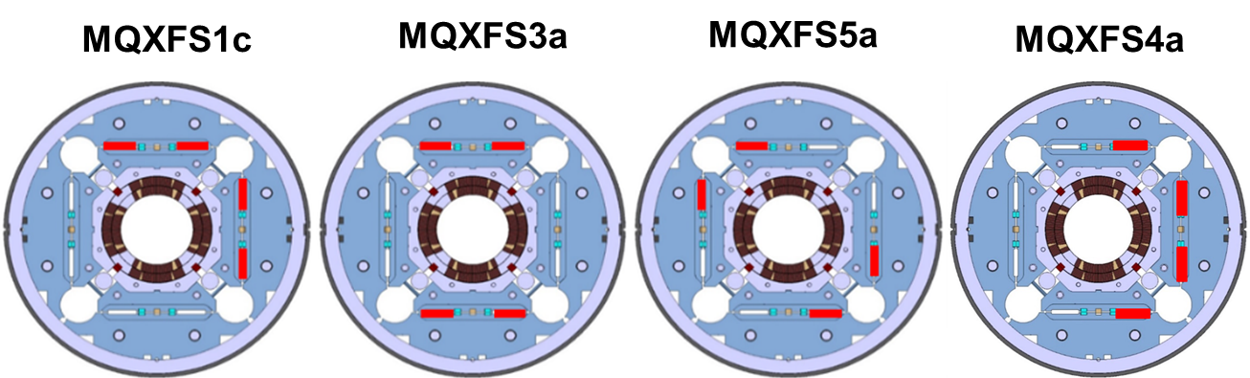
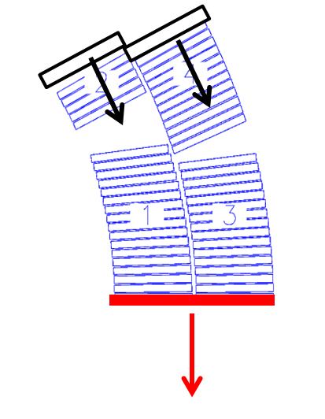
Field quality
Field quality either in spec or correctable with shims
Lesson learned from short models
  Magnetic shimming validated
  Correction of b₆ with pole and mid-plane shims
  The dominant source of errors is coil geometry and its initial assembly in the coil pack (before pre-loading)
See A. Milanese, WEPM060

Slide 30
Outline
Introduction and program goals
Magnet design
Program overview
The early magnets
Performance overview
Additional studies and outcomes
Conclusions

Slide 31
Conclusions
MQXF short models: collaborative effort of 4 different labs
7 magnets fabricated and tested
6 out of 7 reached ultimate
Maximum field level of 13 T
  Relevant for both CERN HFM and US MDP magnet program
90-95% of I_{ss} both at 1.9 K and 4.5 K
No degradation after thermal cycles and current cycles
No re-training after thermal cycle
A wide pre-load window to reach ultimate demonstrated
  From -75 MPa to -170 MPa after cool down
Validation of QP, insulation and correction of magnetic errors

Slide 32
Thank you

