Slide 1
Update on Costheta quench protection
V. Marinozzi
6/27/2023

Slide 2
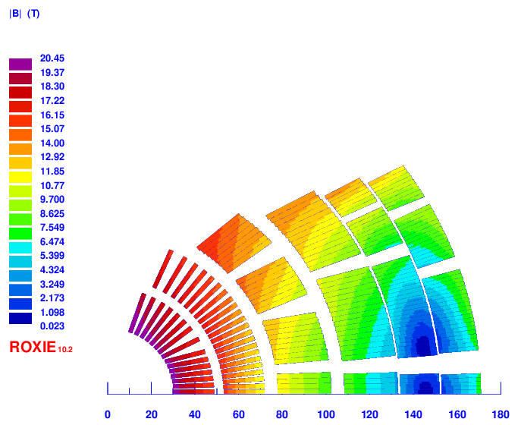
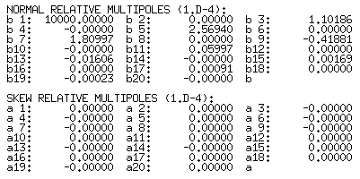
v26
2 layer HTS, 4 layer LTS
Strands: 0.9 – 1.1 – 0.8 mm, 36 – 40 – 40
Cable width: 18.59 – 24.38 – 17.73 mm
Stabilizer/Superconductor: 3 – 1 – 1.2
Coil width: 138 mm
Current: 13500
Peak field: 20.45 – 15.95 – 13.6 T
Margin: 87 – 84 – 83 %
J_{cu} on LTS: 1230 A/mm²

Slide 3
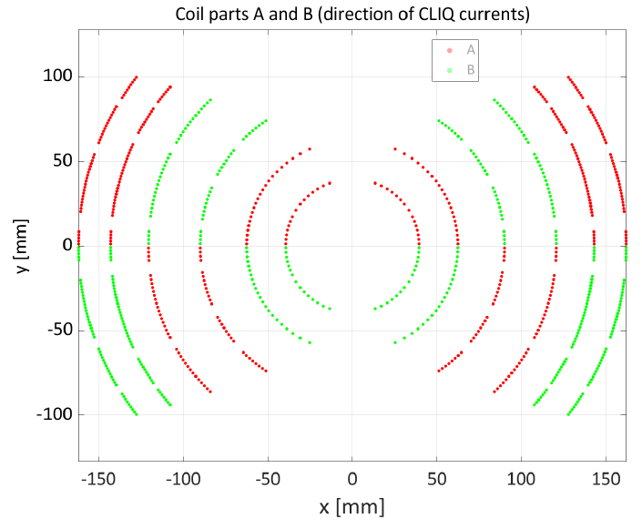
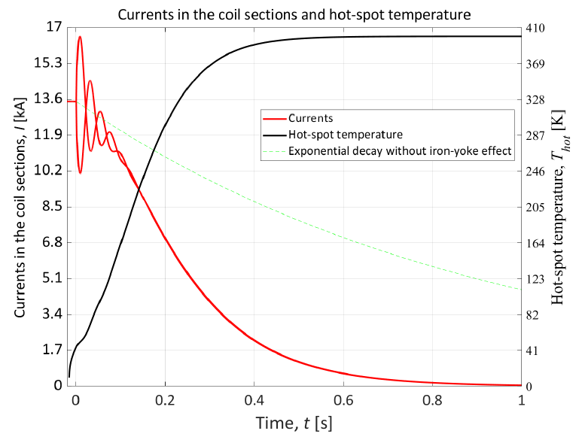
Optimized 40 mF, 1kV CLIQ
74 mΩ dump resistor
No QH

Slide 4
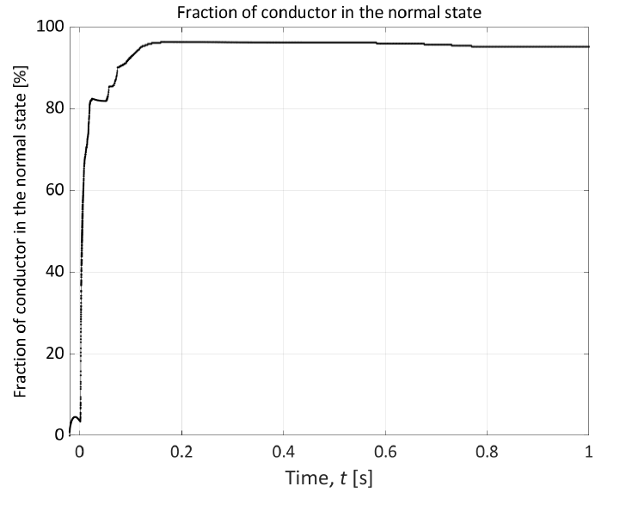
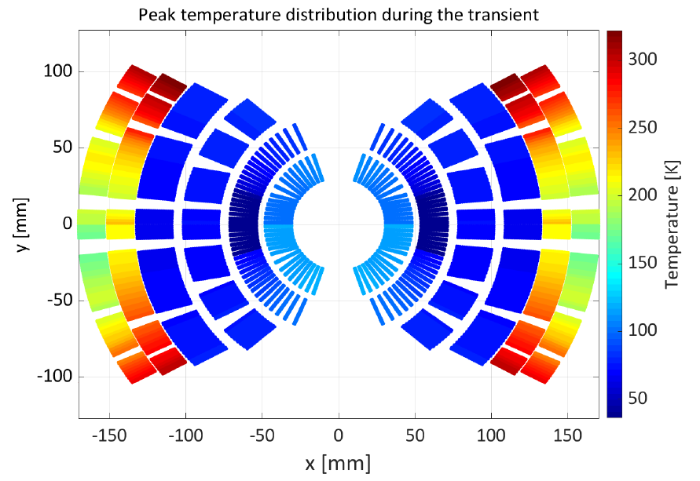
Exploiting almost all magnet resistance
Inner layers too cold respect to layers 5-6
Possible solution: reduce grading

Slide 5
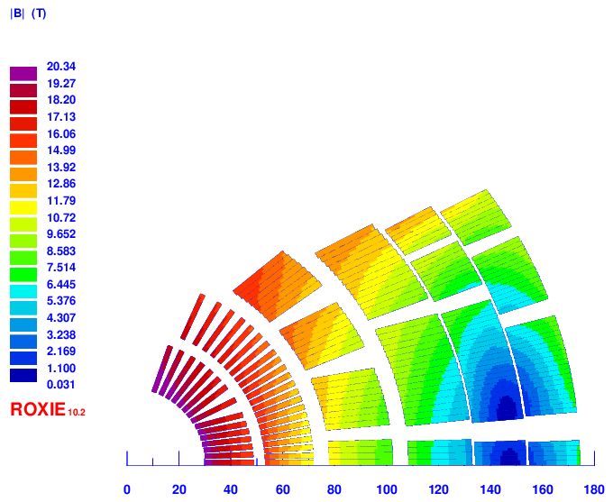
v28
2 layer HTS, 4 layer LTS
Strands: 0.9 – 1.1 – 0.8 mm, 36 – 40 – 44
Cable width: 18.59 – 24.38 – 19.503 mm
Stabilizer/Superconductor: 3 – 1 – 1.8
Coil width: 143 mm
Current: 13500
Peak field: 20.45 – 15.95 – 13.6 T
Margin: 87 – 84 – 87 %
J_{cu} on LTS: 950 A/mm²

Slide 6
Optimized 40 mF, 1kV CLIQ
74 mΩ dump resistor
No QH
Peak voltage: 1.5 kV

Slide 7
More uniform temperature distribution

Slide 8
Optimized 40 mF, 1kV CLIQ
No dump
No QH
Peak voltage: 1.5 kV

Slide 9
Optimized 40 mF, 1kV CLIQ
74 mΩ dump resistor
No QH
Peak voltage: 850 V

