Slide 1

Neutrino flavor transformation and the cosmic lepton asymmetry
Luke Johns

Slide 2


collaborators
George Fuller
Vincenzo Cirigliano & Mark Paris
Mattia Mina
Luke Johns

Slide 3
BBN and the CMB agree on the baryon asymmetry:
Luke Johns

Slide 4
BBN and the CMB agree on the baryon asymmetry:
But what about the lepton
asymmetry?
Luke Johns

Slide 5
BBN and the CMB agree on the baryon asymmetry:
But what about the lepton
asymmetry?
The constraint on lepton number
is orders of magnitude weaker:
Luke Johns

Slide 6
Lepton numbers much larger than the
baryon asymmetry are utilized in a
viable production scenario for sterile
neutrino dark matter.
BBN and the CMB agree on the baryon asymmetry:
Prob. that neutrino
is in sterile state
But what about the lepton
asymmetry?
The constraint on lepton number
is orders of magnitude weaker:
Luke Johns

Slide 7

Lepton numbers much larger than the
baryon asymmetry are utilized in a
viable production scenario for sterile
neutrino dark matter.
BBN and the CMB agree on the baryon asymmetry:
Prob. that neutrino
is in sterile state
But what about the lepton
asymmetry?
The Standard
Model struggles;
leptogenesis is
promising.
The constraint on lepton number
is orders of magnitude weaker:
baryon
asymmetry
Luke Johns

Slide 8
A lepton number modifies the way
neutrino flavor evolves.
(See next slide.)
Moreover, BBN is sensitive to both
lepton number and flavor:
An asymmetry drives a faster
expansion rate.
Lunardini & Smirnov 2001
Dolgov et al. 2002
Abazajian et al. 2002
Wong 2002
Pastor et al. 2009
Gava & Volpe 2010
Mangano et al. 2011
Mangano et al. 2012
Castorina et al. 2012
Luke Johns

Slide 9
Neutrinos oscillate even in vacuum.
But things get more interesting in medium…
“coherent”
“incoherent”
dominates at
low temp.
dominates at
high temp.
The coherent term is like a
nonlinear, matrix-structured
index of refraction:
Lepton asymmetry
Luke Johns

Slide 10
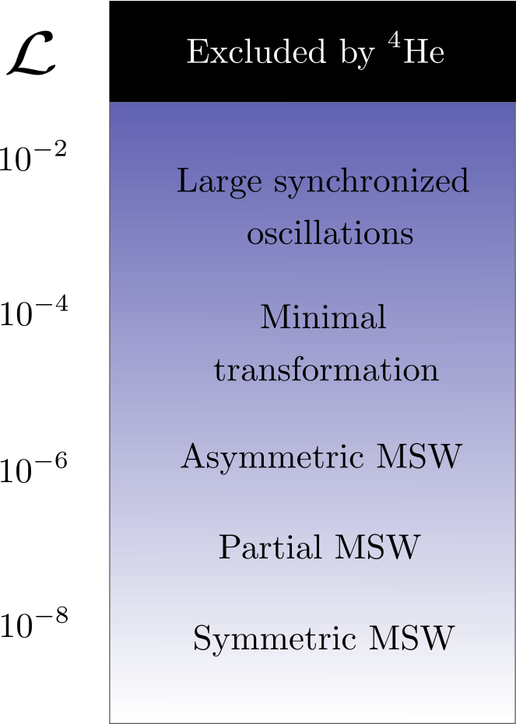
Our calculations have revealed a menagerie of different behaviors for sub-constraint lepton asymmetries…
Luke Johns
Johns, Mina, Cirigliano, Paris, and Fuller, PRD 2016

Slide 11
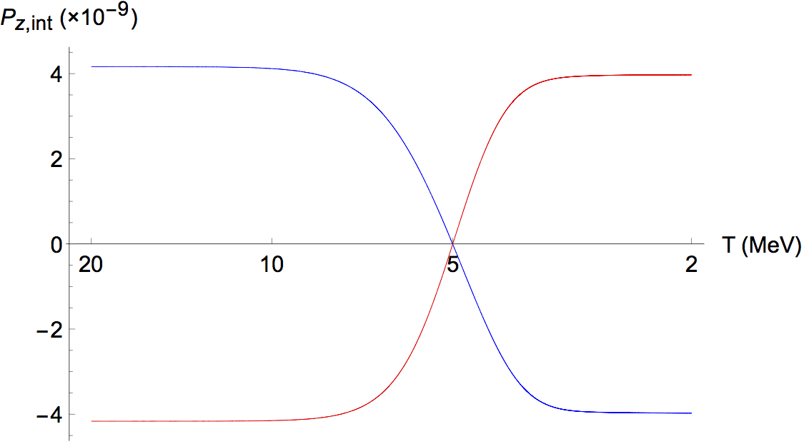
Our calculations have revealed a menagerie of different behaviors for sub-constraint lepton asymmetries…
MSW resonance
neutrinos antineutrinos
Luke Johns
Johns, Mina, Cirigliano, Paris, and Fuller, PRD 2016

Slide 12
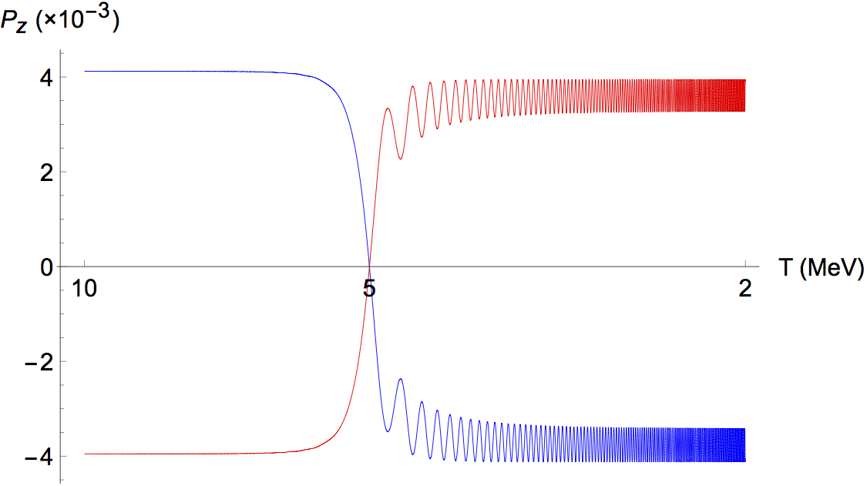
Our calculations have revealed a menagerie of different behaviors for sub-constraint lepton asymmetries…
MSW resonance
neutrinos antineutrinos
Luke Johns
Johns, Mina, Cirigliano, Paris, and Fuller, PRD 2016

Slide 13
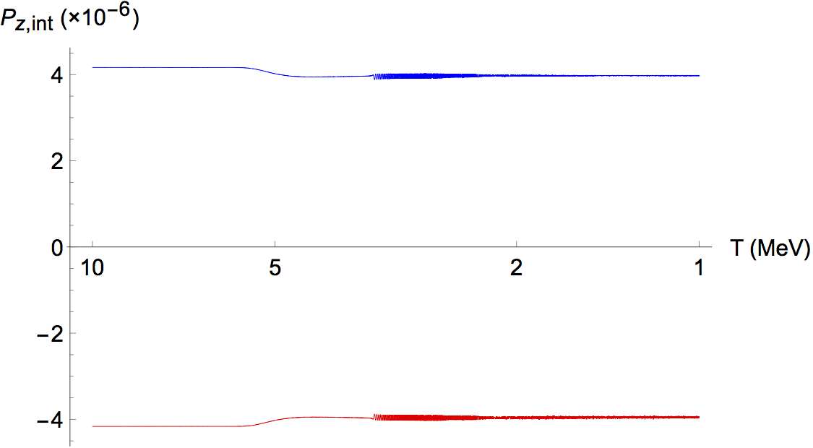
Our calculations have revealed a menagerie of different behaviors for sub-constraint lepton asymmetries…
MSW resonance
neutrinos antineutrinos
Luke Johns
Johns, Mina, Cirigliano, Paris, and Fuller, PRD 2016

Slide 14
Suppression of flavor conversion…
There is an exact mathematical equivalence
between astrophysical neutrino flavor evolution
and gyroscopic pendulum motion.
Hannestad et al., PRD 2006
Duan et al., PRD 2007
  Oscillations in vacuum
  correspond to the top
  swinging like a pendulum,
  with gravity set by vacuum
  mixing parameters.
  A lepton asymmetry
  corresponds to the spin of
  the top, which induces
  precession.
Johns and Fuller, PRD 2018
Luke Johns

Slide 15

Suppression of flavor conversion…
There is an exact mathematical equivalence
between astrophysical neutrino flavor evolution
and gyroscopic pendulum motion.
Hannestad et al., PRD 2006
Duan et al., PRD 2007
  Oscillations in vacuum
  correspond to the top
  swinging like a pendulum,
  with gravity set by vacuum
  mixing parameters.
  A lepton asymmetry
  corresponds to the spin of
  the top, which induces
  precession.
Luke Johns
Wikipedia

Slide 16
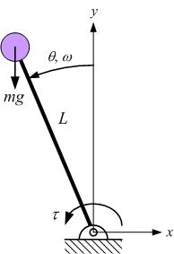
What happens at MSW?
Nonadiabaticity.
dsc.utrgv.edu

Slide 17
Log₁₀[ω_{eff}/H]
T
(MeV)
P_{z}
T
(MeV)
η_{e}
This explains the minimal-transformation regime.

Slide 18
This ω_{eff} phenomenon might also apply to
compact-object environments…
Lunardini, Muller, Janka, PRD 2008
Example:
O-Ne-Mg
supernovae
SNe (canonical)
EU (asymmetric)
(e.g.)

Slide 19
conclusion
Lepton asymmetries are associated with a rich array
of flavor phenomena. This talk emphasized a
new one, which can suppress resonant flavor
conversion.
Ongoing project: Realistic coupling of neutrinos, nuclides,
and plasma over the weak-decoupling / BBN epoch.
(Building on Grohs et al., PRD 2016.)
Open questions: How does this relate to compact objects?
  Or to flavor instabilities? (e.g., Shalgar et al., PLB 2017.)
Luke Johns

