Slide 1
Dark Matter Searches with the ATLAS Detector
Young-Kee Kim
The University of Chicago
On behalf of The ATLAS Collaboration
May 30, 2018
CIPANP 2018

Slide 2
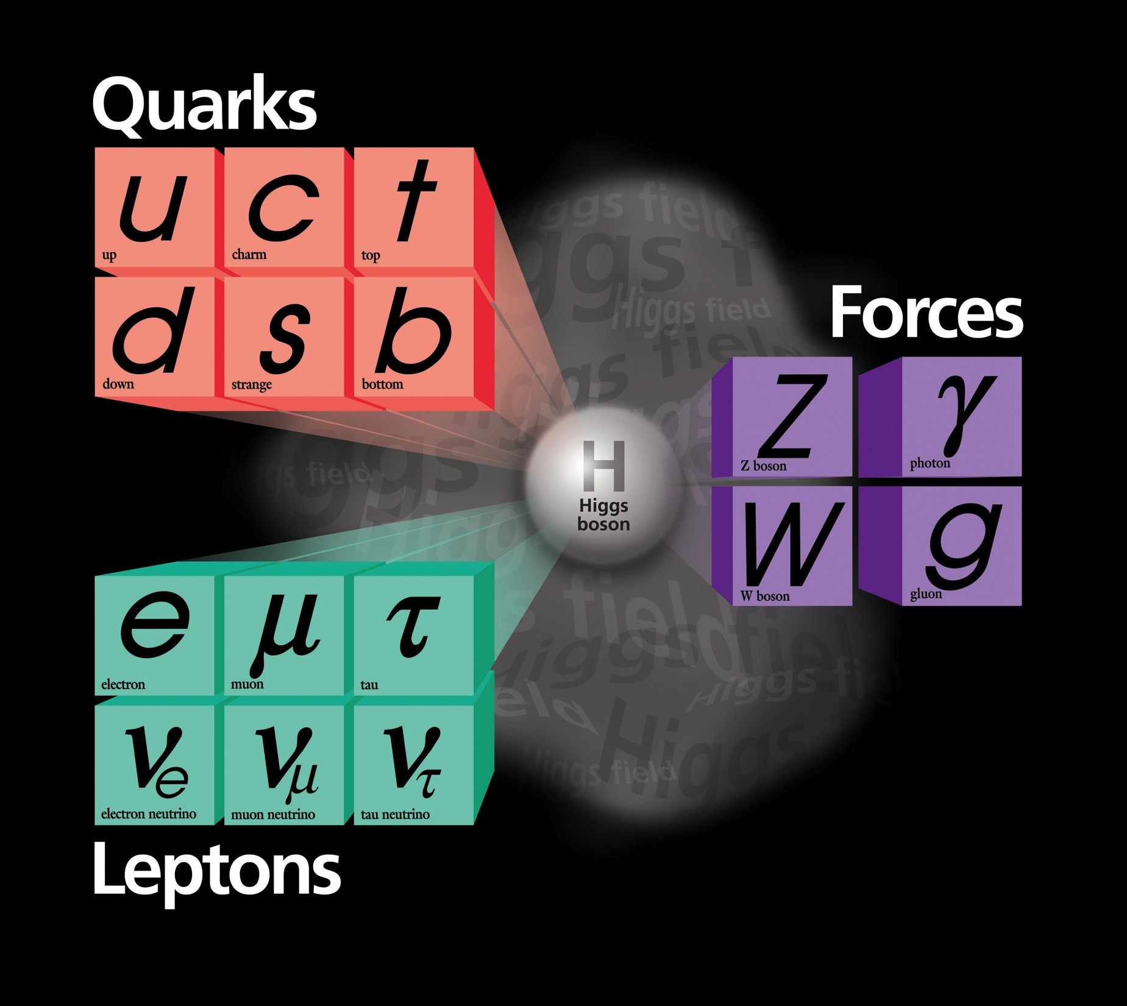
…… the mysteries
Physics beyond the SM
is needed to answer.
The Standard Model
WHY ?
  origin of mass
  6 quarks
  3 families
  neutrinos
  forces
  anti-matter
WHAT ?
  dark matter
  dark energy
New physics searches at LHC
  Higgs as a new tool for discovery
  Dark matter
  SUSY
  Other known new physics models
  The unknown unknowns

Slide 3
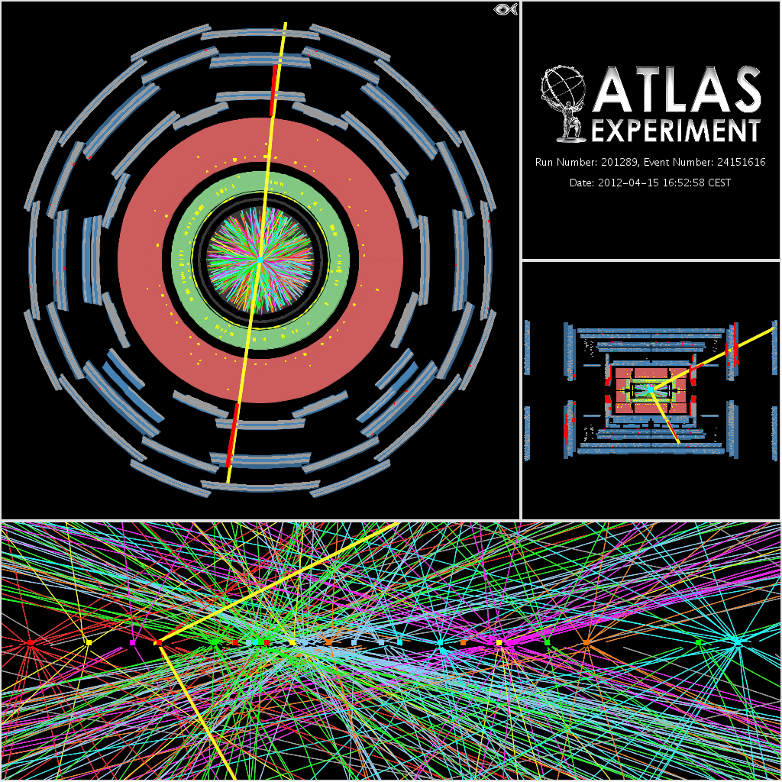
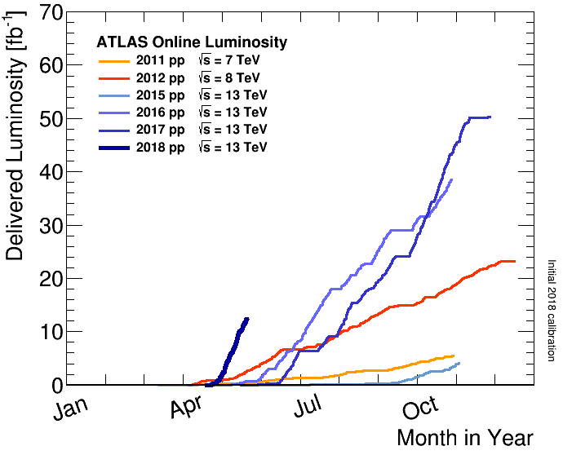
Exploring the unknown at LHC
at a wide range of unexplored energies and couplings
with unprecedented rates
Challenges from a large # of pp interactions in an event
(“pileup”)
using state-of-art tools
  Detectors
  Triggers
  Computing
  Analysis techniques
  Theoretical calculations
Run I
Run II
2017
2016
2018
2012
2011
2015

Slide 4
Dark Matter Searches
Scattering Annihilation Production
q
χ
q
q
χ
q
χ
χ
χ
q
q
χ
χ q → χ q χ χ → q q q q → χ χ
Direct Search Indirect Search Collider

Slide 5
Dark Matter Searches at LHC
Weakly Interacting Massive Particle (WIMP)
Run I
Effective-field-theory approach
Run II
variety of mediator models:
spin-1 vector / axial vector
spin-0 scalar / pseudoscalar
Simplified model framework
[arXiv: 1507.00966]
g_{q}, g_{l}, g_{χ}, m_{χ}, m_{A}: σ(qq → χχ, qq, ll)
q
χ
χ
q
Zoom in
A
_{mediator}
g_{q}
g_{χ}
q
χ
χ
q

Slide 6
Dark Matter Searches at LHC
Weakly Interacting Massive Particle (WIMP)
qq → A → χ χ
qq → A → qq, ll
Dark Matter
Mediator Searches
at ATLAS
Talk by Peter McNamara
m_{χ}
σ
m_{χ}
g_{q}, g_{l} , g_{χ}
Excluded by non-LHC
@90% CL
off-shell
mediator
m_{A} = 2 m_{χ}
Excluded by LHC
@90% CL
on-shell
mediator
Excluded by LHC
@95 CL
Excluded
@95%CL
g_{q}, g_{l}, g_{χ}
g_{q}, g_{l}, g_{χ}
m_{A}
m_{χ}
m_{A}
σ(pχ → pχ) ~ [ g_{q} g_{χ} m_{χp} / m_{A} ] ²
This presentation: ATLAS w/ L = 36 fb⁻¹ @13 TeV (2015-2016)

Slide 7
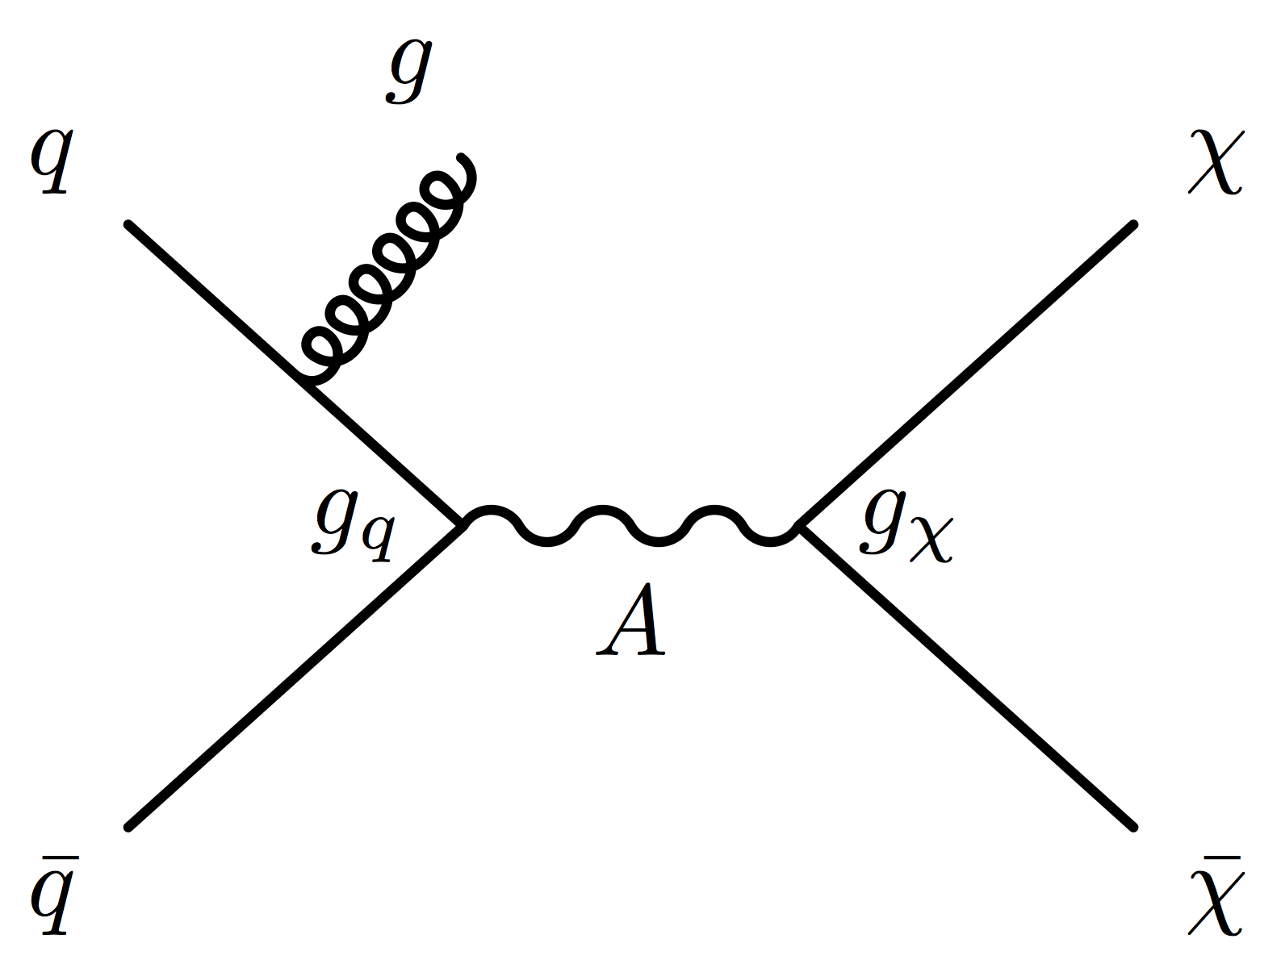
Mono-object searches for Dark Matter
qq → A → χχ (not observable) qq → A → χχ + “observable”
“mono” system of observable particles, recoiling against χ χ
jet (g), photon (γ), weak bosons (Z/W), Higgs (h), Heavy Flavor quarks (t, b), ….
g, γ, Z/W, h, t, b, …
χ
χ
”mono-object” list growing recently with the increasing number of theoretical ideas
Triggers: missing energy triggers or γ / e / μ triggers
Event selection: missing energy + mono object (E_{T}^{miss} = p_{T}^{mono} > 250 ~ 100 GeV)

Slide 8
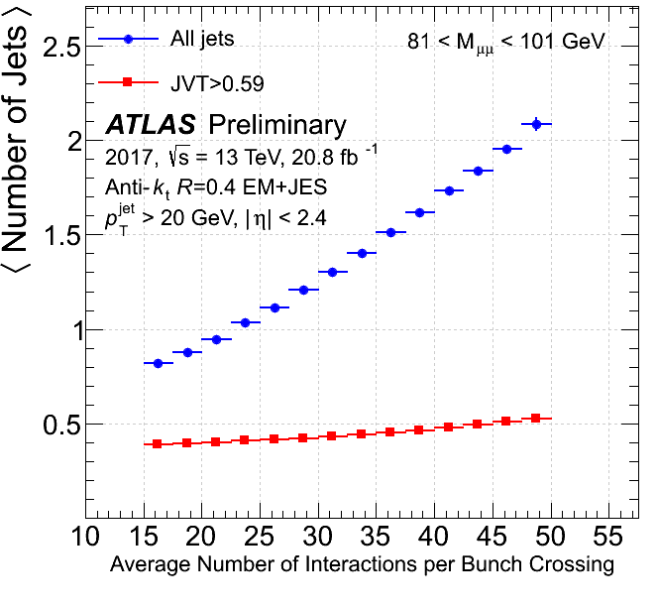
Algorithms for objects
jet, e, μ, γ, b, top, W, Z, missing energy, …
Boosted particles: high energy top, W, Z, H, …
  daughters merged into a single object (jj, jjj → J)
Jet construction
”pileup” suppression
[1510.03823]
<# of interactions> / p-p bunch crossing

Slide 9
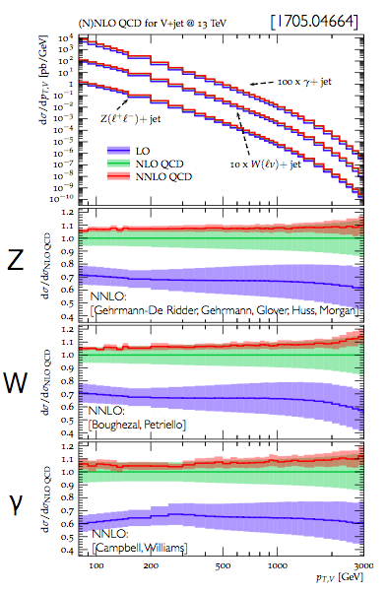
Background: Standard Model contributions
Theory σ(W, Z, γ + jet)
W,Z,γ + jet, top: data driven with aid of MC simulation
  Identify control regions (Z→ll, W→lν, tt/ttγ/ttZ: no DM expected)
  Prediction (higher order QCD / EWK corrections) → Data vs MC: Normalization → Extrapolation to signal region
  Systematic uncertainty: statistics in control regions
Multi-jet QCD: data driven
  Fit a smooth function
  Counting in neighboring regions
Electroweak: MC simulation
  Higher order corrections
[1510.03823]
100 x σ(γ + jet)
σ(Z + jet)
10 x σ(W + jet)
Z + jet
W + jet
γ + jet
NNLO
NLO
LO
dσ/dσ_{NNLO}
100 200 500 10000 3000
p_{T} of Z, W, γ [GeV]

Slide 10
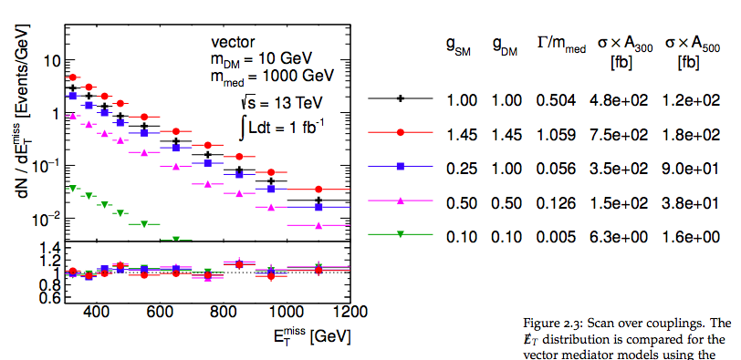
Benchmark signal model
Simple extension of the Standard Model
Additional U(1) gauge symmetry
m_{A} = 1 TeV, m_{χ} = 10 GeV, g_{q} =1, g_{χ} = 0.25, g_{l} = 0
(recommended by ATLAS/CMS DM forum, arXiv:1507.00966)
300 GeV

Slide 11
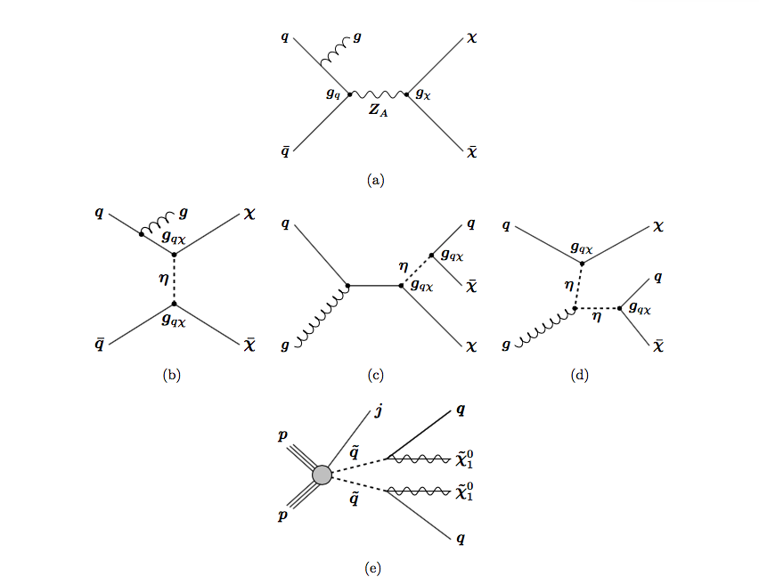
Jet + Dark Matter
Mediator Z_{A}
with axial-vector couplings
exchanged in the s-channel
…
Colored scalar mediator η
…
…
…
q
SUSY (compressed mass scenario)
q → (q) + X₁⁰
boosted
~
~
q
…

Slide 12
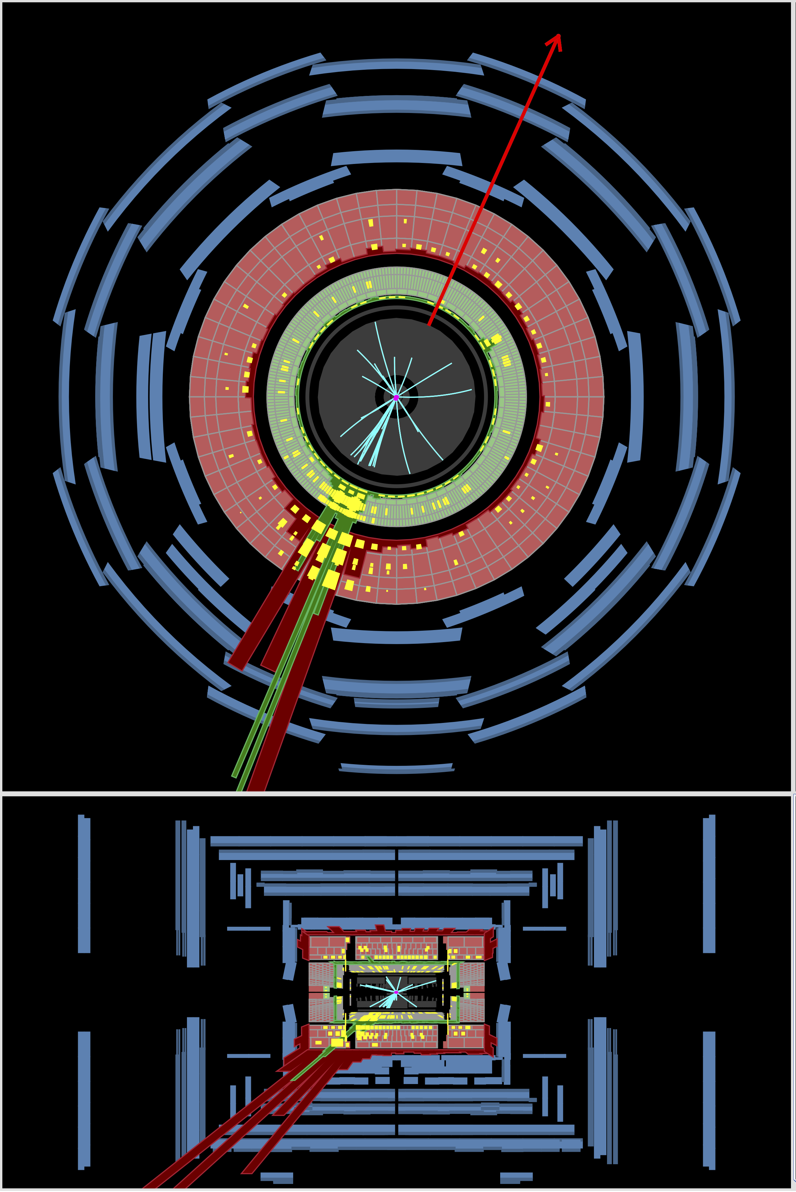
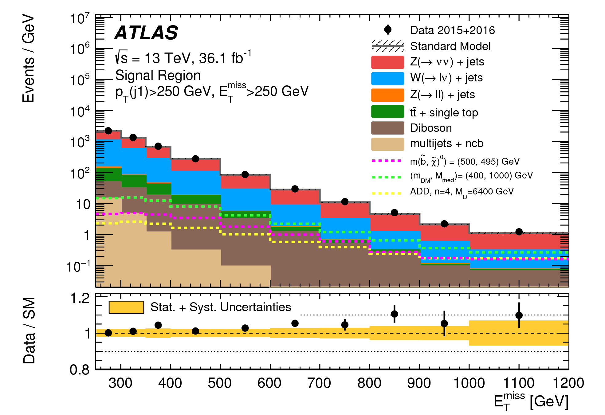
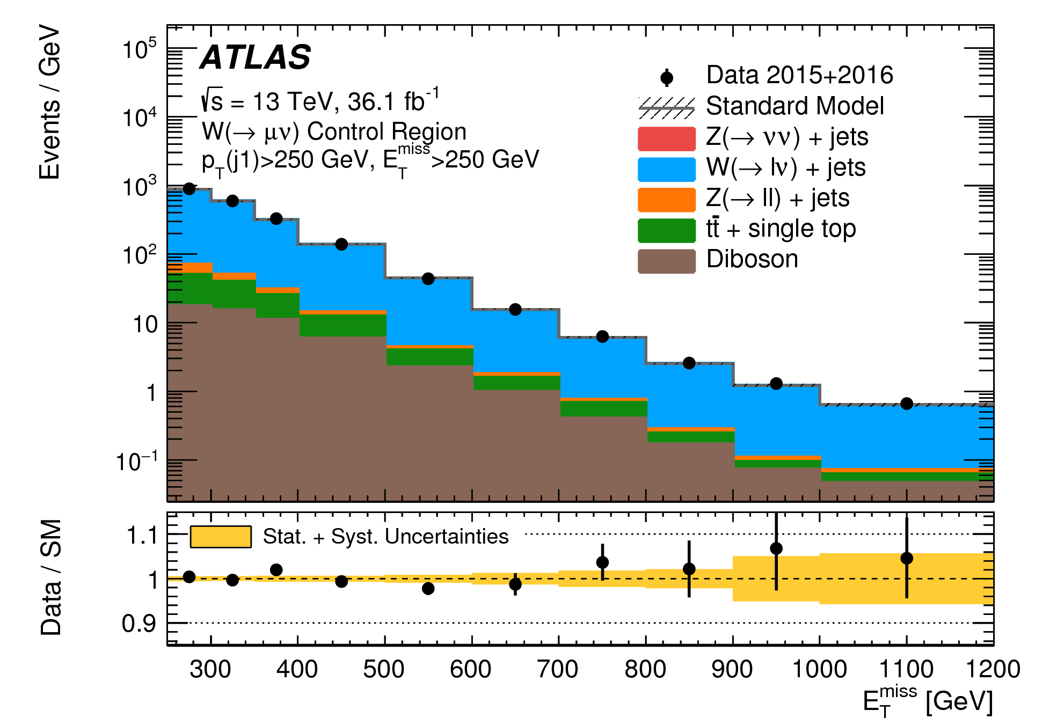
Jet + Dark Matter
JHEP 01 (2018) 126
E_{T}^{miss} = 954 GeV
2015
W → τν
Signal region
250 GeV
p_{T} ^{jet} = 973 GeV
Control region

Slide 13
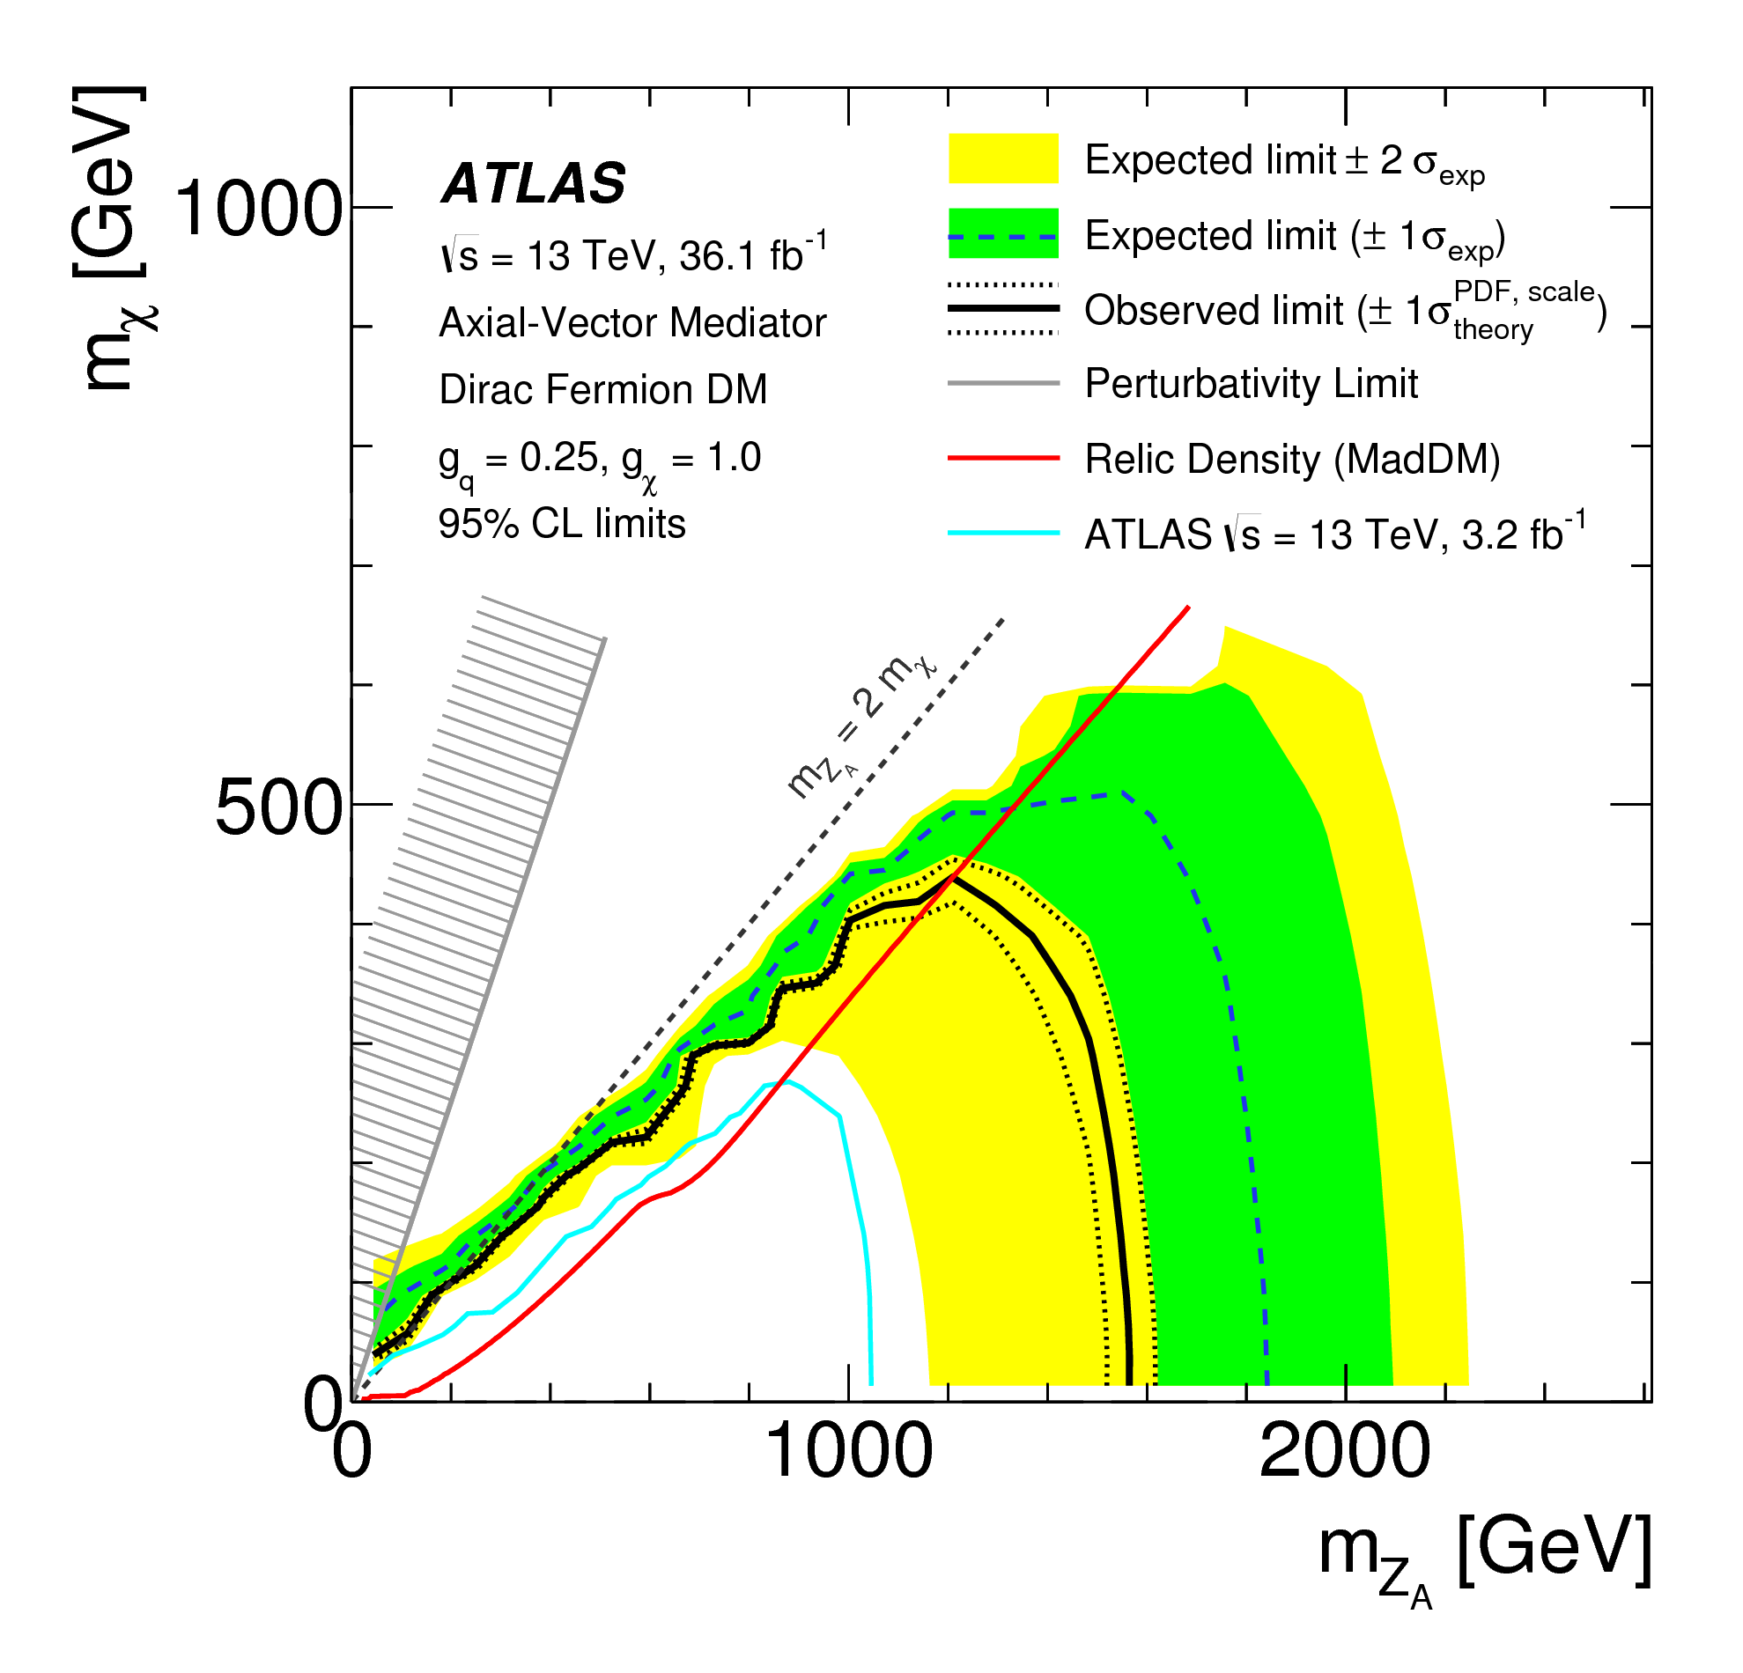
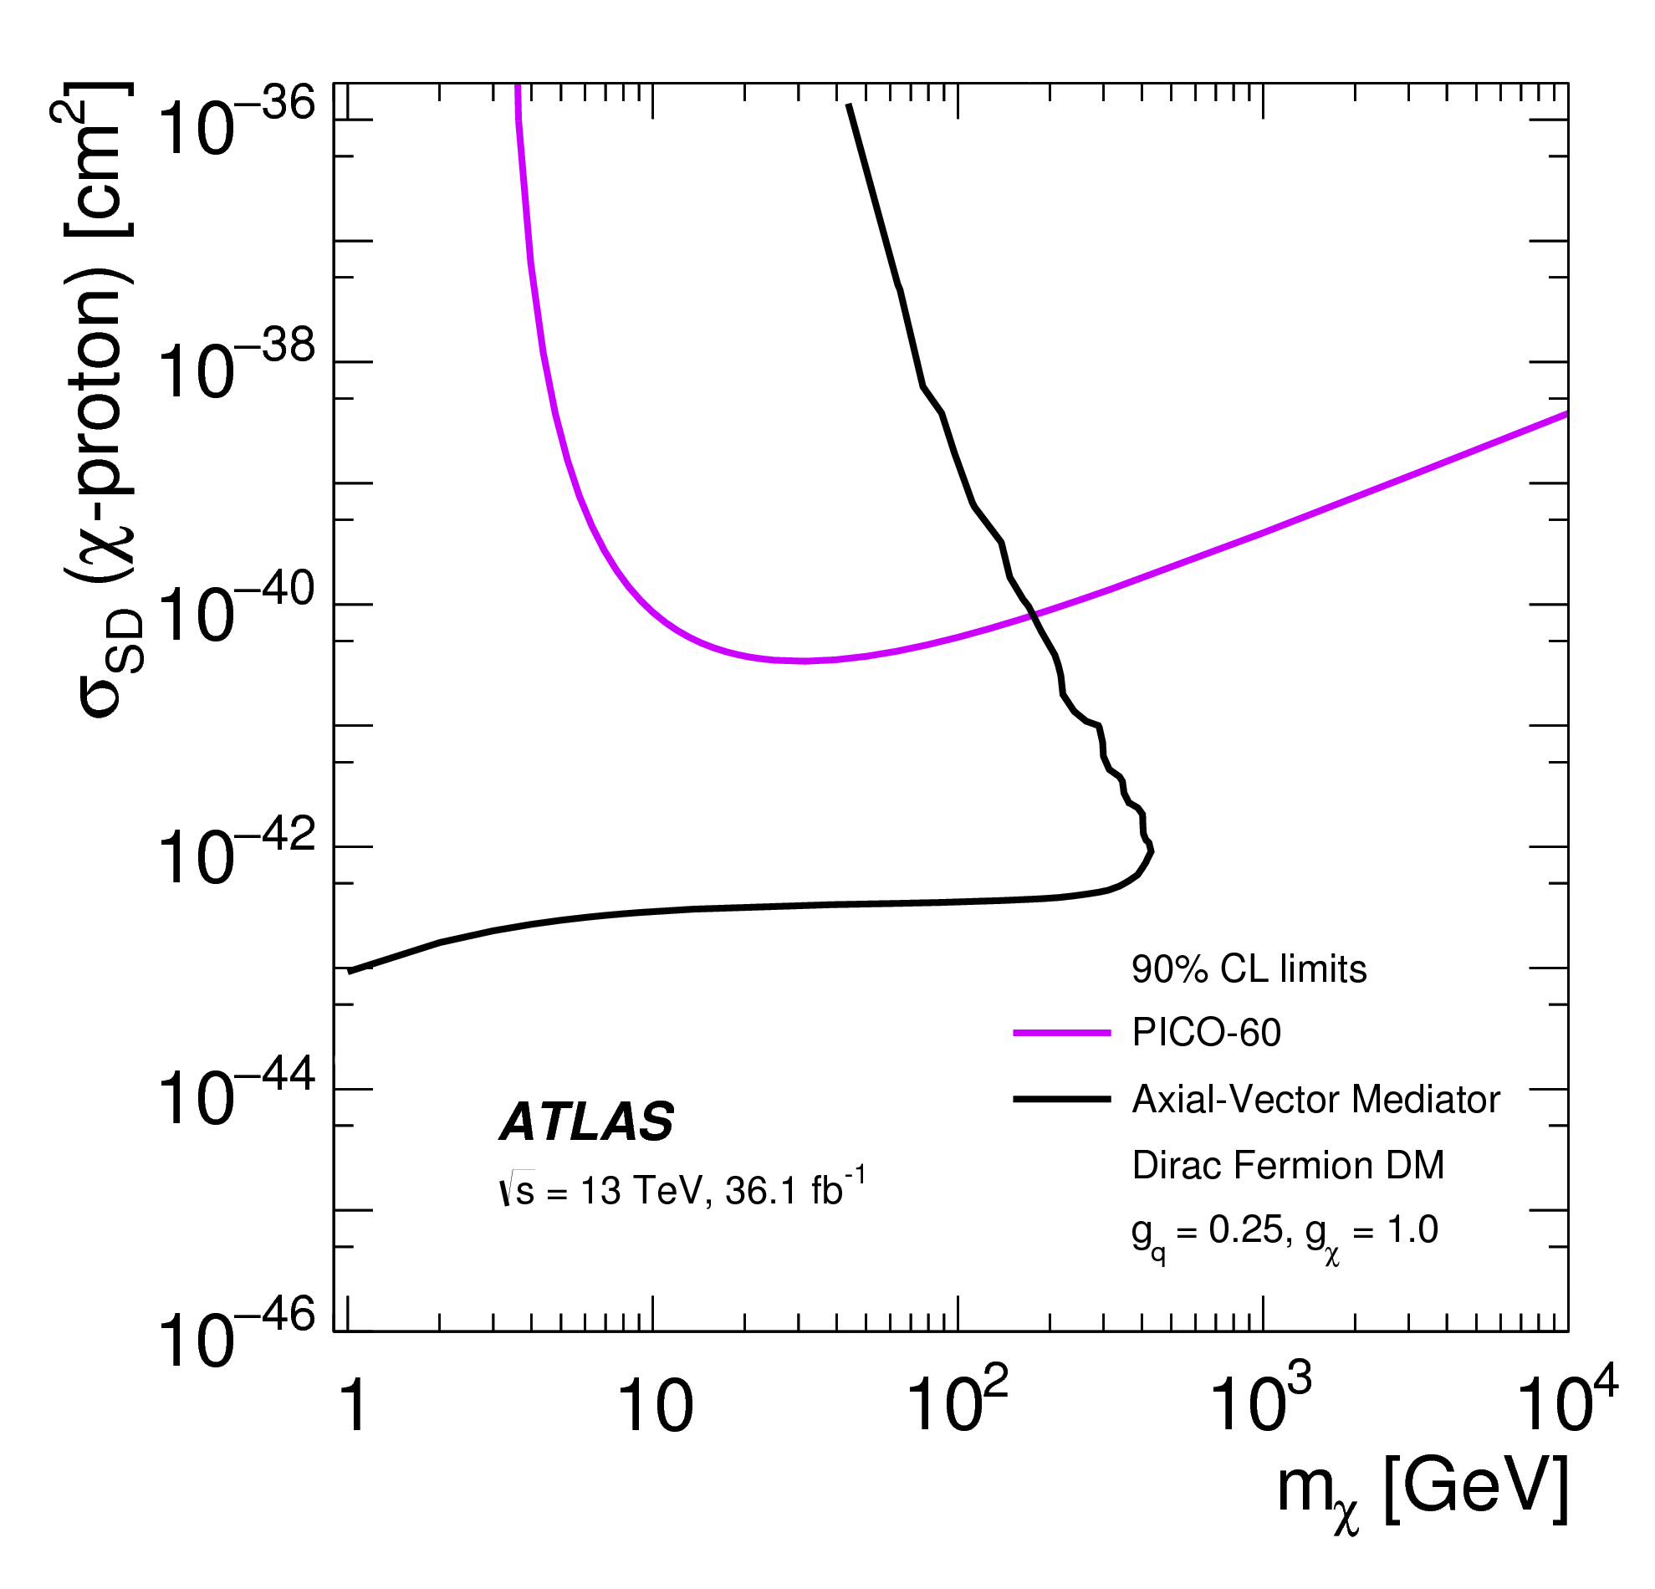
Jet + Dark Matter
JHEP 01 (2018) 126
PICO-60
ATLAS
Perturb. unitarity
vio.: m_{χ} > m_{Z} ⎷(π/2)
Planck + WMAP
1.55 TeV
Observed limits: worse than expected sensitivity due to slight excess in data
(similar limits for the vector mediator)

Slide 14
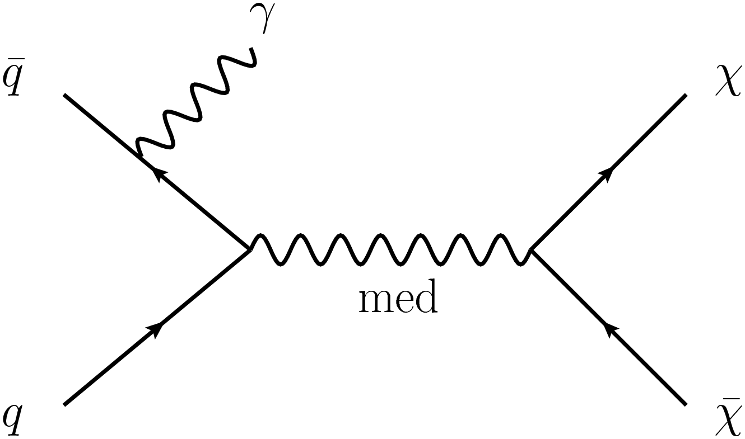
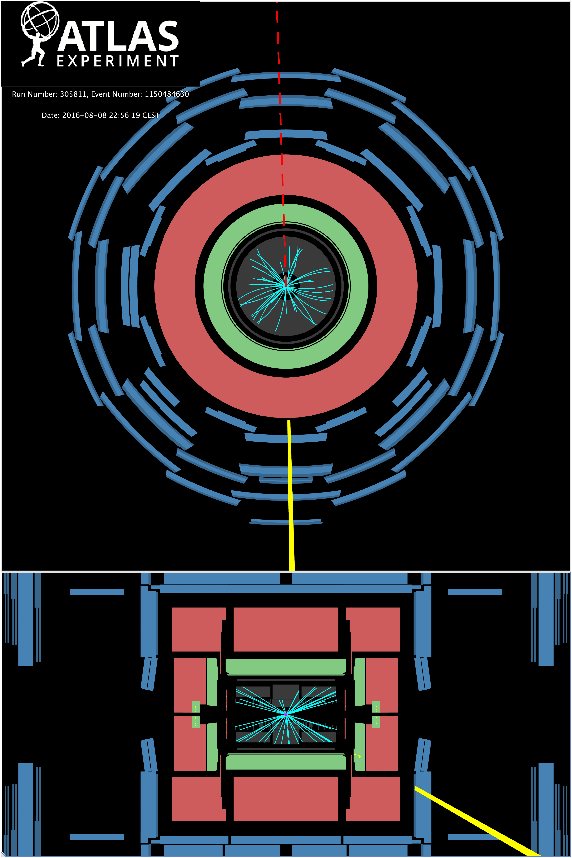
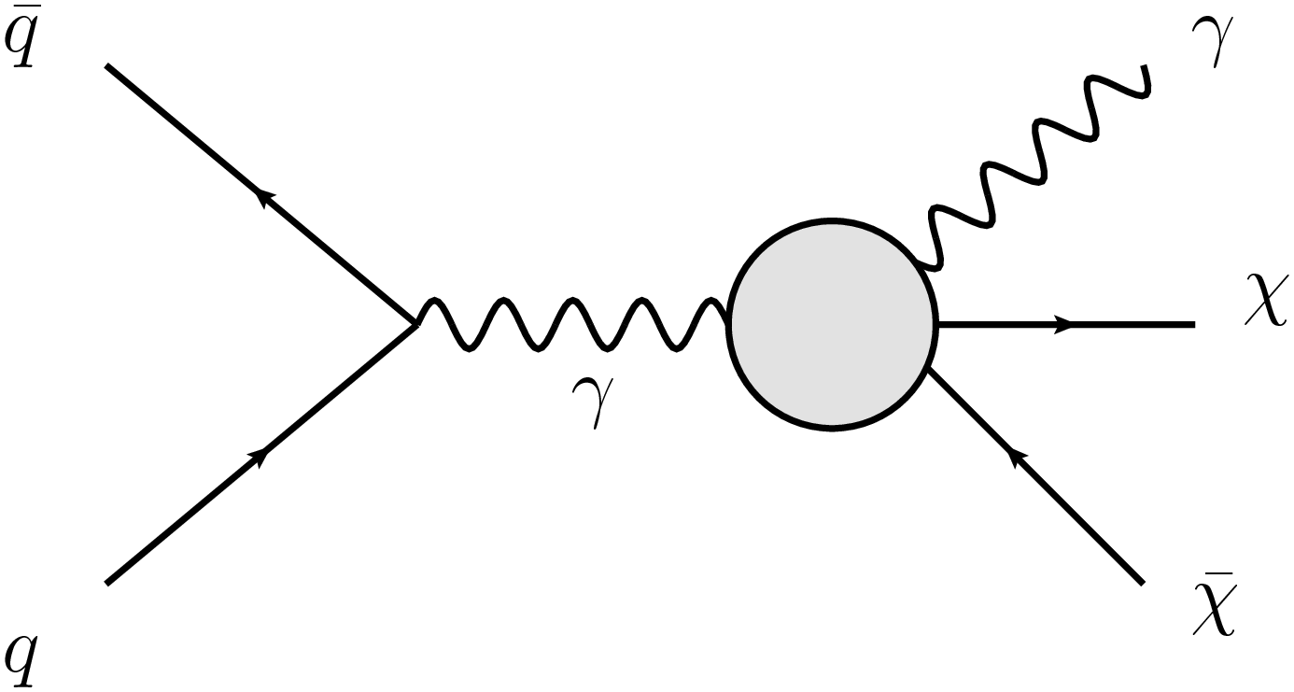
γ + Dark Matter
E_{T}^{miss} = 268 GeV
2016
via mediator
p_{T}^{γ} = 265 GeV
via effective vertex
(γγχχ contact interaction)

Slide 15
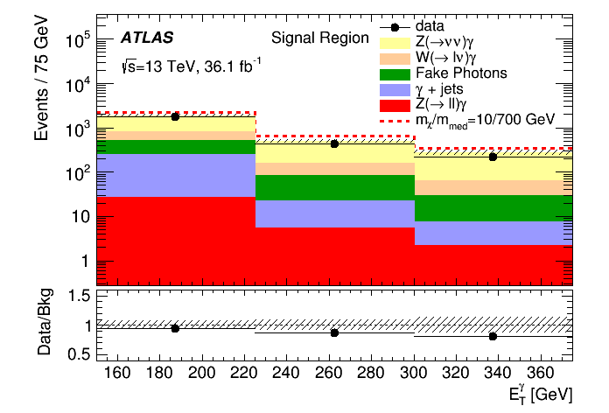
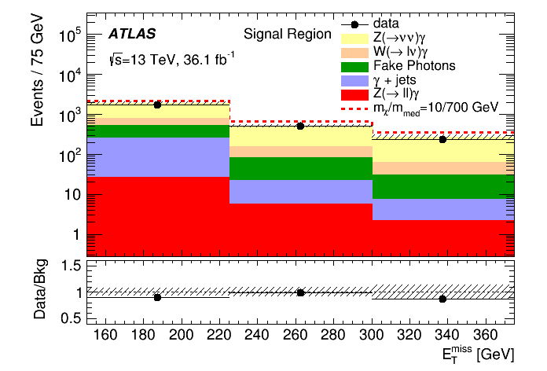
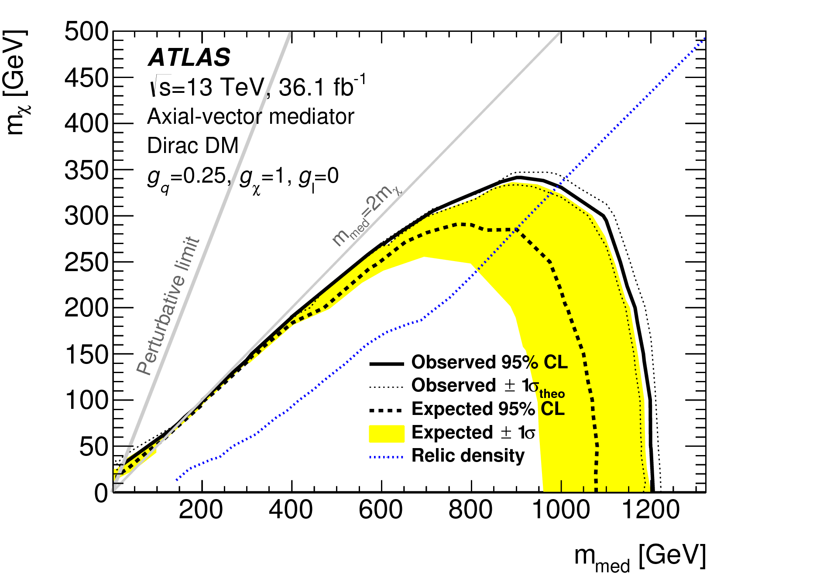
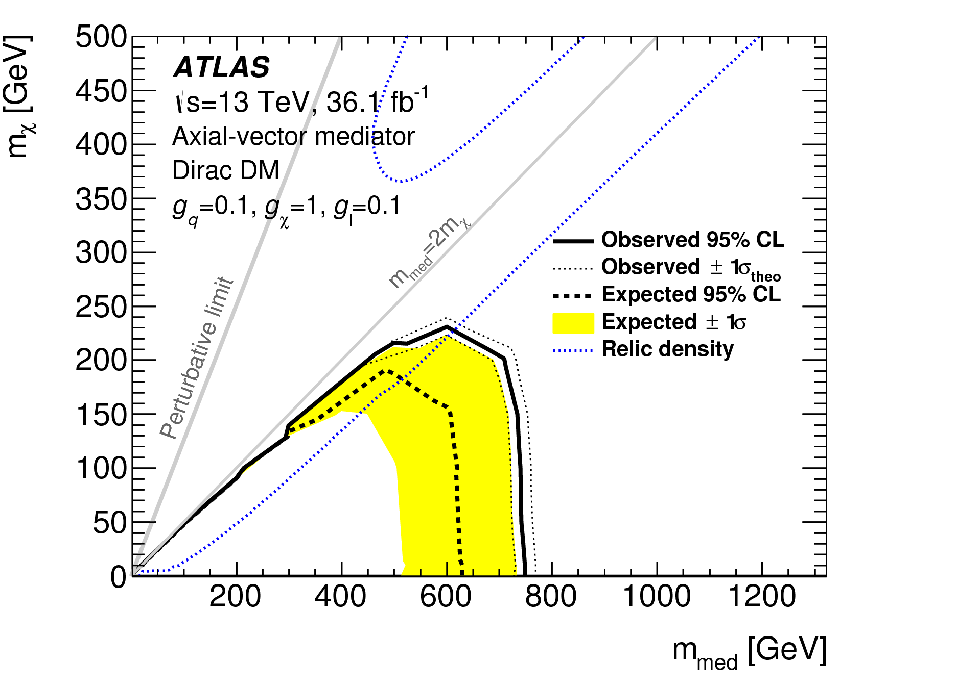
γ + Dark Matter
Eur. Phys. J. C77 (2017) 393
150 GeV
150 GeV
Similar limits set for the vector mediator

Slide 16
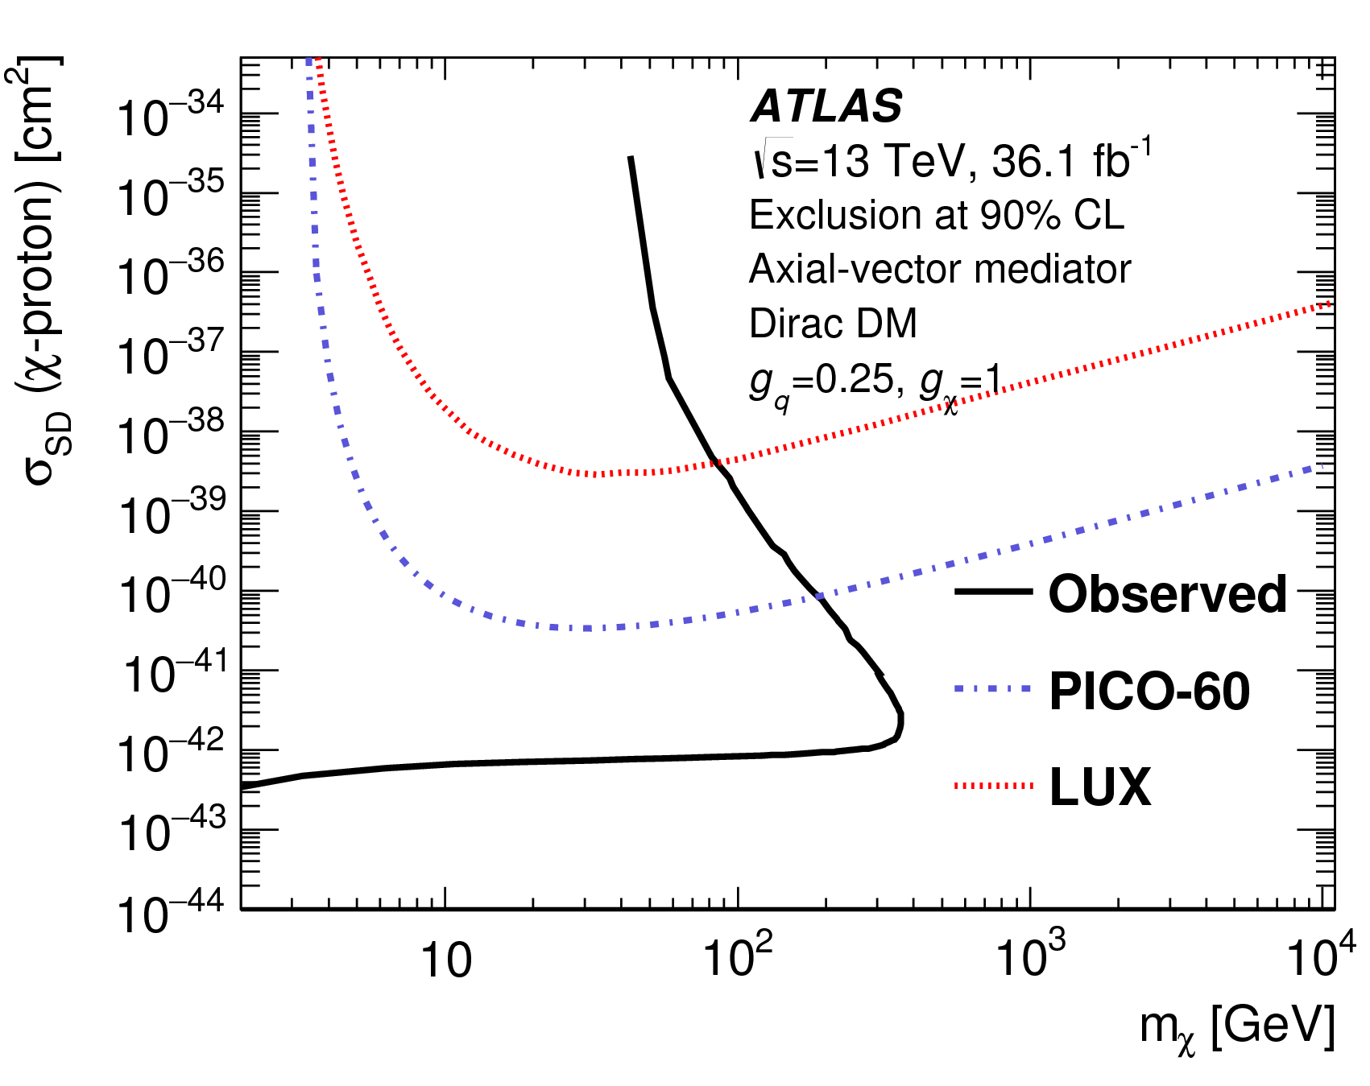
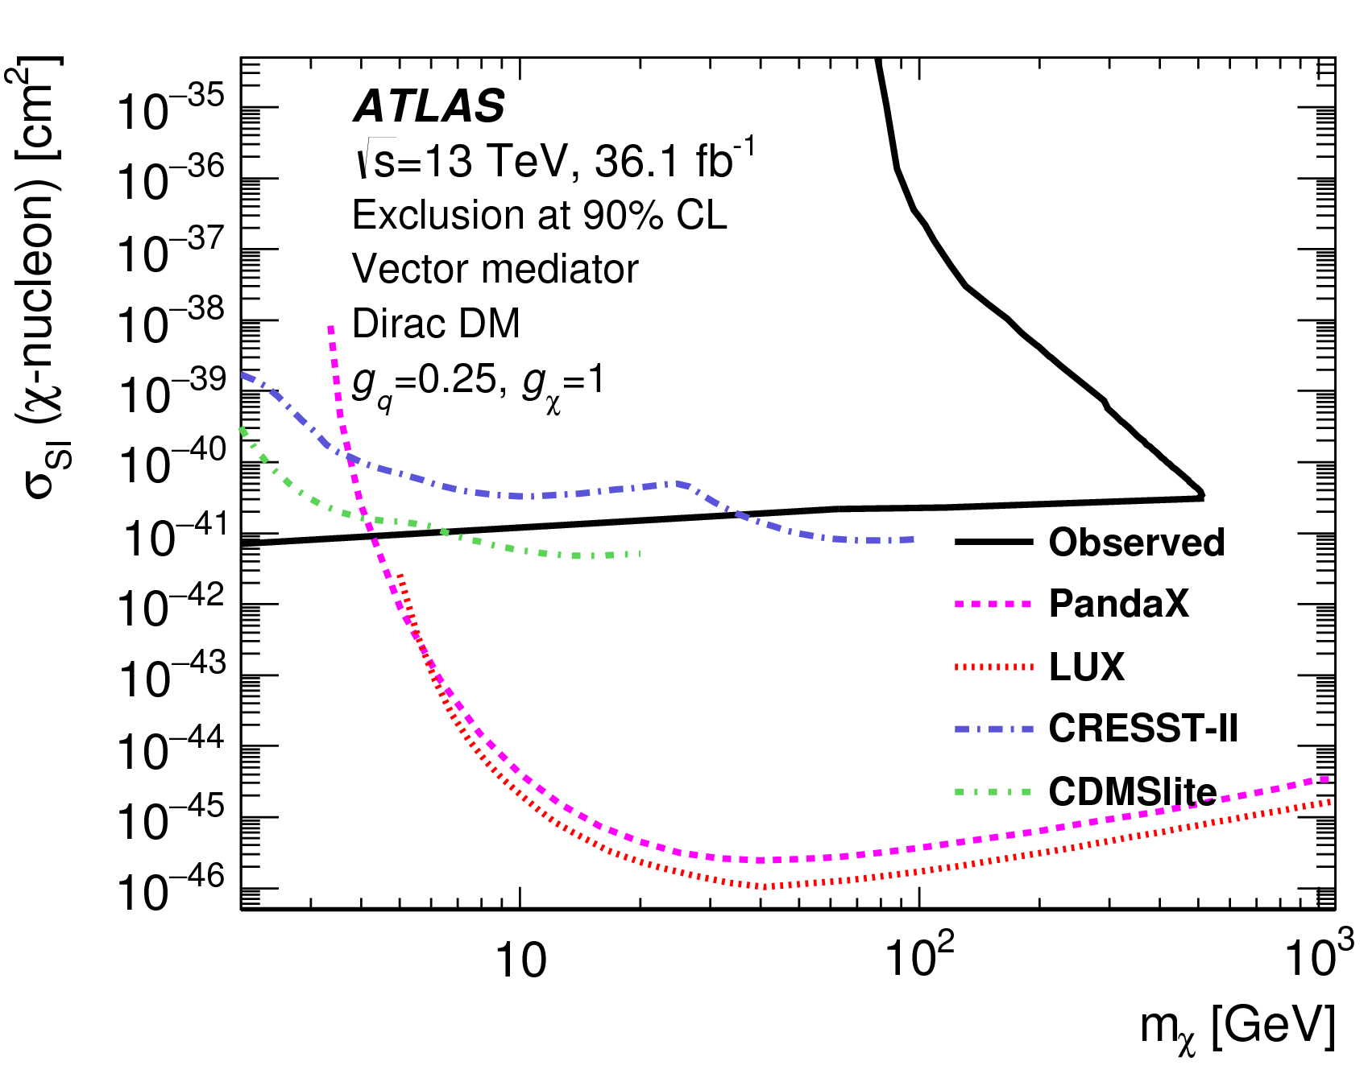
γ + Dark Matter
Eur. Phys. J. C77 (2017) 393
Axial vector, Spin dependent Vector, Spin independent
ATLAS
ATLAS

Slide 17
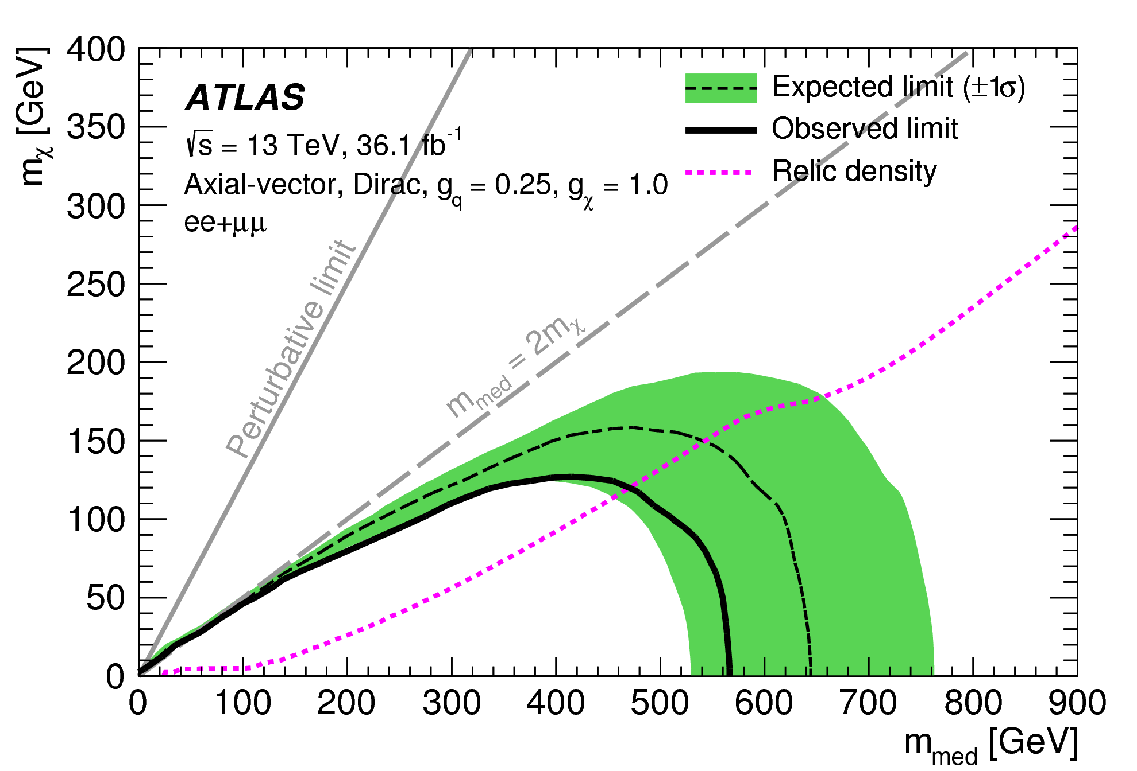
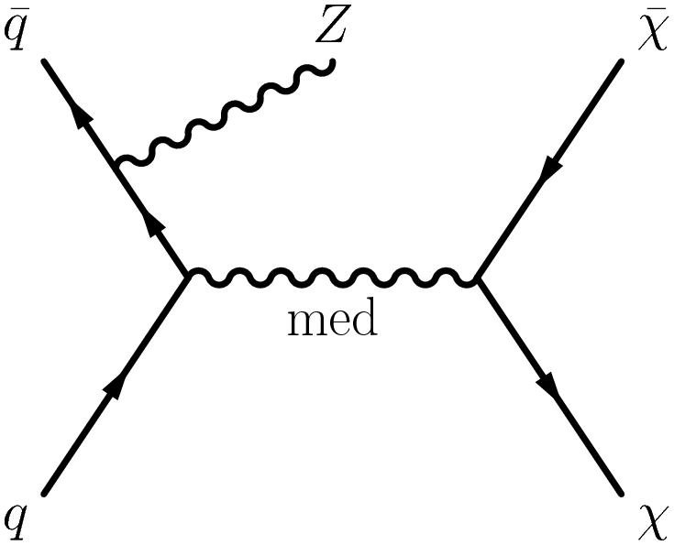
Z (e⁺e⁻, μ⁺μ⁻) + Dark Matter
PRB 776 (2017) 318
Excluded
@95% CL

Slide 18
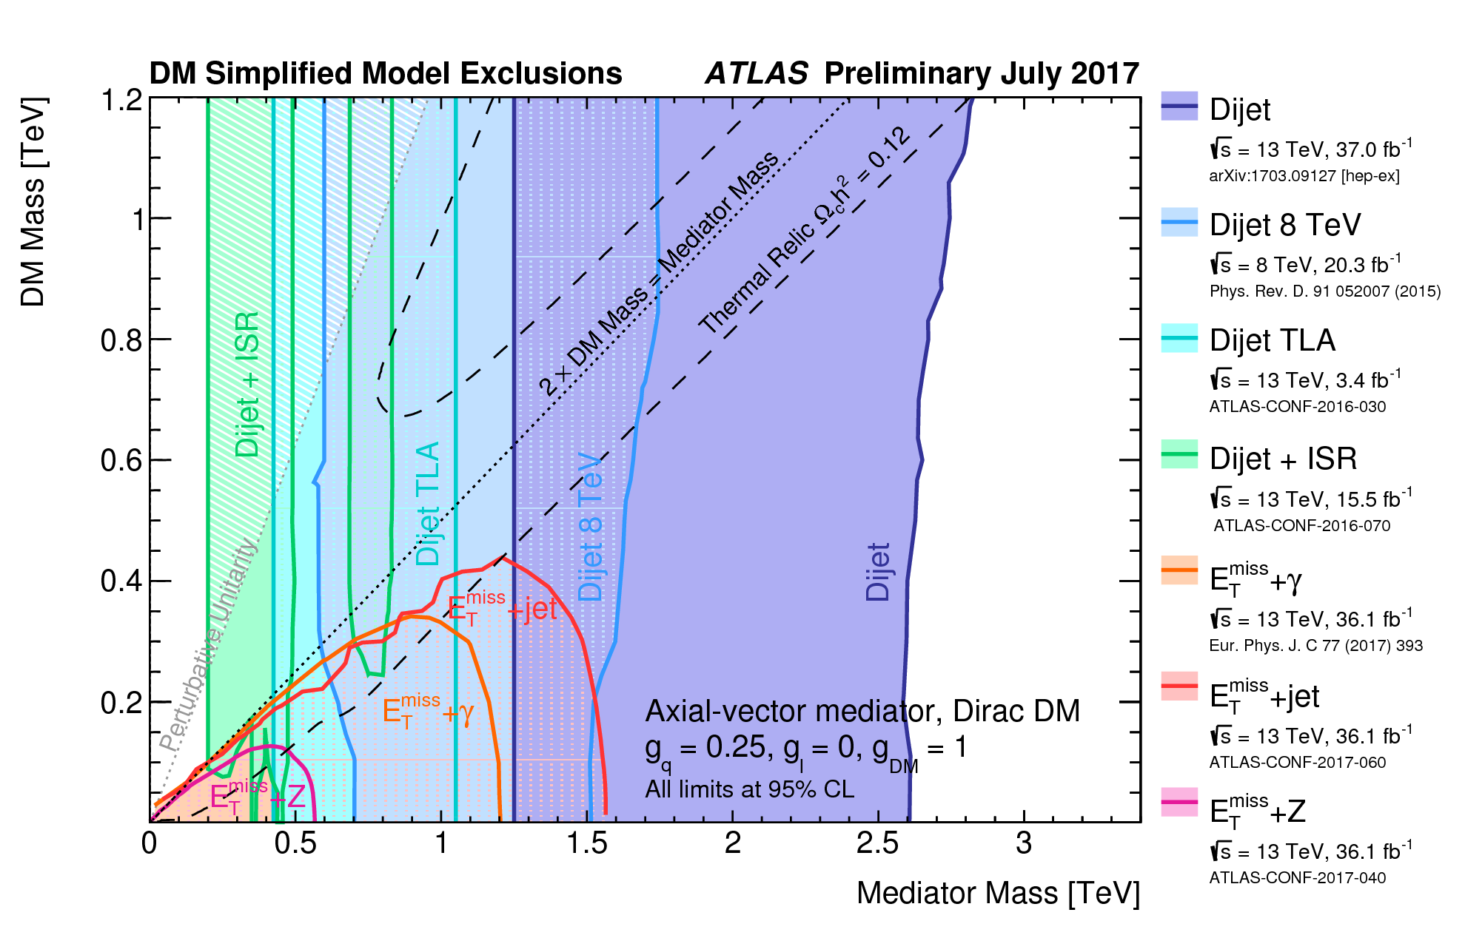
Combination: X (Jet, γ, Z) + E_{T}^{miss} (Dark Matter)
DM Mediator Searches
Talk by Peter McNamara
g_{q} = 0.25, g_{l} = 0, g_{χ} = 1

Slide 19
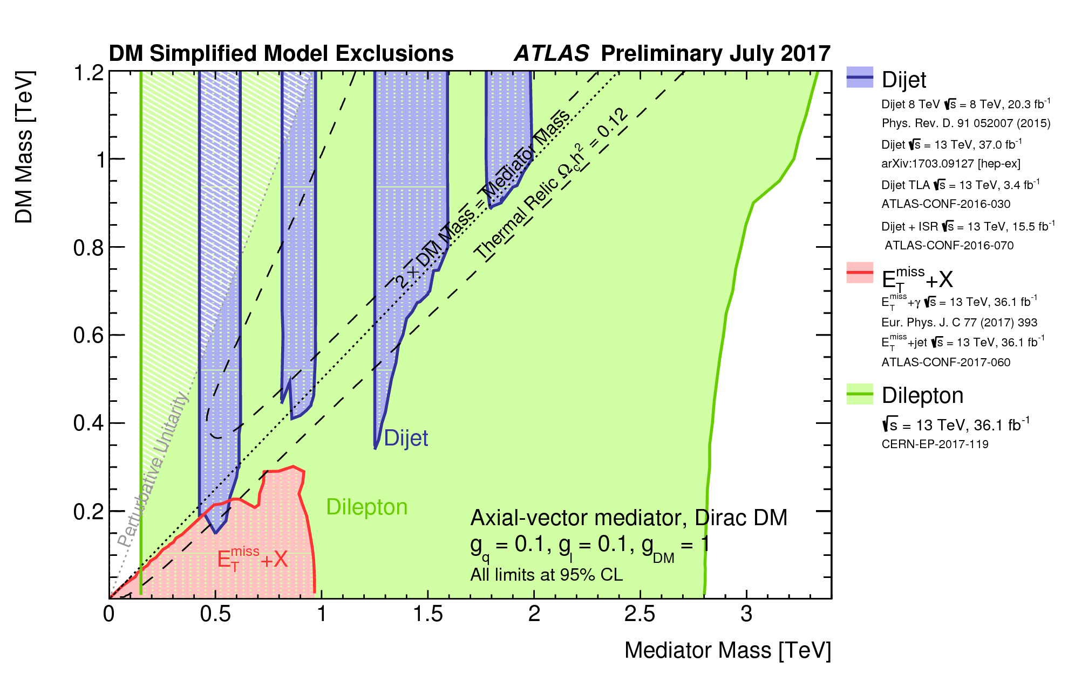
Combination: X (Jet, γ, Z) + E_{T}^{miss} (Dark Matter)
DM Mediator Searches
Talk by Peter McNamara
g_{q} = 0.1, g_{l} = 0.1, g_{χ} = 1

Slide 20
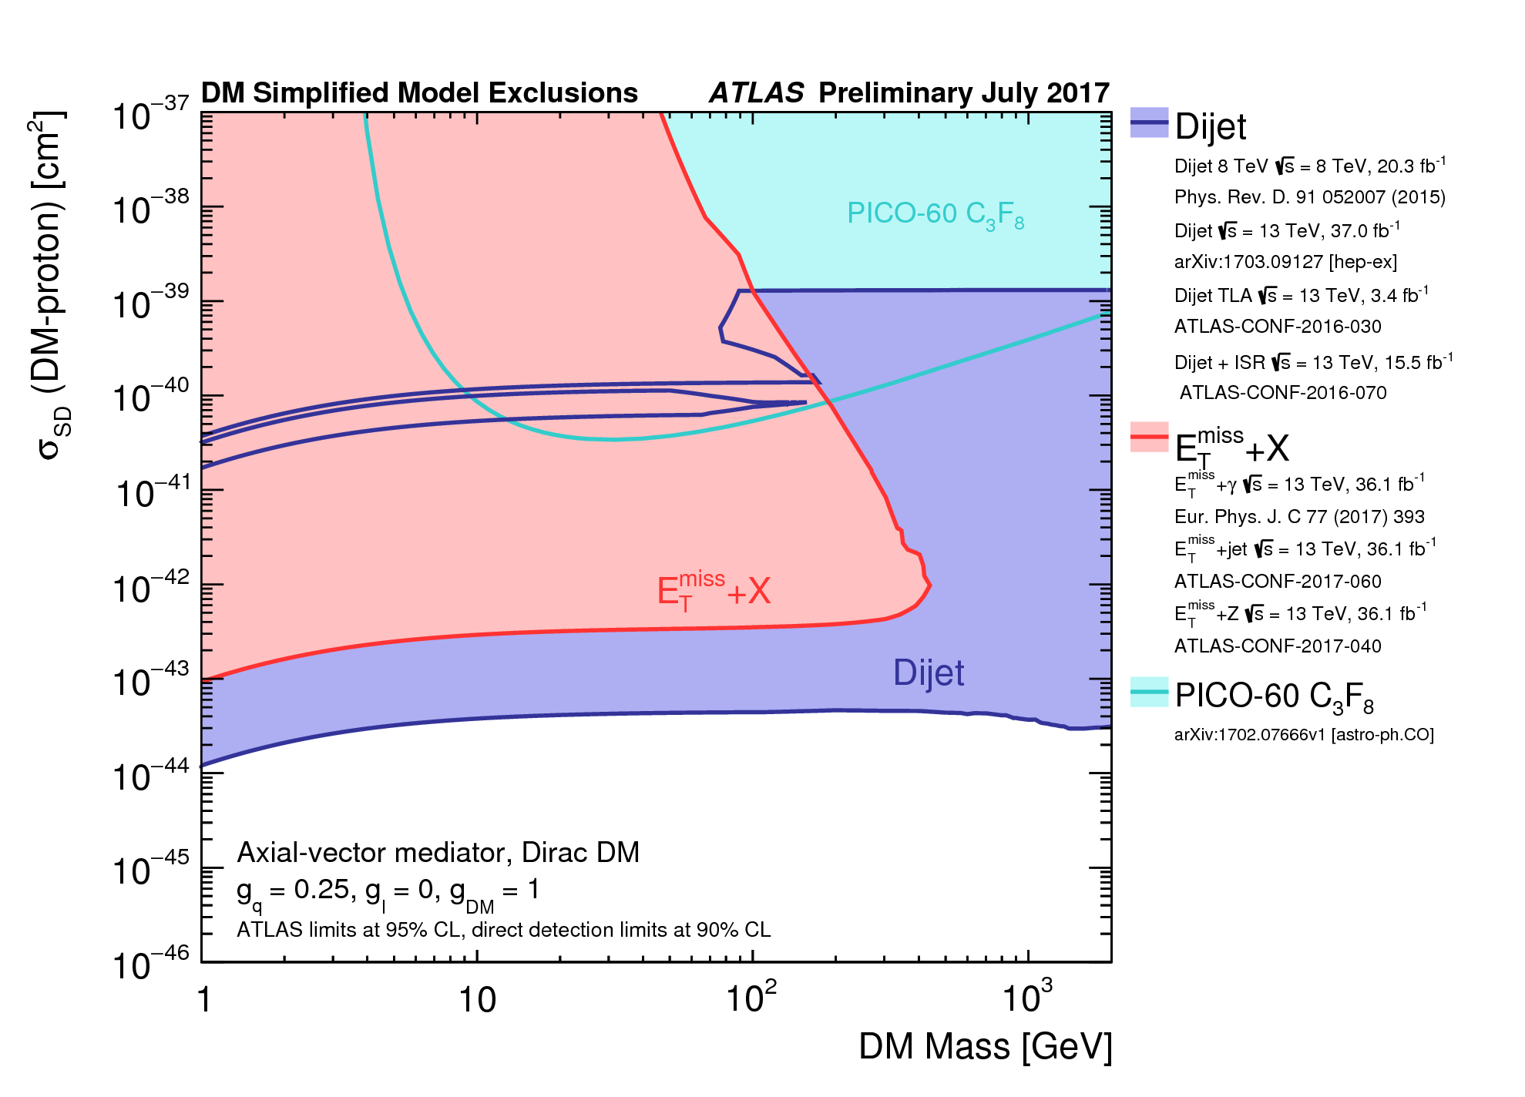
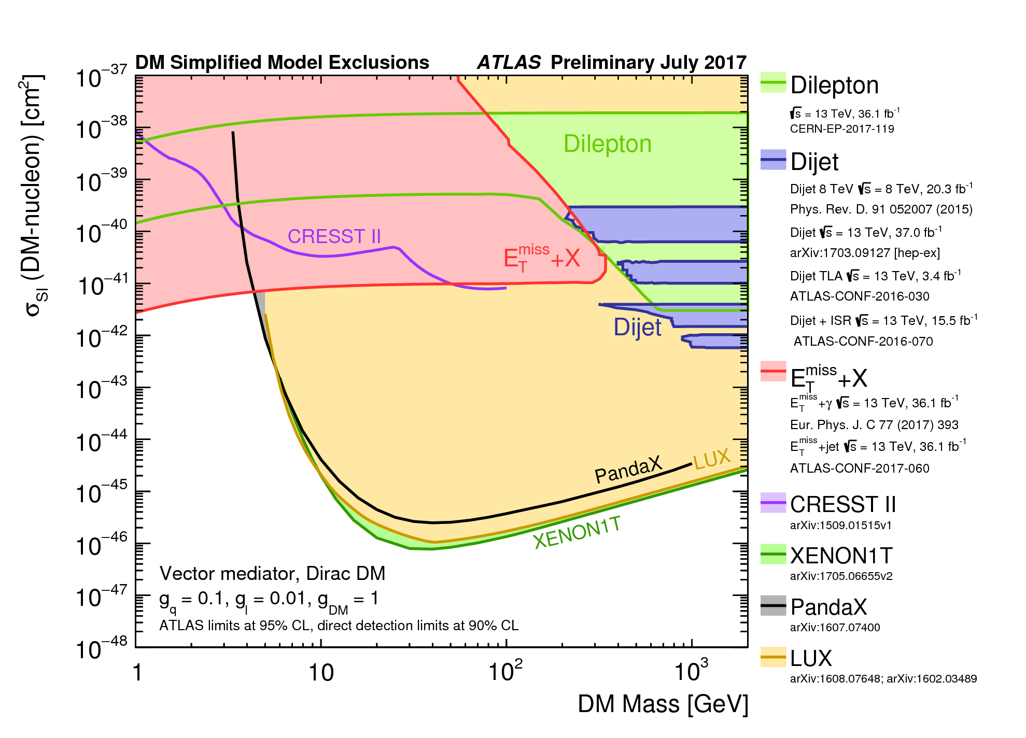
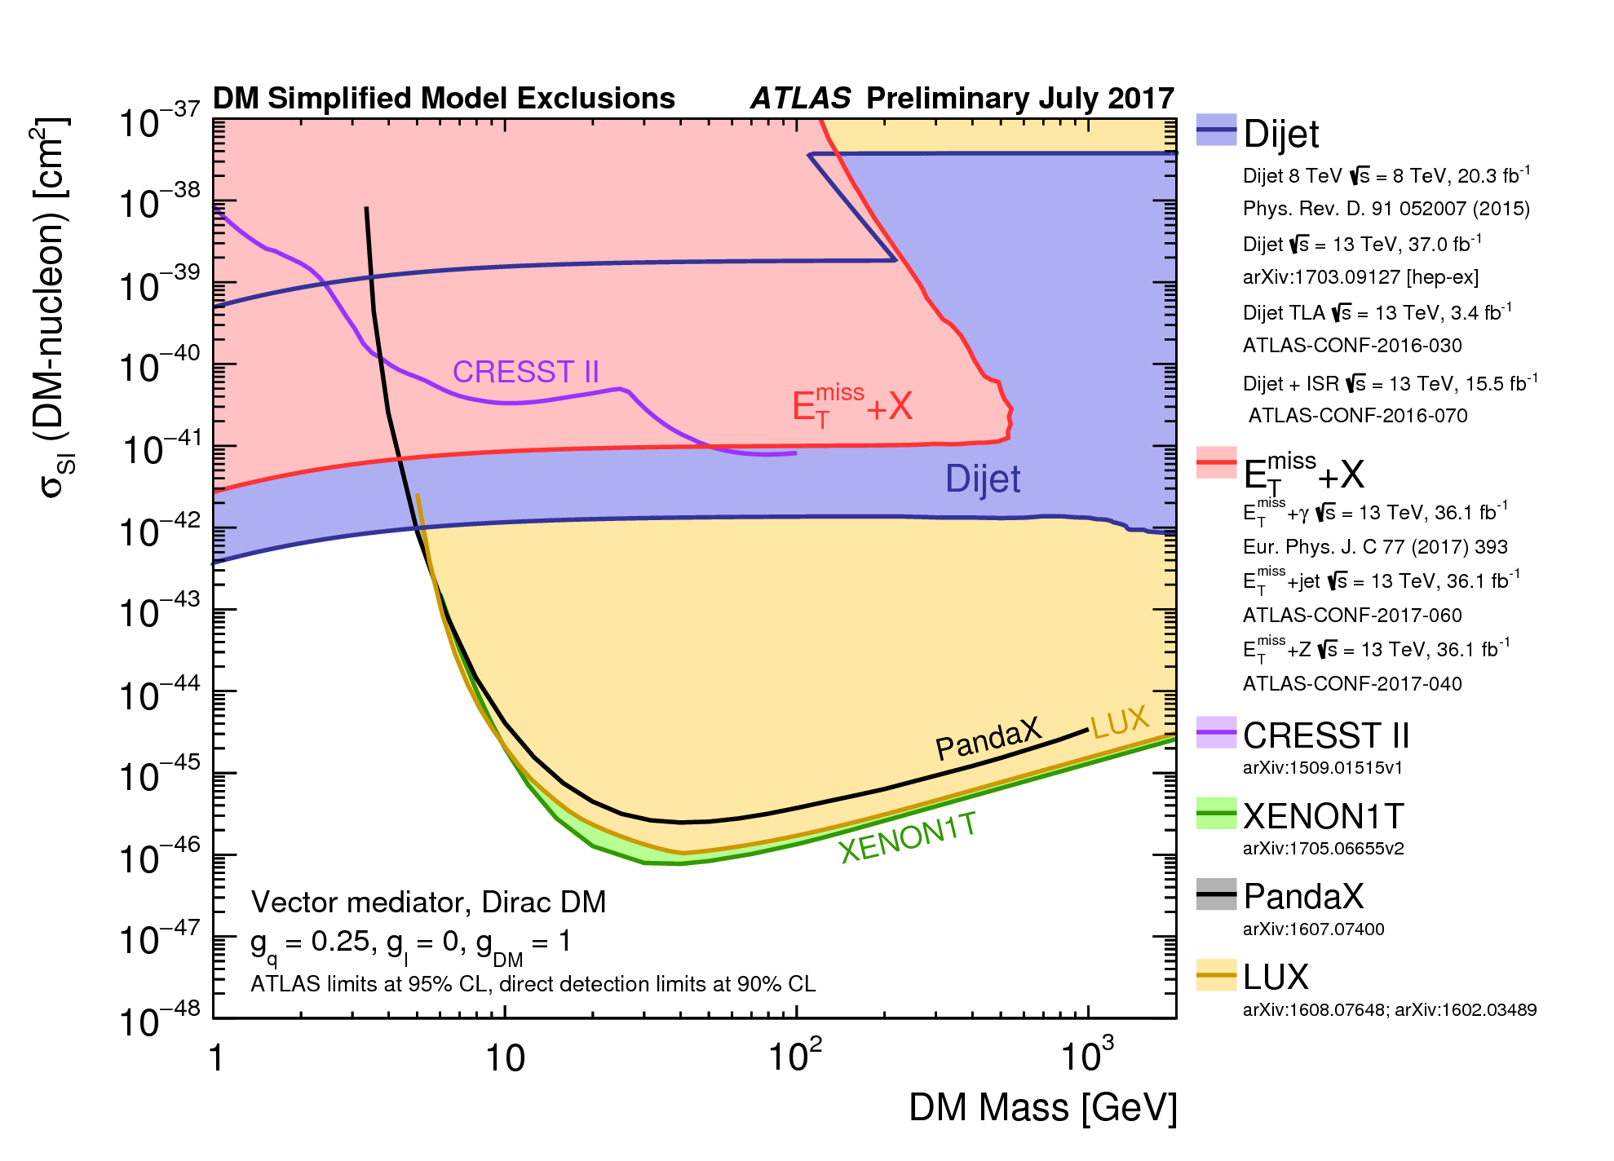
Combination: X (Jet, γ, Z) + E_{T}^{miss} (Dark Matter)
g_{q}=0.25, g_{l}=0, g_{χ}=1
g_{q}=0.25, g_{l}=0, g_{χ}=1
g_{q}=0.1, g_{l}=0.01, g_{χ}=1

Slide 21
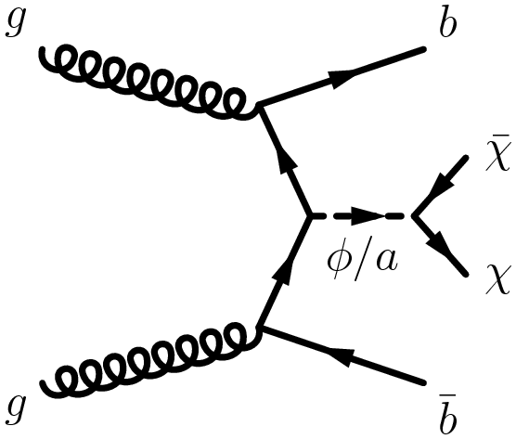
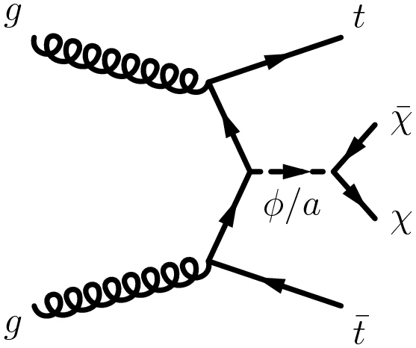
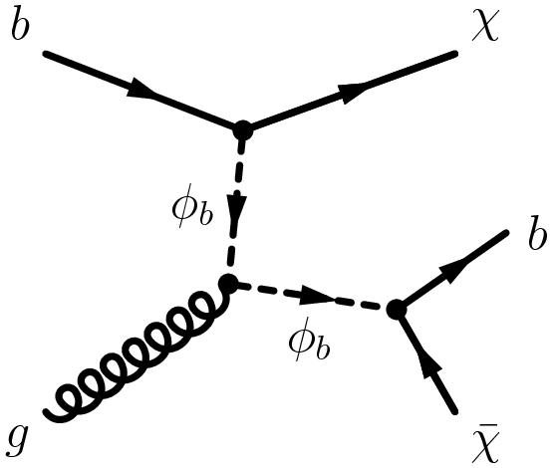
Heavy Flavor + Dark Matter
spin-0 mediator associated production with top and bottom quarks
color-neutral
spin-0 mediator
associated production
with bottom quarks
bb̄+φ/a
color-neutral
spin-0 mediator
associated production
with top quarks
tt̄+φ/a
color-charged
scalar mediator
decaying into
a bottom and a DM particle
b-FDM

Slide 22
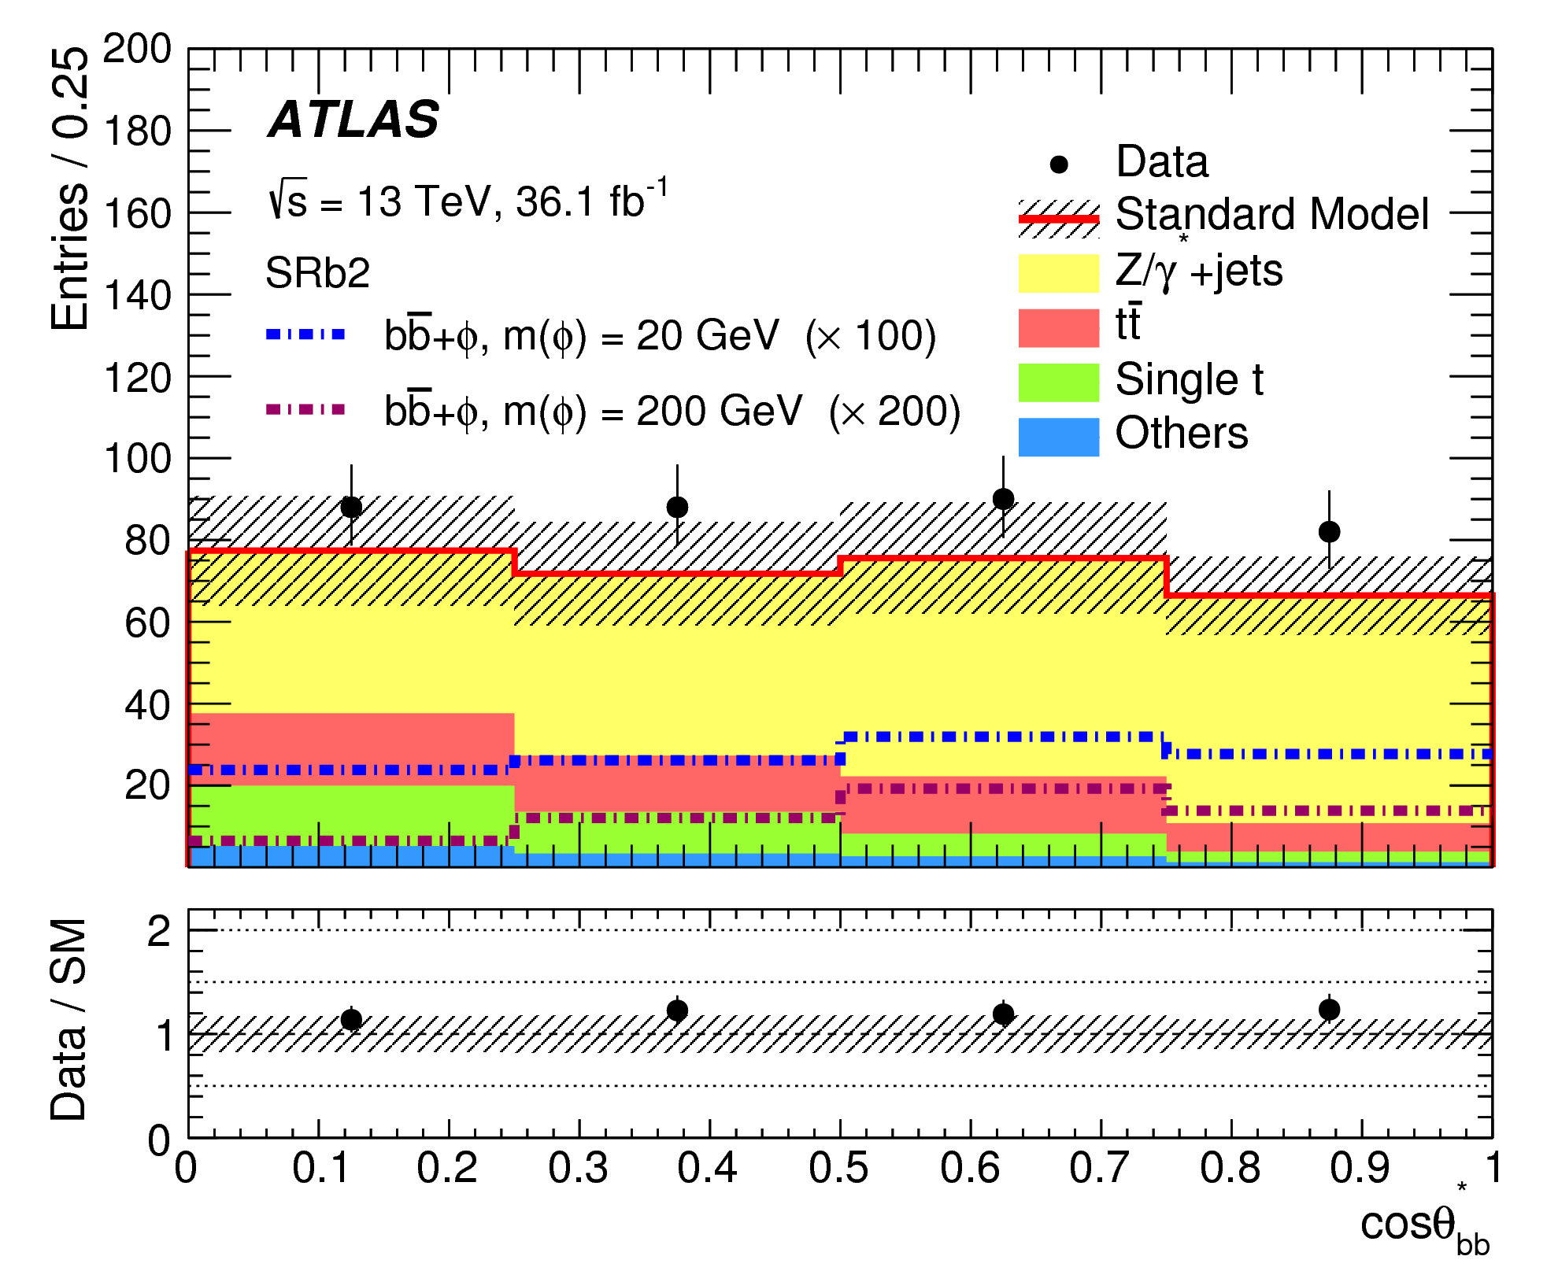
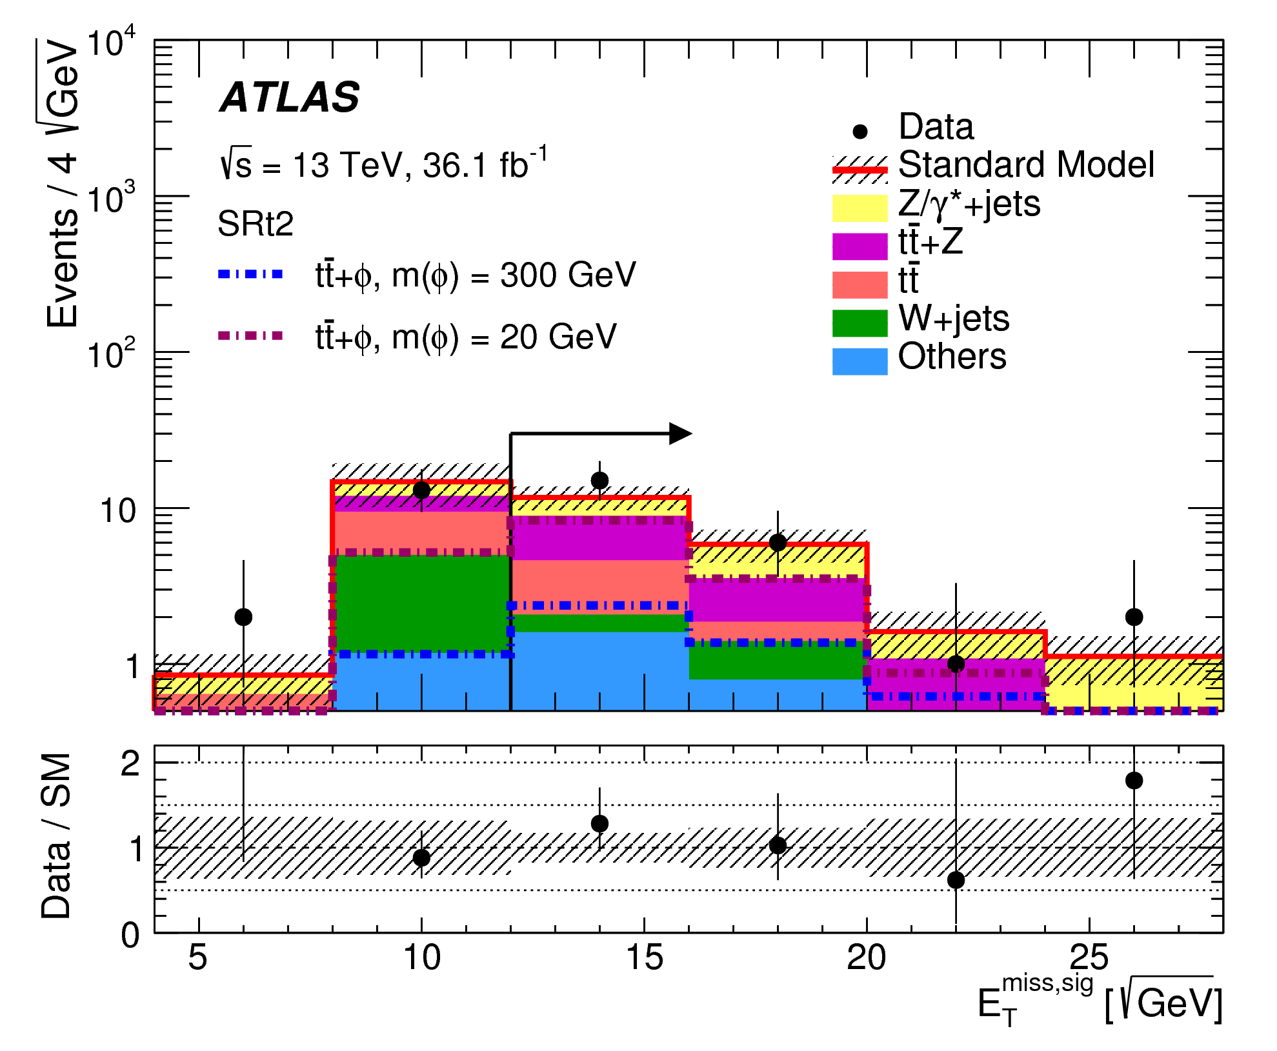
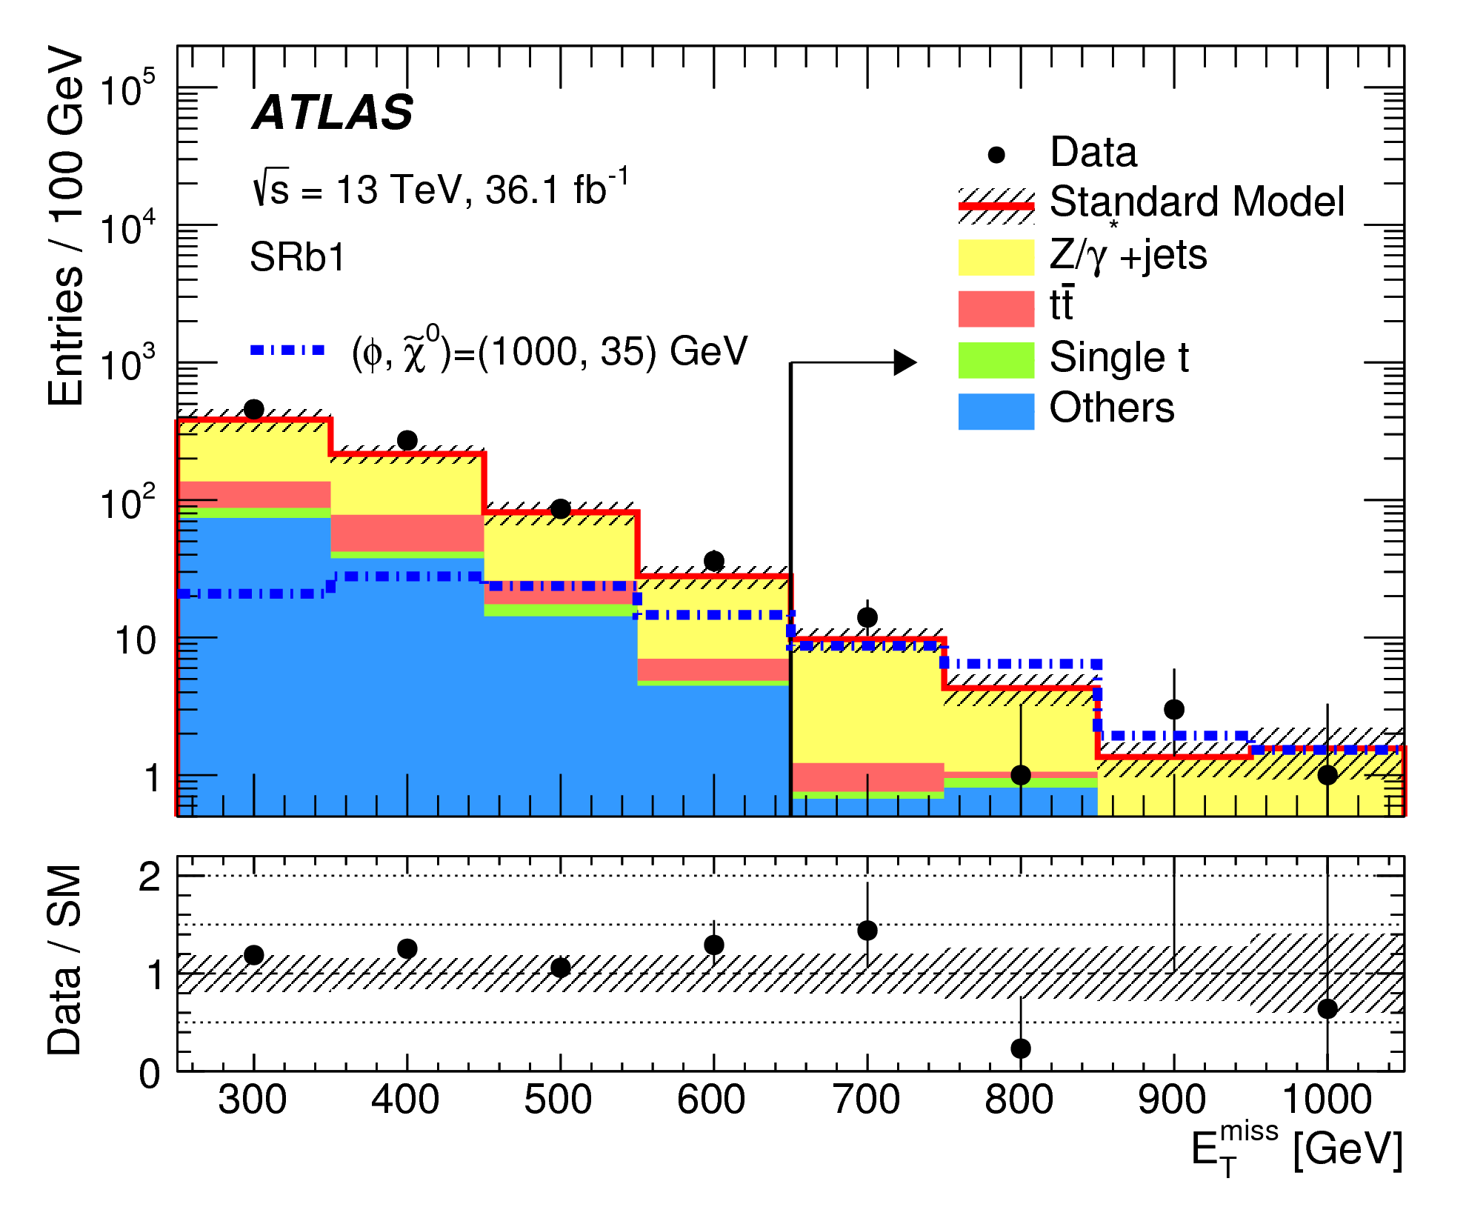
Heavy Flavor + Dark Matter
Eur. Phys. J. C78 (2018) 18
b
b
t
t
Color-neutral scalar mediator Color-charged scalar mediator

Slide 23
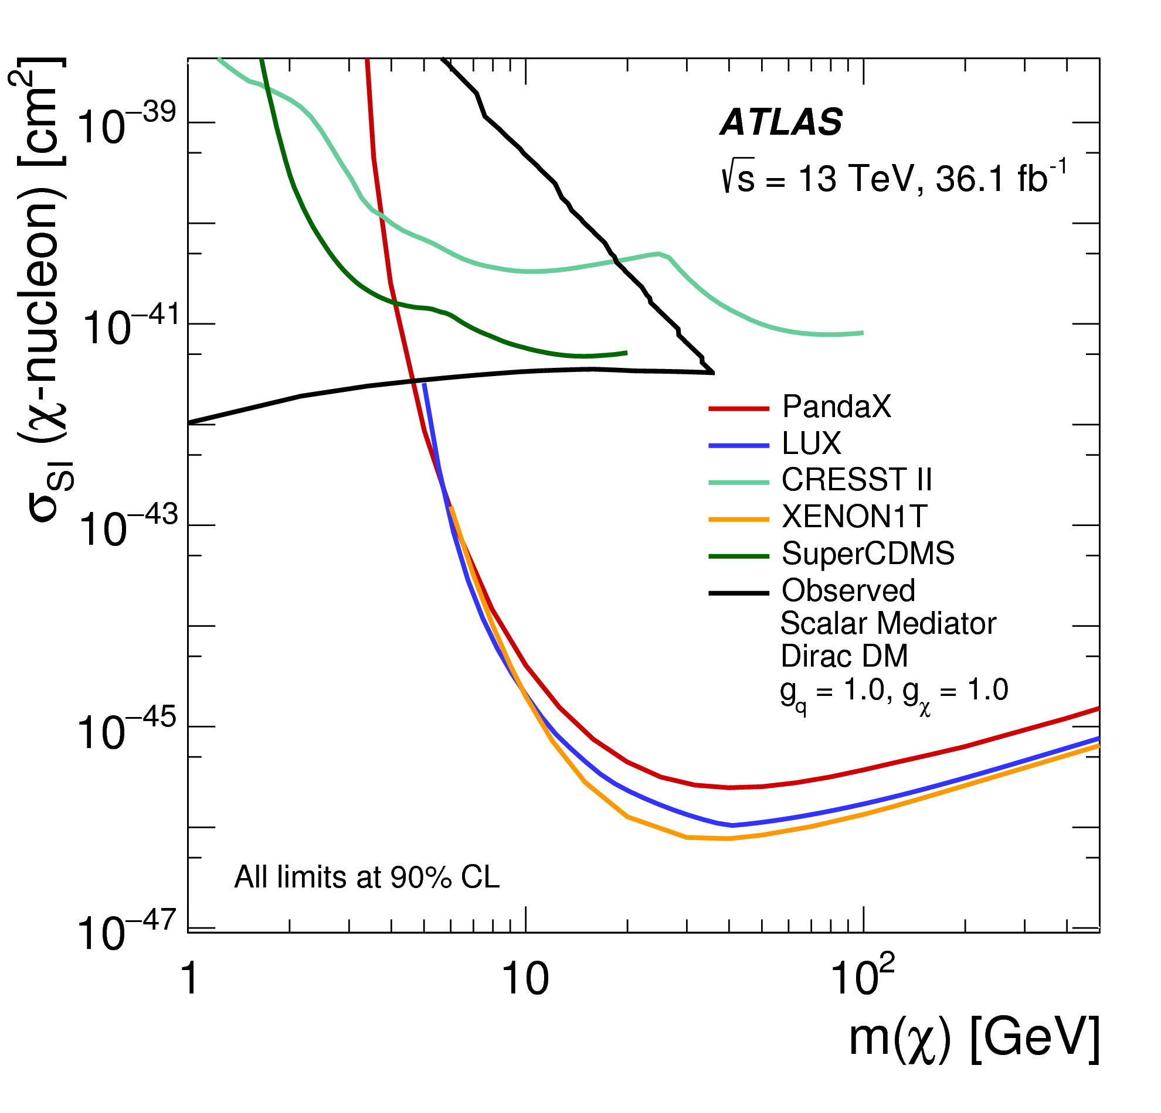
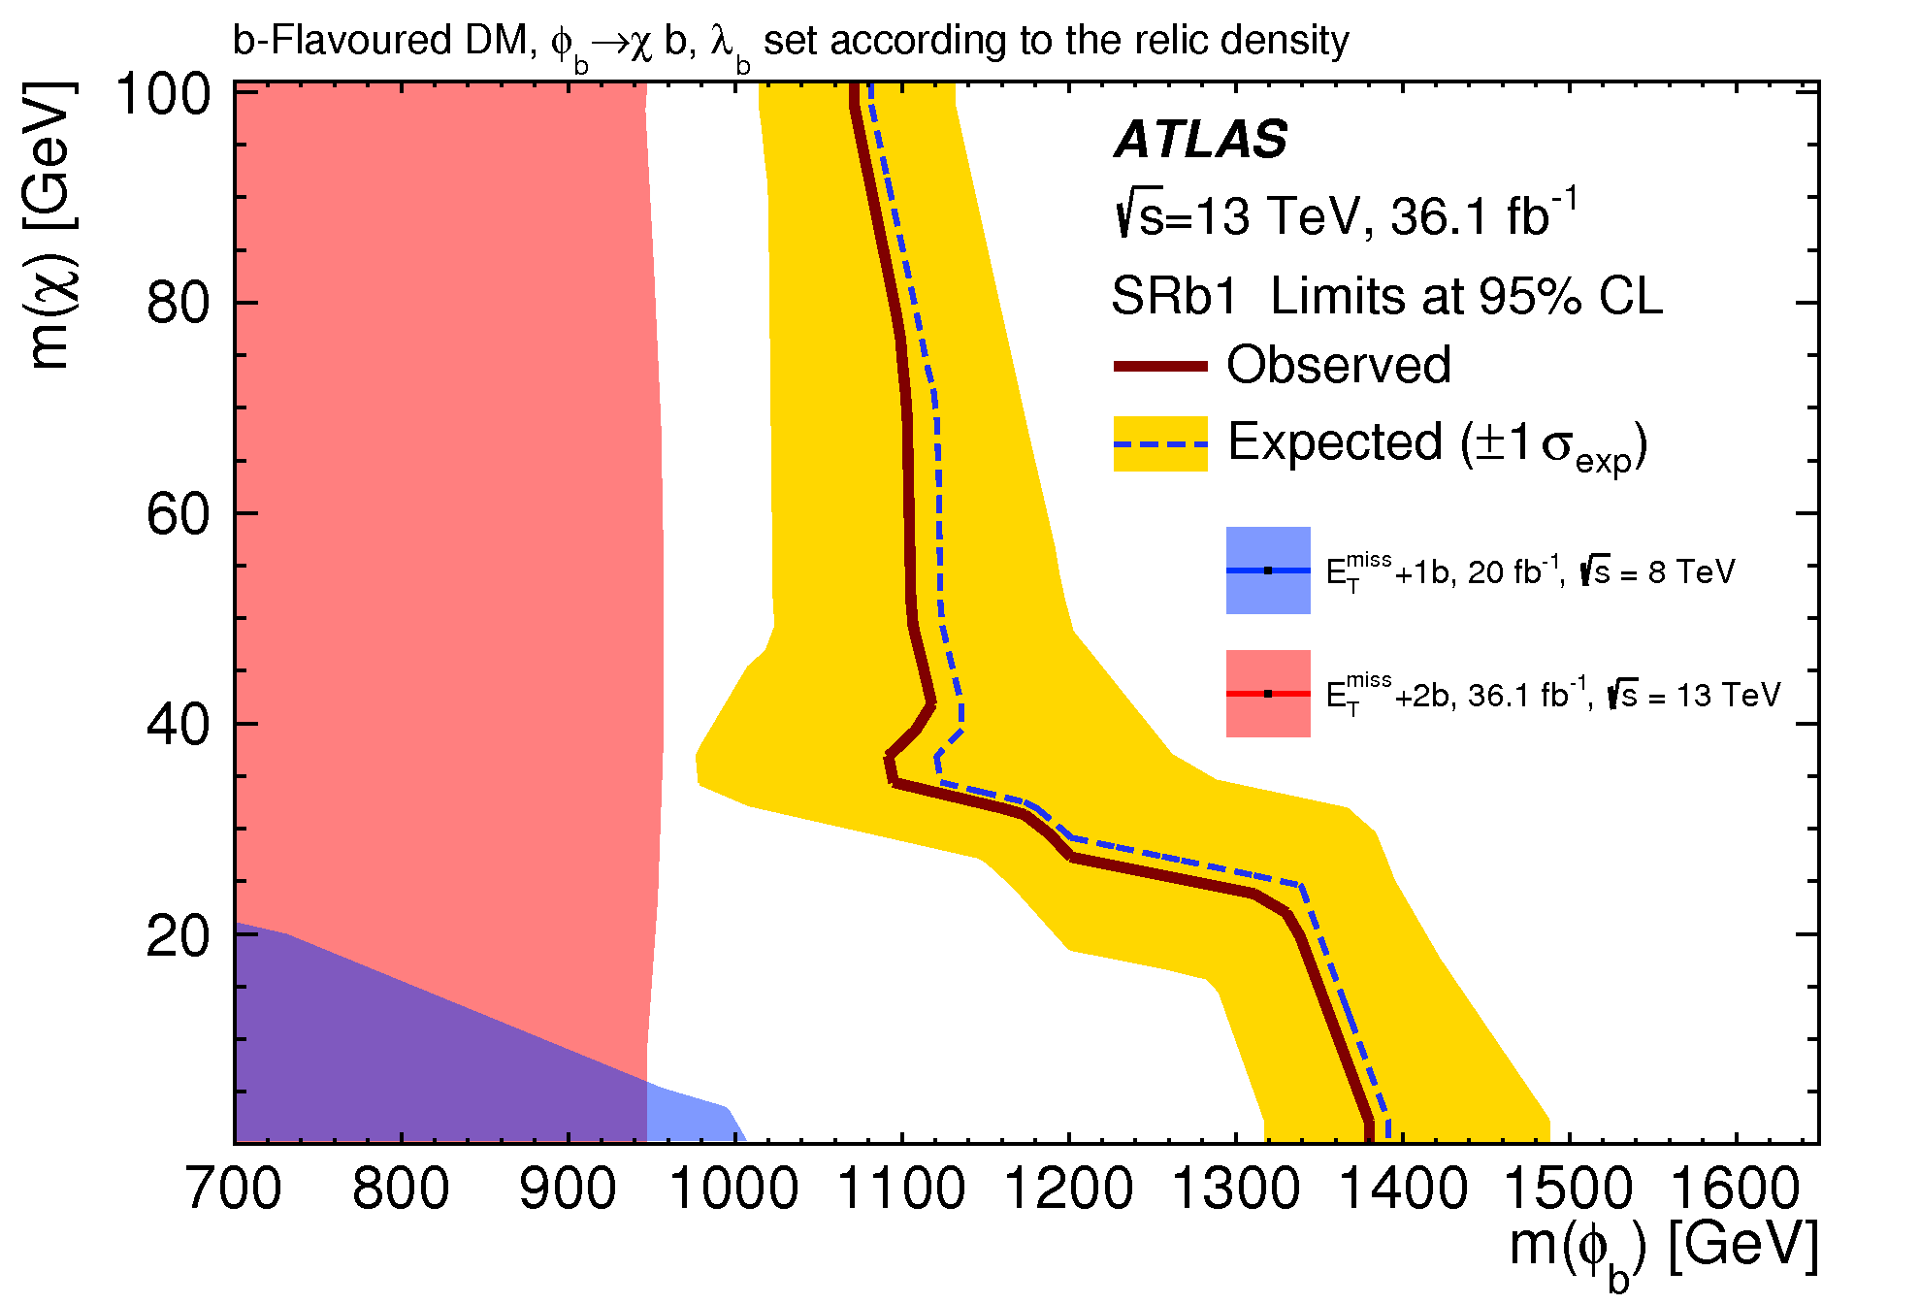
Heavy Flavor + Dark Matter
Eur. Phys. J. C78 (2018) 18
Color-neutral scalar mediator Color-charged scalar mediator
ATLAS
Run II
sbottom
pair
Run II
DM
Run I

Slide 24
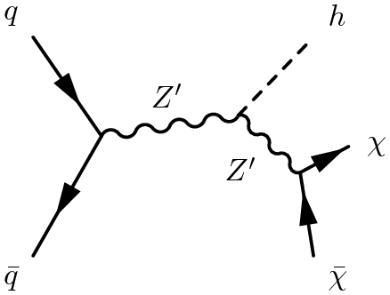
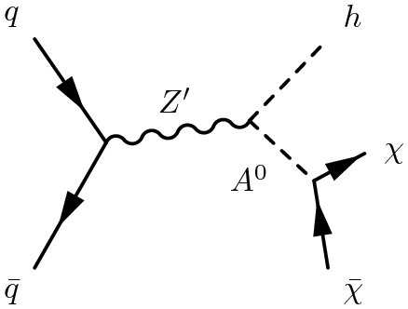
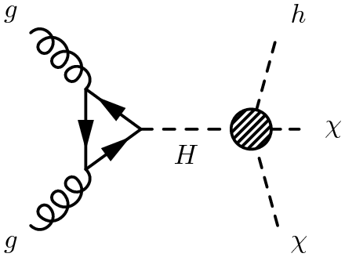
Higgs + Dark Matter
Production of Dark Matter in association with a SM Higgs boson (h)
Z’ vector boson
A⁰ pseudoscalar
H heavy scalar
Z'_{B} model Z’ – 2 Higgs Doublet model Heavy-scalar model
p_{T}^{h} and E_{T}^{miss}: large
p_{T}^{h} and E_{T}^{miss}: small
h → γγ: small Br (< 1%), but good mass resolution
h → bb: large Br (58%), but poor mass resolution

Slide 25
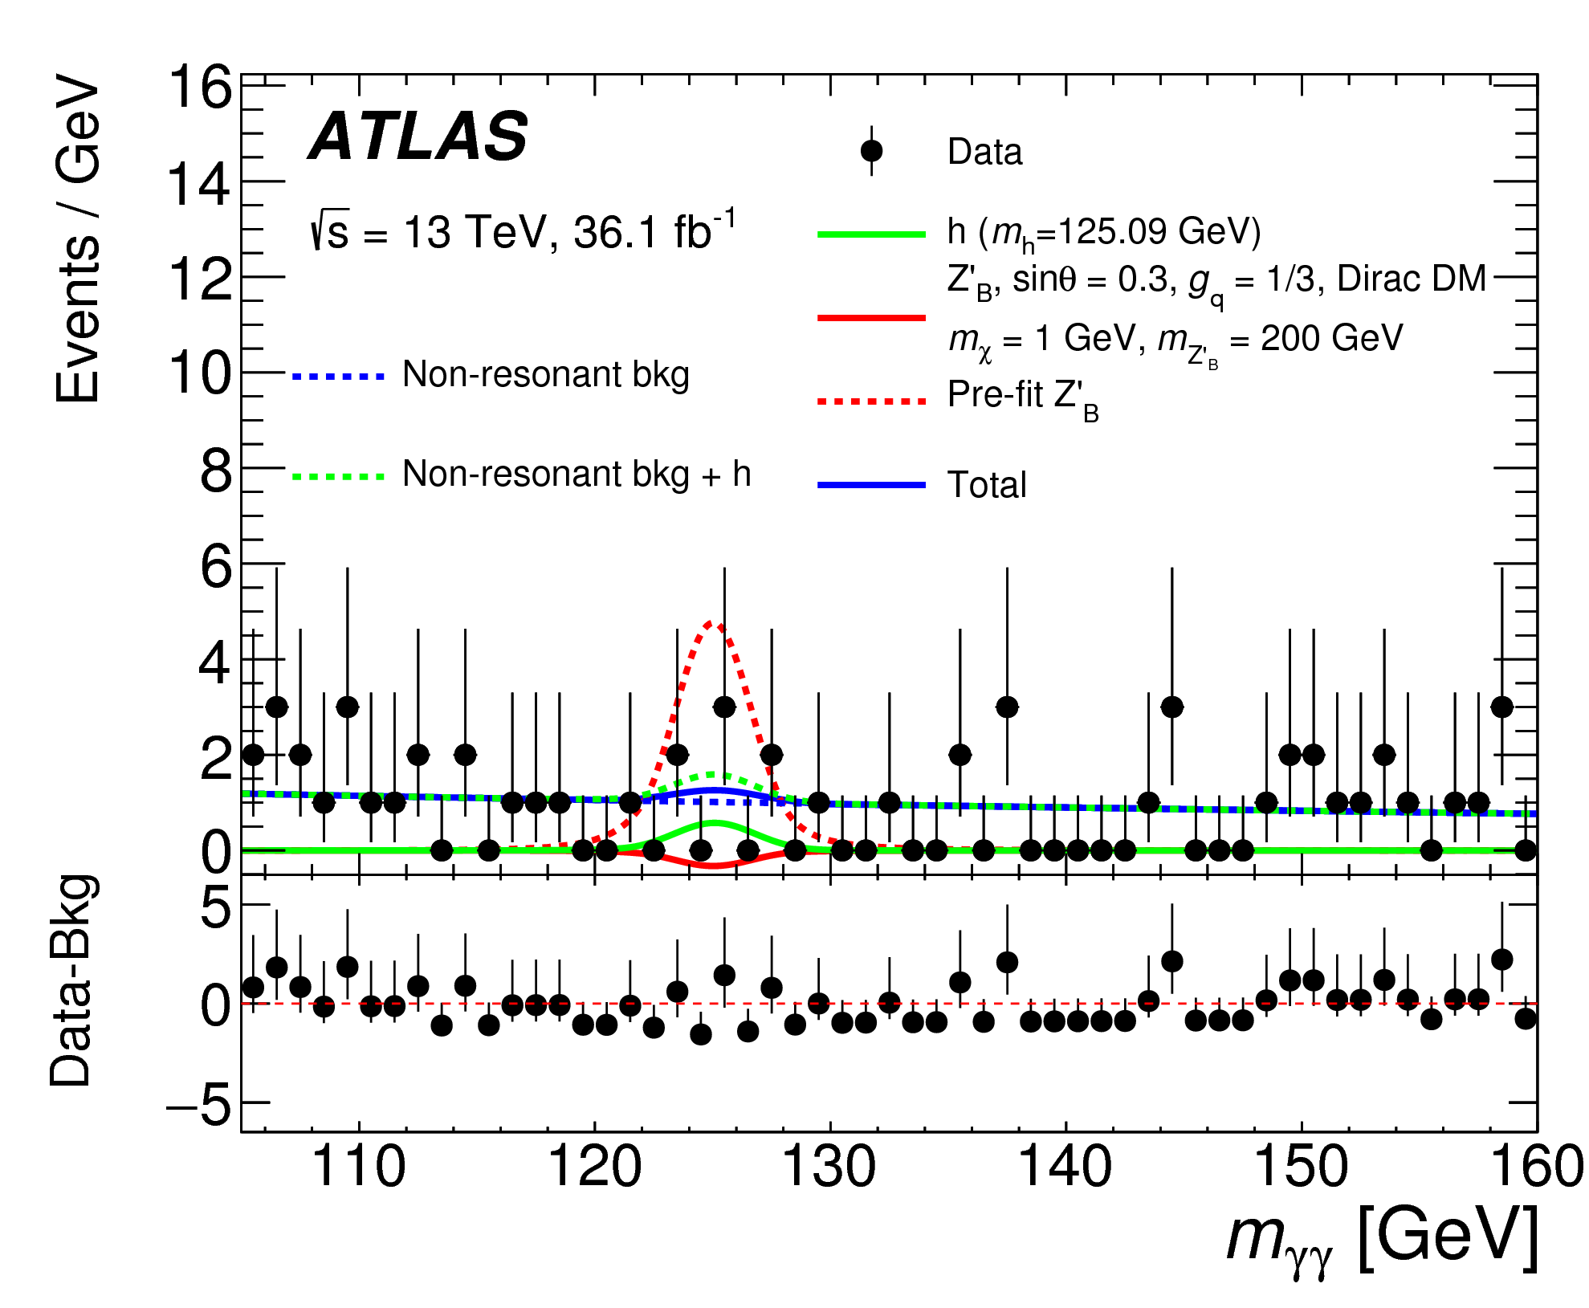
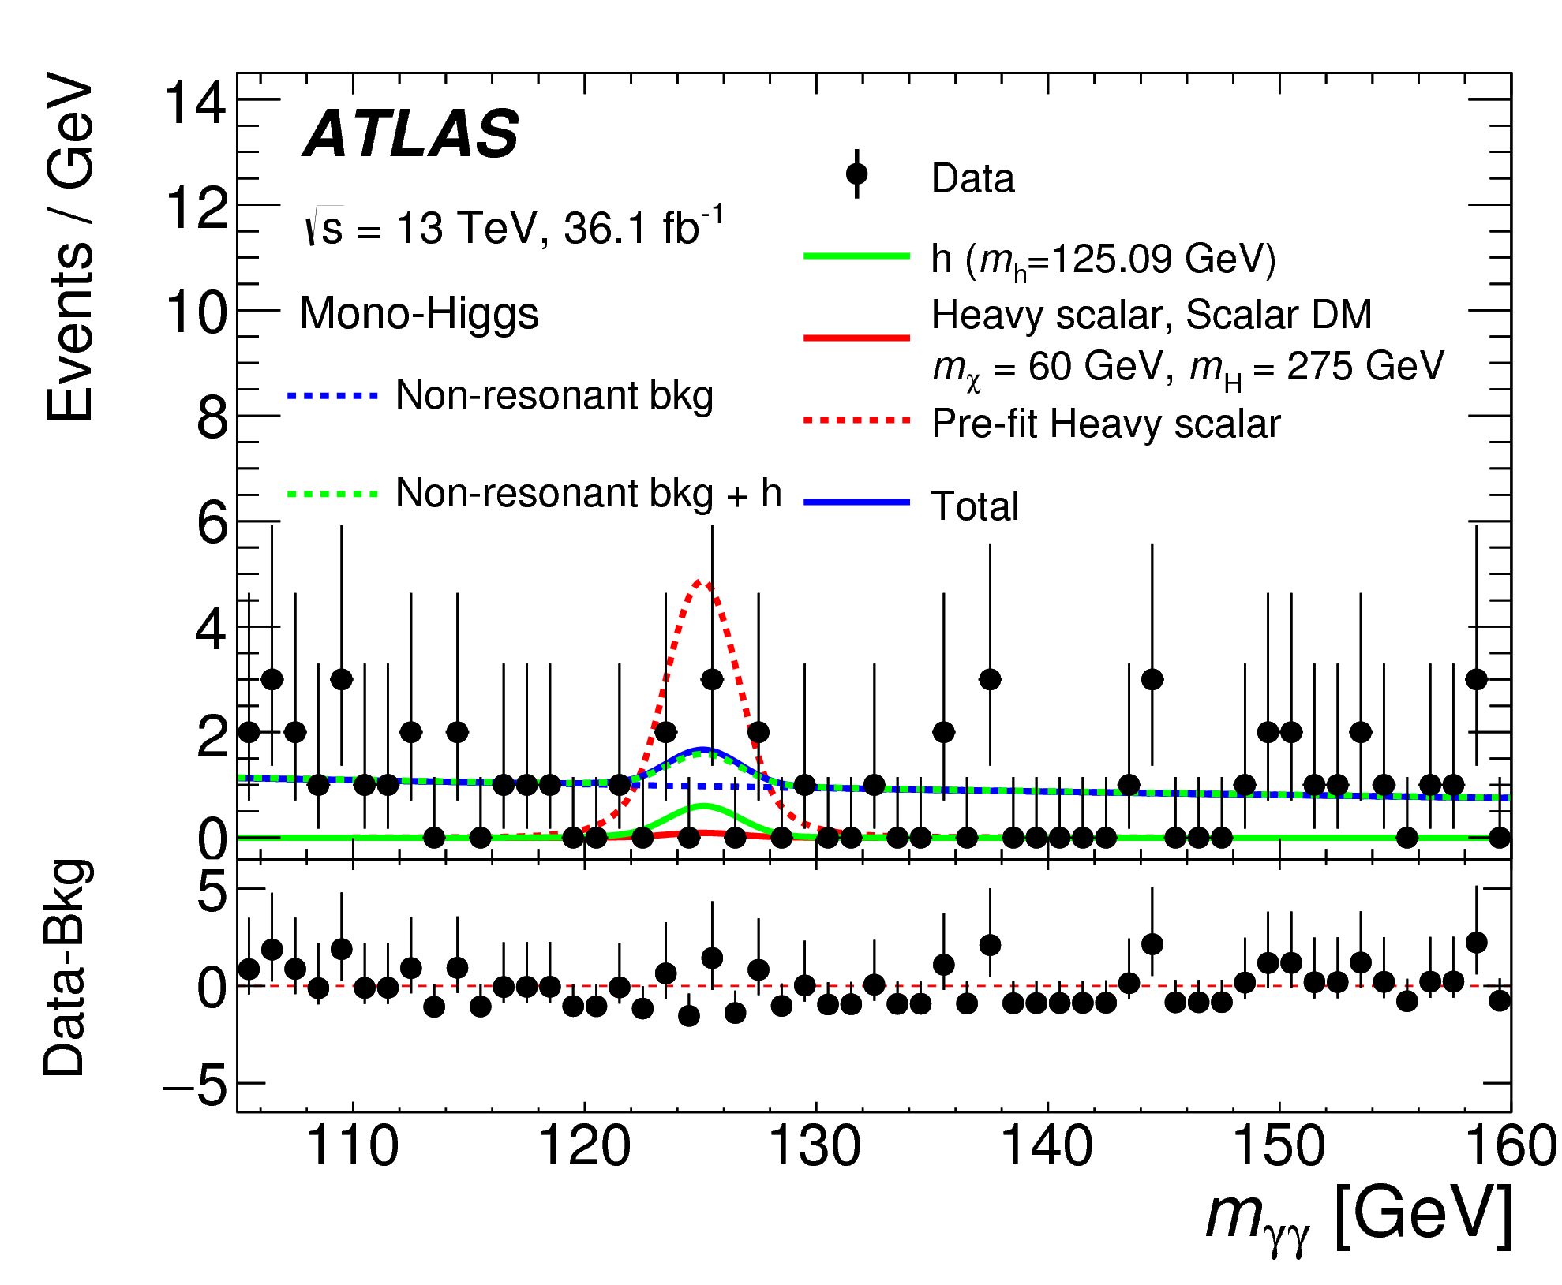
Higgs (h → γγ) + Dark Matter
PPD 96 (2017) 112004
Z’_{B} model Heavy-scalar model
θ mixing between baryonic h and SM h

Slide 26
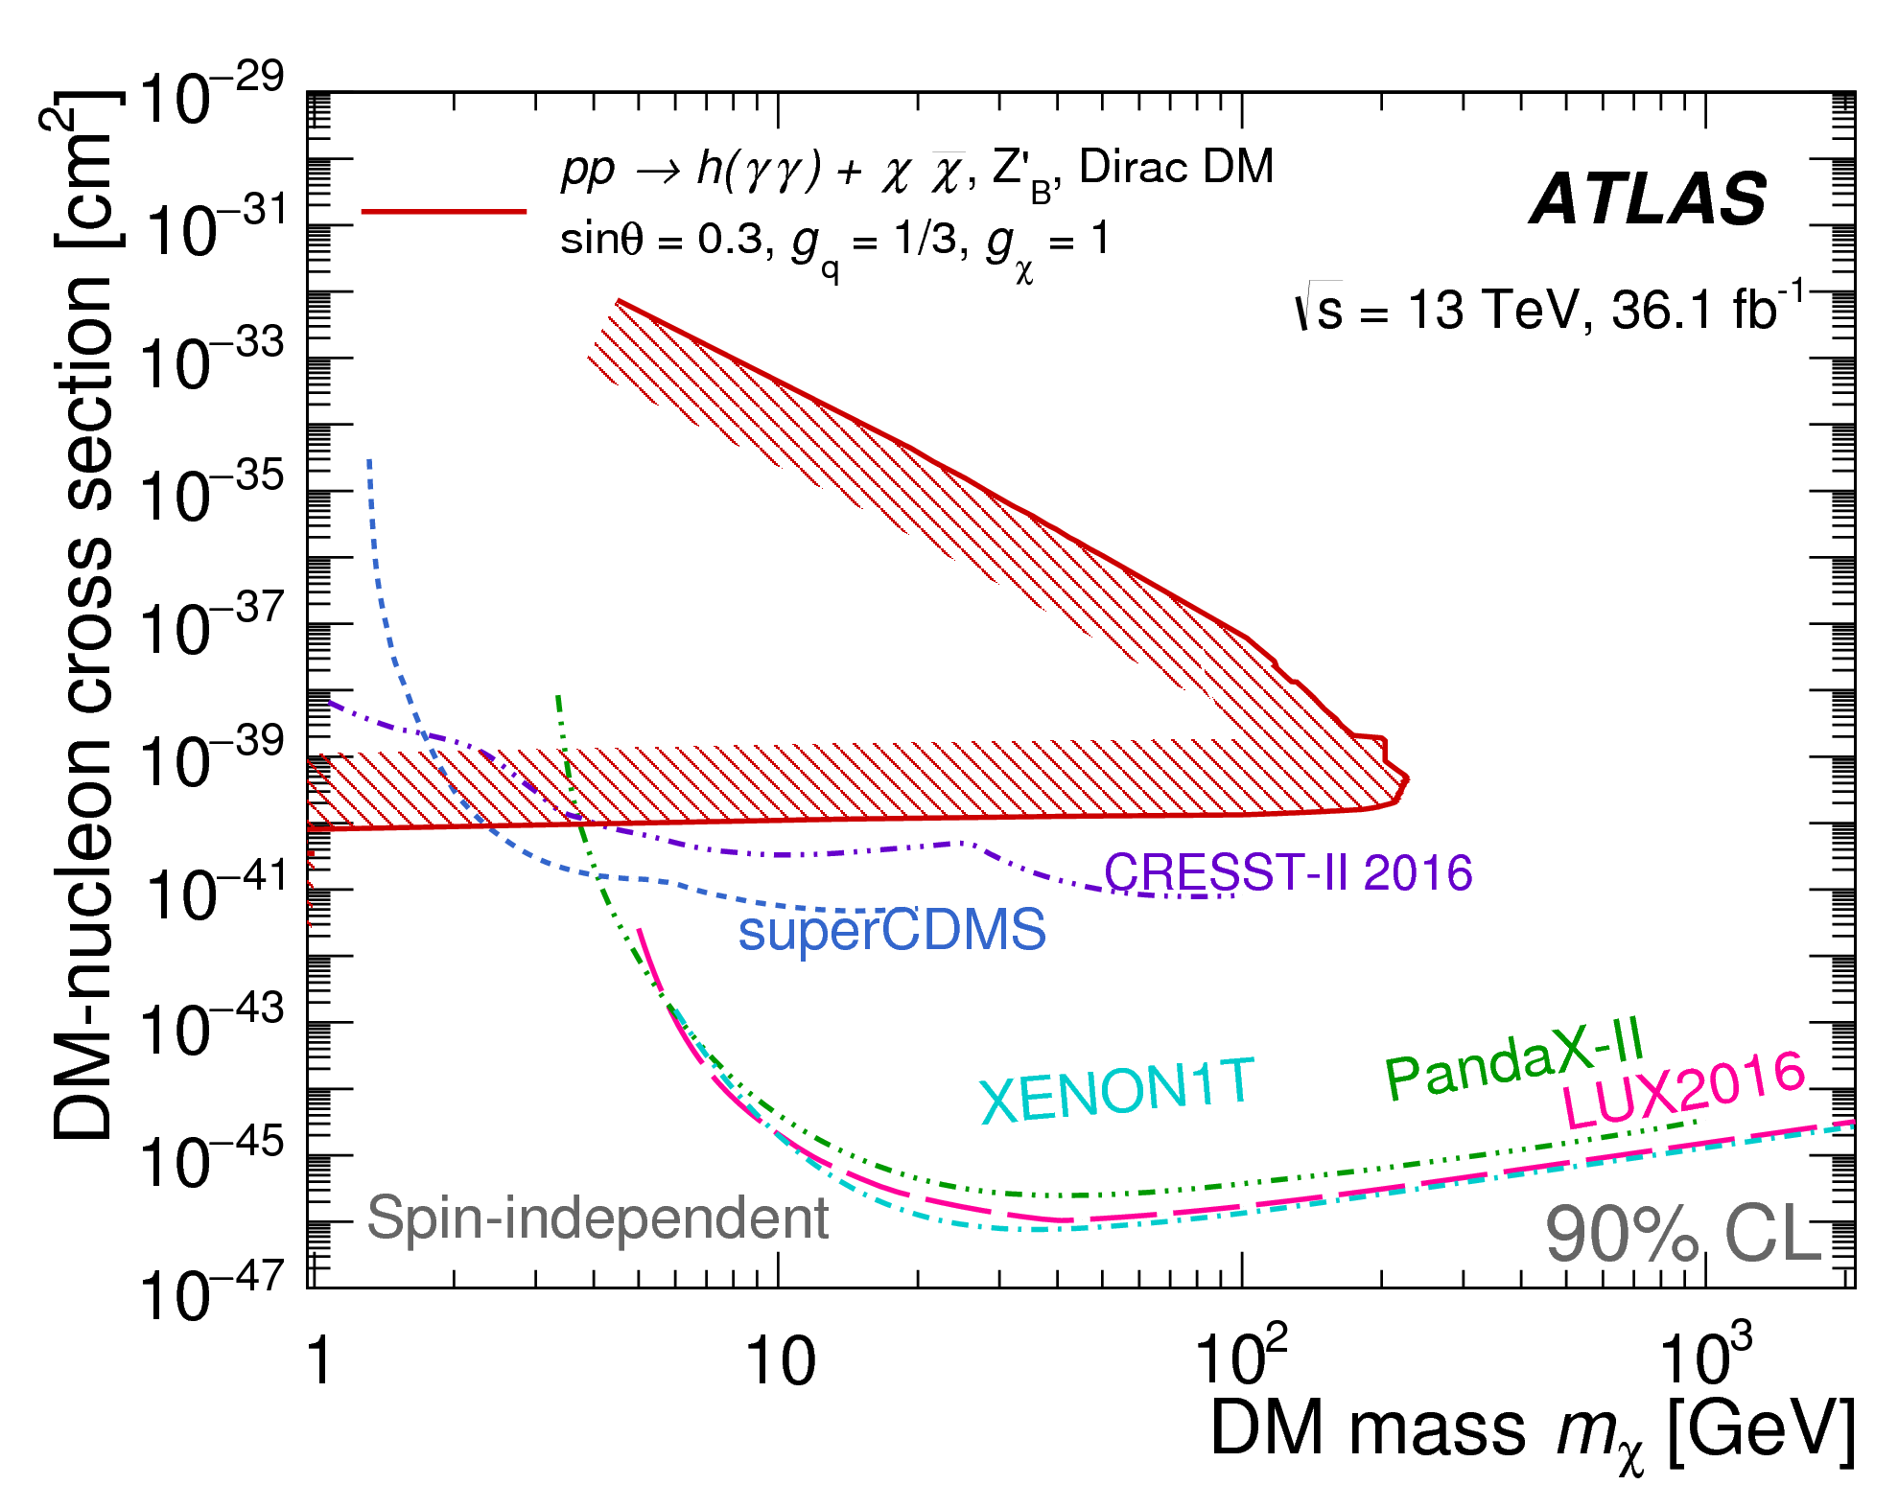
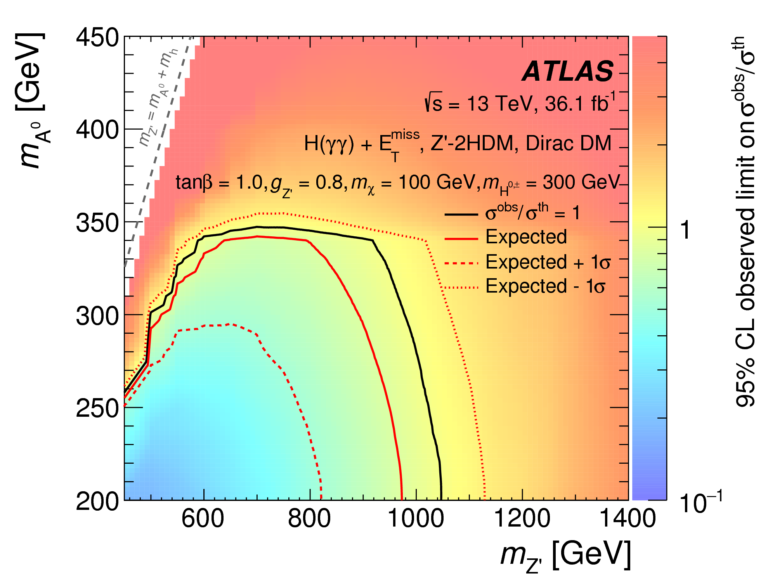
Higgs (h → γγ) + Dark Matter
PPD 96 (2017) 112004
Z’_{B} model Z’ – 2 Higgs Doublet model
ATLAS

Slide 27
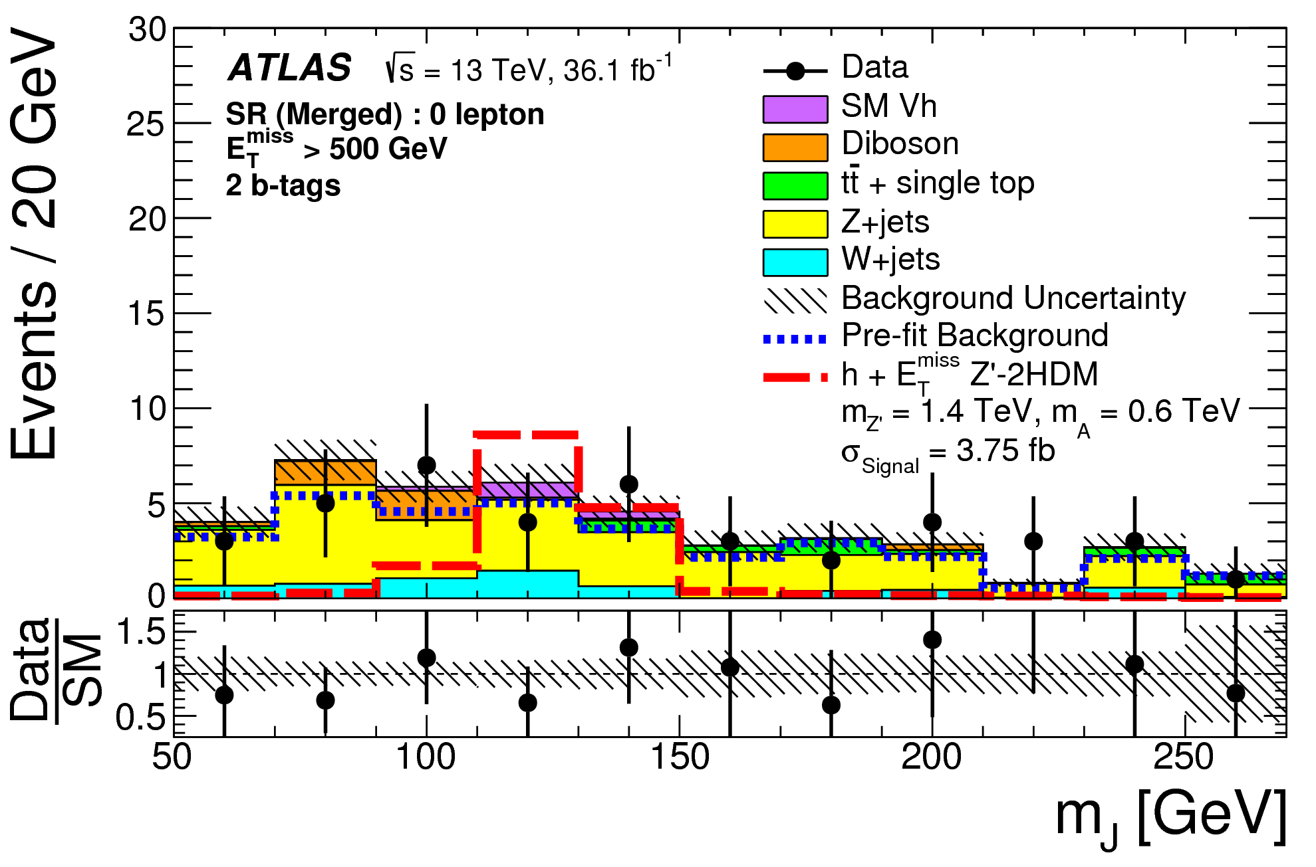
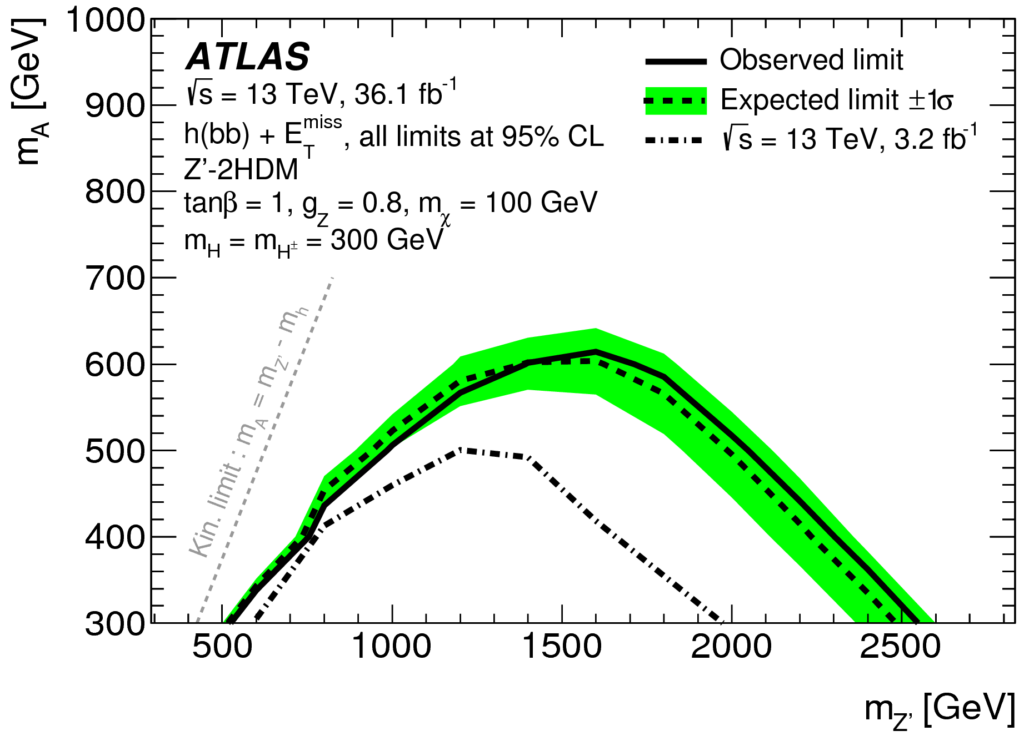
Higgs (h → bb) + Dark Matter
PRL 119 (2017) 181804
Branching ratios
  Br(h → bb) = 58%
  Br(h → γγ ) < 1%
p_{T}^{h → bb} > 500 GeV: boosted Higgs
Z’_{B} model Z’ – 2 Higgs Doublet model
h → bb
h → γγ

Slide 28
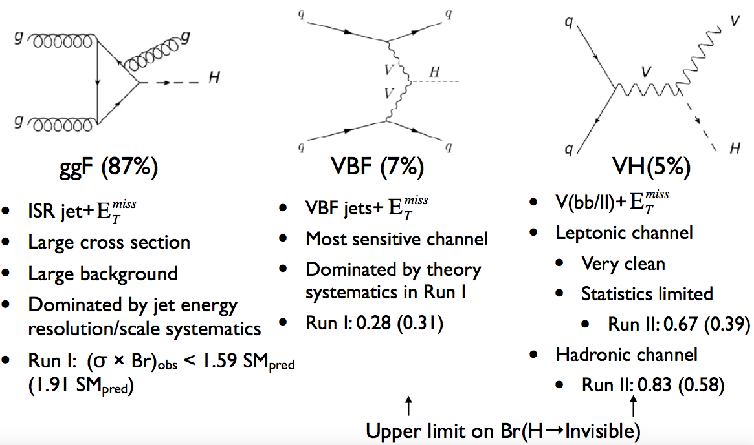
Higgs (h → Dark Matter)
gluon-gluon fusion (87%) vector-boson fusion (7%) associate production (5%)
.
h
h
h
Jet + large E_{T}^{miss}
Large cross section
Large background
Syst. uncertainty (Jet energy)
Run I: (σ x Br) limit
Obs 1.59 SM_{pred}
(Exp 1.91 SM_{pred})
VBF jets + large E_{T}^{miss}
Most sensitive channel
Syst. Uncertainty (theory)
Run I: Br(H → inv) limit
Obs 0.28 (Exp 0.31)
Run II: Coming soon!
V(ll) + large E_{T}^{miss}
Clean / Syst. limited
Run II: Br(H → inv) limit
Obs 0.67 (Exp 0.39)
V(bb) + large E_{T}^{miss}
Run II: Br(H → inv) limit
Obs 0.83 (Exp 0.58)

Slide 29
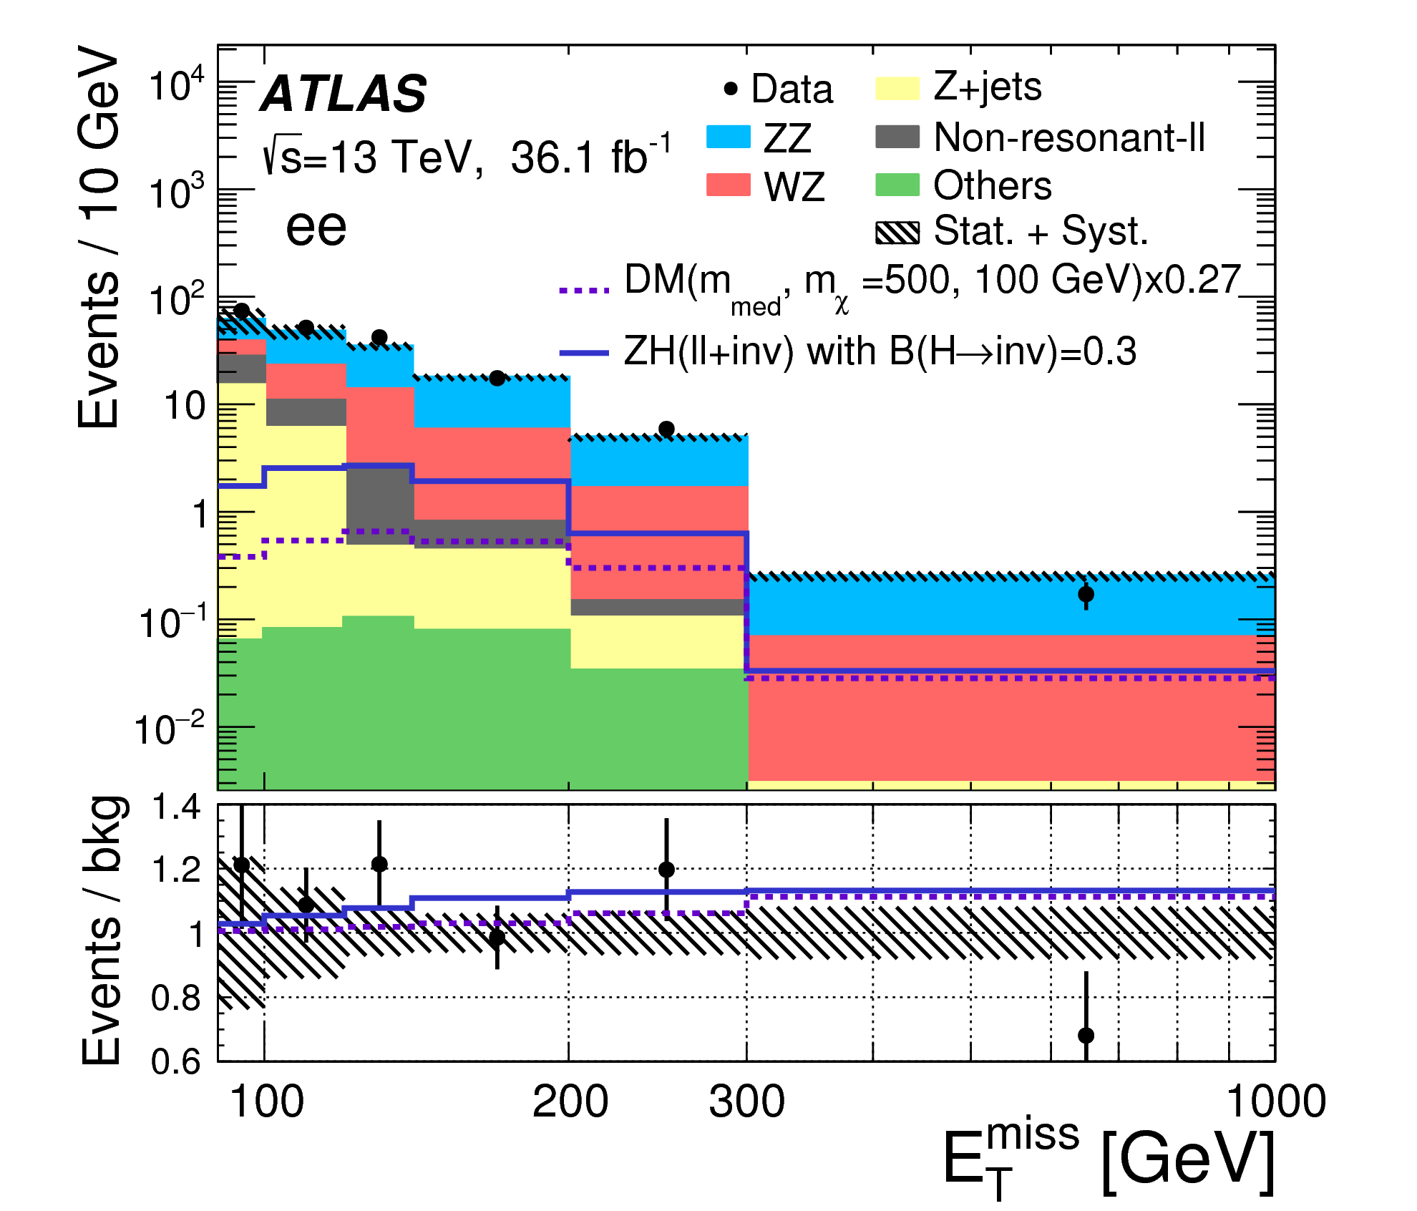
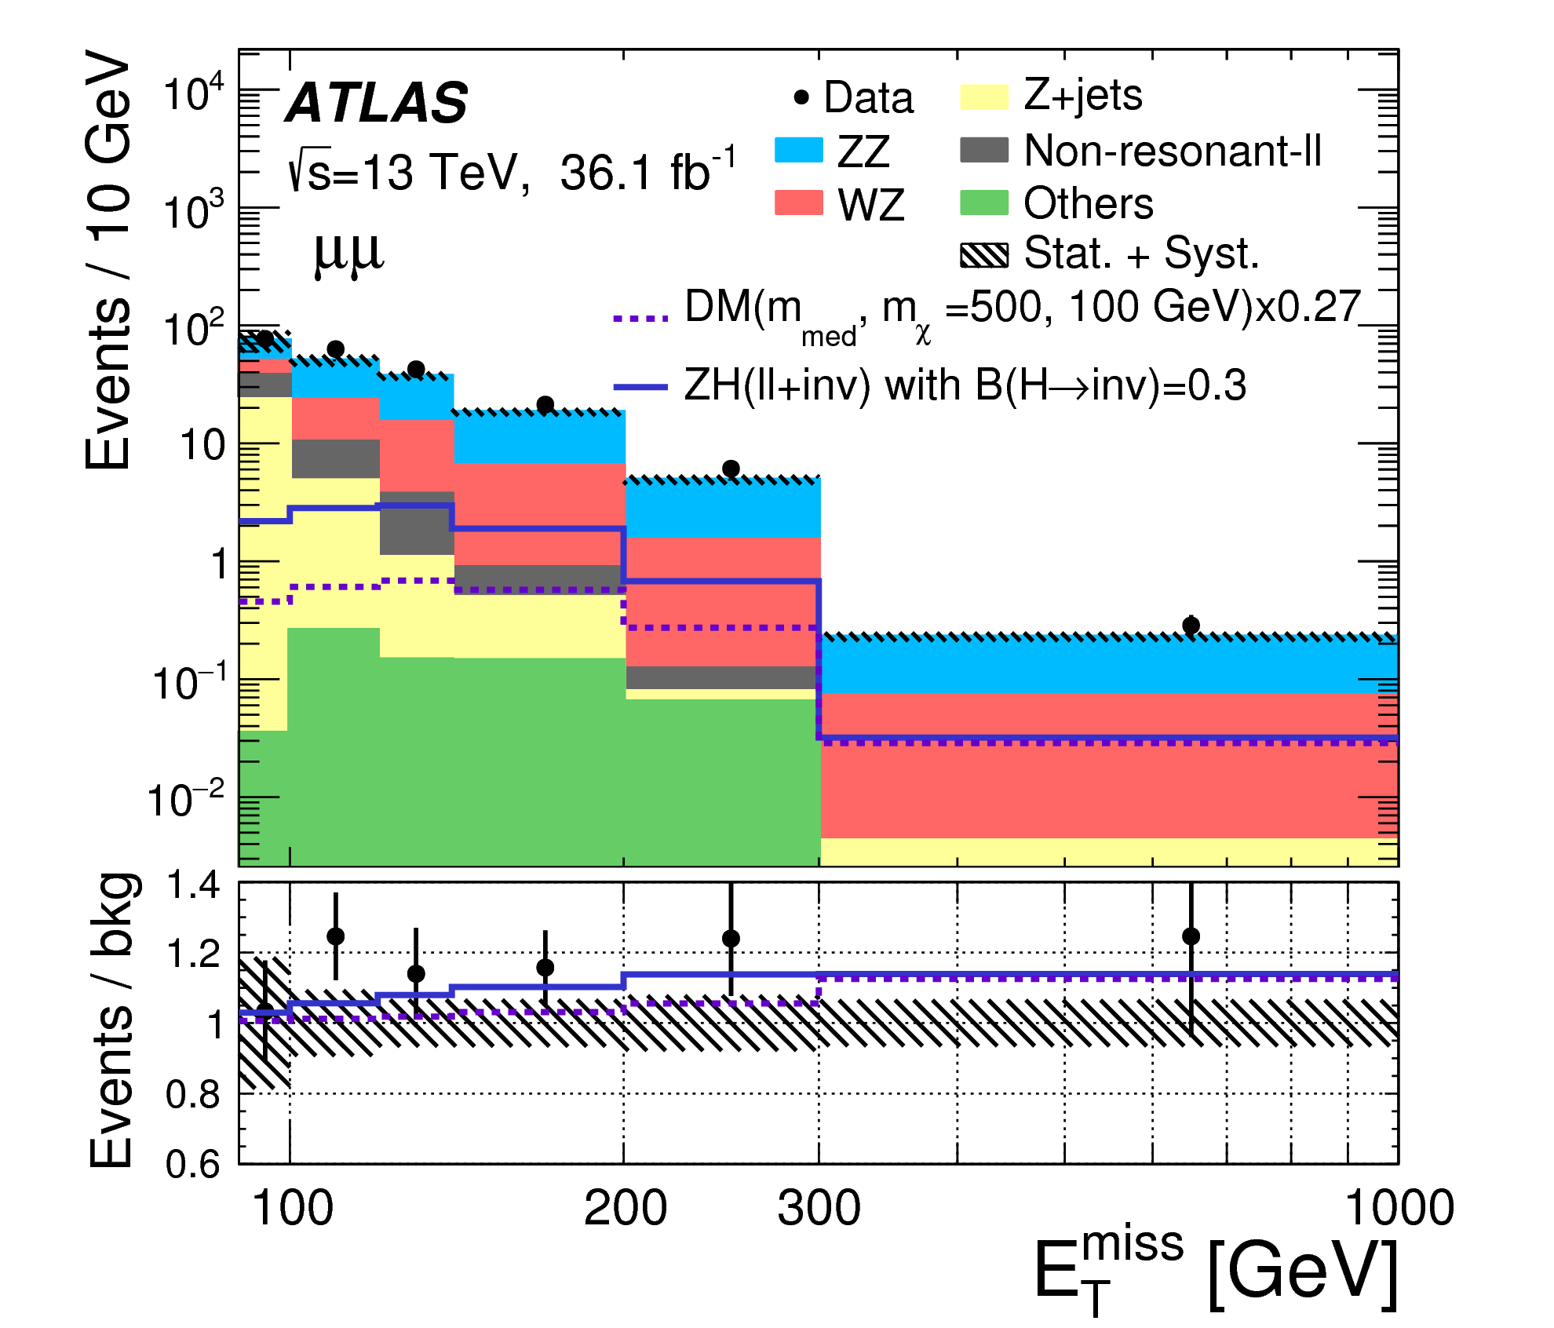
Z (Z → ee/μμ) + Higgs (h → Dark Matter)
PRB 776 (2017) 318
Z
Z
h

Slide 30
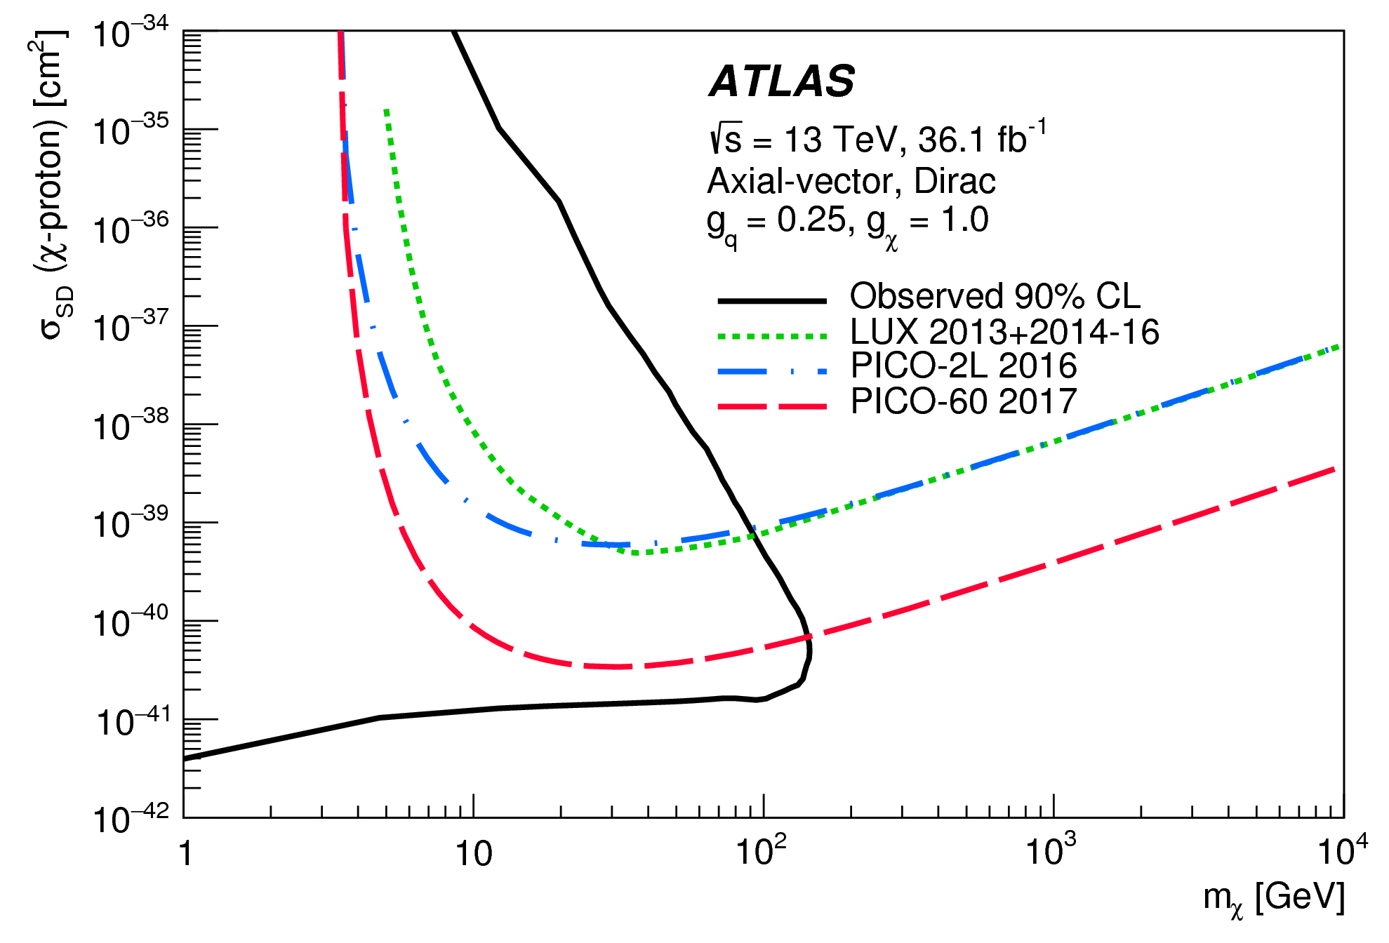

Z (Z → ee/μμ) + Higgs (h → Dark Matter)
PRB 776 (2017) 318
Z
Z
h
ATLAS
ATLAS

Slide 31

Conclusions
The LHC is performing extremely well
Dark matter searches in Run II at 13 TeV
  36 fb⁻¹ (2015 and 2016 data)
  Rich with variety of theoretical models
  Brought significant increase in sensitivity, shaping the dark matter searches program
  Good sensitivity: low mass DM & spin dept. (complementary to direct searches)
  New results yet to come
Entire Run II analysis
  Additional ~100 fb⁻¹ data (2017-2018)
  Cover a much larger parameter space
ATLAS-HIGGS-2015-03
(for illustration)
Direct searches
Direct searches
ATLAS

Slide 32
Additional Slides

Slide 33
ATLAS-HIGGS-2015-03

Slide 34

Missing E_{T} trigger efficiency (2016)

Slide 35


γ + Dark Matter
Eur. Phys. J. C77 (2017) 393

Slide 36

Heavy Flavor + Dark Matter
Eur. Phys. J. C78 (2018) 18
Validation of background processes

