Slide 1
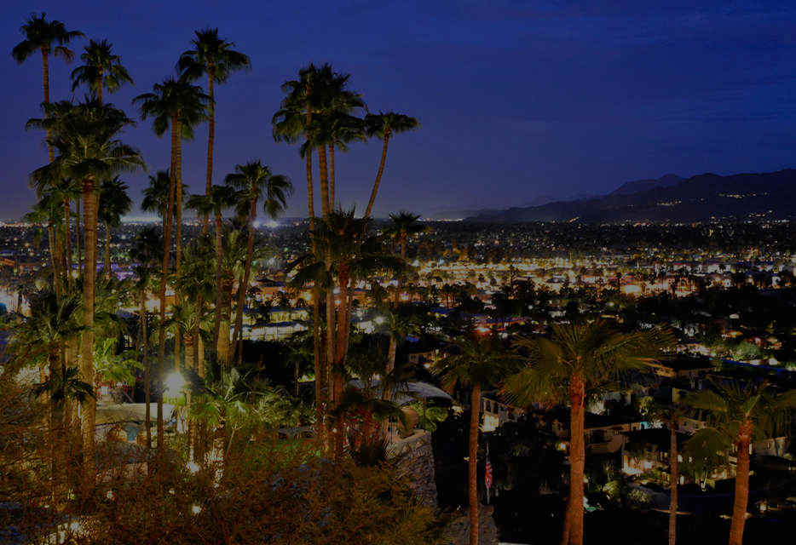
Dark Matter Interpretation
of the Neutron Decay Anomaly
Bartosz Fornal
University of California, San Diego
13th Conference on the Intersections of Particle and Nuclear Physics
Palm Springs, May 29, 2018
In collaboration with: Benjamin Grinstein

Slide 2
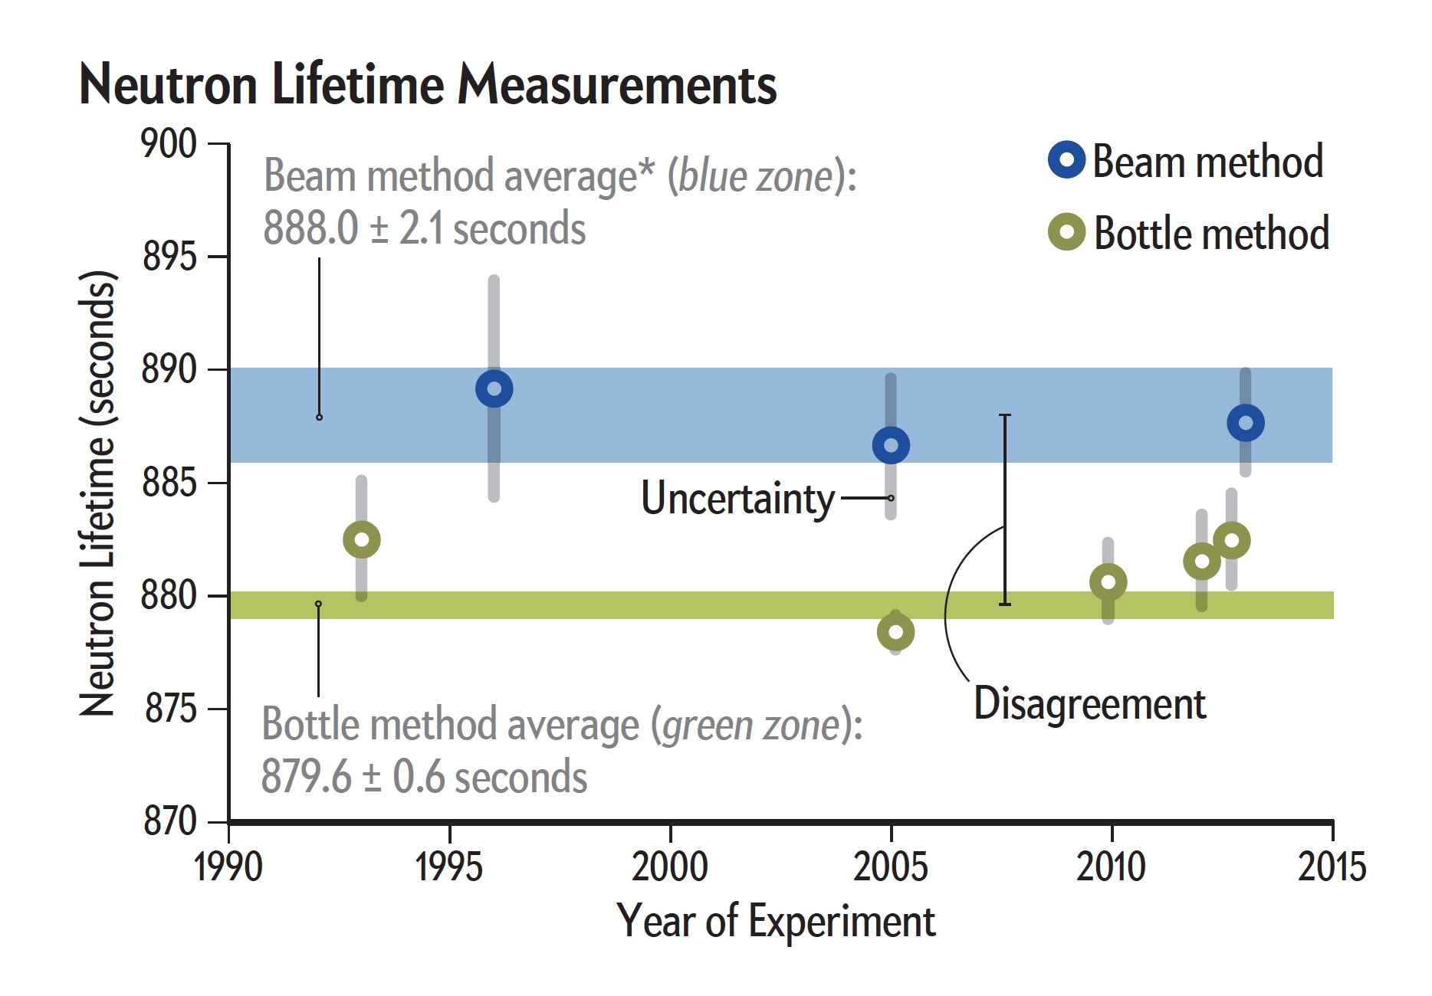
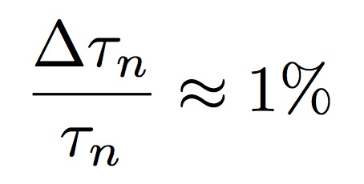
Neutron lifetime measurements
Discrepancy
Source: https://www.scientificamerican.com, modified

Slide 3
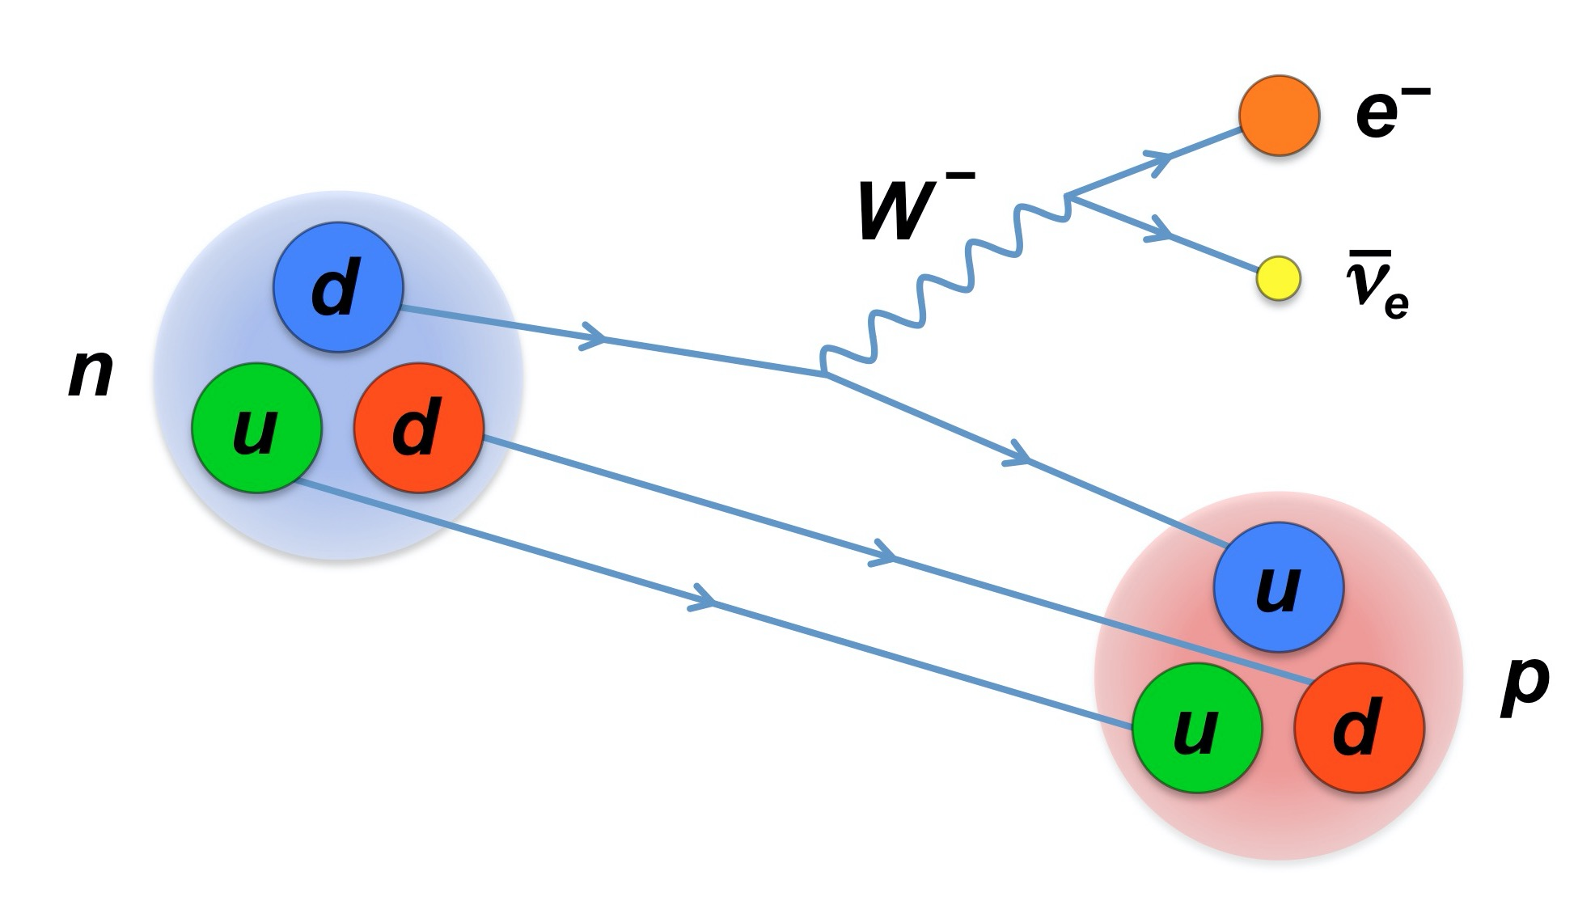
Neutron decay in the Standard Model
Theoretical prediction
Marciano & Sirlin,
PRL 96, 032002 (2006)

Slide 4
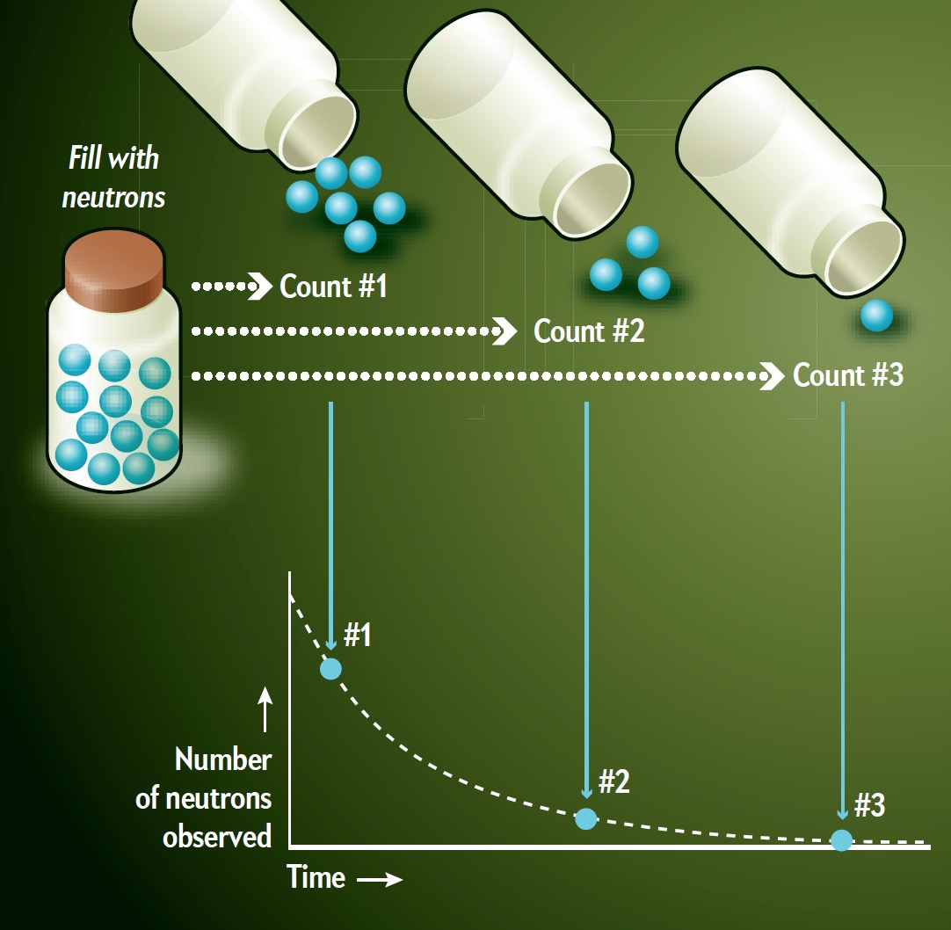
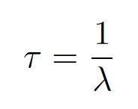
Bottle experiments
Data points fit to an exponential decay
Lifetime
Source: https://www.scientificamerican.com

Slide 5
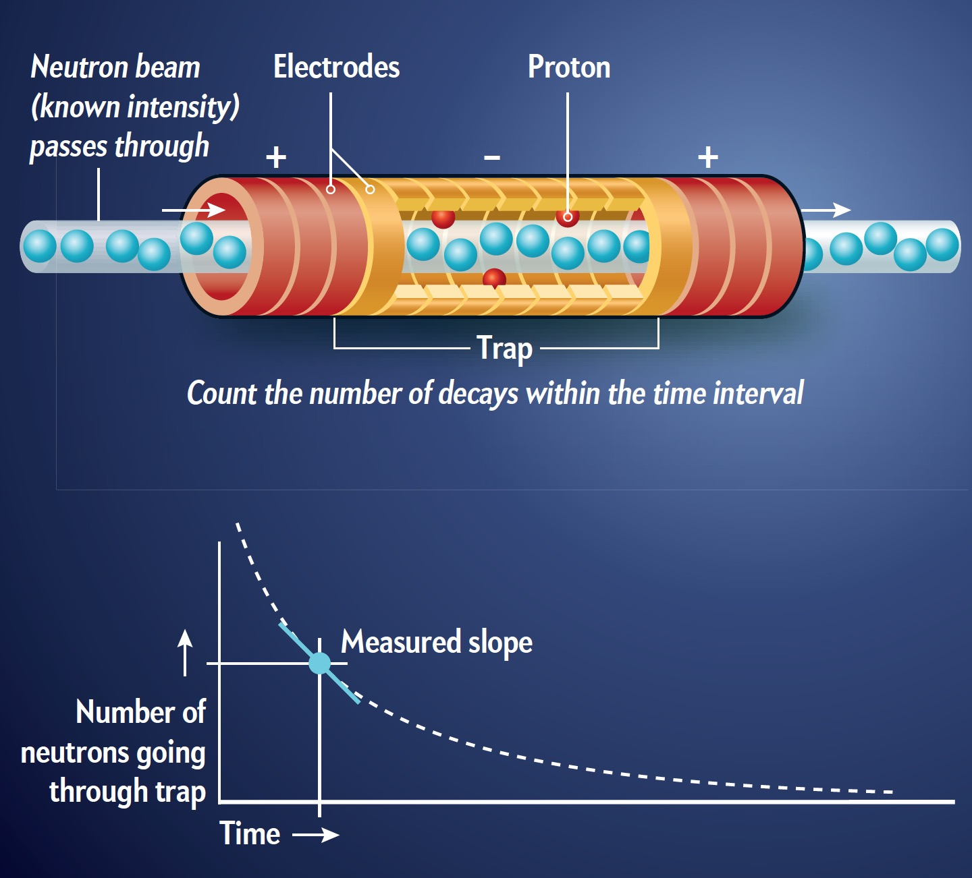
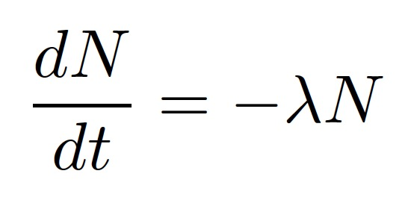
Beam experiments
Only the decay rate to protons is measured
Source: https://www.scientificamerican.com

Slide 6
Neutron dark decay
Remaining 1% :

Slide 7
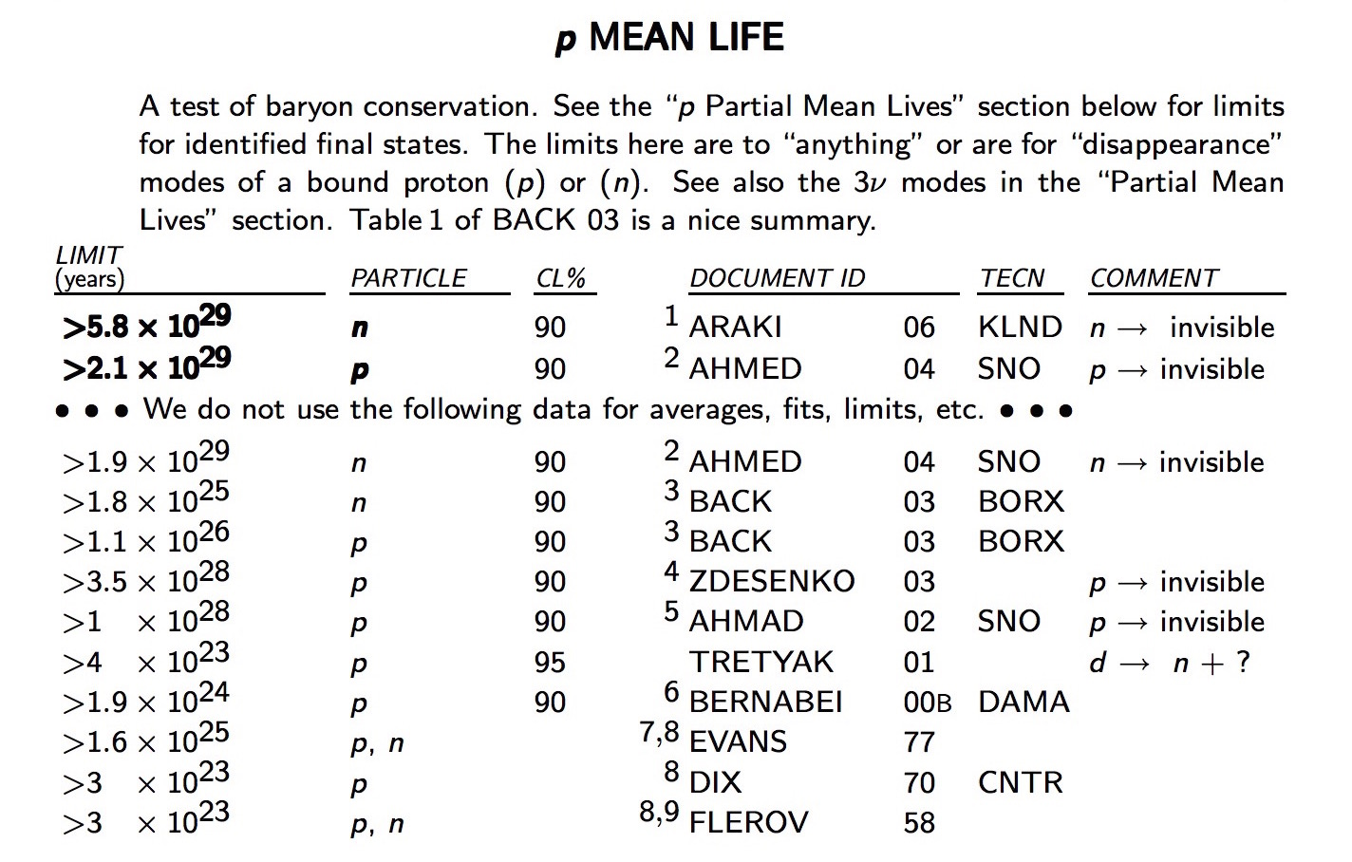
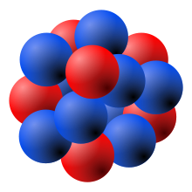
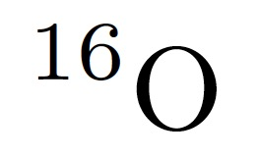
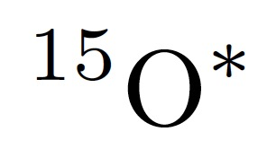
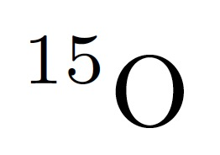
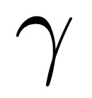
Nuclear physics bounds

Slide 8
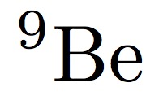
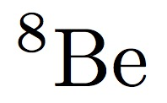
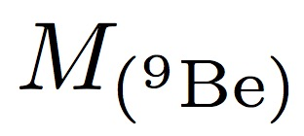
Nuclear physics bounds – ⁹Be
+
⁹Be decay forbidden if:

Slide 9
Possible decay channels
Neutron dark particle + photon
Neutron dark particle + e⁺e⁻
Neutron two dark particles
Neutron …

Slide 10
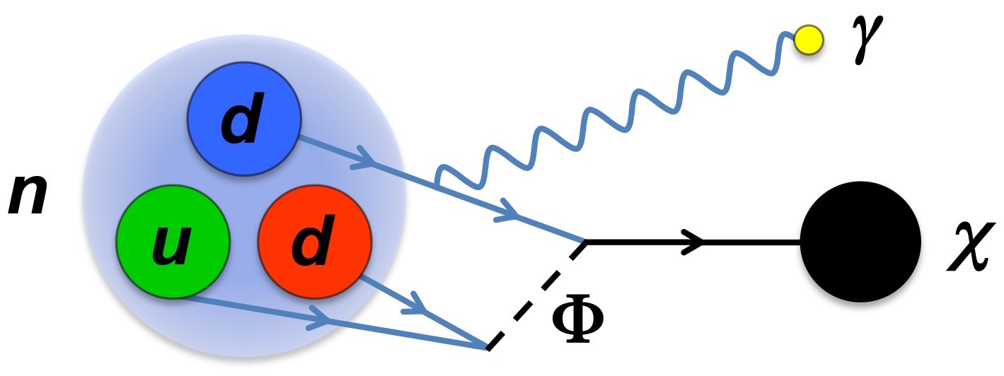
Neutron dark particle + photon
χ
Dark particle mass
Dark decay photon energy
Dark matter case

Slide 11
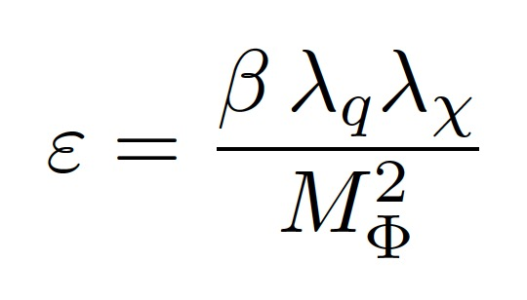
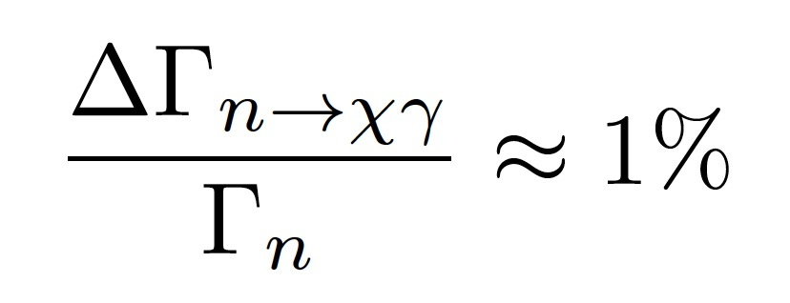
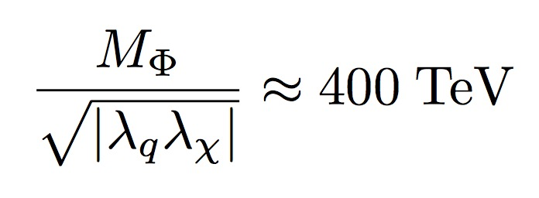
χ
Model 1
(minimal)
Lagrangian
Dark decay rate
To explain the neutron lifetime discrepancy

Slide 12
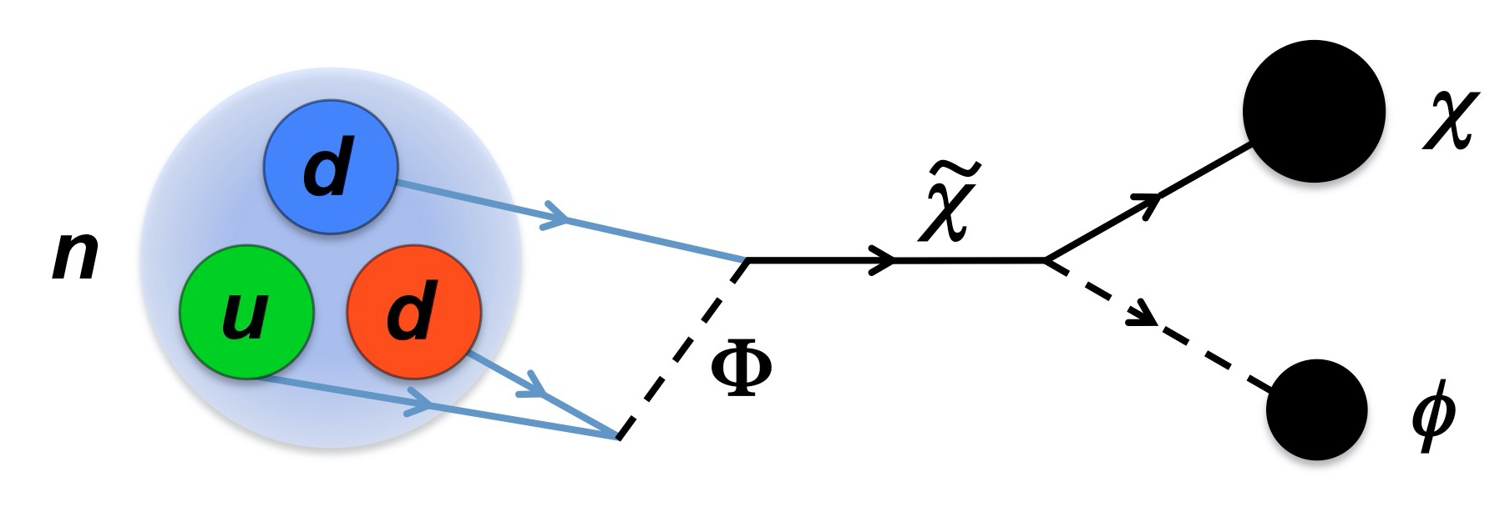
Neutron two dark particles
Constraints on masses
Dark matter case

Slide 13
Model 2
Lagrangian
Dark decay rate

Slide 14
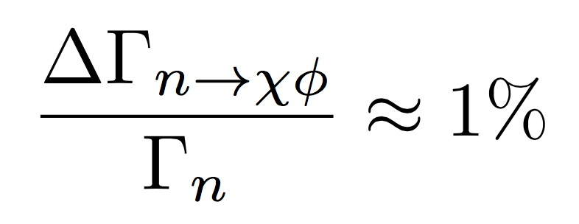
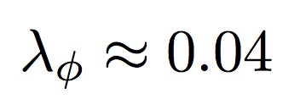
Model 2
For m_{χ} > m_{n}
~
For 937.9 MeV < m_{χ} < m_{n}
~
χ

Slide 15
Neutron star constraints
McKeen, Nelson, Reddy & Zhou, Neutron stars exclude light dark baryons, arXiv:1802.08244 [hep-ph]
Baym, Beck, Geltenbort & Shelton, Coupling neutrons to dark fermions to explain the neutron lifetime anomaly is incompatible with observed neutron stars, arXiv:1802.08282 [hep-ph]
Motta, Guichon & Thomas, Implications of neutron star properties for the existence of light dark matter,
J. Phys. G 45 05LT01 (2018), arXiv:1802.08427 [nucl-th]
Dark matter self-interactions needed to block the neutron dark decay and allow the observed neutron star masses

Slide 16
Neutron star constraints
McKeen, Nelson, Reddy & Zhou, Neutron stars exclude light dark baryons, arXiv:1802.08244 [hep-ph]
Baym, Beck, Geltenbort & Shelton, Coupling neutrons to dark fermions to explain the neutron lifetime anomaly is incompatible with observed neutron stars, arXiv:1802.08282 [hep-ph]
Motta, Guichon & Thomas, Implications of neutron star properties for the existence of light dark matter,
J. Phys. G 45 05LT01 (2018), arXiv:1802.08427 [nucl-th]
Dark matter self-interactions needed to block the neutron dark decay and allow the observed neutron star masses
Cline & Cornell, Dark decay of the neutron, arXiv:1803.04961 [hep-ph]
Karananas & Kassiteridis, Small-scale structure from neutron dark decay, arXiv:1805.03656 [hep-ph]

Slide 17
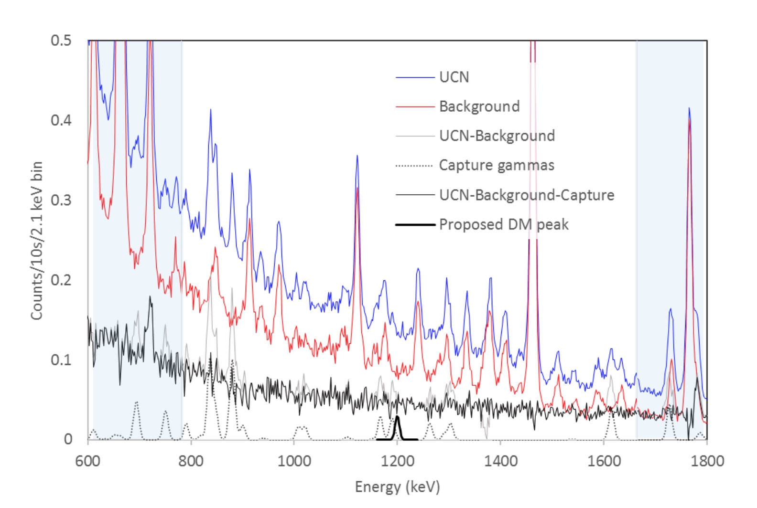
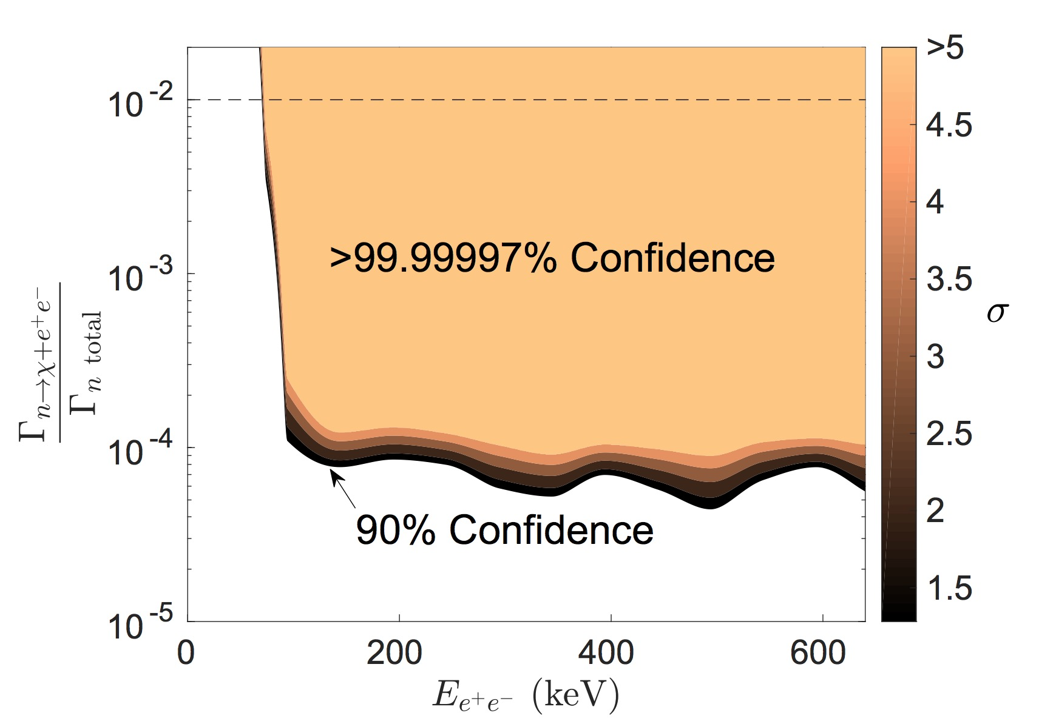
Neutron dark decay – excluded regions
monochromatic photons
Tang et al., Search for the neutron decay
n → X + γ where X is a dark matter particle,
arXiv:1802.01595 [nucl-ex]
electron-positron pairs
Sun et al., Search for dark matter decay of the free neutron from the UCNA experiment: n → χ + e⁺e⁻, arXiv:1803.10890 [nucl-ex]

Slide 18
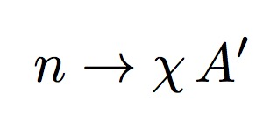
Neutron dark decay – exciting results
Experimental nuclear physics hint
Pfutzner & Riisager, Examining the possibility to observe neutron dark decay in nuclei, PRC 97, 042501(R) (2018)
Riisager et al., ¹¹Be(βp), a quasi-free neutron decay?, PLB 732, 305 (2014)
Theoretical progress
Cline & Cornell, Dark decay of the neutron, arXiv:1803.04961
resolution of the small-scale problems in ΛCDM
Karananas & Kassiteridis, Small-scale structure from neutron dark decay, arXiv:1805.03656

Slide 19
Wishful thoughts
“Missing Neutrons May Lead a Secret
Life as Dark Matter”,
C. Moskowitz, Scientific American (January 29, 2018)
It would be truly amazing if the good old neutron turned out to be the particle enabling us to probe the dark matter sector of the universe

Slide 20
Thank you!

Slide 21
Thank you!

Slide 22
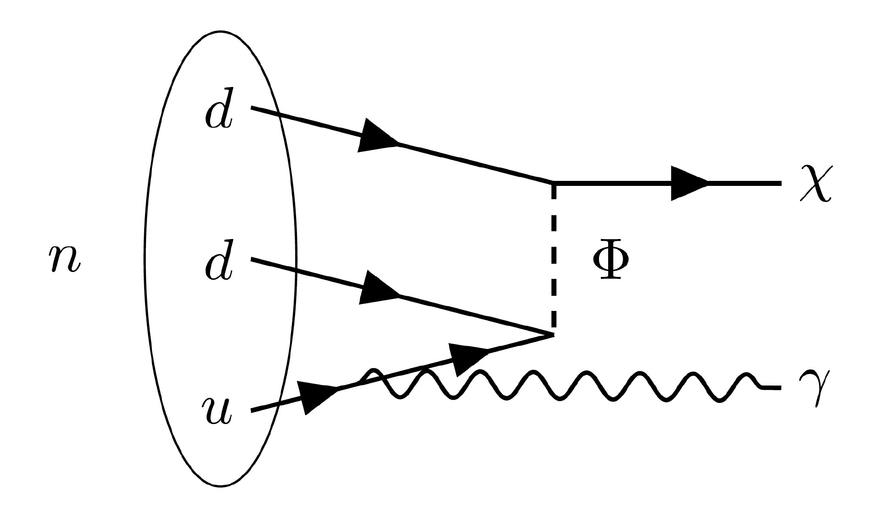
Back-up slide: LHC signatures
Φ can be singly produced through u d ➔ Φ or pair produced via gluon fusion g g ➔ Φ Φ
Collider signatures involve:
2 jets, monojet + MET
2 jets + MET, 3 jets + MET, 4 jets
2-jets, MET (not necessarily suppressed)

Slide 23
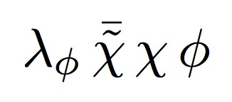
Back-up slide: Dark matter
Model 1: non-thermal DM production
χ
( Allahverdi, Dev, Dutta, PLB 02, 019 (2018) )
Model 2: (a) DM non-thermally produced
(b) DM thermally produced
Observed DM relic abundance for:
DM annihilation

Slide 24
Back-up slide: Model 1 – Effective nuclear level
Effective Lagrangian
Dark decay effective term
Dark decay rate

Slide 25
Back-up slide: Particle – nuclear matching
Particle level Lagrangian
Nuclear level Lagrangian
χ

Slide 26
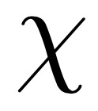
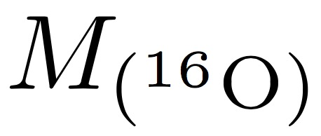
Back-up slide: Nuclear physics bounds
+

Slide 27
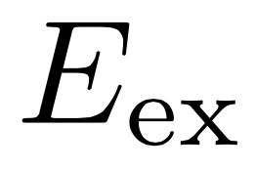
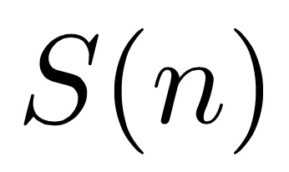
Back-up slide: Nuclear physics bounds
+
Nuclear decay forbidden if:

Slide 28
Back-up slide: ⁹Be bound – a closer look
+
⁹Be decay forbidden if:

Slide 29
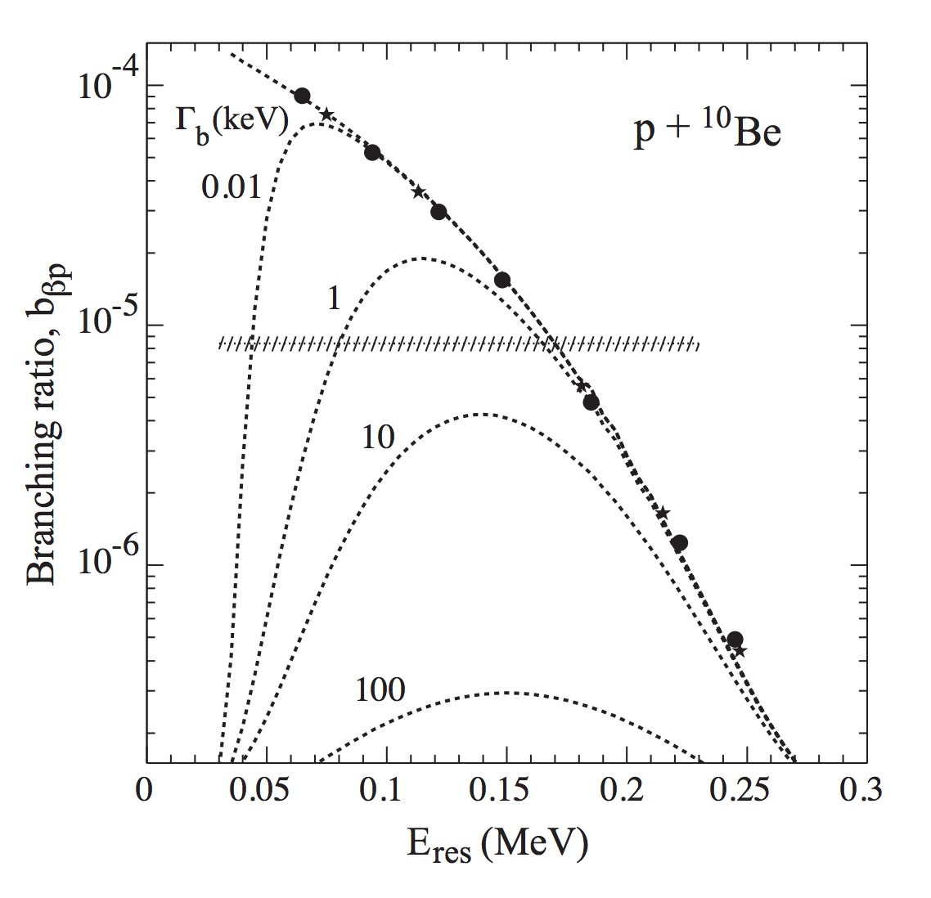
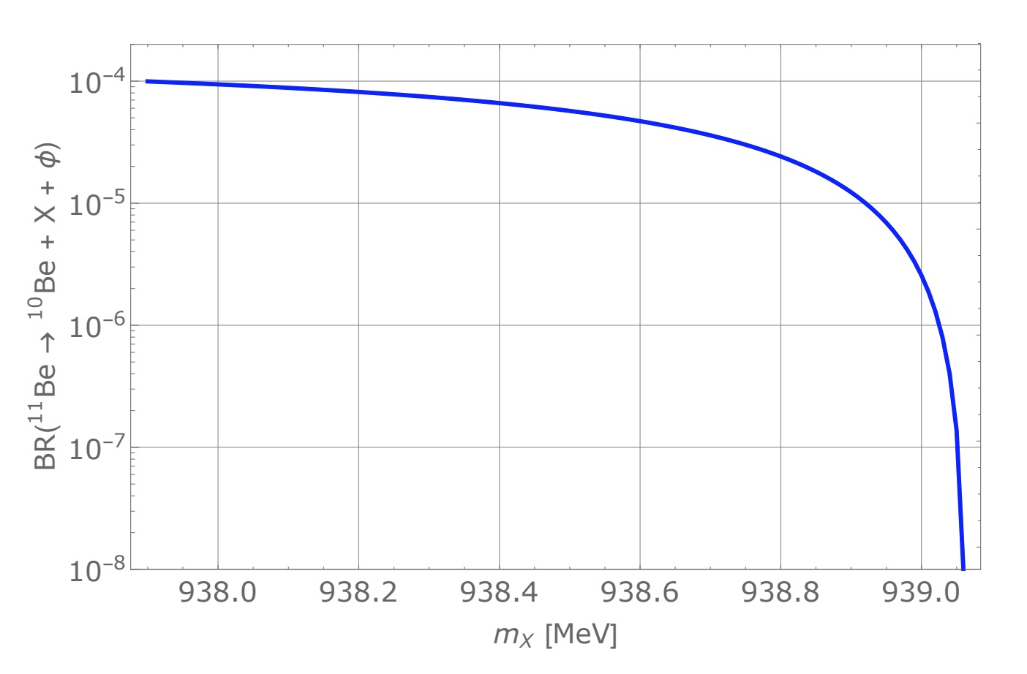
Back-up slide: Hint from ¹¹Be decays?
Pfutzner & Riisager, Examining the possibility to observe neutron
dark decay in nuclei, PRC 97, 042501(R) (2018)
¹¹Be: one-neutron halo nucleus
experiment suggests
Riisager et al., ¹¹Be(βp), a quasi-free neutron decay?, PLB 732, 305 (2014)
?
Resonance
or
dark decay
?

Slide 30
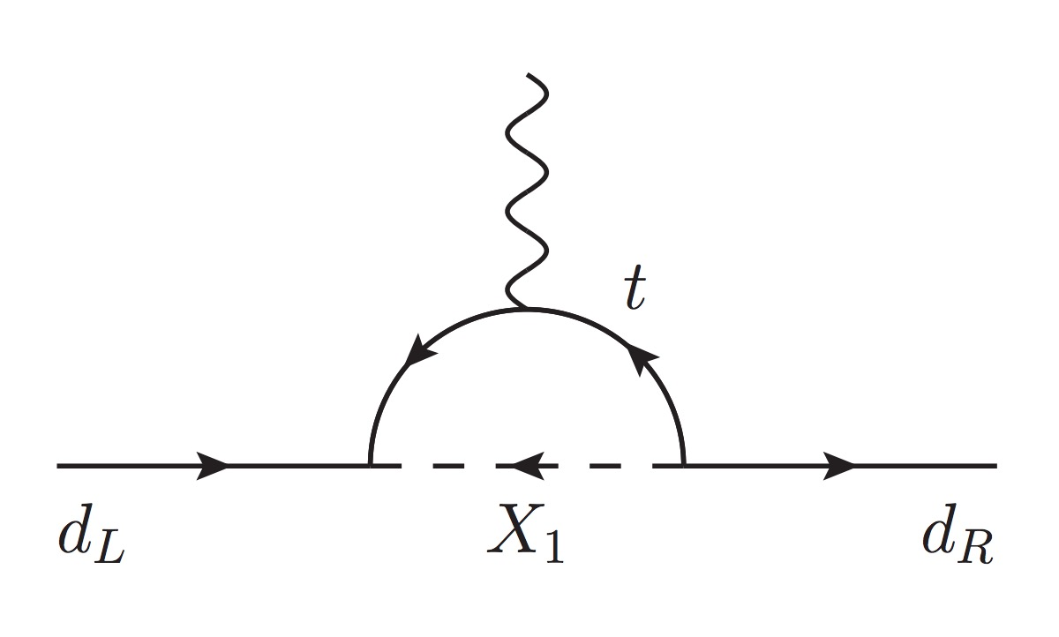
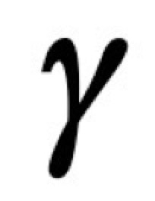
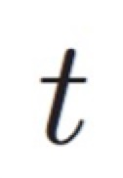
Back-up slide: Neutron EDM
Extended Lagrangian for model 1
Neutron EDM
Constraint

Slide 31
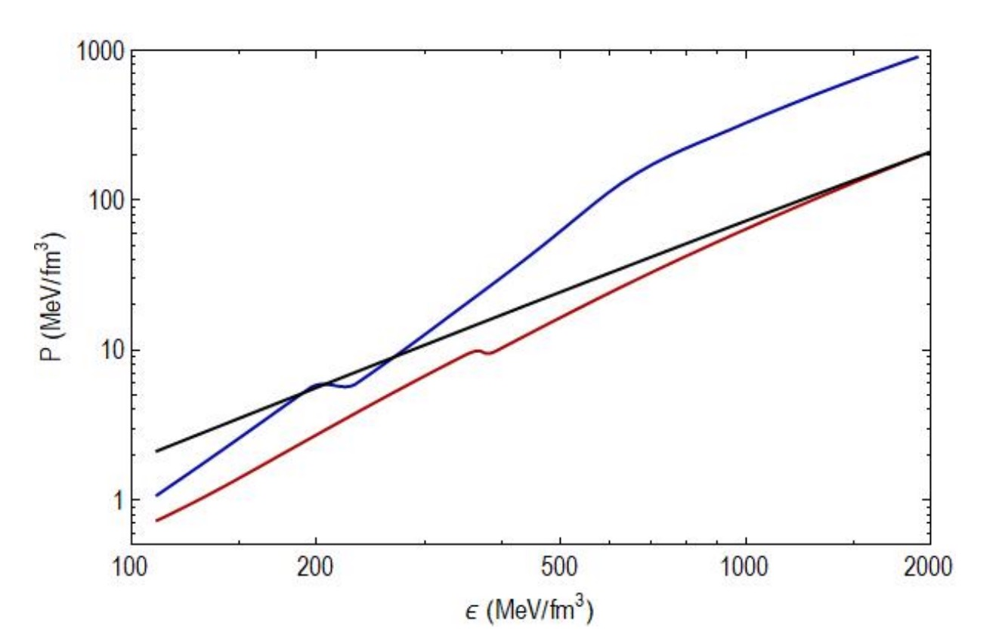
Back-up slide: Neutron star constraints
(arXiv:1802.08244, 1802.08282, 1802.08427)
Neutron dark decay channel affects the equation of state for neutron stars
Total energy density
Total pressure
(arXiv:1802.08282)

Slide 32
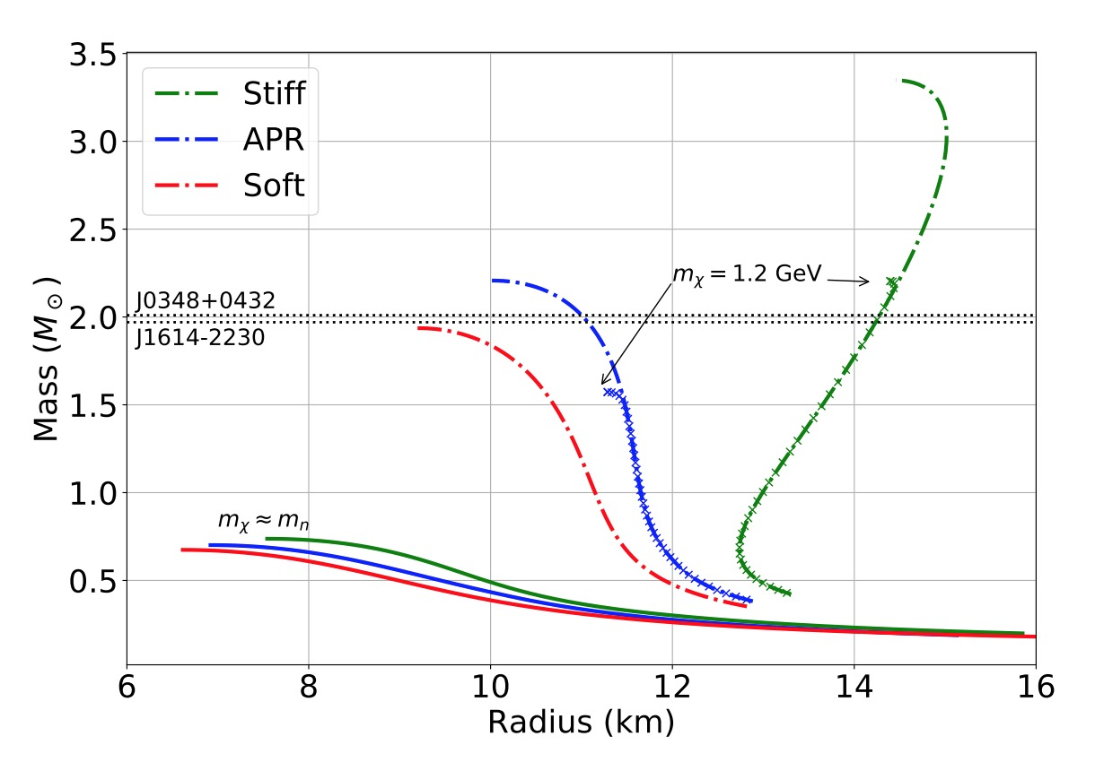
Back-up slide: Neutron star constraints
(arXiv:1802.08244, 1802.08282, 1802.08427)
Neutron dark decay channel and no DM self-interactions imply neutron star masses < 0.8 M
(arXiv:1802.08244)
DM self-interactions can block the neutron dark decay, allowing observed neutron star masses

Slide 33
Back-up slide: Neutron beta decay

