Slide 1
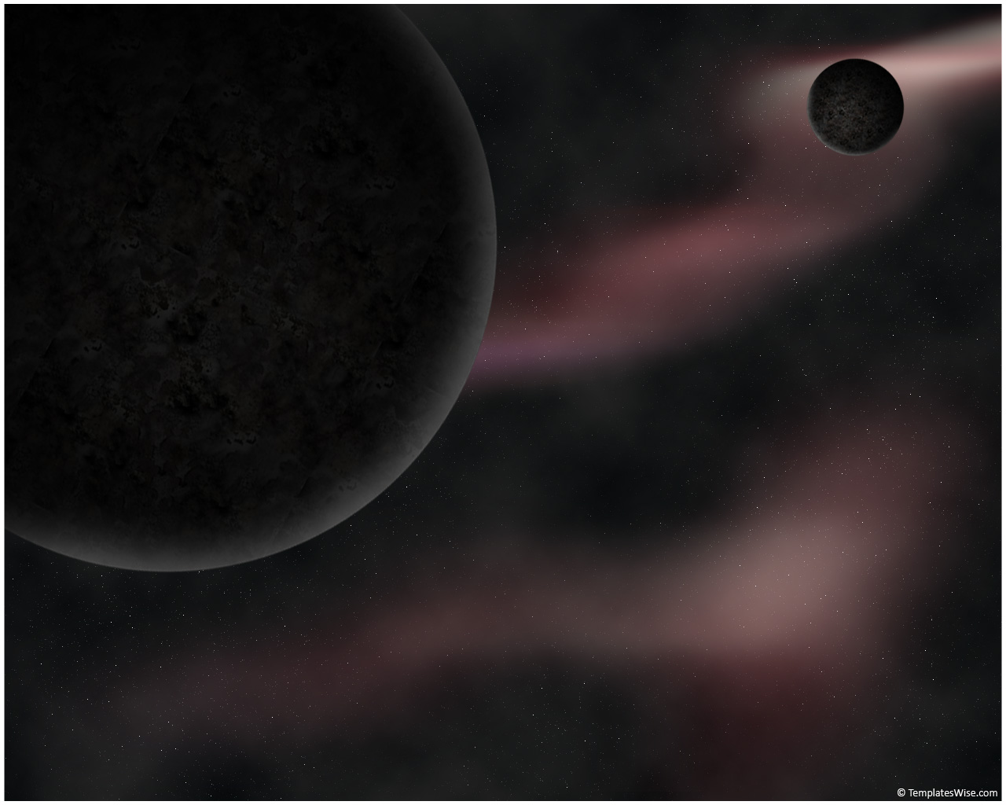
Outline
Results and Future Plans for the PICO Dark Matter Bubble Chamber
PICO superheated liquid technology
PICO Background Mitigation
Recent Results from PICO 60
Future Plans: PICO 40 → PICO 500
Tony Noble
Queen’s University

Slide 2
The Bubble Chamber Technology

Slide 3
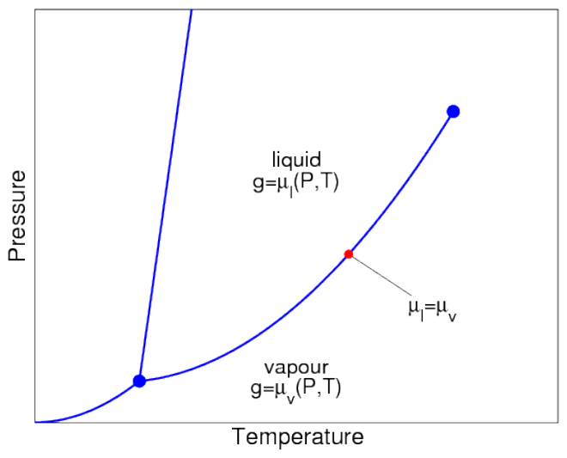
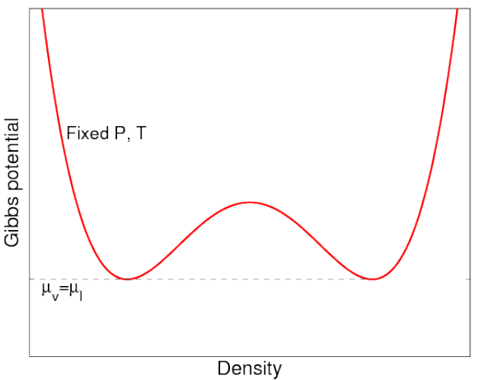
Bubble Chamber Operation
Phase diagram
Gibbs free energy
Vapour
Liquid
Gas Like
Liquid Like
When on the saturation curve, liquid and gas are in equilibrium. (Same pressure, temperature and chemical potential).
At equilibrium, the potential has two minima (one dominantly gas like and one liquid dominated)

Slide 4
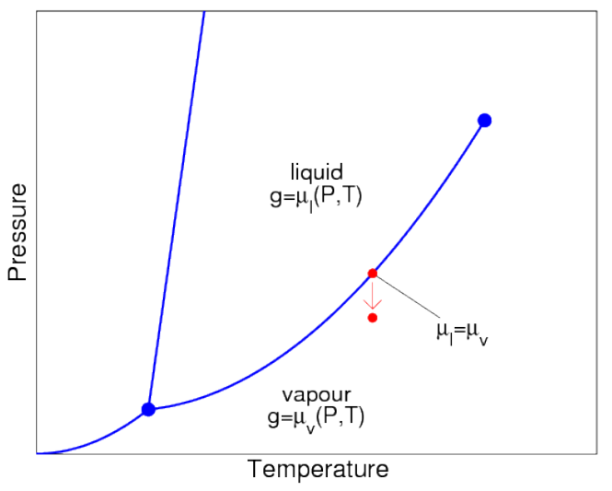
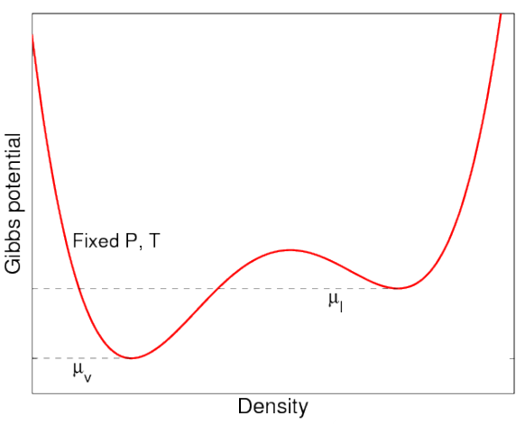
Bubble Chamber Operation
Phase diagram
Gibbs free energy
Superheated Liquid
Vapour
We now lower the pressure of the chamber carefully….starting from the pure liquid phase.
This distorts the potential, leading to a meta-stable superheated liquid state. Unless sufficient energy is added, it will stay in meta-stable state.

Slide 5
Particle detection with bubble chambers
A bubble chamber is filled with a superheated fluid in meta-stable state.
Energy deposition greater than E_{th} in radius less than r_{c} from particle interaction will result in expanding bubble (Seitz “Hot-Spike” Model).
A smaller or more diffuse energy deposit will create a bubble that immediately collapses.
Surface energy
Latent heat
Take away message:
To be sensitive, particle must deposit enough energy within a critical radius.

Slide 6
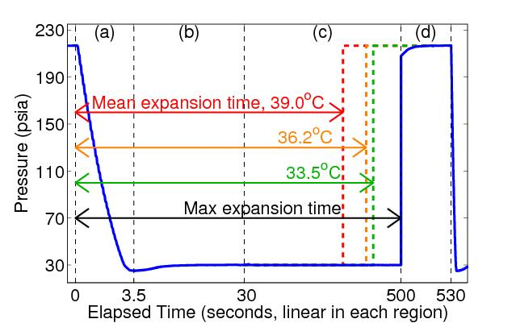
Principle of Operation: Original Bubble Chambers
Buffer fluid
(water)
Synthetic silica jar
Target fluid
(CF₃I/C₃F₈)
Hydraulic
fluid
to hydraulic controller
Lower the pressure to a superheated state.
See the bubble:
  Cameras trigger. record position, multiplicity
  Microphones record acoustic trace
  Fast pressure transducer recording.
Raise pressure to stop bubble growth (100ms), reset chamber (30sec)

Slide 7
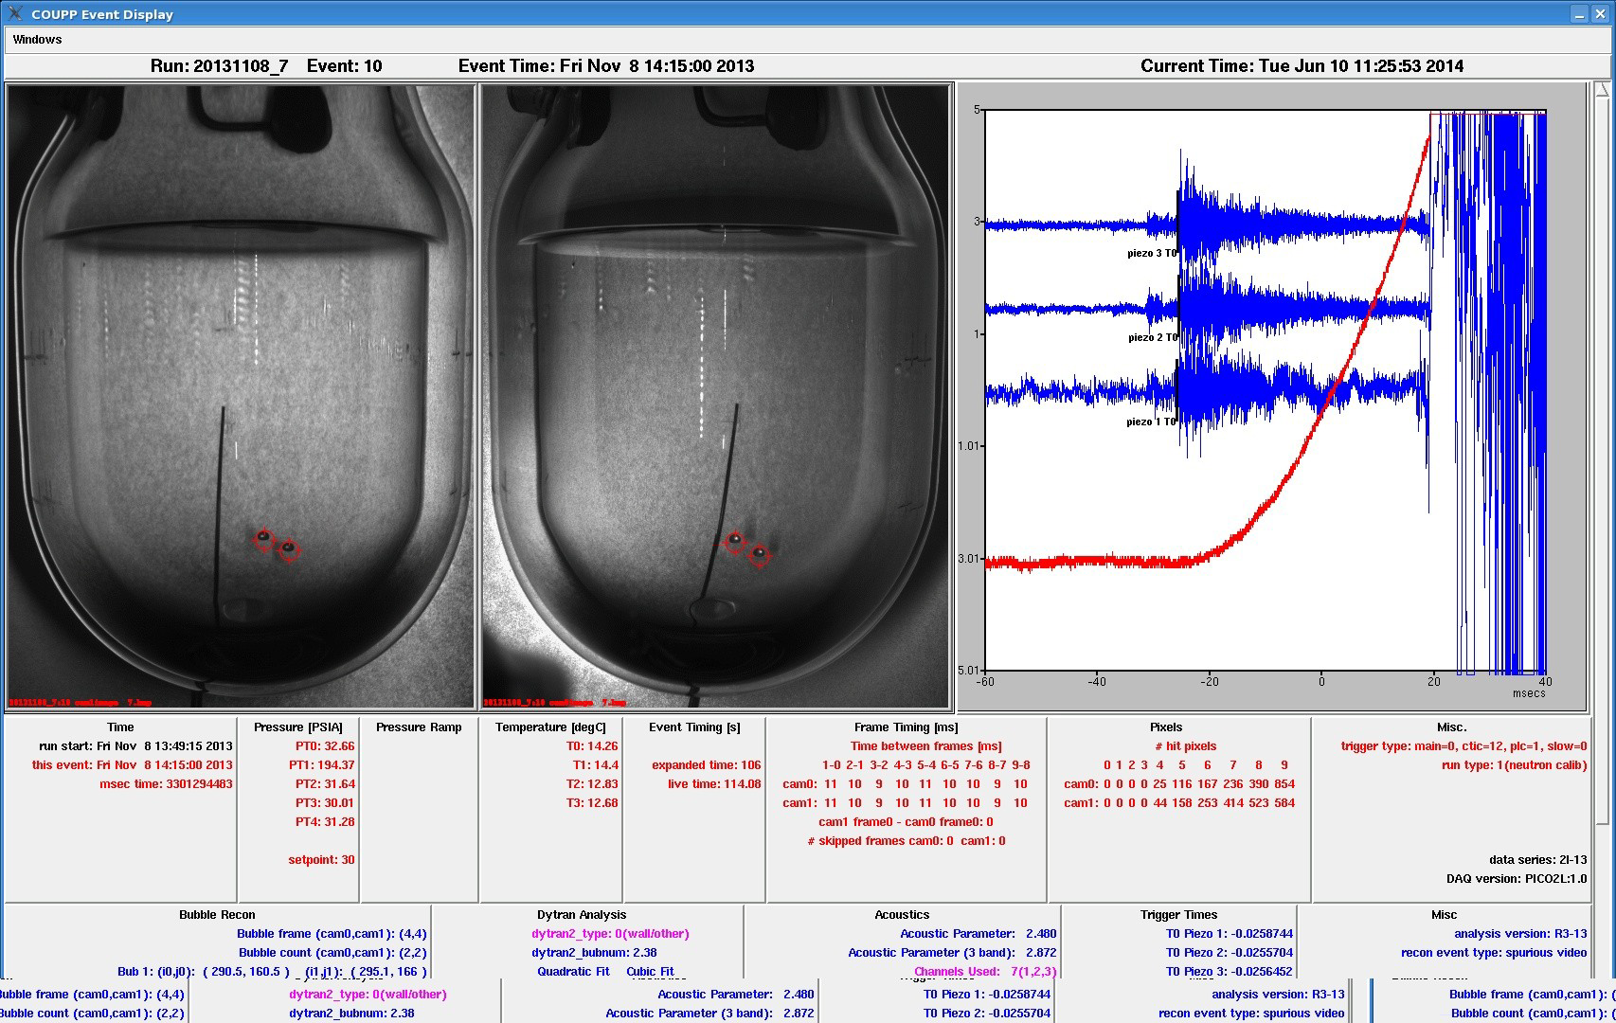
Acoustic Transducers
100fps stereo images
Fast Pressure Transducer
Screen Display during operations

Slide 8
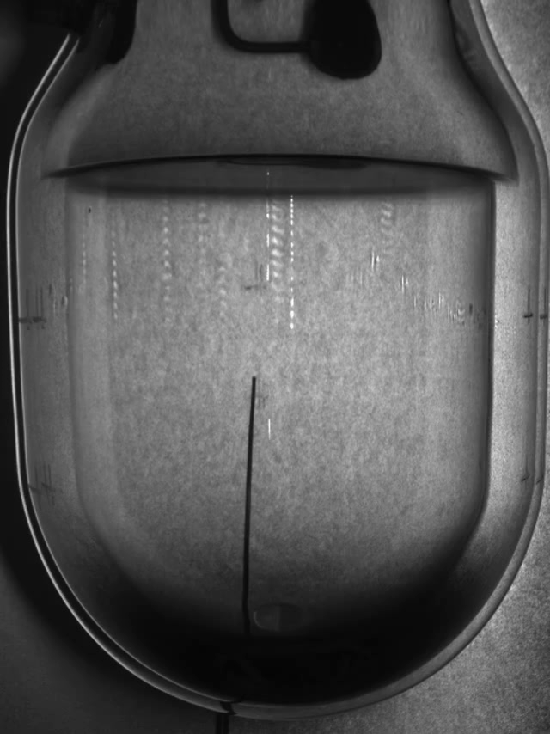
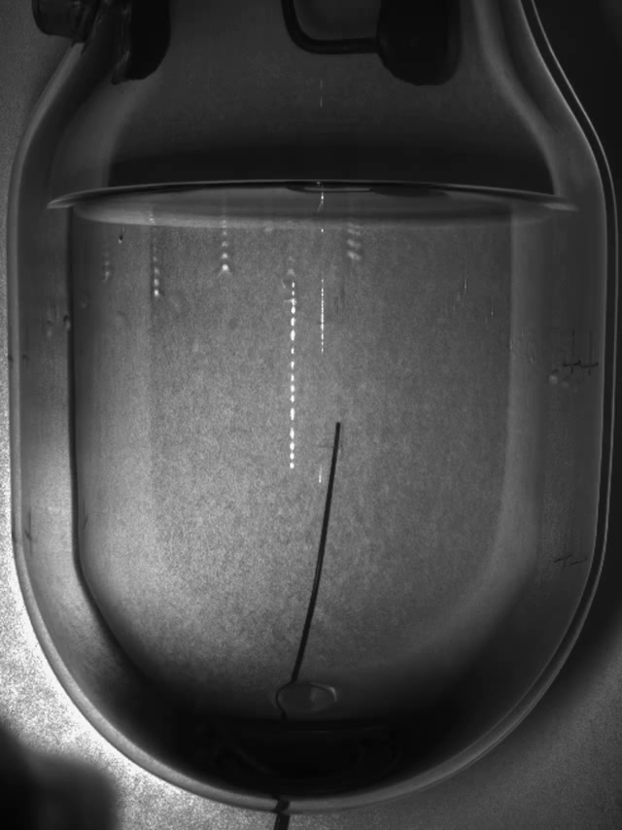
Two example events recorded
Single Bubble event
Neutron event

Slide 9
Background Mitigation:

Slide 10
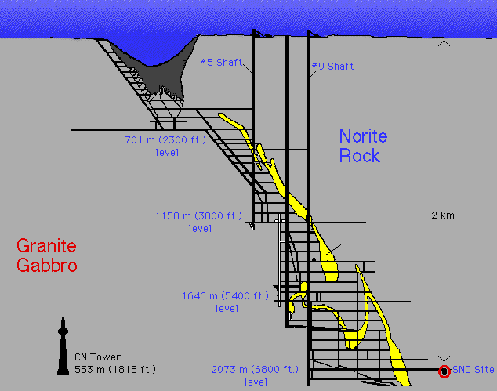
Backgrounds:
  Require very low background environment to see rare events ….
    Go deep underground to escape cosmic rays.
    Provide local shielding
    Use materials with ultra-low levels of radioactivity
    Develop particle discrimination techniques….
Neutrons
Electrons/gammas
Alpha
Neutrinos
Non-particle induced
SNOLAB, CANADA

Slide 11
Gamma/Beta Background Rejection.
C₃F₈
CF₃I
Various PICO Detectors
PICO-60
(set by adjusting T,P)
Excellent electron/gamma rejection has been demonstrated. < 10⁻¹⁰
C₃F₈ can reach lower thresholds than CF₃I for same rejection.
A lower threshold extends the sensitivity to lower mass WIMPs.

Slide 12
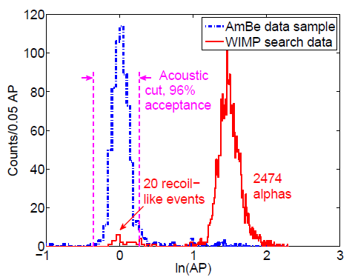
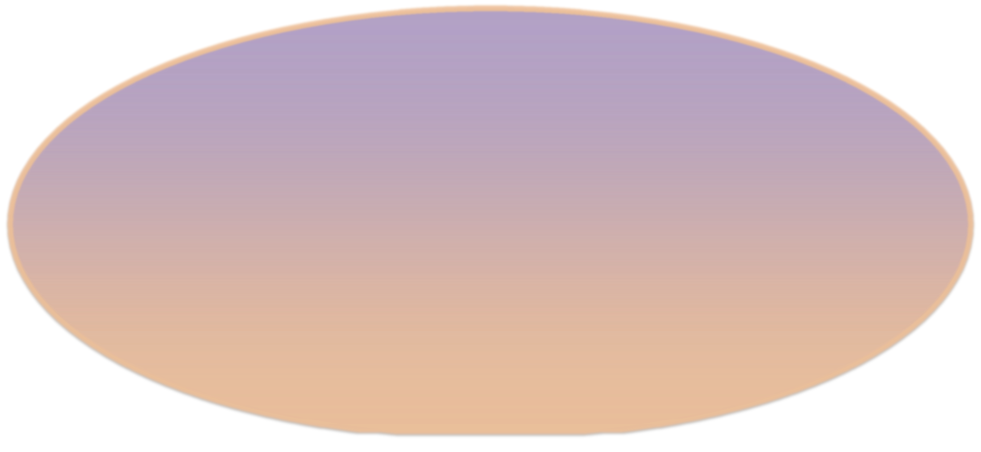
Alpha Acoustic Discrimination
Discovery by PICASSO of acoustic discrimination against alphas
  Nuclear recoils deposit their energy over tens of nanometers.
  Alphas deposit their energy over tens of microns.
In bubble chambers alphas are several times louder due to the difference in the rate of expansion and the number of protobubbles.
Observable bubble ~mm
~40 μm
~50 nm
Daughter heavy nucleus
(~100 keV)
Helium nucleus
(~5 MeV)

Slide 13
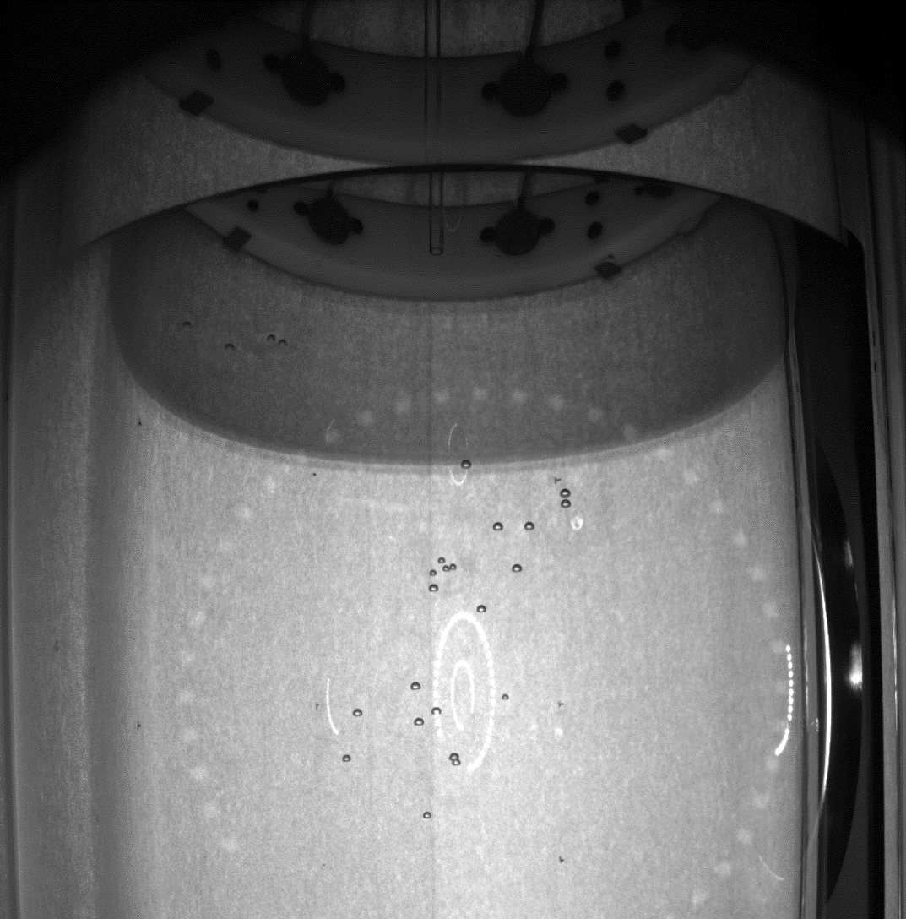
Neutron Backgrounds
Preferentially multiple-scatter
  Allows us to measure background rate directly
Simulation tells us to expect 3:1 multiples to singles ratio in PICO 60
With water tank to shield external sources, residual background dominated by detector materials
How many bubbles can you count?
Answer: 25

Slide 14
Anomalous Background
PICO-2L Run1
  9 candidate events in 32 live-days at 3.2keV
  Inconsistent with known radioactive backgrounds AND dark matter
PICO-2L Run2
  1 candidate event in 66 live-days at 3.2keV
  Consistent with neutron expectations
Between runs, the detector was cleaned of particulate contamination
Before
After
C. Amole et al. Phys. Rev. D 93, 061101(R) (2016)
Hypothesis: combination of particulate matter and water leads to anomalous nucleation mechanism

Slide 15
Latest PICO Results

Slide 16
PICO is a merger of the original PICASSO and COUPP experiments (2014)
Since then we have been progressing with a series of world leading results in SD interactions as we resolve background issues and build larger detectors:
Brief History:
COUPP – 4 CF₃I (2011) Unknown background limits physics reach
PICO – 2L - 1 C₃F₈ (2014) Change fluid to type used by PICASSO
PICO – 60 - 1 CF₃I (2014) Large scale to understand background
Understand backgrounds to be related to particulates at the 10’s of nm scale
PICO – 2L – 2 C₃F₈ (2016) Background event (1) consistent with environmental neutrons
Go big !
PICO – 60 - 2 C₃F₈ (2017) Background free. Blinded data.
Fix residual background issues and go even bigger

Slide 17
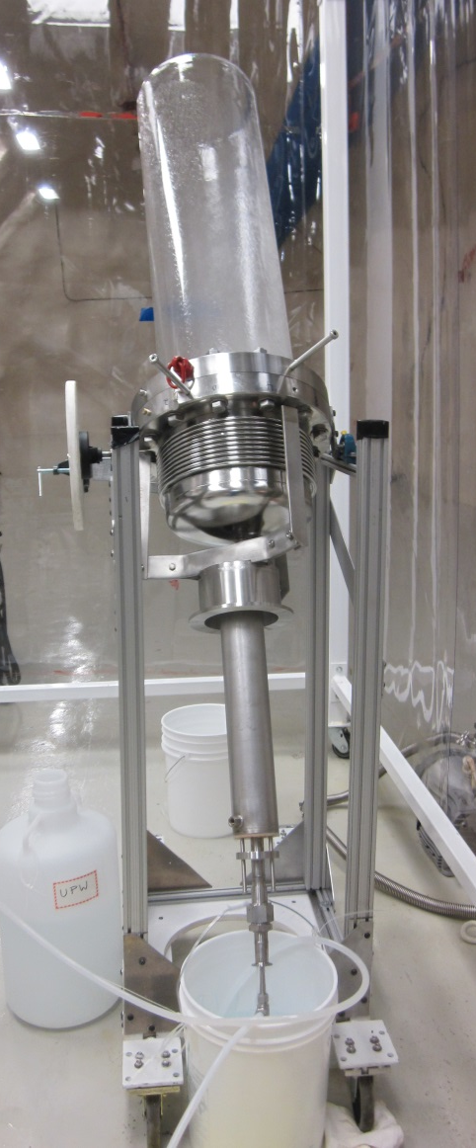
PICO-60 Cleaning
Every component touching the inner volume was cleaned against to the standard: MIL-STD-1246C level 50
Post-Filtration Particulate Size Distribution
----- Mil-Std 1246C level 100
----- Mil-Std 1246C level 50 (Goal)
----- Mil-Std 1246C level 25
* Filter Sample Normalized by Flow
<5μm
<15μm
<25μm
<50μm
<100μm
Particulate Size Bin

Slide 18
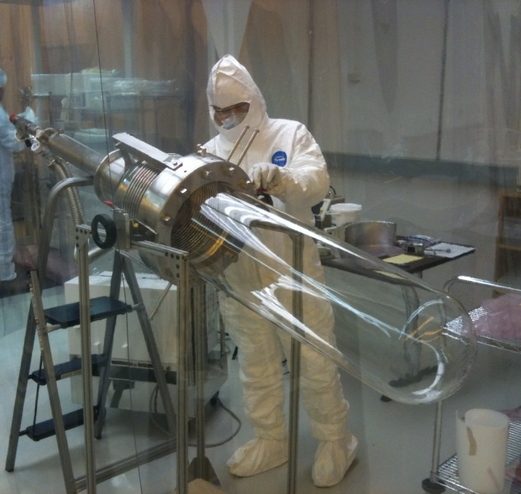
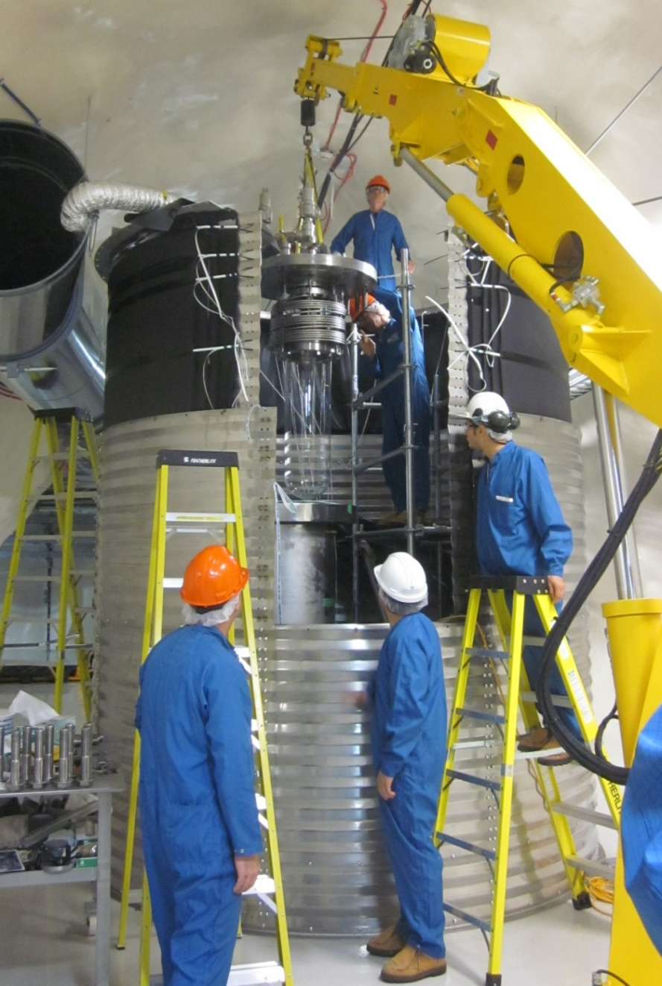
COUPP-60

Slide 19
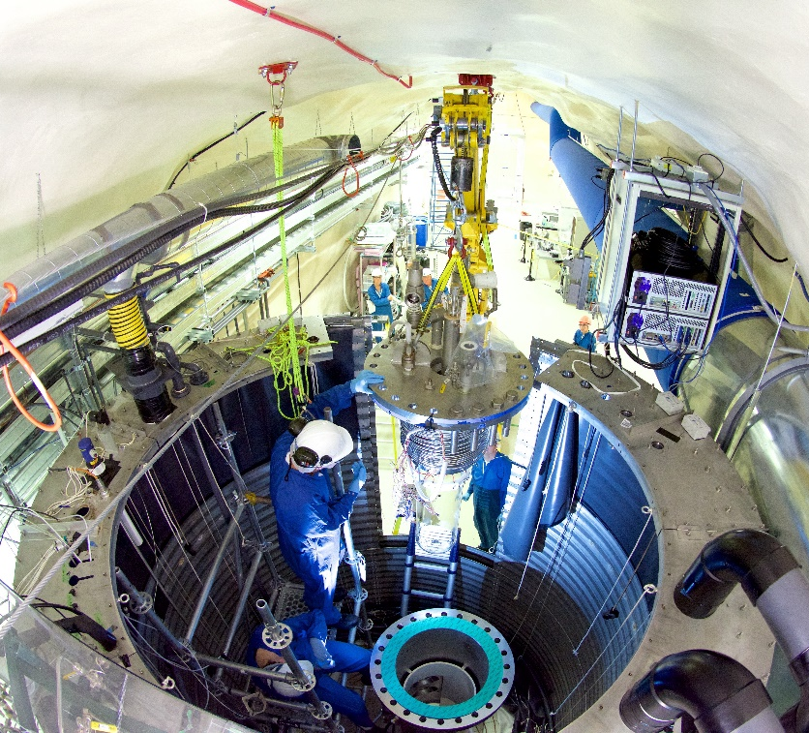
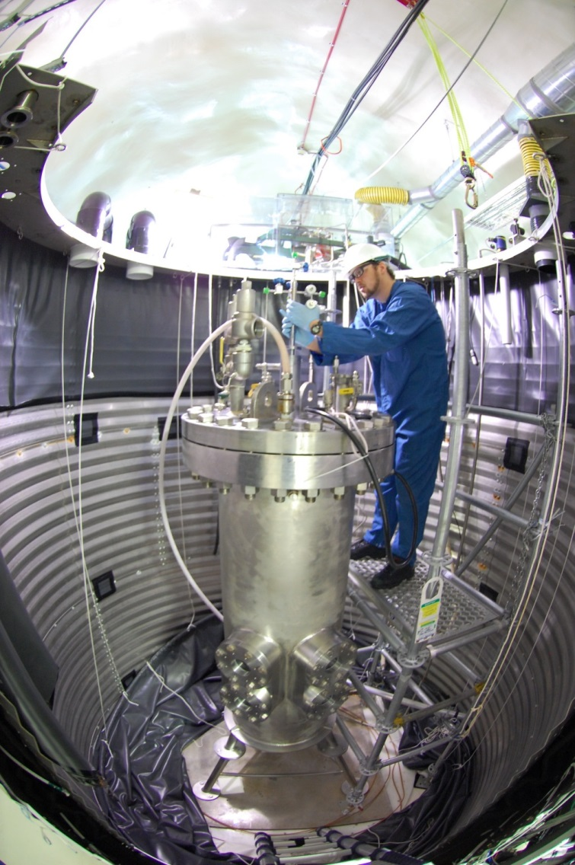
Commissioning
Filled with 40L C₃F₈ on June 30, 2016
First physics run Nov. 2016 – Jan. 2017

Slide 20
What do we measure?
Camera images (primary trigger)
  How many bubbles were there?
  What was the bubble’s position?
Temperature
Pressure (secondary trigger)
Acoustic signal
Neutron Rejection
Surface Rejection
Threshold
Determination
Alpha Rejection

Slide 21
What do we measure?
Camera images (primary trigger)
  How many bubbles were there?
  What was the bubble’s position?
Temperature
Pressure (secondary trigger)
Acoustic signal
Neutron Rejection
Surface Rejection
Threshold
Determination
Blind this information
Alpha Rejection

Slide 22
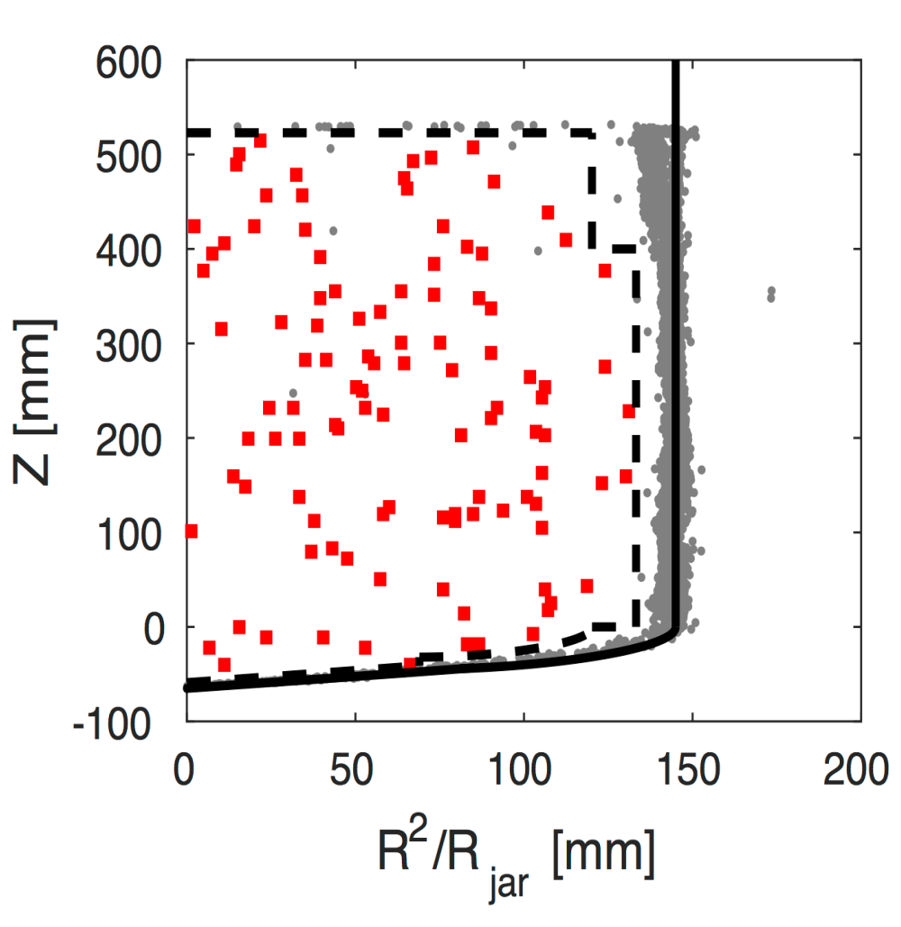
Before Opening the Box
106 bulk singles in WIMP search dataset
  Acoustics Still Blind
  Consistent with Rn decay rate in pre-WIMP search unblinded data
Neutron Background
  Not blinded to multiplicity
  3 multiple bubble events in the physics data
  Multiples to singles ratio is approximately 3:1 from calibration and simulation
Conclusion: 0-3 bulk singles would be consistent with neutrons and no anomalous background
C. Amole et al., arXiv:1702.07666

Slide 23
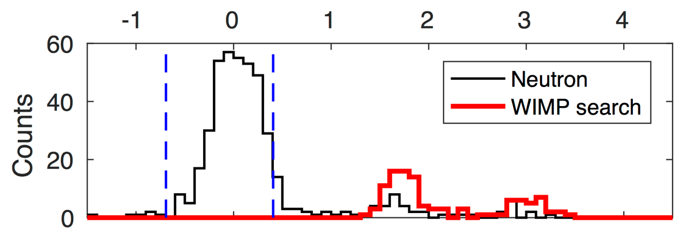
After Opening the Box
C. Amole et al., arXiv:1702.07666
No events in signal region!
Acoustic Power
Of the 106 fiducial-bulk singles, none are consistent with nuclear recoil hypothesis (all are consistent with radon chain alphas)
No background events observed !
Blind analysis

Slide 24
Spin-Dependent WIMP-Proton Coupling
Recent (2017) Limits from PICO-60
C. Amole et al., arXiv:1702.07666
PICASSO
SIMPLE
PandaX-II
PICO-2L C₃F₈
PICO-60 CF₃I
SuperK
IceCube
PICO-60 – Blind analysis, 0 events observed, x17 improvement to set world best limit on spin dependent proton coupling

Slide 25
Future Plans:
  PICO 40 …. ~ now
  PICO 500 …. ~ 2019

Slide 26
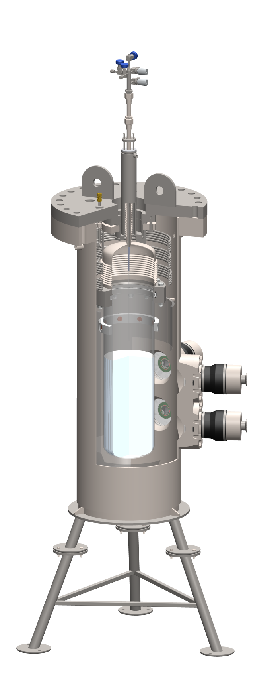
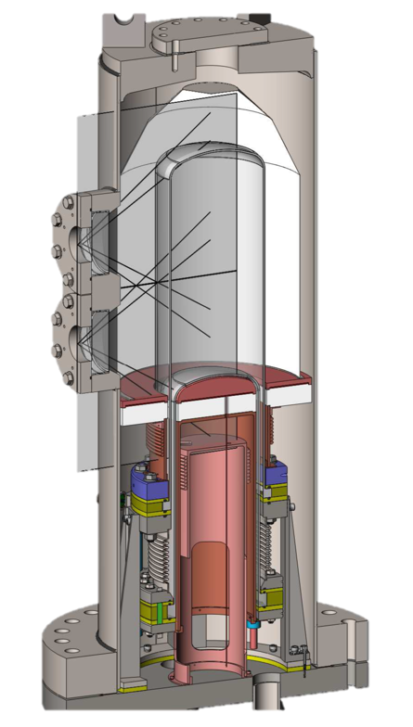
PICO-40L: Eliminate buffer fluid
Purpose of buffer liquid is to isolate the active liquid from the stainless parts
PICO-40L
Thermal Gradient
Thermal gradient can ensure that target fluid near stainless parts is not active
PICO-60

Slide 27
PICO-40L
Main Objectives
  Reduced neutron backgrounds, allowing us to push down in cross-section. We expect an order of magnitude improvement in exclusion by running for a year.
  Added stability could allow us to push down in threshold (WIMP mass) until we hit electron-recoil backgrounds.
  Ability to use new target fluids optimized for different WIMP masses
  Tests technology for future tonne scale detector: PICO 500

Slide 28
Advantages
40-liter
Superheated
Volume
15⁰C
Cold Normal
Liquid
-25⁰C
Elimination (~entirely) of anomalous backgrounds
  • Backgrounds caused by
    • Water,
    • Particulates,
    • Surface tension effects
  • Elimination of Water will break the chain
Additional technical benefits of no water buffer:
  • Can operate below ⁰C
  • Active fluid choice does not require a compatible buffer fluid
  • Full recirculation & in-place purification is technically possible

Slide 29
36-inch Diameter Pressure Vessel (much larger than before to keep neutrons at bay).
New Larger Capacity Hydraulic System
(Necessary for larger diameter pressure vessel)
New Thermal Control system
(Necessary to maintain dual temperature zones)

Slide 30
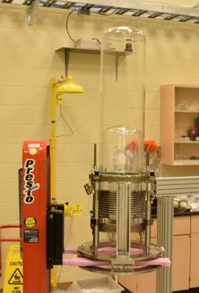
Schedule:
All significant components have been fabricated and are on site.
Installation work is underway. Expected to be complete by August
Commissioning to begin in the fall to establish running conditions, do calibrations, etc.
After initial open data set to establish good working conditions, the experiment will be blinded.
Roughly one year of exposure is planned for the moment.
Early commissioning data will be used to finalize design of PICO 500

Slide 31
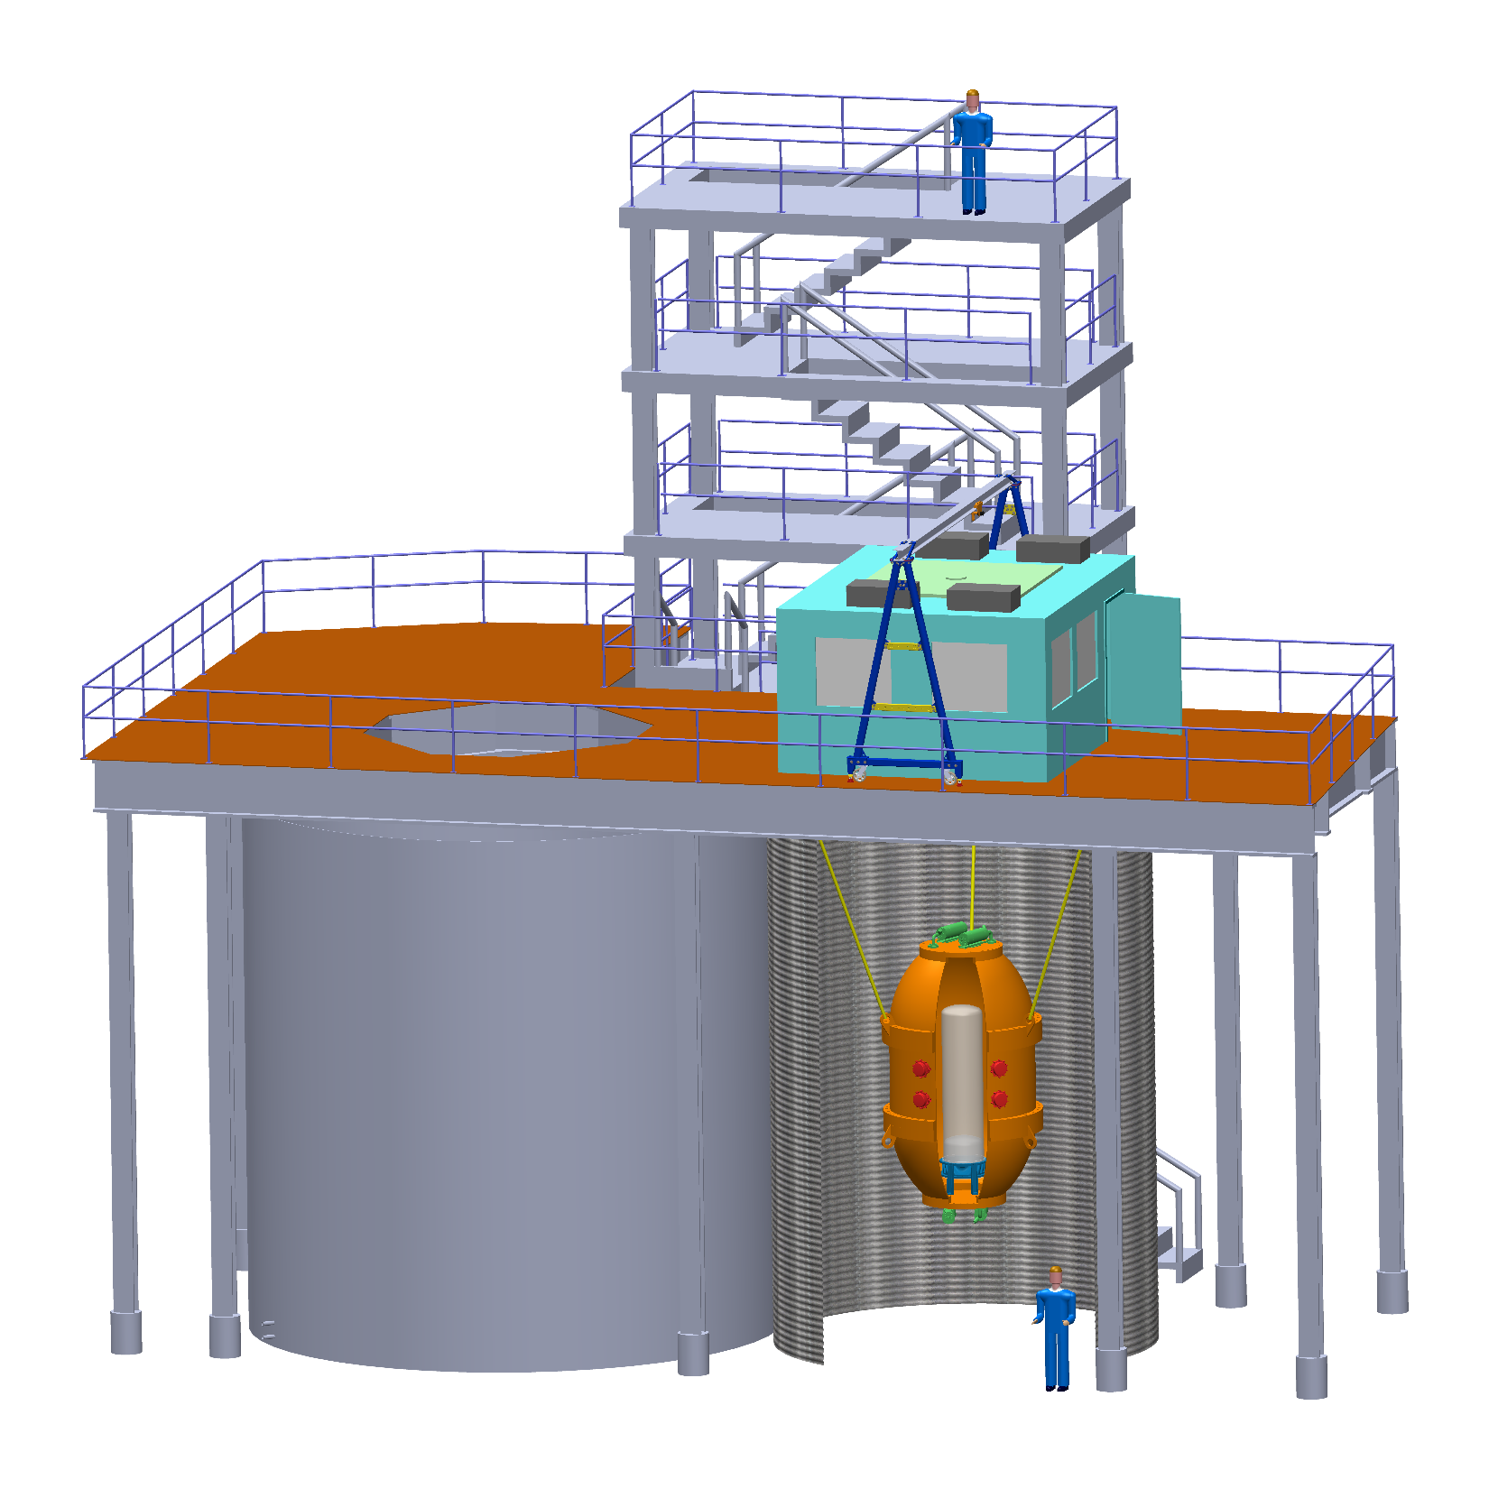
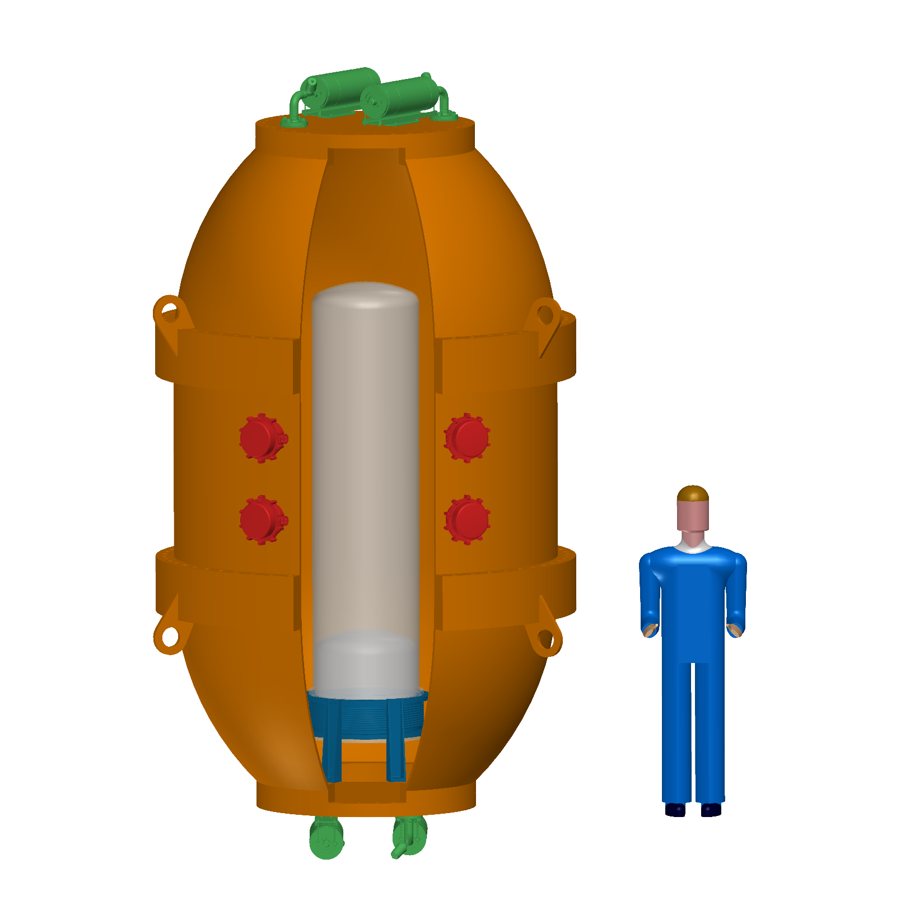
PICO-500
Engineering work ongoing as part of R&D program
Funding (~$5M CAD) has been awarded. Going through final budget finalization with agency now. Cash flow early 2018
Construction envisioned for 2019

Slide 32
Spin-Dependent Future
PICO program has significant reach in parallel to G2 experiments
Lower neutrino floor opens unique phase to PICO

Slide 33
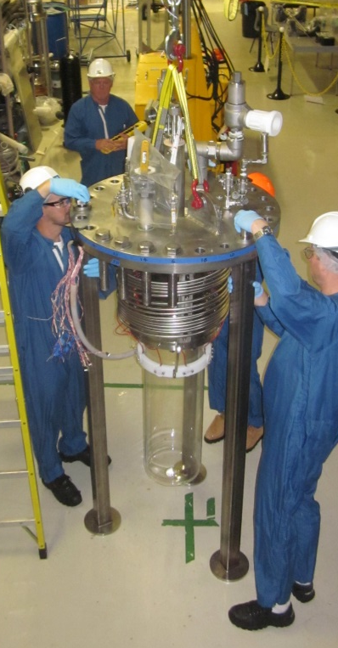
Summary
PICO bubble chambers at the 40L scale can be built background-free
PICO dominates the search for spin-dependent WIMP-proton couplings
Construction of PICO 40 is well underway
The design of PICO 500 is very advanced. Final technology choice for inner vessel to be made based on PICO 40 experience.
C. Amole et al., arXiv:1702.07666
PICASSO
SIMPLE
PandaX-II
PICO-2L C₃F₈
PICO-60 CF₃I
SuperK
IceCube

Slide 34






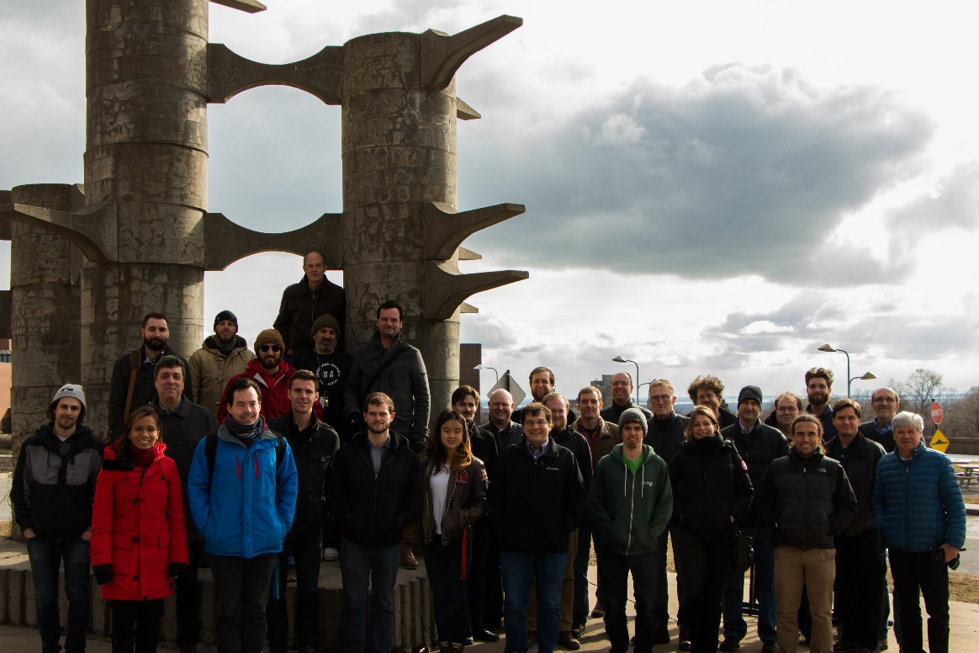













O. Harris
S. Chen, M. Laurin,
J.-P. Martin, A. Plante,
A.E. Robinson, N. Starinski, F. Tardif, D. Tiwari, V. Zacek, C. Wen Chao,
R. Filgas, I. Stekl
J.I. Collar
I. Lawson
E. Behnke, I. Levine, T. Nania
M. Ardid, M. Bou-Cabo, I. Felis
M. Das, S. Sahoo, S. Seth
M. Bressler, R. Neilson
D. Maurya, S. Priya, Y. Yan
P.S. Cooper, M. Crisler, W.H. Lippincott, A. Sonnenschein
C. Coutu, S. Fallows, C. Krauss, M.-C. Piro
D. Baxter, C.E. Dahl, M. Jin,
J. Zhang
E. Vázquez-Jáuregui
B. Broerman, G. Cao, K. Clark, G. Giroux, C. Hardy, C. Moore, A. Noble
I. Arnquist , C. Cowles, C.M. Jackson, B. Loer, K. Wierman
J. Farine, A. Le Blanc, C. Licciardi, O. Scallon, U. Wichoski

Slide 36
Spin-independent Limits
Light nuclear targets give sensitivity to low-mass WIMPs
Unexplored phase space would be accessible with slightly reduced threshold
C. Amole et al., arXiv:1702.07666
PICO-2L C₃F₈
PICO-60 CF₃I
CDMSlite
CRESST-II
PandaX-II
LUX

