Slide 1
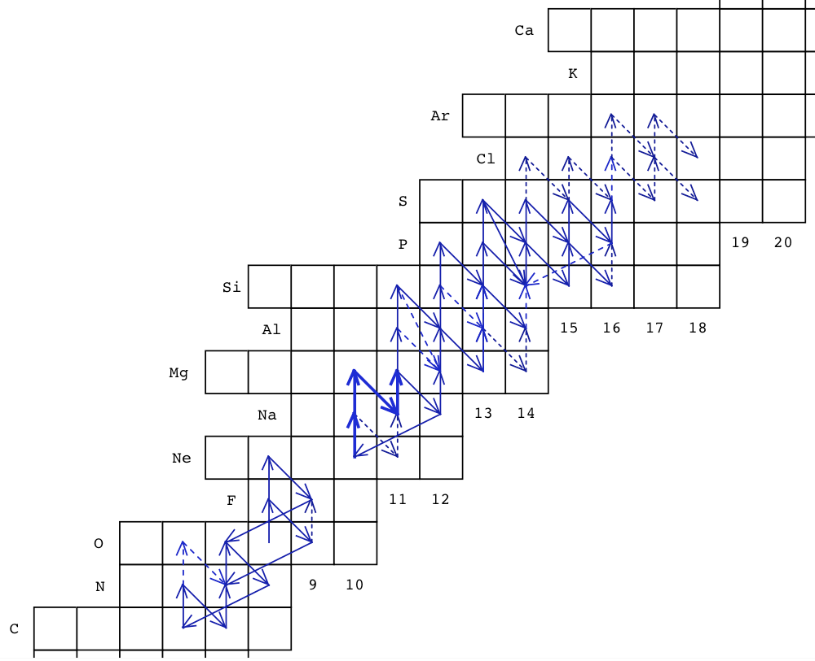
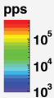

Probing explosive nucleosynthesis through TwinSol Measurements
D. W. Bardayan (Notre Dame)
ReA3

Slide 2
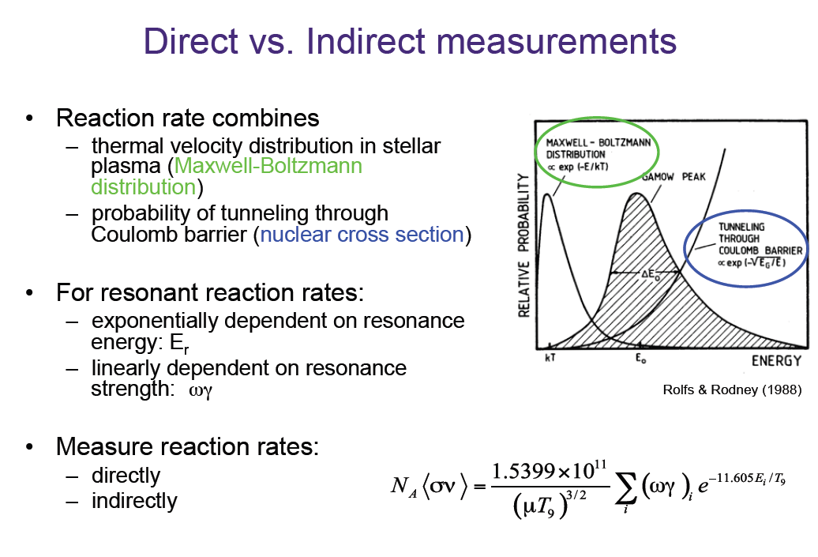
If resonance is narrow
E_{r} & J^{π} are most important
“resonance strength”

Slide 3
Experimental approaches with exotic beams
Challenges
  Beams are lower intensities and frequently contaminated
  Inverse kinematics limits resolution
  “Best” proton transfer reactions have difficult target/detector issues.
(d,n) reactions
  (CD₂) target are relatively easy to use
  Background from spectator C atoms
  Neutron detection difficult. Groups avoid at all costs.
(³He,d) reactions
  Localized targets of ³He hard
  ³He expensive
  d detection easy

Slide 4
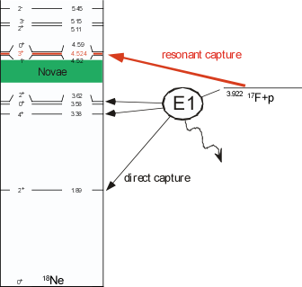
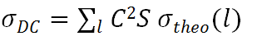
¹⁷F(p,γ)¹⁸Ne
¹⁷F(p,γ)¹⁸Ne strongly affected by unmeasured DC rate.
3⁺
DC unmeasured
σ (mb)
strength from
ORNL measurement
E (keV)
Need C²S to calculate DC rate.
Will use the ¹⁷F(d,n) reaction to measure the needed spectroscopic strengths.

Slide 5
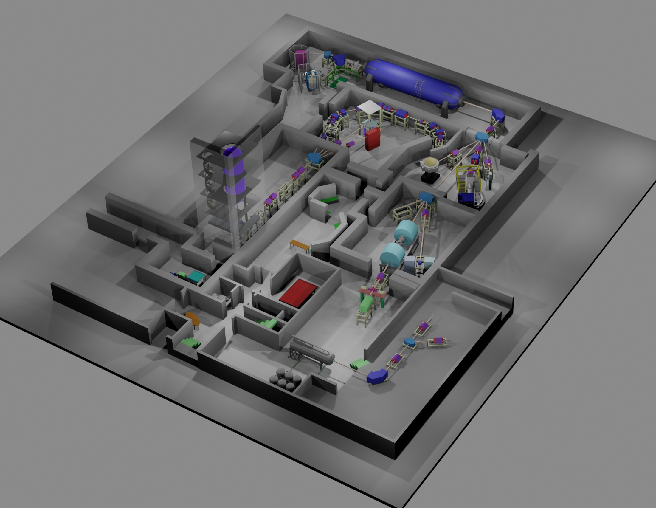
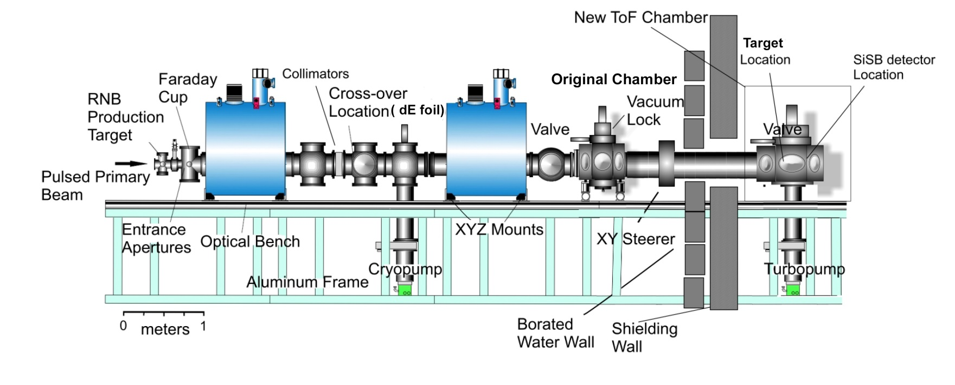
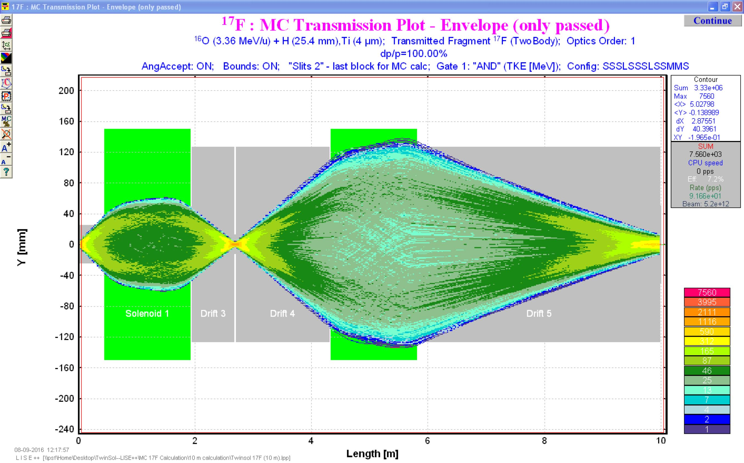
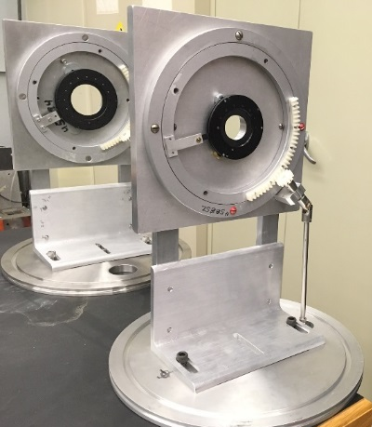
TwinSol
First facility dedicated to exotic beam production in the U.S.

Slide 6
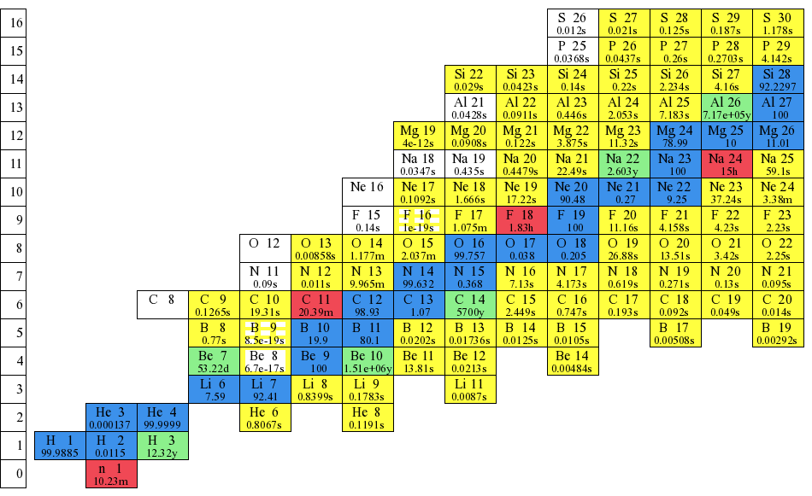
15 Radioactive Beams in the last 3 years.

Slide 7
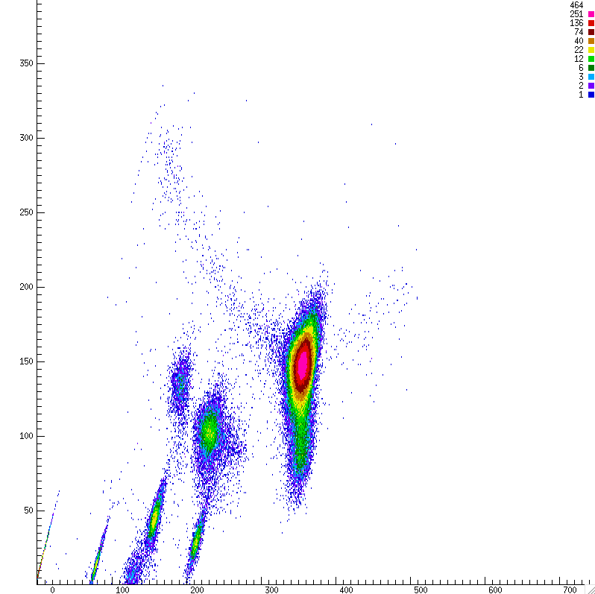
¹⁷F Production
¹⁶O Primary on gas cell filled with 1 atm d₂ gas target
Silicon telescope at target position to identify beam species and optimize tune
dE (arb)
Composition
87.1% ¹⁷F at 57.2 MeV
5.2% ¹⁶O at 37 MeV
0.5% ¹⁶O at 28 MeV
1.4% ^{14/15}N at 34 MeV
2.1% ^{14/15}N at 24.1 MeV
4.1% various carbon and alpha groups
E_tot (arb)

Slide 8
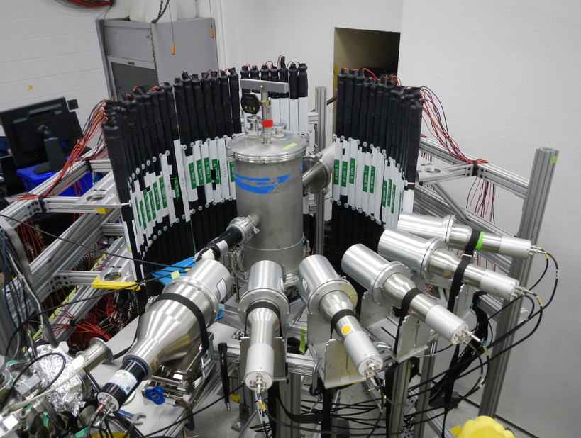
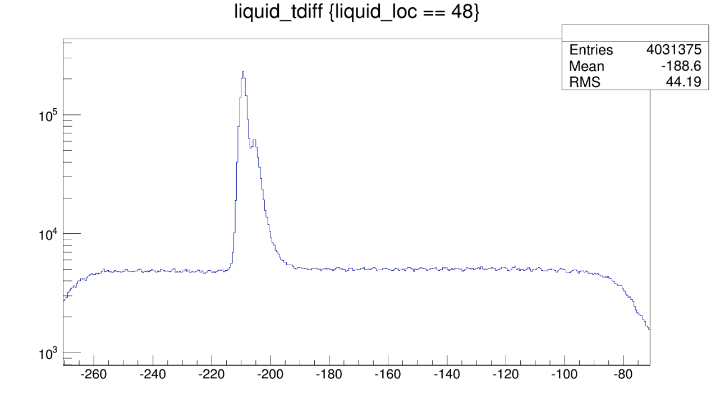
¹⁷F(d,n)¹⁸Ne at Notre Dame
– P. O’Malley et al.
¹⁷F
Neutrons detected in array of VANDLE plastic scintillators and U. Michigan deuterated Benzene detectors.
CD₂
n
γ
Start on n detection
Stop on delayed beam stop
2 γ flashes from beam on target and beam stop (i.e., the scintillator).
n?
Counts
Time of Flight (arb. Units)

Slide 9
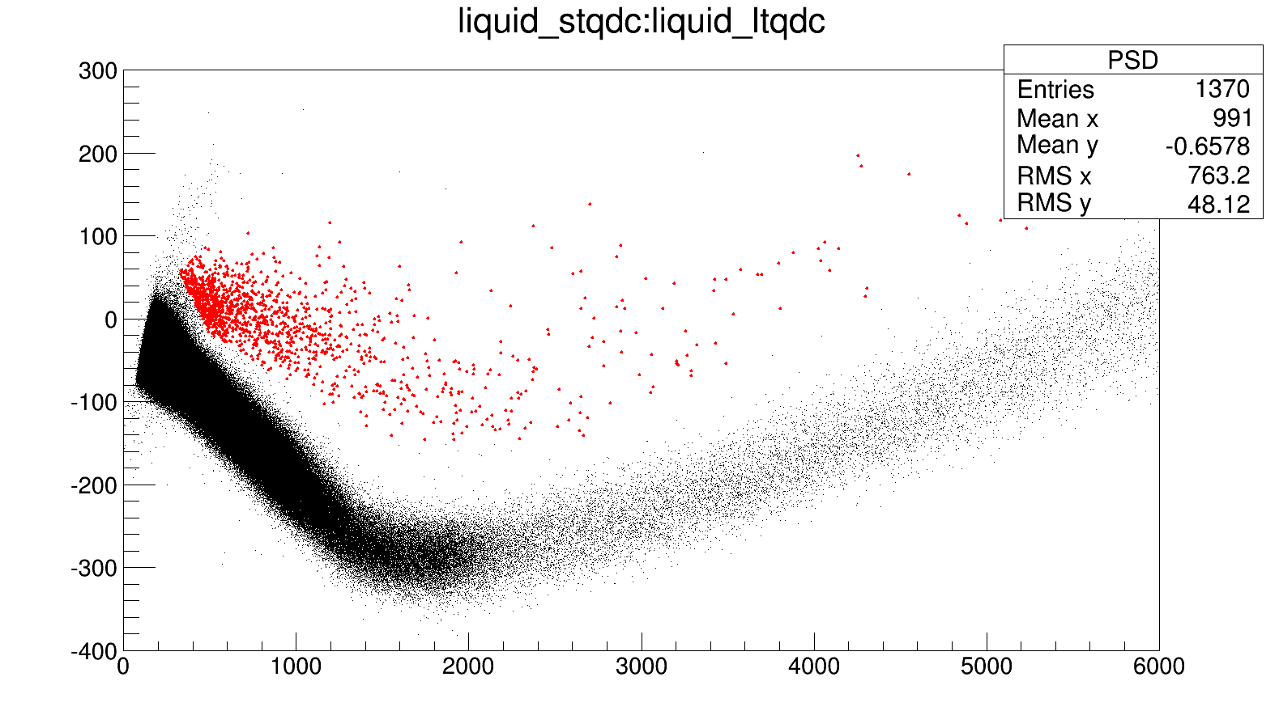
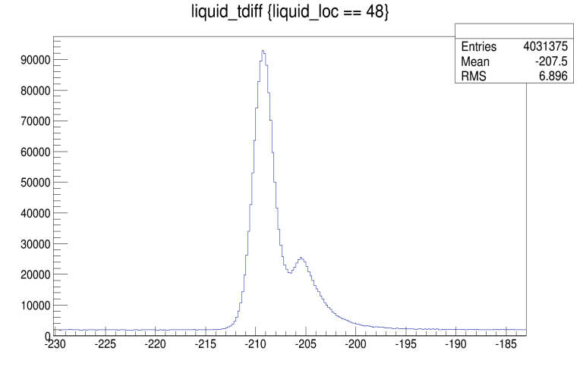
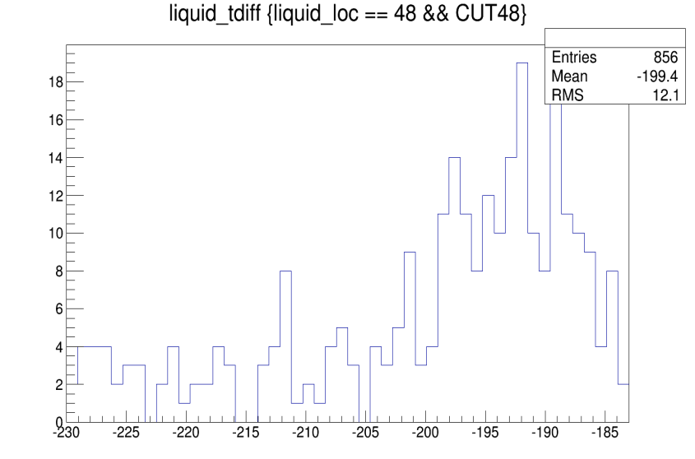
¹⁷F(d,n)¹⁸Ne at Notre Dame
– P. O’Malley et al.
γ
n
Counts
Short integral
n?
γ
Time of Flight (arb. Units)
Long integral
n gated
Time of Flight (arb. Units)

Slide 10
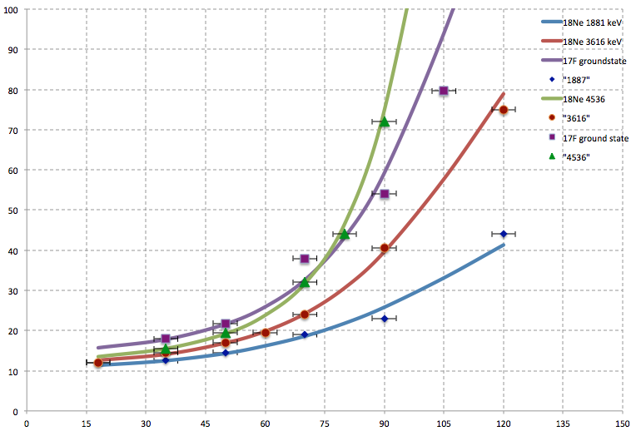
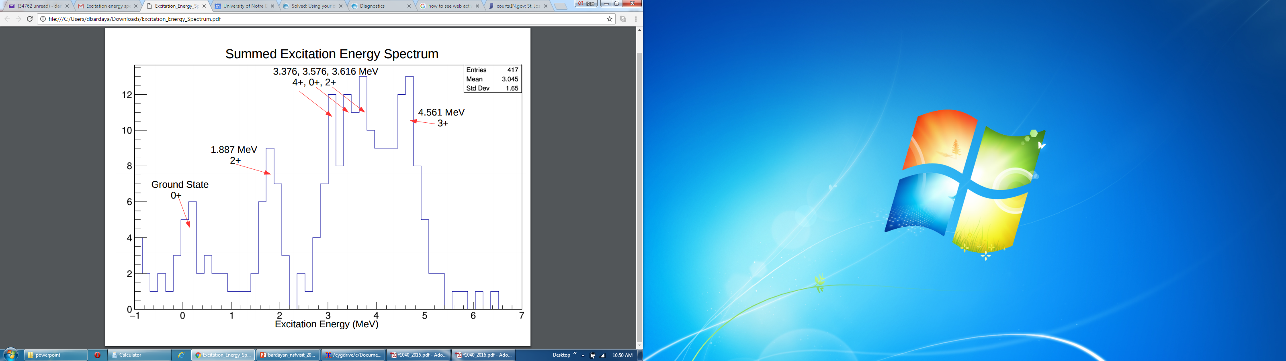
¹⁷F(d,n)¹⁸Ne
Small interference from ¹⁶O(d,n). Will repeat with pulsed beam and greater statistics.
Time of Flight (ns)
Lab Angle(degrees)
Excitation energies determined via n TOF.

Slide 11
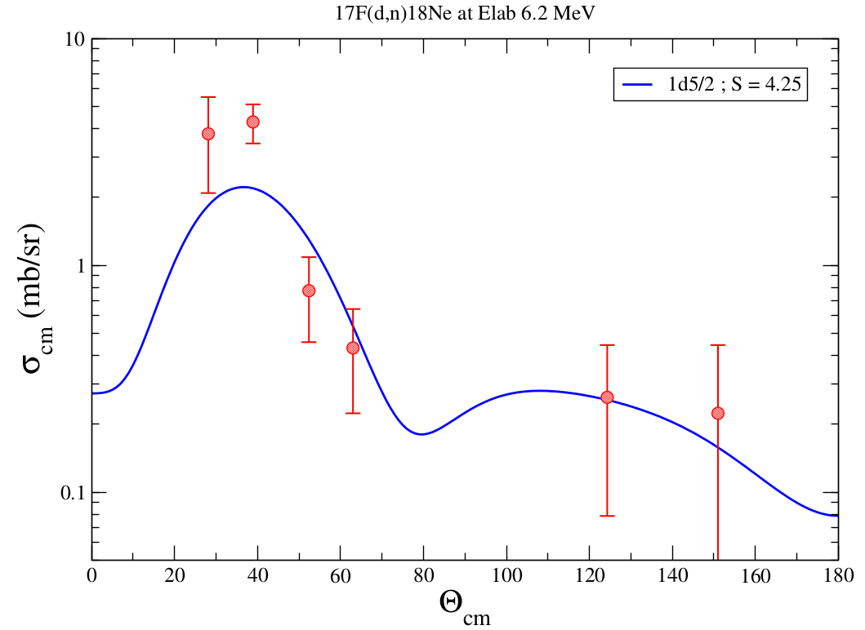
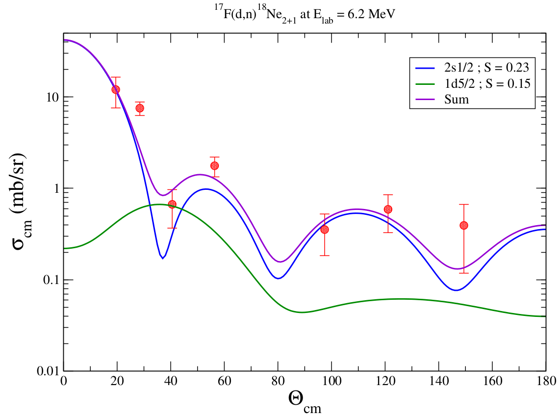
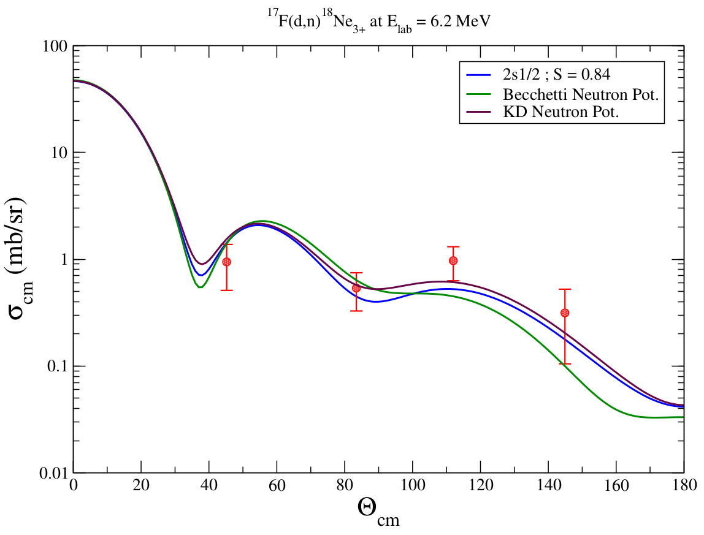
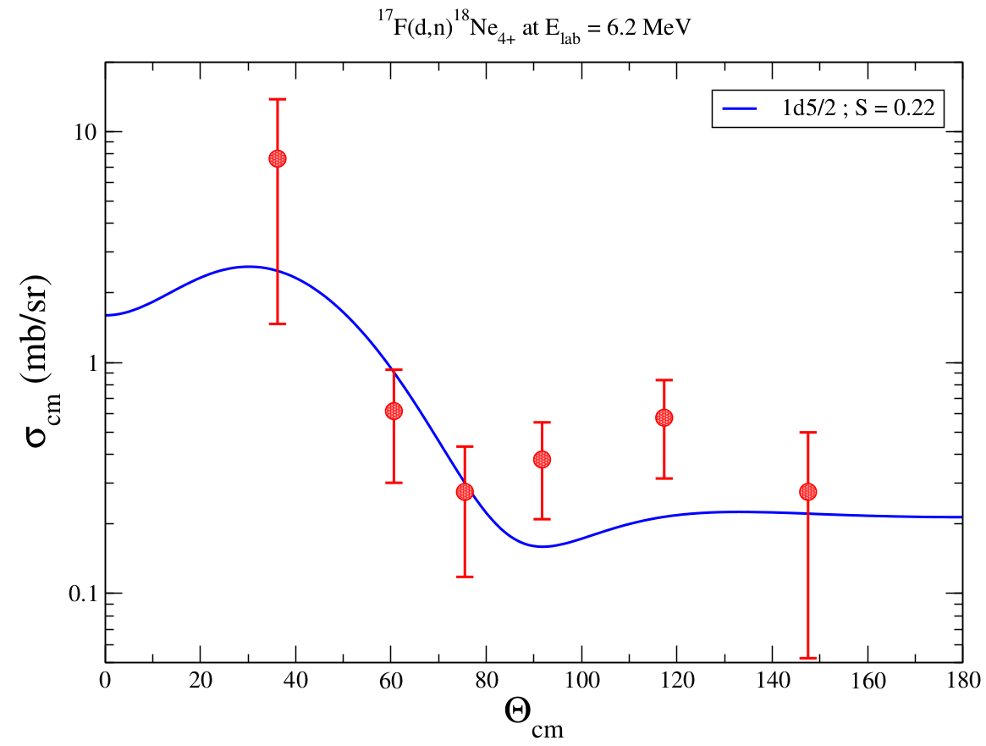
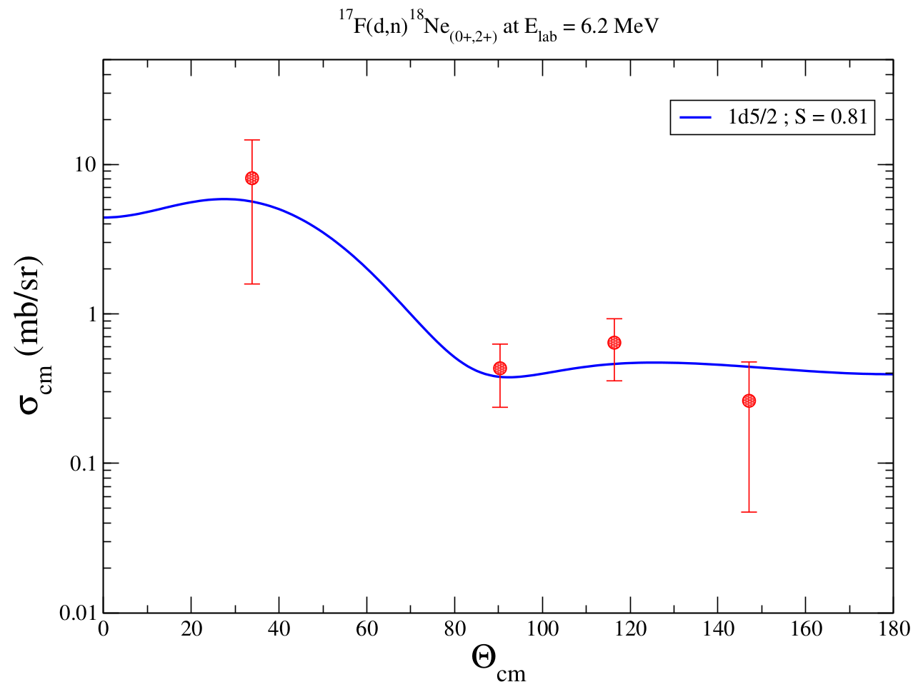
Angular Distributions
¹⁸Ne_{1.887 (2+)}
¹⁸Ne_{gs}
¹⁸Ne_{4.561 (3+)}
¹⁸Ne_{3.376 (4+)}
¹⁸Ne_{3.616 (2+)}

Slide 12
Spectroscopic Factors
 | Present |  | Kuvin et al. (PRC96, 045812) |  | Mirror Li. et. al. (PRC13,55)
State | 1d5/2 | 2s1/2 | 1d5/2 | 2s1/2 | 1d5/2 | 2s1/2
G.S. | 4.25 |  |  |  | 1.22
1.887 (2+) | 0.15 | 0.23 | 0.88 | 0.22 | 0.83 | 0.21
3.376 (4+) | 0.22 |  | 1.42 |  | 1.57
3.616 (2+) | 0.81 | 0 | 0.76 | 0.41 | 0.94 | 0.35
4.561 (3+) |  | 0.84 |  | 0.84 |  | 1.01
Notes:
park et al paper for optical model parameters PRC59

Slide 13
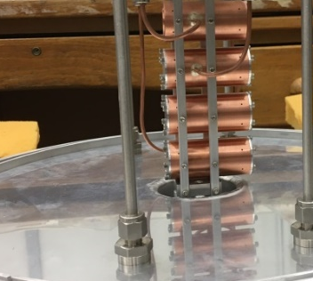
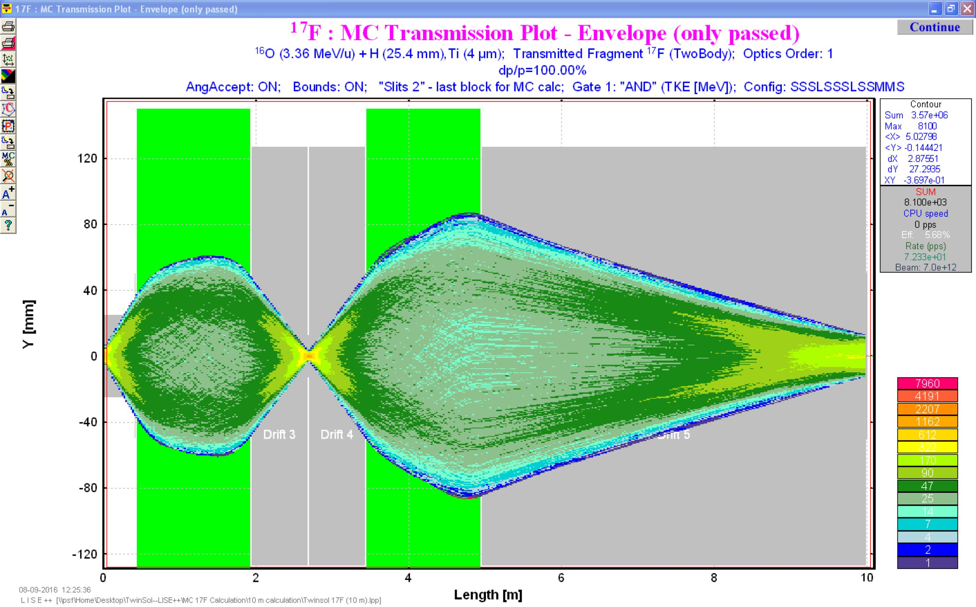
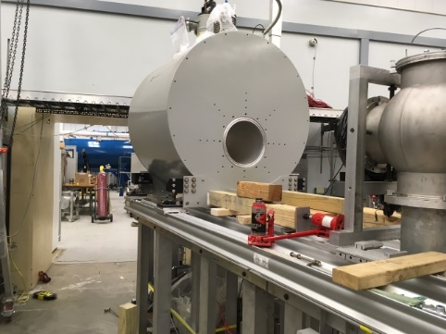
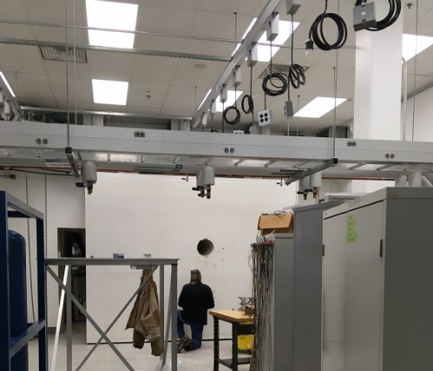
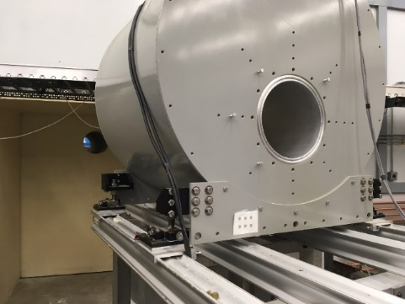
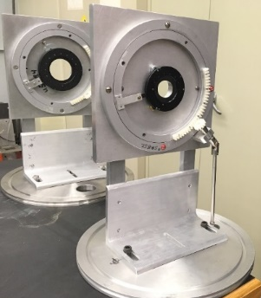
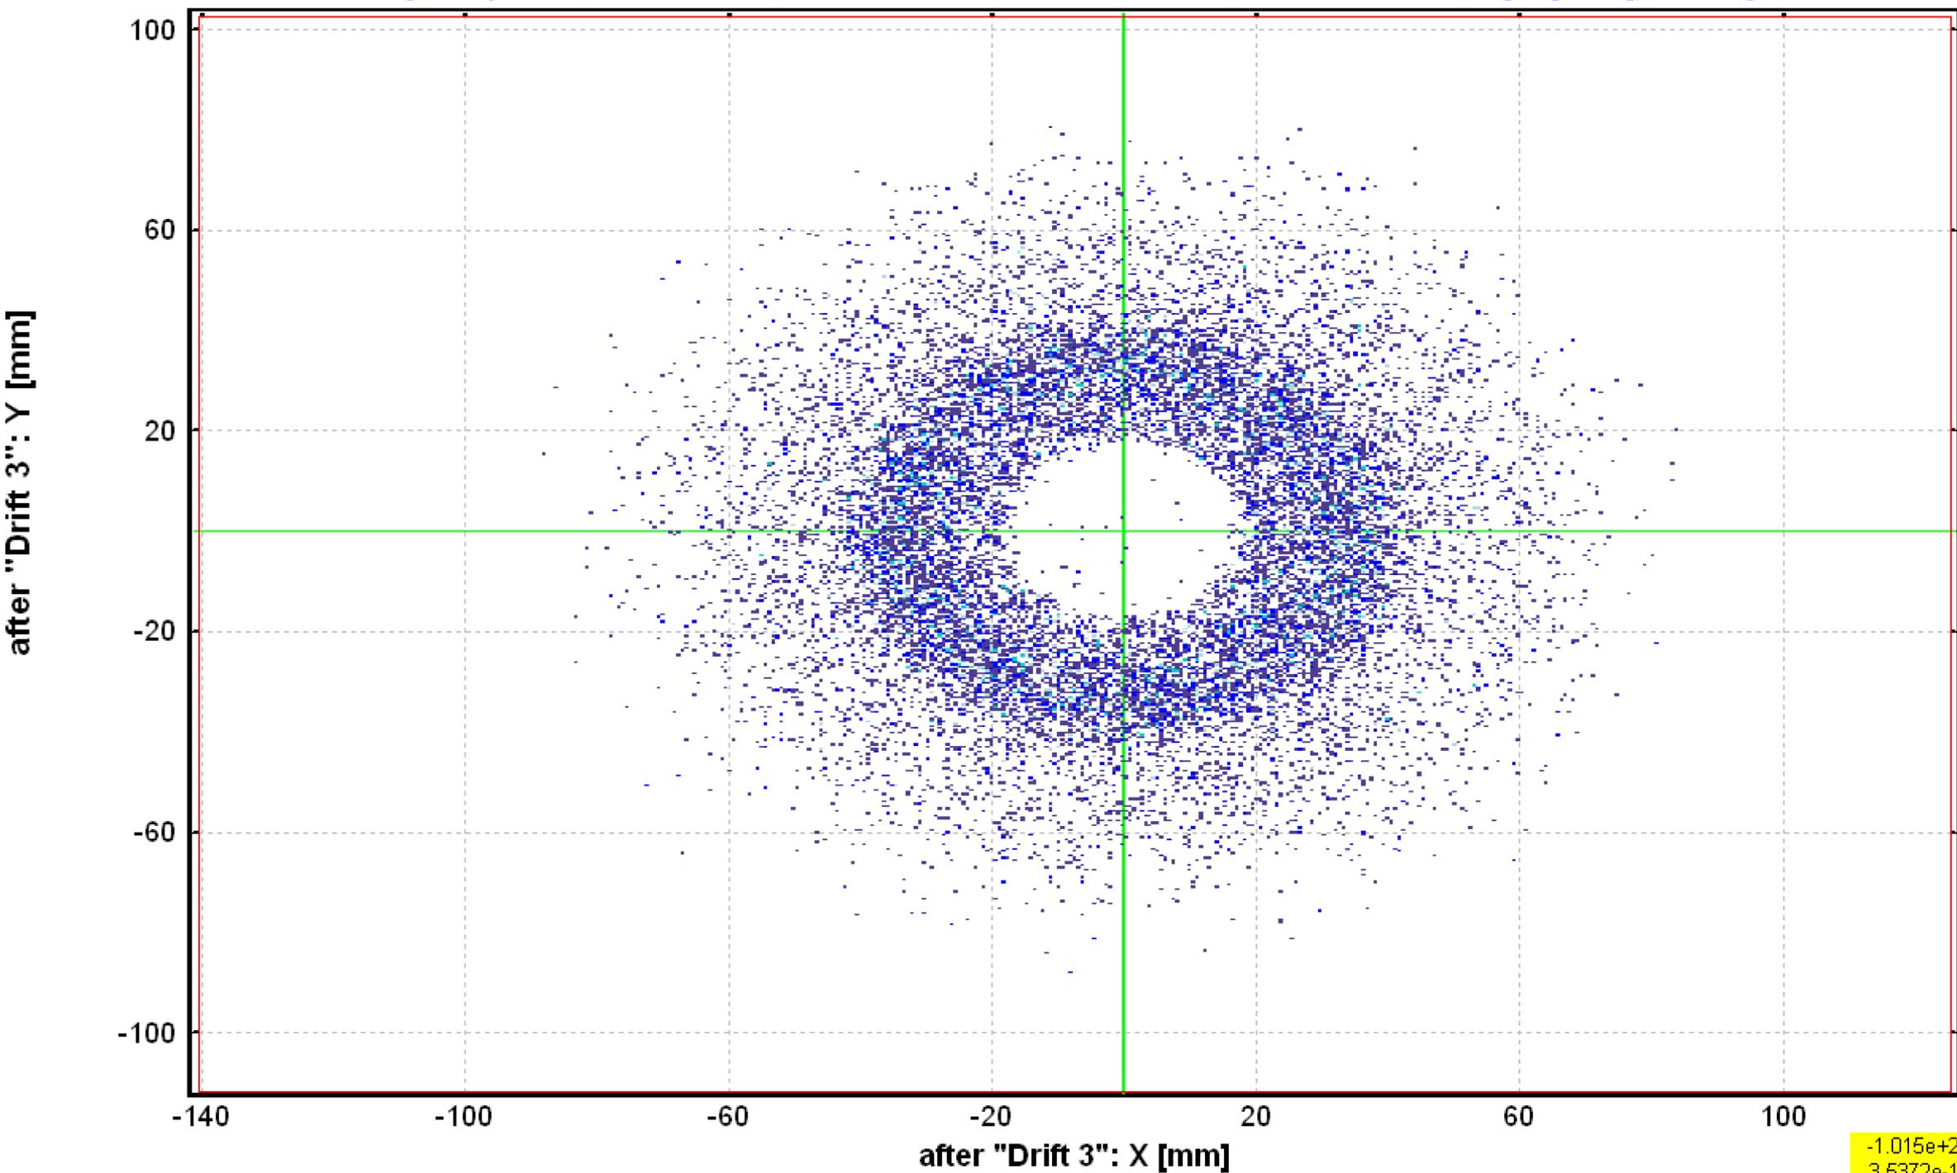
TwinSol Improvements
Solenoid 2 moved 90 cm downstream reduced radioactive beam spot by factor of 2.
Production cells doubled in length – window thickness reduced 40%.
New penetration drilled to allow expansion into renovated experimental space.
New University renovated space with full utility support (power, water, air, He recovery).
Contaminant image at crossover
New irises at TwinSol crossover and focus.

Slide 14
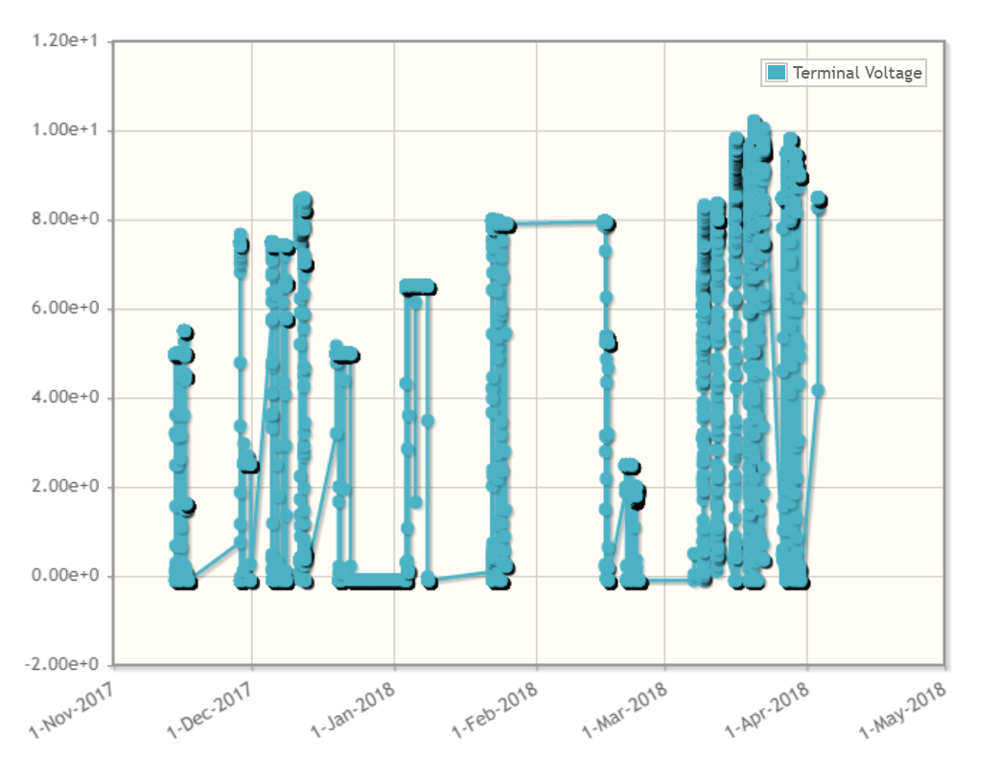
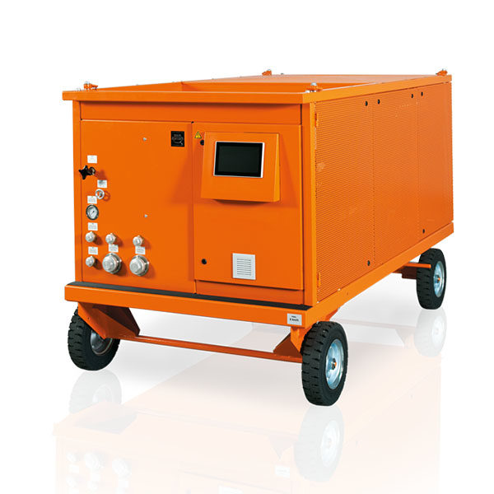
$2M / 5-Year Upgrade and Refurbishment of FN and Supporting Systems
End 2018: Remove and Replace Gas Handling System with DILO SF6 System
Beginning 2019: Construct Pad for Enge Spectrograph and Install Magnet
End of 2019: Upgrade and Replace FN Water Cooling System For ETR and WTR Also
Beginning of 2020: Upgrade of FN Beamline Systems. Upgrade and Replacement of ETR Beamline Systems
End of 2020: Upgrade of HE end of FN for AMS Offset Faraday Cups
Beginning of 2021: Upgrade of Helium Ion Source and Installation of 2nd MC-SNICS
End of 2021 – Beginning of 2022: Catch Up On Everything That Didn’t Work
Immediate 2 MV increase with 10% SF₆
FN Terminal Voltage (MV)
Full SF₆ Upgrade With Liquid Storage and Transfer

Slide 15
Phoswich (U. Tenn./ORNL)
Short for “phosphor sandwich”
Thin plastic scintillator film dE layer pressed onto a thick plastic E layer.
EJ-299-07
EJ-240-PS

Slide 16
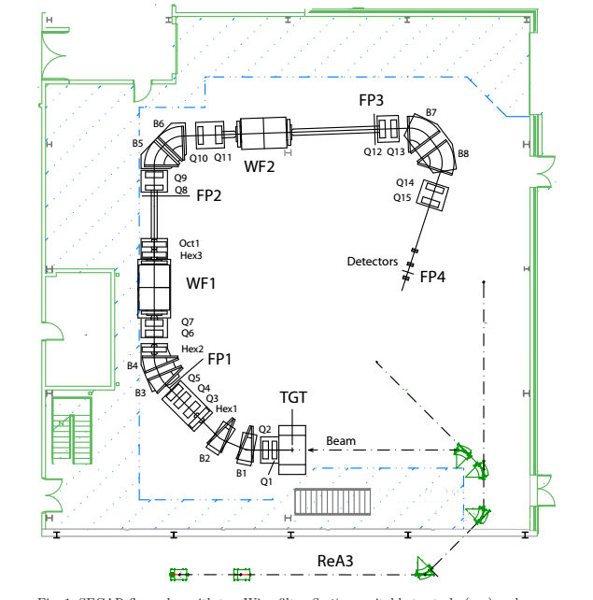
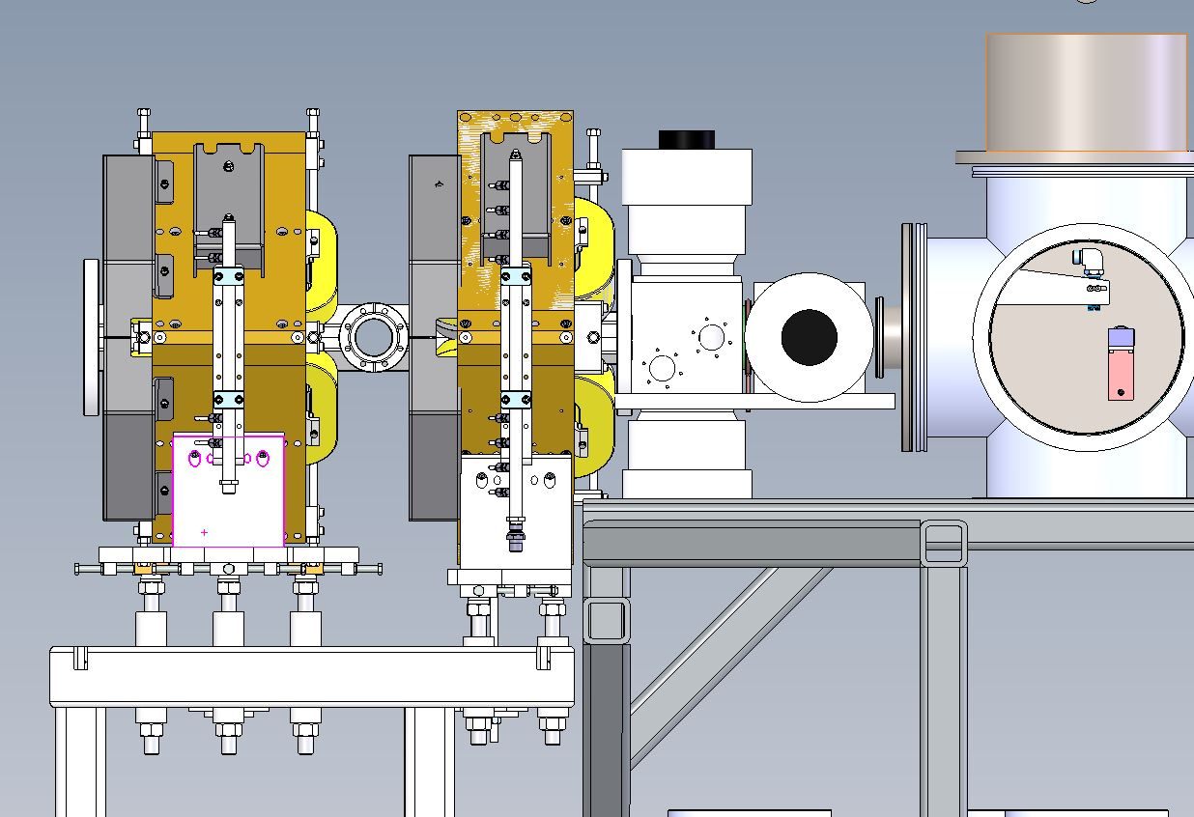
JENSA+SECAR for (d,n) at FRIB
Advantages of JENSA+SECAR
-Could take full beam current.
-Pure deuterium target (no fusion-evap γ’s from C)..
-Clean selection of events from SECAR.
-Could measure neutron angular distributions and (d,n) cross section.
-Large number of silicon detectors in chamber to measure (d,p), (d,d), and p-decay simultaneously.
Disadvantages
-Only 3-6 MeV/u.
-Acceptance of SECAR not complete.
-JENSA geometry somewhat confining.

Slide 17
Conclusions/Questions
Availability of exotic beams allows for some of the first measurements on radioactive nuclei of astrophysical interest.
(d,n) studies can provide information needed to plan direct (p,γ) studies and first estimates of many reaction rates.
We are developing techniques for such studies using TwinSol at Notre Dame.
Made (one of) the first (d,n) angular distribution measurement via neutron detection from radioactive beam.
See differences between ¹⁷F(d,n) and ¹⁷O(d,p) spectroscopic strengths.
Upgrades at Notre Dame should allow greater variety, purity, and quality of radioactive beams for such studies.
In the future, hope to use JENSA+SECAR at FRIB.
Thank you and TwinSol Collaboration!!!

Slide 19
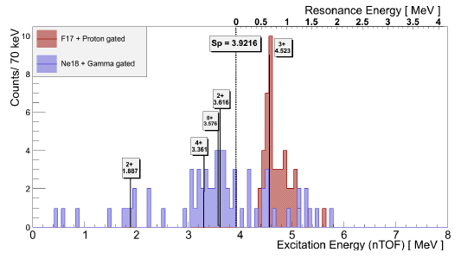
¹⁷F(d,n)¹⁸Ne
Small interference from ¹⁶O(d,n). Will repeat with pulsed beam and greater statistics.
Time of Flight (ns)
Lab Angle(degrees)
Excitation energies determined via n TOF.

Slide 20
¹⁷F(p,γ)¹⁸Ne
¹⁷F(p,γ)¹⁸Ne strongly affected by unmeasured DC rate.
3⁺
DC unmeasured
σ (mb)
strength from
ORNL measurement
E (keV)
Need C²S to calculate DC rate.
Will use the ¹⁷F(d,n) reaction to measure the needed spectroscopic strengths.

