Slide 1
Heavy Element Production: Before and After GW170817
Chris Fryer
LANL

Slide 2
NS Winds: Understanding the conditions needed for r-process
Before GW170817
Qian, Woosley and collaborators studied neutrino driven winds from neutron stars. With a simple trajectory evolution , T=T₀ e^{(-1.28t/texp)}, they determined the conditions needed to produce the 3rd r-process peak.
Hoffman et al. (1997) determined that either high entropy, low Y_{e}, or fast expansion timescales were needed to produce the r-process. Based on this, Thompson and ud-Doula (2018) derived a figure of merit for r-process production: S³/(Ye³ t_{exp})

Slide 3
Solutions to the Core-Collapse Conundrum
Lower the electron fraction (Y_{e})
Decrease the explosion timescale (e.g. add energy – Hoffman et al. 1997)
Find a way to increase the entropy
Deviate from the exponential (T=T₀ e^{(-1.28t/texp)}) evolution
For neutron star winds, solutions include:
Advanced neutrino physics to change the Y_{e}
Magnetars modifying the timescale and entropy
Fallback mass ejection altering the trajectories

Slide 4
Neutrino Effects
Neutrinos are responsible both for driving winds and for setting the composition (i.e. electron fraction) and entropy in the flow.
Fuller, Qian, McLaughlin, … have studied, in detail, the effects on the r-process of a range of neutrino effects: revised absorption rates, flavor transformations, oscillations.
If they can assume an r-process site and we know the conditions well, we could probe nuclear/neutrino physics!!!
With and without sterile neutrino mixing: McLaughlin et al. (1999)
Takeaway: Neutrino effects are important and we must include the uncertainties in this physics to calculate detailed r-process yields.

Slide 5
Magnetars
Thompson & ud-Doula (2018)
A lot of proposals exist: Suzuki & Nagataki 2005, Metzger et al. 2007, 2008, Vlasov et al. 2014,2017.
Recent calculations by Thompson & ud-Doula show that 3rd r-process peak ejecta can be produced, but not enough to explain the r-process.
High spin rates may produce larger fractions of 3rd peak elements.
But this model requires that the magnetic fields exist at collapse.
The special conditions also argue that a range of 1st to 2nd to 3rd r-process peak elements are produced in each collapse.
Thompson & ud-Doula (2018)

Slide 6
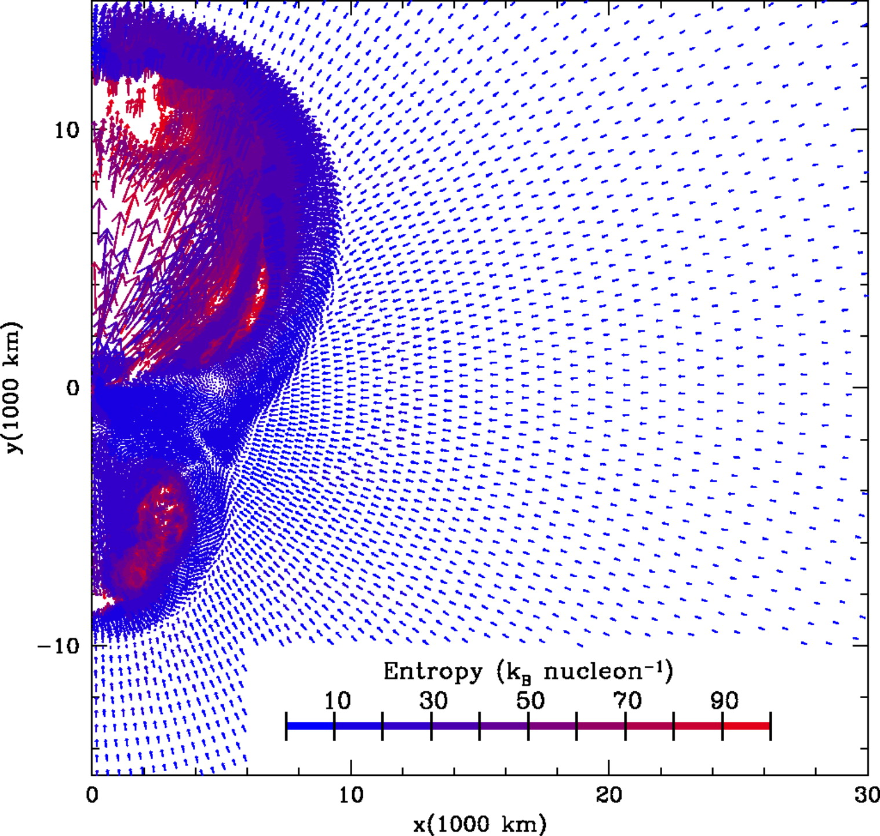
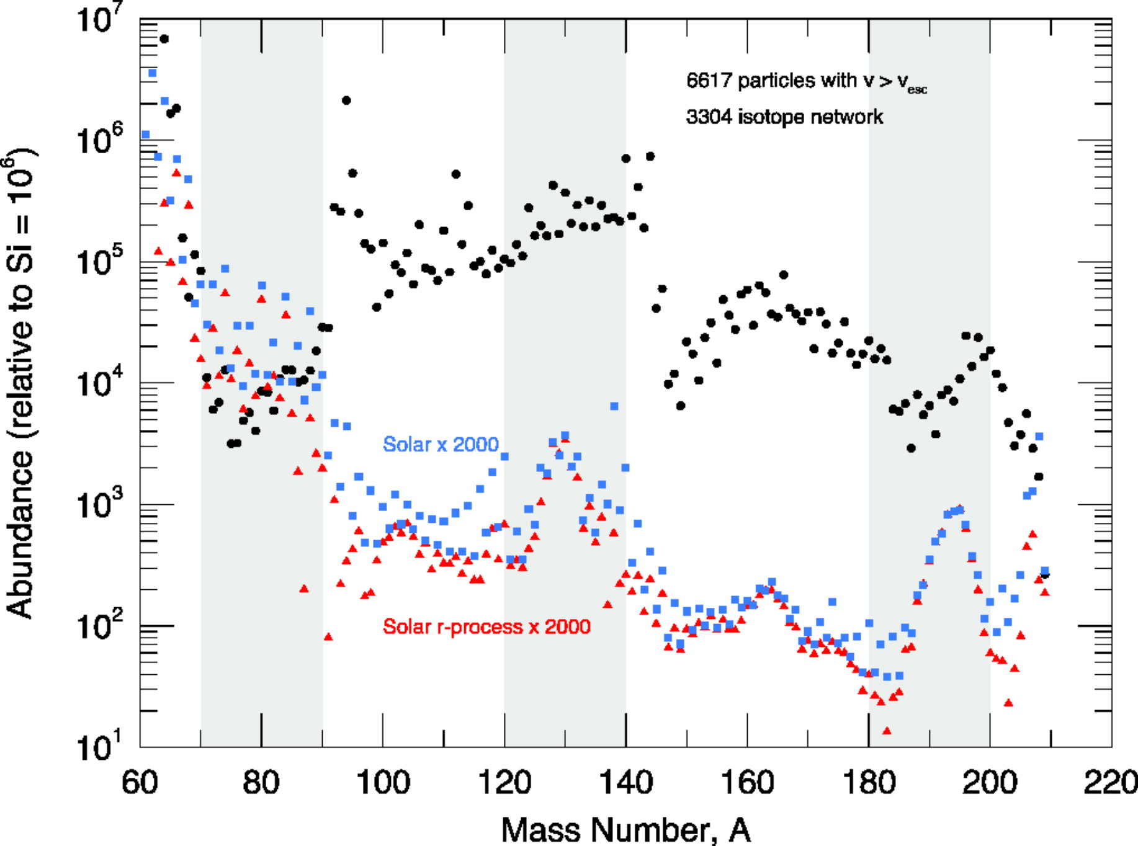
Fallback Mass Ejection
As the shock in a supernova explosion moves outward, some material decelerates and accretes back onto the neutron star (Colgate 1971, Shigeyama 1988, Woosley 1989, Fryer 2009).
Fryer et al. (2006) found that the trajectories of some of this ejecta could produce r-process elements.
Consequences:
Revival of the intermediate or i-process. This is now changing what we believe can be produced in burning shells (what is s-process).
The exact trajectory matters. We need to move beyond exponential trajectories.

Slide 7
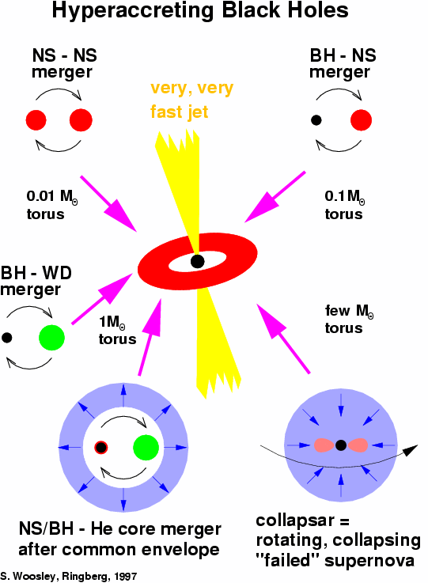
GRBs and Black Hole Accretion Disks
The Black Hole Accretion Disk model remains the favored engine behind GRBs (both long and short).
Stellar angular momentum distributions argue for disks primarily around collapsed systems forming black holes (collapsar GRB model).
A suite of other scenarios also produce black hole accretion disk systems.
These systems produce both jets and disk winds that can produce r-process elements.

Slide 8
Yields from Disk Winds
Surman, Mclaughlin and collaborators have produced a series of parameterized studies of nucleosynthetic yields from disk winds.
Caballero et al. (2012) studied a range of disk models varying entropy, timescale, Newtonian vs. GR effects, disk and black hole rotation.
Equilibrium Y_{e} values are typically not reached and if the initial Y_{e} is low (e.g. mergers), r-process elements can be produced.

Slide 9
Jets
Jets from highly magnetized NSs or BH accretion disks can also produce r-process (e.g. Nishimura et al. 2015).
Jets have much faster explosion timescales than wind models.
As in the fallback scenario, the trajectory is far from simple. This produces both lower Y_{e} ejecta. Because of the complex profile, the final yields may depend sensitively on the calculation.

Slide 10
r-Process in Neutron Star Mergers
Dynamical Ejecta: Y_{e} is low, much easier to make a relatively clean r-process abundance profile
Korobkin et al. 2012

Slide 11
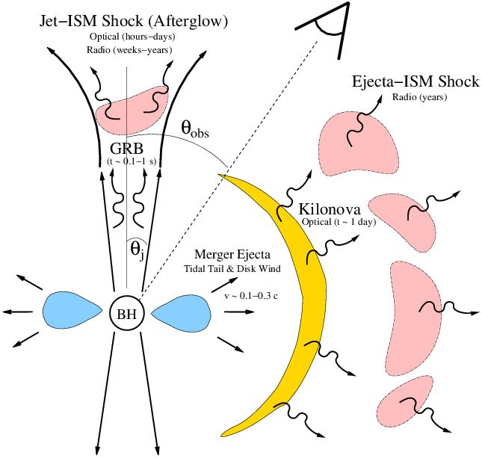
Neutron Star Mergers
Metzger & Berger 2012
Neutron star mergers eject material both in the initial tidal disruption and in a wind from the disk formed from the disrupted neutron star.
The dynamical (tidal ejecta) from these mergers produces a clean r-process distribution.
The wind material is more tricky.
GW170817 moved this from a theory model to a reality.

Slide 12
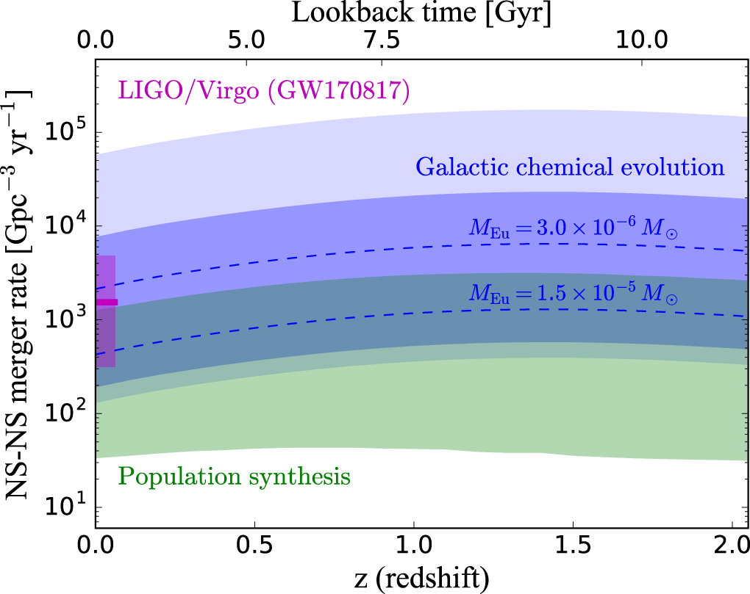
After GW170817
Inferred Rate matches what is needed
Cote et al. 2018

Slide 13
Yields may be more Complicated
Depending upon the light-curve and spectral models, the amount of wind vs. dynamical ejecta varies considerably.
The dynamical ejecta is neutron rich and produces the right distribution of 2nd and 3rd r-process peaks.
But if there is a lot of wind ejecta that produces predominantly 1st and 2nd peaks, can we explain the r-process yields?

Slide 15
Current population synthesis models argue for a t^{-~1} profile. Are we missing something?

Slide 16
Neutron Star Mergers and Galactic Chemical Evolution
Cote et al. 2018
Modifications to the predicted time-dependent merger rate may be needed to match the data.

Slide 17
Other Solutions exist, but not without going beyond what the population synthesis models predict.
Shen et al. 2015

Slide 18
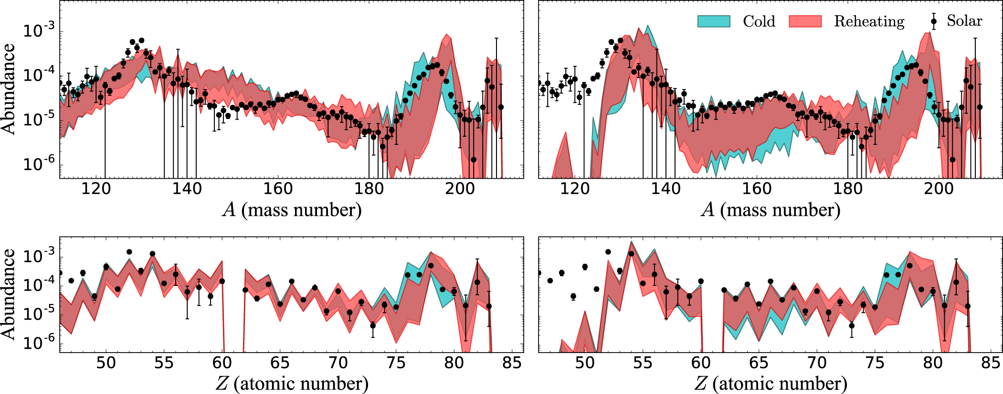
Nuclear Physics problem
Understanding the relative production of r-process depends on the nature of the ejecta (wind versus dynamical ejecta) and the clean signal from neutron star mergers may not be so clean.
Uncertainties in the nuclear physics can also drastically alter the yields.
Fission rates (multi-chance beta-delayed fusion and reaction rates) are active areas of research.

Slide 19
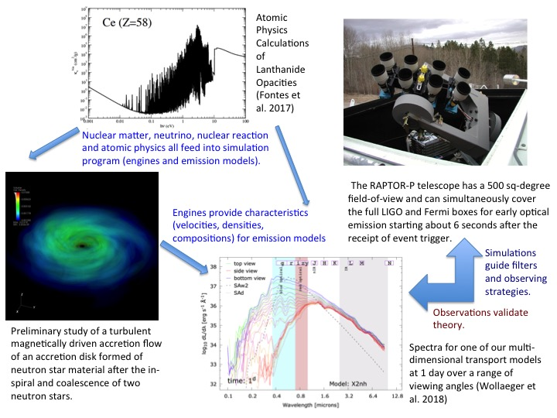
LANL plan: full system models

Slide 20
Summary
A wide range of sites have been proposed to produce the r-process, but the extreme conditions required to produce 3rd peak elements places constraints on many of these sites.
The dynamical ejecta from NS mergers cleanly produces the r-process and, with the rates inferred from the GW170817 event, this is the most plausible site.
But issues persist in matching the r-process distribution and there is much more work to be done.
Doing this precision work allows us to use r-process to better under stellar populations, compact object formation and, potentially, nuclear and neutrino physics.

