Slide 1





Heavy Flavor Jet Quenching at RHIC and LHC
CIPANP 2018 (06/01/2018)
Shanshan Cao
Wayne State University

Slide 2
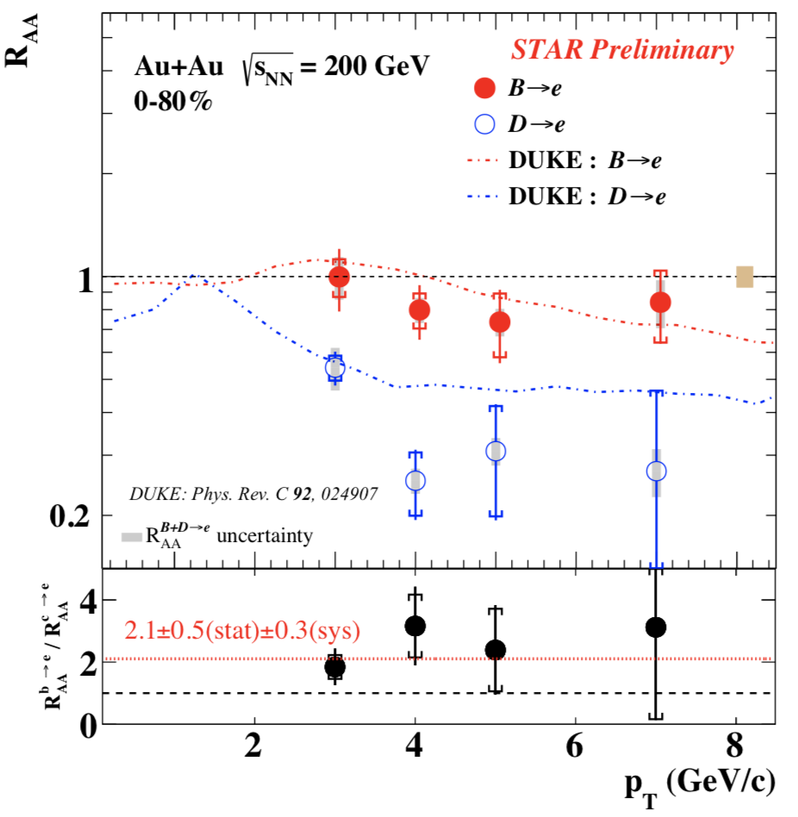
Mass effects in heavy quark energy loss
Produced early and probe the full QGP history
Provide unique opportunity to study mass effects on energy loss
Comparable R_{AA} between light hadron, B and D at high p_{T}
R_{AA} (b->e) > R_{AA} (c->e) at low p_{T}
This motivates a detailed theoretical investigation of the mass hierarchy of parton energy loss, especially its p_{T} dependence.

Slide 3
Outline
A linear Boltzmann transport model (LBT) for heavy vs. light parton energy loss in QGP
A multi-stage approach for heavy quark energy loss
Open questions, e.g. extracting transport coefficients

Slide 4
Part I: A linear Boltzmann transport model
( In collaboration with T. Luo, G.-Y. Qin and X.-N. Wang, PRC 94 and PLB 777 )
Boltzmann equation for parton “1” distribution:
The collision term:
transition rate from p₁ to p₁-k
Elastic scattering (2->2 process)
microscopic cross section of 12->34

Slide 5
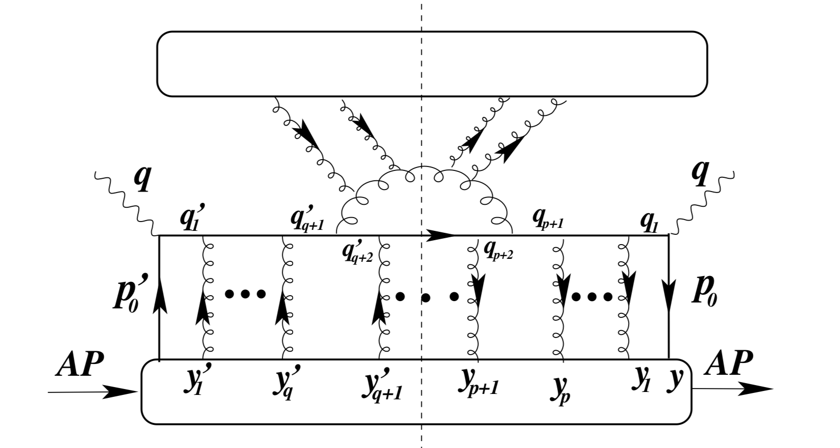
Inelastic scattering (2->2+n process)
Inelastic scattering rate (average gluon number per Δt):
Medium-induced gluon spectrum
[ Guo and Wang (2000), Majumder (2012); Zhang, Wang and Wang (2004) ]
of quark/gluon due to 2->2 scatterings

Slide 6
Framework overview
(Parton evolution inside the QGP)
Generation of QGP medium: hydrodynamic model
Initialization of hard partons: MC-Glauber for position space and pQCD calculation for momentum space (PDF: CTEQ5+EPS09)
Simulation of parton evolution: the Boltzmann transport model in the local rest frame of the medium
Hadronization: fragmentation + recombination model
outside the medium
(below T_{c}), converted into hadrons

Slide 7
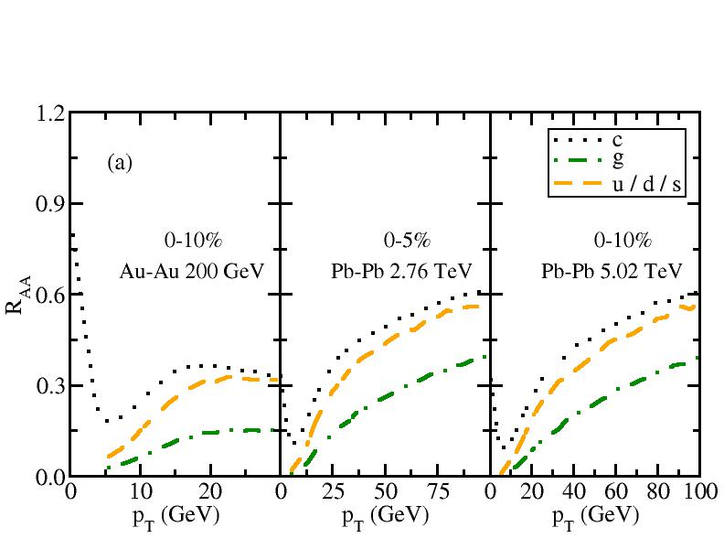
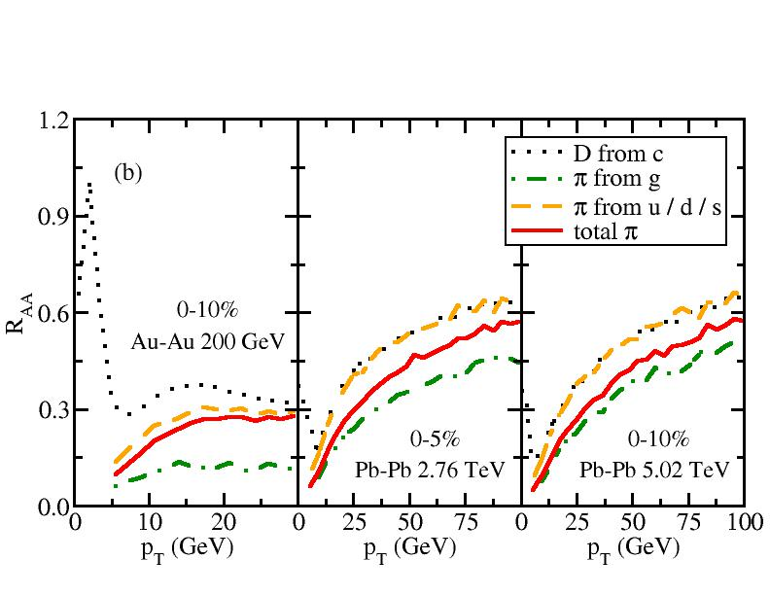
Heavy vs. light hadron suppression
u/d/s are slightly more suppressed than c quark, g is significantly more suppressed
Due to different fragmentation function, π from light quark has similar R_{AA} to D, π from gluon is still more suppressed

Slide 8
Simultaneous description of D and light hadron R_{AA}
Au-Au @ 200 AGeV
Pb-Pb @ 2.76 ATeV
D meson
light hadron
LBT treats heavy and light parton evolution on the same footing and simultaneously describes R_{AA} of D and light flavor hadrons.

Slide 9
Part II: Effects of multi-stage evolution
( In collaboration with G.-Y. Qin, C. Shen and A. Majumder, arXiv:1711.09053 )
Particles in current transport models are usually on-shell
Quantum fluctuation allows particles to be off-shell (virtual)
within a finite splitting time
Partons produced in energetic collisions usually start with high Q and then evolve back to shell after several splittings
Parton evolution at high Q is usually treated by vacuum showers (Pythia) in transport without considering medium modification
Develop a combined approach that includes medium modification in different stages

Slide 10
A multi-stage approach
Stage 1 (Q>>M_{HM}) – rare scattering multiple emission
HQ fragmentation function is treated with DGLAP equation
Splitting function:
[ HT: Guo and Wang (2000), Majumder (2012) ]
Input fragmentation function
Extracted from transport model (in stage 2) – medium-modified fragmentation function at Q₀ ~ M_{HM}

Slide 11
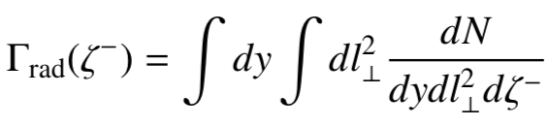
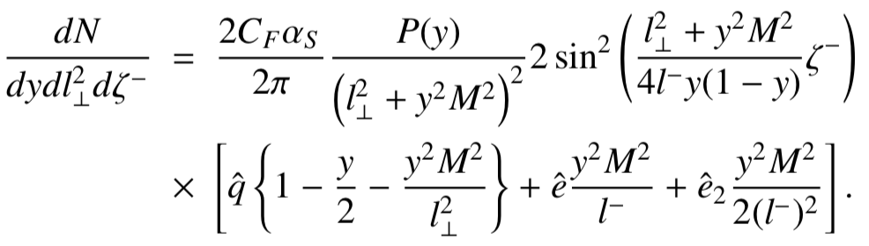
A multi-stage approach
Stage 2 (Q ~ M_{HM}) – single scattering induced emission
Transport model ( elastic + inelastic processes)
Inelastic scattering rate
Medium-induced gluon spectra (contribution from longitudinal drag and diffusion to slowly moving heavy quark)
Abir, Kaur, Majumder, PRD 90 (2014) 114026
Abir, Majumder, PRC 94 (2016) 054902
Assume Einstein relation:
Extract medium-modified for DGLAP in stage 1

Slide 12
Evolution of b-quark fragmentation function
in-medium
transport
vac DGLAP
medium-modified
DGLAP

Slide 13
Nuclear modification of heavy mesons
^
^
Contributions from e and e₂ terms
More important to b-quark than c-quark (mass hierarchy)
Non-negligible at low p_{T} but diminish at large p_{T}
Decrease B meson R_{AA} and narrow the difference between D and B

Slide 14
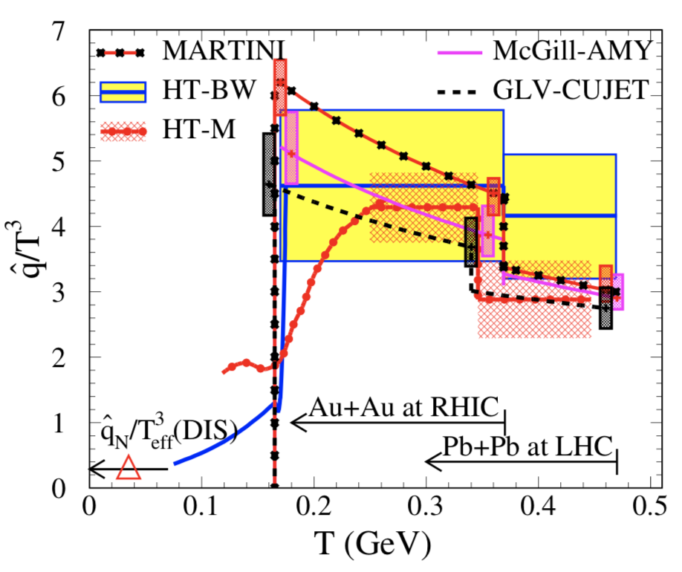
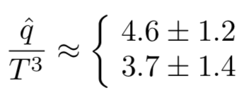
Part III: Open questions in progress
Extraction of heavy quark transport coefficient
Example from JET Collaboration [ Phys. Rev. C90 (2014), 014909 ]
Now extended to heavy quark, initiated by JET Collaboration

Slide 15
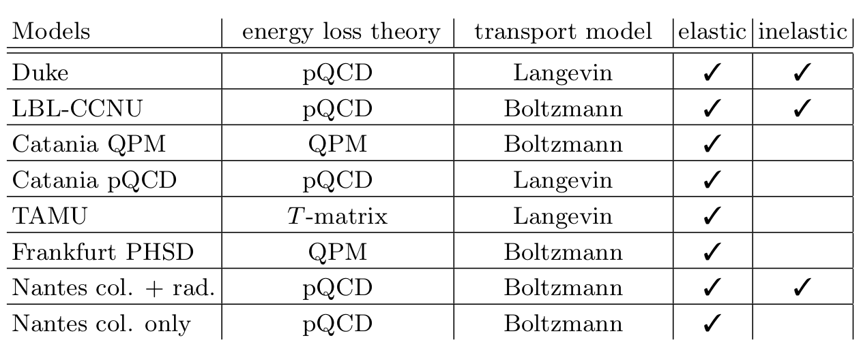
Heavy quark transport models
RHIC
LHC

Slide 16
Heavy quark transport coefficient
direct theory calculations
adjusted to describe data
A factor of 5 difference in the extracted transport parameter
Possible differences from the bulk medium and hadronization

Slide 17
Common baseline in a static medium
elastic: QPM
elastic: pQCD or T-matrix
elastic + inelastic
Common baseline: same initial c spectrum, static medium T = 250 MeV, R_{AA}(c) = 0.3 at t = 3 fm and p_{T} = 15 GeV
Convergence of transport parameter into 3 groups
Crucial baseline to understand heavy quark transport coefficients
Necessity of more constraints on the bulk medium and hadronization schemes

Slide 18
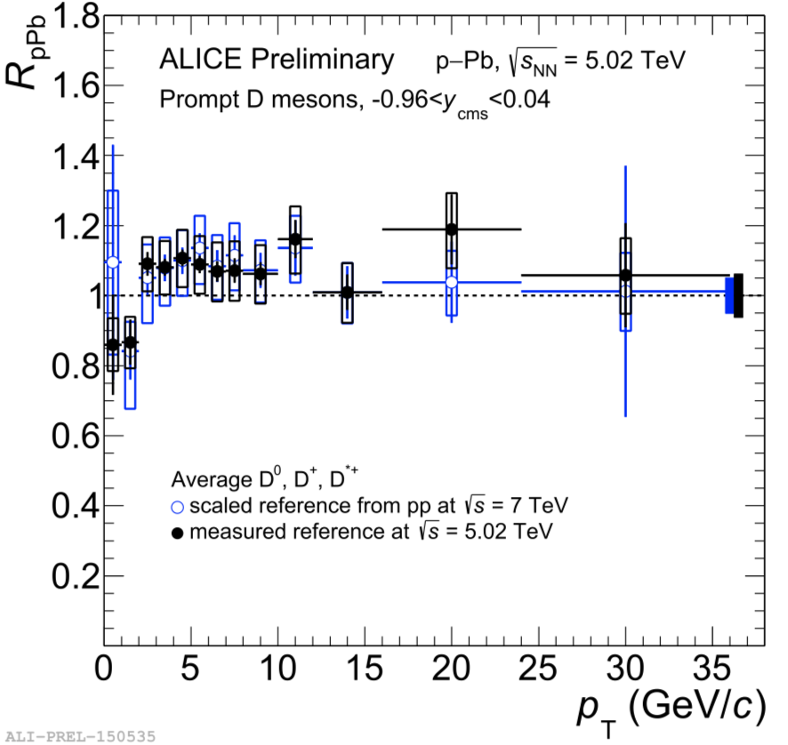
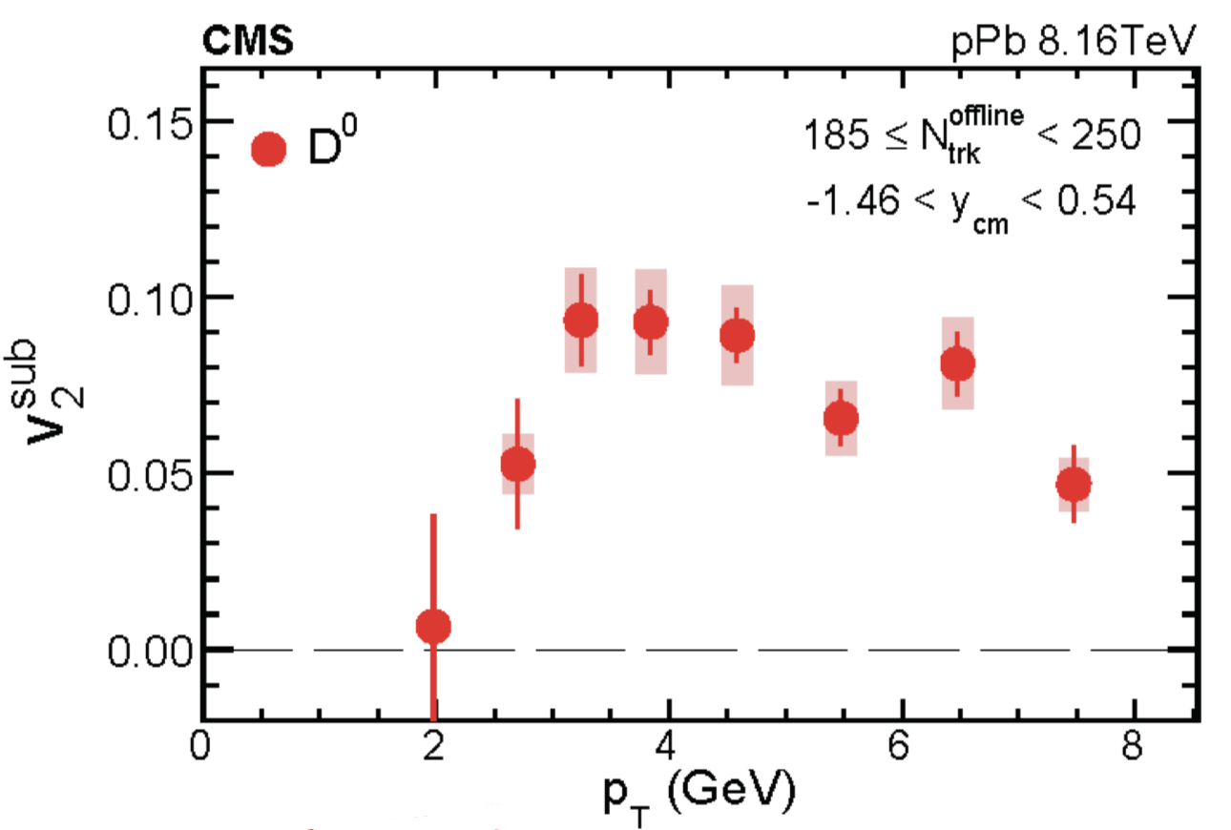
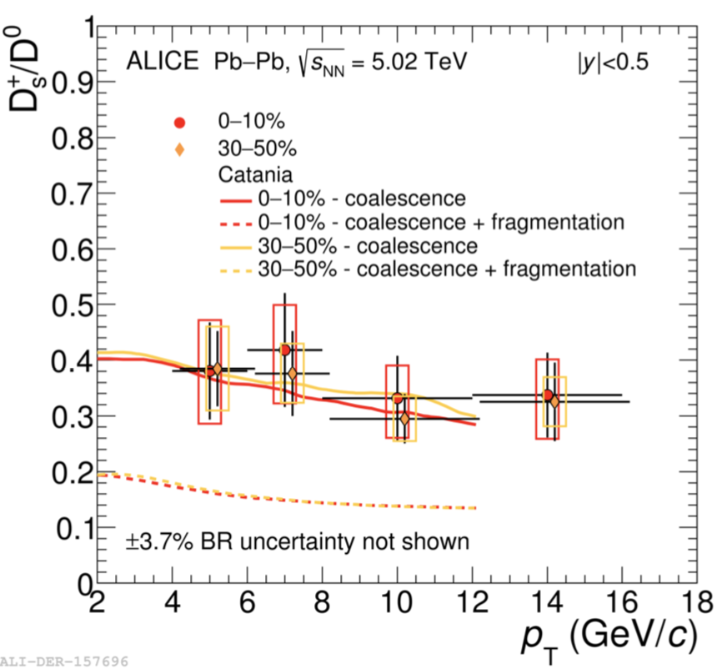

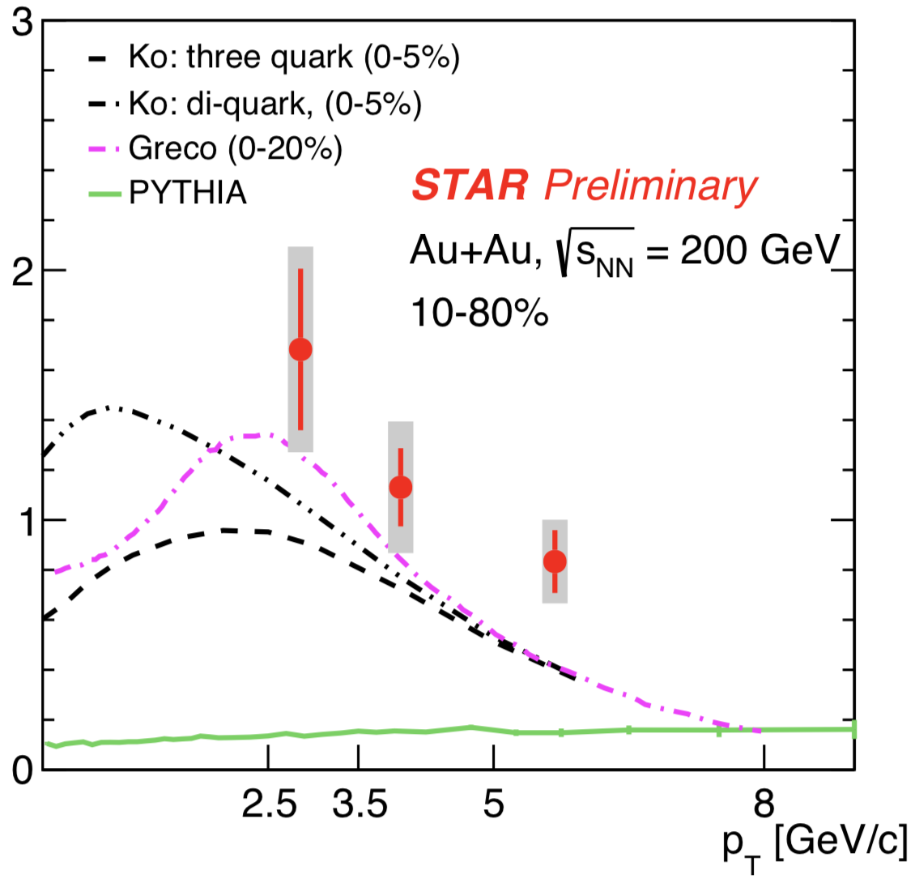
p-Pb: no suppression but finite v₂ -> QGP vs. initial state effect
Large D_{s}/D⁰ and Λ_{c}/D⁰ ratio -> challenge to hadronization model

Slide 19
Summary
Discussed heavy quark energy loss from different perspectives
Presented a linear Boltzmann transport model (LBT) that treats heavy and light parton evolution on the same footing and simultaneously describes the nuclear modification of charm and light hadrons
Introduced a multi-stage approach of heavy quark energy loss that further narrows down the difference between D and B meson R_{AA}
Discussed open questions about heavy quarks, e.g. systematical extraction of transport coefficients

Slide 20
Thank you!

Slide 21
Heavy meson spectra
Convolute vacuum/medium-modified fragmentation function with c/b initial spectra
Vacuum fragmentation function -> D/B spectra consistent with p-p data

Slide 22
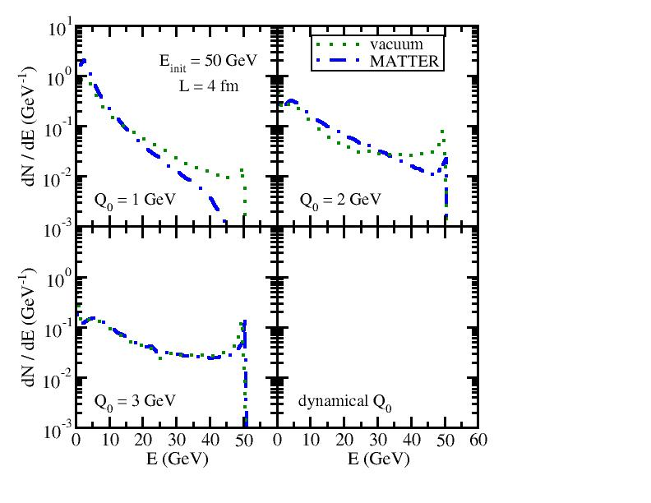
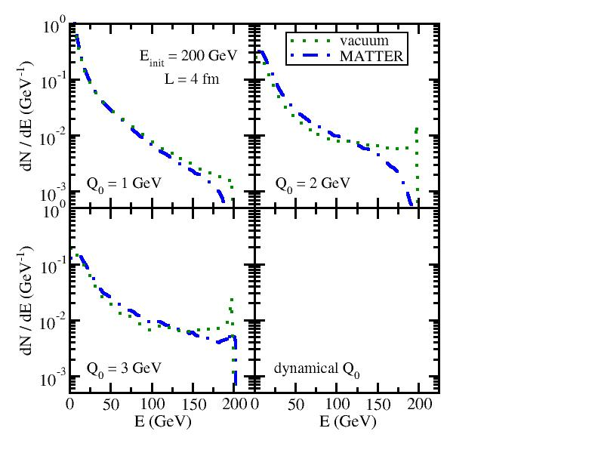

MATTER vs. vacuum shower
50 GeV jet
200 GeV jet
Energy loss in MATTER is stronger when Q₀ is smaller
Energy loss in MATTER disappears when (medium scale).
increases with the jet energy; MATTER evolution is more important to high energy partons than to low energy ones

Slide 23
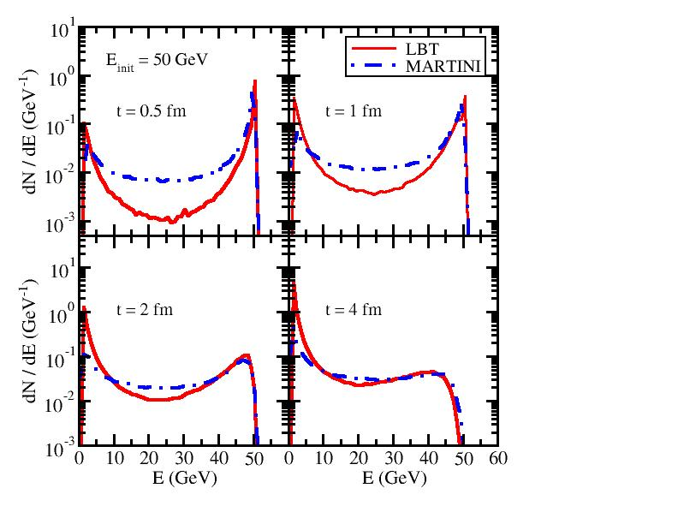
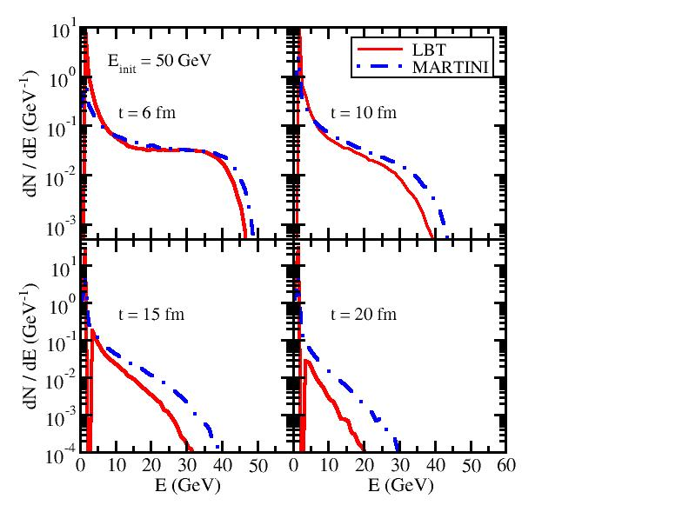
LBT vs. MARTINI at different times
Parton energy loss in LBT (HT) is weaker than in MARTINI (AMY) at early t, but catches up and becomes stronger when t is large
At t around the QGP lifetime, LBT and MARTINI are indistinguishable
Need to explore observables beyond R_{AA} to distinguish them

Slide 24
Flavor hierarchy of parton energy loss
elastic energy loss
inelastic energy loss
Consistency between semi-analytical calculation and MC simulation with the assumption of fixed medium T and fixed parton E
Clear flavor hierarchy within transport model: ΔE_{g}> ΔE_{q}> ΔE_{c}> ΔE_{b}

Slide 25
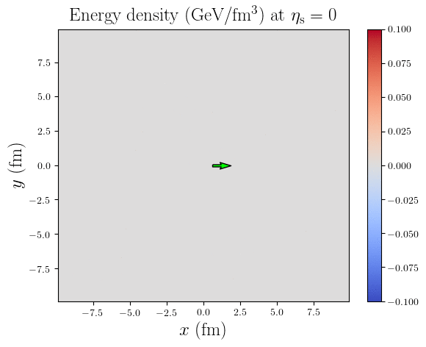

Energy deposition of heavy quarks into QGP
5 GeV charm quark
5 GeV beauty quark

Slide 26
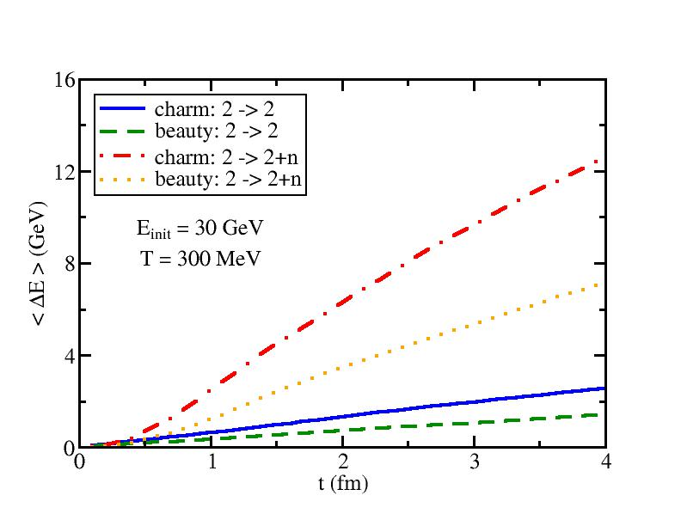
Elastic vs. Inelastic Energy Loss
Divide scattering probability of jet parton into two regions:
Pure elastic scattering without radiated gluons:
Inelastic scattering:
Total probability:
In model calculation:
Use to determine whether the jet parton scatter with the thermal medium
If so, we then determine whether this scattering is pure elastic or inelastic
Simulate the 2->2 or 2->2+n process
HQ energy loss due to elastic and inelastic processes are comparable at early time, but is dominated by the inelastic process at large t.

Slide 27
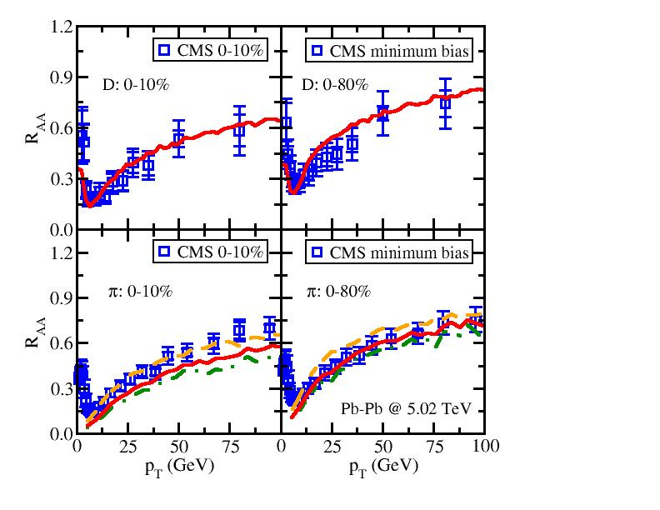
Simultaneous Description of D and π R_{AA} in 5.02 TeV Pb-Pb Collisions
With a delicate treatment of heavy and light parton in-medium evolution and their hadronization, one may provide reasonable description of heavy and light hadron suppression simultaneously.

Slide 28
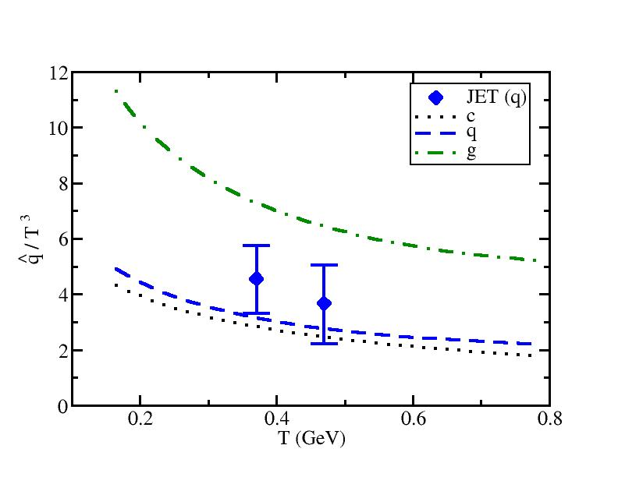
Quark and Gluon Transport Coefficient: q
^
The extracted q from model to data comparison within our LBT framework is consistent with the value constrained by the earlier work by the JET Collaboration [Phys. Rev. C90, 014909 (2014)].

Slide 29
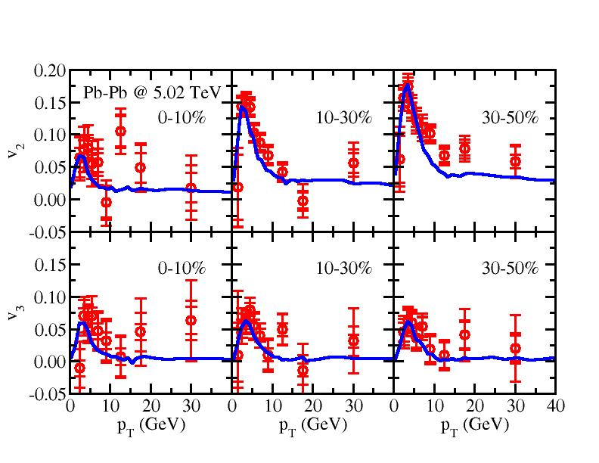
Anisotropic Flow (v₂ and v₃) of D Mesons
Predictions of v₂ and v₃ are consistent with CMS data at 5.02 TeV.
Strong v₂ is observed for the full p_{T} range.
Strong v₃ is observed at low p_{T}, but it is consistent with 0 at high p_{T}.

