Slide 1
Recent Status of Weak-Interaction Tests via Precision Superallowed Beta Decay Studies at TRIUMF
Kyle G. Leach, Colorado School of Mines
Conference on the Intersections of Particle and Nuclear Physics
Palm Springs, California, USA
Wednesday, May 30, 2018

Slide 2
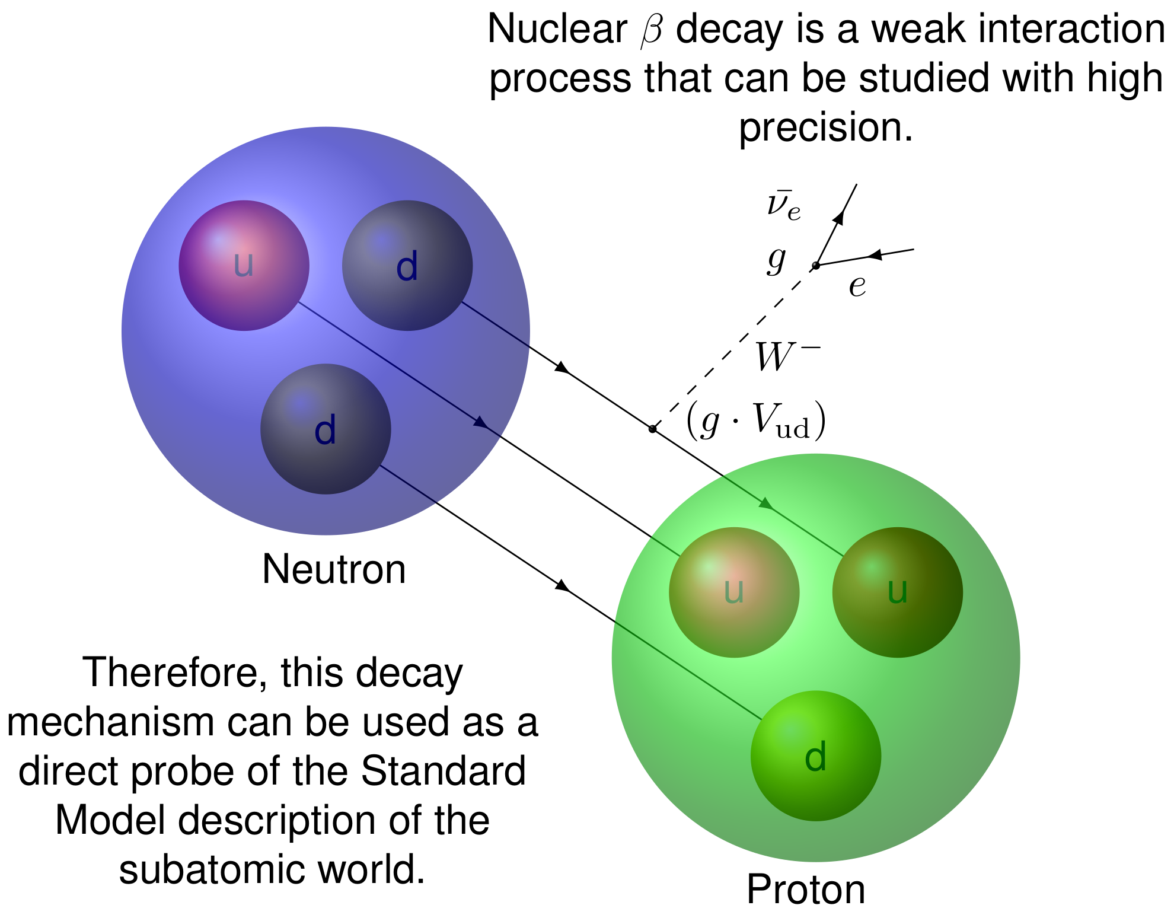
Weak Interaction Testing via Nuclear Beta Decay
Beta Decay ft Values
K.G. Leach
Conference on the Intersections of Particle and Nuclear Physics
Wednesday, May 30, 2018

Slide 3
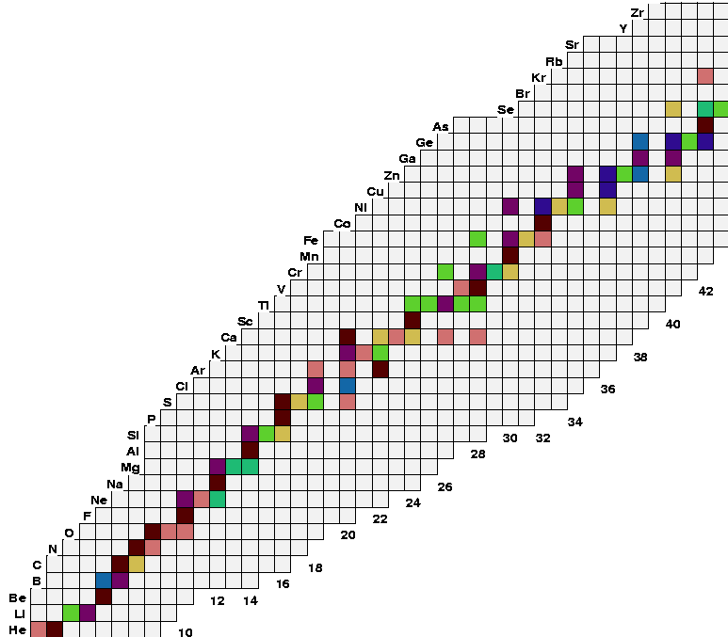
Requirements for Precision Studies of Fermi β Decay
$$T_{1/2} \sim 50 ms −100 s$$
K.G. Leach
Conference on the Intersections of Particle and Nuclear Physics
Wednesday, May 30, 2018

Slide 4
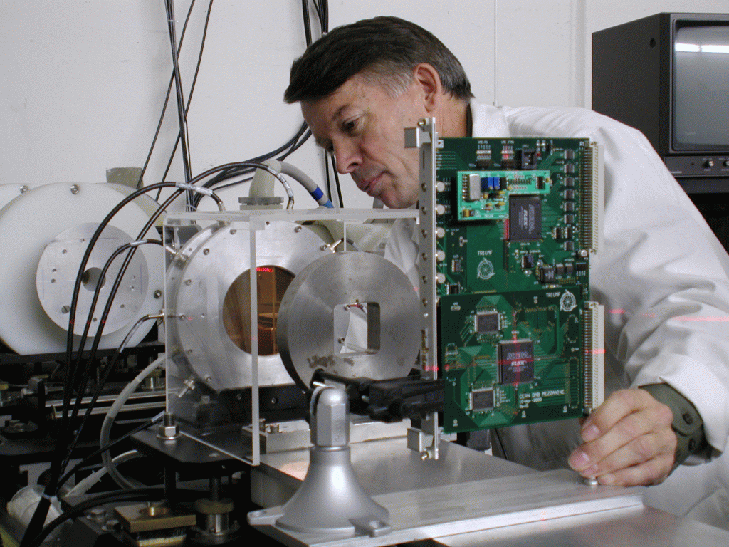
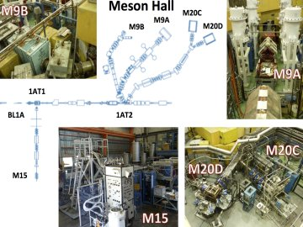
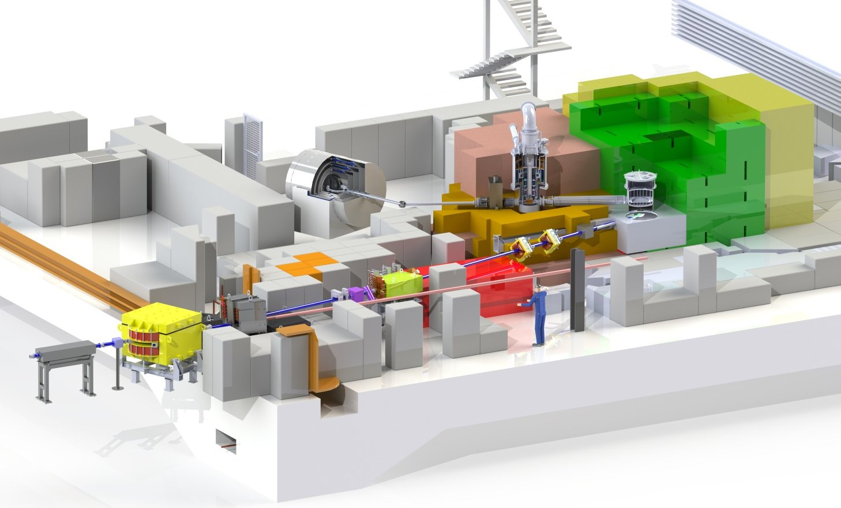
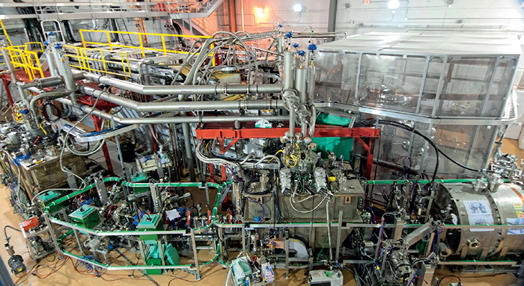
- Canada’s Particle Accelerator Centre
Life Sciences Division
Main Cyclotron and Proton Beam Lines
Institute for Advanced Medical Isotopes (IAMI)
Rare-Isotope Beam
Facilities
Irradiation Facilities
Centre for Molecular and Materials Science
Ultracold Neutron (UCN) Facility [TUCAN]
Electron Hall and Beam Lines
ATLAS Canadian Tier-I Data Centre
Electron LINAC for RIB Production with ARIEL
K.G. Leach
Conference on the Intersections of Particle and Nuclear Physics
Wednesday, May 30, 2018

Slide 5
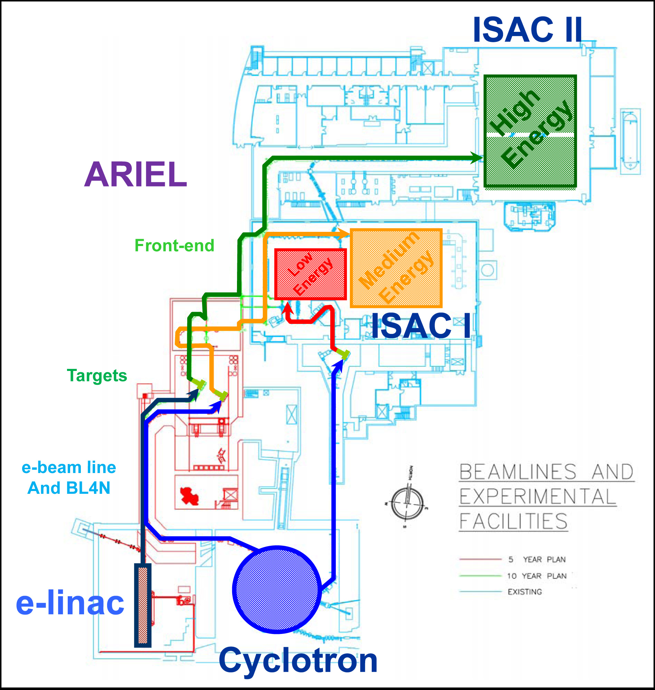
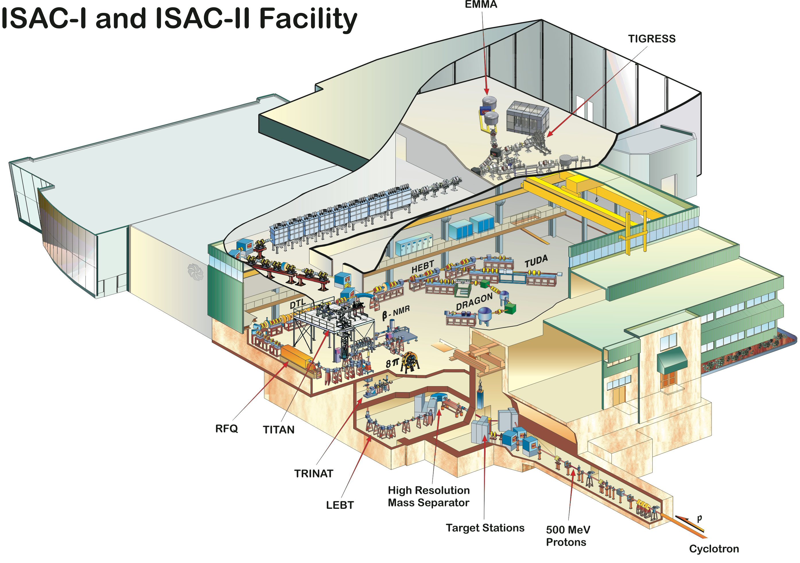
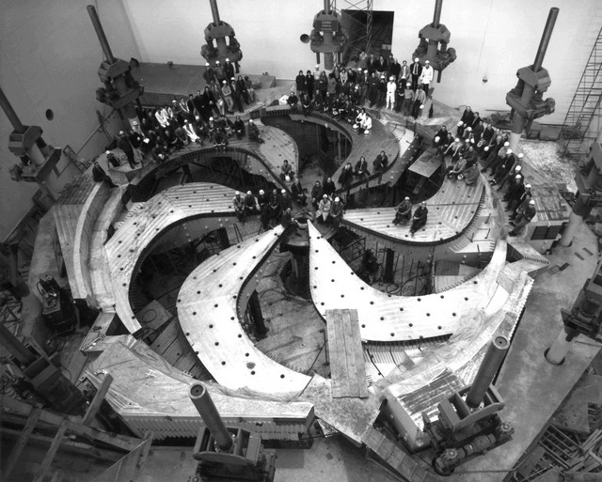
Rare-Isotope Beam Facilities at TRIUMF
500 MeV H⁻ Cyclotron
35 MeV 100kW E-Linac
K.G. Leach
Conference on the Intersections of Particle and Nuclear Physics
Wednesday, May 30, 2018

Slide 6
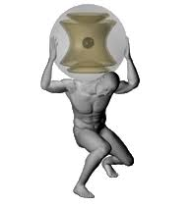
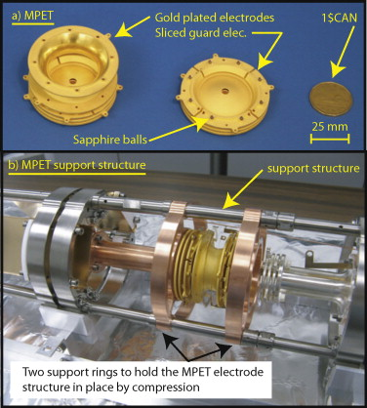
Superallowed Beta Decay Studies at TRIUMF
Q Values
TITAN
K.G. Leach
Conference on the Intersections of Particle and Nuclear Physics
Wednesday, May 30, 2018

Slide 7
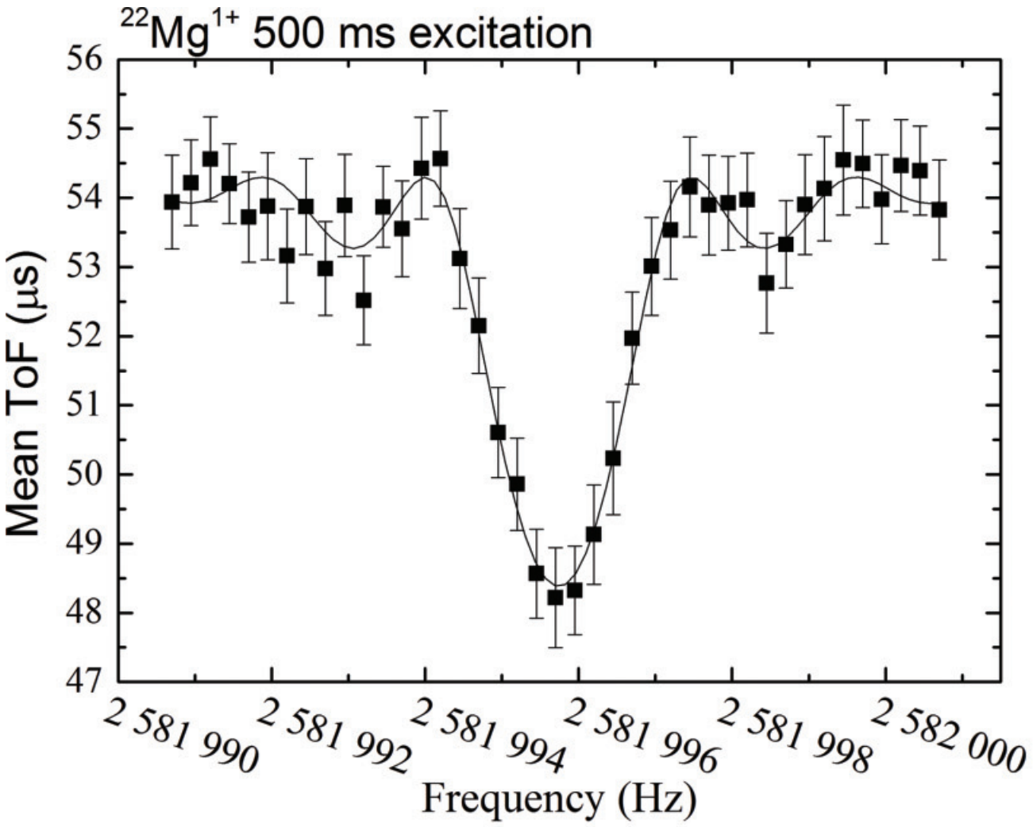
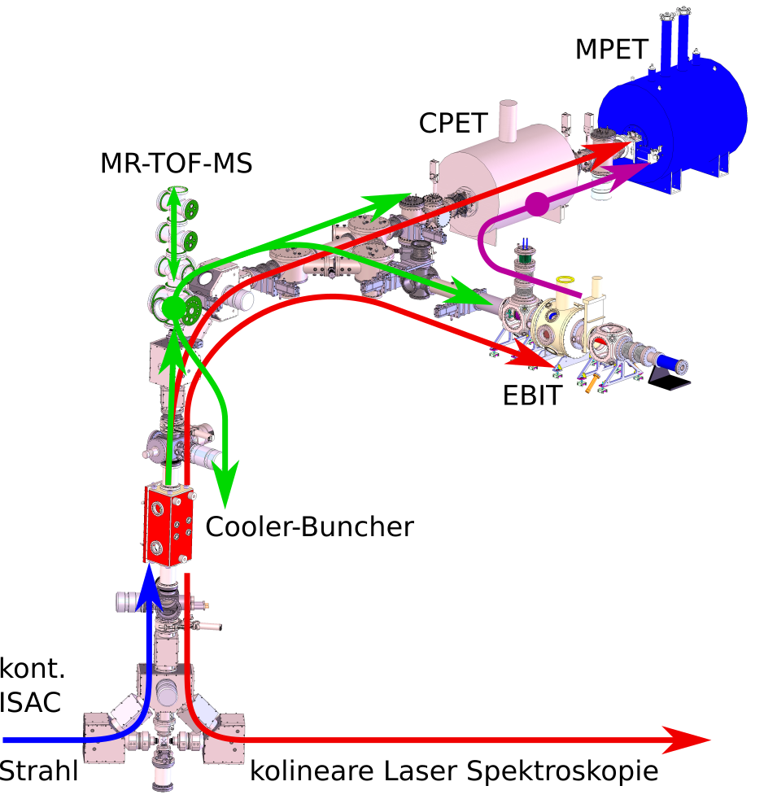
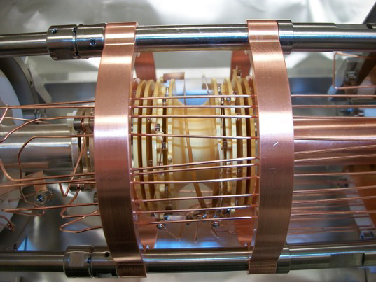
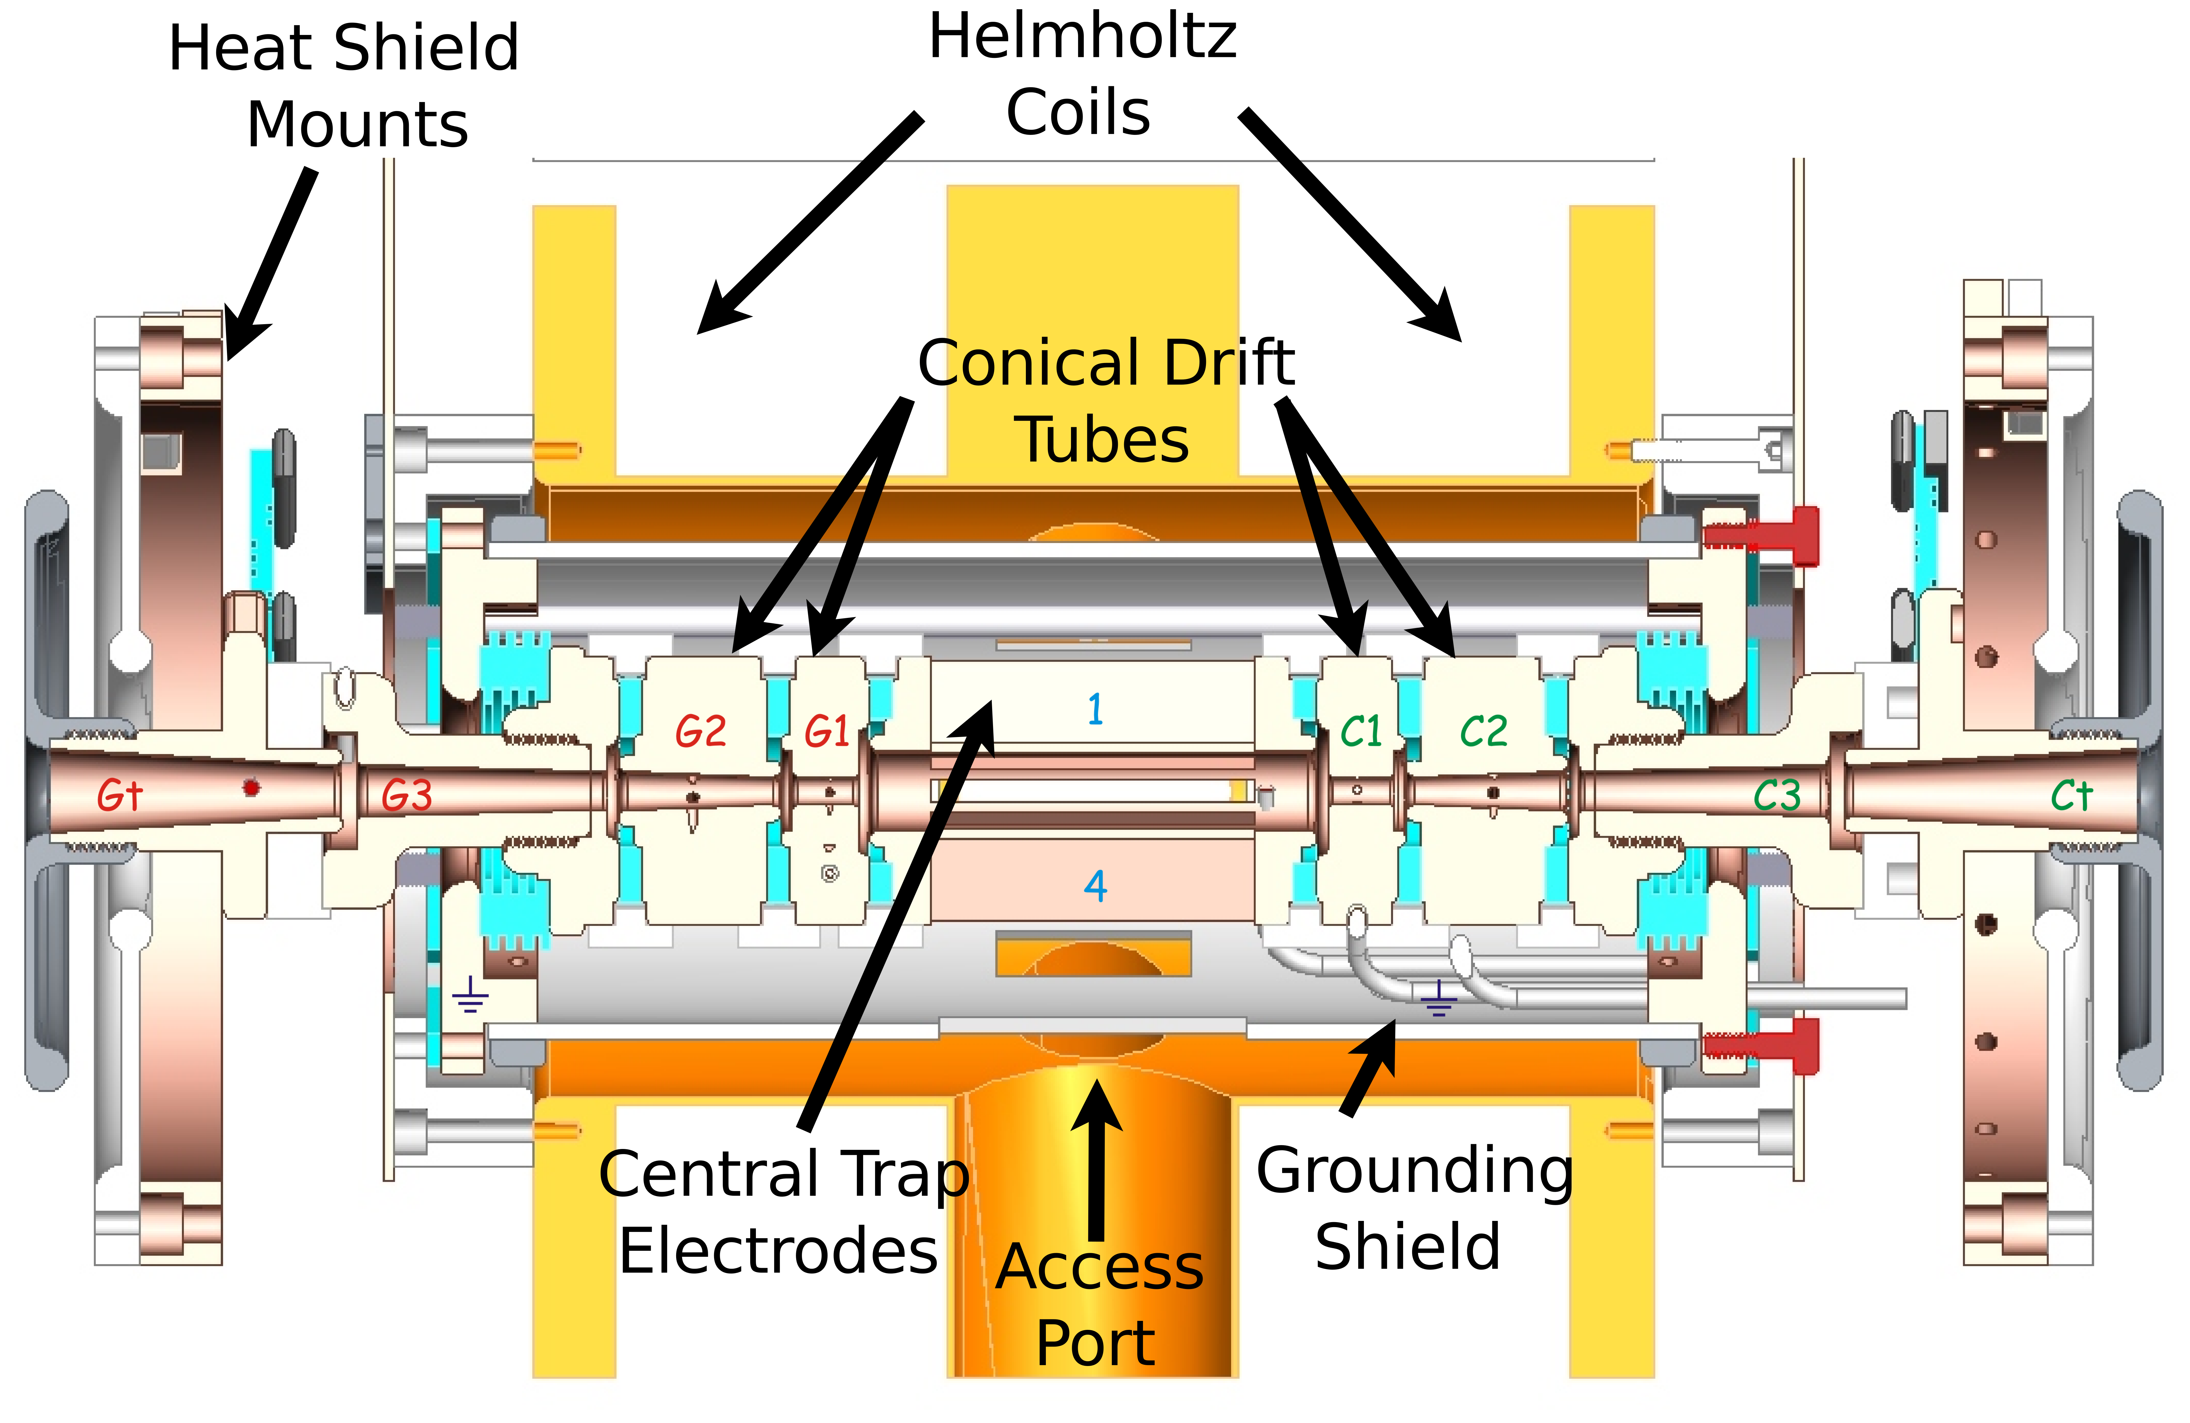
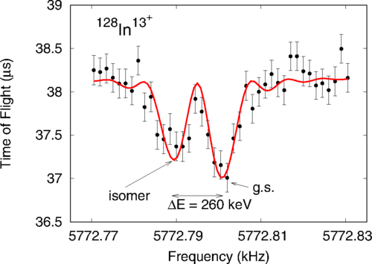
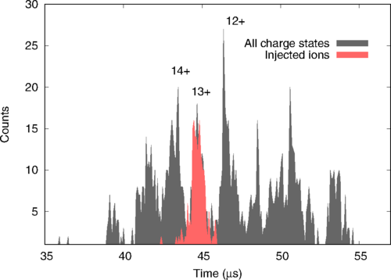
Experimental Method: Q-values
Penning-Trap Mass Spectrometry with TITAN
MR-TOF IS:
Multi-Reflection Time-of-Flight Isobar Separator to remove contaminants
Cooler Penning Trap:
Cooling of HCIs
MPET:
mass measurement
via determination of cyclotron frequency
V.V. Simon et al., Hyp. Int. 199, 151 (2011)
M. Brodeur et al., IJMS 310, 20 (2012)
M.P. Reiter et al., PRC 96, 052501(R) (2017)
C. Jesch et al., Hyp. Int. 235, 97 (2015)
RFQ: Accumulation, cooling, and bunching
EBIT: Charge State Breeding and Decay Spectroscopy of HCI
M. Smith et al., Hyp. Int. 173, 171 (2006)
ISAC RIB
A. Lapierre et al., NIMA 624, 54 (2010)
K.G. Leach et al., NIMA 780, 91 (2015)
J. Dilling et al., NIMB 204, 492 (2003)
J. Dilling et al., IJMS 251, 198 (2006)
C. Babcock et al., PRC 97, 024312 (2018)
K.G. Leach
Conference on the Intersections of Particle and Nuclear Physics
Wednesday, May 30, 2018

Slide 8
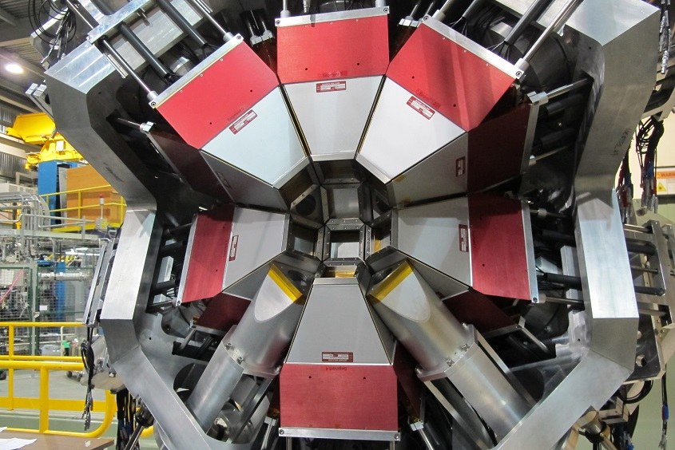
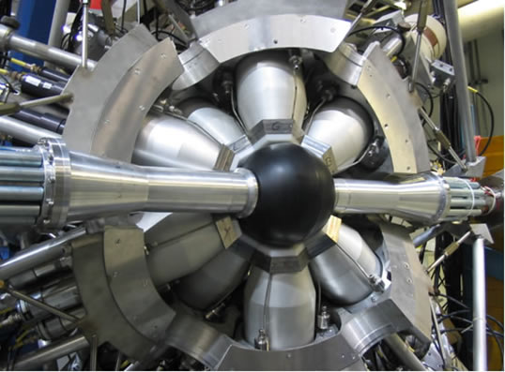
Superallowed Beta Decay Studies at TRIUMF
Branching Ratios
π
π
π
π
8
π
π
π
π
Q Values
TITAN
K.G. Leach
Conference on the Intersections of Particle and Nuclear Physics
Wednesday, May 30, 2018

Slide 9
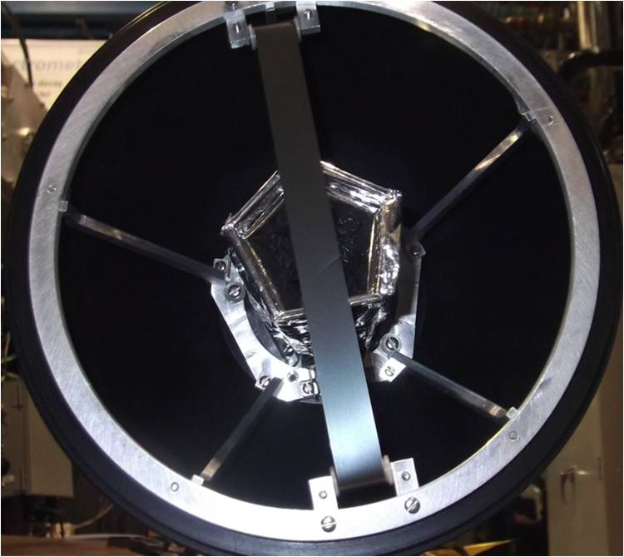
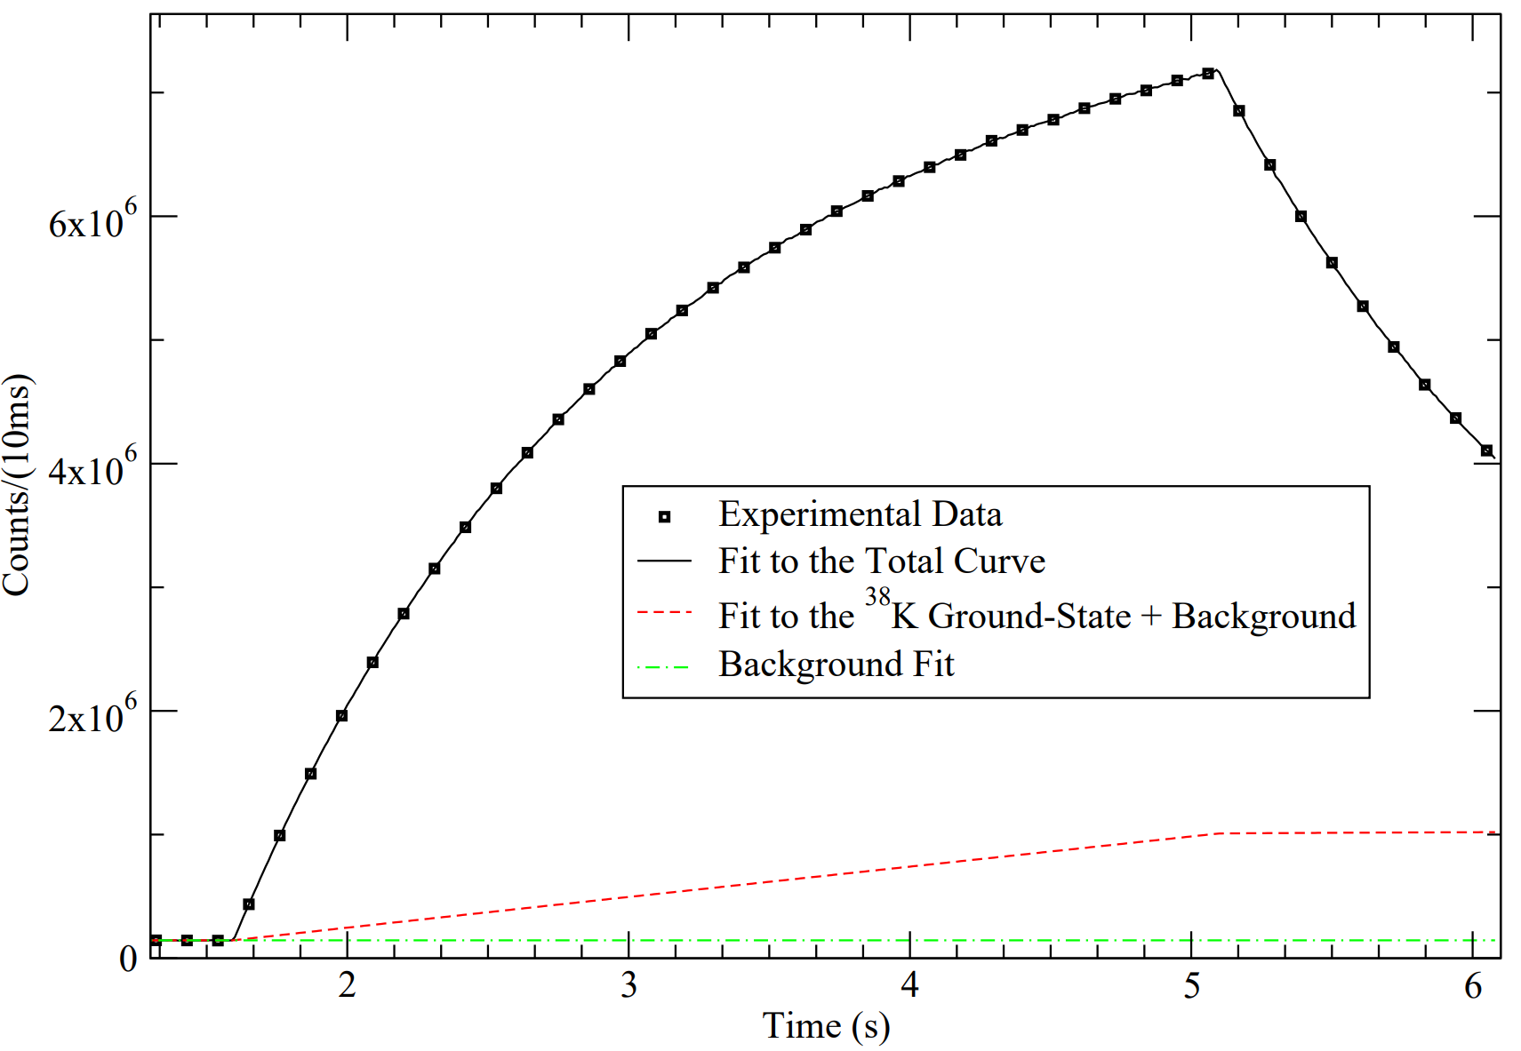
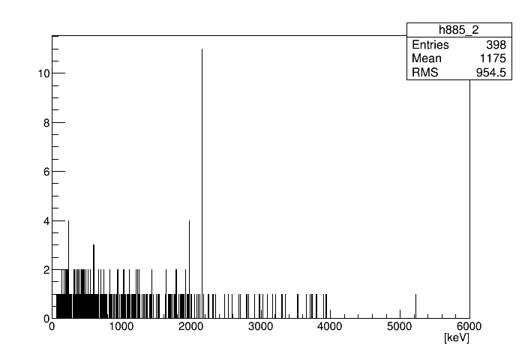
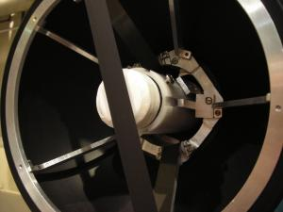
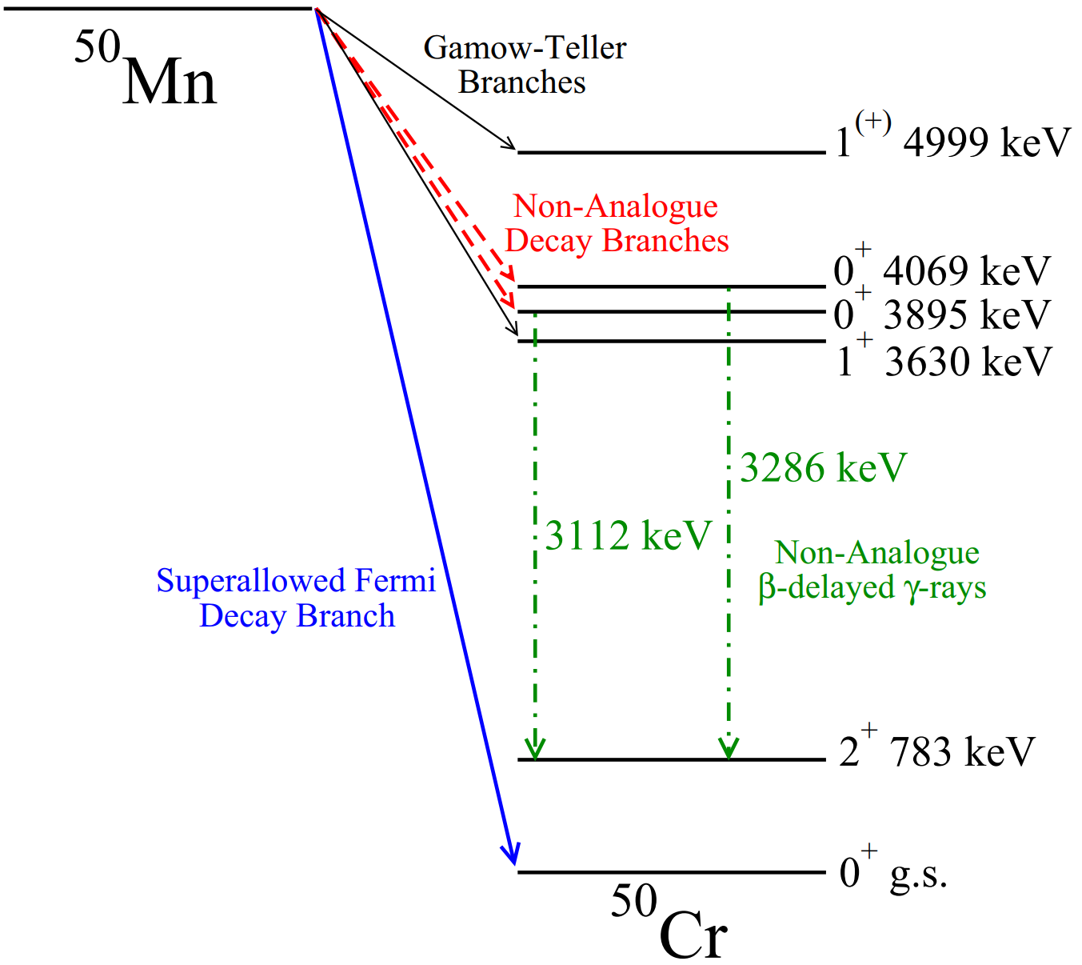
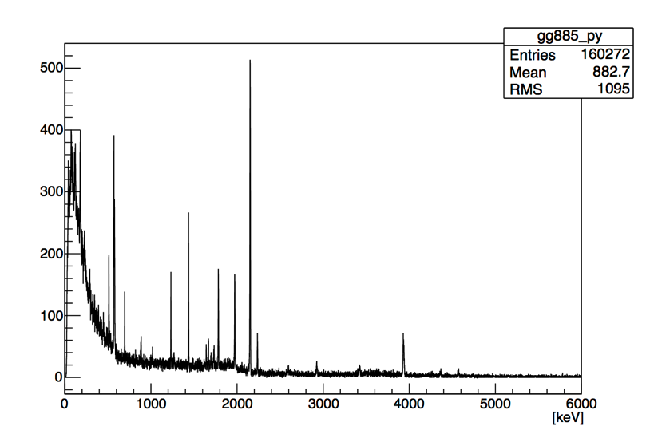
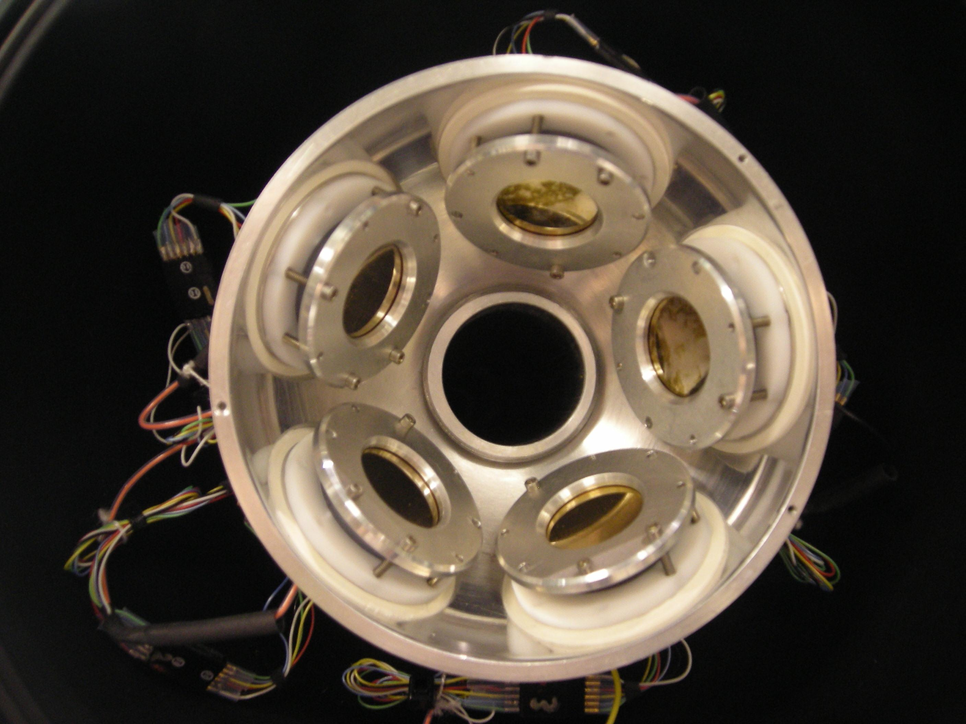
Experimental Method: Branching Ratios
Coincident Gamma-Ray Spectroscopy with the 8pi and GRIFFIN
8pi
2-3 pps, 5 days
SCEPTAR
positron tagging
³²Na β⁻ Decay
ISAC RIB
C.M.Mattoon et al., PRC 60, 017302 (2007)
A.B. Garnsworthy and P.E. Garrett, Hyp. Int. 225, 121 (2014)
GRIFFIN
~9 pps, <2 days
³²Na β⁻ Decay
PACES
electron spectroscopy
K.G. Leach et al., PRC 94, 011304(R) (2016)
A.B. Garnsworthy and C.E. Svensson, Hyp. Int. 225, 127 (2014)
K.G. Leach
Conference on the Intersections of Particle and Nuclear Physics
Wednesday, May 30, 2018

Slide 10
Superallowed Beta Decay Studies at TRIUMF
Branching Ratios
π
π
π
π
8
π
π
π
π
Half-Lives
Proportional Gas Counter
Q Values
TITAN
K.G. Leach
Conference on the Intersections of Particle and Nuclear Physics
Wednesday, May 30, 2018

Slide 11
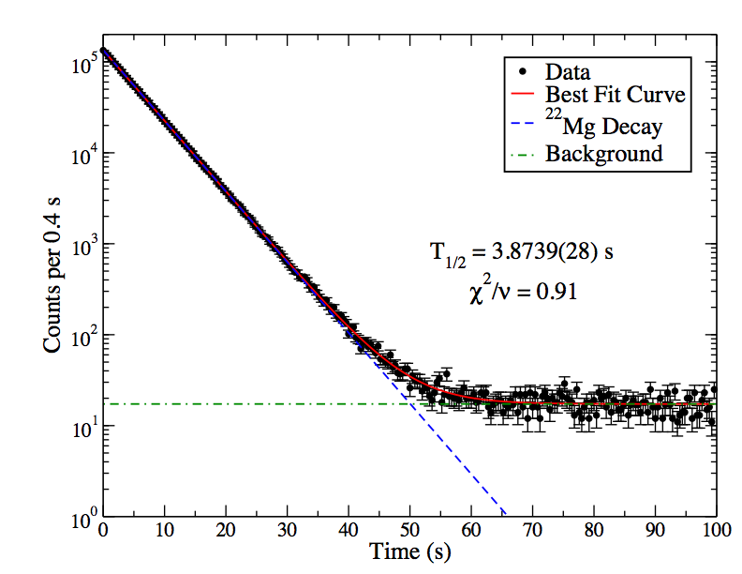
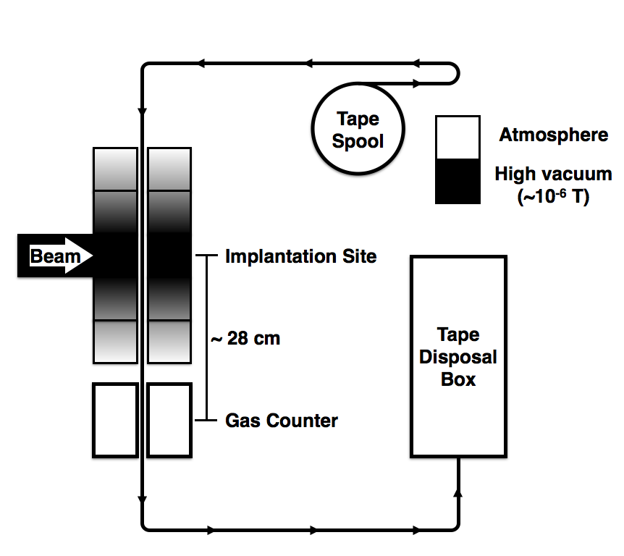
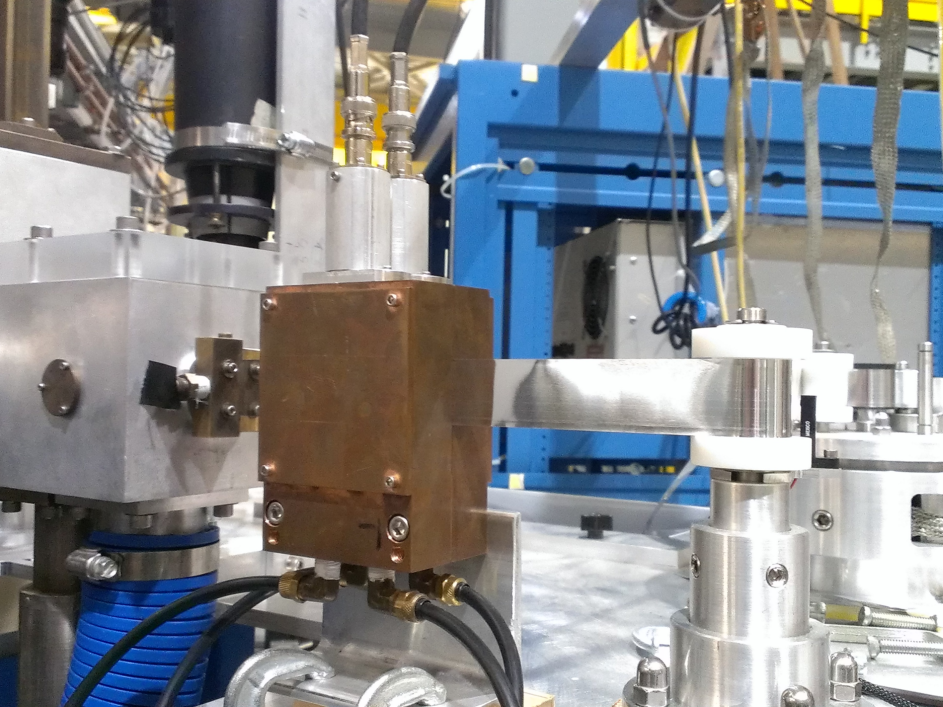
Experimental Method: Half-Lives
Positron Decay Counting with a gas-proportional counter (GPS)
ISAC RIB
4π continuous-flow proportional gas counter with tape transfer system
Detect β particles with ~100% efficiency
Cycles:
Implant beam onto a tape for ~3 half-lives (saturation).
Move the tape into the gas counter and measure the decay activity for ~25 half-lives
Move tape into tape disposal box to remove long-lived contaminants from gas counter
M.R. Dunlop et al., Phys. Rev. C 96, 045502 (2017)
K.G. Leach
Conference on the Intersections of Particle and Nuclear Physics
Wednesday, May 30, 2018

Slide 12
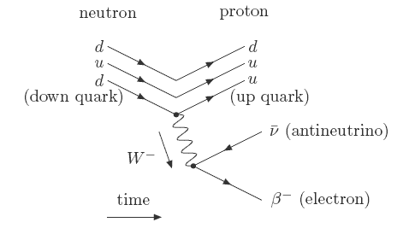
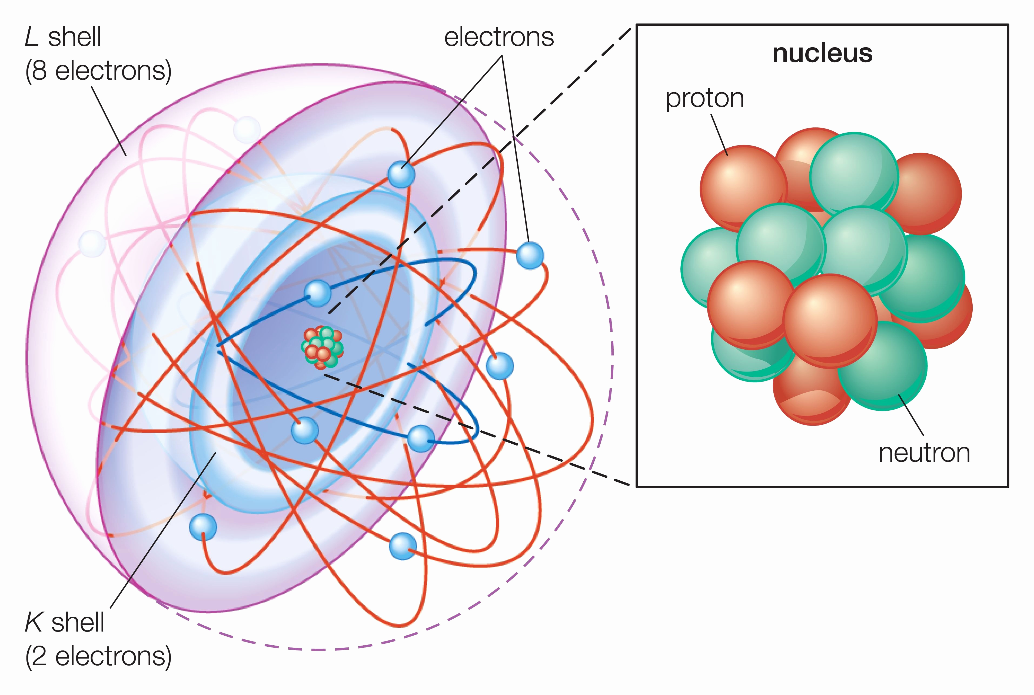
Superallowed Beta Decay Studies at TRIUMF
Branching Ratios
Nuclear Theory
π
π
π
π
8
π
π
π
π
Half-Lives
Proportional Gas Counter
Q Values
J.D. Holt
P. Navratil
S.R. Stroberg
Charge-Radii
Co-linear Laser Spectroscopy
TITAN
K.G. Leach
Conference on the Intersections of Particle and Nuclear Physics
Wednesday, May 30, 2018

Slide 13
History of the Superallowed Program at TRIUMF-ISAC
T _{½} , G.C. Ball et al., PRL 86, 1454 (2001)
BR, A. Piechaczek et al., PRC 67, 051305 (2003)
BR, R. Dunlop et al., PRC 88, 045501 (2013)
Q, S. Ettenauer et al., PRL 107, 272501 (2011)
CR, E. Mané et al., PRL 107, 212502 (2011)
⁷⁴Rb
21 Publications since 2001
2001 - 2005 : 2
2006 - 2010 : 6
2011 - 2015 : 9
2016 - : 4
T_{½} , G.F. Grinyer et al., PRC 77, 201501 (2008)
BR, B.H. Hyland et al., PRL 97, 102501 (2006)
BR, P. Finlay et al., PRC 78, 044321 (2008)
⁶²Ga
BR, K.G. Leach et al., PRL 100, 192504 (2008) T_{½} , G.C. Ball et al., PRC 82, 045501 (2010)
³⁸K^{m}
T_{½} , P. Finlay et al., PRL 106, 032501 (2011)
BR, P. Finlay et al., PRC 85, 055501 (2012)
²⁶Al^{m}
BR, A.T. Laffoley et al., in preparation (2018)
T_{½} , M.R. Dunlop et al., PRC 96, 045502 (2017)
Q, M.P. Reiter et al., PRC 96, 052501(R) (2017)
²²Mg
T_{½} , P. Finlay et al., PRC 96, 025501 (2017)
²¹Na
T_{½} , G.F. Grinyer et al., PRC 76, 025503 (2007) T_{½} , G.F. Grinyer et al., PRC 87, 045502 (2013) T_{½} , A.T. Laffoley et al., PRC 92, 025502 (2015)
¹⁸Ne
T_{½} , A.T. Laffoley et al., PRC 88, 015501 (2013)
¹⁴O
T_{½}, M.R. Dunlop et al., PRL 116, 172501 (2016)
Q, A.A. Kwiatkowski et al., Ann. Phys. 525, 7 (2013)
¹⁰C
K.G. Leach
Conference on the Intersections of Particle and Nuclear Physics
Wednesday, May 30, 2018

Slide 14
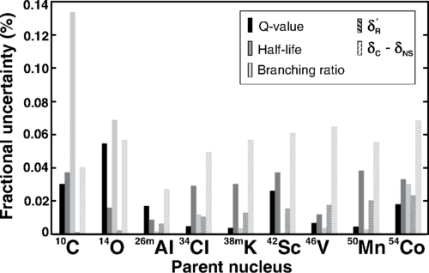
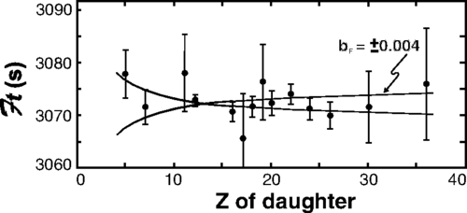
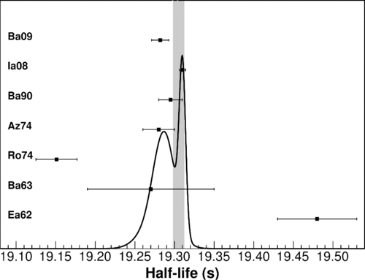
Recent Experimental Highlights: ¹⁰C
The superallowed 0⁺ to 0⁺ nuclear beta decays currently provide the most stringent limit on scalar currents in the weak interaction via the Fierz interference term:
b_{F} $=−2\frac{Cs}{CV}$
= -0.0028(26)
¹⁰C
The half-life of 10C is the second largest experimental uncertainty, which is dominated by a discrepancy in previous measurements
¹⁴O
J.C. Hardy and I.S. Towner, Phys. Rev. C 91, 025501 (2015)
M.R. Dunlop et al., Phys. Rev. Lett. 116, 172501 (2016)
K.G. Leach
Conference on the Intersections of Particle and Nuclear Physics
Wednesday, May 30, 2018

Slide 15
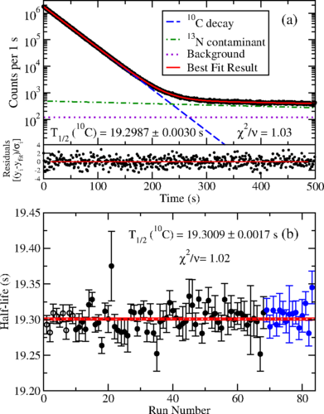
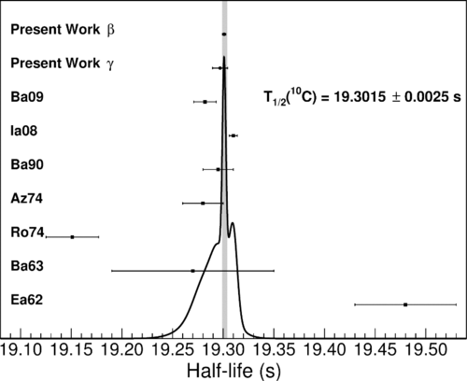
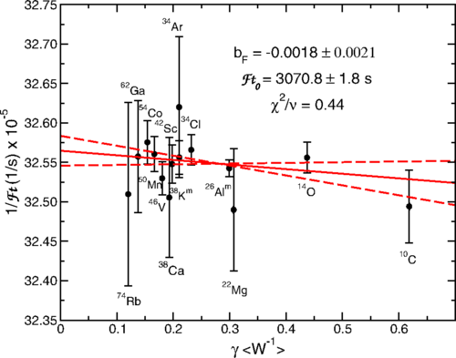
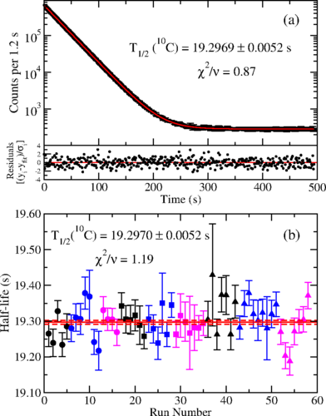
Recent Experimental Highlights: ¹⁰C
Positron Counting
Gamma Counting
The most precise superallowed half-life measurement, and first to achieve a relative precision of better than 10⁻⁴
Improvement of world-average uncertainty by more than a factor of 2
Resolution of previous measurement discrepancy
$$\frac{C_{S}}{C_{V}}=0.0009\left(11\right)$$
M.R. Dunlop et al., Phys. Rev. Lett. 116, 172501 (2016)
K.G. Leach
Conference on the Intersections of Particle and Nuclear Physics
Wednesday, May 30, 2018

Slide 16
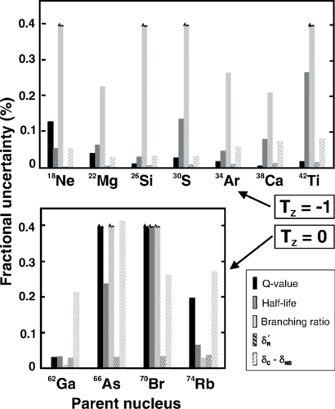
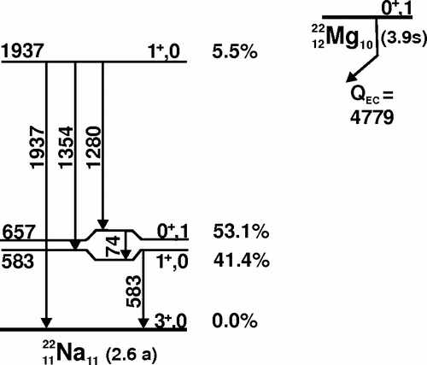
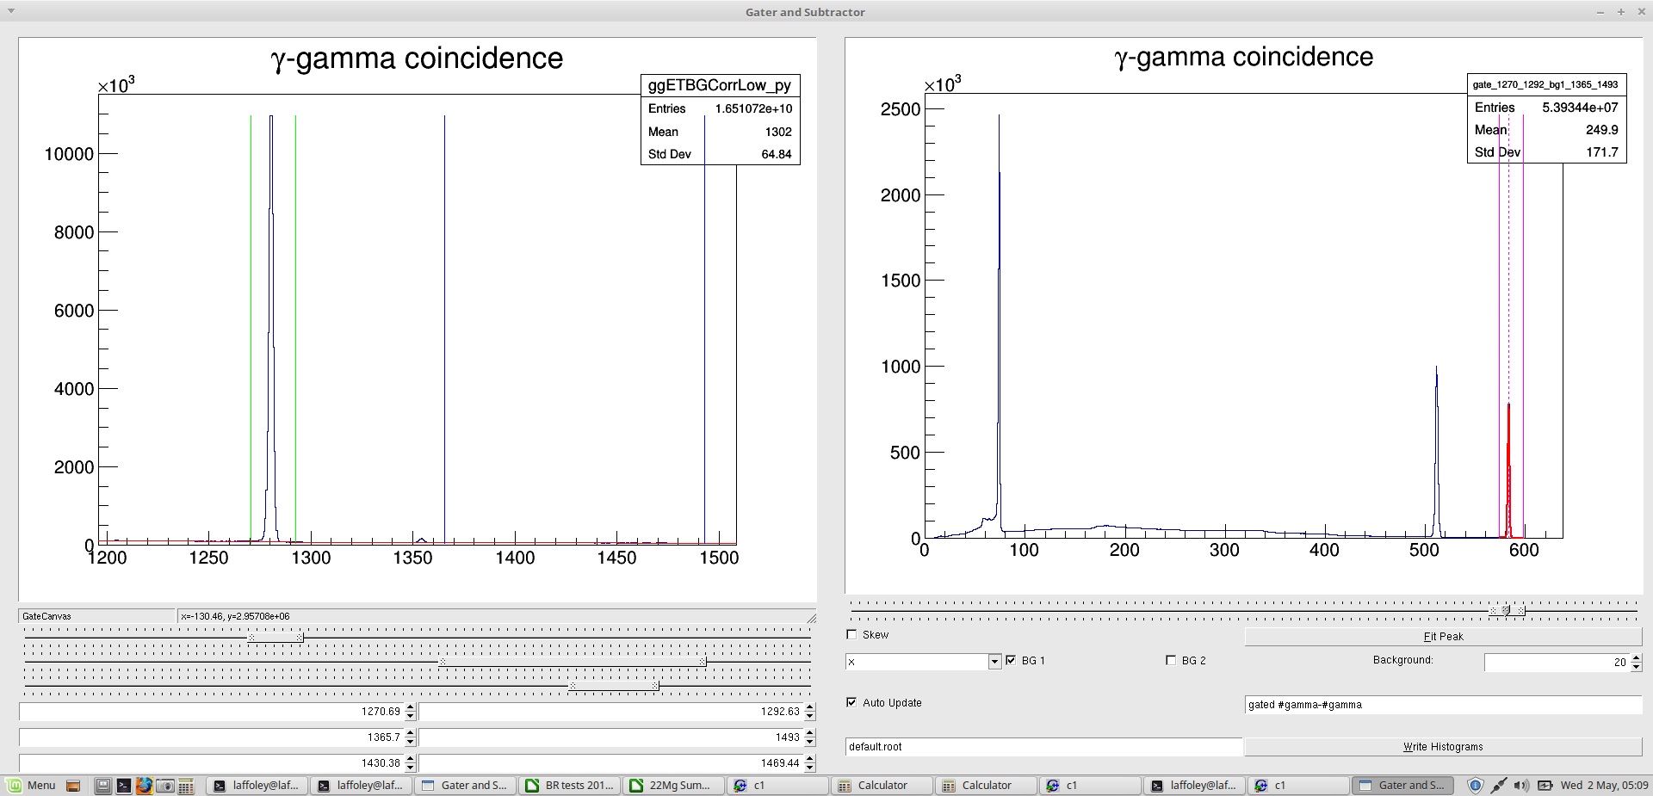
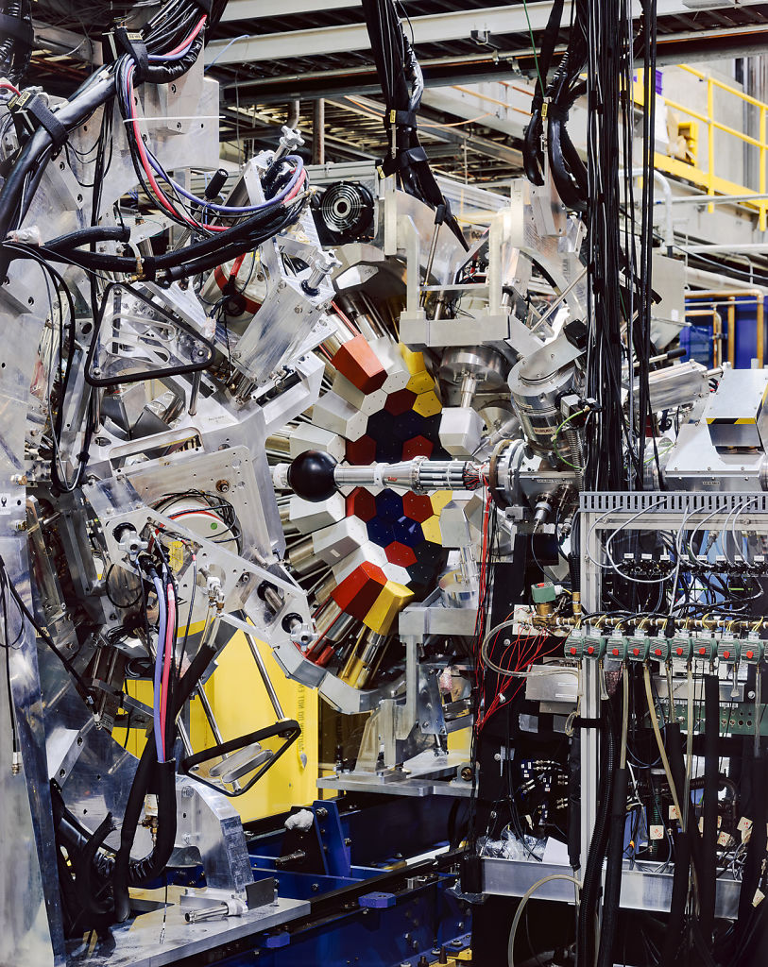
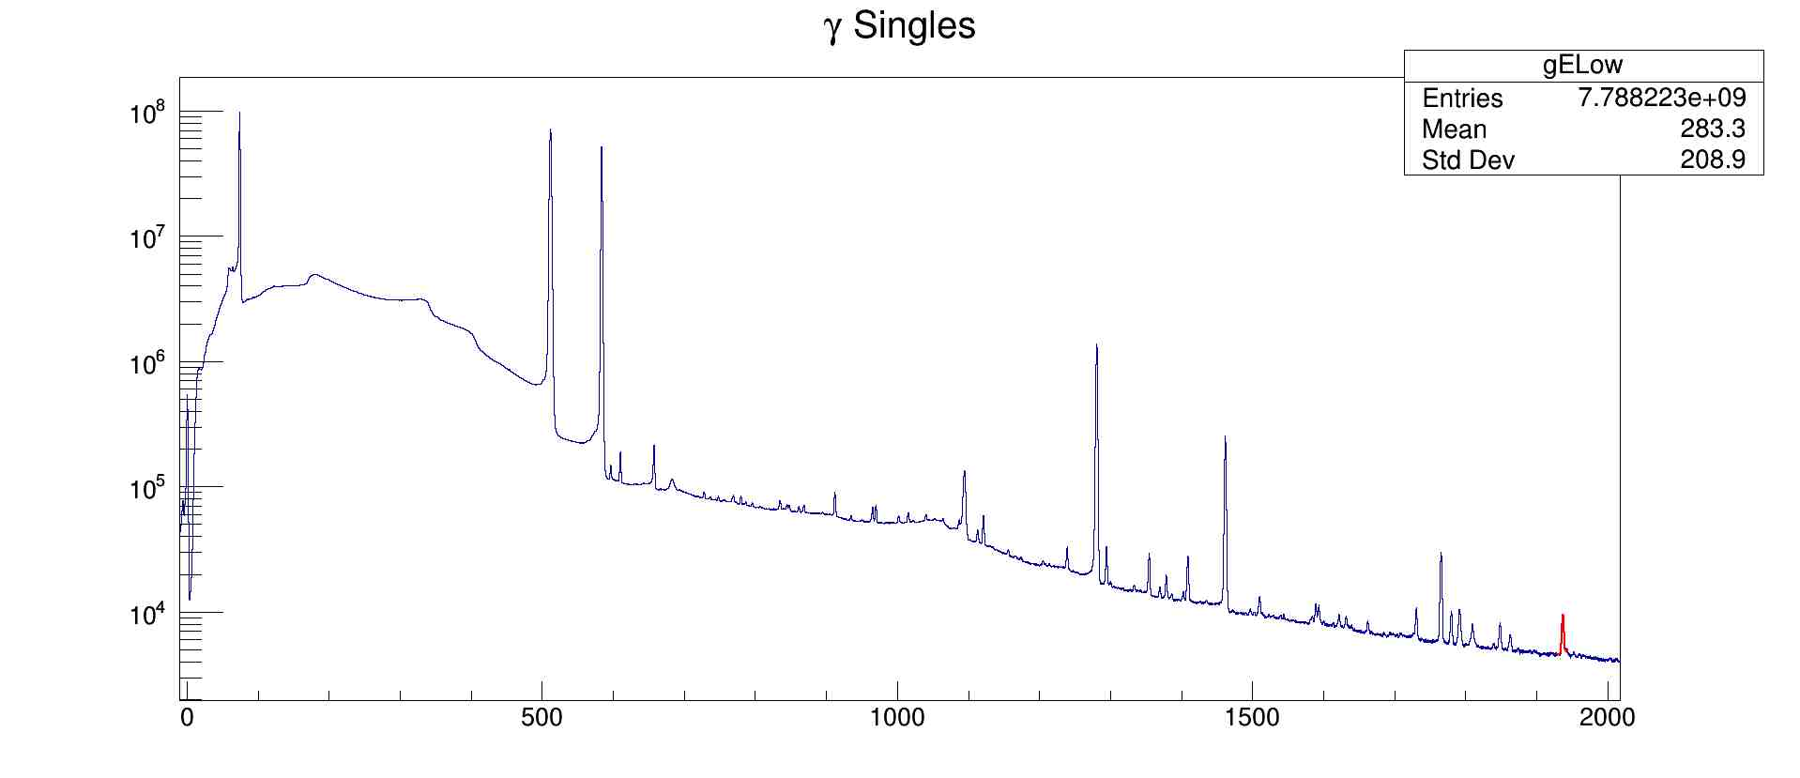
Recent Experimental Highlights: ²²Mg
Branching Ratio with GRIFFIN
A.T. Laffoley et al., Under analysis
In coincidence with 1280 (for ratio of efficiencies):
74 keV: 5.2 x 10⁶ counts 583 keV: 2.2 x 10⁶ counts
583 keV – ²²Mg
74 keV – ²²Mg
583 + 74
511 + 583
1280 keV – ²²Mg
511 keV – annih.
1354 keV – ²²Mg
1460 keV – ⁴⁰K
1937 keV – ²²Mg
Statistical precision <0.1%
J.C. Hardy and I.S. Towner, Phys. Rev. C 91, 025501 (2015)
K.G. Leach
Conference on the Intersections of Particle and Nuclear Physics
Wednesday, May 30, 2018

Slide 17
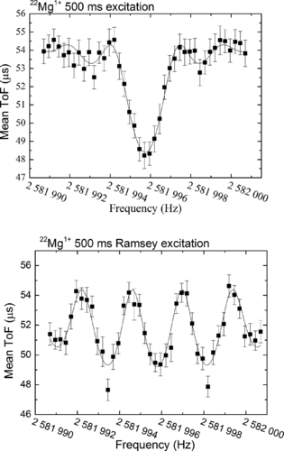
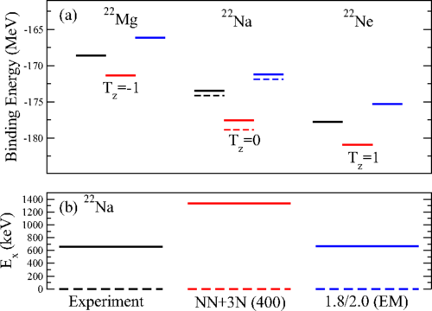
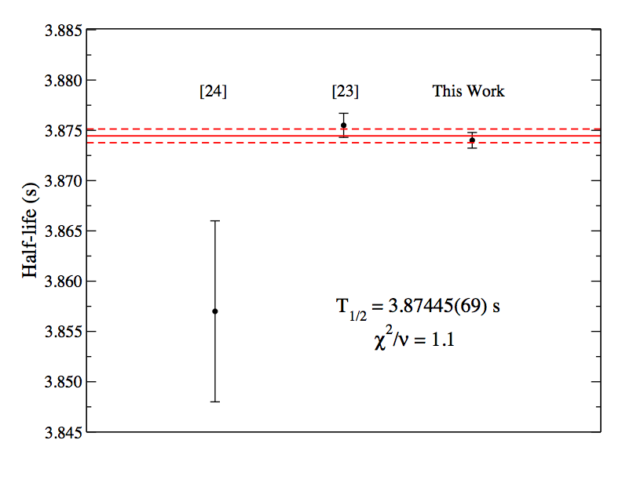
Recent Experimental Highlights: ²²Mg
Half-Life with GPS
Q-value with TITAN
M.R. Dunlop et al., Phys. Rev. C 96, 045502 (2017)
M.P. Reiter et al., Phys. Rev. C 96, 052501(R) (2017)
Q=4781.40(22) keV
Relative precision of 0.005%
Most precise Q_{EC} value measurement of ²²Mg
Comparison of ab-initio shell-model calculations of the IMME in the A=22 isobaric triplet
Relative precision of 0.02%
Improved precision by a factor of 3 over previous measurements
Resolved discrepancy between previous measurements
K.G. Leach
Conference on the Intersections of Particle and Nuclear Physics
Wednesday, May 30, 2018

Slide 18
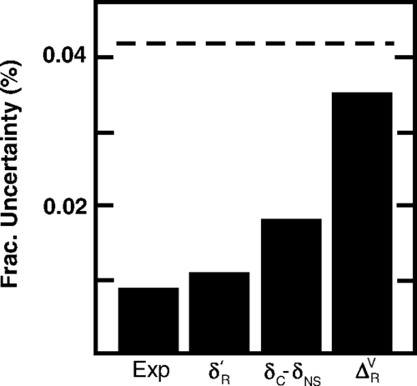
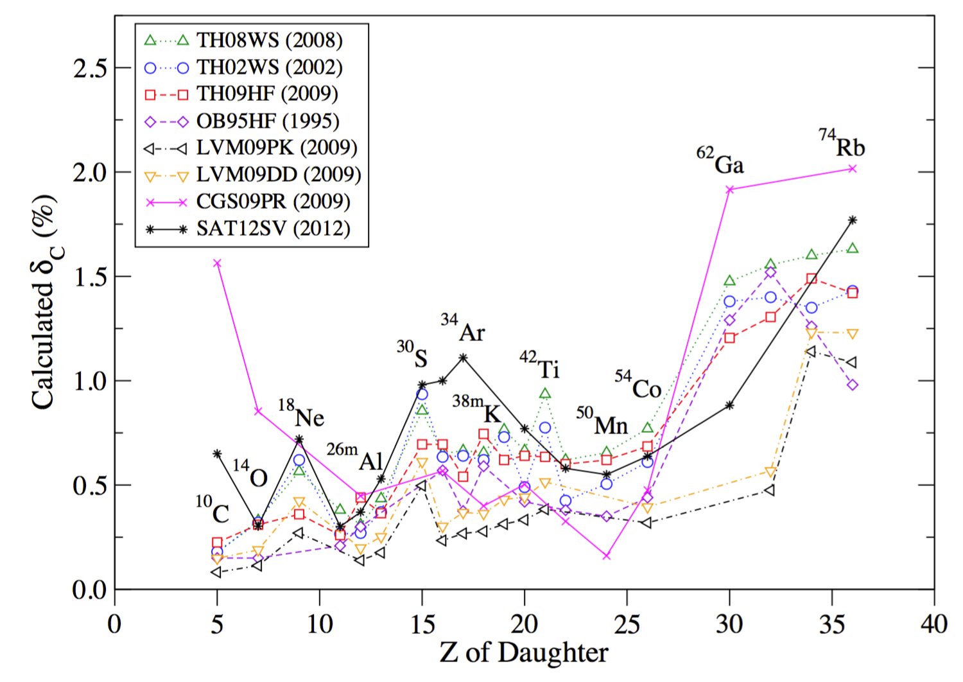
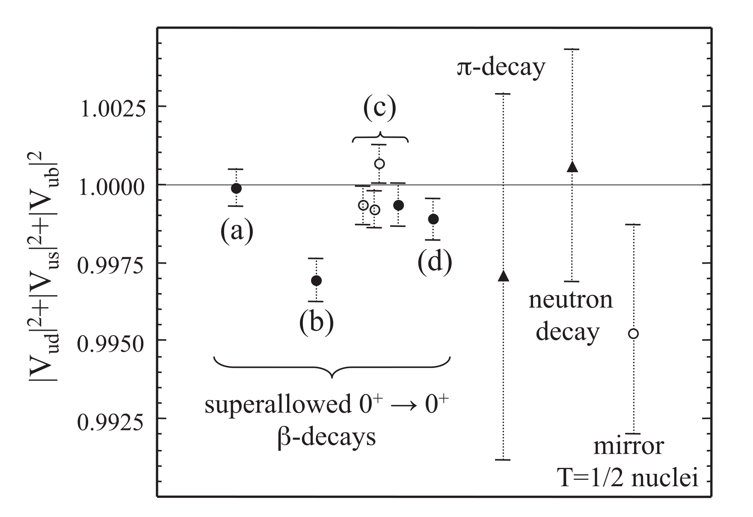
Nuclear Isospin Symmetry Breaking (ISB) Calculations
J.C. Hardy and I.S. Towner, Phys. Rev. C 91, 025501 (2015)
Experimental data are so precise, the limiting uncertainties on the extraction of G_{V} are the theoretical correction
Understanding the complex nuclear structure calculations are critical to ensure the reliability of CKM and CVC limits
W. Satula et al., Phys. Rev. C 86, 054316 (2012)
K.G. Leach
Conference on the Intersections of Particle and Nuclear Physics
Wednesday, May 30, 2018

Slide 19
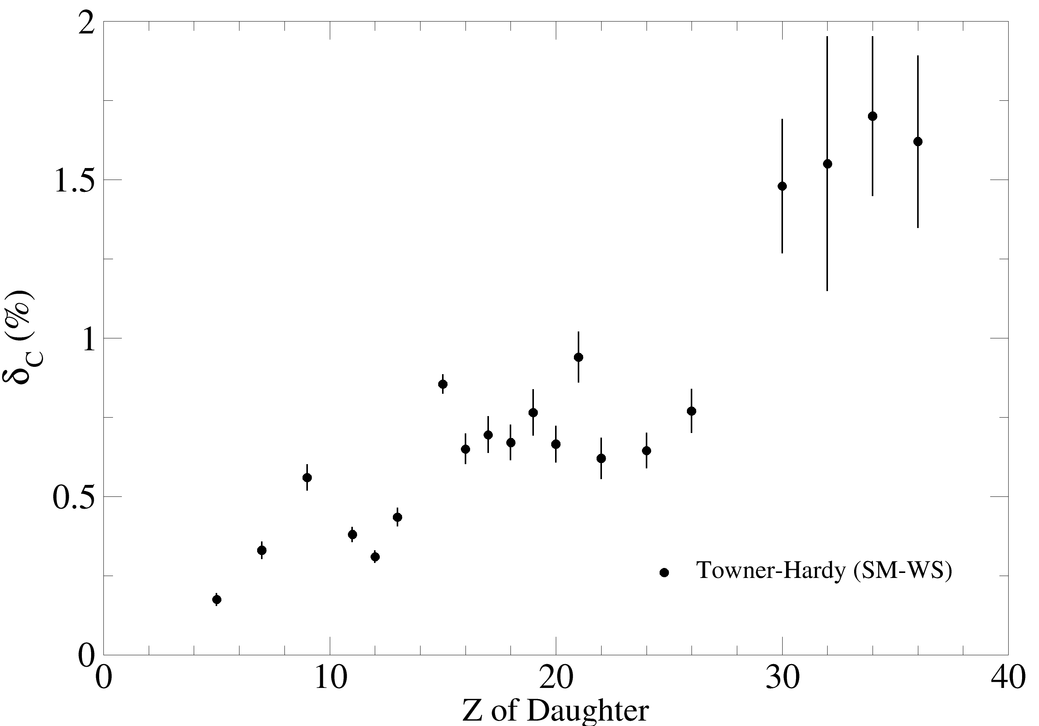
Nuclear Isospin Symmetry Breaking (ISB) Calculations
Using χ-EFT + VS-IMSRG now extends ab-initio shell-model techniques up to the pf-shell and beyond
Can calculate M_{F} directly to extract δ_{C}
PRELIMINARY
$$δ_{C}=1−\frac{{\left|M_{F}\right|}^{2}}{{\left|M_{F}^{0}\right|}^{2}}$$
$$=1−\frac{{\left|M_{F}\right|}^{2}}{2}$$
⁴²Sc
⁴⁶V
J.C. Hardy and I.S. Towner, Phys. Rev. C 91, 025501 (2015)
W. Satula et al., Phys. Rev. C 86, 054316 (2012)
J.D. Holt and K.G. Leach, in progress (2018)
K.G. Leach
Conference on the Intersections of Particle and Nuclear Physics
Wednesday, May 30, 2018

Slide 20
Future Precision Superallowed Cases in the Evaluation
J.C. Hardy and I.S. Towner, Phys. Rev. C 91, 025501 (2015)
K.G. Leach
Conference on the Intersections of Particle and Nuclear Physics
Wednesday, May 30, 2018

Slide 21
The Ongoing Superallowed Experimental Program at TRIUMF
S961LOI - A ≥ 62 Super-Allowed Fermi β Decays: Constraining Unknown Corrections with ⁶⁶As and ⁷⁰Br Decay
S1073 - High Accuracy Mass Measurements for Superallowed Nuclear β-decay Emitters
S1445 - High precision mass measurements for the determination of ⁷⁴Rb's Q-value
S1517 - High-precision ft value measurement for ³⁵Ar
S1518 - Isospin-symmetry breaking in the β+ decay of ⁶²Ga
S1639LOI - The QEC values of the Superallowed Fermi Beta-decays of As-66 and Br-70
S1824LOI - High-precision Q_EC-value measurement of the superallowed beta+ emitter Fe-50
S1848 - High-Precision Half-Life and Branching-Ratio Measurements for the Superallowed Fermi Beta+ Emitter 34Ar
K.G. Leach
Conference on the Intersections of Particle and Nuclear Physics
Wednesday, May 30, 2018

Slide 22
Conclusions
A successful superallowed decay measurement program has existed at TRIUMF for nearly 20 years
We have the capability to perform high-precision measurements on all three quantities needed to extract the ft values within the ISAC-I experimental hall (TITAN, GRIFFIN, GPS)
Recent highlights from this program include:
The most precise (>10⁻⁴) superallowed beta decay half-life measurement (¹⁰C)
Improvement in the ²²Mg half-life precision by a factor of 3
Measurement of the ²²Mg branching ratio to a statistical precision of < 0.1% (analysis ongoing)
Testing of ab-initio shell-model ISB theory through the most precise Q-value measurement in ²²Mg
We have also started to look at the nuclear-structure corrections that applied to the experimental data from an ab-initio shell-model approach to compare with the adopted SM-WS calculations of Ian and John
The program is still ongoing, with new equipment development and ISAC beam development allowing for an increased number of cases that are available for Standard Model tests from nuclear decay
K.G. Leach
Conference on the Intersections of Particle and Nuclear Physics
Wednesday, May 30, 2018

Slide 23
Acknowledgements
Slides and Content
Funding
Gordon Ball
Jens Dilling
Adam Garnsworthy
Jason Holt
Jens Lassen
Erich Leistenschneider
Pascal Reiter
Michelle Dunlop
Alex Laffoley
Carl Svensson
G.F. Grinyer
DE-SC-0017649
PHY-1419765
K.G. Leach
Conference on the Intersections of Particle and Nuclear Physics
Wednesday, May 30, 2018

Slide 24
BACKUP SLIDES

Slide 25
CKM Unitarity and Superallowed Beta Decay
CKM Matrix
d
s
b
u
.
c
t
.
K.G. Leach
Conference on the Intersections of Particle and Nuclear Physics
Wednesday, May 30, 2018

Slide 26
Proton-Induced Rare-Isotope Beam Production at TRIUMF-ISAC
Courtesy Jens Lassen
K.G. Leach
Conference on the Intersections of Particle and Nuclear Physics
Wednesday, May 30, 2018

Slide 27
Experimental Method: Q-values
Penning-Trap Mass Spectrometry with TITAN
B
z
²³Na
Detector
K.G. Leach
Conference on the Intersections of Particle and Nuclear Physics
Wednesday, May 30, 2018

Slide 28
Recent Experimental Highlights: ¹⁰C
The superallowed 0⁺ to 0⁺ nuclear beta decays currently provide the most stringent limit on scalar currents in the weak interaction via the Fierz interference term:
Gamma Counting with the 8pi
Positron Counting with GPS
b_{F} $=−2\frac{Cs}{CV}$
M.R. Dunlop et al., Phys. Rev. Lett. 116, 172501 (2016)
K.G. Leach
Conference on the Intersections of Particle and Nuclear Physics
Wednesday, May 30, 2018

Slide 29
Next Steps for Q-Value Measurements
Courtesy Pascal Reiter
K.G. Leach
Conference on the Intersections of Particle and Nuclear Physics
Wednesday, May 30, 2018

Slide 30
Nuclear Isospin Symmetry Breaking (ISB) Calculations
Using χ-EFT + IM-SRG now extends ab-initio shell-model techniques up to the pf-shell
Can calculate M_{F} directly to extract δ_{C} without the need for a separation of terms (δ_{C1} + δ_{C2})
PRELIMINARY
PRELIMINARY
J.D. Holt and K.G. Leach (2018)
K.G. Leach
Conference on the Intersections of Particle and Nuclear Physics
Wednesday, May 30, 2018

Slide 31
Increasing Precision: TITAN CryoMPET Upgrade and PI-ICR
CryoMPET
Phase-Imaging Ion Cyclotron Resonance
(PI-ICR) Technique
S.Eliseev et al., PRL 110, 082501 (2013)
K.G. Leach
Conference on the Intersections of Particle and Nuclear Physics
Wednesday, May 30, 2018

