Slide 1
Improved Search for Heavy Neutrinos and a Test of Lepton Universality in the Decay π → eν
Precision Physics at High Intensities
CIPANP18
R.E. Mischke
for the PIENU collaboration
29 May 2018

Slide 2
Introduction
Today’s presentation will include two recently published results from the PiENu Experiment:
Limits on heavy neutrinos coupling to electrons
A. Aguilar-Arevalo et al., Phys. Rev. D 97, 072012 (2018)
Test of Lepton Universality in pion decay
A. Aguilar-Arevalo et al., Phys. Rev. Lett. 115, 071801 (2015)
Plus the status of the full analysis for the π → eν branching ratio

Slide 3
The PiENu Experiment and Heavy Neutrinos
PiENu stops pions to make a precise measurement of the rate for the rare decay π → eν.
It is also sensitive to π → eν_{h} for 60 < M_{ν} < 135 MeV/c² and sets impressive limits on the coupling of a ν_{h} to the electron (|U_{ei}|²)
A. de Gouvêa and A. Kobach
D. I. Britton et al., Phys. Rev. D 46, R885 (1992).

Slide 4
Importance of Heavy Neutrino Searches
Many extensions of the Standard Model include additional massive neutrinos.
The νMSM includes three sterile neutrinos, two of which may have masses in the range probed by meson decays.[1]
Other models (such as dark matter or thermalization) also have neutrino masses in the MeV/c² range.[2]
[1] A. Boyarsky, O. Ruchayskiy and M. Shaposhnikov, Ann.Rev. Nucl. Part. Sci. 59, 191 (2009).
[2] B. Bertoni, S. Ipek, D. McKeen, and A. Nelson, JHEP, 04, 170 (2015).
B. Batell, T. Han, D. McKeen, and B. Haghi, arXiv:1709.07001, (2015).
T. Appelquist, M. Piai, and R. Shrock, Phys. Rev. D 69, 015002 (2004).

Slide 5
The PiENu Experiment at TRIUMF
Beam:
60kHz pions @ 75 MeV/c
Detector: [1]
Acceptance: 20%
Plastic Scintillators
NaI(Tl) + CsI Calorimeter
Wire Chambers
Silicon Strips
Energy resolution:
2.2% FWHM @ 70MeV
Temperature Stabilization
Data taking:
2009-2012
[1] A. Aguilar-Arevalo et al., Nucl. Instrum. Methods Phys.Res., Sect. A 791, 38 (2015).

Slide 6
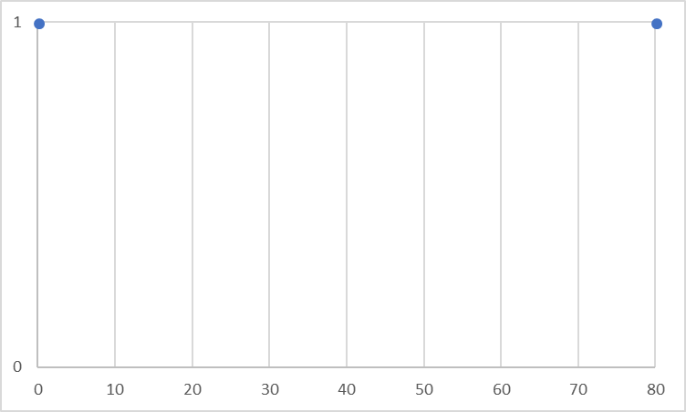
Ideal and observed spectra
two-body decay:
monoenergetic positron
π → eν E_{e} = 69.8 MeV
for m_{h} = 90 MeV/c²
π → eν_{h} E_{e} ≈ 40 MeV
Simulation of spectrum including detector response
Add positrons from π→μ→ e decay chain
Positron Energy (MeV)

Slide 7
Suppressed spectrum
π → eν
π→μ→e
Suppress π→μ→e
events with cuts
including timing (ns), target energy, and Z vertex
4 MeV
Simulation of spectrum including effects of detector
π→μ→ e decay chain Suppressed

Slide 8
Search for heavy neutrinos
Start with suppressed spectrum

Slide 9
Search for heavy neutrinos
Start with suppressed spectrum
Fit known components prior to neutrino search
Extrapolation of π → eν tail from simulation

Slide 10
Search for heavy neutrinos
Start with suppressed spectrum
Fit known components prior to neutrino search
Extrapolation of π → eν tail from simulation
Include π→μ→ e shape from late-time events

Slide 11
Search for heavy neutrinos
Fit known components prior to neutrino search
Extrapolation of π → eν tail from simulation
Include π→μ→ e shape from late-time events
Add component for muon decay-in-flight

Slide 12
Search for heavy neutrinos
Extrapolation of π → eν tail from simulation
Include π→μ→ e shape from late-time events
Add component for muon decay-in-flight
Background fit over 4 – 56 MeV

Slide 13
Search for heavy neutrinos
Include π→μ→ e shape from late-time events
Add component for muon decay-in-flight
Background fit over 4 – 56 MeV
Residuals from background fit shown in insert

Slide 14
Search for heavy neutrinos
Step signal shape for candidate π → eν_{h} decay across positron energy spectrum
Sample test signal for π → eν_{h} at 40 MeV shown
Shape of test signal at each energy follows detector response

Slide 15
Search for heavy neutrinos: Result
NA62 Collaboration,
Phys. Lett. B 778, 137 (2018)

Slide 16
Precise prediction for the π → eν decay rate
Pion Decay Rate:
Branching Ratio (assuming LEPTON UNIVERSALITY):
With Radiative and Structure Corrections:
S. Berman: Phys.Rev.Lett. 1(12), 468 (1958)
T. Kinoshita: Phys.Rev.Lett. 2(11), 477 (1959)
T. Goldman, W.Wilson: Phys.Rev.D 14(9), 2428 (1976)
W. Marciano, A. Sirlin: Phys.Rev.Lett. 36(24), 1425 (1976)
M. Terent’ev: Yad. Fiz. 18(870) (1973)
V.Cirigliano, I.Rosell: Phys.Rev.Lett. 99(23), 231801 (2007)

Slide 17
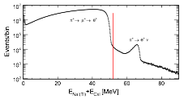
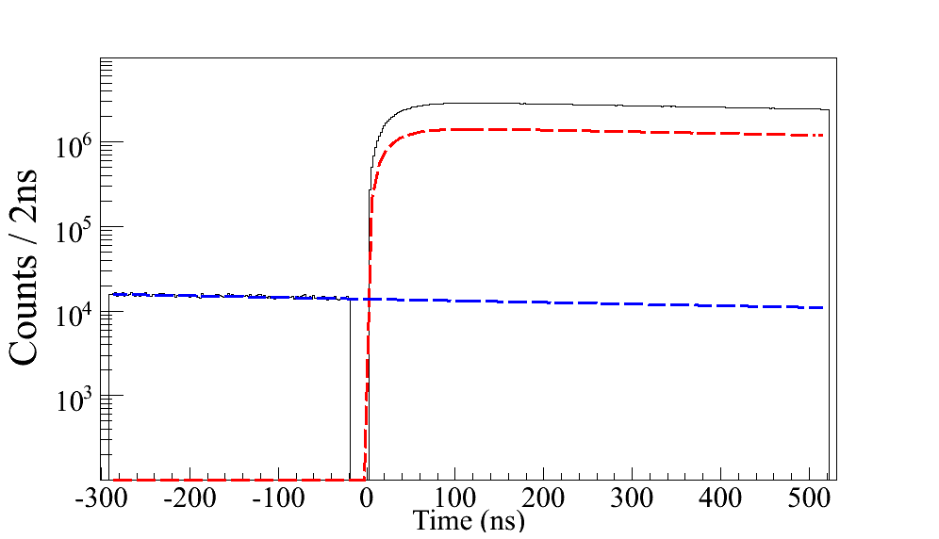
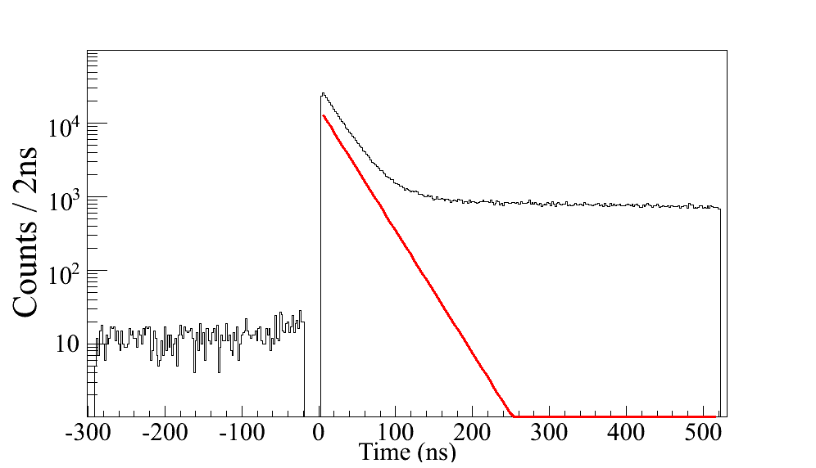
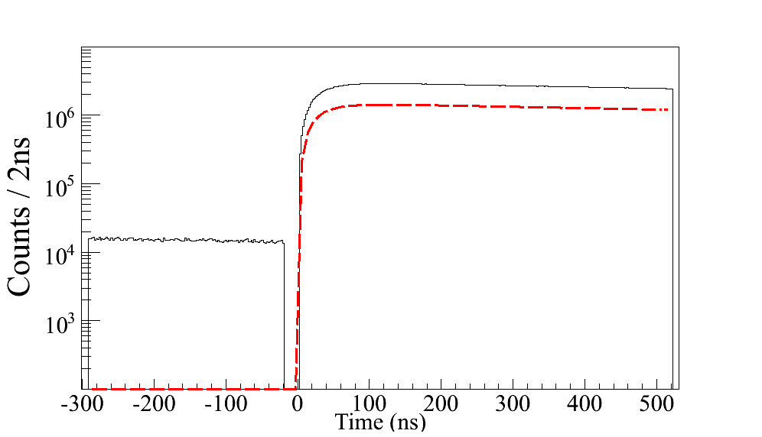
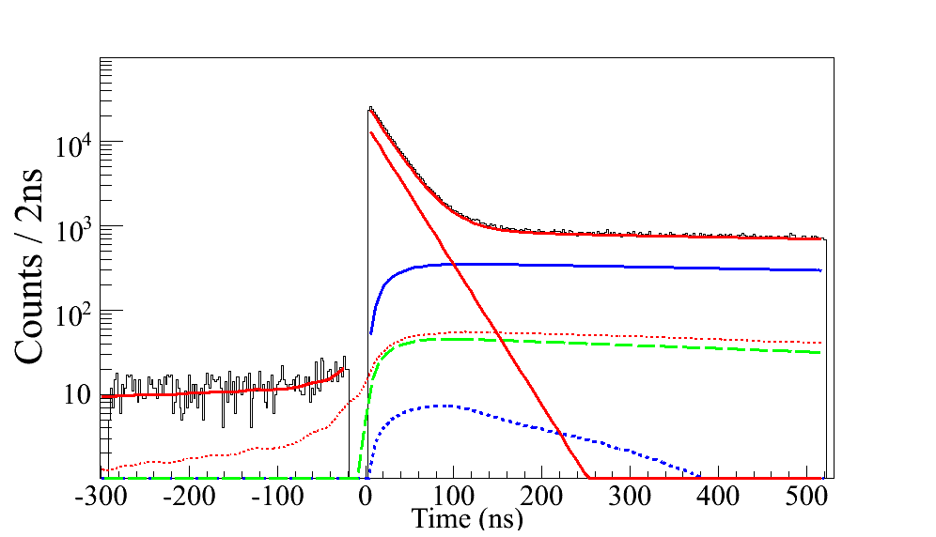
Analysis: π → eν decay
E<52MeV
E>52MeV
Positron Energy (MeV)
T1res
Double Decay
Radiative
Low Energy time (ns)
High Energy time (ns)
Simultaneous fit of both time spectra with all components

Slide 18
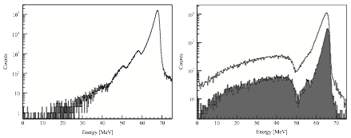
Low Energy Tail (LET)
Largest correction
From data: MC does not reproduce hadronic reactions (photonuclear with neutron escape)[1]
Positron beam (0°)
Combine LET estimate from positron beam with estimate from suppressed spectrum
Estimated LET: (3.06 +/- 0.10) %
[1] A. Aguilar-Arevalo et al., Nucl. Instrum. Methods Phys. Res., Sect. A 621, 188 (2010).

Slide 19
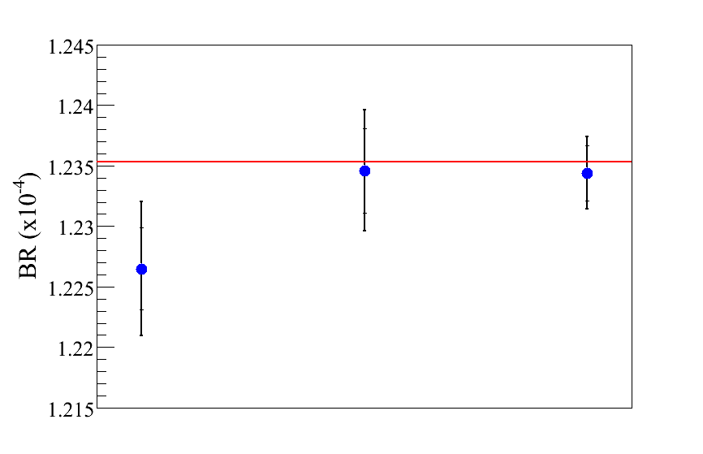
Initial Result: π → eν decay
Based on one month
(~12% of data)
Result blinded until:
all cuts finalized
stability checks OK
syst. uncertainties set
Standard Model
PSI
TRIUMF (NEW)
TRIUMF

Slide 20
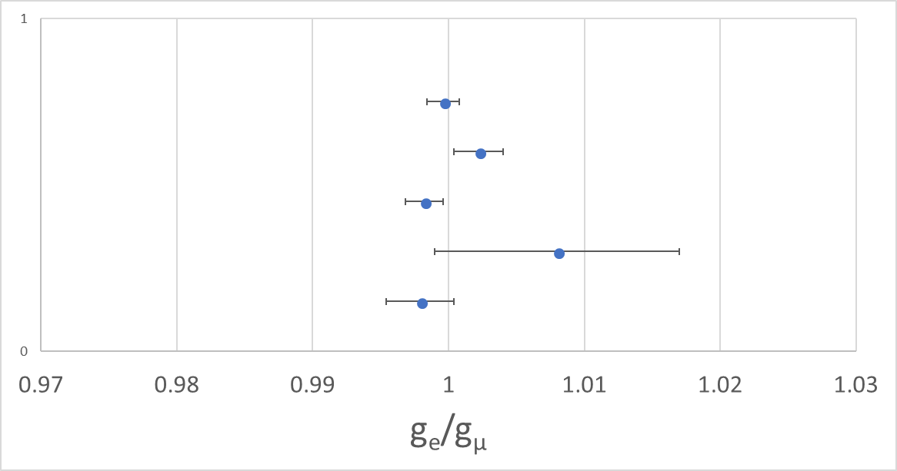
Lepton Universality Summary
$$\frac{g_{e}}{g_{μ}}=0.9996 ±0.0012$$
Complementary to tests with heavy quarks
The ensemble of B decay results appear to violate lepton universality [1]
most precise test
[1] See recent summary in CERN Courier, 58, 23 (2018)
In this conference: G. Onderwater, A. Datta, O. Witzel, …

Slide 21
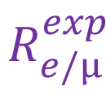
Status of full analysis for $R_{e/μ}^{exp}$
All data have been processed
~8 times more data than for 2015 result
10⁷ π → eν events
Value of branching ratio is blinded
Final review of cuts underway
Statistical uncertainty
<0.1% in
dependent on cut for
solid angle acceptance
2012 data
40% of total
2.5 × 10⁶
π → eν events

Slide 22
Status of full analysis for $R_{e/μ}^{exp}$
Systematic uncertainties under evaluation
approx. equal to statistical uncertainty
two examples of improved study of backgrounds
pion stops upstream of target
pion interacts in target
tgt
tgt
π
π
e⁺
p
select “positron” in tgt
cut ?
good events
false triggers
positron
proton
Time in tgt (ns)
E in downstream counters

Slide 23
Thank You on behalf of the PiENu Collaboration

Slide 24
Extra slides

Slide 25
Energy dependent acceptance
Correction for heavy neutrino limits

